Slide 1
Progress of LHAASO-WCDA++ electronics
陈建，申丰兆
指导师：周荣，刘成
SiChuan University
四川大学

Slide 2
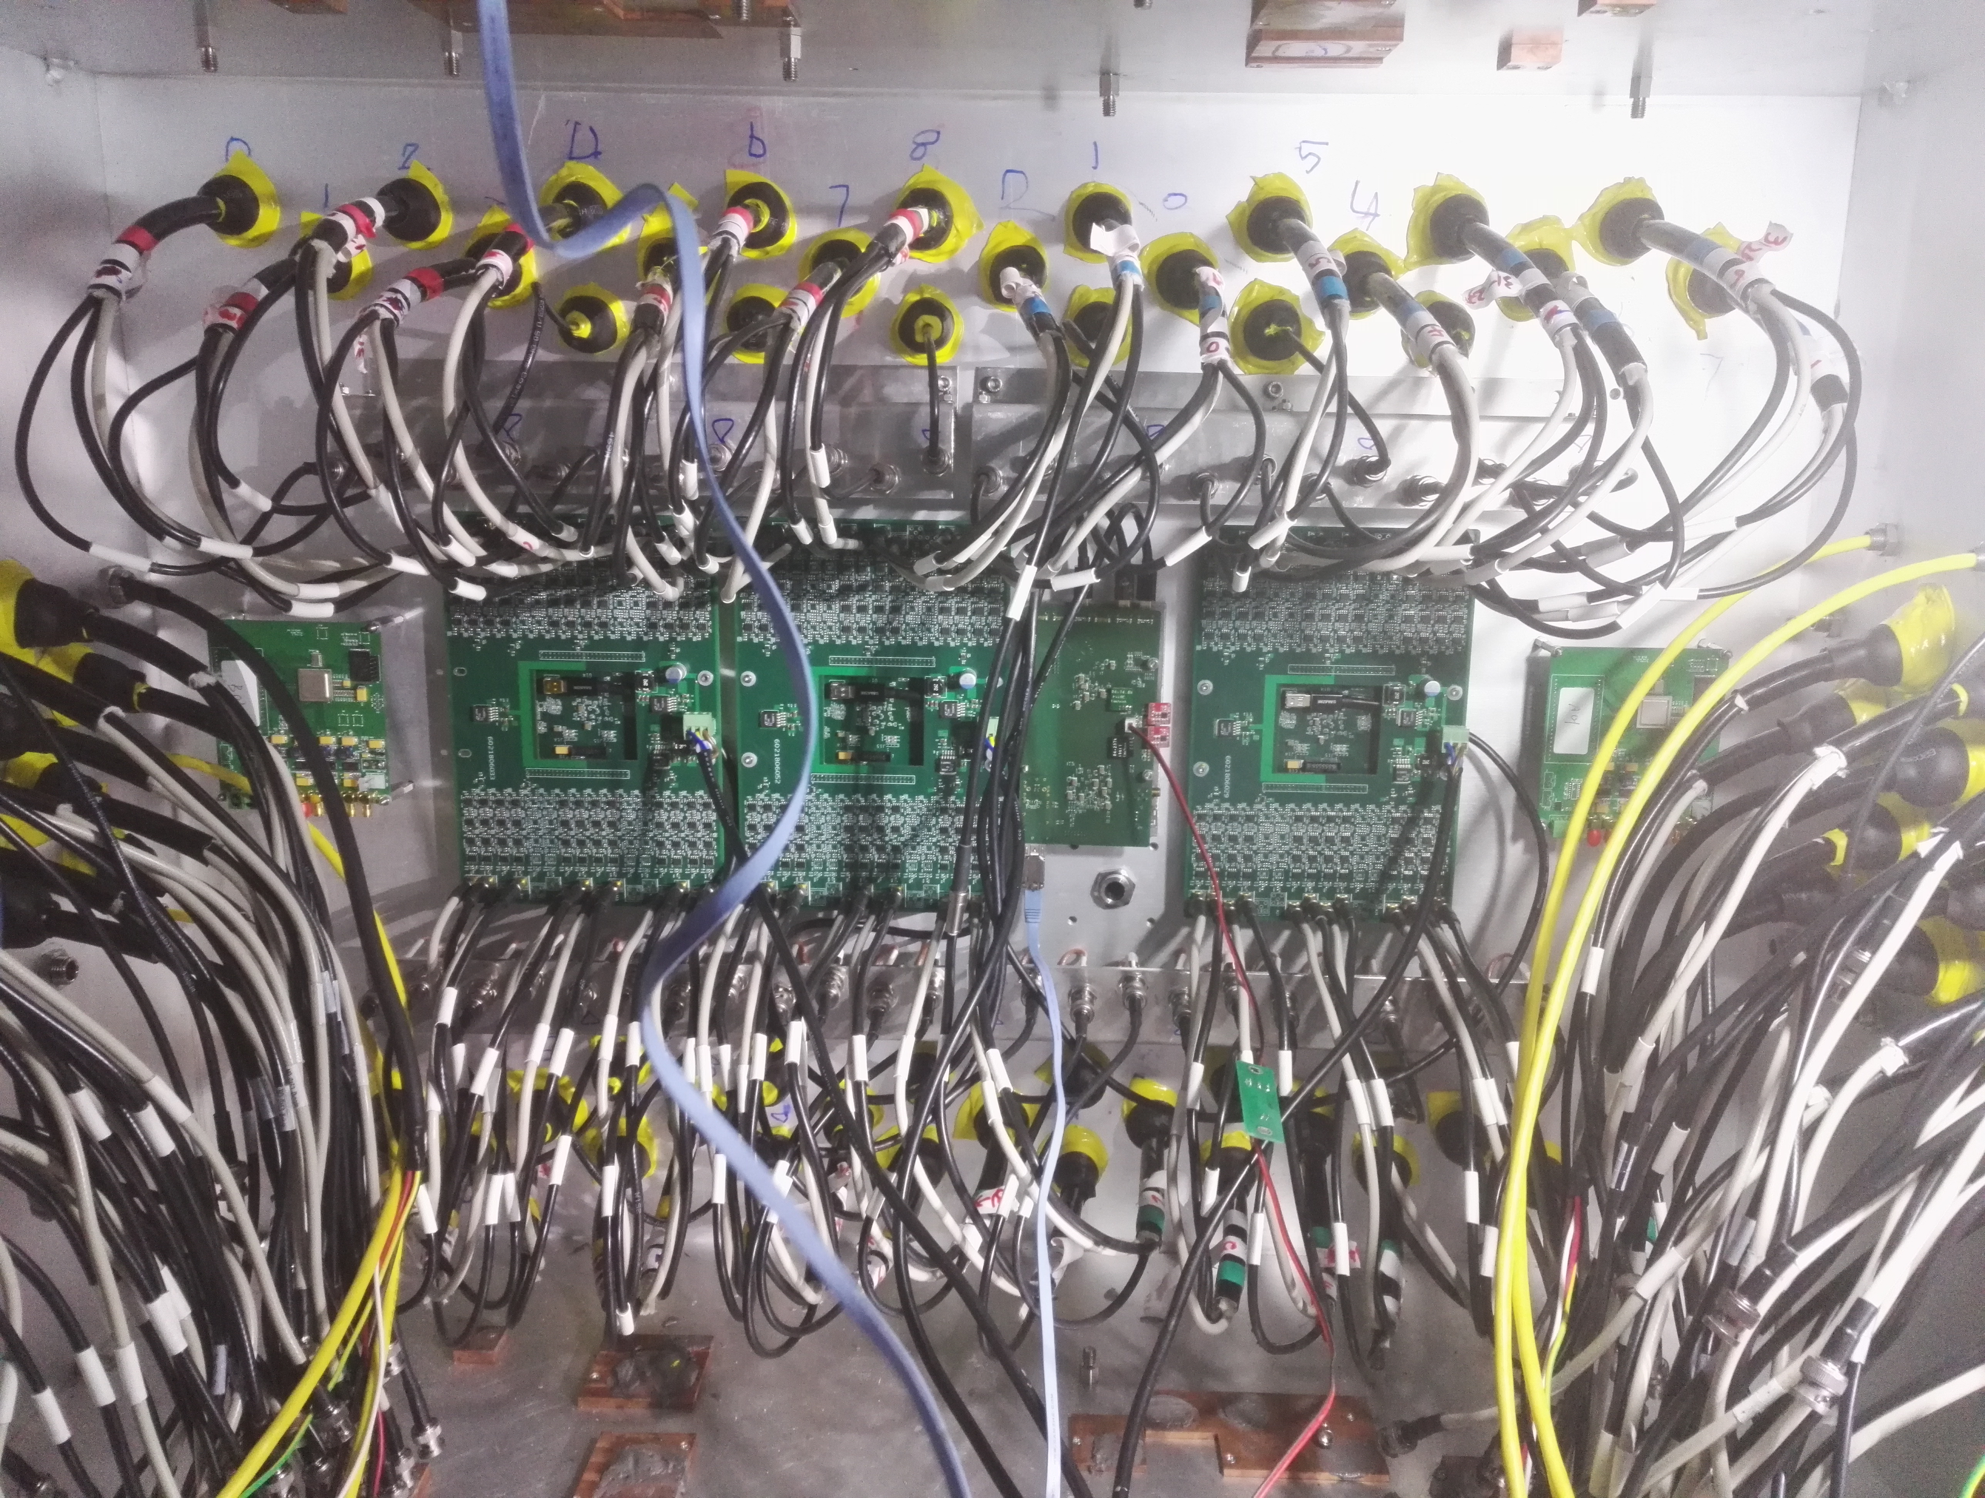
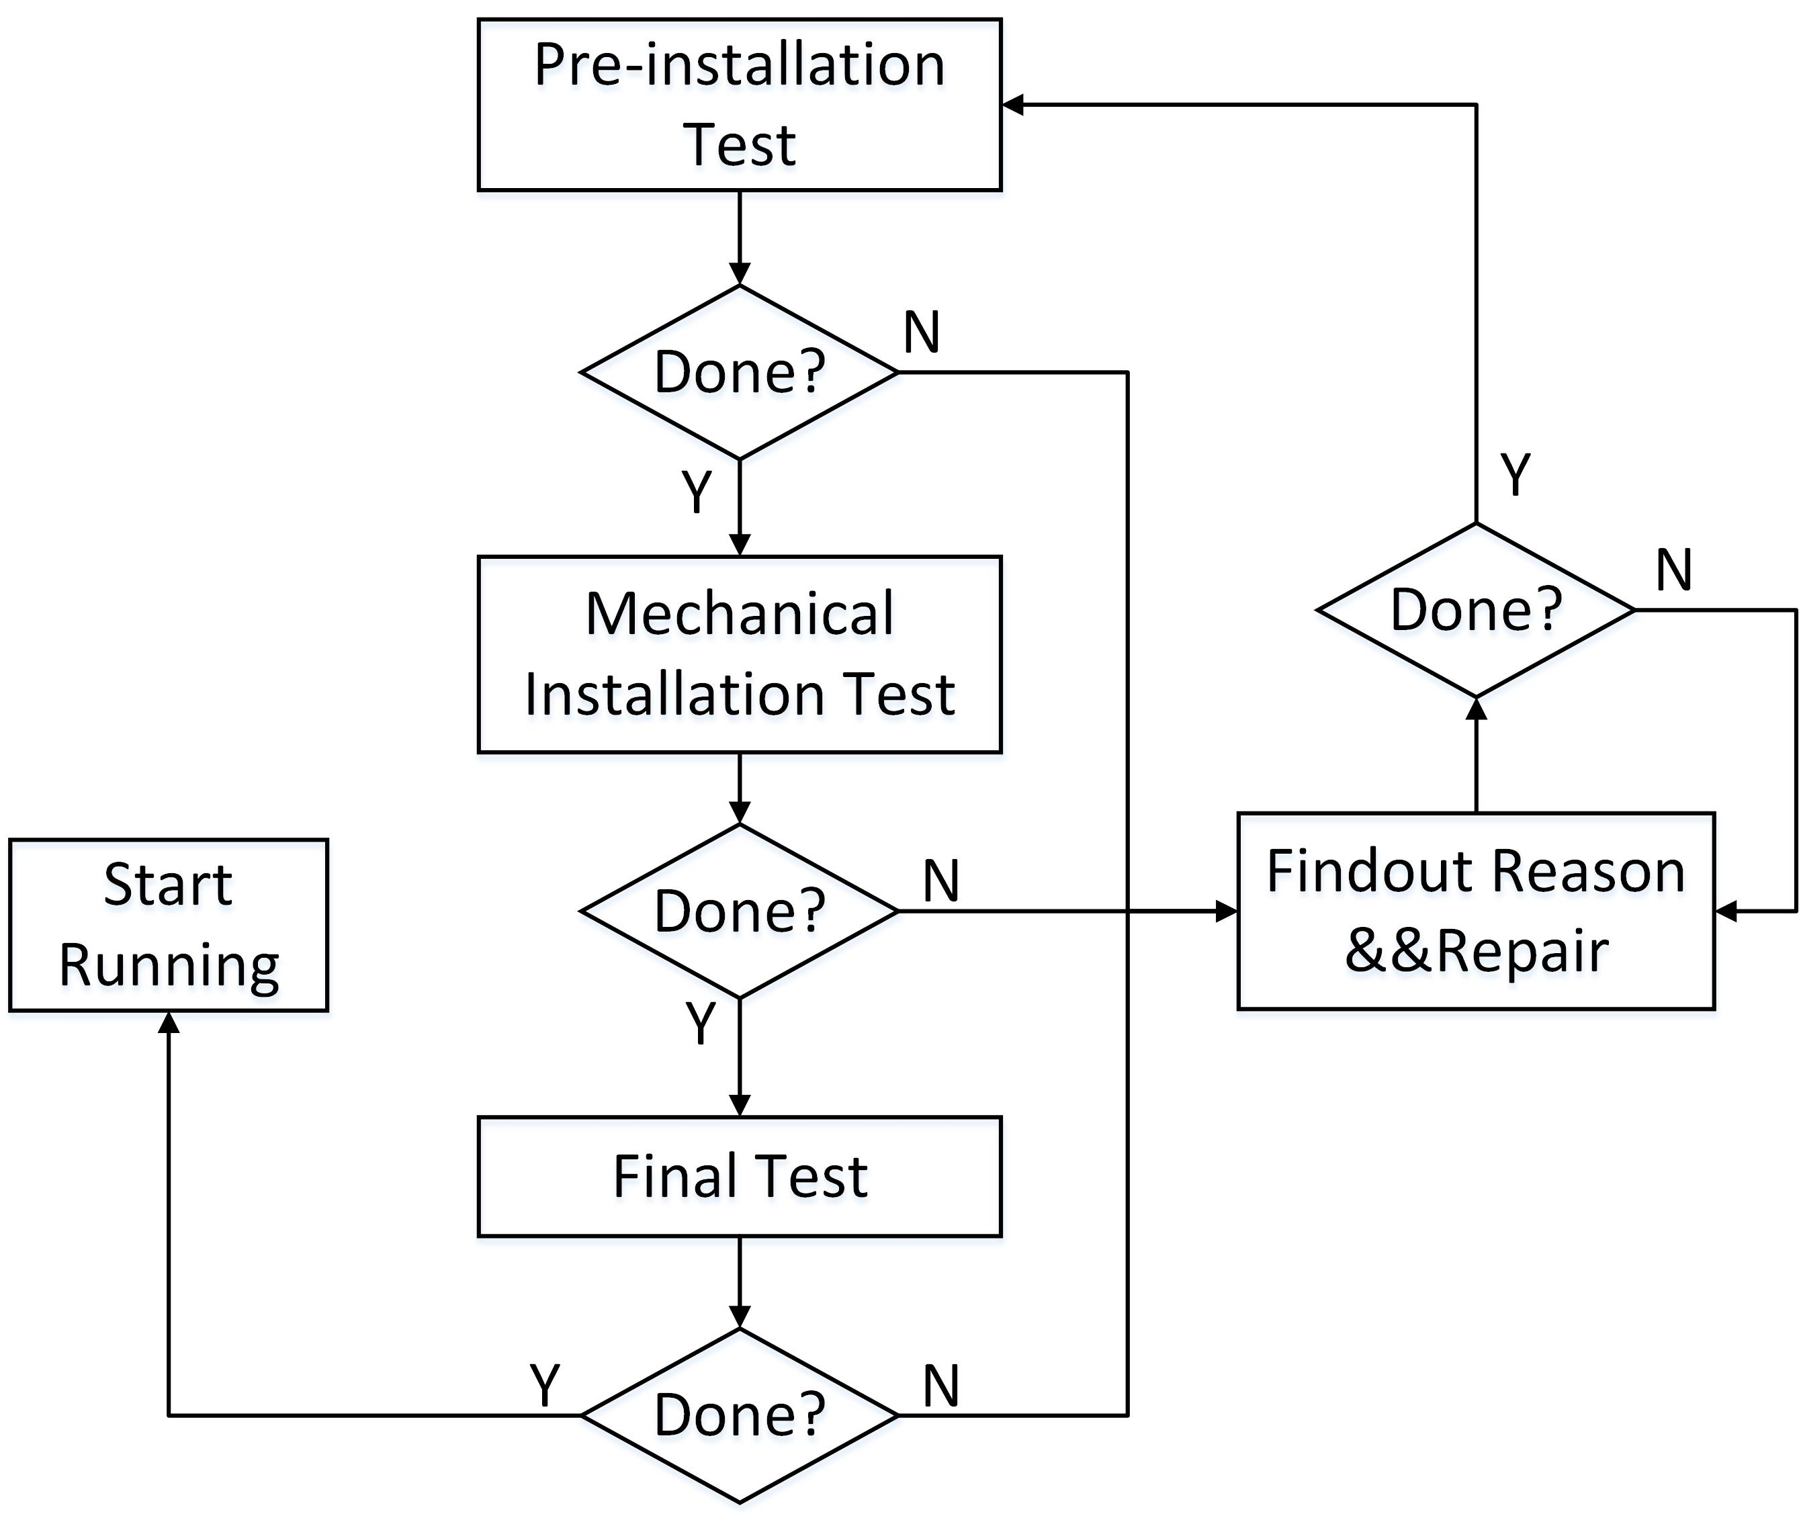
Electronics Installation Process：
1.Pre-installation testing
2.Testing after mechanical installation
（No signal line twisted）
3.Testing after Twisting Signal Line
Test Content：
1.Temperature data
2.Baseline data
3.Read data for remote update
Such testing covers the normal operation of electronic components and the quality of circuit.

Slide 3
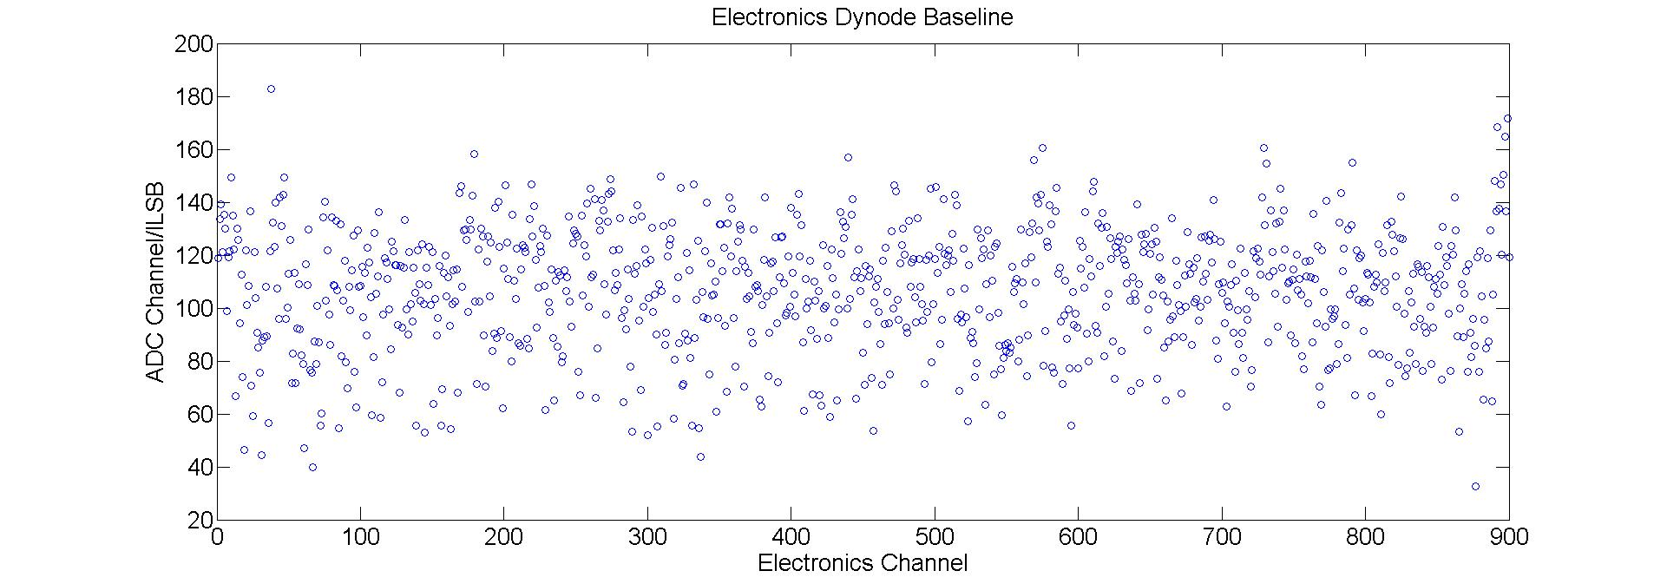
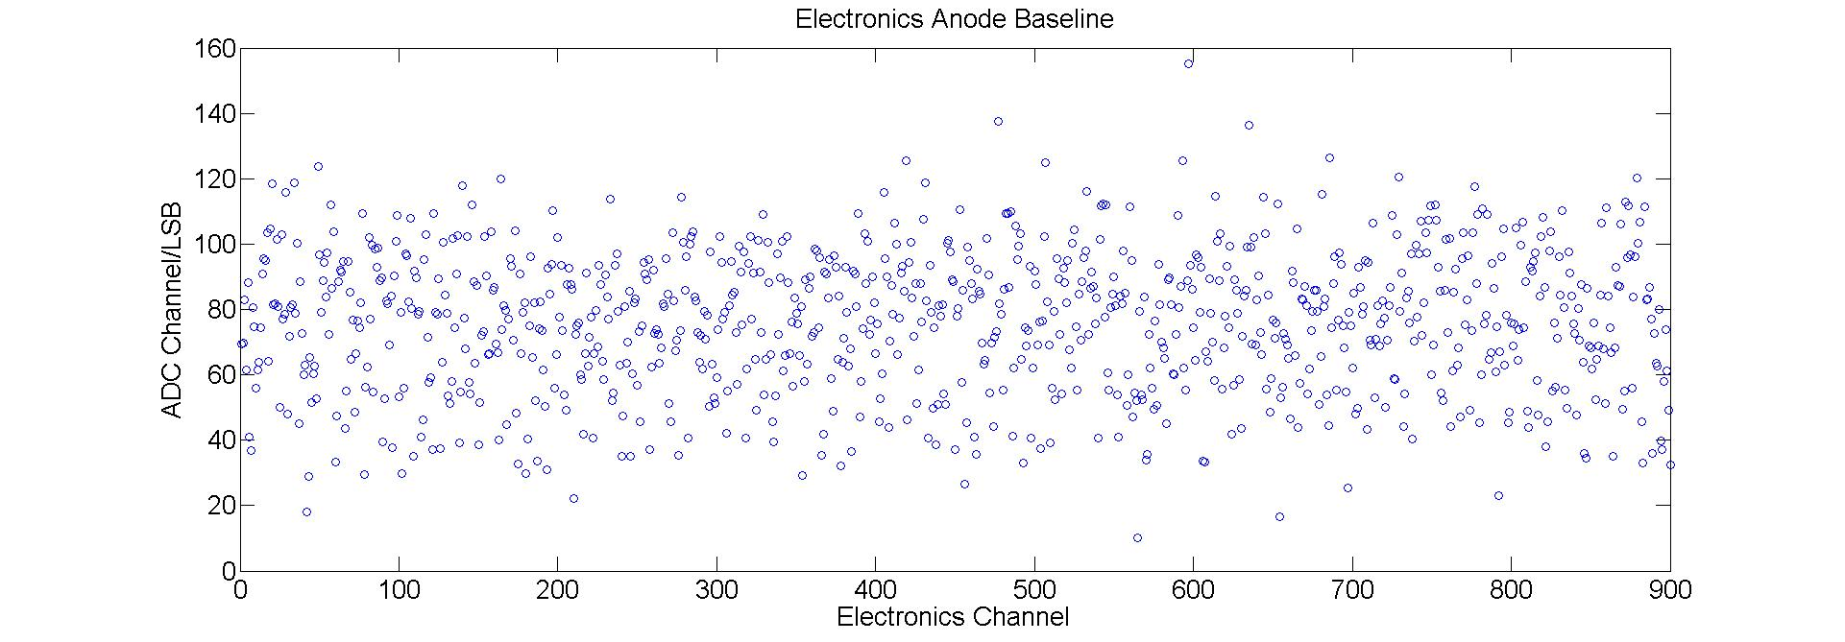
Test Results：
1800 electronic channels are working normally

Slide 4
Changes in Electronics Comparing with the First Pool
（1） Adjust the gain to fit the new PMT output charge range;
（2）Raise the baseline to avoid a baseline with zero baseline when the first pool baseline is too low;
（3）Increase the spacing of the interfaces at the input of the analog board for easy chassis installation;
（4） Increase the data transfer upper limit of the communication board to meet the 10 kHz sampling rate;

Slide 5
WCDA++ Technical agreement indicator
key parameter | indicator
Anode charge measurement range | 0.48pC-72pC
Dynode charge measurement range | 0.48pC-72pC
Resolution | <30%@0.48pC, <3% @72pC
Relative deviation | <5% @0.48pC, <2% @72pC
Baseline temperature drift | <0.2mV/℃
Channel gain inconsistency | <3%
Noise trigger rate | Anode: <1Hz @=0.16pC the single channel threshold of 0.16 pC
Power | 小于70W
Resolution of Time | 20ns
Sample rate | 10kHz
range of working temperature | 0℃－+60℃
Crosstalk | <0.03%

Slide 6
电荷测试平台以及测试方法
Q=CU
Signal generator output voltage:12mV-1.86V; The anode selection capacitor value can meet the dynamic range measurement of 0.468pC-72.54pC at 39pF; similarly, the dynode is connected in series with 39pF, which satisfies the dynamic range measurement of 0.468pC-72.54pC.

Slide 7
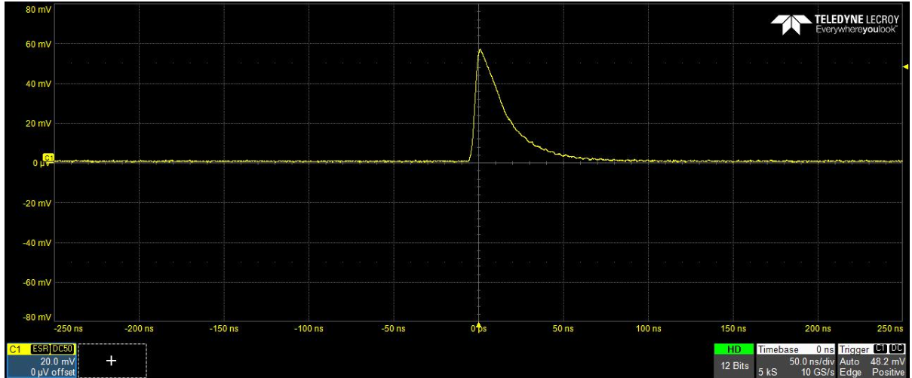
Calibration of Fan-out board
Testing system of Fan-out board
Output waveform of Fan-out board

Slide 8
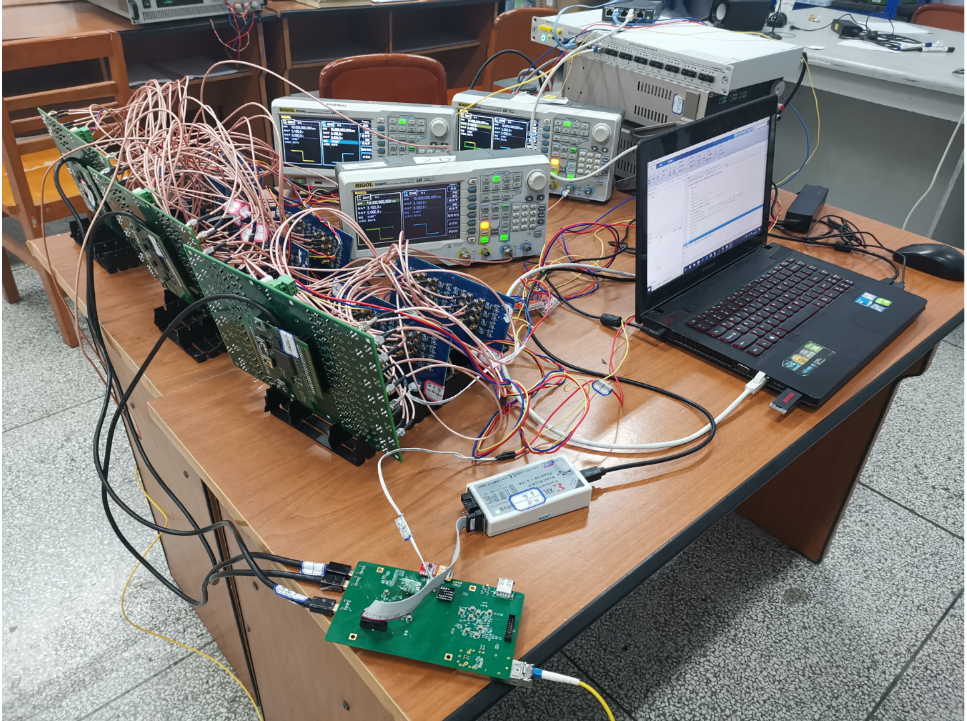
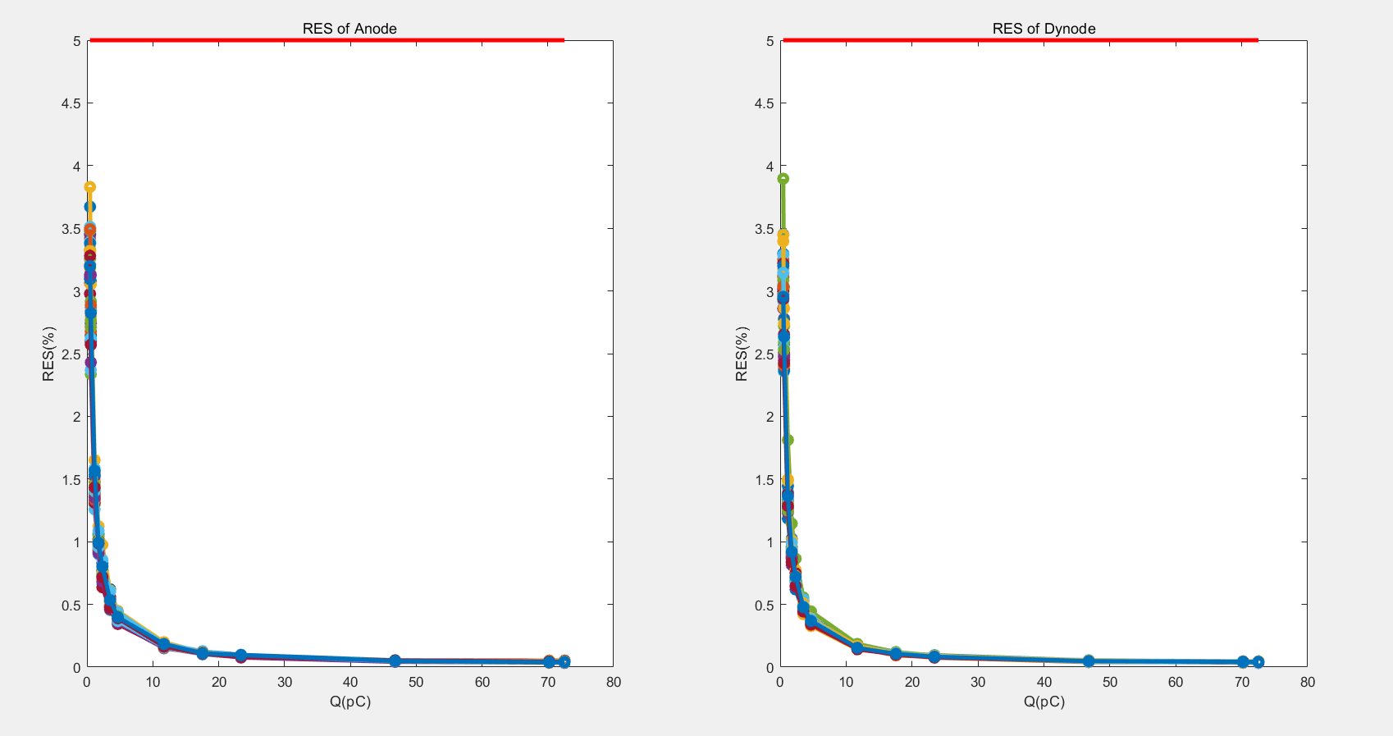
Resolution of Electronics
Testing system
Resolution of 36 Anode and Dynode Channels
Indicator requirements of Resolution: <30%@0.48pC,<3%@72pC;Relative deviation:<5% @0.48pC,<2% @72pC。
Measured values:
Resolution:<5% @0.48pC, <2% @72pC
P=$\frac{RMS}{Mean} ∗100\%$

Slide 9
Relative deviation of Electronics
$σ=\frac{y_{i}−Y_{i}}{y_{i}}$*100%
Indicator:<5%@0.48pC, <2% @72pC
Measured values:
Relative deviation:<3% @0.48pC, <2% @72pC

Slide 10
Data Flow
The event rate is estimated according to 10 kHz. According to the current design, FEE will record a 192 bit data frame every time the photomultiplier tube is on fire, plus the communication protocol 9 bit, so a valid trigger for a PMT channel will generate 201 bits of data. The data rate is:
201 bit × 1 0kHz = 2.01 Mbps
A DB processes up to 12 PMT signals:
2.01 Mbps × 12 = 24.12 Mbps
DB to BDB transfer rate of 50Mbps, with sufficient redundancy
A BDB has three DBs, and estimating the actual transmission rate is:
24.12 Mbps × 3 = 72.36 Mbps
72.36 Mbps*10s = 723.6Mbit
723.6Mbit<1Gbit， Meet the requirements of the case cache greater than 10s.

Slide 11
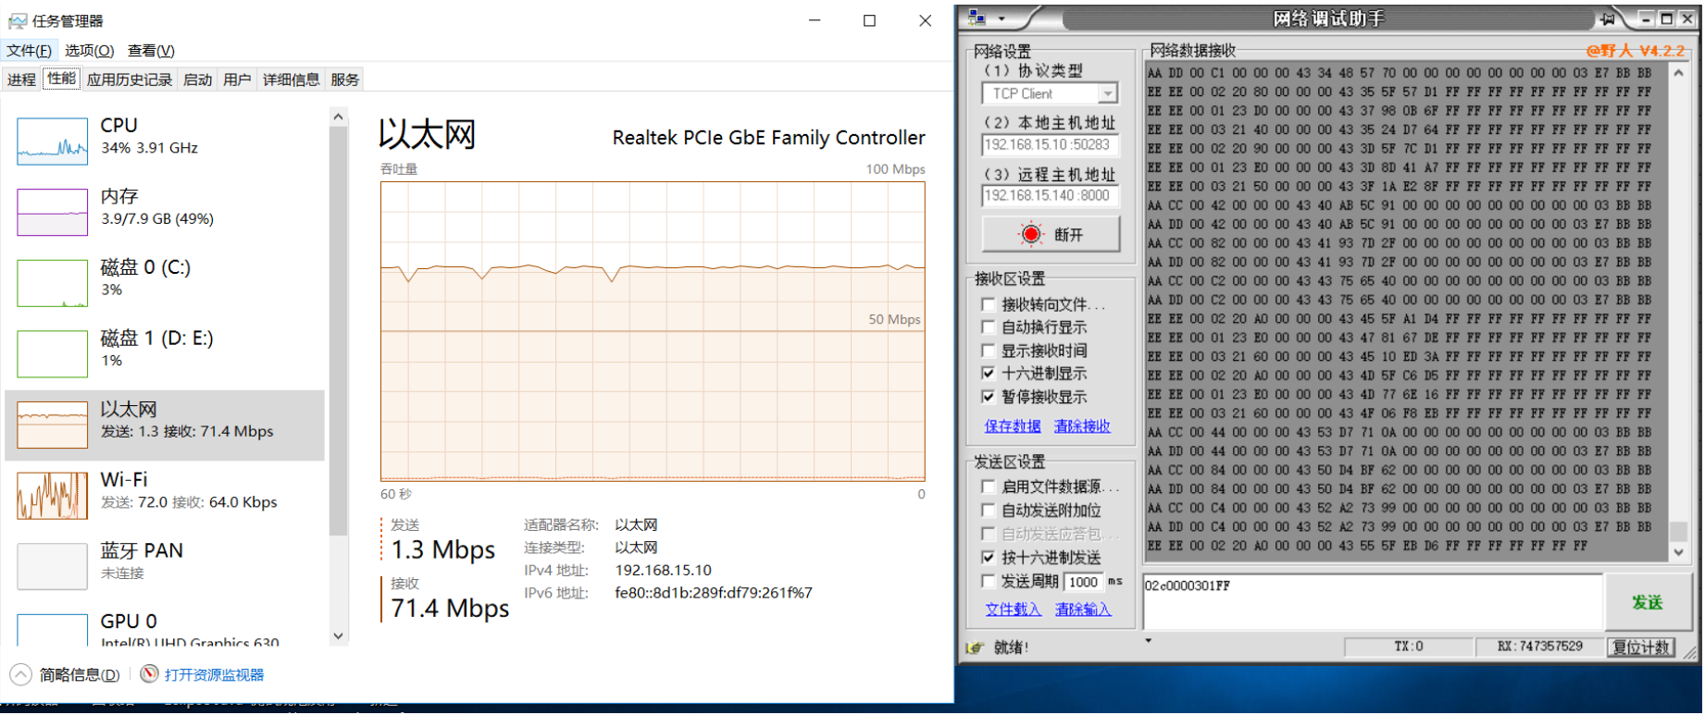
10kHz Sampling Rate
Data flow chart
The amount of data in fact

Slide 12
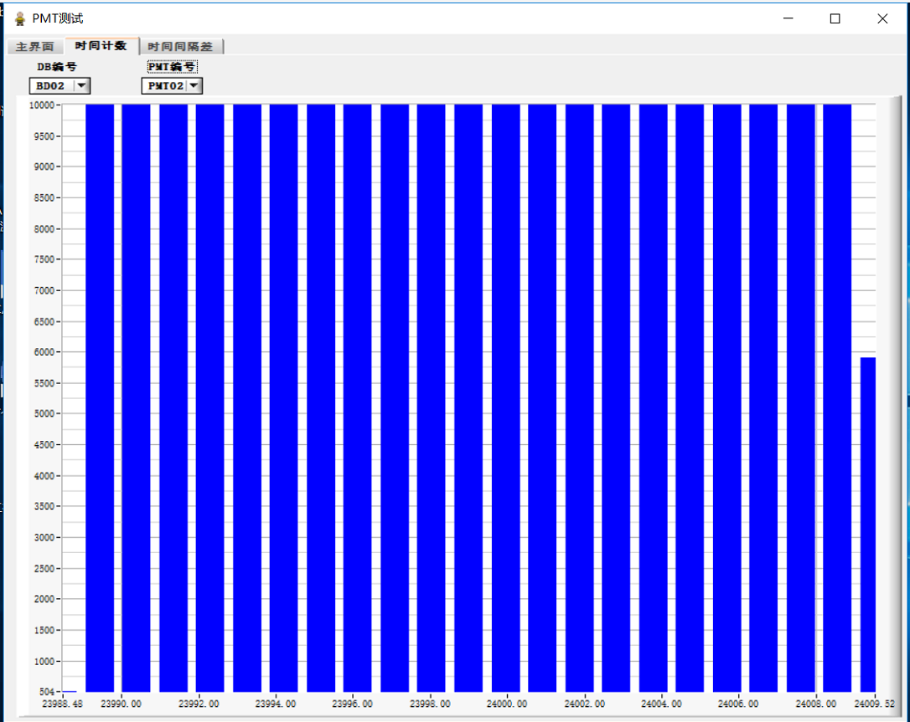
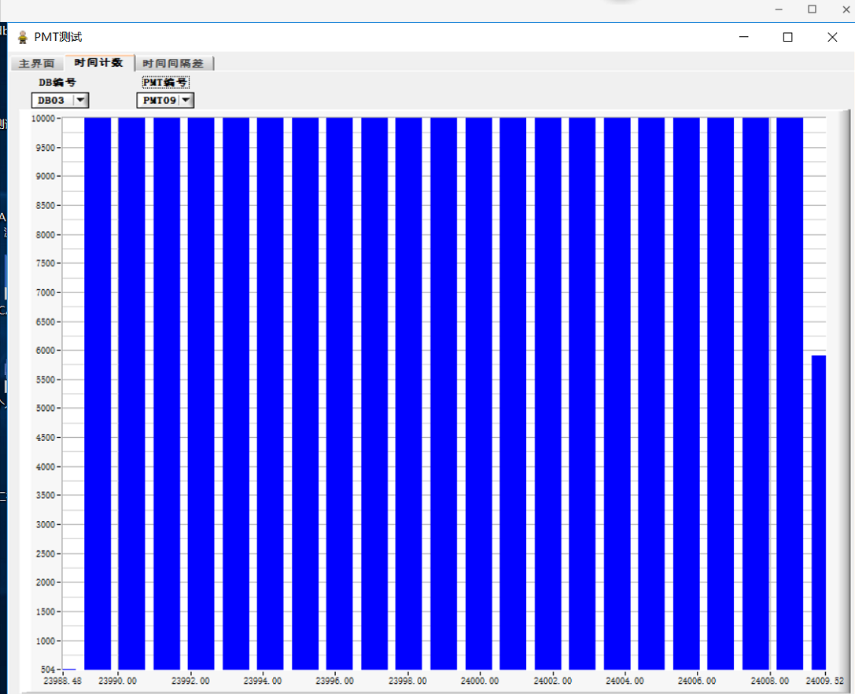
10kHz Sampling Rate
DB1
DB2
DB3

Slide 13
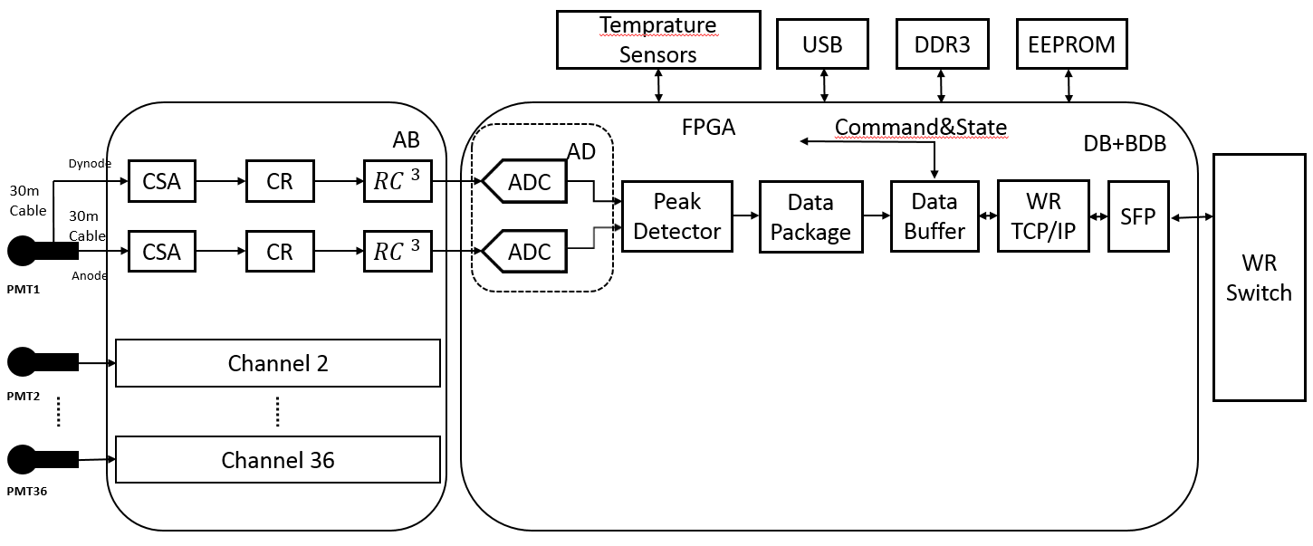
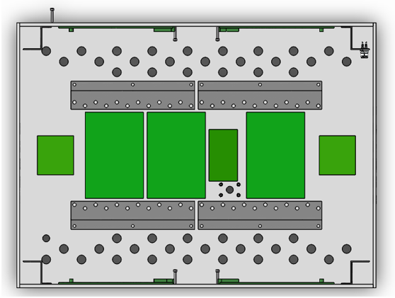
The structure of WCDA++ Electronics
DB
DB
DB
Each set of Electronics structure is shown in the figure. Each set of electronics is responsible for measuring the time and charge information of 36 PMTs.

Slide 14
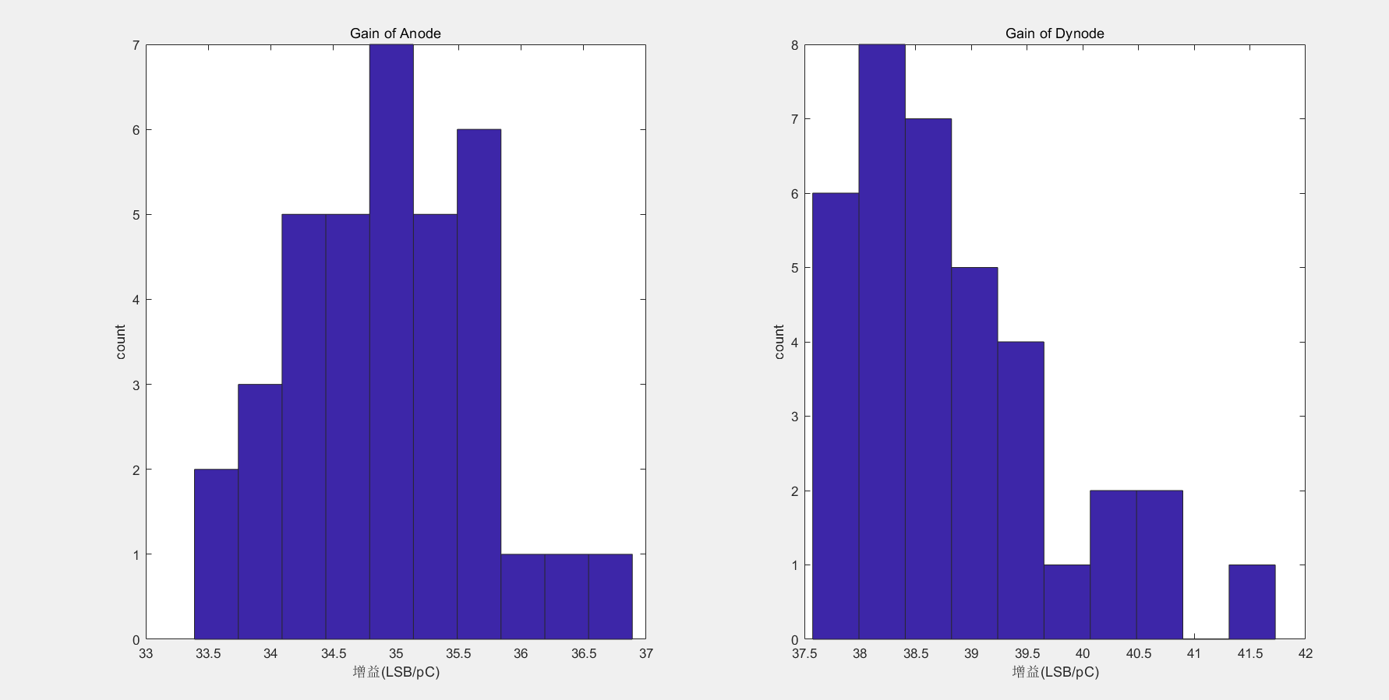
Channel gain inconsistency
inconsistency = Sigma / mean;
Anode:2.20%, Dynode:2.46%, indicator:3%.

Slide 15
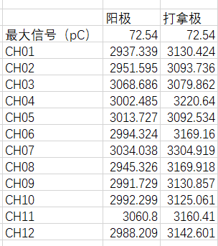
The Range of Charge Measurement
Maximum signal
Dynode:72.54pC(peak 3200LSB)800LSB redundancy ,72.54pC+20pC
Anode:72.54pC(peak3000LSB)1000LSBredundancy ,72.54pC+29pC

Slide 16
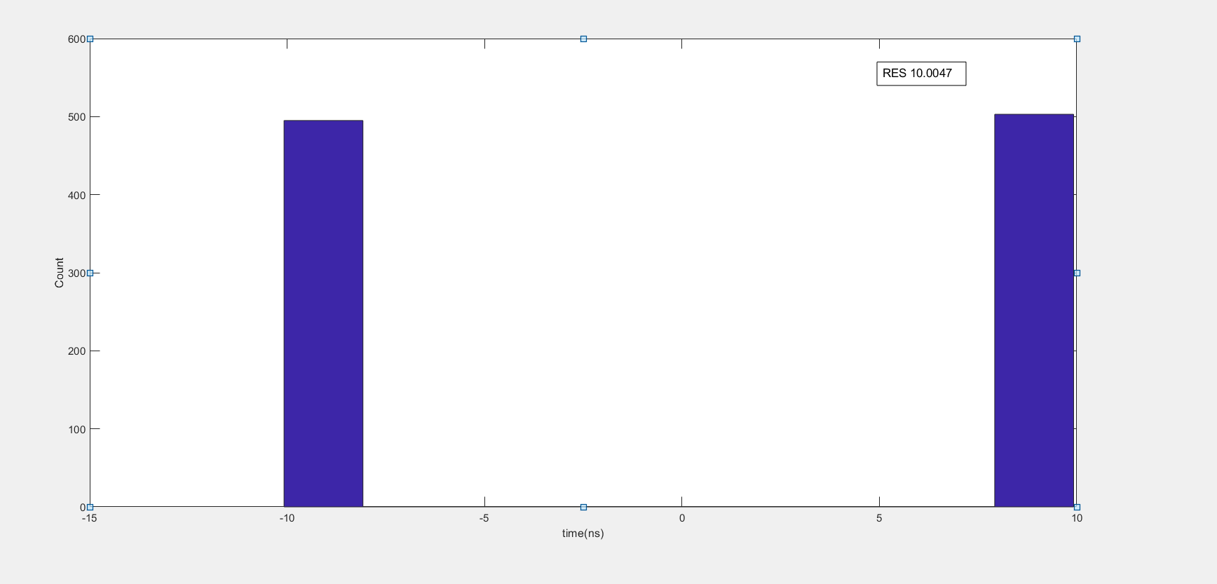
Resolution of Time
Resolution = sigma /$\sqrt{2}.$
Sigma is the standard deviation of the time difference ($∆T$)between the arrival and departure cases.
Sigma:10.0047ns;resolution of time is 7.1ns.

Slide 17
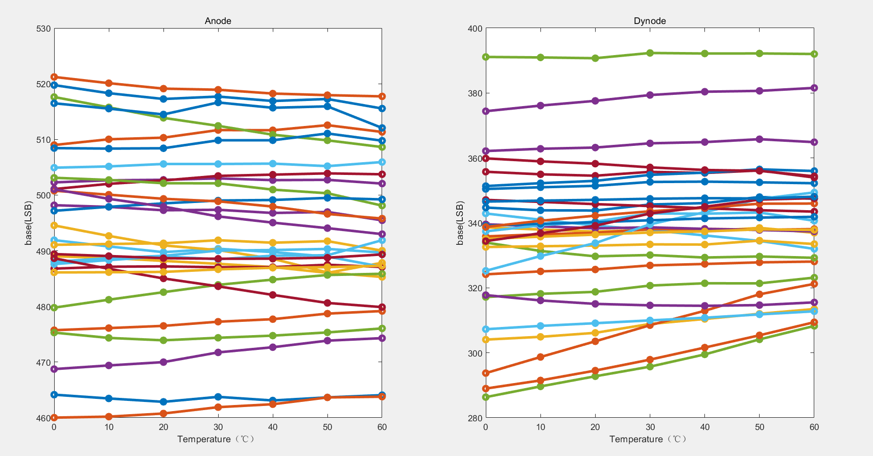
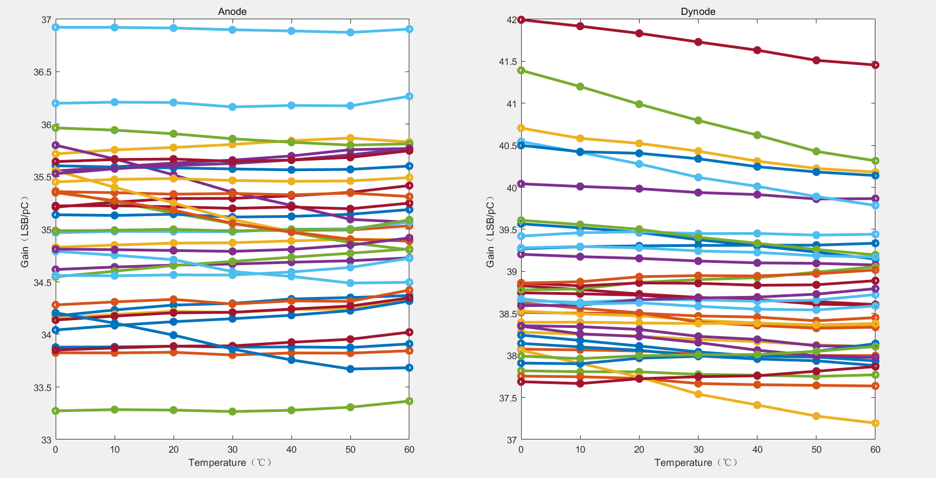
Stability of electronic baseline and gain with temperature
Temperature: 0℃-60℃
2LSB = 1mV
Anode:0.14mV/℃ <0.2mV/℃.
Dynode:0.09mV/℃ <0.2mV/℃.

Slide 18
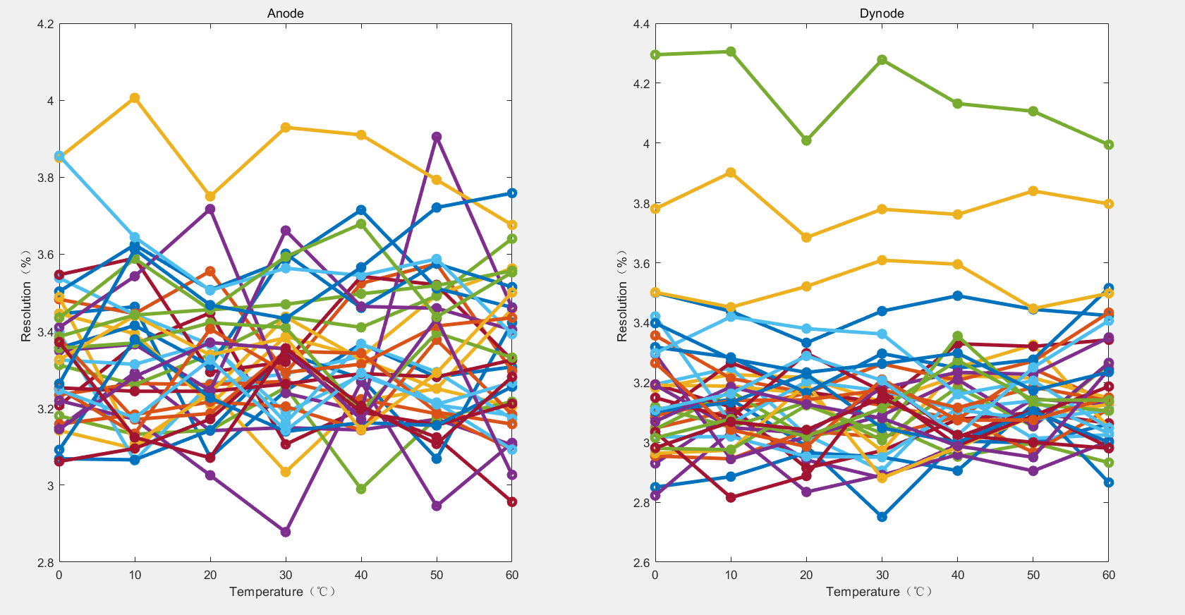
Minimum signal resolution varies with temperature

Slide 19
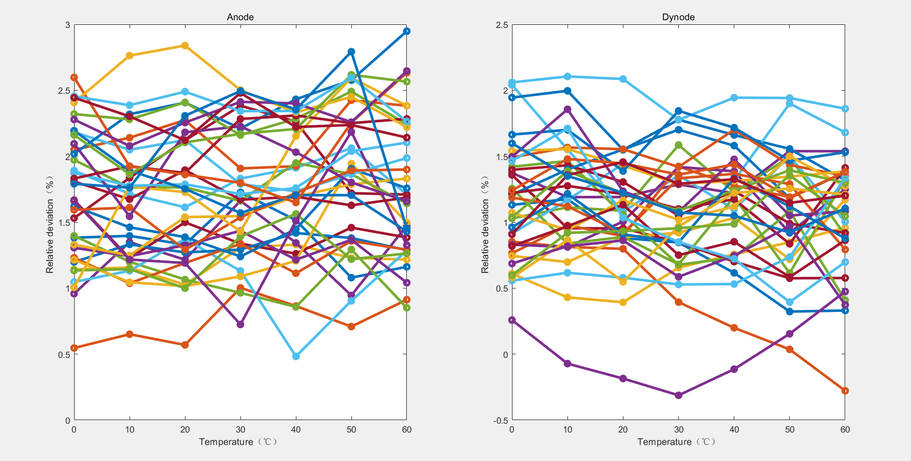
Minimum signal relative deviation varies with temperature

Slide 20
Power of Electronics
Power of a DB +AB:
5.5V * (1.74 A+ 1.016A) =15.16W
Power of two DB +ABs:
5.5V * (3.618 A+ 2.040A) =31.12W
Power of a BDB:
5V*1.098A = 5.49W
Total = 15.16W + 31.12W + 5.49W = 51.77W
Small than 70W

Slide 21
Remote refactoring
Download two different programs to Flash through the network cable. Compare the success of the readback status of each of the two programs.

Slide 22
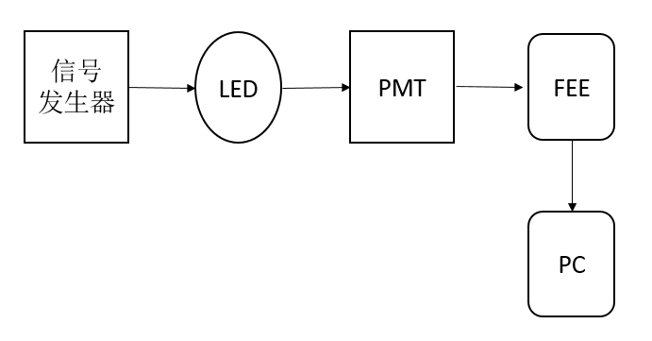
Noise trigger rate And Crosstalk
Noise trigger rate:
indicator: <1Hz @0.48pC Single channel threshold =0.16pC;
@0.468pC,The peak after electronics quantification is about 17LSB . Therefore, the single channel threshold of 0.16 pC corresponds to the threshold of 6 LSB.
Experimental value:
@1min, Noise trigger rate is 0;
Crosstalk:
No crosstalk found

Slide 23
Summary: Comparison of electronic indicators
key parameter | indicator | Results of Testing
Anode charge measurement range | 0.48pC-72pC | 0.468pC-72.54pC
Dynode charge measurement range | 0.48pC-72pC | 0.468pC-72.54pC
Resolution | <30%@0.48pC, <3% @72pC | <5%
Relative deviation | <5% @0.48pC, <2% @72pC | <3% @0.48pC, <2% @2pC
Baseline temperature drift | <0.2mV/℃ | 0.14mV/℃(Max)
Channel gain inconsistency | <3% | 2.46%
Noise trigger rate | Anode: <1Hz @=0.16pC the single channel threshold of 0.16 pC | 1min No noise found
Power | 小于70W | 55.58W
Resolution of Time | 20ns | 7.2ns
Sample rate | 10kHz | 10kHz
range of working temperature | 0℃－+60℃ | 0℃－+60℃
Crosstalk | <0.03% | No crosstalk found

Slide 24
Thanks!

