Slide 1
Progress of LHAASO-WFCTA
Shoushan Zhang
Institute of High Energy Physics
LHAASO collaboration meeting，Nanjing， 2019/4/13-15

Slide 2
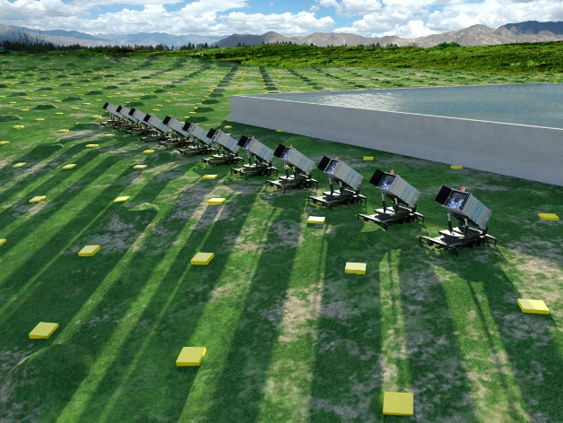
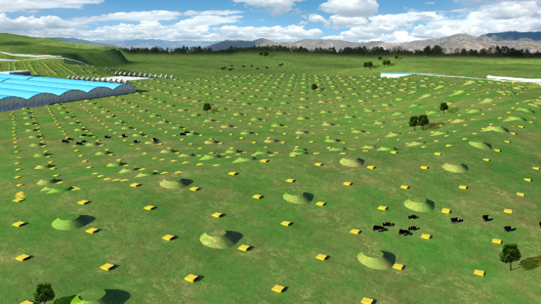
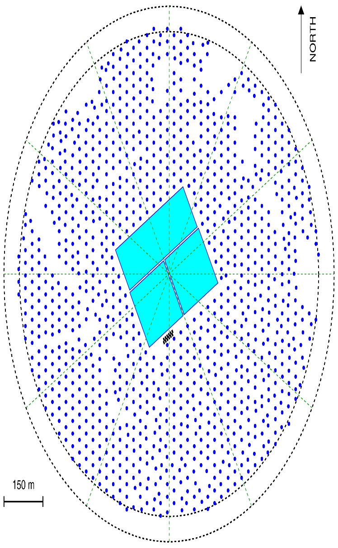
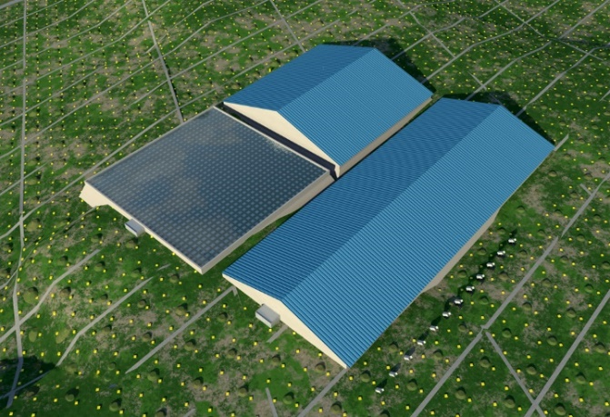
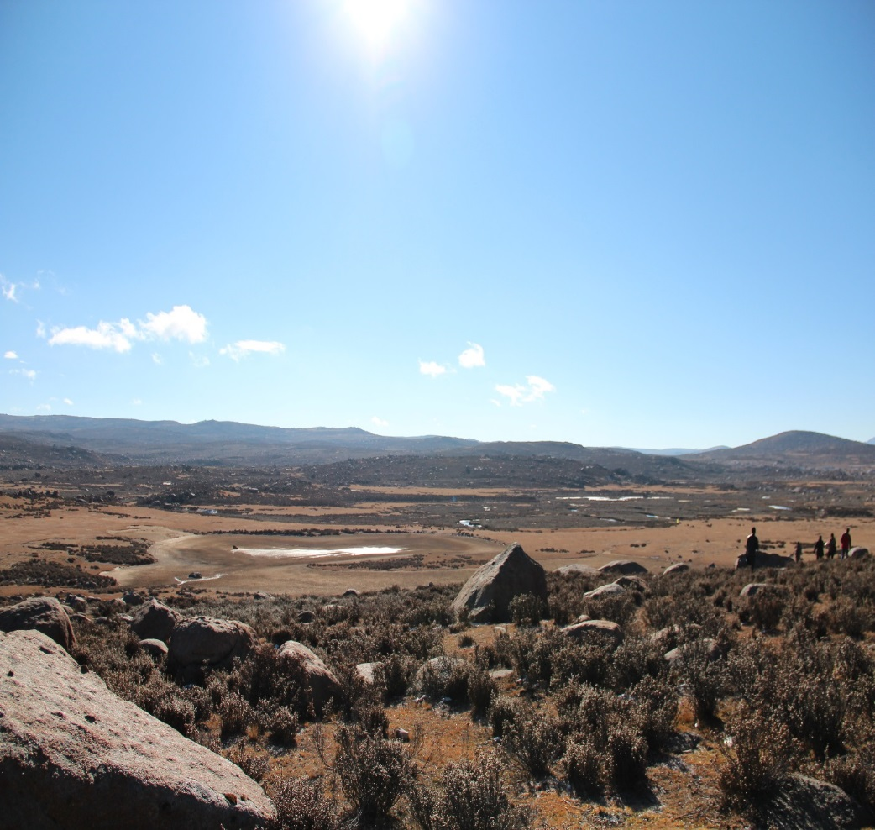
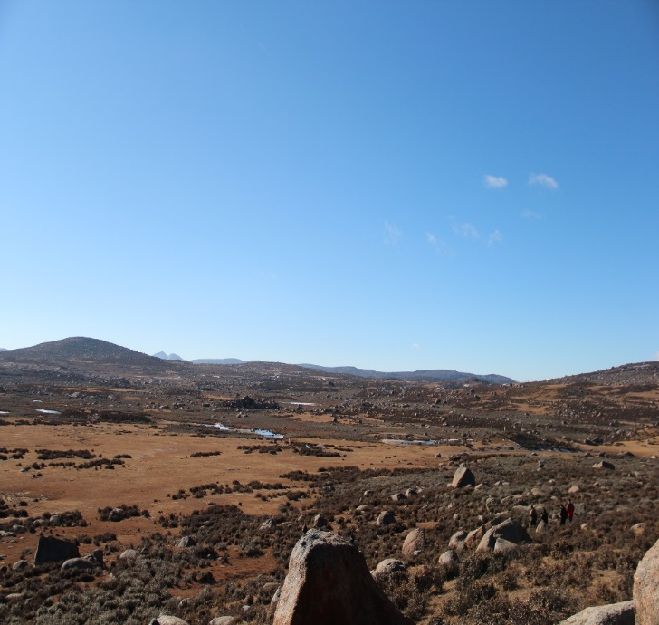
LHAASO
KM2A:
5195 EDs
1171 MDs
WFCTA:
18 Cherenkov telescopes (1024 pixels/telescope)
WCDA:78,000 m² 3000 cells (25m²/cell)
Daochen, Sichuan (29º21’ 31” N, 100º08’15” E, 4410 m a.s.l., 600 g/cm)

Slide 3

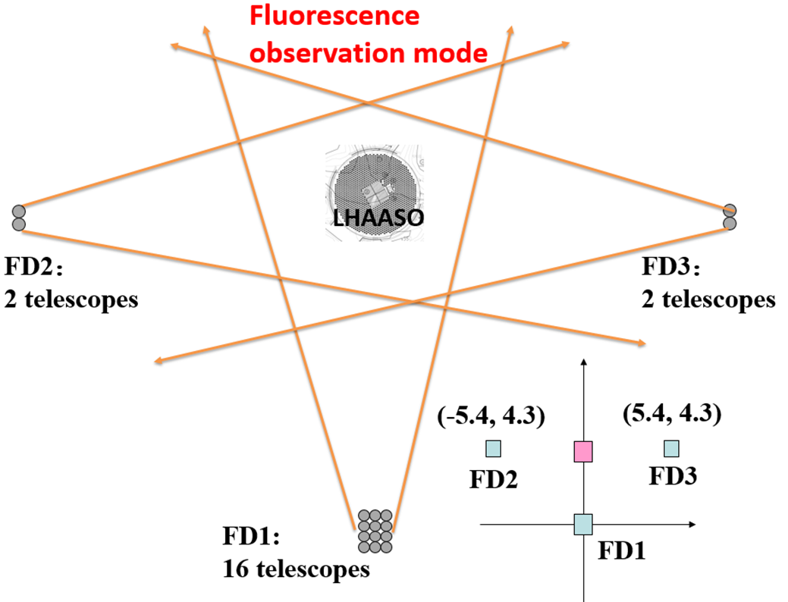
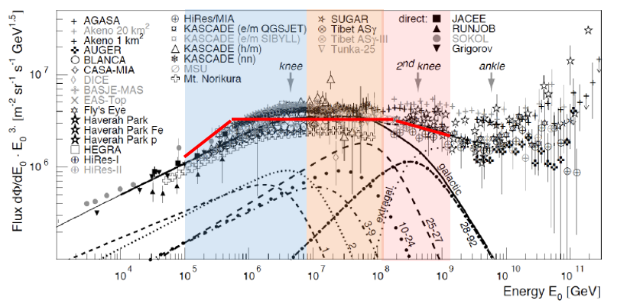
LHAASO science in cosmic ray measurement
  Measure individual cosmic ray spectra from 10TeV to EeV
  Multi-parameters, Multi-stages
0.1-10 PeV (Cherenkov mode)
  pure proton and light nuclei (P+He) spectra
  6 telescopes (30°in zenith) + ¼ WCDA
1- 100 PeV (Cherenkov mode)
  Pure iron or heavy nuclei spectra
  18 telescopes (45 °in zenith) + scintillator detectors + muon detectors array
>100 PeV (fluorescence mode)
  2nd knee
  20 telescopes + muon detectors array

Slide 4
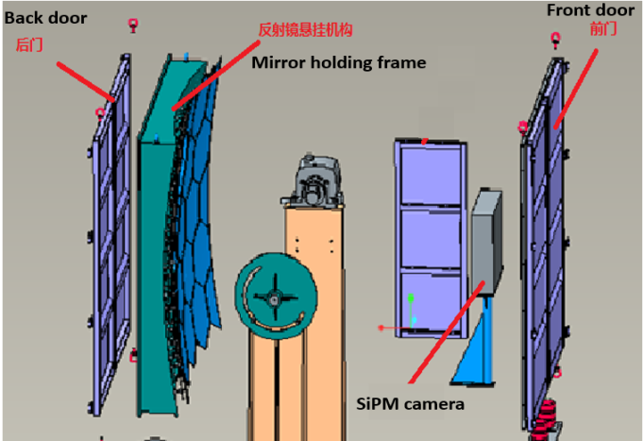
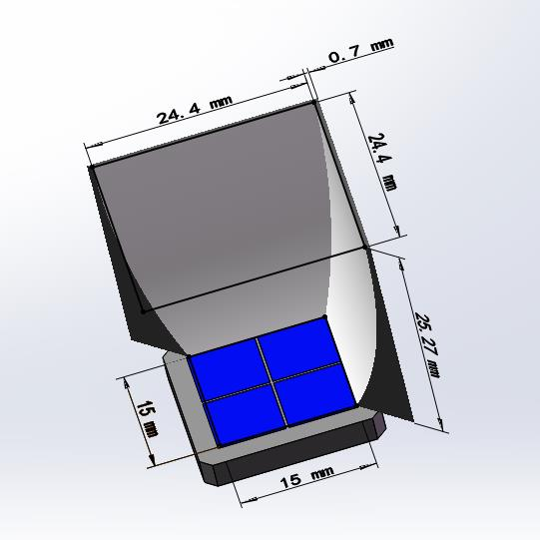
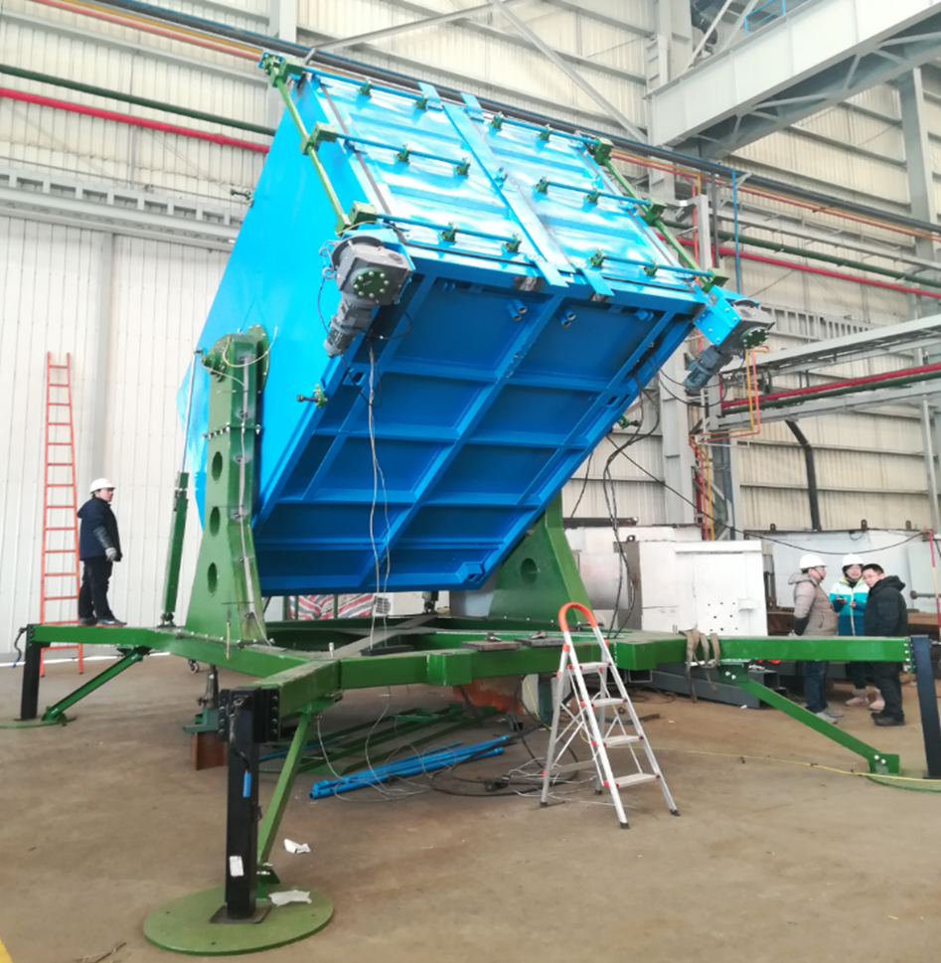
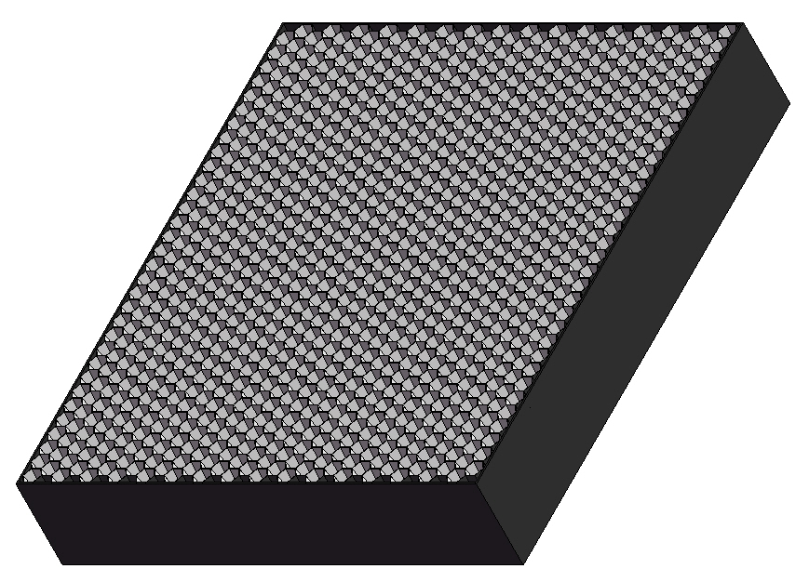
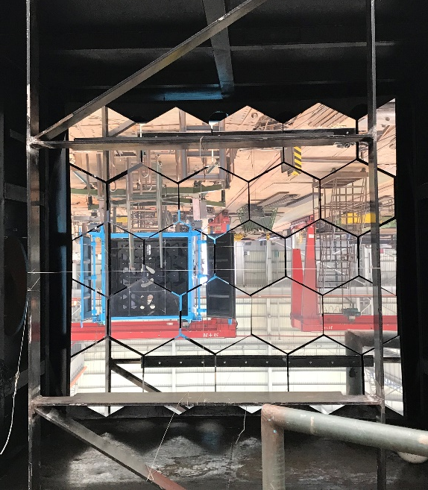
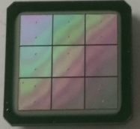
Wide Field of View Cherenkov Telescope (WFCTA)
5m² spherical mirror
32×32 SiPMs array
Pixel size 0.5°
FOV: 16°× 16°
Portable design: easy to switch the array configurations
SiPM camera
A prototype of WFCTA

Slide 5
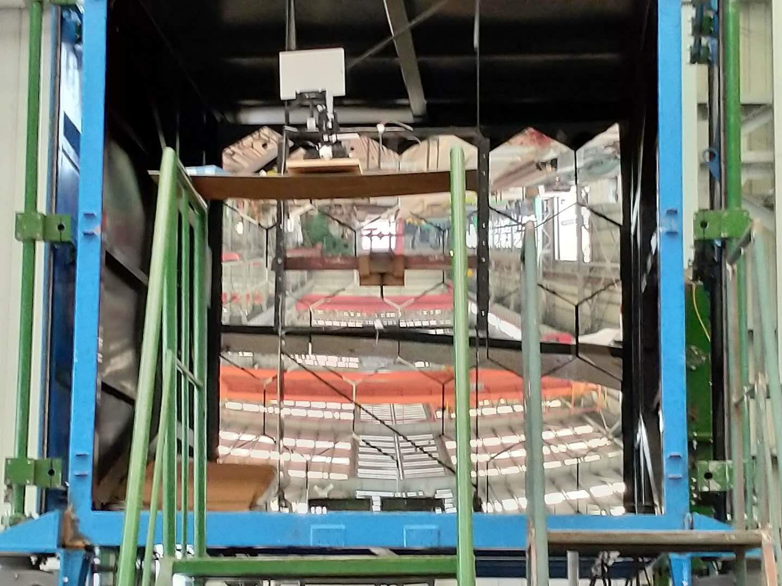
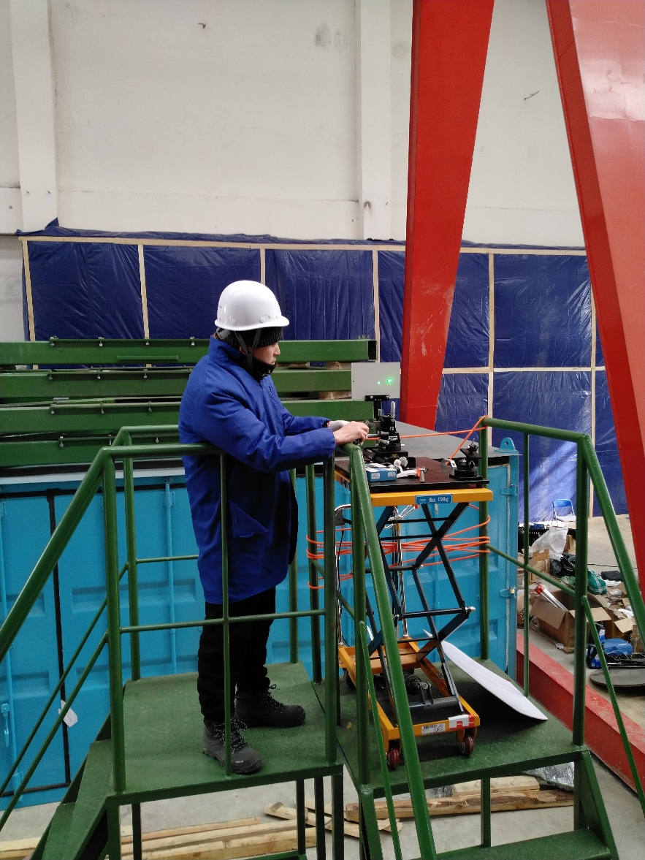
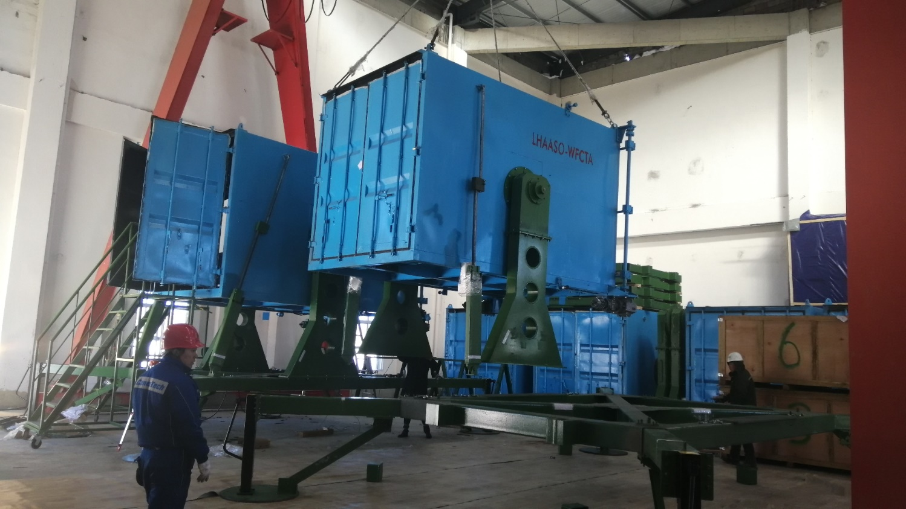

Slide 6
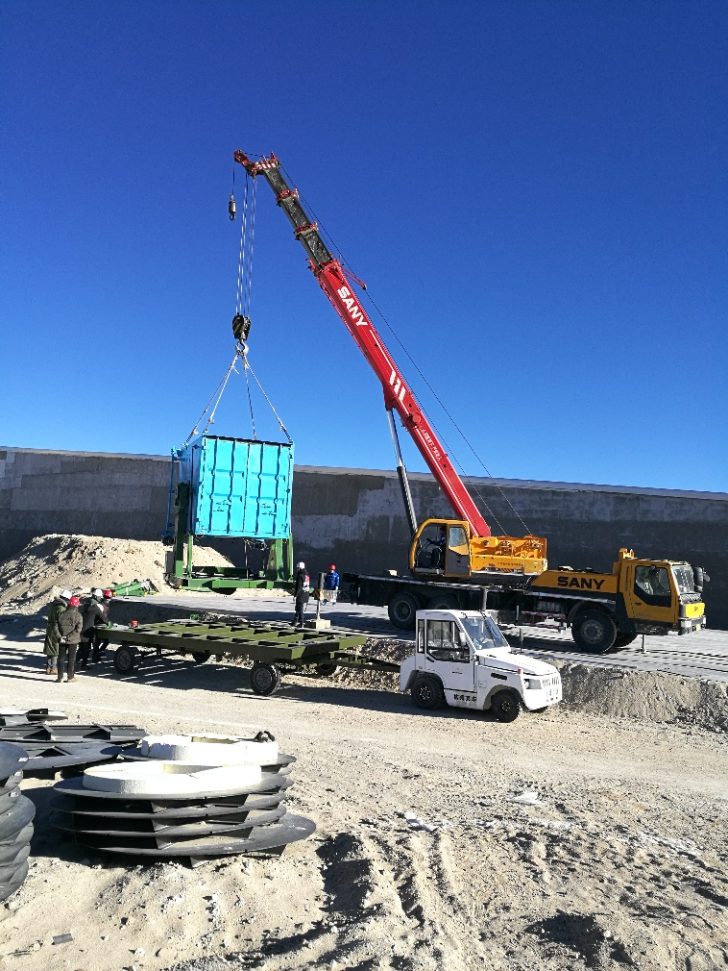
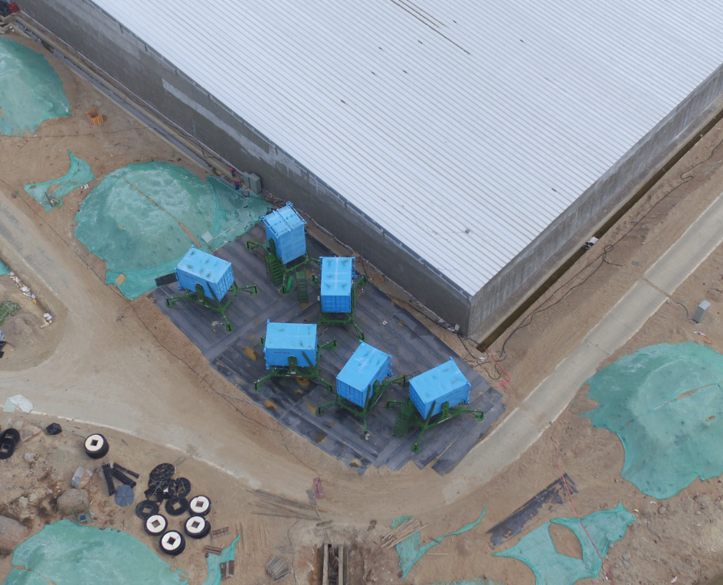
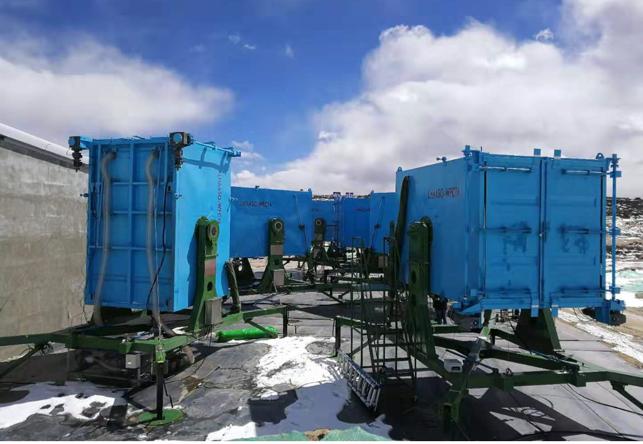
Six movable/adjustable containers, and spherical mirrors have been installed at LHAASO site.

Slide 7
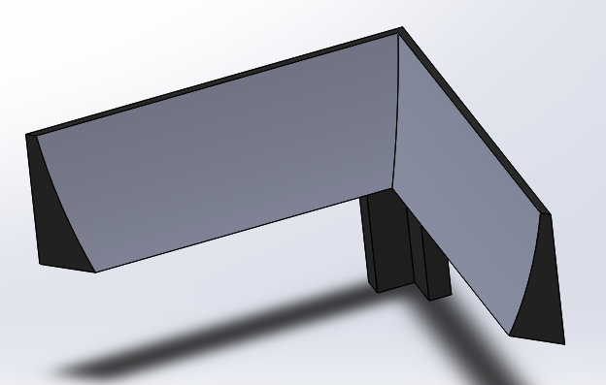
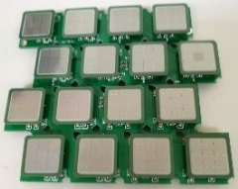
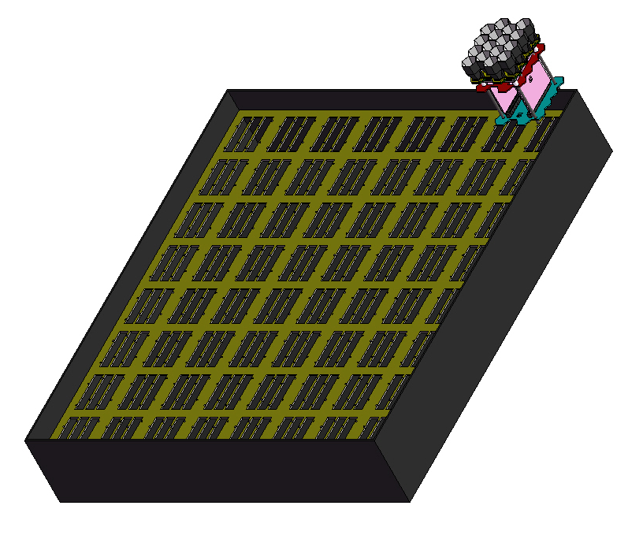
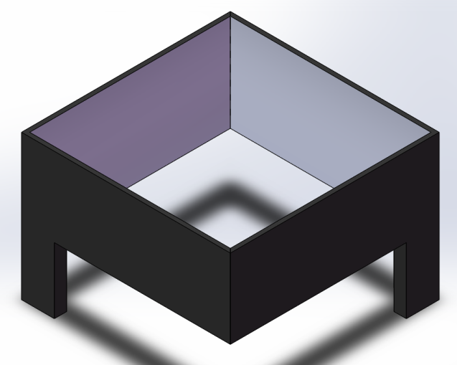
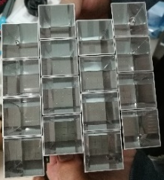
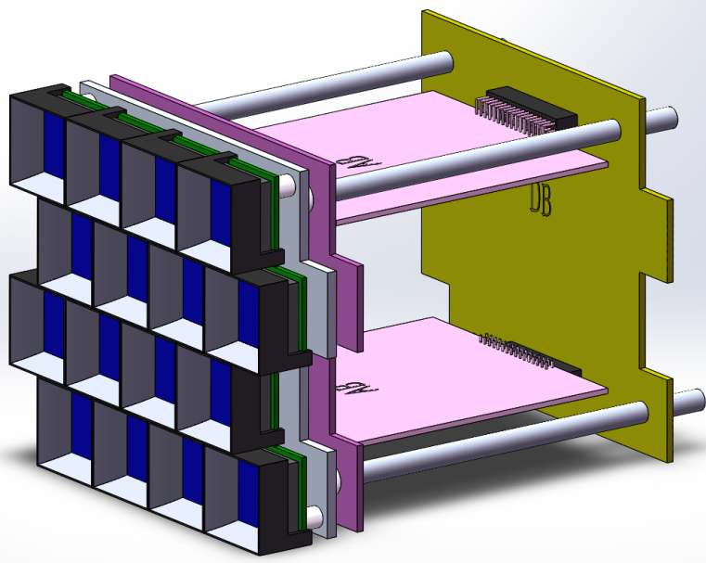
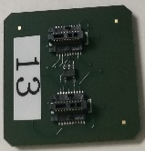
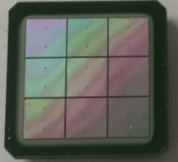
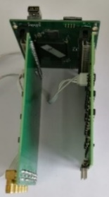
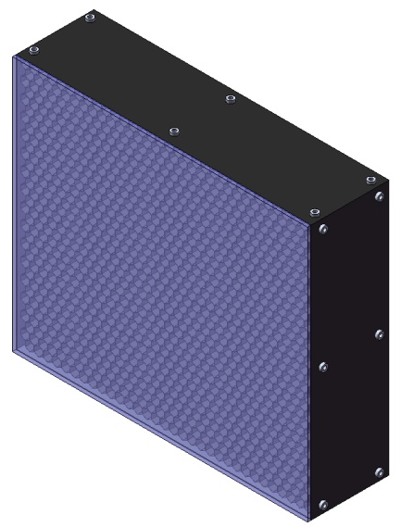
Schematic diagram of SiPM camera assembly
64 ×
AB2
A module has 4×4 SiPMs.
SiPM camera box
AB1
Cluster
DB
SiPM camera：32×32 SiPMs
Optical filter
In the cleaning room (Yunnan university lab)

Slide 8
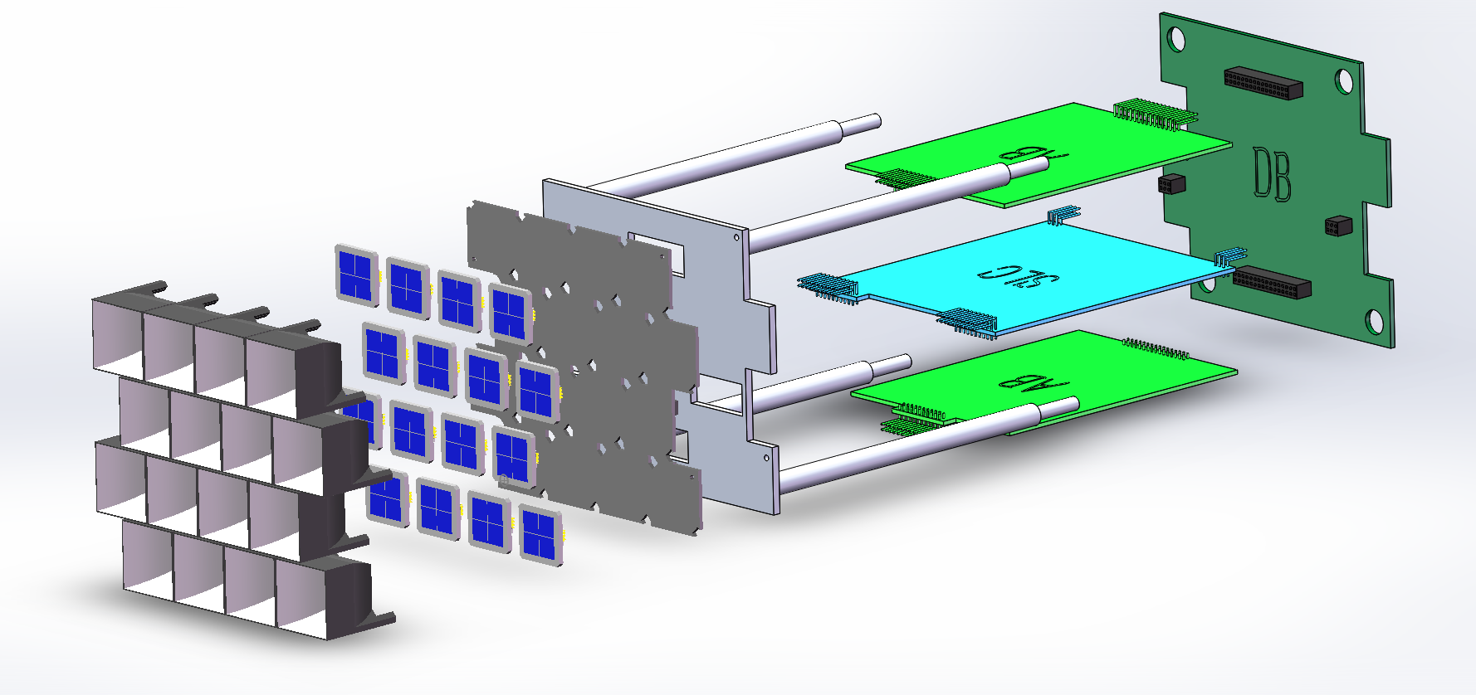
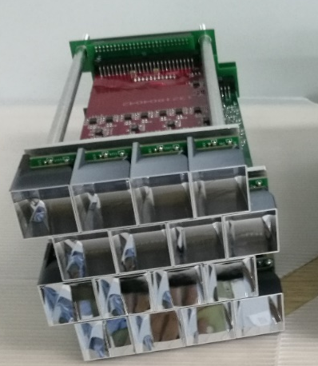
  Square SiPM：15 mm×15 mm
Digital Board
Metal frame
Analog Board
SiPM board
Winston cone
V&T compensation loop board
Light concentrator (Winston cone): is to increase the effective area of the SiPM
SiPM board: 16 SiPMs, 16 temperature sensors (embedded in the SiPM chip ), and 16 pre-amplifiers
Voltage and temperature compensation loop:
  16 temperature and high voltage compensation loops;
  16 channels of high voltage power supply.
Analogue board: 16 channels of amplifier and shaping circuit
Digital board: 50 MHz FADC and FPGA

Slide 9
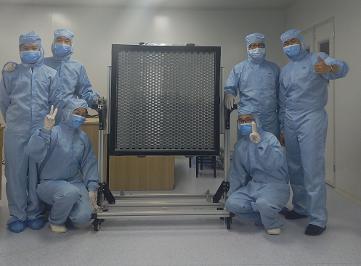
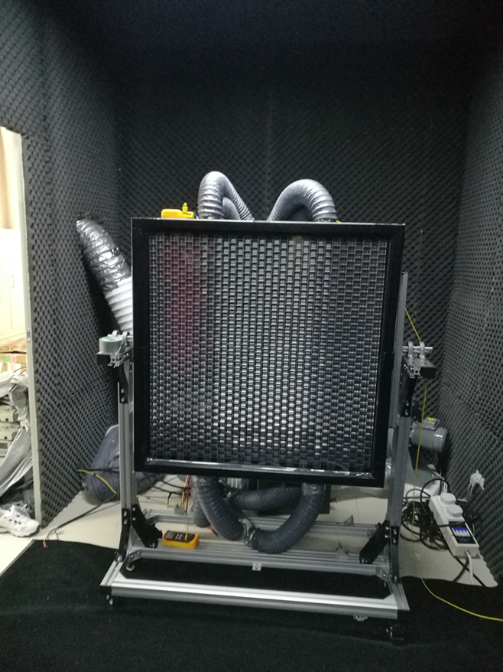
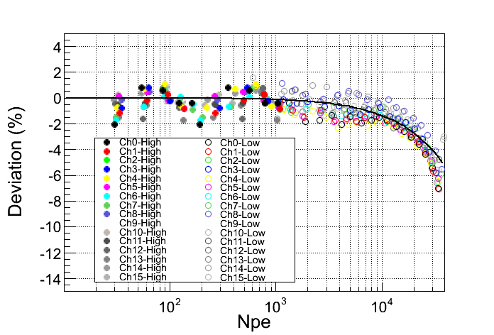
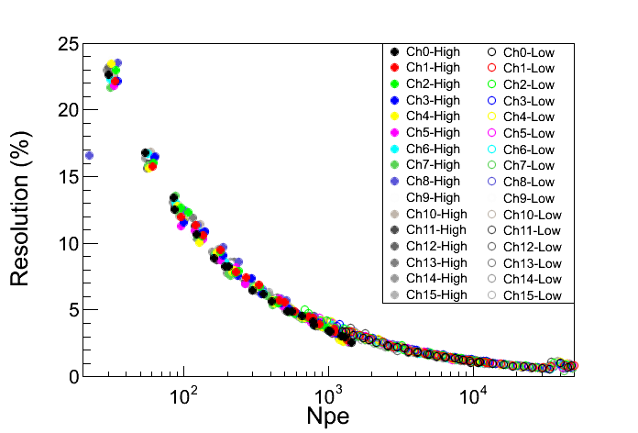
Dynamic range
resolution

Slide 10
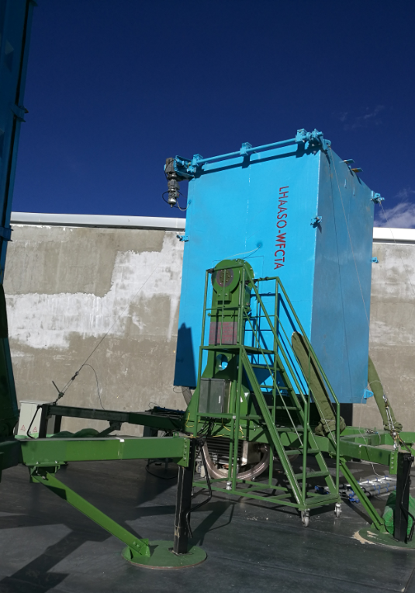
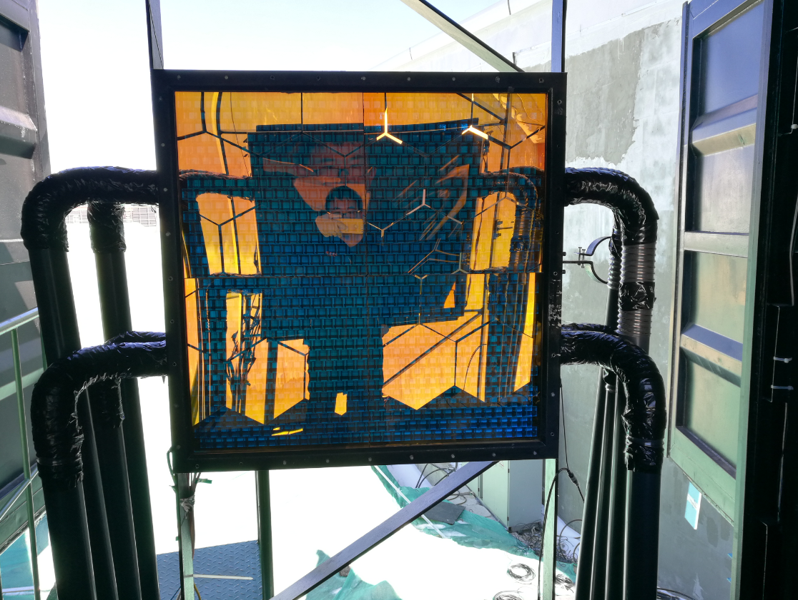
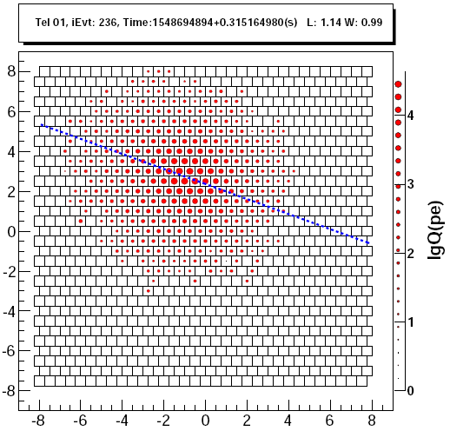
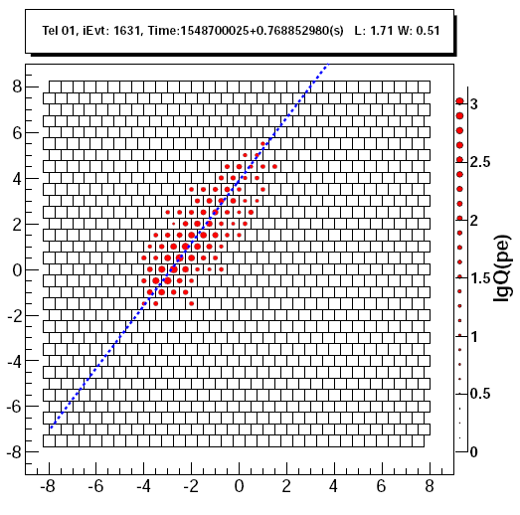
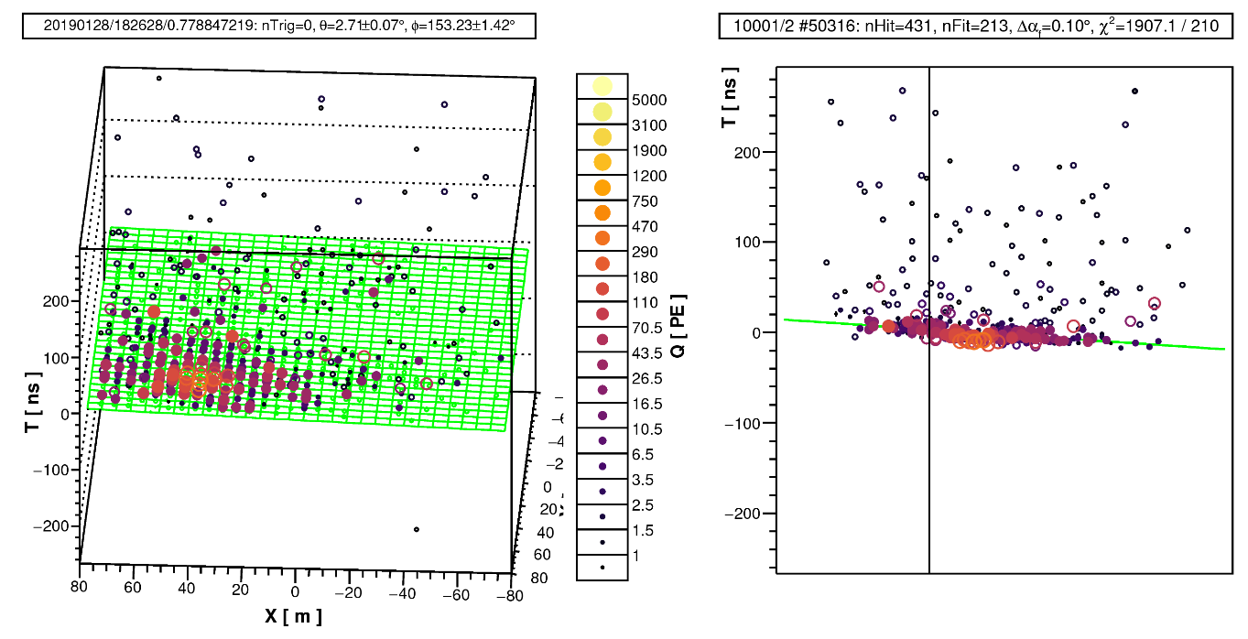
Telescope pointing： zenith angle 0 °;
Running time：from 2019-01-29.
A coincidence event of WFCTA and WCDA

Slide 11
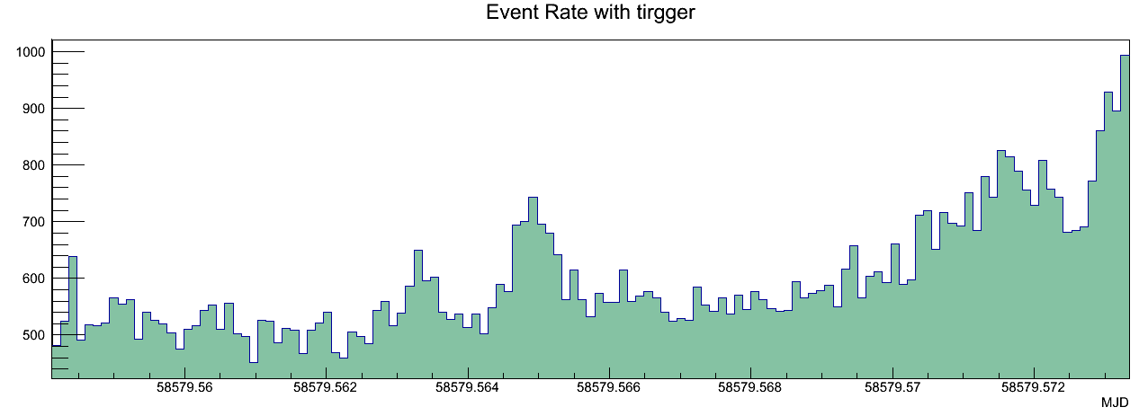
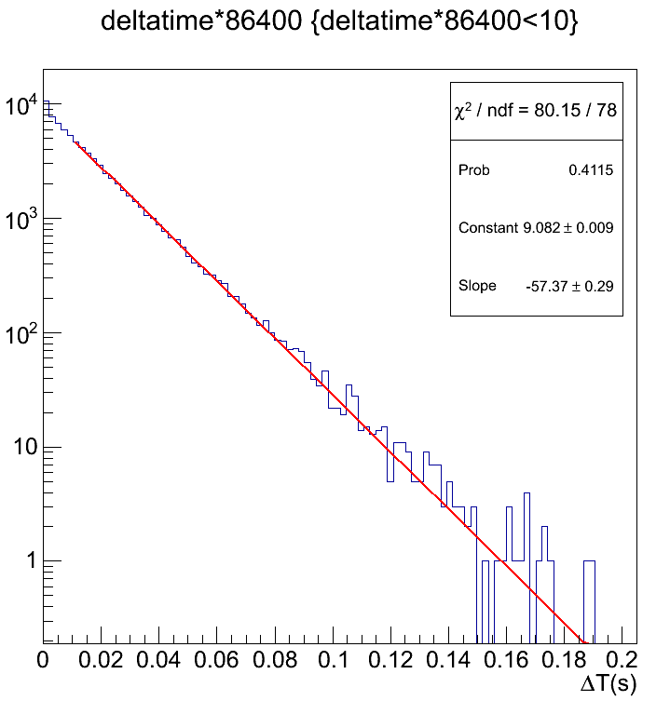
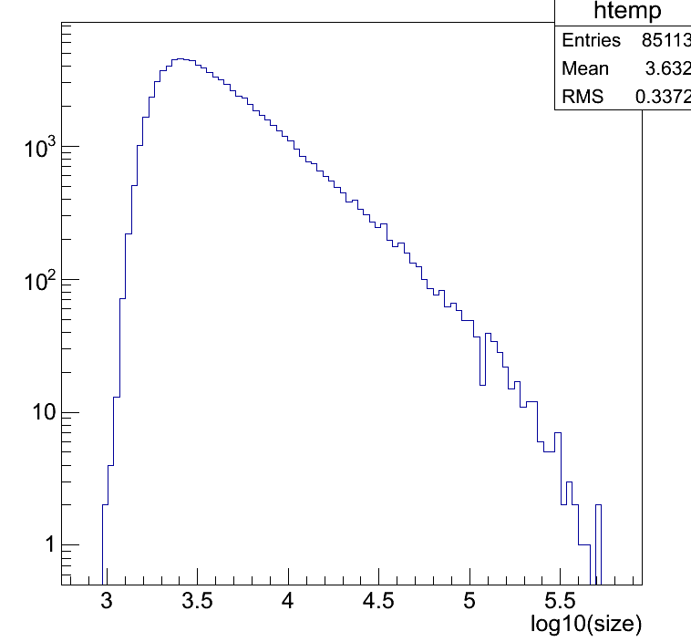
Trigger condition: single pixel threshold = 30pe & pattern=3 adjacent pixels
2019/04/06
Event Rate with time: 50Hz – 100 Hz
Total size distribution
Exponential fitting
Delta time between two arriving events
3 3.5 4 4.5 5 5.5
log10(total Npe)

Slide 12
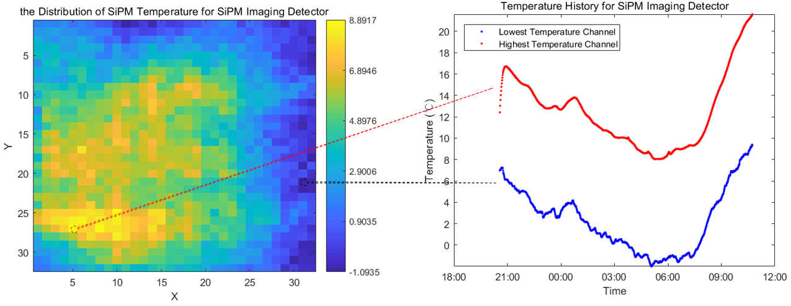
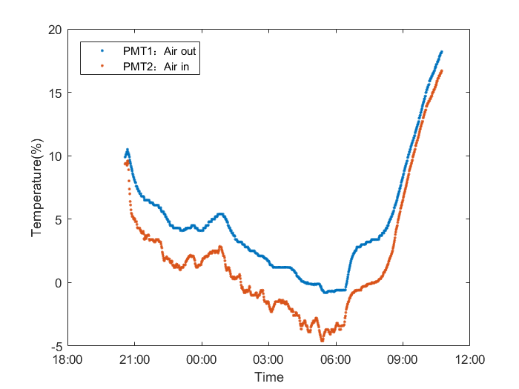
Temperature distribution
8.9℃
℃
20℃
15℃
Day
10℃
Air in
Night
Air out
5℃
0℃
-1.1℃
20℃
℃
15℃
Air out
10℃
5℃
0℃
Air in

Slide 13
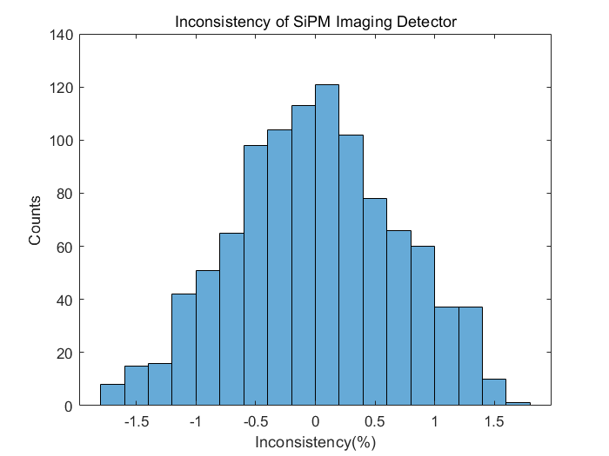
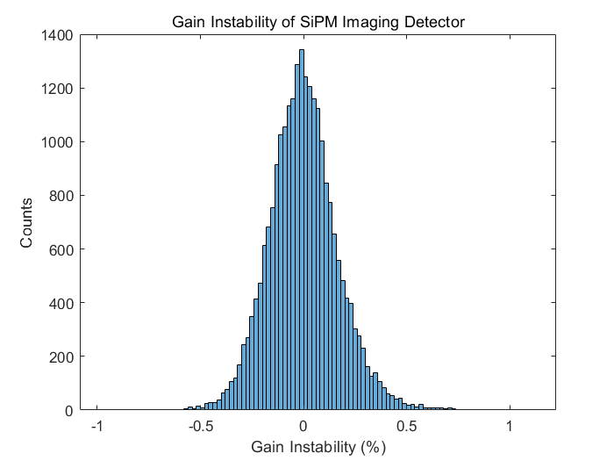
UV-LEDs are mounted at the center of the mirror to monitor and calibrate the gain of the SiPM camera.
Gain instability is within ±1% in the whole night after the temperature and high voltage compensation loops.
The temperature distribution on camera is within the adjustable range of high voltage and temperature compensation loops.
Mirror
UV light 400 nm
UV LED
SiPM camera
Gain instability is within ±1% in the whole night
Gain ununiform is less than ±2% in the camera

Slide 14
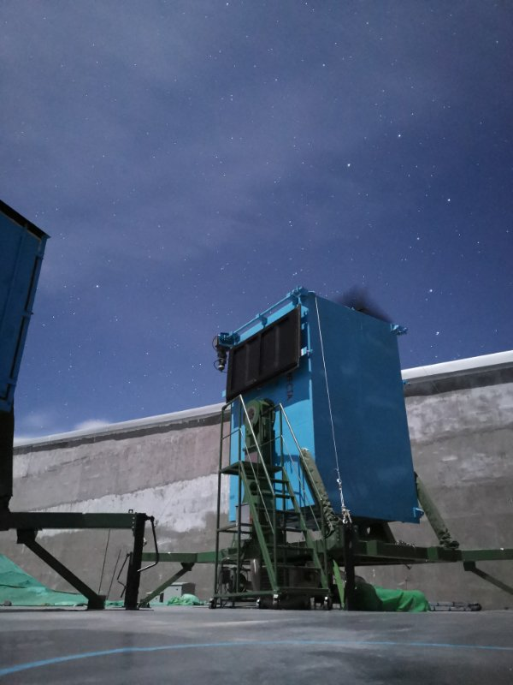
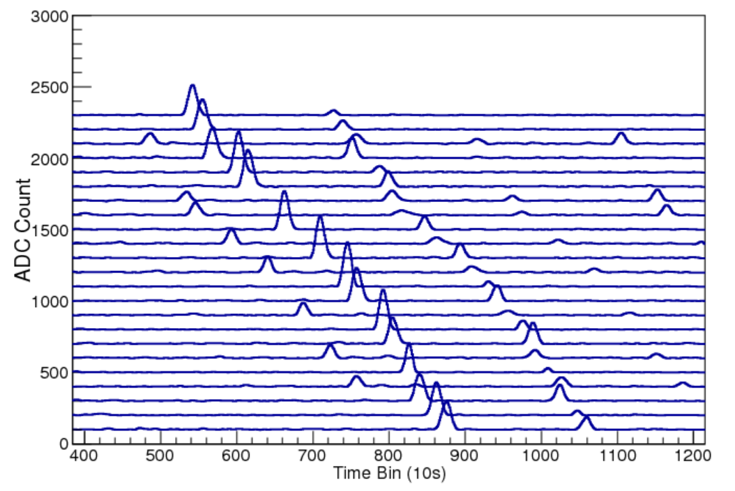
The telescope can be run in the moon night
Stars passing through the field of view of the telescope
Stars can be used to calibration the direction of the telescope and study the spot shape etc.
See Dr. Lingling Ma’s talk in 15 April

Slide 15


Filter window：AR + cutoff
To improve signal to noise ratio
Filter
Moon less night
550 nm
Sky background light spectrum
in the moon less night
Moon night
NSB(without filter)/NSB（with filter）
λ （nm）

Slide 16



Slide 17




Calibration and Atmosphere Monitoring
Device | Parameters
N₂ laser | Wave length=337nm Energy≥170μJ
YAG laser | Wave length=337nm Energy≥2mJ
3-D Rotary Platform
See Dr. Fengrong Zhu’s talk in 15 April

Slide 18
Conclusion and future plan
First Cherenkov telescope has been successfully run in January 2019.
Six movable/adjustable containers, and spherical mirrors have been installed at LHAASO site.
More stable version online FPGA program would be finished in May 2019.
Dynamic threshold and more function FPGA program would be finished in July. (see Prof. Guoqiang Zeng’s talk in tomorrow)
  Single pixel threshold: using signal to noise ratio (S/N>n), threshold varies with the intensity of the sky background light.
  More functions: e.g. recording more longer pulse width for laser event
Second camera will be installed at LHAASO site before 26 April.
Total 6 cameras will be installed at LHAASO site in August.
Total 10 telescopes will be installed at LHAASO site in the end of 2019.

Slide 19
Thank you for your attention!

Slide 21
Task and collaboration of WFCTA
Task
Collaboration
Movable and adjustable container
Institute of High Energy Physics
Readout electronic system
Sichuan University
SiPM camera
Yunnan University
  Geneva University
Institute of High Energy Physics
Spherical mirror
Institute of High Energy Physics
Calibration system
Southwest Jiaotong University
Slow control system
National Space Science Center

