Slide 1
Transient High-energy Gamma-Rays and Neutrinos from Nearby Type II Supernovae
Kai Wang
(Peking University)
Collaborators: Tian-Qi Huang, Zhuo Li
LHAASO, Nanjing, 2019.04.15

Slide 2
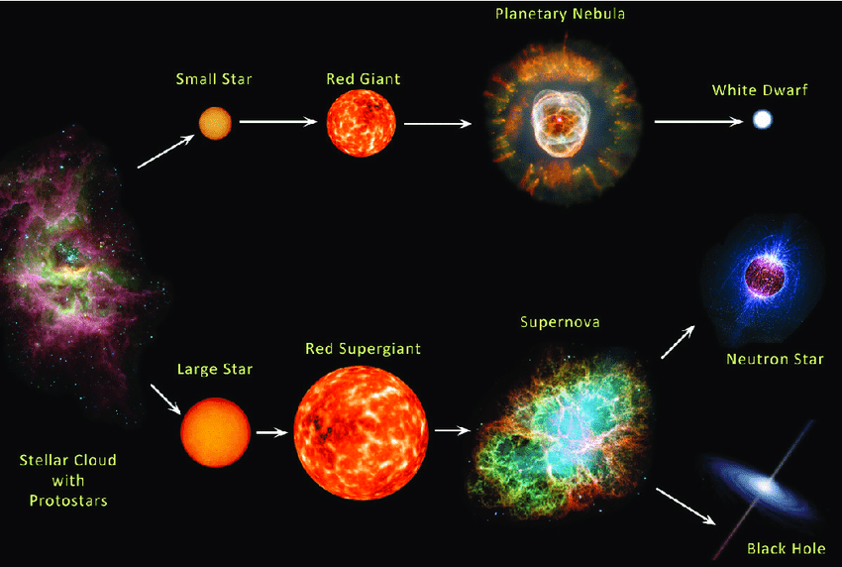
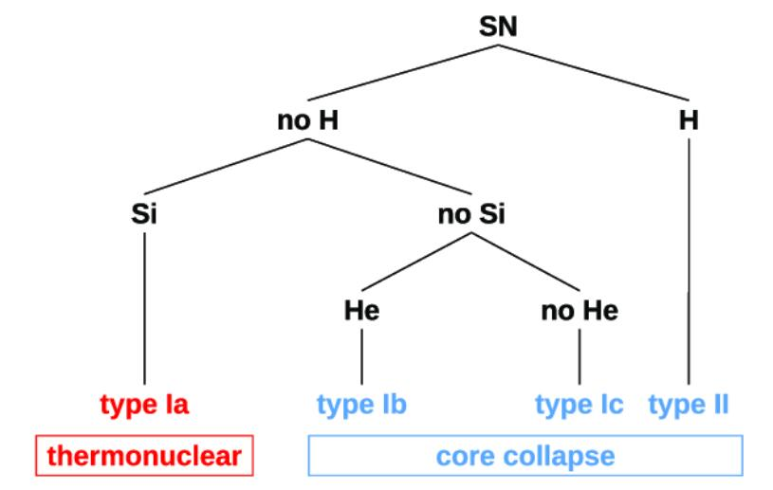
Why are there different types ?
Answer: progenitor stars are different
Type II:
collapse of Fe core in a normal massive star (H envelope)
Type I: 2 possibilities:
Ia: white dwarf accreted matter from companion
Ib,c collapse of Fe core in star that blew its H (or He) envelope
into space prior to the explosion

Slide 3
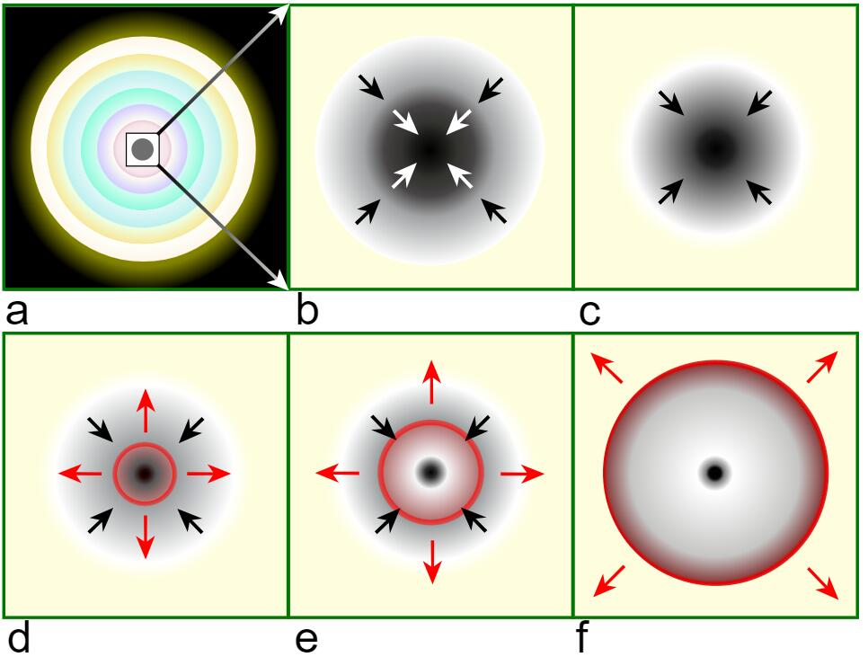
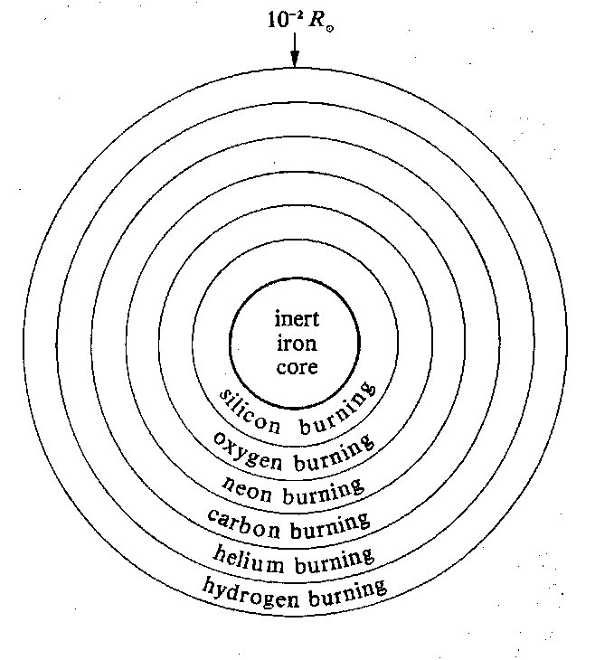
Core Collapse Supernova
10³ R
core

Slide 4
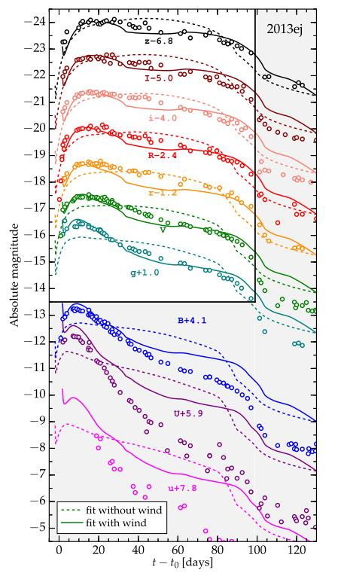
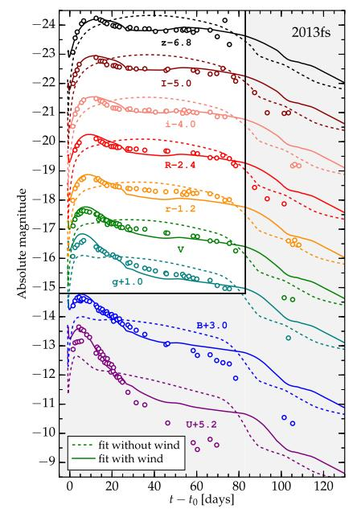
Morozova+2017

Slide 5
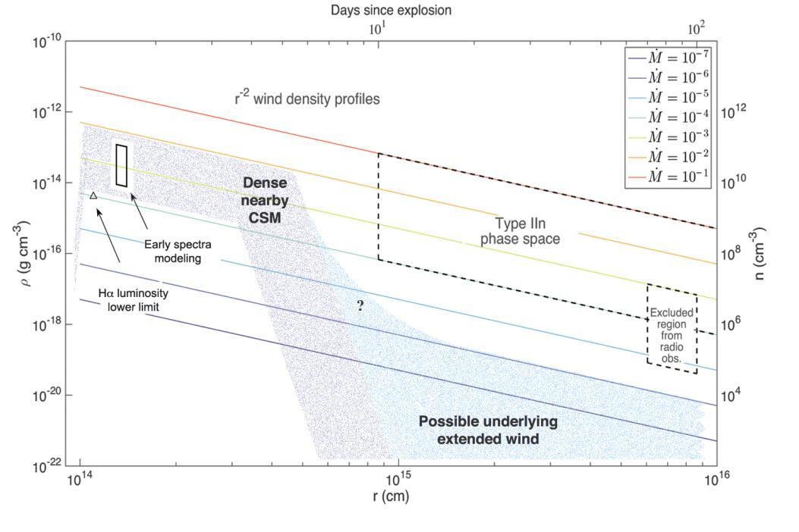
Circumstellar medium
Lasts for years
Yaron+2017, NatPh

Slide 6
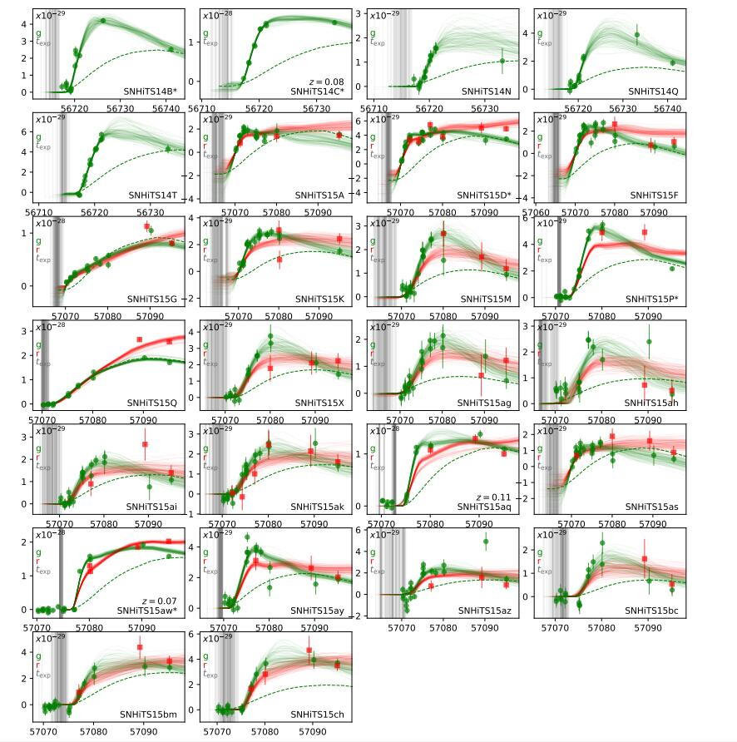
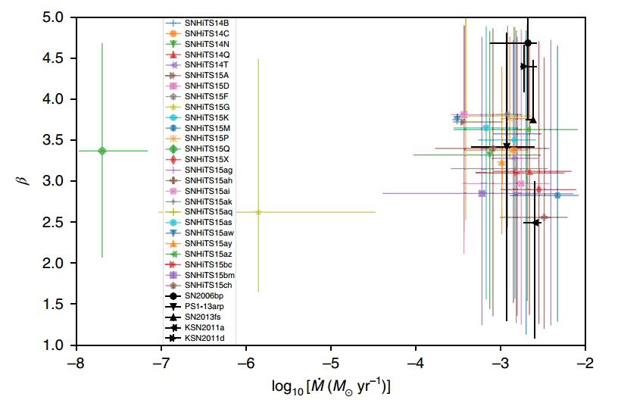
Forster+2018, NatAs

Slide 7
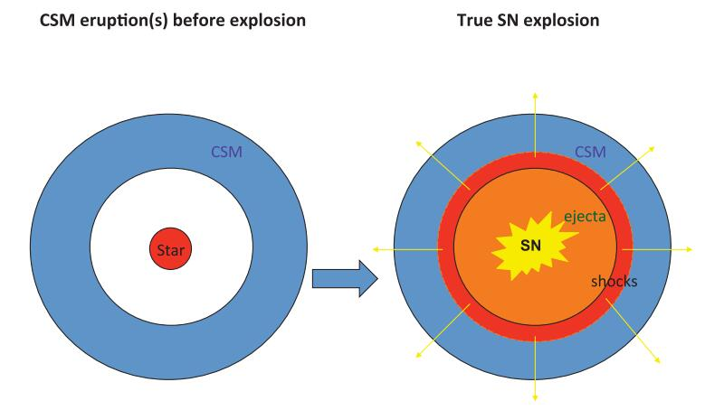
Credit to Murase, K.

Slide 8
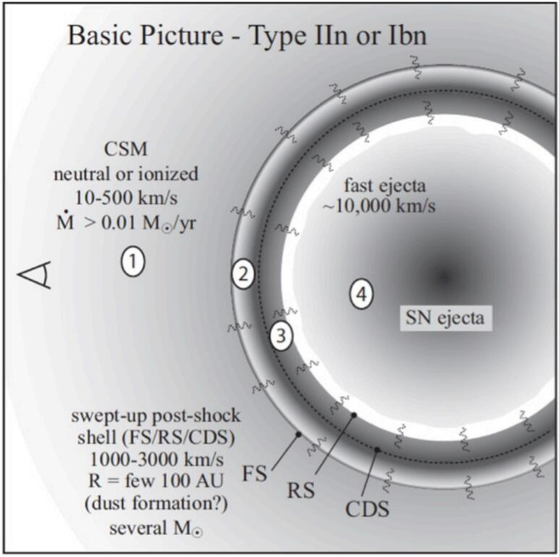
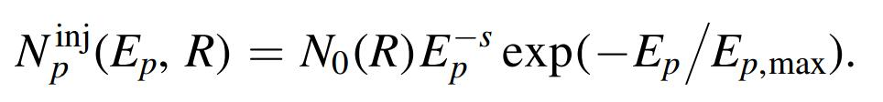
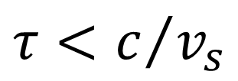
CSM interaction
Pre-shock CSM
Shocked CSM
Shocked ejecta
Unshocked freely expanding ejecta
$$τ<c/{v_{s}}$$
Credit to Nathan Smith

Slide 9
Hadronic processes
With the radiation field
Photomeson
Bethe-Heitler
With the gas
p-p collision

Slide 10
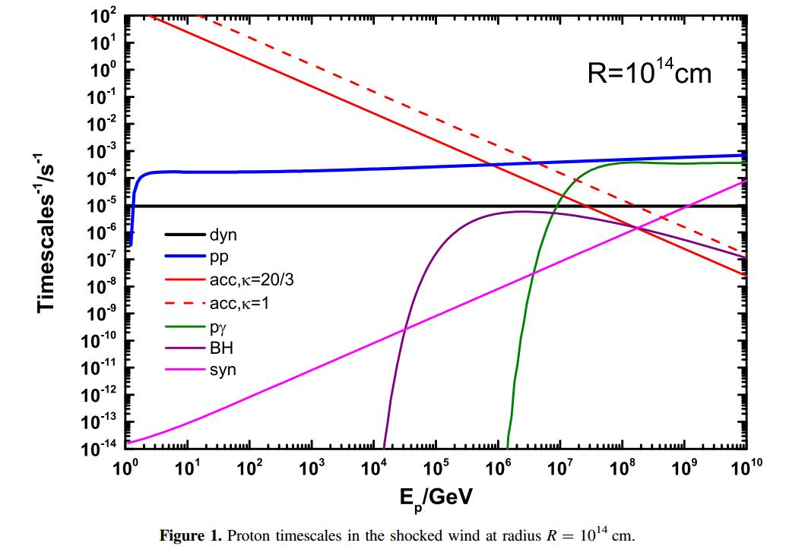
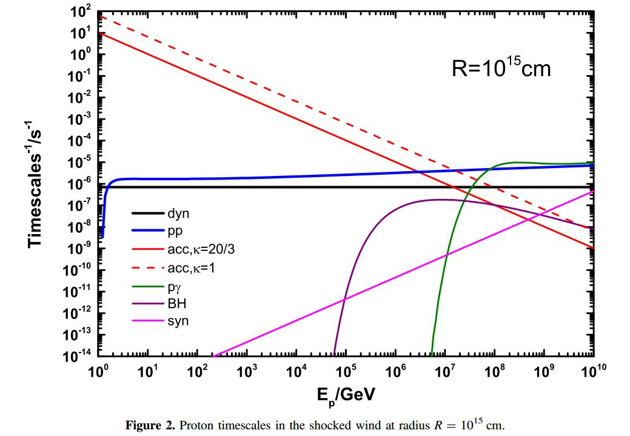
Timescales and Maximum Proton energy
Wang et al., 2019, ApJ

Slide 11

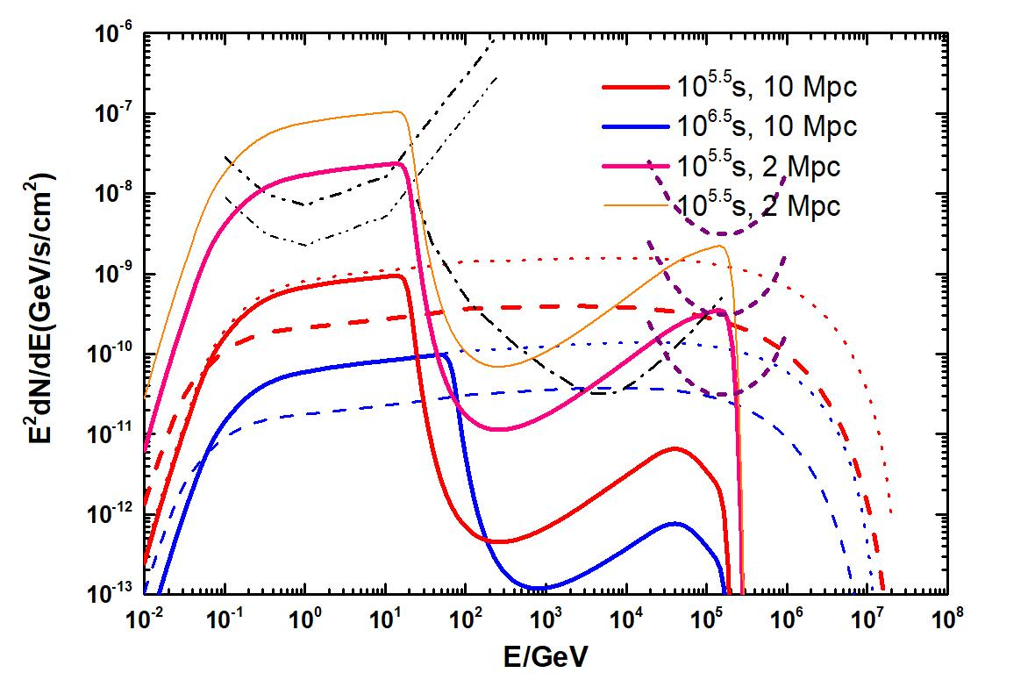

High energy gamma-rays and neutrinos
LAHHSO?
1. Absorbed by thermal optical photons, CMB and EBL.
2. ~Week-scale transient at 2-3 Mpc for Fermi-LAT and CTA.
3. Few in ten years

Slide 12
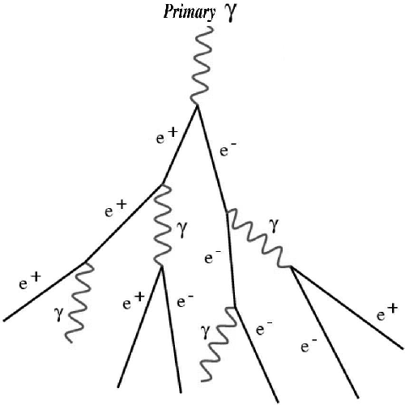
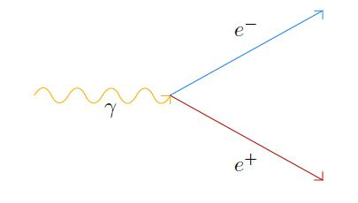
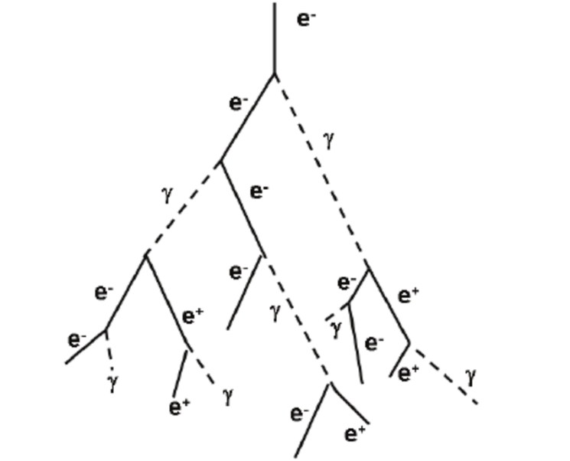
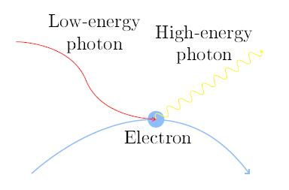
Electromagnetic Cascades
High energy gamma rays
Electron/positron pair production
Background radiation
Inverse Compton
Electromagnetic Cascades

Slide 13
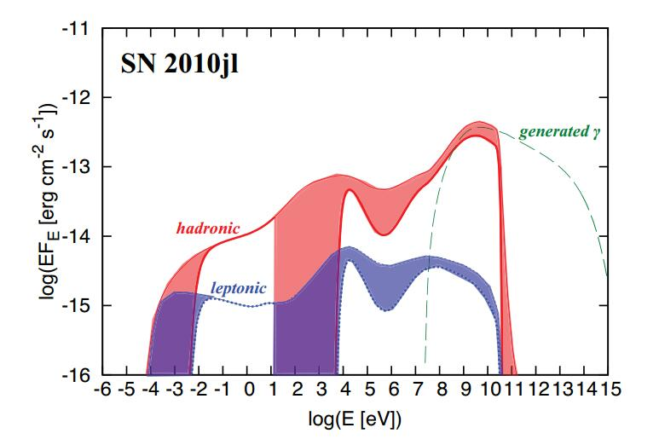
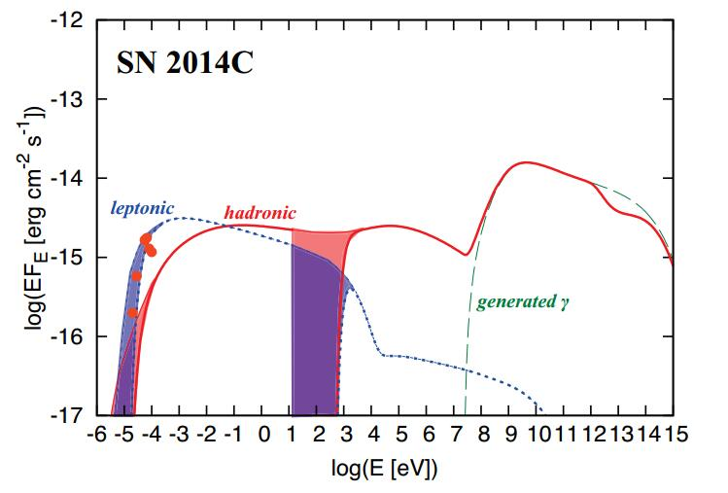
Lower-energy non-thermal radiations
Murase+2018

Slide 14

Lower–energy thermal Radiations
X-rays:
HMXT
Balanced by coulomb heating and cooling processes
Radio:
EP
Affected by free-free absorption, SSA, Razin–Tsytovich process
, Comptonization of thermal electrons

Slide 15
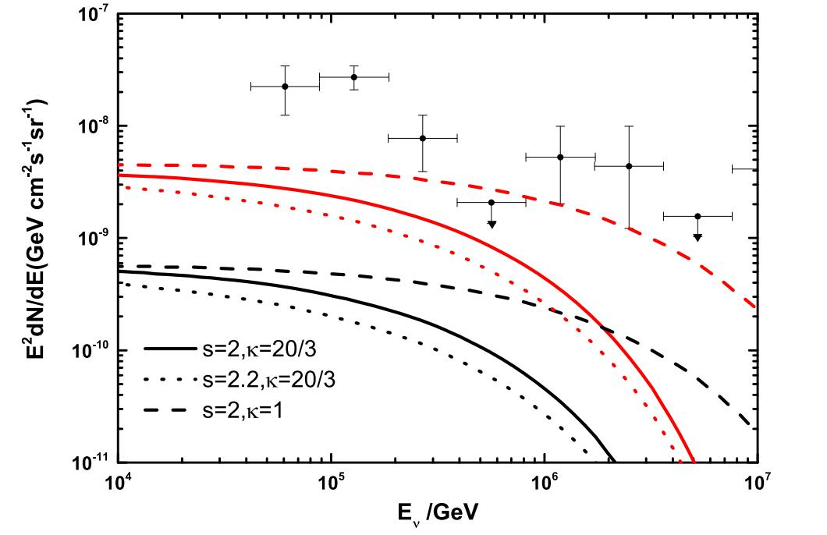
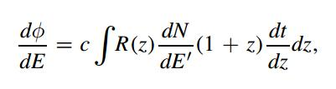
Wang et al., 2019, ApJ

Slide 16
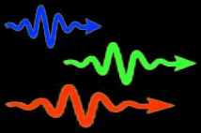

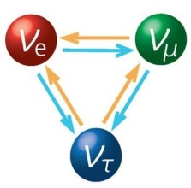
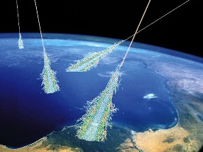
Multi-messenger Astronomy
Photons
GWs
Neutrinos
CRs
GW170817/GRB170817A
SN 1987A
Blazar TXS 0506+056

Slide 17
γ
Fermi, HAWC, HESS, MAGIC, VERITAS
GWs
LIGO/Virgo
CRs
PAO, TA
ν
IceCube Gen2, Km3Net. GRAND
CTA, SVOM, LHAASO
IceCube
LISA, Tianqin, Taiji
GRAND
HMXT, EP
>=3 messengers?

Slide 18
Conclusions
A dense wind environment (or circumstellar medium) may be ubiquitous in regular Type II supernovae before explosion.
for the SN 2013fs-like wind environment, multi-GeV and a few hundred TeV gamma-rays are detectable with a time window of ~week at <2-3 Mpc by Fermi-LAT and CTA.
For a denser wind environment, the production of Neutrinos could be conspicuous above 300 TeV.
LHAASO could detect such a transient for a distance of <~1Mpc, at least for a galactic event!
Both high-energy and lower energy (Chinese devices? Early-stage observations) can be helpful to classify the nature of SNe.
Searching early-stage Gamma-ray signals from nearby SNe
Thanks for your attentions！

