Slide 1
LHAASO Collaboration metting in Nanjing, 2019.04.12—15
Effects of thunderstorms electric field on intensities of e+/e-, and γ at Daocheng
Daihui Huang, Xunxiu Zhou
Bing Zhao, Kegu Axi, Ruirui Yan
Southwest Jiaotong University

Slide 2
Outline
Introduction
Corsika Parameters
Simulation Results
Longitudinal Development in ±1000V/cm
Percent change of number in different field
Rate of Cosmic Ray in KM2A-EDs
Summary

Slide 3
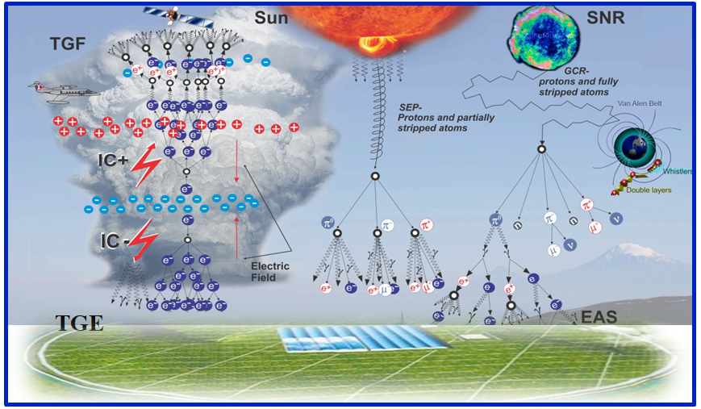
Introduction---Experiment Results
Thunderstorm effects
Satellite-based Experiments:TGFs
Ground-based Experiments:TGEs
RREA--Gurevich(1992)
TGFs: CGRO、Fermi et.al.
TGEs: Baksan Carpet array、ASEC、AS-γ et.al.

Slide 4
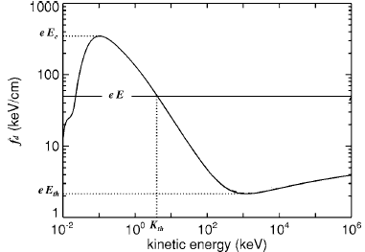
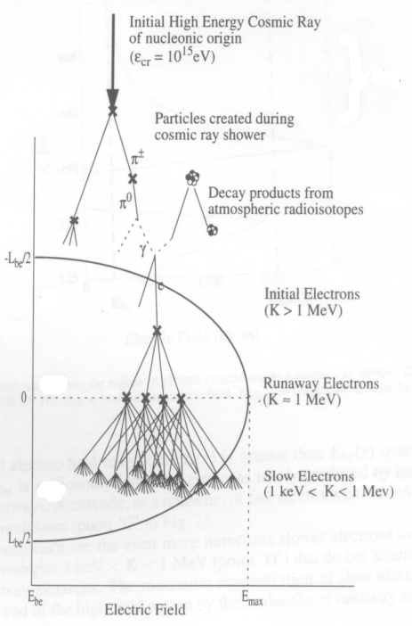
Introduction---RREA
B
D
A
C
Relativistic Runaway Electron Avalanches (RREA)
PhysicsLettersA 165 (1992) 463—468
Dwyer et. al
RREA
e⁺:positron e⁻:electron
e±:the sum of positron and electron
?

Slide 5
Introduction---Study Singnificance
Our previous work :only about e ±，but the number of γ changes significantly during thunderstorms.
EDs in KM2A (LHAASO) is sensitive to e ± and γ . The simulations may provide important information for giving reasonable explanations to the forthcoming experimental data of LHAASO.

Slide 6
Photon generation mechanism
1. positron annihilation（2 photons are released）
2. Electron-Positron annihilation（2 photons are released）
3. Bremsstrahlung(high-energy electron >84.2MeV)
（many photons are released）
4.Spontaneous radiation（1 photon is released）
5.Cherenkov radiation（many photons are released）

Slide 7
Electron/Positron generation mechanism
1. Compton scattering （1 electron is released）
2. positron annihilation ( lead to a decrease of positron )
3. Pair production（1 electron and 1 positron are released）
4.The energy of electron/positron increases and reaches the detection range in electric field.

Slide 8
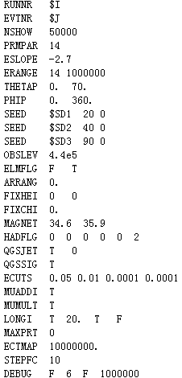
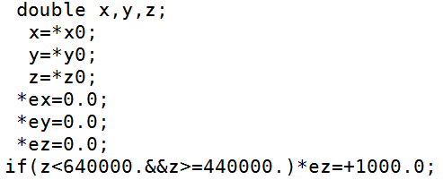
Corsika-75700 Parameters
P： 14 -2.7
He：402 -2.64
scope of field:4400-6400m （599-458 g/cm²）
Fifty thousand showers
Positive field is downward!

Slide 9
Simulation Results
Longitudinal Development in ±1000V/cm
Percent change of number in different field
Rate of Cosmic Ray in KM2A-EDs

Slide 10
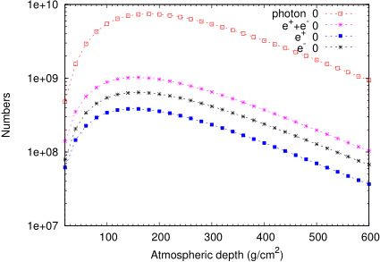
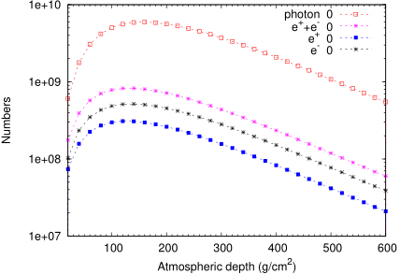
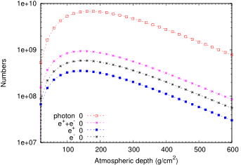
Longitudinal Development E=0
P
He
The longitudinal development of primary protons and primary helium is consistent well!
P+He

Slide 11
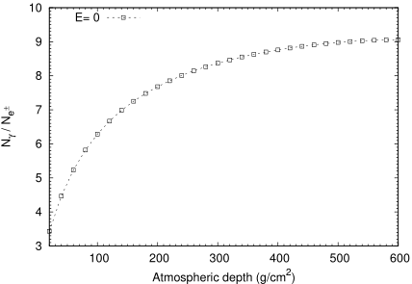
Longitudinal Development E=0
Atmospheric depth ↑
N_{γ}/ N_{e}± ↑
The longitudinal development of photons is similar to that of electrons.
At Daocheng:
N_{γ}/ N_{e}±~9.06

Slide 12
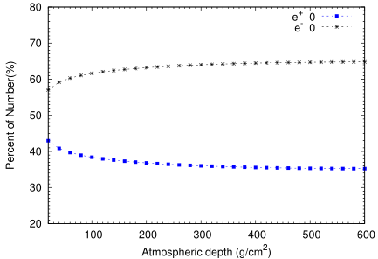
Longitudinal Development E=0
Atmospheric depth ↑
N_{e-}/ N_{e+} ↑
At Daocheng:
N_{e-}/ N_{e+}~1.84
e⁻ ~65% e⁺ ~35%
Due to Compton scattering and positron annihilation, the number of positrons is less than that of electrons in cosmic rays.

Slide 13
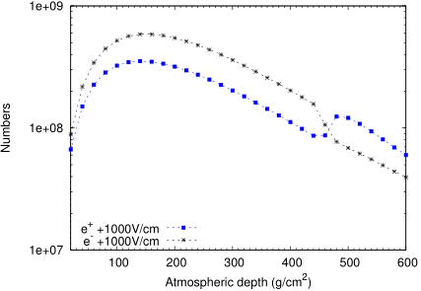
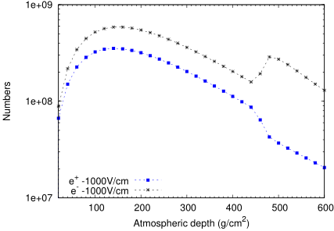
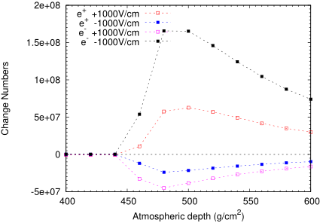
Longitudinal Development in ±1000V/cm
E=0
E=0
At Daocheng:
E(V/cm) | 0 | +1000 | -1000
Ne⁻/Ne⁺ | 1.84 | 0.66 | 6.30

Slide 14
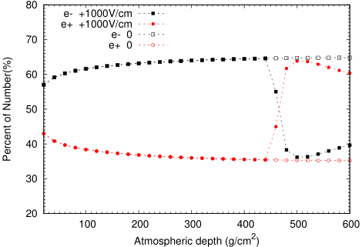
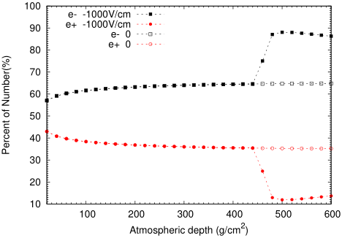
Longitudinal Development in ±1000V/cm
E=0
E=0
Percent of number at Daocheng
E(V/cm) | 0 | +1000 | -1000
e- | 65% | 40% | 86%
e+ | 35% | 60% | 14%

Slide 15
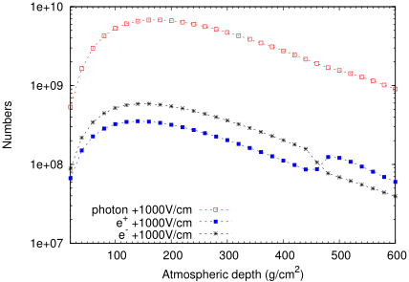
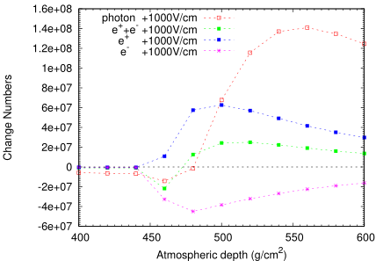
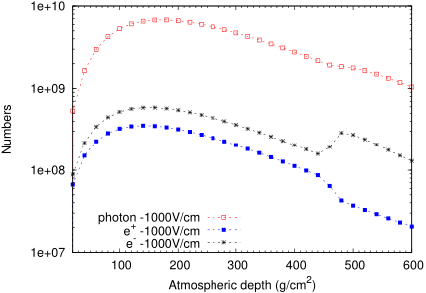
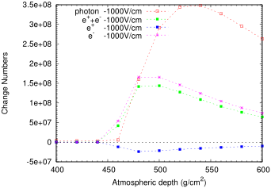
Longitudinal Development in ±1000V/cm
E=0
E=0
N_{γ} is always increasing !

Slide 16
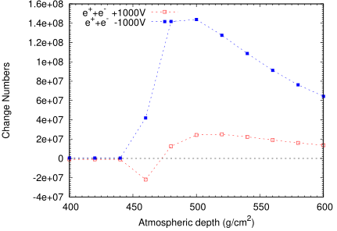
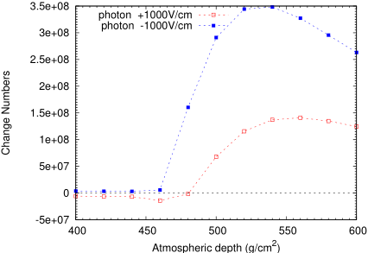
Longitudinal Development in ±1000V/cm
Though the change of numbers is different, but the trend is the same!

Slide 17
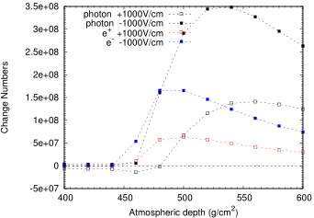
Longitudinal Development in ±1000V/cm
At Daocheng:

Slide 18
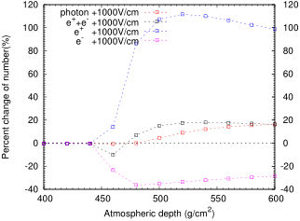
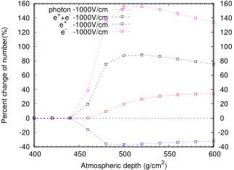
Longitudinal Development in ±1000V/cm
Percent change of number at Daocheng
E(V/cm) | e+ | e- | e⁺+e⁻ | photon
+1000 | 98.79% | -28.54% | 16.24% | 16.21%
-1000 | -31.84% | 133.7% | 75.49% | 34.16%
It can not be explaied by RREA mechanism.

Slide 19
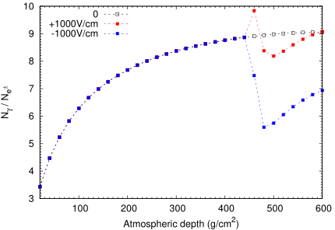
Longitudinal Development in ±1000V/cm
E=0

Slide 20
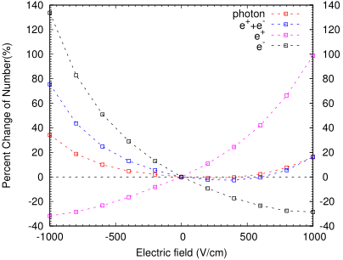
Percent change of number in different field
In negative electric field, the percent change of number increase with the strength of the field. As for positive field, the sum of the electron and positrion may decline, and the same thing happens to photons.

Slide 21
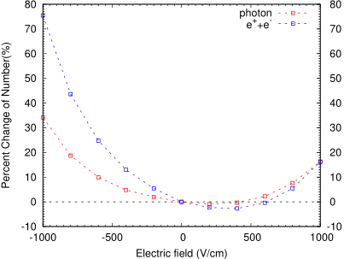
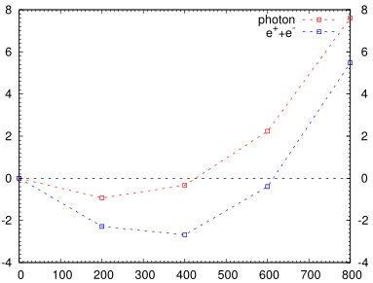
Percent change of number in different field

Slide 22
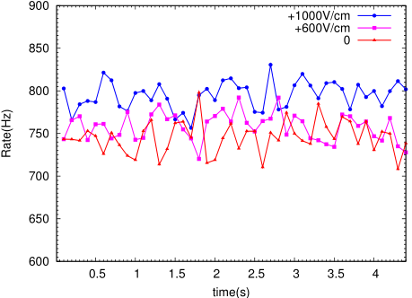
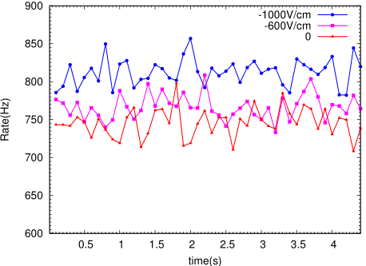
Rate of Cosmic Ray in KM2A-EDs
P+He
P+He
E(V/cm) | 0 | +600 | +1000 | -600 | -1000
Rate (Hz) | 746 | 758 | 795 | 766 | 812
Percent Change(%) | 0 | 1.61 | 6.57 | 2.68 | 8.85
The rates of the cosmic ray in field are increasing and the increases are more obvious in the negative electric field!

Slide 23
Summary
The intensity of secondary particles changes significantly in thunderstorms electric field.
2. The variations of particles are closely related to the strength and polarity of the electric field.
When E<0 and E>600V/cm, the intensity of the sum of electrons and positrons (the intensity of the photons) increases with the strength of the field.
In 0<E<600V/cm, the intensity of the sum of electrons and positrons (the intensity of the photons) declines.
3. The rates of the cosmic ray in field are increasing and the increases are more obvious in the negative electric field!

Slide 24
Thank you!

