Slide 1
MC simulation of the EM cascades: analytical SEDs
Jie-Shuang Wang
Tsung-Dao Lee Institute
Collaborators: Ruo-Yu Liu (DESY), Felix Aharonian (MPIK,DIAS), Zi-Gao Dai (NJU)
15 Apr. @ LHAASO Meeting, Sci Park, NJU

Slide 2
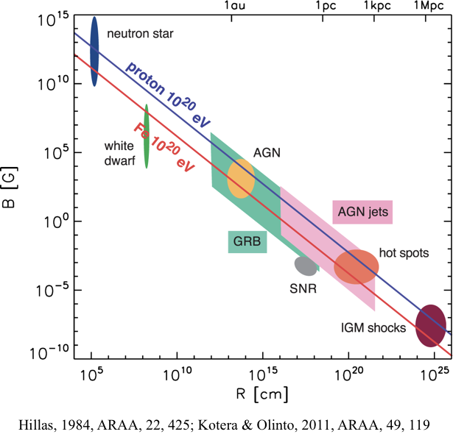






Cosmic ray sources
Critical B field：
Dimensionless：
Mean photon energy of classical synchrotron:
$$χ∼100α_{−1}B_{4}^{2}R_{12}$$
$$B_{cr}=4.4×{10}^{13}G$$
$$χ=εB_{⊥}/m_{e}c^{2}B_{cr}$$
$$ℏω_{c}=1.5χγm_{e}c^{2}$$
$$>γm_{e}c^{2}ifχ>1$$

Slide 3
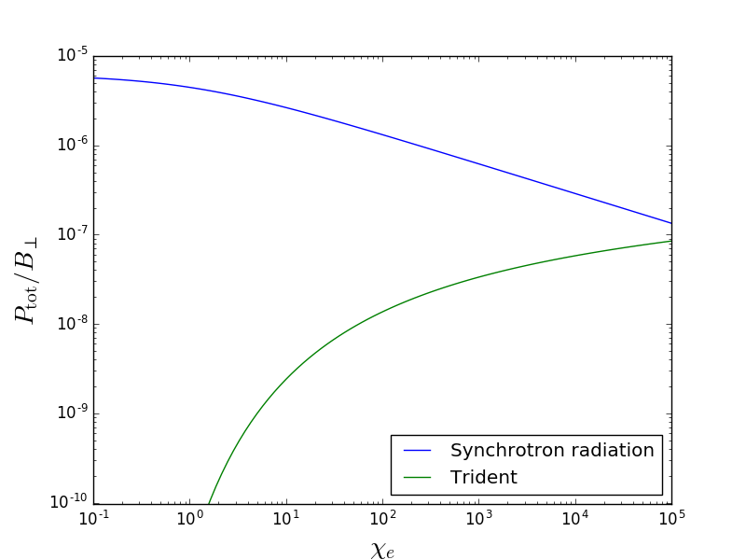
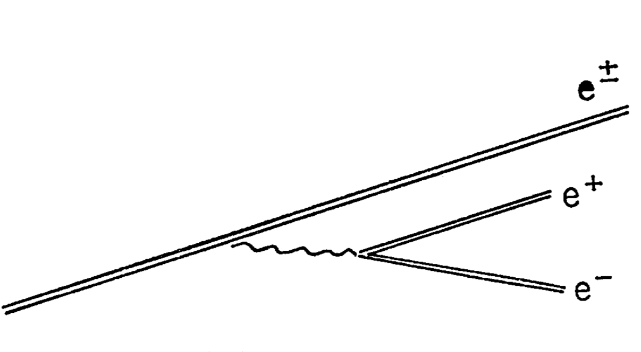

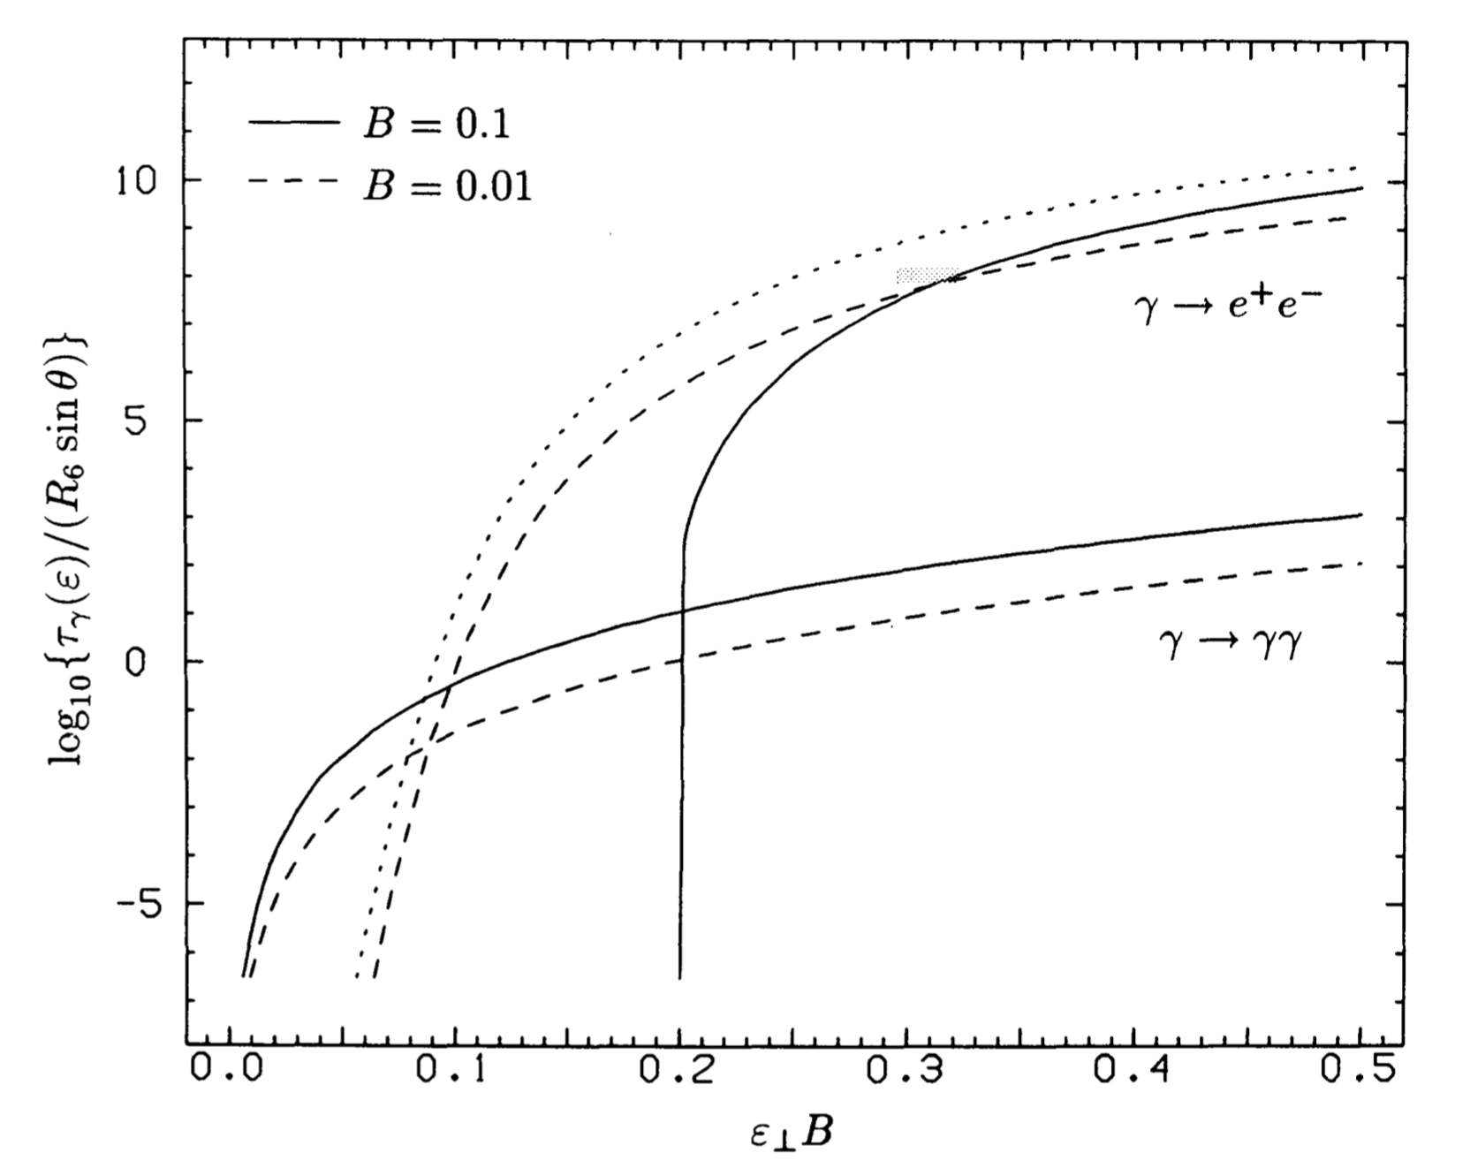

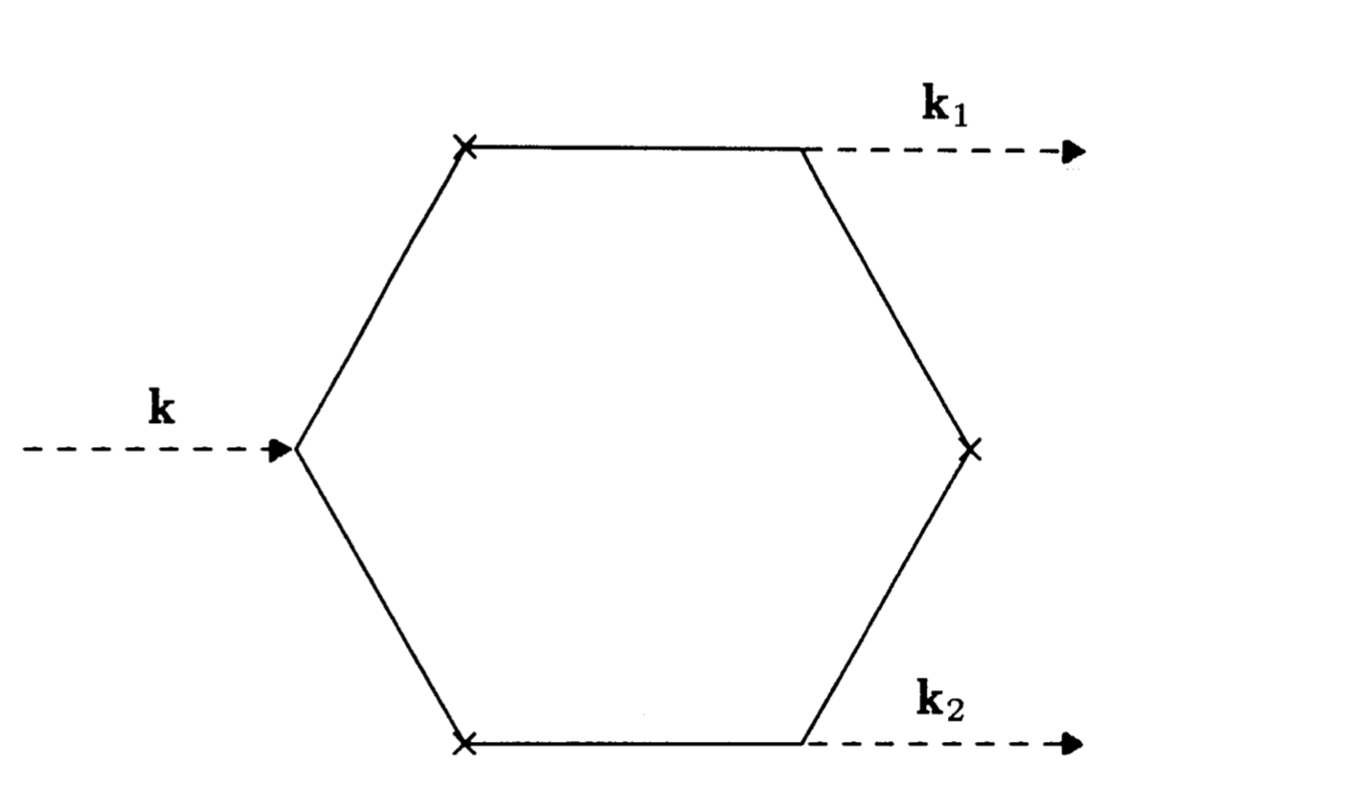
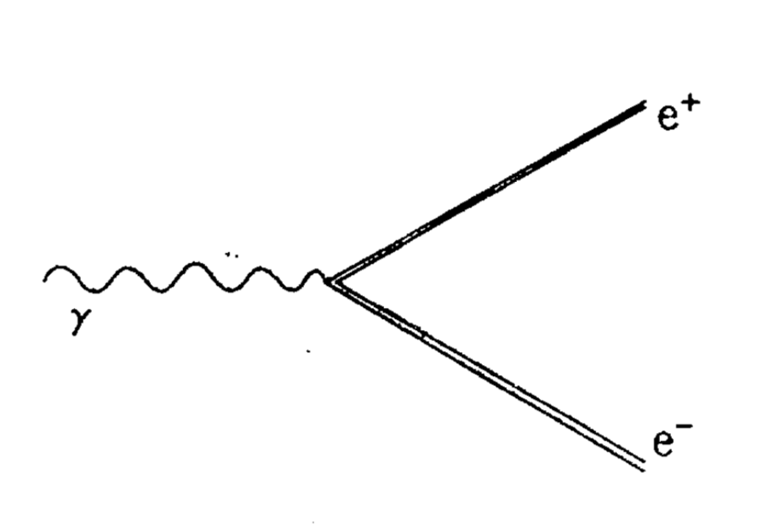
High energy process in strong B field
Electron - magnetic field interaction
  Synchrotron radiation
  Trident process
Photon - magnetic field interaction
  Pair production
  Photon splitting
Erber,1966, RvMP, 38, 626
Baring, 1991, A&A, 249, 581

Slide 4
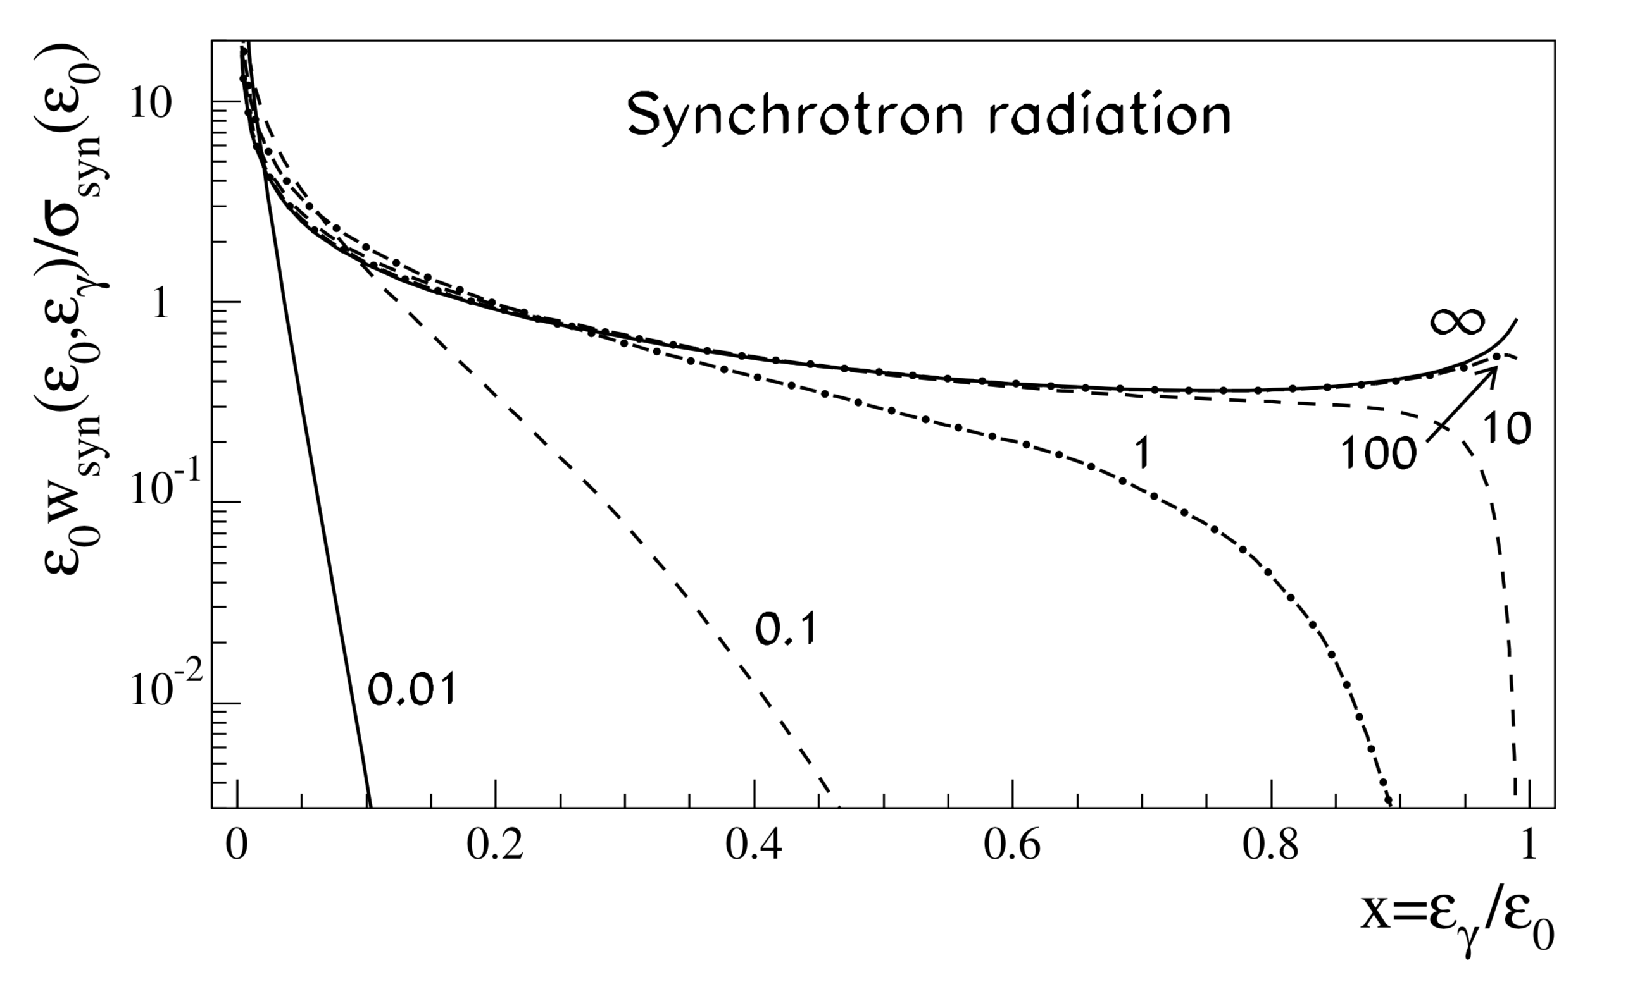
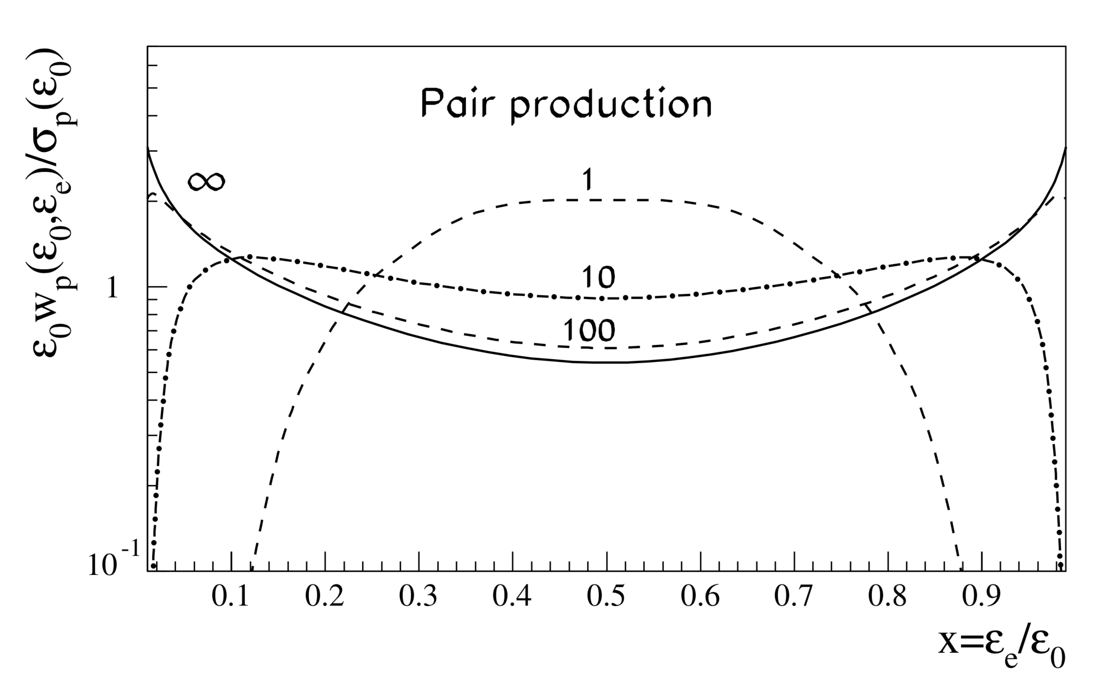
Differential
probability
Aharonian & Plyasheshnikov 2003, APh, 19, 525

Slide 5


















High-energy process in B field
$$e^{±}$$
$$B$$
$$γ$$
$$e^{±}$$
$$R$$
$$γ$$
$$γ$$
$$γ$$
$$γ$$
$$γ$$
$$γ$$
$$γ$$
$$γ$$
$$γ$$
$$γ$$
$$γ$$
$$γ$$
$$γ$$
Saturated cascade：all the energy of the primary
particles transfers to the photons

Slide 6
Monte-Carlo simulation
Initiated by electrons or photons
No difference
Different initial energy
No difference of spectrum shape
  Wang et al, PhRvD, 97, 103016

Slide 7
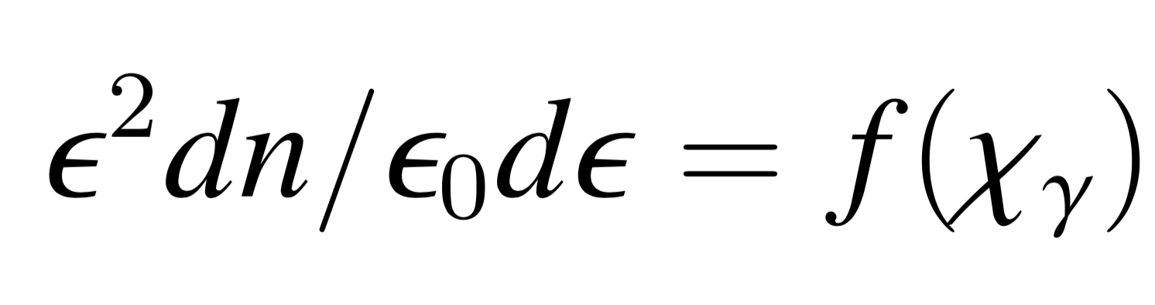
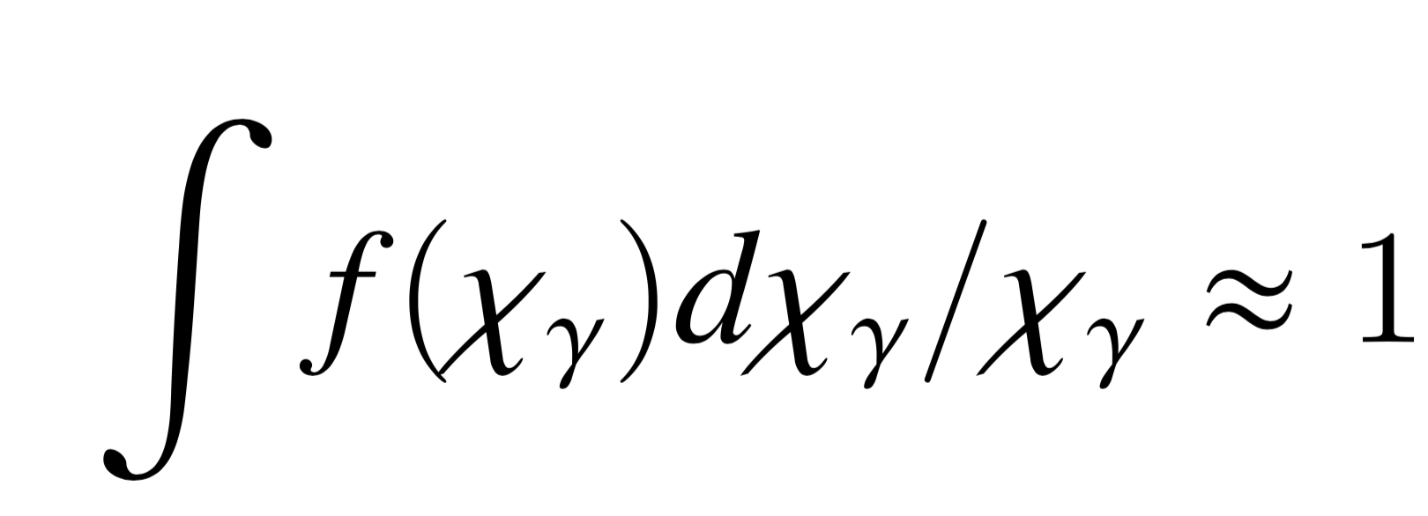

Monte-Carlo simulation
$$R×B$$
Fix
No difference
  Wang et al, PhRvD, 97, 103016

Slide 8
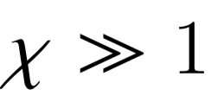
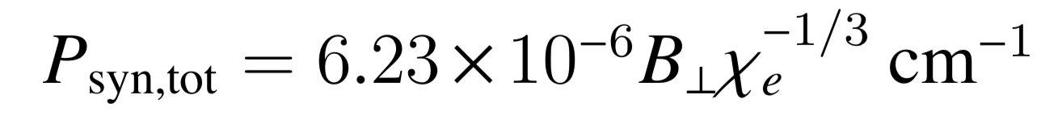
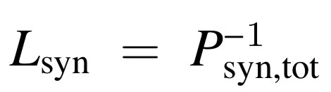
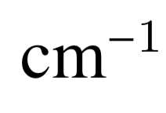
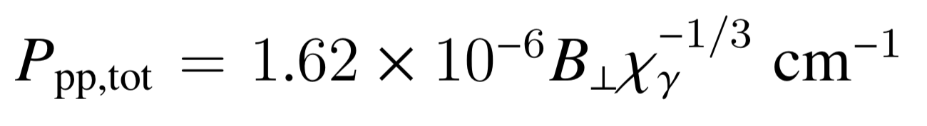
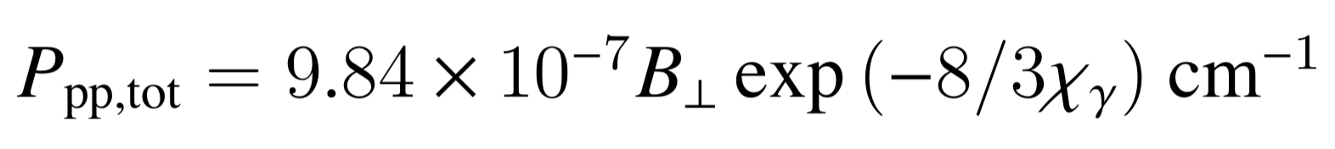
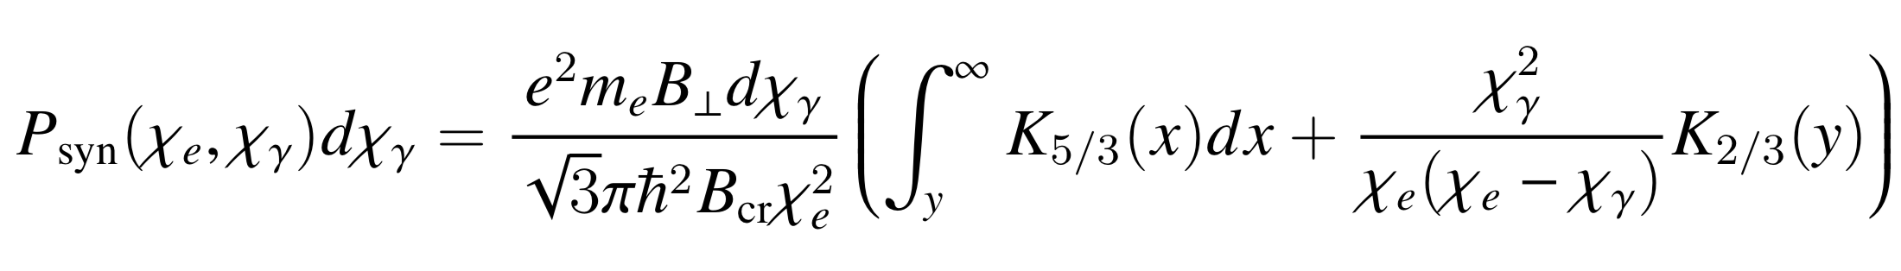
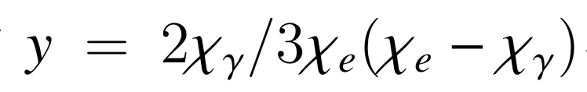
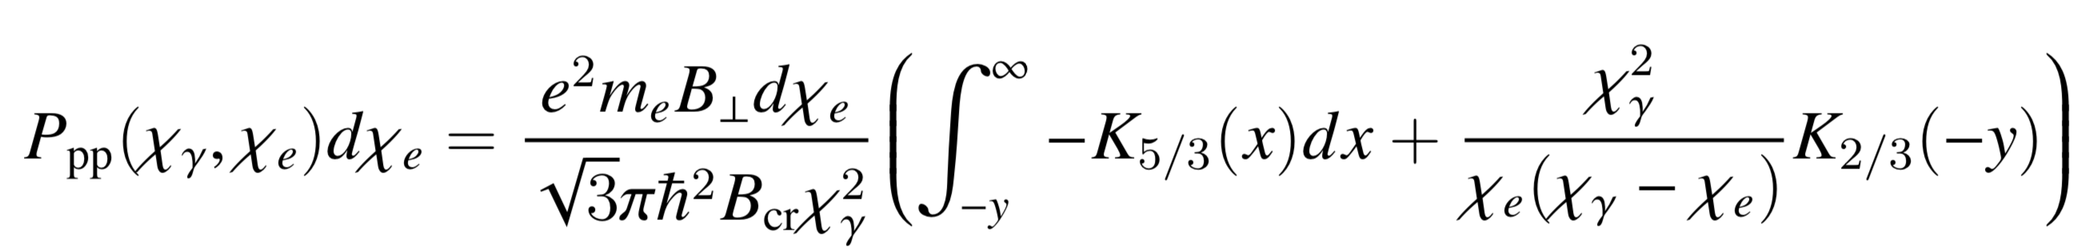

Interaction probability
P total: synchrotron
otherwise:
P total: pair production
otherwise:
$$P(χ)B^{−1}∝(R×B)^{−1}$$
Differential P: synchrotron
Differential P: pair production

Slide 9
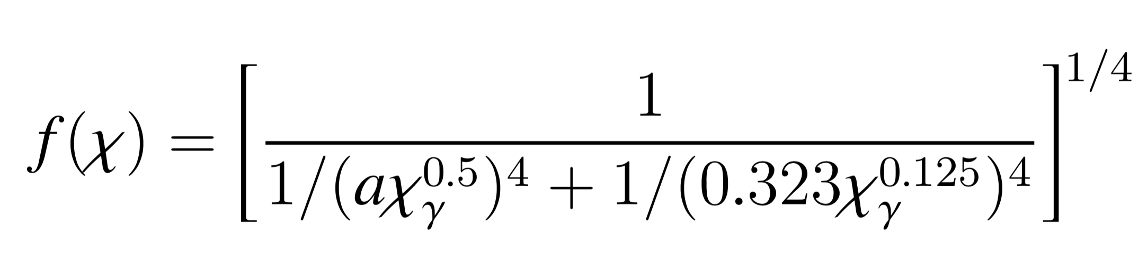
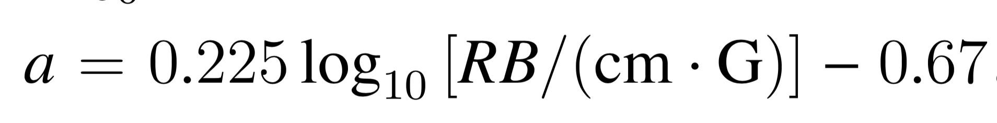
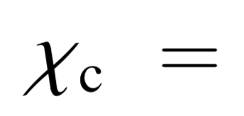
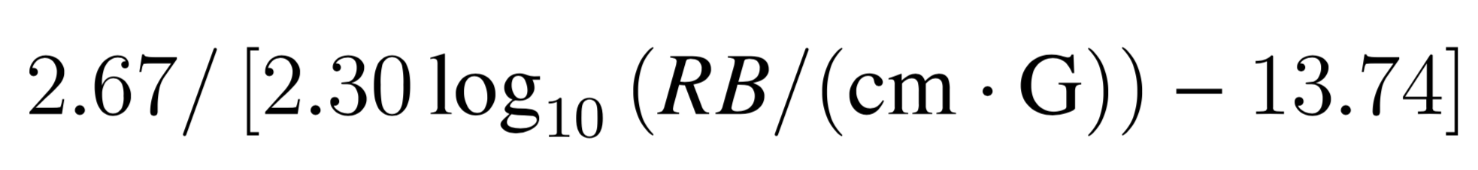
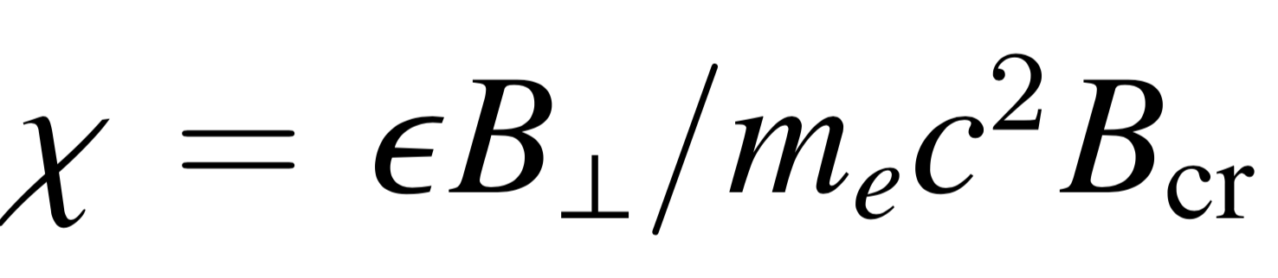
Empirical SED fitting
Error<4%

Slide 10
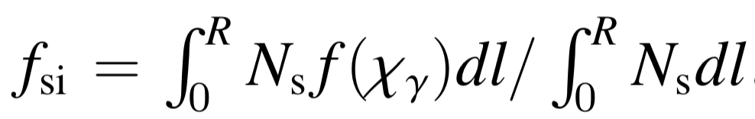
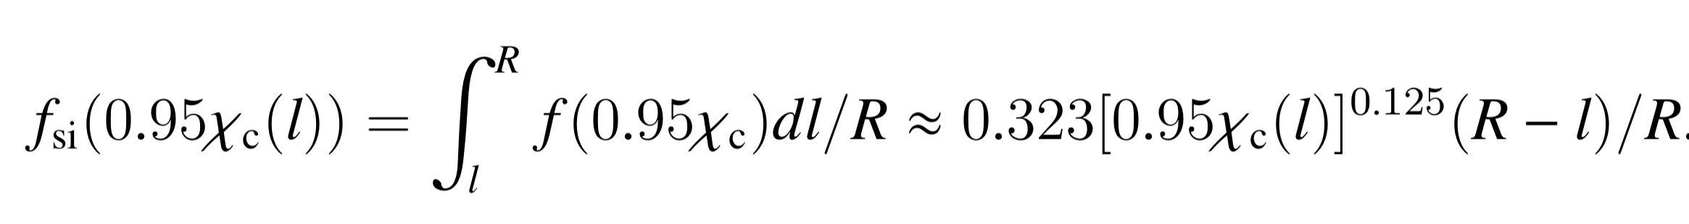
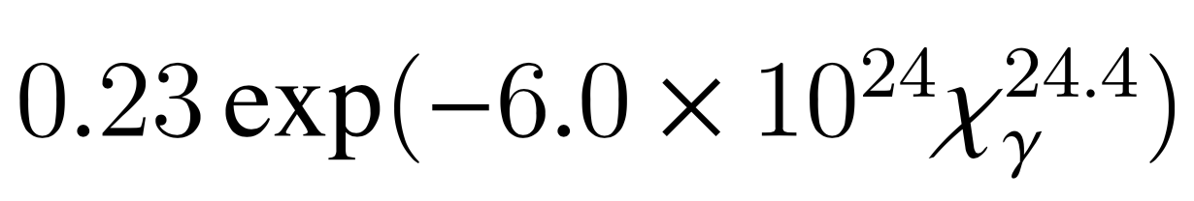
Cut-off of the SED
Assuming particle injected
along the cascade trajectory
Without injection

Slide 11
An Example in Binary NS inspiral

Slide 12
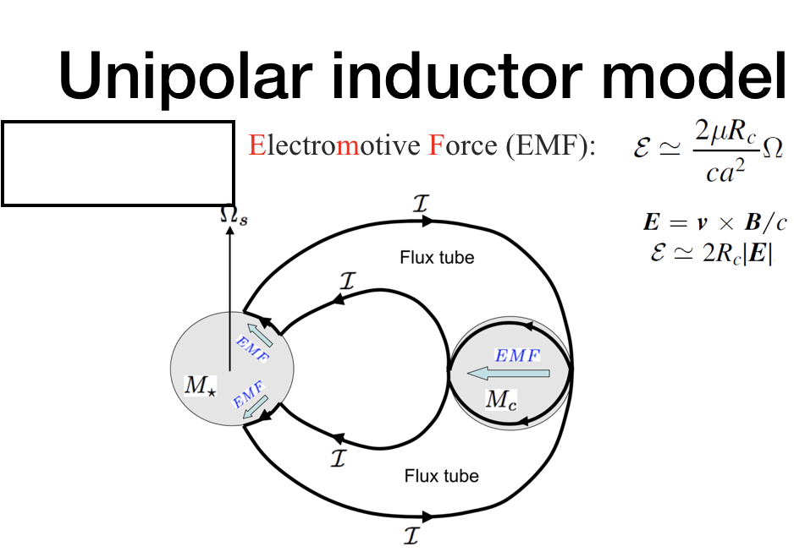
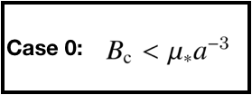
Lai, 2012, ApJ, 757, L3; Wang et al. 2016, ApJL, 822, L7

Slide 13
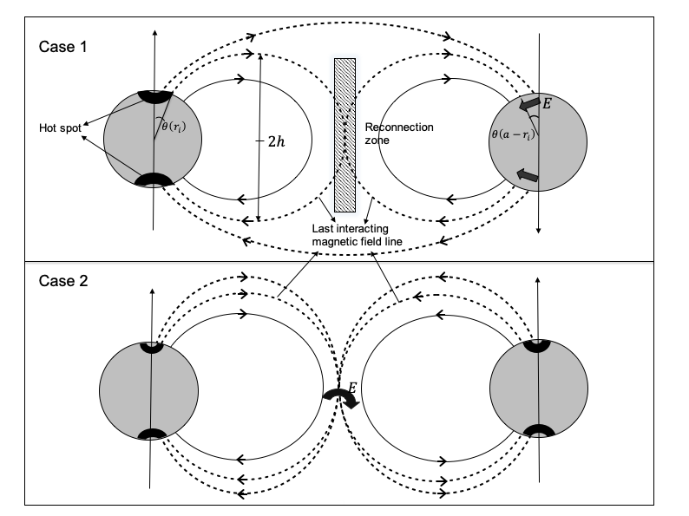

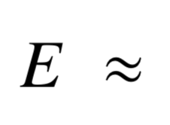
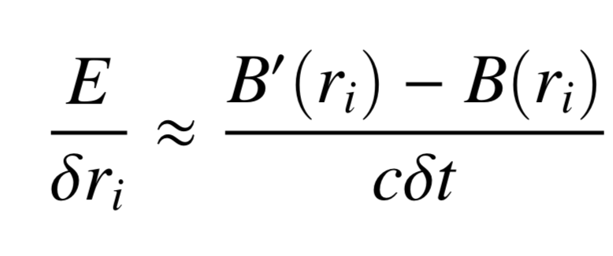
Binary NS inspiral: HE radiation
Curvature
Thermal
Synchrotron
Wang et al. 2018, ApJ, 868, 19

Slide 15
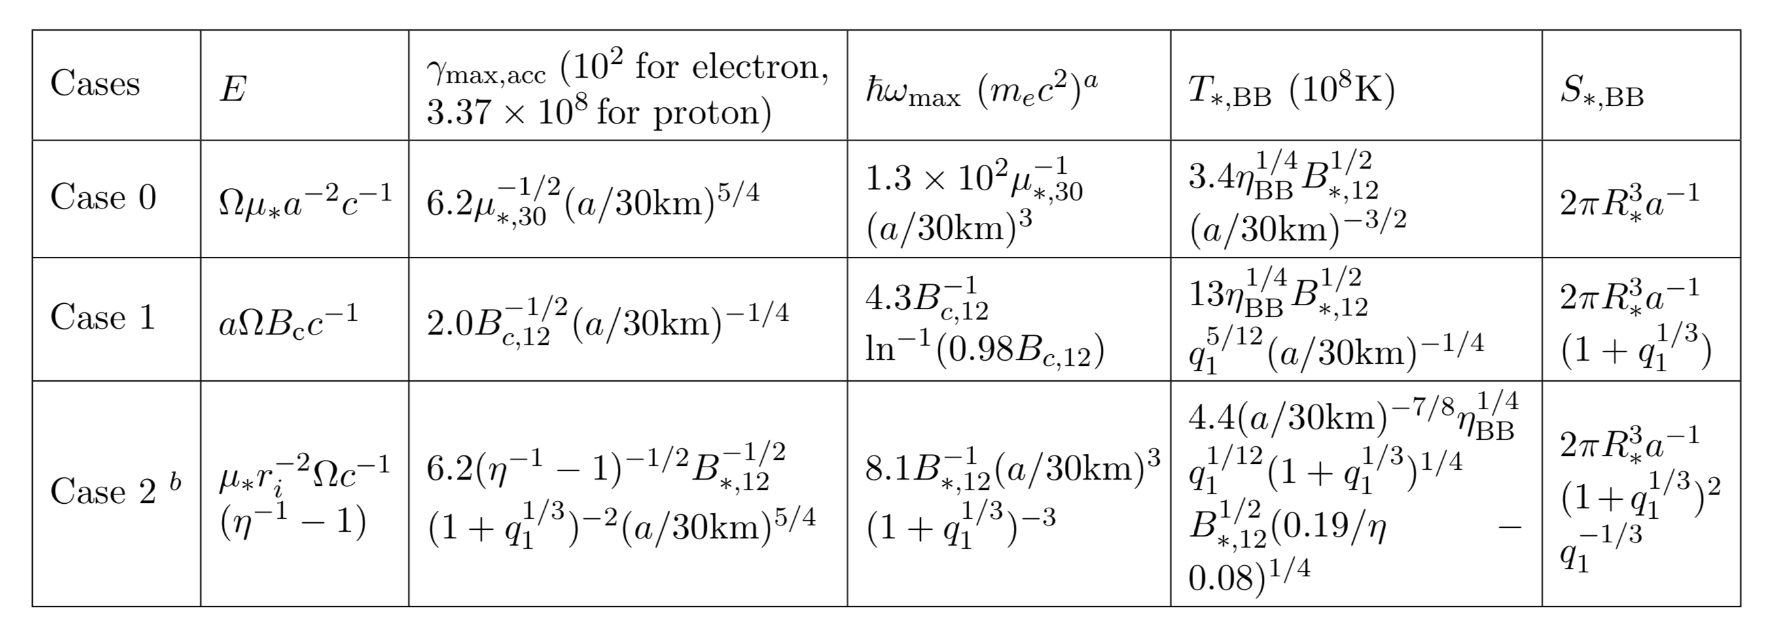
Summary of the basic features
Acceleration=cooling
Hillas criterion
Absorption
Wang et al. 2018, ApJ, 868, 19

Slide 16
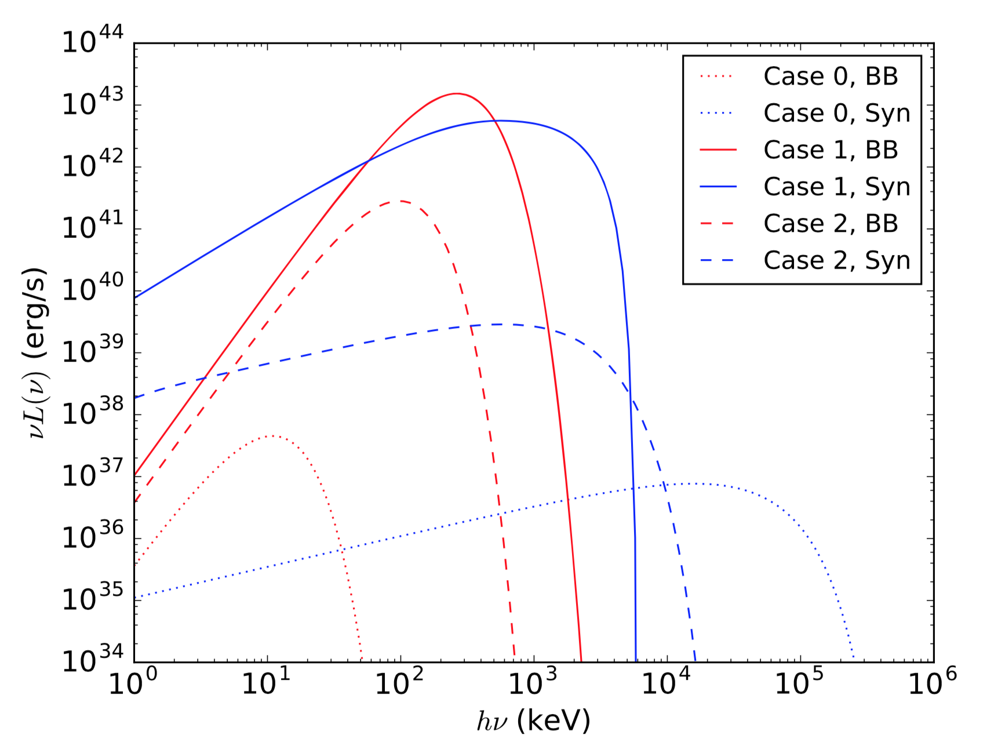

High energy spectrum from binary neutron stars
$$B_{∗}=B_{c}={10}^{12}G$$
Wang et al. 2018, ApJ, 868, 19

Slide 17
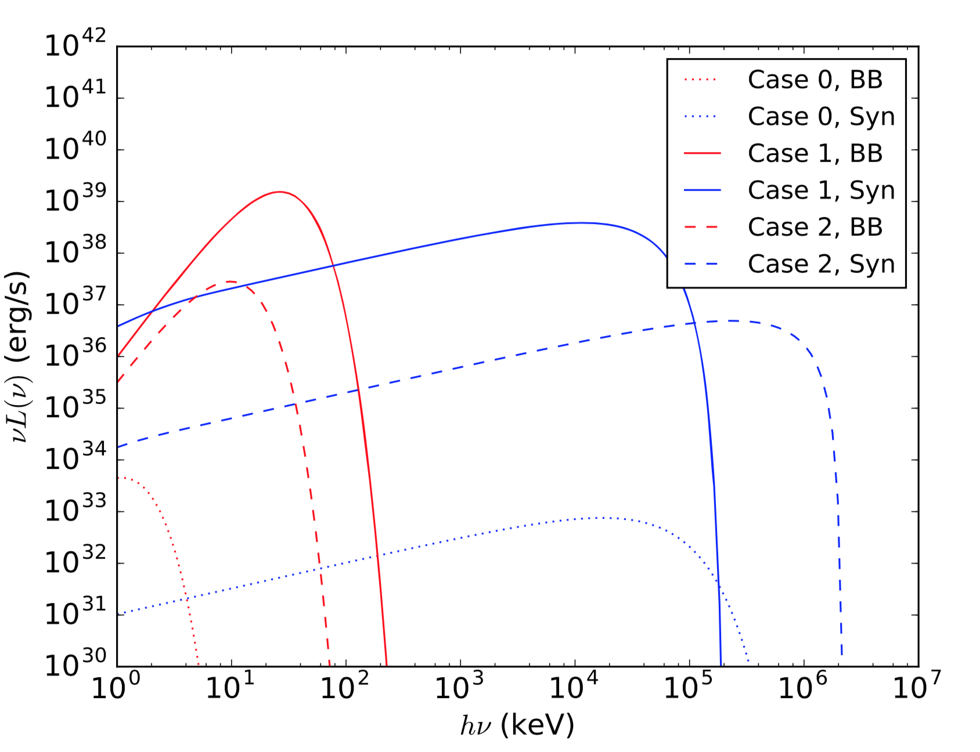
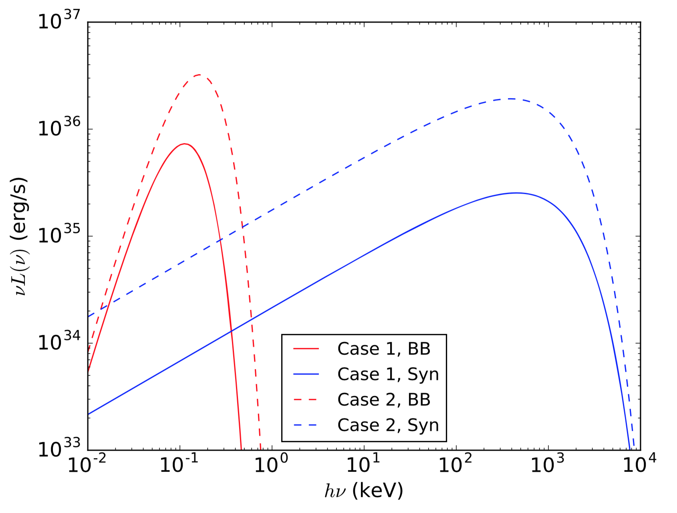



Neutron star - White dwarf
$$B_{∗}R_{∗}^{3}={10}^{30}{Gcm}^{3}$$
$$B_{c}R_{c}^{3}={10}^{33}{Gcm}^{3}$$
Binary White Dwarf
$$B_{∗}R_{∗}^{3}=B_{c}R_{c}^{3}={10}^{33}{Gcm}^{3}$$
Wang et al. 2018, ApJ, 868, 19

Slide 18

















Cascade in photon fields
$$e^{±}$$
Very important for CR sources:
  TeV radiation and absorption
E.g. TeV photon in EBL
$$γ$$
$$e^{±}$$
$$R$$
$$γ$$
$$γ$$
$$γ$$
$$γ$$
$$γ$$
$$γ$$
$$γ$$
$$γ$$
$$γ$$
$$γ$$
$$γ$$
$$γ$$
$$γ$$

Slide 19
Empirical fitting of cascade SED in black-body photon fields

Slide 20
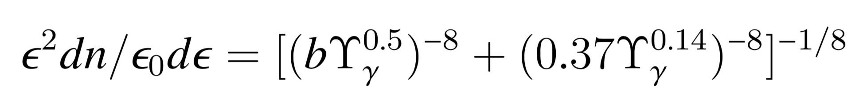
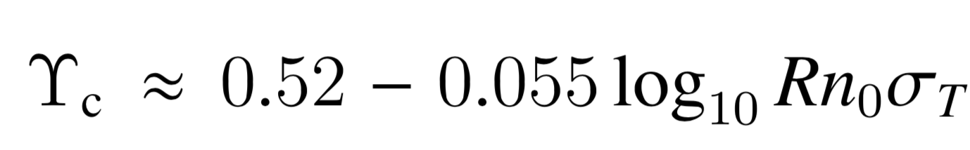
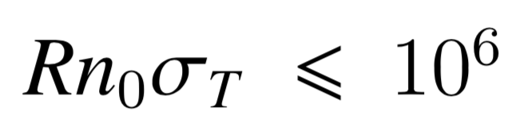
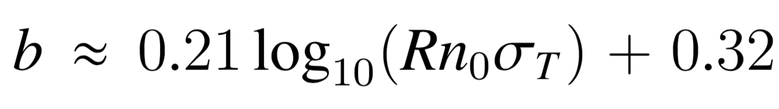

Empirical fitting of cascade SED in black-body photon fields
$$Υ=2.7k_{B}Tε/m_{e}^{2}c^{4}$$
  Wang et al, PhRvD, 97, 103016

Slide 21
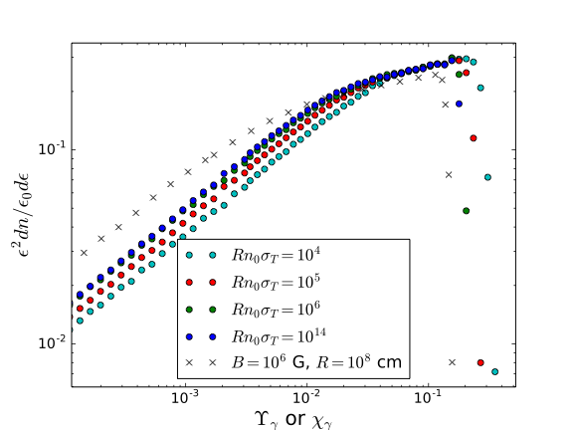
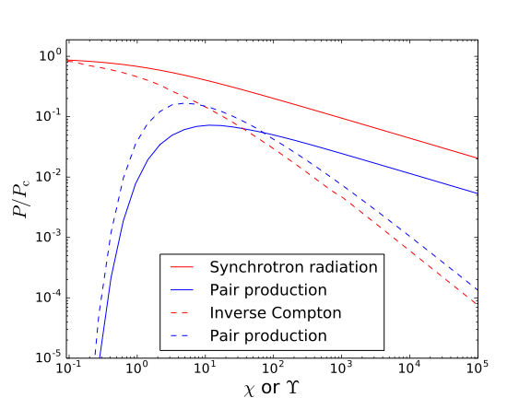

Cascade in black-body photon fields
$$Υ=2.7k_{B}Tε/m_{e}^{2}c^{4}$$
  Wang et al, PhRvD, 97, 103016

Slide 22
Empirical fitting of cascade SED in photon fields
$$Υ=2.7k_{B}Tε/m_{e}^{2}c^{4}$$
  Wang et al, PhRvD, 97, 103016

Slide 23
initial particle energy
cascade size (R)
B field
initial particle energy
cascade size (R)
photon number density & T
Using our SED formula
Monte-Carlo simulation
SED of Cascade
MeV ~ TeV (CR source)

Slide 24
Simulation and fitting of the cascades in photon fields with different spectra?

Slide 25
Input primary electron energy + cascade size + B field —> SED with a simple analytical function
Input primary electron energy + cascade size + photon number density of BB spectrum —> SED with a simple analytical function
  Wang et al, PhRvD, 97, 103016

