Slide 1
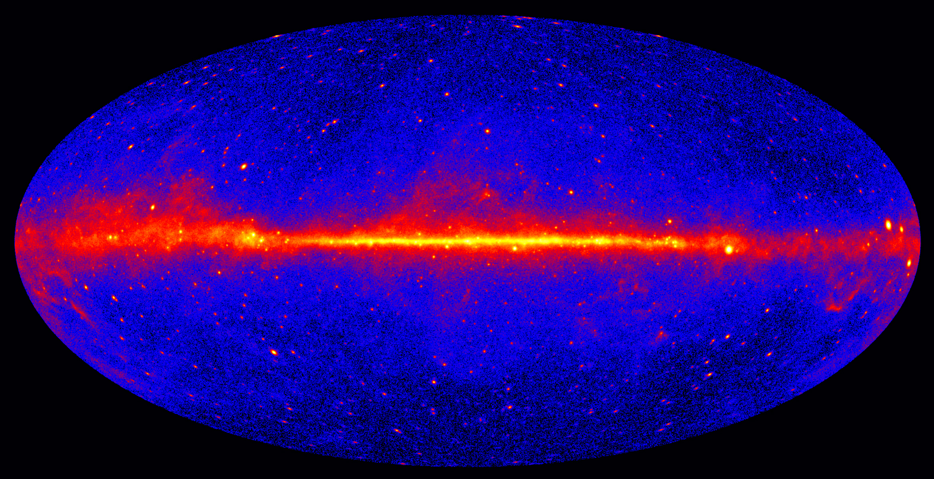
Gamma-Ray Emitting Binaries in the Fermi Era
王仲翔
（Shanghai Astronomical Observatory）
Collaborators: 邢祎, J. Takata, 张潇, 陈阳
2019 April 13，Nanjing
Notes:
各位评委老师,我们申请的题目是,,,参加人有中山大学谭,南京大学陈,,,

Slide 2
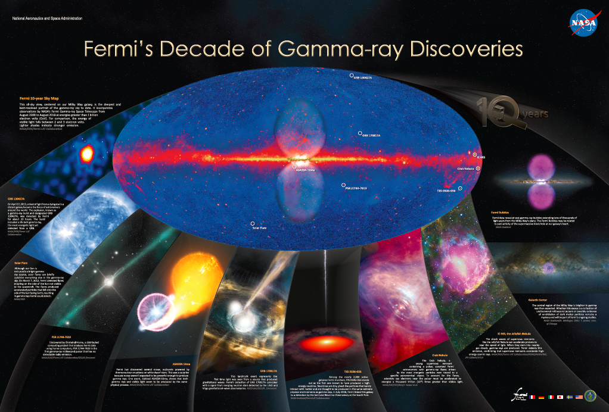
Fermi bubble
Gamma-ray bursts (including GW 170817A)
SNRs as origin of cosmic rays
Blazars (with neutrino emission)
Various pulsar systems
Dark matter signals (Galactic center)
Novae (unexpected)
Solar flares
10 years from 2008-08 to 2018-08
(NASA’s Fermi Mission Site)

Slide 3
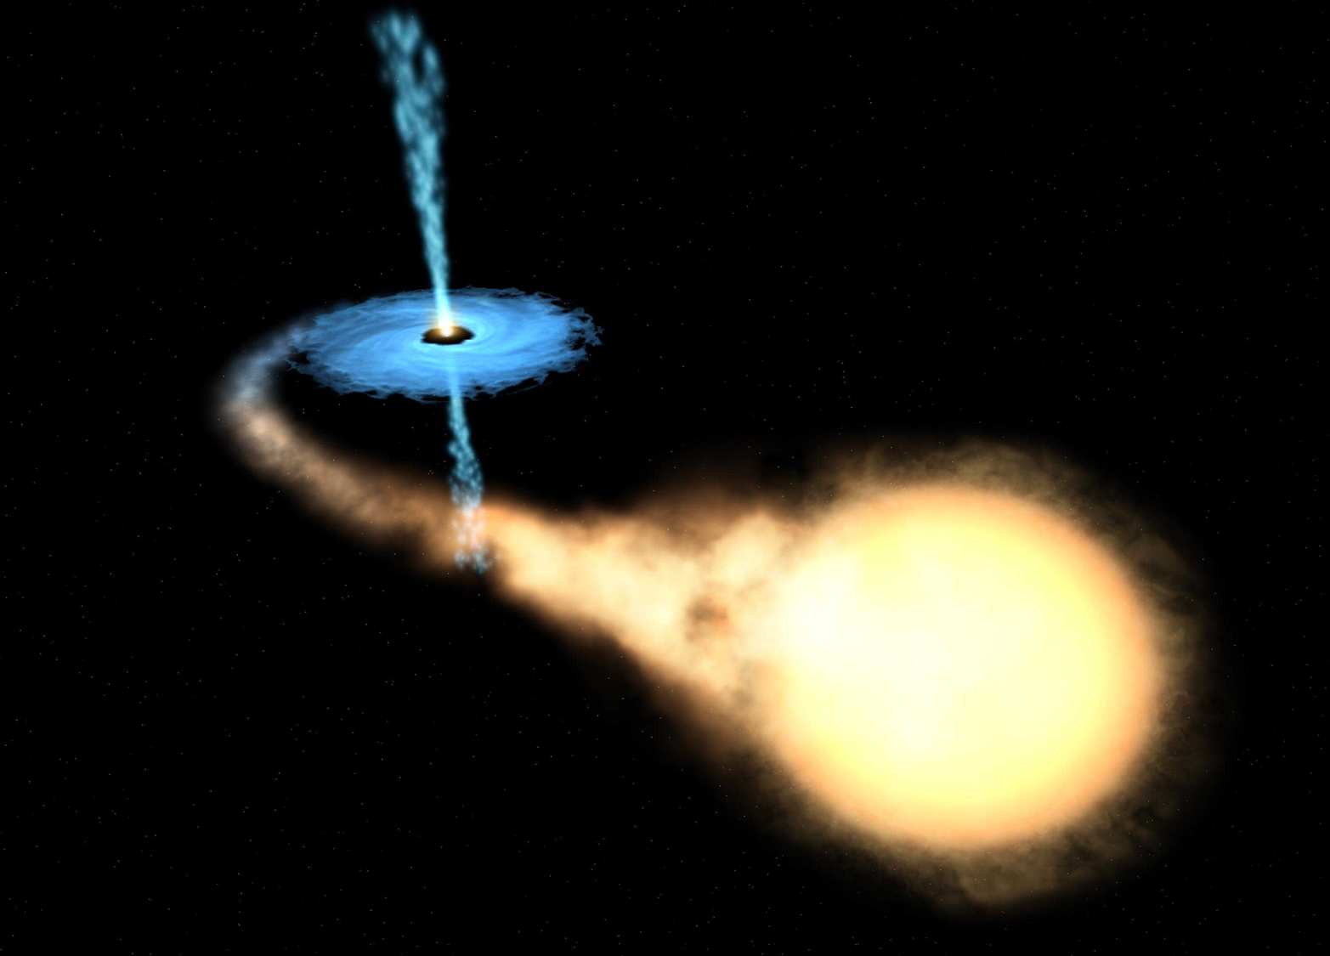
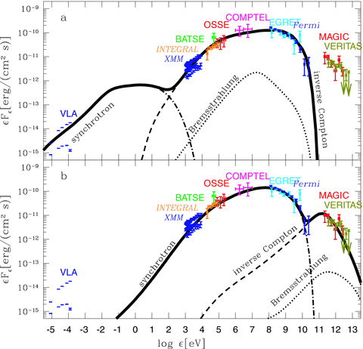
Gamma-ray binaries
Definition: X-ray binaries while with the emission peak at gamma-rays (>1 MeV)
Contain an O/B massive companion
Binary orbits highly eccentric
Observable at multi-wavelengths, from radio to TeV
Variable sources
Showing different phenomena, which reflect underlying physical processes
“Classical” gamma-ray binaries:
There are only a handful of them known
Emission peaks at gamma-rays
SED of LSI +61d303 (Zdziarski et al. 2010)

Slide 4
Two possible scenarios
Key question: whether they are rotation powered (a young pulsar as the primary) or accretion powered?
(Dubus 2013)

Slide 5
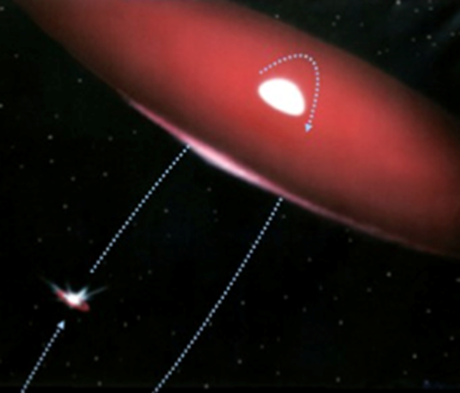
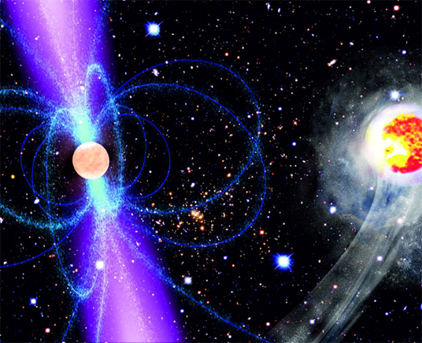
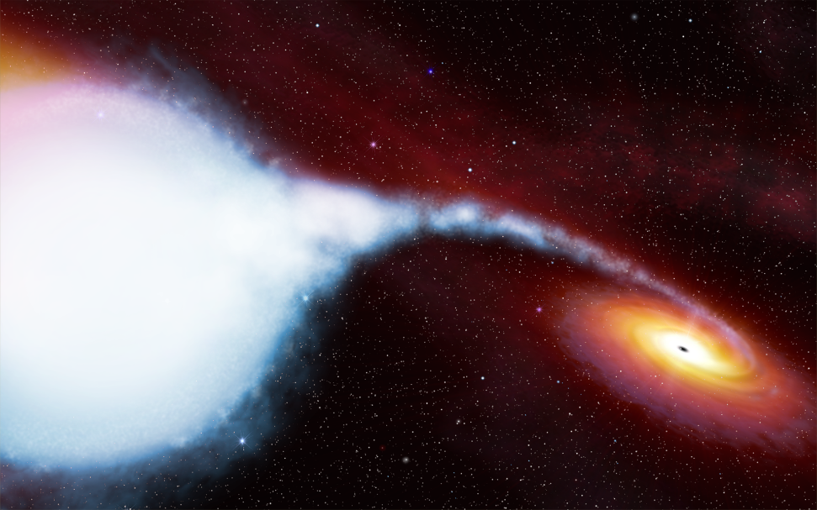
New in Fermi era
There are also
Novae
Colliding wind binaries
Gamma-ray emitting binaries
Eclipsing pulsar binaries
(e.g., PSR J1311-3430):
Due to interaction of a pulsar wind with the outflow of a low-mass companion
Micro-quasars
(e.g., Cyg X-1):
Due to the presence of a jet
Classical gamma-ray binaries
(e.g., PSR B1259-63):
Due to interaction of the winds of a pulsar and a high-mass star

Slide 6
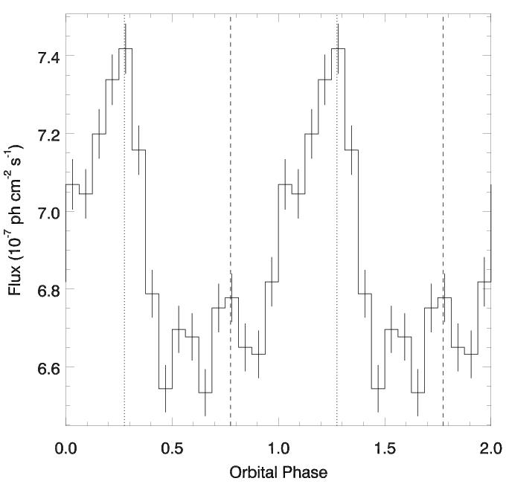
LSI +61d303
Porb=26.5 d, e=0.54
Emission peaks at gamma-rays
Fermi/LAT 0.1-300 GeV orbital light curve.
Periastron at orbital phase 0.275
SED of LSI +61d303 (Zdziarski et al. 2010)

Slide 7
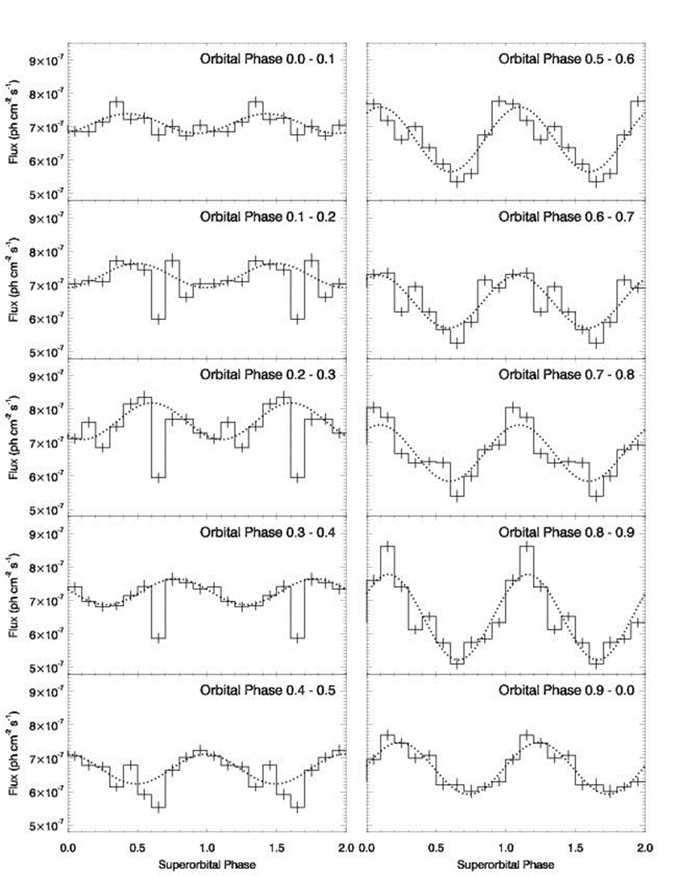
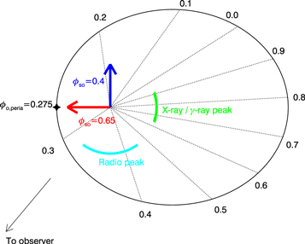
Super-orbital modulation in LSI +61d303
Significant TeV emission during this superorbital phase range
1667 days super-orbital modulation
radio pulsar
Determined the origin of super-orbital modulation
(Xing, Wang, Takata, 2017, ApJ)

Slide 8
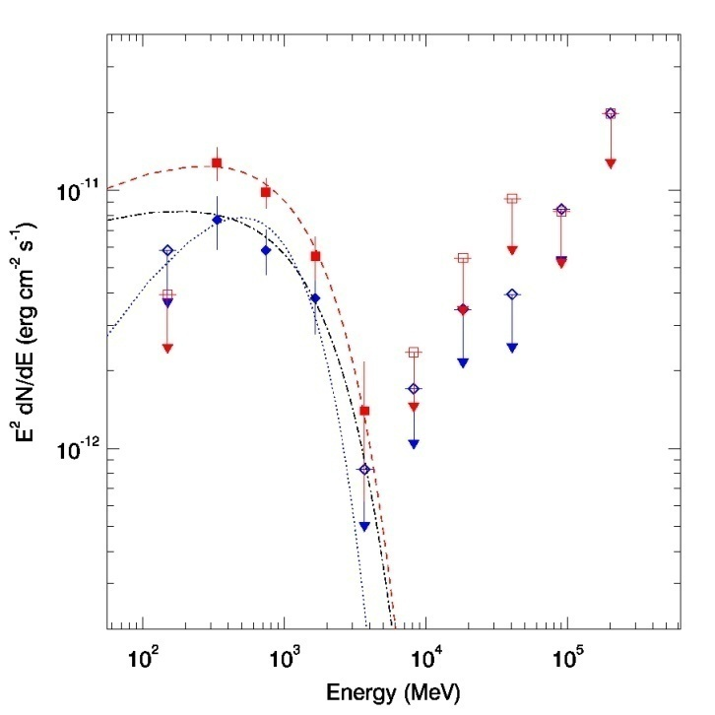
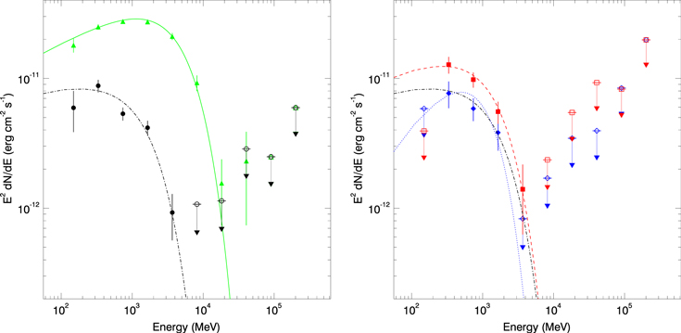
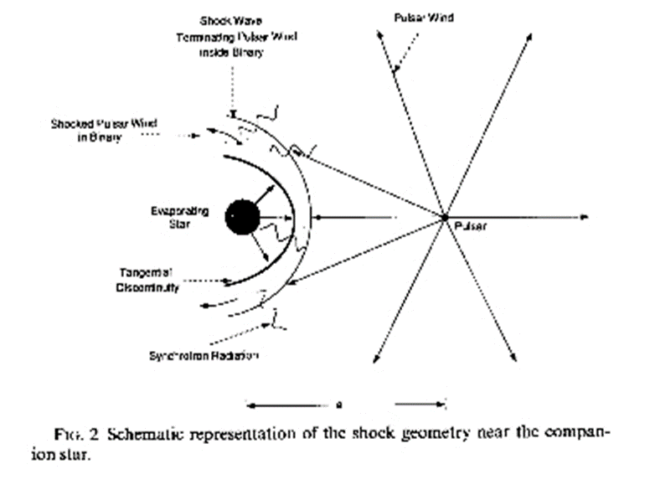
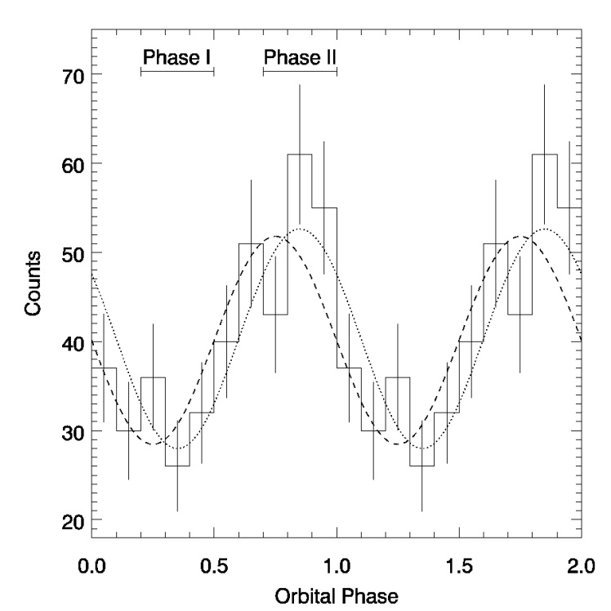
Intrabinary gamma rays from black widow pulsar system PSR J1311-3430
Now there are more than 20 of such pulsar systems found with Fermi obserations
However, not likely detectable at TeV energies, such as with LHAASO
The only MSP found from Fermi Gamma-ray timing（Pletsch et al. 2012, Science)
Orbital period 94 min，companion mass 0.01Msun
In off-pulse data, orbital modulation is found
Provide first clear evidence for intrabinary gamma-ray emission
Xing & Wang (2015, ApJL)

Slide 9
Micro-quasar: Cygnus X-3
Contains a black hole and a high-mass Wolf-Rayet star (an evolved star)
Show variable bright emission at multi-wavelengths
Gamma-ray flares were seen (associated with the jet’s activity)
Possibly detectable with TeV telescopes

Slide 10
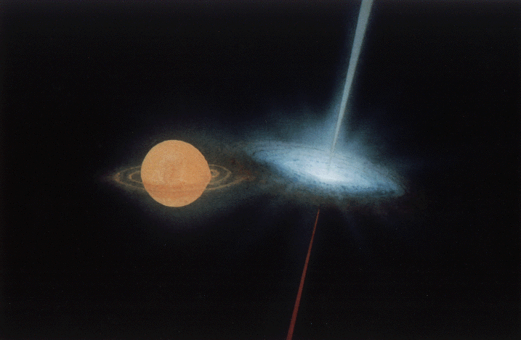
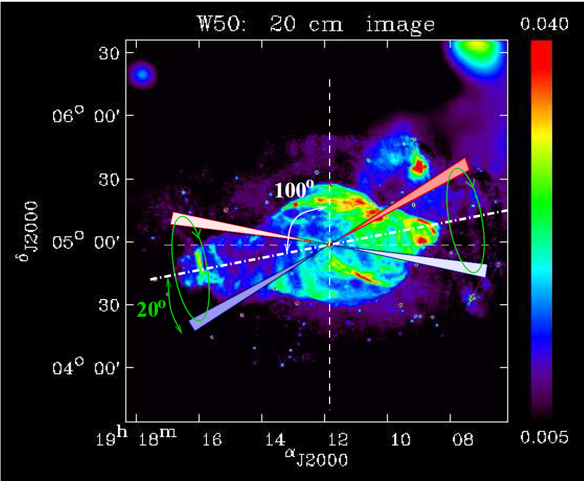
Micro-quasar SS 433
A very well-known source
Likely a black hole with an A-type companion
Porb = 13.0682 days
Two precessing jets pointing to the east and west
Pprec = 162.375 days
Contained in the SNR W50
Bright from radio to X-rays
Detailed review see, e.g., Fabrika 2006
180 pc
Fuchs 2002

Slide 11
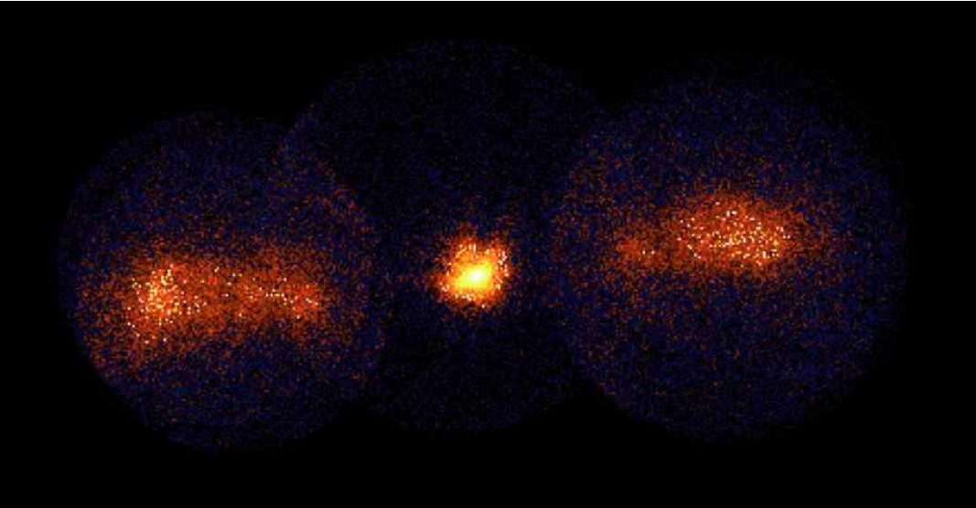
X-ray lobes
Two extended lobes are visible in X-rays
They are believed due to the interaction of the jets with ambient medium
W1
W2
e3 e2 e1
ASCA image of the lobes of SS 433
(Kotani 1998)

Slide 12
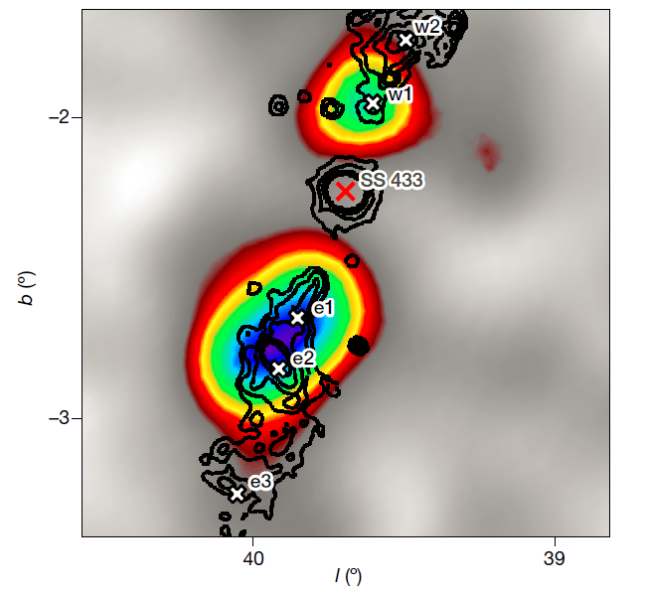
HAWC TeV detection
High-Altitude Water Cherenkov Gamma-ray observatory (located in Mexico)
Resolves SS 433
Detects e1/e2 and w1 at 20 TeV
Finds emission from the jets, not from the compact star
Abeysekara et al.
2018, Nature

Slide 13
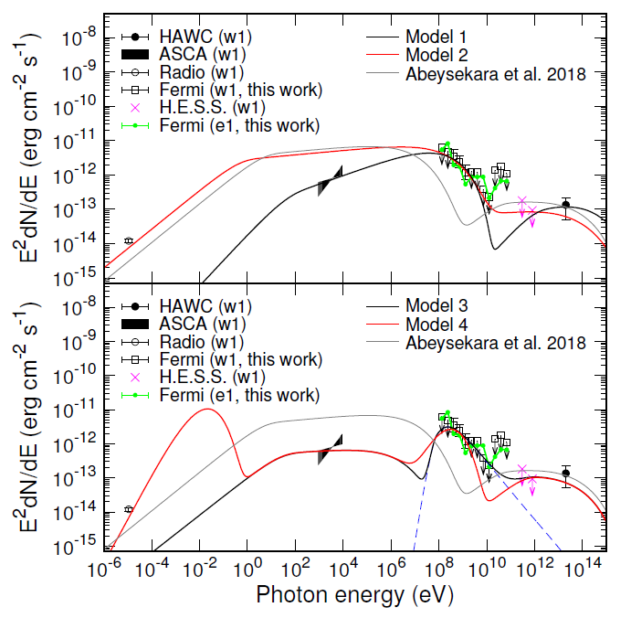
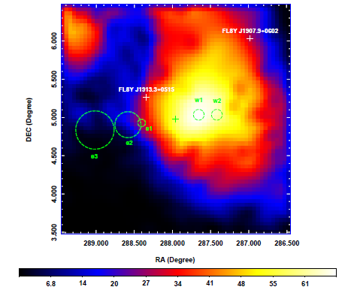
Fermi GeV Detection of W1
Hadronic model can be excluded
p+p-> π0 -> γ photons
Requires energy comparable to the total energy carried in the jet
Leptonic models may explain the TeV and GeV emission
Inverse-Compton scattering background photons to high energies
But we can not explain the X-ray and radio simultaneously
Xing, Wang, Zhang, Chen (2019 ApJ)

Slide 14
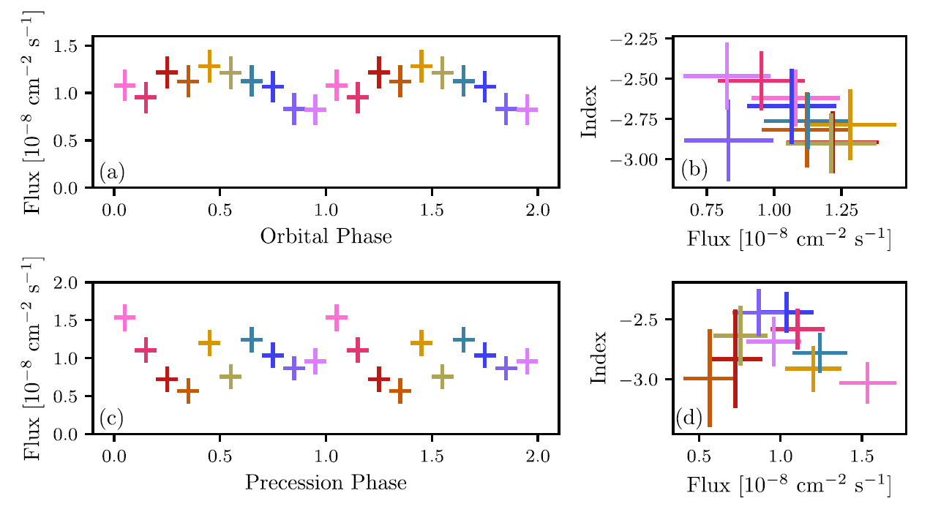
Periodicities?
2-sigma orbital signal
2.9 sigma precessional signal
If these signals are true, emission should be close to the binary, different from our results
Rasul et al. (2019, MNRAS)
At least some of gamma-rays comes from the region close to the binary (<0.2 pc)

Slide 15
Discussion
It is not clear why we see w1 GeV emission, not e1/e2
Our models cannot fully explain the SEDs of w1
Considering periodic signals as true, there could be GeV emission from the regions close to the binary
In any case, SS 433 is the first micro-quasar detected with persistent GeV emission; others only had detectable GeV emission occasionally
Micro-quasars are potential LHAASO sources
Sun et al. last week points out that gamma-rays may come from the SNR W50

Slide 16
In Fermi+LHAASO era: ???
There are also
Novae
Colliding wind binaries
Gamma-ray emitting binaries
Looking forward to the soon Fermi+LHAASO era!
Eclipsing pulsar binaries
(e.g., PSR J1311-3430):
Due to interaction of a pulsar wind with the outflow of a low-mass companion
Micro-quasar
(e.g., Cyg X-1):
Due to the presence of a jet
Classical gamma-ray binaries
(e.g., PSR B1259-63):
Due to interaction of the winds of a pulsar and a high-mass star

Slide 17
Discussion
X-ray studies of w1/w2 are not complete, i.e., they may be brighter
e1/e2 regions have similar emission to w1/w2, at radio, X-rays, and TeV; probably Fermi is close to detecting e1/e2 at GeV energies
In any case, SS 433 shows a clear science case of the jet interaction and the resulting radiation at multi-wavelengths

Slide 18
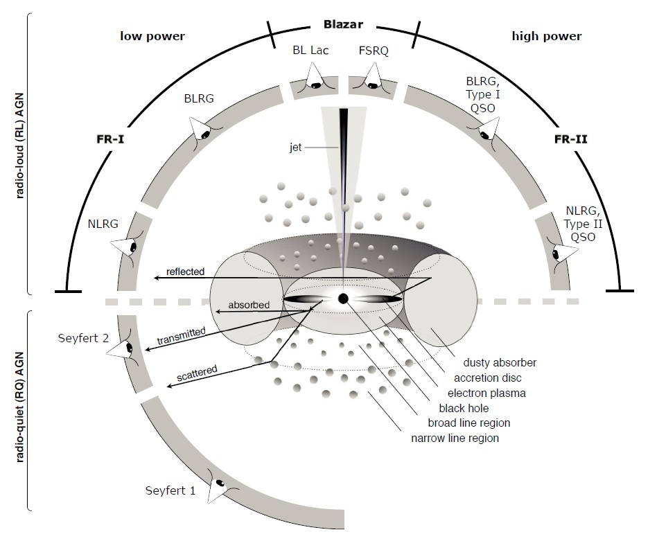
AGN Classification
About 10% AGN have a jet
In blazars, jet emission dominates because of Doppler beaming effect
Due to beaming, blazars show rapid and large-amplitude flux variations
Mointoring of blazars, mainly at optical and X-ray, not only can detect variability, but also see a rare phenomenon: Quasi-Periodic Oscillations (QPOs)
Beckmann & Shrader
(2013)

Slide 19
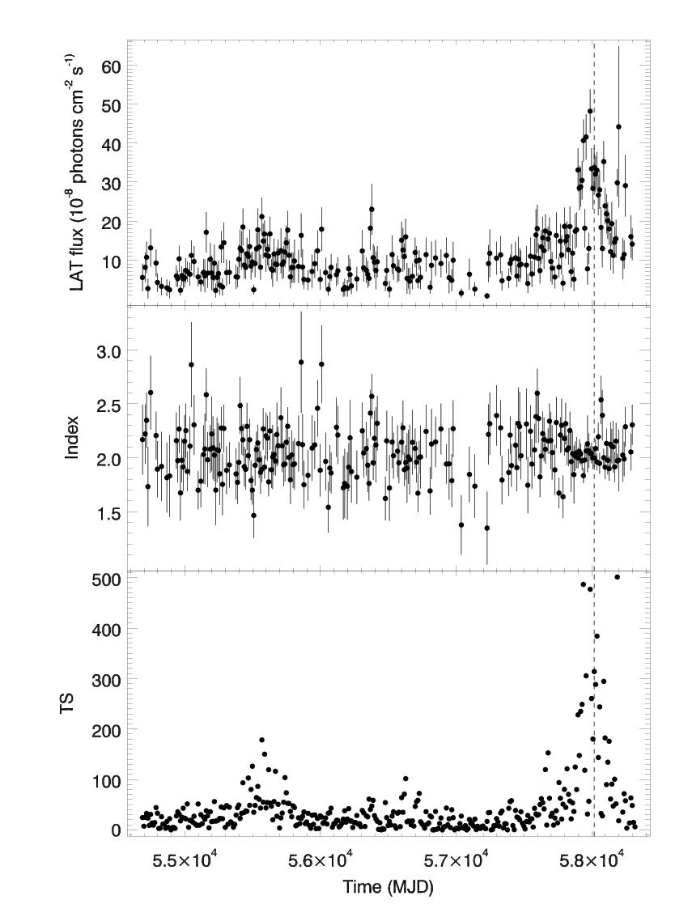
Examples at GeV gamma rays

Slide 20
Current Focuses on Blazars with Fermi
Emission properties with mulit-band data -> radiation processes
Shortest variability timescale -> location of the jet emission

Slide 21
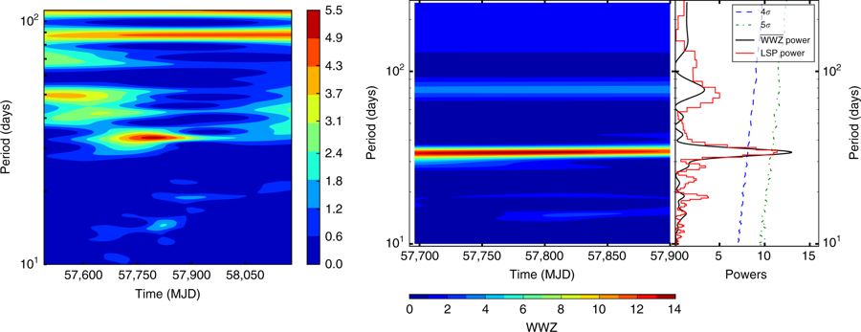
Outburst and a 34.5 day QPO signal
5.2-Sigma Signal
5-day binned Gamma-ray light curve of
PKS 2247-131 (Zhou, Wang et al. 2018)

Slide 22
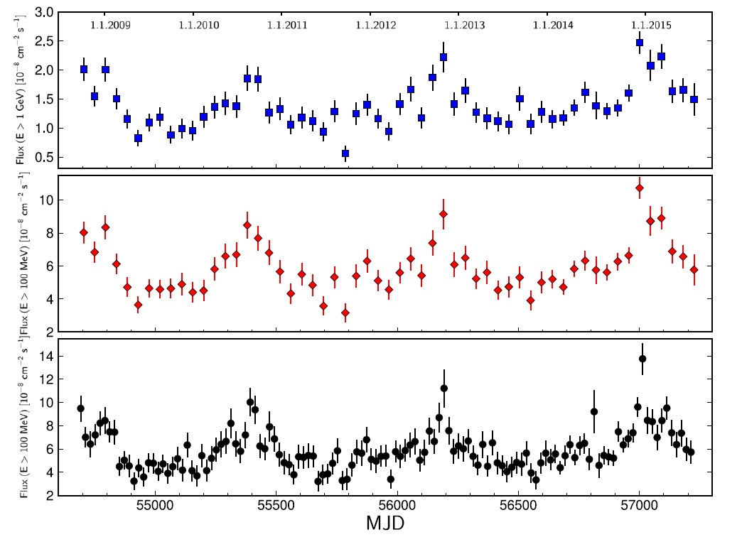
Before: Blazar PG 1553+113
Possible origins:
Pulsational accretion flow instabilities
Jet precession, rotation, or helical structure
Low frequency QPO such as in the Galactic stellar-mass black hole systems
Binary SMBH system
Latter followups more think it’s a binary SMBH system (e.g., Tavani et al. 2018)
Gamma-ray modulation: 2.18 year
(Ackermann et al. 2015, ApJL); Several followup studies
Have found similar time-scale QPOs

Slide 23
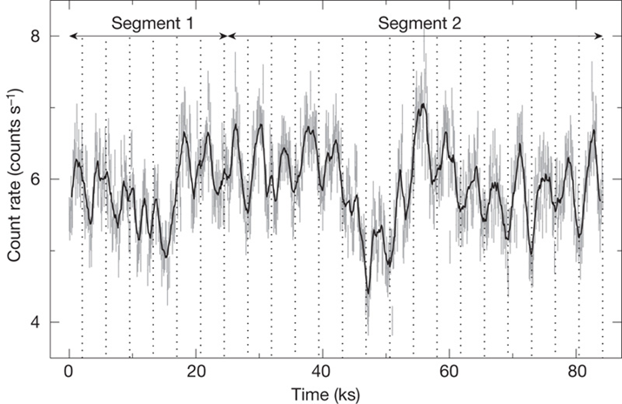
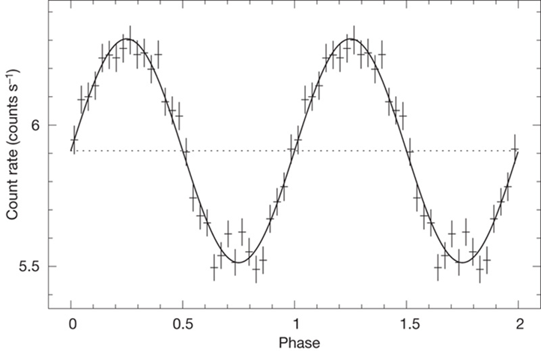
Time Scales for Possible Blazar QPOs
Binary SMBH systems:
Orbital periods can be about several years, given two 10^8 Solar mass SMBHs
Precessing accretion disk (and the jet), with time scales of hundreds of years
QPOs similar to those of stellar mass black holes: sub-day variations
Pulsational accretion flow instabilities: intra-day QPOs
Folded light curve
(Gierlinski et al. 2008
Nature)

Slide 24
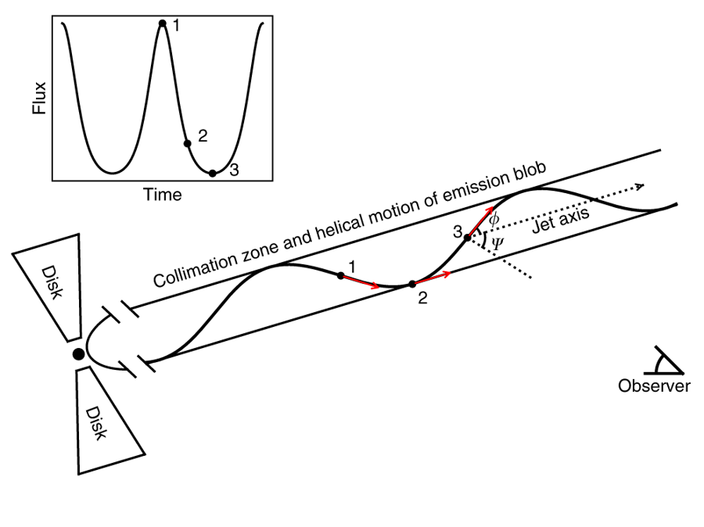
A Jet with A Helical Structure?
Beaming effect
Folded light curve

Slide 25
Summary
A first clear case: a month-long modulation is seen in a jet from a blazar
A new window onto jet structures: probably the first time seeing a helical structure through high-energy flux modulation
Thus far a rare case: we have looked for similar modulation in more than 1500 Fermi blazars, for the purpose of checking the appearance frequency of similar QPOs at gamma-rays, and our case thus far has been the only one based on our search
Transient nature: multi-wavelength confirmation should be a key, but it is difficult (Future: LSST+Fermi?)

Slide 26
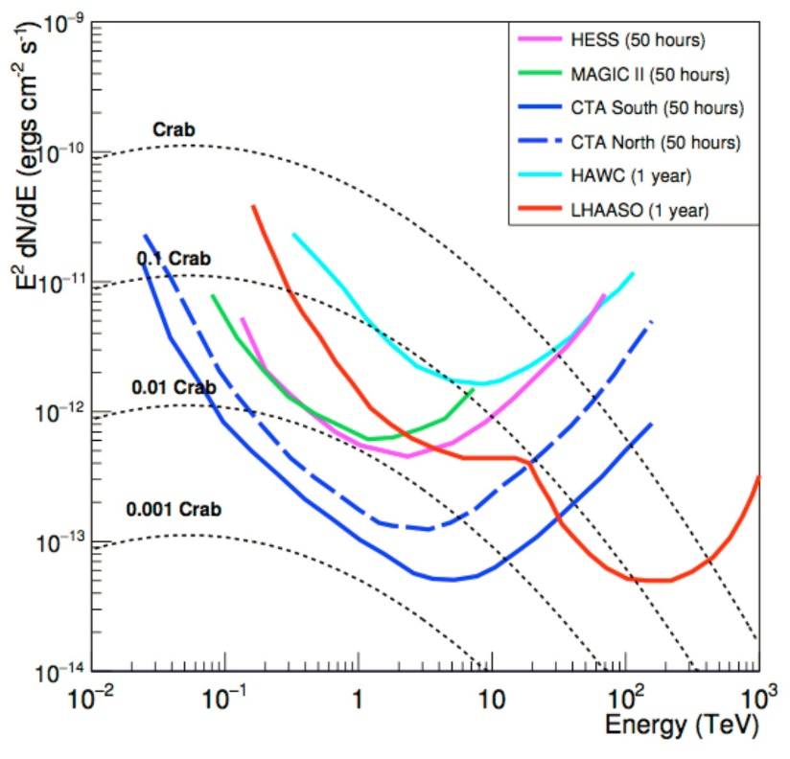
LHAASO(高海拔宇宙线观测站
THE LARGE HIGH ALTITUDE AIR SHOWER OBSERVATORY (LHAASO)
Being built right now
Will start observations in April 2019
Covering 1-1000 TeV
Best sensitivity at 100-1000 TeV energies
Fermi

Slide 27
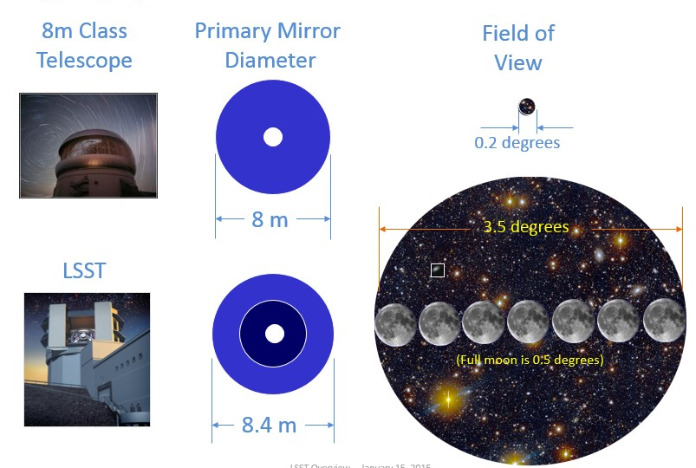
LSST(Large Synoptic Survey Telescope)
Will produce deep-wide-fast image of the Universe
Imaging in six optical bands, 15 sec, r’~ 24.5
Every night, there will be 10 million alerts about candidate transients
Will start operation from 2023

Slide 28
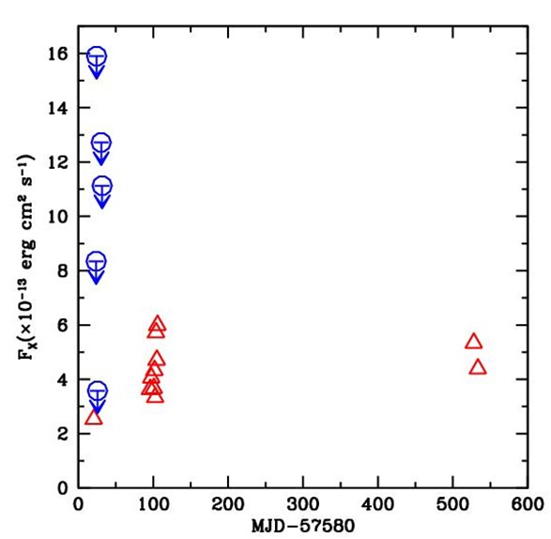
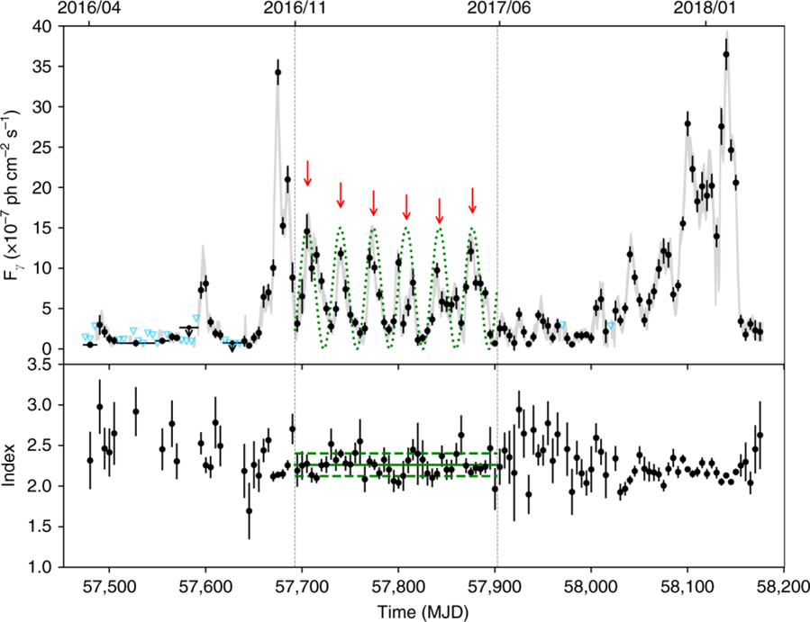
Multiwavelength Studies
Swift X-ray
LHAASO or LSST may allow multiwavelength confirmation; Key!

Slide 29
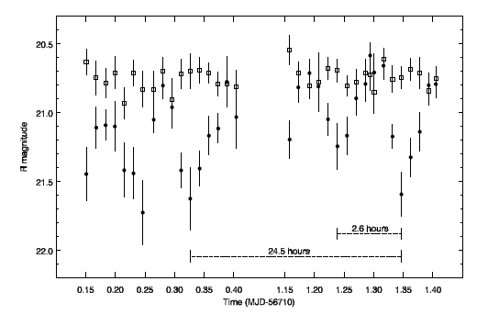
Multiwavelength Studies
Thanks for your attention!
Gamma-ray and Pan-STARRS optical light curves of a Fermi source
PTF optical light curve
Identifying gamma-ray binaries
From multiwavelength observations

