Slide 1
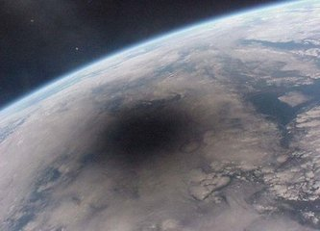
WCDA simulation of moon shadow
The first LHAASO collaboration meeting in 2019
WANG Yanjin (王岩瑾)
Northeastern University / IHEP
（东北大学/ 中国科学院高能物理研究所）

Slide 2
Research background
Research methods
Results
The next work

Slide 3
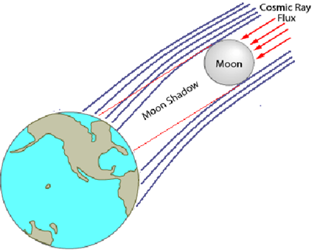
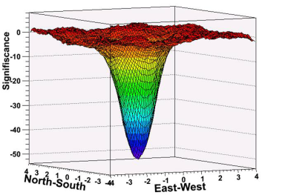
Research background：
The definition of moon shadow:
The distribution of cosmic ray is isotropic, and
cosmic ray will be hampered by moon when it come to the earth, as a result of the deficition of the cosmic ray, it becomes moon shadow.

Slide 4
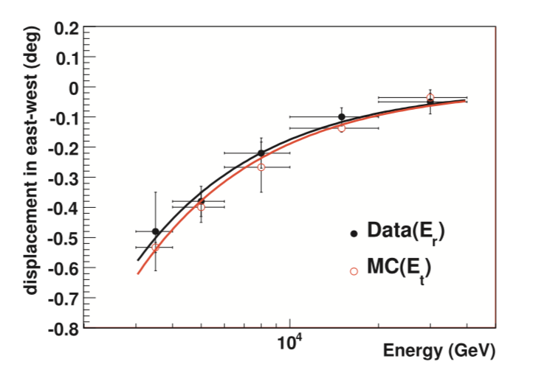
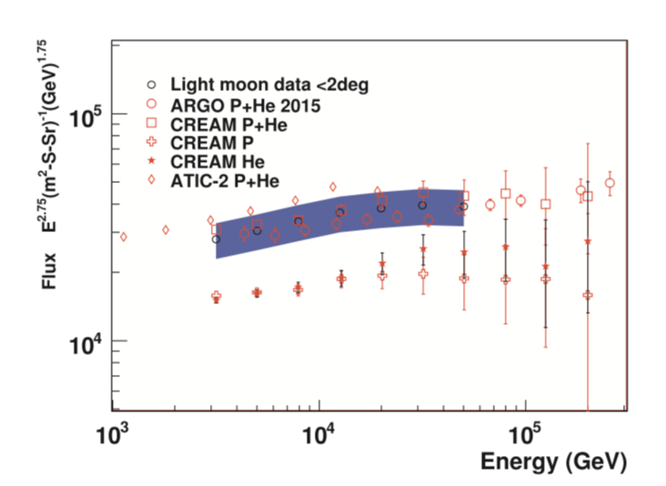
The significance of the moon shadow researching：
Using the geomagnetic field, high altitude and low threshold energy features of LHAASO-WCDA,we selected the moon shadow data by using light component during the low energy and establishing the energy calibration.
Using moon shadow East-West displacement to calibration energy.
Notes:
利用地磁场的磁谱仪的作用，再加上LHAASO-WCDA高海拔、低阈能得特点，挑选阴影数据通过对宇宙线轻成分在低能端能谱的测量，建立“能标”。

Slide 5
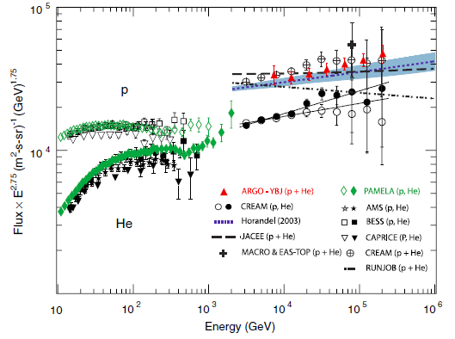
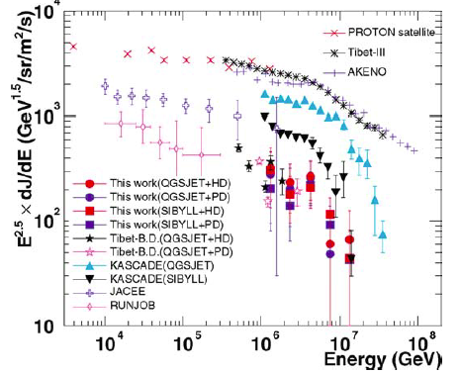
Motivation: constructing an energy “anchor”
Important progress on elemental
CR energy spectrum from satellite/balloon-born experiments
Normalization and absolute energy calibration and reference for indirect measurements

Slide 6
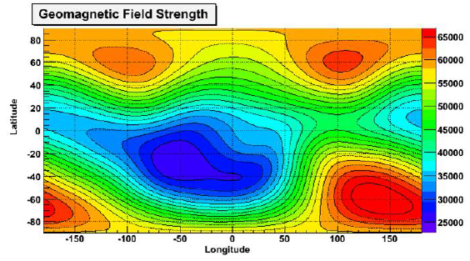
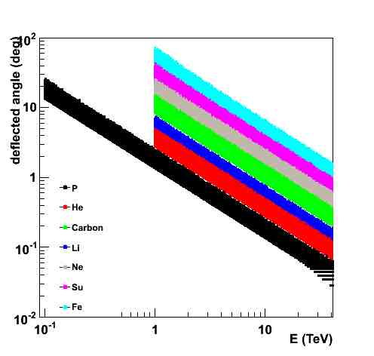
Rearch method：
Moon shadow simulation:
Based on existed simulation data to get input energy spectrum;
Geomagnetic field： IGRF
Backtracking the particles to the Moon;
Add PFS to produce experimental angular resolution

Slide 7
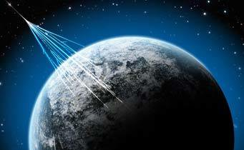
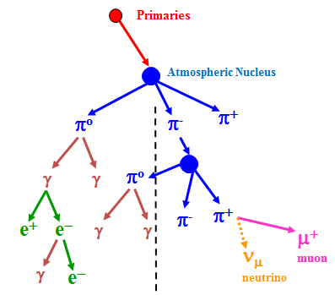
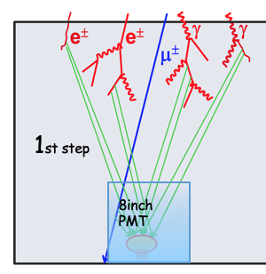
Detailed simulation:
Using above code to generate moon data
Shower production
CORSIKA package
Hadronic models:
EPOS-LHC + Fluka (now)
Moon orbit : 20181001-20181031
CR primary composition from CREAM result
P /He /CNO/MgAlSi/Iron
P + 100GeV-100TeV: (10⁵ events)
Detector simulation:G4WCDA5.1+5.2
Core in 400m×400m around pool #1 center

Slide 8
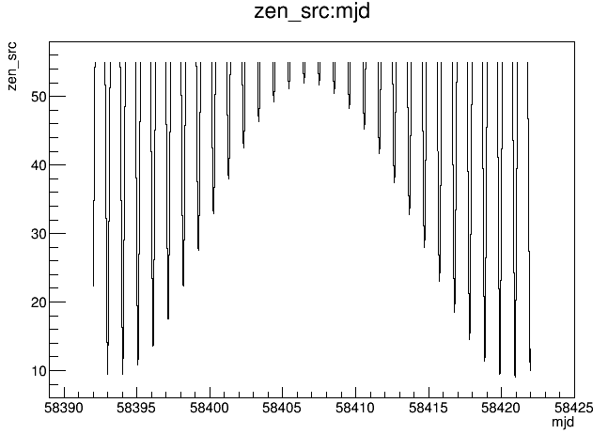
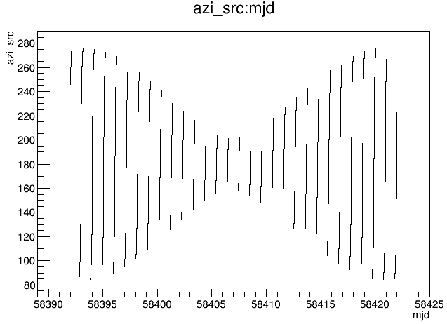
Direction extraction：
The direction of moon changes along an orbit.
In order to hit moon more efficiently, we extract primary direction of cosmic ray near to the moon .
angle range : extracting events within solid angle of moon center depend on energy.

Slide 9
Mass production data:
primary | energy | omega | all events (GMF) | moon shadow events (GMF) | moon shadow events (corsika) | moon shadow (Geant4)
P | 100GeV-700GeV | 20° | 1.3×10⁸ | 1.9×10⁴ | 1.0×10⁴ | 8.0×10³
 | 700GeV-1TeV | 5° | 1.5×10⁷ | 4.2×10⁵ | 4.2×10⁵ | 3.0×10⁴
 | 1TeV-10TeV | 3° | 5.5×10⁶ | 5.0×10⁴ | 5.0×10⁴ | 5.0×10⁴
 | 10TeV-100TeV | 1° | 1.6×10⁶ | 1.0×10⁴ | 1.0×10⁴ | 8.5×10³
He | 1TeV-10TeV | 5° | 2.5×10⁶ | 7×10³ | 7×10³ | 7×10³
CNO | 1TeV-10TeV | 10° | 1.0×10⁷ | 5×10³ | 4.4×10³ | 4.4×10³

Slide 10
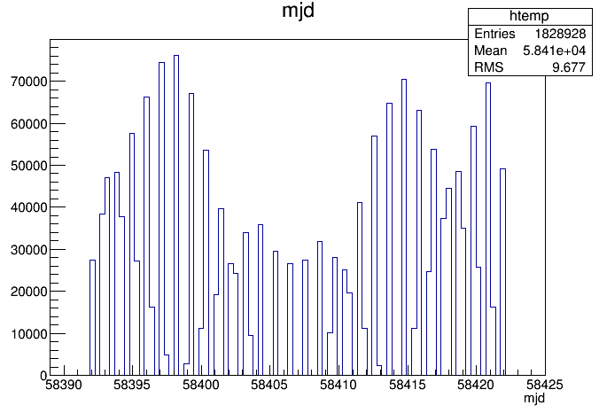
Extracted cosmic ray time dirstribution （2018.10.1-2018.10.31）
Results:
Observing time of moon

Slide 11
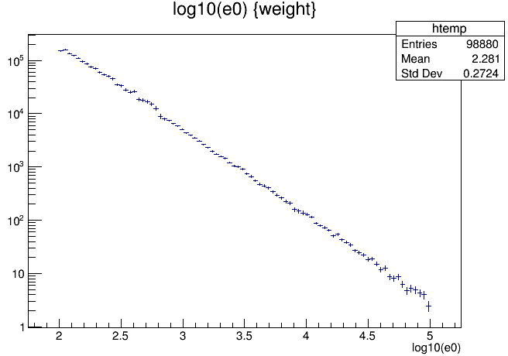
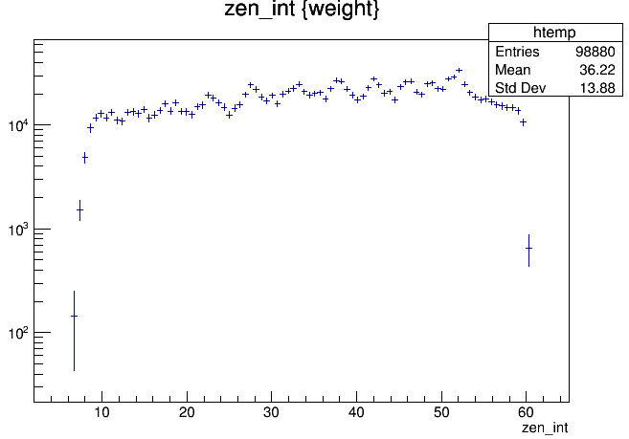
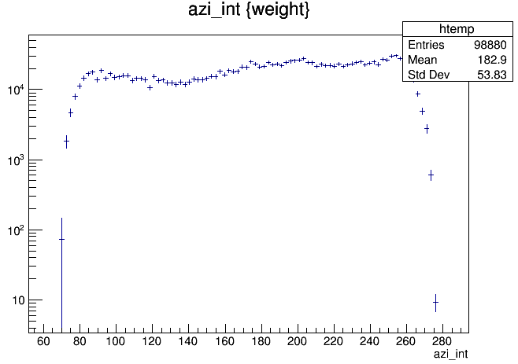
Some parameters distribution

Slide 12
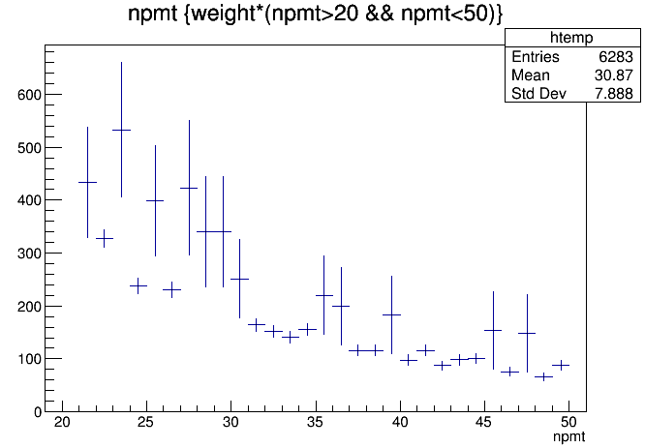
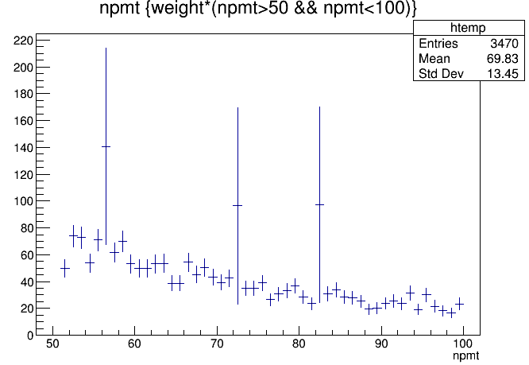
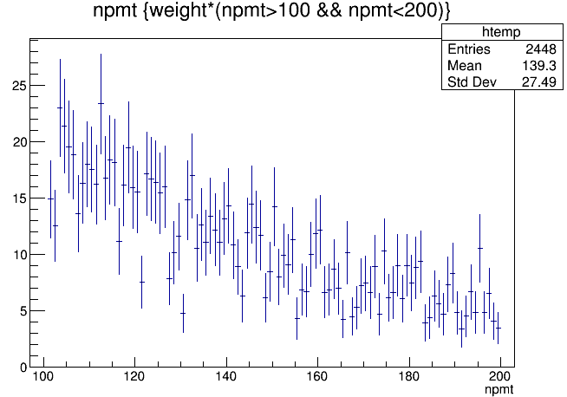
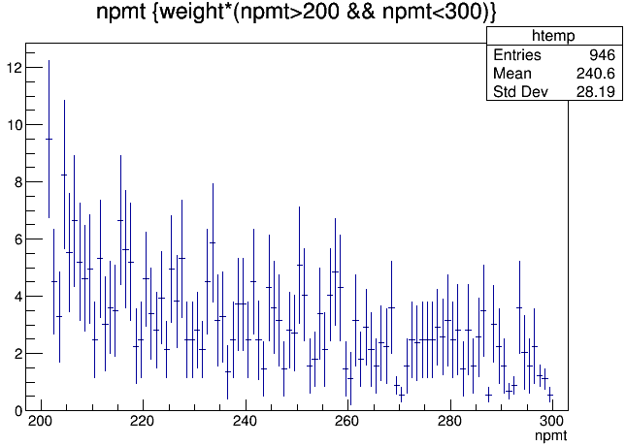
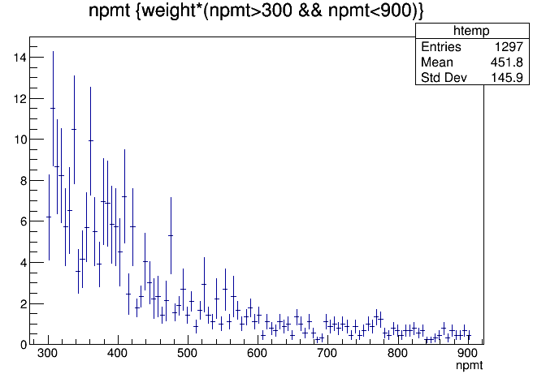
NPMT distribution
NPMT | 5-20 | 20-50 | 50-100 | 100-200 | 200-300 | 300-900
angular Resolution | 6.26505° | 2.27175° | 1.30505° | 0.89045° | 0.63925° | 0.49105°

Slide 13
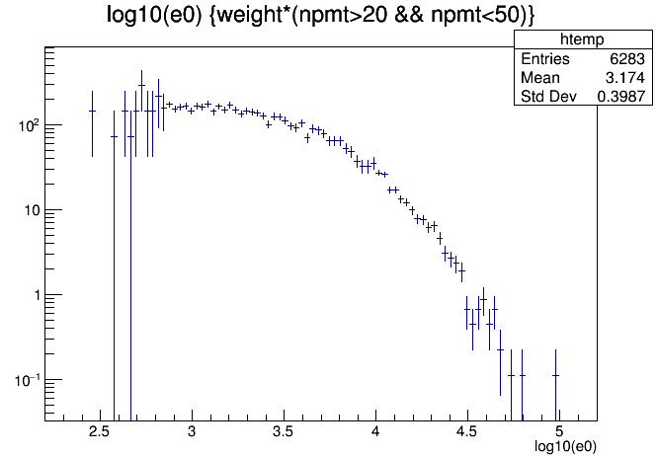
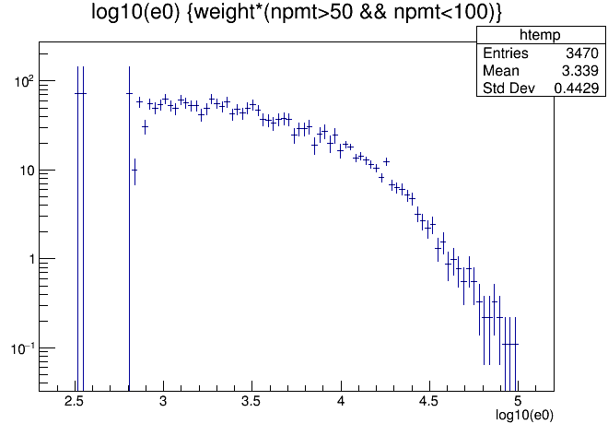
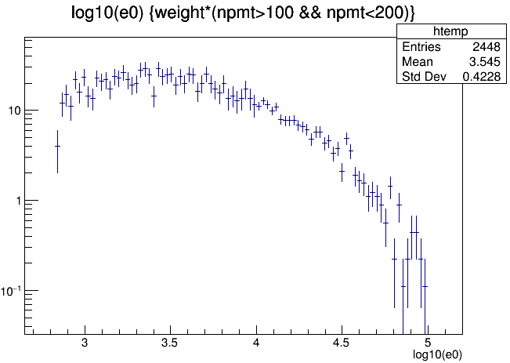
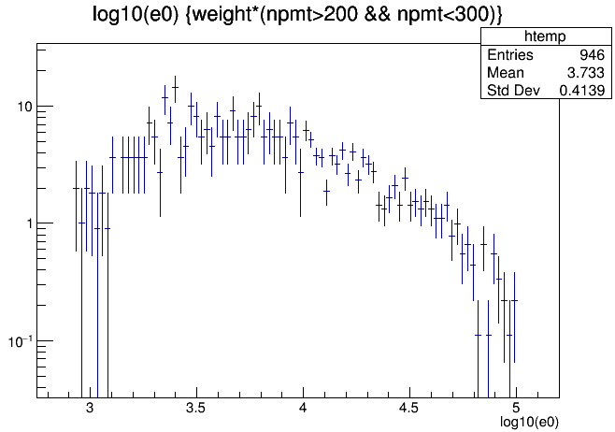
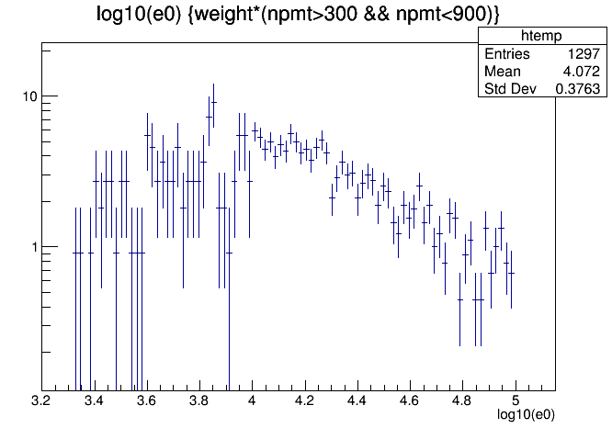
Energy distribution

Slide 14
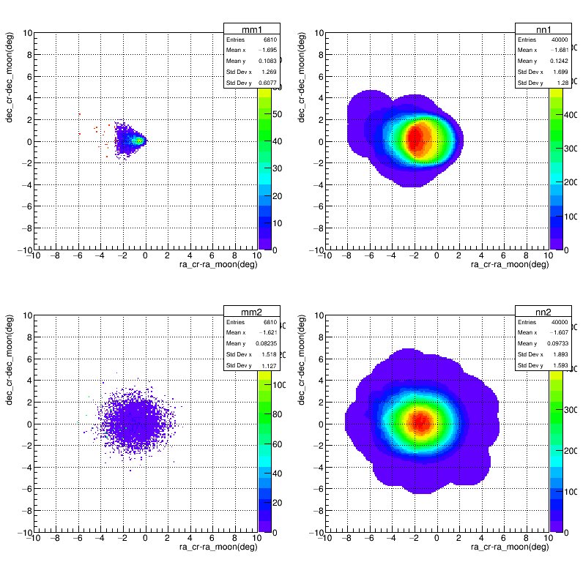
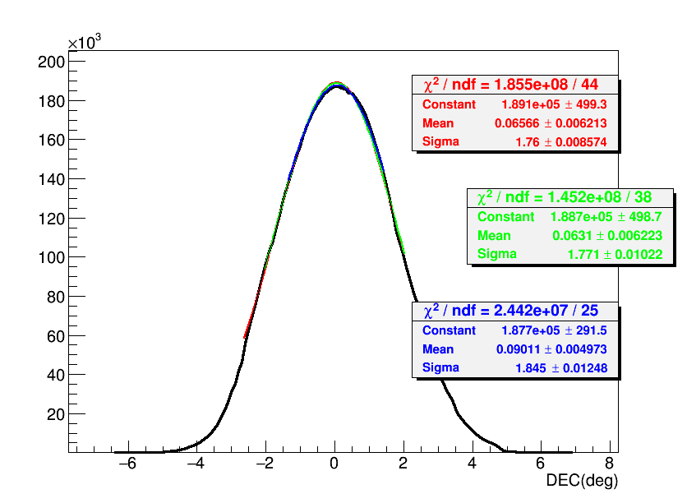
Simulation result NPMT:20-50
Casting shadow on the ra direction
no smooth smooth
The ideal
detector
Casting shadow on the dec direction
The detector
with angle
resolution

Slide 15
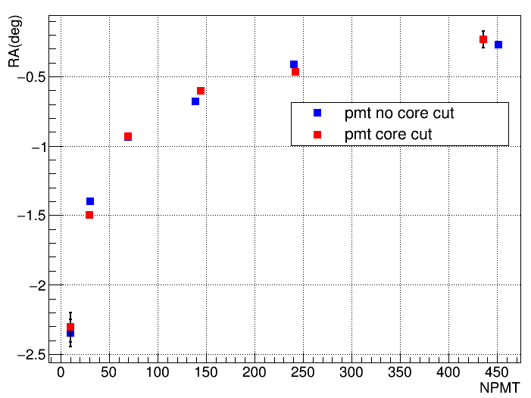
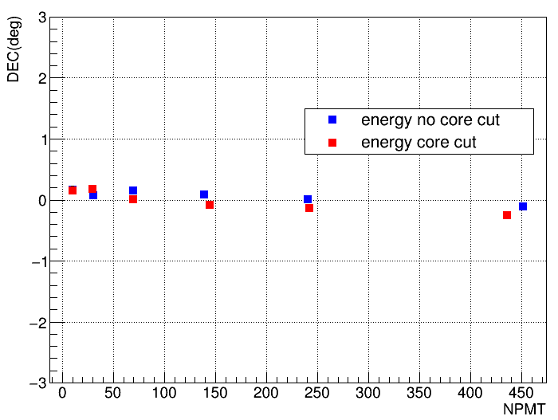
The relationship between NPMT and direction of deflection.

Slide 16
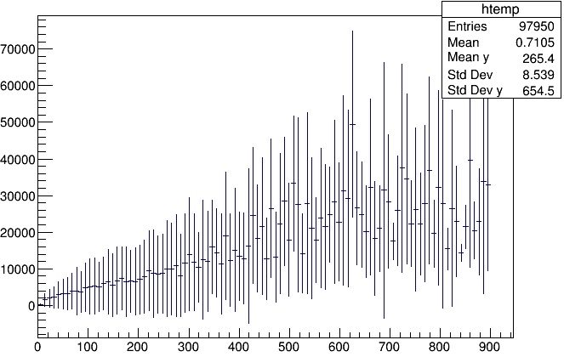
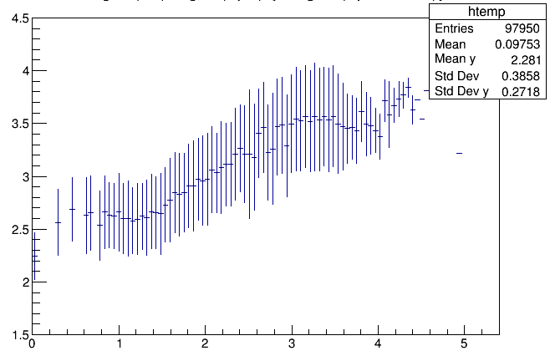
The relationship between NPMT and energy
The relationship between NPE and energy
E(GeV)
log10(E/GeV)
NPMT
log10(NPE)

Slide 17
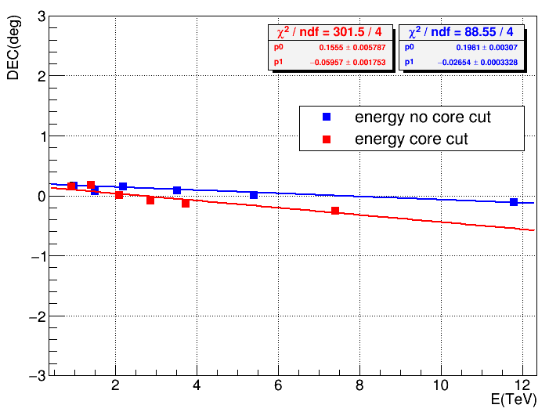
The relationship between energy and direction of deflection.

Slide 18
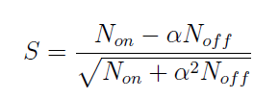
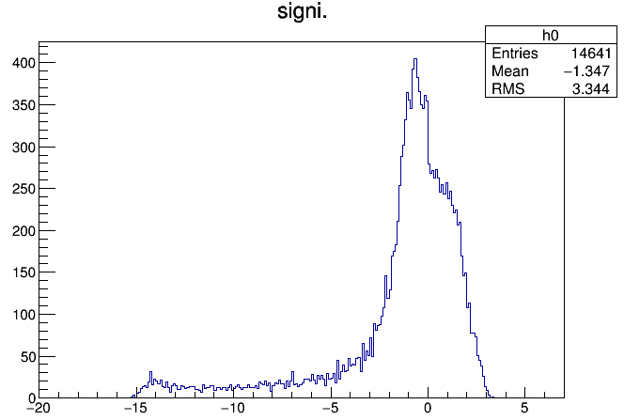
Significance of moon shadow using the ASɤ data (207 days)

Slide 19
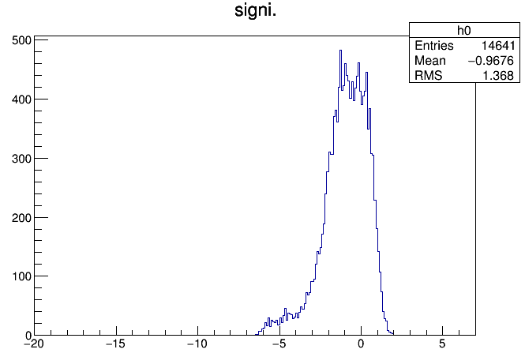
Significance of moon shadow using the ARGO data (30 days)
2008.01.01-2008.02.01

Slide 20
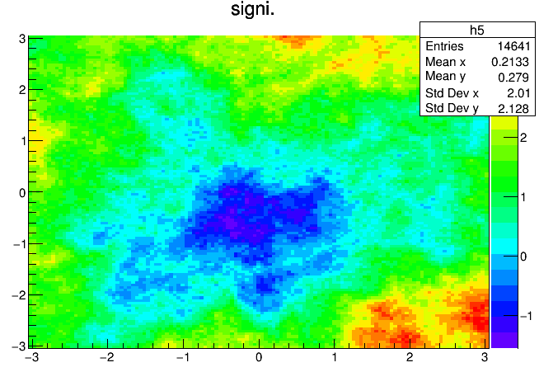
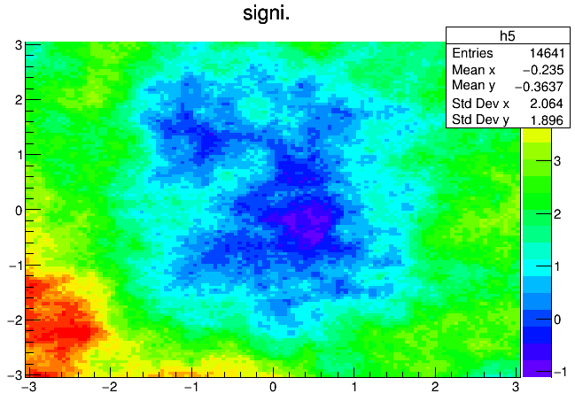
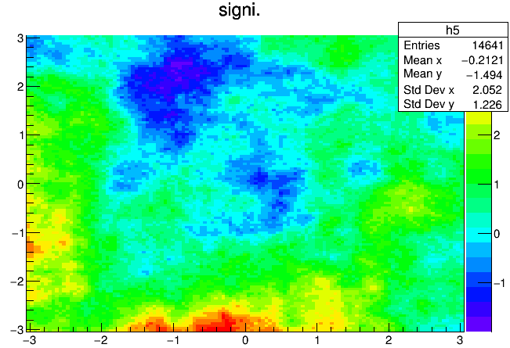
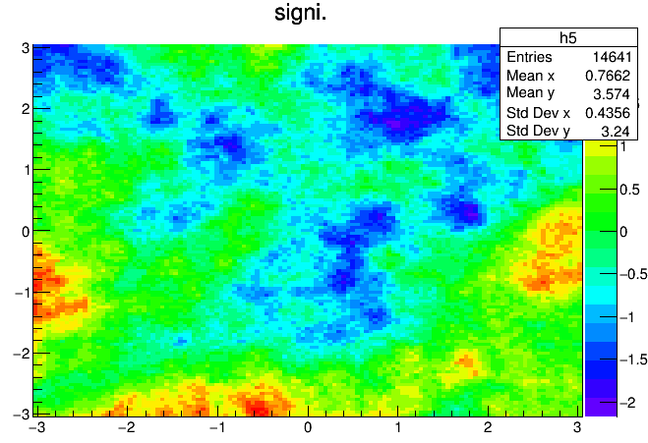
Significance of “naked” moon shadow using the WCDA data (24 days)
nfit>20
nfit>50
nfit>100
nfit>200
Primary reconstruction (nhit>100) with out time calibration.

Slide 21
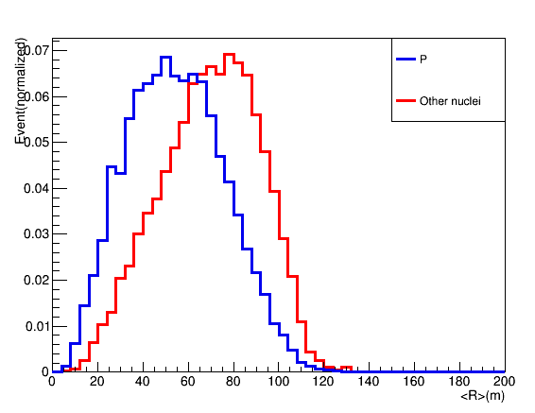
Light moon data or pure proton moon data
Notes:
nFit :参与重建着火PMT个数；cxPE45:重建芯位45m之外着火PMT最大光电子数；PEi：第i个着火PMT上的光电子数；Ri：第i个着火PMT到芯位的距离。

Slide 22
The next work:
The light/proton moon data selection;
Reconstruction resolution update;
Reconstruction energy.

Slide 23
Thank you

