Slide 1
Study on the identification of the primary cosmic ray compositions at knee
王玉东
(Wang Yudong)
Supervisor: Yang Chaowen
四川大学
(Sichuan University)
Supervisor: Andrea Chiavassa
(Università degli Studi di Torino)

Slide 2
Content
Identification method on CORSIKA data
a) Single parameter method
b) Double parameters method
Identification method on LHAASO simulation data
Summary

Slide 3
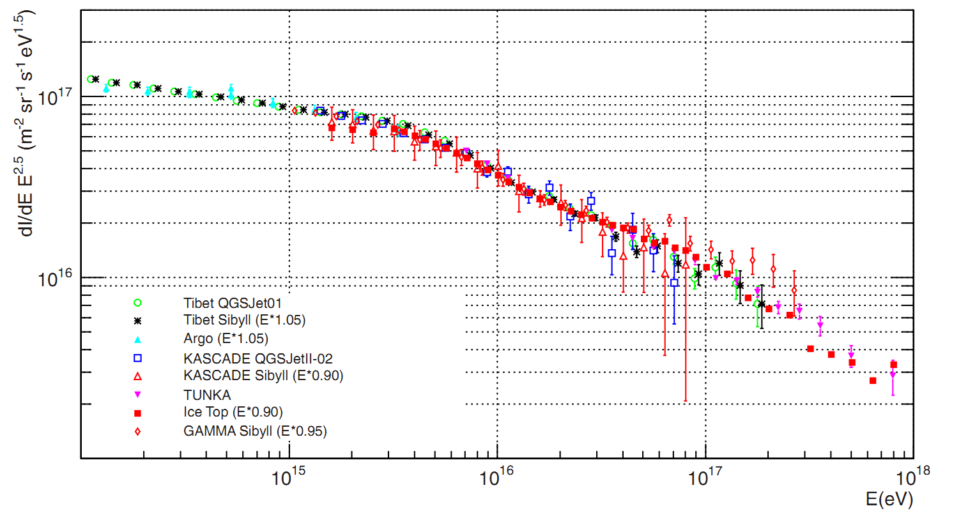
Knee in Cosmic ray Spectrum

Slide 4
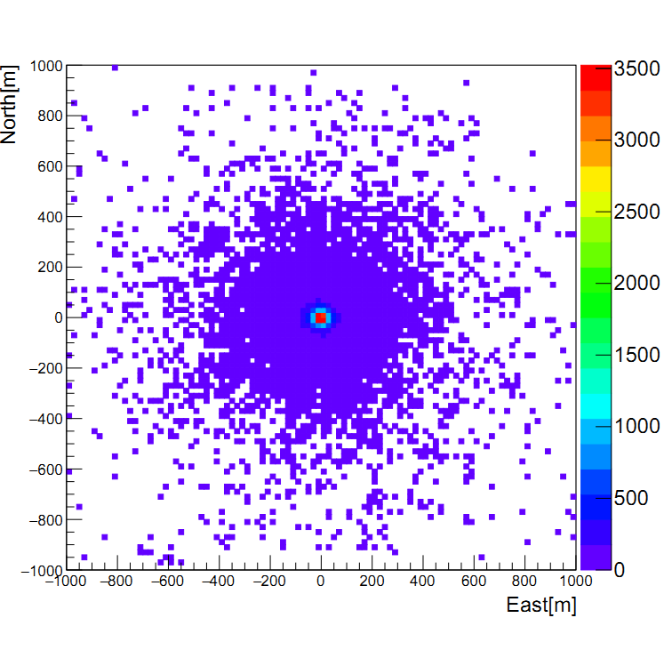
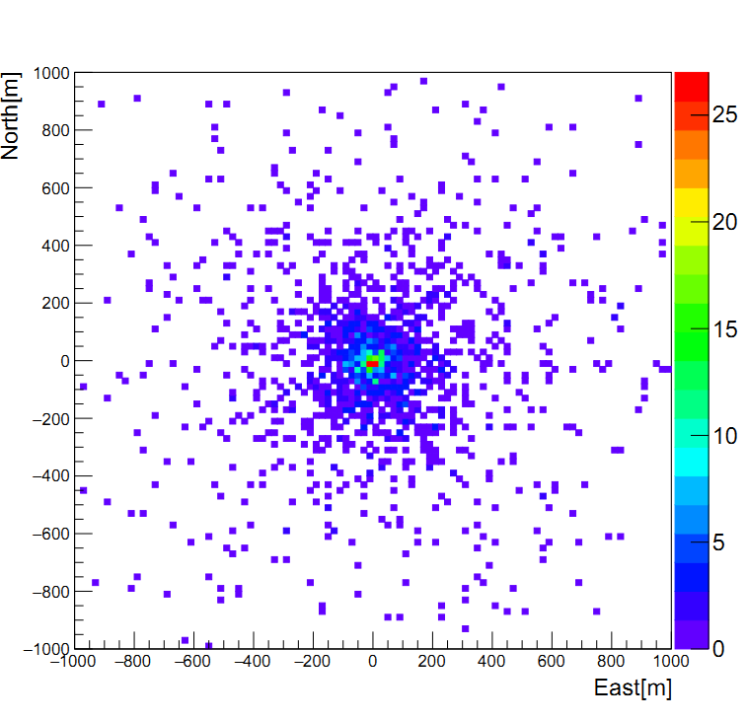
2-D distribution of secondary particles
electrons
muon
The primary particle is proton and the energy is 100 TeV

Slide 5
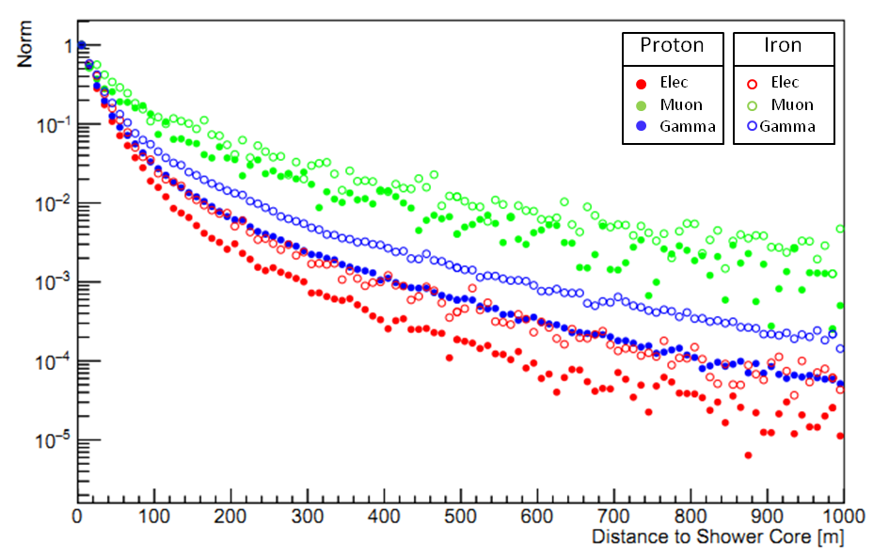
Normalization Lateral Distribution
The Normalization lateral distribution of Shower, primary particles are proton and iron, their energies are both 100 TeV

Slide 6
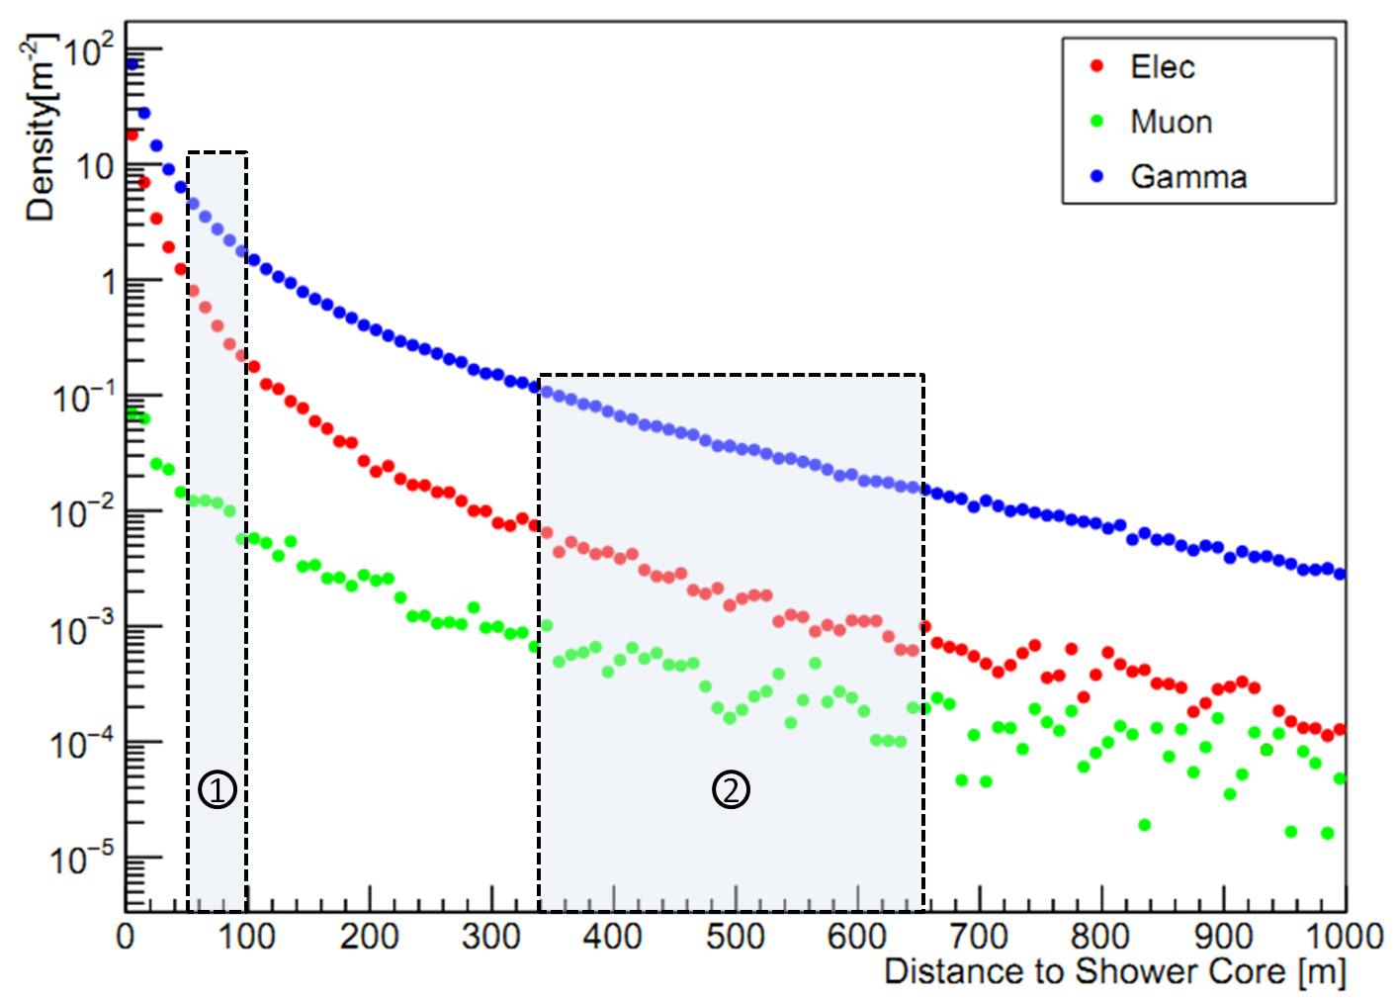
Single Parameter Method

Slide 7
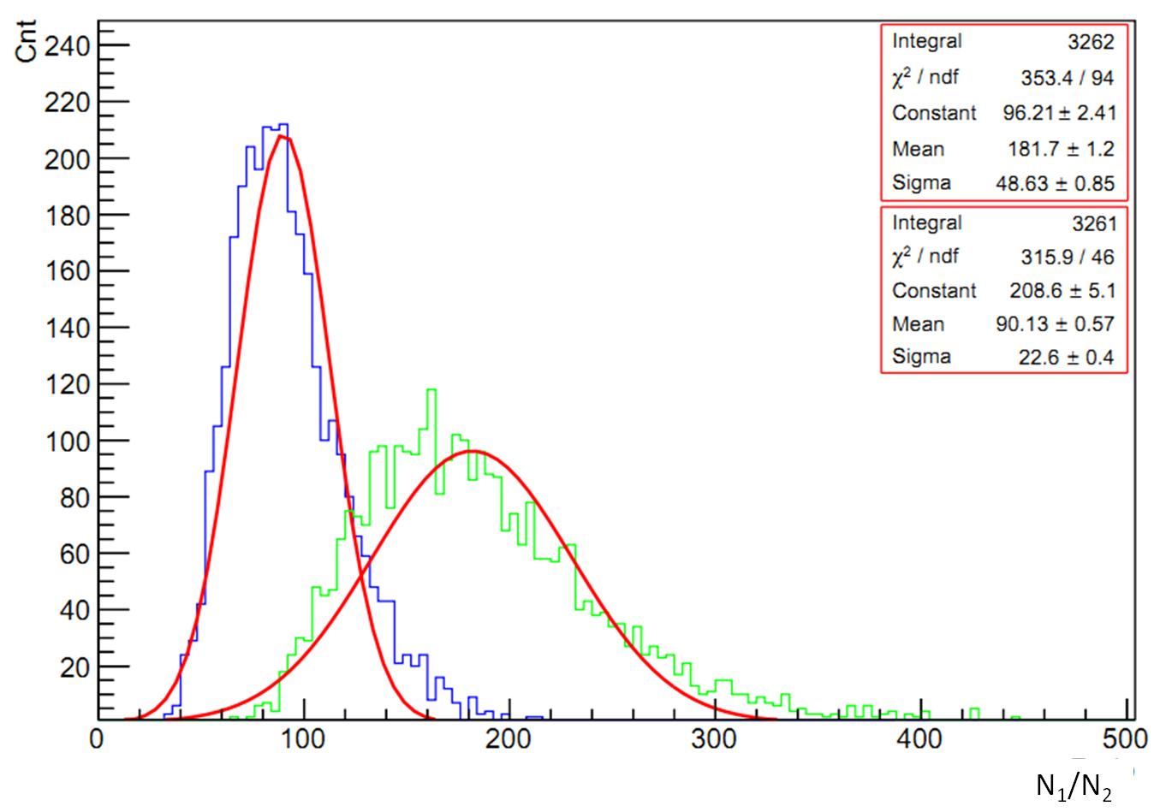
Discrimination of protons and irons
The energy range of protons and irons are both from 100 TeV to 10 PeV

Slide 8
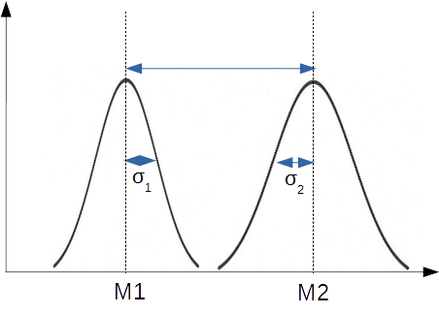
Definition of FoM

Slide 9
Discrimination of protons and irons
FoM=1.286

Slide 10
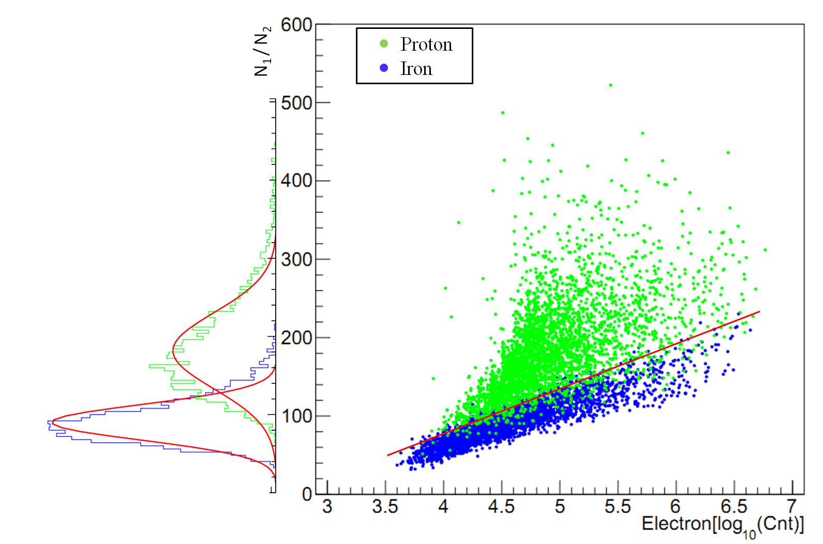
2-D discrimination of protons and irons

Slide 11
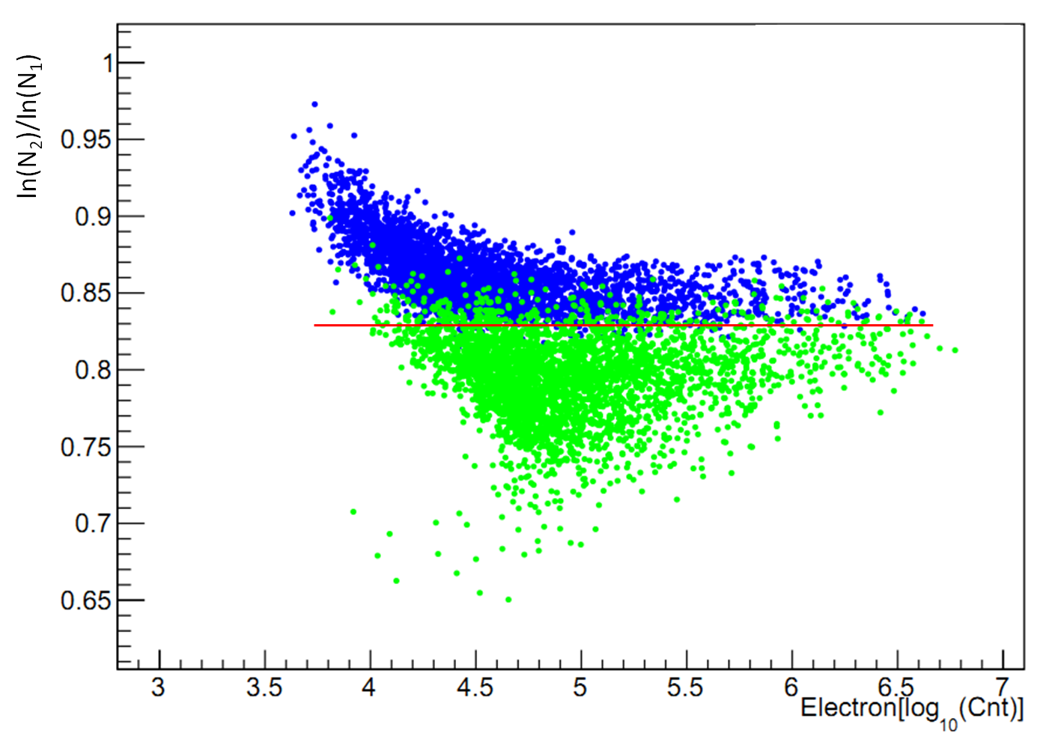
2-D discrimination of protons and irons

Slide 12
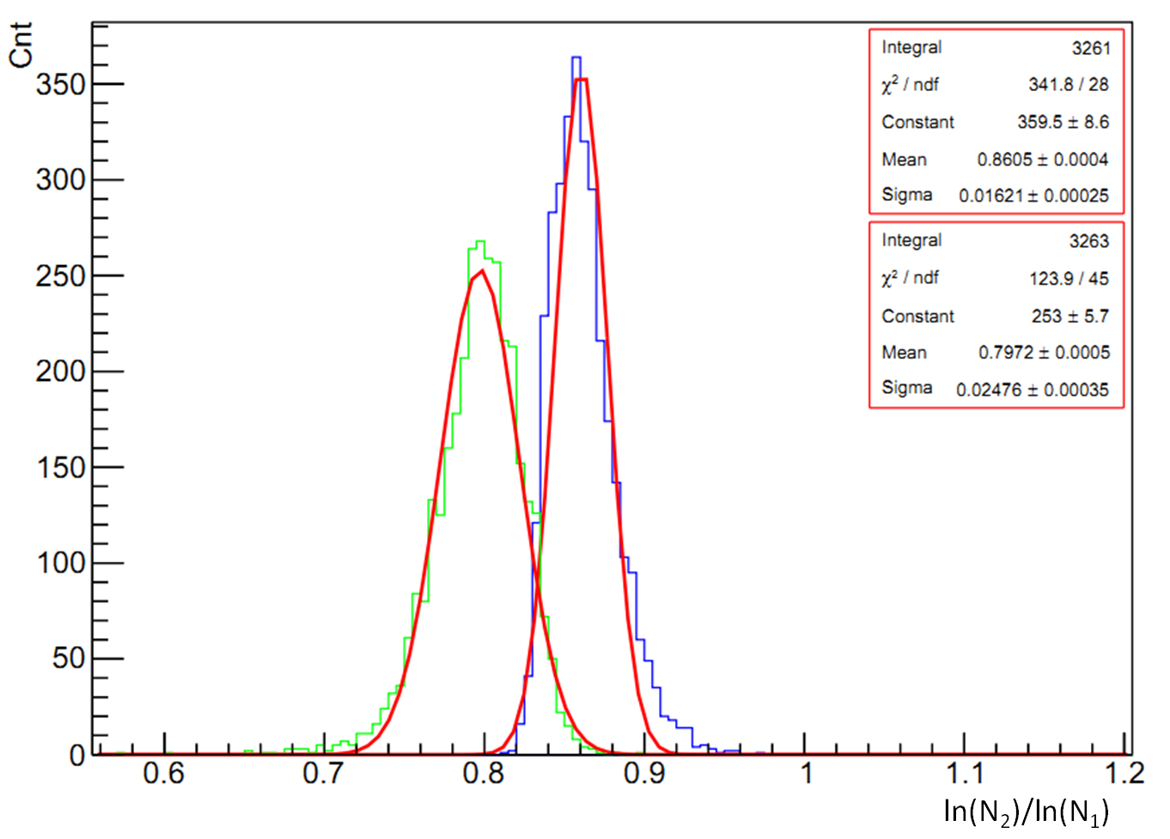
2-D discrimination of protons and irons
FoM=1.545

Slide 13
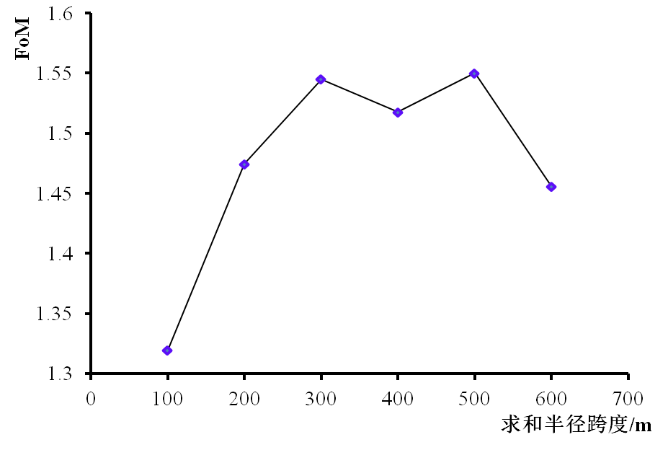
Results of Sum Range
Range of Sum /m
No 1 district is from 50 m to 100 m, the start position of the No 2 district is 350 m, the end position increases with step 100 m.

Slide 14
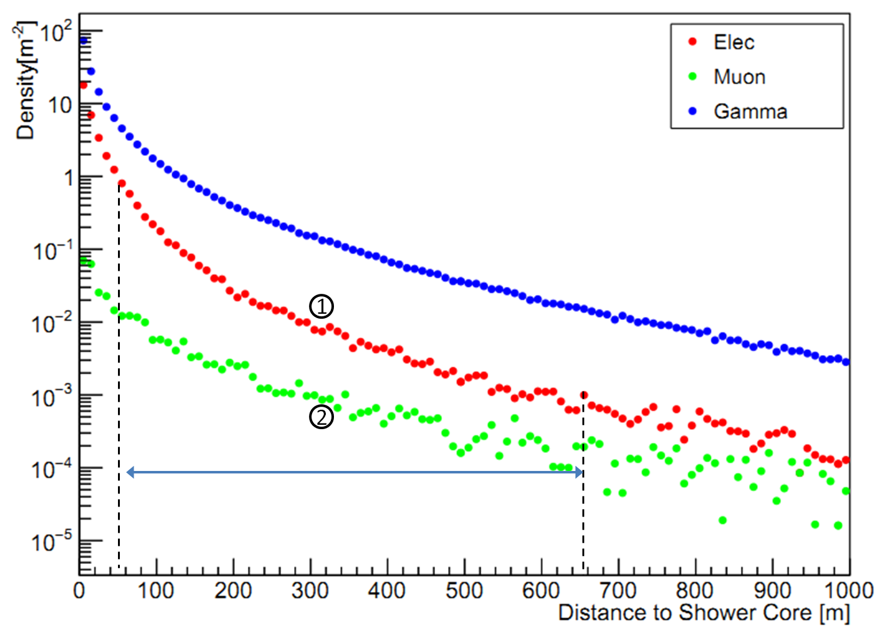
Double Parameters Method

Slide 15
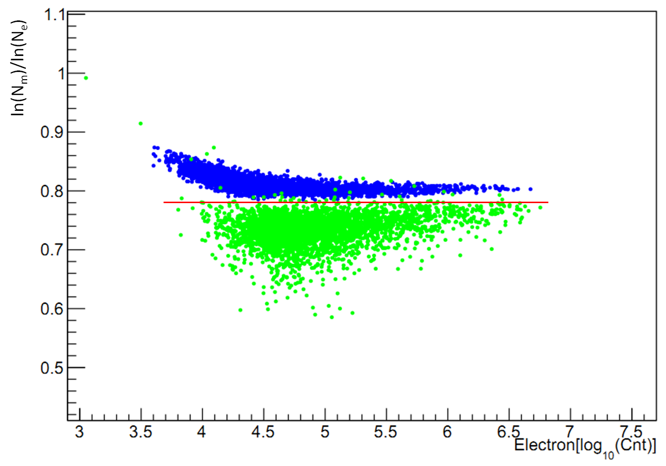
2-D discrimination of protons and irons

Slide 16
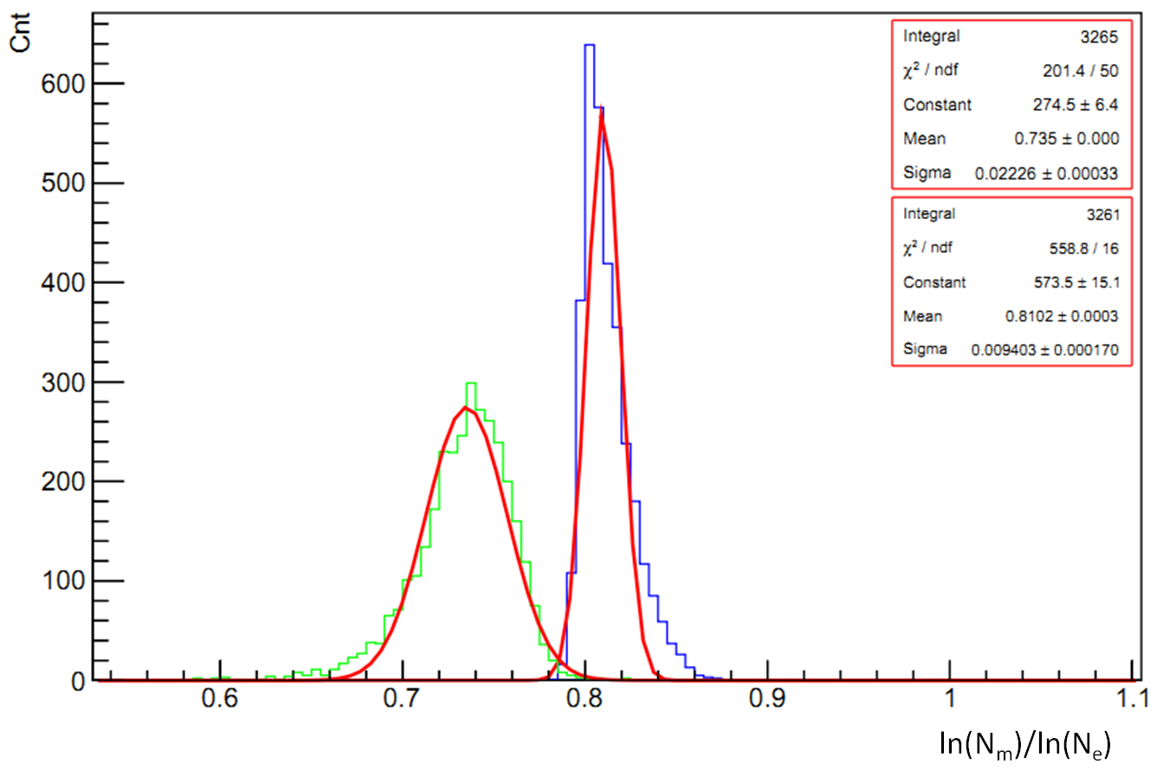
Discrimination of protons and irons
Double parameters method : FoM=2.540
(single parameter method : FoM=1.545)

Slide 17
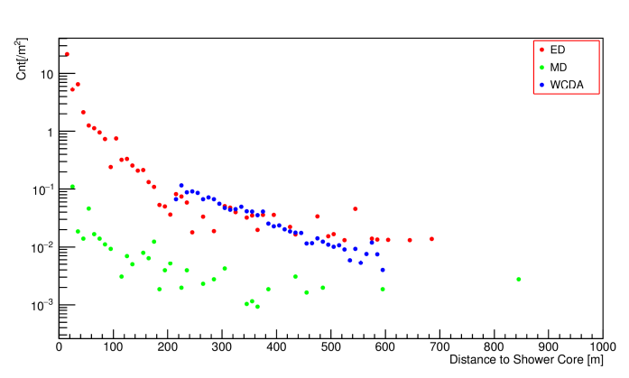
Lateral Distribution LHAASO Data

Slide 18
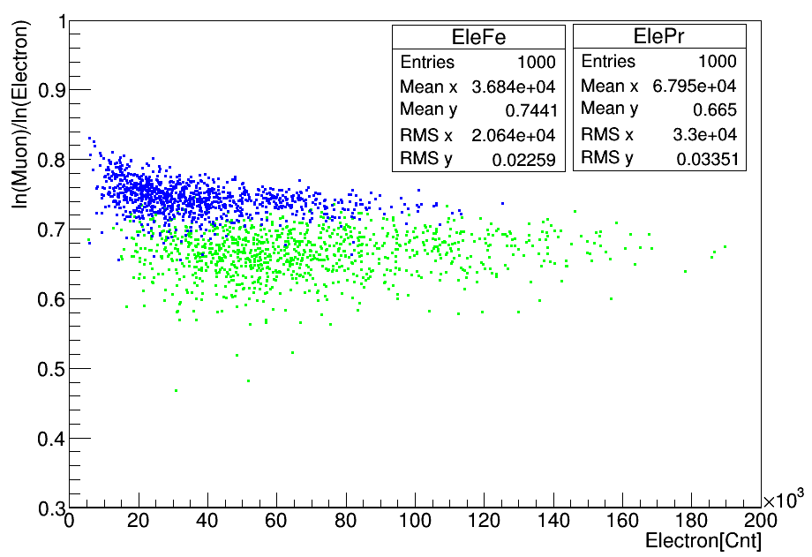
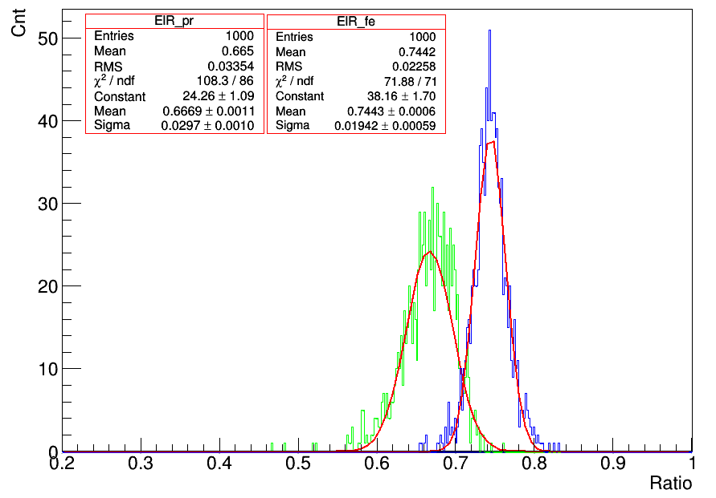
Discrimination of protons and irons
FoM=1.575

Slide 19
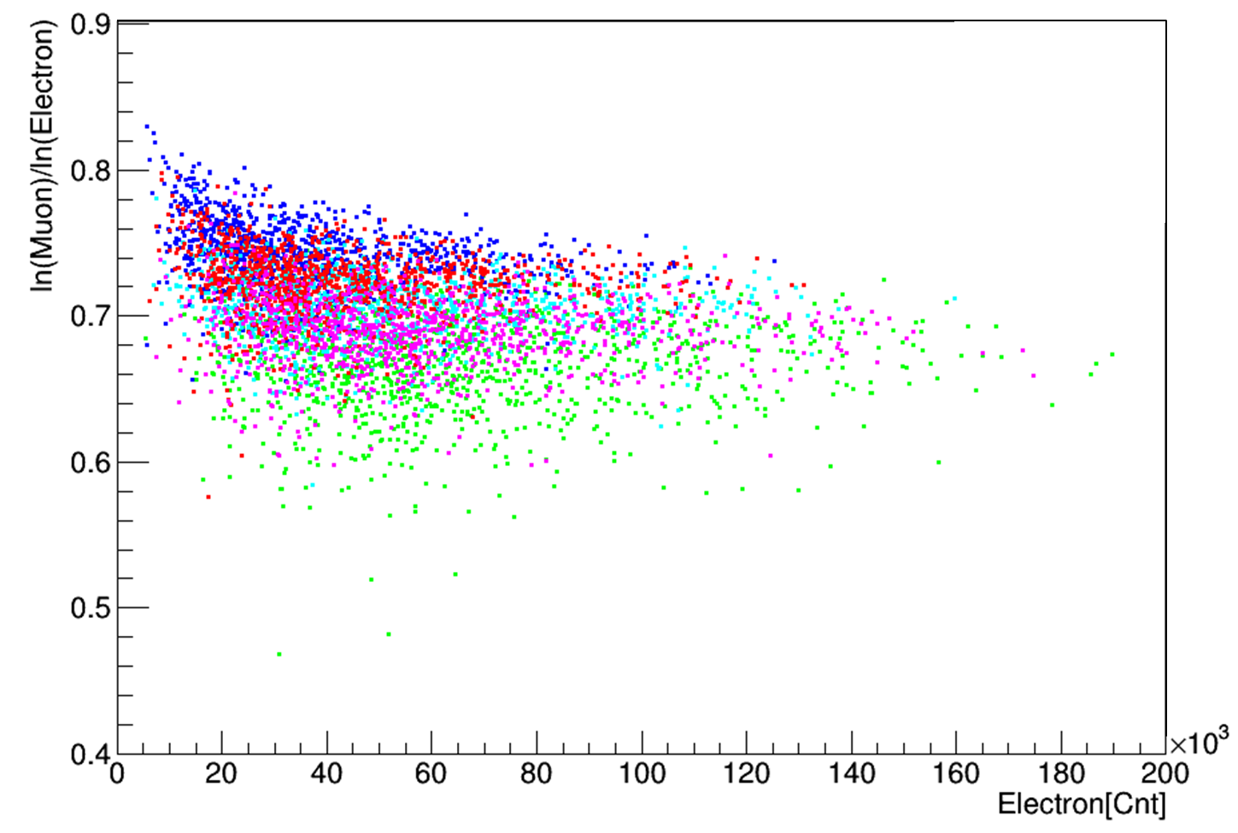
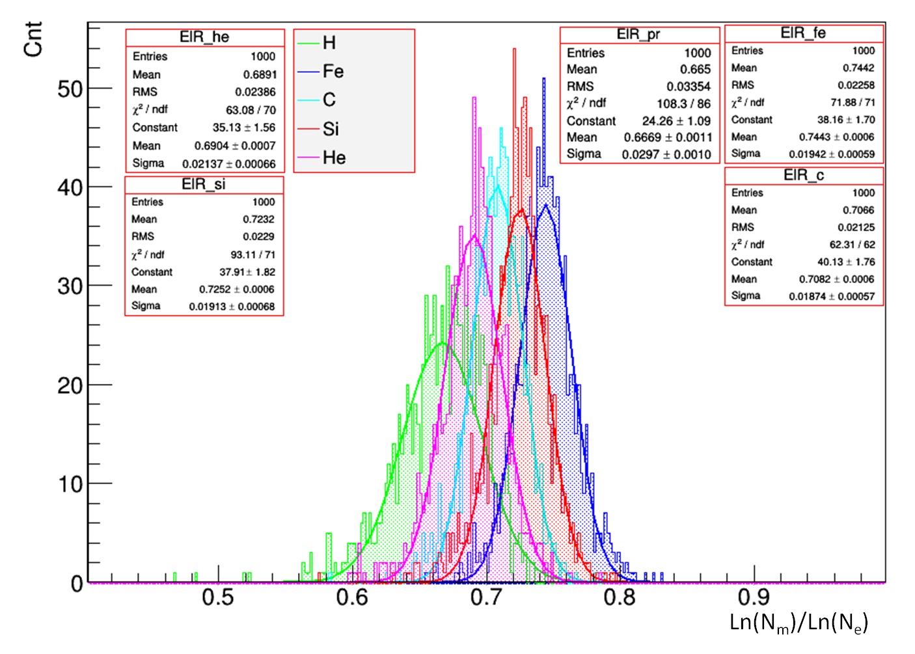
Discrimination of five elements

Slide 20
Summary
The double parameters of method is better than single parameter of method.
The Ratio between ln(N_{m}) and ln(N_{e}) changes a little with energy of primary particle.
The protons and irons can be identified by double parameters for LHAASO simulation data.
Five elements cannot be identified well by double parameters for LHAASO simulation data.

Slide 21
Thank you!

Slide 23
