Slide 1
Progress on DBPM development in IHEP
Huizhou Ma
On behalf of beam diagnostics group of IHEP

Slide 2
Outline
1
Background
2
The development of Digital BPM electronics
3
The test of DBPM
4
Summary

Slide 3
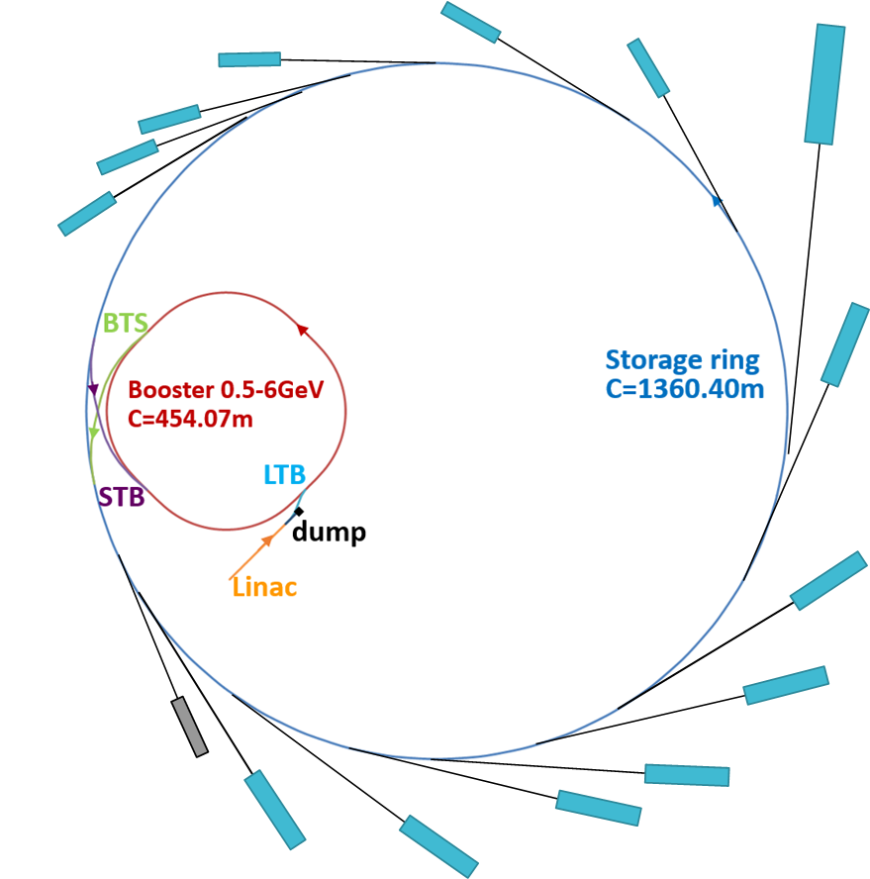
Technical features of the new light source
The High Energy Photon Source (HEPS) is designed as an ultra-low emittance ring-based synchrotron radiation light ;
About fourteen beamlines will be constructed in Phase I of the project;
Storage ring circumference: 1360.4m
Energy: 6GeV
Emittance<60pm.rad
Current: >200mA
Construction:2019-2025

Slide 4
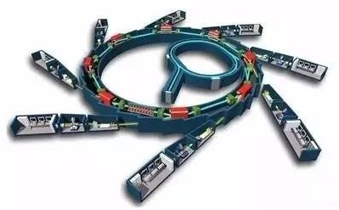
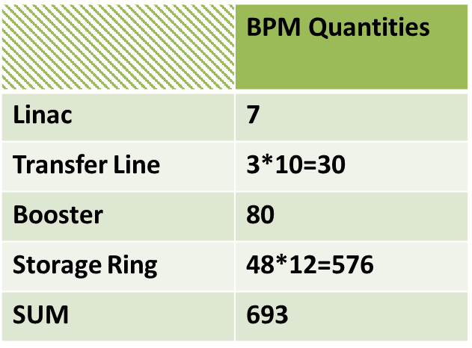
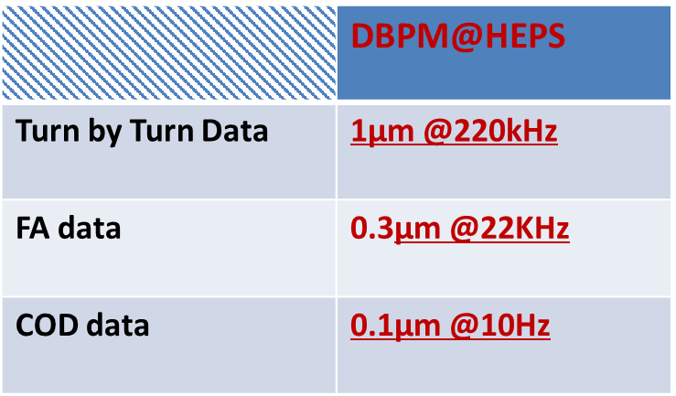
The Digital BPM requirement of HEPS project
HEPS BPM quantities
Storage ring BPM Parameters

Slide 5
The development of Digital BPM electronics
For the HEPS will have been built several years later, so we develop the DPBM prototype with BEPCII parameters, and DBPM system will be tested in BEPCII.
HW design
  RTM Design
  AMC Design
Test of the DBPM

Slide 6
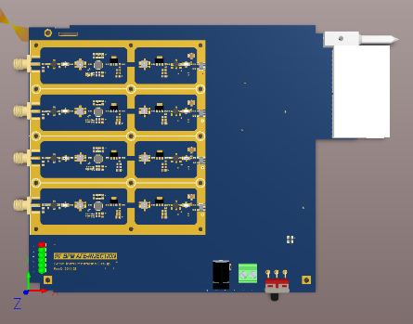
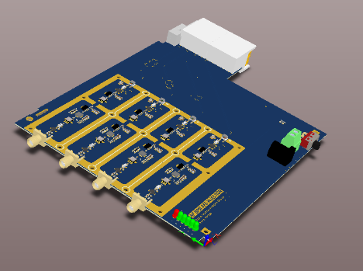
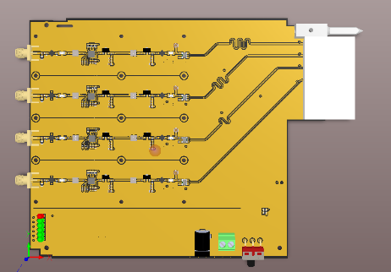
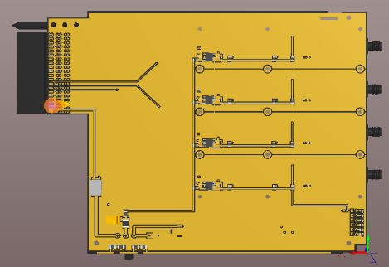
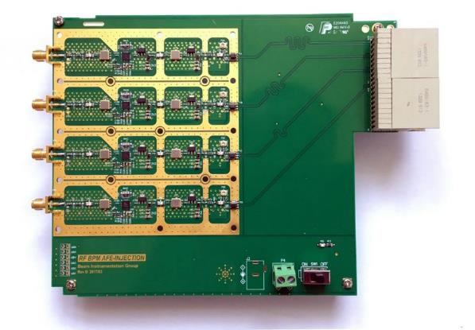
RTM Module design
No cross-calibration
Low Noise design
Low power consumption

Slide 7
DBPM_RTM function block
Switched Attenuators
LNA
LNA
LNA
-9dB
Fc=500MHz
BW=10MHz
NF=0.46dB
Gain=20dB
P1dB=19dBm
IP3=36dBm
0dB
to
31dB
NF=2.9dB
Gain=23.75dB
P1dB=18.1dBm
IP3=37dBm
Fc=500MHz
BW=10MHz
0dB
to
31dB
NF=3.39dB
Gain=20dB
P1dB=16.3dBm
IP3=37dBm
-3.1dB
AGC
LNA
LNA
π
Att
π
Att
balun
-6dB
Fc=500MHz
BW=10MHz
0dB
to
31dB
NF=0.9dB
Gain=20dB
P1dB=18.1dBm
IP3=37dBm
Fc=500MHz
BW=10MHz
NF=1.2dB
Gain=20dB
P1dB=16.3dBm
IP3=37dBm
-3.1dB
1、Two LNAs are enough
2、The place of Attenuator is designed carefully
3、Attention to the Impedance matching & Noise

Slide 8
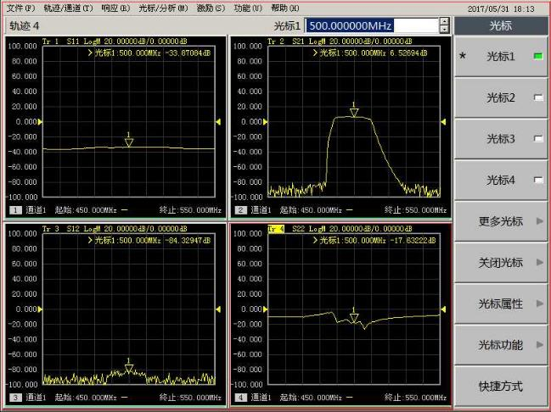
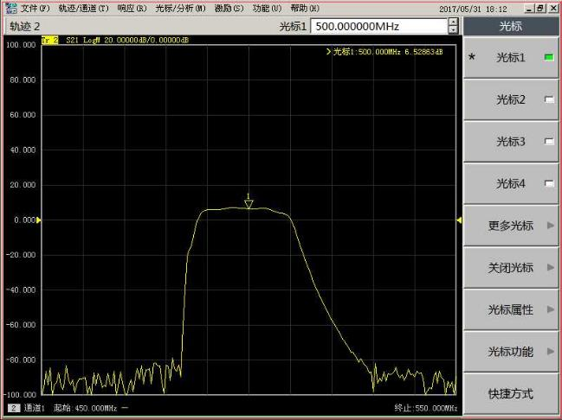
S-Parameter Characterization
S11
S21
S21
S12
S22
Receiver S-Parameter Characterization
S21-Parameter Characterization
The performance of band pass filter is good!

Slide 9
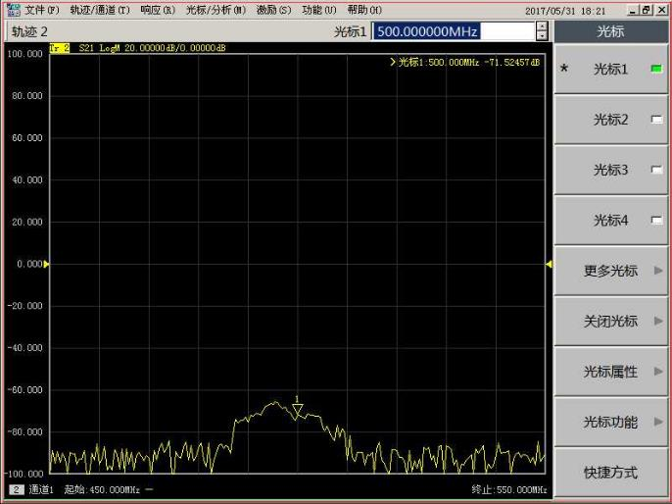
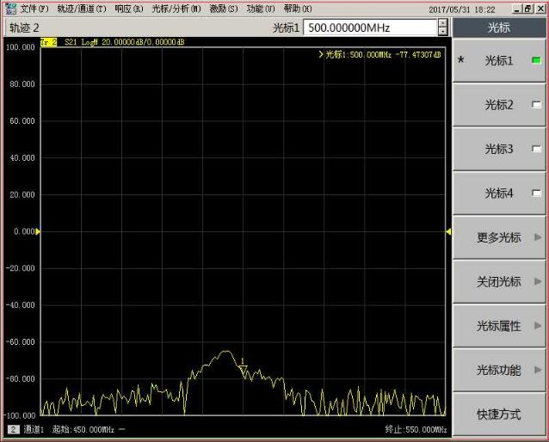
Channel to Channel Isolation
--78.824dBm
--77.473dBm
-60dBm
-60dBm
A→B
B→A
6.5dBm→-78.8dBm
6.5dBm→-77.47dBm

Slide 10
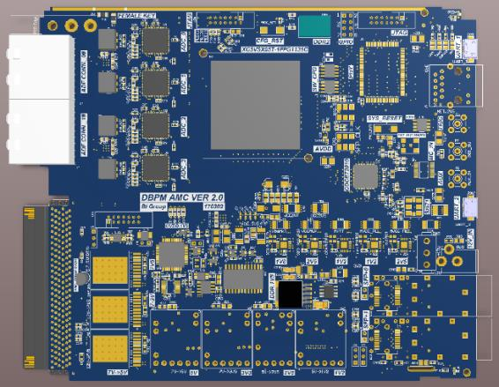
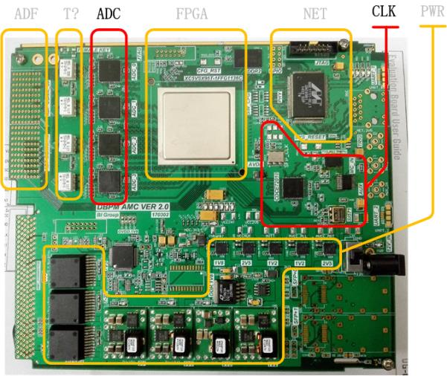
AMC Function module
Power Logic
Clock Logic
FPGA Logic
ADC Logic
NET Logic
Other Logic…

Slide 11
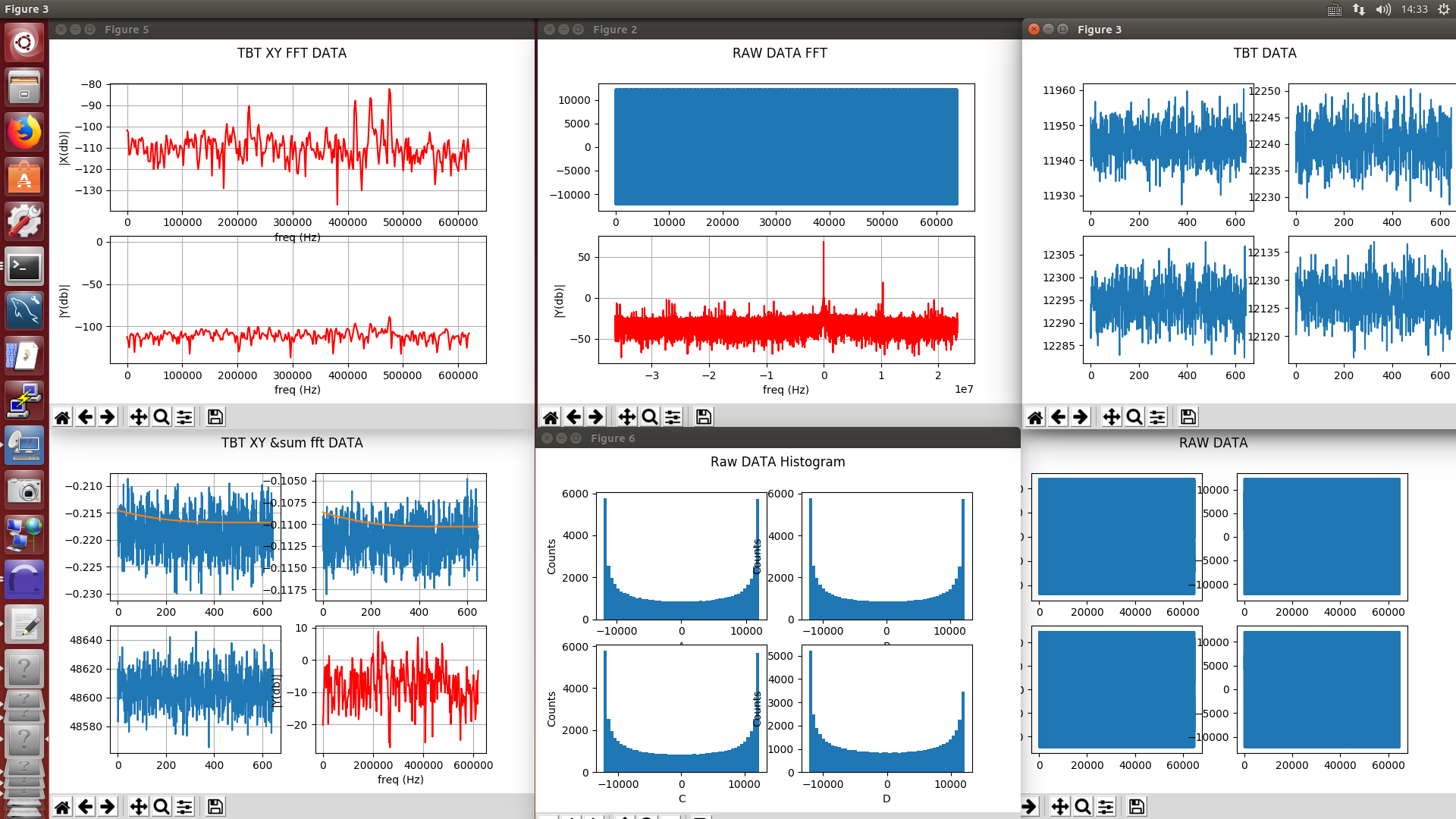
RAW ADC data and Analysis
RAW ADC data and analysis

Slide 12
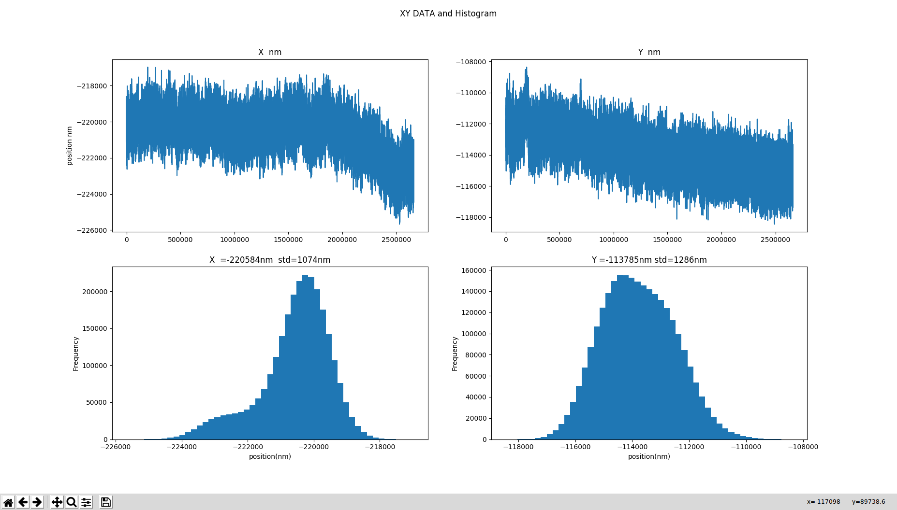
SA Data testing
RAW ADC data and analysis

Slide 13
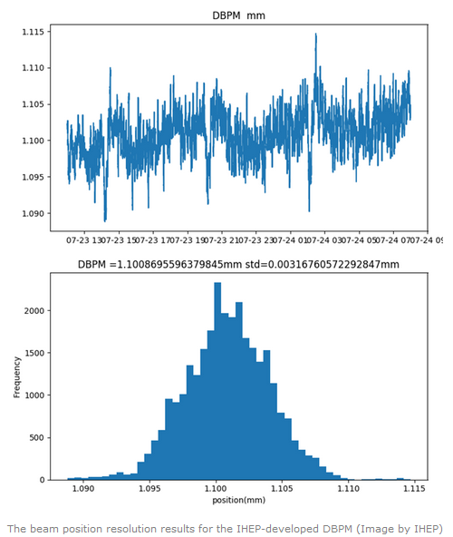
Beam test in BEPCII

Slide 14
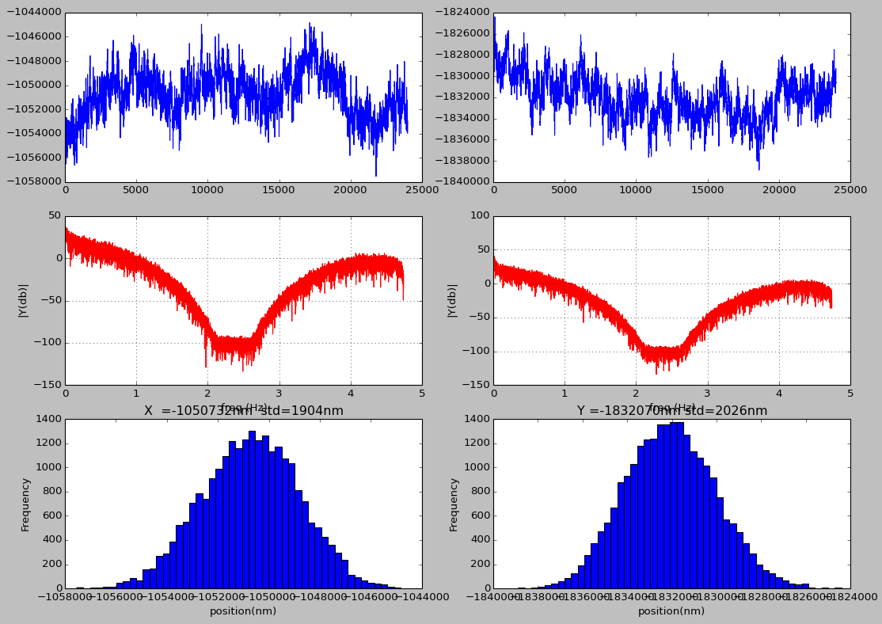
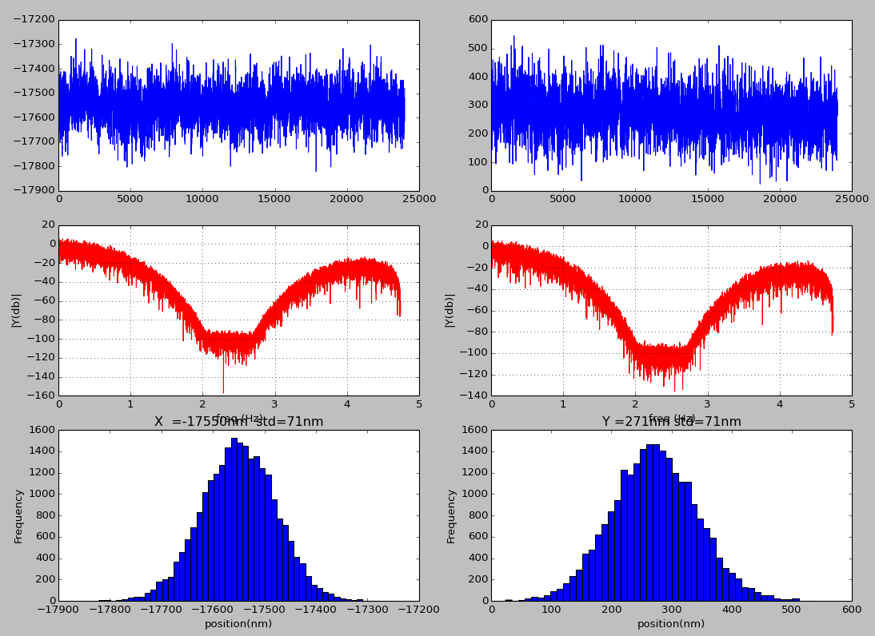
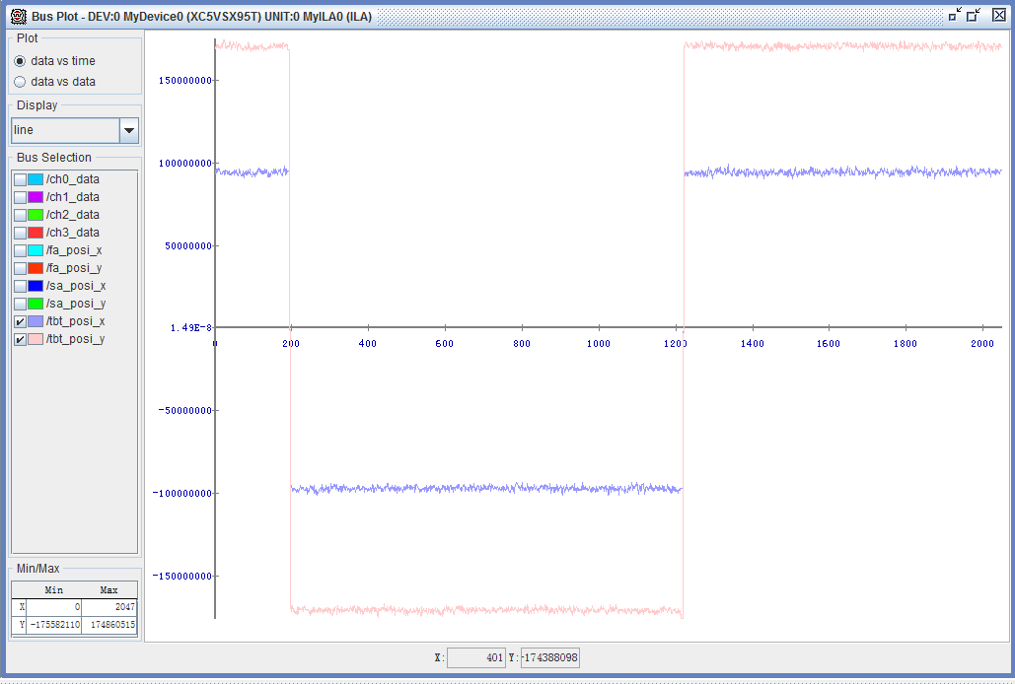
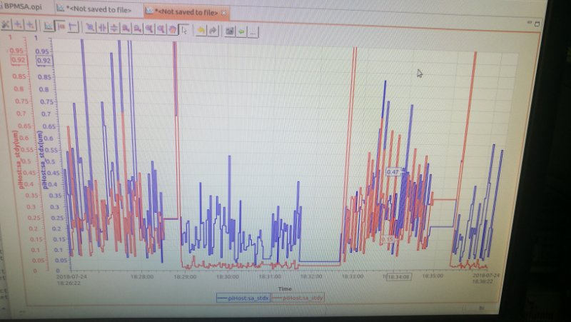
Temperature influence
Thermostatic control Cabinet
Cross-bar
Pilot-Tone
Turn ON Status

Slide 15
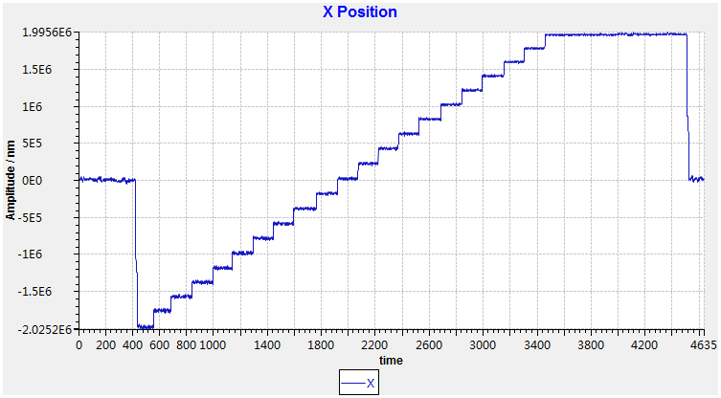
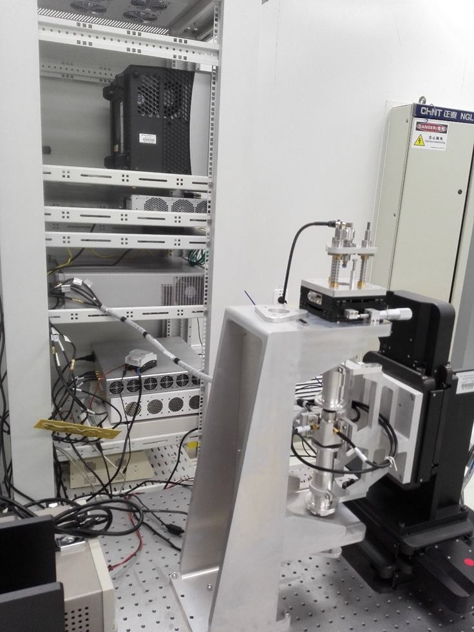
Calibration Bench Test with DBPM
  Input signal: -6dBm
  RAW ADC counts：3k+
  Kx,Ky=5.5
  Step:200µm

Slide 16
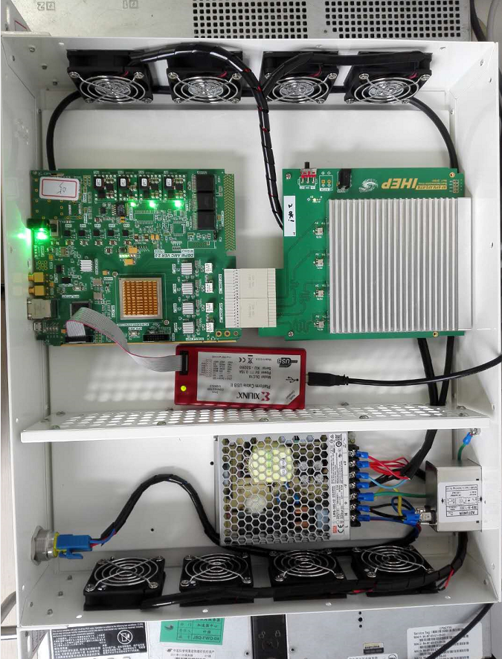
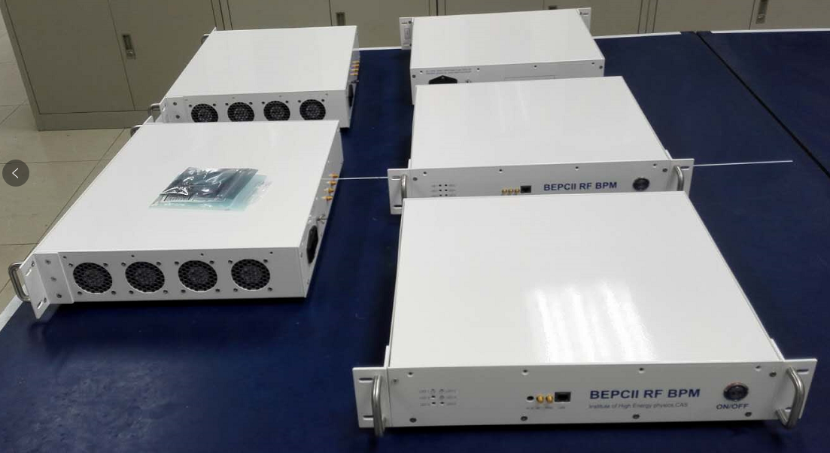
Small-Lot Production of DBPM

Slide 17
Summary
Digital BPM Electronics hardware has been designed carefully and had been tested in laboratory;
The digital BPM electronics have been tested with the calibration bench and the real beam on BEPCII.
There are still a lot of work to do towards the detail design of BPM.

Slide 18
Thanks for your attention!

