Slide 1
The MTCA/ATCA Workshop for Research and Industry Summary Xinpeng Ma

Slide 3
Attendee Statistics:
99 people attend the workshop, 19 foreigner guests and 80 domestic attendee;
Institutions include: IHEP/CSNS, SARI, IMP, NSRL, PKU, CIAE, ASIPP, DICP, and DESY, PSI, ESS, KEK, U.Mainz, ……
Industries:30 attendees

Slide 4
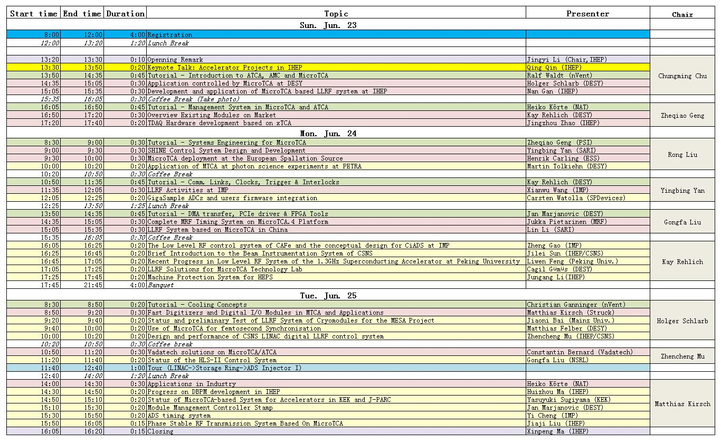
Topics Summary:

Slide 5
Topics Statistics :
35 talks, including 6 tutorials, ;
Topics includes applications and/or requirements:
HEP detectors DAQ, Photon Science, LLRF(Linac/SR/SC/NC), BI(BPM, BLM), Control system: MPS, Timing, FemtoSync/transmission.
Overview solutions: platform, management, digitizers,

Slide 6
other vendors and representatives: Vadatech, CAENels，Fountainsys, Queentest，DAQ-tech
Thanks to the sponsors / exhibitors:

Slide 7
Many thanks to …
All the speakers,
Program committee,
Local committee support team,

Slide 8
You found answers for your questions? You learnt more about MTCA/ATCA? More choices for your future decisions?

Slide 9
Thank you very much! Enjoy your stay in IHEP and Beijing!

