Slide 1
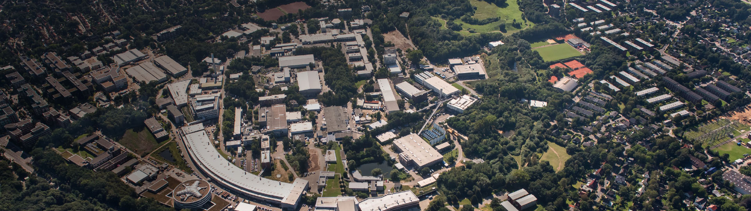
Application controlled by MicroTCA at DESY
Holger Schlarb, Group Leader MSK/DESY
IHEP, Beijing, 23. June 2019

Slide 2
DESY on a glance

Slide 3
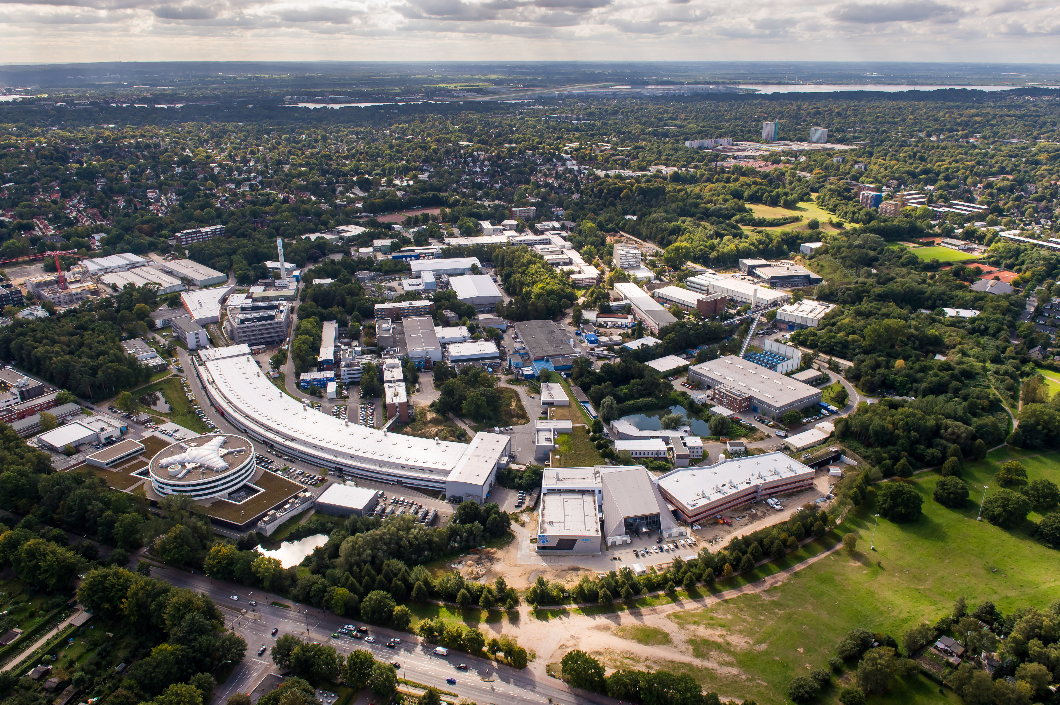












DESY activities : birds view …
+
X-Ray Free-Electron Laser
atomic structure & fs dynamics
of complex matter
PETRA
ext. East
REGAE
DESY II
PIA
SINBAD
CMTB
LINAC II
NanoLab
AMTF
MPI-SD
PETRA III
PETRA ext. Nord
FLASH
Synchrotron radiation source (highest brilliance)
VUV & soft-x-ray free-electron laser

Slide 4
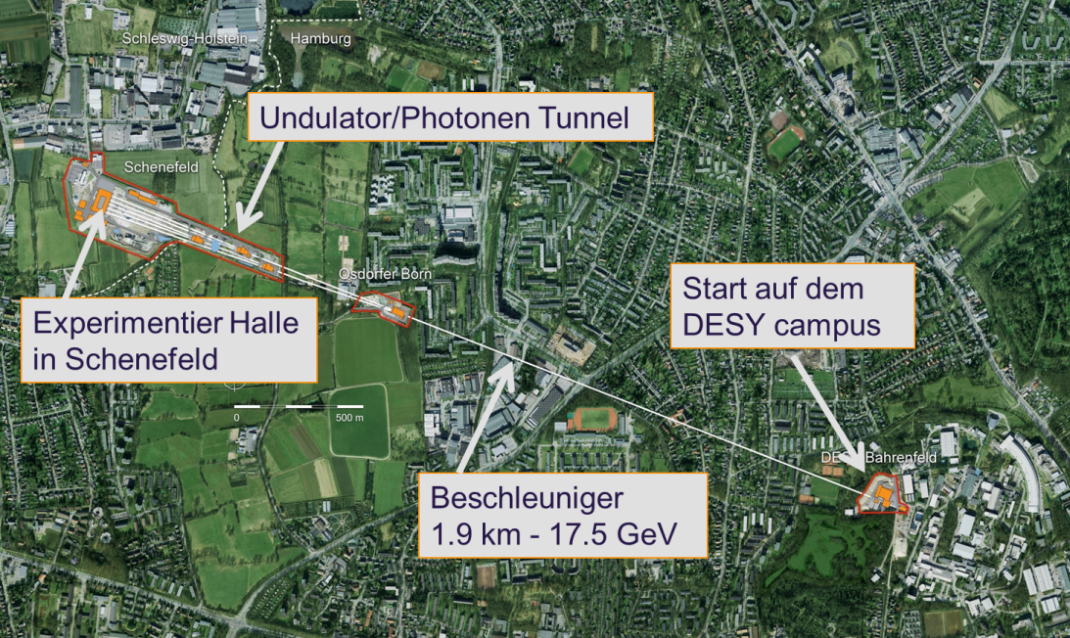
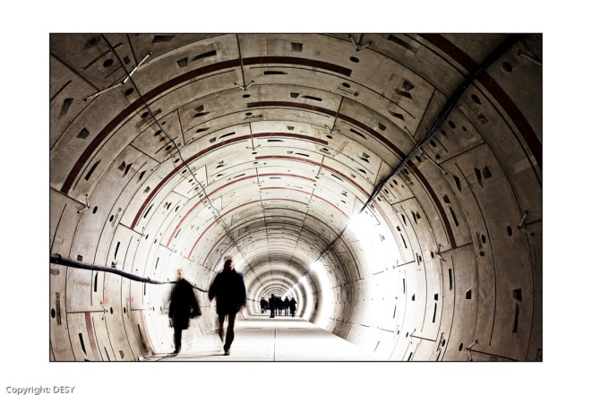

European EuXFEL
North of Germany: between Hamburg Bahrenfeld and Schenefeld
Super conducting accelerator with up to 17.5 GeV electron beam energy.
Three undulator beamlines in two branches (north and south).
In total 6 experiments, 4 for hard X-rays and 2 for soft X-rays.
Undulators/Photon beamlines
Electron beam
distribution
Start on the DESY campus
Experimental hall in Schenefeld
Accelerator
1.9 km/ 17.5 GeV
Notes:
Before you start editing the slides of your talk change to the Master Slide view:
Menu button “View”, Master, Slide Master:
Edit the following 2 items in the 1st slide:
1) 1st row in the violet header:
Delete the existent text and write the title of your talk into this text field
2) The 2 rows in the footer area: Delete the text and write the information
regarding your talk (same as on the Title Slide) into this text field.
If you want to use more partner logos position them left
beside the DESY logo in the footer area
Close Master View

Slide 5
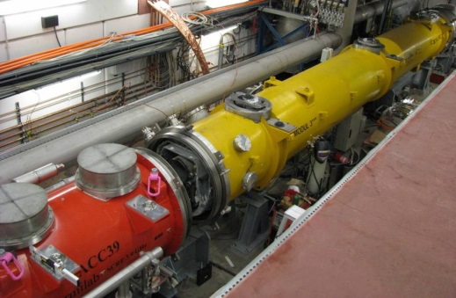
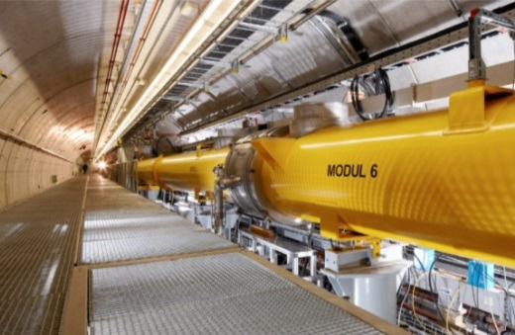
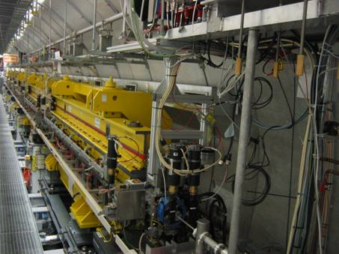
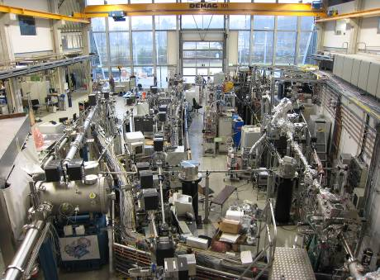
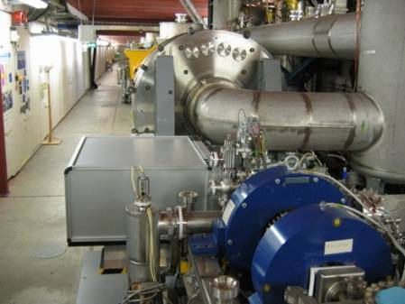
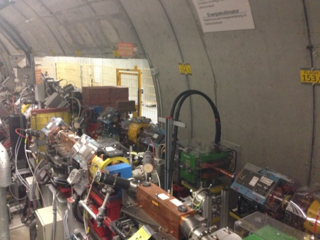
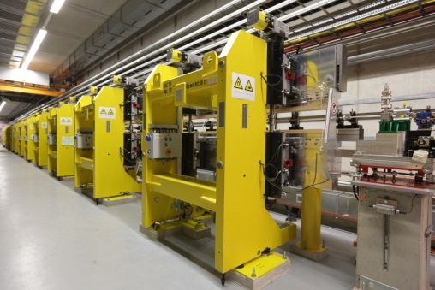
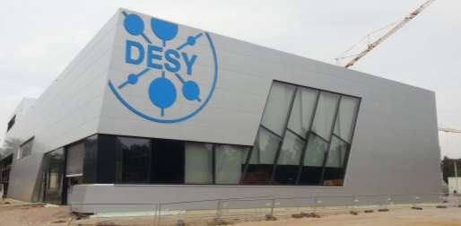
FLASH = Free electron LASer at Hamurg
FLASH.
Free-Electron Laser
in Hamburg
3rd harmonic sc module 3.9 GHz
TESLA type superconducting accelerating modules 1.3 GHz
FLASH1 fixed gap undulators
FLASH1 Experimental Hall
Albert Einstein
315 m
Soft X-ray Undulators
RF Stations
Accelerating Structures
sFLASH
Photon Diagnostics
FLASH1
THz
RF Gun
Bunch Compressors
FLASH2
Lasers
5 MeV
150 MeV
450 MeV
1250 MeV
Beam Dump
FEL Experiments
Kai Siegbahn
Normal conducting 1.3 GHz RF gun
Ce₂Te cathode
Two Nd:YLF based ps photocathode lasers
Extraction to FLASH2
FLASH2 variable gap undulators
FLASH2 Experimental Hall
| Application controlled by MicroTCA at DESY | Holger Schlarb | MTCA/ATCA Workshop for Research and Industry | IHEP 23.06.2019

Slide 6
Motivation
&
History

Slide 7
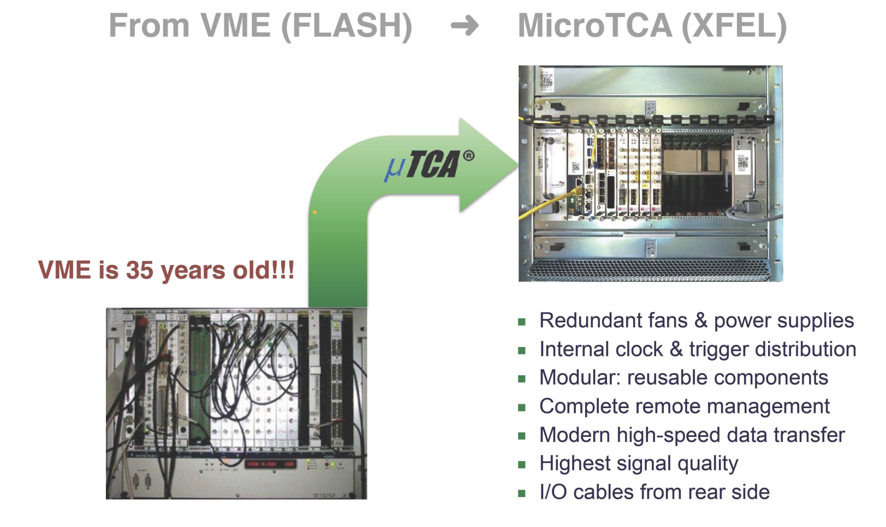
Main motivation …
7
Performance
+
Functions
+
Availability
+ MOSA = Modular Open System Approach
→ no vendor lock-in situation!!!! Any company can step in!
reduce development expense, design cycle time, and manufacturing costs
Access to hardware/software/firmware (to provide functionalities we need)
Notes:
Before you start editing the slides of your talk change to the Master Slide view:
Menu button “View”, Master, Slide Master:
Edit the following 2 items in the 1st slide:
1) 1st row in the violet header:
Delete the existent text and write the title of your talk into this text field
2) The 2 rows in the footer area: Delete the text and write the information
regarding your talk (same as on the Title Slide) into this text field.
If you want to use more partner logos position them left
beside the DESY logo in the footer area
Close Master View

Slide 8
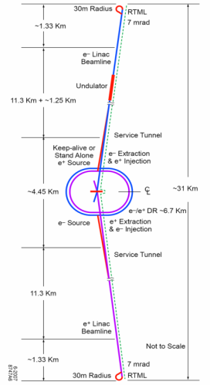


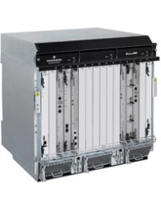
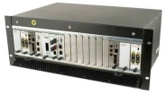


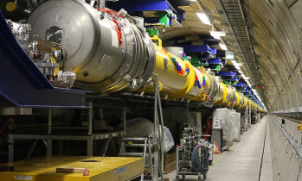
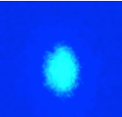
History of MicroTCA@DESY
8
ILC
Nov. 2005: Reliability Workshop in Grömitz, Germany
  Joint meeting with ILC (intern. linear collider, 33km, 500GeV)
Dec. 2007: European XFEL Crate-Standard Workshop
  MicroTCA and ATCA was defined to be used
Mar. 2009: First PICMG Meeting “xTCA for Physics”
  Hardware group: rear I/O and timing
  Software group: standardization of interfaces for FPGAs…OPsys
Oct. 2011: Official announcement of PICMG Specification
  “MTCA.4 Enhancements for Rear I/O and Precision Timing“
Jul. 2012: Start of Helmholtz Validation Funds till Dec. 2014
  „MicroTCA.4 for Industry“
Jan. 2014: Reestablish HW/SW PICMG working groups
  „MicroTCA.4.1 release: 01.Nov 2016“
Oct. 2016: Start of MicroTCA TechLab
Jan. 2017: Commissioning European XFEL …
31km
Notes:
Before you start editing the slides of your talk change to the Master Slide view:
Menu button “View”, Master, Slide Master:
Edit the following 2 items in the 1st slide:
1) 1st row in the violet header:
Delete the existent text and write the title of your talk into this text field
2) The 2 rows in the footer area: Delete the text and write the information
regarding your talk (same as on the Title Slide) into this text field.
If you want to use more partner logos position them left
beside the DESY logo in the footer area
Close Master View

Slide 9
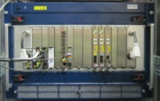
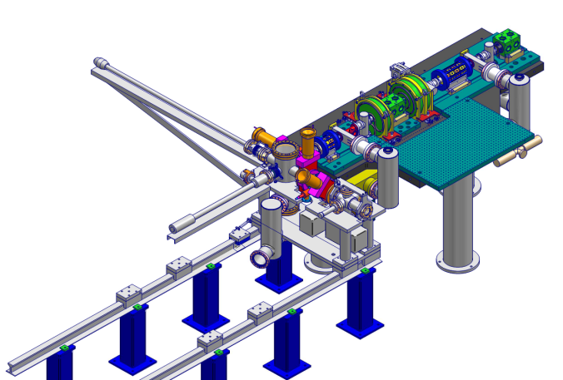
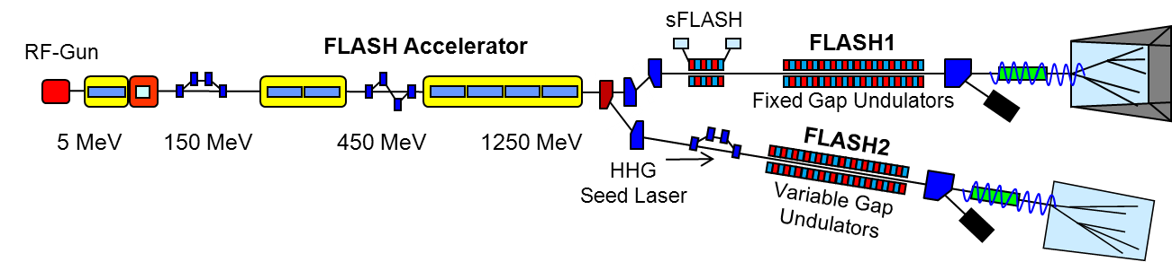


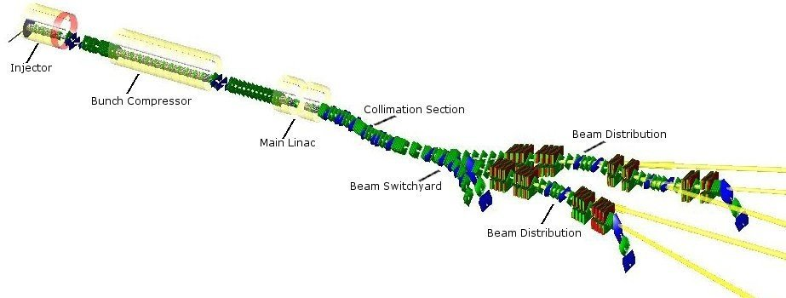
Start: small … medium … large scale …
History of MicroTCA at DESY
Equipping of facilities …
2013 FLASH II ~ 20 crates
2018 Refurbish ~ 50 crates
RF controls
2012 REGAE ~ 1 crate
2015/16 European XFEL ~ 250 crates
2024 PETRAIV …
Notes:
Before you start editing the slides of your talk change to the Master Slide view:
Menu button “View”, Master, Slide Master:
Edit the following 2 items in the 1st slide:
1) 1st row in the violet header:
Delete the existent text and write the title of your talk into this text field
2) The 2 rows in the footer area: Delete the text and write the information
regarding your talk (same as on the Title Slide) into this text field.
If you want to use more partner logos position them left
beside the DESY logo in the footer area
Close Master View

Slide 10
MicroTCA@Accelerators

Slide 11
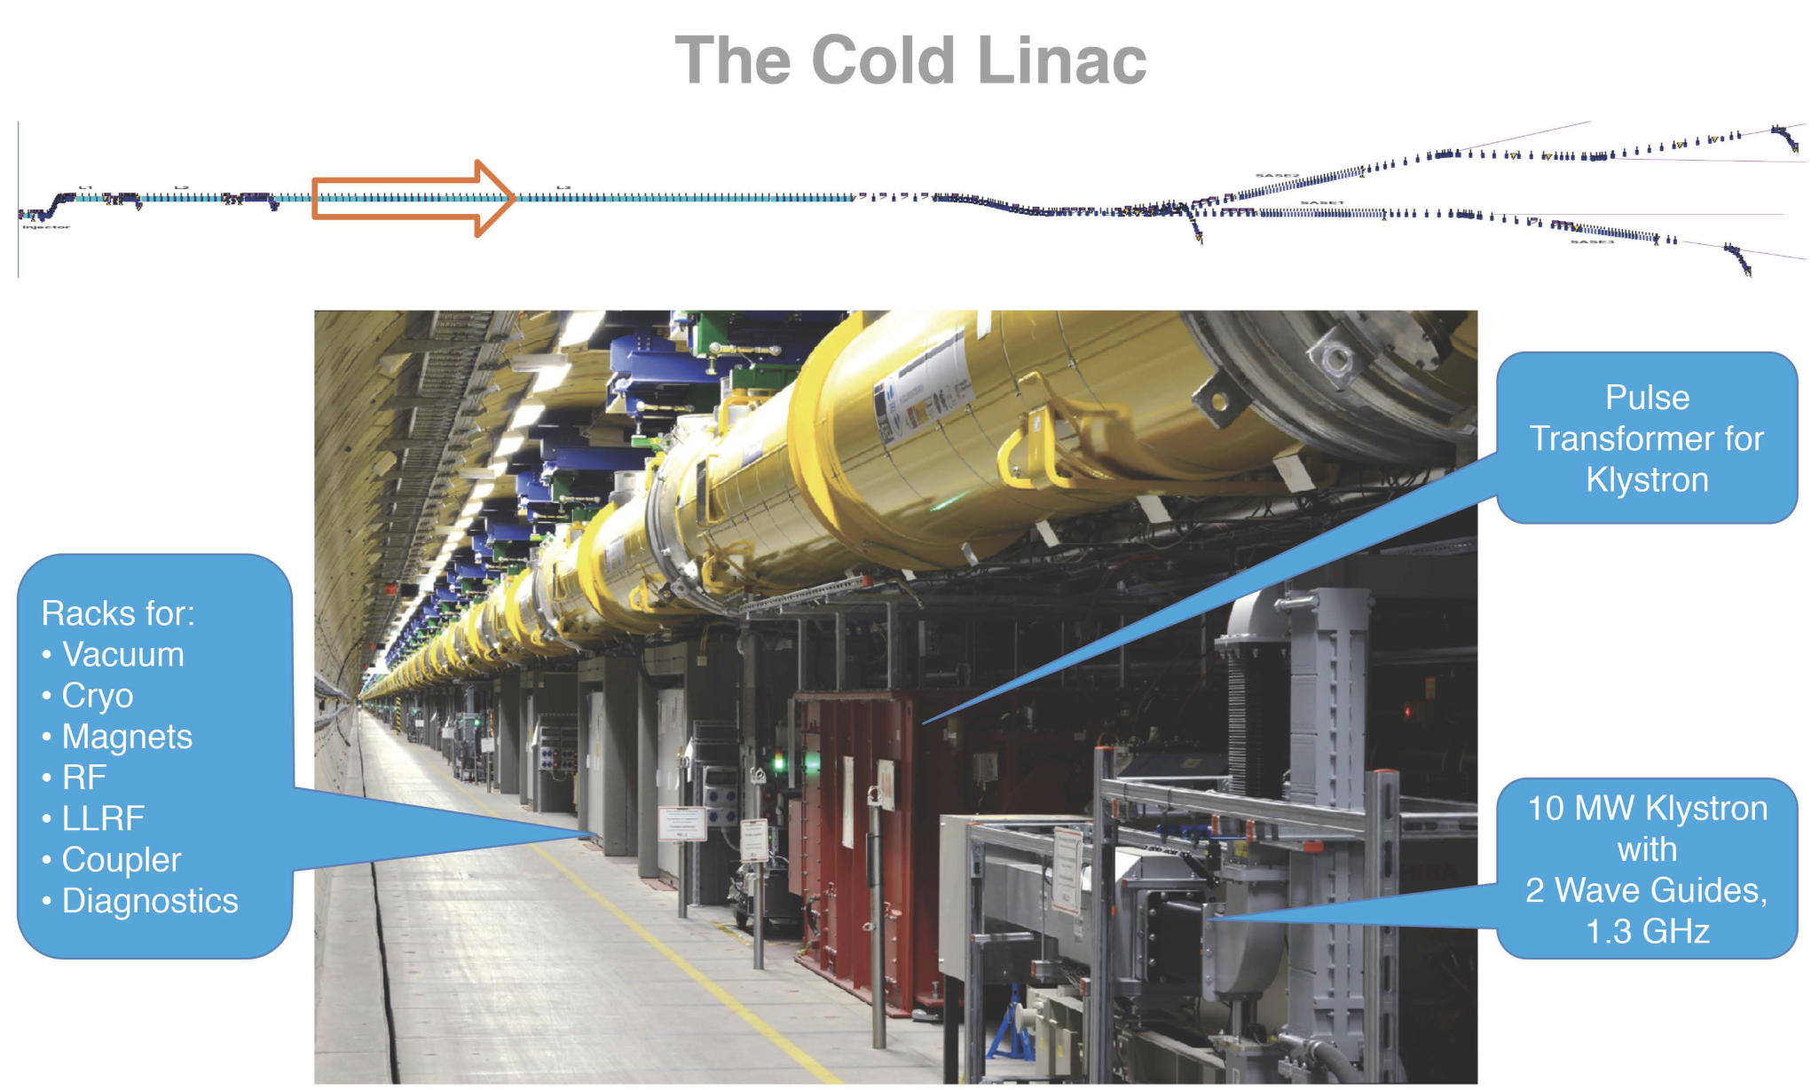
European XFEL Linac
Systems using MicroTCA in EuXFEL Accelerator Tunnel
| Application controlled by MicroTCA at DESY | Holger Schlarb | MTCA/ATCA Workshop for Research and Industry | IHEP 23.06.2019

Slide 12
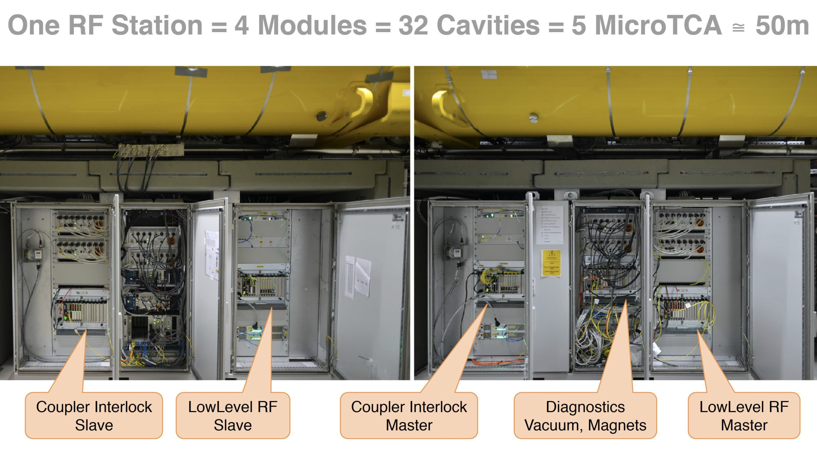
European XFEL Linac
Systems using MicroTCA in EuXFEL Accelerator Tunnel
| Application controlled by MicroTCA at DESY | Holger Schlarb | MTCA/ATCA Workshop for Research and Industry | IHEP 23.06.2019

Slide 13
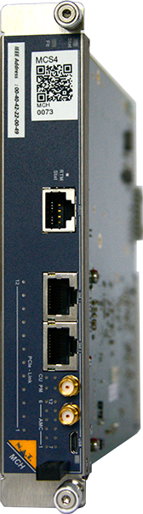
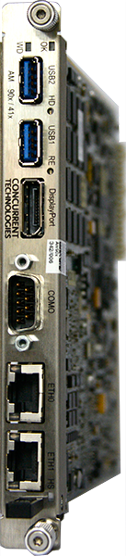
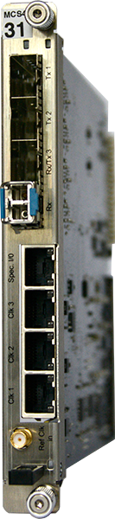
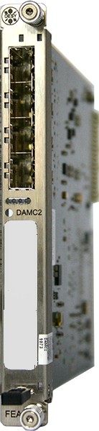
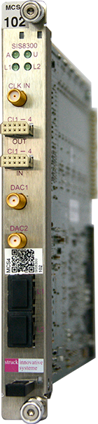


Standard set of MicroTCA modules …
Standard set of MicroTCA modules used in the European XFEL accelerator control system
Common Modules
Application Modules
Machine
Protection
System
ADC
Digital I/O
Controller
Electron Beam Diagnostics
Laser Controls
Kicker Controls
Special Diagnostics
  Arrival time monitors
  Kalypso
  CRISP
LLRF
RF Coupler Interlocks
Magnet and Vacuum Controls
Photon Beam Diagnostics
  Gas Monitor Detector
  Imagers
  …
MCH
CPU
Timing
From central timing
Ethernet
Clock
Clock
Clock
MTCA.4 Backplane
Trigger
Trigger
Interlock
Interlock
Courtesy K. Rehlich
| Application controlled by MicroTCA at DESY | Holger Schlarb | MTCA/ATCA Workshop for Research and Industry | IHEP 23.06.2019

Slide 14
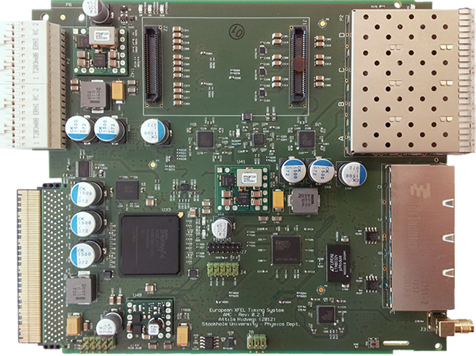
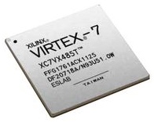
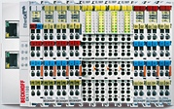
Timing & Clock systems
Timing System @ EuXFEL
Star topology with master timing system synchronized to 1.3 GHz reference from master oscillator
Timing Master distributes encoded data with events for trigger, bunch pattern table, clocks to all receivers across the accelerator subsystems as well as shot or train ID for tagging data
Master
Clock
Master Transmitter
Up to 4km optical link
1.3 GHz
Trigger #
1
Drift Compen-sation
Receiver
Trigger out
delay
1
Data Word
delay
Data Word
Data
Data Word
Timestamp
Data
Macropulse ID
Clock
÷
Clock out
Bunch Pattern Table:
Number of bunches
with source and
destination
Bunch Pattern
delay
&
Qualified
Trigger out
Local Trigger Mask
Machine Protection
Limitation of bunches
Courtesy K. Rehlich
| Application controlled by MicroTCA at DESY | Holger Schlarb | MTCA/ATCA Workshop for Research and Industry | IHEP 23.06.2019

Slide 15

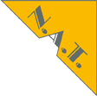
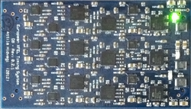
Timing & Clock systems
Tutorial on MicroTCA.4
Timing System
Kay Rehlich
Timing System Workhorse – NAMC-psTimer AMC
Transmitter
Daughter Board
length compensated
10 ps jitter
Three optional RTM variants:
9 lemo outputs, SFP outputs, optical outputs with more trigger or clock signals
Fiber Optics
SFP
IN OUT OUT OUT
4 x General I/O
RJ45
LVDS
2 x Trigger out
1 x Clock out
MicroTCA backplane
Clocks: TCLKA and TCLKB,
Trigger: 8 x M-LVDS
2 x Trigger out
1 x Clock out
NAMC-psTimer AMC
2 x Trigger out
1 x Clock out
Courtesy K. Rehlich
| Application controlled by MicroTCA at DESY | Holger Schlarb | MTCA/ATCA Workshop for Research and Industry | IHEP 23.06.2019

Slide 16
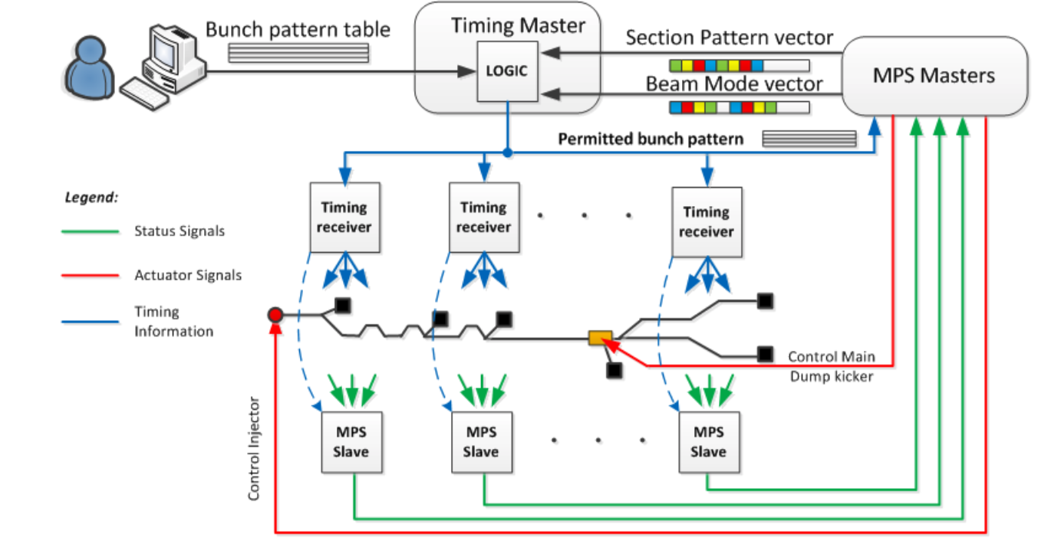
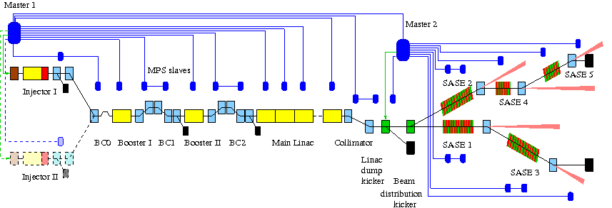
Machine Protection System (MPS)
Machine protect to prevent acc. & photon sub-system damages
Timing Master
Laser Pulse Controller
MPS Master
Tight connection timing & MPS
160 collectors boards
~ 4000 different signals (magnets/BLMs/toroids/vacuum/ diagnostic/couplers/waveguides/..)
Beam destination & Beam Modes
→ up 500kW electron beam power
→ damages within ~ few us possible
3.5 km
Courtesy: J. Jäger et. al
| Application controlled by MicroTCA at DESY | Holger Schlarb | MTCA/ATCA Workshop for Research and Industry | IHEP 23.06.2019

Slide 17
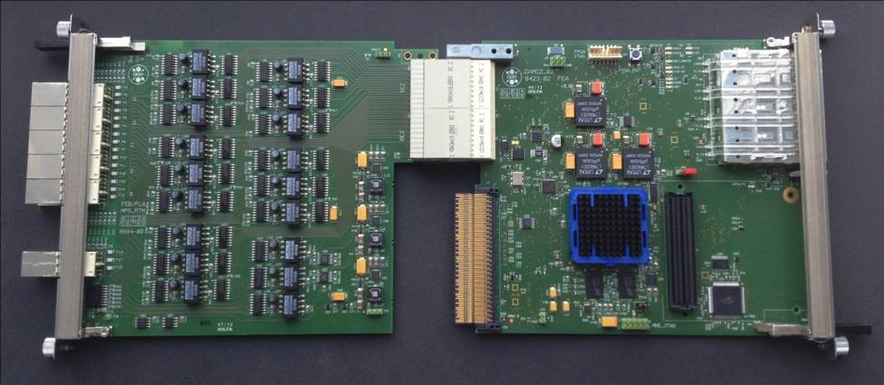
Machine Protection System (MPS)
MPS Hardware
DRTM-MPS
DAMC2
45 digital inputs (RS422)
7 digital outputs (RS422)
3 input lines from backplane
2 output lines to backplane
3 digital inputs from FMC-card
I²C-bus to FMC-card
PCIe-bus to all FPGA-registers
4 double-fibred bi-directional optical links (SFPs)
IPMI and JTAG for firmware updates
SFPs
RS422
in
RS422
out
PCIe
BP
FMC
Safety & availability & timeliness
  all machine safety-relevant functions are realized within FPGA logic (~100 ns latency)
  to be independent from the availability of network, operating system, DOOCS-servers, PCIe-device drivers …
Maintainability & scalability
  MPS architecture can be extended by utilizing the cascaded communication topology
  same firmware on every board, same DOOCS-server on every crate
  all alarm-responses can be configured through DOOCS/JDDD even during machine run
  boards and RTMs are hot-swappable
Courtesy: J. Jäger et. al
| Application controlled by MicroTCA at DESY | Holger Schlarb | MTCA/ATCA Workshop for Research and Industry | IHEP 23.06.2019

Slide 18
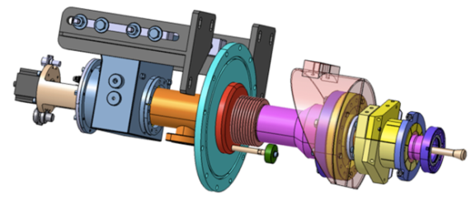
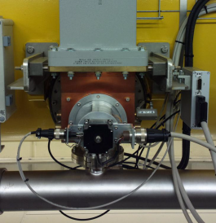
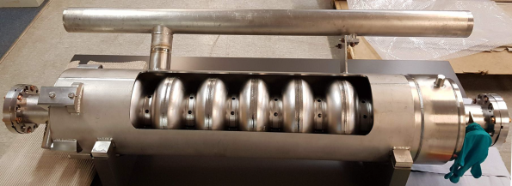
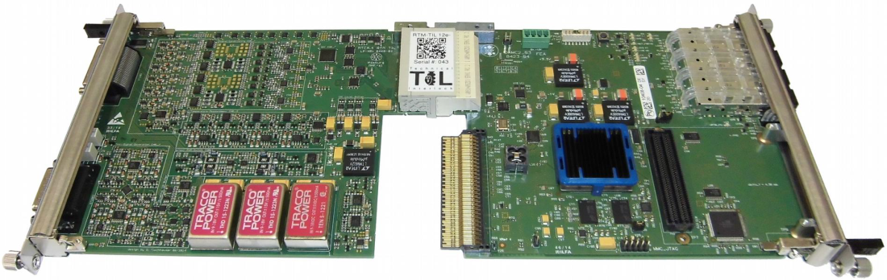
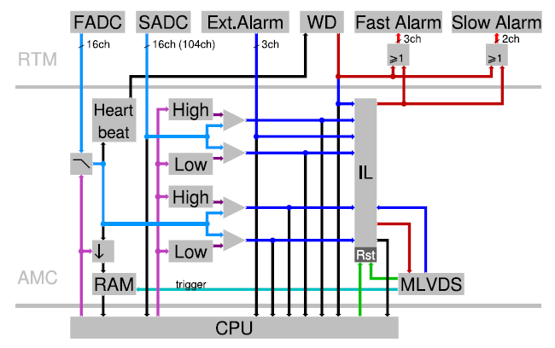
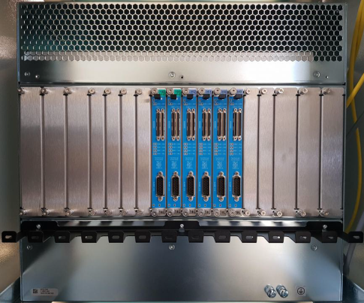
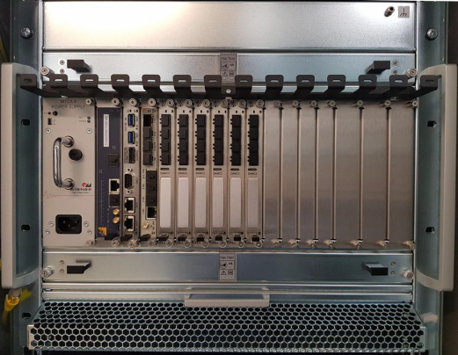
Technical InterLock (TIL) for Power coupler & Cavity
Superconducting cavity & coupler protection system EuXFEL/FLASH
Courtesy: D. Tischhauser
see MTCAWS2018
Sensors per coupler / cavity (Σ = 32 x 6 = 192 inputs)
  3x e- antenna (free electrons)
  1x spark (light)
  2x temperature
Sensors per RF-Station (32 cavities)
  6x vacuum
  2x cryogenic (He level, He presure)
DRTM-TIL
DAMC02
MPS/Kly/LLRF
| Application controlled by MicroTCA at DESY | Holger Schlarb | MTCA/ATCA Workshop for Research and Industry | IHEP 23.06.2019

Slide 19
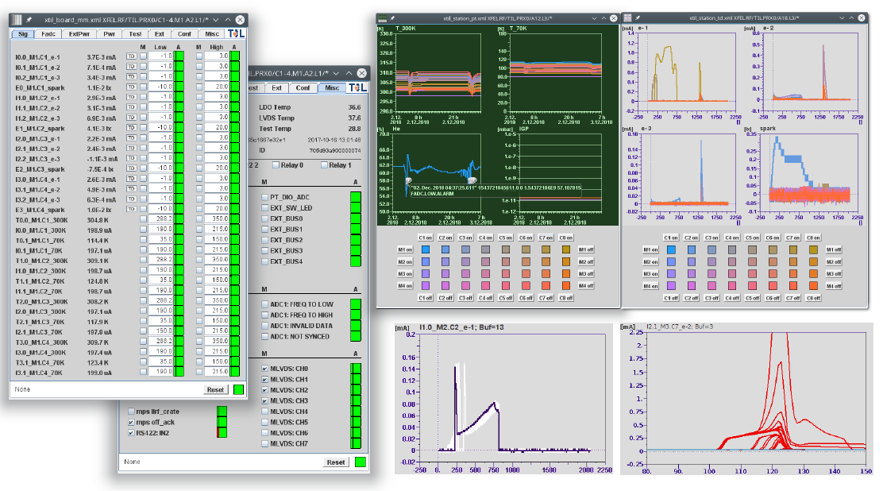
Technical InterLock (TIL) for Power coupler & Cavity
Courtesy: D. Tischhauser
Ref: MTCAWS2018
Superconducting cavity & coupler protection system EuXFEL/FLASH
| Application controlled by MicroTCA at DESY | Holger Schlarb | MTCA/ATCA Workshop for Research and Industry | IHEP 23.06.2019

Slide 20
Low Level RF System
System overview
HF-Oscillator
RTM
HPA
HF
Vector
Modulator
Waveguide
for
ref
Cavities
X 8
FB Feedback
loop
uLOG
DAC
DAC
RTM
probe
HF
Clocks
FPGA
FPGA
ADC
ADC
ZF
LO
ADC
Controller (TCK7)
DAQ (SIS8300L)
Field detectors (uDWC)
Local RF (uLOG)
AMC
AMC
RTM
eRTM
| Application controlled by MicroTCA at DESY | Holger Schlarb | MTCA/ATCA Workshop for Research and Industry | IHEP 23.06.2019

Slide 21
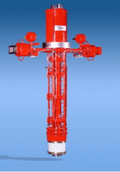
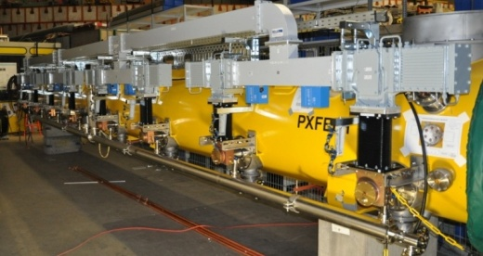
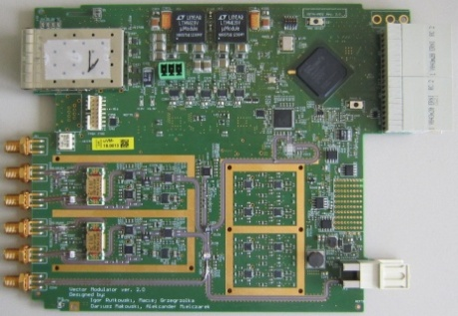
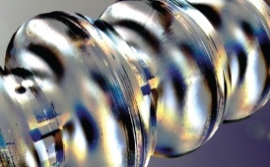
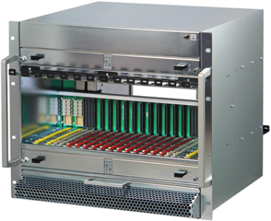





Low Level RF System
System overview
HF-Oscillator
RTM
Klystron
HF
Vector
Modulator
Waveguide
for
ref
Cavities
X 16
FB Feedback
loop
uLOG
DAC
DAC
RTM
probe
HF
Clocks
FPGA
FPGA
ADC
ADC
ZF
LO
ADC
Controller (TCK7)
DAQ (SIS8300L)
Field detectors (uDWC)
Local RF (uLOG)
AMC
AMC
RTM
eRTM
| Application controlled by MicroTCA at DESY | Holger Schlarb | MTCA/ATCA Workshop for Research and Industry | IHEP 23.06.2019

Slide 22





EuXFEL RF station
CM1 (8 cav.)
CM2 (8 cav.)
CM3 (8 cav.)
CM4 (8cav.)
KLYSTRON
LLRF master
LLRF slave
Drift compensation
Reference synchr. + distr.
Clocks + local oscillator
Main controller crate (MicroTCA)
Piezo*
Power supplies
* not installed yet
More than 3000 RF channels
Requirements: <0.01deg and <0.01%
| Application controlled by MicroTCA at DESY | Holger Schlarb | MTCA/ATCA Workshop for Research and Industry | IHEP 23.06.2019

Slide 23


LLRF for EuXFEL: crate occupation
Front
Rear
| Application controlled by MicroTCA at DESY | Holger Schlarb | MTCA/ATCA Workshop for Research and Industry | IHEP 23.06.2019

Slide 24







Diagnostics: Beam position monitor
110 BPMs installed at FLASH
AMC: SIS8300L Digitizer
RTM: RF front-end
Double Peak detector electronics
4 input channels
Test pulse generator
Test output connectors
Vrf_pk_min = 5mV
B_{3dB} ~ 600MHz (~-6dB@ 1GHz)
N.F.=3.3dB(maximum gain)
RF-Gain ~40dB
1um
50pC
Delay-Line:1/2”, ~26m, ~100ns
RF front-end
Ref: B Lorbeer et al 2018 J. Phys.: Conf. Ser.1067 072011
| Application controlled by MicroTCA at DESY | Holger Schlarb | MTCA/ATCA Workshop for Research and Industry | IHEP 23.06.2019

Slide 25




Diagnostics: Toroid readout system
Used charge measurement & beam transmission based Interlock
Charge measurement with ~0.2pC resolution RMS
36 Toroids along EuXFEL
Integrated test pulser functionality
Machine Protection:
  Fast Protection: transmission of adjacent Toroids
  Slow Protection: consecutive alarms block further bunchtrains
Self Trigger: beam detection on pC level
RTM Toroids
SIS8300L2
First beam in XTL
1 pC
Ref: M. Werner MTCAWS2016
| Application controlled by MicroTCA at DESY | Holger Schlarb | MTCA/ATCA Workshop for Research and Industry | IHEP 23.06.2019

Slide 26




Beam Loss Monitors
474 BLMs along the EuXFEL for protection
Plastic scintillators and quartz rods (Cherenkov radiation)
DAMC02 + RTM-BLM
  Analog alarm path, independent from digital electronics and timing
Machine Protection:
  Fast Protection: single, multibunch and integral alarms cutting within current bunchtrain
  Slow Protection: consecutive alarms block further bunchtrains until user acknowledgement
  Integrated tests: LED and software alarm
Courtesy: T. Wamsat IBIC2018, WEOB03
| Application controlled by MicroTCA at DESY | Holger Schlarb | MTCA/ATCA Workshop for Research and Industry | IHEP 23.06.2019

Slide 27







Special Diagnostics: THz spectrometer
Special Diagnostics – CRISP THz Spectroscopy with MHz readout
Diffraction
Radiation
Detector Board
RTM: TAMC532-TM AMC TEWS TAMC532
32 ch.
shaper
+
14bit
50 MSPS
ADC
absorber
Electron bunch length characterization
4 pyroelectric detector board with 30 channels
Parallel readout of all 120 channels by 4 TAMC532 each with 32 ADCS and TAMC532-TM shaper RTM
Channel 1
...
Channel 120
Courtesy C. Gerth/B. Schmidt/ N. Lockmann
| Application controlled by MicroTCA at DESY | Holger Schlarb | MTCA/ATCA Workshop for Research and Industry | IHEP 23.06.2019

Slide 28











Special Diagnostics: EO Sampling/ XUV Spectrometer / …
Soft X-ray Spectrometer
Special Diagnostics – KALYPSO Line Detector with MHz readout
0th order
to experiment
KALYPSO detector
KALYPSO
mezzanine card
MTCA.4 Crate
AIES MFMC (Artix 7)
CAENels SFP2+ 2-ch. Transceiver (FMC20)
60nm
6nm
Courtesy C. Gerth
Multimode Fibre
(< 500 m, 6.4GB/s)
1st order
CeYAG scintillator screen converts X-ray laser pulses to visible pulses
KALYPSO ASIC / 1-D array
variable line spacing
grating (VLS)
X2Timer
12V DC
FEL beam
G. Brenner et al.,
Nucl. Instr. and Meth A 635, 99–103 (2011).
Start up of FEL tuning:
Instabilities at the end of pulse train
After machine tuning:
FEL spectra more uniform over pulse train
A. Mielczarek et al., IEEE Transactions on Nuclear Science, in print, 2018.
KALYPSO mezzanine card + FPGA Carrier
Parameters for current version 2.1
  256 pixels, 50 µm pitch
  14 bit ADC, 2.7 Mfps
Synchronisation to clock of timing system
Continuous, low-latency data stream out
| Application controlled by MicroTCA at DESY | Holger Schlarb | MTCA/ATCA Workshop for Research and Industry | IHEP 23.06.2019

Slide 29



Femtosecond synchronization system
Talk on femtosecond Synchr. System
M. Felber
Laser oscillator Locking & Optical fiber links stabilization
Photodiode based lock (~ 30 laser osc. at DESY)
Optical synchr. fiber stabilisation ~ 40
Realized by modified LLRF boards
Balanced
photodetector
DRTM-DWC10
Struck SIS8300L2
Detection
Feedback/
Actuators
Readout/ controls
e.g. XFEL Injector Laser …
| Application controlled by MicroTCA at DESY | Holger Schlarb | MTCA/ATCA Workshop for Research and Industry | IHEP 23.06.2019

Slide 30


Misc. MicroTCA Application
“Slow” MTCA.4 Applications
Magnet Controls connected to P/S controls via CANbus
Vacuum Controls connected via CANbus to vacuum electronics
Large, distributed Dosimetry System
  Using FMC on MPS DAMC2 w/ external DOSIMON Boxes connected via ring line (RS488 telegrams)
Vacuum And Magnet Controls
RADMON
ESD 4-Fold CANbus AMC
| Application controlled by MicroTCA at DESY | Holger Schlarb | MTCA/ATCA Workshop for Research and Industry | IHEP 23.06.2019

Slide 31




XFEL Accelerator Controls
MicroTCA.4-based components used as standard hardware platform (LLRF, Diagnostics, Vacuum, HPRF, Magnets, Timing, ….)
About 250 crates installed, serving more than 10.000.000 control parameters, 700000 DAQ channels & 30 TB/day
Operational from day 1 of deployment
Key benefits:
  Fully automated and standardized installation procedure allows rapid deployment and recovery
  Enhanced remote management via IPMI and Ethernet allow for simplified maintenance
  Extended monitoring and management of module ensure reliable crate operation
  No major hick-ups during commissioning and operation
  Significant benefits due to remote controls of MicroTCA components
| Application controlled by MicroTCA at DESY | Holger Schlarb | MTCA/ATCA Workshop for Research and Industry | IHEP 23.06.2019

Slide 32
Photon Science
Diagnostics & Experiments

Slide 33






Photon diagnostics/Experiments EuXFEL
Talk Photon Diagnostics M. Tolkiehn
Used MicroTCA board portfolio in photon science EuXFEL
MicroTCA Crates
Large 12 slot 9U and small 6 slot 2U
(including MCH, Power Supply and CPU)
X2Timer
XFEL Timing System module for synchronization (clocks and triggers) and pulse parameters from NAT
DAMC2
Required for Clock & Control system for fast 2D detectors, VETO System, Machine Protection System and photon beam loss monitors from DESY
SIS8300
Fast 125MSPS ADC with 10 channels and 16bit resolution for diagnostics and detectors from Struck Innovative Systeme
ADQ412/ADQ14/ADQ7
High-speed digitizers from 1.8GSPS to 10GSPS with 12 to 14 bit resolution from Teledyne SP Devices
Courtesy: P. Gessler see MTCAWS2017
| Application controlled by MicroTCA at DESY | Holger Schlarb | MTCA/ATCA Workshop for Research and Industry | IHEP 23.06.2019

Slide 34



Photon diagnostics XFEL
34
Courtesy: P. Gessler
see MTCAWS2017
Notes:
Before you start editing the slides of your talk change to the Master Slide view:
Menu button “View”, Master, Slide Master:
Edit the following 2 items in the 1st slide:
1) 1st row in the violet header:
Delete the existent text and write the title of your talk into this text field
2) The 2 rows in the footer area: Delete the text and write the information
regarding your talk (same as on the Title Slide) into this text field.
If you want to use more partner logos position them left
beside the DESY logo in the footer area
Close Master View

Slide 35


Photon diagnostics/Experiments EuXFEL
Used MicroTCA board portfolio in photon science EuXFEL
Aggregation of 16 electron Time-of-Flight tubes
Electrons hitting the detector generate electrical pulses
All 16 channels are digitized with MicroTCA Digitizer
  8 x SP Devices ADQ412-4G Module
  16 Channels @ 2/4GSPS @ 12bit
Possible measurements:
  Angle resolved energy spectrum
  Polarization
Courtesy: Photon Diagnostics Group (XPD) and collaborators
Courtesy: P. Gessler see MTCAWS2017
| Application controlled by MicroTCA at DESY | Holger Schlarb | MTCA/ATCA Workshop for Research and Industry | IHEP 23.06.2019

Slide 36


Photon diagnostics FLASH
36
MicroTCA@FLASH I
MicroTCA@FLASH II
Applications:
Gas Monitor Detector (GMD)
OPIS XUV Spectrometer
Online Spectrometer → Kalypso (256 pixel array MHz readout)
ToF‘s for diverses beam lines and experiements (as local readout system)
Diverse fast photodetectors
Boards: Primarily SP Device (1-7 GSPS) or Struck ADC 125MSPS
Notes:
Before you start editing the slides of your talk change to the Master Slide view:
Menu button “View”, Master, Slide Master:
Edit the following 2 items in the 1st slide:
1) 1st row in the violet header:
Delete the existent text and write the title of your talk into this text field
2) The 2 rows in the footer area: Delete the text and write the information
regarding your talk (same as on the Title Slide) into this text field.
If you want to use more partner logos position them left
beside the DESY logo in the footer area
Close Master View

Slide 37

Thanks for your attention

