Slide 1
Tutorial
Introduction in xTCA
Basics
MTCA/ATCA Workshop for
Research and Industry
IHEB Beijing
June, 2019
Ralf Waldt
June, 2019

Slide 2
Agenda
What is xTCA?
Specifications Overview
ATCA Features
AMC Features
MTCA.0 Features
MTCA.4
    Initial Requirements
    Mechanical Features
    Module sizes
    Management extensions compared to MTCA.0
    Keying
    Hot Swap Transition States
    Backplane
    Cooling
    Redundancy
MTCA/ATCA Workshop 2019

Slide 3
What is xTCA?
xTCA
ATCA
MTCA
Advanced
Telecom
Computing
Architecture
AMC
Micro
Telecom
Computing
Architecture
Advanced
Mezzanine
Card
MTCA/ATCA Workshop 2019

Slide 4
ATCA
MTCA/ATCA Workshop 2019

Slide 5
Overview
Specification initially targeted to the Telco Industry
Industry, however, HA features of interest too
Many other “up time” critical systems!
Introduced in 2002
System throughput to 2 Tb/s (full mesh)!
System Availability 99.999% (~5 min/yr)!
Port data rate to 40 Gb/s (4 x 10Gb/s), 100Gb/s is now available!
Management, monitoring and control!
Software infrastructure providing APIʼs, etc!
Sponsored by the PCI Industrial Computer
Manufacturers Group (PICMG)
MTCA/ATCA Workshop 2019

Slide 6
ATCA Specification Family
PICMG 3.1
IRTM.0
Ethernet/Fibre Channel Over PICMG 3.0
Intelligent Rear Transition Module (IRTM) Base
PICMG 3.2
InfiniBand Over PICMG 3.0
AMC.0
PICMG 3.0
AdvancedTCA Base Specification
Advanced Mezzanine Card Base Specification
PICMG 3.3
StarFabric/Advanced Switching for AdvancedTCA Systems
PICMG 3.4
PICMG 3.5
PICMG 3.8
PCI Express and Advanced Switching for AdvancedTCA Systems
Serial RapidIO for AdvancedTCA Systems
AdvancedTCA Rear Transition Module Zone 3A
MTCA/ATCA Workshop 2019

Slide 7
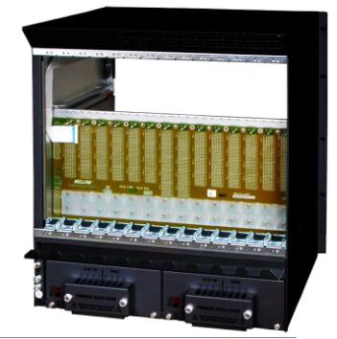
ATCA Crate Elements
Front View
Rear View
Alarm Board
Backplane
Redundant Fan Trays
Power Entry Module (PEM)
Dual redundant Shelf Managers
MTCA/ATCA Workshop 2019

Slide 8
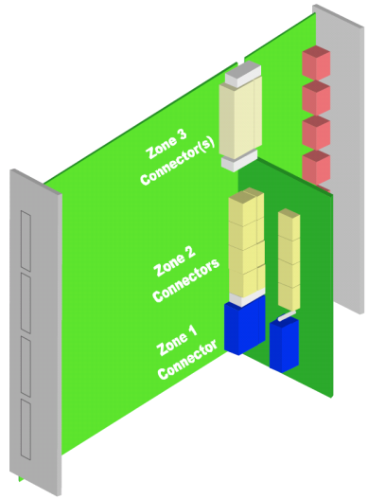
ATCA Crate Elements
Board size and connectors
Front board size 8U x 280
Rear board (RTM) size 8U x 70 mm
  Connects directly to front board
Board width 6HP (1.2”)
Alignment/Key pins
Zone 1: Management and Power
Zone 2: Base Interface and Fabric Interface
Zone 3: Interface to RTM
MTCA/ATCA Workshop 2019

Slide 9
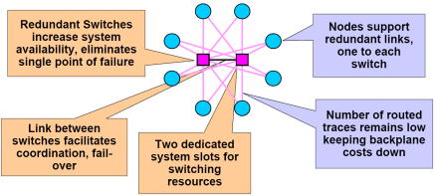
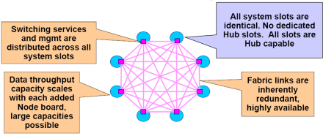
ATCA Interfaces
Zone 2 Backplane Interfaces
Base Interface
  - 10/100/1000 BASE-T Ethernet
  - Always Dual Star topology
Fabric Interface
  Star topology
  Mesh topology
Clock Interface
  - Three dedicated clock interfaces
Update Channel
  - Direct connection between two slots
MTCA/ATCA Workshop 2019

Slide 10
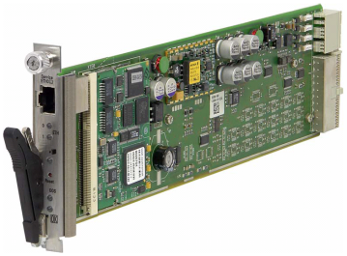
ATCA Management
ATCA Shelf Management purpose
Monitor & control low-level aspects of ATCA boards and other Field Replaceable Units within a shelf
Watch over basic health of the shelf, report anomalies, take corrective action when needed
Retrieve inventory information & sensor readings
Receive event reports and failure notifications from boards and other intelligent FRUs
Manage power, cooling & interconnect resources in the shelf (electronic keying)
Management Protocol IPMI (I2C-bus on backplane)
MTCA/ATCA Workshop 2019

Slide 11
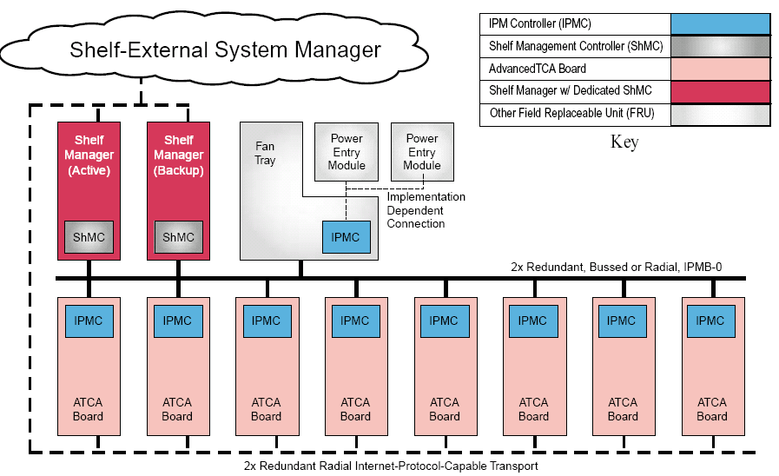
ATCA Management
Dedicated Shelf Management Controller (ShMC)
ATCA Boards with IPMC
Protocol IPMI (Physical layer I²C-Bus)
Intelligent and Managed FRUs
Bused or Radial IPMB
MTCA/ATCA Workshop 2019

Slide 12
AMC
MTCA/ATCA Workshop 2019

Slide 13
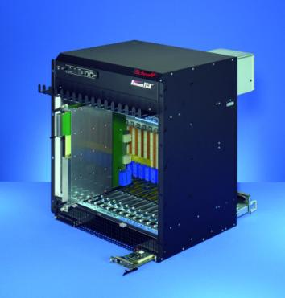
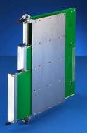
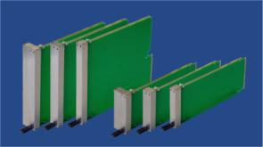
AMC Modules
Initially developed as function extension for ATCA Boards
Fully integrated into the ATCA IPMI management structure
Plugged into a so called ATCA Carrier
Hot Swap capability
AMC Carrier
Double
AMC Modules
Single
3HP 4HP 6HP
Compact Mid-size Full-size
MTCA/ATCA Workshop 2019

Slide 14
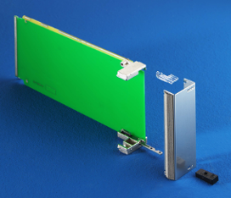
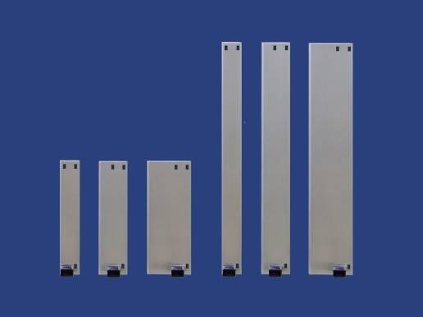

AMC Modules
AMC Module Sizes
6 Standard Sizes:
1 Depth dimensions: 180 mm
2 Width dimensions: Single and Double
3 Height dimensions: Compact, Mid-size and Full-size
Double
Single
3HP 4HP 6HP
Compact Mid-size Full-size
3HP 4HP 6HP
Compact Mid-size Full-size
MTCA/ATCA Workshop 2019

Slide 15
AMC Modules
AMC Module Sizes
MTCA/ATCA Workshop 2019

Slide 16
AMC Modules
Carrier IPMC represents the MMC on the AMC as a FRU to the Shelf Manager
Functionality of the Carrier Manager
Management interface to the
Shelf Manager
Managing the AMC Modules
MTCA/ATCA Workshop 2019

Slide 17
MTCA.0
MTCA/ATCA Workshop 2019

Slide 18

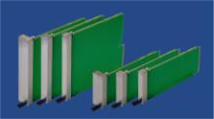
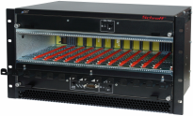
MTCA.0
The basic idea of MTCA is to have a shelf that contains just AMC modules
Backplane directly accepts AMC modules
AMCs are interchangeable between ATCA and MTCA
The infrastructure of a ATCA Carrier was adapted into the MTCA shelf (power, management, switching)
No rear I/O, power input and all outputs to the front
AMC Modules
ATCA Shelf
Single
MTCA Shelf
MTCA/ATCA Workshop 2019

Slide 19
MTCA.0
As MicroTCA does not use a Carrier board, the power, management, clock distribution and switching functionality must be realized onto another device
Management Module: MCH (MTCA Carrier Hub)
  IPMI management
  clock distribution / generation
  Switching functionality
  JTAG slave / master
  Redundant MCHs
Power Module
  12V Payload Power
  3.3V Management Power
  Redundant power modules
Dedicated Slots for these modules are located in the MTCA Shelf
MTCA/ATCA Workshop 2019

Slide 20
MTCA.0
ATCA Carrier
AMC
MMC
Zone 3
Clock distribution
Switching
Zone 2
Carrier
IPMC
AMC
MMC
Current
Limit
Power
Zone 1
Current
Limit
MTCA/ATCA Workshop 2019

Slide 21
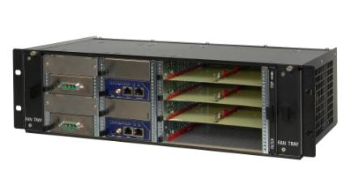
MTCA.0
ATCA Carrier
MTCA Shelf
AMC
MMC
Zone 3
Clock distribution
Switching
Zone 2
Carrier
IPMC
Redundancy added!
AMC
MMC
Current
Limit
Power
Zone 1
Current
Limit
MTCA/ATCA Workshop 2019

Slide 22
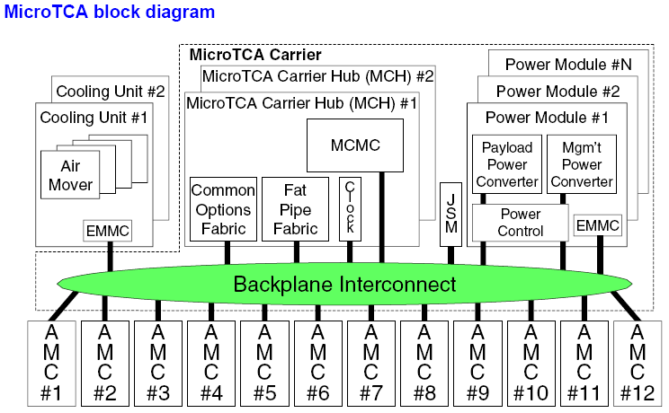
MTCA.0
MTCA/ATCA Workshop 2019

Slide 23
MTCA.0
Terms and Acronyms
MCH MicroTCA Carrier Hub
      This is the complete module you can buy from a vendor
MCMC MicroTCA Carrier Management Controller
      This is the physical IPMI controller on the MCH
MMC Module Management Controller
      This is the physical IPMI controller on an AMC
EMMC Enhanced MicroTCA Carrier Management Controller
      This is the physical IPMI controller on a Cooling Unit and on Power Module
IPMB-0 Intelligent Platform Management Bus 0
      Logical IPMB, physically divided into redundant IPMB-A and IPMB-B
IPMB-L IPMB-Local
      IPMI link between MCH and AMCs
MTCA/ATCA Workshop 2019

Slide 24
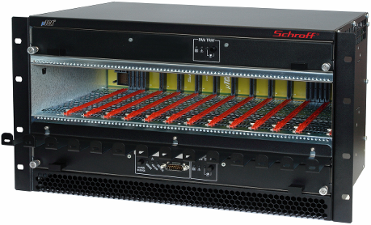
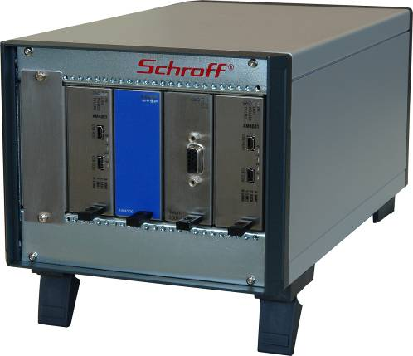
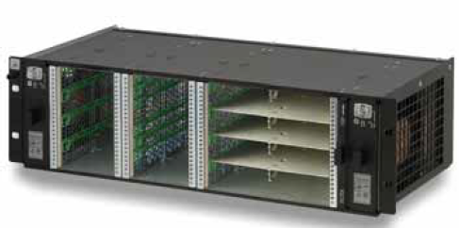
MTCA.0 Crate
The dimension of a MTCA crate is depending on:
Numbers and sizes of slots
Cooling concept
Heat dissipation
Request for redundancy
MTCA/ATCA Workshop 2019

Slide 25
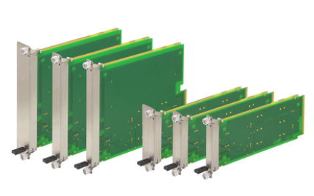
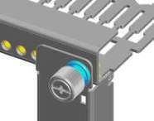
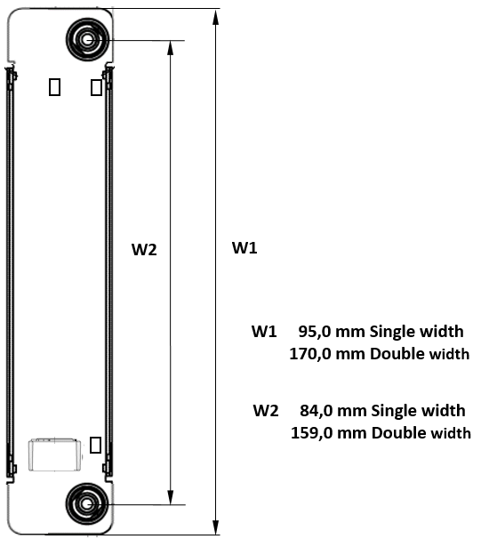
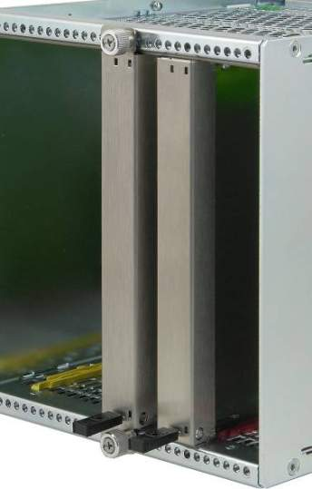
MTCA.1
AdvancedMC front panel has to be fastened (screwed) to the subrack
MTCA.1
modules
( XR2 )
Front panel
with flange
Additional
retention
screw
MTCA.1
front panel
( XR2 )
AdvancedMC.0
front panel
MTCA/ATCA Workshop 2019

Slide 26
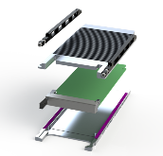
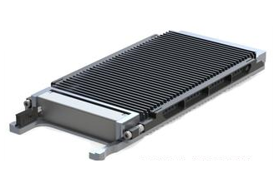
MTCA.2
MicroTCA.2 - Hardened Air Cooled MicroTCA
For Telecommunication outdoor and military air, land and sea applications
Clamshell System for high shock & vibration requirements
Retainer solution allows forced air flow through heat sinks
Dimensions
  Clamshell for single wide module: width 98,0 mm, length 212,7 mm w/o handle
  Clamshell for double wide module: width 173,0 mm, length 212,70 mm w/o handle
MTCA/ATCA Workshop 2019

Slide 27
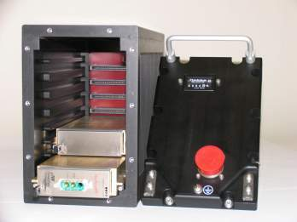
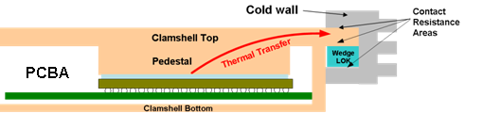
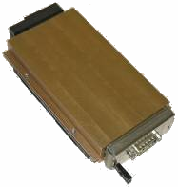
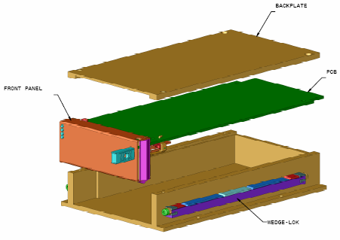
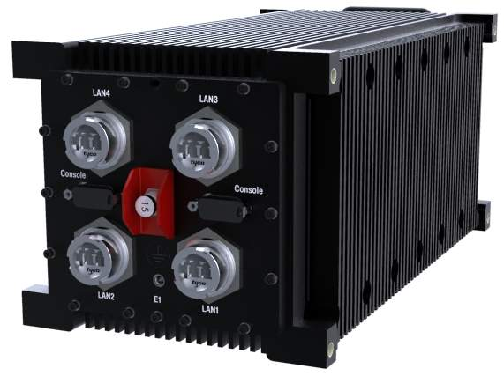
MTCA.3
MicroTCA.3 – Conduction Cooled MicroTCA
For Telecommunication outdoor and military air, land and sea applications
Standard AMC board in a clamshell provides a thermal conduction path to the Thermal Interface Surfaces of the Chassis Sidewall
Dimensions
  Clamshell for single wide module: width 98,0 mm, length 212,7 mm w/o handle
  Clamshell for double wide module: width 173,0 mm, length 212,7, 0 mm w/o handle
MTCA/ATCA Workshop 2019

Slide 28
MTCA.4
MTCA/ATCA Workshop 2019

Slide 29
MTCA.4
Why were extensions needed to the existing MicroTCA specifications?
No Rear Transition Module (RTM) defined for MicroTCA
  Requirement for a large number of I/O cables.
  It makes sense to connect them to the rear of the chassis
Special clock and trigger topology
  MicroTCA.0 specifies 3 Clocks and AMC.0 R2.0 specifies 4 Telecom and 1 Fabric Clock on the AMC Module. Physics applications typically need additional Clocks and Triggers
Sophisticated requirements for the clock and trigger accuracy
  MicroTCA / AMC defines typical telecom clock signals corresponding to PCIe values. Trigger signals are not specified
MTCA/ATCA Workshop 2019

Slide 30
MTCA.4
Requirements for mechanics and sizes
AMC Module size: Double, Mid-size
  Allows for the max number of 12 AMCs in a 19” wide shelf
Large MicroRTM real estate
  MicroRTM size approximately the size of the AMC (doubles depth of existing MTCA chassis)
Use front panel mechanics based on Rugged MicroTCA (MTCA.1)
  Need to mechanically attach a module to avoid it being pushed-out by the corresponding module
  Use Rugged MicroTCA retention device
Reuse existing AMC front panels for the MicroRTM
Allowing mounting of mezzanine modules on the rear of the backplane
Optional zone 3 backplane
Define the management of the system
Suggest clocking and backplane topology
MTCA/ATCA Workshop 2019

Slide 31
MTCA.4
MTCA.0
Micro Telecommunications Computing Architecture Base Specification
MicroTCA Specification Family Tree
MTCA.1
Air Cooled Rugged MicroTCA Specification
MTCA.4
AMC.0
MicroTCA Enhancements for Rear I/O and Precision Timing
Advanced Mezzanine Card Base Specification
MTCA.2
Hardened Air Cooled MicroTCA Specification
MTCA.3
Hardened Conduction Cooled MicroTCA Specification
MTCA/ATCA Workshop 2019

Slide 32
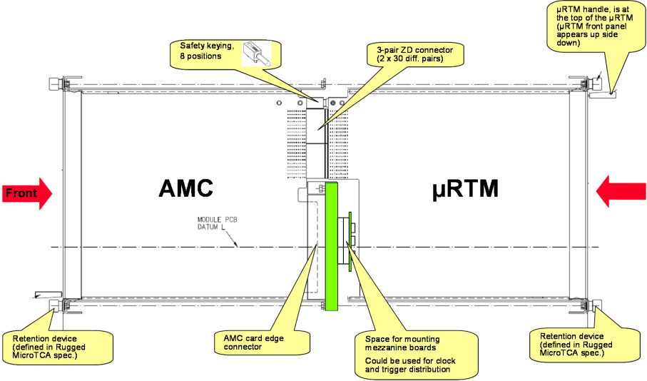
MTCA.4
Features of MTCA.4 shelf with MicroRTM, side view
REAR
MTCA/ATCA Workshop 2019

Slide 33
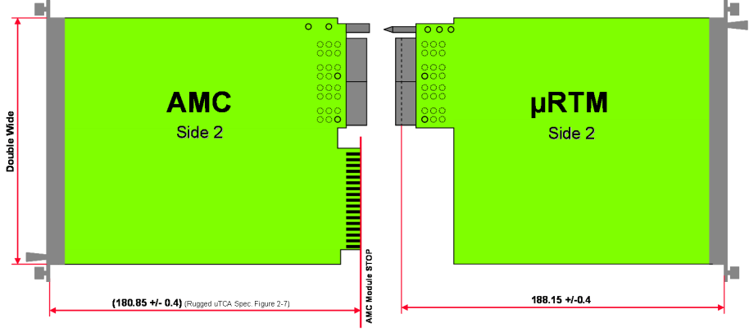
MTCA.4
Module Sizes
MTCA/ATCA Workshop 2019

Slide 34
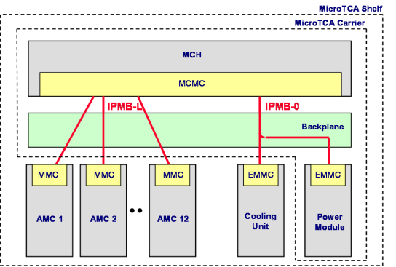
MTCA.4
Management defined in AMC.0 / MTCA.0
IPMB-L
  Connects the MCMC on the MCH to the MMC on the AMC Modules
  Radial architecture
IPMB-0
  Connects the MCMC on the MCH to the EMMC on the PM and CU
  Bused architecture
MTCA/ATCA Workshop 2019

Slide 35
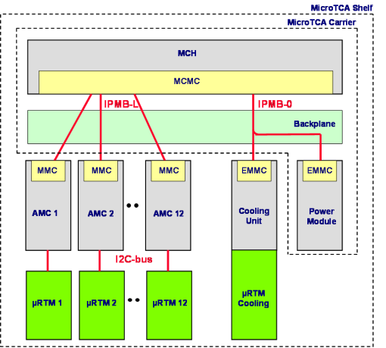
MTCA.4
Management extensions in MTCA.4
IPMB-L
  Connects the MCMC on the MCH to the MMC on the AMC Modules
  Radial architecture
IPMB-0
  Connects the MCMC on the MCH to the EMMC on the PM and CU
  Bused architecture
I2C-Bus
  Connects the AMC to the µRTM
  The µRTM is treated as managed FRU of the AMC
MTCA/ATCA Workshop 2019

Slide 36
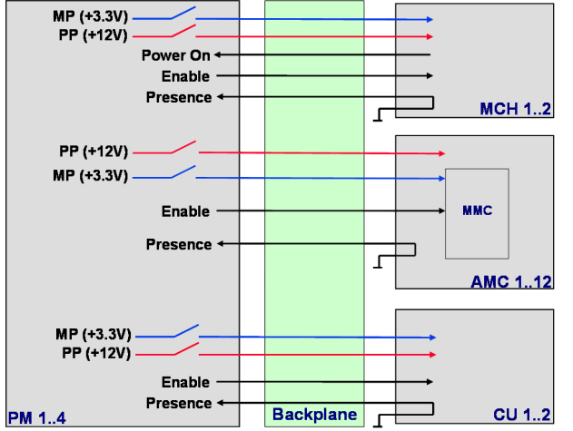
MTCA.4
Control signals as defined per AMC.0 / MTCA.0
MTCA/ATCA Workshop 2019

Slide 37
MTCA.4
Additional RTM control signals for MTCA.4
MP (+3.3V)
MP (+3.3V)
MP (+3.3V)
PP (+12V)
PP (+12V)
PP (+12V)
Power On
Power On
Power On
Enable
Enable
Enable
Presence
Presence
Presence
MCH 1..2
MCH 1..2
PP (+12V)
PP (+12V)
PP (+12V)
PP (+12V)
MP (+3.3V)
MP (+3.3V)
MP (+3.3V)
MP (+3.3V)
Enable
Enable
MMC
MMC
Presence
Presence
Presence
Presence
µ
µ
RTM
RTM
1..12
AMC 1..12
1..12
AMC 1..12
MP (+3.3V)
MP (+3.3V)
MP (+3.3V)
PP (+12V)
PP (+12V)
EMMC
Enable
Enable
Enable
Presence
Presence
Presence
Front fans
Rear
cooling
Backplane
Rear fans
PM 1..4
Backplane
CU 1..2
CU 1..2
PM 1..4
MTCA/ATCA Workshop 2019

Slide 38
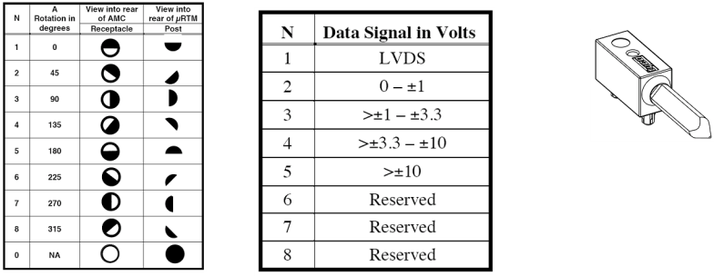
MTCA.4
Alignment and Keying
mechanical keying prevents a module from being inserted which is not electrically compatible and could cause damage
Eight keying positions are implemented that define the electrical interface
MTCA/ATCA Workshop 2019

Slide 39

MTCA.4
M3
FRU State Transition (simplified)
M4
Activation in Progress
Activation complete
Board
Active
LED off
LED off
Activation command
M7
Handle opened
M2
Communication Lost
M5
Activation Request
M0
Deactivation Request
LED long blink
LED short blink
Board not installed
Handle closed
LED off
Deactivation command
Board inserted
M1
Board extracted
M6
Board
Inactive
Deactivation in Progress
Deactivation complete
LED short blink
LED on
MTCA/ATCA Workshop 2019

Slide 40
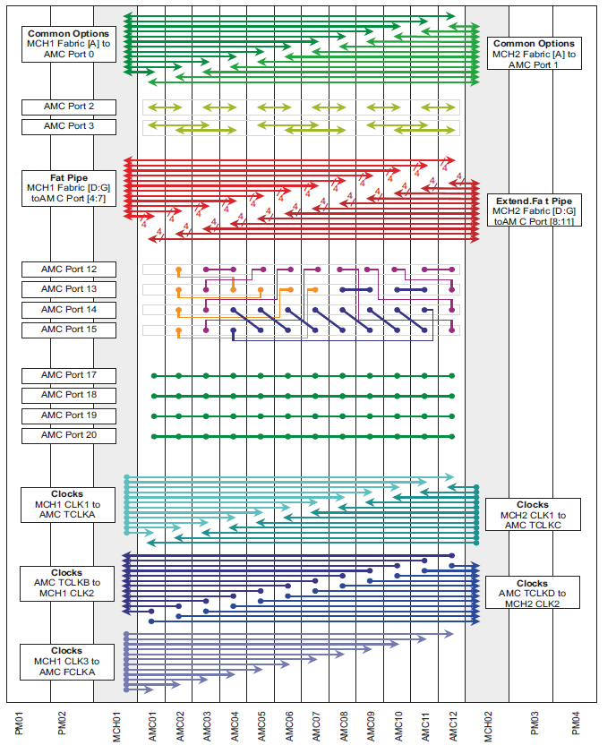
MTCA.4
MTCA.4
Backplane 12-Slot
10GbE
The backplane topology describes the port mapping and the type of connections between the slots
SAS/SATA
PCIe
or
SRIO
1 GbE/
SRIO
Point-to-Point Links
Extended Options
8x M-LVDS Trigger
Clocks
MTCA/ATCA Workshop 2019

Slide 41
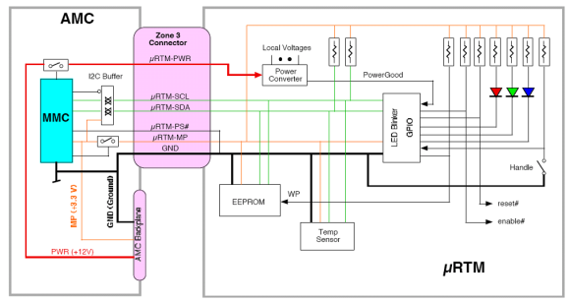
MTCA.4
MicroRTM Management
A management interface is defined on the lower zone 3 connector
Management and power signals:
  µRTM-MP: Management Power for the EEPROM, Temp. Sensor and I/O Expander
  µRTM-PWR: Payload power for the RTM
  µRTM-PS#: RTM Presence signal, grounded on the RTM
  µRTM-SCL/SDR: I²C bus coming from the AMC MMC going to the RTM
MTCA/ATCA Workshop 2019

Slide 42
MTCA.4
Front board and MicroRTM power distribution
The total power for a slot (front board and RTM) is supplied through the front board AMC connector
The MicroRTM power is supplied from the front board through the Zone 3 connectors
Total available power for a slot is 80 Watts, the MicroRTM power is limited to 30 Watts
The power required by the MicroRTM is subtracted from the power for the front board
AMC
30 W
50 W
80 W
MTCA/ATCA Workshop 2019

Slide 43
MTCA.4
Shelf Cooling
Some Physics applications require independent cooling of the front boards and the rear boards due to thermally sensitive oscillators on the rear boards. Also, independent fan speed control contributes to lower noise and power consumption
The fans for the front board and the rear board are on one physical Cooling Unit
Existing specifications did not deal with independent fan speeds on one physical Cooling Unit
MTCA.4 enhances the commands „Get Fan Speed Properties“ and „Get/Set Fan Level“ to include a bit telling the MCH whether the Cooling Unit supports independent cooling and telling the Cooling Unit whether a „Get/Set Fan Level“-command targets the front or the rear fans
MTCA/ATCA Workshop 2019

Slide 44
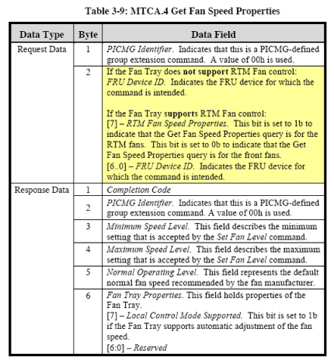
MTCA.4
MTCA.4 fan speed control commands
Request sent by the MCH
Response sent by the CU
MTCA/ATCA Workshop 2019

Slide 45
MTCA.4
Sequence of IPMI commands to determine whether the CU supports independant MicroRTM cooling
MCH
CU
1. Step: Request: GetFanSpeedProperties
2. Step: Request: GetFanSpeedProperties
00h (looking for a CU on FRU#0)
00h (Ok, CU on FRU#0 is present)
Response: GetFanSpeedProperties
Response: GetFanSpeedProperties
80h (looking for RTM fan support on FRU#0)
00h (RTM fans are supported)
C9h (RTM fans are not supported)
MTCA/ATCA Workshop 2019

Slide 46
MTCA.4
Air flow measurements in MTCA.4 Shelves
One of the most critical issues in a shelf is cooling of the installed modules
A reliable method to define the cooling capability of a shelf is to measure the volumetric air flow in m³/h or cfm
Measured Air flow values:
  Bulk air flow value for the total shelf air flow
  Individual air flow per slot
Cooling capacity can be calculated based on the Air Flow and desired temperature differential between air intake and air exhaust
MTCA/ATCA Workshop 2019

Slide 47
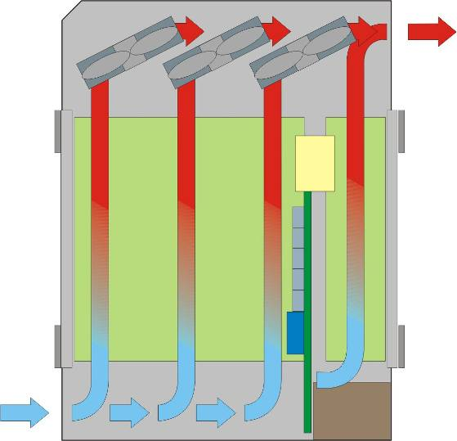
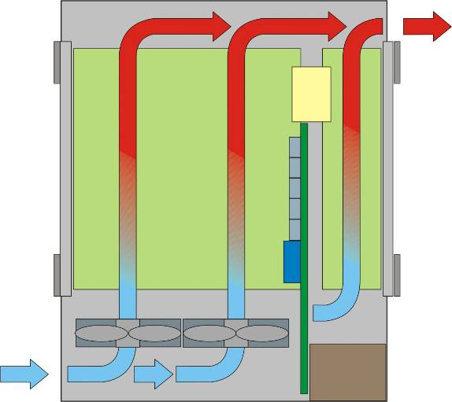
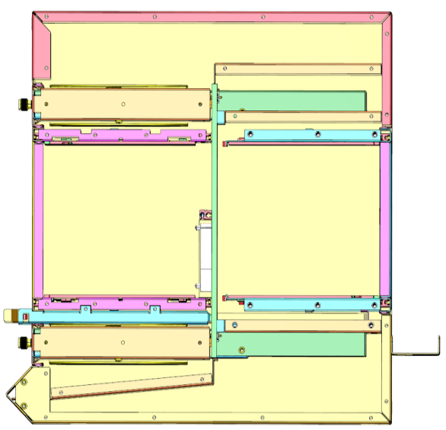
MTCA.4
Cooling concepts
The cooling concept depends on the installation situation of the chassis:
Front-to-rear air flow
Side-to-side air flow
Bottom-to-top air flow
Front-to-side air flow
Fan configuration:
Push
Pull
Push-pull
AMC
RTM
Pull configuration,
Front-to-rear
Push configuration,
Front-to-rear
Push-Pull configuration
Front to rear
AMC
RTM
Push-Pull configuration
Side-to-side
Pull configuration,
bottom-to-top
MTCA/ATCA Workshop 2019

Slide 48
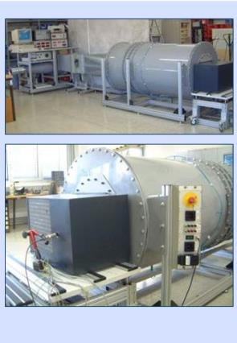
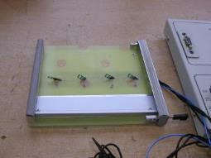
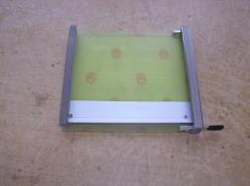
MTCA.4
Bulk air flow measurements in wind tunnel:
Per slot air flow measured with air flow measurement boards and Flow Impedance Boards (similar to cp-ta in ATCA)
MTCA/ATCA Workshop 2019

Slide 49
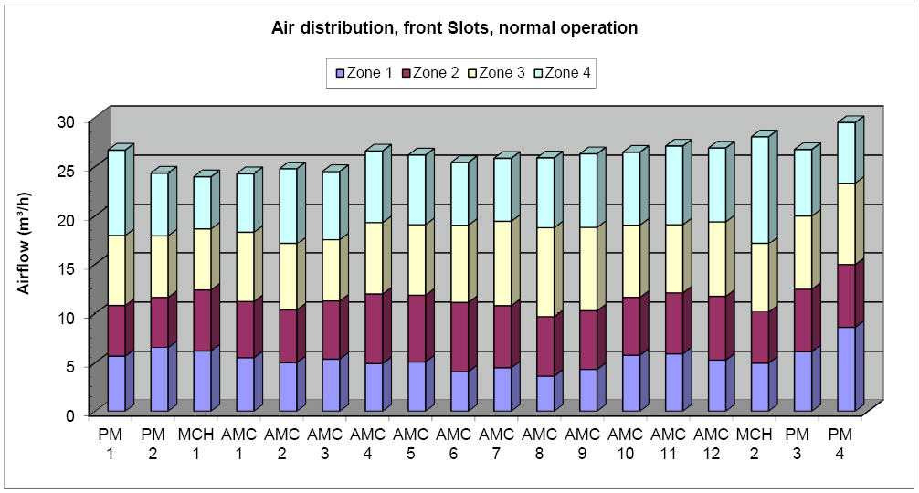
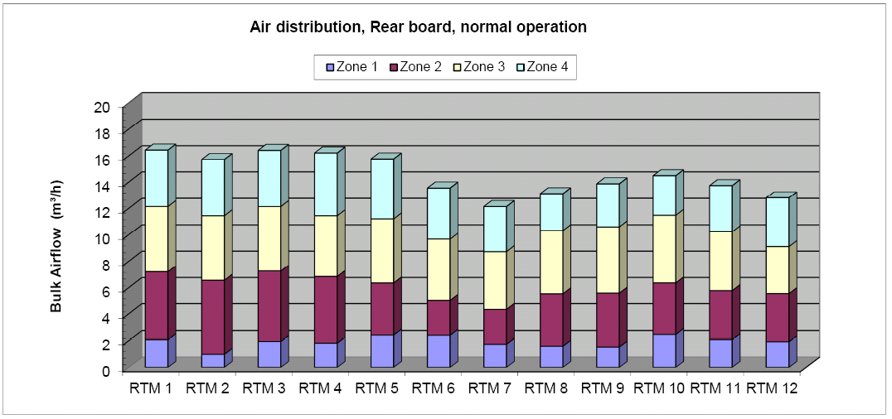
MTCA.4
Test results:
Bulk air flow measured in wind tunnel = 635 m3/h
Sum of per slot air flow (front and rear) = 644 m3/h
Cooling capability approximation: Power = Air Flow * ΔT / 3.3
AMC slot 1: 24.3 m³/h => cooling capability (at ΔT=12k) ~ 88 Watts
RTM slot 7: 12.1 m³/h => cooling capability (at ΔT=12k) ~ 44 Watts
MTCA/ATCA Workshop 2019

Slide 50
MTCA.4
How can MTCA.4 improve the reliability of the system?
Prediction of failures (e.g. a fan does normally not fail instantly)
Monitoring of every temperature sensor on every module and FRU
Isolation of faulty modules(e.g. powering down over-heated modules)
Power management
Redundancy
MTCA/ATCA Workshop 2019

Slide 51
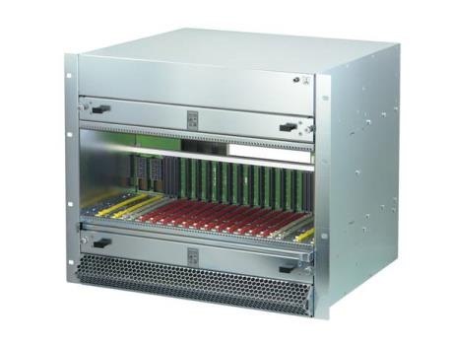
MTCA.4
Redundancy
For high availability applications all modules are redundant:
2 x MCH
4 x Power Module
2 x Cooling Unit
IPMB-0:
One logical bus divided into two physical busses: IPMB-A and IPMB-B
MTCA/ATCA Workshop 2019

Slide 52
MTCA.4
MCH Redundancy
Two MCH: One is Master, One is Redundant
Redundant chassis / shelf FRU Information SEEPROM
Redundancy Interface between the two MCH
Redundancy defined in chassis / shelf FRU information
Chassis / Shelf FRU SEEPROM
Chassis / Shelf FRU SEEPROM
Local I2C-bus
Local I2C-bus
IPMB_L
Clocks
Fabric update channels
Redundancy Interface between the MCHs
MCH 1
MCH 2
MTCA/ATCA Workshop 2019

Slide 53
MTCA.4
Power Module Redundancy
Up to 4 Power Modules per chassis
Redundancy mode defined in shelf FRU file
Individual power channel to each module and FRU
Pass FET
ORing FET
to Module
ORing FET
Pass FET
Primary
Power
Redundant
Power
+12V Payload Power
2 x MCH
2 x CU
12 x AMC
ON
ON
OFF
ON
Primary
Control
Redundant
Control
Pass FET
ORing Diode
to Module
ORing Diode
Pass FET
Primary
Power
Redundant
Power
2 x MCH
2 x CU
12 x AMC
+ 3.3V Management Power
ON
ON
Primary
Control
Redundant
Control
PM 1: Primary
PM 2: Redundant
MTCA/ATCA Workshop 2019

Slide 54
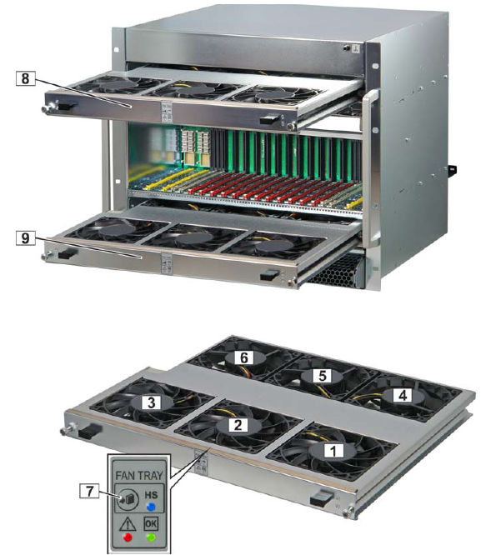
MTCA.4
Cooling Unit Redundancy
Redundant Cooling Units in push-pull configuration
Scenario 1: fan failure
Scenario 2: Cooling Unit replacement
1 – 6 Fan
7 Hot Swap bush button
8 CU1
9 CU2
Pull
Push
MTCA/ATCA Workshop 2019

Slide 55
MTCA.4
IPMB redundancy
Individual IPMB-L to each AMC
Redundant logical IPMB-0 to PMs and CUs
MCH
CU 1
CU 2
PM 1
PM 2
PM 3
PM 4
IPMB-A
IPMB-0
IPMB-B
AMC 1
AMC 2
AMC 3
AMC 4
AMC 5
AMC 6
AMC 7
AMC 8
IPMB-L
AMC 9
AMC10
AMC11
AMC12
MTCA/ATCA Workshop 2019

Slide 56
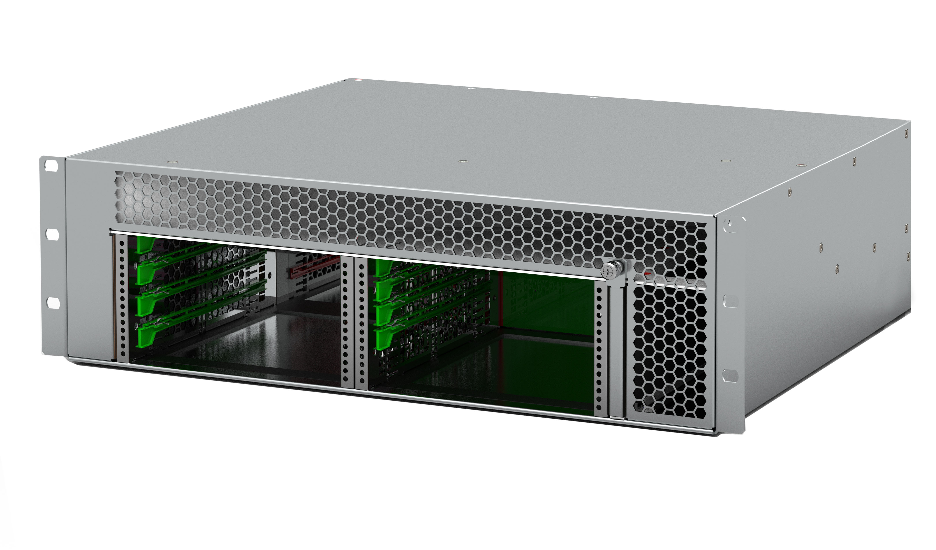

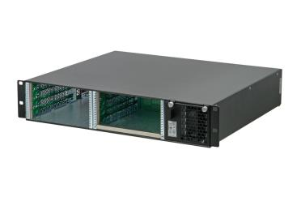


MTCA.4
MTCA.4 Chassis types
Various different MTCA.4 chassis available now:
Laboratory use
Fully redundant
Compact sizes
Small form factors
Different cooling concepts
Different backplane topologies
MTCA/ATCA Workshop 2019

Slide 57


MTCA.4
Standardization continues:
MTCA.4 Standardization activities
Definition of a RTM Auxiliary Backplane (MTCA.4.1)
Based on the LLRF backplane
Optional connector usage
Protective mechanical cover for AMC and RTM modules
Protective cover to mechanically protect components
For Side A and Side B
MTCA/ATCA Workshop 2019

Slide 58




MTCA.4.1
MTCA.4.1
Auxiliary backplane for rear transition modules
Rear power modules
MCH Management Support & Extended Rear Transition Module (MCH-RTM)
Shield plane
RTM Backplane
Shield plane
Location for the RTM backplane in a MTCA.4 shelf
Dimension: Height: 159.5mm
Width: 424.5mm
Thickness: 2mm (backplane) + 2mm (shield extension)
MTCA/ATCA Workshop 2019

Slide 59
MTCA.4.1
MTCA.4.1 Rear Power Module
The rear power module is connected with the RTM backplane and it provides additional power to the RTMs.
Output power: up to 600W
Dimensions: Double width, full-size but reduced depth due to the connector position
on the RTM backplane
Depth: 185,85 mm – distance the AMC backplane to the RTM backplane
MTCA.4.1 MCH-RTM
The MCH-RTM can contain CPU, storage and peripherals which safes space in the AMC area.
Dimensions: Double width, full-size, depth 185,85 mm
MTCA/ATCA Workshop 2019

Slide 60
Thank You

