Slide 1
Development and Application of MicroTCA Based LLRF System at IHEP
Nan Gan (gann@ihep.ac.cn)
On behalf of Linac team
Institute of High Energy Physics, CAS
23rd, June, 2019

Slide 2
Outline
LLRF History
MTCA Based LLRF Applications at IHEP
ADS Injector I
ADS Main Linac CM4
BEPCII SHBs
Other applications
Future Applications
Summary

Slide 3
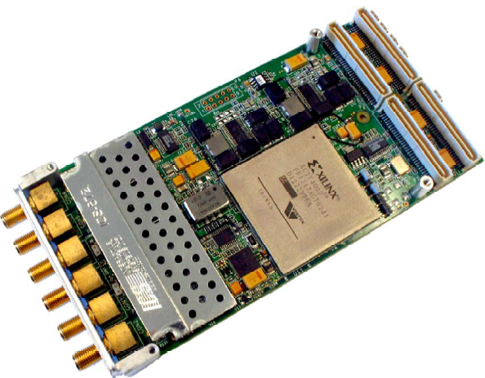
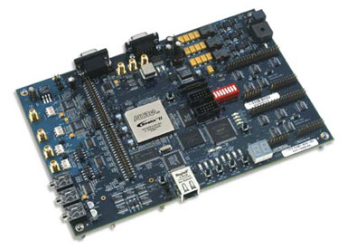
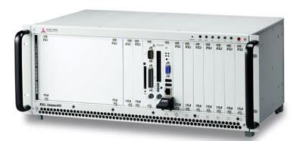
LLRF History
Before 2009, analog LLRF
2009 ~ 2012, digital LLRF
Hardware from many vendors: Altera, NI, ADLink, GE ... or customized
Data bus: Ethernet, PCI ...
MicroTCA.4 adopted since 2013
FPGA development kit
PXI crate
Multi-channel digitizer
PXI LLRF DSP board

Slide 4
Outline
LLRF History
MTCA Based LLRF Applications at IHEP
ADS Injector I
ADS Main Linac CM4
BEPCII SHBs
Other applications
Future Applications
Summary

Slide 5
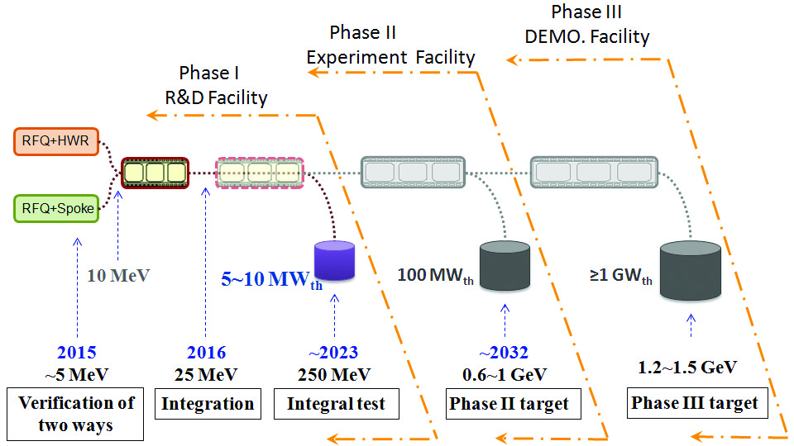
C-ADS Project
Strategic project for nuclear transmutation of long-lived radio active waste
C-ADS accelerator started in 2011. IHEP (Institute of High Energy Physics, CAS) and IMP(Institute of Modern Physics, CAS) are responsible for this project
C-ADS Road Map

Slide 6
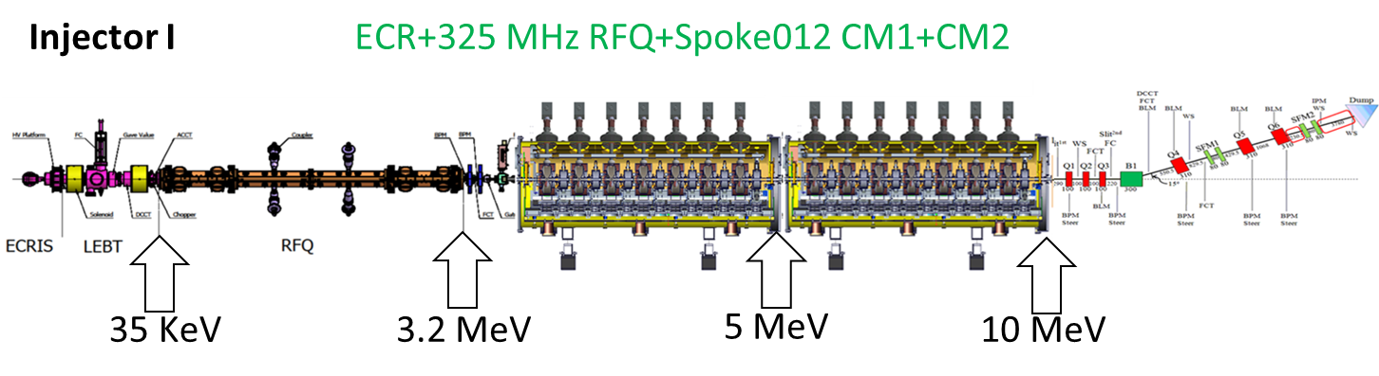
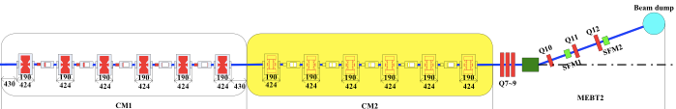
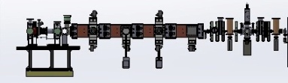
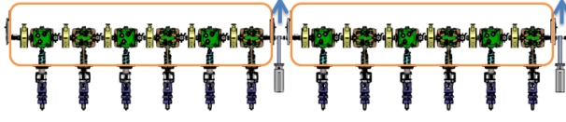
C-ADS Project
ECR + 325MHz RFQ + Bunchers + Spoke012 CM1+CM2
Injector I (IHEP): 10MeV@10mA
IMP
IHEP
HWR010
HWR010
HWR015
Spoke021
35 KeV
2.1 MeV
5 MeV
10 MeV
15~17 MeV
20~25 MeV
Injector II (IMP):10MeV@10mA ; Main LINAC (IHEP and IMP): 25MeV@10mA

Slide 7
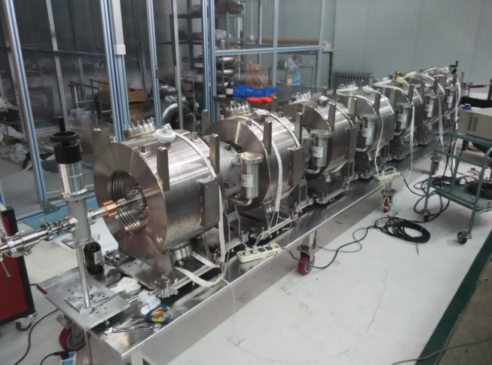
C-ADS Injector I
RFQ
Frequency 325 MHz
RF power 300 kW, 4-vane type, 4 couplers
Bunchers
Frequency 325 MHz
RF power 6.3 kW, 4 couplers
SRF Cavities
Frequency 325 MHz, 2 K
Spoke β = 0.12, Epeak = 32.5 MV/m, Eacc = 0.82 MV
7 Spokes, 7 solenoids and 7 BPMs per module
RFQ
Buncher
Cavity string: 7 cavities+7 solenoids+7 BPMs

Slide 8
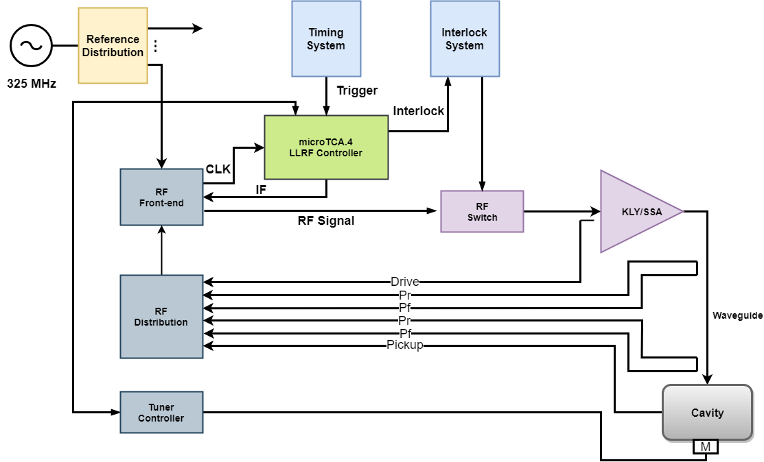
C-ADS Injector I
LLRF system diagram

Slide 9
C-ADS Injector I
Reference system
The 325 MHz RF reference system includes the MO. (Agilent E4438C) and reference distribution
MO signal is divided into 32-ways for both RF sub-systems, beam instrumentation and timing system
Phase stabilized RF cable, temperature compensation and low noise amplifier are adopted

Slide 10
C-ADS Injector I
Interlock system
A module has been developed to process both fast and slow interlocks to detect exception
The vacuum of RF couplers or accelerate structure, LLRF loop status, ARC, temperature, water flow, tuner limiter, etc., are connected together with and logic to determine switch off RF signal and MPS statues

Slide 11
C-ADS Injector I
RF signal distribution
Customized RF front-end in 19” chassis consists of up and down convertors, generate LO and clock signals
RF signal monitoring unit handles the driver signals, RF amplifier fwd. and rev. signals, coupler fwd. and rev. signals, cavity pickup signal

Slide 12
C-ADS Injector I
Tuning system
Servo motors used for bunchers
Stepper motor with piezo-actuators are used for spoke cavities
Lorenz Force detuning can be compensated by adopting piezo properly

Slide 13
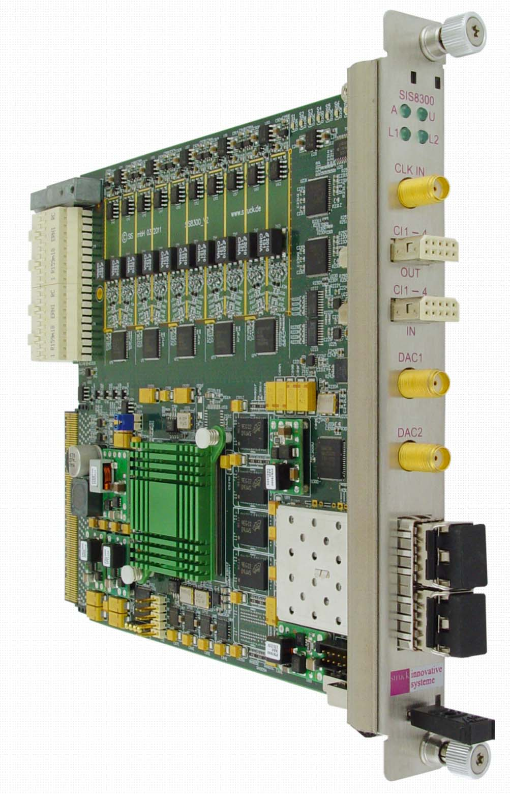
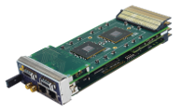
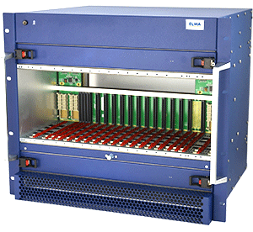
C-ADS Injector I
MTCA.4-based LLRF controller
NAT MCH
SIS8300
Kontron CPU
SIS8900

Slide 14
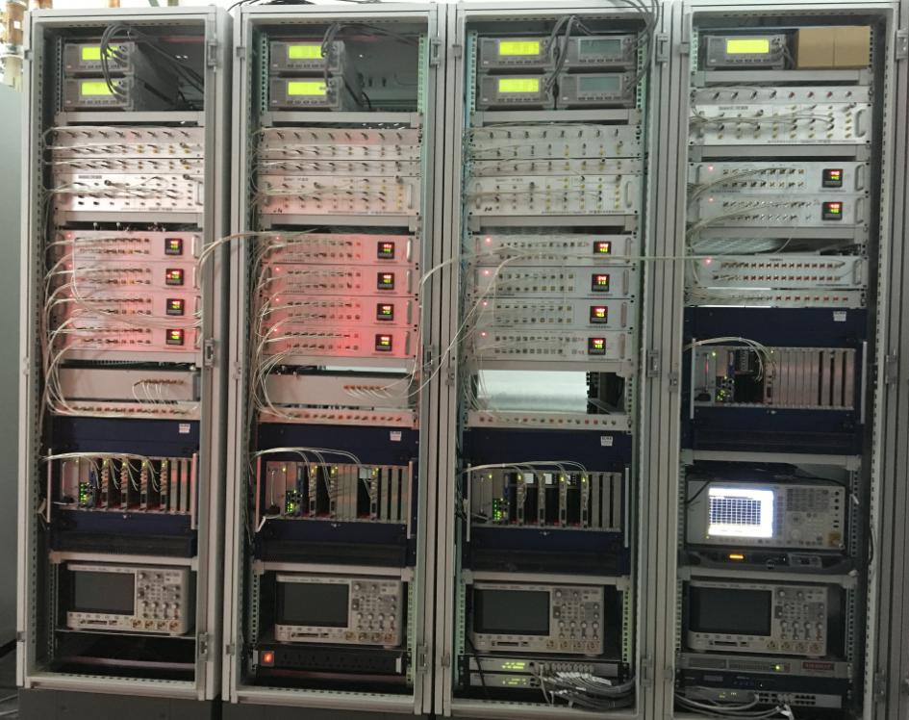
C-ADS Injector I
LLRF Cabinet
Power meters
RF distribution
RF front-end
RF switch
MTCA crate
Oscilloscope

Slide 15
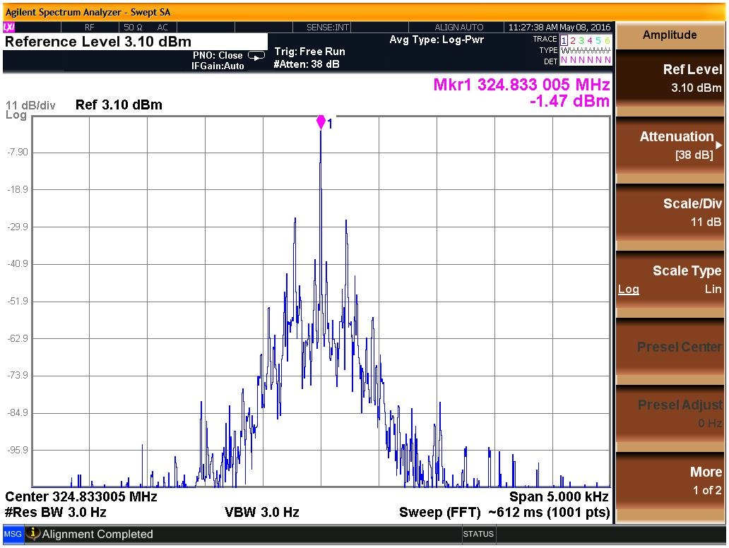
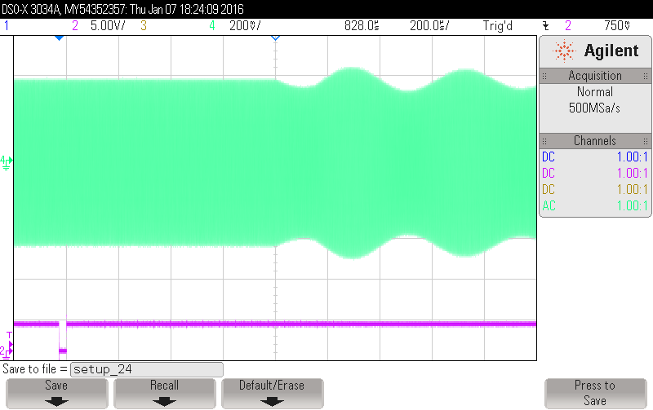
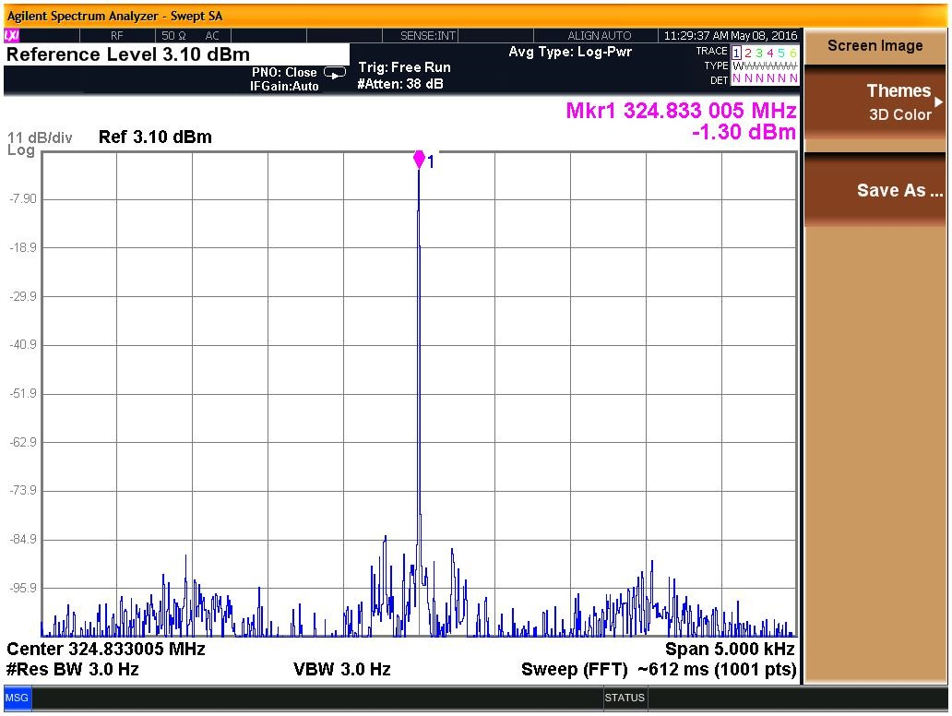
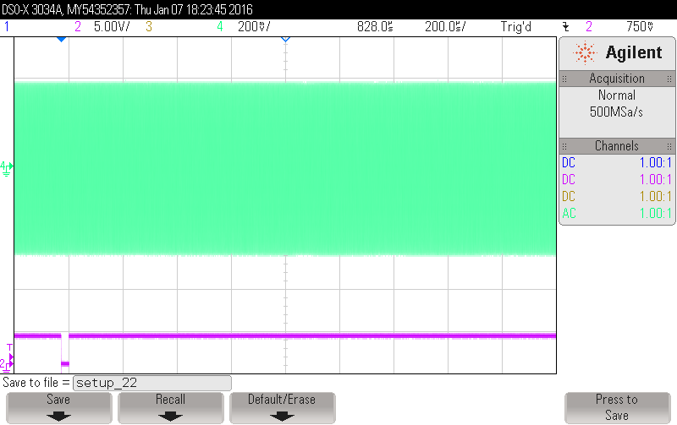
C-ADS Injector I
Beam passing
Open loop
Closed loop
50dB noise suppression
Beam passing with feedforward control

Slide 16
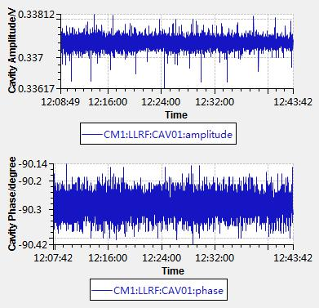
C-ADS Injector I
Cav. # | 1 | 2 | 3 | 4 | 5 | 6 | 7
Ep(MV/m) | 17.1 | 24.4 | 29.1 | 26.4 | 30.6 | 33.7 | 26.3
Cav. # | 8 | 9 | 10 | 11 | 12 | 13 | 14
Ep(MV/m) | 26.0 | 26.0 | 28.6 | 27.8 | 31.0 | 30.7 | 19.2
Operating gradient of the SC cavities @ 10.67MeV
Amplitude stability long-term with beam on : < 0.1% (peak-to-peak);
Phase stability long-term with beam on after optimization : < 0.3°(peak-to-peak);

Slide 17
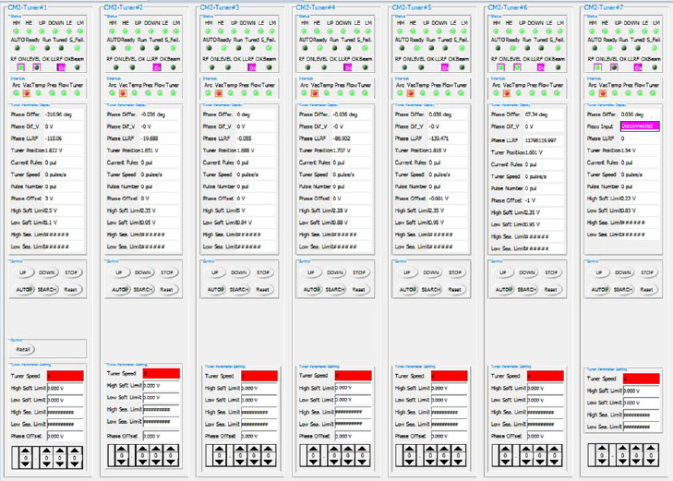
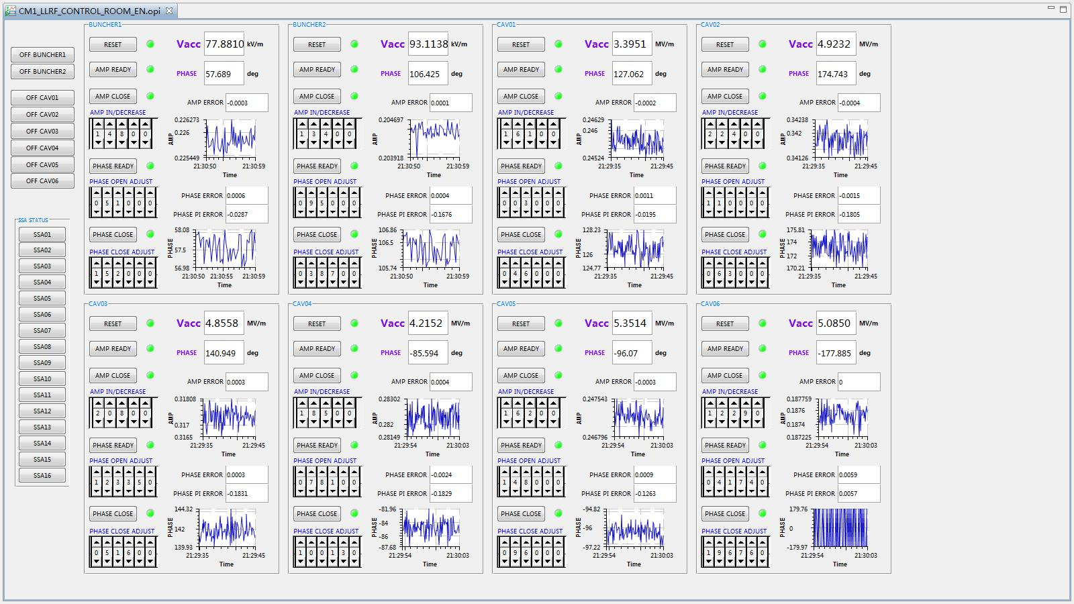
C-ADS Injector I
Tuner & interlock control interface
Interfaces:
Multi-cavity conditioning interface
SSA monitor and control interface

Slide 18
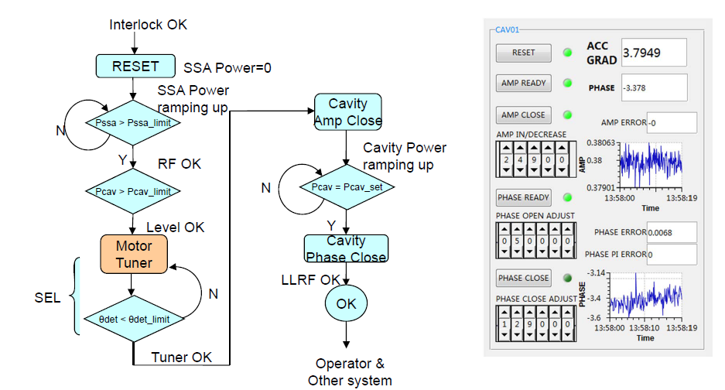
C-ADS Injector I
Automation program:
Auto conditioning of coupler and cavity
Auto phase scan of bunchers and SC cavities

Slide 19
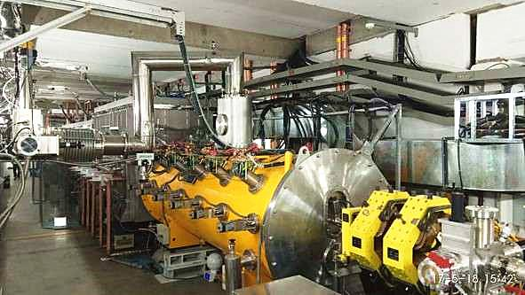
C-ADS Main Linac - CM4
SRF Cryomodules
Frequency 325 MHz, 4 K
Spoke β = 0.21, Epeak = 24/31 MV/m, Eacc =1.64 MV
6 Spokes, 6 solenoids and 6 BPMs in one module

Slide 20
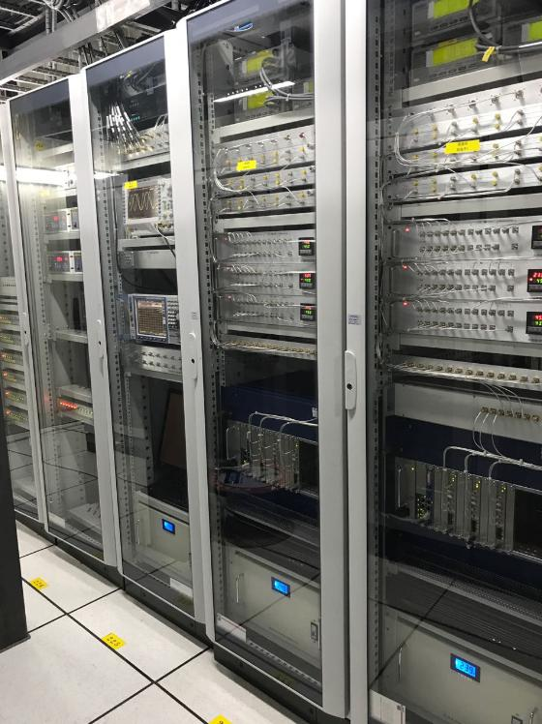
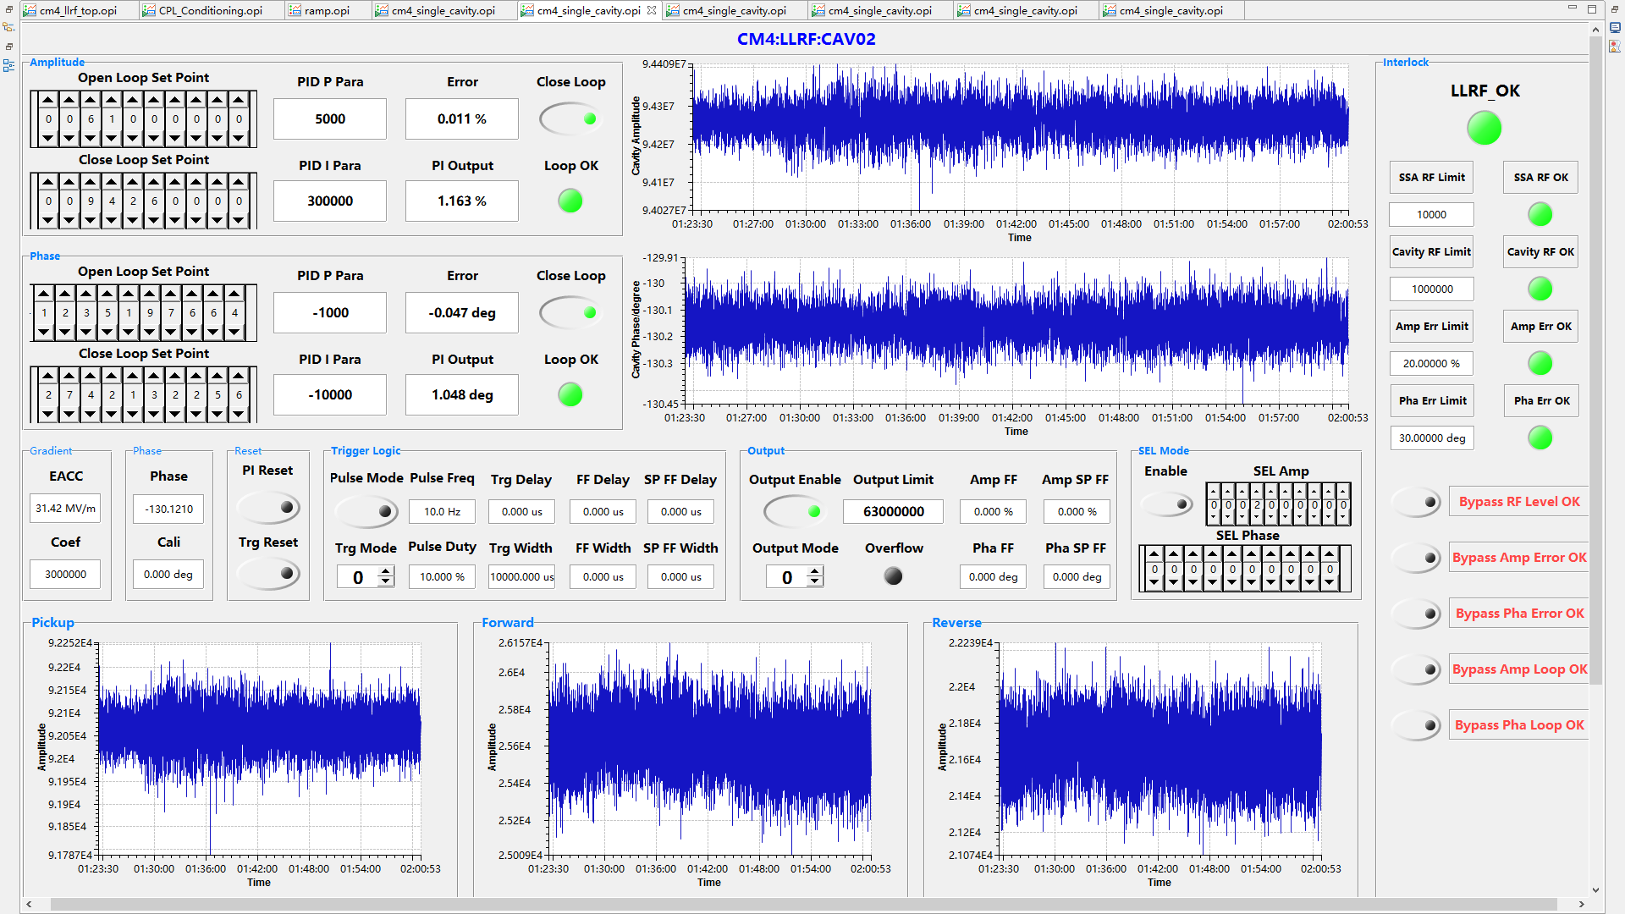
C-ADS Main Linac - CM4
First application of SIS8300L2 in IHEP
New firmware structure
More LLRF algorisms implemented

Slide 21
Beam Commissioning
Sep. 2014, The ECR Source+LEBT+RFQ has been commissioned with Max.90% duty factor beam;
Feb. 2015, MicroTCA based LLRF are implemented;
Oct. 2015, The CM1 output reached 6MeV/10mA/30us beam @2K;
Jan. 2016, The CM1 output reached 6MeV/10mA/1ms beam @2K;
July 2016, The CM2 output reached 10.1MeV/10.6 mA/20μs/20Hz beam@2K，transmission efficiency is 100%;
Jan. 2017, The CM2 output reached 10MeV/2.1mA CW beam @2K;
Apr. 2017, LLRF hardware/firmware upgraded and implemented on CM4;
June 2017, The CM4 output reached 25.0MeV/0.17mA CW beam@4K;

Slide 22
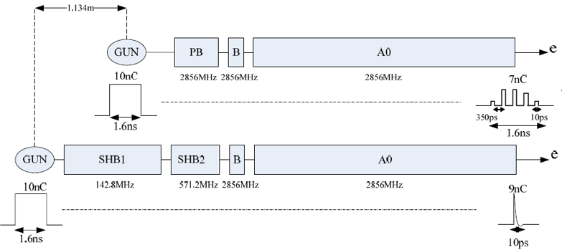
BEPCII SHBs
BEPCII pre-injector consists of a thermionic gun followed by two sub-harmonic bunchers (SHB), a travelling wave pre-buncher and a travelling wave buncher
Pre-injector need providing a low emittance and high intensity electron beam for the positron beam production
BEPC
BEPCII

Slide 23
BEPCII SHBs
Subsystem | Parameters | SHB1 | SHB2
Cavity | RF Frequency | 142.8 MHz | 571.2 MHz
 | Q_{L} | 4046 | 5391
 | Tuning range | 240 kHz | 1.2 MHz
SSA | Max Power | 20 kW | 10 kW
 | Pulse Width | 70 us | 70 us
 | Power flatness | 2 % | 2 %
 | Phase variation in pulse | 1 deg | 1 deg
 | Repetition rate | 1 – 50 Hz | 1 – 50 Hz
LLRF stability requirements | Amplitude | 1.5 % | 1.5 %
 | Phase | 1.5 deg | 1.5 deg

Slide 24
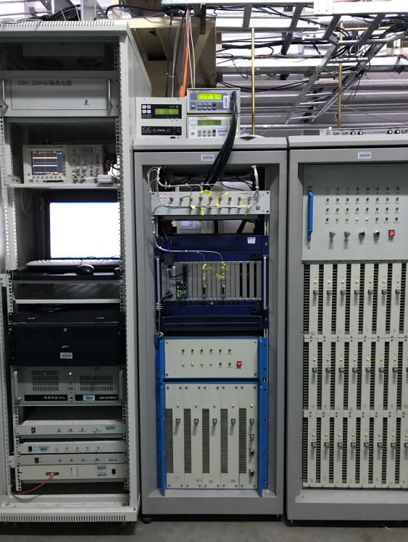
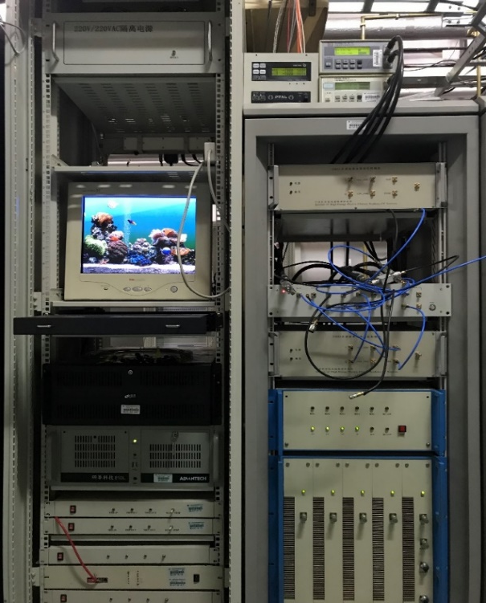
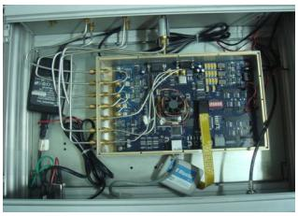
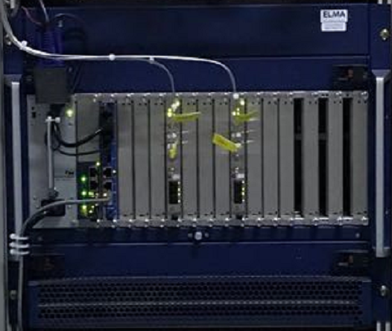
BEPCII SHBs
Upgraded in 2017
“Pizza Box” architecture
MicroTCA architecture

Slide 25
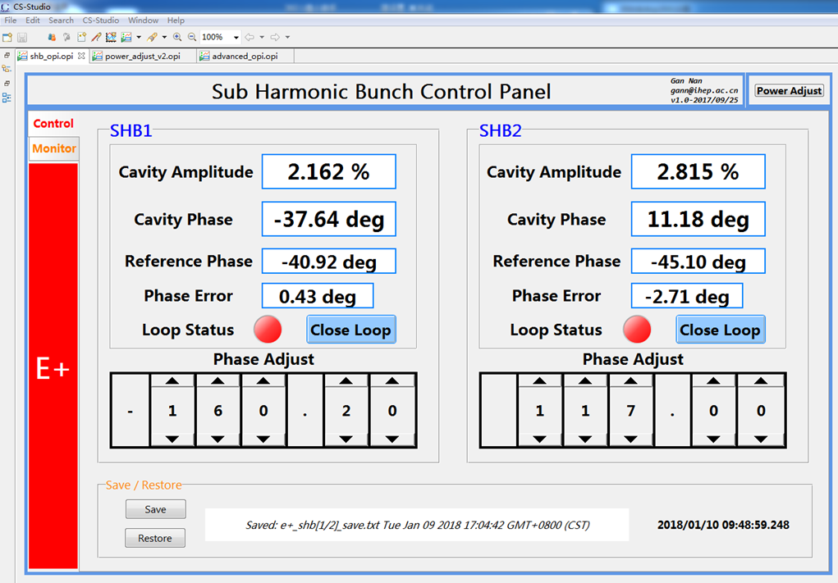
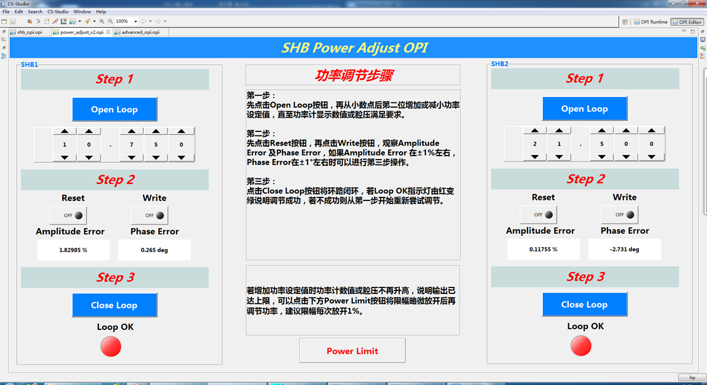
BEPCII SHBs
2 SIS8300L2/SIS8900 boards for 2 Sub-harmonic bunchers
Intra-pulse amplitude and phase feedback
8192 points setpoint look-up table
Auto switch parameters for E+/E- operating mode
Amplitude stability < 0.1% p-p, phase stability < ±0.5°p-p

Slide 26
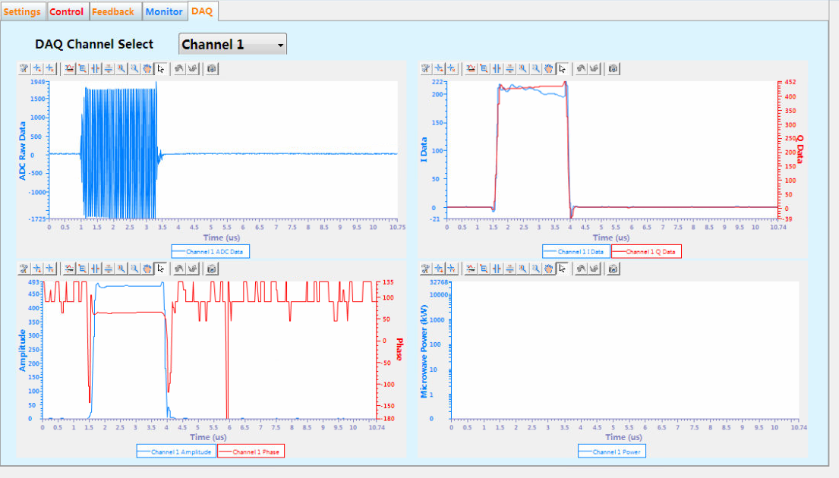
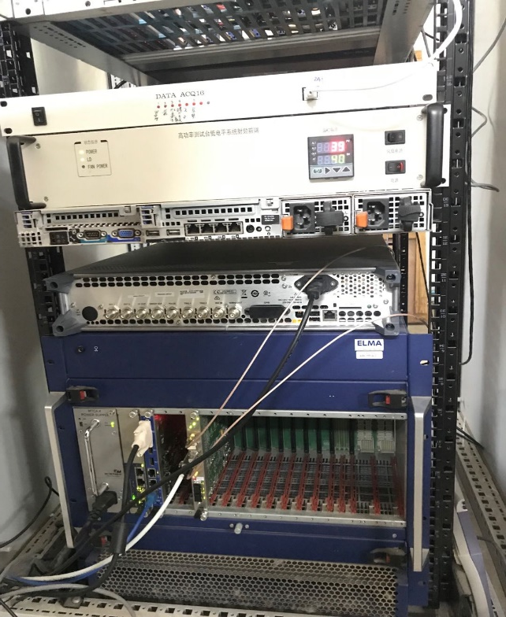
Other applications
BEPCII high power RF test stand
Multi-channel signal data acquisition: amplitude, phase, waveform
Realize auto conditioning and SWR protection
Multi-channel DAQ

Slide 27
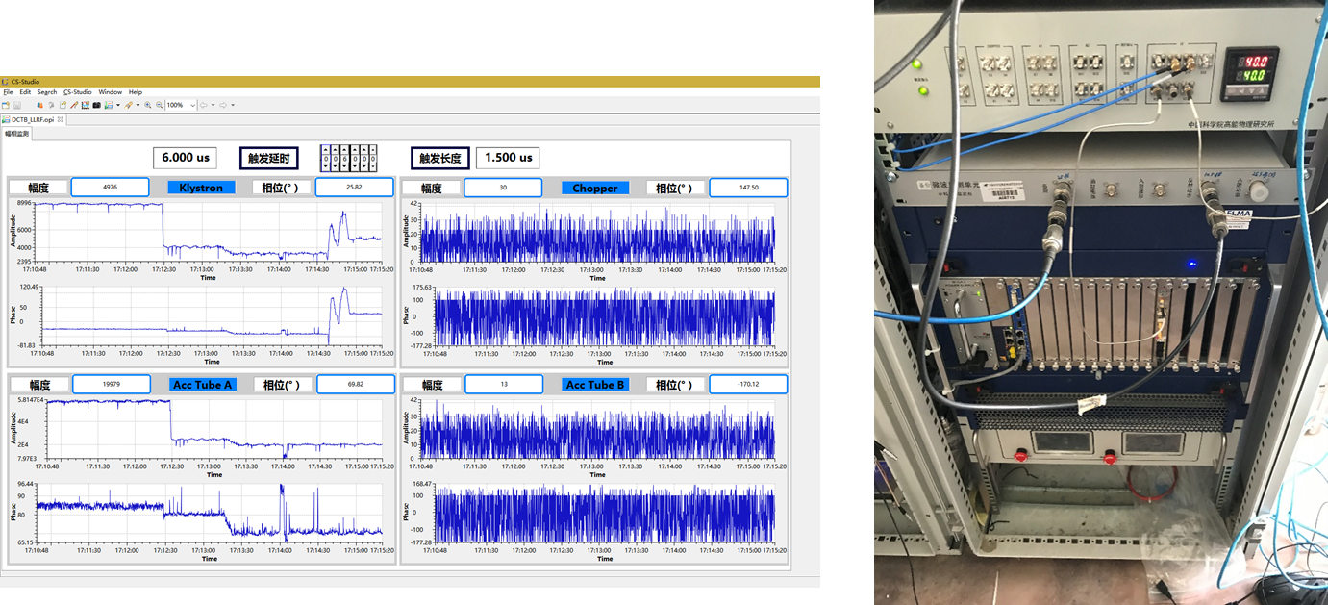
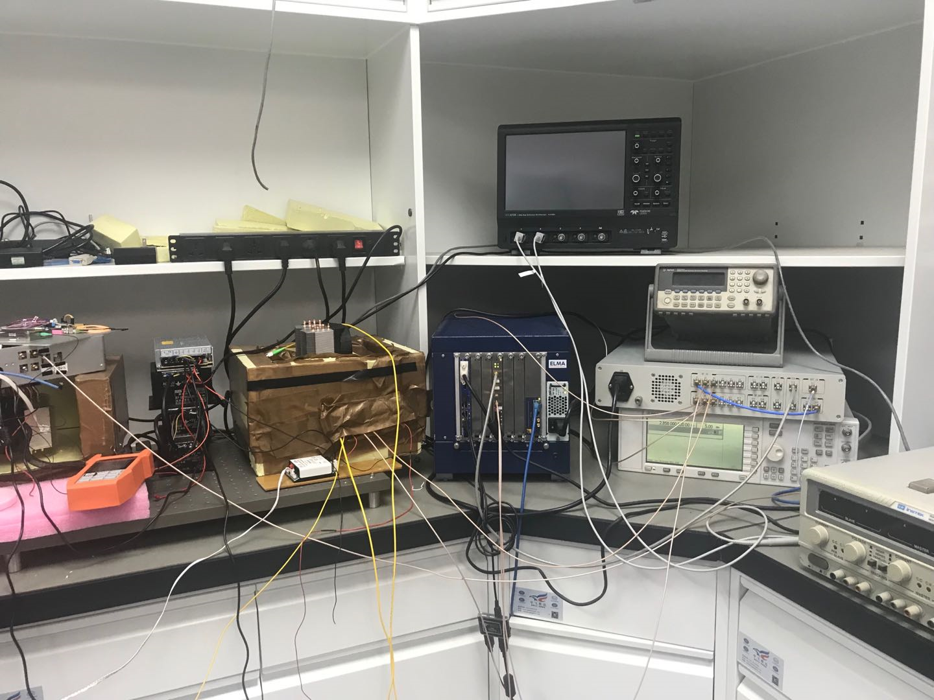
Other applications
Femtosecond-level phase stabilized RF transmission system
DCTB 50MeV accelerator
Amplitude and phase stability monitor
Klystron phasing
High precision RF phase detection
--> Jiaji Liu, Phase Stable RF Transmission System Based On MicroTCA

Slide 28
Outline
LLRF History
LLRF Applications of IHEP
ADS Injector I
ADS Main Linac CM4
BEPCII SHBs
Other applications
Future Applications
Summary

Slide 29
PAPS
Platform of Advanced Photon Source Technology R&D
Project supported by Beijing Gov.
Budget: 500M RMB
Construction: 2017.5-2020.6
Consist of 7 systems:
SRF system
Cryogenic system
Magnet technology
Beam test
X-ray optics
X-ray detection
X-ray application

Slide 30
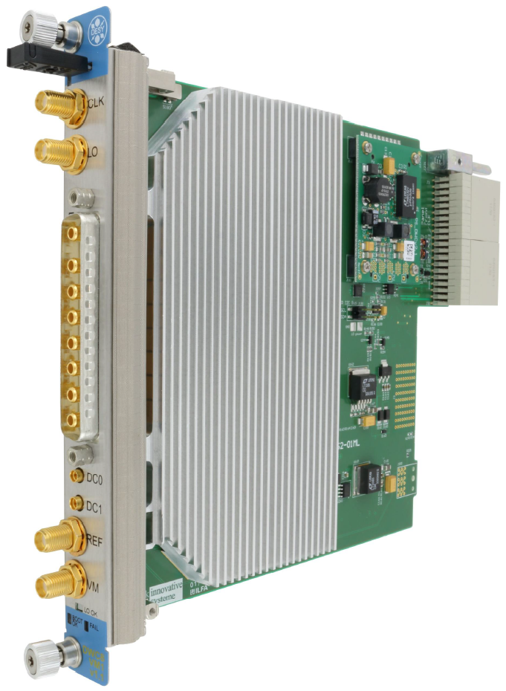
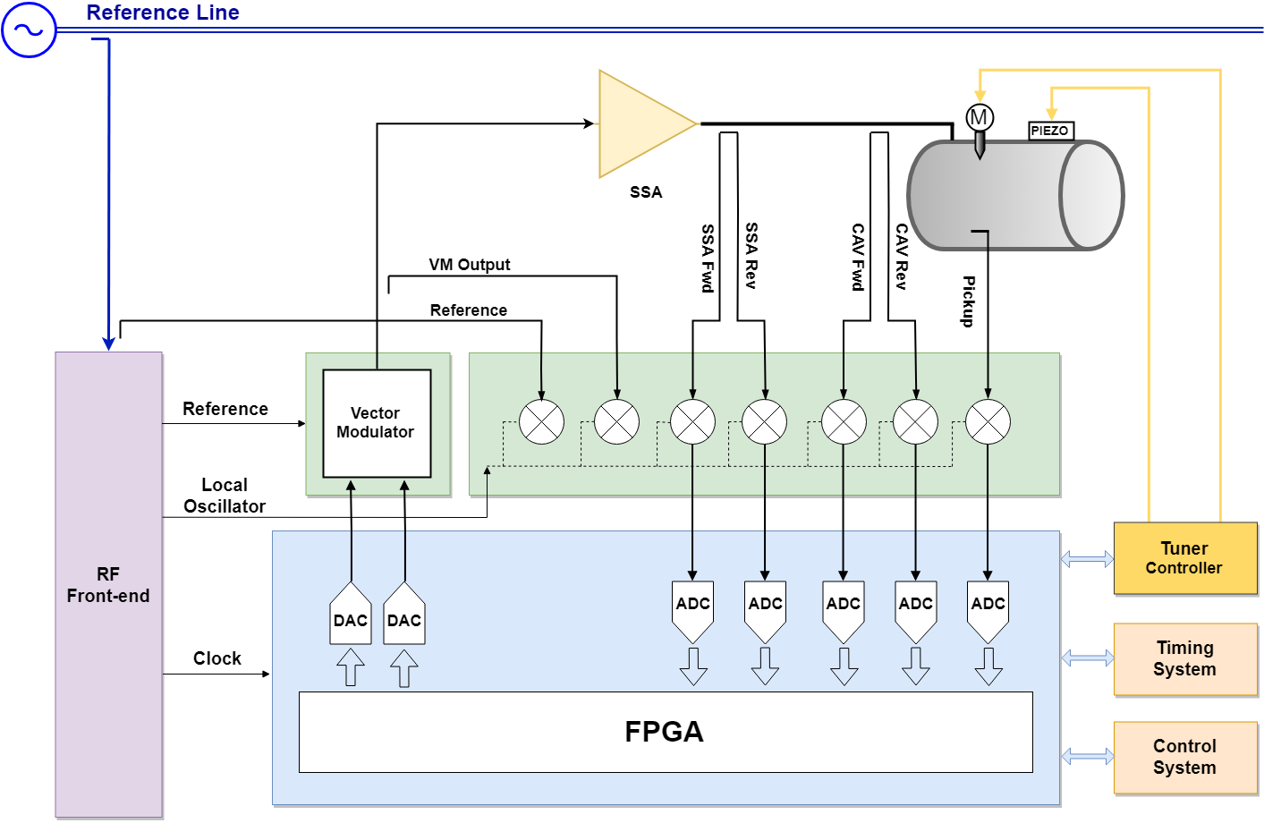
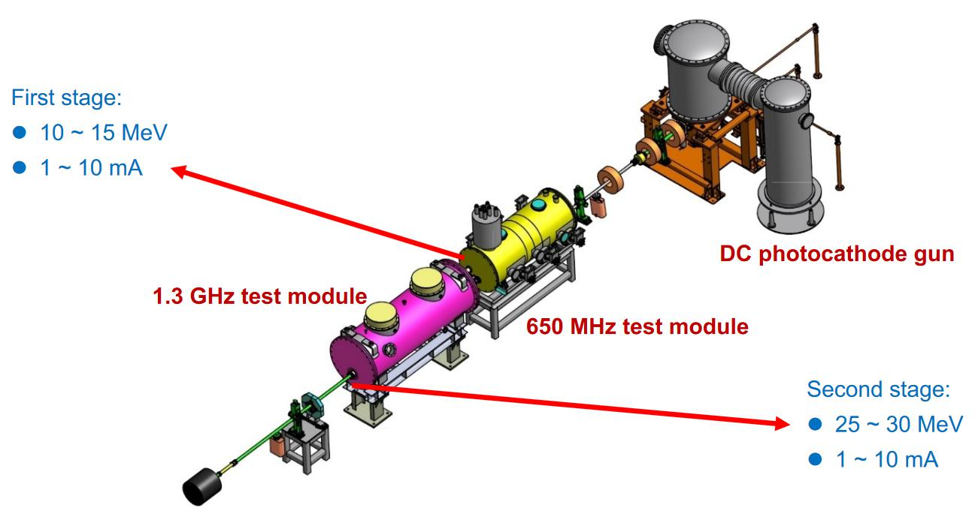
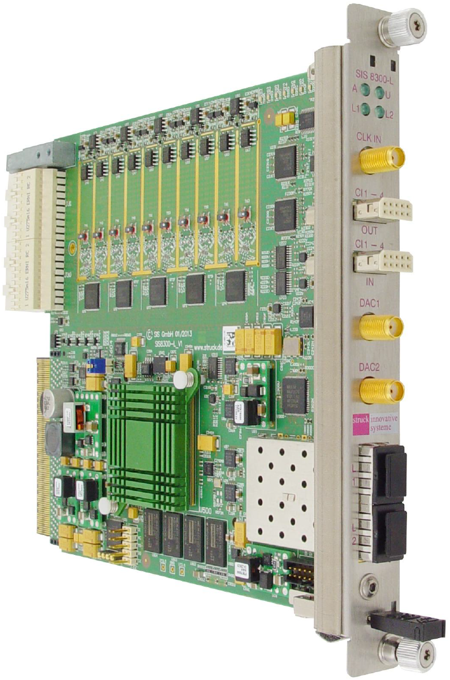
PAPS Beam Test System
A photocathode DC-Gun, a 1.3GHz buncher and two 650MHz 2-cell SC cavities in one CM
High requirement: amplitude 0.01% rms, phase 0.01 deg rms
SIS8300L2/DWC8VM1 will be used

Slide 31
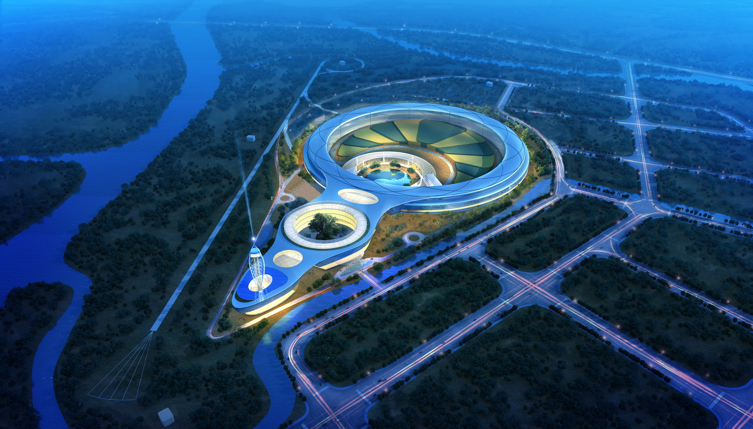
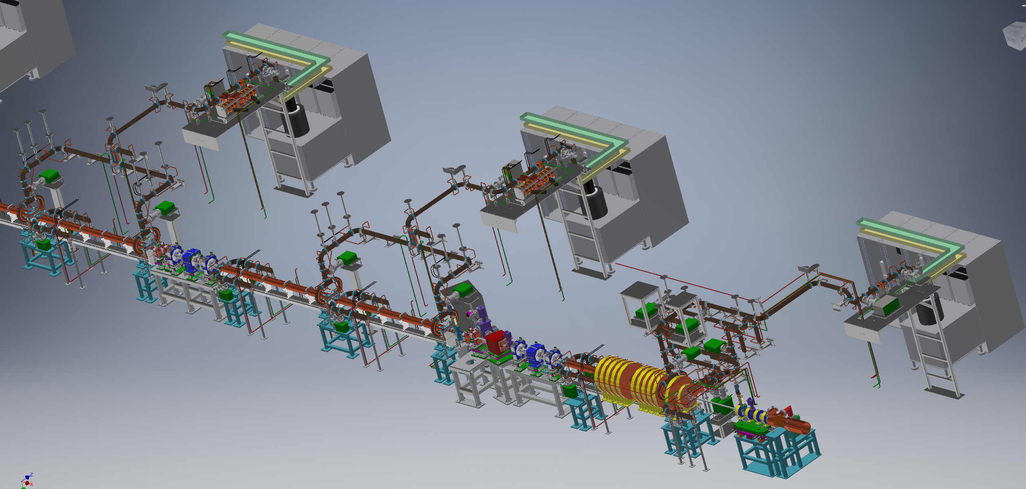
HEPS Linac
The High Energy Photon Source (HEPS), a 6 GeV green-field diffraction limited storage ring light source, will be built in Beijing, China
The light source consists of a 500 MeV Linac, a 0.5 - 6.0 GeV booster, a 6 GeV storage ring, and transport lines for connecting the accelerators

Slide 32
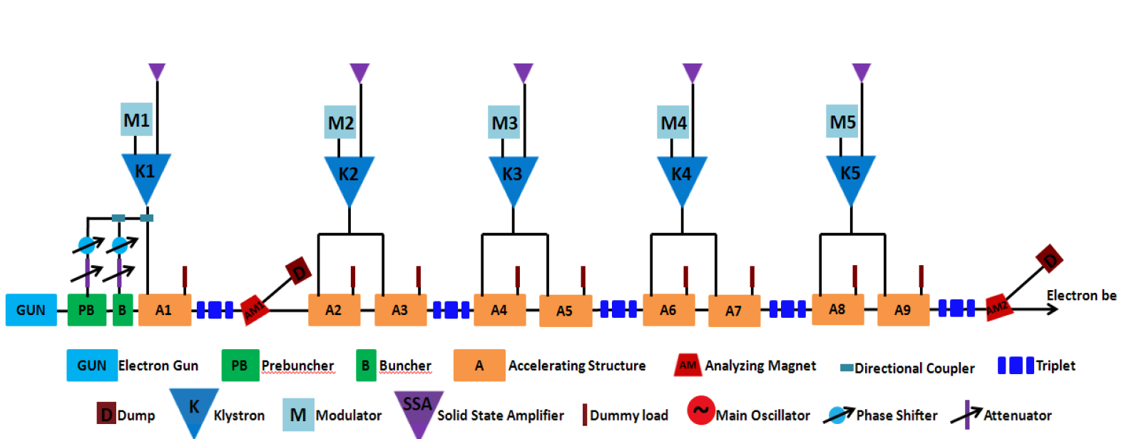
HEPS Linac
Parameter | Specification | Unit
RF frequency | 2998.8 | MHz
Single bunch charge | ≥2.5 | nC
Width of macro-pulse (FWHM) | 1.1 | ns
Width of micro-pulse (RMS) | 5 | ps
Energy | ≥500 | MeV
Relative energy spread | ≤0.5% | -
energy stability | ±0.25% | -
Max repetition rate | 50 | Hz
Normalized emittance | ≤40 | μm∙rad
Beam timing jitter | ≤100 | ps
LLRF Requirements
Inter-pulse feedback, phase stability ±0.5º
PSK with adjustable delay and width
Feedforward
Reference signal phase tracking
IQ imbalance and offset compensation
Measurement and calibrate RF loop
SWR protection
Klystron linearization

Slide 33
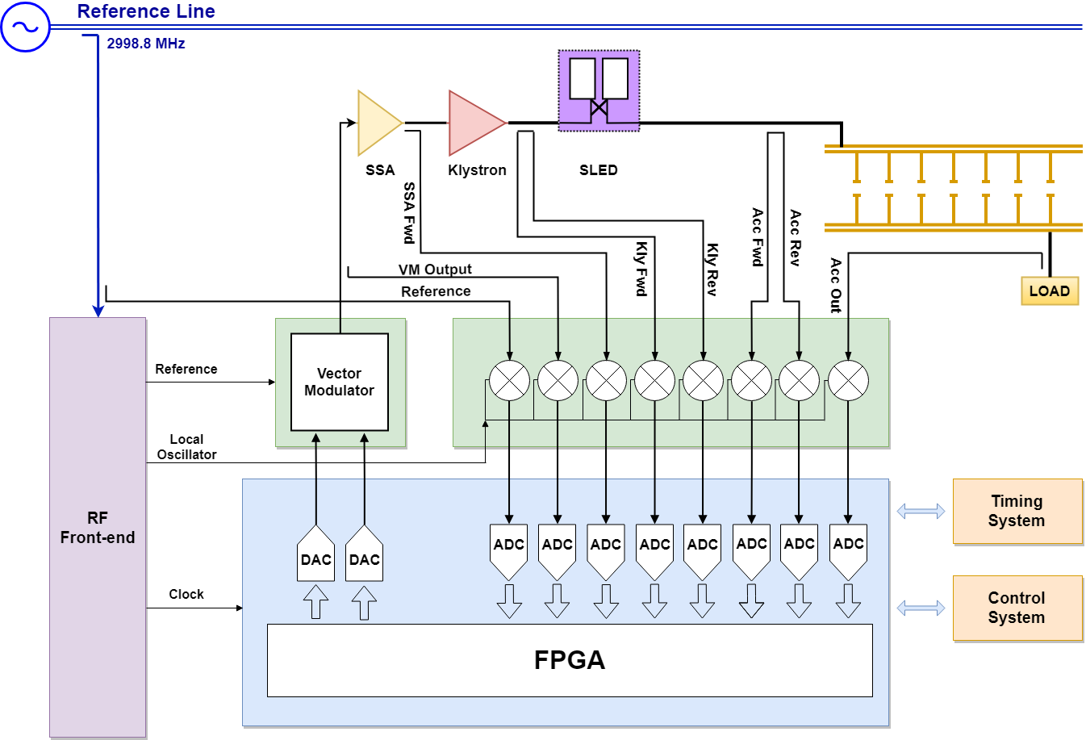
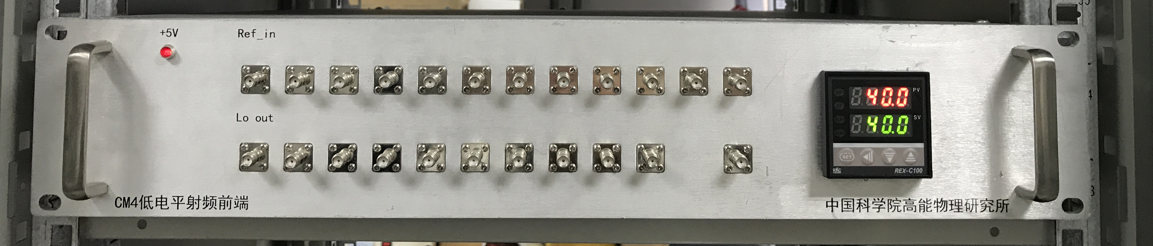
HEPS Linac LLRF Systems
RTM Front-end
LO & Clock
Generator
AMC Digitizer

Slide 34
Summary
MicroTCA.4 standard hardware platform has been successfully implemented in several projects during last five years
These MicroTCA based LLRF systems have good reliability and performance
MicroTCA.4 based LLRF system is proposed be used in future project

