Slide 1

Status of the HLS-II Control System
Gongfa Liu
24 June 2019

Slide 2
Outline
Introduction to Hefei Light Source
Overview of Control System
Development of Personnel Safety System
Plan for Post-Mortem System
Summary
2

Slide 3
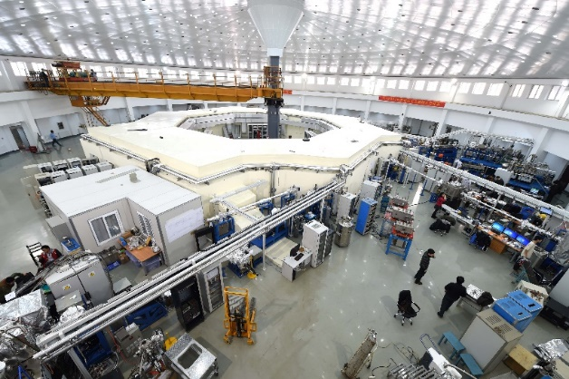
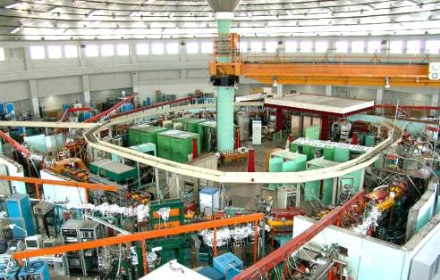
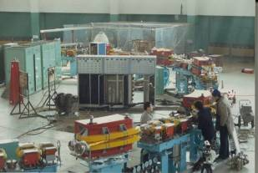
History of Hefei Light Source
HALS？
(Hefei Advanced Light Source)
Full energy injection
Lower emittance
More insertion devices
More reliable/available
More beam lines/end stations
Upgrade Project
2009-2014
800MeV/800MeV
10 beam lines/end stations
HLS-II
Phase II
1998-2004
200MeV/800MeV
15 beam lines/end stations
Phase I
1984-1991
200MeV/800MeV
5 beam lines/end stations
Notes:
本页PPT用来介绍各个阶段HLS的项目情况，以及现在HLSII所具有的参数；
3

Slide 4
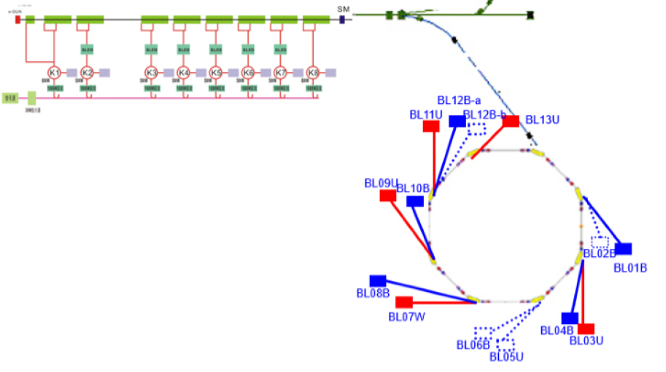
HLS-II
VUV and soft X-ray synchrotron radiation facility
0.8GeV, 66m, 38nm⋅rad, 360mA, top-off
5 IDs, 10 beam lines/end stations
Open since 2015, research projects >1200
Availability: >99% since 2016
Notes:
本页PPT用来介绍各个阶段HLS的项目情况，以及现在HLSII所具有的参数；
4

Slide 5
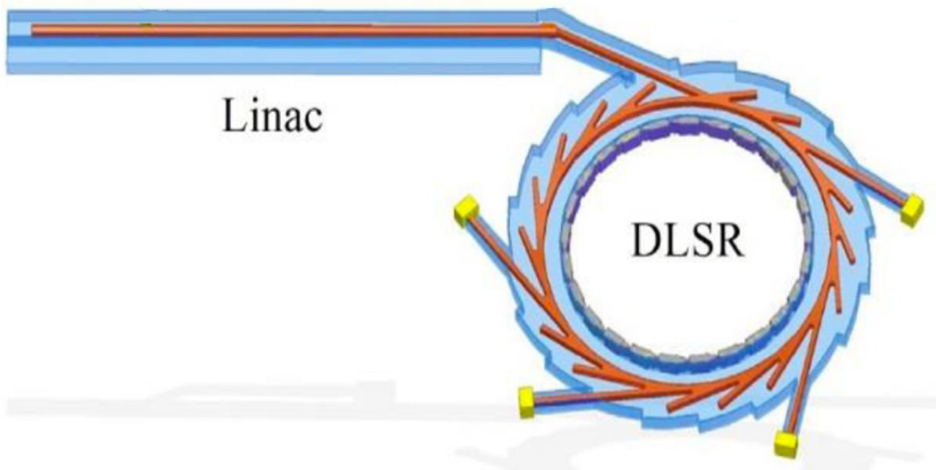
HALS
Hefei Advanced Light Source
Project under proposal
Preliminary R&D is undergoing, supported by the Chinese Academy of Sciences and local government
Soft X-ray diffraction limited storage ring (DLSR) light Source
2.4GeV, 672m, 32cells,7BA, 23pm⋅rad, 300mA
Notes:
本页PPT用来介绍各个阶段HLS的项目情况，以及现在HLSII所具有的参数；
5

Slide 6
Hardware Structure of Control System

Slide 7
Hardware Components
Server Platform: VMware vSphere
  Physical Machine: 4 DELL PowerEdge R710
  Virtual Machine: > 40, test and development platform, file server, database server, web server, softIOC
  Storage: iSCSI SAN, RAID
OPI: 5 Linux/PC + 1 virtual server, NIS
Screen Wall: 3*4 55″ LED screen
Front end controller
  cPCI: 5, timing system
  PLC: 8, IDs, vacuum valve etc.
  NI cRIO 9073: 20, temperature monitor
7

Slide 8
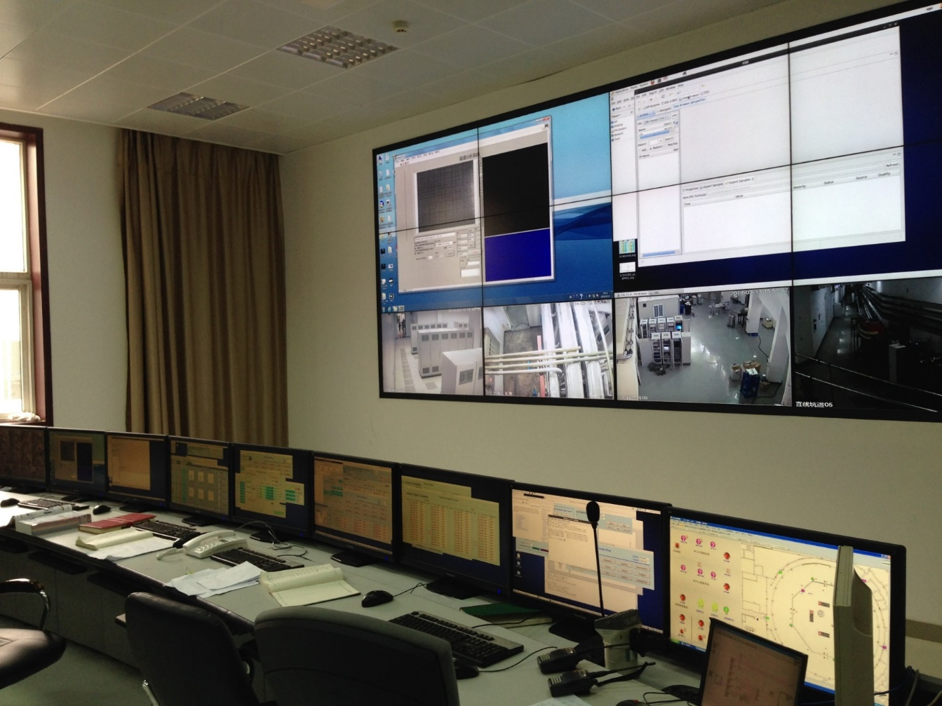
Central Control Room
8

Slide 9
Software Design
Development tools: EPICS
  base：R3.14.12.2
  modules：seq-2.1.6, asyn4-18, streamDevice-2-5, s7plc、tds3000-2.4, iocStats-R3-1-9, autosave-4-7
  Extensions：edm-1-12-75, SNS_CSS_3.1.4, pyepics-3.2.0, procServ
Operating system
  Server/OPI：CentOS 6
  SoftIOC：CentOS 6
  NI cRIO 9073: vxWorks
IOC：～15,000 records
Database
  RDB Channel Archiver＋ Oracle＋JSP
  History data:～15GB/week
Programming Language
  C/C++, Java, MATLAB, Python, LabVIEW

Slide 10
Timing System
Hardware
  cPCI controller: 5
  MRF cPCI modules
    EVG300: 1
    Fanout12: 1
    EVR300: 8
    EVRTG300: 4
Software
  OS: CentOS 6
  IOC Device/Driver Support
    General record type: ai, ao, bi, bo, mbbi and mbbo
    Developed by ourselves
Performance
  Jitter: 180ps (peak to peak), 27ps (stdev), within 24h

Slide 11
Layout of Timing System

Slide 12
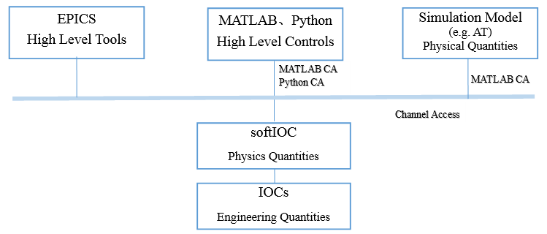
HLA(High Level Application)
Feature
  Physics Quantities Based Control
  A softIOC is used for the conversion between Engineering Quantities and Physics Quantities

Slide 13
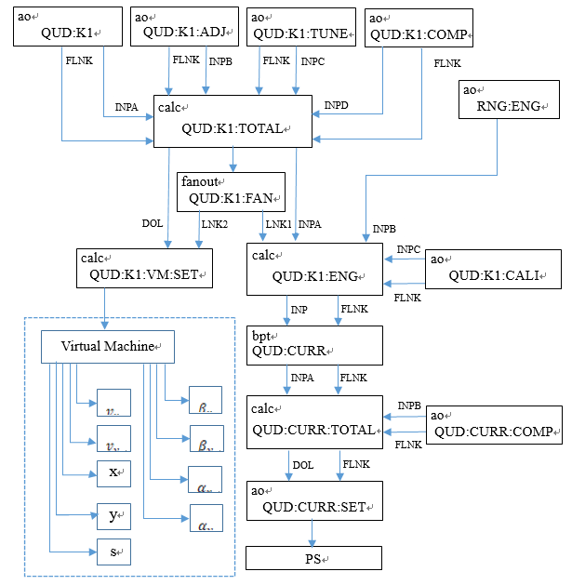
Conversion Diagram
13

Slide 14
Archiver System
Data Archiver
  RDB Channel Archiver: Oracle
  Python Scripts: SQLite，Data file
  Java Channel Access: IOC
Data Retrieval
  Front end: Vue.js
  Back end: Spring Boot
  Web server: Nginx
  Functions
    Operation status
    Historical data query: customized, free
    Data analysis
    Radiation dose monitor
    PSS (Personnel Safety System) access information
14

Slide 15
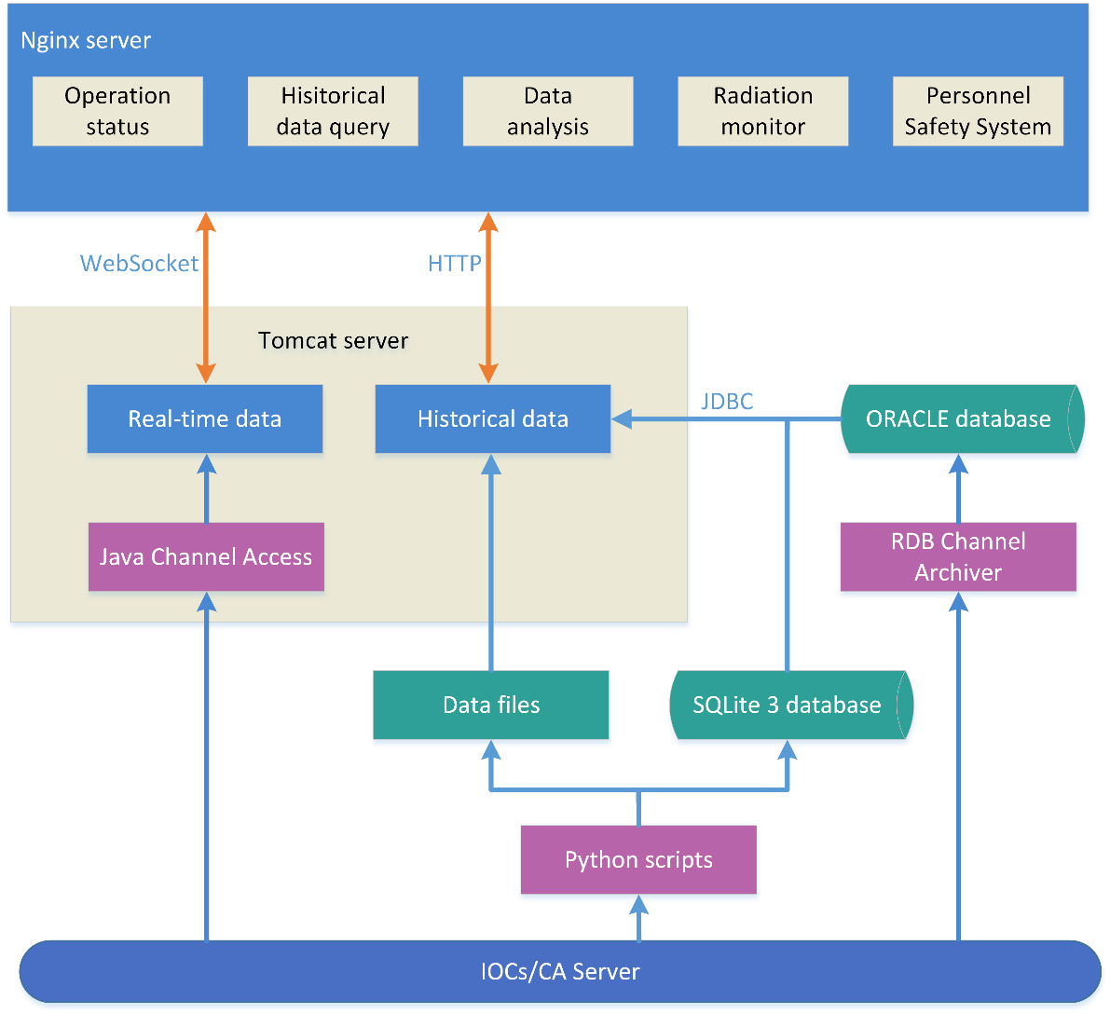
Structure of Archiver System
15

Slide 16
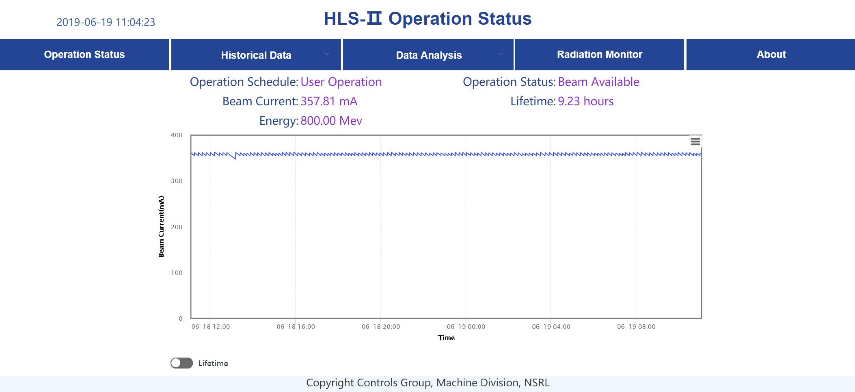
Operation Status
16

Slide 17
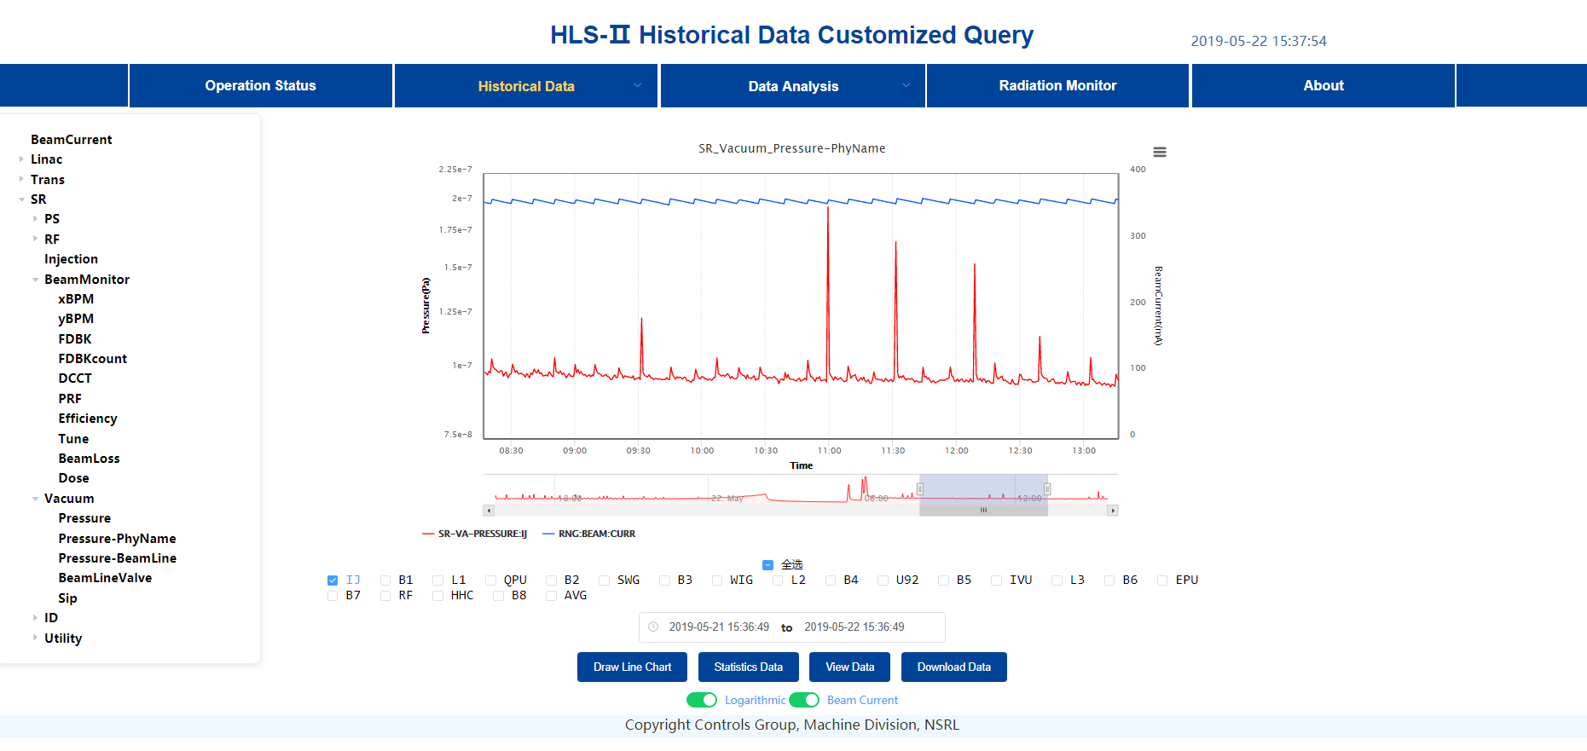
Data Query: Customized
17

Slide 18
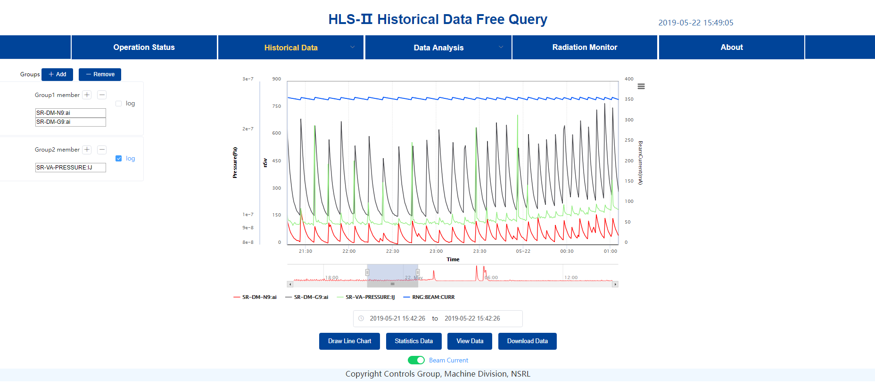
Data Query: Free
18

Slide 19
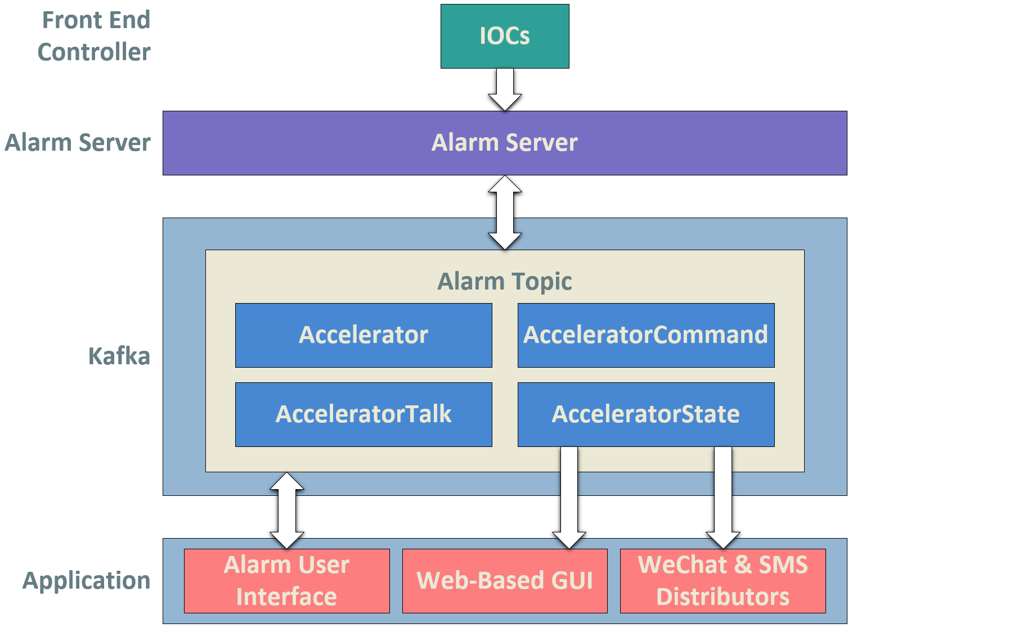
Alarm System Based Phoebus/Alarms

Slide 20
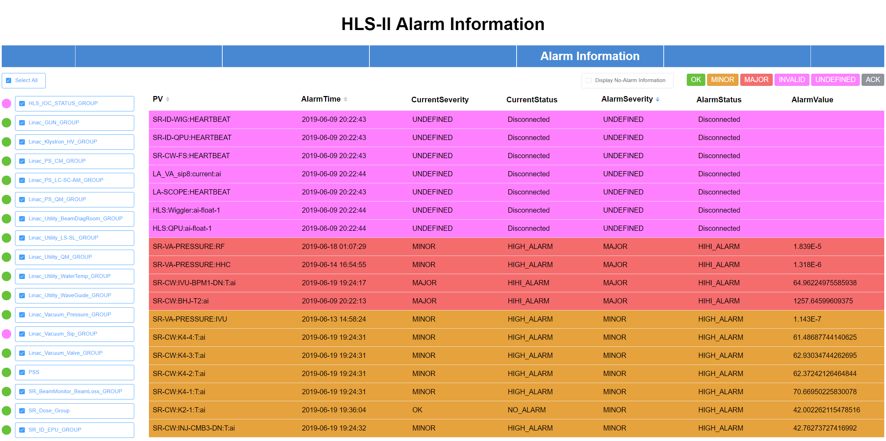
Web Based GUI of Alarm System

Slide 21
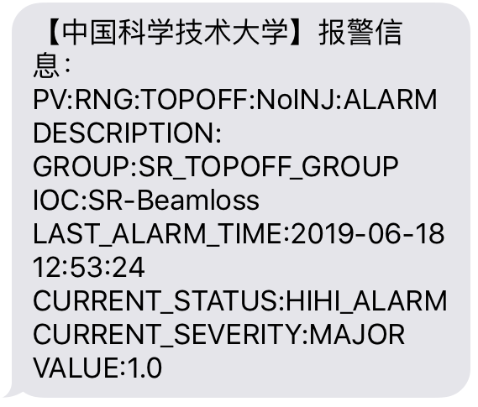
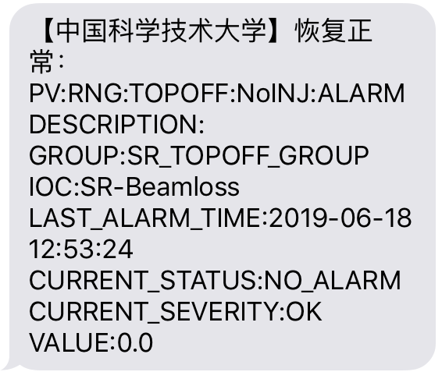
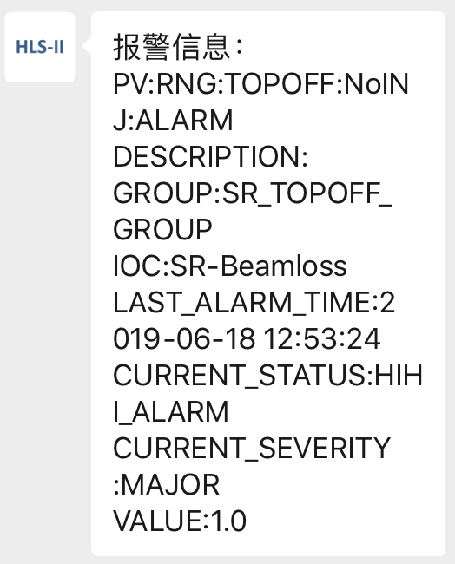
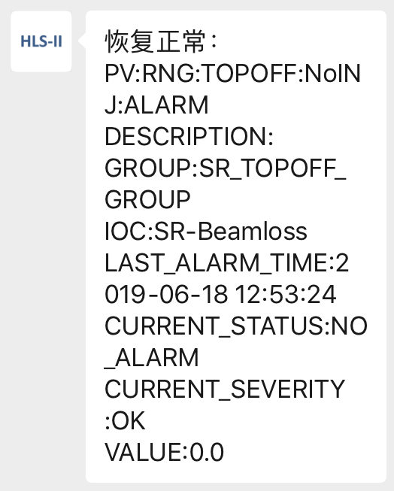
Alarm Messages Distributed by SMS& WeChat
SMS: Failure Message Recovery Message
WeChat: Failure Message Recovery Message

Slide 22
Personnel Safety System (PSS)
Upgrade Background
  The existing system is based SiPASS, turn-key mode
    Not easy to maintain
    Can not share info
  Add the function of personnel management
Development
  Hardware
    Redundant PLC: Siemens S7-412-5H
    PROFINET
  Software
    EPICS
    IOC Driver for Redundant PLC
Offline Test：has worked well since Mar. 2019
To be installed in Aug. 2019

Slide 23
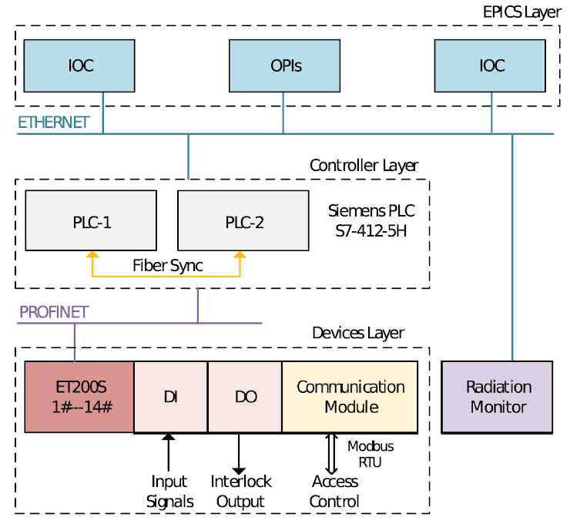
System Architecture of PSS
EPICS IOC/OPI
Redundant PLC
Front Device
  IO Station：14
  Door: 14
  Input Signal: 149
  Output Signal: 46

Slide 24
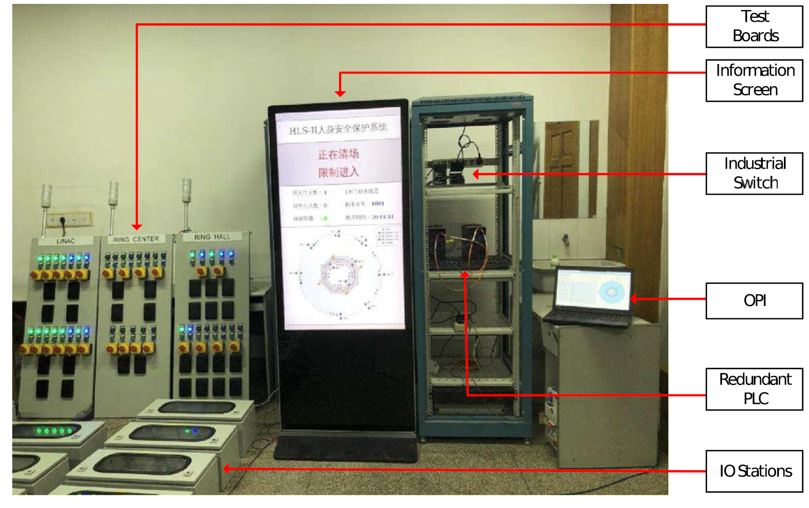
Photo of PSS Test Platform

Slide 25
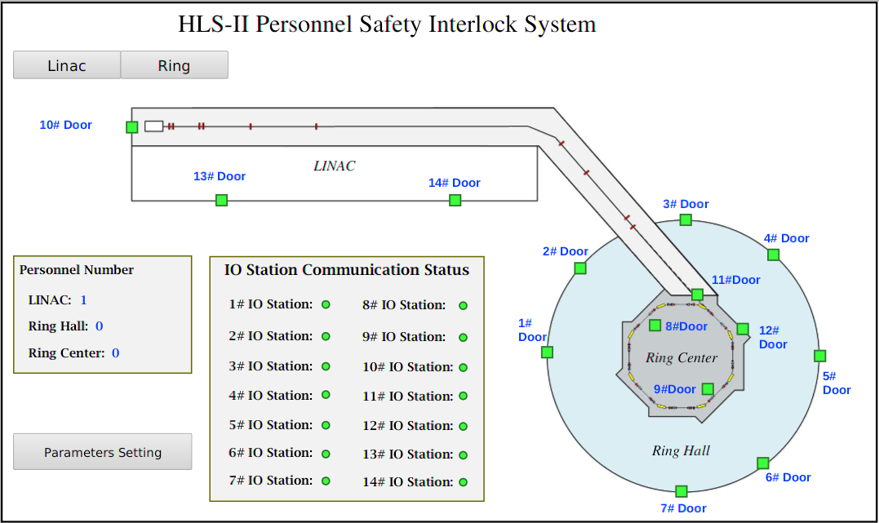
Control Panel of PSS

Slide 26
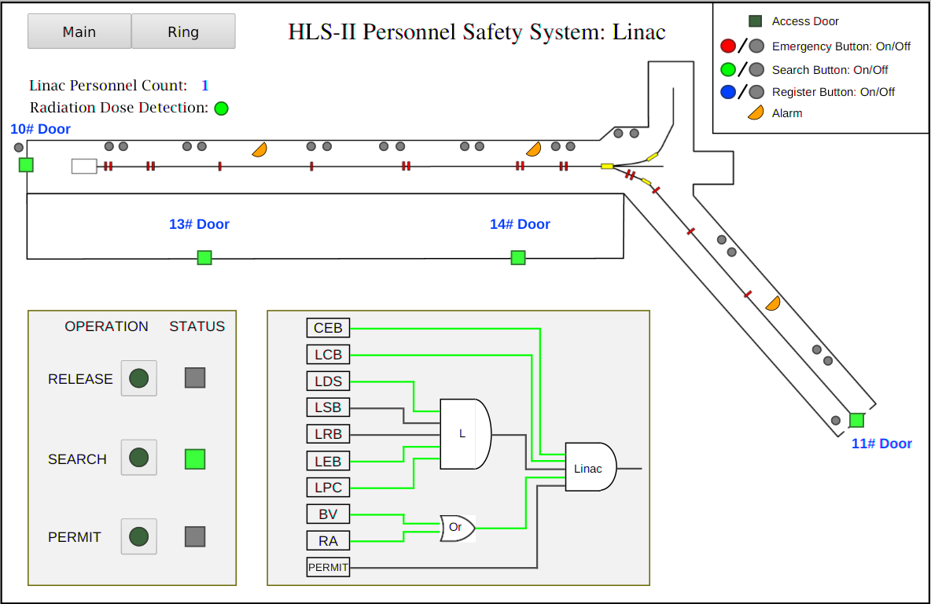
Control Panel of PSS: Linac

Slide 27
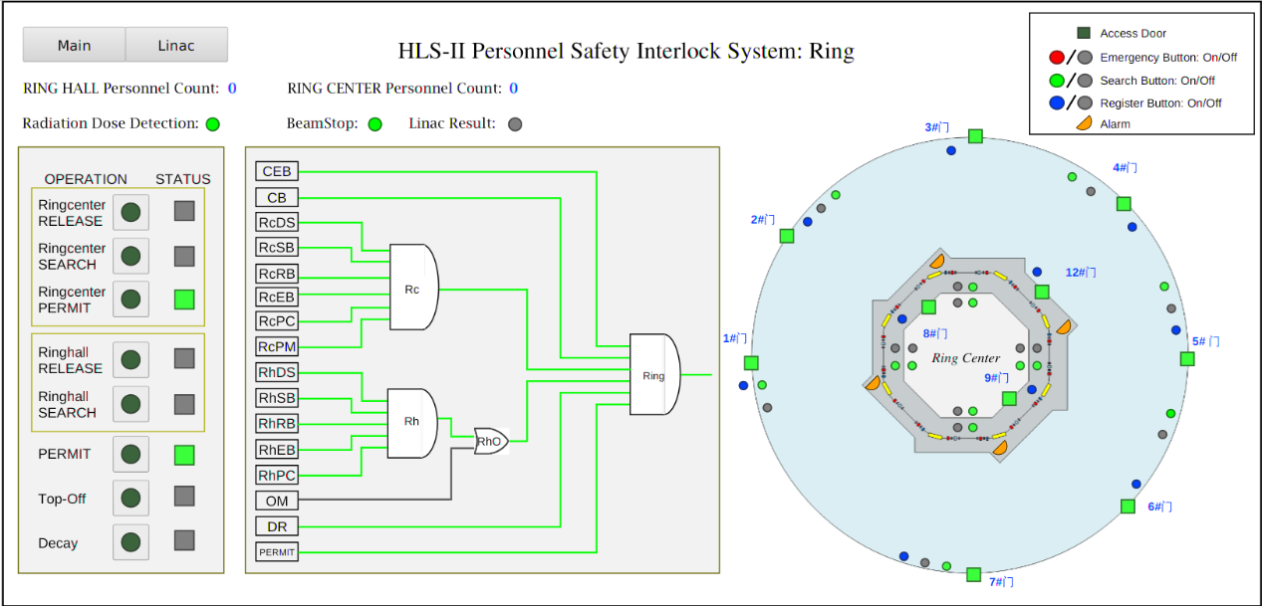
Control Panel of PSS: Ring

Slide 28
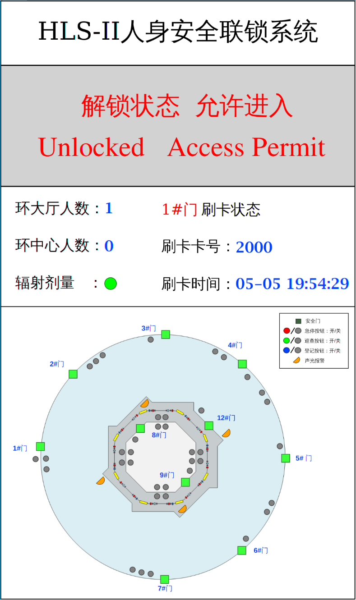
Info Screen of PSS Beside the Door

Slide 29
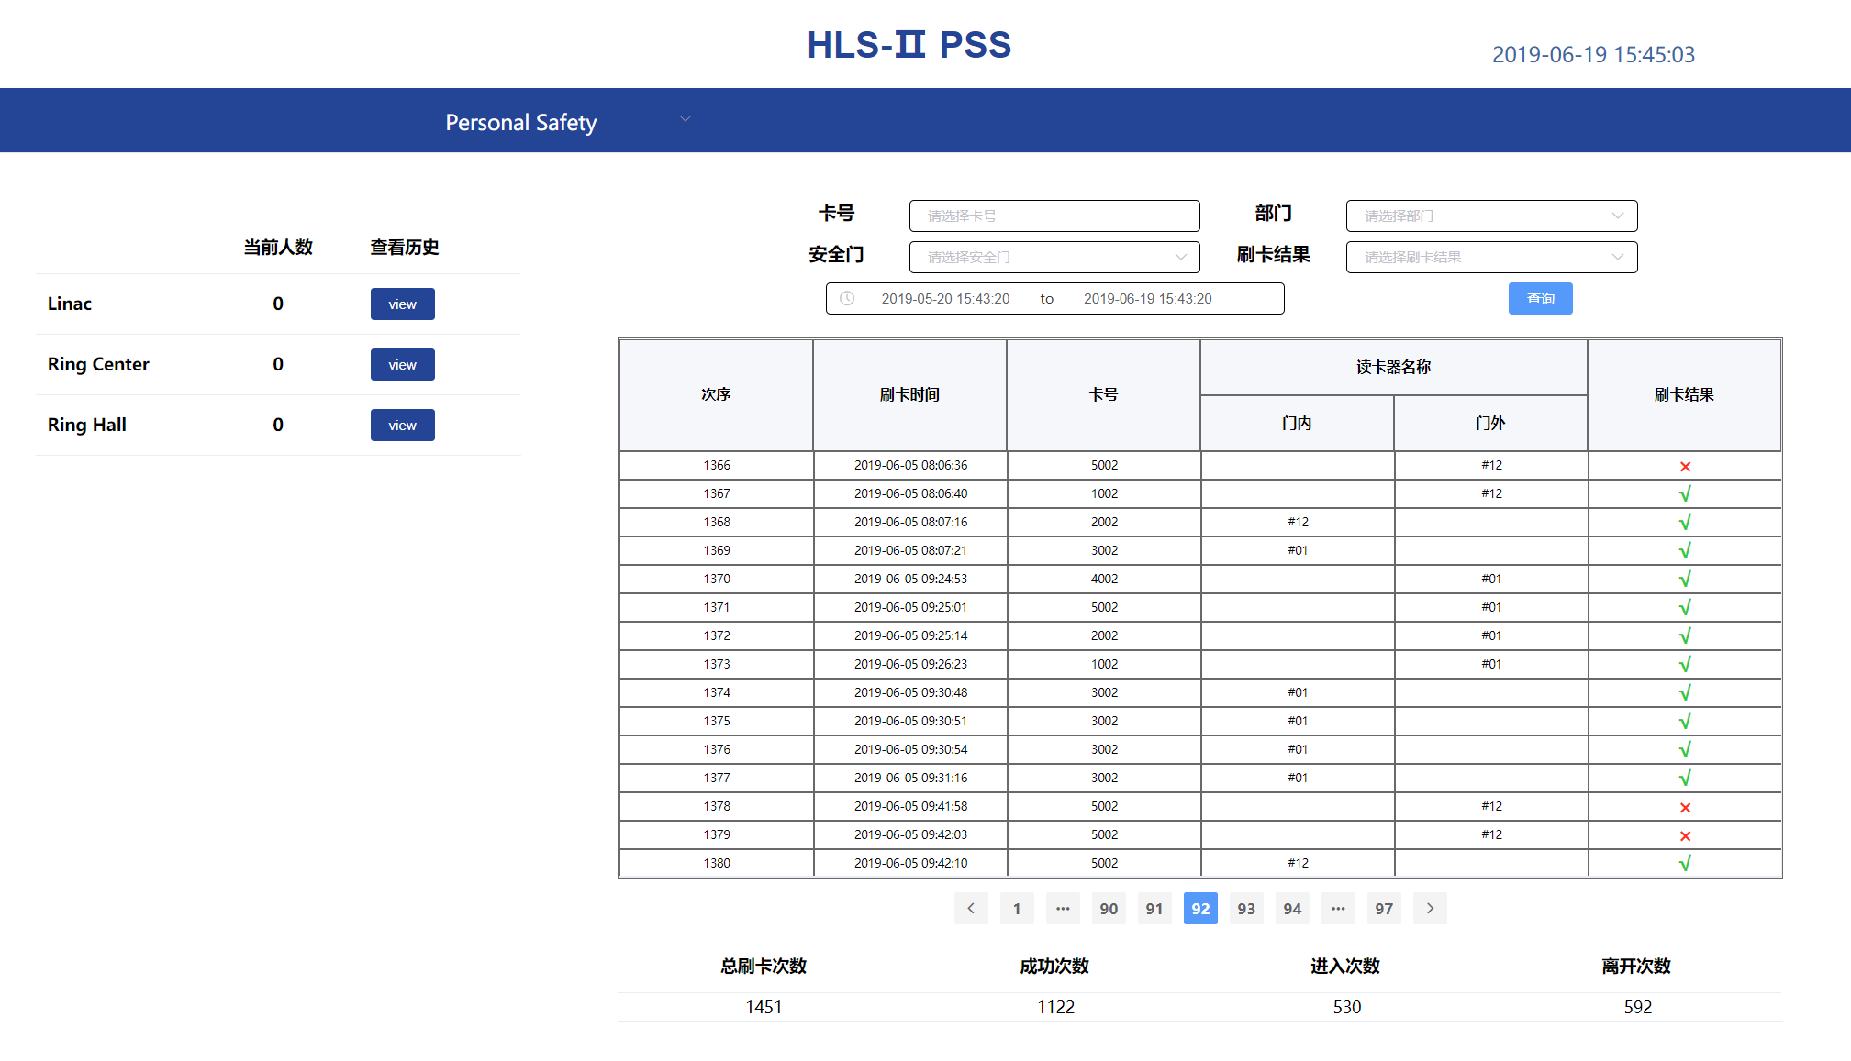
Access Information of PSS

Slide 30
Post-Mortem System（PM）
Important tool to analyze the cause of beam trip
PM Components
  Generation and distribution of the trigger signal
  Storage of relevant signals
    RF, BPM, PS, etc.
  Data Recorder
    BPM platform, Oscilloscope, Data Recorder, etc.
Our Plan
  YOKOGAWA DL850E ScopeCorder
  Update the timing system to distribute the trigger signal
  …

Slide 31
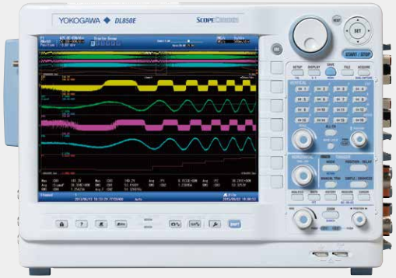
Architecture of PM
YOKOGAWA DL850E ScopeCorder
  8 input module slots
  Up to 128 channels
  Up to 100 MS/s sampling rate
  Up to 16-bit analog resolution

Slide 32
Summary
The control system has been put into operation since 2015
  Failure Time: 2.5 Hours totally
  Stable and Reliable
Use virtualization technology to build the server system
Try to use the software existing in the EPICS community as much as possible
Make development based on the existing software, e.g. the timing system, the alarm system, etc.
Minimize the kinds of hardware and software
Develop the new PSS with EPICS, redundant PLC and PROFINET
Plan to set up the post-mortem system

Slide 33
Thank You！

