Slide 1
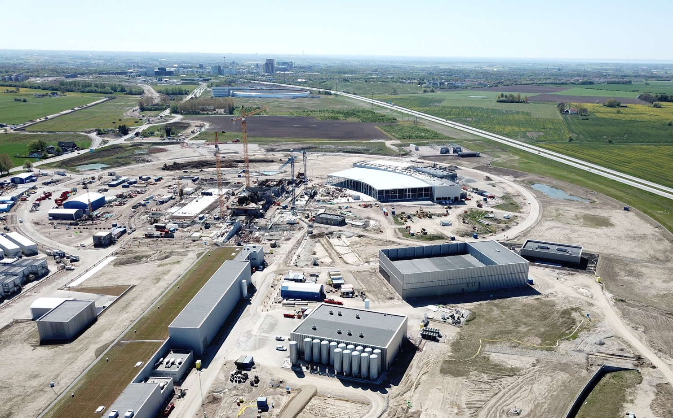

  MicroTCA deployment at the European Spallation Source
  Henrik Carling - Head of integrated control systems division
  2019-06

Slide 2

ESS - production of neutrons
Fission of uranium
in nuclear reactor
2-3 neutrons per process
Spallation is a process in which fragments of material (spall) are ejected from a body due to impact or stress. In the context of impact mechanics it describes ejection or vaporization of material from a target during impact by a projectile.
Spallation on target
using proton accelerator
>30 neutrons per process

Slide 3
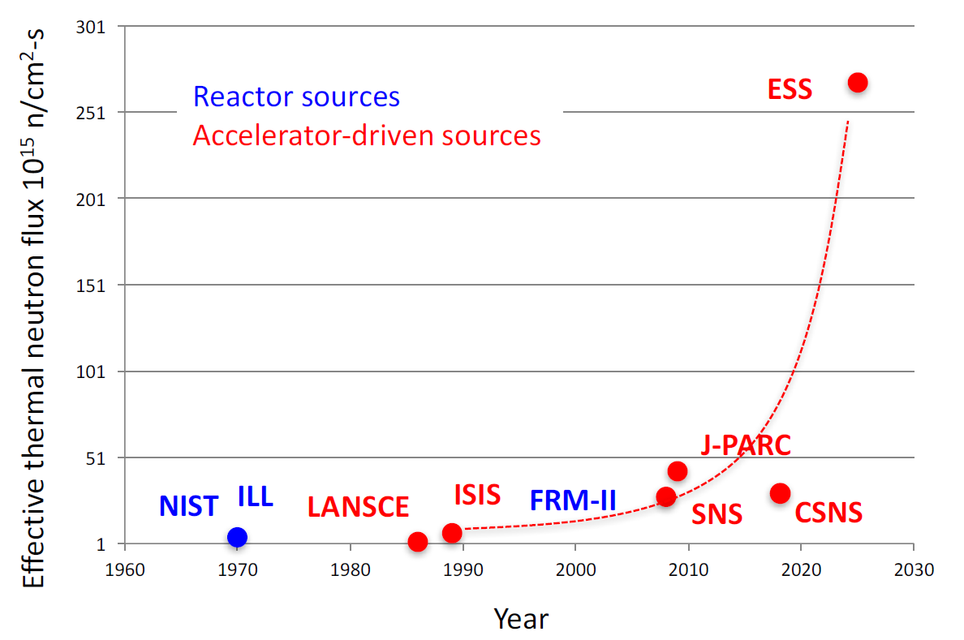
ESS will be the world brightest neutron source

Slide 4

Journey to deliver the world’s leading facility for research using neutrons
2025
ESS Construction Phase Complete
Now
2014
Construction Starts on Green Field Site
2023
ESS Starts
User Program
2009
Decision to Site ESS in Lund
2022
Machine Ready for
1st Beam on Target
2012
ESS Design Update Phase Complete
2003
European Design of ESS Completed

Slide 5
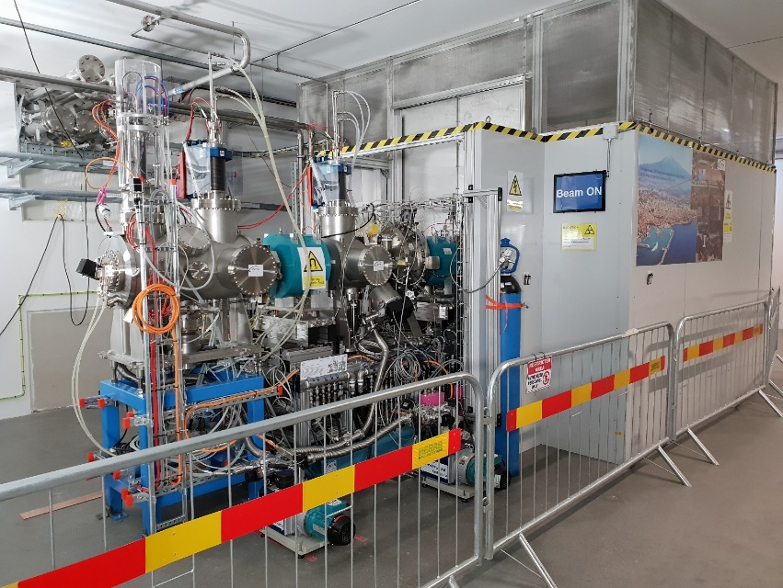
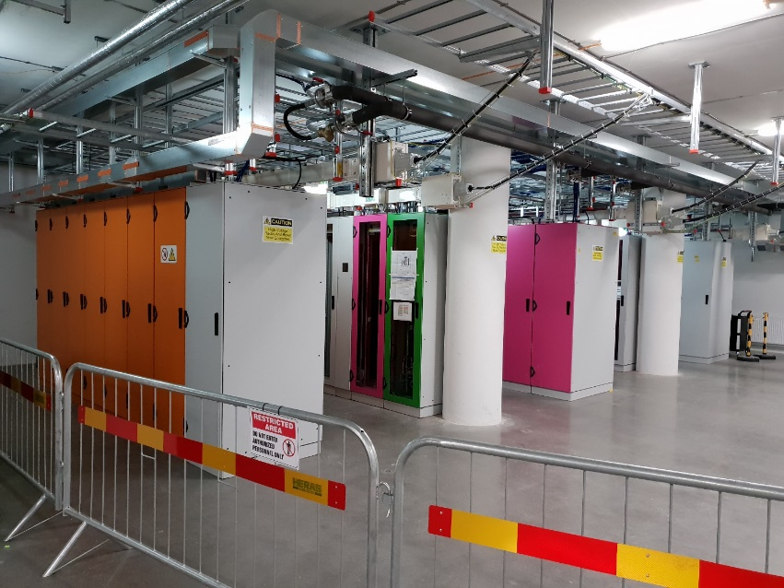
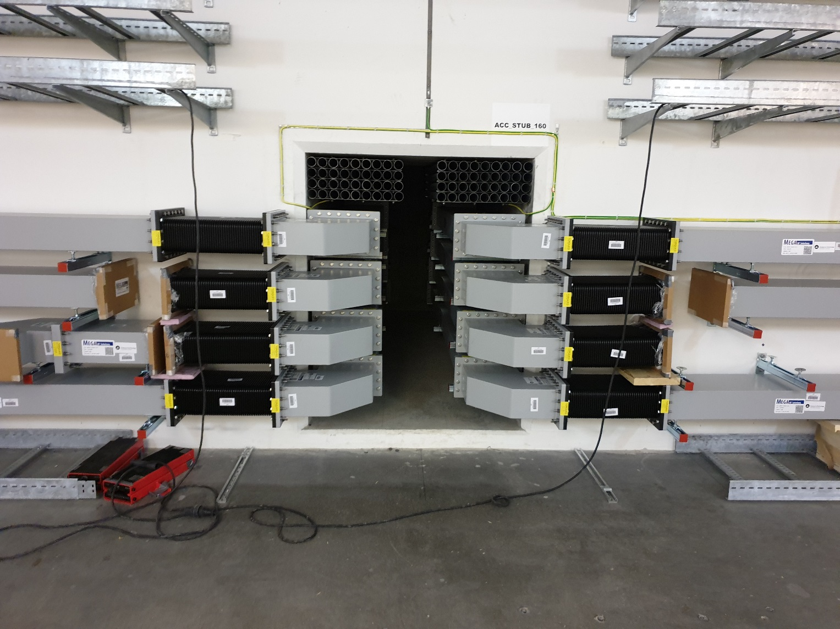
ESS construction is 56% complete
2019 is the peak of construction activity
In-kind deliveries of high tech equipment arriving
Accelerator part of the facility to be ready in 2020/2021
Target part to be ready in 2022

Slide 6
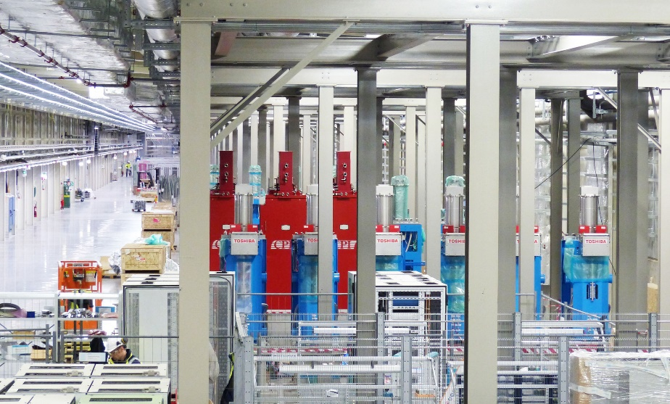
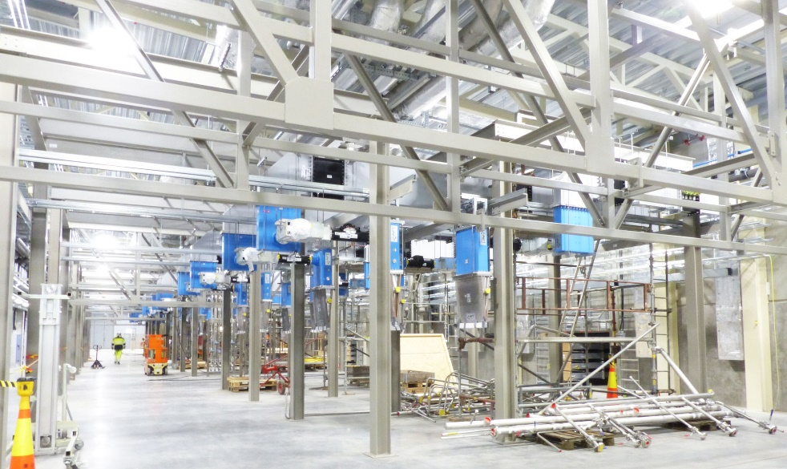
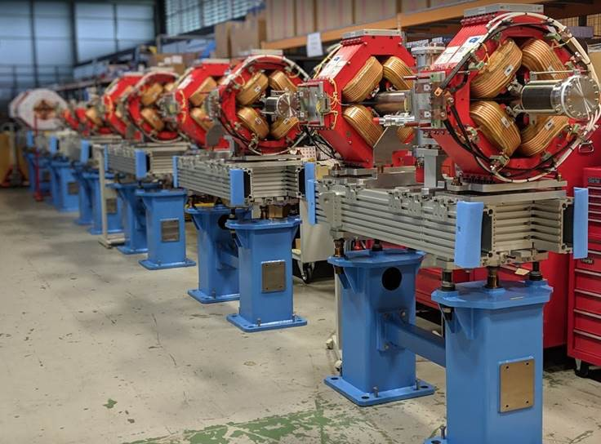

ESS - A facility under construction
Klystrons, magnets and equipment racks

Slide 7
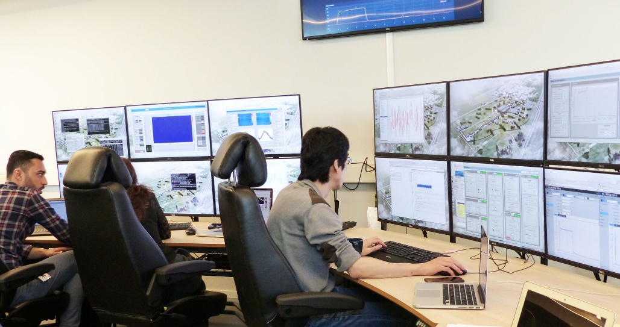
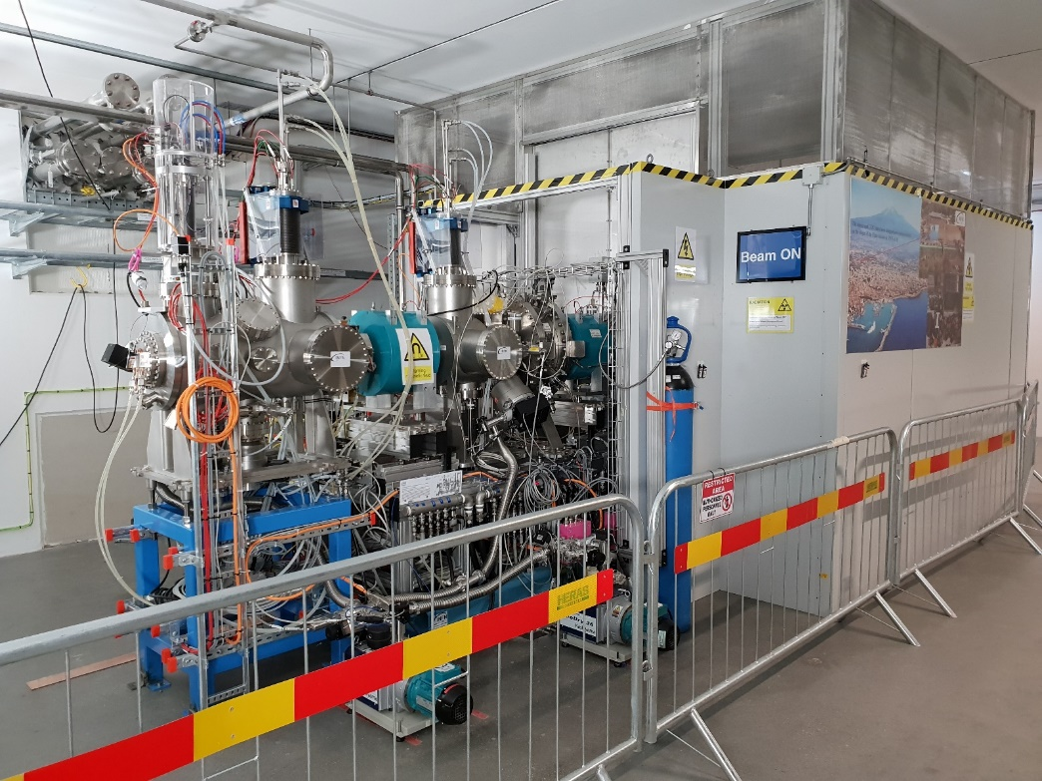
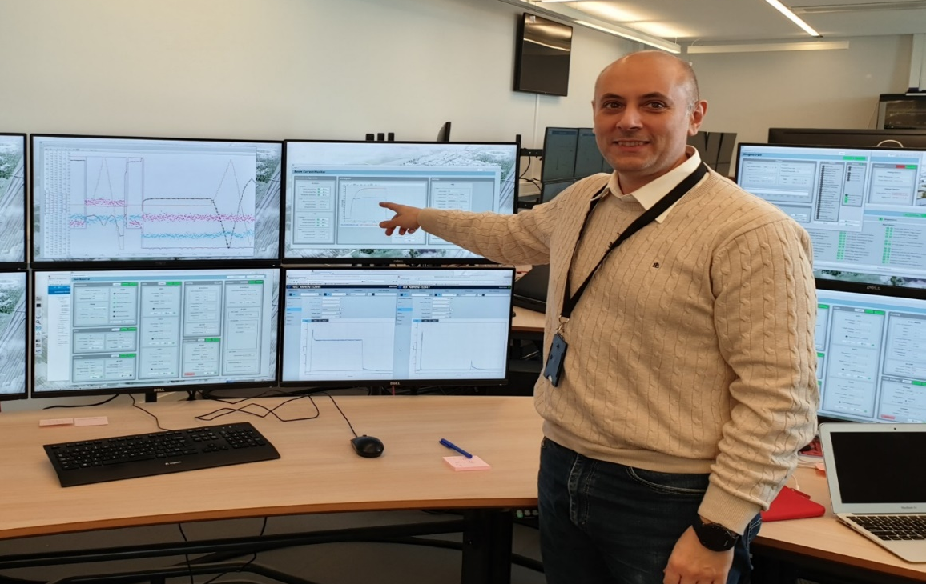
Commissioning the first parts of the accelerator
Ion source and low energy beam transport
First beam in temporary control room

Slide 8
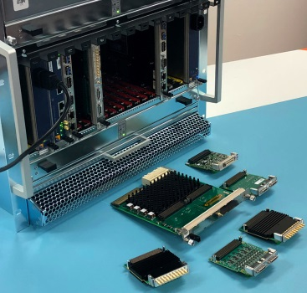
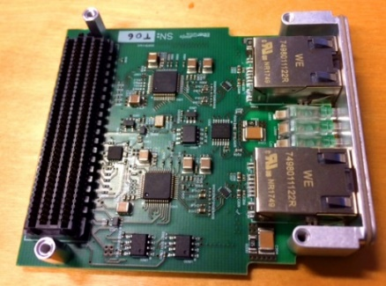
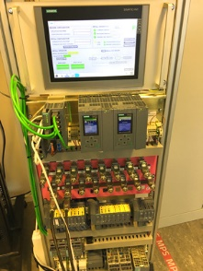
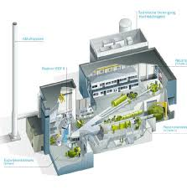
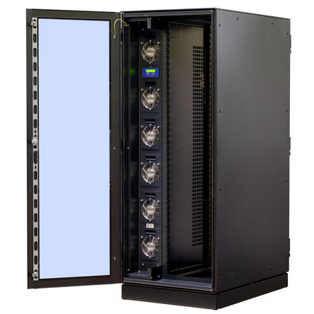
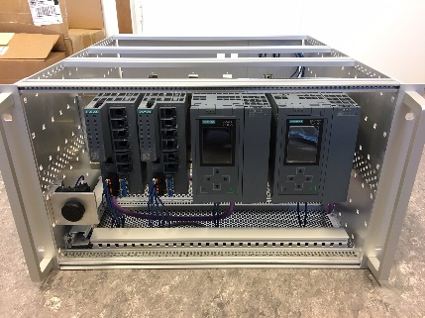
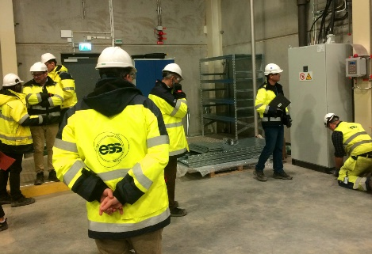
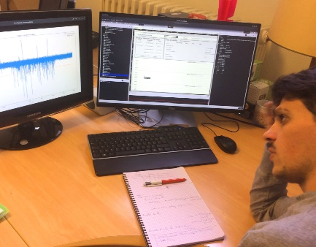
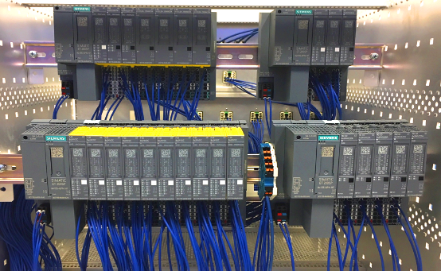

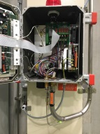
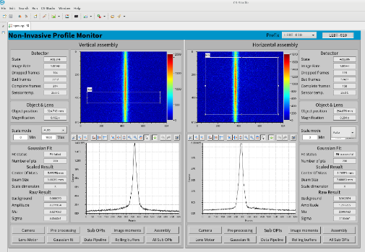
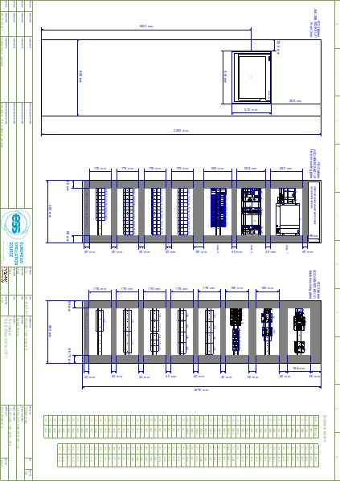
Control system installations

Slide 9
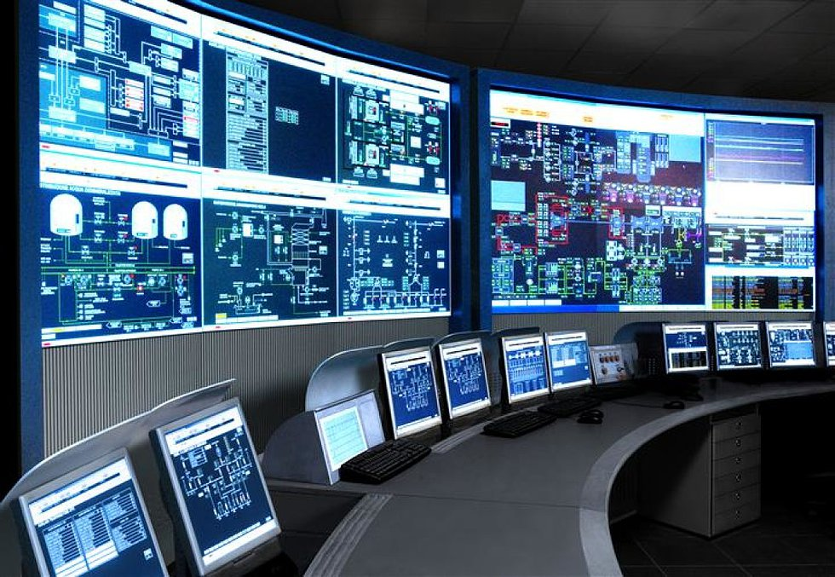
The ESS integrated control system
The ESS facility is a large and complex machine with very much and diverse equipment that needs to work in synchronization and with well-known configurations
The Integrated Control System Division (ICS division) is responsible for the control systems within the ESS facility including controls for
  Accelerator
  Target
  Neutron Scattering Systems
  Conventional Facilities
In addition, ICS will implement
  Machine Protection System
  Personnel Safety System
To build a distributed control
system of this size is a major
undertaking

Slide 10



ESS/ICS challenges
The ESS control system complexity is very high
  About 1 600 000 “process values”
  Ambitious approach to automation of control system configuration
Facility availability goals are very high
  ICS plays a key role for the availability of the facility - 95% availability
  High performance and availability requirements on equipment used
Some new approaches will be implemented at ESS/ICS
  Full scale deployment of EPICS 7
    ESS is committed to contributing to the EPICS community
  Full scale deployment of MicroTCA.4
    ESS is involved in a public procurement for innovation initiative
  Machine learning/Artificial intelligence assisted control system
    Project started to explore how machine learning technologies can be applied

Slide 11





ICS Project scope
Work package 01 Management and administration
Work package 03 Software core
Work package 04 Hardware core
Work package 05 Machine protection
Work package 06 Equipment
Work package 07 Control system infrastructure
Work package 08 Physics
Work package 09 Personnel safety systems
Work package 10 Integration - Accelerator
Work package 11 Integration - Target
Work package 12 Integration - Instruments
Work package 13 Integration - Conventional facilities
Work package 14 Test Stands
Work package 20 Installation
Software
Electronics
Infrastructure
Safety & protection

Slide 12
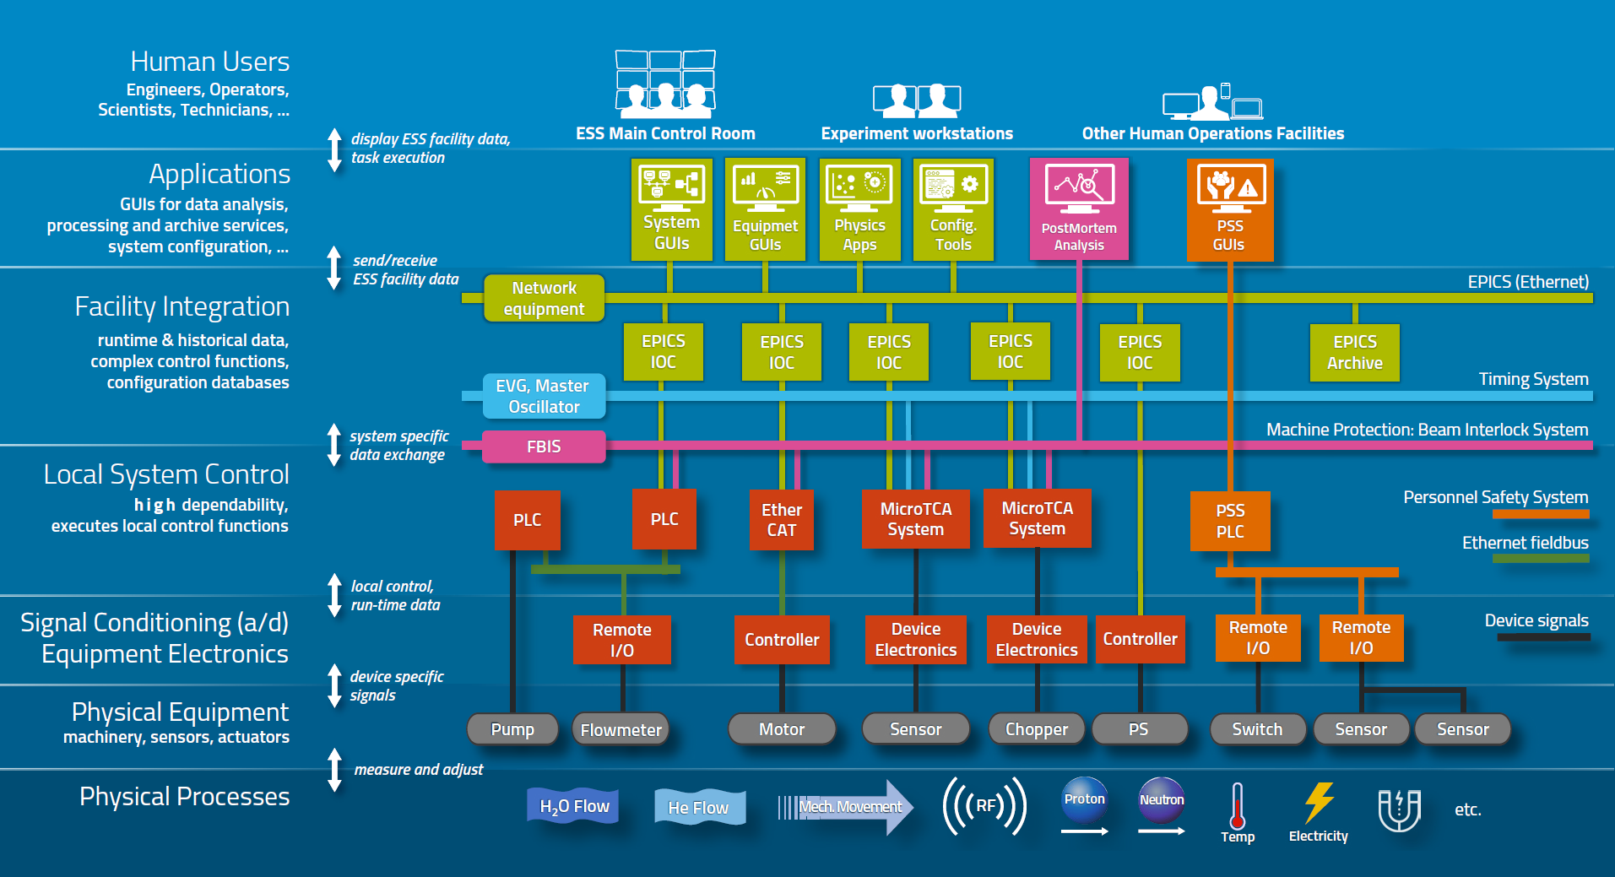
Control system layers
Complex, multi-layered control system based on EPICS

Slide 13
MicroTCA at ESS

Slide 14
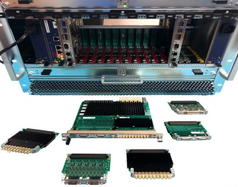

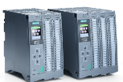
Three layers of hardware at ICS
Signal speed
MicroTCA boards with a powerful FPGA. A FPGA framework constitutes the development environment. The CPU runs EPICS
ICS has adopted a three layer strategy for implementing the control system based on signal speed
  Platforms based on MicroTCA for applications with data acquisition exceeding 100 kHz
  The CPU will run EPICS and the FPGA will have a complete application development environment
  For slower signals, EtherCAT will be used as a real-time fieldbus with good price/performance ratio
  Synchronization and event information are key for applications where a full custom platform solution would be too costly
  Low speed signals are handled with commercially available PLC systems from Siemens
  This is a cost-effective solution that addresses ESS reliability and maintainability requirements
  The PLC:s will be connected to EPICS for further integration into the control system
10 MHz
1 MHz
100 kHz
10 kHz
1 kHz
Digital controls platform
100 Hz
EtherCAT I/O modules that are connected to commercial or open-source EtherCAT master controllers which are in turn connected to the EPICS based control system
10 Hz
EtherCAT
1 Hz
Slower signals are handled by industrial automation (PLC) for reliability and cost reasons. The standardized platform for ESS applications comes from Siemens
0.1 Hz
Industrial automation (PLC)

Slide 15
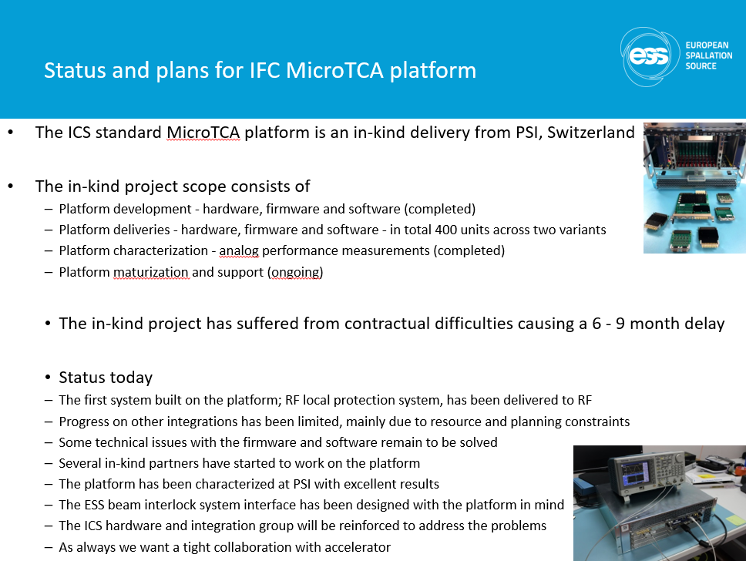
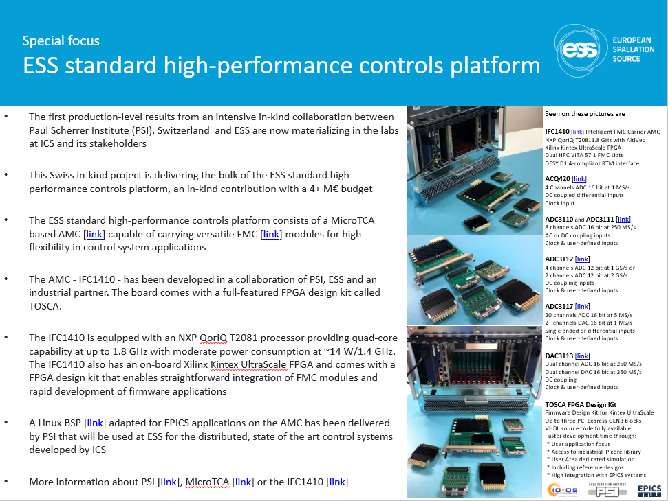
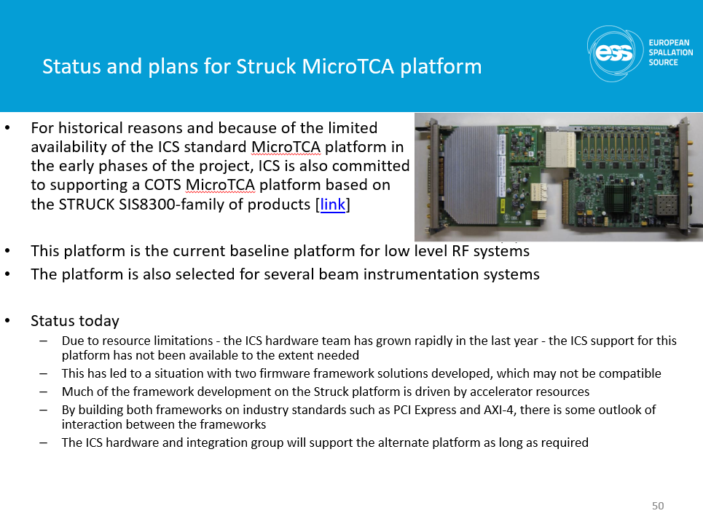
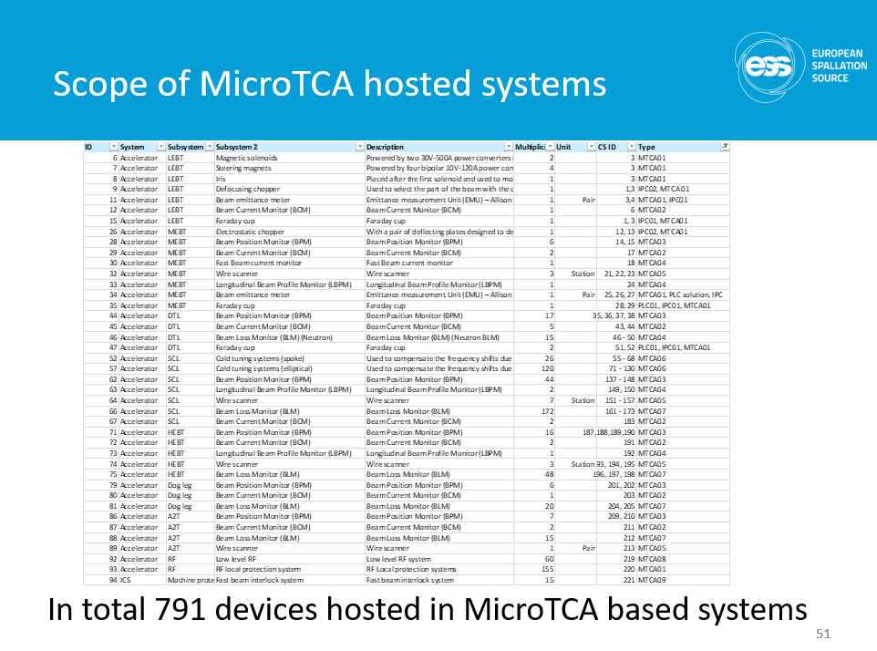
ESS driving technology - MicroTCA
ESS is investing significantly in MicroTCA technology
ESS will be around for many years to come
MicroTCA is a hardware platform generating a lot of interest

Slide 16
Why MicroTCA.4?
MicroTCA® is a modular, open standard for building high performance switched fabric computer systems in a small form factor. The standard is built on Advanced Mezzanine Cards which provide processing and I/O functions. Hundreds of different AMC’s are commercially available.
MicroTCA has its background in smaller telecom systems but has moved into
many non-telecom applications, with standardized, ruggedized versions becoming popular in mobile, military, telemetry, data acquisition, and avionics applications.
Because of its modularity and flexibility, MicroTCA is well-suited for a wide range of applications, including industrial control and automation, test & measurement, mobile and fixed mil/aero, avionics, traffic control and transportation, telecom and more
Key Benefits and Features
  Provides computer architecture consistent with Modular Open Systems Approach principles for reduced life cycle costs
  Defines fully redundant and non-redundant system configurations including power budgeting and hot-swap
  Defines complete component and system management that allow failure detection and isolation

Slide 17
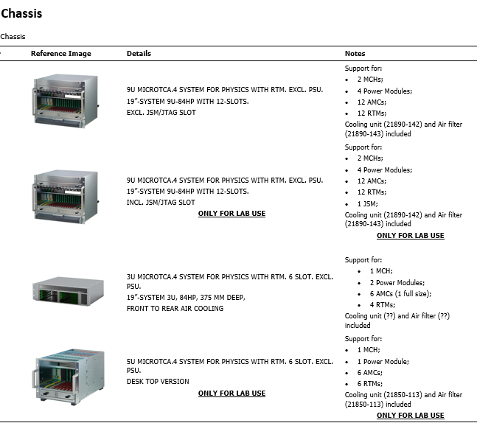
ESS standardized MicroTCA products
In order to create a cost-efficient development and deployment, ICS has created a standardized product portfolio for MicroTCA products
For high-volume products, framework contracts have been created
All ESS MicroTCA users, including in-kind partners, use the same product portfolio to minimize maintenance and delivery issues

Slide 18
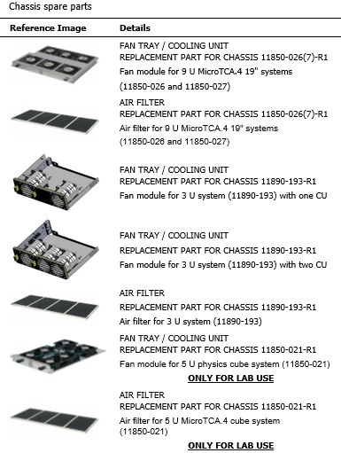
Range of standardized MicroTCA products
The ESS/ICS standard product portfolio
contains a range of equipment including
  Chassis
    Chassis replacement parts
  Power Modules
  MCH (PCI-express/Multi GbE)
  Advanced Mezzanine Cards
    CPU
    FMC Carrier
    DAQ
    Timing System
    Other AMCs
  Rear Transition Modules
    CPU
    DAQ signal conditioning
    Other RTMs
  FPGA Mezzanine Cards

Slide 19

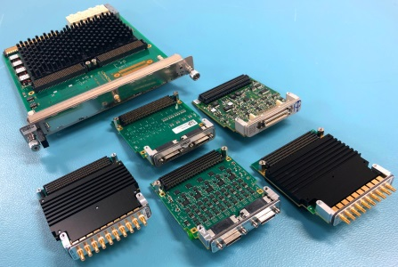
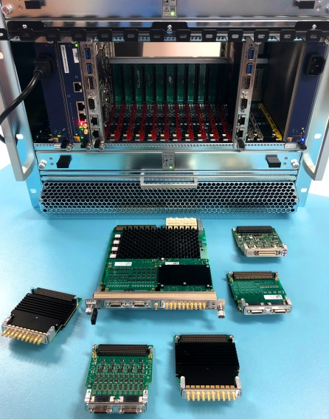



Example:
ESS standard high-performance controls platform
The first production-level results from an in-kind collaboration between Paul Scherrer Institute (PSI), Switzerland and ESS are being deployed at ESS
This Swiss in-kind project is delivering the bulk of the ESS standard high-performance controls platform as an in-kind contribution
The ESS standard high-performance controls platform consists of a MicroTCA based AMC [link] capable of carrying versatile FMC [link] modules for high flexibility in control system applications
The AMC - IFC1410 - has been developed in a collaboration of PSI, ESS and an industrial partner. The board comes with a full-featured FPGA design kit called TOSCA.
The IFC1410 is equipped with an NXP QorIQ T2081 processor providing quad-core capability at up to 1.8 GHz with moderate power consumption at ~14 W/1.4 GHz. The IFC1410 also has an on-board Xilinx Kintex UltraScale FPGA and comes with a FPGA design kit that enables straightforward integration of FMC modules and rapid development of firmware applications
A Linux BSP [link] adapted for EPICS applications on the AMC has been delivered by PSI that will be used at ESS for the distributed, state of the art control systems developed by ICS
More information about PSI [link], MicroTCA [link] or the IFC1410 [link]
Seen on these pictures are
IFC1410 [link] Intelligent FMC Carrier AMC
NXP QorIQ T20811.8 GHz with AltiVec
Xilinx Kintex UltraScale FPGA
Dual HPC VITA 57.1 FMC slots
DESY D1.4-compliant RTM interface
ACQ420 [link]
4 Channels ADC 16 bit at 1 MS/s
DC coupled differential inputs
Clock input
ADC3110 and ADC3111 [link]
8 channels ADC 16 bit at 250 MS/s
AC or DC coupling inputs
Clock & user-defined inputs
ADC3112 [link]
4 channels ADC 12 bit at 1 GS/s or
2 channels ADC 12 bit at 2 GS/s
DC coupling inputs
Clock & user-defined inputs
ADC3117 [link]
20 channels ADC 16 bit at 5 MS/s
2 channels DAC 16 bit at 1 MS/s
Single ended or differential inputs
Clock & user-defined inputs
DAC3113 [link]
Dual channel ADC 16 bit at 250 MS/s
Dual channel DAC 16 bit at 250 MS/s
DC coupling
Clock & user-defined inputs
TOSCA FPGA Design Kit
Firmware Design Kit for Kintex UltraScale
Up to three PCI Express GEN3 blocks
VHDL source code fully available
Faster development time through:
* User application focus
* Access to industrial IP core library
* User Area dedicated simulation
* Including reference designs
* High integration with EPICS systems

Slide 20
Scope of MicroTCA hosted systems
In total ~791 devices hosted in MicroTCA based systems

Slide 21
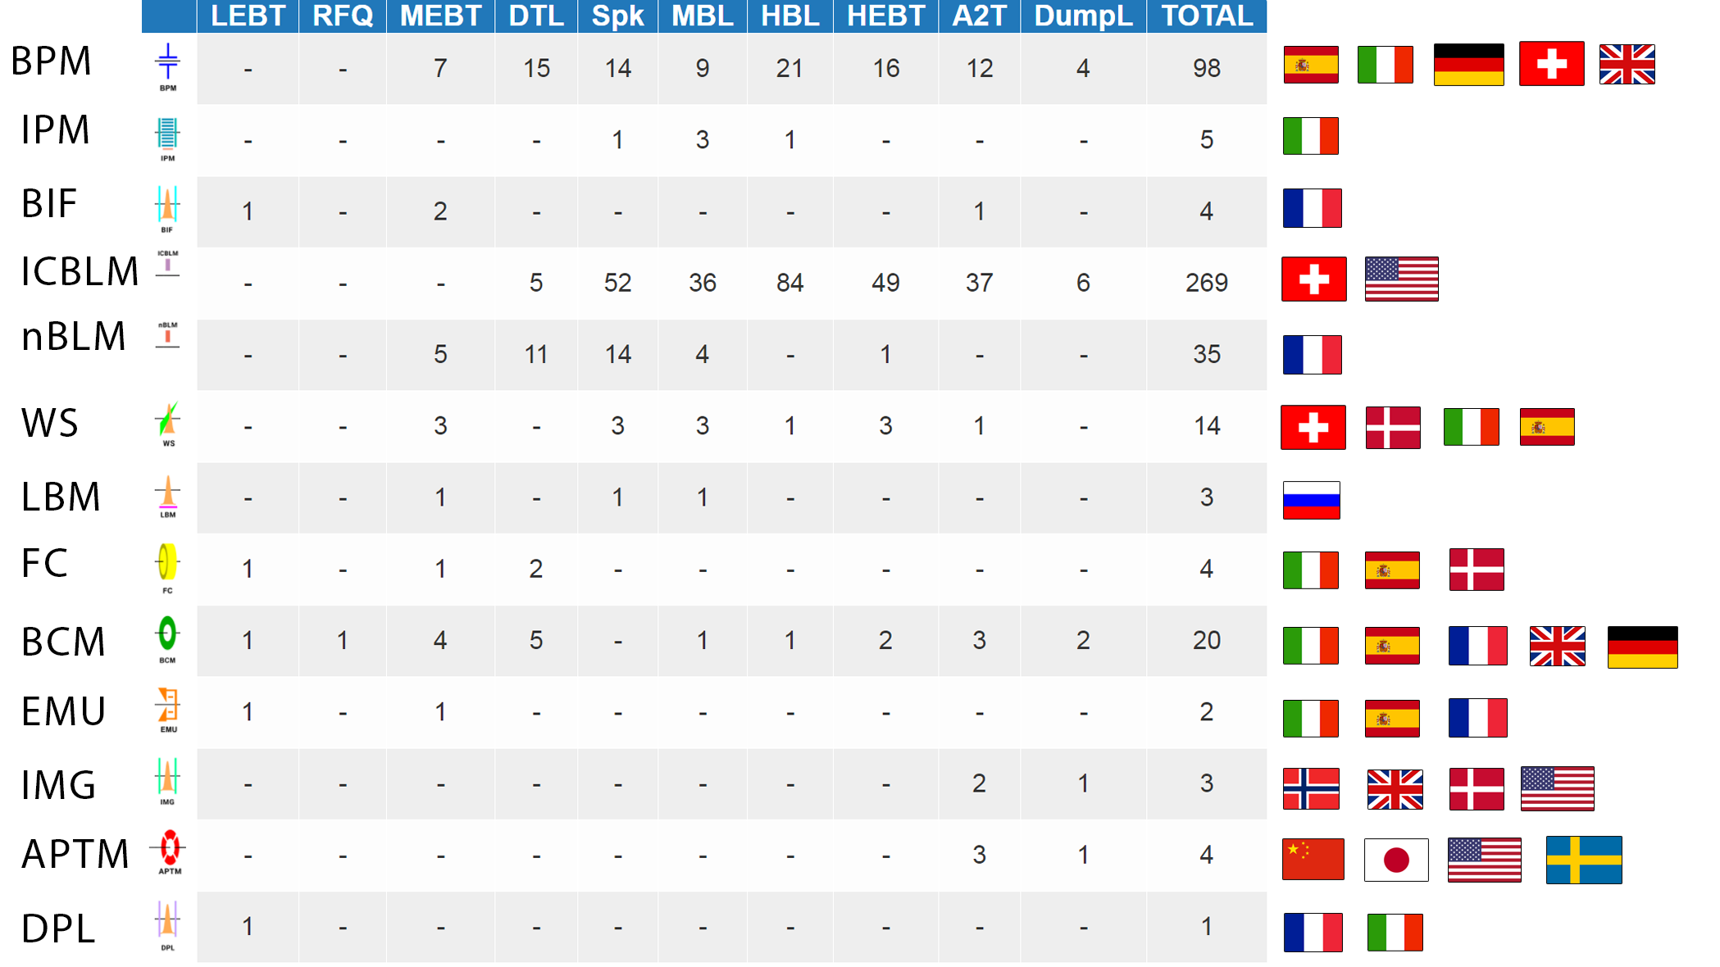




Example:
Beam diagnostics systems

Slide 22
Scale of beam diagnostics scope
22 types of beam diagnostic systems
466 diagnostic systems with ~µs protection capability
>10000 tracked assets
~ 50 equipment racks in gallery
Tunnel: 514 diagnostic systems in the baselined lattice and shown in synoptic display
Stubs: 1740 long-haul cable runs (ion chamber BLM cables highlighted)
Gallery: 2260 named devices (rack-mounted electronic devices for ion chamber BLM highlighted

Slide 23
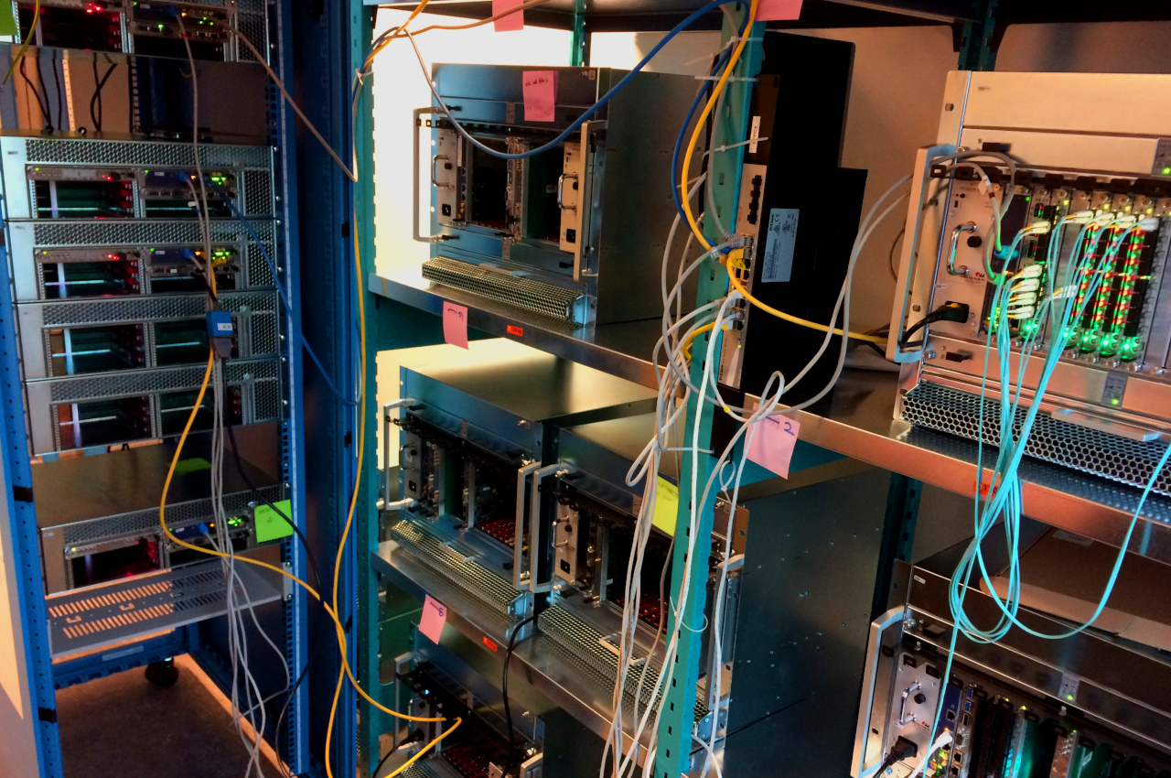
MicroTCA system production line
A MicroTCA system production line has been set up in the ICS laboratory at ESS to assemble, configure and test MicroTCA systems before deployment

Slide 24
More information
ICS overview document available [link]
ICS weekly reports (130+ recipients)

Slide 25

Thank you
Questions

