Slide 1
Recent Progress of
Peking University LLRF System
MTCA/ATCA Workshop 2019
Liwen Feng, Fang Wang
2019 Beijing

Slide 2
Overview
Introduction of PKU SRF Group
LLRFv2, the old platform
LLRFv3, the new platform
  Clock Circuitry
  Digital PLL
  Code Quality
  Results
Laser-RF Synchronizing System
Summary

Slide 3
PKU SRF Group
Peking University (PKU) Superconducting Radio Frequency (SRF) Group is one of the earliest team involved in SRF accelerator technology in China (1988~)
A small team of 9 staffs but in many fields:
SRF Material Research: Nb, MgB₂, Large Grain, Nitrogen Dropping
Different types of SRF Cavity: 1.3GHz TESLA-Type, HWR, QWR
Ultrafast Electron Diffraction, Terahertz FEL
High rep-rate, low emittance SRF Injector targeting XFEL
Notes:
MgB2: Magnesium diboride

Slide 4
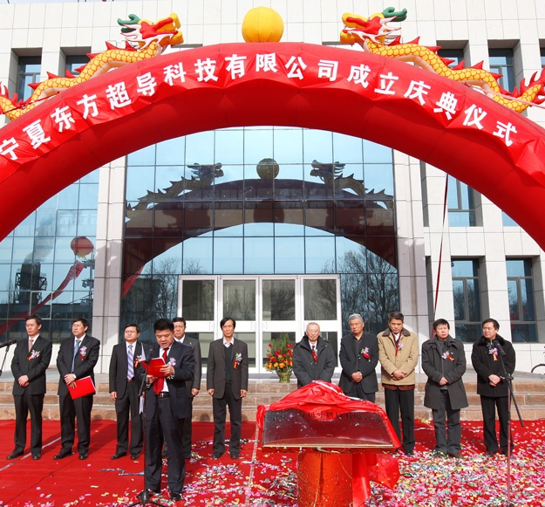
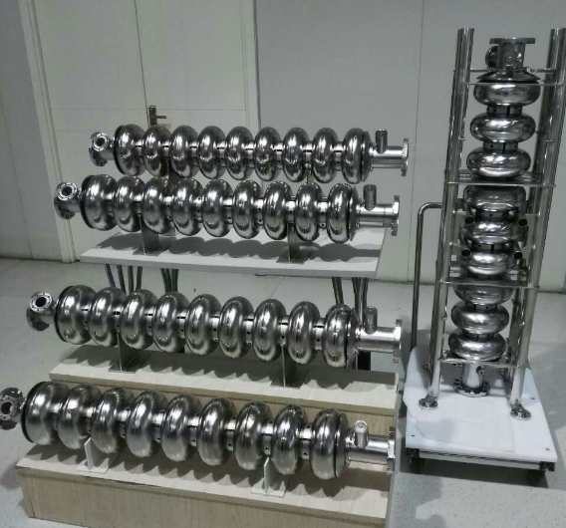
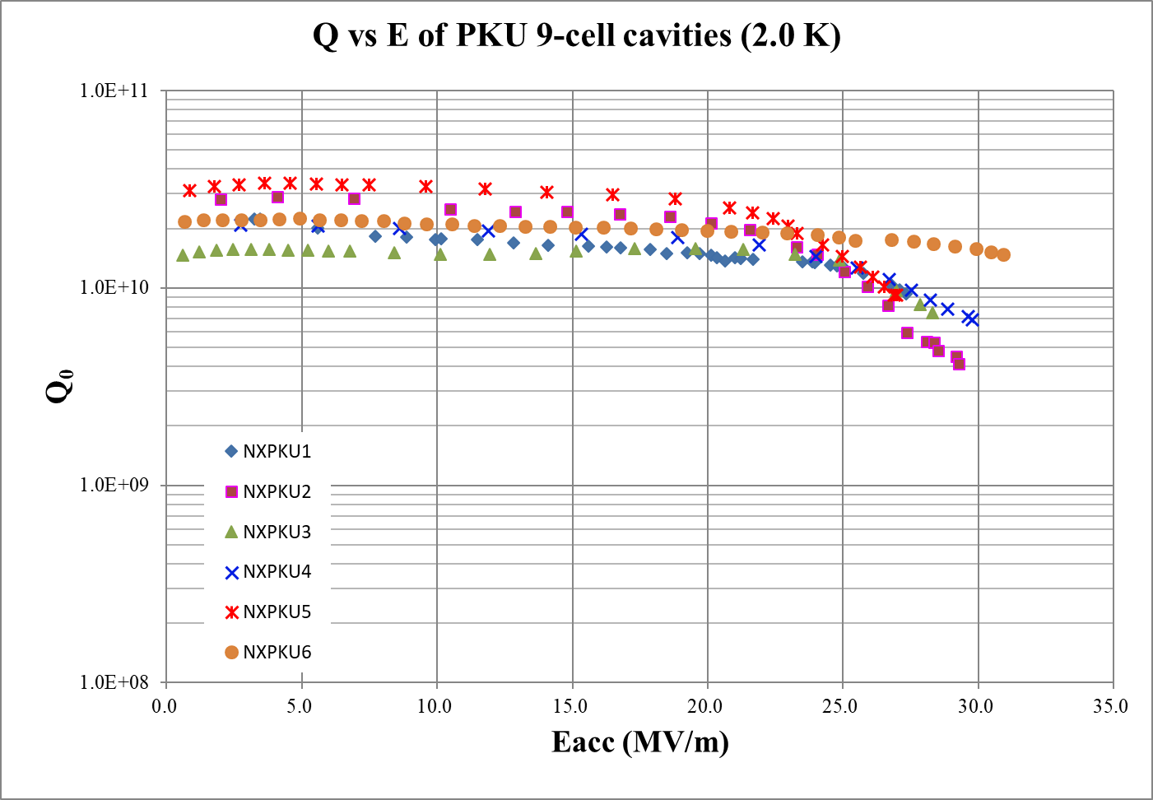
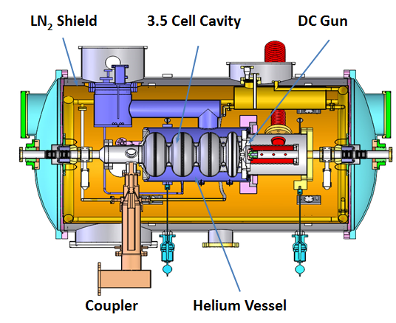
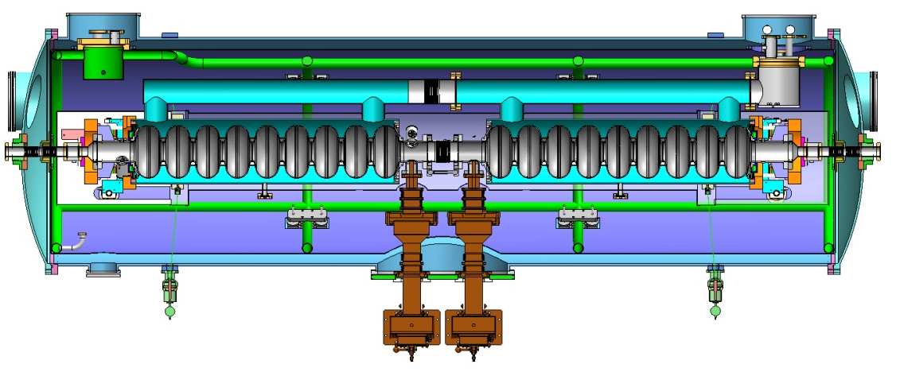
SRF Cavities Fabrication
SRF Cavity Fabrication, Treatment and Test as a candidate supplier for Chinese XFEL project
SRF Injector, TESLA cavity horizontal test stand

Slide 5
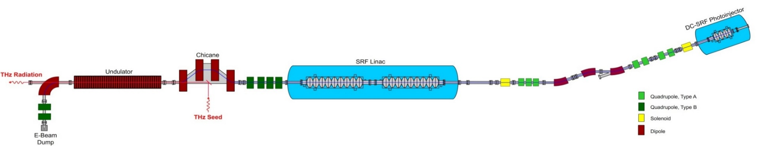
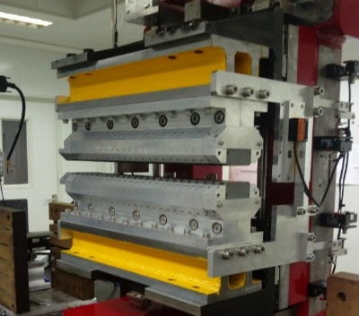
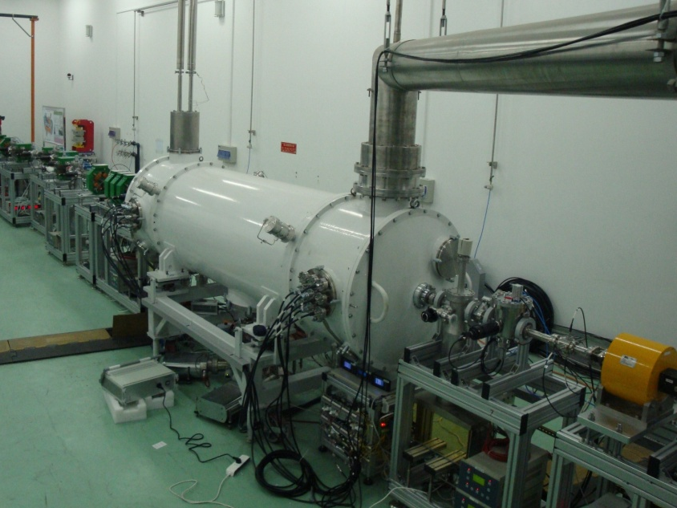
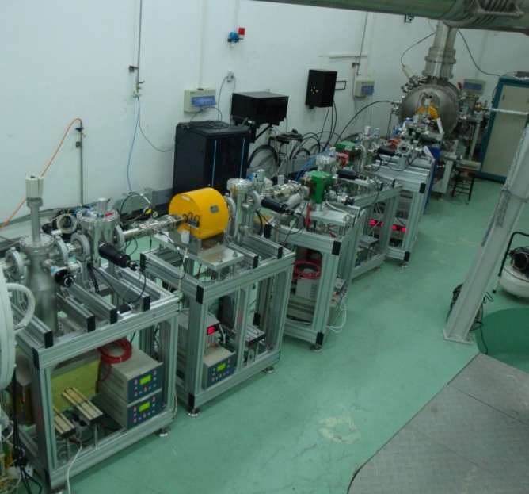
Seeded Terahertz FEL
THz Wiggler
2x9-Cell Cryomodule
3.5-Cell Photoinjector
Driver Laser
THz Power ~ 1W
1.3GHz TESLA Cavity
2x10kW Solid State Amplifier
1.3GHz DC-SRF Injector
Bunch Charge: 100pC
81.25MHz
266nm

Slide 6
PKU RF Control
Wiggler
2x9-Cell
Injector
Laser
81.25MHz
1.3GHz 10kW SSA
1.3GHz
Tuner Control
Master Oscillator
3 x LLRF
1.3GHz
EPICS/Control
Control Room

Slide 7
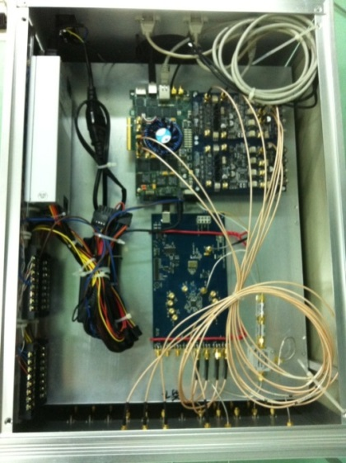
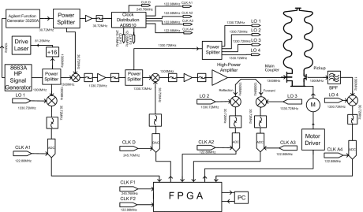
PKU LLRFv2
Developed in 2012-2014 with the help from IHEP
Constructed of commercial boards & components
Use for the operation of PKU DC-SRF Injector (1.3GHz) test cryomodule

Slide 8
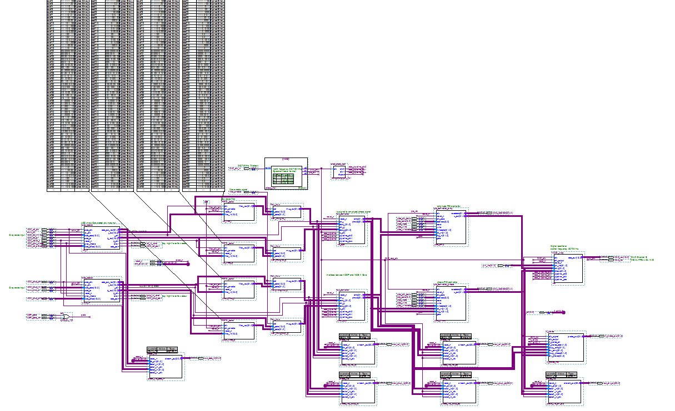
PKU LLRFv2: Algorithm
IQ Sampling→FIR Filter→CORDIC→PI Controller
NIOS II for Low Speed Comm.
Hardware UDP Core for High Data Streaming
Altera Quartus Block Diagram

Slide 9
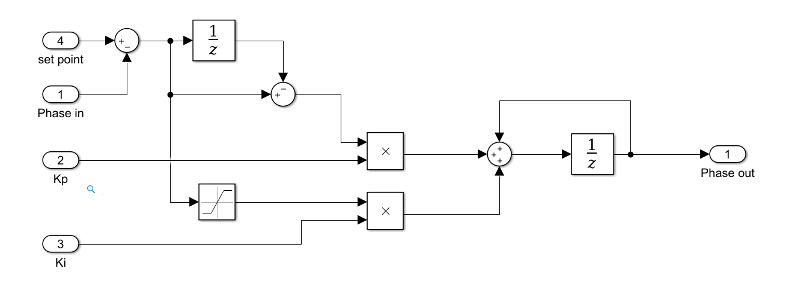
Phase normalized to fixed-point (-1,1]
Kp = -1, SEL mode
Kp > 0, GDR mode

Slide 10
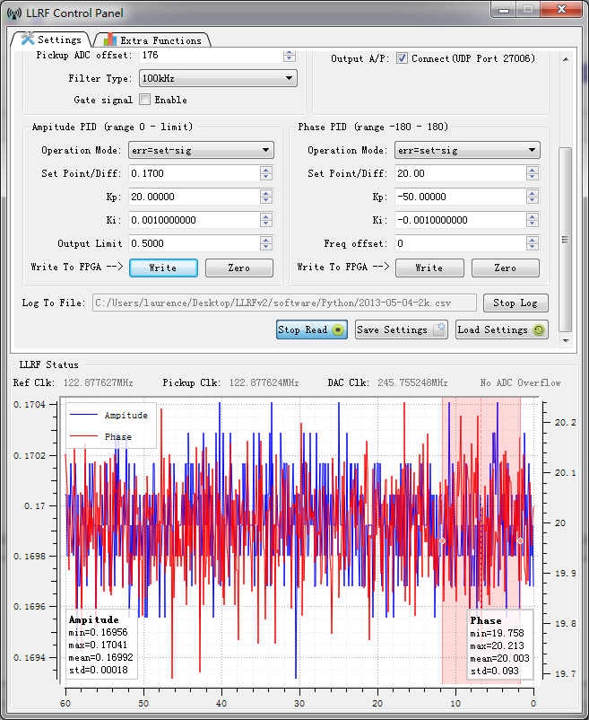
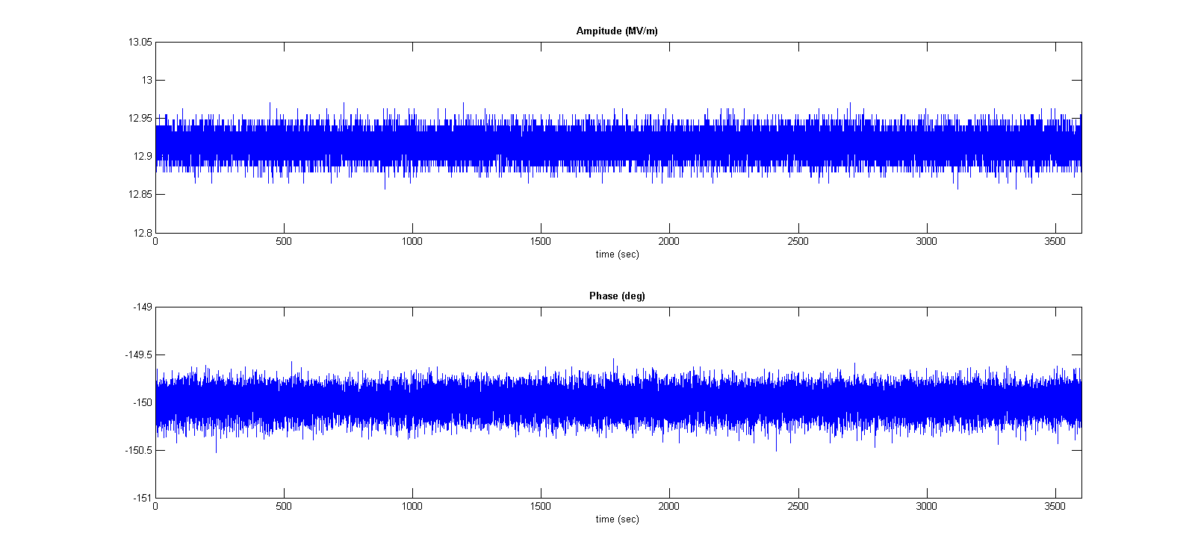
3.5-Cell Injector (2013)
1 Hour
Q_{L}~10⁷, Eacc 12.9MV/m, CW Mode
Amplitude Stability: 0.13%RMS
Phase Stability: 0.1°RMS

Slide 11


Limitation of LLRFv2
Tight couple of Modules, Impossible Hard to modify
Tuner of SRF injector test cryomodule not work well, usually offset by 1~2MHz from 1.3GHz
All other cavity have to follow the change of reference signal
Have to distribute/generate 3 low noise Clock
REF 1.3GHz ??
ADC
IQ Sample
LO 1.33072GHz
122.88MHz
$$σ_{LO}$$
$$σ_{DIG}$$

Slide 12
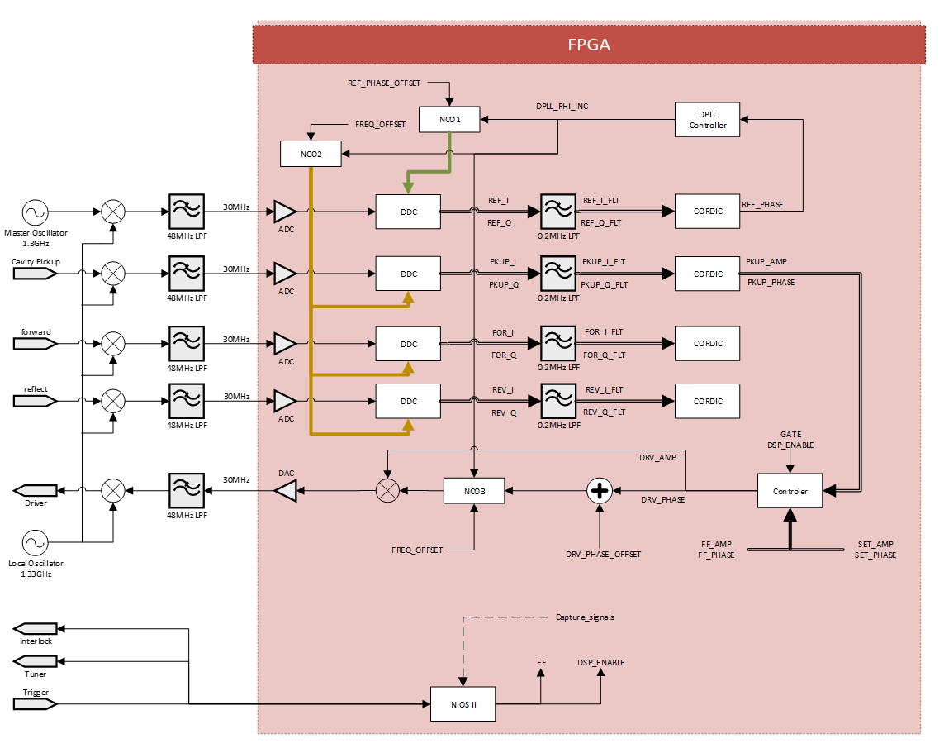
LLRFv3: DPLL + Var-IF

Slide 13
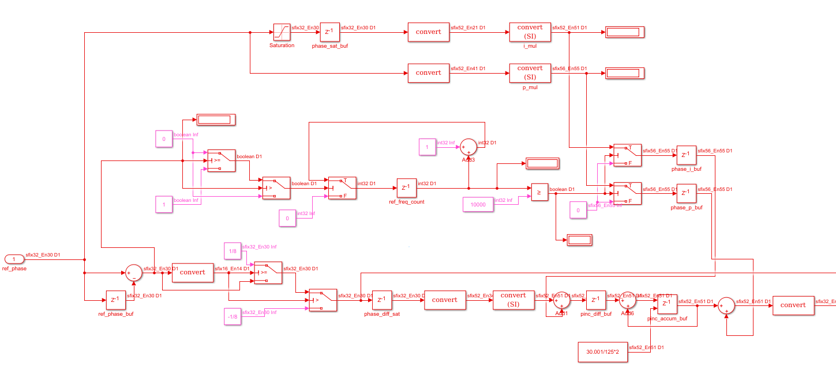
DPLL Modeling
Lock-Detection FSM
Input Saturation
PI Control
DPLL Model with Simulink
Software simulation shows tracking error Δφ~1e-5°
Hardware implementation tracking error Δφ~1e-4°

Slide 14
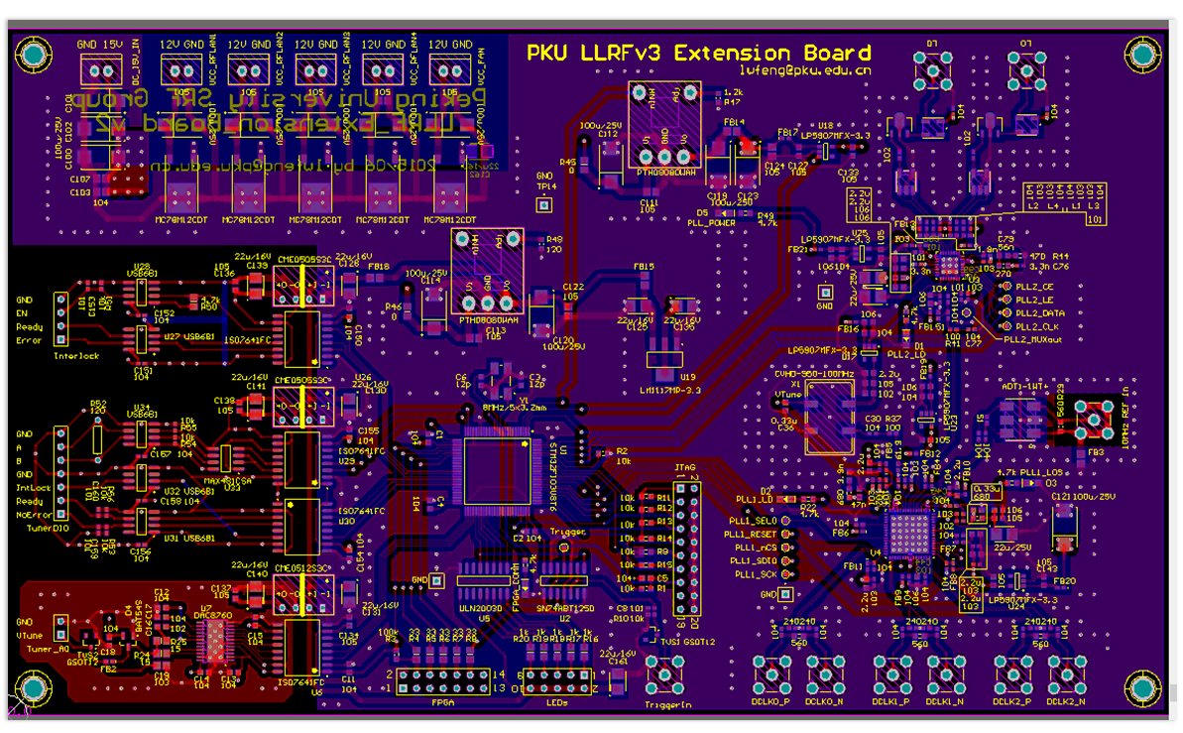
Integrated Clocking Board
Integrated Digital Clocks (125M/250M), LO (1330M), Interlock and step motor/Piezo interface
Clock jitter for LO ~200fs

Slide 15
LLRFv3: Code Quality
In LLRFv2:
No unit test, design with block diagram
Hard to handle Fraction & Scale in Fixed-point Arithmetic
NO Truncate/Overflow management
Many Work Spent in Debugging
Hard to Implement Complex Algorithm

Slide 16
LLRFv3
70%~80% Work Spent in RTL Verification
Use Matlab/Simulink for Modeling
Use SystemVerilog for Modulation Design：Data Type Annotate, Sub-Module
Functional Model
Optimization
Fixed- Point Model
Verilog
Code
Verilog test bench
FPGA Verify
Functional Model
Optimization
Fixed- Point Model
Verilog
Code
Verilog test bench
FPGA Verify
Functional Model
Optimization
Fixed- Point Model
Verilog
Code
Verilog test bench
FPGA Verify
For Each Sub-Module

Slide 17
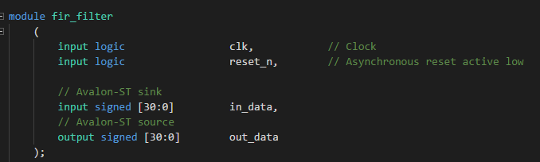
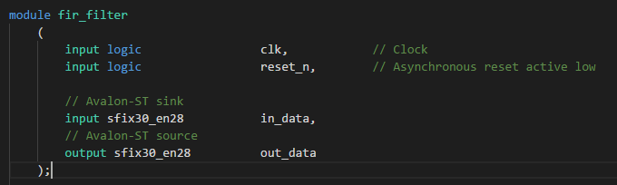
SystemVerilog Type Annotate

Slide 18
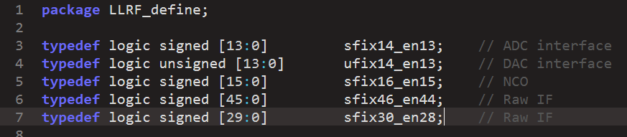
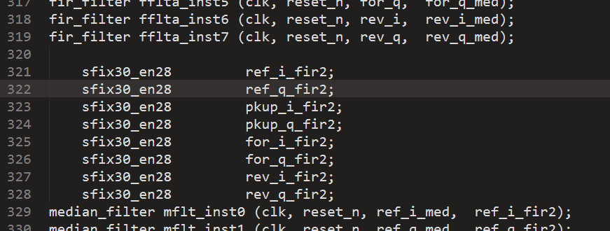
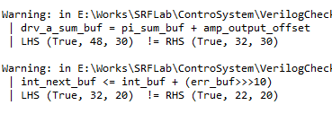
Type Checking
  Apply Data Type Checking

Slide 19
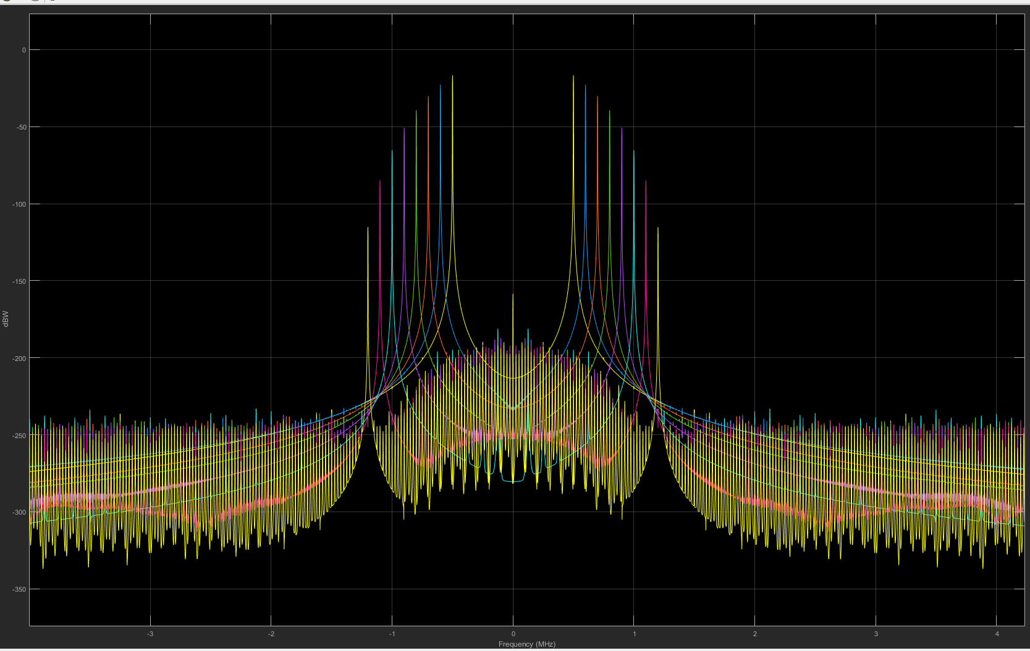
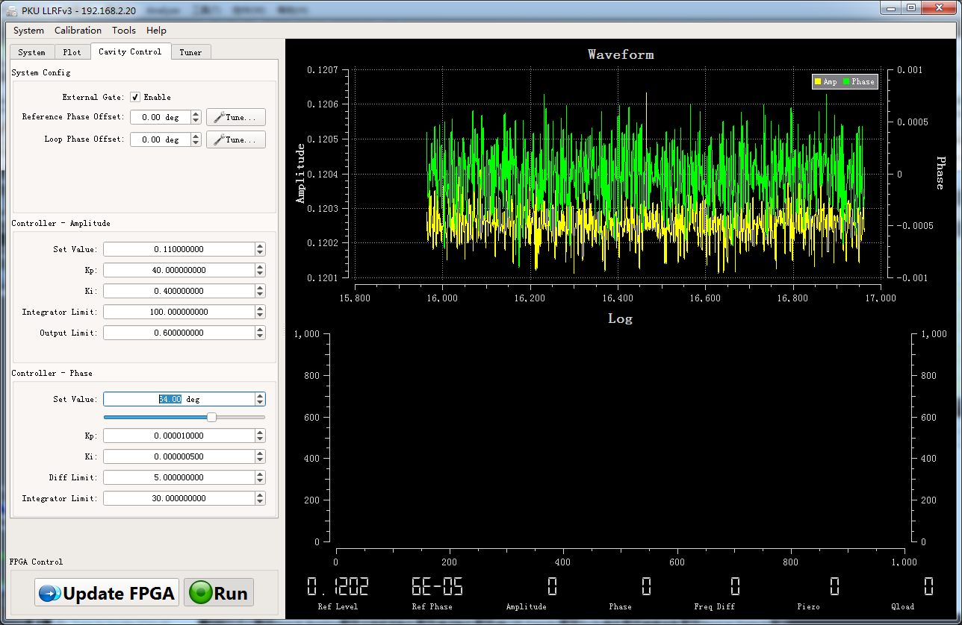
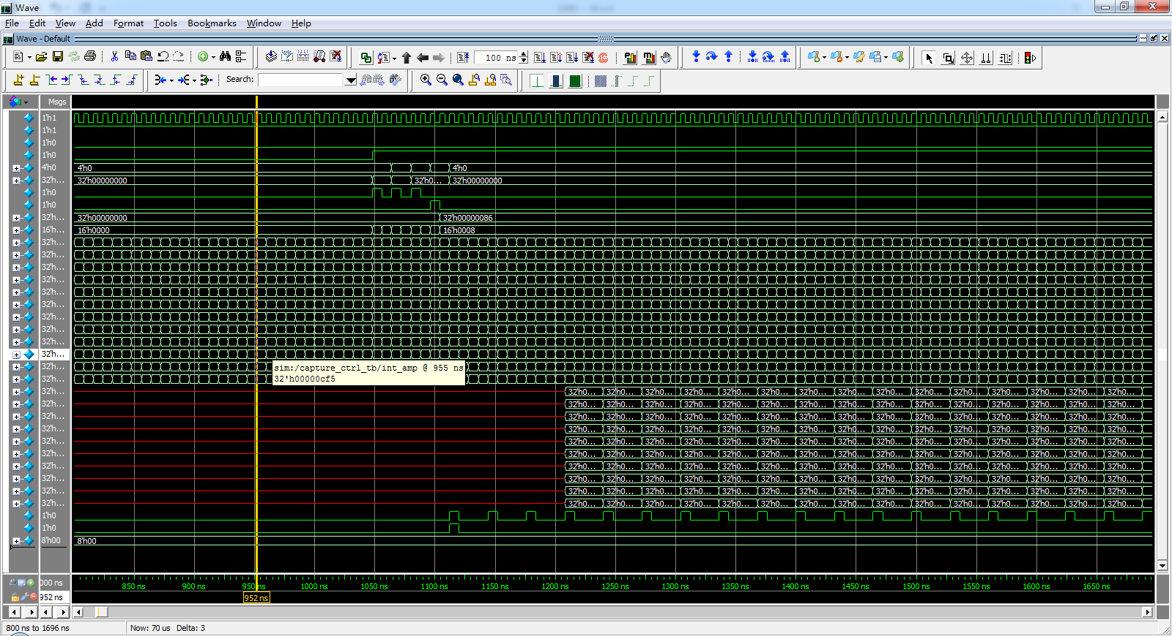
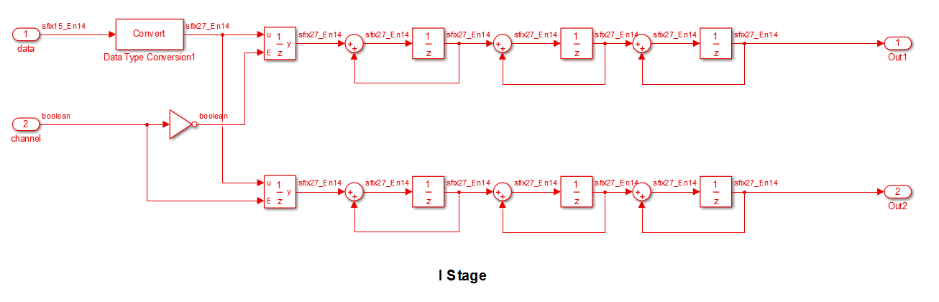
Sub-Module Implementation
Truncate
Overflow
Fixed-Point Opt
In Simulink
Hardware Verify
For Some subset
of the modules
Math Model
In Simulink
RTL Implement
Functional Model
Optimization
Fixed- Point Model
Verilog
Code
Verilog test bench
FPGA Verify
Register Model
In Simulink
RTL Verify
Modelsim/HDL Verifier
Document

Slide 20
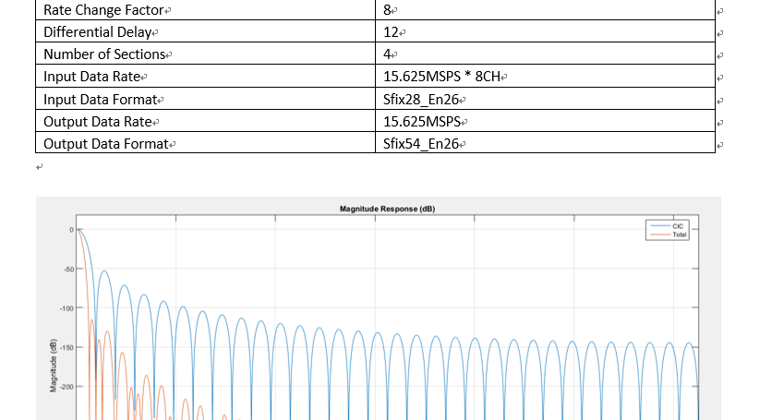
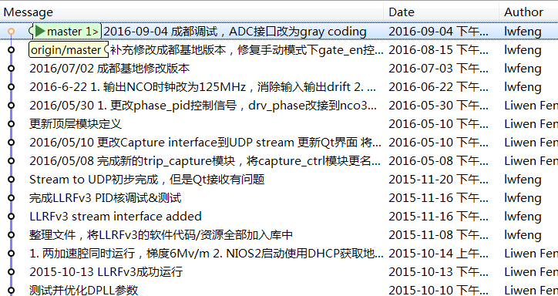
Results
For 2x9-cell 1.3GHz cavity
Q_{L}~10⁷
Amplitude ~ 0.01%RMS
Phase ~ 0.02°RMS
Saved a lot of debugging time (from one month to a week)
Design Document
Version Control

Slide 21
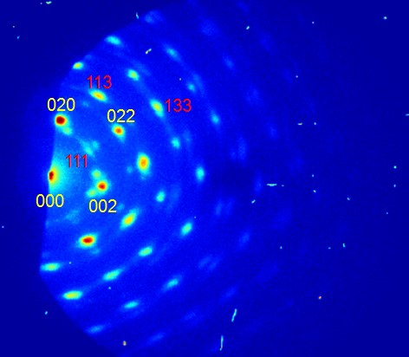
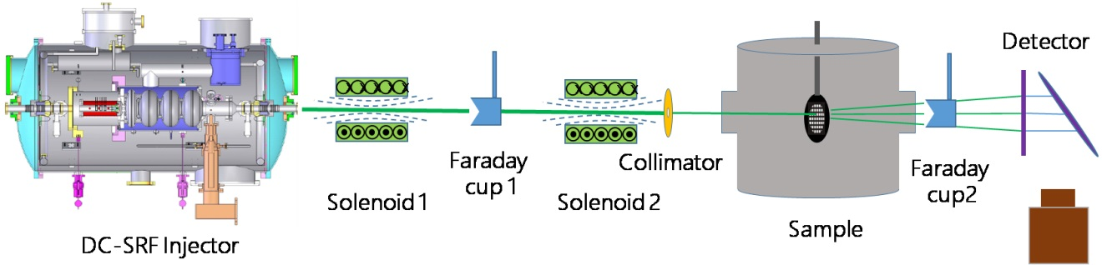
Laser-RF Synchronizing
First MHz MeV (81.25MHz @ 3MeV) ultrafast electron diffraction demonstrated. APL, 107, 224101 (2015)
May use for gas/rare sample UED
Current Laser-RF synchronizing within 300fs
Need better jitter performance (~fs)

Slide 22
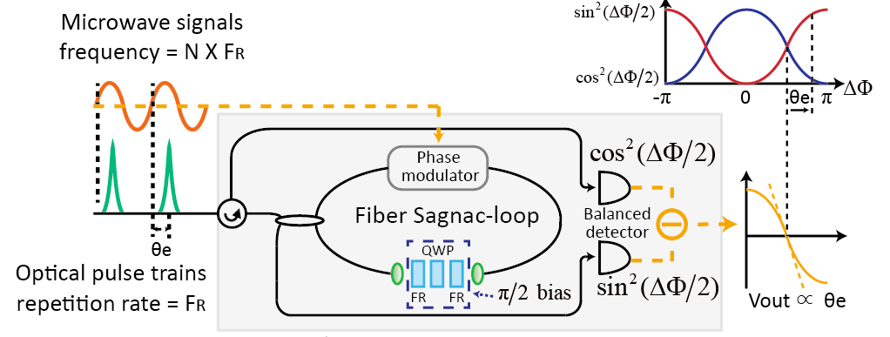
Fiber-Loop Sync-System
Optics
Optronics
Balanced Optical Microwave Phase Detector (BOMPD)
Laser Rep-Rate: 81.25MHz
RF: 1.3GHz

Slide 23
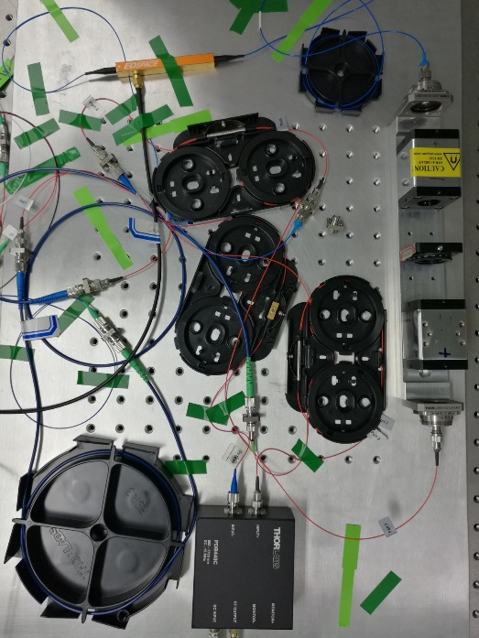
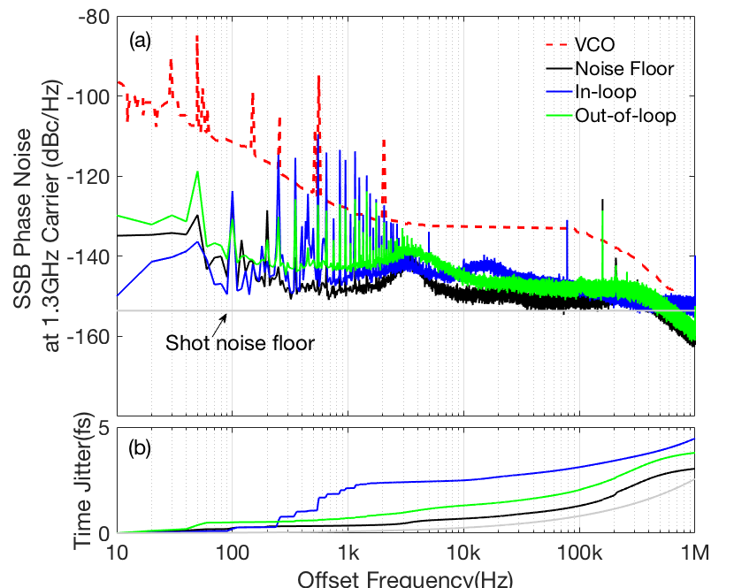
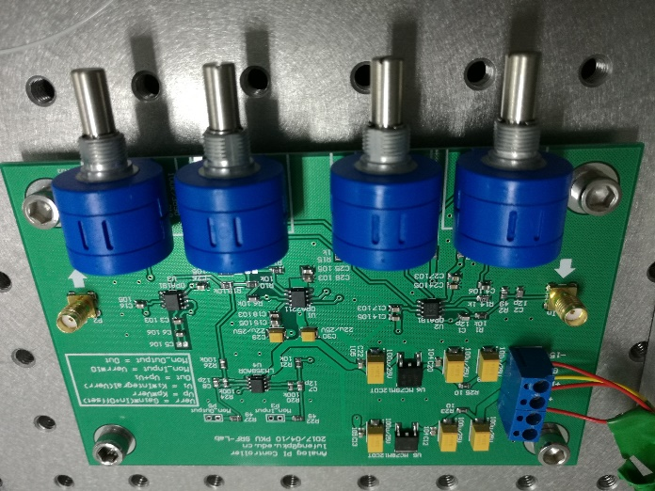
Results
BOMPD
Integrated jitter:3.8fs(10Hz~1MHz)
More Works Had to be Done!
PID Feedback

Slide 24
Summary
Custom hardware and software had been built for Peking University SRF test facility
  For 9-Cell cavity with QL~10⁷, Amplitude stability is 0.01% RMS and Phase stability of 0.02°RMS
  The LLRF system are applied for SRF Accelerator in Peking University and China Academy Of Engineering Physics
  Laser-RF synchronize system of 3.8fs jitter

Slide 25
Thank You!
Liwen Feng, Fang Wang

Slide 26
DPLL + None-IQ Sampling
With Δphase→0,
σ_{LO}+σ_{DIG}
0
Pickup
ADC
IF1
*
LO 1.33GHz
σ_{LO}
122.88MHz
σ_{DIG}
REF
*
ADC
IF2
σ_{LO}+σ_{DIG}
FPGA
IF1
AP
-σ_{LO}-σ_{DIG}
Δphase
DPLL Controller
IF2
AP
NCO

