Slide 1
Beam Instrumentation System of CSNS
Jilei Sun
On behalf of BI group of CSNS, IHEP
MTCA/ATCA Workshop for Research and Industry, Beijing, CHINA
June 23-25, 2019

Slide 2
Outline
Overview of CSNS project
Introduction of BI system
Beam Current Monitor, BCM
Beam Position Monitor, BPM
Beam Loss Monitor, BLM
Beam Profile Monitor, Wire Scanner
Others
Current data acquisition strategy
Summary

Slide 3
Overview of CSNS project
RCS service building
LINAC service building
Target hall

Slide 4
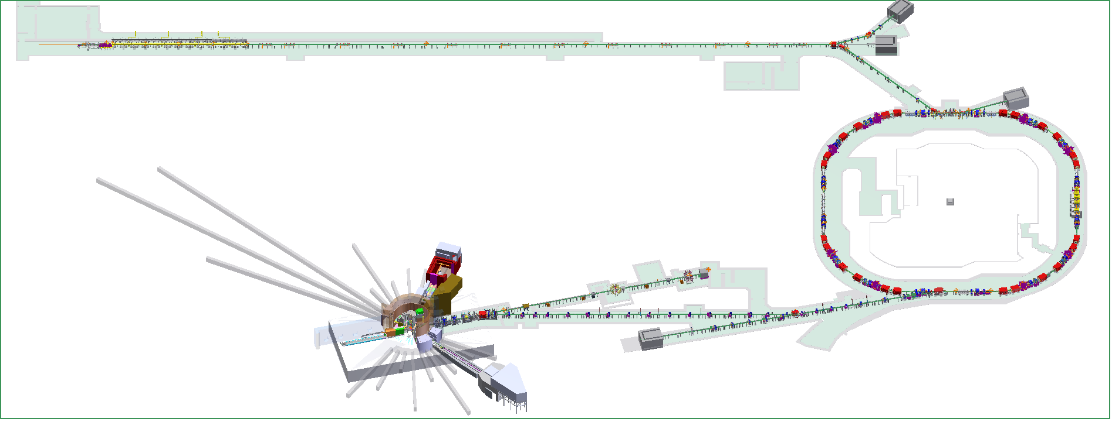
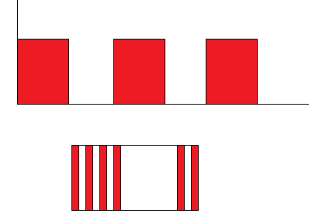
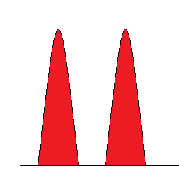
Layout of CSNS
50 keV H⁻ Ion source
3 MeV RFQ
80 MeV DTL
50 ~ 500 μs 25 Hz
1 MHz 50% chopping rate
1.6 GeV
25 Hz
RCS
500 ns -> 100 ns
Target station and instruments
Peak beam power: 100 kW

Slide 5
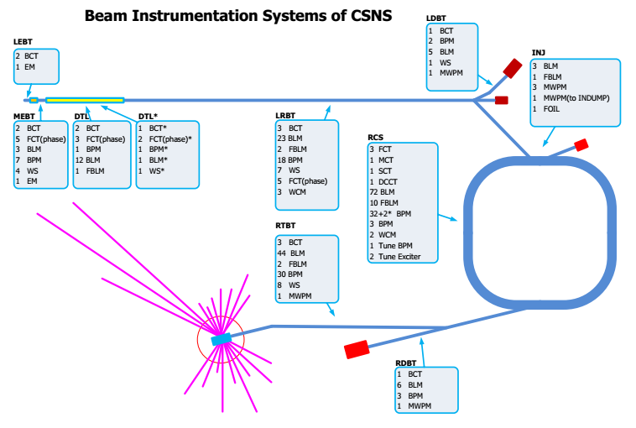
Beam instrumentation system

Slide 6
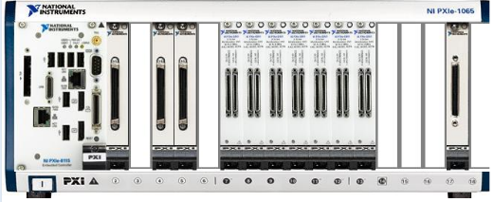
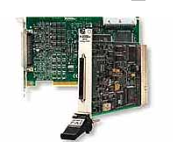
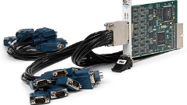
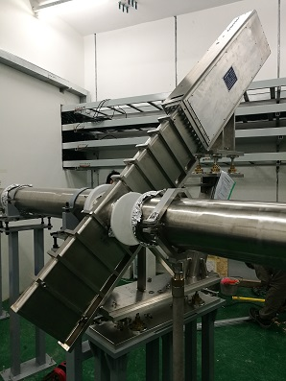
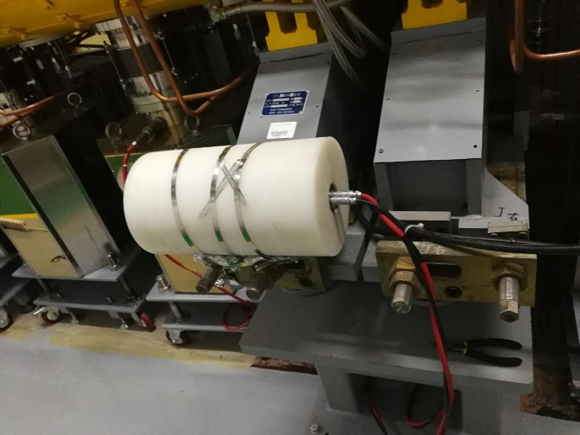
Data Acquisition Strategy
System setup
CSS OPI
NI – PXIe cards
AD/DA/DIO
Oscilloscope card
LabVIEW EPICS release
Front end electronics
Detectors

Slide 7
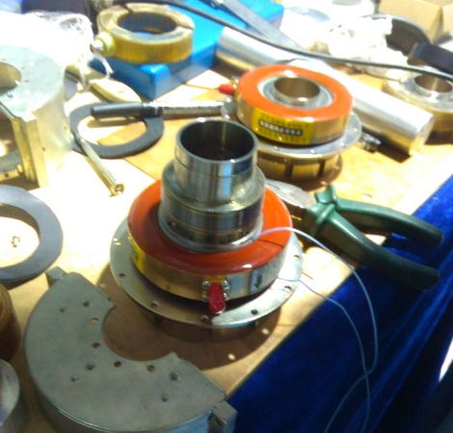
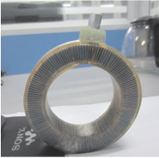
Current Monitor
Current Monitor @LINAC
11 CTs in total
Magnetic ring from Bergoz
Magnetic ring from domestic company
Current Monitor @RCS
3 different types
DCCT: Commercial product from Bergoz
SCT/MCT: Self developed sensor
Current Monitor @RTBT
4 CTs (1 ICT + 3 FCT)
Magnetic ring from Bergoz

Slide 8
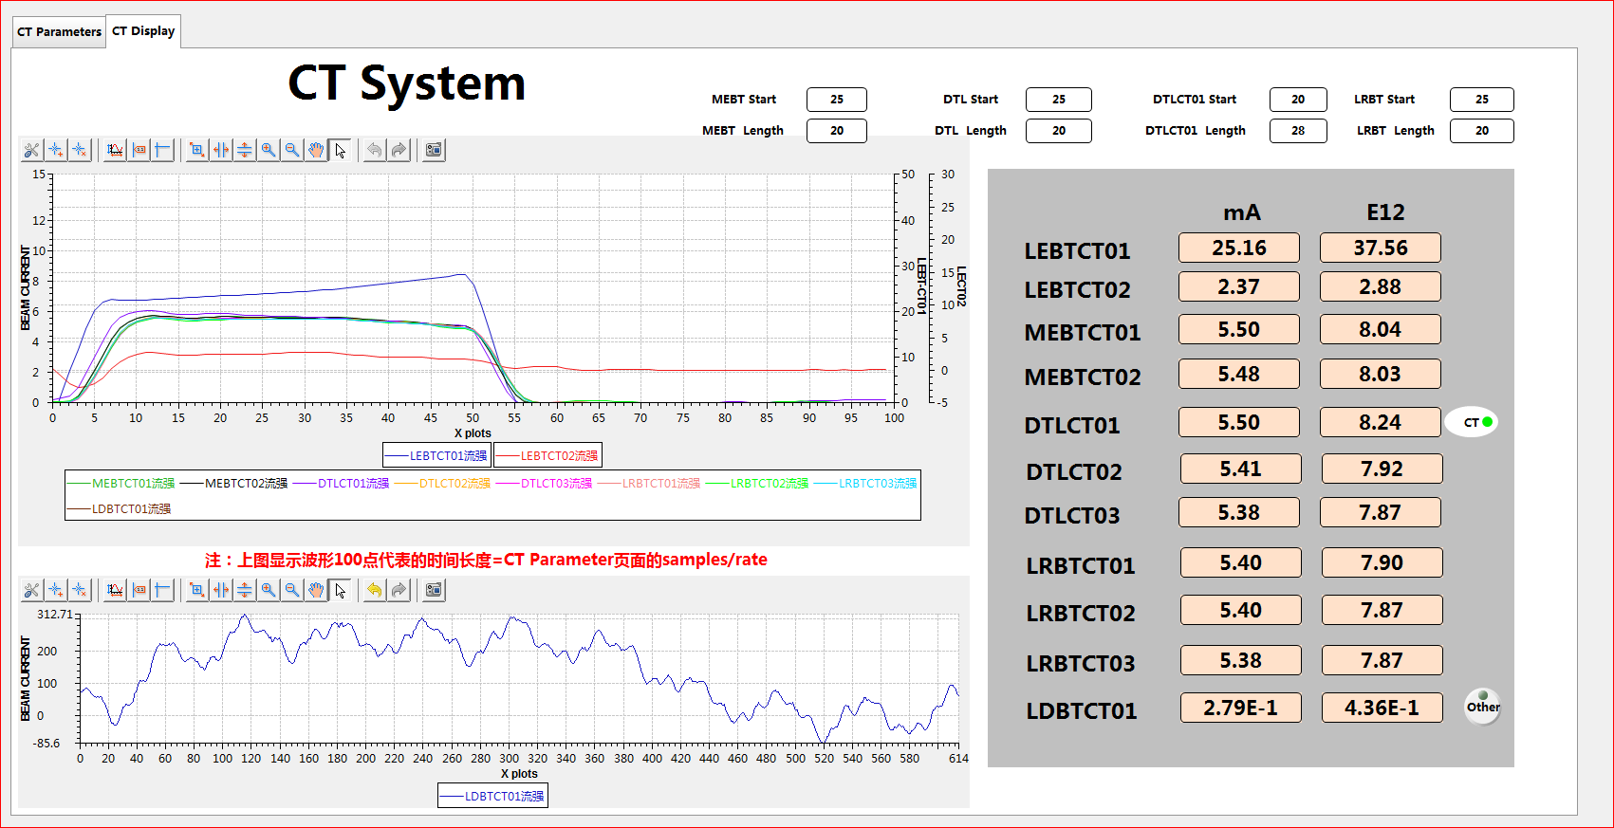
Beam Current Monitor @LINAC
Beam Current = [Sum(Valid) – Sum(Background)] / n
$$n$$
Valid count
Background count
$$n$$
MACRO pulse measurement, up to 500 μs
Front end electronics + NI PXIe-6358 (16 bit, 1.25 MS/s)

Slide 9
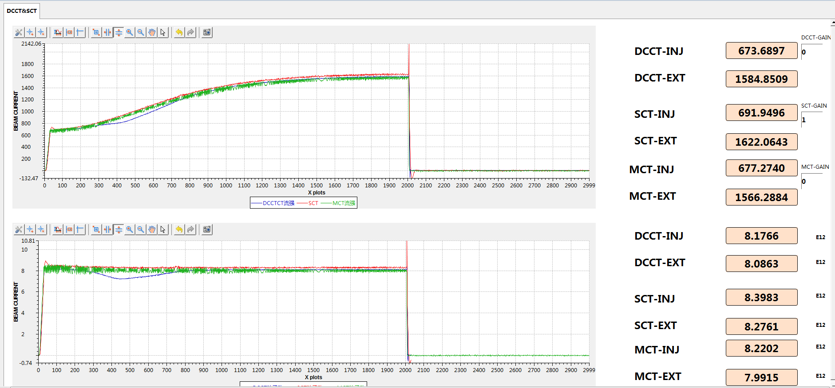
RCS – DCCT / SCT / MCT
DCCT: Commercial electronics from Bergoz
SCT/MCT: Self developed electronics
NI PXIe-6358 100 kS/s
200 mA
2 A
20 A

Slide 10
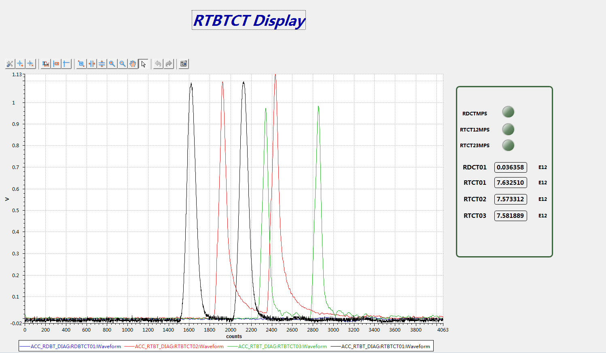
RTBT - CT
Two short pulses, 100 ns each
NI PXIe-5160 oscilloscope card
1.25 GS/s
500 MHz band width
10 bits

Slide 11
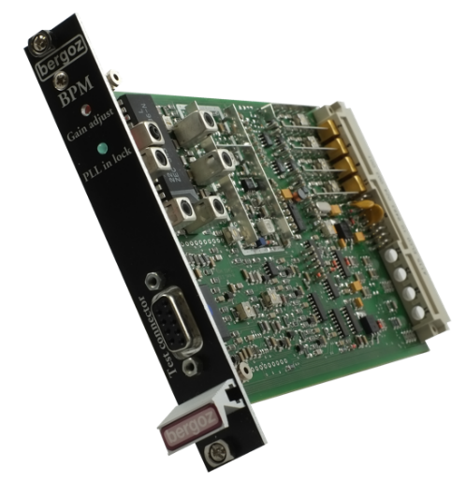
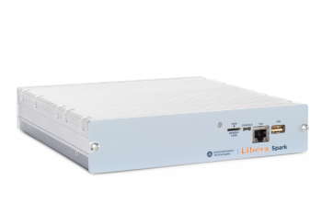
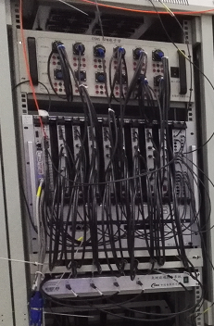
Beam Position Monitor, BPM
LINAC
29 Strip-line type
324 MHz RF pulse
Libera Spark HL, 14 bit
Bergoz
RCS
38 Shoe-box
1 MHz ~ 2 MHz cycling frequency
Self-developed electronics
TBT or COD mode
RTBT
33 Shoe-box
Libera Spark HL

Slide 12
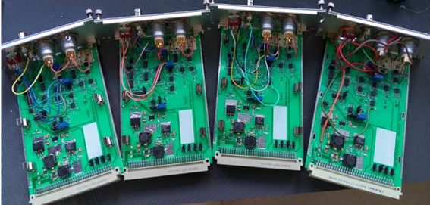
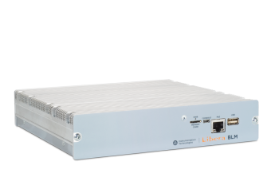
Beam Loss Monitor, BLM
156 ion chamber type BLM
Front end electronics
NI PXIe-6358 waveform acquisition
NI PXI-8430 RS232 for HV control
NI PXI-6713 for threshold configuration for FMPS
15 plastic scintillator + PMT as FBLM
Libera BLM
50 MHz bandwidth
125 MHz / 14 bit

Slide 13
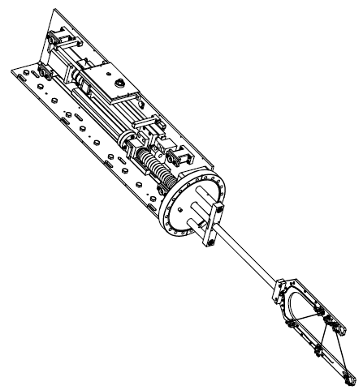
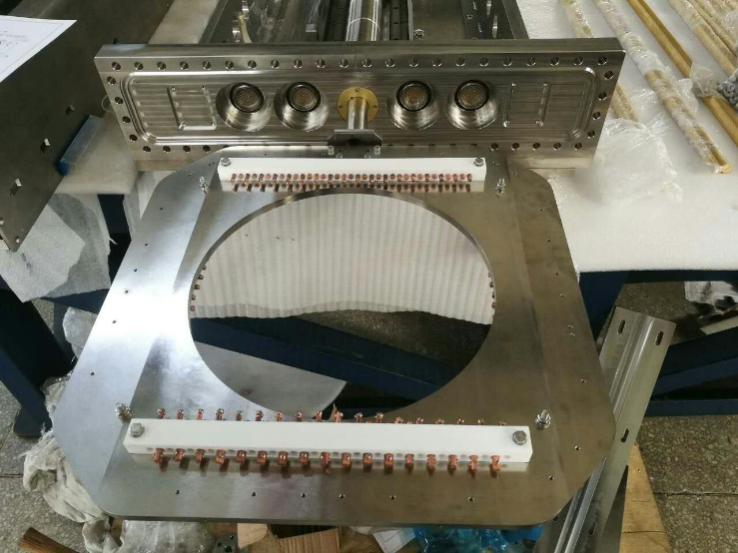
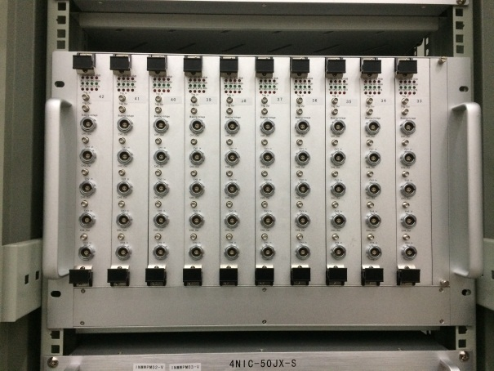
Beam Profile Monitor, Wire Scanner
20 wire scanners at LINAC&RTBT
7 multi-wire at the injection & dump
Stepper motor driven
NI PXI-7330/7358 motor control
NI PXIe-6358 do the DAQ after front end
Wire Scanner
Multi-Wire
Front end Electronics

Slide 14
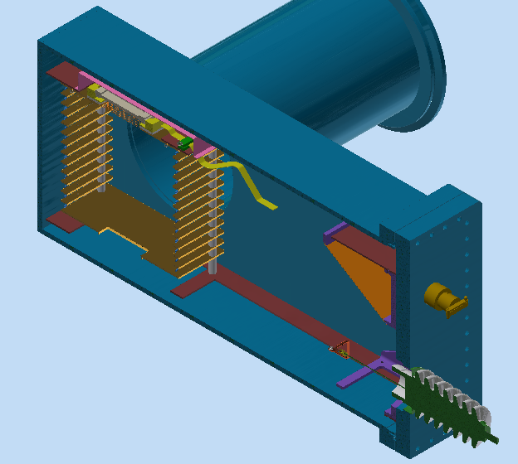
Profile Monitor @RCS - IPM
Ionization Profile Monitor
64 channel signals
≥ 14 bit
20~100 MHz sampling rate
Memory size: ≥ 100 MB / channel

Slide 15
Summary of the DAQ requirement
Detector | Type of Signal | No. of channels | Sampling Rate | Resolution
CT | 50~500 μs, 25 Hz 500~100 ns, 25Hz | 18 | 1.23 MHz@LINAC 100 kHz@RCS 1.25 GHz@RTBT | 16 bit
BPM | 324 MHz 1~2 MHz 100 ns, 25Hz | 100*4 | 125 MHz@LINAC 60 MHz@RCS 125 MHz@RTBT | ≥14 bit
BLM | 50~500 μs, 25 Hz 500~100 ns, 25Hz | 156+15 | 500 kHz@LINAC 50 kHz@RCS 100 kHz@RTBT | 16 bit
Profile | 100 μs, 1Hz 500~100 ns, 25 Hz | ~400 | 1 MHz@LINAC ≥20 MHz@RCS 1 MHz@RTBT | 16 bit
FCT | 324 MHz | 13 | 100 MHz | 14 bit

Slide 16
Shortage of current system
17 PXI Windows host computers
6 times OS failures in last one year
NI real time OS: Phar Lap ETS
I/O control
Data storage
EPICS configuration

Slide 17
Summary
CSNS running @50 kW stably, opening to users already. The goal is have ~80 kW, by the end of this year.
DAQ system of our beam instrumentation nearly all based on NI PXI/PXIe platform. Performance acceptable, and we are keep improving and updating on software.
PXI based EST real time OS is under developing.

Slide 18
Thanks for your attention！

