Slide 1
Adapting
Cabinet to Crate Cooling
Cooling strategies
Ralf Waldt/Christian Ganninger
June 2019
MTCA Workshop 2019

Slide 2
Planning the cooling concept
Calculation of the total heat dissipation Cooling solutions on crate level
Cooling solutions on cabinet level
Crate configuration vs cabinet cooling
Additional considerations
Thermal simulation
Conclusion

Slide 3
Planning the cooling concept
The planning of a cabinet cooling concept requires to consider different topics to find the optimal cooling concept
Cooling concepts of all integrated crates
Total heat dissipation of all integrated crates
Max. acceptable temperature increase
Environmental conditions (temperature, dust, IP protection, etc.)
Infrastructure (installation site)
Noise requirements
Redundancy
Emergency concepts
MTCA WS 2018

Slide 4
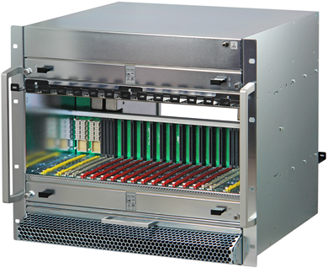
Calculation of total heat dissipation
Example:
Power losses in a MTCA.4.1 CRATE
12x >80 W per AMC / RTM slot -> ~ 1000 W heat dissipation
2x MCH + RTM -> 160 W
2x Cooling units -> 160 W
Power modules (88% efficiency) ~ 150 W heat dissipation
=> Crate heat dissipation > 1.5 kW
POWER LOSSES IN THE WHOLE CABINET
3 MTCA Crates + other Electronics
=> Cabinet heat dissipation 5 to 10 kW

Slide 5
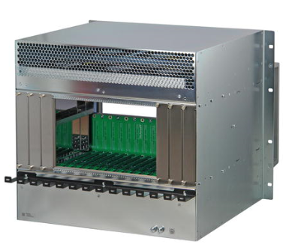
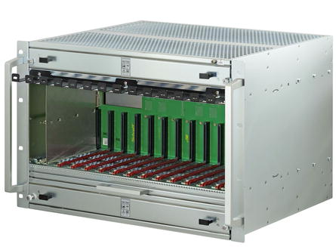
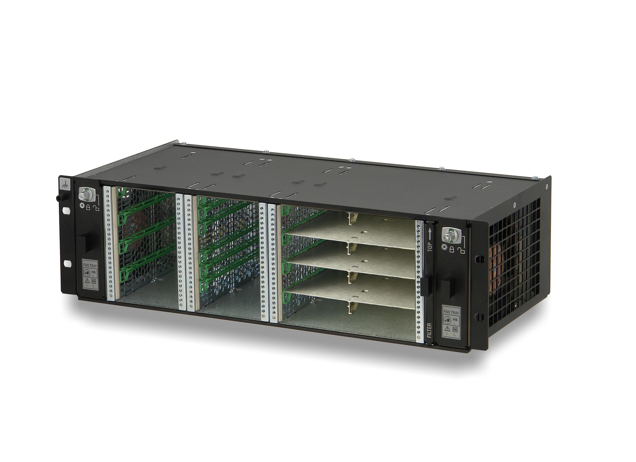
Cooling solutions on crate level
Common cooling concepts for crates
Front-to rear air flow
Bottom-to-top cooling air flow
Right-to-left air flow

Slide 6
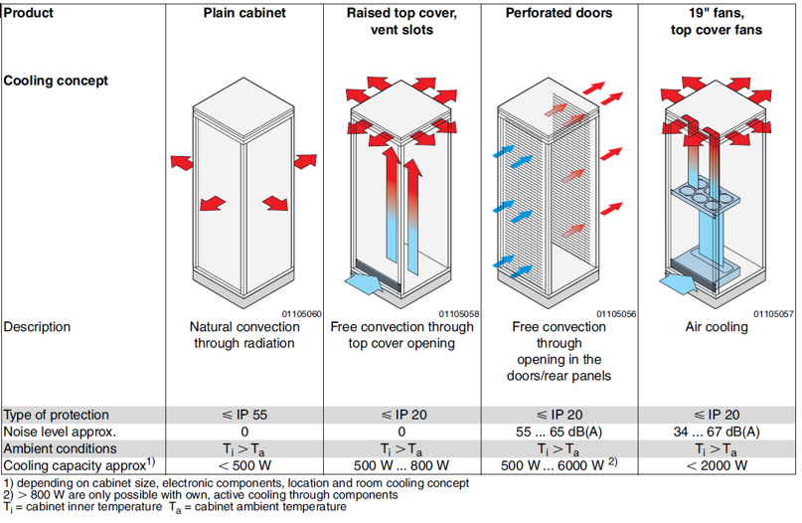
Cooling concepts on cabinet level

Slide 7
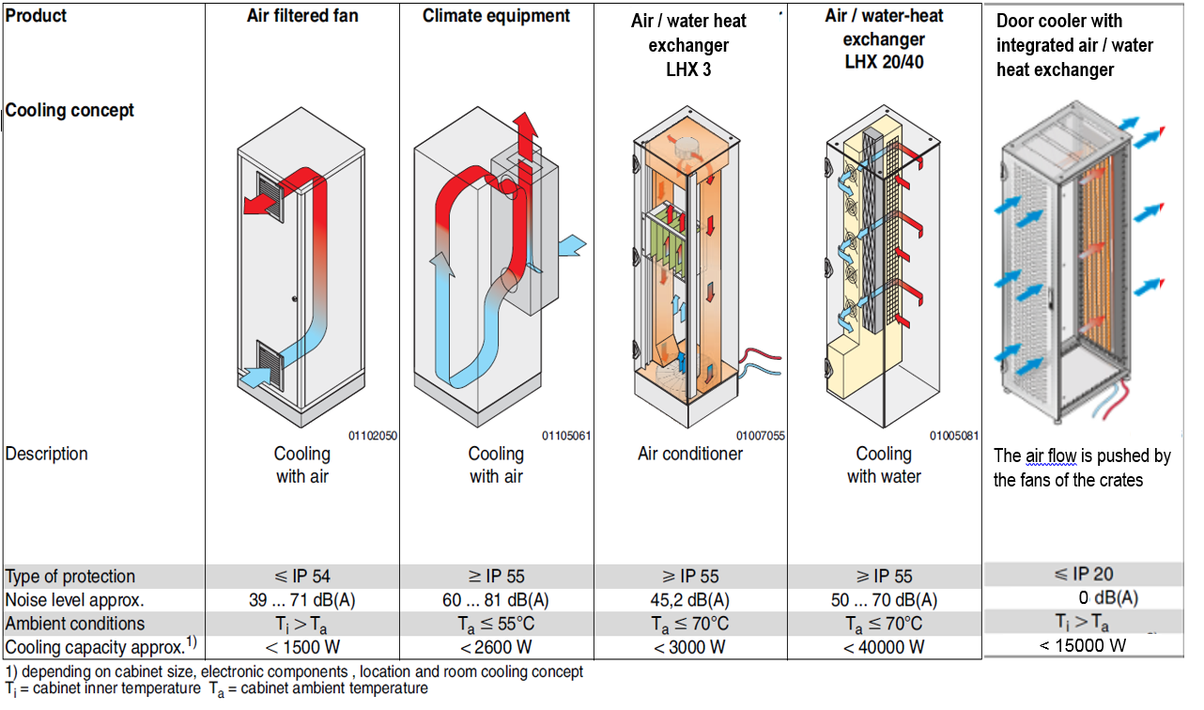
Cooling concepts on cabinet level

Slide 8

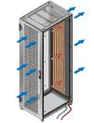
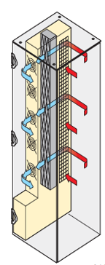
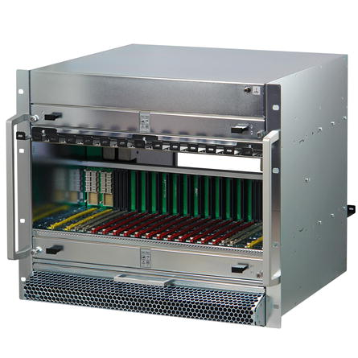
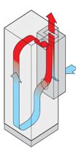
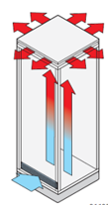

Crate configuration vs cabinet cooling
Cabinet configuration only with crates
front-to rear air flow
Cabinet cooling
Best solutions
Perforated doors Rear door cooler Air/water heat exchanger
High cooling efficiency due to low air resistance.
Easy to separate the cold and the warm air area with air baffles beside the 19” frame.
Further solutions but with lower efficiency
Raised top cover Climatic equipment
with fans
Additional bypasses for air flow
necessary. They are reducing the
efficiency
-> Higher input power required
-> Higher noise level

Slide 9
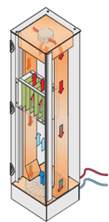
Crate configuration vs cabinet cooling
Cabinet configuration only with
crates bottom-to-top air flow
Cabinet cooling
Best solutions
Raised top cover Air/water heat exchanger Climatic equipment
with fans
High cooling efficiency due to low air resistance.
Easy to separate the cold and the warm air area with air baffles beside the 19” frame.
Further solutions but with lower efficiency
Air/water heat exchanger
Additional bypasses for air flow
necessary are reducing the efficiency
-> Higher input power required

Slide 10
Crate configuration vs cabinet cooling
Cabinet configuration only with
crates right-to-left air flow
Cabinet cooling
Best solutions
Raised top cover Climatic equipment
with fans
High cooling efficiency due to low air resistance.
Easy to separate the cold and the warm air area with air baffles beside the 19” frame.
Further solutions but with lower efficiency
Air/water heat exchanger
Additional bypasses for air flow
necessary are reducing the efficiency
-> Higher input power required
-> Higher noise level

Slide 11
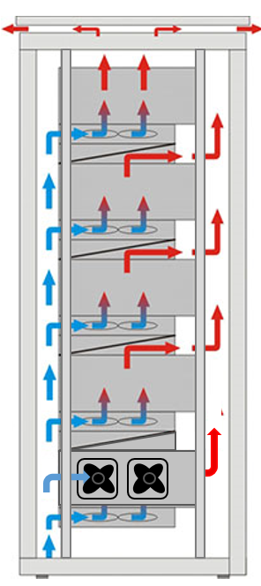
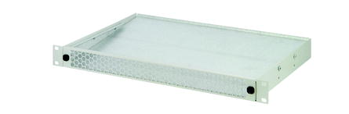
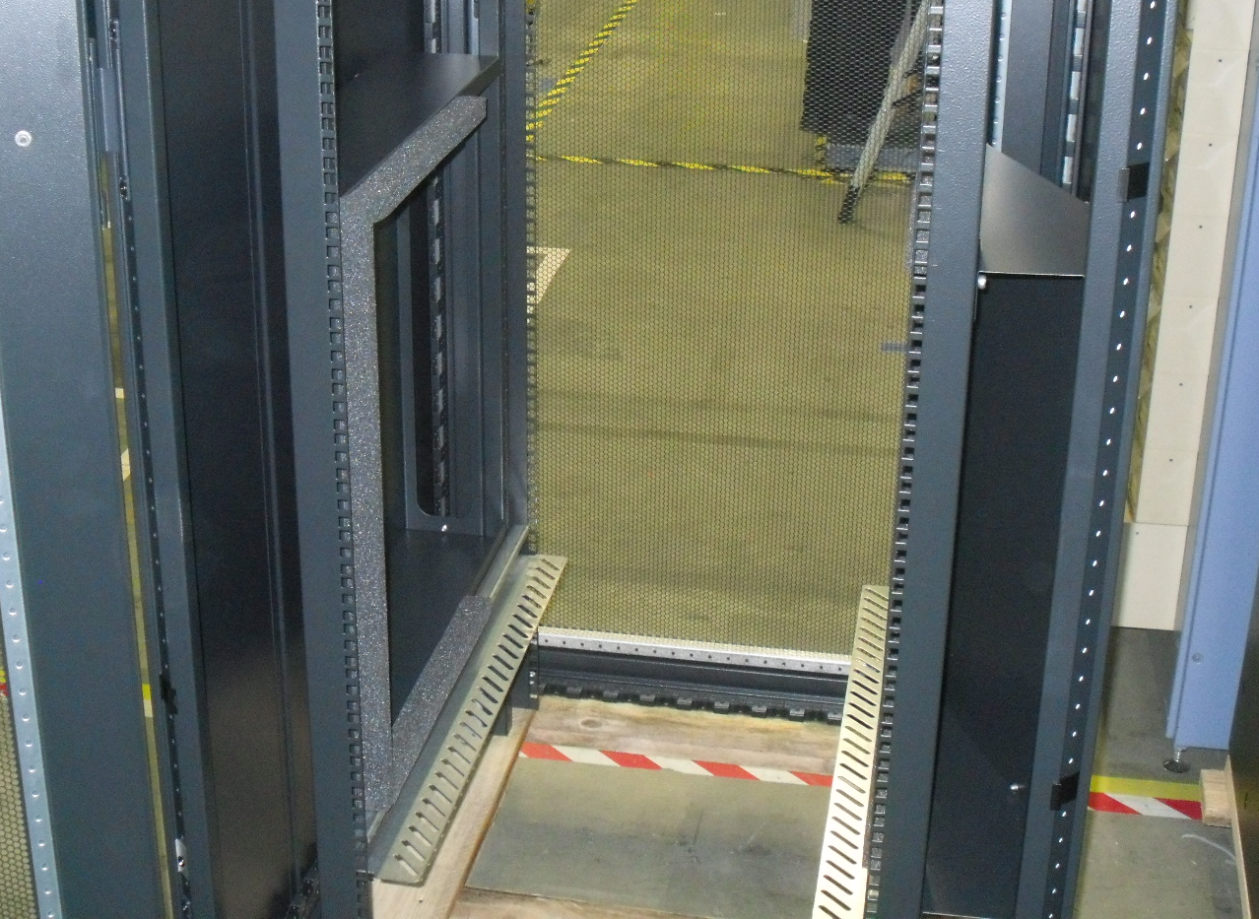
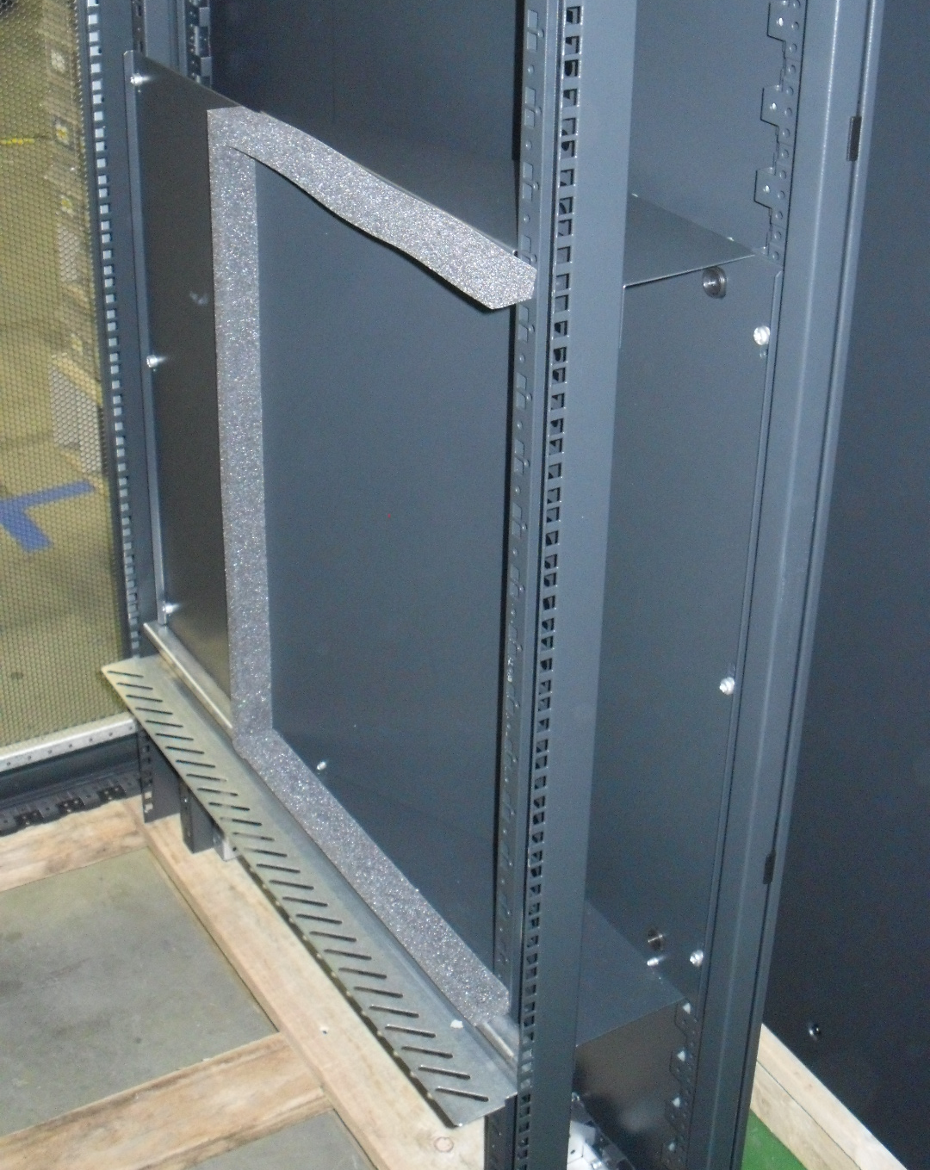
Crate configuration vs cabinet cooling
Cabinet configuration with different cooling concepts of the crate are the worst case
Cabinet cooling
High efforts to separate the cold and the warm air
Additional bypasses for air flow
necessary. They are reducing the
efficiency
-> Higher input power required
-> Higher noise level
-> Lower assembly space due to
additional air guiding components
Workaround

Slide 12
Addional considerations
Air filters providing an air resistance and reducing the air volume
Infrastructure (installation site):
What cooling solution are fitting to the installation site in view of space, temperature, humidity, etc.
Is water connection available?
Redundancy: Power, cooling, etc.
Emergency concepts: Door opening, alternative cooling concept, shutters, etc.
MTCA WS 2018

Slide 13
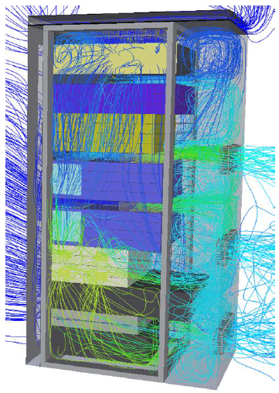
Thermal Simulation
Thermal simulation will provide proper support for designing the optimal cooling concept especially for critical applications.
Simulation critireas:
Air flow
Velocity
Pressure
  The results of the thermal simulation are the platform for
  further decisions.

Slide 14
Conclusion
Cooling concepts of all integrated crates
Total heat dissipation of all integrated crates
Max. acceptable temperature increase
Environmental conditions
(temperature, dust, IP protection, etc.)
Infrastructure (installation site)
Noise requirements
Redundancy
Emergency concepts
Cabinet (enclosure)
+ Cooling requirements
+ Environmental conditions
+ Safety requirements
= Cooling solution
MTCA WS 2018

Slide 15
Thank you

