Slide 1
Systems Engineering (for MicroTCA)
Zheqiao Geng
MTCA/ATCA Workshop for Research and Industry
23-25 June, IHEP, Beijing, China

Slide 2
Outline
Overview
Introduction to Systems Engineering
Some Tips in Systems Design

Slide 3
Overview

Slide 4
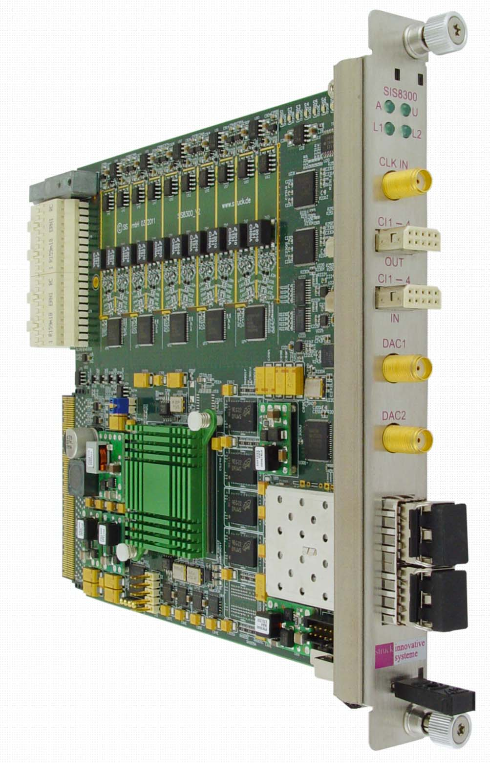

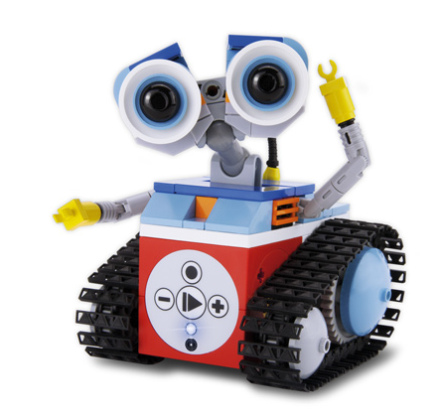


System and Systems Engineering
“System” is an open concept standing for a collection of entities (hardware, software and human) performing a certain functions.
“Systems Engineering” tries to define a systematic approach to enable the realization of successful systems. It focuses on the user requirements, follows a systematic method to define the system architecture, implements the system components aiming for a successful system in early stage of the project.

Slide 5
Questions for System Designers
Where to start if you are asked to design a fresh system?
Which procedure to follow to reach a system design from the user requirements?
How to make the system provides complete and correct functions with desired performance?
How to design a system to be successful at the first switch-on without redesigning the core components?
How to …
Systems engineering helps to answer these questions…but
The systems engineering methodology is general and flexible, you need to select only necessary process steps which fit to your system, and fit to you!

Slide 6
Destination Audience
System designer and integrator
Persons who wants to design any components (hardware, firmware or software) in a systematic way
Reading materials
  Cathleen Shamieh, Systems Engineering for Dummies
  Tim Weilkiens, System Engineering with SysML/UML
  https://www.incose.org/systems-engineering
  INCOSE Systems Engineering Handbook

Slide 7
Introduction to Systems Engineering

Slide 8
Systems Engineering Processes
Processes covered in the talk:
  System boundary definition
  Requirements collection and analysis
  Use cases identification and description
  Function analysis
  Hardware/firmware/software partition
  Hardware architecture design
  Firmware architecture design
  Software architecture design
The processes are executed iteratively
V-model of systems engineering processes
System analysis and design: top-to-down
System verification and integration: bottom-to-up

Slide 9
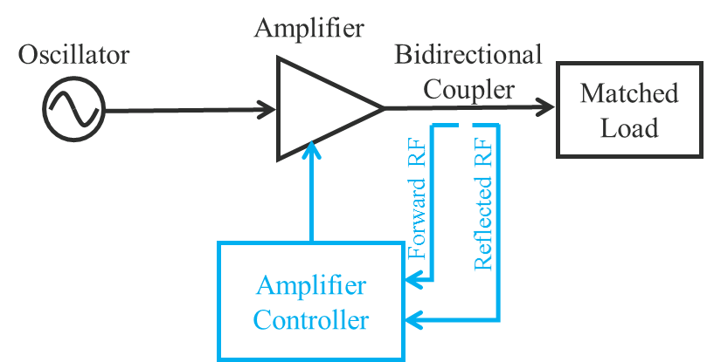
Example System
A control system to scan the output power of an RF amplifier.
Power scan range 0 ~ 1000 W, ramping speed below 100 W/s.
Error of amplifier output power should be within +- 10 W.
Provide reflection power protection (reflection power < 100 W) and the interlock response time < 10 us.
Remote monitoring and control.
Amplifier is digitally controllable with Ethernet: adjust or stop drive power.

Slide 10
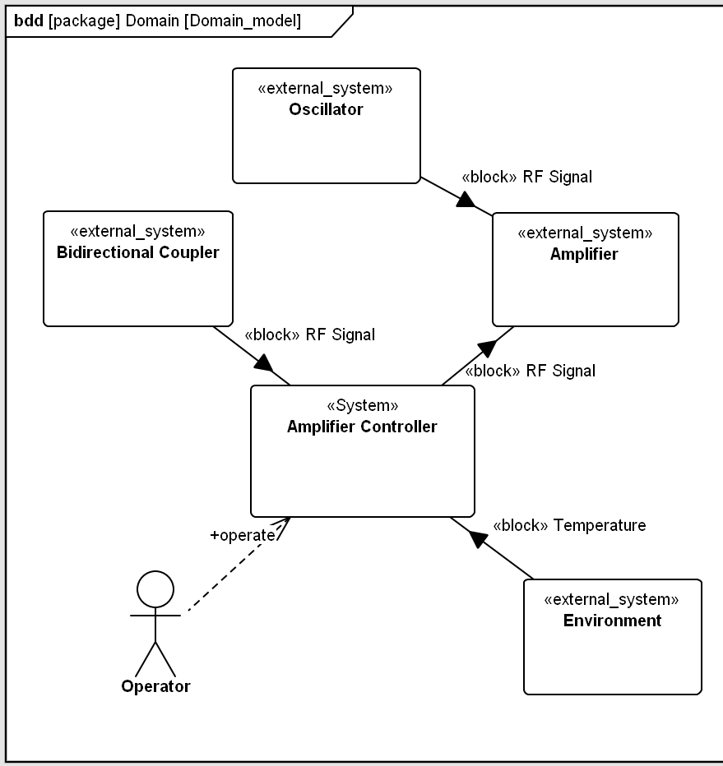
System Boundary Definition
Define what are included in the system, what are not.
Source of info: Design report (e.g. CDR) of the machine; discussions with concerned persons
The output of this step includes:
A list of persons who are interested in your system (e.g. machine physicist, project manager, users, responsible of other systems interacting with your system) - stakeholders
  They will tell their expectations to your system and review the system design
A list of external systems interacting with you system
  The interfaces to these external systems should be defined
Context diagram of the system of Amplifier Controller.

Slide 11
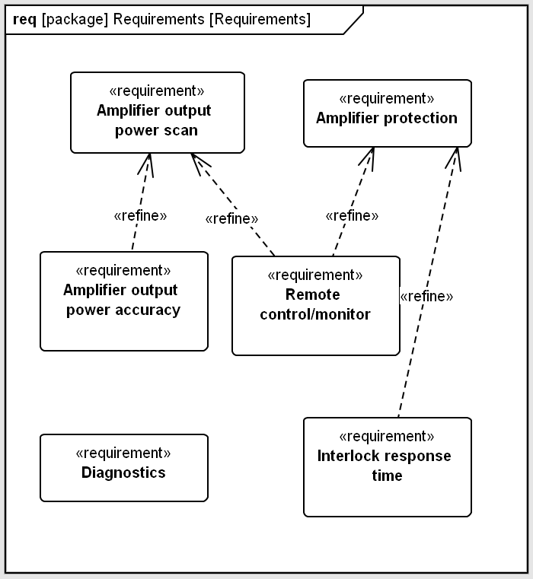
Requirements Collection and Analysis
Define user requirements: desired functions and performance, interfaces to external systems, constrains to system design (e.g. existing hardware, standards).
Source of info: Design report (e.g. CDR) of the machine; stakeholders; experiences
Methods to collect requirements:
  Read existing machine document, find out the related overall operation procedures and scenarios
  Discuss with stakeholders to collect expectations on the system. Make a questionnaire or interview if needed
  Refer to existing systems (works well for systems in a research labs) in other places
Analysis:
  Categorizing, removing redundancy, resolving conflicts in requirements
Describing the requirements in clear text (e.g. The user should be able to scan the amplifier output power between 0 and 1 kW with a adjustable ramping speed below 100 W/s.)

Slide 12
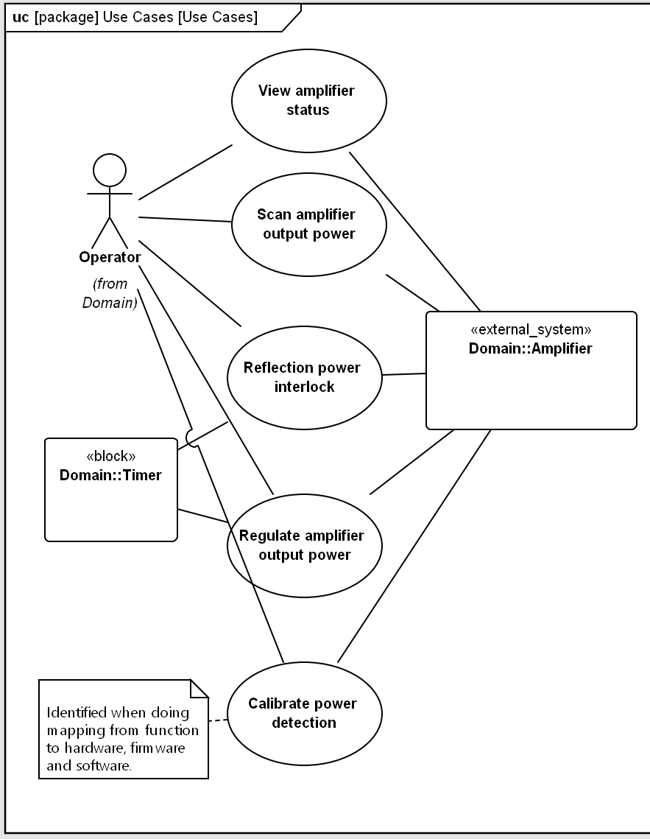
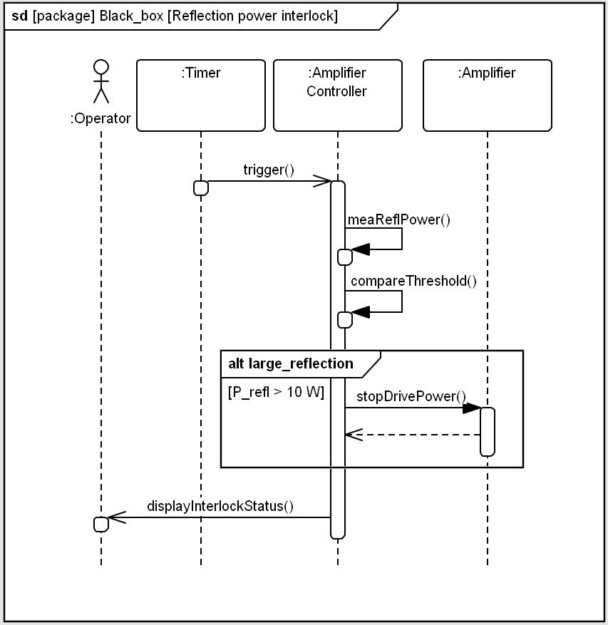
Use Cases Identification and Description
A use case of the system shows how the system is used - interaction with other systems for all top-level machine operation procedures.
Source of info: Design report (e.g. CDR) of the machine; collected user requirements
Use case offers more info for a functional requirements and helps to define machine interfaces.
Use case1: Reflection power interlock
Actors: Timer, Operator, Amplifier
Pre-condition: power mea. calibrated
Basic path:
1. A timer starts this use case
2. The A.C. measures reflection power
3. The A.C. compares the reflection power with threshold (100 W)
4. The A.C. stops the Amplifier output
5. The A.C. displays sys. status to operator
Alternative path:
Performance requirements:
A.C. = Amplifier Controller

Slide 13
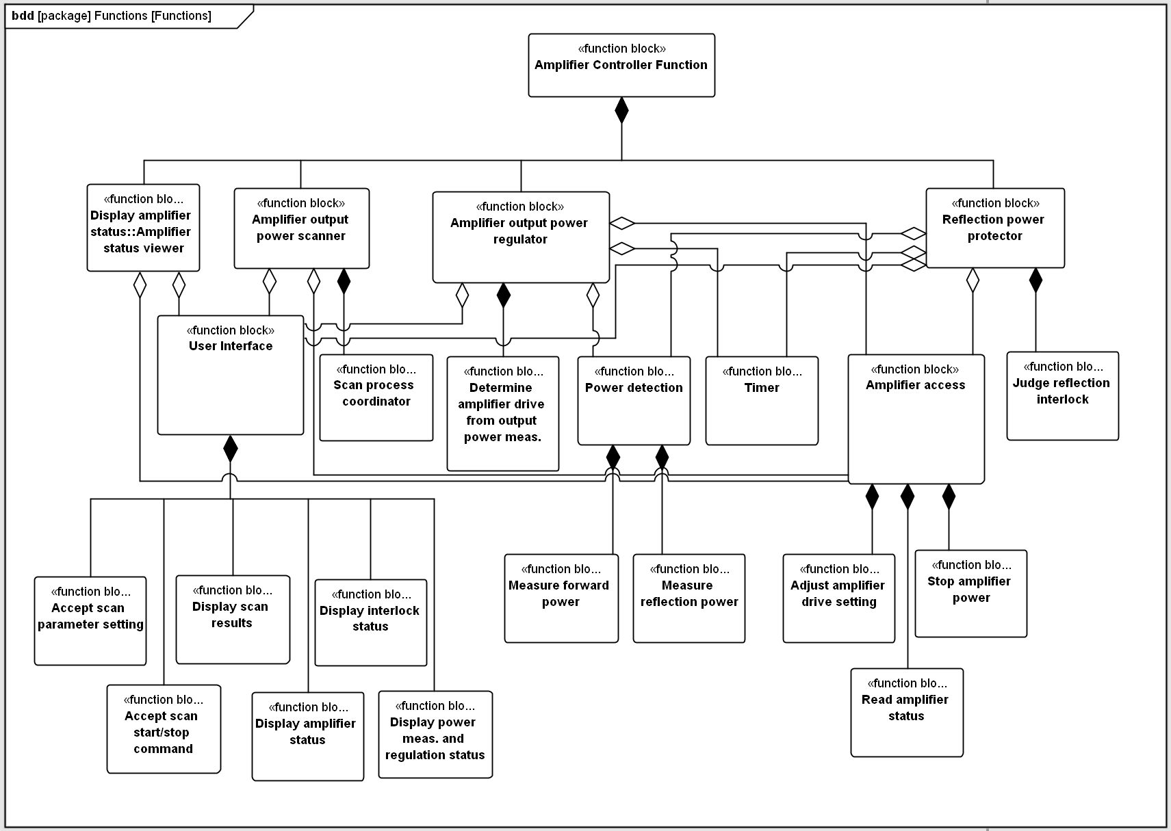
Function Analysis
Go through all user requirements and use cases, find out the functions that the system should provide. Breakdown into smaller pieces – logical architecture.
Abstraction level:
Procedure
Sub-procedure1
Sub-procedure2
…
Element function
Selected level of abstraction as a basis for design.

Slide 14
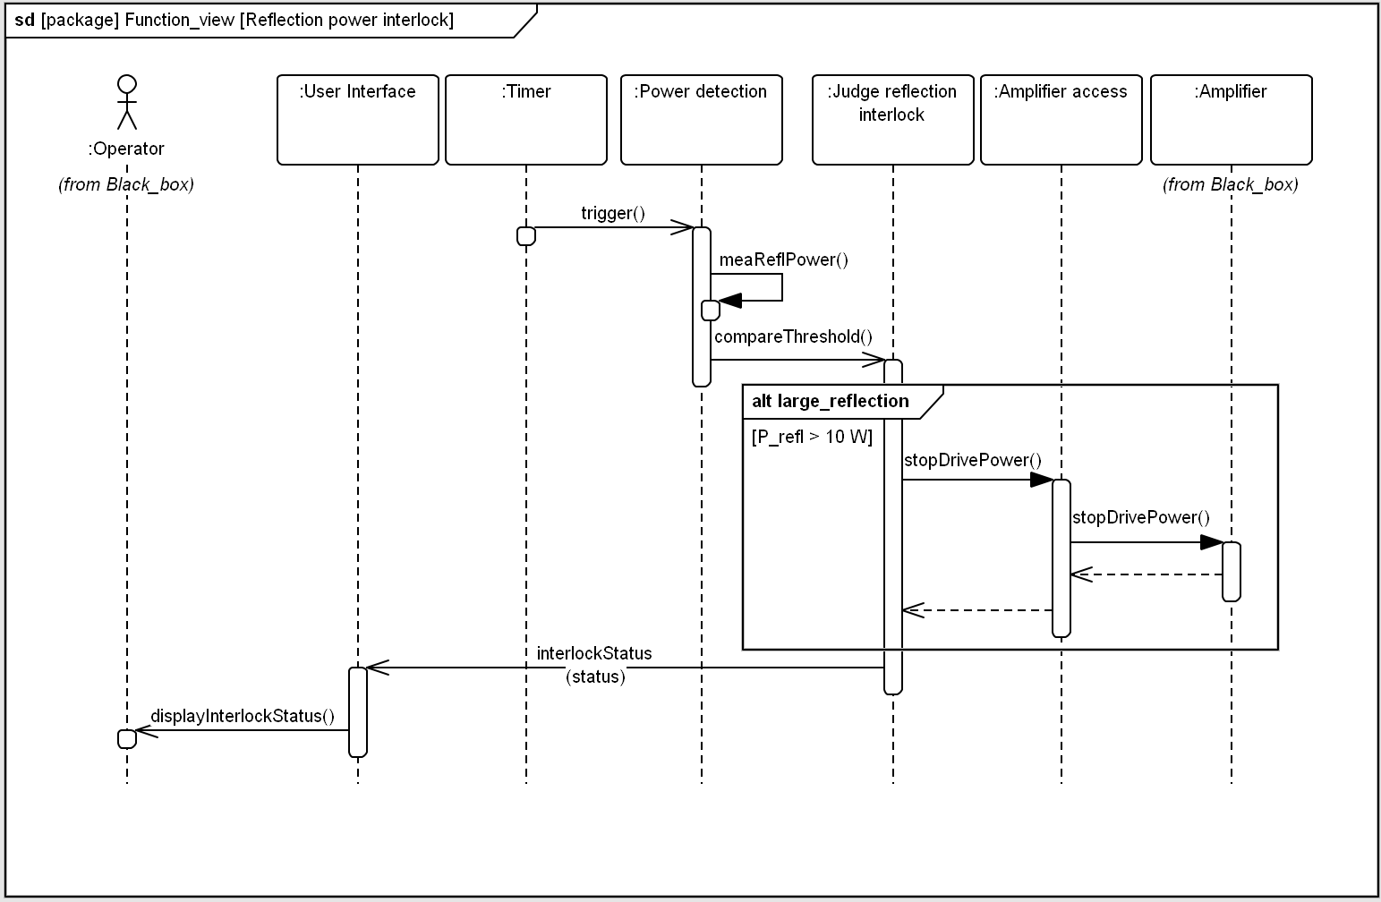
Function Analysis (cont.)
Define the function, performance and interface for each function block:
Revisit all use cases and make a second run of use case description taking into account interactions between function blocks – go from black box to inside the system!

Slide 15
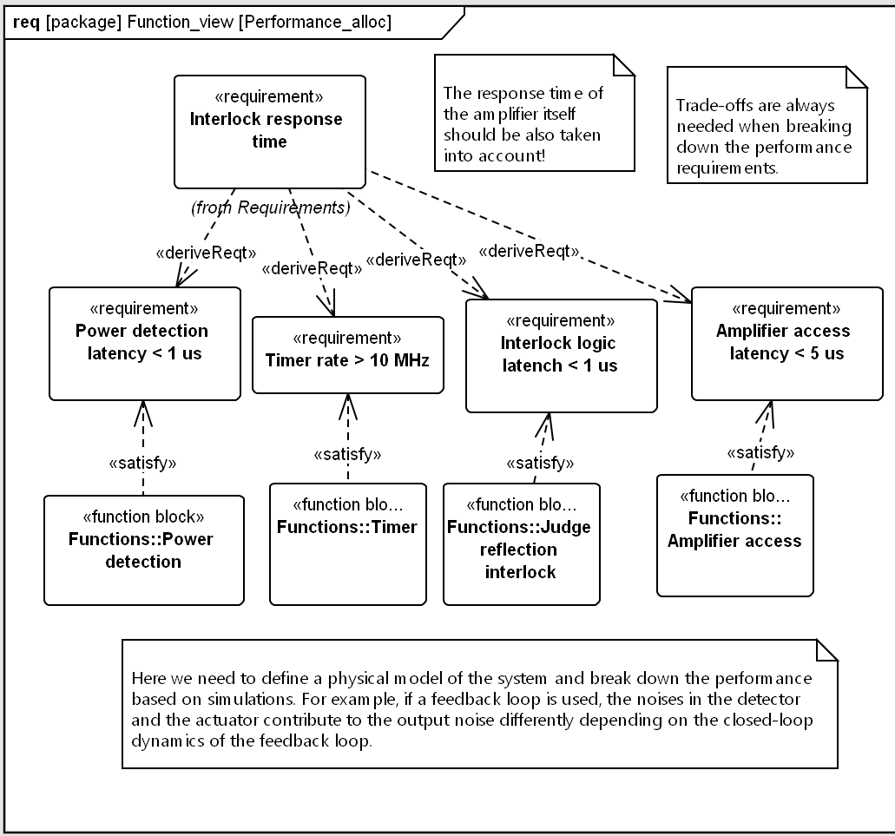
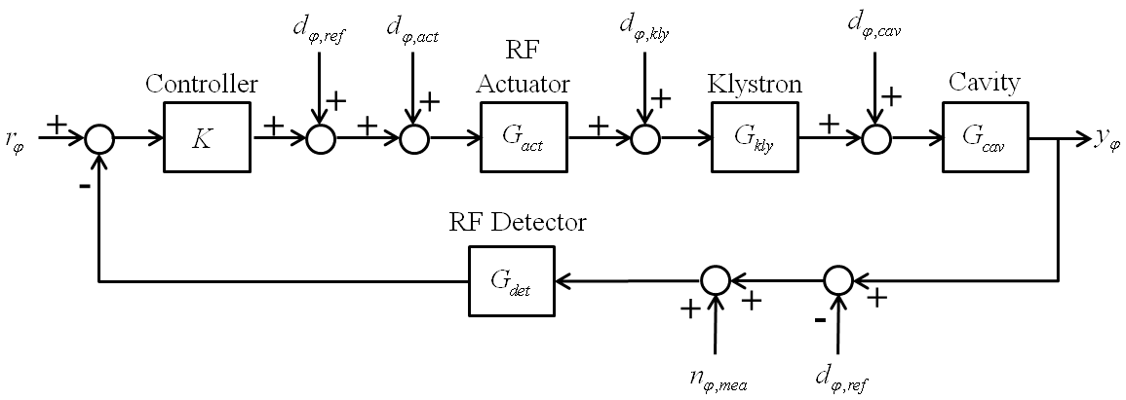
Function Analysis (cont.)
Derive performance requirements for each function block from top-level performance requirements.
A model is usually needed to breakdown performance requirements.

Slide 16
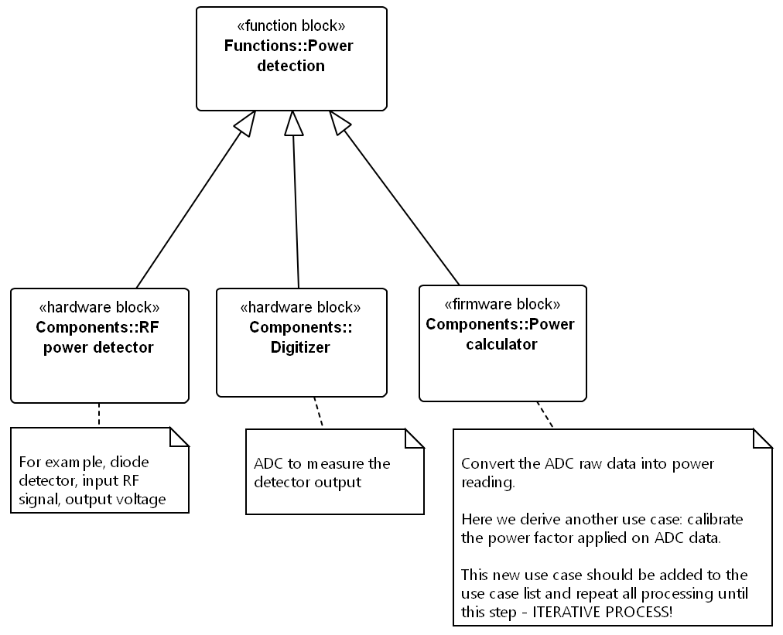
Hardware, Firmware and Software Partition
After defining the specification of the function blocks (functions, performance and interfaces), the function blocks can be further partitioned into hardware, firmware and software.
Here is already some design decision being made. Implementing the functions in hardware, firmware or software depends on the requirements (speed, upgradeability, etc.), technical difficulties and cost.
Notes:
Processes covered in the talk:
Hardware architecture design
Firmware architecture design
Software architecture design
Requirements verification
The processes are executed iteratively
Function partition to hardware/firmware software
Determine platforms (MTCA)
Hardware architecture design – how to determine the boards needed – modulator; determine what board to buy and what to make yourself – collaborate with external company for board design is a good choise – modular design – commercially availability
Firmware/software architecture design

Slide 17
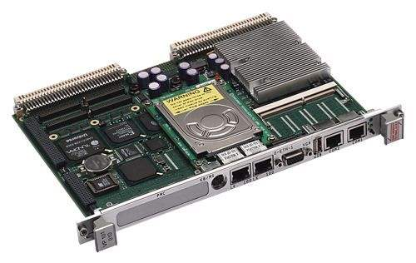
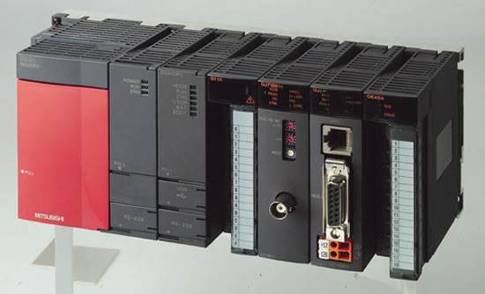
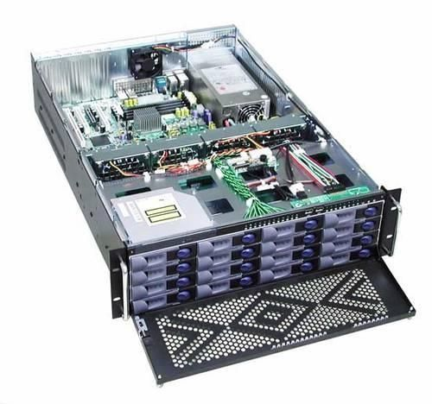
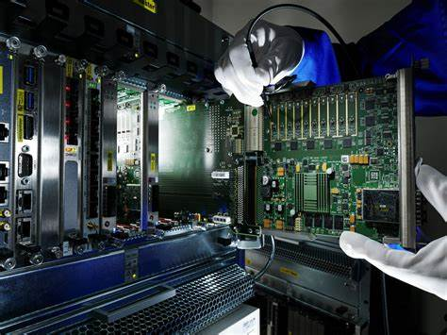
Hardware Platform Selection
Strongly depends on requirements and personal preference, for example:
High voltage, large current – custom chassis
Intensive IO – PLC
Real-time systems – MicroTCA, CPCI serial or VME
Notes:
Processes covered in the talk:
Hardware architecture design
Firmware architecture design
Software architecture design
Requirements verification
The processes are executed iteratively
Function partition to hardware/firmware software
Determine platforms (MTCA)
Hardware architecture design – how to determine the boards needed – modulator; determine what board to buy and what to make yourself – collaborate with external company for board design is a good choise – modular design – commercially availability
Firmware/software architecture design

Slide 18
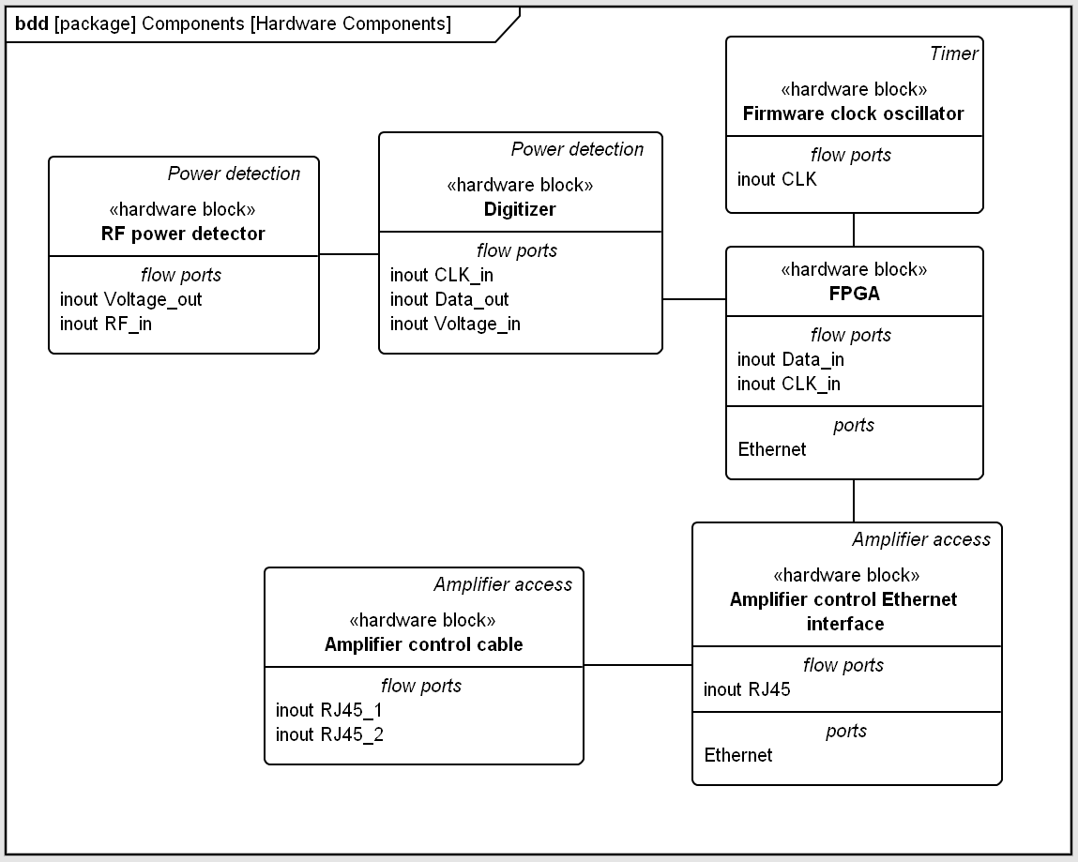
Hardware Architecture Design – identified components
Notes:
Processes covered in the talk:
Hardware architecture design
Firmware architecture design
Software architecture design
Requirements verification
The processes are executed iteratively
Function partition to hardware/firmware software
Determine platforms (MTCA)
Hardware architecture design – how to determine the boards needed – modulator; determine what board to buy and what to make yourself – collaborate with external company for board design is a good choise – modular design – commercially availability
Firmware/software architecture design

Slide 19
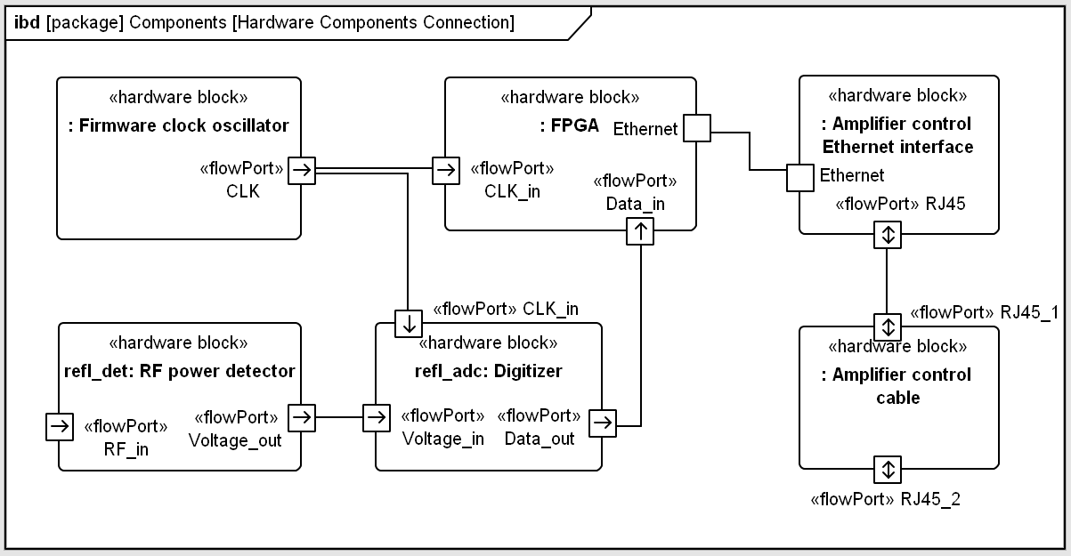
Hardware Architecture Design – specify functions and interfaces
Go through all requirements and use cases, find out the interconnections of hardware components
Part of hardware interconnection for use case “Reflection power interlock”
Notes:
Processes covered in the talk:
Hardware architecture design
Firmware architecture design
Software architecture design
Requirements verification
The processes are executed iteratively
Function partition to hardware/firmware software
Determine platforms (MTCA)
Hardware architecture design – how to determine the boards needed – modulator; determine what board to buy and what to make yourself – collaborate with external company for board design is a good choise – modular design – commercially availability
Firmware/software architecture design

Slide 20
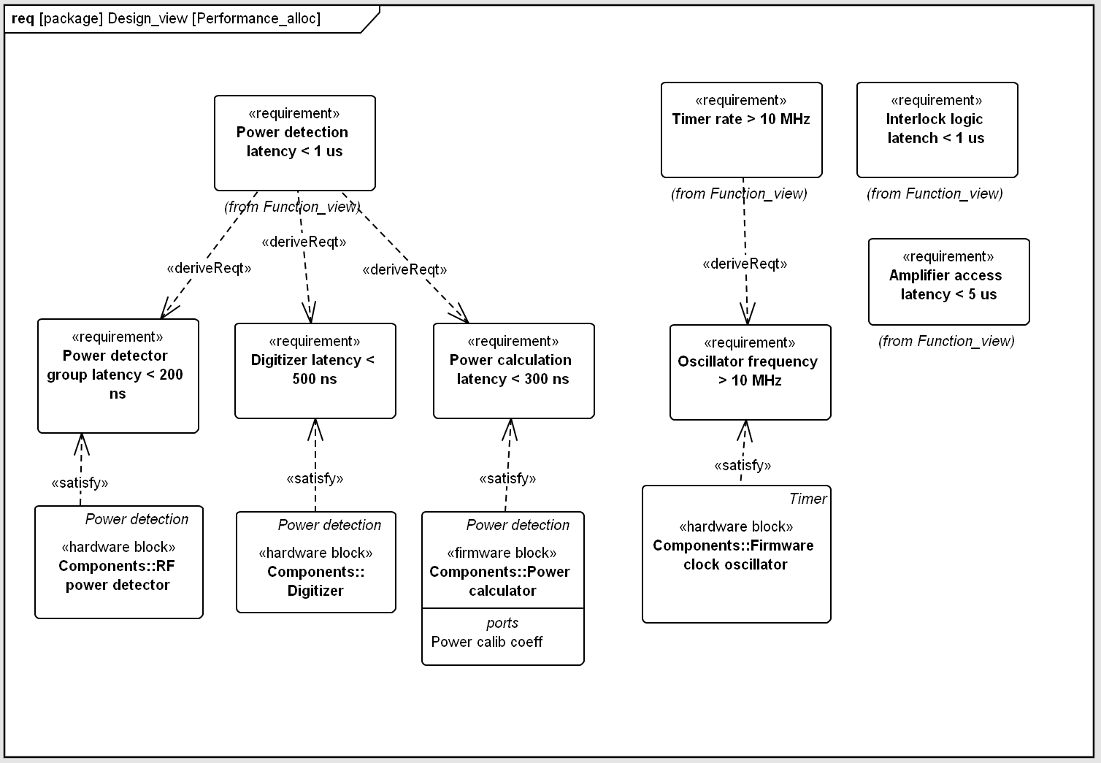
Allocate Performance Requirements to HW/FW/SW Components
Breakdown from function block performance requirements, define performance requirements for each hardware, firmware and software component.
Notes:
Processes covered in the talk:
Hardware architecture design
Firmware architecture design
Software architecture design
Requirements verification
The processes are executed iteratively
Function partition to hardware/firmware software
Determine platforms (MTCA)
Hardware architecture design – how to determine the boards needed – modulator; determine what board to buy and what to make yourself – collaborate with external company for board design is a good choise – modular design – commercially availability
Firmware/software architecture design

Slide 21
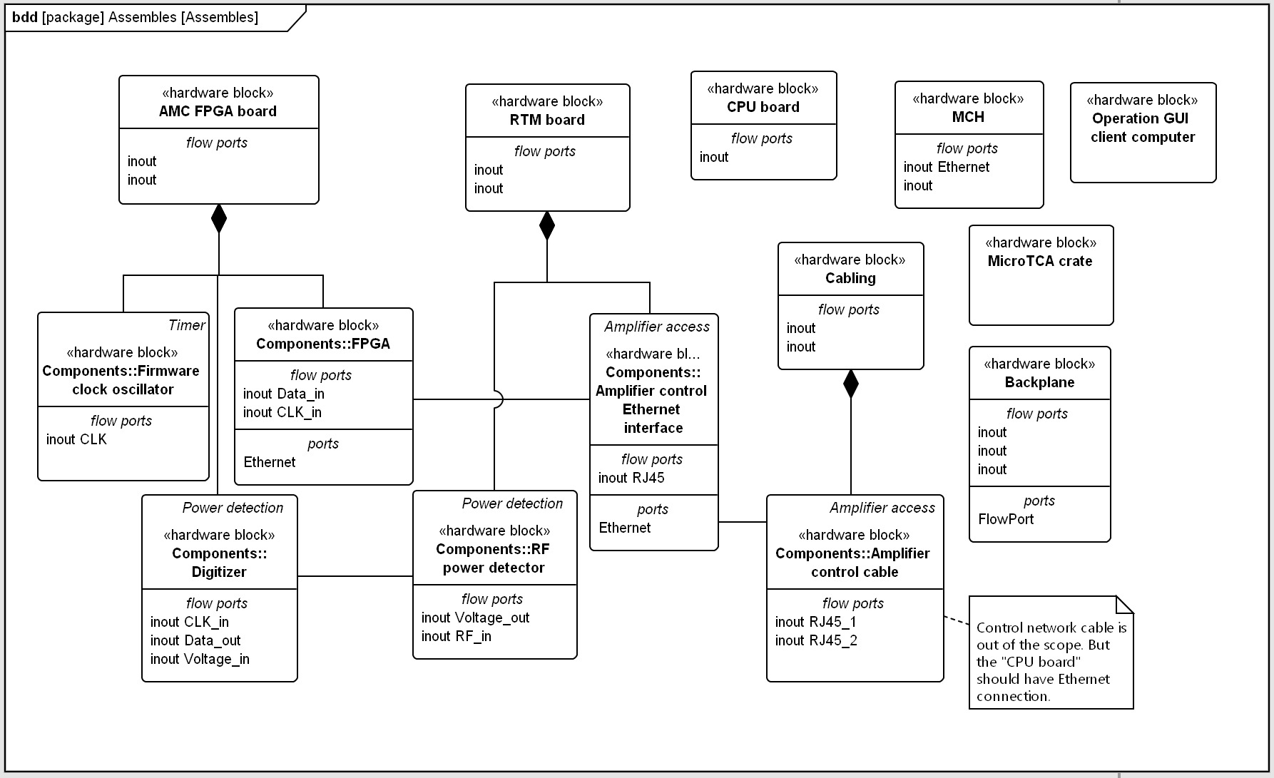
Hardware Architecture Design – define assembles
A hardware assemble can be a board, a chassis or other group of hardware components usually treated as a whole
When mapping HW components into MicroTCA boards:
  Minimize the types of boards – reuse the AMC and attach different RTM
  Standardize firmware (e.g. platform related registers) and software (e.g. kernel driver, device driver)
  To buy and to develop in house?
Notes:
Processes covered in the talk:
Hardware architecture design
Firmware architecture design
Software architecture design
Requirements verification
The processes are executed iteratively
Function partition to hardware/firmware software
Determine platforms (MTCA)
Hardware architecture design – how to determine the boards needed – modulator; determine what board to buy and what to make yourself – collaborate with external company for board design is a good choise – modular design – commercially availability
Firmware/software architecture design

Slide 22
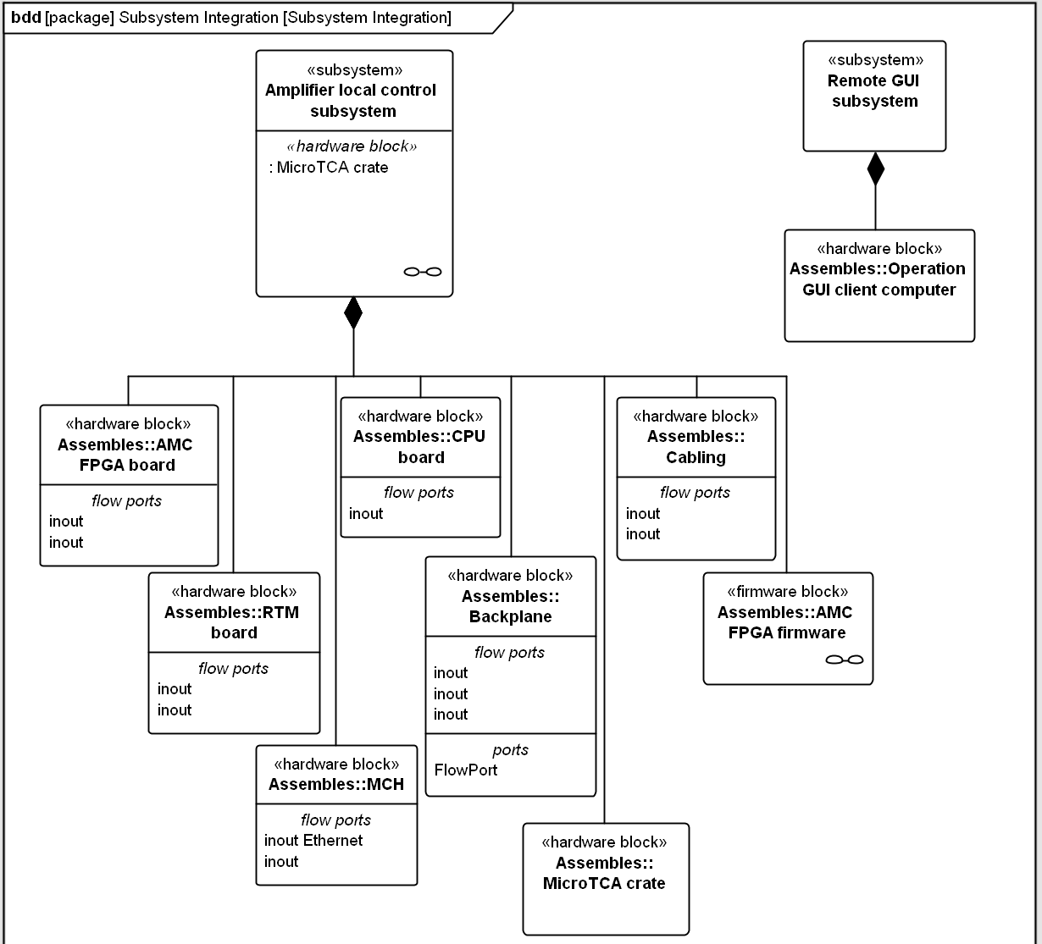
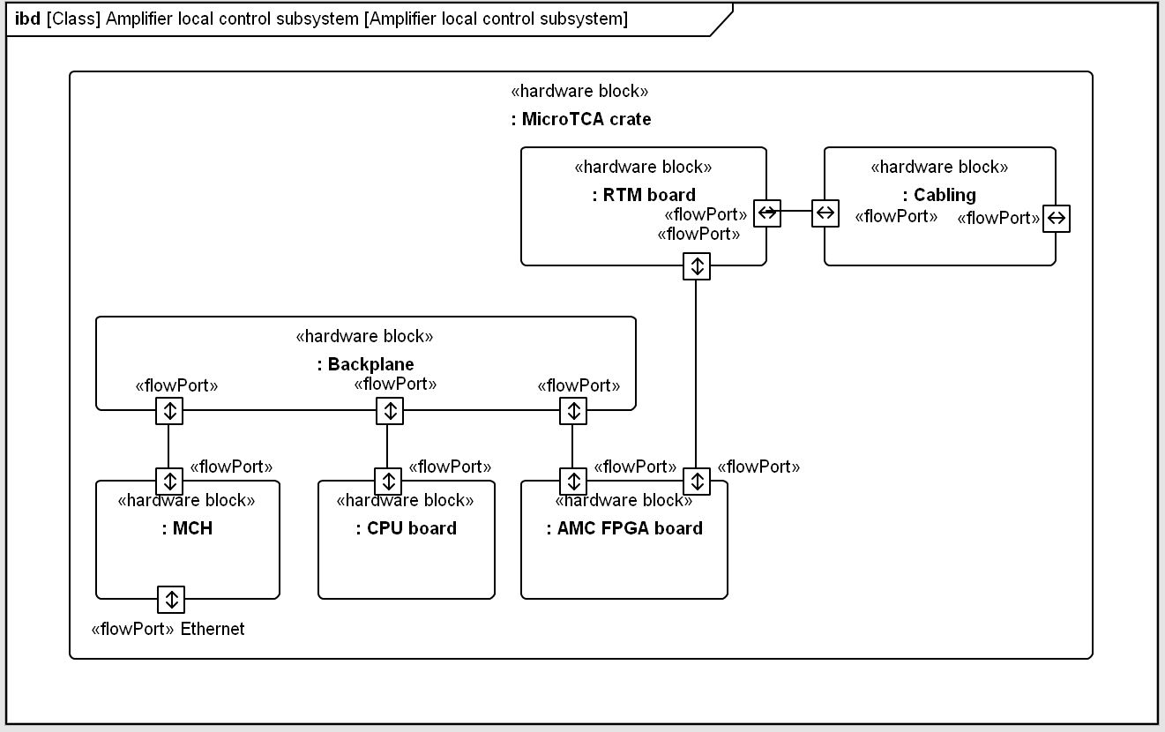
Hardware Architecture Design – define subsystems
A subsystem is a set of closely coupled assembles (e.g. chassis installed in the same location for distributed system). Here we define subsystems mostly referring to the hardware.
For large scale systems, the system can be also firstly divided into subsystems. We firstly specify the subsystem functions, performance and interfaces and then design each subsystem following the method in this talk.
Notes:
Processes covered in the talk:
Hardware architecture design
Firmware architecture design
Software architecture design
Requirements verification
The processes are executed iteratively
Function partition to hardware/firmware software
Determine platforms (MTCA)
Hardware architecture design – how to determine the boards needed – modulator; determine what board to buy and what to make yourself – collaborate with external company for board design is a good choise – modular design – commercially availability
Firmware/software architecture design

Slide 23
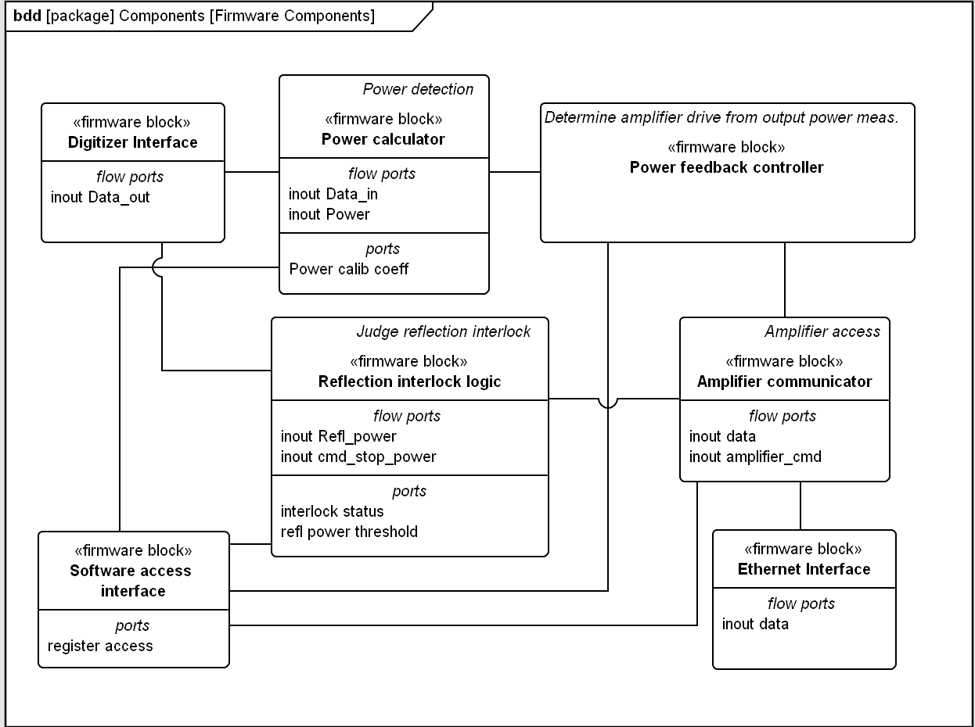
Firmware Architecture Design – identified components
Notes:
Processes covered in the talk:
Hardware architecture design
Firmware architecture design
Software architecture design
Requirements verification
The processes are executed iteratively
Function partition to hardware/firmware software
Determine platforms (MTCA)
Hardware architecture design – how to determine the boards needed – modulator; determine what board to buy and what to make yourself – collaborate with external company for board design is a good choise – modular design – commercially availability
Firmware/software architecture design

Slide 24
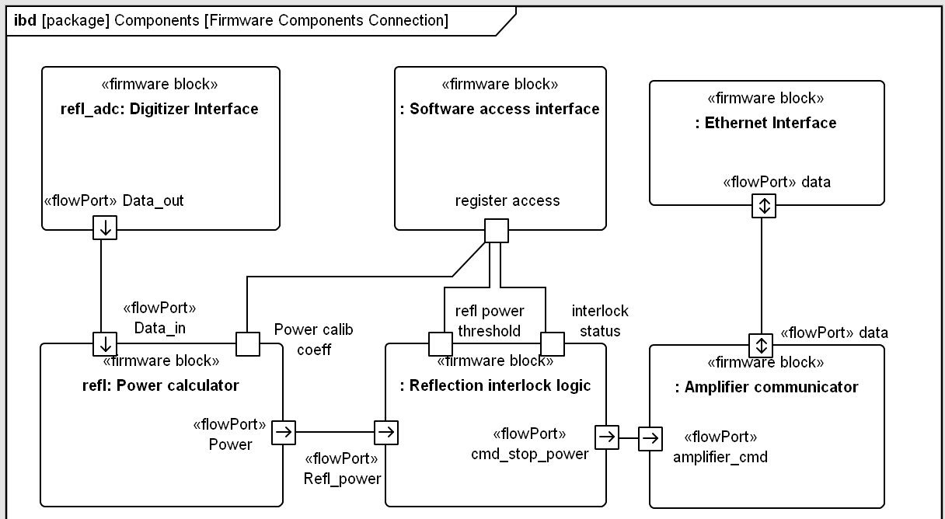
Firmware Architecture Design – specify functions and interfaces
Go through all requirements and use cases, find out the interconnections of firmware components
Part of firmware interconnection for use case “Reflection power interlock”
Notes:
Processes covered in the talk:
Hardware architecture design
Firmware architecture design
Software architecture design
Requirements verification
The processes are executed iteratively
Function partition to hardware/firmware software
Determine platforms (MTCA)
Hardware architecture design – how to determine the boards needed – modulator; determine what board to buy and what to make yourself – collaborate with external company for board design is a good choise – modular design – commercially availability
Firmware/software architecture design

Slide 25
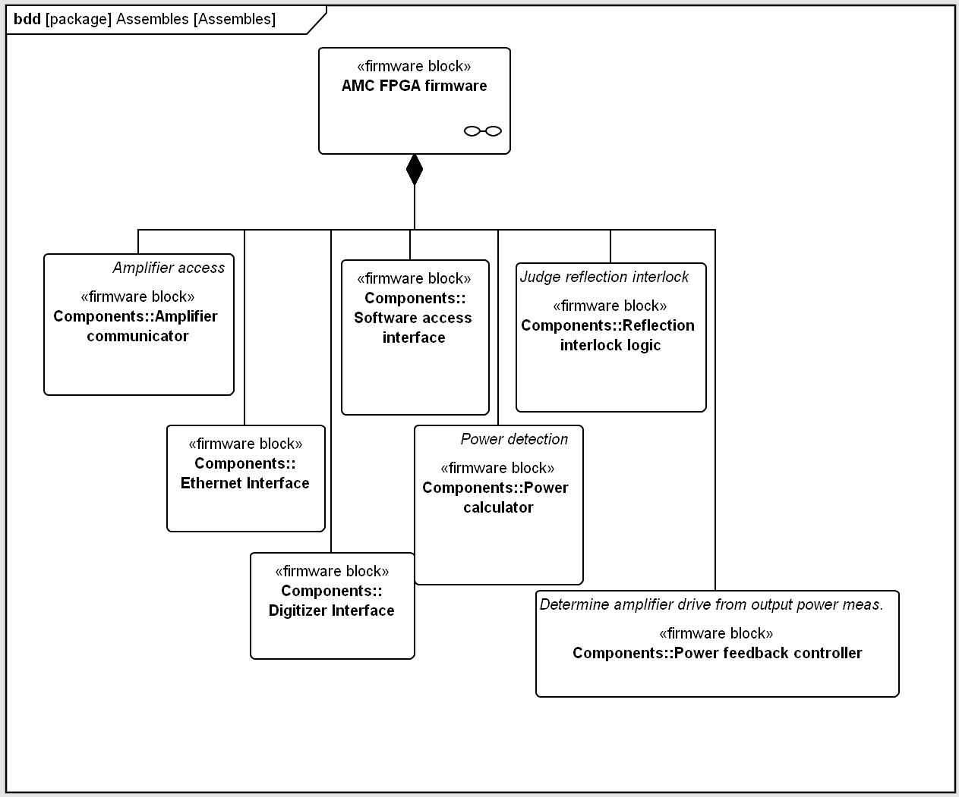
Firmware Architecture Design – define assembles
A firmware assemble can be a firmware package for an FPGA or a group of firmware components treated as a whole
Notes:
Processes covered in the talk:
Hardware architecture design
Firmware architecture design
Software architecture design
Requirements verification
The processes are executed iteratively
Function partition to hardware/firmware software
Determine platforms (MTCA)
Hardware architecture design – how to determine the boards needed – modulator; determine what board to buy and what to make yourself – collaborate with external company for board design is a good choise – modular design – commercially availability
Firmware/software architecture design

Slide 26
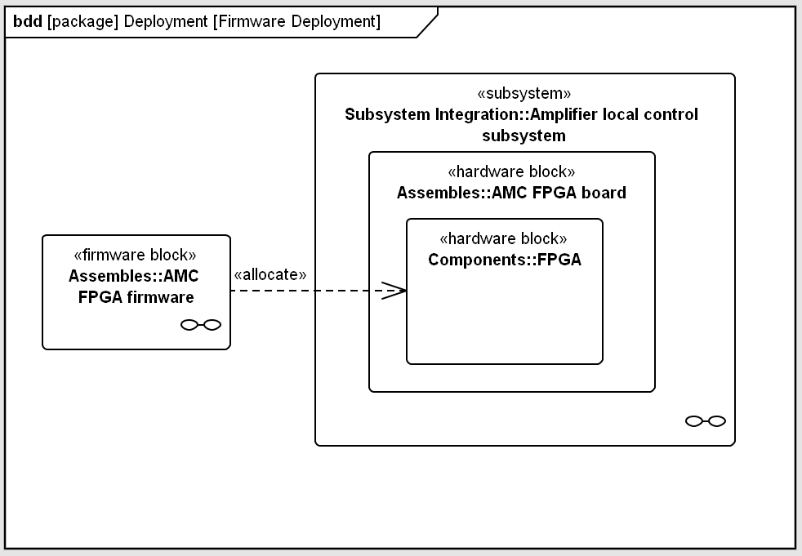
Firmware Architecture Design – allocation to hardware
Allocate the firmware assembles into hardware components
Notes:
Processes covered in the talk:
Hardware architecture design
Firmware architecture design
Software architecture design
Requirements verification
The processes are executed iteratively
Function partition to hardware/firmware software
Determine platforms (MTCA)
Hardware architecture design – how to determine the boards needed – modulator; determine what board to buy and what to make yourself – collaborate with external company for board design is a good choise – modular design – commercially availability
Firmware/software architecture design

Slide 27
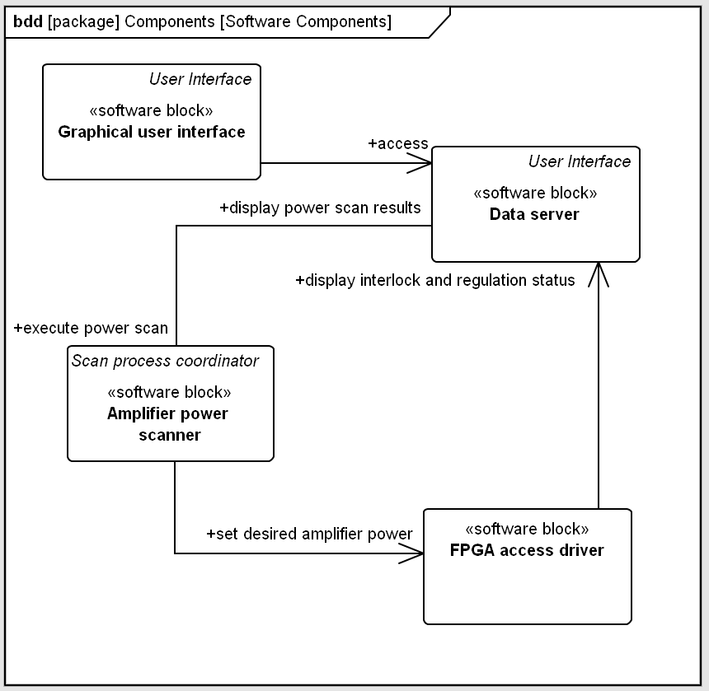
Software Architecture Design – identified components
Notes:
Processes covered in the talk:
Hardware architecture design
Firmware architecture design
Software architecture design
Requirements verification
The processes are executed iteratively
Function partition to hardware/firmware software
Determine platforms (MTCA)
Hardware architecture design – how to determine the boards needed – modulator; determine what board to buy and what to make yourself – collaborate with external company for board design is a good choise – modular design – commercially availability
Firmware/software architecture design

Slide 28
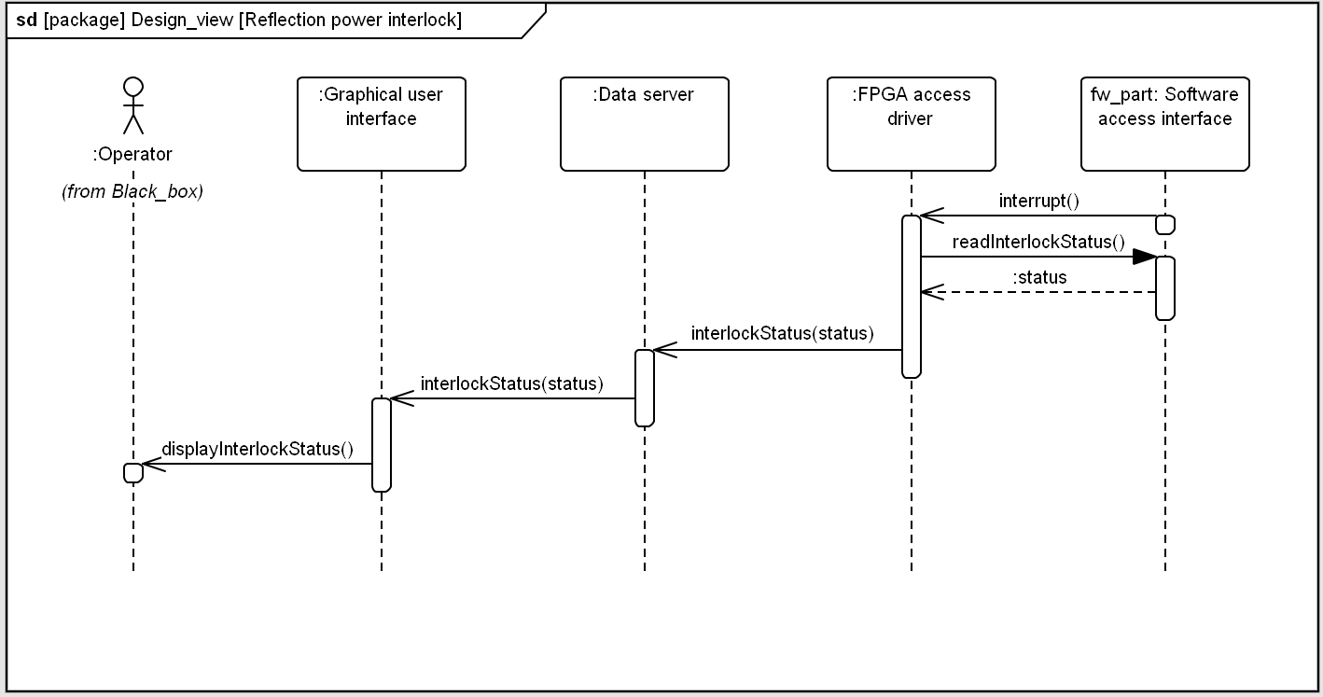
Software Architecture Design – specify functions and interfaces
Revisit all use cases and make a third run of use case description taking into account interactions between software (or firmware if the firmware is intelligent) components.
Notes:
Processes covered in the talk:
Hardware architecture design
Firmware architecture design
Software architecture design
Requirements verification
The processes are executed iteratively
Function partition to hardware/firmware software
Determine platforms (MTCA)
Hardware architecture design – how to determine the boards needed – modulator; determine what board to buy and what to make yourself – collaborate with external company for board design is a good choise – modular design – commercially availability
Firmware/software architecture design

Slide 29
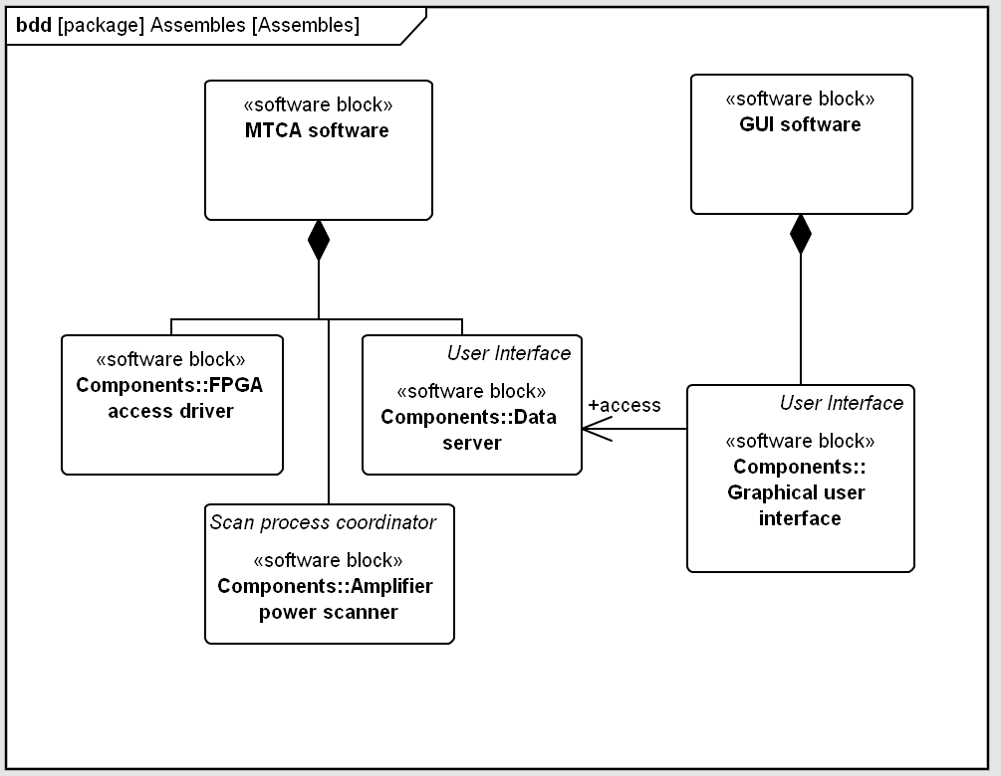
Software Architecture Design – define assembles
A software assemble can be a software process in a CPU (e.g. an soft EPICS IOC)
Notes:
Processes covered in the talk:
Hardware architecture design
Firmware architecture design
Software architecture design
Requirements verification
The processes are executed iteratively
Function partition to hardware/firmware software
Determine platforms (MTCA)
Hardware architecture design – how to determine the boards needed – modulator; determine what board to buy and what to make yourself – collaborate with external company for board design is a good choise – modular design – commercially availability
Firmware/software architecture design

Slide 30
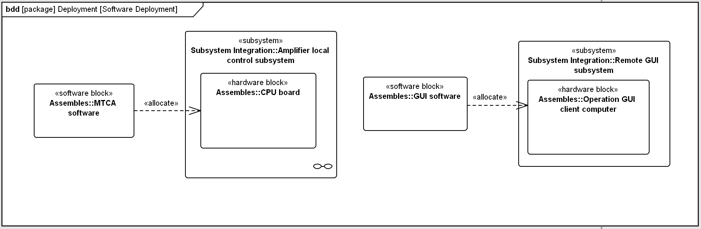
Software Architecture Design – allocation to hardware
Allocate the software assembles into hardware components
For software design, there are rich methodologies available in the domain of “Software Engineering”.
Notes:
Processes covered in the talk:
Hardware architecture design
Firmware architecture design
Software architecture design
Requirements verification
The processes are executed iteratively
Function partition to hardware/firmware software
Determine platforms (MTCA)
Hardware architecture design – how to determine the boards needed – modulator; determine what board to buy and what to make yourself – collaborate with external company for board design is a good choise – modular design – commercially availability
Firmware/software architecture design

Slide 31
Some Tips in System Design

Slide 32
(Negotiable) Tips
Documentation !!!
Standardization (hardware, especially for firmware and software)
Modulator design
Commercially availability (especially for parts with general functions – FPGA, CPU, ADC …)
Keep it simple (if a simple solution works well, do not complicate it)
Loose coupling (one part fail, other parts still can function generally)
Diagnostics (add enough measurements, you will benefit when doing trouble shooting)
Simulation (when you have a feedback, do the full feedback control simulation homework)

Slide 33
Documentation with Text or Diagramm
Documentation is necessary for a successful system design. Document any ideas, requirements, design, constraints, conflicts and all issues in a trackable document (e.g. version control).
Documentation is so important that even a simple text based description is helpful.
Of course, diagrams helps a lot to understand: simple diagram (e.g. MS Visio) or complex formal models – UML/SysML.
Usually a combination of text and diagram based documentation is a trade-off: this helps to document all information without blowing up the complexity of diagrams
Anyway, make documentations, regardless any format!

Slide 34

Thank you!

