Slide 1
Peter’s work of BesVis and Suggestions
Long Peixun
2019.2.21

Slide 2
Outline
Peter’s work of BesVis:
Display of MC truth track.
My work this week:
Check Peter’s code and correct errors.
Suggestions

Slide 3
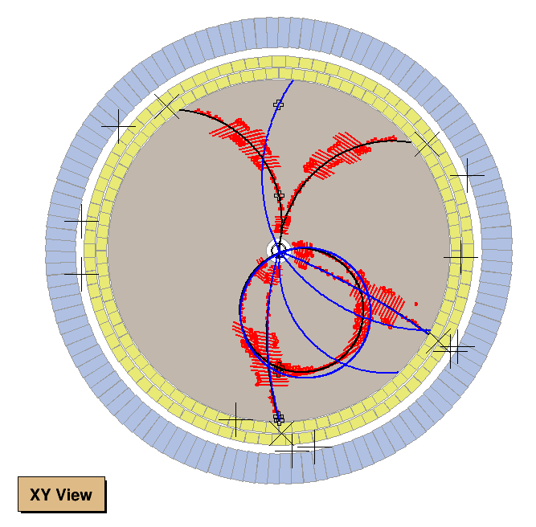
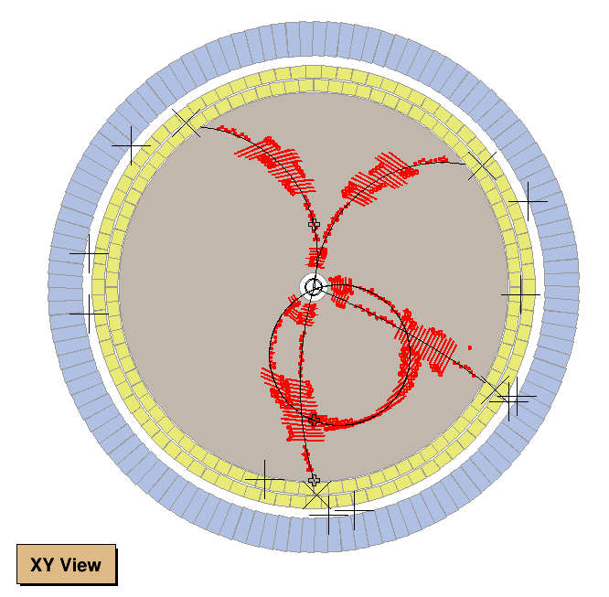
Peter’s Work
MC Truth Track
REC Track
Peter’s upgrade in CgemBOSS 665c
Previous BesVis

Slide 4
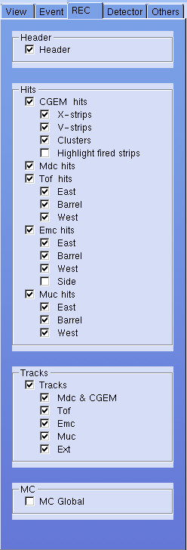
Suggestions
The color and width of tracks
Text of View Opitons
Tracks
Mdc & CGEM
Tof
Emc
Muc
Ext
MC Truth Tracks

