Slide 1
Muon reconstruction with convolutional neural networks (CNNs)
Liu Yan, Li Weidong, Lin Tao, Wang Lu, Xu Jilei
Nanjing University
2019/5/31

Slide 2
Outline
Introduction
Motivation
CNNs Implementation and performance
Rotation method and performance
Summary
Notes:
introduction => Introduction

Slide 3
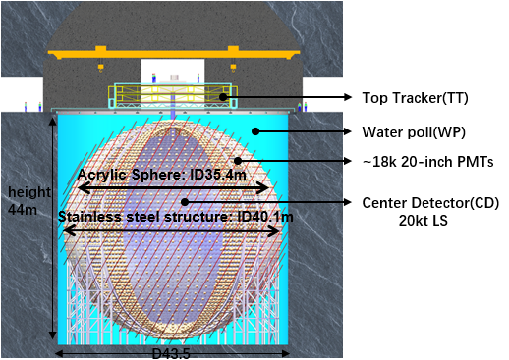
The JUNO Experiment
The Jiangmen Underground Neutrino Observatory (JUNO) is a multiple purpose neutrino experiment to determine neutrino mass hierarchy and precisely measure neutrino oscillation parameters.
Central Detector
spherical container, radius=17.7m
20k ton liquid scintillator
~18k 20 inch PMTs, catching the
lights emitted by the liquid scintillator
Water Pool
Top Tracker
Notes:
加入WP和TT的介绍

Slide 4
Motivation
Cosmic muon is one of the major sources of neutrino backgrounds. To efficiently veto these backgrounds, we need to reconstruct the trajectory of muon[arXiv:1803].
Traditional reconstruction，for example based on fastest light model [JUNO-doc-2740].
Reflection and refraction of optical photons, latency of the light scintillation and time resolution of the PMTs may affect the precision of this method. Complex optical model .
Additional corrections to the FHT bias are necessary for these methods.
Reconstruction with CNNs
No need to consider optical model
Without any corrections
Notes:
传统的重建方法，例如依赖最快光模型的重建方法，
Motivation 不需要考虑光学，CNN的优势
Classic

Slide 5
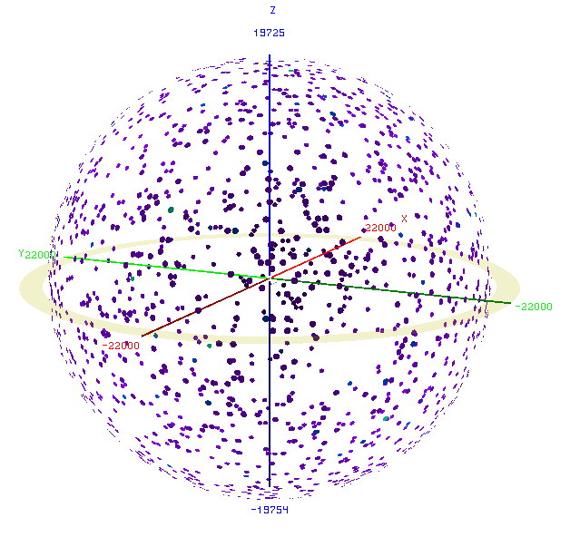
Applying CNNs in muon reconstruction
Initial CNNs rec[JUNO-doc-3139-v4].
Dataset
320 K simulation events in 200 GeV, generating from WP, direction is true muon track direction
Labeled with injecting point and direction from simulation
Divide into 300k training set, 20k testing set
network architecture
projection
…
output
input
Muon track
inject point(x,y,z)
direction(px,py,pz )
Full
connected
layer
Convolution
layer
Sampling
layer
2D plots
Notes:
With Deep learning has been wildly used in HEP , try to apply convolutional neural networks (CNNs) to solve the muon reconstruction problem.
Input is the nPE (Q) and First Hit Time (T) in
each PMT. Project the data into 2D plots.
Output is the track of injecting point
(x,y,z) and direction (px,py,pz)

Slide 6
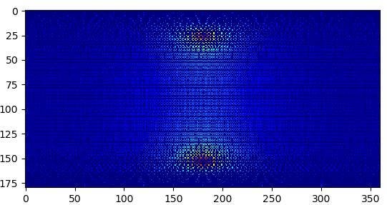
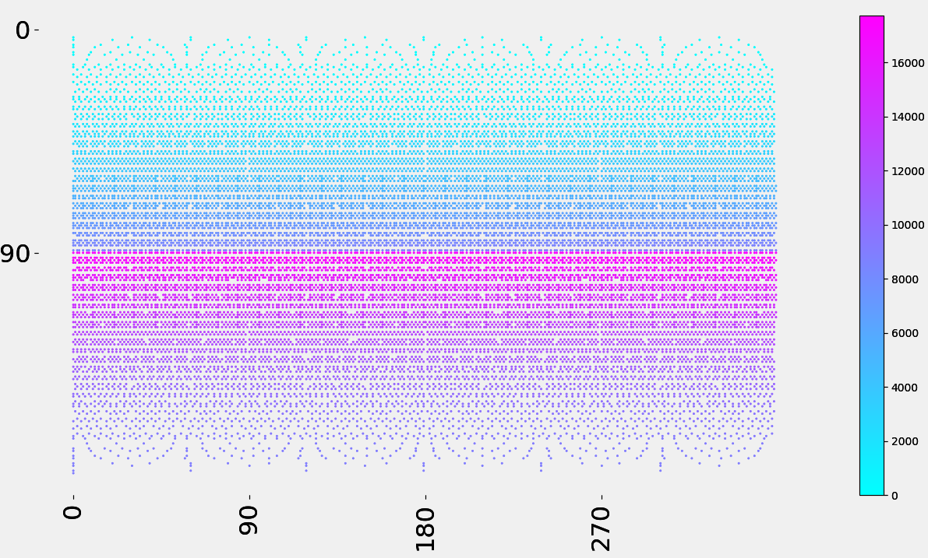
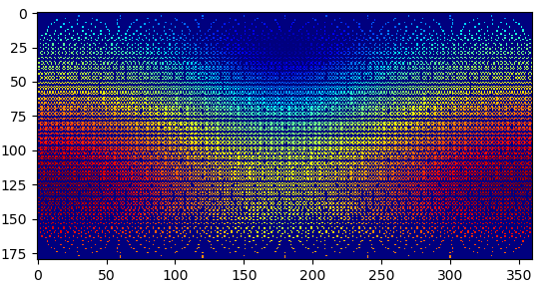
Image Construction
Projection of ~18k PMTs
Cylindrical isometric projection
number of photoelectrons(Q)
2D plots color means the pmt id
first hit time (T)
The different project methods may have impacts on the performance
Notes:
Based on initial implement of DL reconstruction, update the network architectures. mainly Increase convolution layers and kernels. And then considering the pmt projection influence, using cylindrical isometric projection

Slide 7
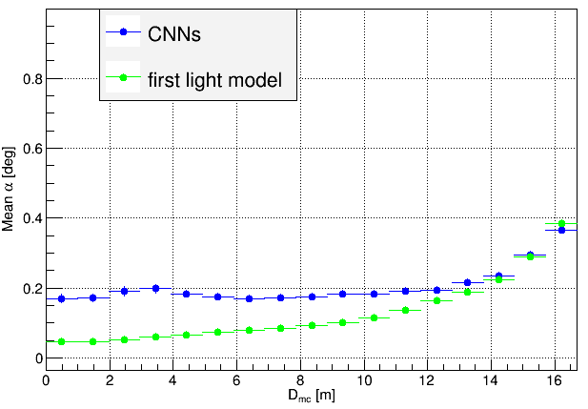
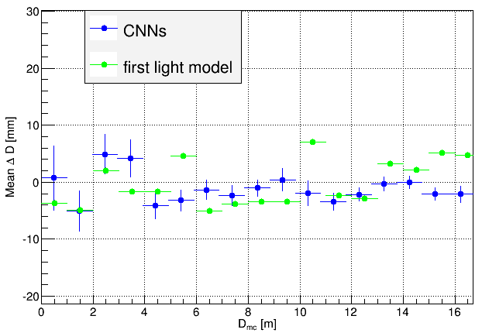
Compare performance
CNNs method Comparable to the performance
of based on FLM reconstruction method
α
true
dr
rec
dt
△D=dr - dt
notice：more near to edge of CD, more events
performance of bias of α smaller than 0.4 degree and △D(ist) smaller than 1 cm
Notes:
图变大，delta D，字变少
After update ,try to compare the reconstruction performance. The alpha means angle between the track direction of simulation and reconstruction, delta distance means the difference of distances to the center of the simulated and reconstructed tracks.

Slide 8
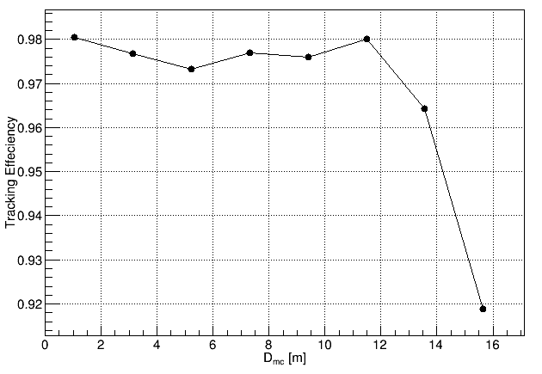
Reconstruction efficiency
Rec eff = 𝑁𝑠/𝑁a
𝑁𝑠= the deviation of each parameter is less than five
times their standard deviation
𝑁𝑎= all muon events of test set
Notes:
定义

Slide 9
Time cost of muon reconstruction
Reconstruction speed is greatly improved with CNNs method, especially in GPU
1000 events test time
Method | hardware | time per event [ms]
1.Fastest light module reconstruction | one CPU | ~5000
2.DL(batch size=1) | one CPU(E5-2650 v4) | ~950
3.DL(batch size=1) | One GPU(V100) | ~9
~5x speed up vs 1
~100x speed up vs 2
batch size means once time run number of reconstruction events
Notes:
And then compare the DL reconstruction with based on FLM reconstruction. DL reconstruction

Slide 10
Motivation of considering TT reconstruction
The labels we previously used the true muon track information from simulation.
But how to get the muon track information in JUNO?
The Top tracker (TT) can only cover the central segment above the WP, but they can provide a calibration set of relatively high precision track-starting points.[JUNO-doc-3322-v8]
TT
true
WP
CD
TT rec
CD rec
Notes:
强调为什么用TT，WP。图放大

Slide 11
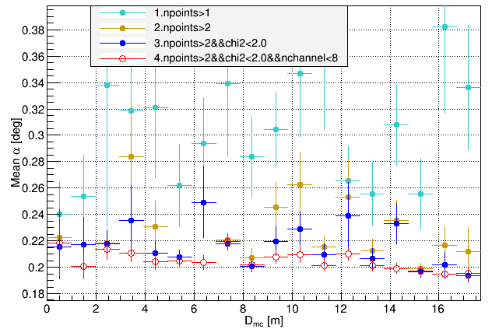
TT reconstruction
TT reconstruction[JUNO-doc-3122],choose the better TT reconstruction events
npoints： Track hits the number of layers of TT.(no cross talk)
chi2：TT reconstruction least squares value
channel： Number of activated scintillator bars
10k muon event cross TT and WP
Compare the bias of △α , after add selection criteria the bias become smaller.
The best is “4”, smaller than 0.22 degree.

Slide 12
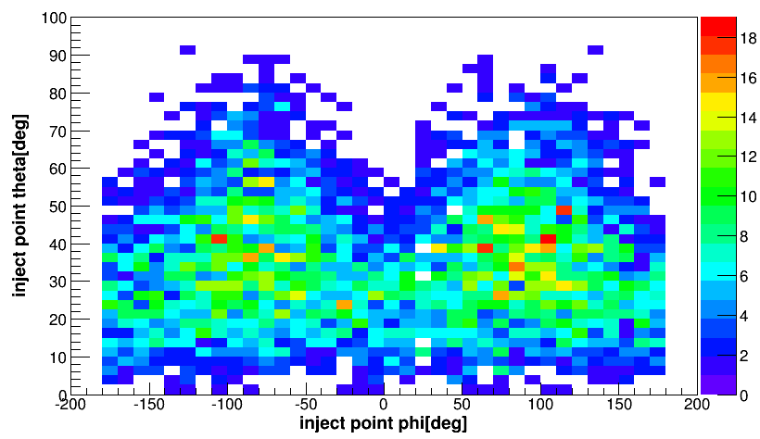
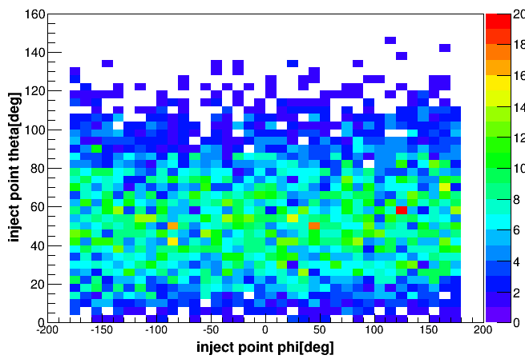
dataset generation process
Generate dataset
distribution of inject points
dataset | generate type | label
train set | Through TT | track information of TT reconstruction
test set (TT) | Through TT | true track information
test set (WP) | Through WP | true track information
Same Muon generator
TT sim data
CD sim data
TT rec
Train dataset
through TT and CD
through WP and CD
Notes:
After choose the better TT reconstruction events, generate 20K events in 200Gev.

Slide 13
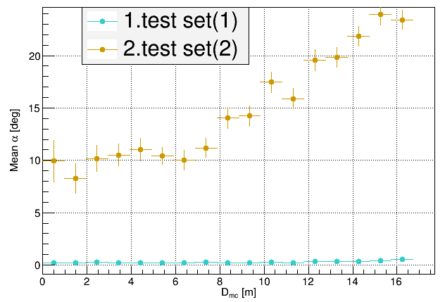
Muon reconstruction performance
CNNs model trained with 20k training set
Performance of test set
test set (TT)
test set (WP)
Bad performance for test set (WP).
One of the reasons is sample space of training data can not cover the test set (WP)

Slide 14
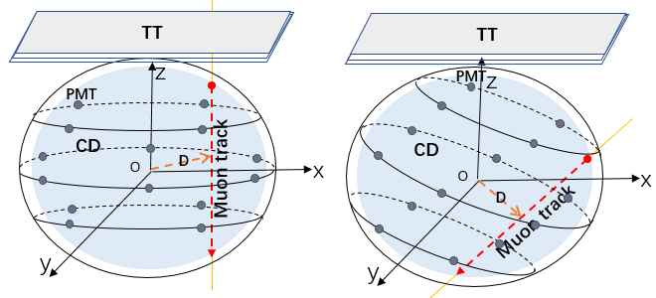
Rotation method
data steps:
40k data from TT
Use different rotation methods, then get 260k events.
Use 300k events as training data to train model
Use 20k test set(WP) as test set
Notes:
For solving the problem of insufficient sample space, improve a method of rotating events. To verify the feasibility of the rotation method, divide 20K train set into 10K train set inject points phi in[180,360],

Slide 15
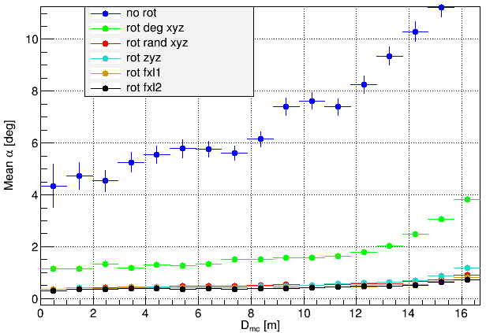
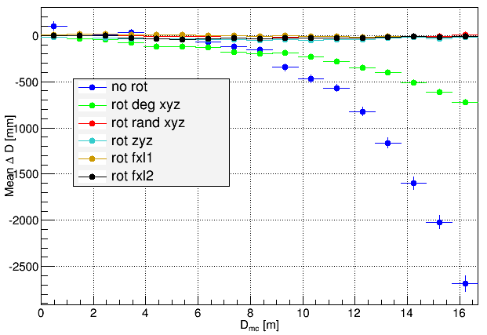
Performance of rotation
Performance
After rotation, the angle bias obviously become better. So rotating events maybe useful for reconstruction
The best rotation method is “rot fxl2”, the angle bias smaller than 0.55degree and △ D bias smaller than 3cm.
Notes:
After verifying that the rotation may be useful, further apply rotation.

Slide 16
Summary
Reconstruction performance of CNNs is bias of α smaller than 0.4 and △D smaller than 1cm.
Reconstruction speed is more than 100 times faster than the fastest light model in GPU
In JUNO
Using TT reconstruction, due to muon track unknown in JUNO
Rotation methods, due to insufficient sample space
the reconstruction performance is reasonable.
Notes:
性能提高多少，时间信息
列出问题，idea，简要

