Slide 1
The Mono-Photon Process With Signal (Preliminary)
Hao LIANG
2019.2.22

Slide 2
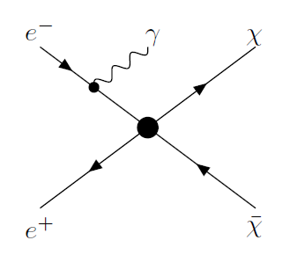
Signal
A dark matter model:
WIMP(Weakly interacting massive particle)
Inverse to the square of the energy scale $Λ$
Four forms of interaction
WIMP pair production

Slide 3
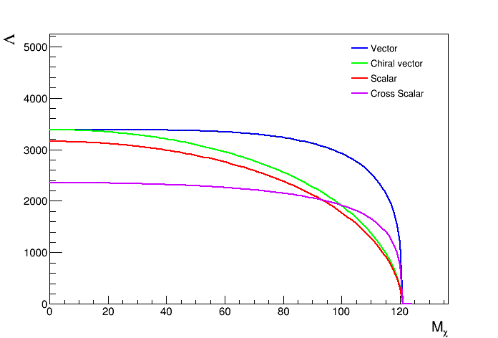
Events Counting Analysis
Repeat the work of arXiv:1211.4008v1
@ 250GeV & 250 fb^-1 & un-polarized
Events selection
$E_{γ}/125GeV$ :(0.064, 0.8) + (0.9,1)
|cos(theta)|<0.995
Background: 1.07fb
Exclusion cure of $Λ$ vs $M_{χ}$ at 3 sigma level
(Ok, note we sill have problem the absolute scale of the curve)

Slide 4
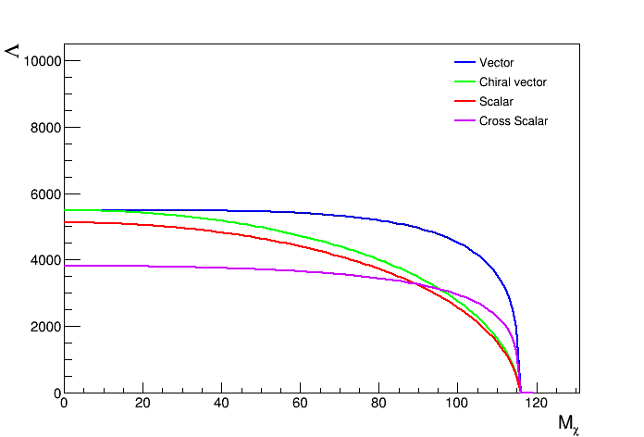
Events Counting Analysis
@ 240GeV & 5600fb^-1 & un-polarized
Events selection
$E_{γ}/125GeV$ :(0.064, 0.78)
|cos(theta)|<0.995
Background: 2219 ~ 0.40fb*5600fb^-1
Exclusion cure of $Λ$ vs $M_{χ}$ at 3 sigma level
(Ok, note we sill have problem the absolute scale of the curve)

Slide 5
Analysis with differential distribution
Effective number of backgrounds
$N_{bkg}/∫\frac{{pdf}_{sig}^{2}(x)}{{pdf}_{bkg}(x)}dx$
Note: $∫\frac{{pdf}_{sig}^{2}\left(x\right)}{{pdf}_{bkg}\left(x\right)}dx≥1$ with constraint $∫{pdf}_{sig}=1$
$N_{bkg}^{eff}=$0.32fb*5600fb^-1

Slide 6
Next work
Study the effect of photon angular and energy resolution

