Slide 1
Expectation of cosmic ray energy spectrum with LHAASO
Lingling Ma for LHAASO collaboration
Institute of High Energy Physics, Beijing
Chengdu 4.2019

Slide 2
Content
Status of cosmic ray spectra measurement
Cosmic ray spectra measurements in stages by multi-parameters with LHAASO
Expectation of cosmic ray spectra measurements in stages
Summary

Slide 3
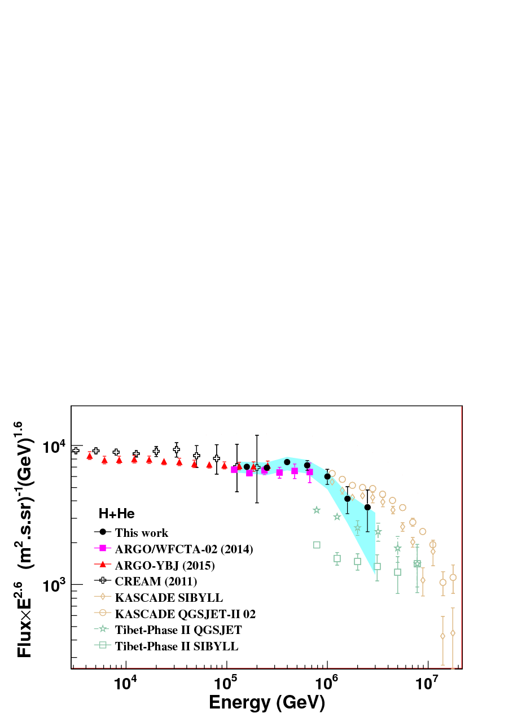
Status of cosmic ray spectra measurement
Measurements of H+He
  ARGO-YBJ：
    3TeV-300TeV
  ARGO-YBJ+C-telescopes
    100TeV-3PeV
The absolute energy scale is uncertain
Composition discrimination is difficult
Dependent on hadronic models

Slide 4
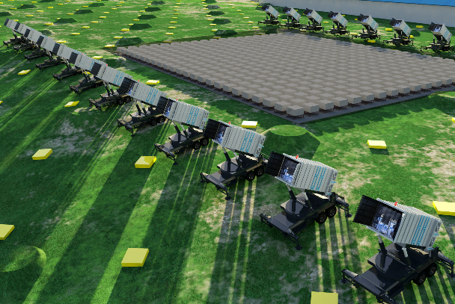
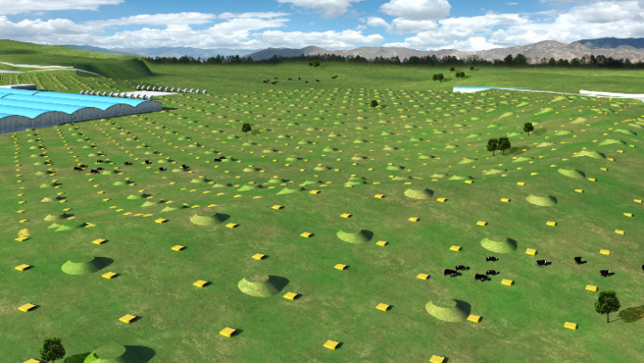
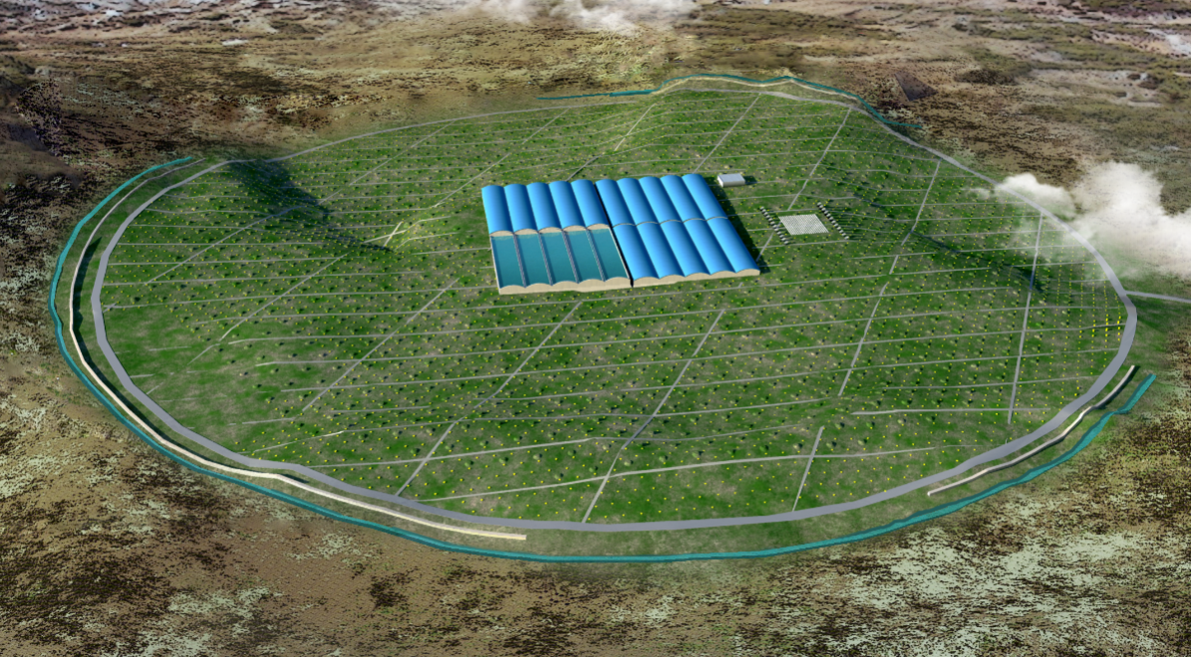
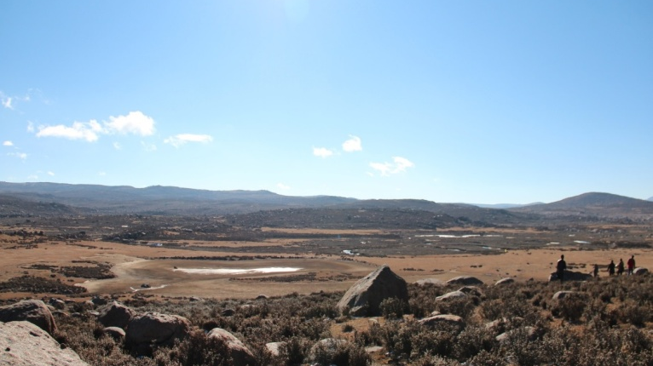
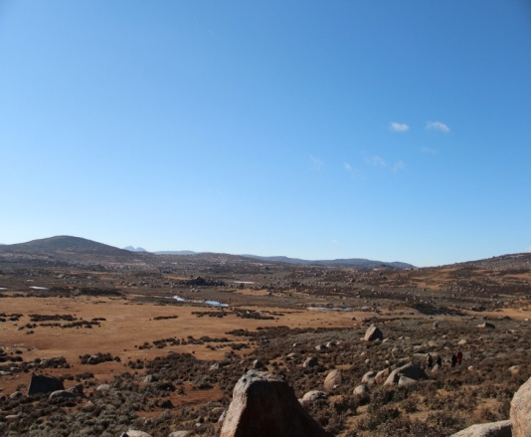
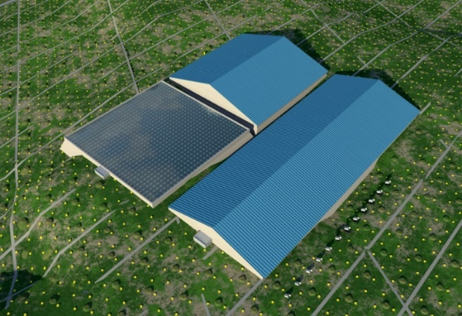
Large High Altitude Air Shower Observatory
LHAASO
WFCTA:
18 Cherenkov telescopes (1024 pixels/telescope)
KM2A:
5195 Scin’s: 1 m², 15m spacing
1171 MDs: 36 m², 30m spacing
WCDA:
3120 cells (25m²/cell)
Daochen, 4410 m a.s.l., 600 g/cm²
(29º21’ 31” N, 100º08’15” E)

Slide 5
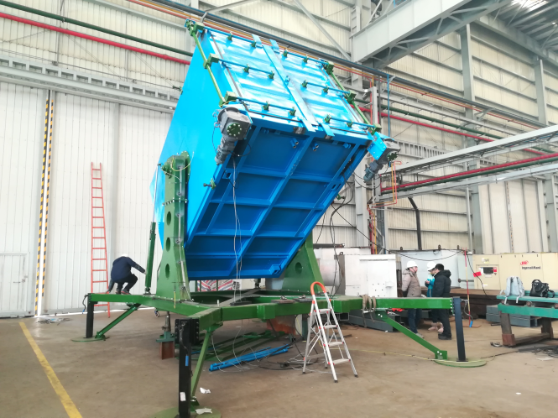
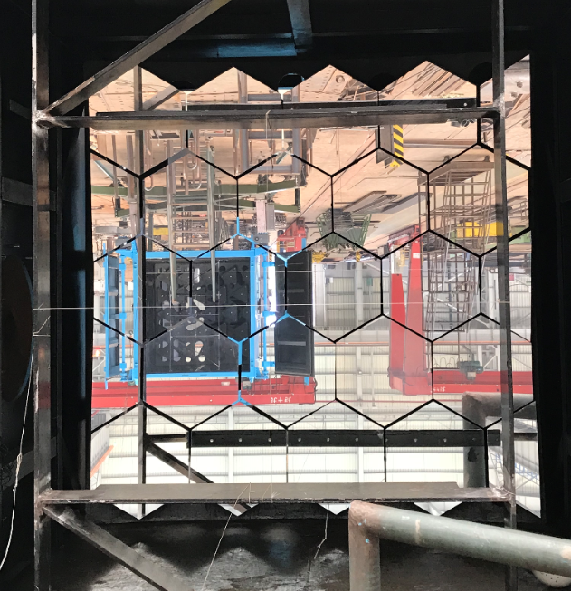
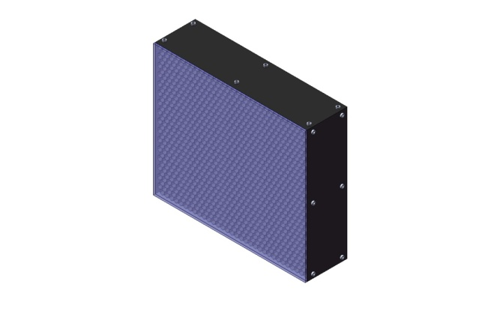
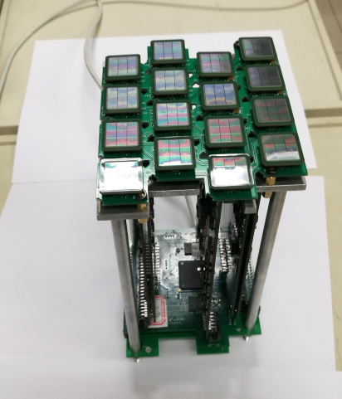
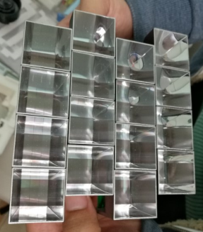
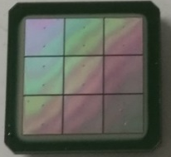
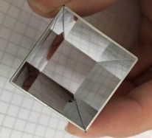
Wide FoV C-Telescope Array
Fully portable telescopes allow reconfiguring the array easily
Movable telescope housing
Rotating from 0º to 90º in elevation
5 m² spherical aluminized mirror
Reflectivity of 85%
32×32 SiPM array
FoV of 16º×16º
0.5º pixel
1-4000 PE nonlinearity less than 5%
4×4 20μm SiPM
sub-cluster
50 MHz FADC
Temperature-compensation power supply
T-stamp from WR network
Aluminized Winston cones
Cut-off angle 30º with efficiency of 93%
Filter transmission of 92% in 310–550 nm
with full-moon duty cycle >30% above 100 TeV

Slide 6
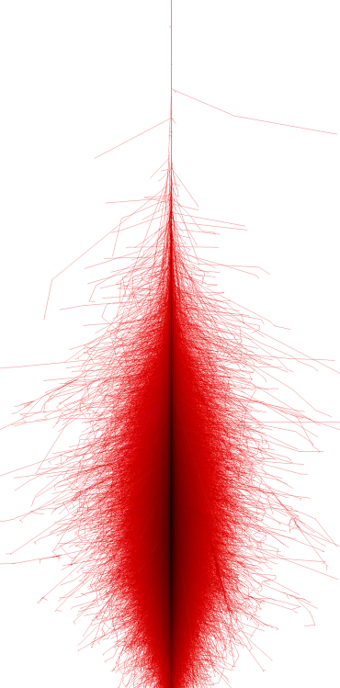
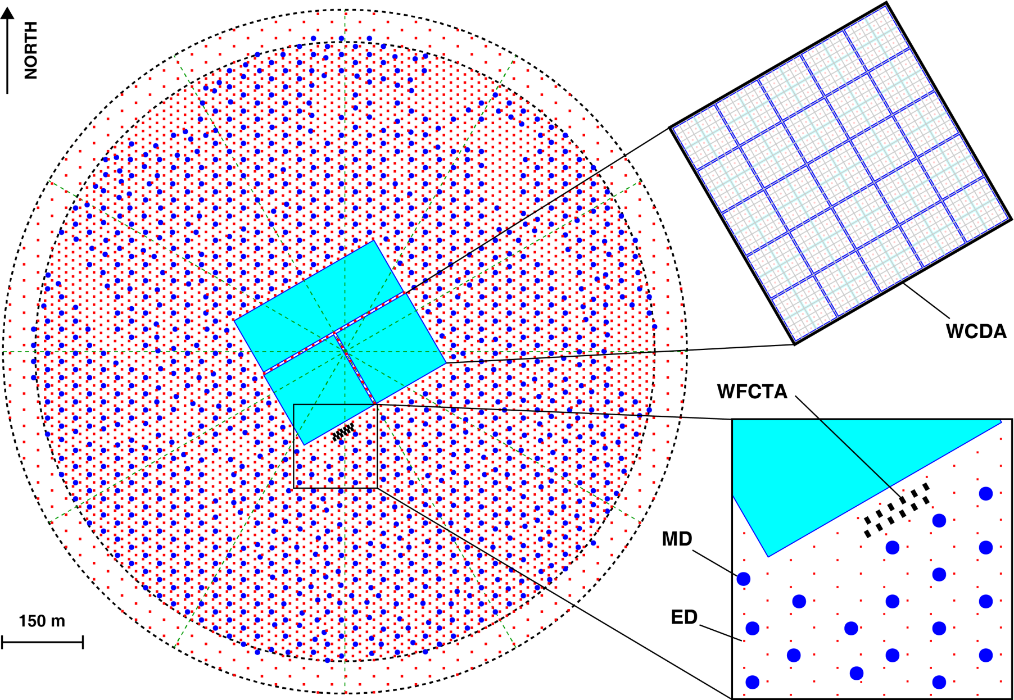
Complementary advantages by hybrid observations

Slide 7
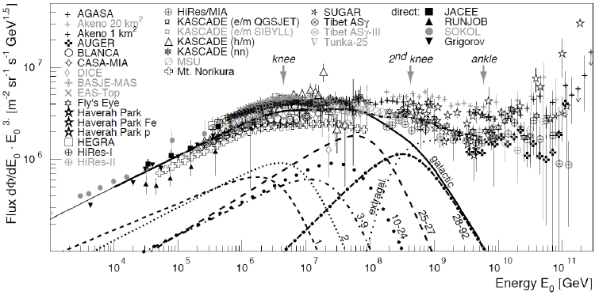
Cosmic ray spectra measurements in stages by multi-parameters with LHAASO
  10TeV-200TeV
  Energy Scale
  WCDA, WFCTA
100TeV-10PeV
  Knees for H,He,…
  WCDA, WFCTA, KM2A
10PeV-100PeV
  knee of Fe
  WFCTA, KM2A
100PeV-2EeV
  2nd knee & composition changing
  Transition from galactic to extra-galactic
  WFCTA, KM2A

Slide 8
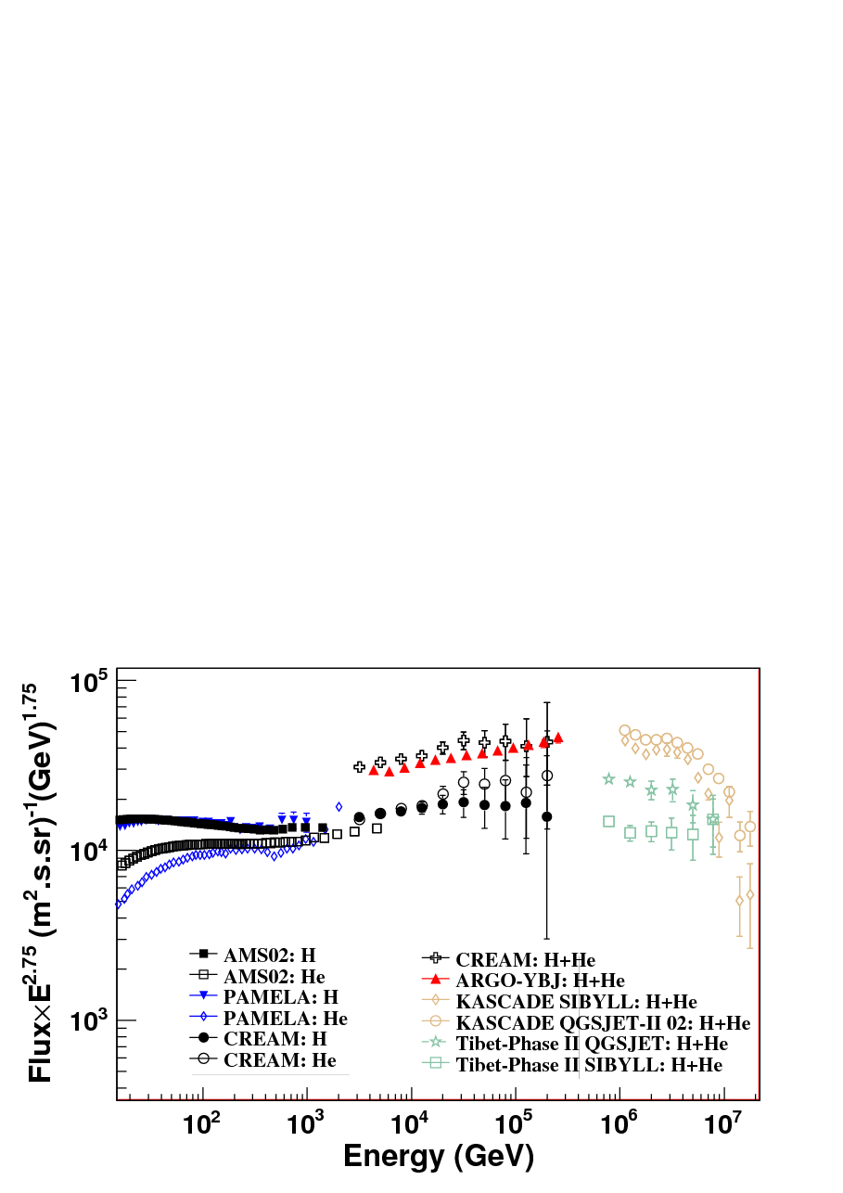
Energy Scale
LHAASO
observation for knees
good
good
good ??
350GeV
P-beam
at CERN
?

Slide 9
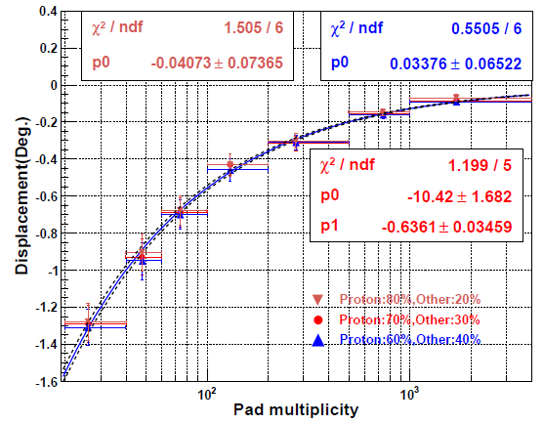
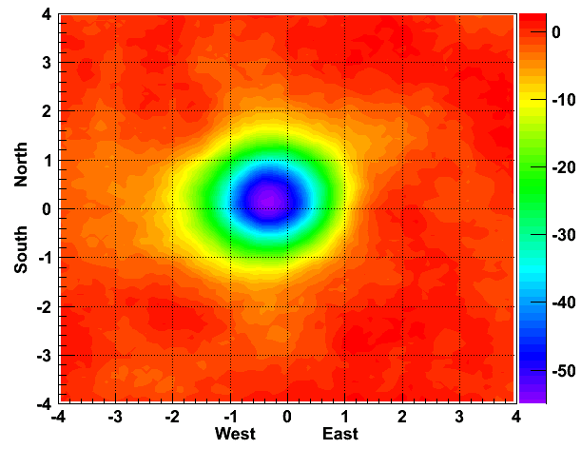
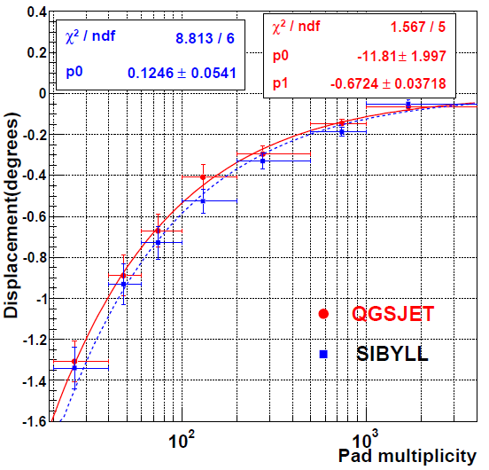
Energy scale in experiment
ARGO-YBJ : Moon Shadow displacement
N ≈ 21 · (E_{TeV}/Z)^{1.5}
1 – 30 (TeV/Z)
55 s.d.
The energy scale uncertainty: smaller than 13%:
T
the assumed primary CR chemical composition (7%)
the uncertainties of different hadronic models (6%) statistical uncertainty (8%)

Slide 10
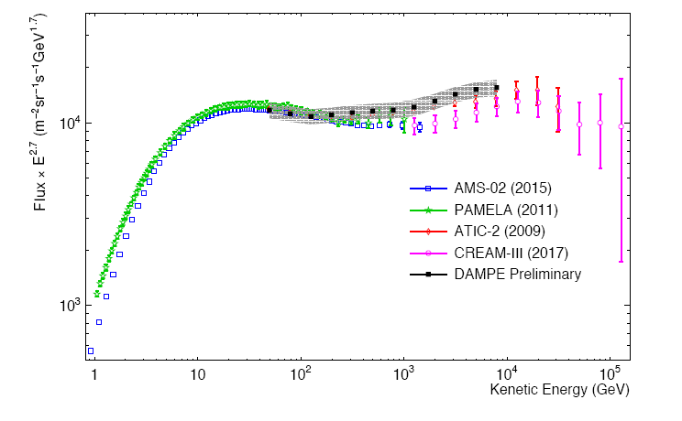
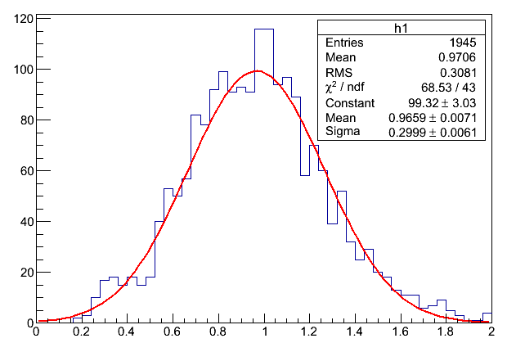
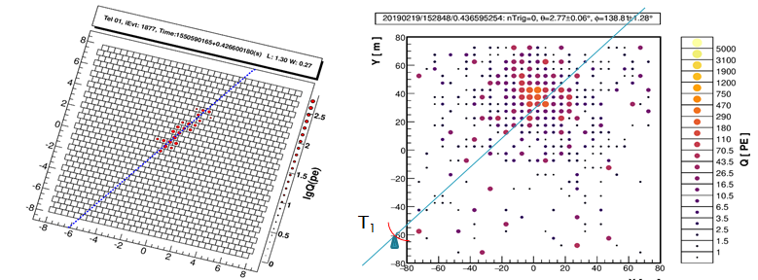
Energy spectrum @ 10TeV
Proton spectrum becomes soft after 10TeV
The structure can be used to test the energy scale
WFCTA-telescops are pointed to zenith .
The energy resolution at 10 TeV is about 30%

Slide 11
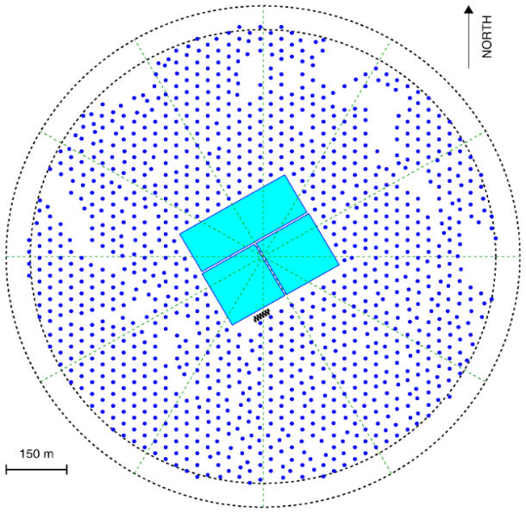
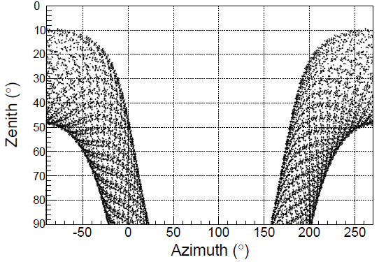
Prospects of P, He knees from 100TeV to 10PeV
¼ LHAASO array is expected to be operated by the end of this year
  6 WFCT telescopes
  WCDA++, namely the pool with higher dynamic range.
  300 muon detectors, 1000EDs
¼ LHAASO
6 Tel. FoV

Slide 12
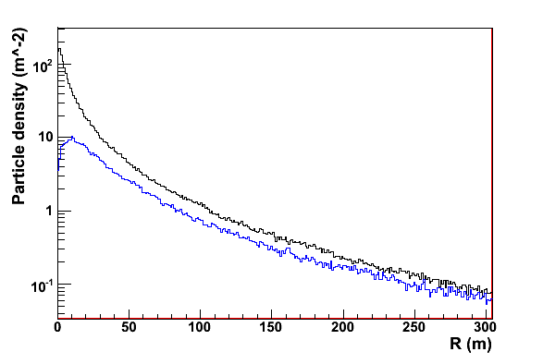
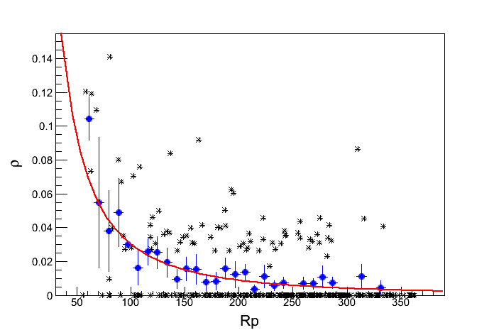
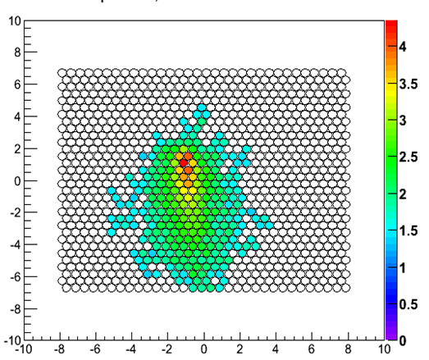
proton
  WCDA
  Energy flux near the core (full coverage)
  Core reconstruction: 3m
  Arrival direction reconstruction: 0.3°
  WFCTA
  SIZE (total PE in image)
  Width, Length
  Angular offset between arrival directions
  to the image center
  KM2A - MD
  Lateral distribution
  of Muon
iron
* Measured Muon lateral distribution
● Average Muon lateral distribution
― Fiting

Slide 13
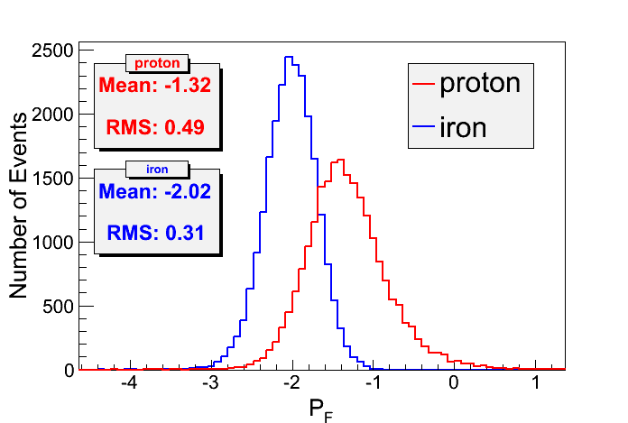
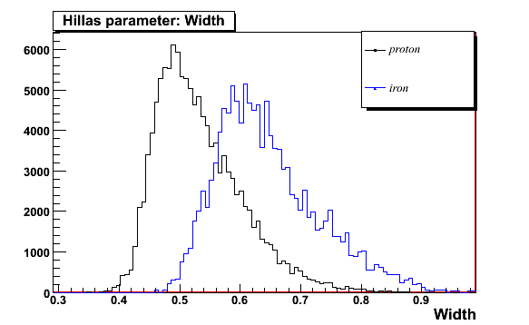
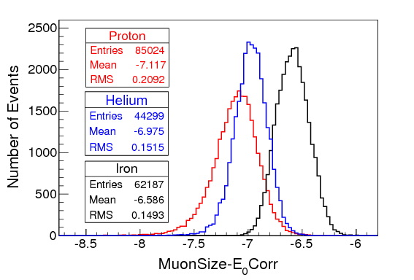
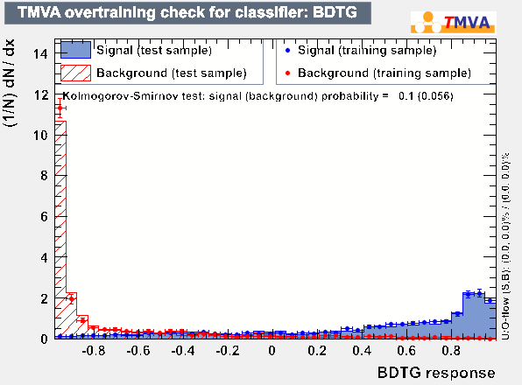
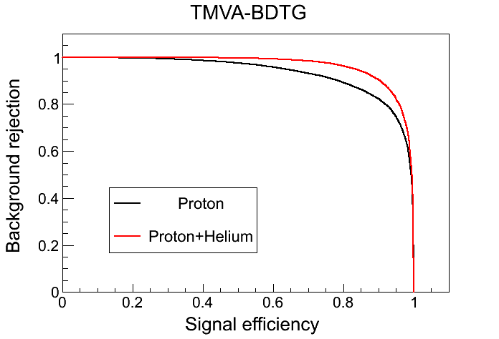
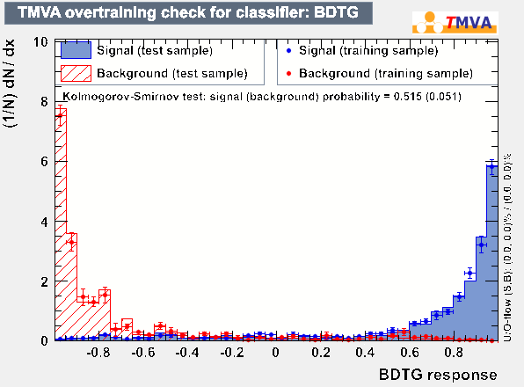
Particle Identification
pμ1
Proton + Helium
Proton

Slide 14
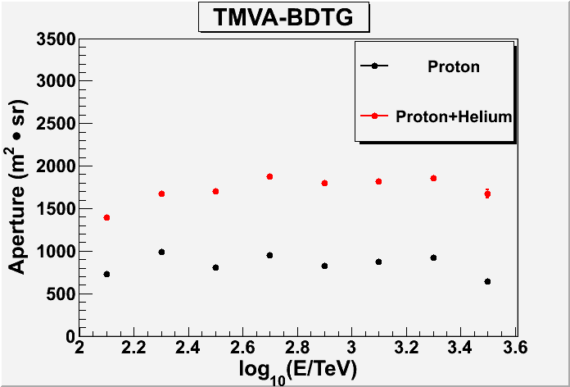
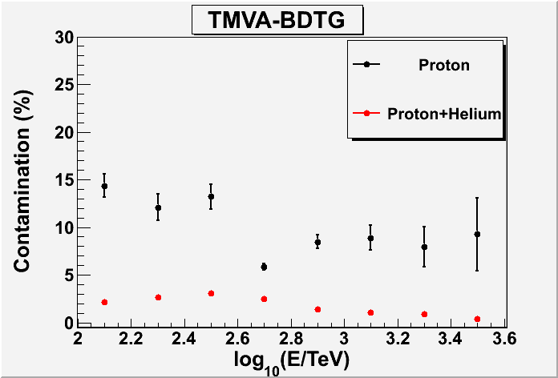
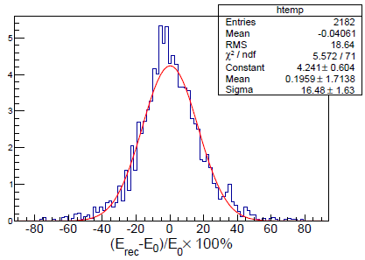
Aperture and energy Resolution
Aperture
Contamination
E = E(ΣN_{pe}; R_{p}, α)
 | Proton | Proton+Helium
Aperture | ~900 | ~1800
Contamination | ~10% | <4%

Slide 15
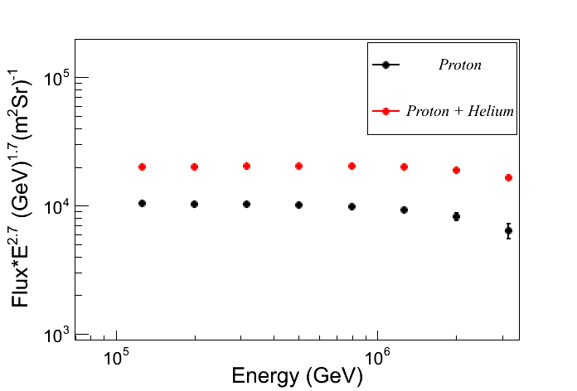
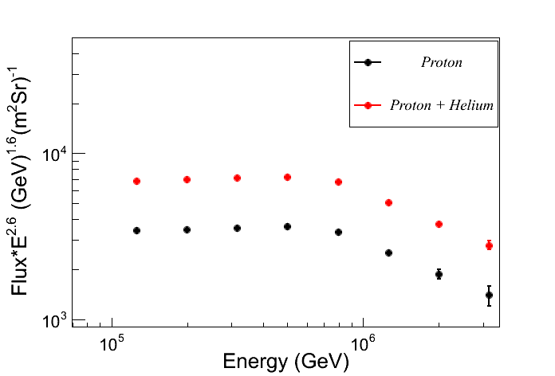
Prospects for cosmic ray spectra
  One year statistics, 10% duty cycle
  6 Cherenkov Telescopes
5121
6461
1130
1476
Horandel model
ARGO-YBJ & WFCT Model

Slide 16
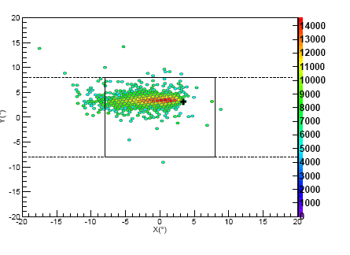
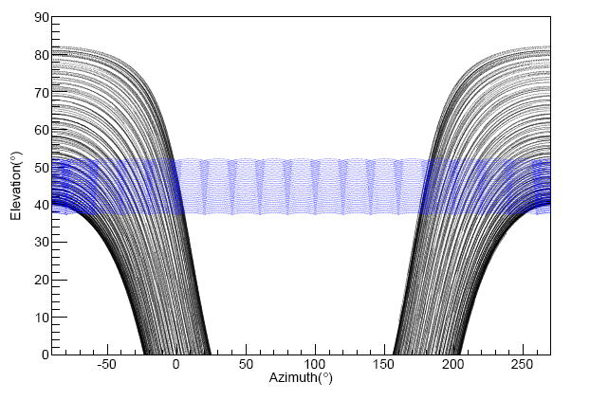
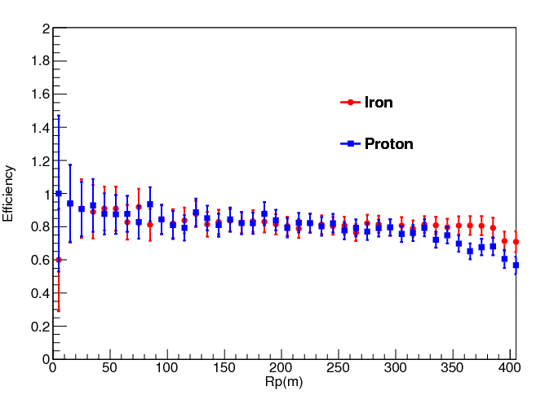
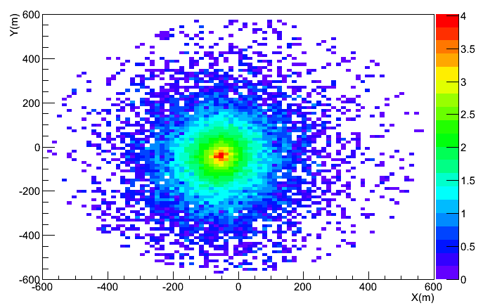
Prospects of iron knee from 10PeV to 100PeV
WFCTA:
  18 Tels
  Xmax ---》mass sensitive
  Size ---》Energy related
Energy resolution: ~20%
Elevation of 45° toward North with full-moon duty cycle >30%
Trigger efficiency for E>7 PeV:
>80% up to 350 m

Slide 17
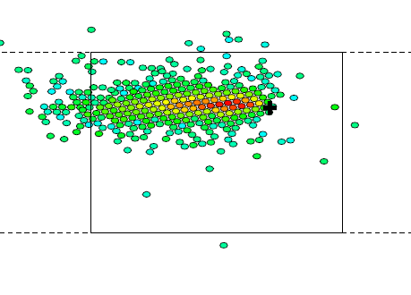
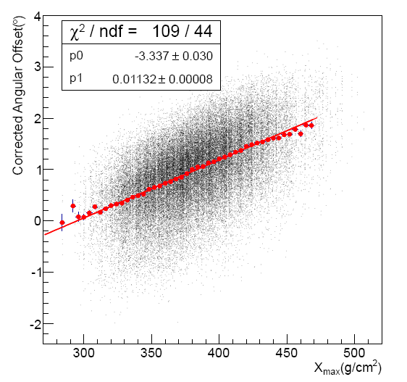
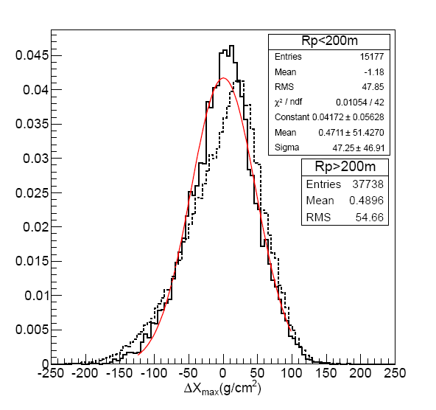
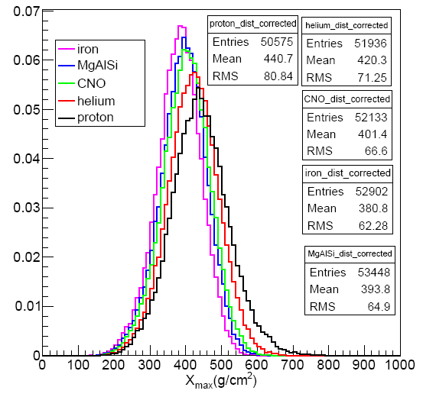
X_{max} reconstruction
Angular offset

Slide 18
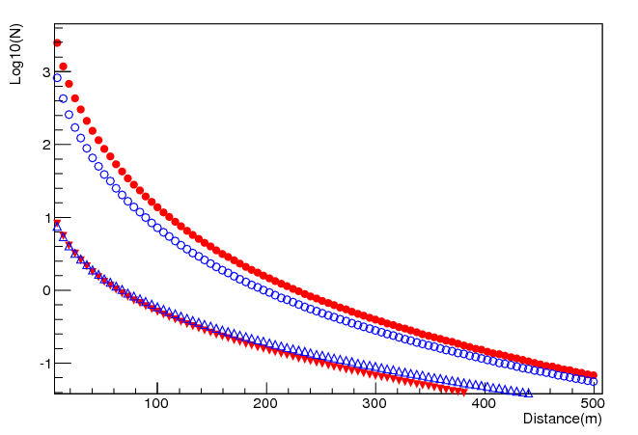
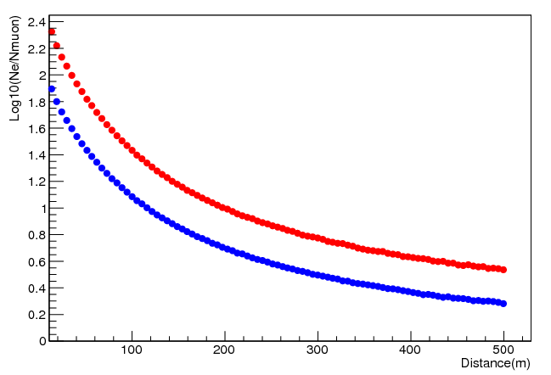


Red: Proton
Blue: Iron
Secondary
Electrons:
Muons:
KM2A:
  Core resolution: ≤ 3m
  arrival direction resolution: ≤0.2°
The Muon content can be measured very well
  Lateral distribution of e/γ and μ
Lateral distributions of Log10(N_{ch}/N_{μ})
Proton, 20PeV

Slide 19




Aperture: ~0.3X10⁶ m²sr
Iron selection:
  μ-content and X_{max} 2-variable analysis
  145events@100PeV for iron with a duty cycle of 30%
the spectrum of pure Fe or mixed heavy components and their knees should be measured
Blue: iron
Red：proton
200
145

Slide 20

Proton and Iron knees by LHAASO
LHAASO 5 yrs
Proton
Iron
100TeV
1PeV
10PeV
100PeV

Slide 21



>0.1EeV: 2nd Knee
Fly’sEye
HiRes/MIA
Second knee!
Statistics is much better,
but the energy scale is still problematic…

Slide 22


Scale Still Energy
Cherenkov mode ---》fluorescence mode
WFCTA → WFTTA
2
2
2
2

Slide 23
Summary
An energy scale with ~8% uncertainty will be established below 30 TeV by using moon shadow of the pure composition cosmic rays
The energy scale will be tested by the proton spectrum structure at 10 TeV
Individual mass groups are expected to be separated out below 100PeV, knees of their spectra will be well measured With high statistics , high purity energy resolution is better than 16%.

Slide 24
Thank you！

