Slide 1


Gamma-ray Astronomy of LHAASO
Songzhan Chen
on behalf of the LHAASO collaboration
LHAASO Scientific observation and multi-messenger astronomy workshop , Chengdu, 2019 April 25-27

Slide 2
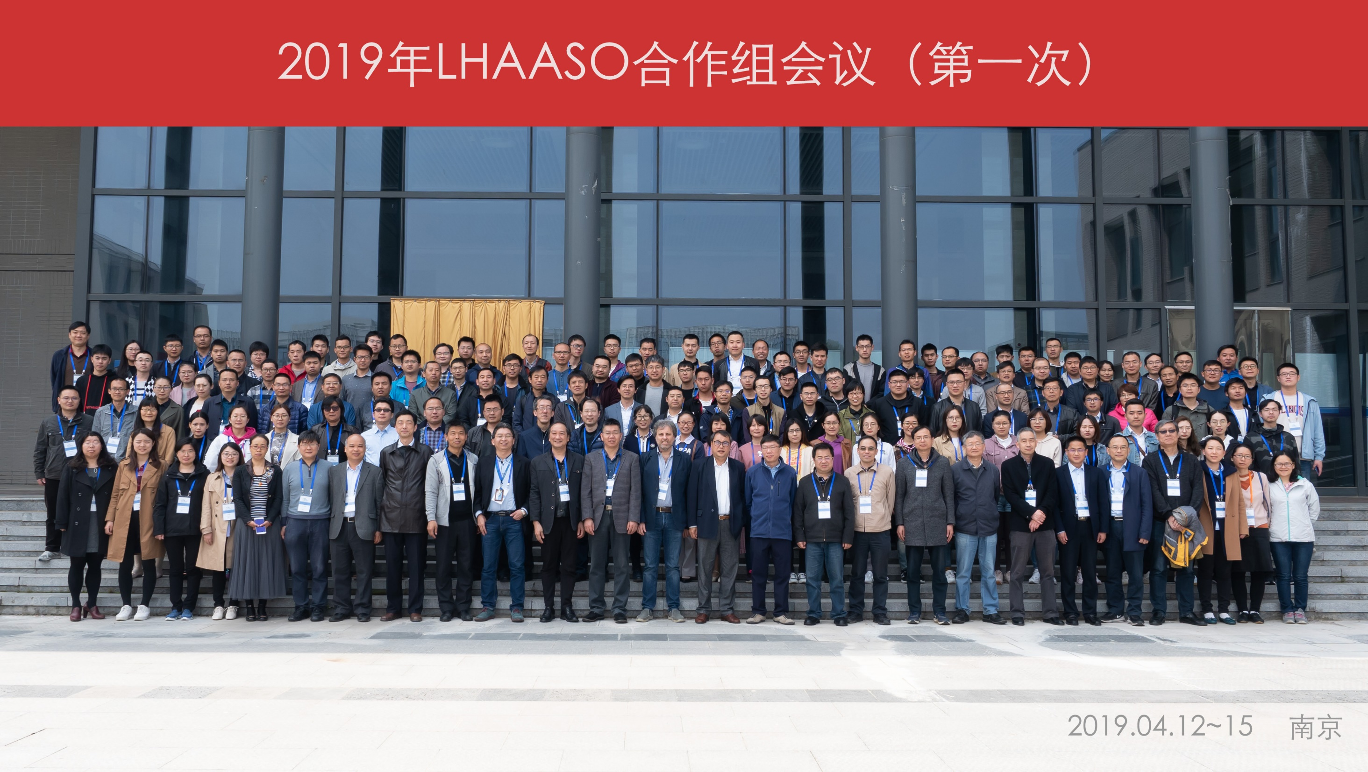
2019-04-12@Nanjing domestic collaboration meeting

Slide 3
Outline
1. Introduction
2. Galactic gamma-ray sources
3. Extra-galactic gamma-ray sources
4. Current status of LHAASO
5. Summary

Slide 4
1. Introduction

Slide 5
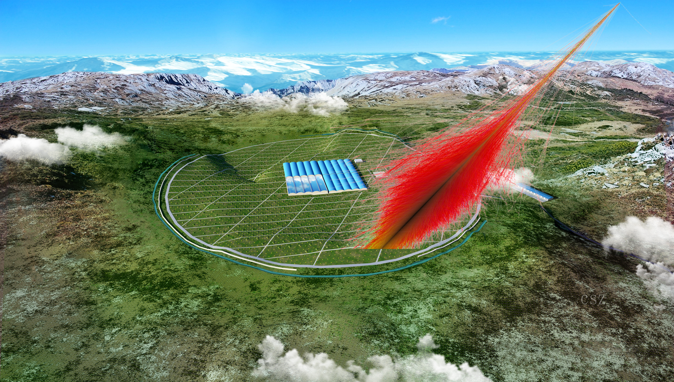
LHAASO: Large High Altitude Air Shower Observatory
2017 May: Construction Start
2019 : ¼ LHAASO
2021 : Full LHAASO
(4410 m a.s.l., 29.36º N, 100.14º E), Sichuan, China

Slide 6
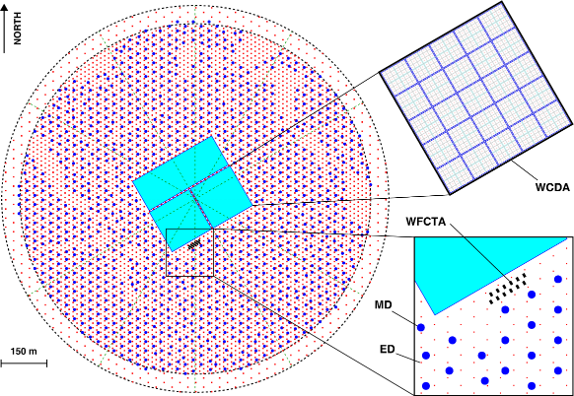
LHAASO detectors
5195 EDs
  1 m² each
  15 m spacing
1171 MDs
  36 m² each
  30 m spacing
3120 WCDs
  25 m² each
12 WFCTs
1.3 km²

Slide 7
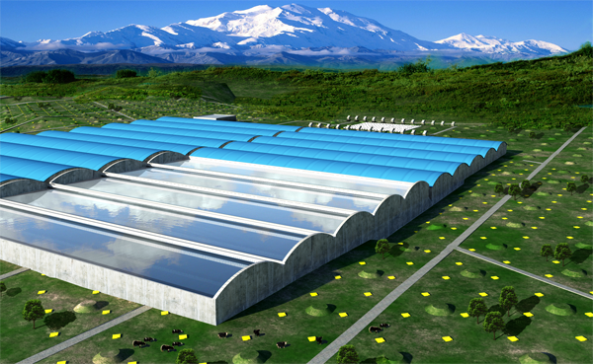
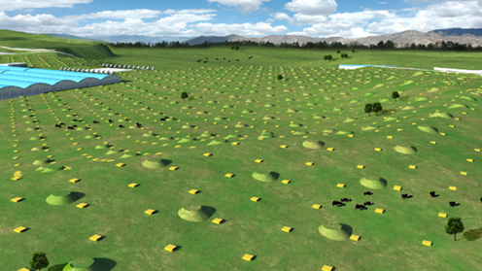
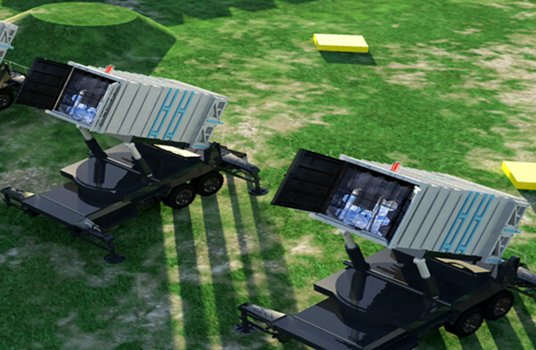
Main goals of LHAASO
WCDA
TeV gamma-ray survey → WCDA (100 GeV-30 TeV)
  AGN, GRB, survey new source, …
>20 TeV gamma-ray survey →KM2A (10TeV-1PeV)
  SNR, PWN, Superbubble, diffuse around 100TeV, …
Individual nuclei spectra →WFCTA (10TeV to EeV)
  Different configures
  Combined with WCDA, WCDA++, KM2A
Benefit regions:
  Anisotropy, Solar physics, dark matter, EBL, IGMF, Lorentz invariance, hadronic interaction, …
KM2A
WFCTA

Slide 8
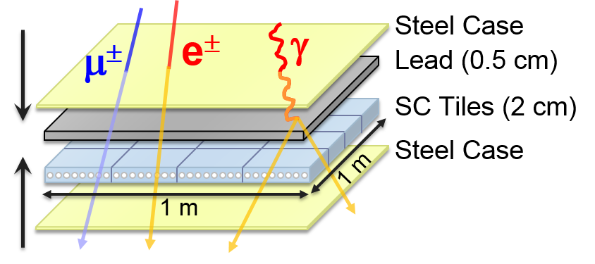
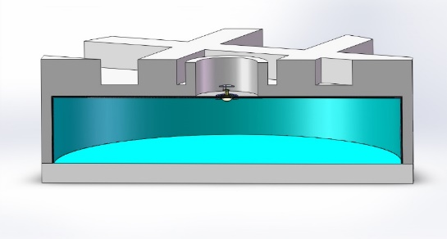
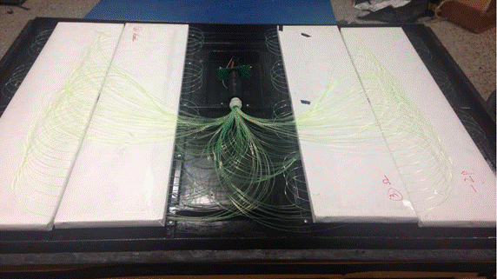
KM2A
MD
ED

Slide 9
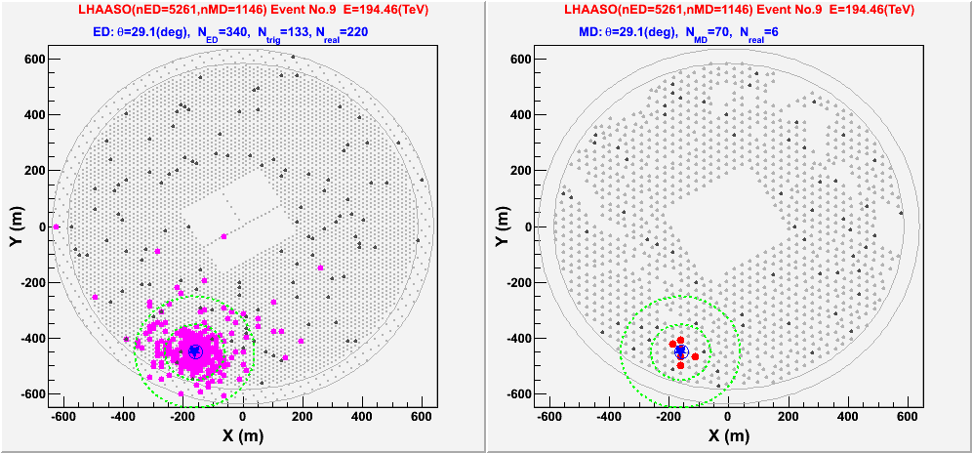
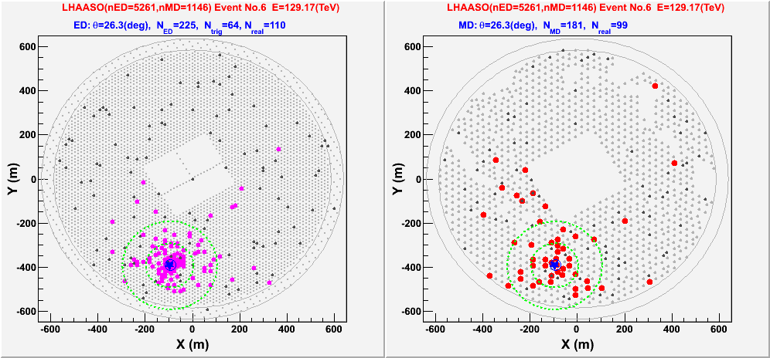
γ/P discrimination
Gamma-ray E=194 TeV
ED
MD
Geant4 based
Proton E=129 TeV

Slide 10
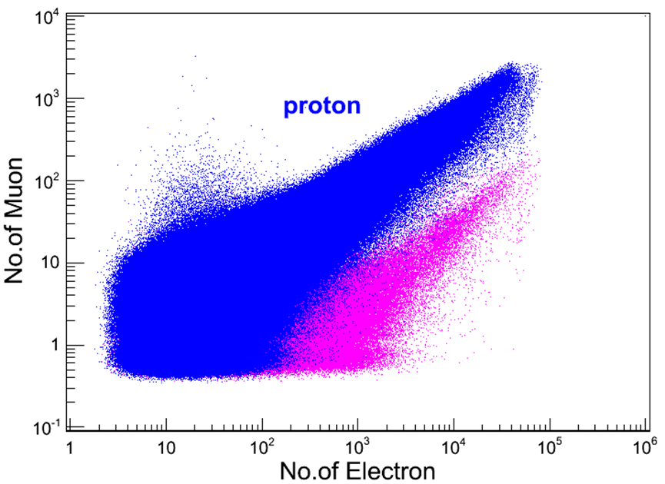
γ/P discrimination
Gamma-ray

Slide 11
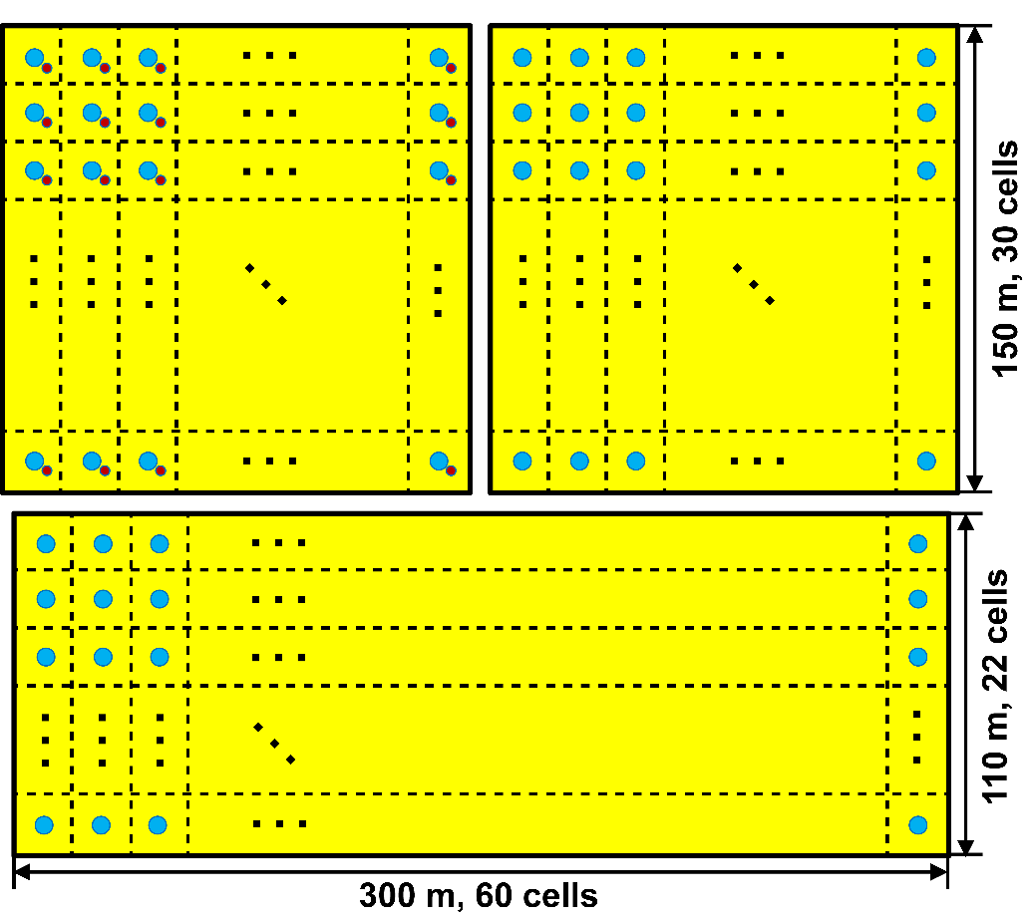
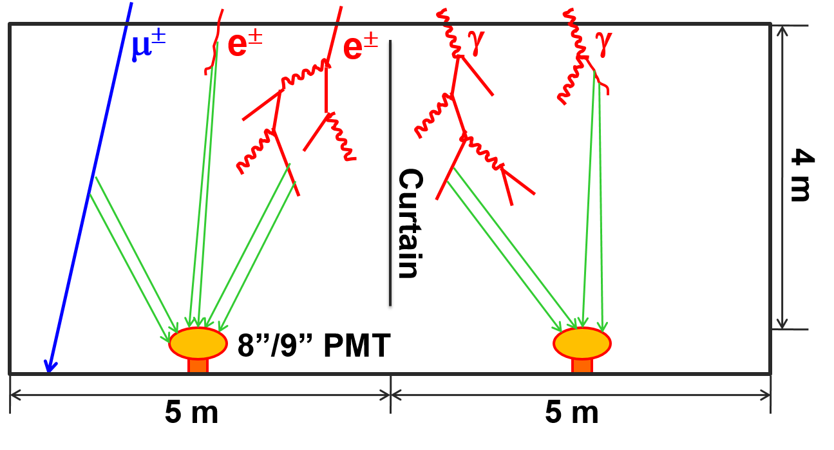
WCDA: Water Cherenkov Detector Array
8’’ PMT for 1# pool
20’’ PMT for 2# and 3# pool

Slide 12
γ/P discrimination
1TeV
2TeV
Geant4 based

Slide 13
γ/P discrimination

Slide 14
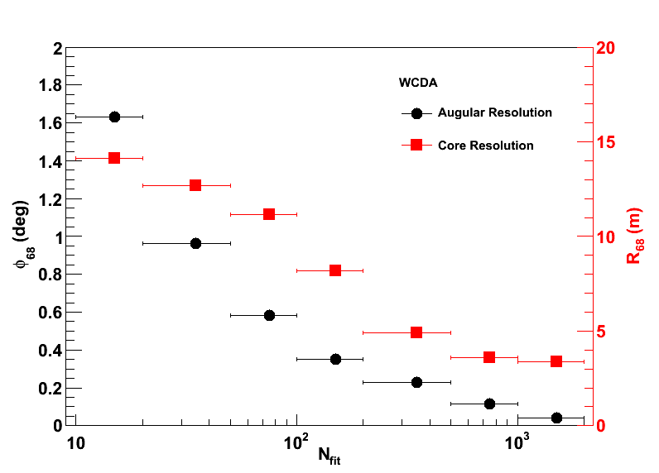
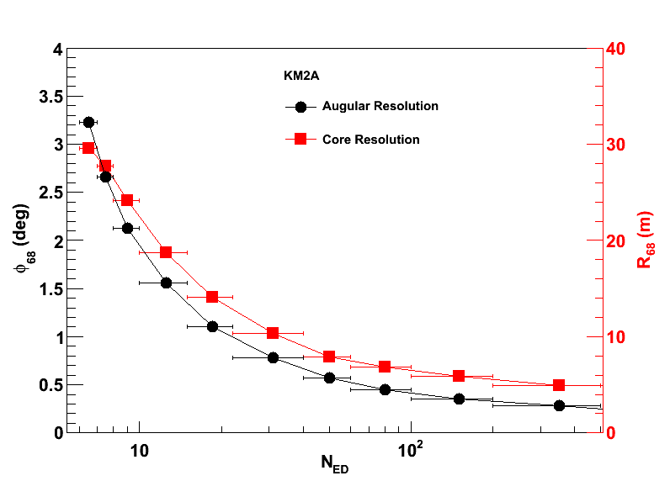
Angular and core resolution
WCDA: 0.6 deg, 11m (68% containing) @1 TeV
KM2A: 0.5 deg, 6m @100 TeV
WCDA
KM2A

Slide 15
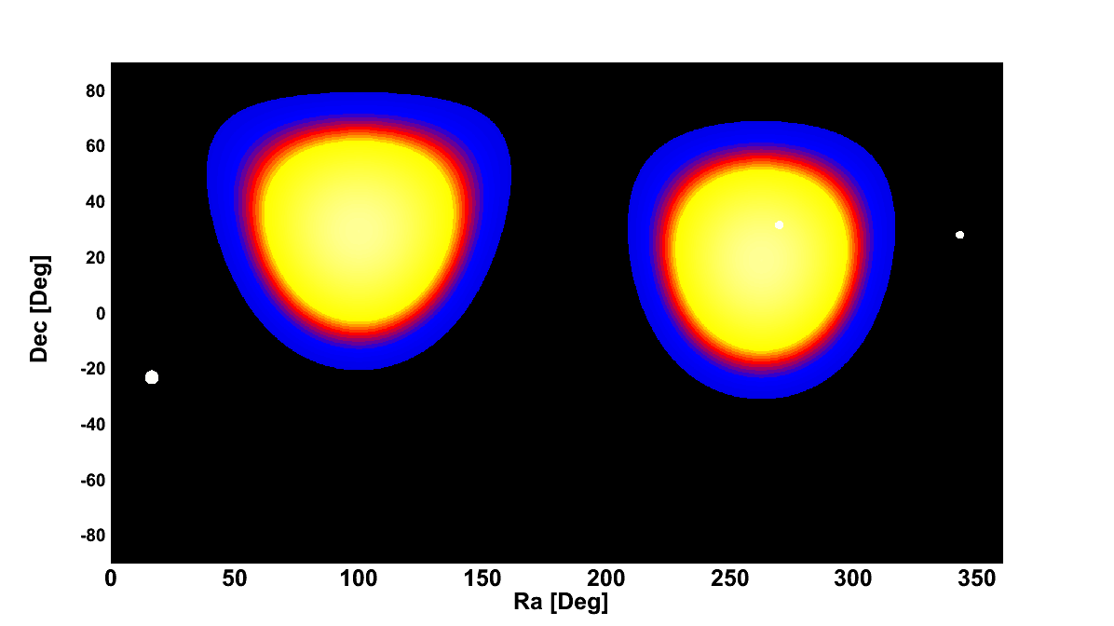
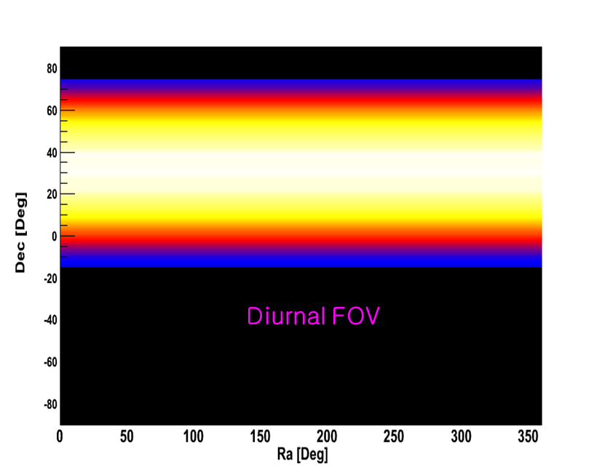
LHAASO:FOV
1/7 of the sky at each moment
60% of the sky every day
LHAASO
HAWC
MAGIC
VERITAS
HESS
LHAASO

Slide 16
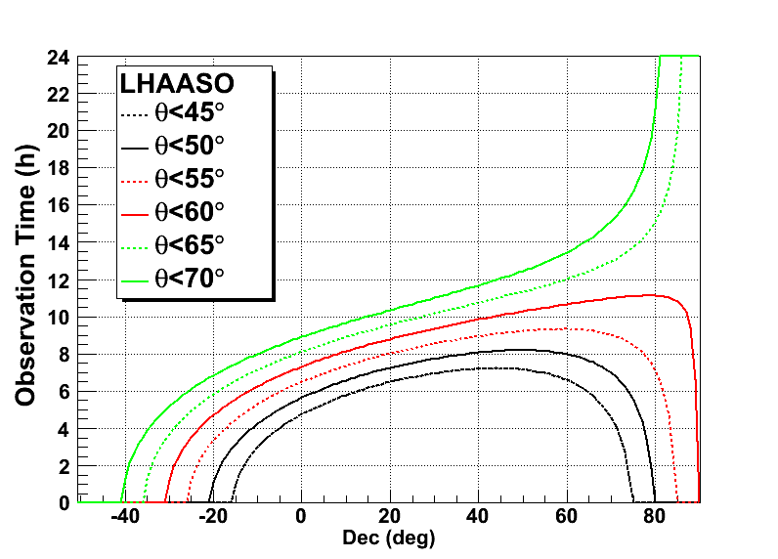
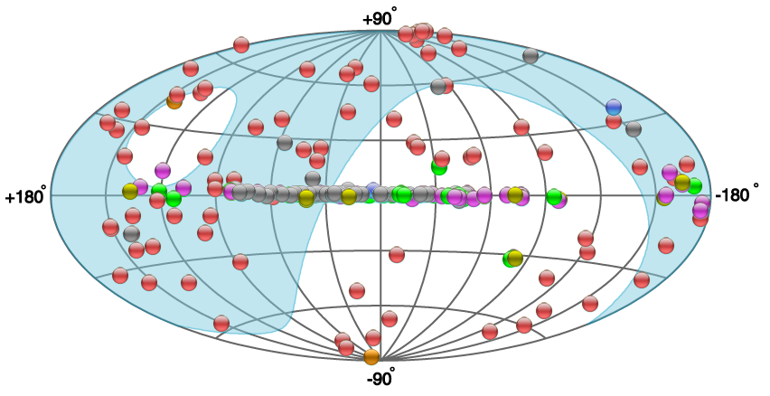
Large FOV is important for sky survey
Source Observation time per day
Galactic center
Crab

Slide 17
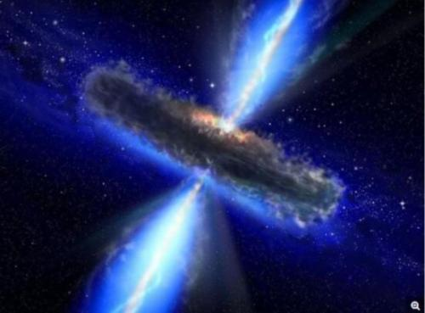
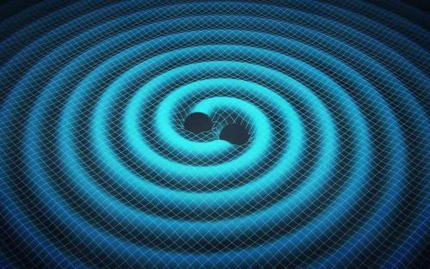
Large FOV is important for transient events
--multi-messenger astronomy
AGN flare
GRB
GW
HE neutrino

Slide 18
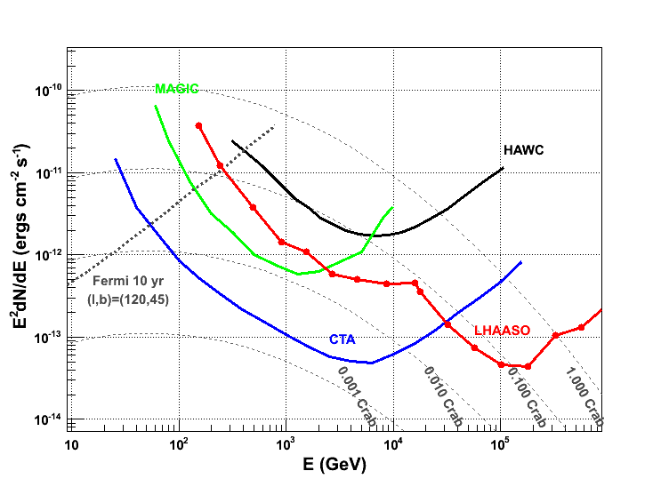
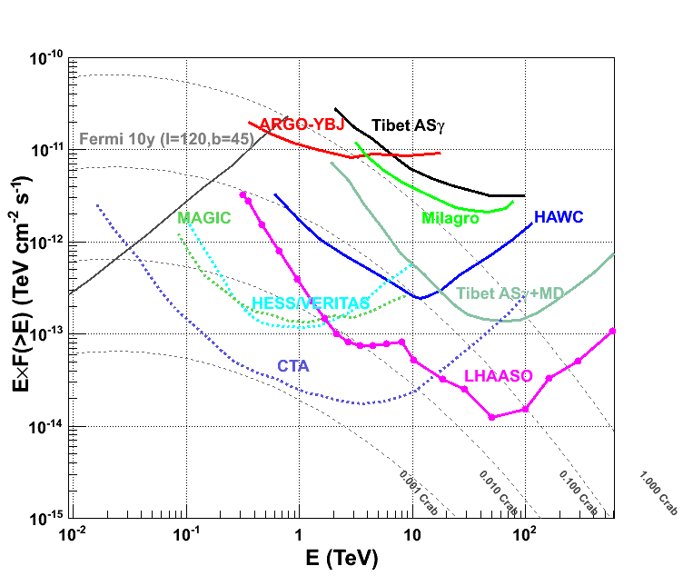
Gamma-ray sensitivity for Crab-like source
WCDA: 1% Crab unit at 2 TeV
KM2A: Unprecedented sensitivity at energy above 20TeV.
Differential
Integral

Slide 19
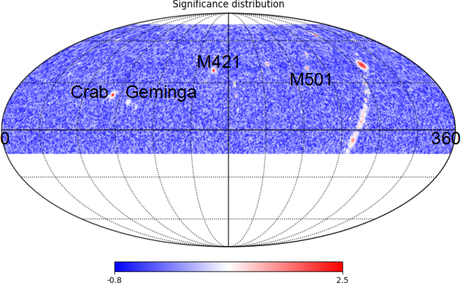
Prospect of LHAASO
WCDA
KM2A
54 known sources can be detected by WCDA in one year
Most of SNR and UNID TeV Sources within FOV can be detected by KM2A if E_{cut}>30TeV

Slide 20
2. Galactic gamma-ray sources

Slide 21
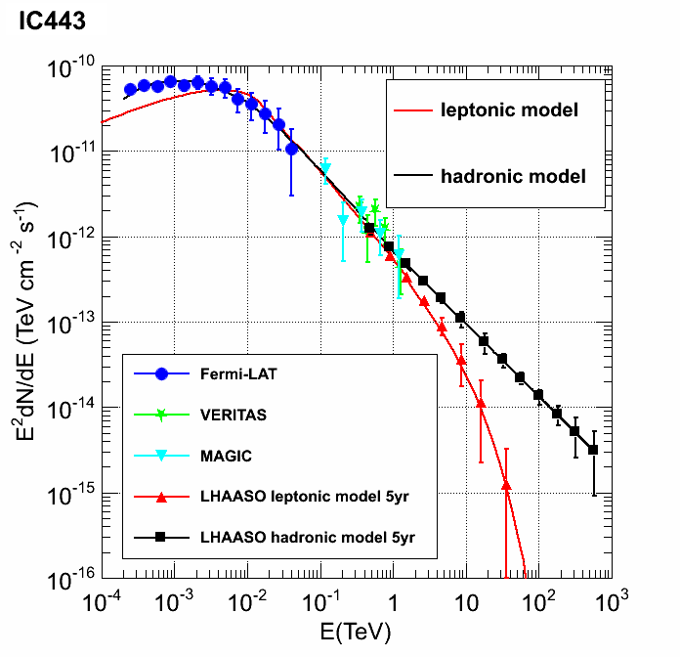
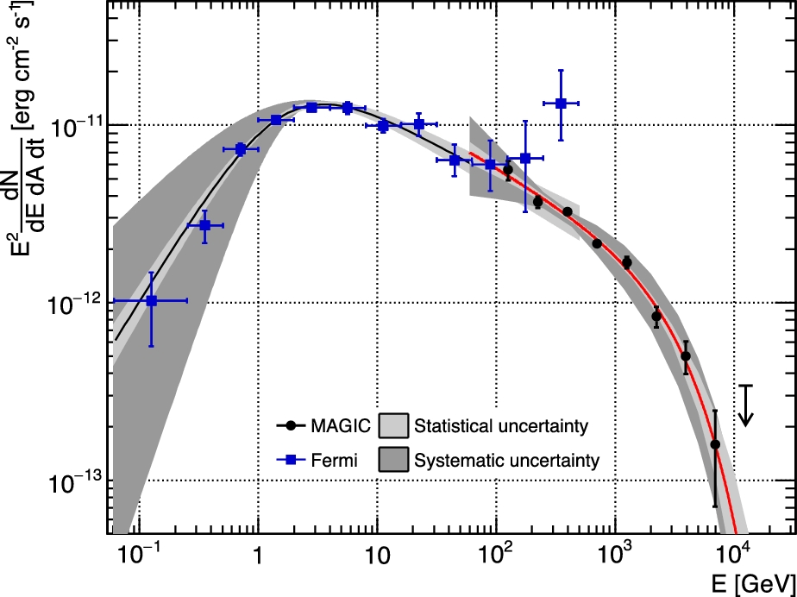
SNR: PeVatron?
LHAASO will play an important role at energy above 20TeV for such an issue! SNRs with interacting with molecular clouds may be good candidates.
Cassionpeia A
E_{pcut}~10TeV
?
MAGIC coll. 2017
Liu, et. al. 2016

Slide 22
Massive Stars as Major Factories of Galactic Cosmic Rays?
The population of young massive stars is sufficient to support the flux of Galactic CRs without invoking other source populations. Can these source be PeVatron?
?
Aharonian et al. 2018
ARGO-YBJ coll. 2014

Slide 23
PWN: the origin of the excess positrons?
LHAASO could provide more information using the extension at different energies.
Abeysekara, et. al. 2017

Slide 24
Crab flare: around 100TeV?
Is there counterpart flare at higher energy around 100TeV?
?
Weisskopf et al., 2013

Slide 25
Fermi Bubble: Gamma-ray >1TeV?
The north part of Fermi Bubble is partly covered by LHAASO. LHAASO may could give some information for its high energy emission.
Ackermann et al., 2014

Slide 26
Galactic plane diffuse: where is the cutoff energy?
The determination of the cutoff energy will provide important information for the cosmic ray and its propagation!

Slide 27
3. Extra-galactic gamma-ray sources

Slide 28
2FHL: 50GeV-2 TeV
360 sources, AGNs are dominated
Ackermann, et. al. 2016

Slide 29
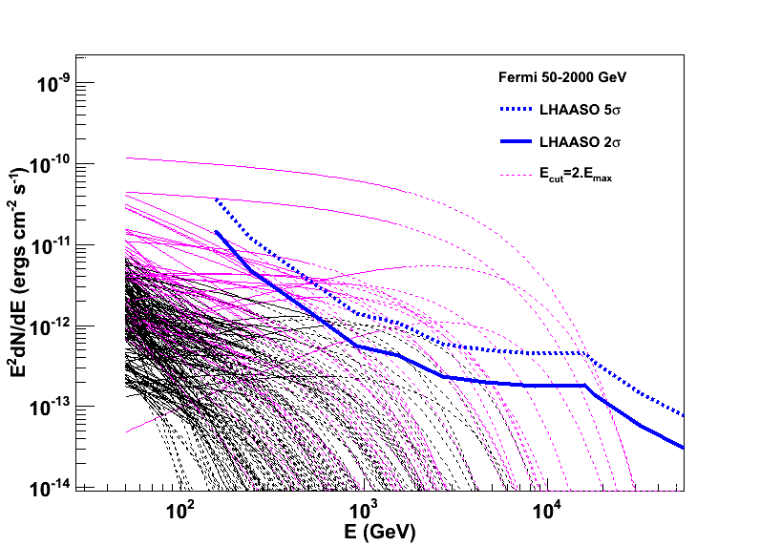
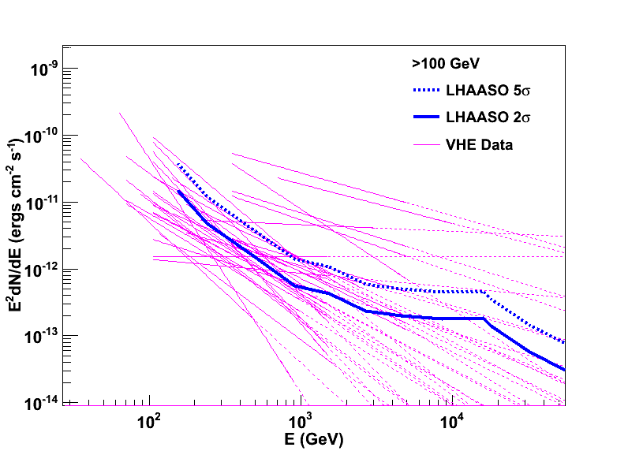
AGN: Expectation of LHAASO
2FHL: 21 AGNs, where 17 are known AGNs.
>100GeV catalog: 23 AGNs
Only for steady AGNs!

Slide 30
AGN: long-term continue observation
Long-term MWL monitor is essential to systematic study the flares of AGNs
Type 1: 5 states
Type 2: 3 states
Type 3: 1 state
ARGO-YBJ coll., ApJS, 222:6, (2016)

Slide 31
Radio AGN
LHAASO may detect more events for such correlation study.
Abramowski et al., 2012
Cheung et al., 2007

Slide 32
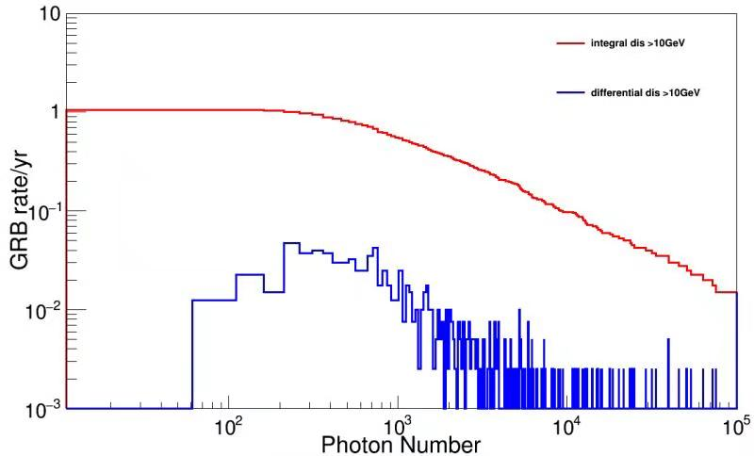
GRB: expectation
>5 σ
Expected GRB detection rate is ~1.0/year for LHAASO-WCDA

Slide 33
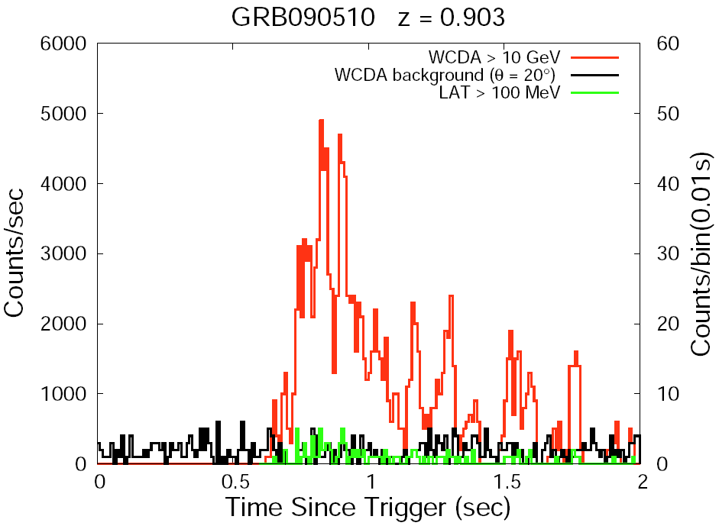
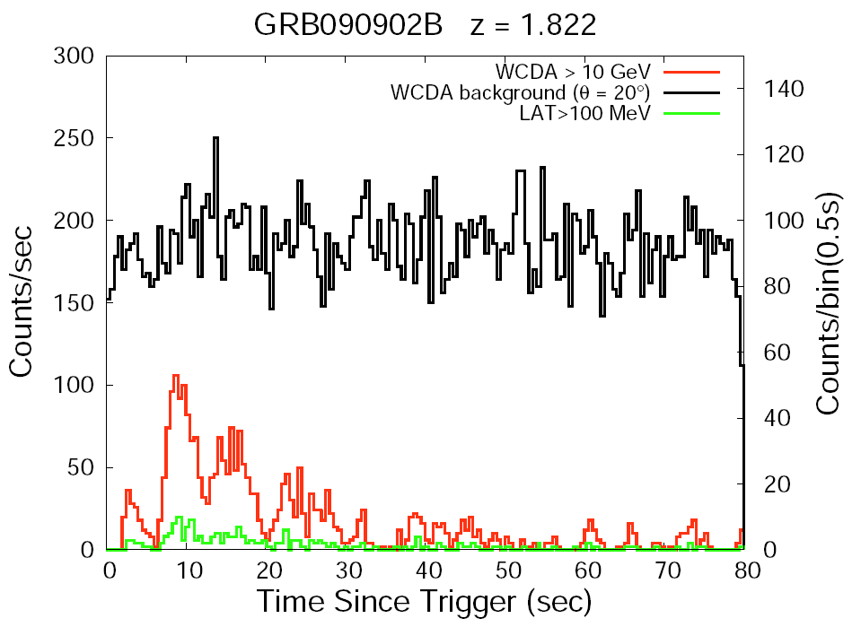
Expected light curve of Fermi-LAT GRBs by WCDA
This will be important to GRB, also for EBL and LIV.
Zenith=20º

Slide 34
4. Current status of LHAASO

Slide 35
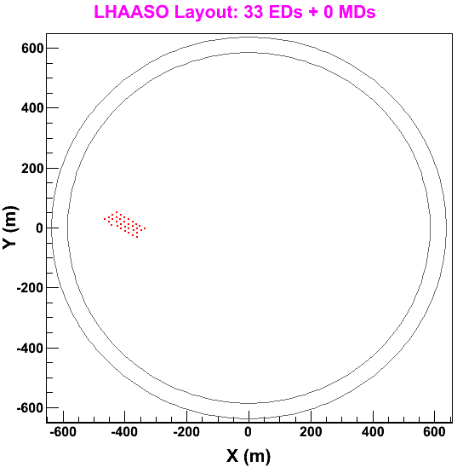
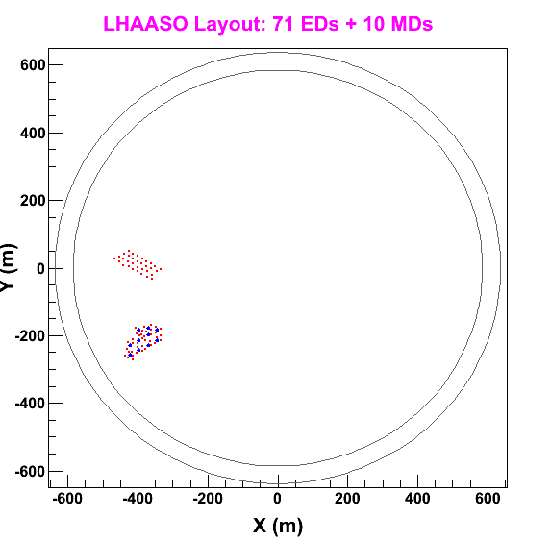
Status of LHAASO-KM2A
2018.2—2018.12
2018.12—2019.3

Slide 36
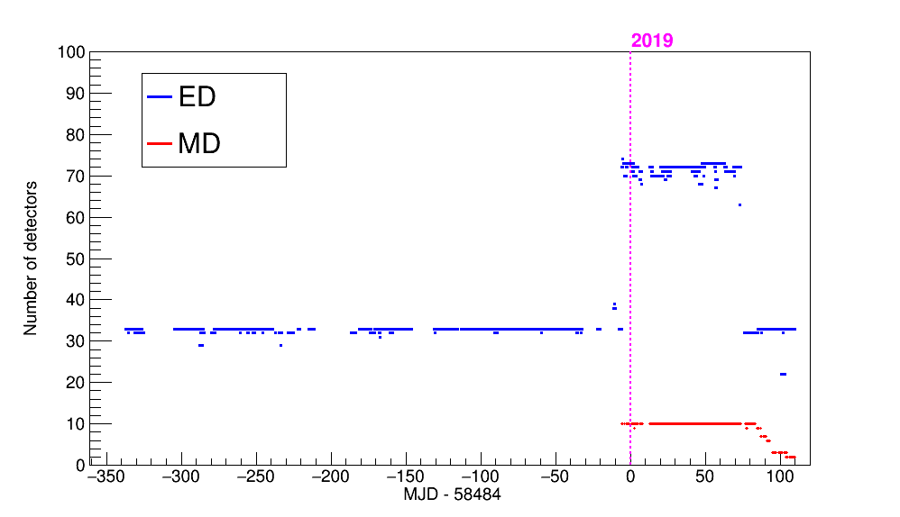
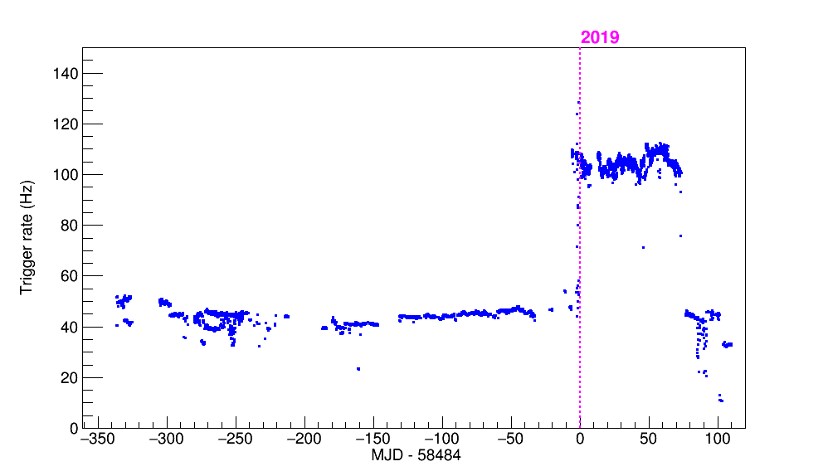
KM2A data
Number of detectors
Trigger Rate
Number of events: 1.4x10⁹

Slide 37
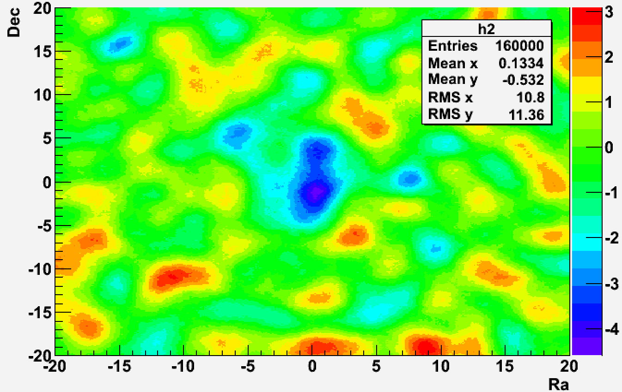
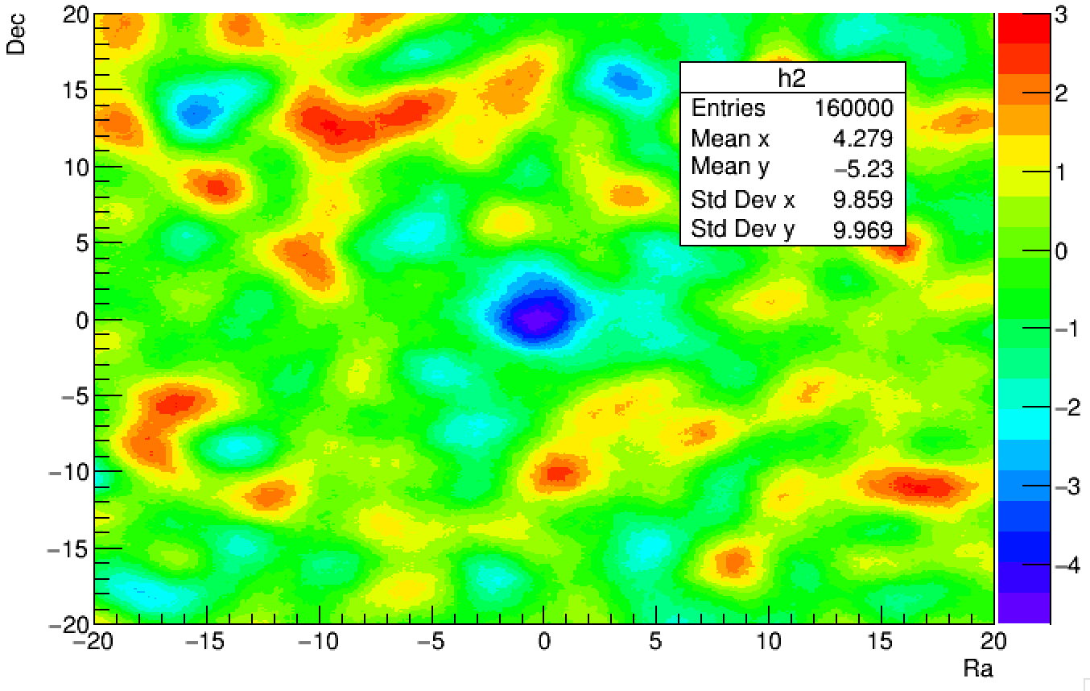
Moon+Sun shadow of 33EDs data
S=-4.4 Ra=-1.27 Dec=0.36
S=-4.8 Ra=-0.50 Dec=0.10
preliminary
Before TDC calibration
After TDC calibration

Slide 38
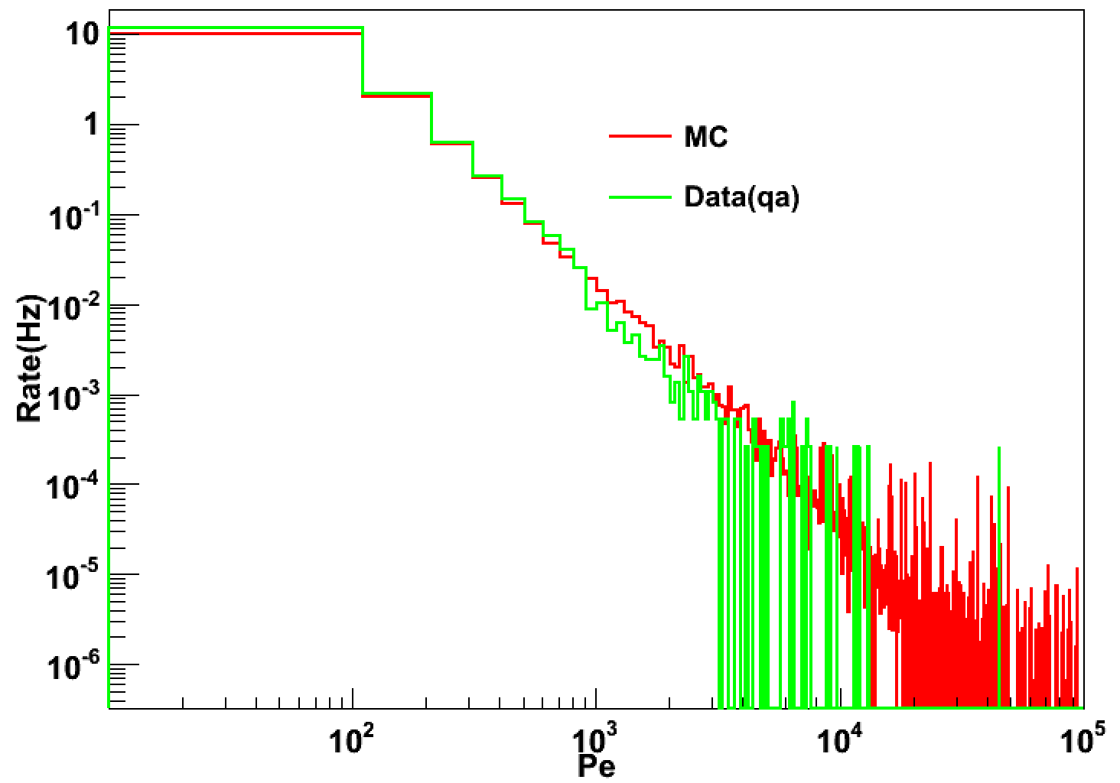
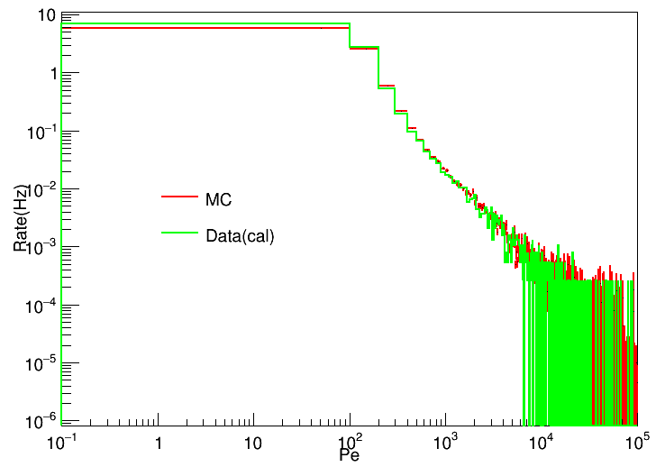
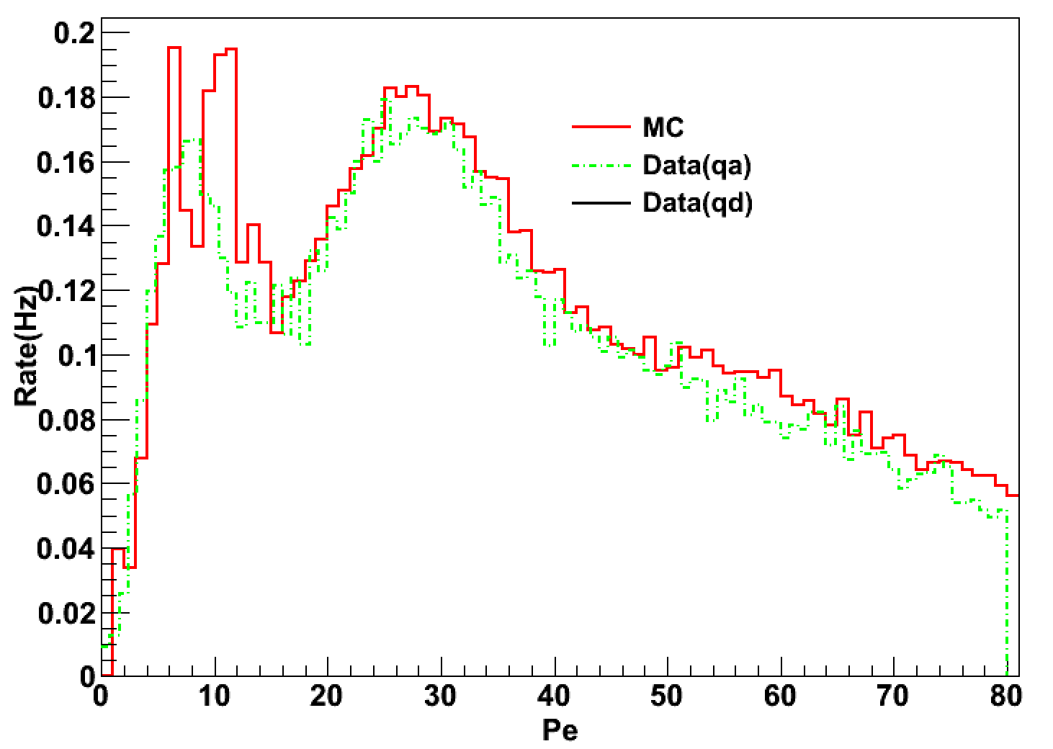
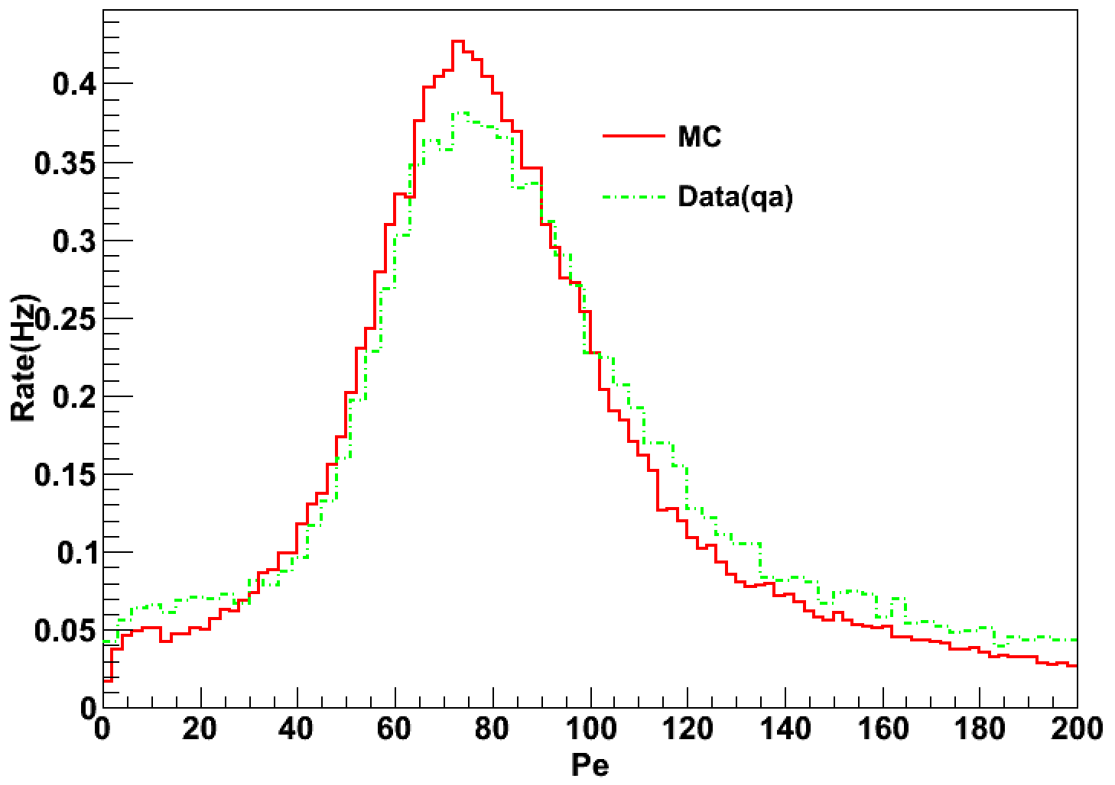
ADC distribution of ED and MD
ADC peak is used for ADC calibration
ED
MD
Distribution of number of photoelectrons after calibration

Slide 39
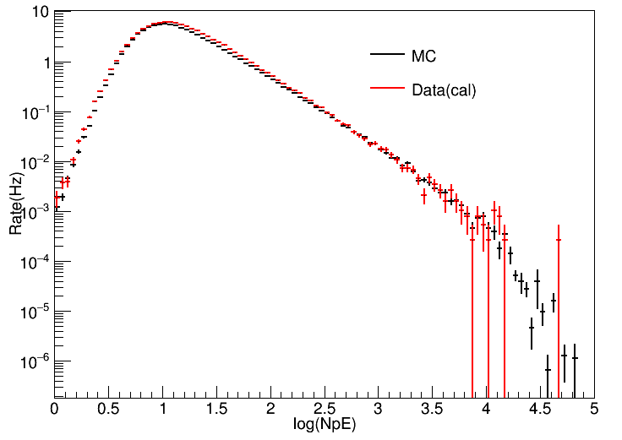
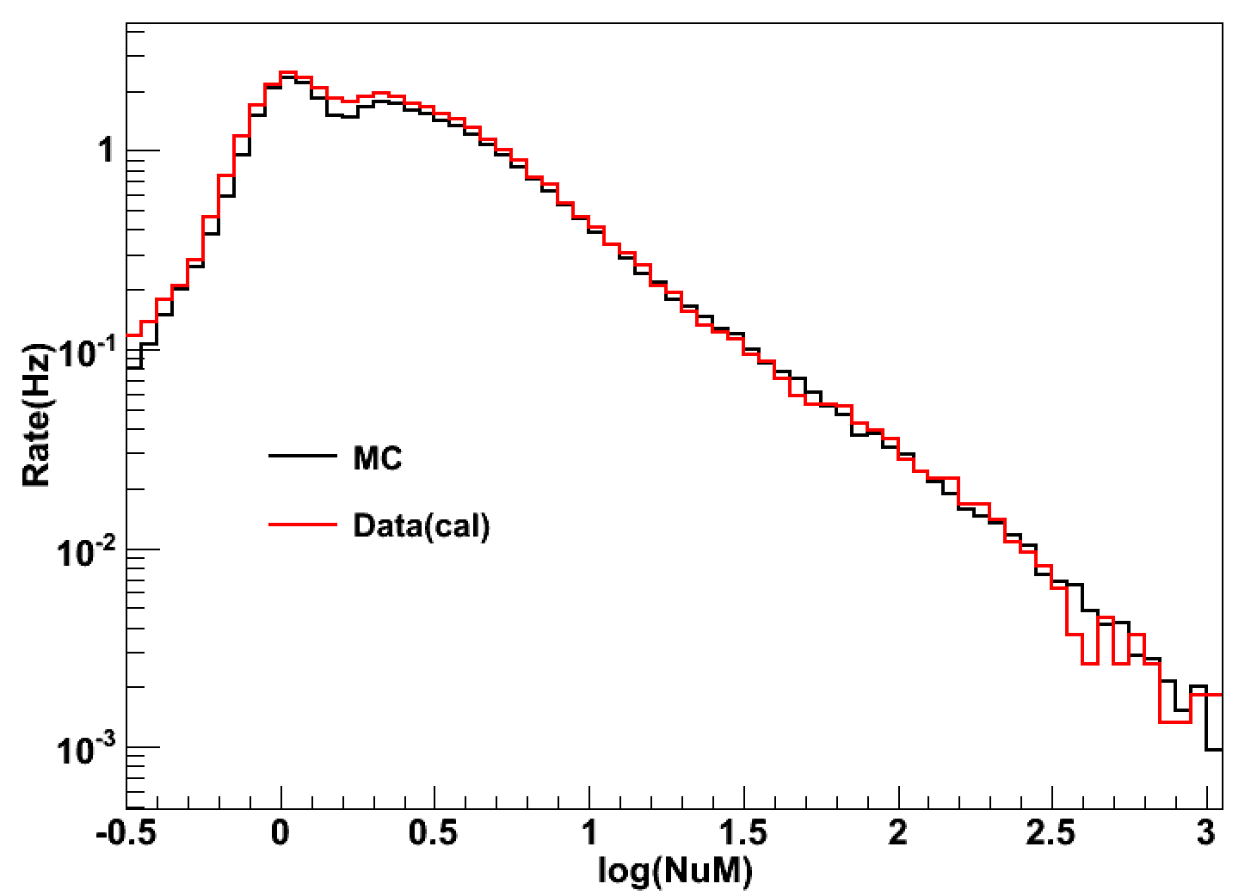
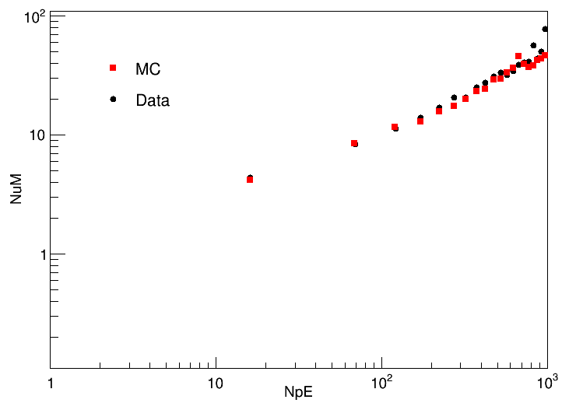
Particles number distribution of 71EDs+10MDs
1 u 2u
71 EDs
Nu vs Ne
10 MDs
Data: 2019-2-17
electromagnetic particles
Muon particles

Slide 40
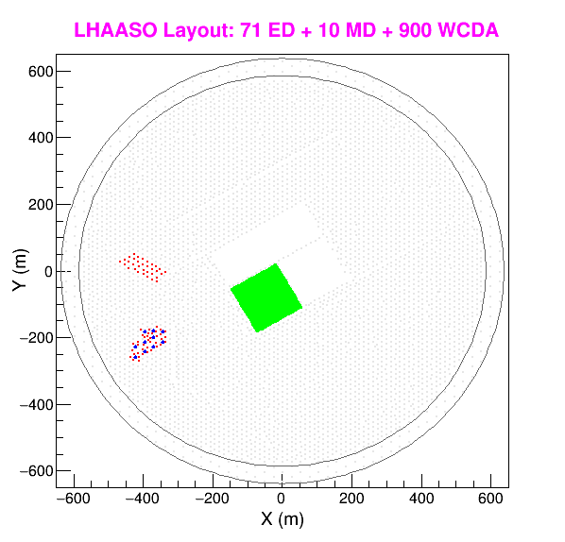
Status of LHAASO-WCDA
1. Without water
2019-01-25—2019-02-26
2. Water injection
2019-02-26—2019-04-07
3. Stable 4.5m water
2019-04-07 ----- now

Slide 41
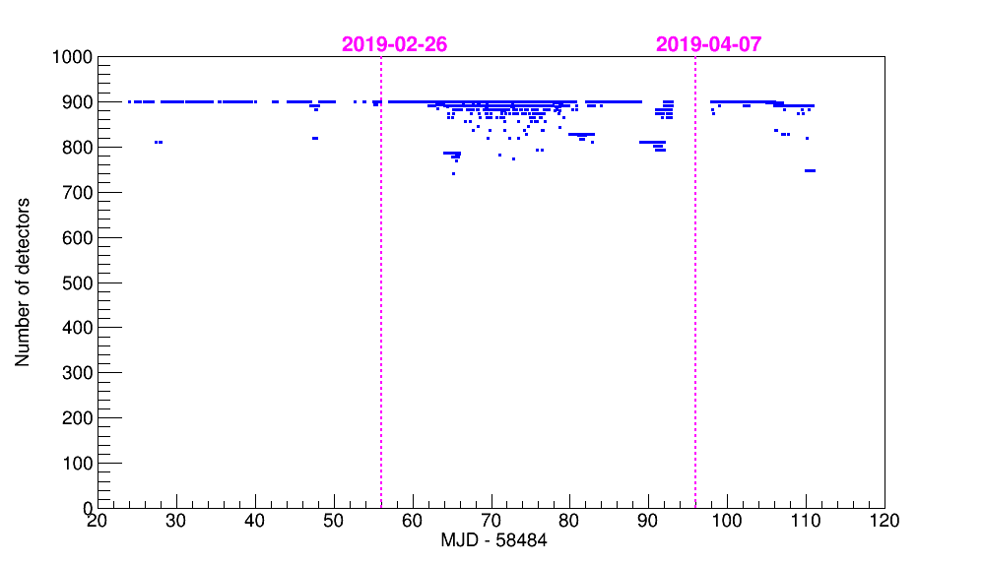
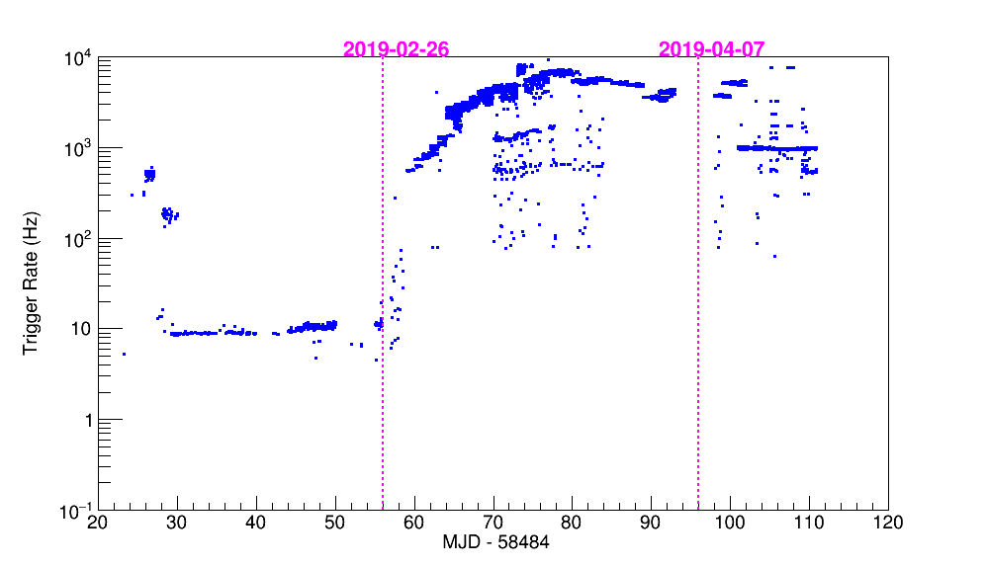
WCDA data
Number of detectors
Trigger Rate
Number of events: 2x10⁹
Different trigger modes are being tuned.

Slide 42
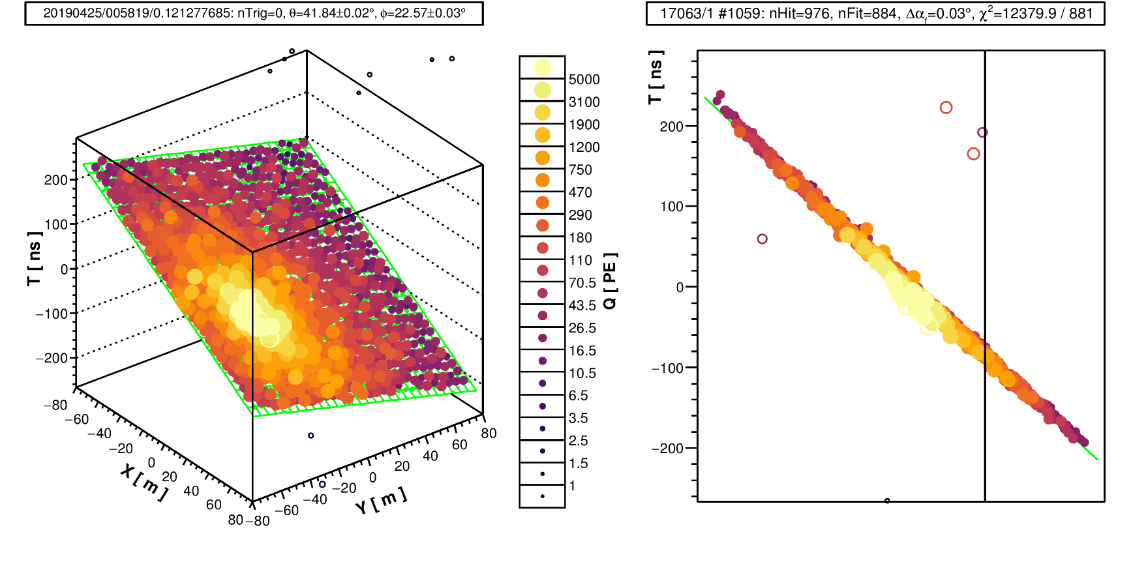
Event show

Slide 43
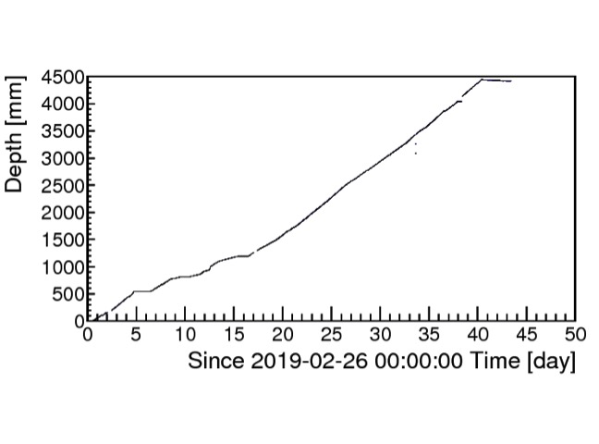


Detector stability vs water depth
Single rate
Anode/Dynode ratio
2019-2-26 to 2019-4-11
Water injection
Add curtain
Cluster 13

Slide 44
Summary
LHAASO will improve the sensitivity of wide field sky survey up to 1% Crab unit.
LHAASO will deeply extend the gamma-ray astronomy from about 10 TeV to 100TeV or higher.
LHAASO results around 100 TeV on specific sources may be millstone, like SNR,PWN, GP diffuse and so on.
Current ¼ of WCDA is in operation, the detectors are normally. ¼ of KM2A will come soon.
Thank you!

