Slide 1
Galactic gamma-ray sources with LHAASO
Xiao ZHANG (Nanjing University)
Yang CHEN, Yiqing GUO, Ye LIU, Thomas TAM, Zhongxiang, WANG, Ruizhi YANG

Slide 2
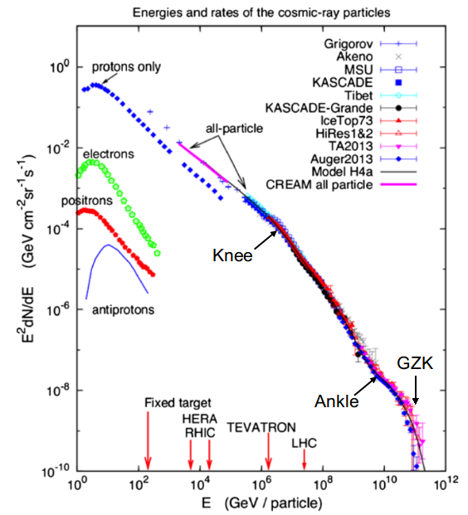
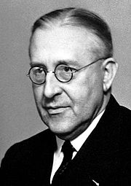
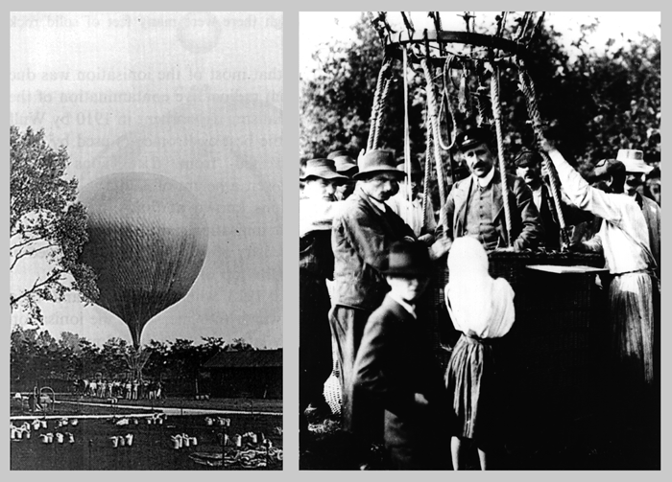
Cosmic Rays (CRs)
Victor Hess
Blasi 2013

Slide 3
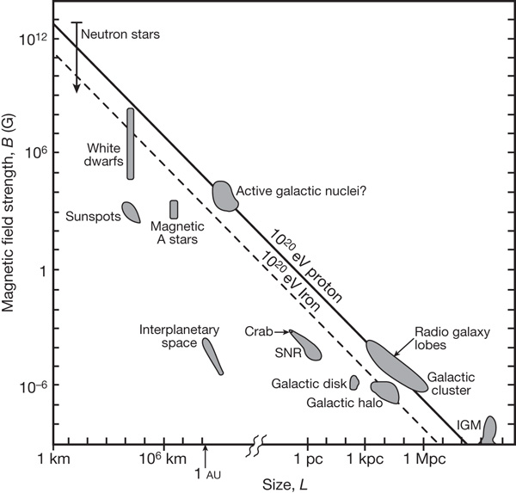
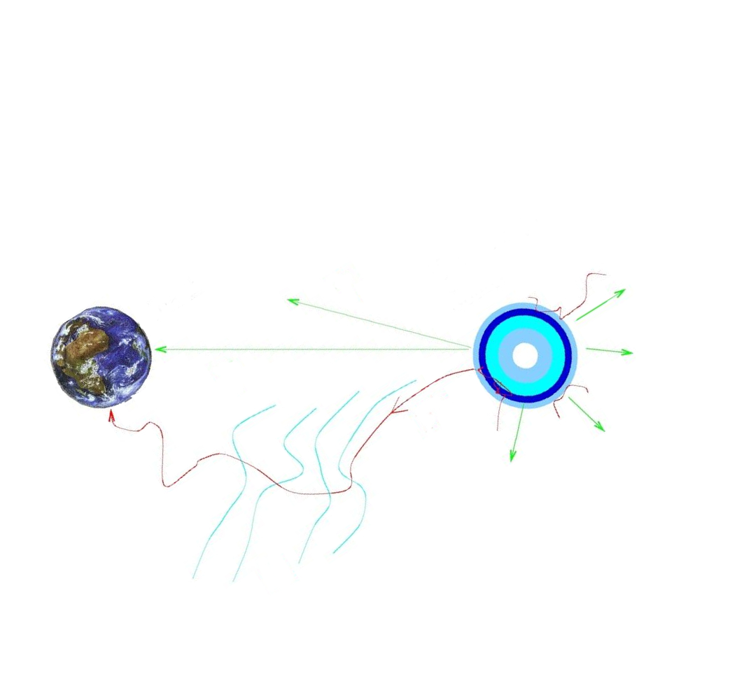
CRs: what is their accelerator?
Hillas diagram
Bauleo & Martino 2009 Nature 458, 847
B
CR source
Earth
source
Emax ~ ZBL
p⁺
γ
Gamma ray: probe

Slide 4
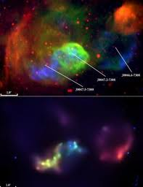
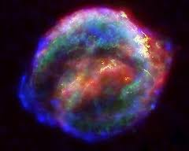
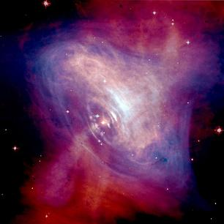
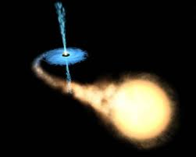
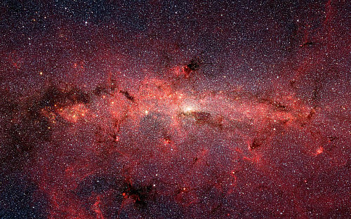
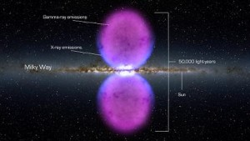
Galactic candidates
Superbubble
SNRs
PSR&PWNe
Binaries
Galatic centre
Fermi Bubbles
Notes:
briefly introduce part of them

Slide 5
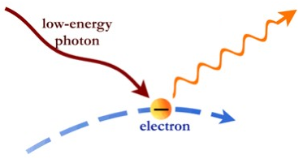
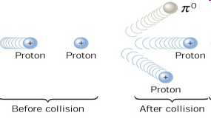

Gamma rays：
Leptons vs hadrons
IC scattering
Proton-proton collision
Notes:
our barrier

Slide 6
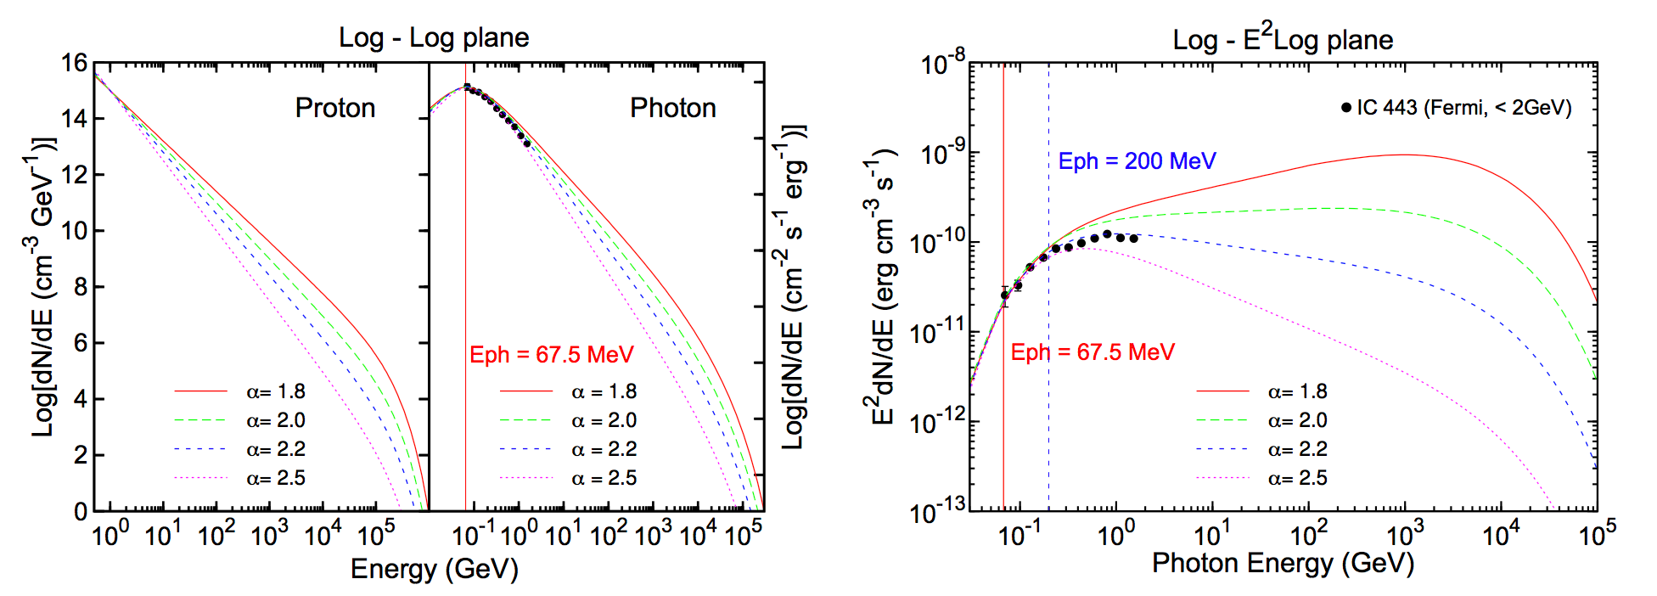
Distinguish I. Pion-decay bump
“pion-decay bump"

Slide 7
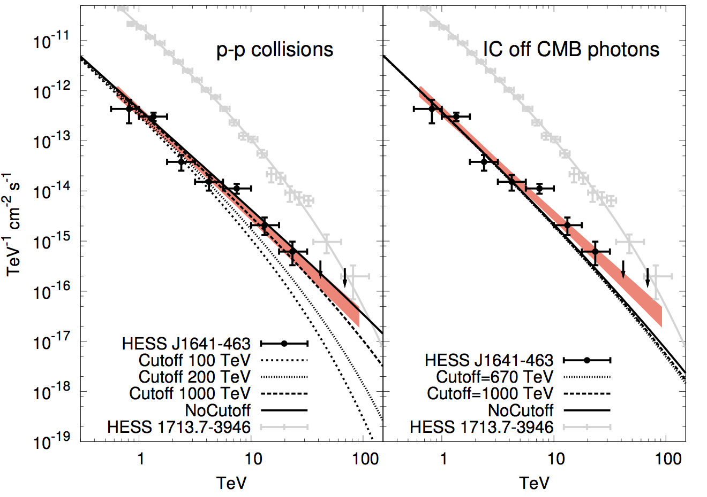
Distinguish II. Spectrum ~100 TeV
HESS J1641-463
Abramowki+ 2014

Slide 8
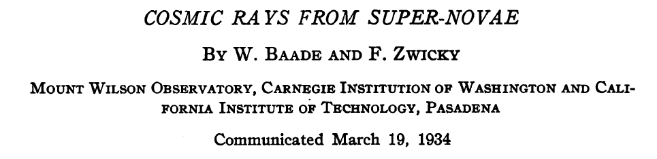
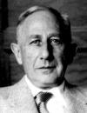
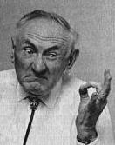
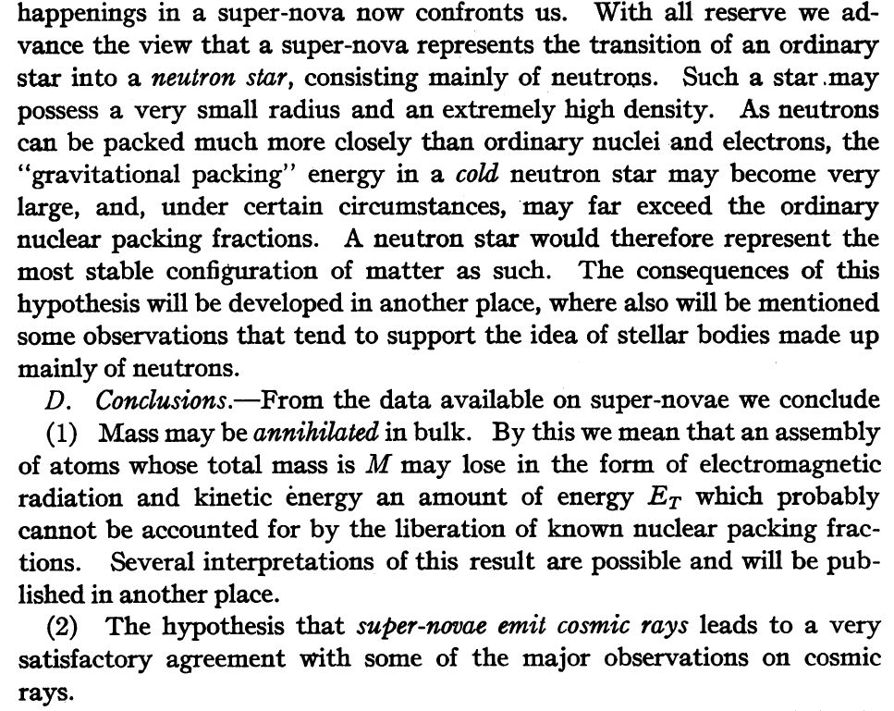
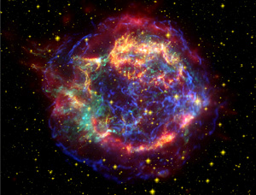
Supernova remnants (SNRs)
Baade & Zwicky (1934) :
SN → CRs & NS
Two great ideas in a single short paper！

Slide 9
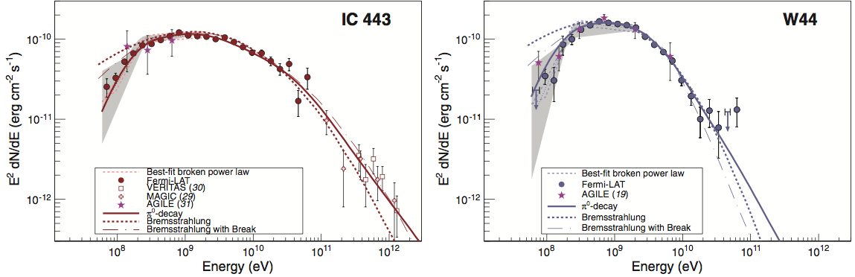
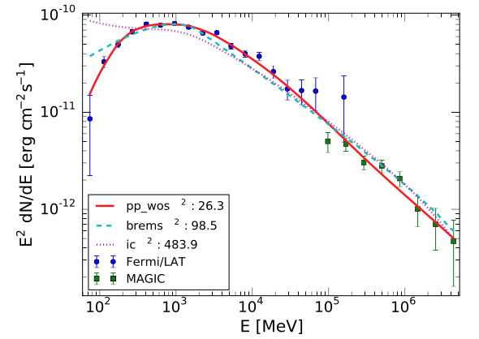
Characteristic signal of p-p in SNRs
Ackermann+ 2013
Ackermann+ 2013
W51C
Jogler & Funk 2016

Slide 10
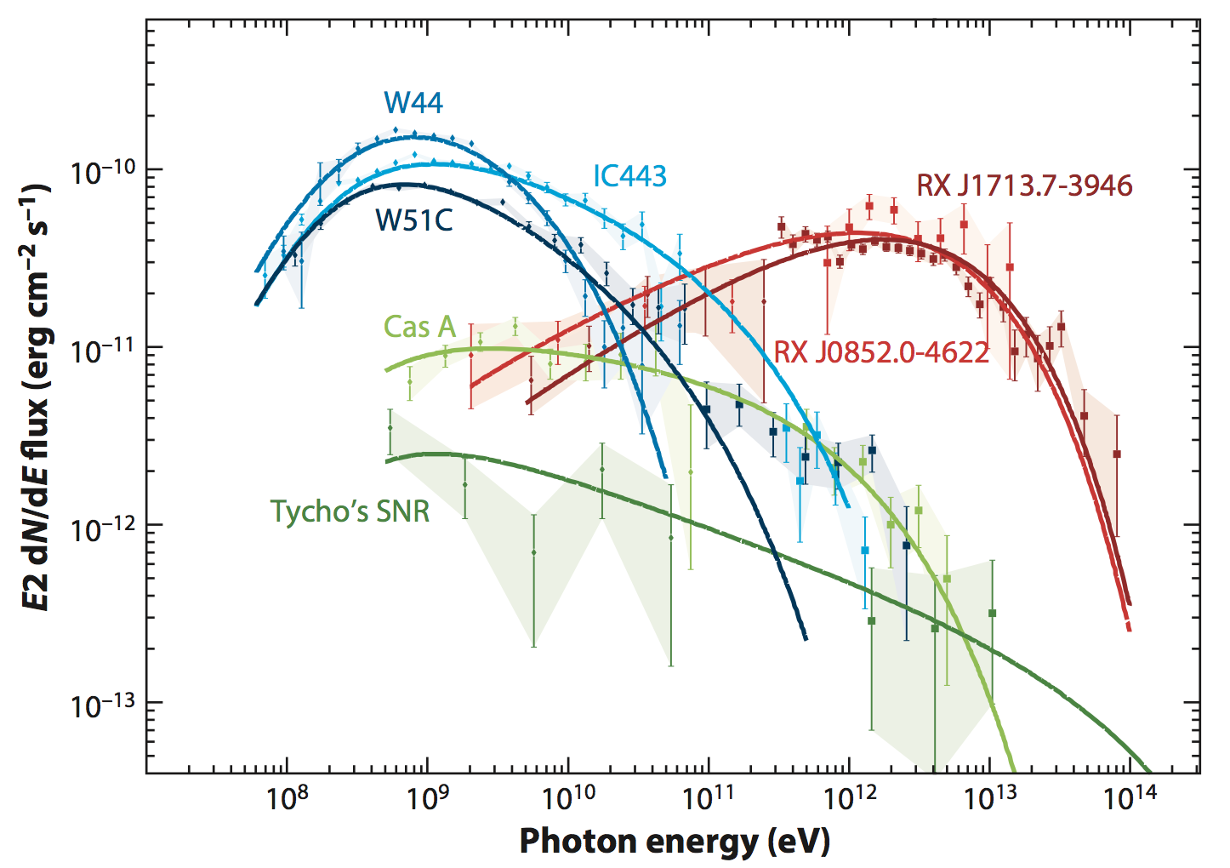
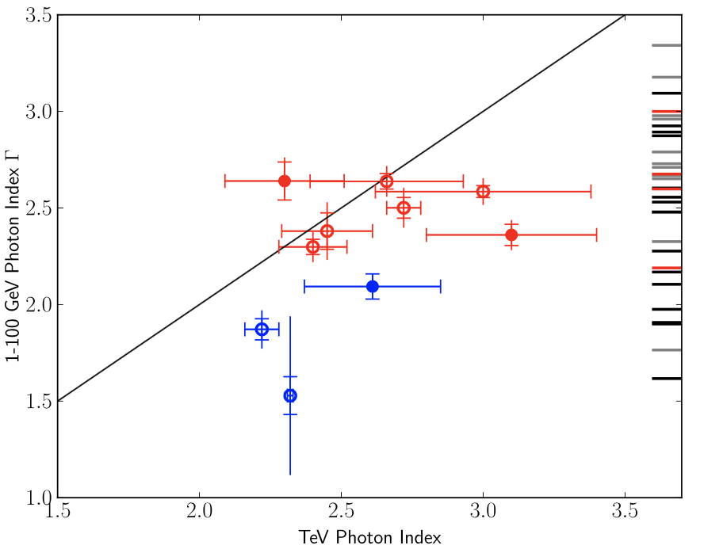
SNRs @ GeV and TeV
GeV: 39 in 4FGL
TeV: 22 in TeVcat
Spectra in GeV-TeV band
Photon index
GeV
TeV
Acero+ 2016
Funk 2015

Slide 11
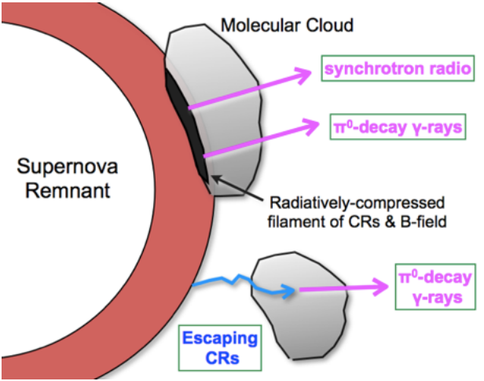
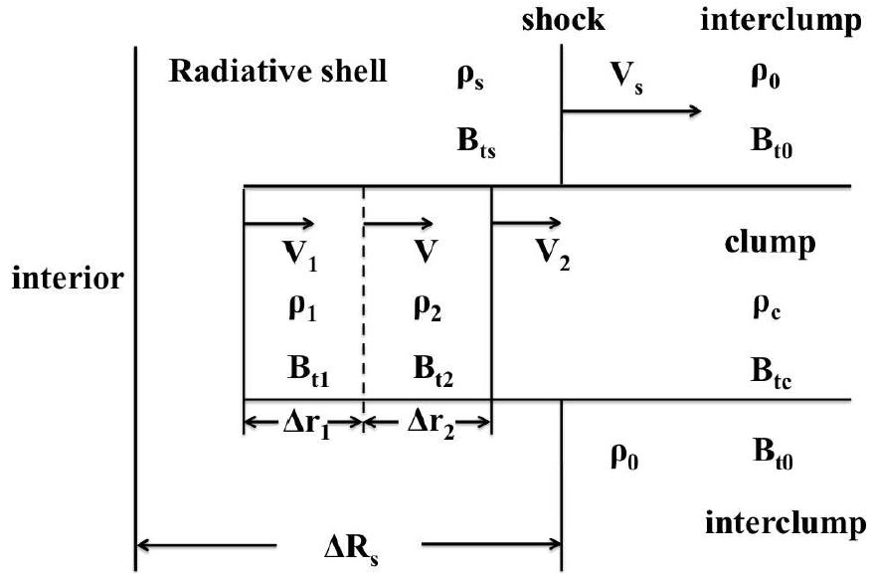
Interacting SNRs
1. Interaction!
From crushed mollecular clumps
Blandford & Cowie1982
Uchiyama+ 2010
Tang & Chevalier 2014
… …
2. Illumination!
From “illuminated MCs” collided by protons
Aharonian & Atoyan 1996
Gabici et al. 2009
Li & Chen 2010, 2012
Ohira et al. 2011
… …
Tang & Chevalier 2014

Slide 12
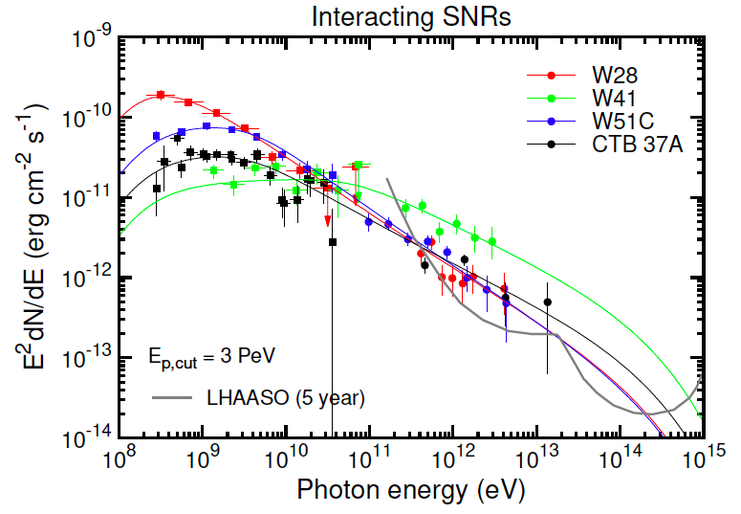

Slide 13
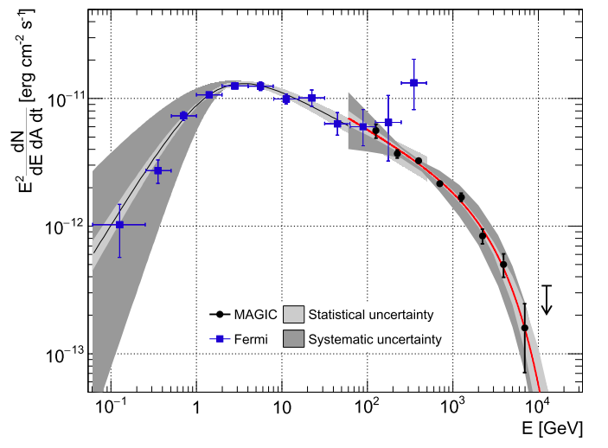
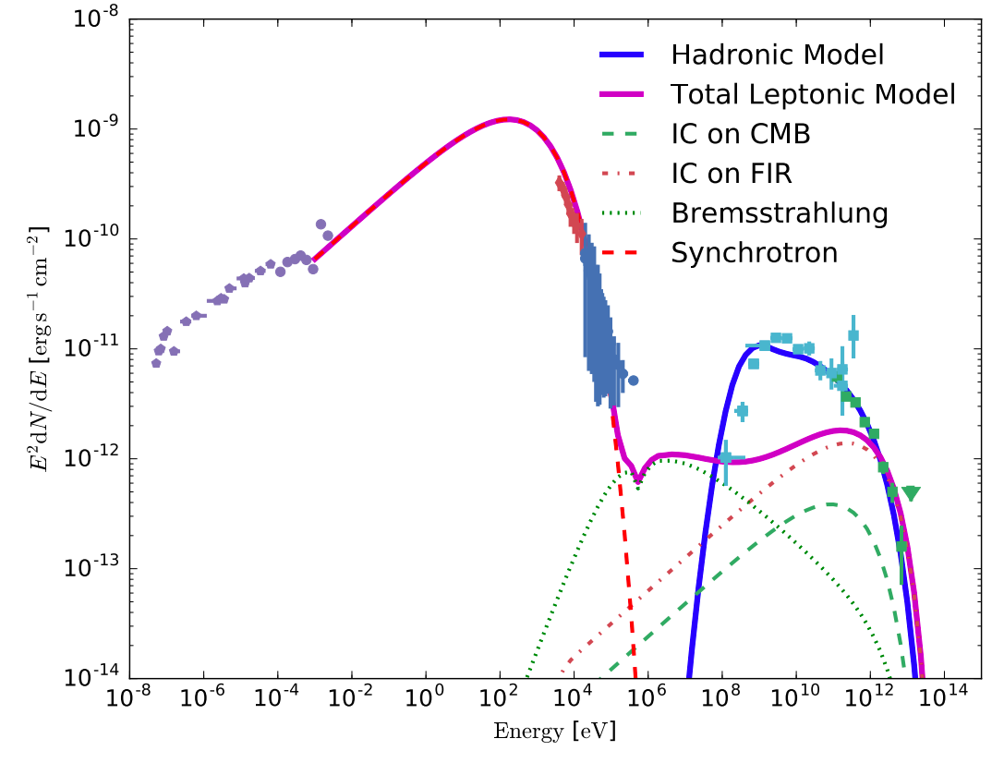


Young SNR: Cas A
$$E_{c}=3.5 TeV$$
(4.6 sigma)
$$E_{p,cut} \sim 12 TeV$$
﻿SNR Cas A is not a PeVatron at its present age
Ahnen+ 2016

Slide 14
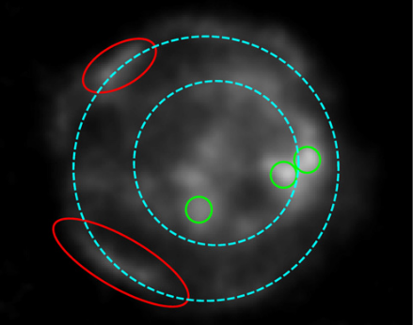
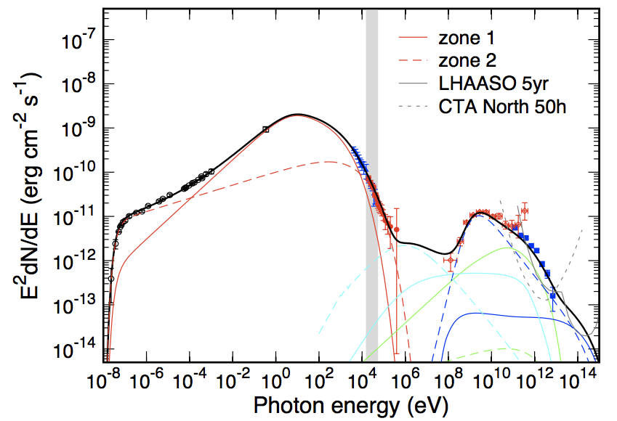
Cas A: A two-zone model
NuSTAR (> 15 keV, 2015)
Zhang & Liu 2019
SNR Cas A can be still treated as a PeVatron!

Slide 15
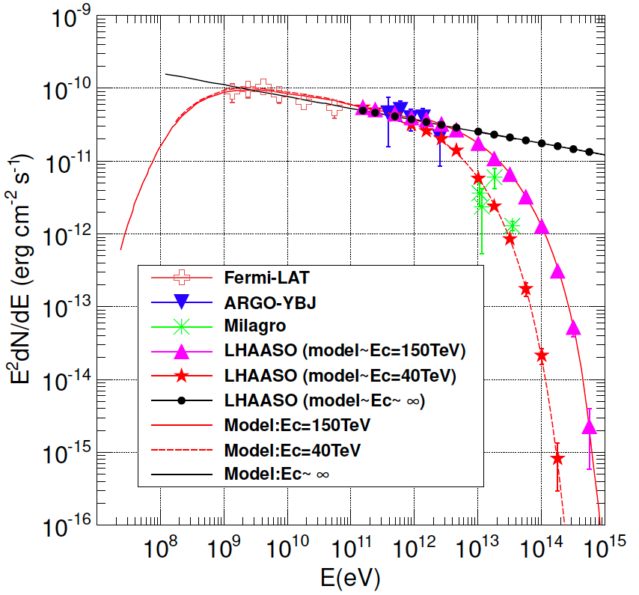
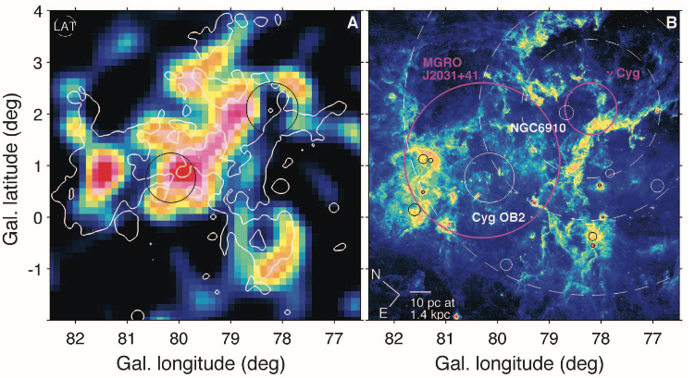
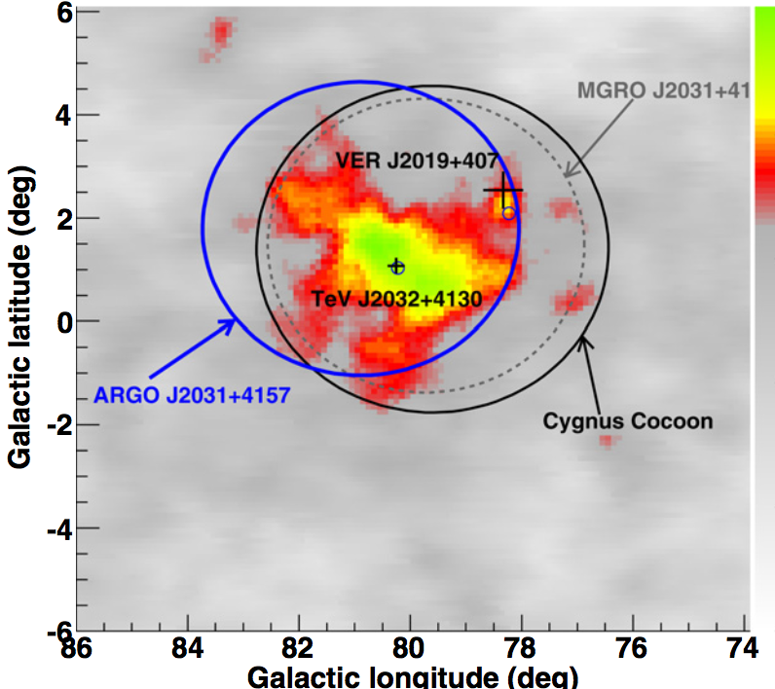
Star-forming Regions (SFR)
superbubbles, massive stars (OB), giant MCs
60Fe abundance
radial distribution of the Galactic diffuse gamma-rays
Cygnus Cocoon
E.g., Cygnus region
Fermi: 10-100 GeV
ARGO TeV
Ackermann+ 2011
Bartoli+ 2014
Liu+ 2016

Slide 16
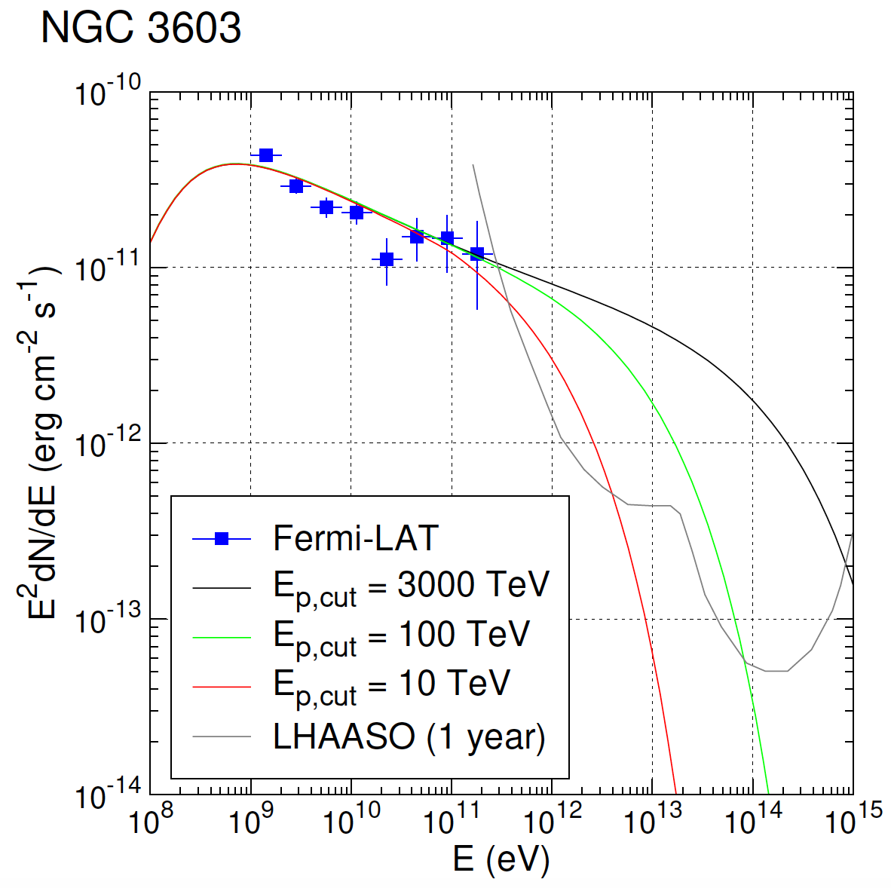
Star-forming Regions (SFR)

Slide 17
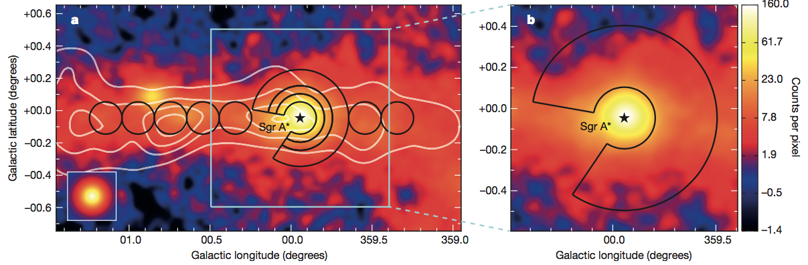
Galactic Centre (GC)
~ 200 pc
Abramowski+ 2016
white contour: gas density (traced by CS)
Notes:
central engine: black hole or massive star?

Slide 18
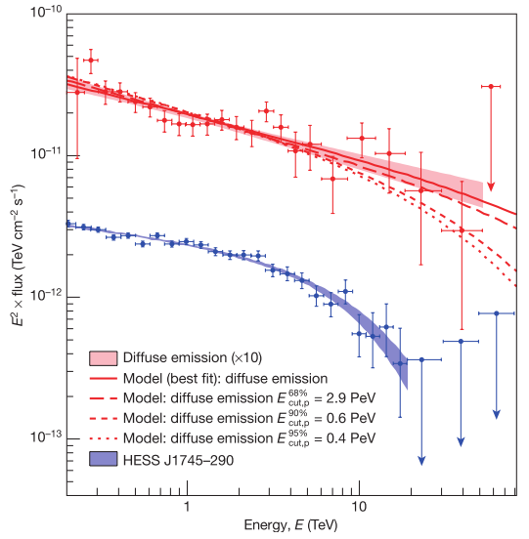
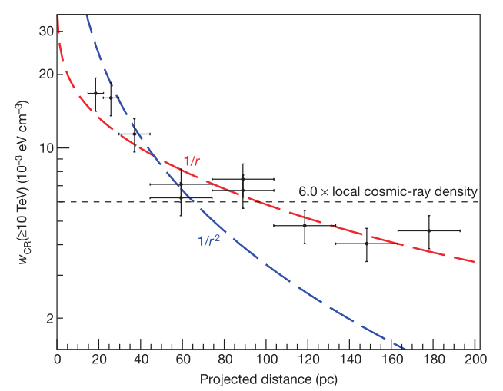
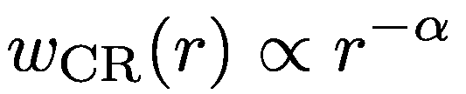
GC: spectral and spatial
red(ɑ=1): 11.8/9 √
blue(ɑ=2): 73.2/9
black(ɑ=0): 61.2/9
fit: ɑ= 1.10 ± 0.12
R2:
0.15-0.2
R3:
0.2-0.3
one order of magnitude larger than that of 'sea'
PeVatron!
Notes:
black hole or massive star or milisecond psr

Slide 19
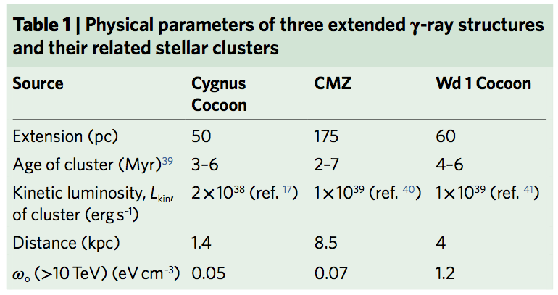
SFR/GC connection: massive stars ?
Aharonian+ 2019, Nature Astronomy

Slide 20
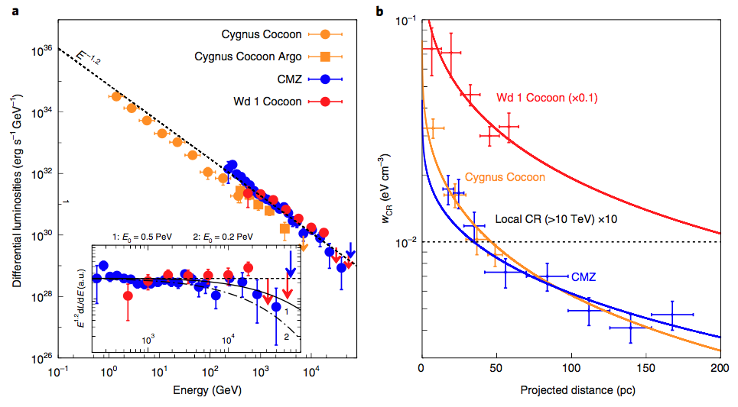
SFR/GC connection: massive stars ?
Aharonian+ 2019
Aharonian+ 2019, Nature Astronomy

Slide 21
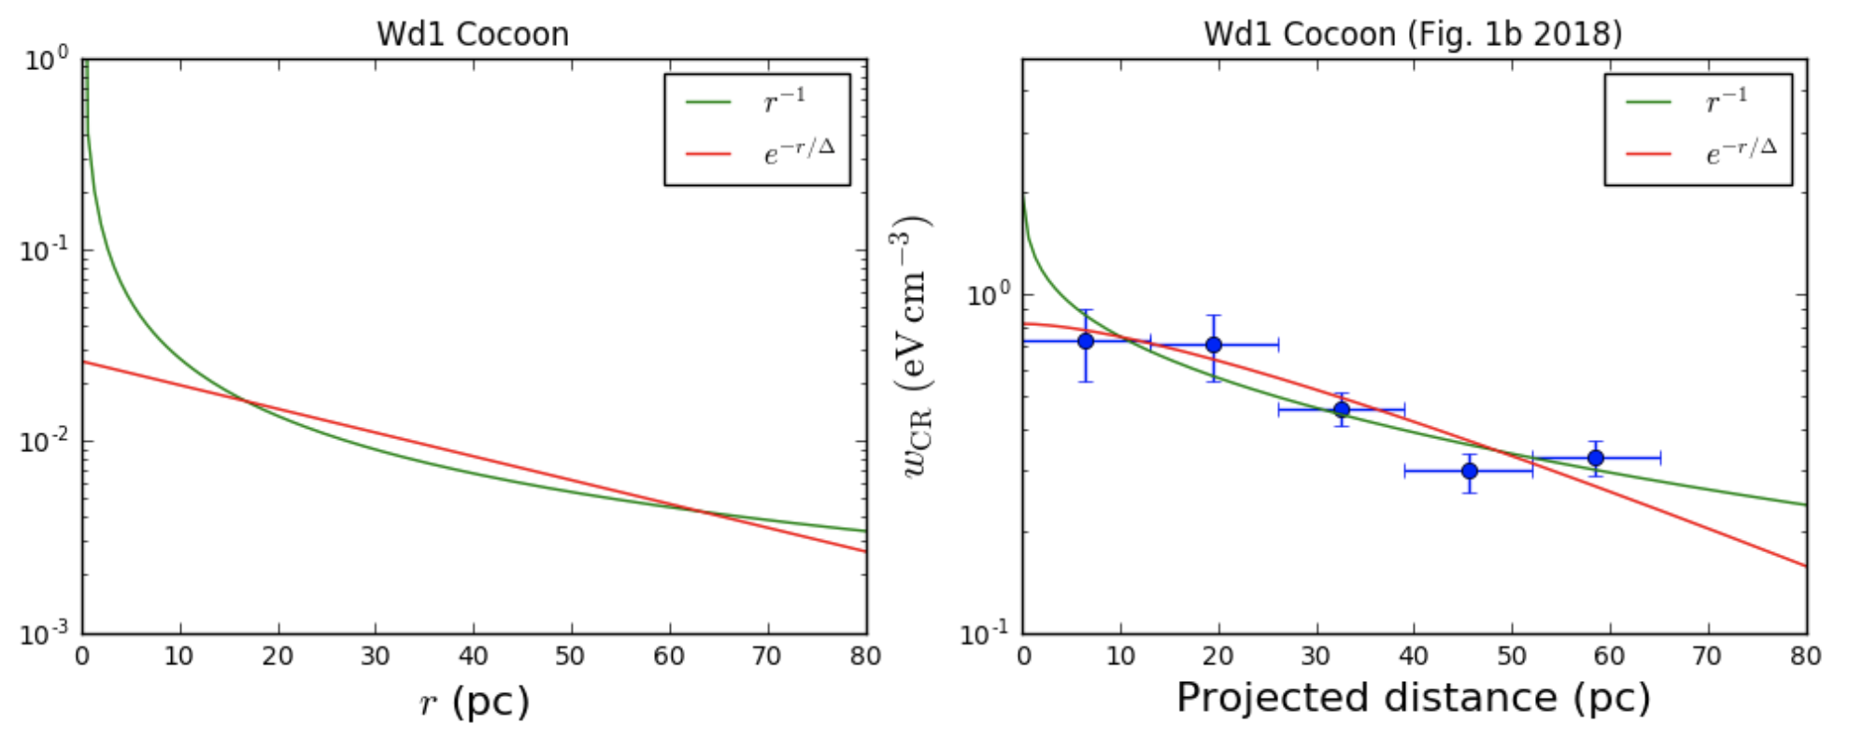
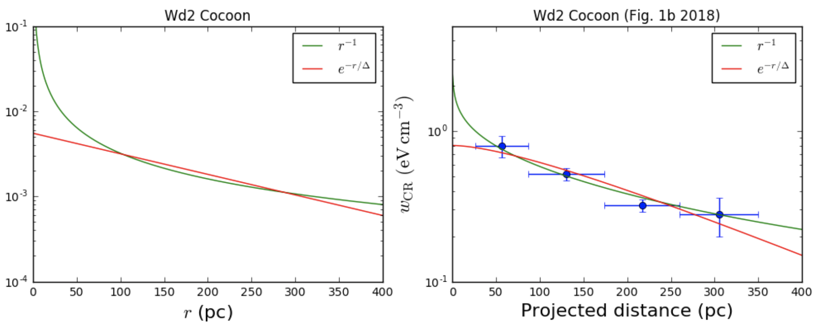
Alternative model
massive stars
vs
superbubble
PRELIMINARY

Slide 22
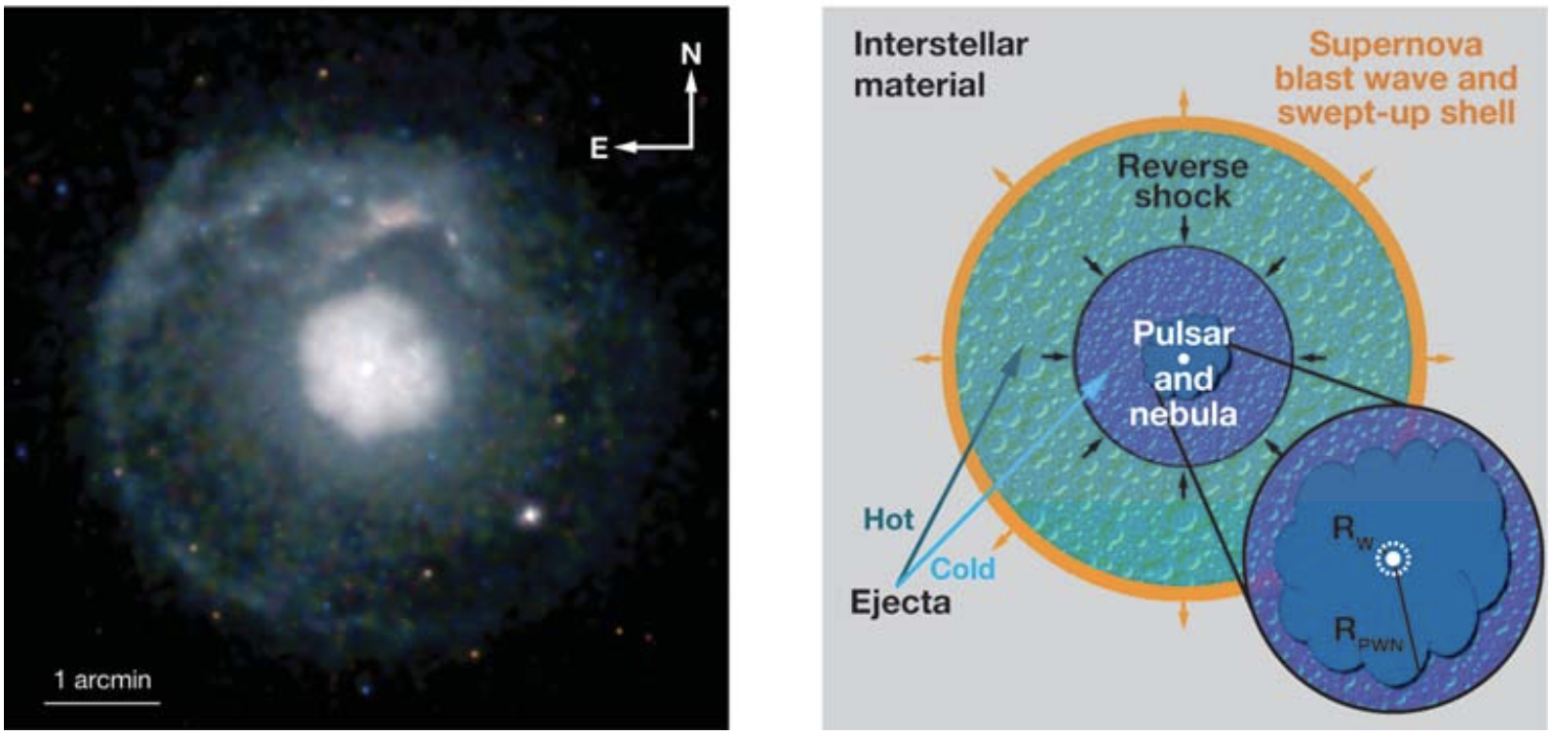
Pulsar wind nebulae (PWNe)
G21.5-0.9 (Matheson & Safi-Harb 2005)
Gaensler & Slane 2006
Notes:
数目最多的gamma ray sources

Slide 23
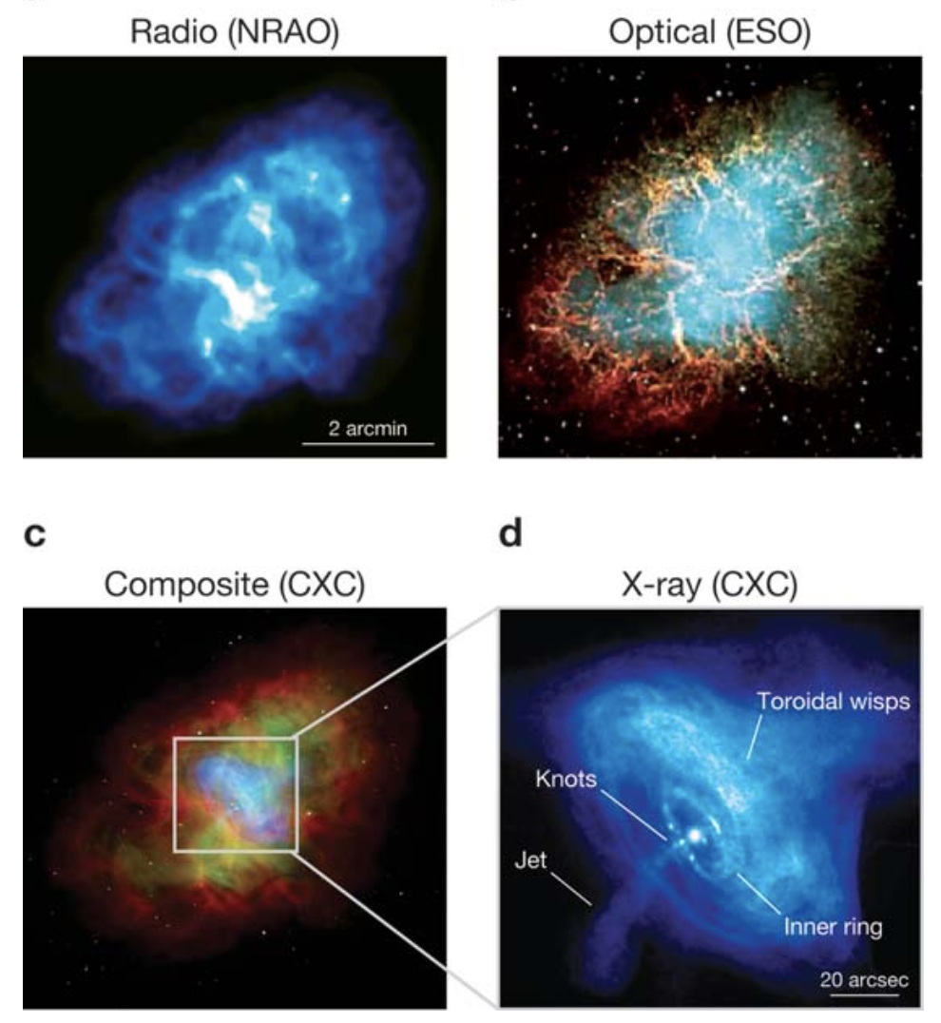
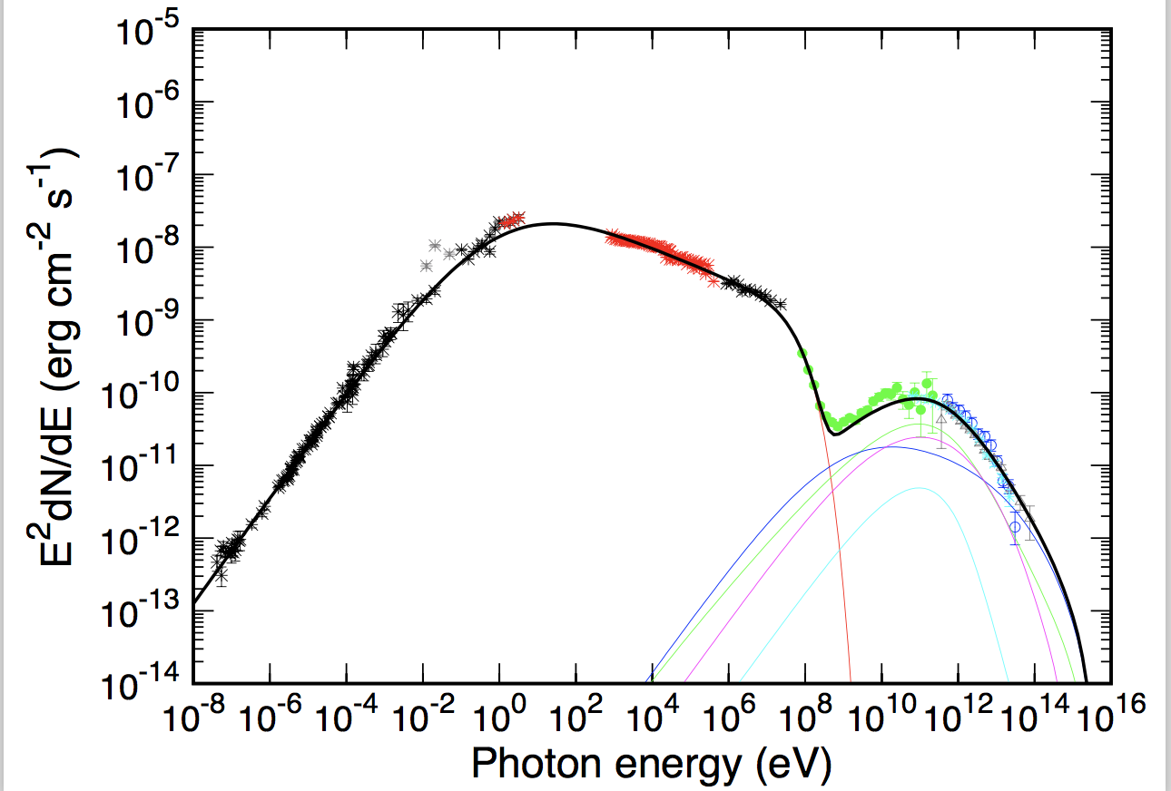
PWN: Crab
Leptonic Origin!

Slide 24
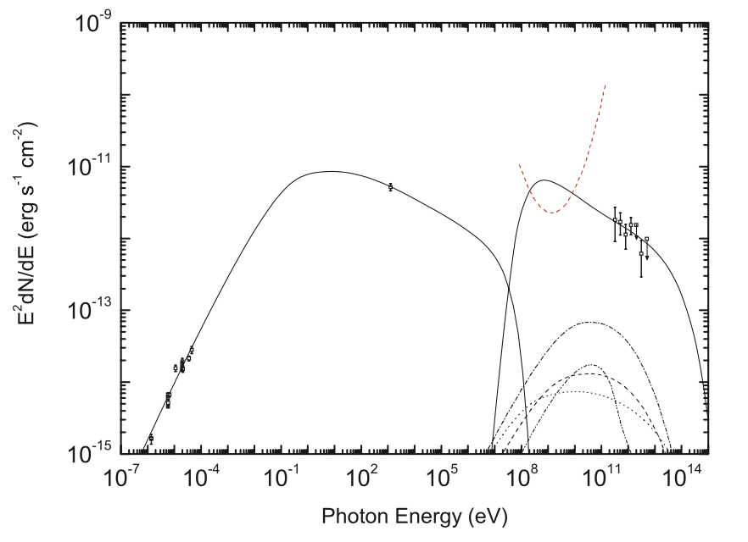
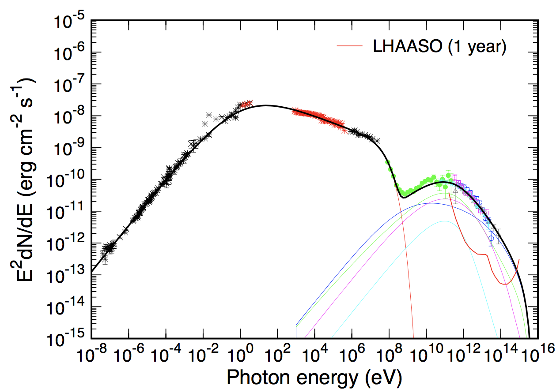
PWN: relativistic protons ?
Cheng 1990: Protons may be accelerated upto PeV in PWN
G54.1
Crab
Li & Chen 2010

Slide 25
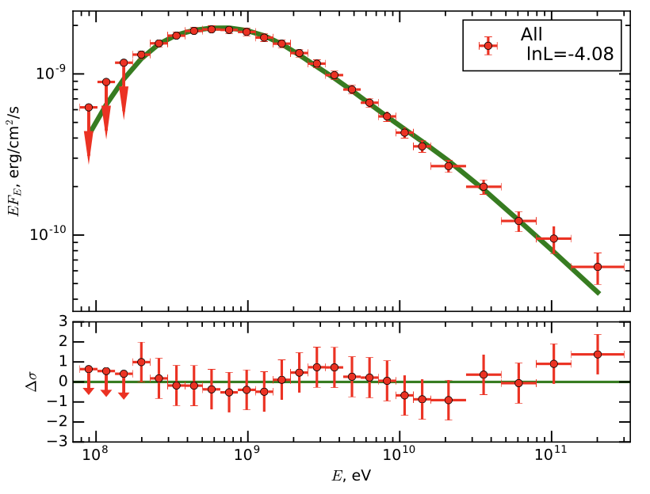
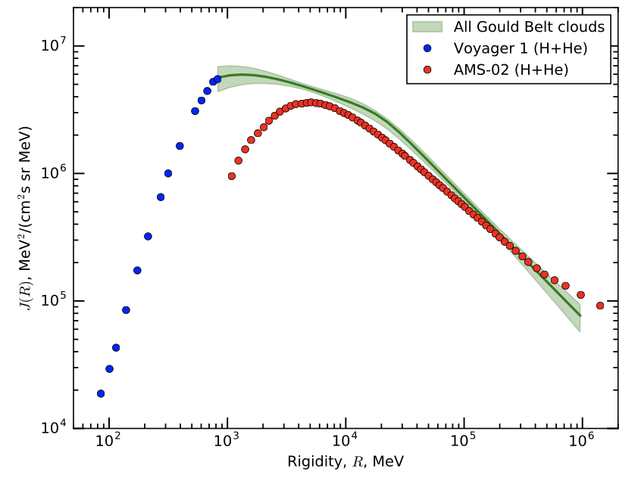
Molecular clouds (MCs): CR calorimeter
E.g., Gould Belt clouds seen by Fermi
gamma ray
Green:
derived protons
Neronov+ 2017

Slide 26


MCs with LHAASO
MC:
Protons: AMS 02 extrapolated to 10 PeV

Slide 27
Summary
SNRs: are they PeVatrons?
PWNe: can they accelerate protons?
SFRs: massive stars vs superbubbles
Giant MCs: derived spectrum vs observational one
(or Global vs Local)
Thanks!

