Slide 1
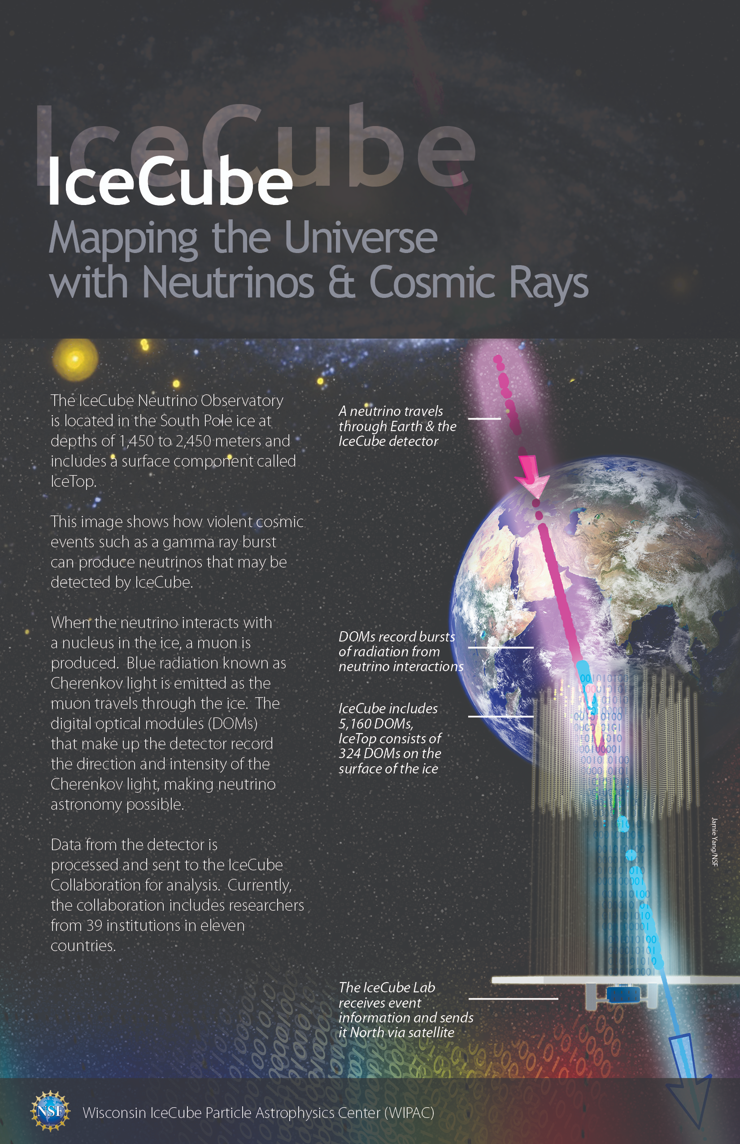
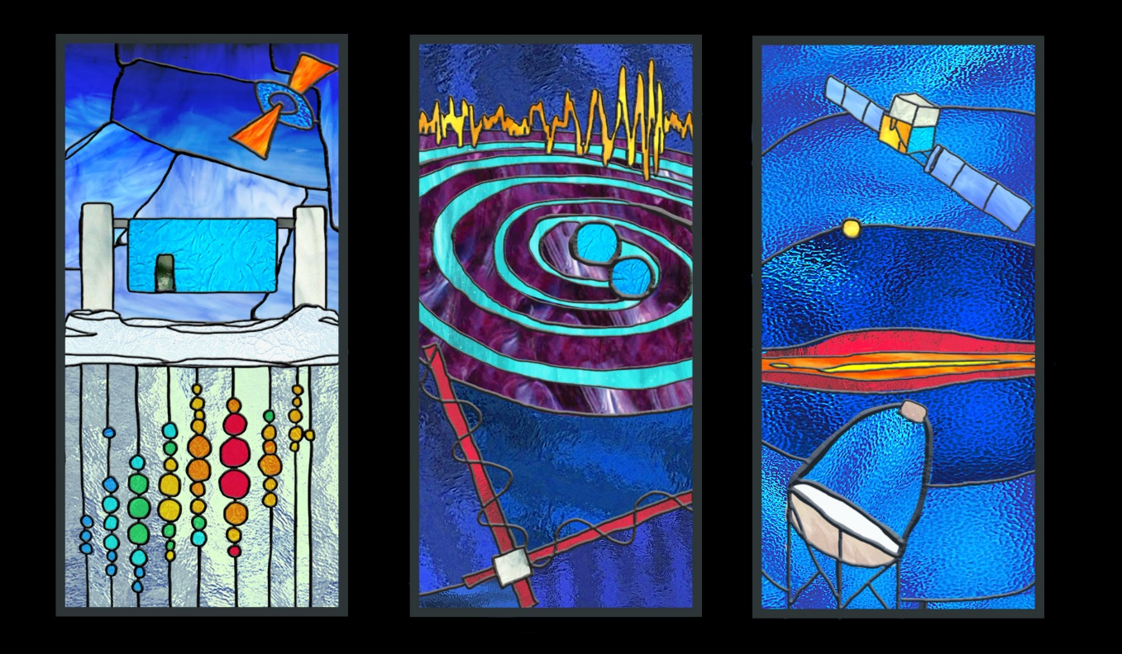

Multimessenger Astronomy with The IceCube Neutrino Observatory
IceCube and Future Observatories in the Ice
Kael Hanson
Director, Wisconsin IceCube Particle Astrophysics Center (WIPAC)
University of Wisconsin – Madison
LHAASO Workshop, Chengdu
April 25th 2019

Slide 2
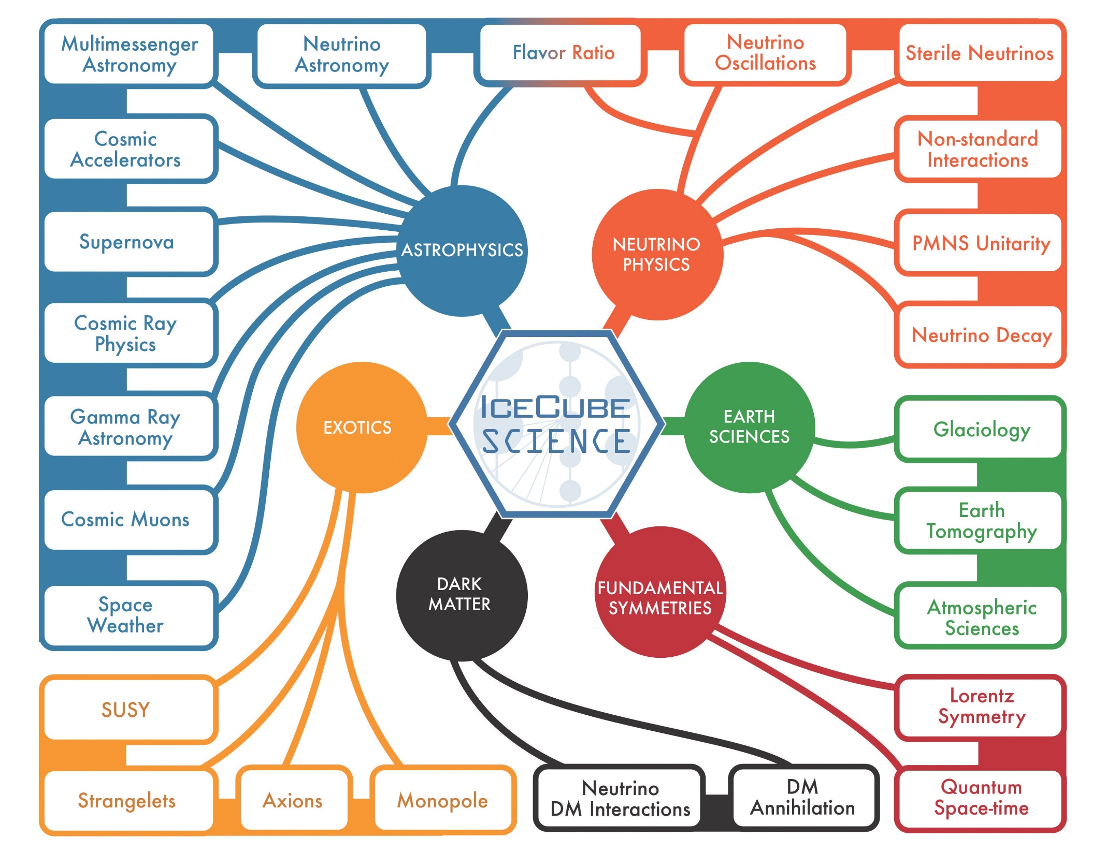

Slide 3
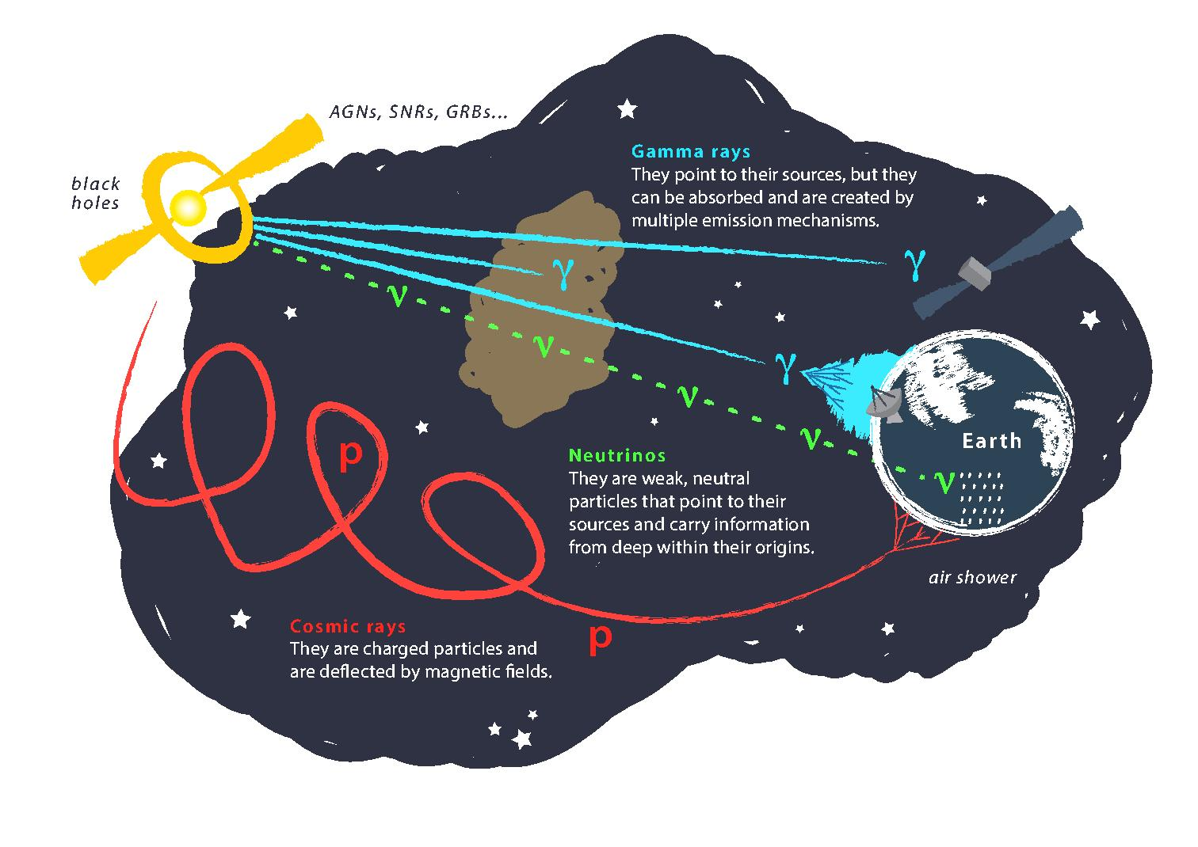
The Case for Multimessenger Astronomy
Take all you are given
High energy astrophysical acceleration sites are likely emitters of gammas, charged ions, and neutrinos. Each particle used as a messenger particle has it own strengths and weaknesses – we can push our knowledge deeper by combining them.
Gamma rays: point back to sources and easily detectible but there is problem of interactions in dense sources or in transit over not-so-long distances. PeV and above constrained to intergalactic-scale distances. EM and hadronic production possible and often difficult to discriminate.
Cosmic rays: and up to 10¹⁹ eV travel over cosmological distances. Not impossible but difficult to trace back to source due to deflection in GMF/IGMF. UHE detection requires large ground arrays.
Neutrinos: point back to sources and offer pristine look even deep into compact objects; no horizon – a good thing overall but has implications in point-source searches; require large, expensive underground or underwater (ice) detector facilities; radio is however promising economical technique at UHE.

Slide 4
Challenge / Opportunity: Cosmic Horizons
Neutrinos are alone the only astronomical messengers capable of directly imaging the extreme energy sky. Photons interact with EBL and already at 100’s of TeV are limited to Mpc scales.
Charged cosmic rays processed by galactic and inter-galactic magnetic fields as well as galactic diffusion: energy and angles at observation no longer follow source.

Slide 5
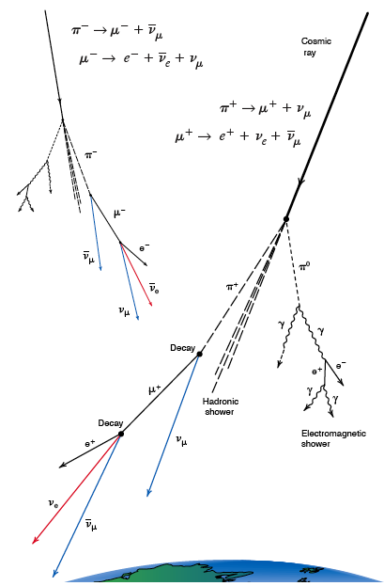
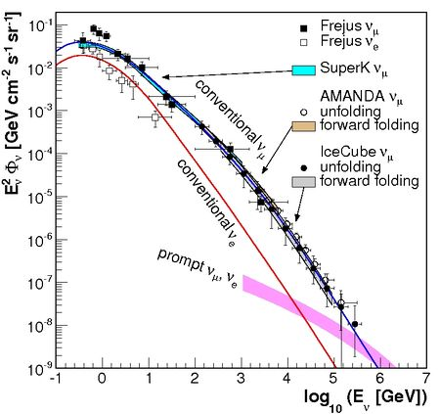
Atmospheric Neutrino “Backgrounds”
Neutrinos are also produced in quantity by cosmic ray interactions in the Earth’s atmosphere: decaying mesons yield muons, ν_{e}, and ν_{μ} (not ν_{τ} however). These form a nearly irreducible background for astrophysical neutrinos (IceCube detects 1 every 5 minutes vs 1/week for astrophysical ν).
The handle is the energy: because mesons lose energy in the atmosphere the flux of atmospheric neutrinos is approx. power law with spectral index -3.7.

Slide 6
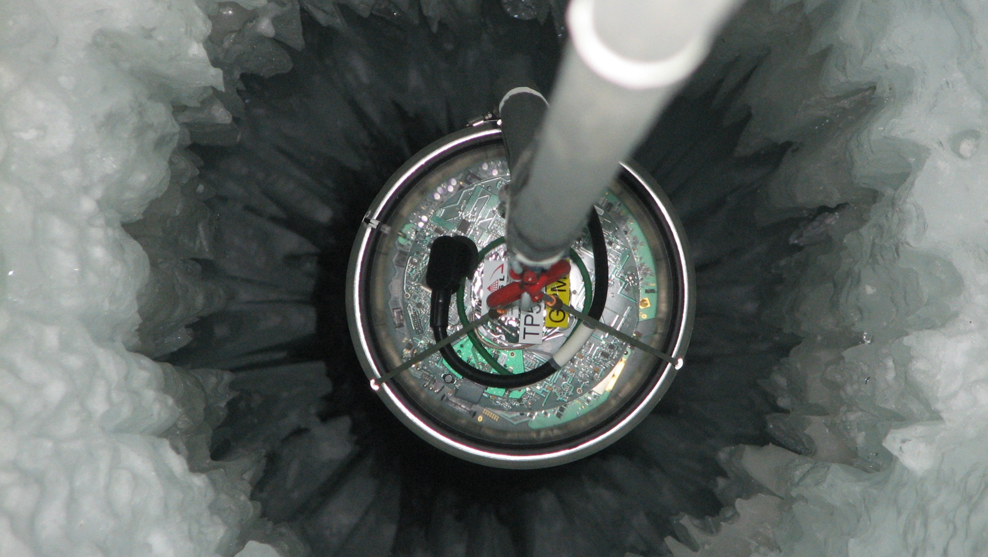
IceCube
Still the biggest TeV neutrino telescope

Slide 7
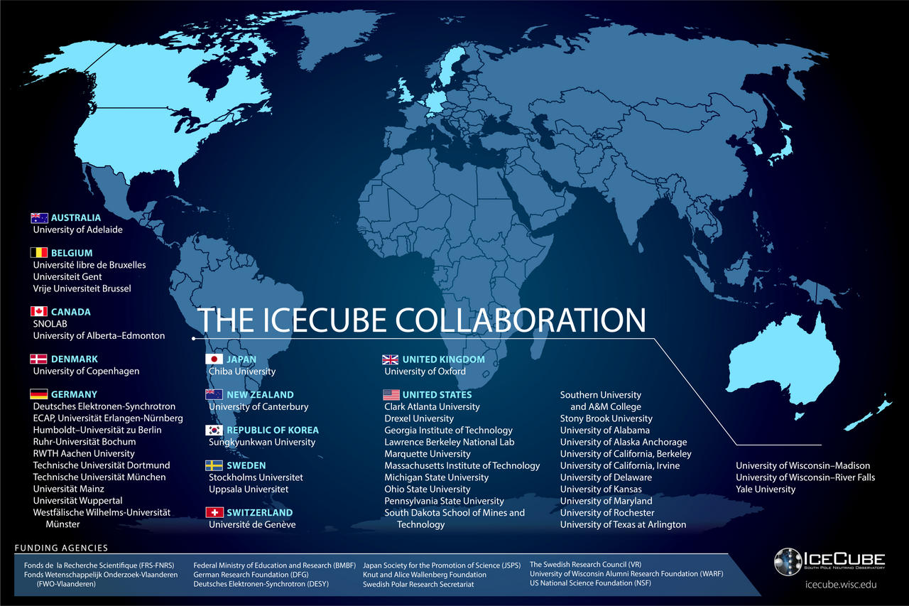
The IceCube Collaboration includes > 300 researchers from 47 institutes in 12 countries.
IceCube is one of the NSF’s large facilities (LIGO, LSST, … 2 dozen others).
The Operations and Management of the facility is handled by WIPAC at UW-Madison. In addition to having a large science group, our center supports the technical aspects: computing, data storage, detector maintenance, …

Slide 8
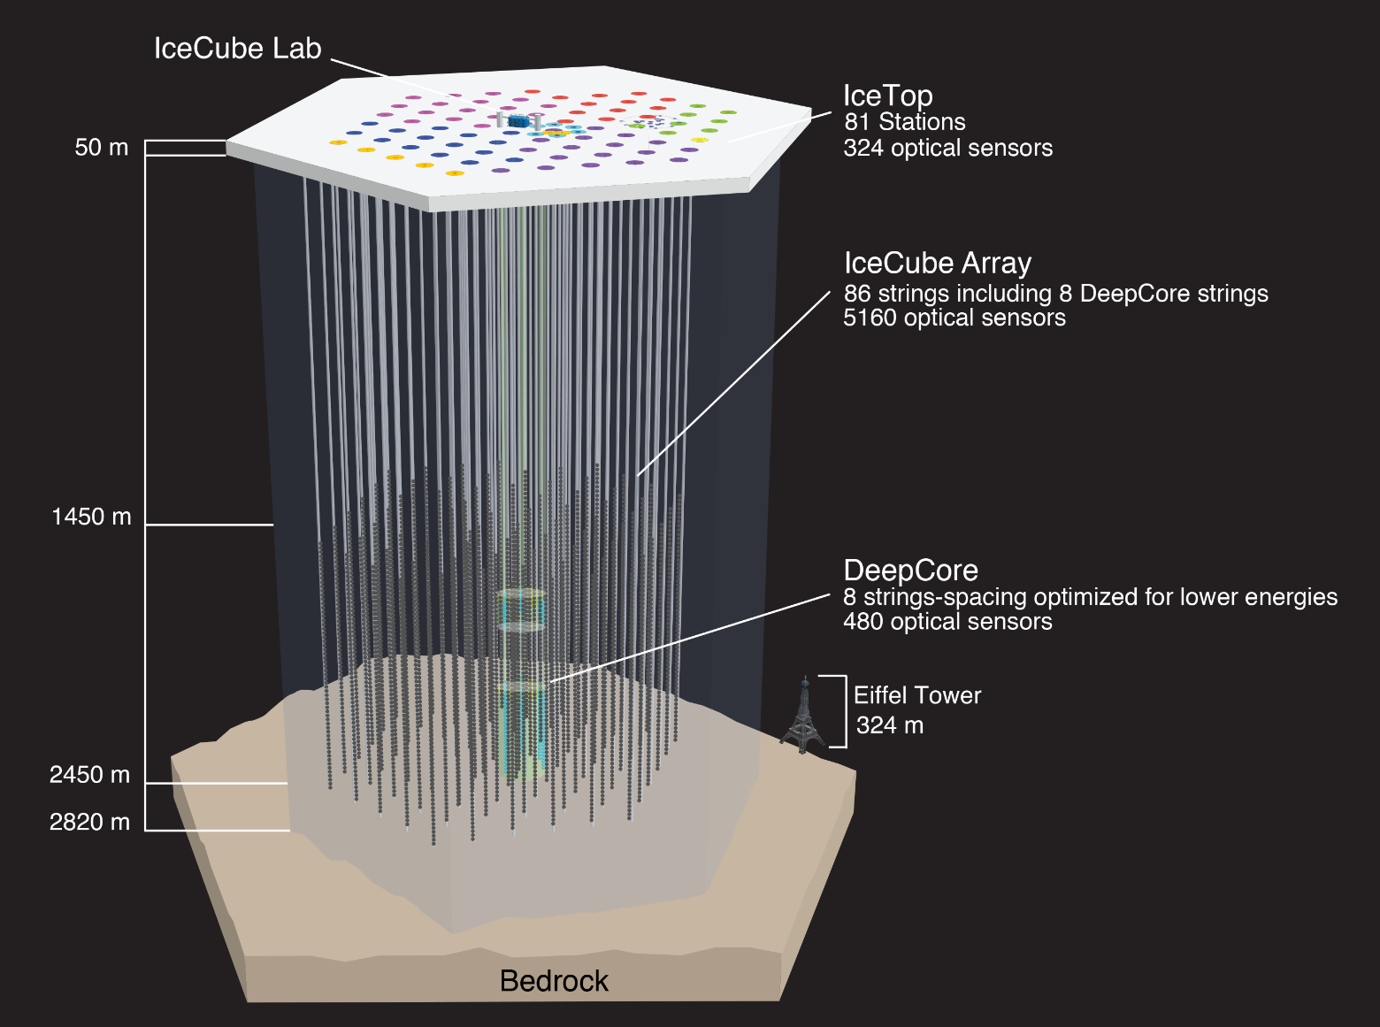
The IceCube Neutrino Observatory
IceCube construction began in 2002 with design and procurement of the drill. The first string to be deployed was in Jan 2005. Over the next 6 season 85 more strings were deployed with the last string being “tied off” on December 17, 2010. Full 86 string data taking started May 2011.
TPC: $279M USD - $40M non-US
The South Pole site was chosen
Because there is a lot of ice;
Logistic support: 5 million lbs. of cargo were delivered and 77 person-years of effort on-ice it took to make IceCube. Everything was at that time airlifted inside LC-130 Hercules aircraft.

Slide 9
The IceCube Digital Optical Module (DOM)
Optical
Communicatons / Timing
Large Area Photocathode 10” 10-stage Hamamatsu R7081-02 PMT (QE 24% @ 420 nm); High QE variant (QE 35% @ 420 nm) used in DeepCore DOMs
Low noise 500 Hz bkg count rate in-ice @ 0.25 pe threshold.
Glass / Gel 0.5” thick Benthos pressure housing rated to 10,000 psi. Better transmission in 330 - 400 nm relative to AMANDA OM. Low radioactivity glass.
Optical calibration Each DOM calibrated ε(λ, T) in the lab to about 7%; in-situ flashers additionally permit in-ice optical measurements
Comunications is digital at rate of 1 Mbit/s shared by 2 DOMs on a single copper pair.
The DOMs each timestamp PMT pulses using a local XO. Nevertheless, 1 ns time resolution is achieved through automatic clock synchronization protocol
Digitizer
IceCube adopted waveform readout of PMT pulses to deal with complex scattering of photons in ice. There are two digitizers:
300 MSPS ASIC 14-bit effective resolution but limited to ~500 ns
40 MSPS pipelined ADC capture to 6.4 µs
Smart Sensor
FPGA + ARM CPU SoC. 4k-hit deep memory buffer stores hits until readout over 1 Mbit digital link to surface.
Power supplied by 18 AWG Cu pair to surface (3.5 km). 96 V, 3.75 W per channel (DOM)
Power

Slide 10
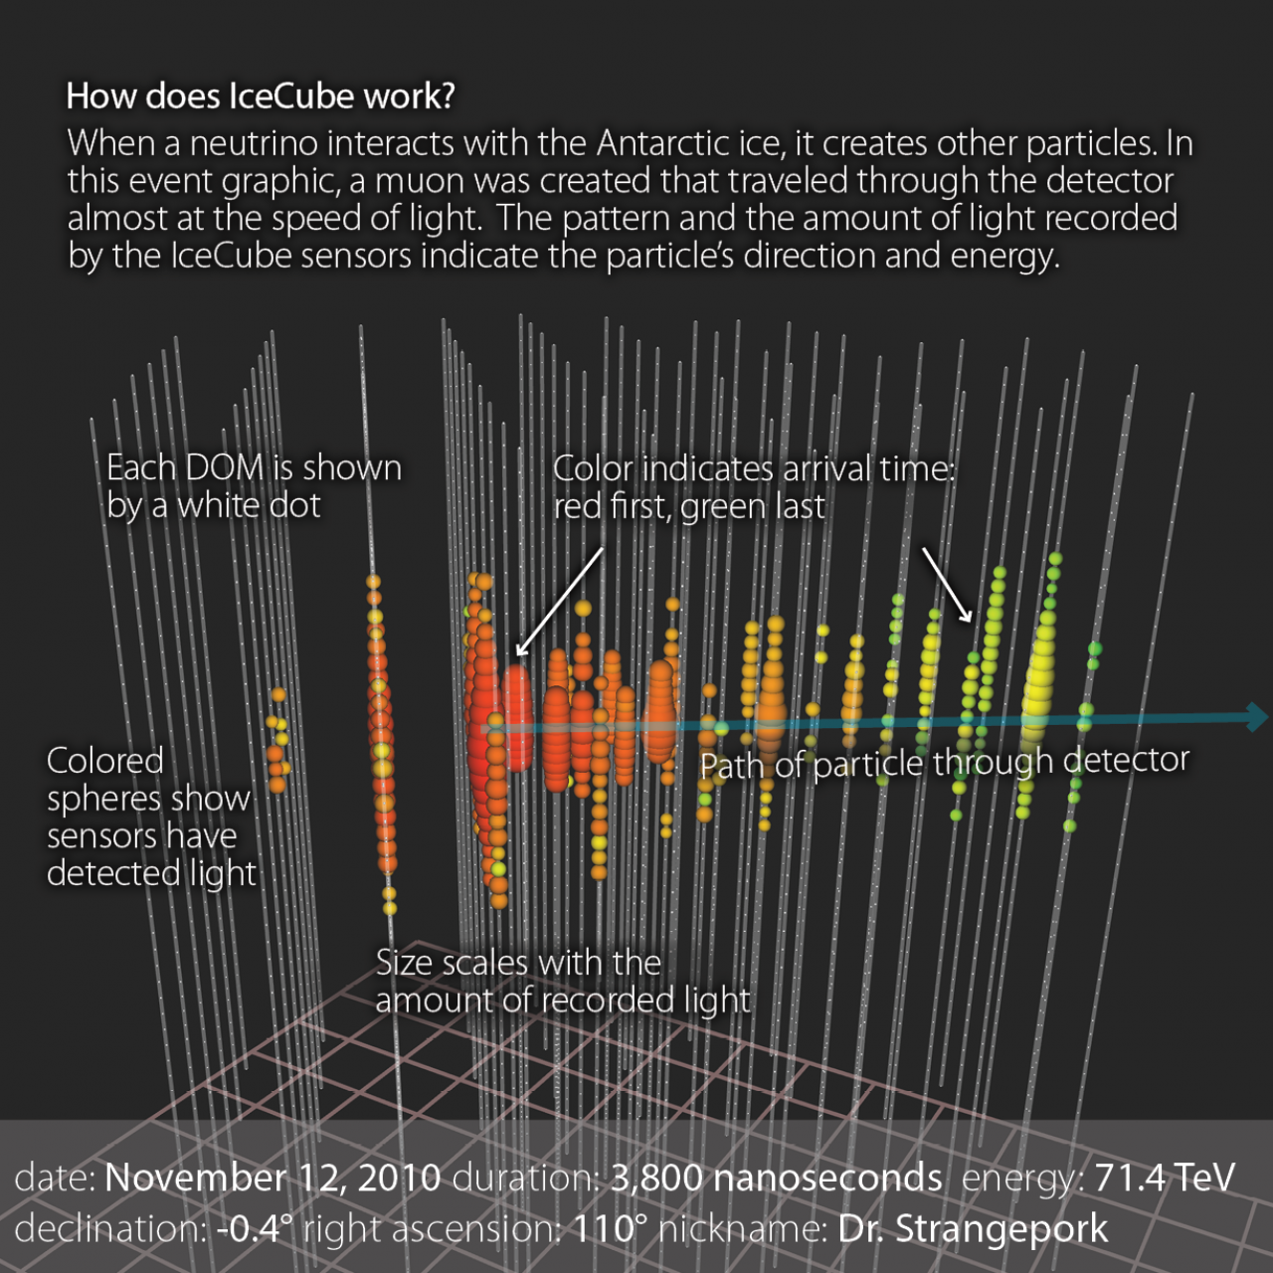
Detecting Neutrinos in the Ice
IceCube is “water” Cherenkov detector: we detect the charged ultrarelativistic secondaries which are produced in neutrino scattering in ice or detect CR muons and their stochastic secondaries.
Ice is a good calorimetric medium: we can get 10% resolution on E (dE/dX for muons).
Scattering and non-uniformity is problematic both for precision reconstruction and for simulation of the detector. Still we are able to obtain O(½) degree angular resolution for tracks.

Slide 11
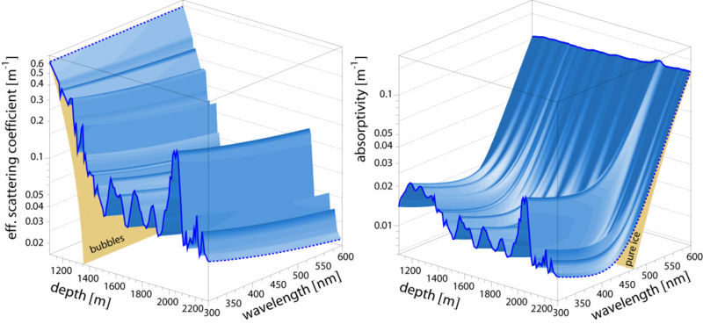
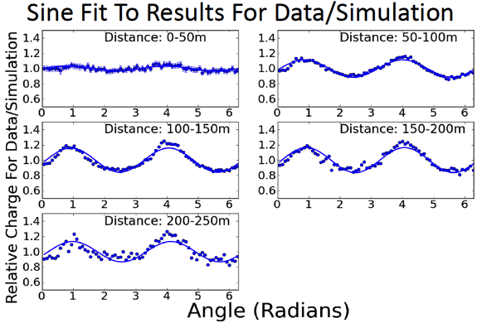
Ice
The complex ice structure deposited over 100 k-yr contains much structure and is prominent challenge for IceCube:
Simulation of 10¹⁰ photons or more for high energy events now possible with GPU acceleration
Not only is there z structure, there is tilt and directional anisotropy!
Ice properties measured with in-ice calibration sources:
12 high brightness 400 nm LEDs per DOM – a few DOMs have different colors;
Handful of special calibrated sources;
Dedicated dust logging of boreholes – IceCube also contains a few glaciologists.
Notes:
Dust! And ice flow

Slide 12
It started with 2 muppets: Bert and Ernie
Quite by accident, while looking for extremely high energy neutrinos from the GZK interacting protons, we found two events in the first year of full IC86 data that didn’t look like any background: they were clear cascade-like events which started inside the detector just like a neutrino should. And they had extremely high energy: 1.05 PeV and 1.15 PeV, each had nearly 100,000 detected photo-electrons!
Now that we had seen real, unmistakable signal events with our “eyes”, we knew how to proceeed:

Slide 13
High-Energy Starting Event (HESE) Analysis
Strategy: focus on high-energy events (2 > PeV events in 1 year, either we got really lucky or the ice is full of them). The very simple cut developed (it is now running in real time at Pole) is this:
Qtot > 6000 p.e. : this will setup an energy threshold of approx. 30 TeV, but, again, there should be many events out there based on the two observations;
Use part of IceCube’s outer shell as a veto. It’s OK if hits occur in the veto as the particle exits (PC muons will do this) but not OK if the first hits occur in the veto region.
It is also possible to use data to check the veto performance
The HESE analysis was then sensitive to all flavors above about 60 TeV (muons are penalized slightly because some energy escapes); background could be estimated from data. The effective volume of the search was 400 Mton – about 40% efficient.

Slide 14
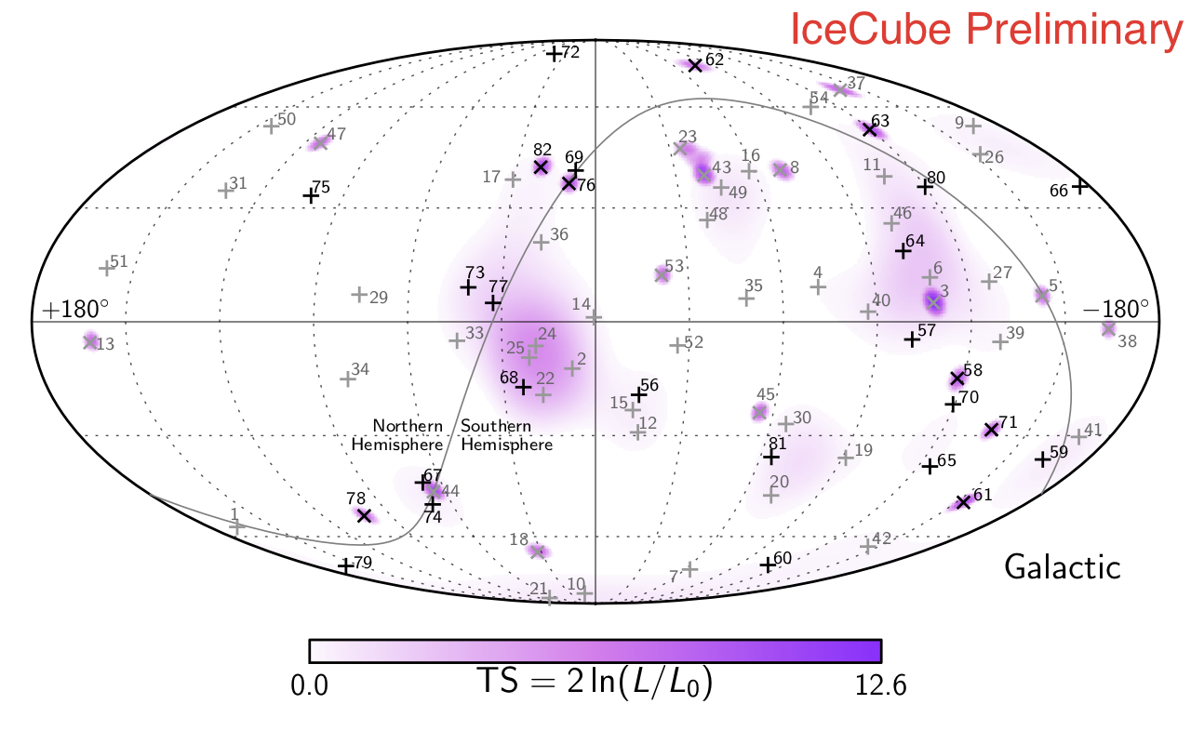
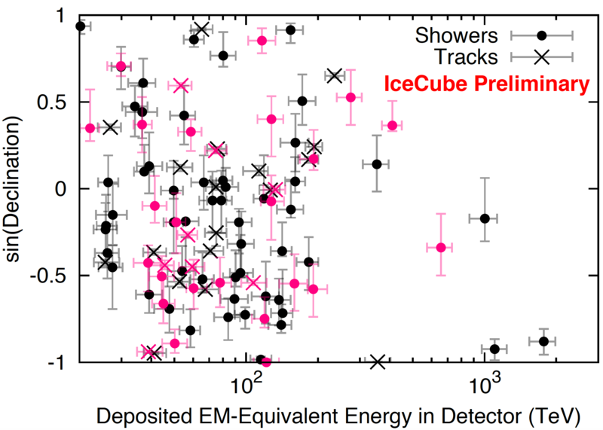
HESE 6-year Results

Slide 15
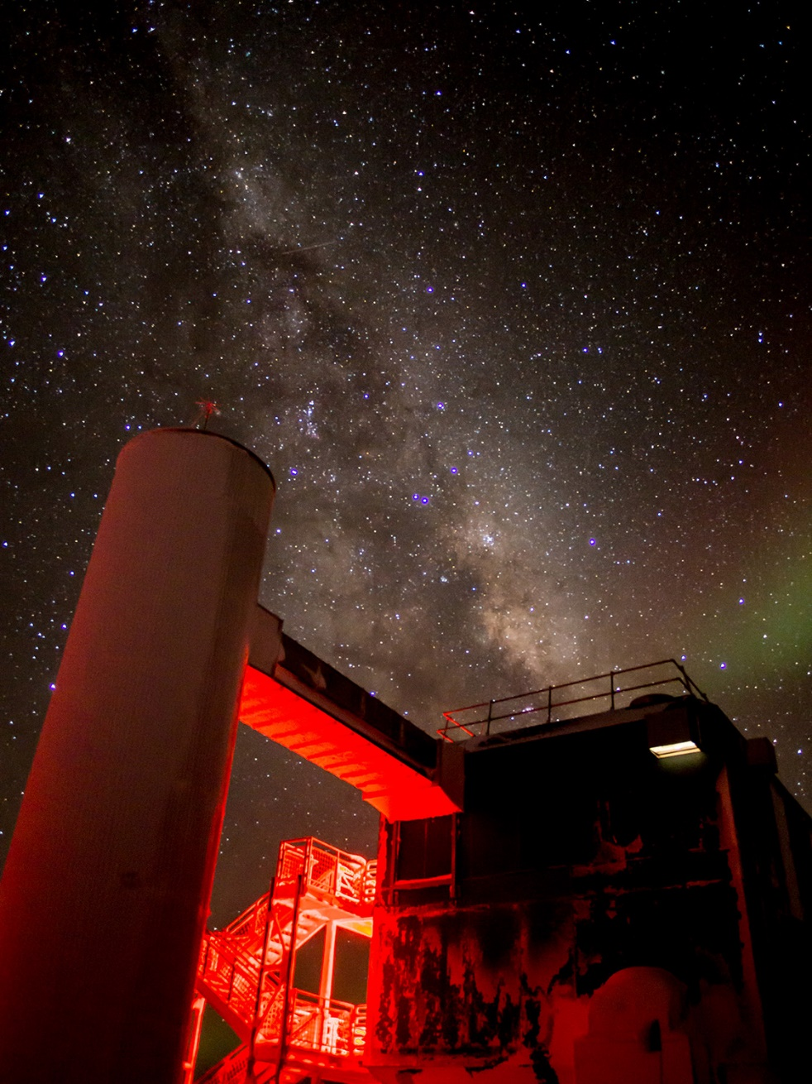
The IceCube Realtime System
IceCube operates largest data center on continent
Digital data packets from sensors sent to surface and processed by software trigger and readout system (IceCube DAQ) – 3 kHz trigger rate (mostly cosmic ray muons from above) yields about 10 MB/sec written to disk with ~ 5 sec latency.
Online compute farm performs event reconstructions.
High significance events sent via Iridium satellite link to Northern Hemisphere where automated GCN alerts sent out.
IceCube has been sending RT alerts several years but high-energy tracks sent only since Spring 2016 – about 10/yr.
On 22 Sept 2017 at 20:54:30.43 UTC alert IC170922 issued
43 seconds elapsed between event in ice and GCN alert dissemination on network.

Slide 16
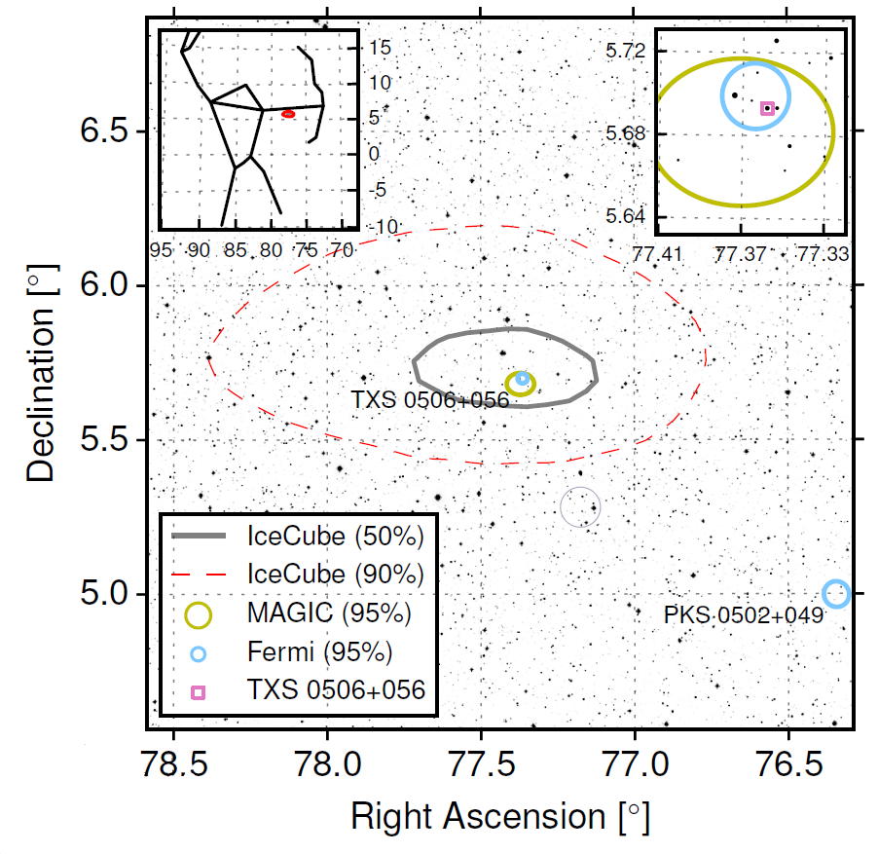
TXS 0506+056
First Observation of Astrophysical Source in EM and Neutrinos
I've seen things you people wouldn't believe. Attack ships on fire off the shoulder of Orion. I watched C-beams glitter in the dark near the Tannhäuser Gate. All those moments will be lost in time, like tears in rain …
-- Roy Batty (Rutger Hauer) Blade Runner (1982)

Slide 17
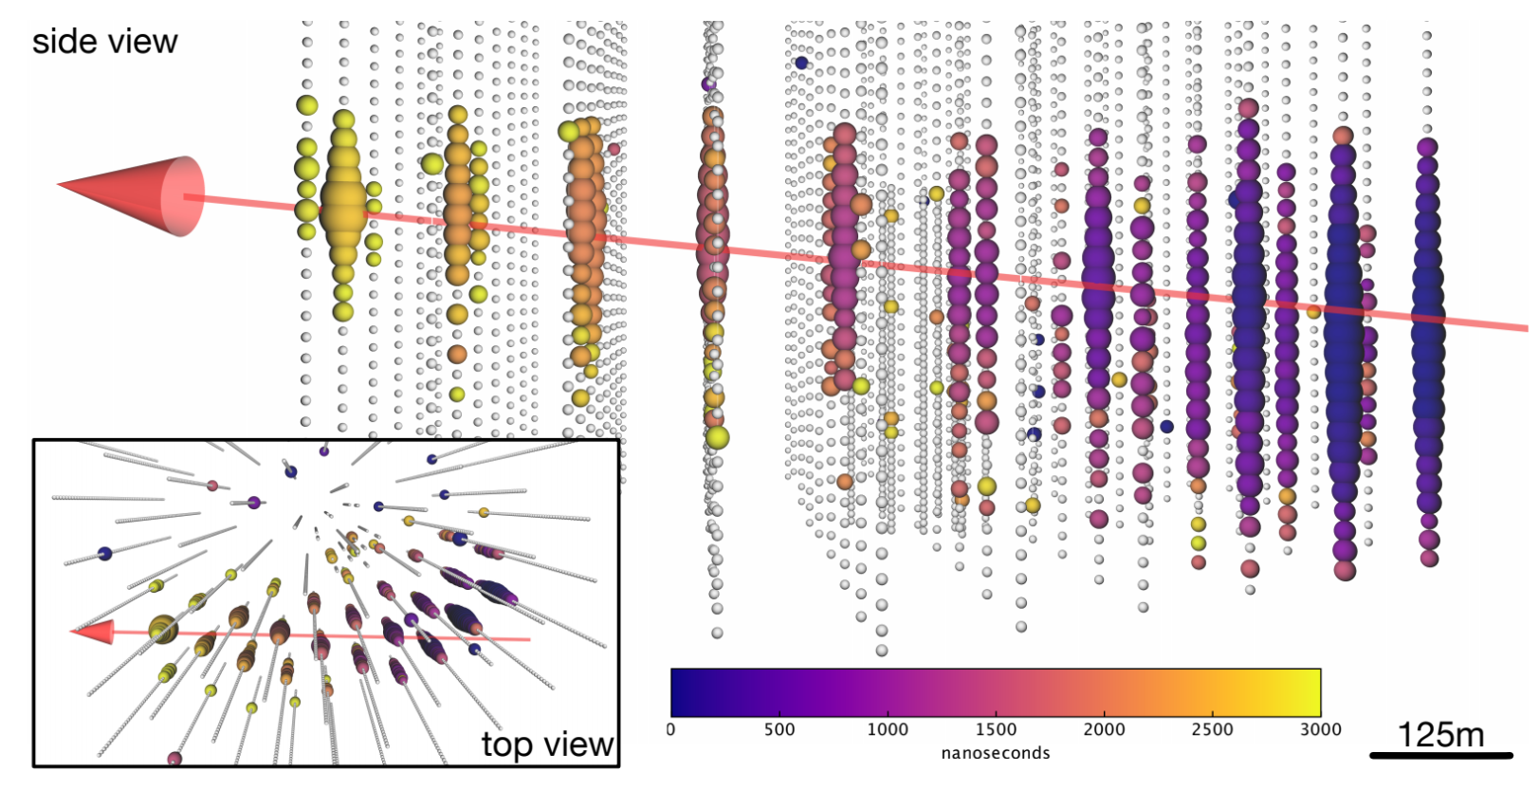
The IceCube HE Muon Event
Event was high energy through-going muon event: ~25 TeV energy deposited in detector with most probable neutrino energy ~ 300 TeV.
Muon track reconstruction to within 0.1° of TXS 0506.

Slide 18
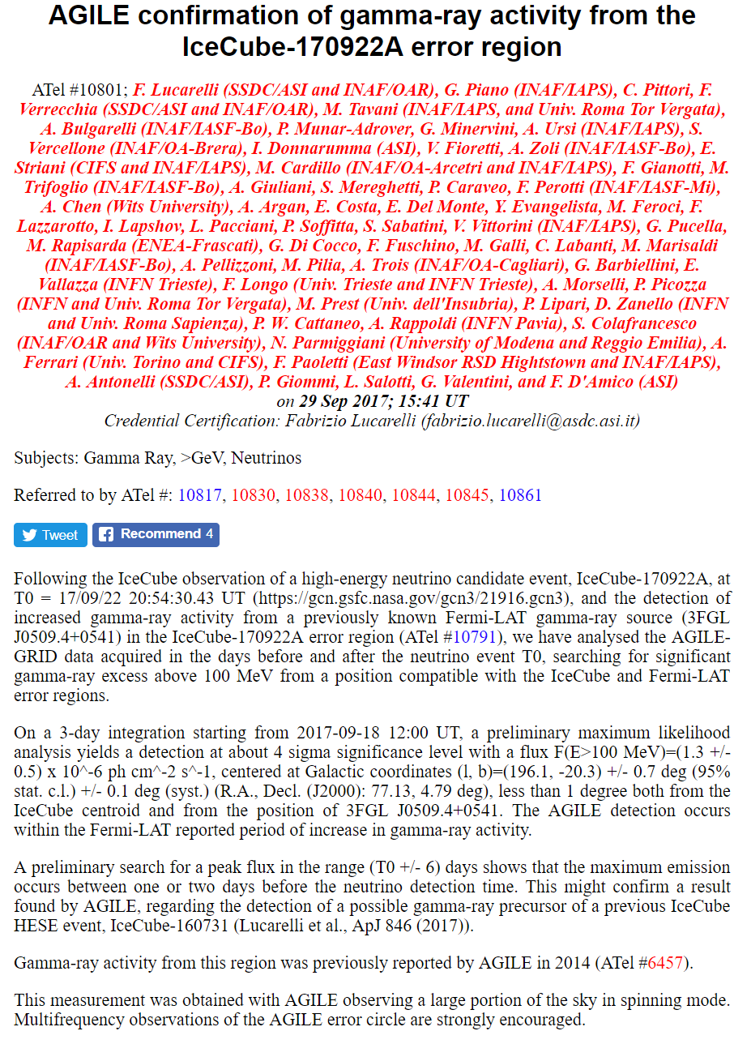
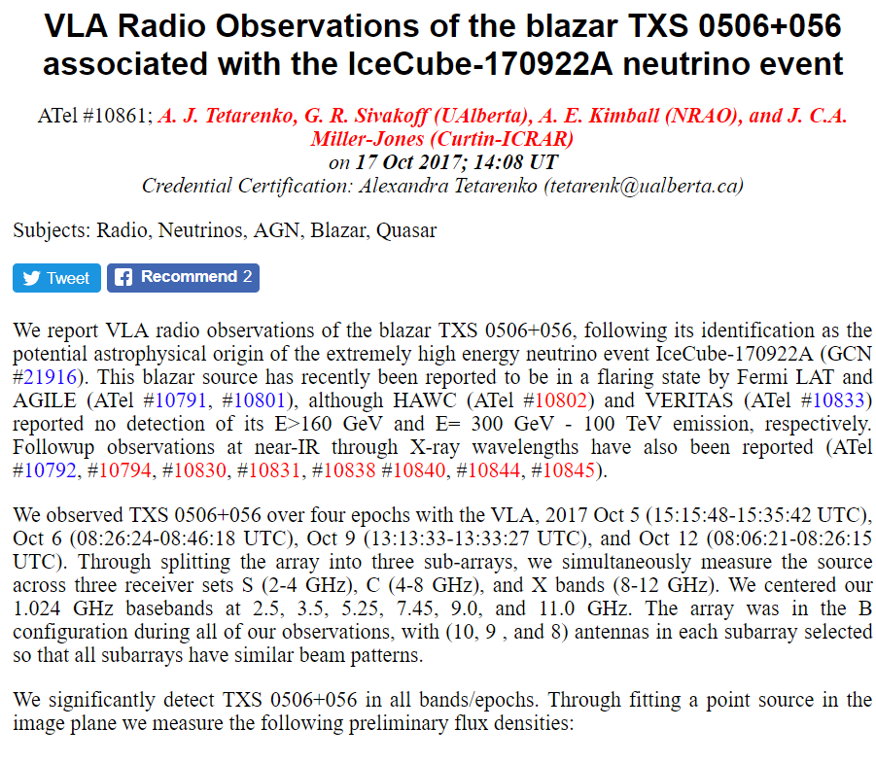
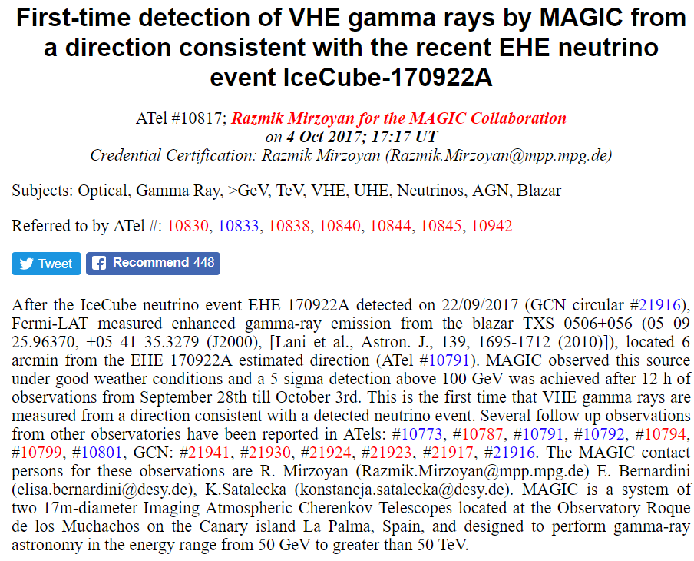
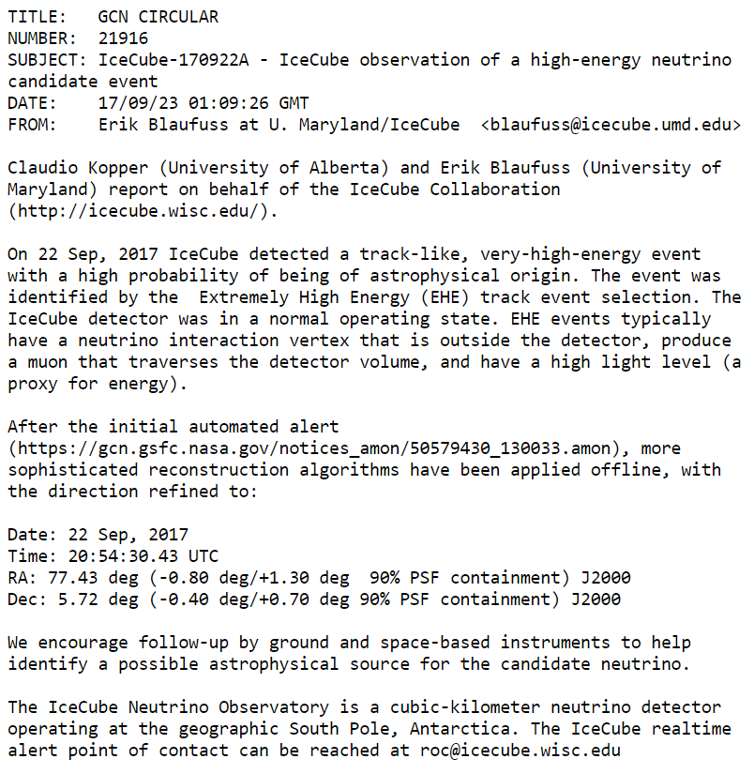
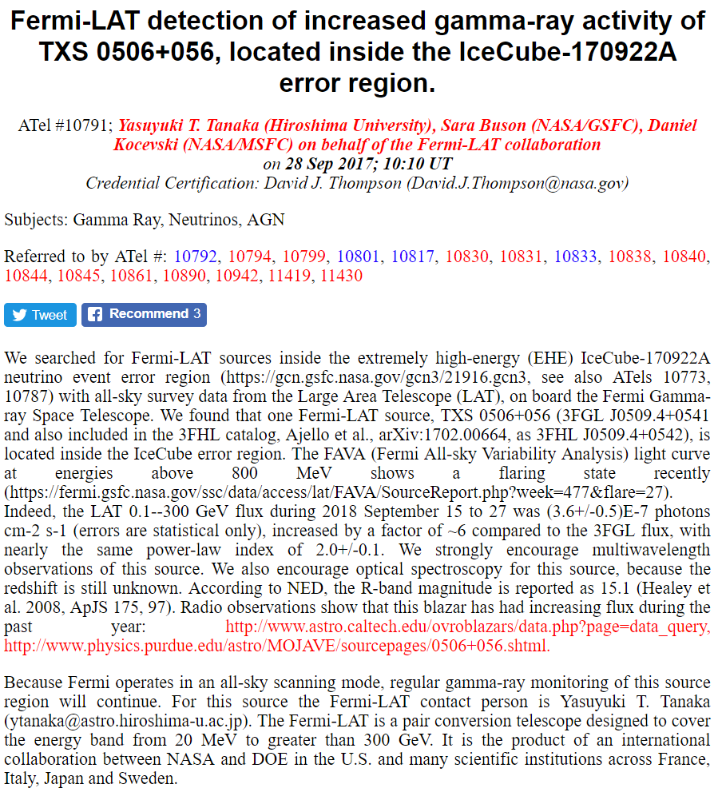
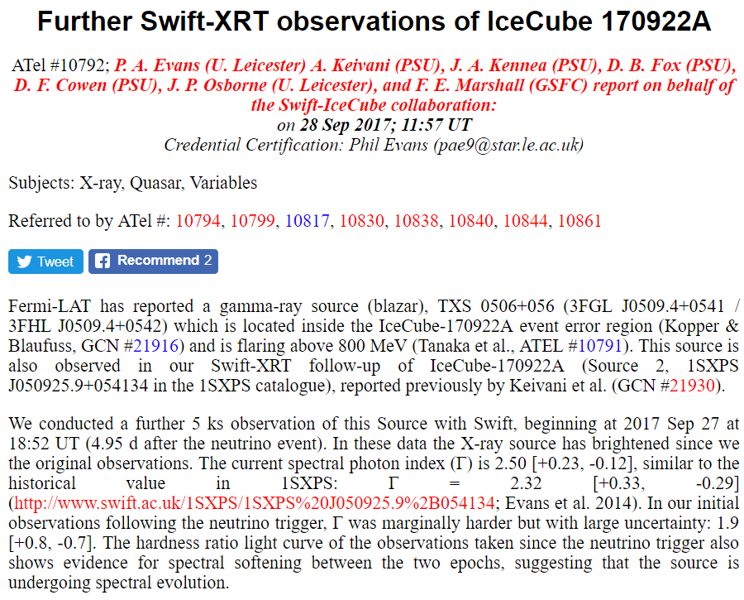
Realtime HE Neutrino Candidate IC170922

Slide 19
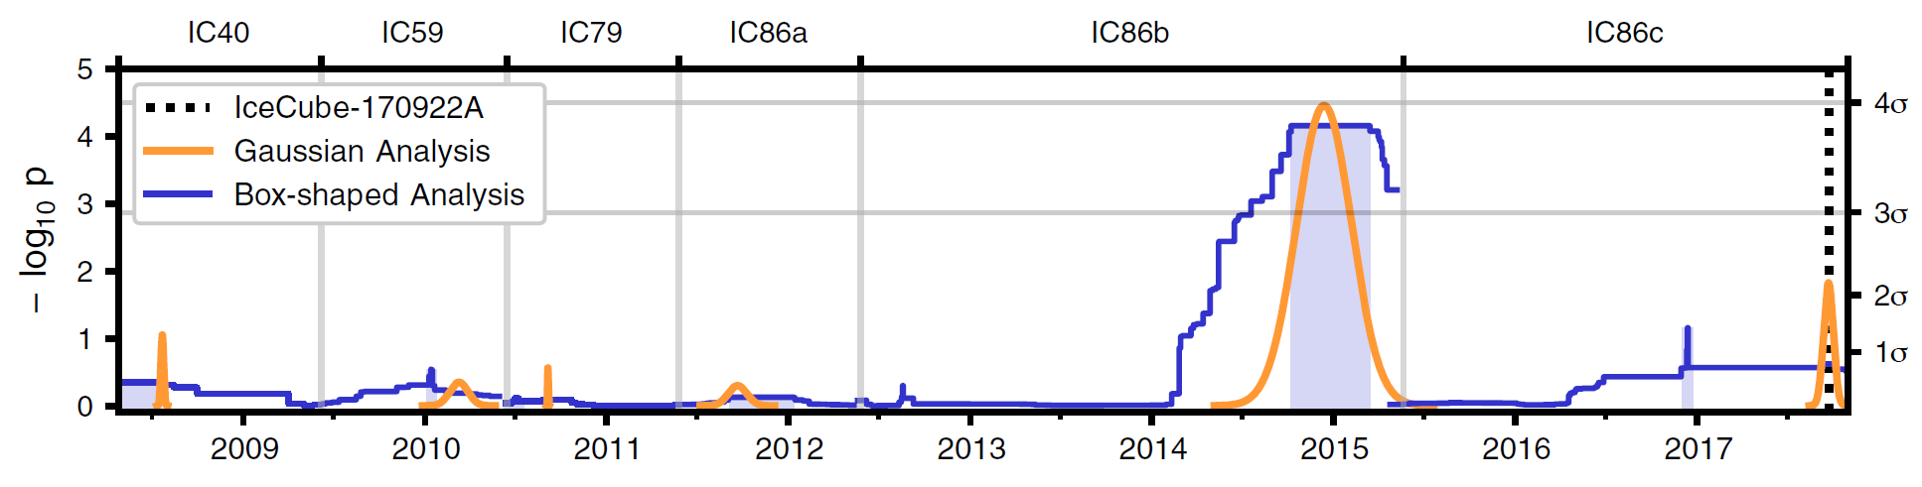
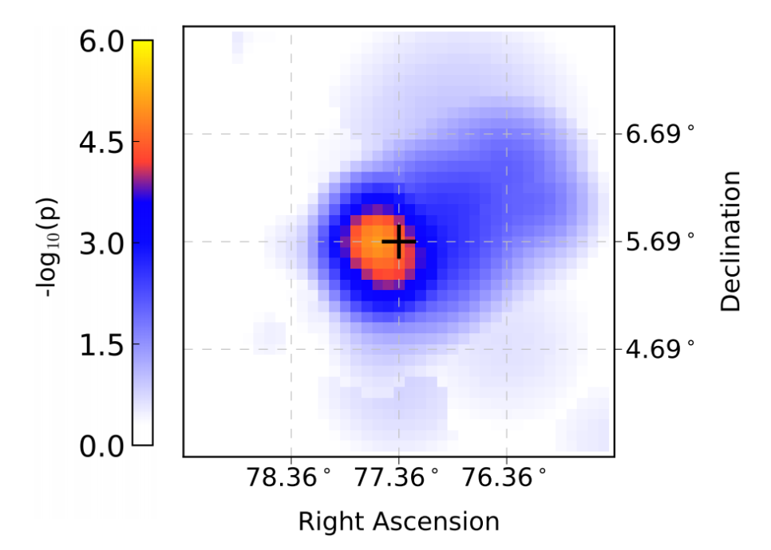
IceCube Archival Search – Neutrino “Flare”
Observations divided into 6 periods of differing run configurations.
One period contains significant excess – 19 events on background of 6.
Gaussian time window centered at 13 Dec 2014 with full width of 110 days.
Spectral index of 2.1.
3.5 σ rejection of background hypothesis.

Slide 20
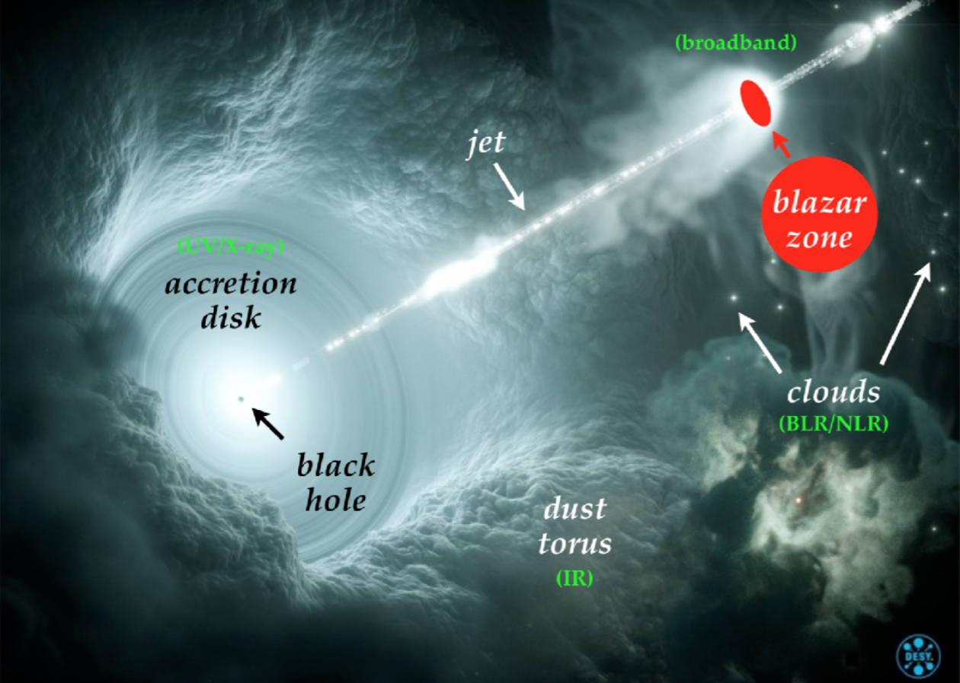
What is TXS 0506 and What Are Implications?
Known source in EM – z = 0.3365 (GTC Oct 2017) giving distance of 4 Glyr
Blazar (AGN with jet pointed at observer)
Radio, optical, x-ray, and gamma all indicate blazar was in flaring state for weeks / months leading up to the Sep 2017 neutrino alert.
Source had never been considered as likely source of detectable neutrino flux – without MMA observations its presence in IceCube skymaps overshadowed by hotter spots on sky.
Among 50 brightest gamma ray sources in Fermi-LAT catalog → one of most luminous objects, 10x more luminous than Markarians.
This result consistent with previous IceCube analysis giving upper limit of 27% contribution of AGNs to HE diffuse neutrino flux.
Discrimination of acceleration models at source, see https://arxiv.org/abs/1807.04537, hybrid lepton/hadron + multi-zone.

Slide 21
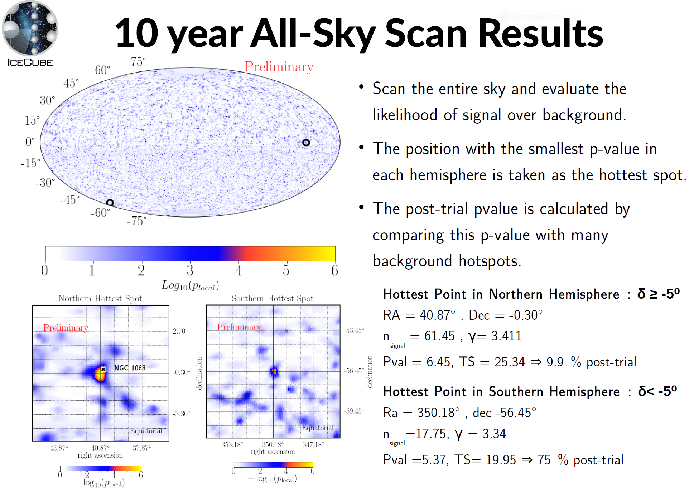
From T. Carver Venice Workshop

Slide 22
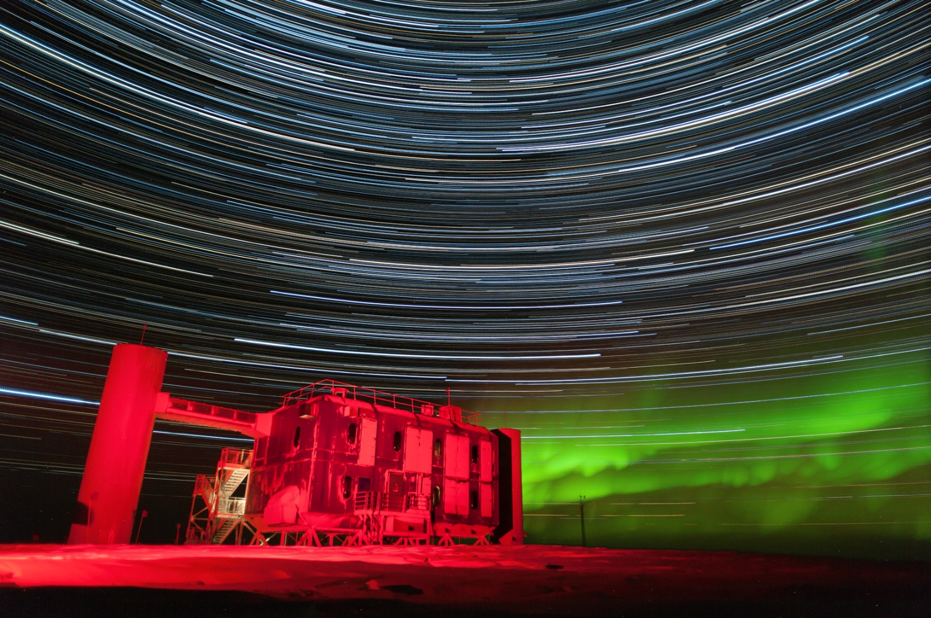
IceCube Gen2 – The Future of Neutrino Astronomy
IceCube Upgrade
High Energy Array
Cosmic Ray Array
Radio Array
IceCube Gen2 White Paper:
arXiv: 1412.5106v2

Slide 23
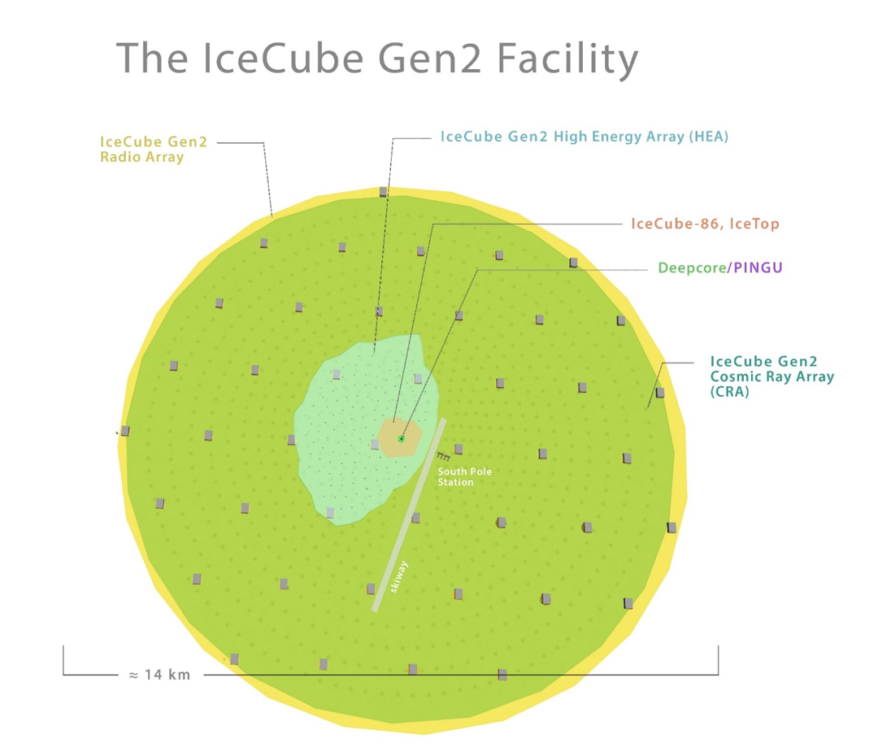
Conceptual Design
A conceptual drawing of the IceCube Gen2 Facility is shown at right. Specific points of design are likely to evolve quite a bit. However salient points are the multiple sub-detectors spanning energy range of ~ GeV to EeV:
  Upgrade: low energy, tau neutrinos, precision calibration of ice;
  High Energy Array (HEA) – 100 TeV+ neutrino detector using optical sensors evolved from IceCube
  Cosmic Ray Array (CRA) – veto array for HEA as well as exploration of cosmic ray physics
  Radio Array (RA) – ARA-like or perhaps much denser array of RF power envelope detectors. Overtakes optical in region 100 PeV+

Slide 24
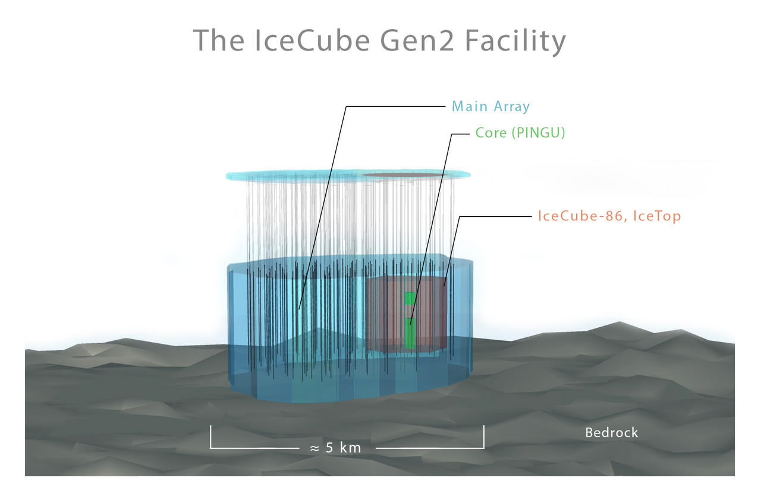

Slide 25

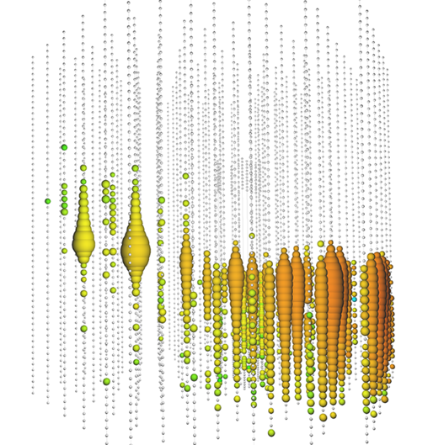
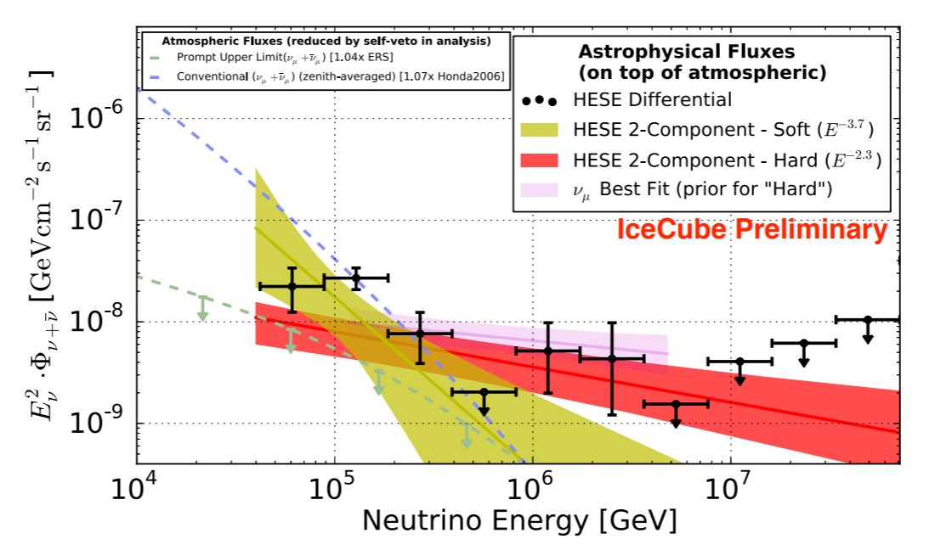
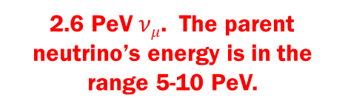
PeV-Scale Neutrinos
2.6 PeV $νμ$. The parent neutrino’s energy is in the range 5-10 PeV.
Region above 100 TeV is sweet spot for neutrino astrophysics:
Background-free region for study of
  Point sources
  Correlation studies
  Energy spectra
Gen2/HEA would deliver O(10) events per year above 1 PeV
At PeV scales new phenomena arise which help disentangle flavors providing information on source physics:
  Tau double bangs – separated – O(1-2) per year in IceCube Gen2/HEA
  Glashow resonance events [arXiv:1108.3163 Battacharya, et al] have pure muon, tau lollipop signatures – discrimination of pp versus pγ at source.
Recent TXS 0506 source → 10x IceCube detect several new blazars (an other source classes or exclude?) per year!

Slide 26
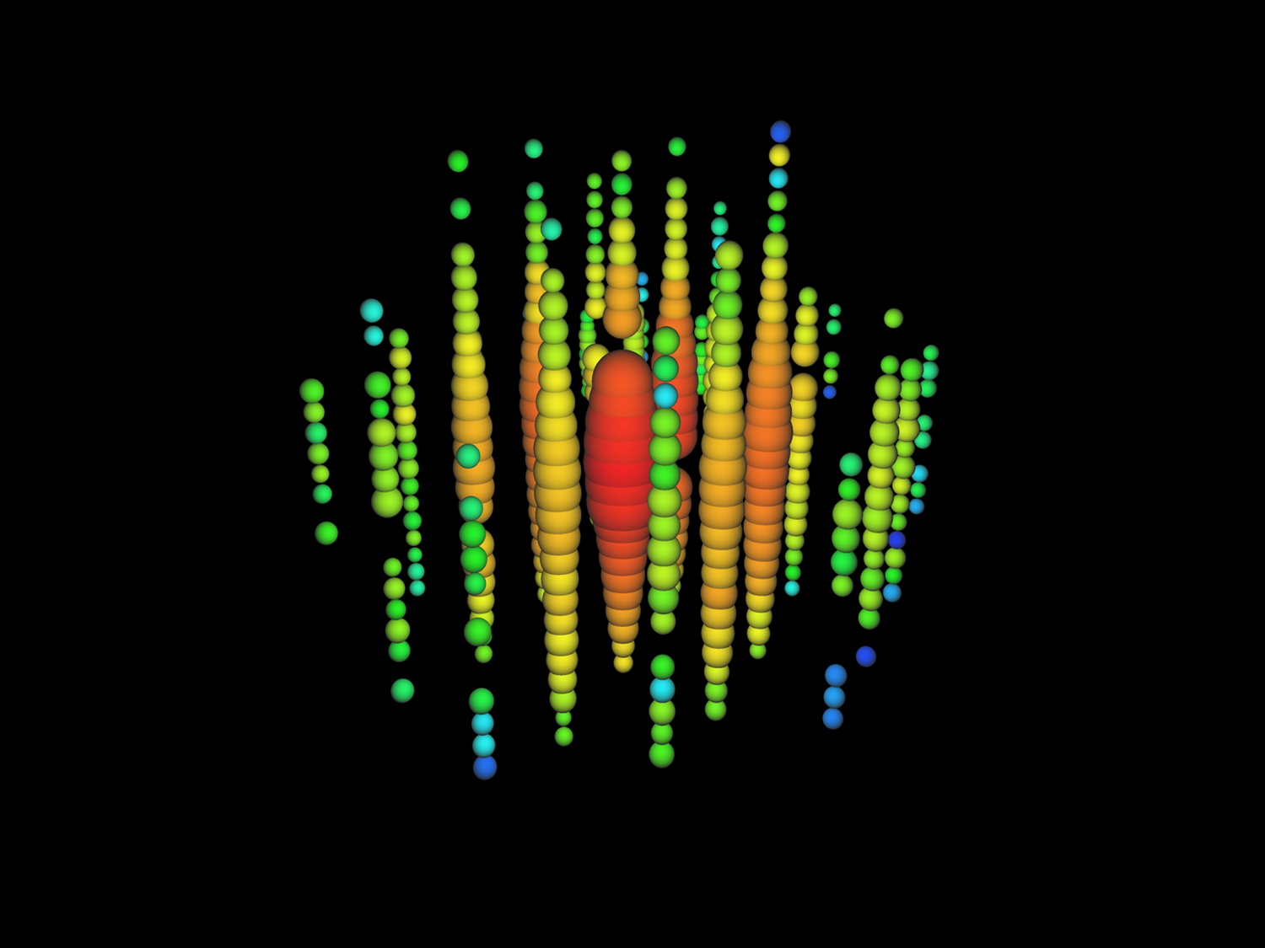
PeV neutrinos don’t need dense detector
Take Bert – one of the two original ~ 1 PeV neutrinos found in IceCube data.
Study reconstruction of this event with real sparse detector: IceCube with strings removed to simulate wider spacing. With 20 strings separated by 250 m
Vertex resolution 12 m
Angular resolution 30°
Energy resolution 10%

Slide 27
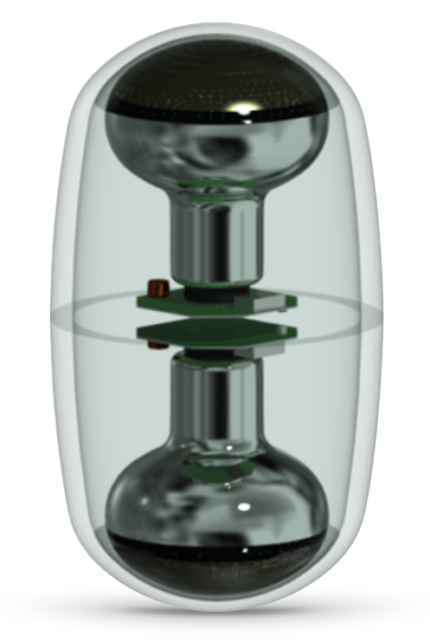
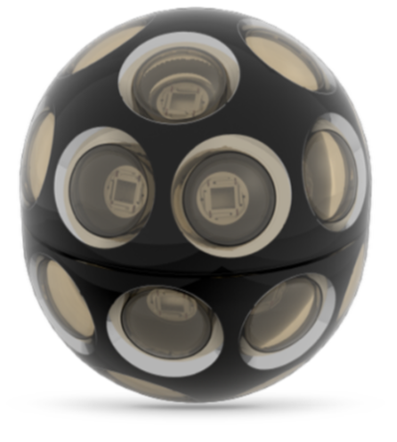
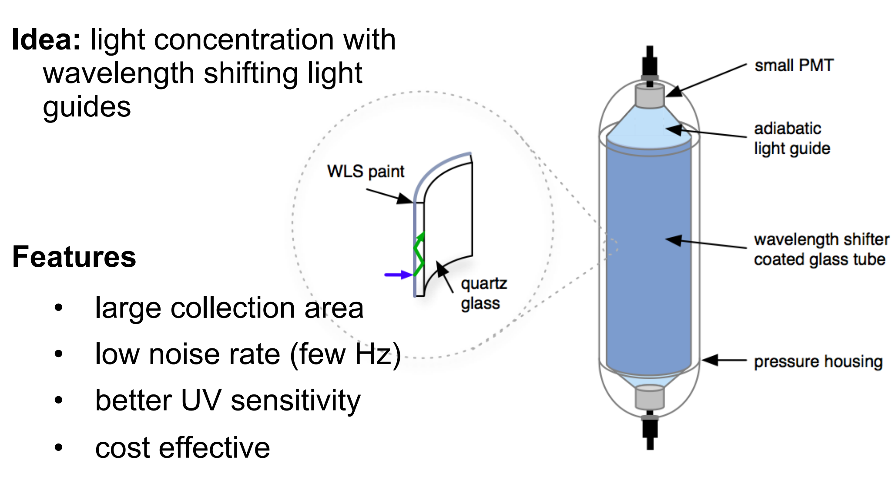
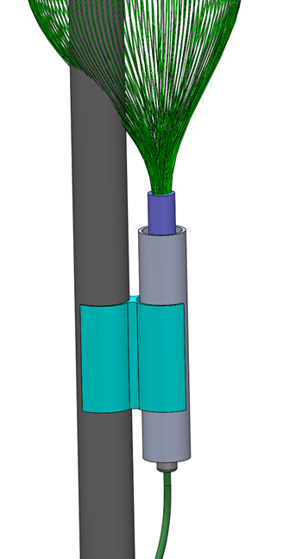
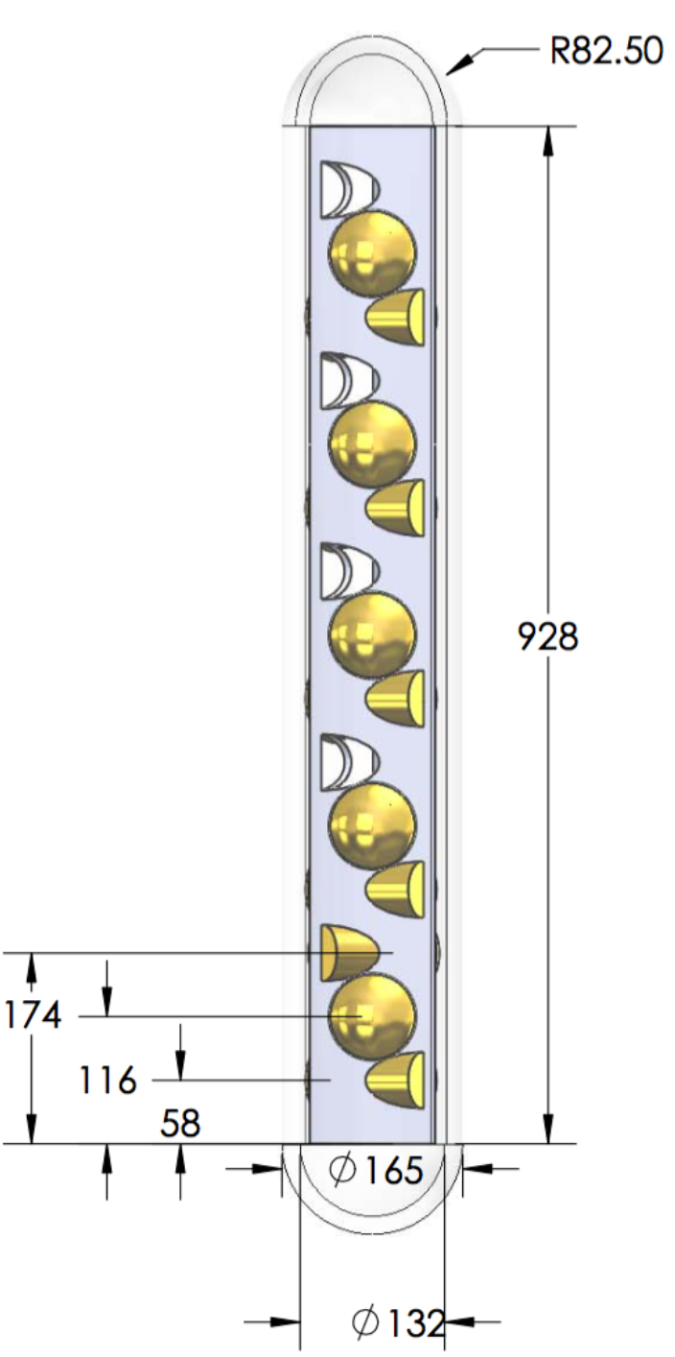
Gen2 Sensor Designs
Name of the game is photon effective collection area:
Several new sensors under consideration for Gen2: D-Egg and mDOM will be utilized in the Phase I Upgrade. Other sensor technologies require more R&D. Profit from availability of drill holes to deploy future instrumentation and retire risk early.

Slide 28
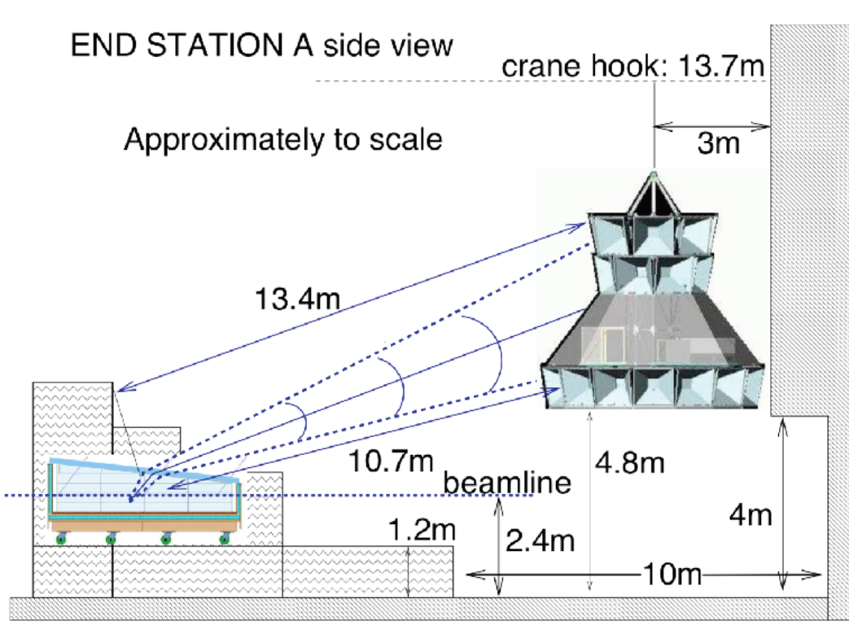
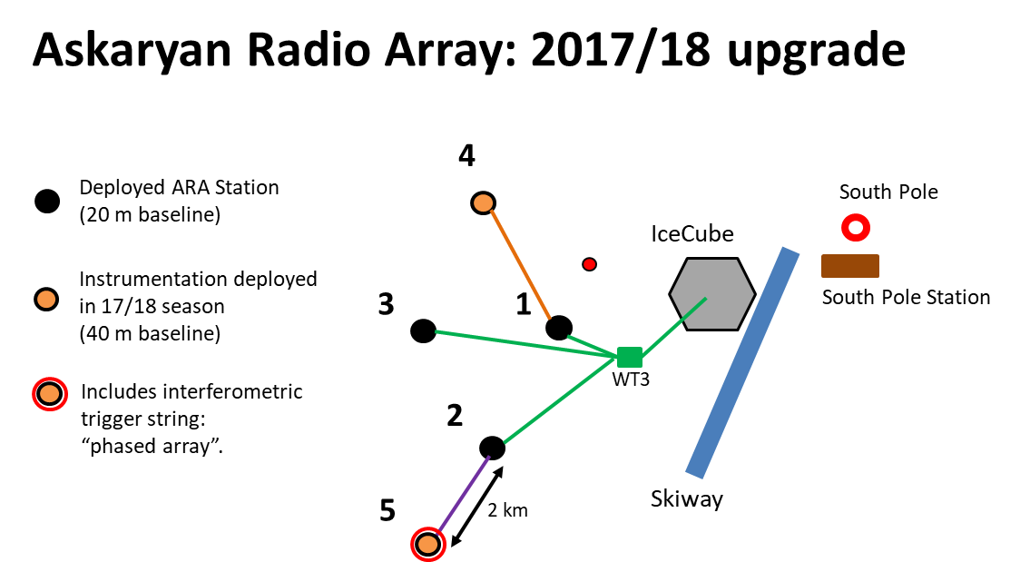
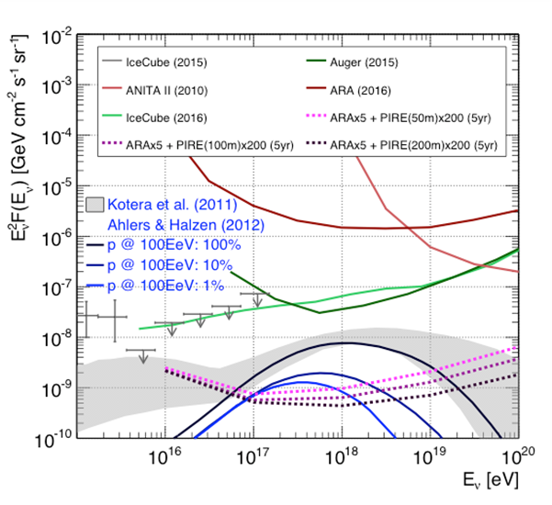
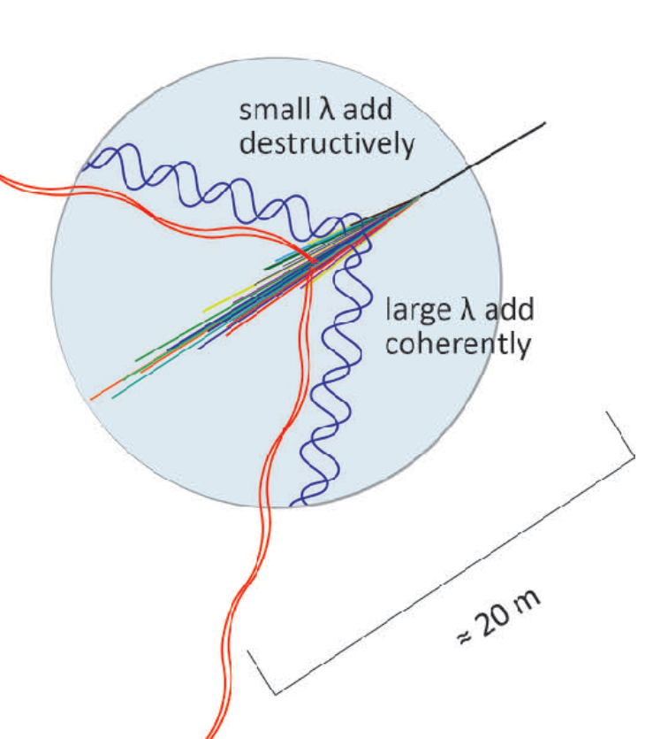
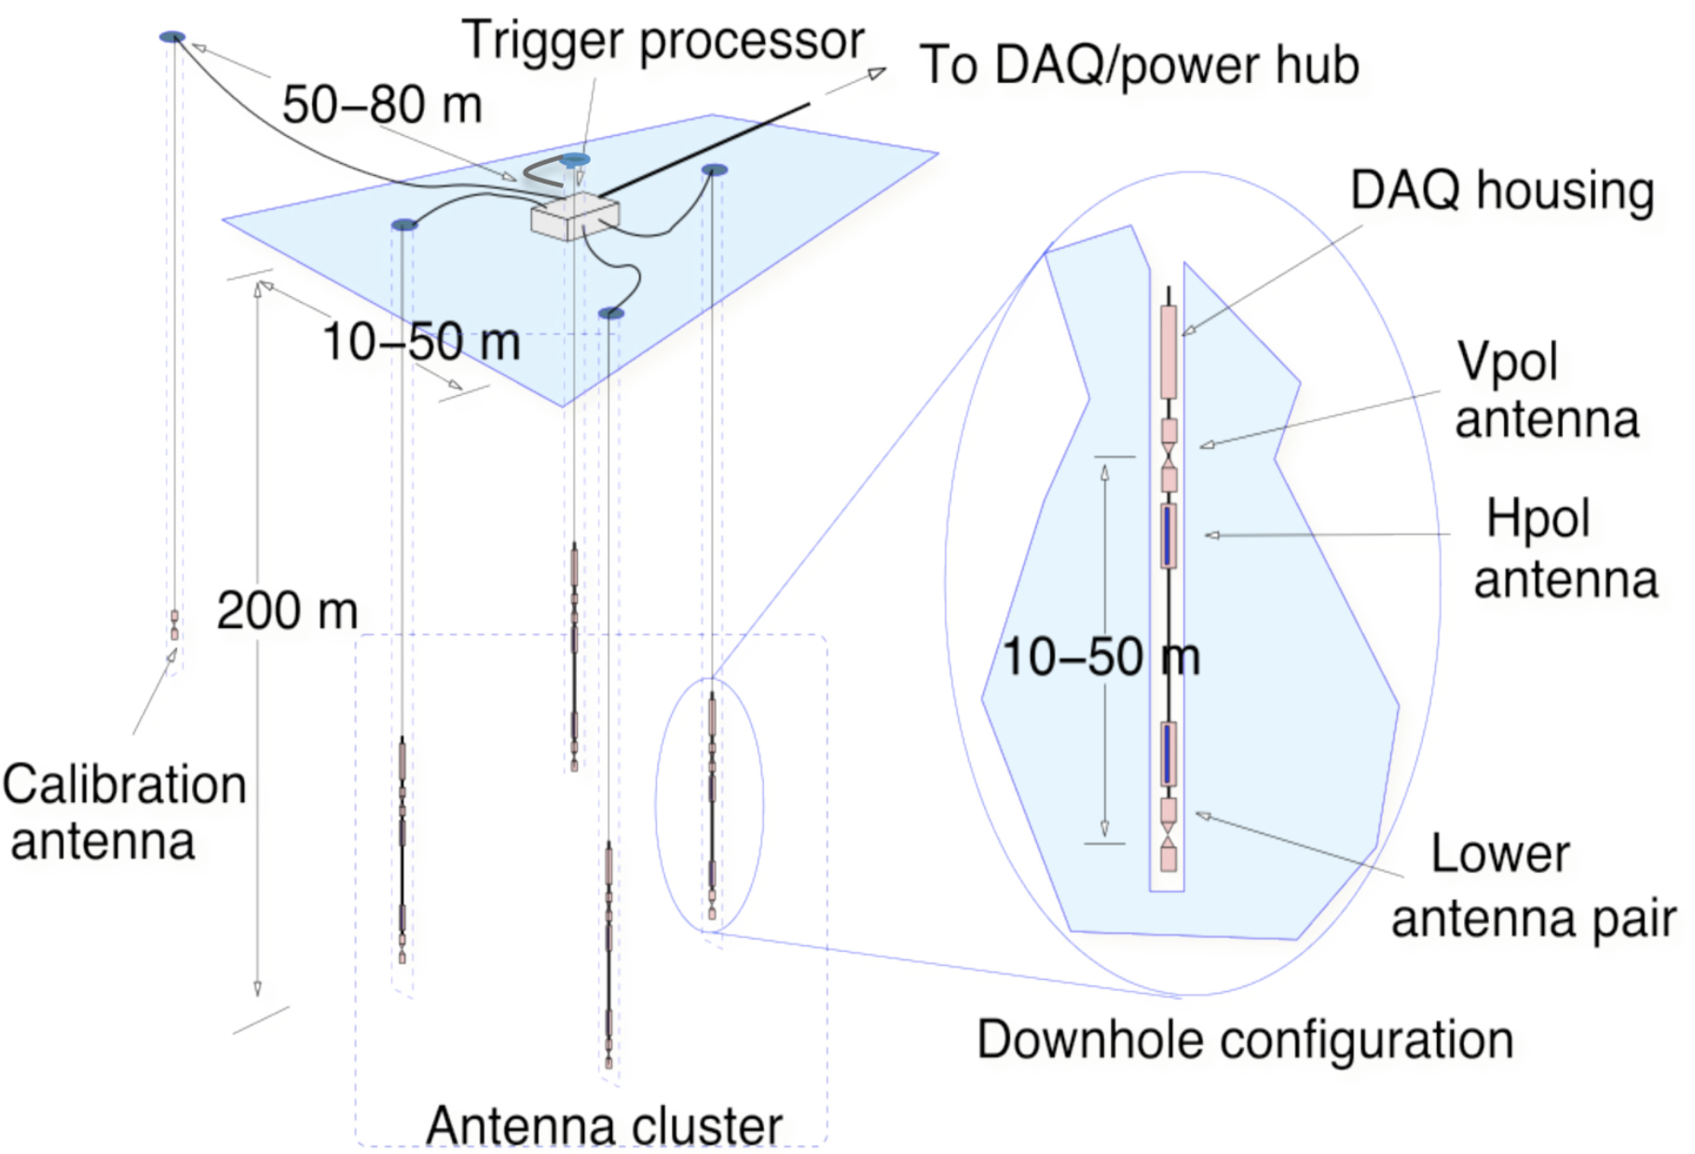
Radio Detection of Neutrinos
Radio technique high threshold – 10’s of PeV – but 10x more cost effective at UHE.

Slide 29
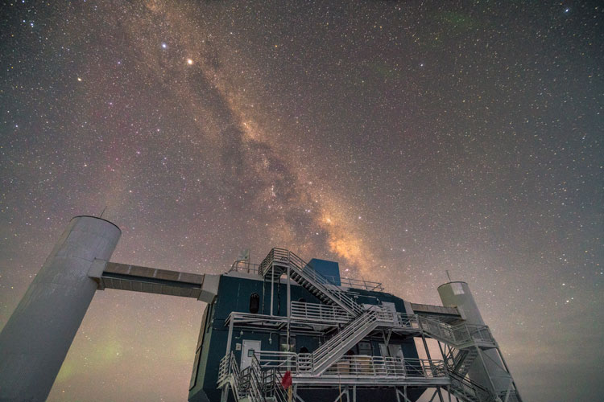
The IceCube Phase I Upgrade

Slide 30
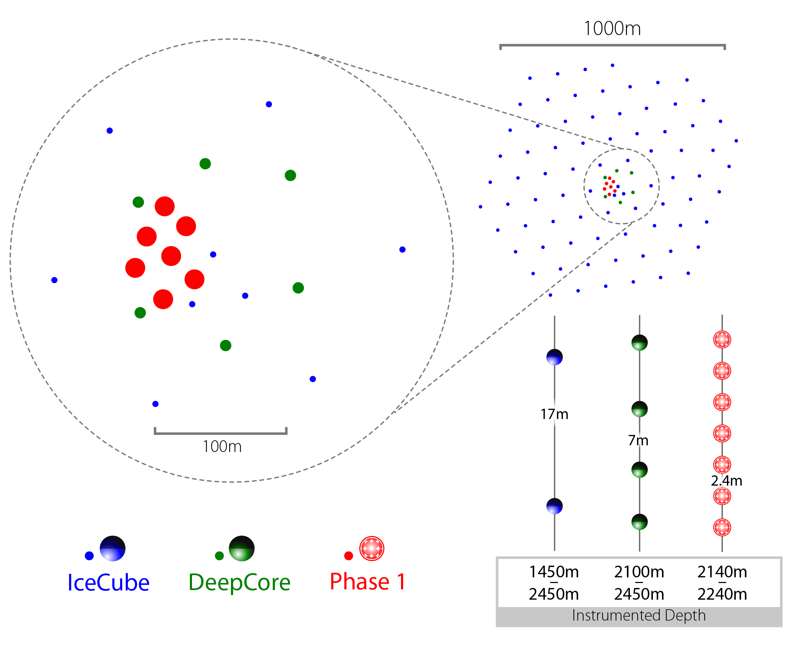

Gen2 Phase 1: First Steps
Science goals:
Probe unitarity of PMNS matrix
Improve calibration and characterization of ice for improved HE multimessenger neutrino astronomy
7 strings (US 3 | JP 2 | DE 2) densely populated with next generation, high performance photodetectors:
Integrates with existing IceCube: data acquisition, event filtering, simulation will require extension;
No significant increase in steady-state operations;
Negligible increase in data rate
+3 kW power (+5% increase relative to IceCube)
Proposed project leverages significant effort already invested by US/Non-US IceCube groups to develop instrumentation and infrastructure for next-generation neutrino detector at South Pole.
Array | String Spacing | Module Spacing | Modules per String
IceCube | 125 m | 17 m | 60
DeepCore | 75 m | 7 m | 60
Phase 1 | 20 m | 2 m | 125

Slide 31
Tau Neutrinos with IceCube DeepCore
Details – see Phys. Rev. D 99, 032007.
Rightmost column of PMNS matrix poorly constrained. Know |U_{e3}|² + |U_{u3}|² is about 0.5 but only know |U_{t3}|² > 0.
Measurement of |U_{t3}|² not 0.5 could mean:
  NSI
  Sterile neutrinos
DC detects approx. 500 events / yr
Taus on event by event level indistinguishable from electron CC, NC interactions → this is a statistical measurement of “cascade-like” events relative to “track-like” events

Slide 32
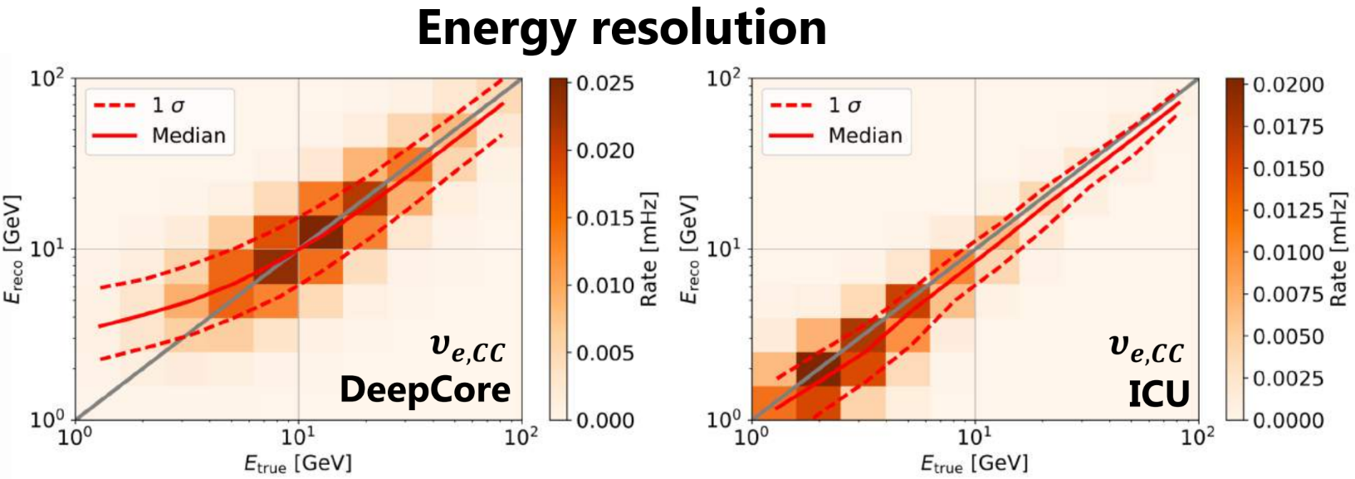
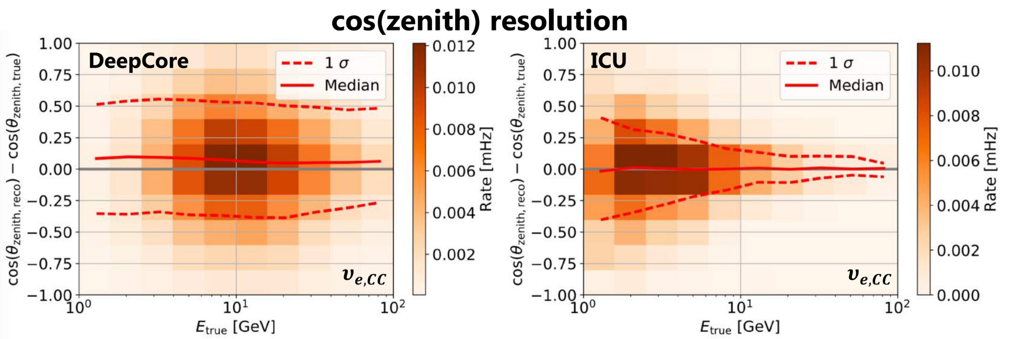
Tau Neutrinos with the IceCube Upgrade
Thanks to T. Stuttard for these and following Monte Carlo simulations of IceCube Upgrade

Slide 33
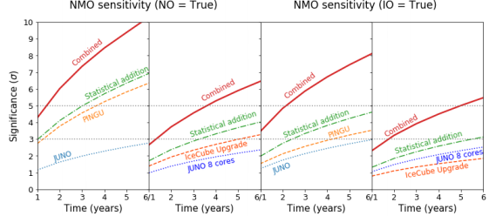
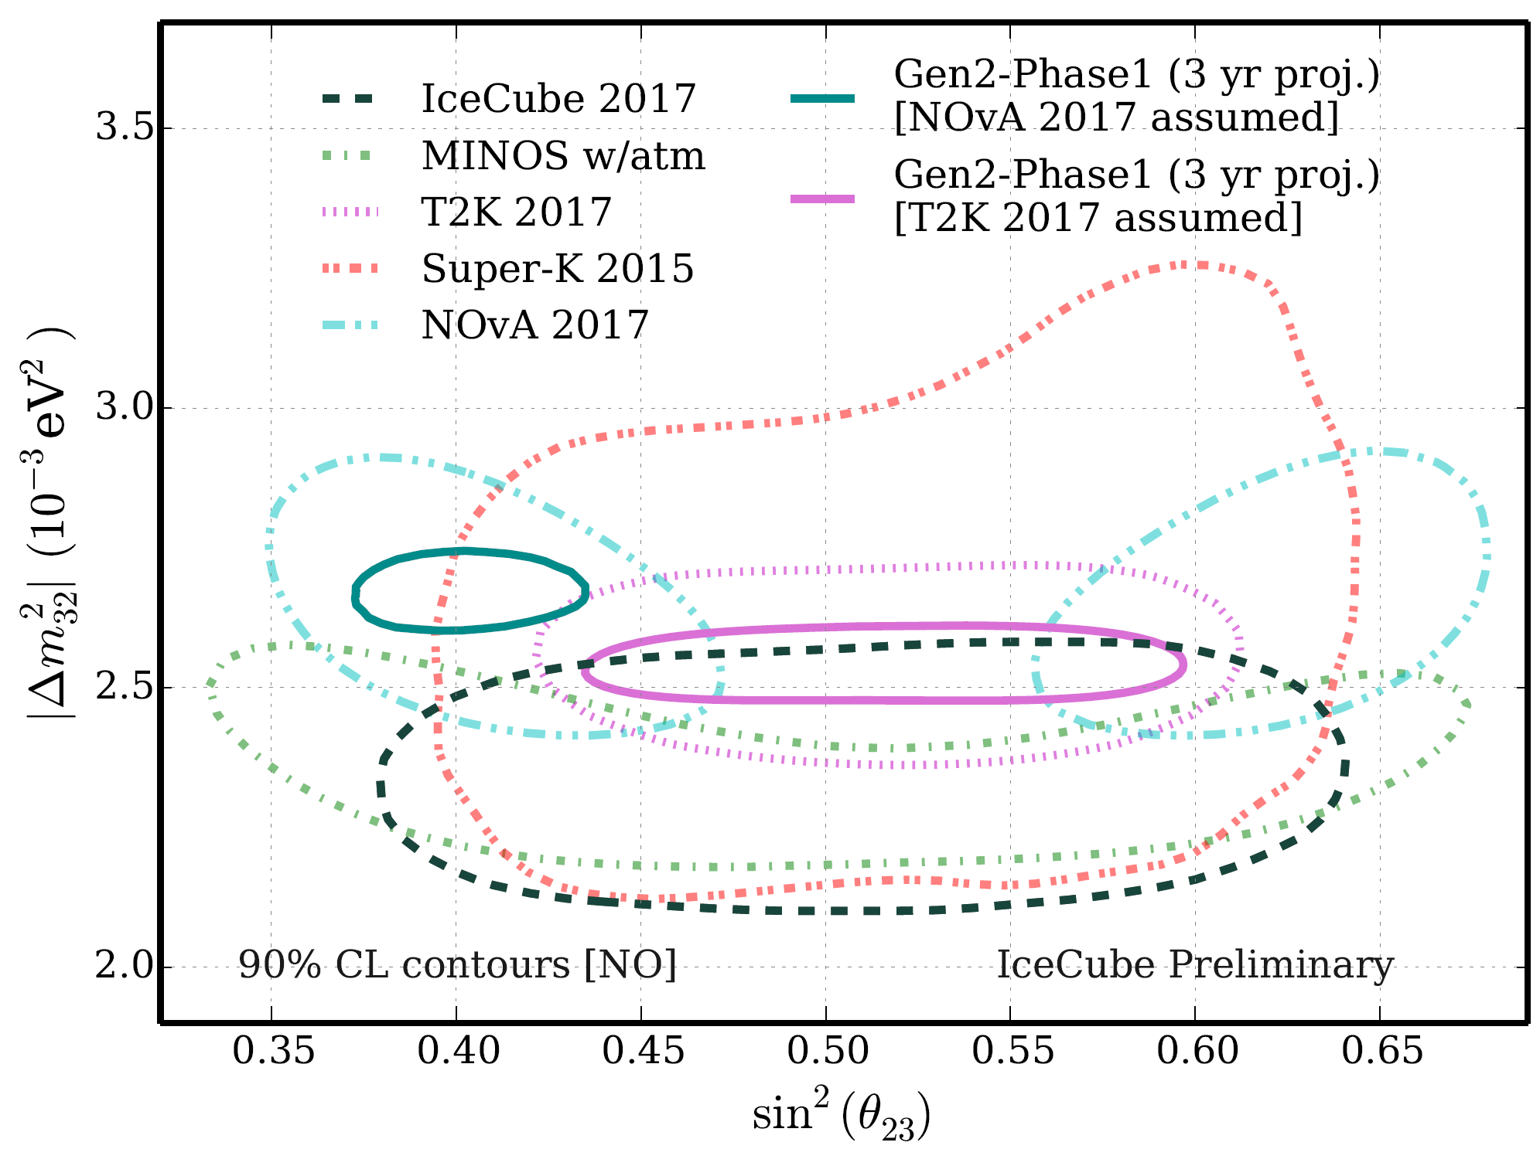


Neutrino Mixing
With only 7 but densely instrumented strings …
Expect 2500 CC+NC tau neutrino events per annum. Statistically measure taus based on energy and angle.
Will exlude no-tau appear w 14 sig after 3 years.
Best constraints on atmospheric mixing parameters (maximal mixing / octant for ATMNU).

Slide 34


Improving IceCube Reconstructions
Lack of precision knowledge of ice limits angular reconstructions – in particular bad at high energy where, contrary to expectation, the reconstruction gets worse. Cascade reconstruction (right) at PeV has median ang. res of 15° but would be improved to 3-5° with better ice characterization. This applies to muon reconstructions as well with improvements to 0.1 - 0.2 ° foreseen.
Obvious benefit to MMA is improved source localization: HESE-160427a, a 140 TeV track coincident with Pan-STARRS SN PS16cgx.
Improved flavor ID for tau neutrinos to better constrain source physics. This is currently limited by ice anisotropy uncertainty: tau double-pulse harder than PeV double bang.
Improved calibrations are retroactively applicable to 10+ years IceCube archival data!

Slide 35
Timeline
IceCube Upgrade Proposal (nee Phase 1 Upgrade) submitted 2016 receives excellent reviews. Submitted to NSF mid-scale program.
NSF FY19 budget request includes allocation for “Big Ideas” which include multi-messenger astronomy ($30 million) and mid-scale infrastructure ($60 million).
Gen2 scale, O(300) million USD must be MREFC project ➔ multiple years in design phases.
Time | IceCube Upgrade Milestone
2019Q1 | Preliminary Design Review; drill recon season @ Pole
2019 | Preparation for final design; long lead procurement
2020Q1 | Final Design Review
20/21 Pole Season | Drill generators ship to Pole; refurb drill structures @ Pole
21/22 Pole Season | Firn drilling; drill IV&T
22/23 Pole Season | Deploy 7 strings
Time | Gen2 Milestone
2020 | Concept Design Review
2021 | Preliminary Design Review
2022 | Final Design Review; begin production
2025-2031 | Deployment 120 HEA deep ice strings

Slide 36
Conclusions
Neutrinos are going to play a key role in MMA from now and through the 2020’s. They allow us to reach into the ultrahigh-energy sky and peer deep into exotic high energy phenomena. TXS 0506 first source identified in neutrinos and EM.
Need next generation instrument to study source physics at TXS and to identify other neutrino souces - but this is still a long way off. New Gen2 facility not likely to be fully operational until ~ 2030.
In the short term, with a modest investment, we can improve our knowledge of the ice and get better multimessenger astronomy from IceCube going forward and going backwards too with Phase I Upgrade.

Slide 37

THE END

Slide 38

Classical Astronomy - The Visible Sky

Slide 39

The Sky In Gamma Rays

Slide 40
The Photon Sky at Ultrahigh Energies
No – this is not me forgetting to add the slide content. Above several hundred trillion eV, photons don’t travel more than galactic distances.

Slide 41

M87 – A Nearby Natural Particle Accelerator

Slide 42


Hot Water Drilling
5 MW Drill power plant gives 195°F hot water in closed loop system.
5500 gallons AN-8 jet fuel / hole
30 man crew
30 h drilling – 3 day cycle time
“Hole lifetime” – 24hr
DOM installation – 8 hr
Typical freezeback times > weeks
DOMs not operated in liquid under normal circumstances.
Drilling improved over time. The first 2004-2005 hole took weeks to drill. A few years later the drill crew was able to get the time down to 50 h. By the end – 30 h was achieved with repeatable performance.

Slide 43
Scattered Cherenkov Photon Tracks in Ice: A HE Muon

Slide 44
Photons from an electromagnetic cascade

Slide 45


Slide 46

“Multimessenger observations of a flaring blazar coincident with high-energy neutrino IceCube-170922A,” The IceCube, Fermi-LAT, MAGIC, AGILE, ASAS-SN, HAWC, H.E.S.S, INTEGRAL, Kanata, Kiso, Kapteyn, Liverpool telescope, Subaru, Swift/NuSTAR, VERITAS, and VLA/17B-403 teams, Science 361, eaat1378 (2018).
“Neutrino emission from the direction of the blazar TXS 0506+056 prior to the IceCube-170922A alert,” IceCube Collaboration: M.G. Aartsen et al. Science 361, 147-151 (2018).
“The blazar TXS 0506+056 associated with a high-energy neutrino: insights into extragalactic jets and cosmic ray acceleration,” The MAGIC Collaboration: M. L. Ahnen et al, Accepted for publication in The Astrophysical Journal Letters.
“Dissecting the region around IceCube-170922A: the blazar TXS 0506+056 as the first cosmic neutrino source,” P. Padovani, P. Giommi, E. Resconi, T. Glauch, B. Arsioli, N. Sahakyan, and M. Huber, Accepted for publication in Monthly Notices of the Royal Astronomical Society.
“VERITAS Observations of the BL Lac Object TXS 0506+056,” VERITAS Collaboration: Abeysekara et al. The Astrophysical Journal Letters (2018).
“A Multimessenger Picture of the Flaring Blazar TXS 0506+056: Implications for High-Energy Neutrino Emission and Cosmic Ray Acceleration,” A. Keivani, K. Murase, M. Petropoulou, D. B. Fox, S. B. Cenko, S. Chaty, A. Coleiro, J. J. DeLaunay, S. Dimitrakoudis, P. A. Evans, J. A. Kennea, F. E. Marshall, A. Mastichiadis, J. P. Osborne, M. Santander, A. Tohuvavohu, and C. F. Turley, Submitted to The Astrophysical Journal.
“Search for neutrinos from TXS 0506+056 with the ANTARES telescope,” ANTARES Collaboration: A. Albert et al, Submitted to The Astrophysical Journal Letters.
See https://icecube.wisc.edu/pubs/neutrino_blazar for up-to-date information

Slide 47

Multi-messenger Follow-Up Observations

