Slide 1
Insight-HXMT observations of
black holes, neutron stars & γ-ray bursts
Shuang-Nan Zhang (张双南)
on behalf of the Insight-HXMT team
Institute of High Energy Physics
Chinese Academy of Sciences

Slide 2
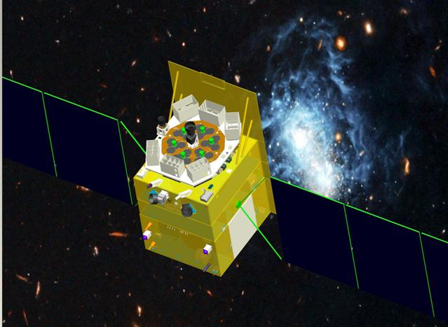
Hard X-ray Modulation Telescope (HXMT) satellite
  China’s 1st X-ray astronomy satellite
  Selected in 2011
  Total weight ~2500 kg
  Cir. Orbit 550 km, incl. 43°
  Pointed, scanning and GRB modes
  Designed lifetime 4 yrs
  Launched on June 15th, 2017
  Dubbed “Insight”
Notes:
相关计划表加入到PPT中
2

Slide 3
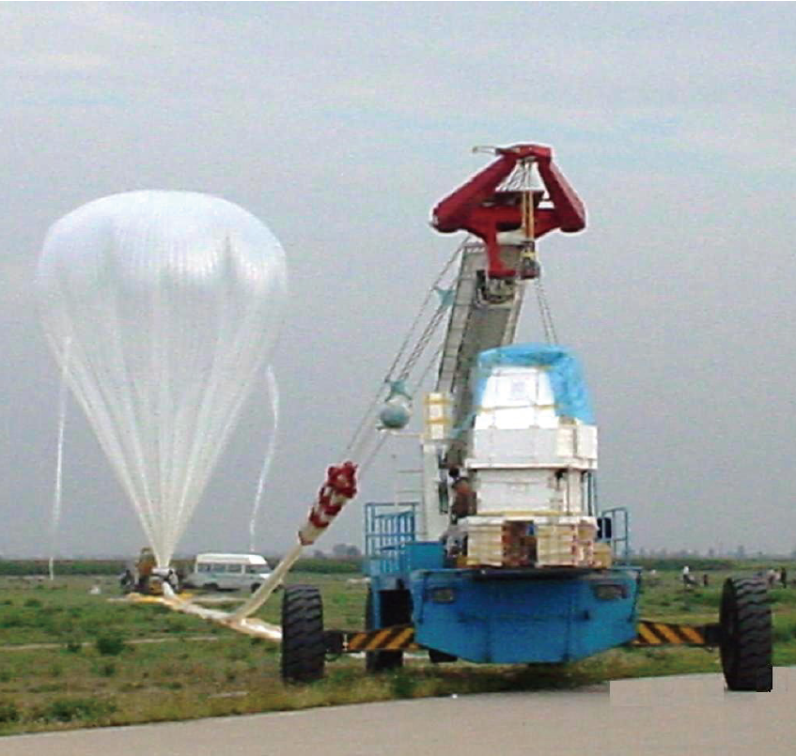
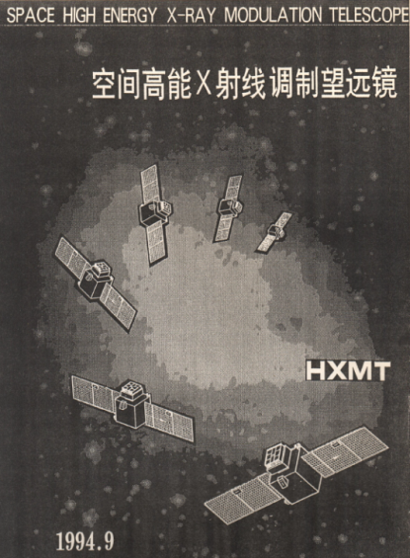
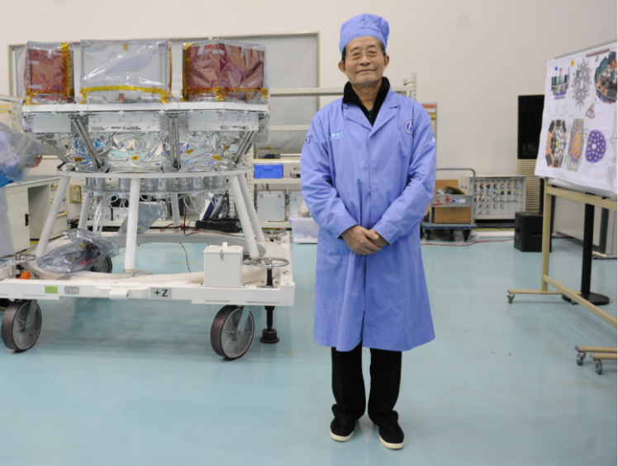

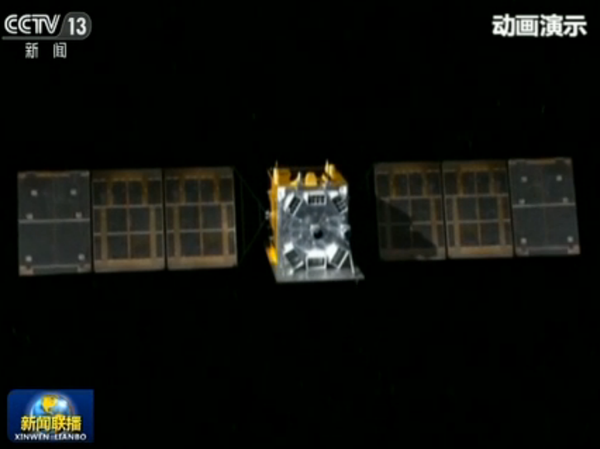
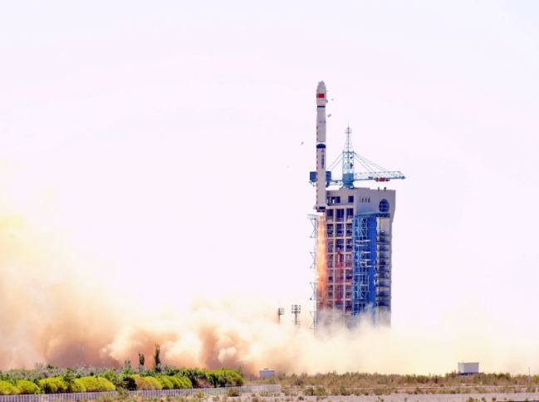
History of 慧眼Insight-HXMT
1970-80s balloon flight
1994 first proposal, 2011 funded
李惕碚院士Prof. Ti-Pei Li
In honor of
何泽慧 Ho Zah-wei (1914-2011)
“慧眼” Insight
2017.6.15 Launched in Jiuquan, China

Slide 4
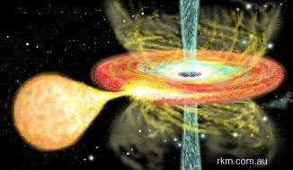
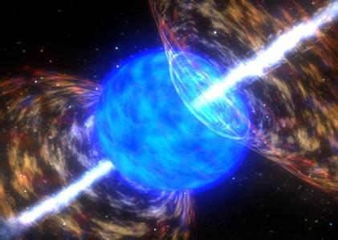
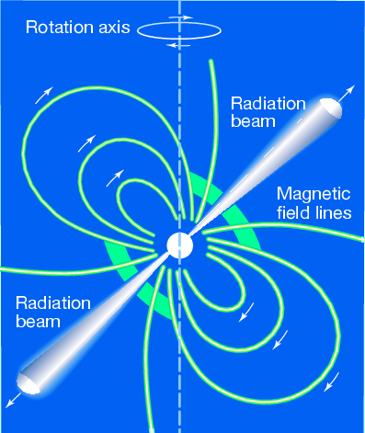
Core sciences
Galactic plane scan and monitor survey for more weak & short transient sources in very wide energy band (1-250 keV)
Pointed observations: High statistics study of bright sources and Long-term high cadence monitoring of XRB outbursts
Multi-wavelength Observations with other telescopes
All sky monitor for GRBs & pulsars (0.2 – 3 MeV)

Slide 5
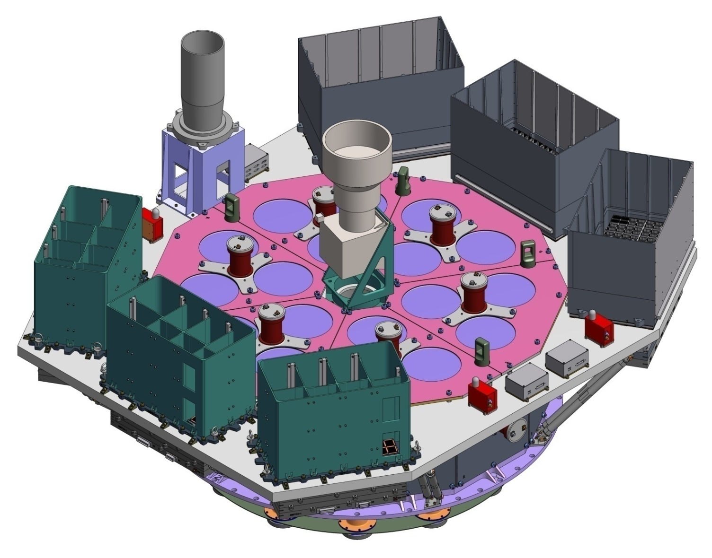
Science payloads
ME:Si-PIN,5-30 keV, 952 cm²
Star tracker
LE:SCD,1-15 keV, 384 cm²
HE: NaI/CsI, 20-250 keV, 5000 cm²
Notes:
China’s first X-ray astronomy satellite
already launched in this June
Three main payloads
Non-imaging instrument; use collimators to confine FoV
Scanning mode and pointing mode

Slide 6
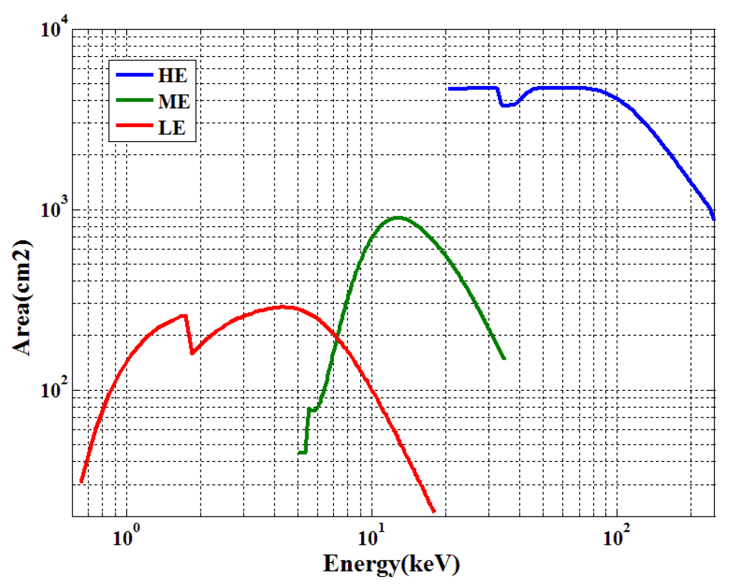
Effective area

Slide 7
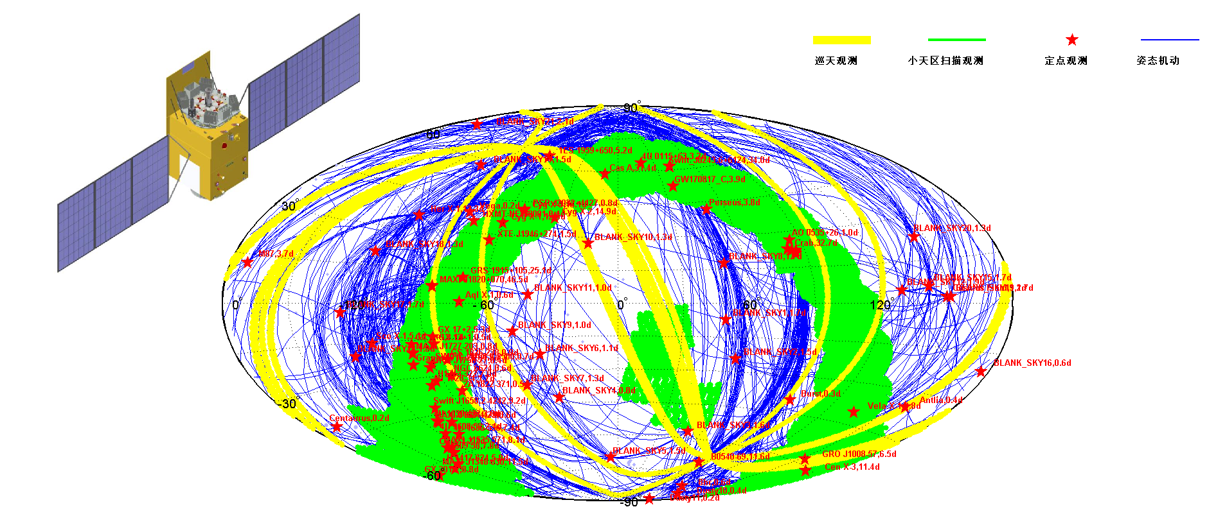
Red stars: pointed observation
Green regions: small area scan

Slide 8
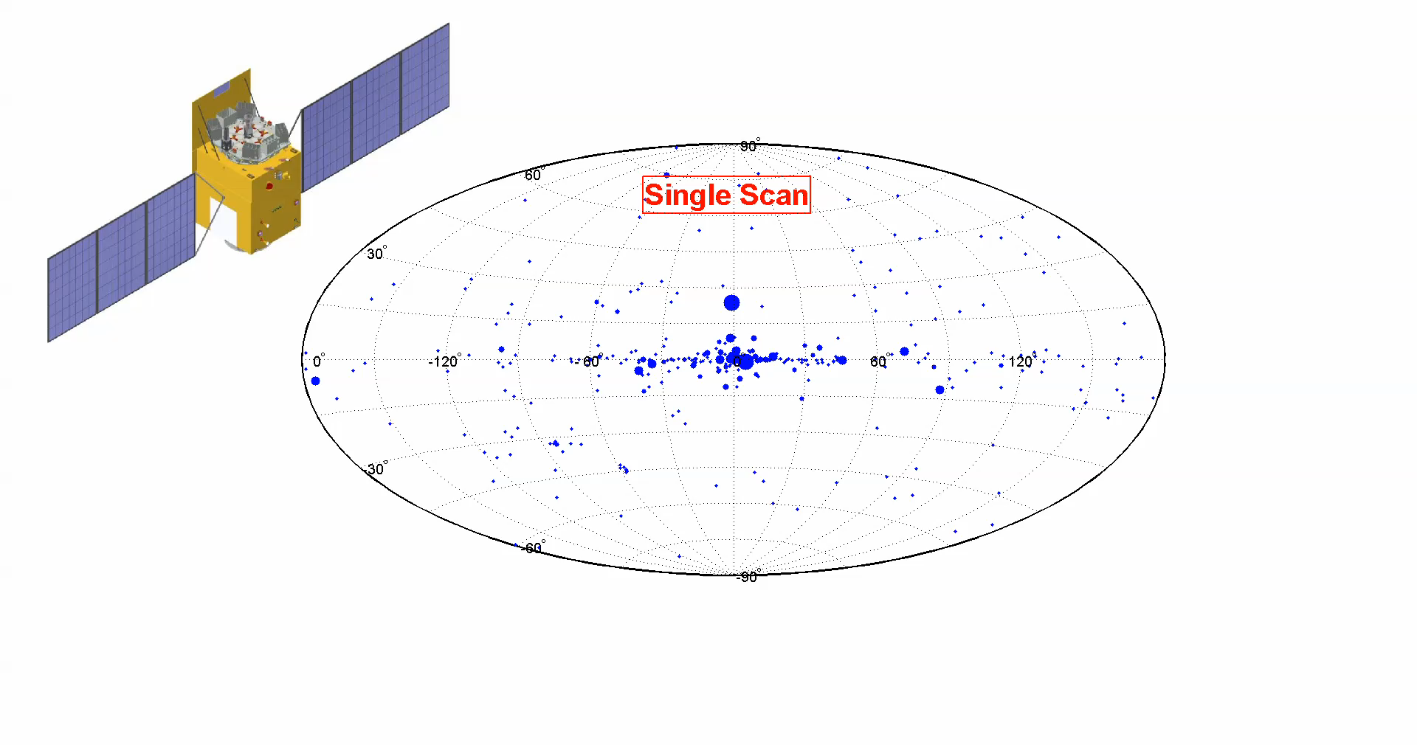
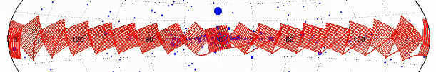
Insight-HXMT scanning survey of the MW
Single scan sensitivity: 3-10 mCrab (spectral shape dependent)
Galactic Plane: (20°*20°)*18 + (20°*20°)*4
11 center regions: 90 times/year (-60°~60°)
11 outer regions: 10 times/year

Slide 9
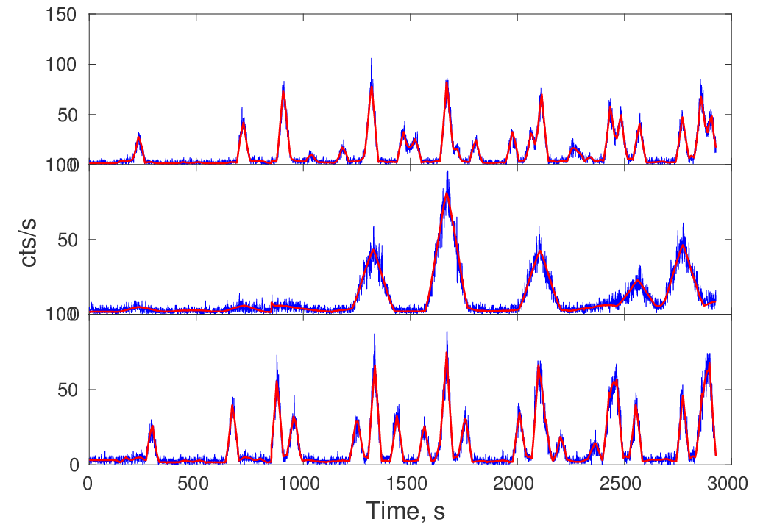
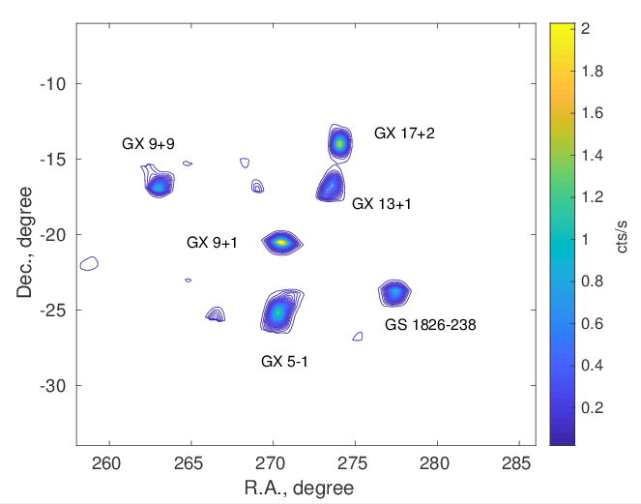
Scan light curve & reconstructed image
July 16 on Galactic center (LE 1-6 keV)
Direct Demodulation Method (Li & Wu 1993)

Slide 10
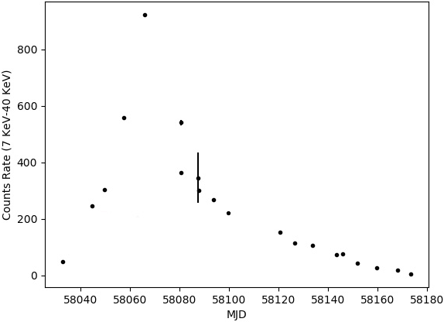
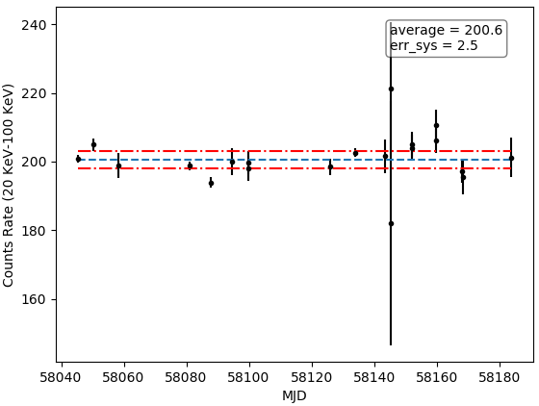
Long-term light curve monitoring
Monitor long-term variations of ~200 sources
Intrinsic variation
Systematic flux error ~ 1%
ME (7-40 keV)
Swift J0243.6+6124
Accreting pulsar
HE (20-100 keV)
Crab
Isolated pulsar
Notes:
Scan GC every day

Slide 11
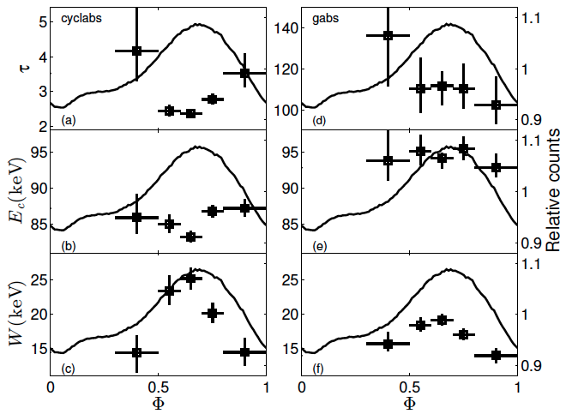
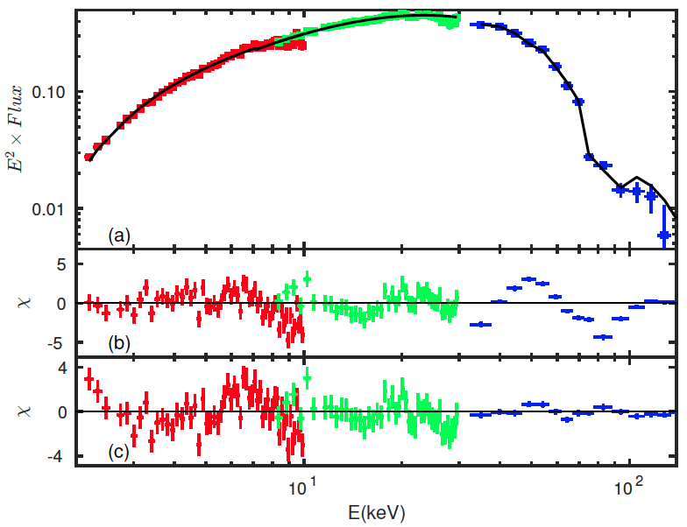
Neutron star cyclotron absorption lines
GRO J1008-57：~80 keV → one of the highest B directly measured in the universe ~10¹³, tentatively observed at ~ 4σ with NuSTAR & Suzaku
4 HXMT observations ~235 ks
~ 20σ detection
HXMT/HE one module, 17 modules ~ 20 σ

Slide 12
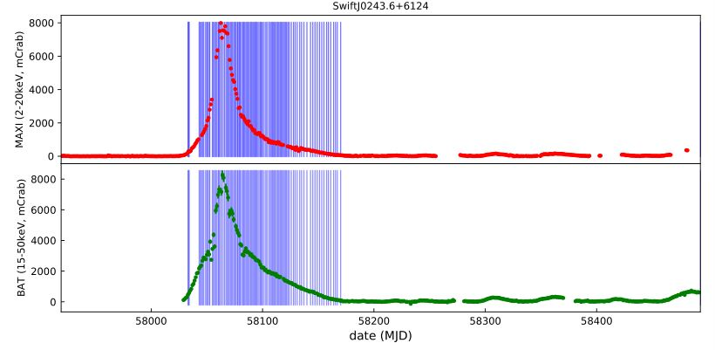
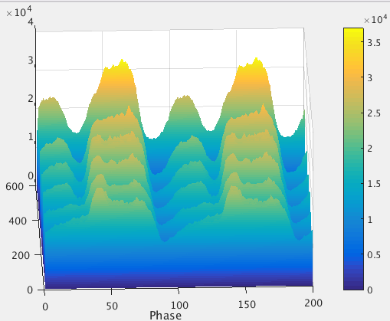
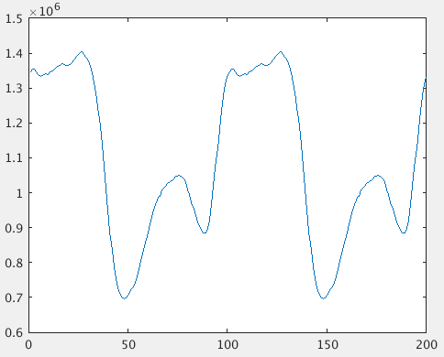
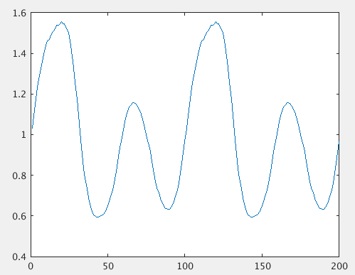
Accreting Pulsar: Swift J0243.6+6124
(Zhang et al., 2019, ApJ, submitted)
HXMT/HE
Oct 17
Oct 26
Oct 17-- Oct 23

Slide 13
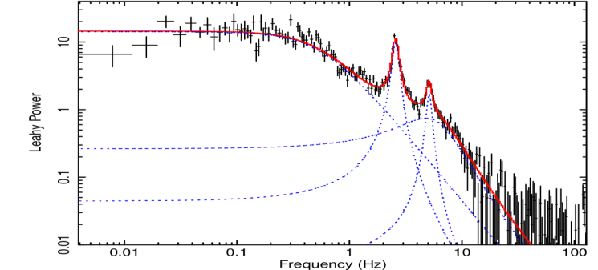
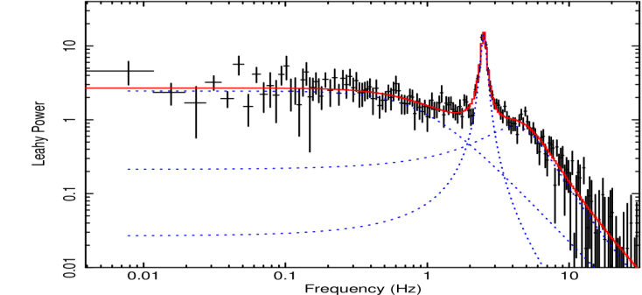
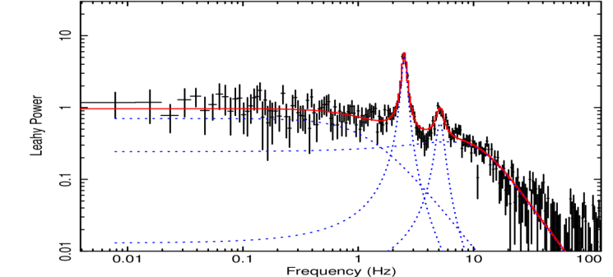
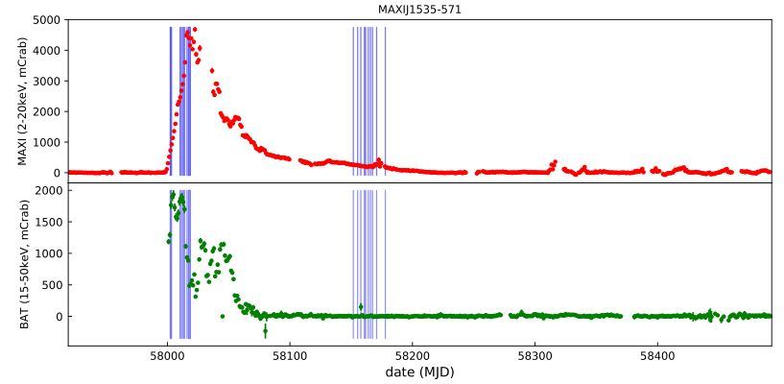
QPO observations of a black hole binary
~3000s
LE:1-7keV
ME:6-26keV
HE:36-80keV
(Huang et al., 2018 ApJ)

Slide 14
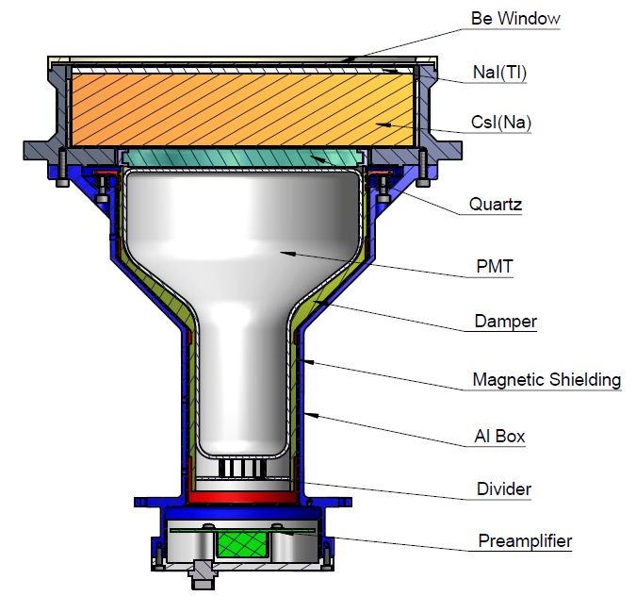
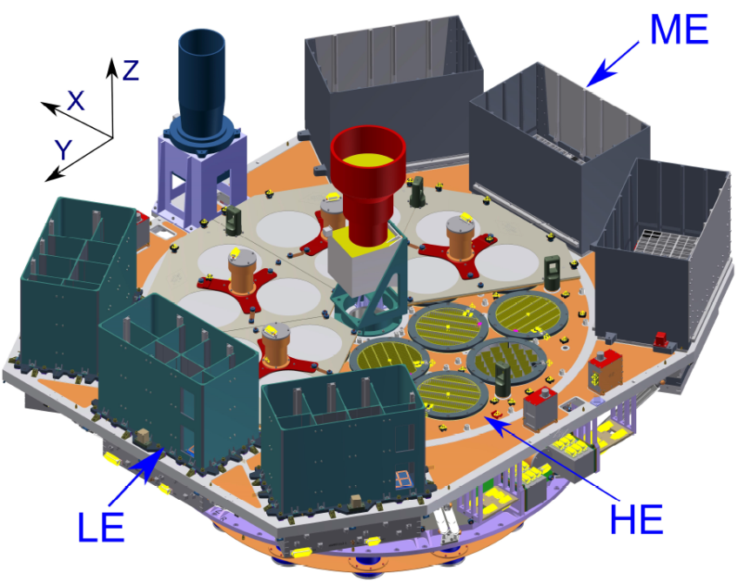
How to observe GRB (GW EM)?
Original design
  afterglow emission
  LE (0.5-10 keV), scanning
Extended capability
  prompt emission
  CsI detector of HE
HE
NaI/CsI

Slide 15
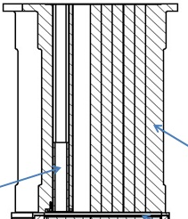
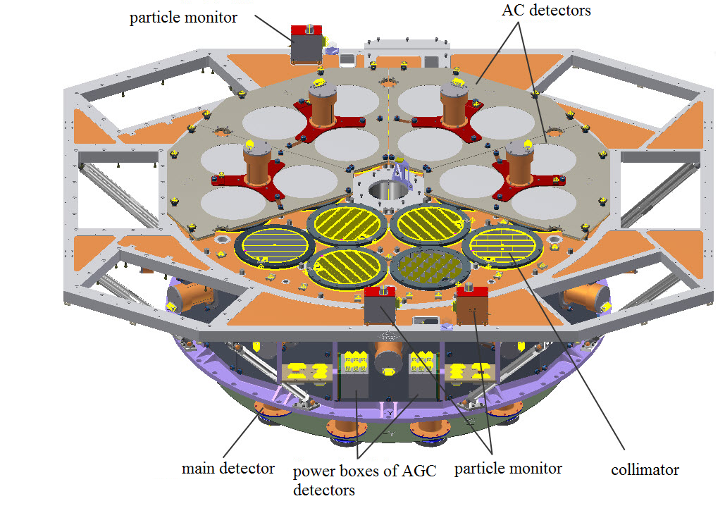
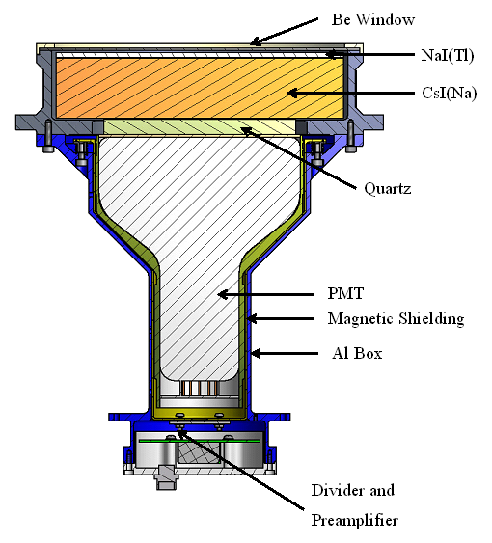
Regular observation vs. GRB observation
X/gamma photons within FOV
Collimator
NaI
CsI
Gamma-rays
（> ~200 keV）

Slide 16
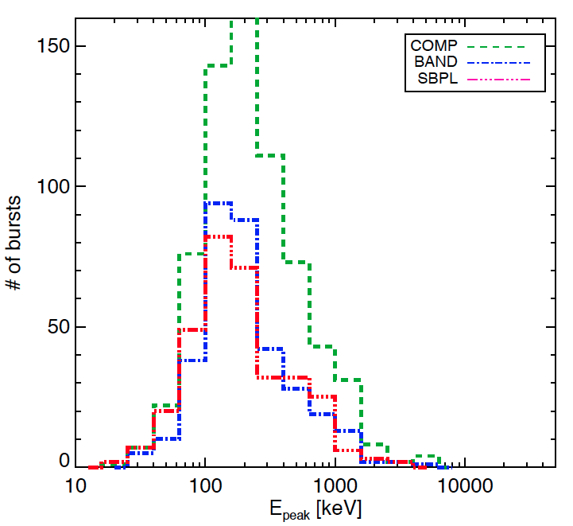
Dedicated working mode for GRB
Working Mode | NaI energy band (keV) | CsI energy band (keV) | Detector Setting
Regular mode | 20-250 | 40-600 | Normal HV
GRB/LG mode | 100-1250 | 200-3000 | Lower the PMT HV, turn off the AGC
GRB mode better energy range:
  According to the simulation, det. efficiency is good for >200 keV
  GRB Epeak distribution
GRB mode: ~30% of obs. time
  When the targeted source is occulted by the Earth in pointed observation
  When HE regular mode is not very useful in an observation
GRB Epeak measured by Fermi/GBM
（Gruber+, ApJS, 2014）

Slide 17
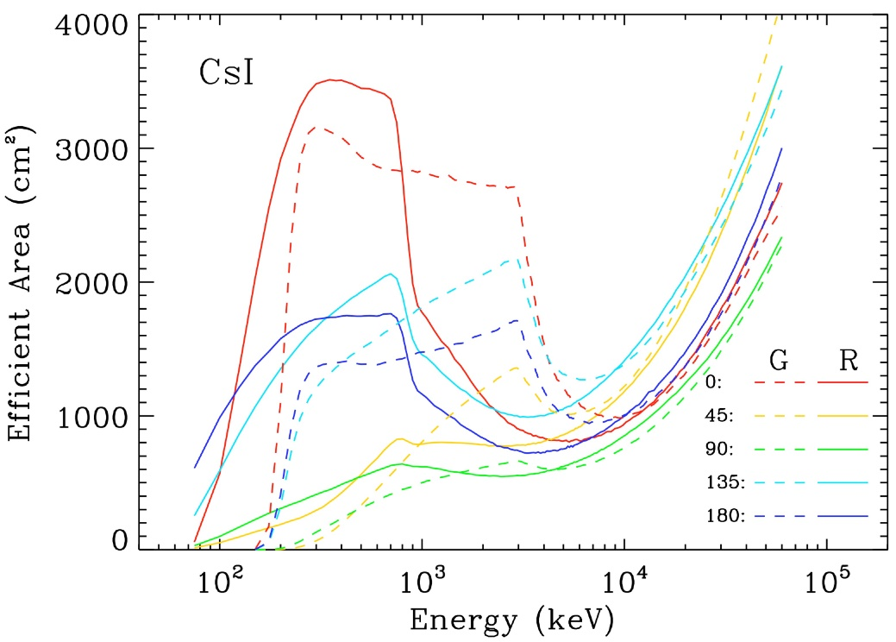
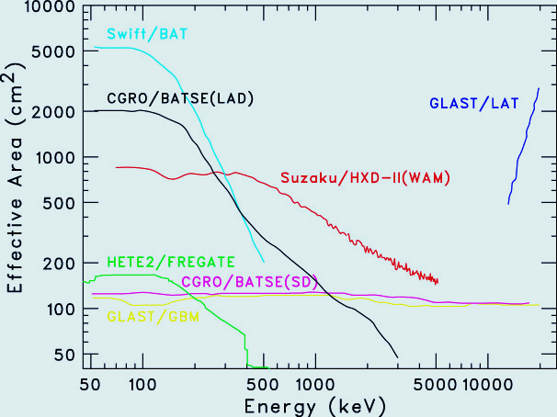
Effective Area for GRBs & Pulsars
Can detect GRBs in both regular & GRB/LG modes (lower HV for PMT)
GRB monitoring FOV: all sky un-occulted by the Earth
HXMT
500~3000 cm² ~ MeV range with single photon counting and energy measurement, ~largest ~ MeV GRB & pulsar monitor ever flown

Slide 18
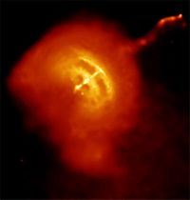
Best MeV detection of the Vela pulsar
HXMT/CsI
380 days
0.06-3 MeV
Fermi/LAT
400 days
0.1-300 GeV
Chandra X-ray image
CGRO/OSSE
60-600 keV
89 ms pulsar: radio, optical, X-ray, γ-ray

Slide 19
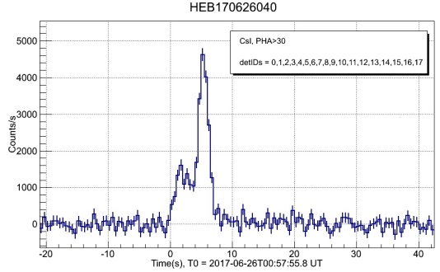
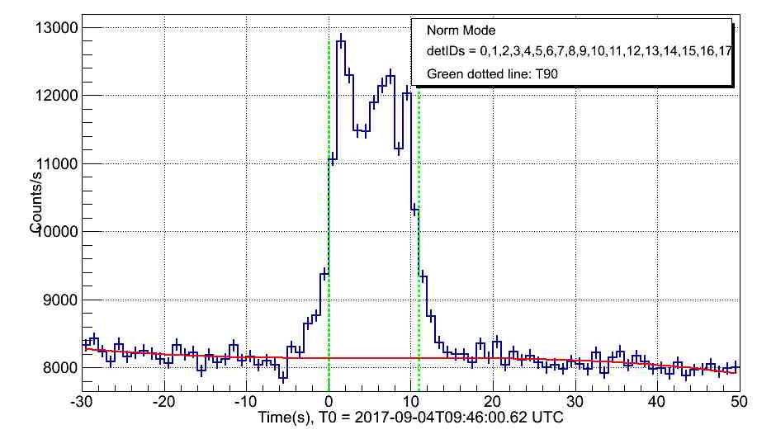
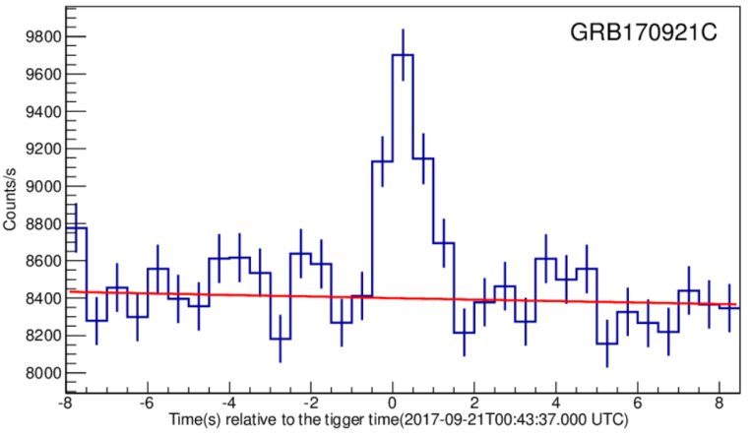
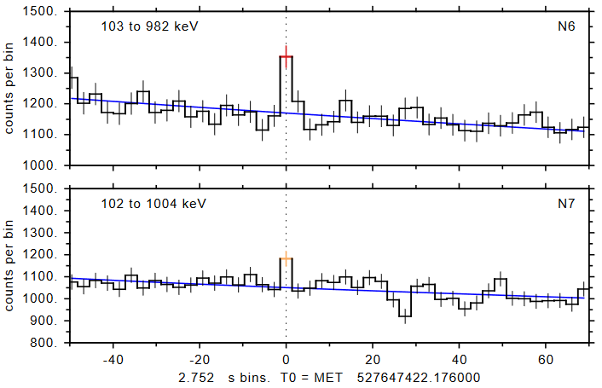
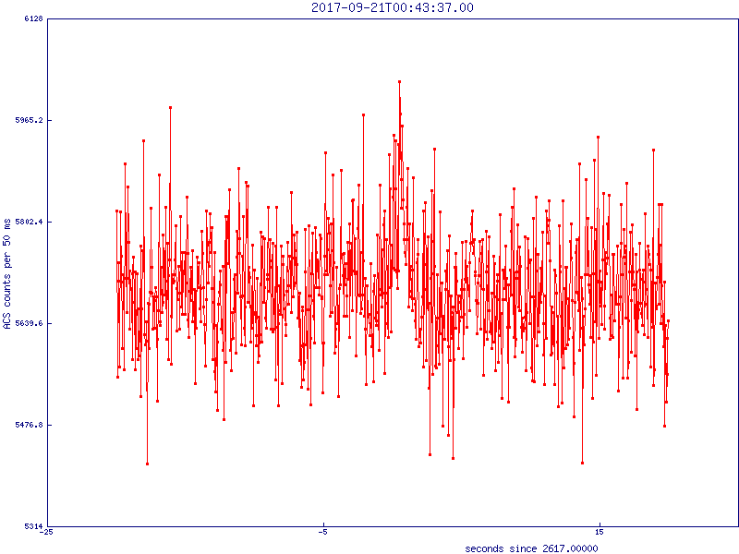
GRB Advantages
Large area: abundant photons → timing
GRB 170626B
GRB 170904A
Sensitive @MeV: short/hard GRBs
  Sig: HXMT=12，GBM=8，SPI-ACS=4 (no spectrum)
HXMT
GRB 170921C
GBM
SPI-ACS

Slide 20
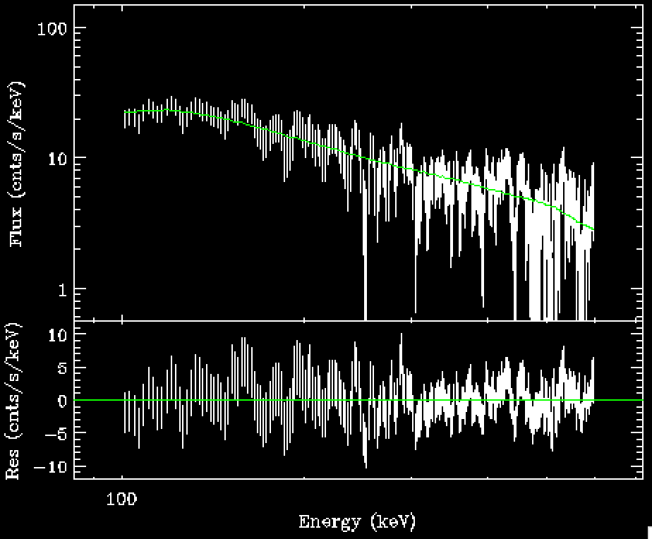
Spectral analysis
GRB 170626B
Band function
alpha: unconstrained beta: -2.38 +/- 0.12

Slide 21
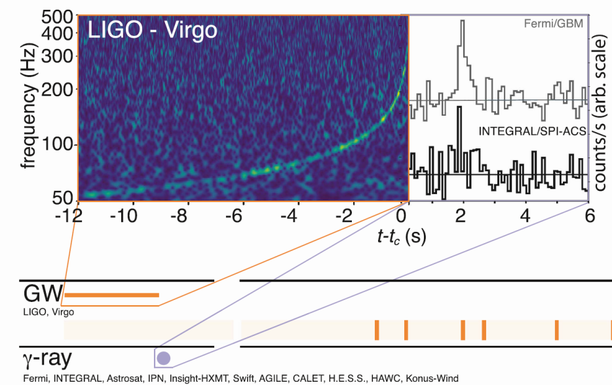
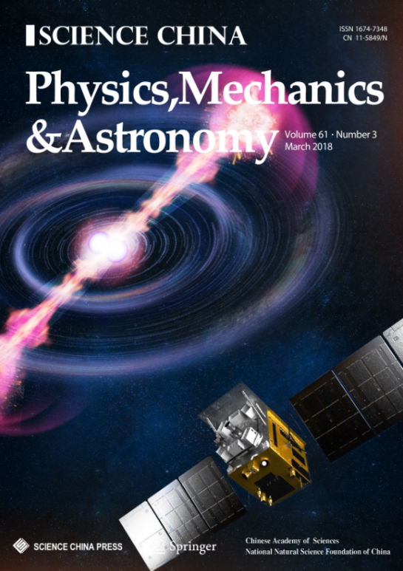
GW EM observations
Monitored 6 GW triggers
  Reported observation results in LVC GCNs
Monitored the first BNS GW event GW170817
  GRB170817A was not detected in MeV range, including HXMT
  Stringent upper limit constraint between 200 keV to 5 MeV
  Joined the MMA paper and published detailed results in Science China

Slide 22
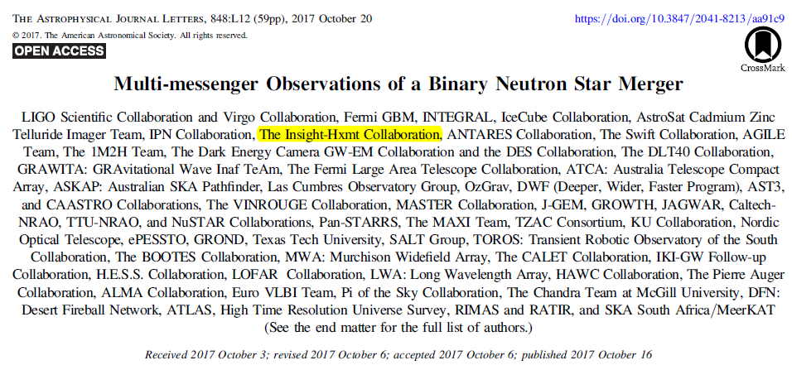
Insight-HXMT joined the MMA paper
Quick response, reported HXMT observation by LVC GCN
Only 4 X/gamma telescopes monitored the GW source throughout the trigger time
  Fermi/GBM, SPI-ACS, Konus-Wind, Insight-HMXT
  HXMT has the largest eff. Area & time resolution in MeV
Reported observation results in main context and table of MMA

Slide 23
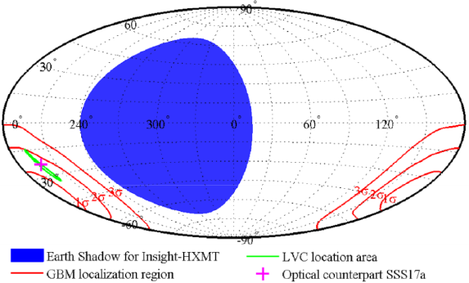
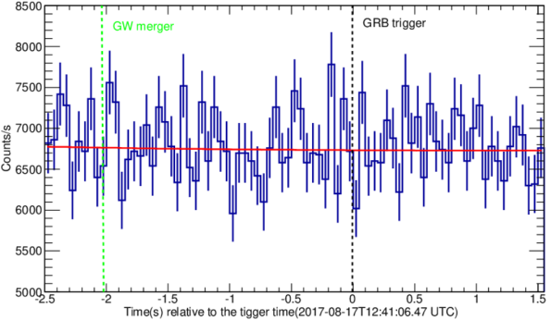
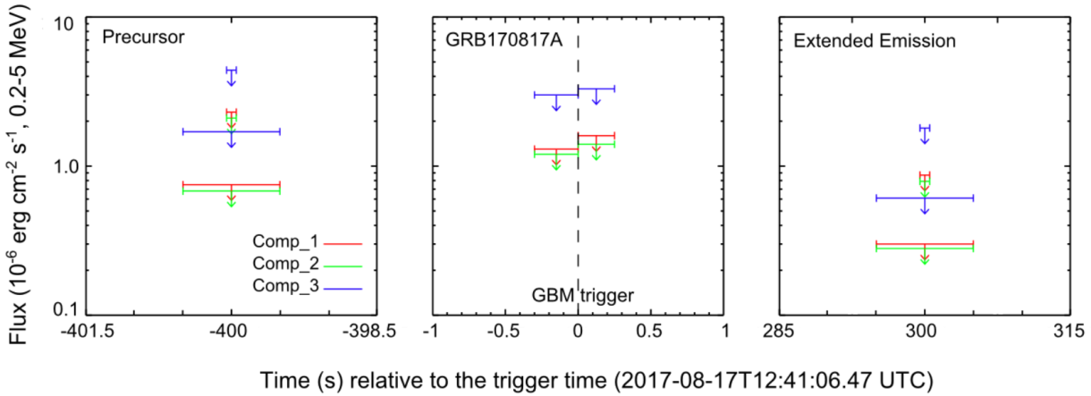
Insight-HXMT observation to GW-EM
Monitored the entire GW area
Light curve around trigger time
3 σ upper limits for Comptonized models
T. P. Li, et al, Sci. China-Phys. Mech. Astron. 61(3), 031011 (2018)

Slide 24
Statistics of detected GRBs
Year | 2017 |  |  |  |  |  |  | 2018
Month | 6 | 7 | 8 | 9 | 10 | 11 | 12 | 1 | 2 | 3 | 4 | 5 | 6 | 7 | 8
All | 2 | 10 | 9 | 12 | 8 | 8 | 8 | 11 | 8 | 7 | 11 | 6 | 8 | 7 | 4
short | 0 | 3 | 5 | 3 | 5 | 2 | 1 | 1 | 1 | 1 | 3 | 2 | 2 | 2 | 0
Year | 2018 |  |  |  | 2019 |  |  | Total
Month | 9 | 10 | 11 | 12 | 1 | 2 | 3 | LG Mode：16；GCN：67/23 (1st)
All | 4 | 4 | 5 | 6 | 7 | 6 | 12 | 163 gamma-ray bursts
short | 1 | 0 | 2 | 1 | 0 | 2 | 2 | 39 short gamma-ray bursts
~100 GRBs/year @ ~MeV

Slide 25
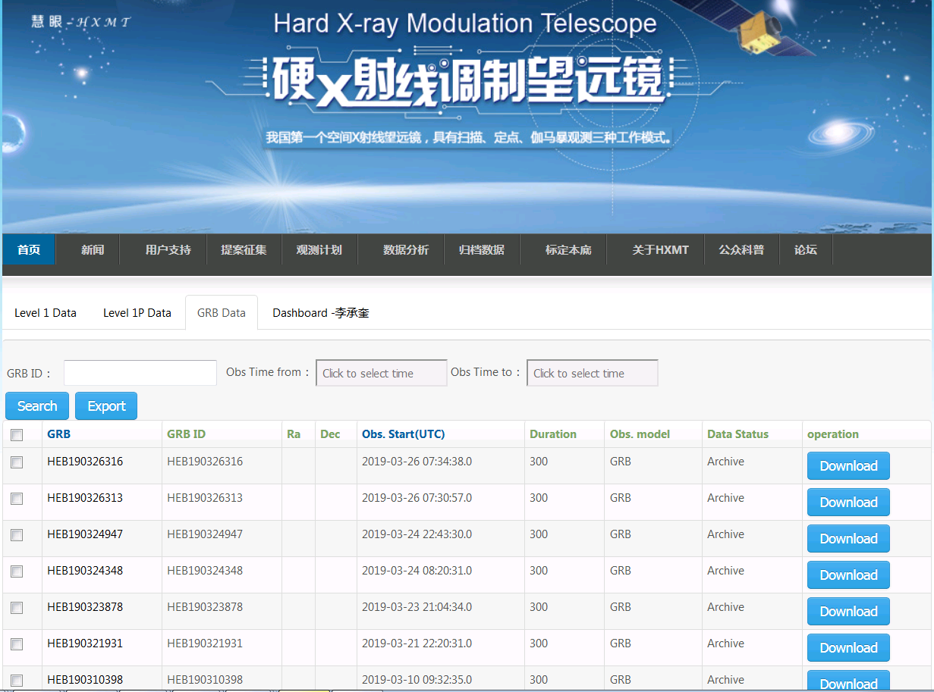
Insight-HXMT GRB data products
http://hsuc.ihep.ac.cn/web/hxmtdata/grb

Slide 26
Summary
Insight-HXMT is China’s 1st X-ray astronomy satellite.
  1-15, 5-30, 20-250 keV (pointed) and 0.2-3 MeV (all-sky monitor)
Insight-HXMT PV & calibration: June 15 to Nov. 15, 2017
Insight-HXMT normal observations: ~ 1.5 years
  ~10 papers published/submitted
  > 20 papers in preparations
Collaborations welcome: three ways
  Partner institutions that contributed to Insight-HXMT
  Coordinated multi-λ observations: space & ground
  Apply and join our core teams
  Write GO proposals (AO2 proposals just reviewed)
http://www.hxmt.org/ for all information.

