Slide 1
Open charm and beauty states production in proton-lead collisions with LHCb
Di Yang (Tsinghua University)
On behalf of the LHCb Collaboration
April 22th 2019

Slide 2
Outline
Introduction
The LHCb detector
LHCb $p$Pb data samples
Prompt open charm production in 5.02 TeV $p$Pb collisions
Open beauty production in 8.16 TeV $p$Pb collisions
Summary and outlook
JHEP 10 (2017) 090
JHEP 02 (2019) 102
Phys. Rev. D99 052011 (2019)

Slide 3
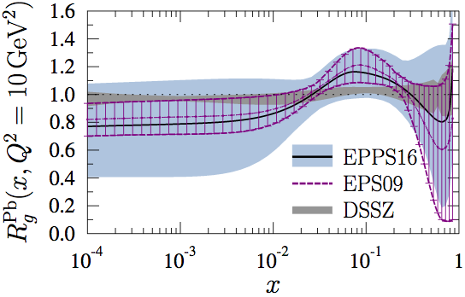
Introduction
Heavy flavor states are good probes in heavy-ion collisions
$m_{Q}≫Λ_{QCD}$: allows perturbative calculations
$t_{prod}≪t_{QGP}$: experience whole time evolution of collision
Cold nuclear matter effects:
Modification of parton distribution functions: nPDF or CGC
Energy-loss with (in) coherent small-angle gluon radiation
Interacting with co-moving particles
…
Observables
Nuclear modification factor $R_{pPb}$
Forward-backward ratio $R_{FB}$
Particle ratios
EPJ C10 (2017) 1140

Slide 4
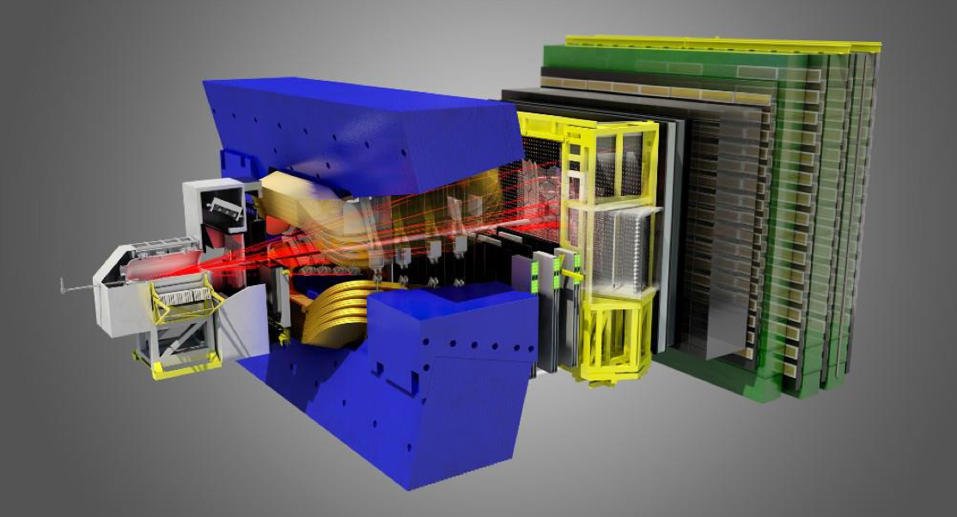
The LHCb detector
A single arm general purpose detector at forward rapidity !
pseudorapidity acceptance $2<η<5$
Muon system: $μ$ identification: $ε$ ($μ→μ$) ~ 97%
Mis-ID:$ε$ ($π→μ$) ~ 1$−$3%
RICH: K/$π$/$p$ separation
$ε$(K$→$K) ~ 95%
Mis-ID: $ε$ ($π→$ K) ~ 5%
Vertex detector: IP resolution ~ 20 $μ$m
Decay time resolution ~ 45 fs
Dipole magnet Bending power 4 Tm
Electromagnetic + hadronic calorimeters
Tracking system: $Δp/p$ = 0.5$−$1.0%
(5$−$200 GeV/c)
JINST 3 (2008) S08005
IJMPA 30 (2015) 1530022

Slide 5
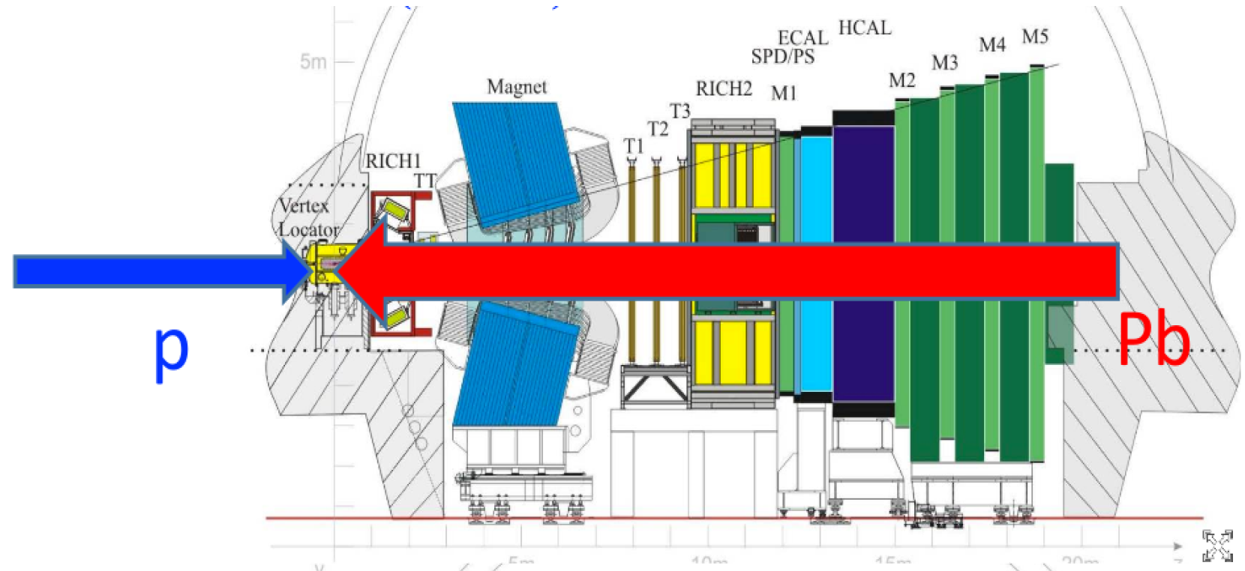
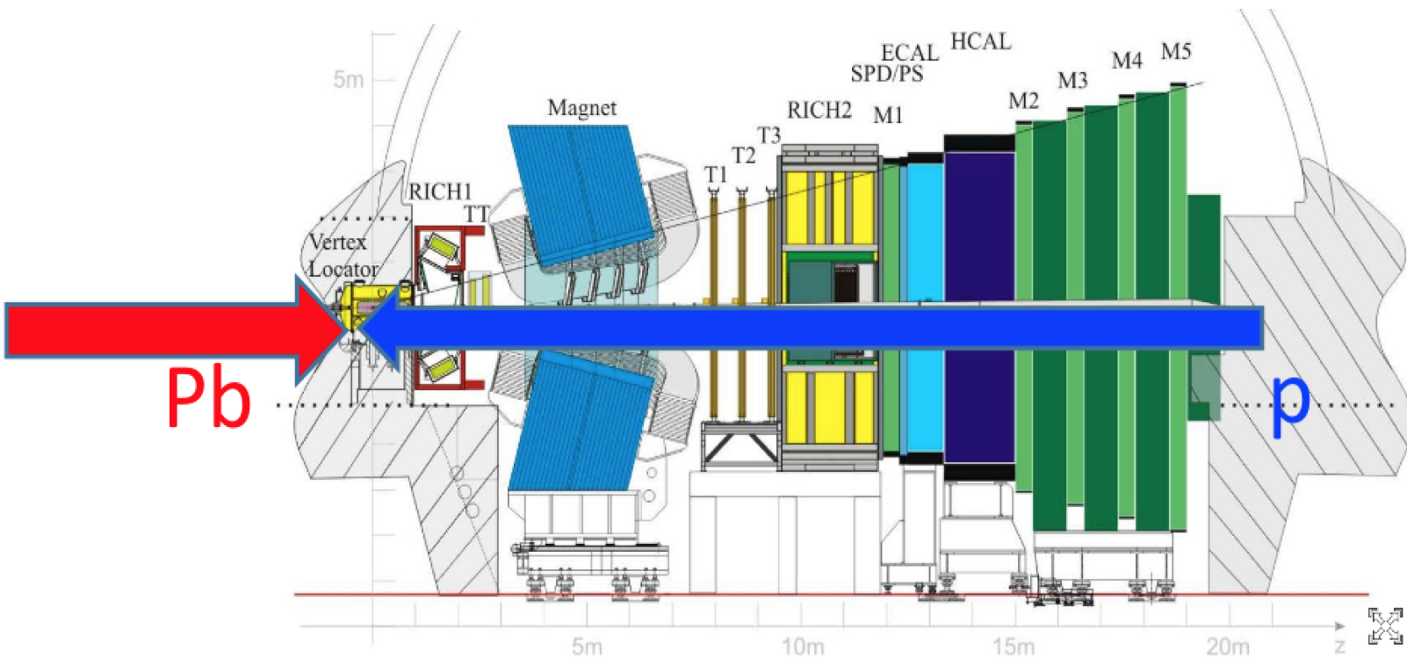
LHCb $p$Pb data samples
Forward: $p$Pb
$\sqrt{s_{NN}}=5.02$ TeV (2013)
$p$Pb $\left(1.06 {nb}^{−1}\right)$+ Pb$p\left(0.52 {nb}^{−1}\right)$
$\sqrt{s_{NN}}=8.16$ TeV (2016)
$p$Pb $\left(13.6 {nb}^{−1}\right)$+ Pb$p\left(21.8 {nb}^{−1}\right)$
Rapidity coverage
$y^{∗}=y_{lab}−y_{cms}$
rapidity in nucleon-nucleon cms
$y_{cms}=±0.465$
Forward ($p$Pb): $1.5<y^{∗}<4.0$
Backward (Pb$p$): $−5.0<y^{∗}<−2.5$
Common region: $2.5<{|y}^{∗}|<4.0$
Backward: Pb$p$

Slide 6
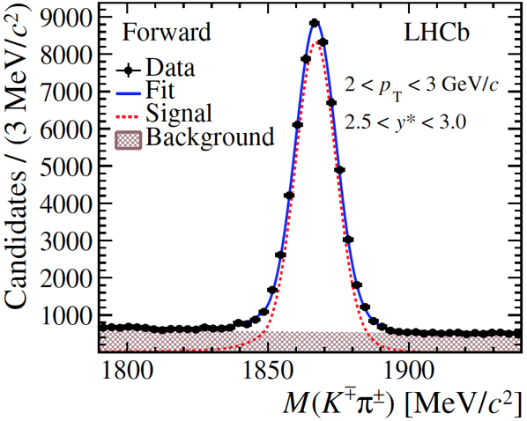
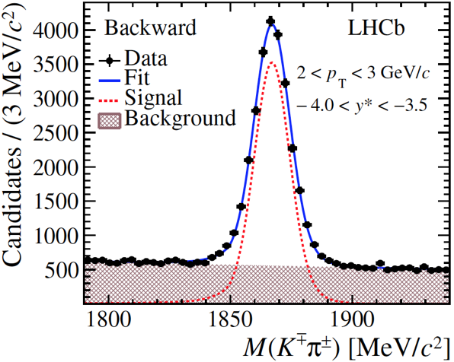
Prompt open charm: signals
Reconstructed through decay channels: $D^{0}→K^{−}π^{+}$,
$$Λ_{c}^{+}→pK^{−}π^{+}$$
$$D^{0}→K^{−}π^{+}$$
$$D^{0}→K^{−}π^{+}$$
$$Λ_{c}^{+}→pK^{−}π^{+}$$
$$Λ_{c}^{+}→pK^{−}π^{+}$$
JHEP 10 (2017) 090
JHEP 02 (2019) 102
Extract yields by fitting invariant mass distribution and obtain cross section $σ$ as a function of $p_{T}$ and $y$

Slide 7
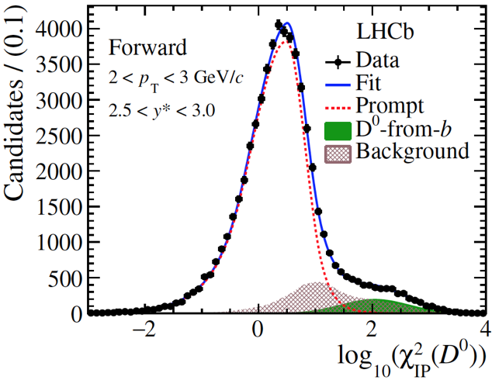
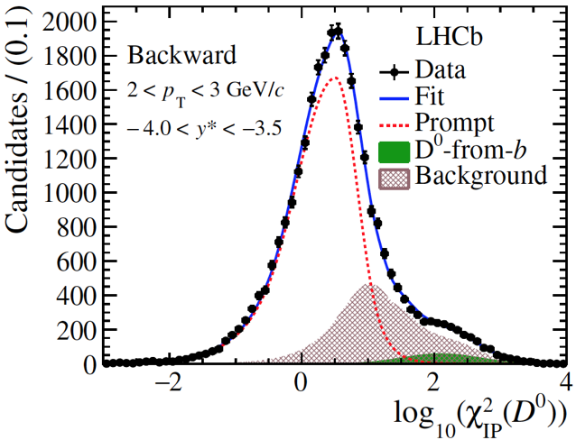
Prompt and non-prompt charm
Distinguish prompt and non-prompt by fitting impact parameter (IP) distribution
$$p\left(K^{−}\right)+p(π^{+})$$
$$D^{0}$$
$$D^{0}$$
$$π^{+}$$
$$K^{−}$$
$$D^{0}$$
b hadron
others
$$PV$$
$$IP$$
Non-prompt: charm produced from b decay (IP>0)
Prompt : charm produced directly in collision (IP=0)
$$Λ_{c}^{+}$$
$$Λ_{c}^{+}$$
Prompt charm yields can be extracted
JHEP 10 (2017) 090
JHEP 02 (2019) 102

Slide 8
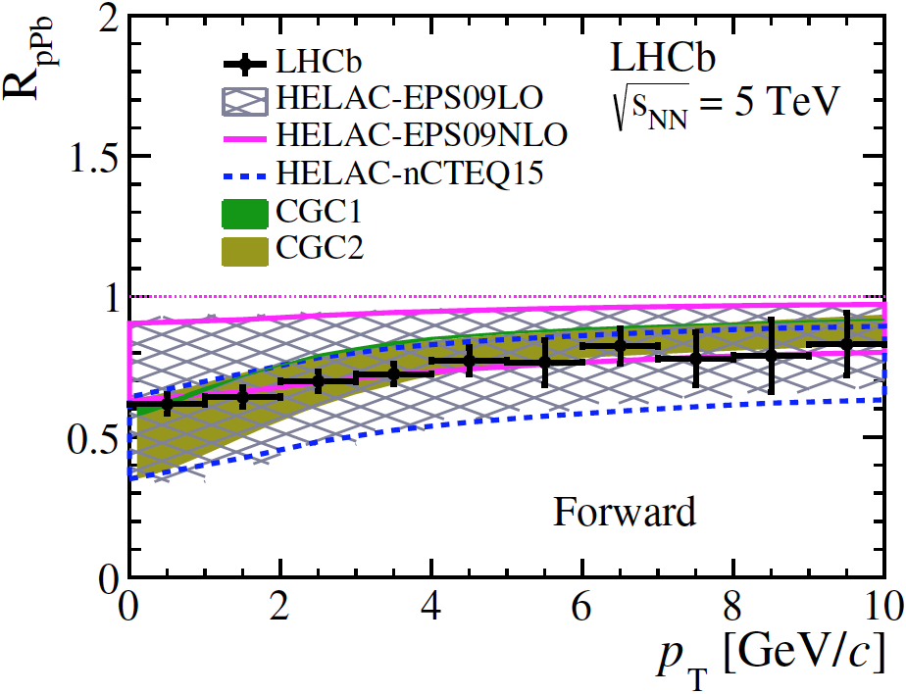
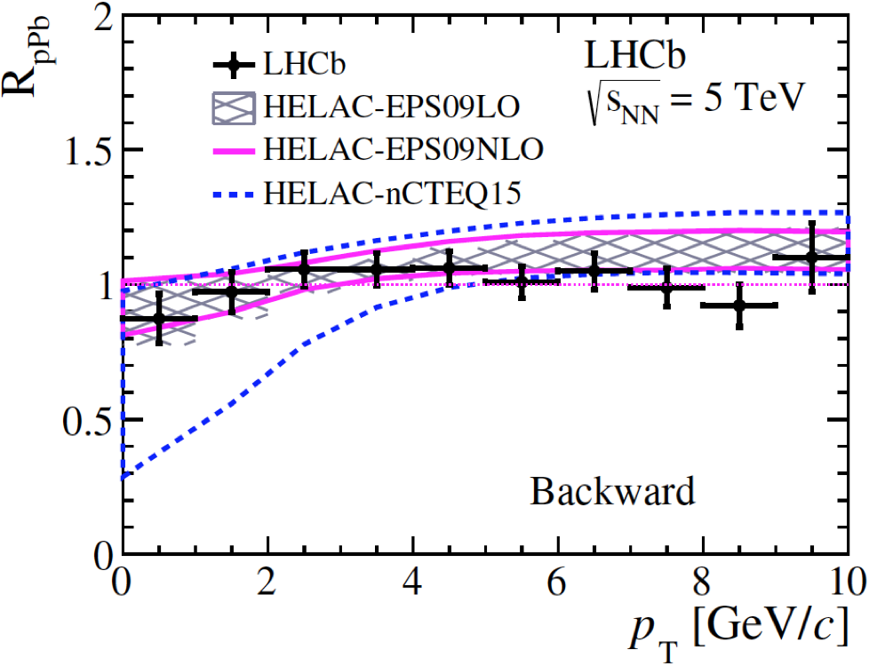
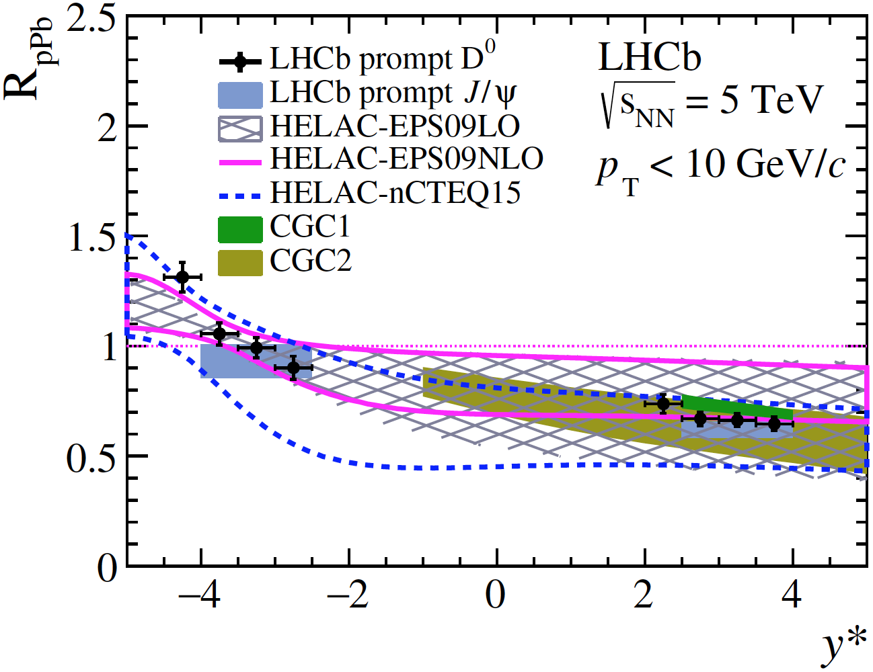
Prompt open charm: nuclear modification factor
$$D^{0}$$
$$D^{0}$$
JHEP 10 (2017) 090
$R_{pPb}=\frac{1}{A}\frac{dσ_{pPb}\left(p_{T},y^{∗},\sqrt{s_{NN }}\right)/dp_{T}(dy)}{dσ_{pp}\left(p_{T},y^{∗},\sqrt{s_{NN }}\right)/dp_{T}(dy)}$, $A=208$
$pp$ reference directly measured by LHCb
$R_{pPb}$ suppressed at forward rapidity
Slight increase with increasing $p_{T}$
$R_{pPb}$ close to 1 at backward rapidity
Data are consistent with models with nPDF, CGC
Data have smaller uncertainties than theory
$$D^{0}$$

Slide 9
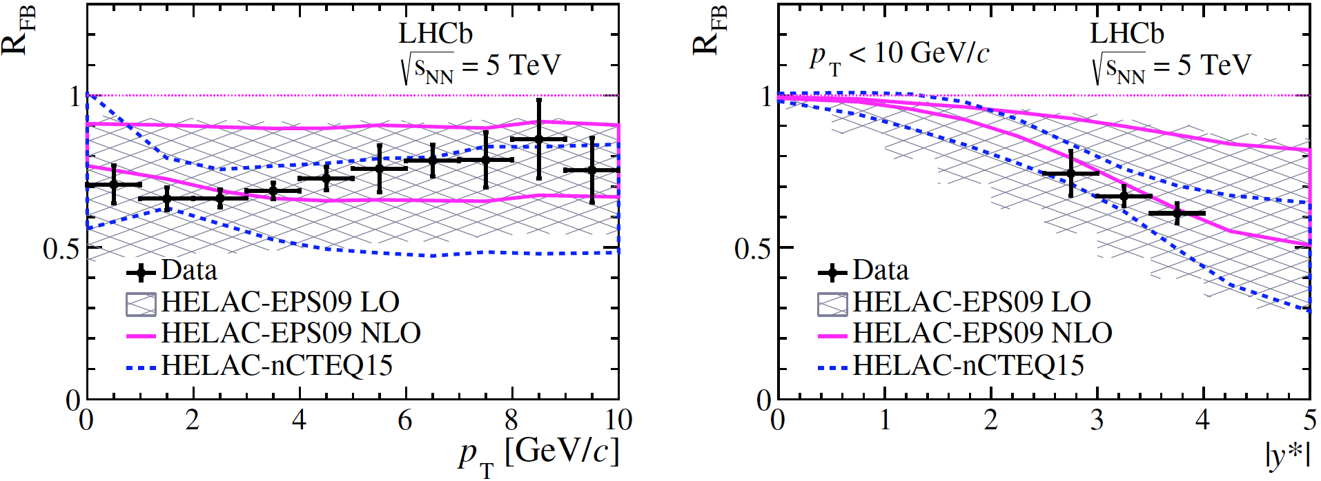
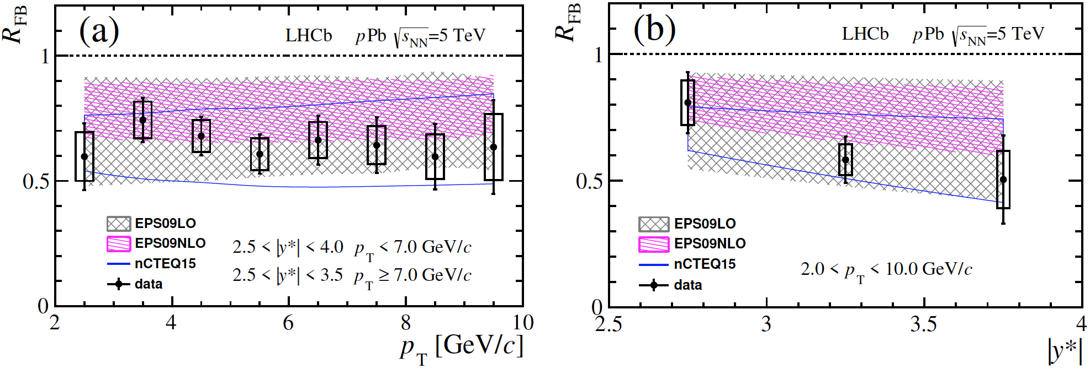
Prompt open charm: forward-backward ratio
$$D^{0}$$
$$D^{0}$$
$R_{FB}= \frac{dσ_{pPb}\left(p_{T},+\left|y^{∗}\right|\right)/dp_{T}(dy)}{dσ_{Pbp}\left(p_{T},−\left|y^{∗}\right|\right)/dp_{T}(dy)}$ $R_{FB}<1$ and decreases with rapidity
$$Λ_{c}^{+}$$
$$Λ_{c}^{+}$$
sys.
sys.
total.
total.
Data agree with calculations using various nPDF sets
$D^{0}$ data have smaller uncertainties than theory
JHEP 10 (2017) 090
JHEP 02 (2019) 102

Slide 10
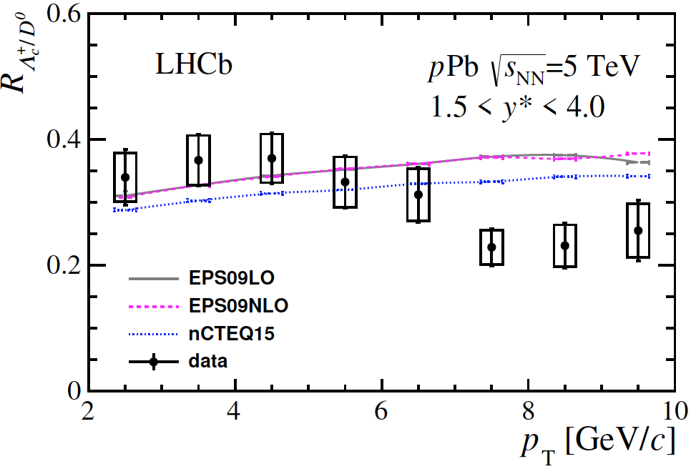
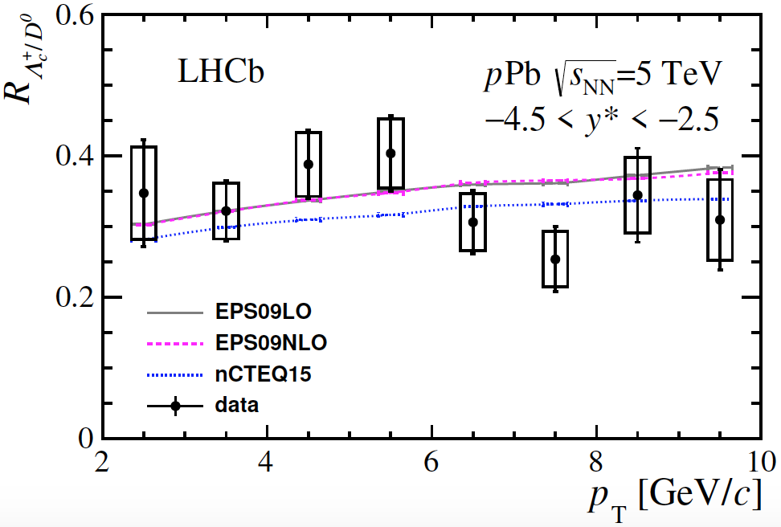
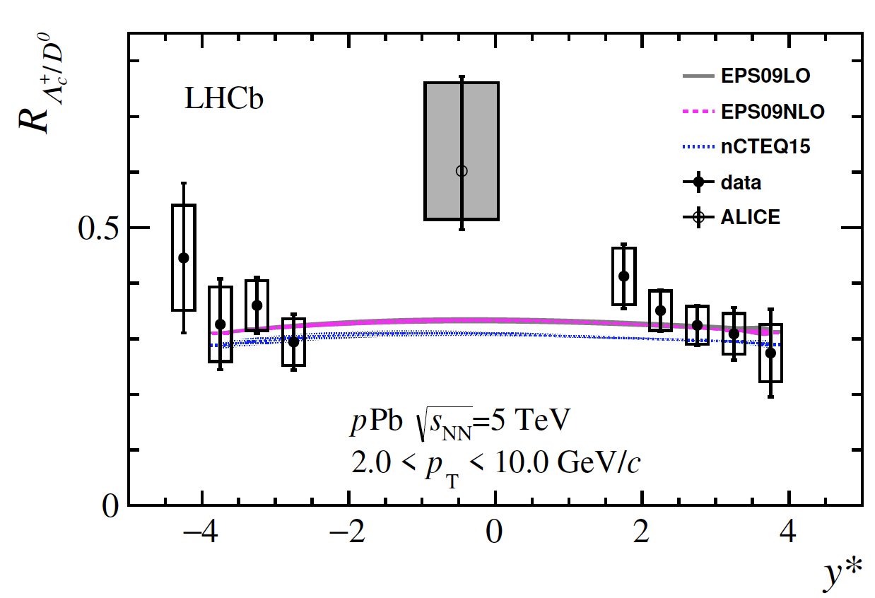
Prompt open charm: particle ratio
Forward
Backward
$R_{Λ_{c}^{+}/D^{0}}=\frac{d^{2}σ_{Λ_{c}^{+}}\left(p_{T},y^{∗}\right)/dp_{T}(dy)}{d^{2}σ_{D^{0}}\left(p_{T},y^{∗}\right)/dp_{T}(dy)}$
Theoretical calculation is based on measured $pp$ results from LHCb
nPDF effects cancel in baryon/meson ratios
Forward: consistent with theory in lower $p_{T}$ and below theory in higher $p_{T}$
Backward: consistent with theory for all $p_{T}$ and $y^{∗}$
JHEP 02 (2019) 102

Slide 11
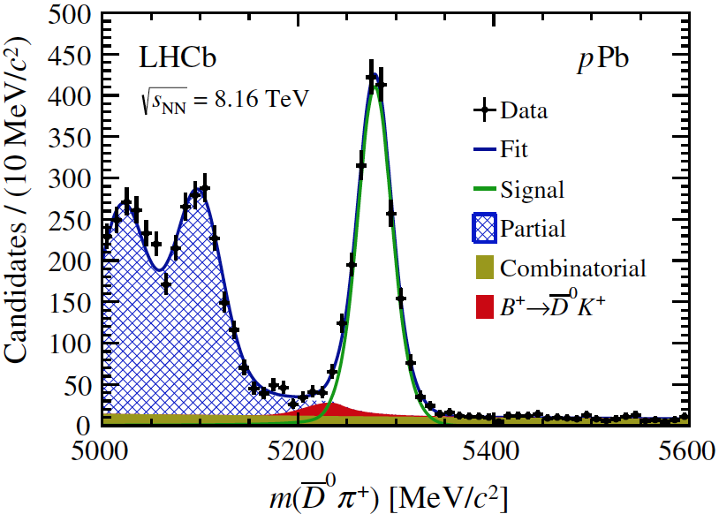
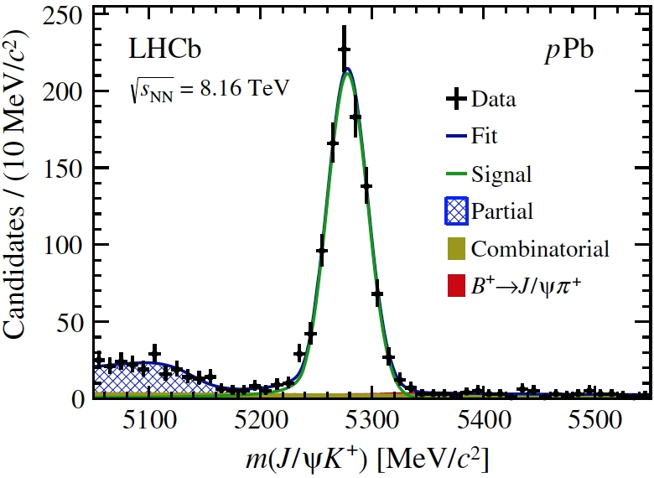
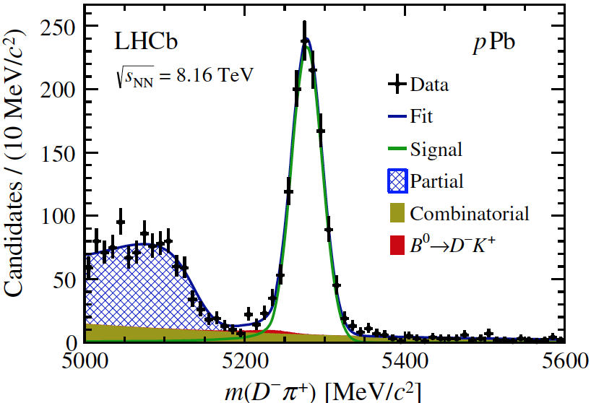
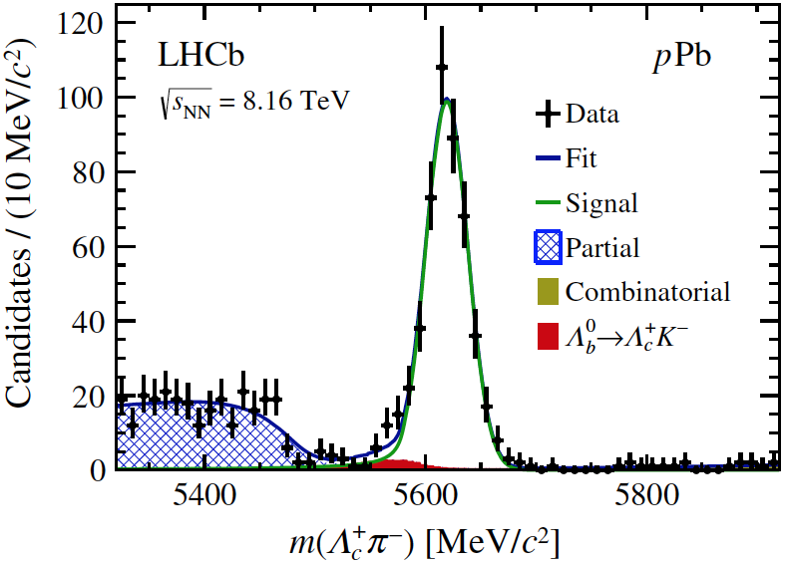
Open beauty: signals
$$B^{+}→\overline{D^{0}}π^{+}$$
$$B^{+}→J/ψK^{+}$$
Reconstructed through decay channels:
$B^{+}→\overline{D^{0}}π^{+}$;
$B^{+}→J/ψK^{+}$ ;
$B^{0}→D^{−}π^{+}$;
$Λ_{b}^{0}→Λ_{c}^{+}π^{−}$
$$B^{0}→D^{−}π^{+}$$
$$Λ_{b}^{0}→Λ_{c}^{+}π^{−}$$
Phys. Rev. D99 052011 (2019)
Extract yields by fitting invariant mass distribution and obtain cross section $σ$ as a function of $p_{T}$ and $y$

Slide 12
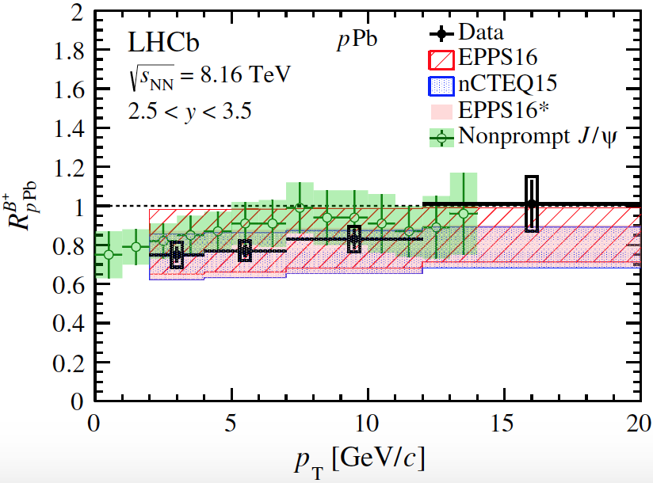
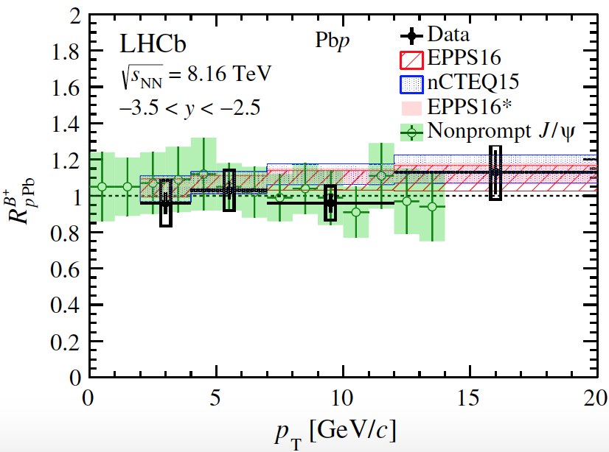
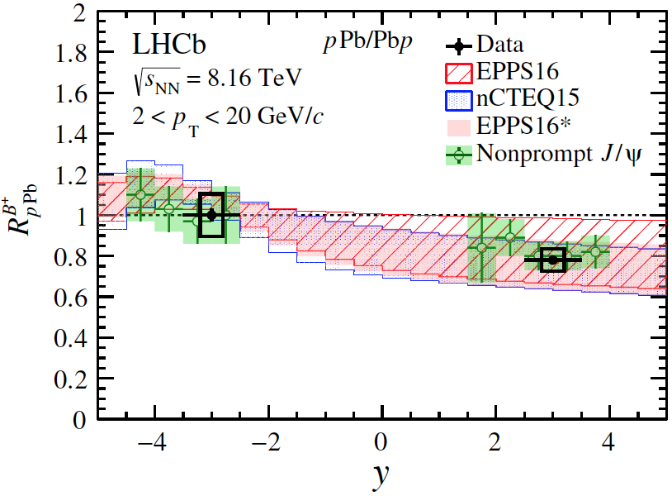
Open beauty: nuclear modification factor
tot.
tot.
stat.
stat.
Forward: suppressed, increases with $p_{T}$
Backward: $≈1$
Data are consistent with nPDF calculations and $J$/$ψ$ from b decay
Beauty suppression is comparable to charm
tot.
stat.
Phys. Rev. D99 052011 (2019)

Slide 13
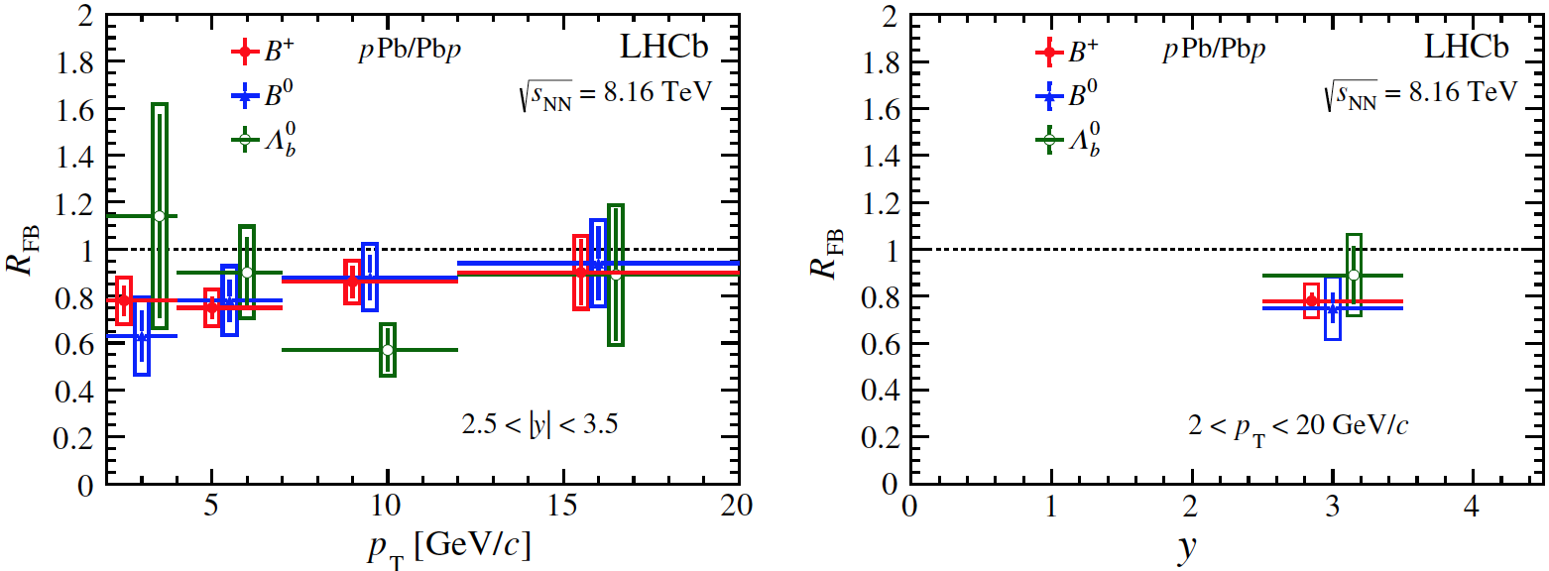
Open beauty: forward-backward ratio
tot.
tot.
stat.
stat.
$R_{FB}$ for $B$ mesons $<1$
No strong dependence on $p_{T}$ is observed
Consistent with nPDF calculations
$R_{FB}$ for $B^{0}$ and $B^{+}$ are similar
$R_{FB}$ for $Λ_{b}^{0}$ suffers larger statistical uncertainty
Phys. Rev. D99 052011 (2019)

Slide 14
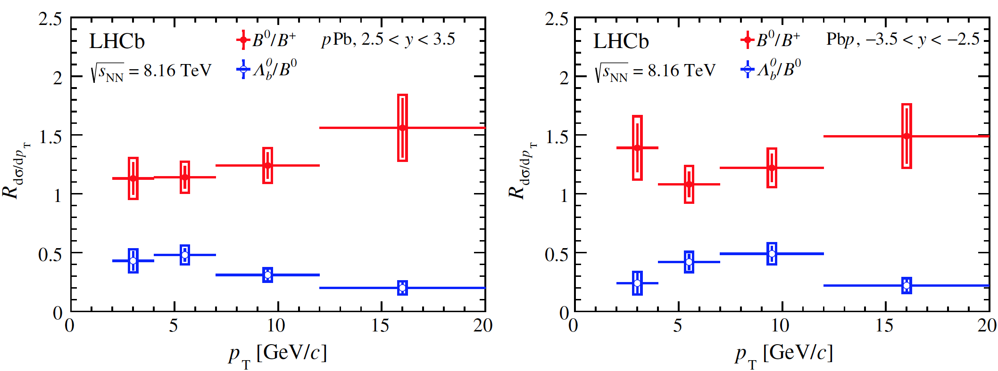
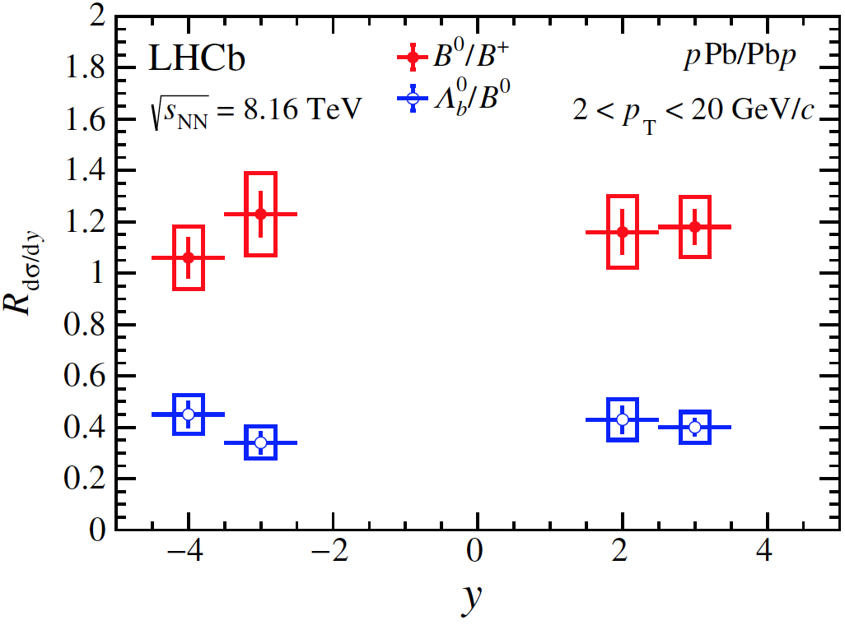
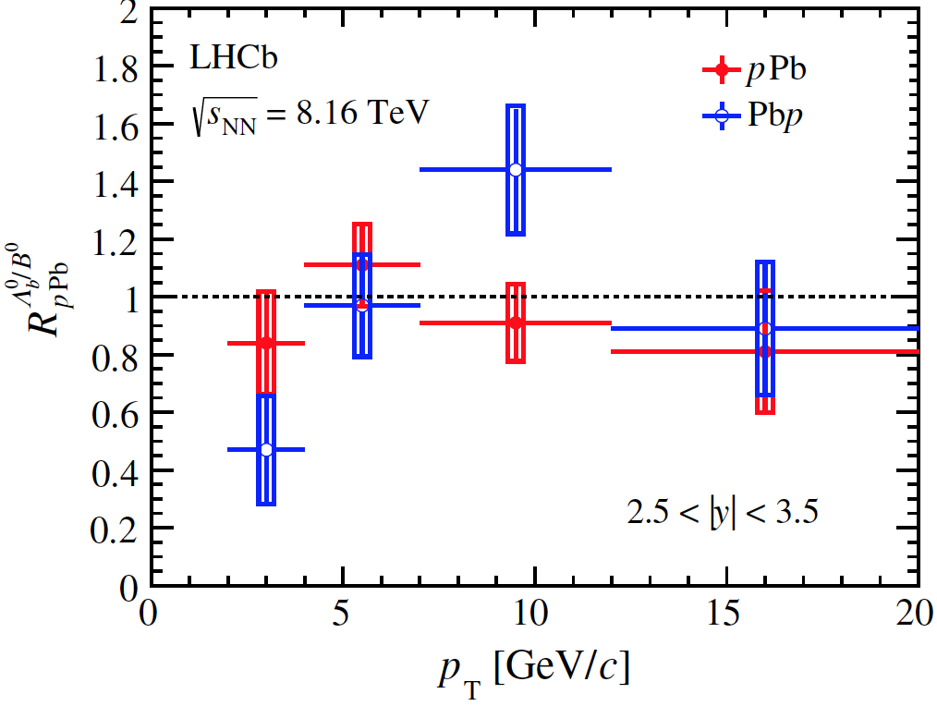
Open beauty: particle ratio
$$\frac{dσ_{B^{0}}/dy(dp_{T})}{dσ_{B^{+}}/dy(dp_{T})}$$
tot.
stat.
$$\frac{dσ_{Λ_{b}^{0}}/dy(dp_{T})}{dσ_{B^{0}}/dy(dp_{T})}$$
tot.
stat.
$B^{0}$/$B^{+}$ about 1-$σ$ from 1, explained by systematic uncertainties
$Λ_{b}^{0}\text{/}B^{0}≈0.4$, decreases at high $p_{T}$, and is compatible to $Λ_{c}^{+}/D^{0}$ in the same region, similar to LHCb $pp$ data [JHEP 08 (2014) 143]
tot.
stat.
tot.
stat.
$R_{pPb}^{Λ_{b}^{0}/B^{0}}≡R_{pPb}^{Λ_{b}^{0}}/R_{pPb}^{B^{0}}≈1$ and is independent of $p_{T}$ at forward rapidity, suffers larger fluctuations due to higher level of background at backward rapidity
Phys. Rev. D99 052011 (2019)

Slide 15
Summary and outlook
LHCb has excellent capabilities to study heavy flavor in heavy ion studies
Production of $D^{0}$ and $Λ_{c}^{+}$ are measured in 5.02 TeV $p$Pb collisions by LHCb
$R_{pPb}^{D^{0}}$ is significantly suppressed in the forward and more precise than theory so that can be used to constrain model
$R_{FB}^{D^{0}}$ and $R_{FB}^{Λ_{c}^{+}}$ agree with QCD theory and $R_{FB}^{D^{0}}$ has smaller uncertainties than theory
$R_{Λ_{c}^{+}/D^{0}}$ agrees with model except in forward high $p_{T}$ bins
Production of $B^{+}$, $B^{0}$ and $Λ_{b}^{0}$ are measured in 8.16 TeV $p$Pb collisions by LHCb (first measured in heavy ion collisions using exclusive hadronic states)
$R_{pPb}^{B^{+}}$ agrees with QCD theory and $J$/$ψ$ from b decay
$R_{pPb}^{Λ_{b}^{0}}$/$R_{pPb}^{B^{0}}$ $≈1$at forward rapidity
Production of open charm in 8.16 TeV and more species in 5.02 TeV $p$Pb collisions are under study
Multiplicity dependence

Slide 16
Thank you!

Slide 17
Back up slides

Slide 18
Open charm production: prompt $D^{0}$
Reconstructed through decay channel: $D^{0}→K^{−}π^{+}$
Obtain $D^{0}$ yields $N(D^{0}→K^{−}π^{+})$ by fitting invariant mass distribution:
Signal: Crystal Ball + Gaussian
Background: linear
JHEP 10 (2017) 090

Slide 19
Open charm production: prompt $D^{0}$
$$p\left(K^{−}\right)+p(π^{+})$$
Extract prompt $D^{0}$ by fitting $χ_{IP}^{2}$ distribution
Prompt: simulation
from $b$: simulation
Background: sideband in data
$$π^{+}$$
$$K^{+}$$
$$D^{0}$$
$$PV$$
others
$$IP$$
JHEP 10 (2017) 090

Slide 20
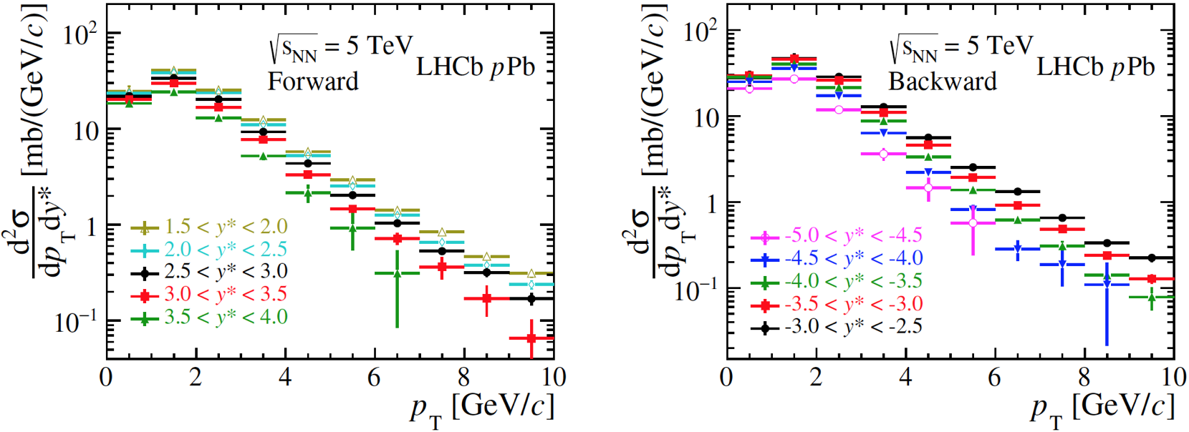
Prompt $D^{0}$: cross section
Double-differential Cross section: $\frac{d^{2}σ}{dydp_{T}}=\frac{N(D^{0}→K^{−}π^{+};{ p}_{T},y)}{ℒ×ε(p_{T},y)×ℬ(Λ_{c}^{+}→pK^{−}π^{+})×Δy×Δp_{T}}$
The uncertainty is the quadratic sum of the statistical and systematic components
$ε(p_{T},y)$: effeciency estimated from simulation sample
$σ(p_{T}<10 GeV/c$ $, 1.5<y^{∗}<4.0)=230.6±0.5(stat)±13.0(sys)$ mb
$σ(p_{T}<10 GeV/c$ $, −5.0<y^{∗}<−2.5)=252.7±1.0(stat)±20(sys)$ mb
JHEP 10 (2017) 090

Slide 21
Open charm production: prompt $Λ_{c}^{+}$
Reconstructed throught decay channel:$Λ_{c}^{+}→pK^{−}π^{+}$
Obtain $Λ_{c}^{+}$ yields $N(Λ_{c}^{+}→pK^{−}π^{+})$ by fitting invariant mass distribution:
Signal: Gaussian
Background: linear
JHEP 02 (2019) 102

Slide 22
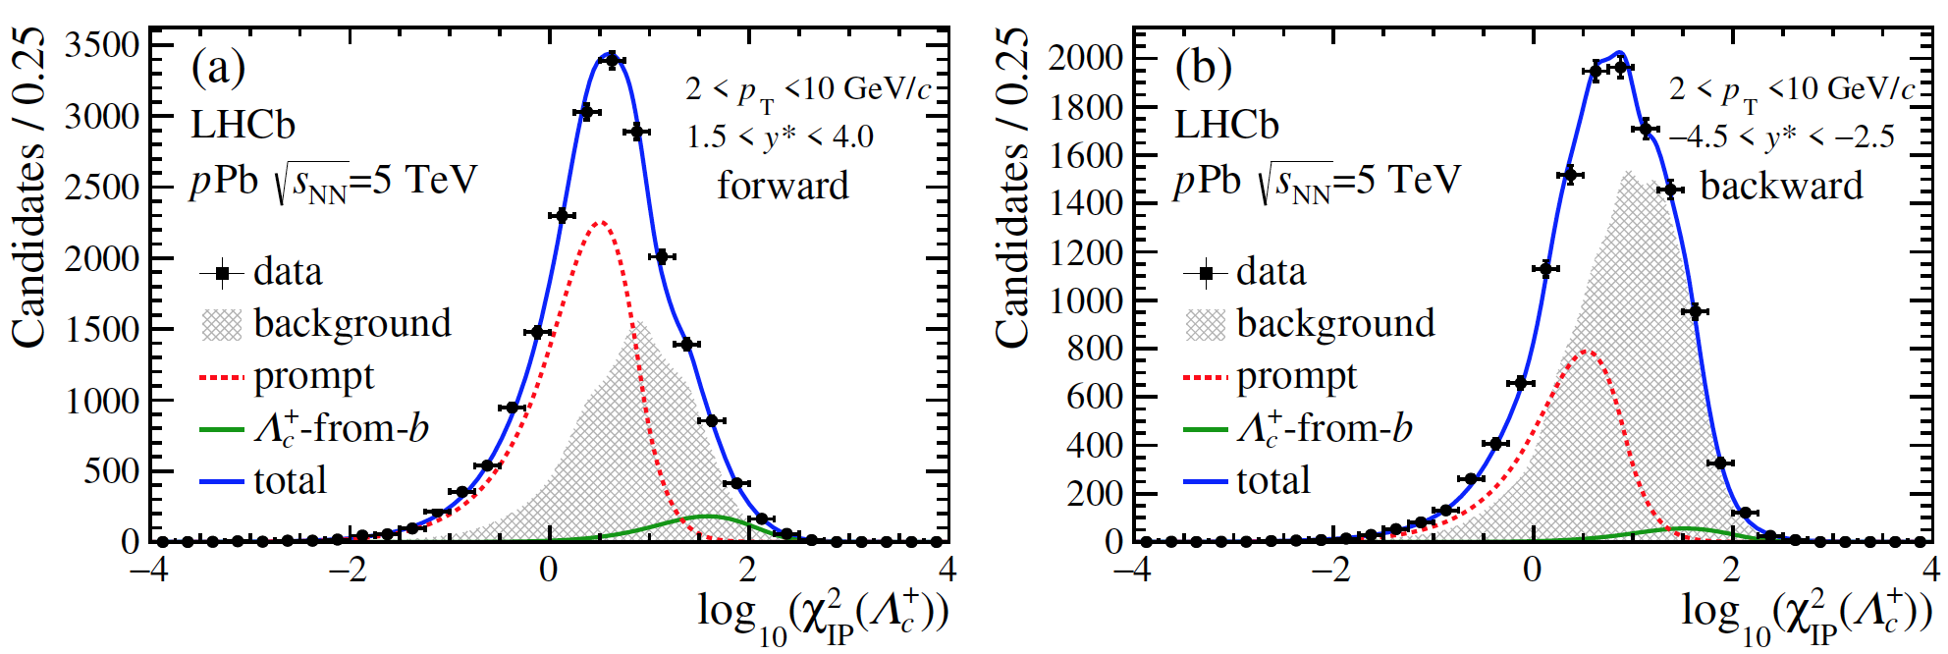
Open charm production: prompt $Λ_{c}^{+}$
Extract prompt $Λ_{c}^{+}$ by fitting $χ_{IP}^{2}$ distribution
Prompt: simulation
from $b$: simulation
Background: sideband in data
$$p\left(K^{−}\right)+p\left(π^{+}\right)+p\left(p^{+}\right)$$
$$p^{+}$$
$$π^{+}$$
$$K^{+}$$
$$Λ_{c}^{+}$$
others
$$PV$$
$$IP$$
JHEP 02 (2019) 102

Slide 23
Prompt $Λ_{c}^{+}$: cross section
stat.+sys.
stat.+sys.
Double-differential Cross section: $\frac{d^{2}σ}{dydp_{T}}=\frac{N(Λ_{c}^{+}→pK^{−}π^{+};{ p}_{T},y)}{ℒ×ε(p_{T},y)×ℬ(Λ_{c}^{+}→pK^{−}π^{+})×Δy×Δp_{T}}$
$ε(p_{T},y)$: effeciency estimated from simulation sample
$σ(2<p_{T}<10 GeV/c$ $, 1.5<y^{∗}<4.0)=32.1±1.1(stat)±3.2(sys)$ mb
$σ(2<p_{T}<10 GeV/c$ $, −5.0<y^{∗}<−2.5)=27.7±1.8(stat)±3.8(sys)$ mb
JHEP 02 (2019) 102

Slide 24
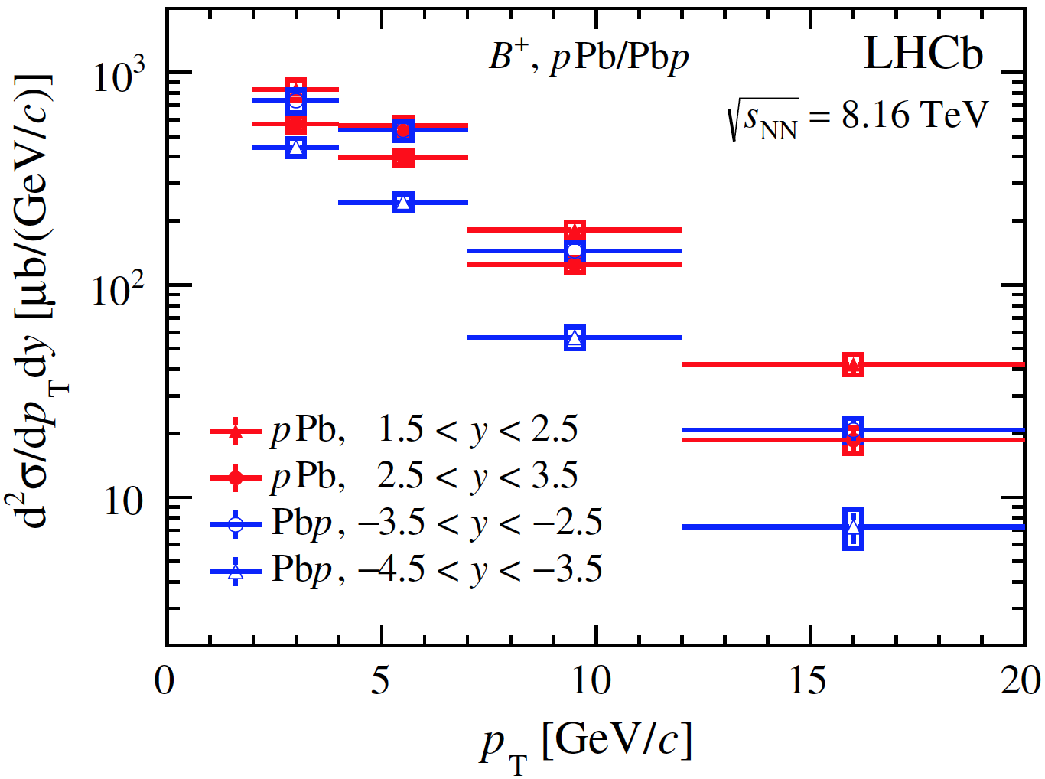
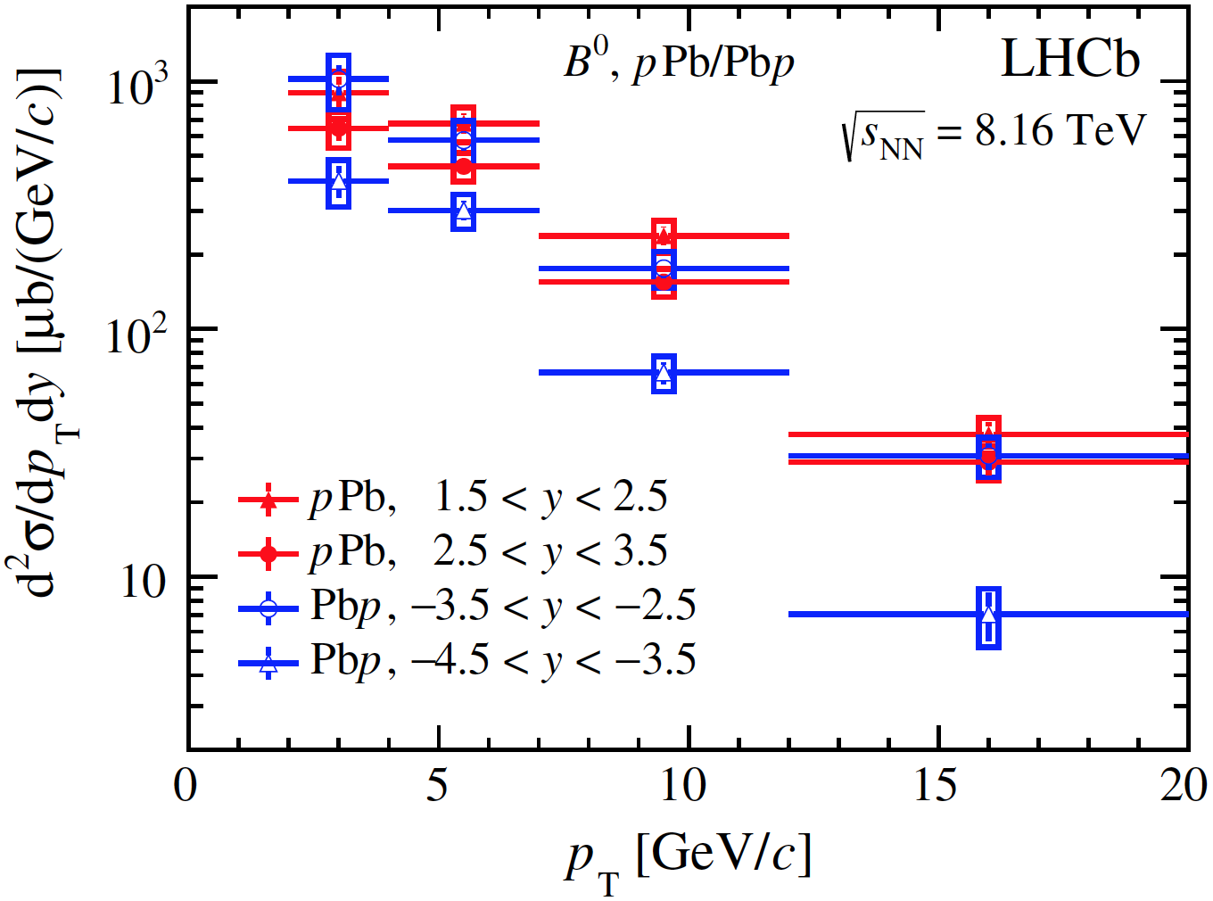
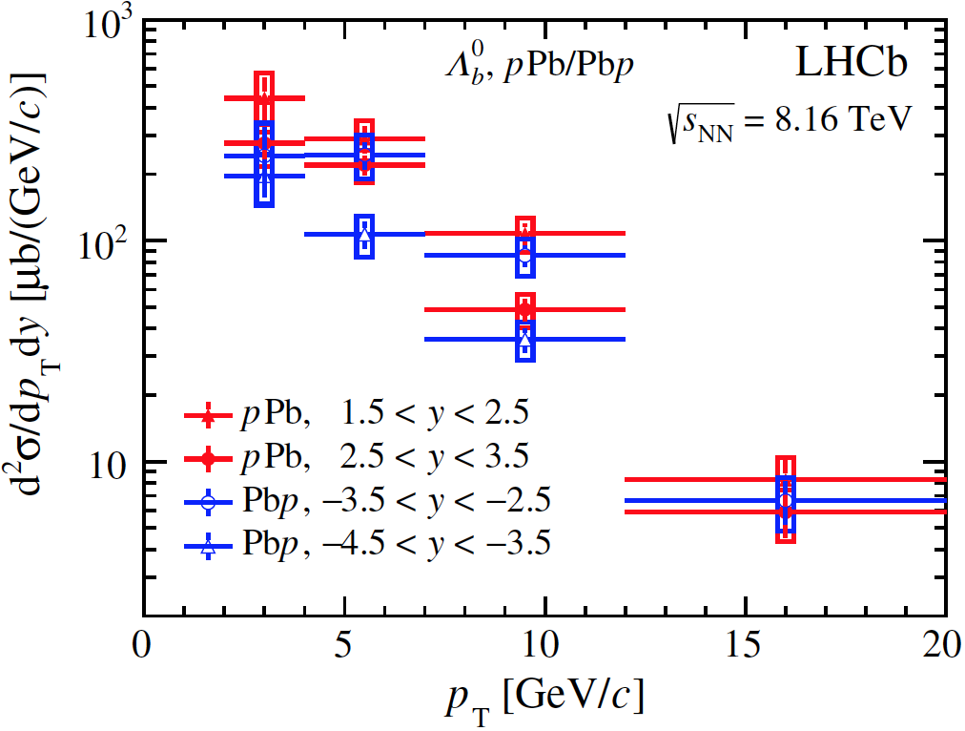
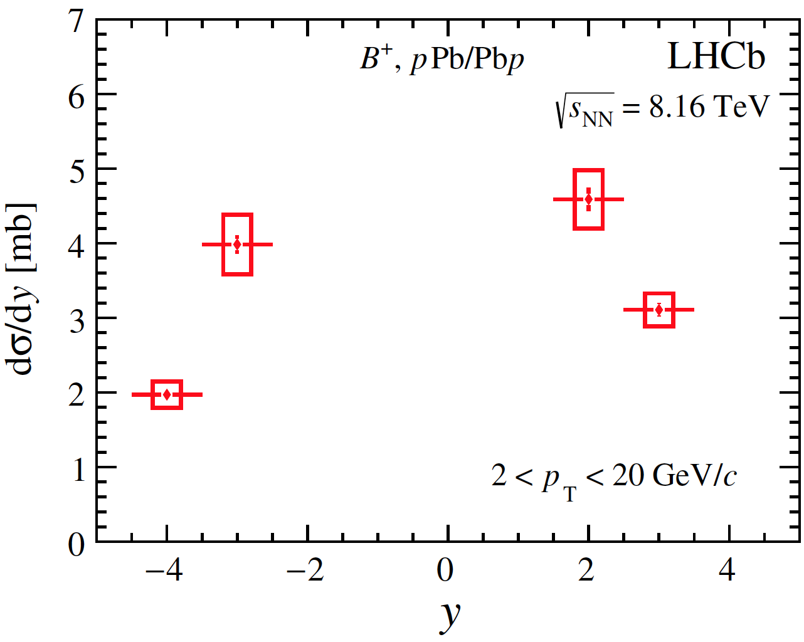
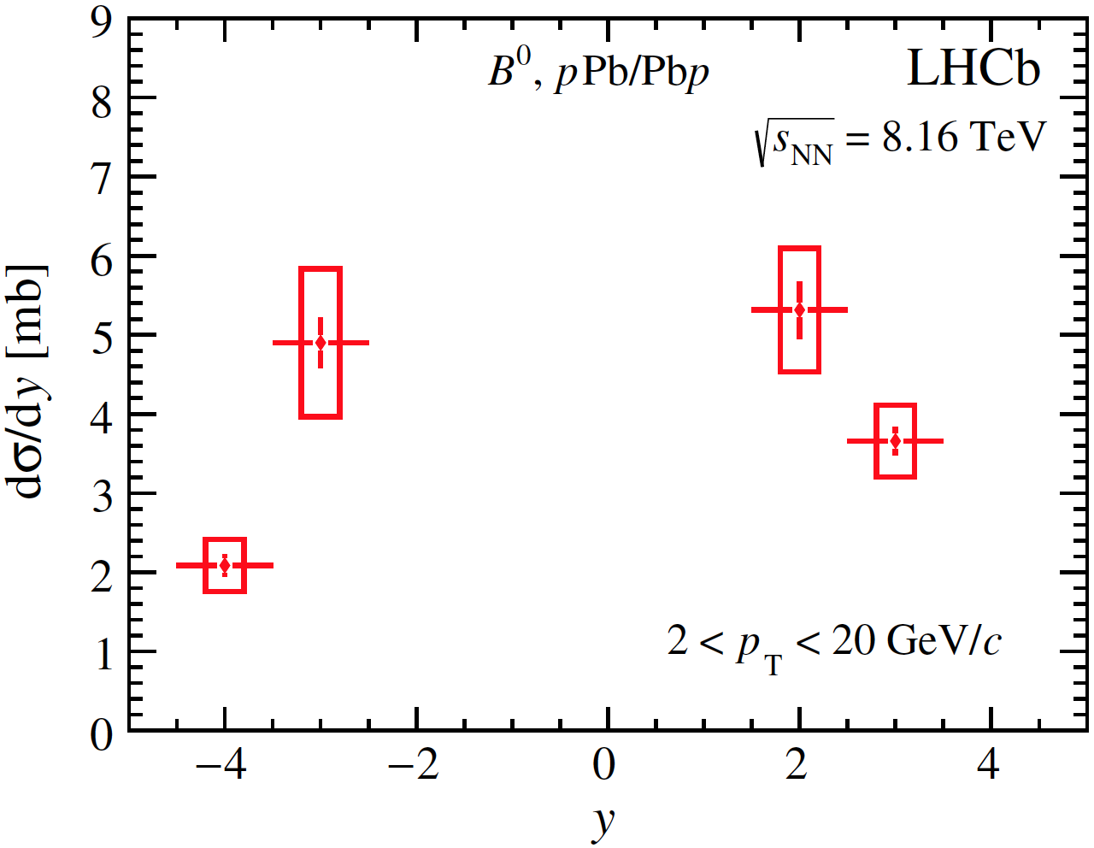
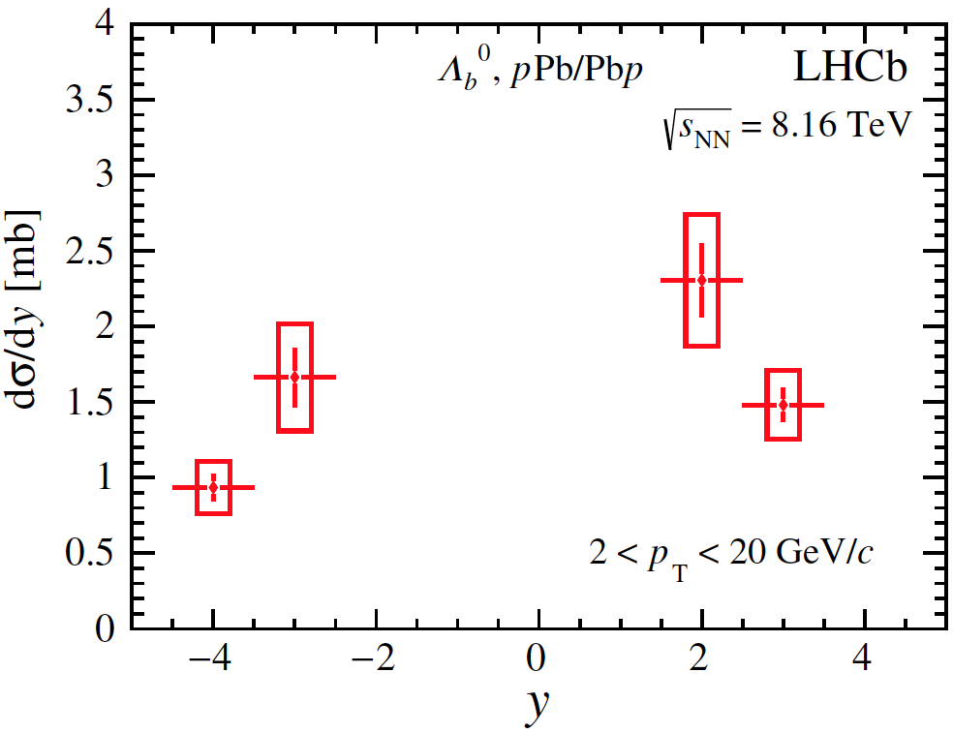
Beauty production: cross section
tot.
tot.
tot.
stat.
stat.
stat.
tot.
tot.
tot.
stat.
stat.
stat.
$p_{T}$ and $y$ distribution for $Λ_{b}^{0}$, $B^{+} and B^{0}$ are similar
Phys. Rev. D99 052011 (2019)

