Slide 1

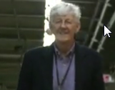
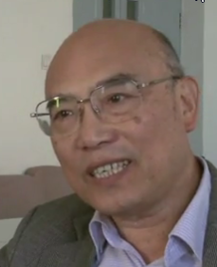
First permanent international computer network connection between China and US
Les Cottrell^{SLAC}, Xu Rong Sheng^{IHEP}
Cottrell@slac.Stanford.edu, Xurs@ihep.ac.cn
^{Sept 5-6, 2019, IHEP Beijing}
Notes:
Talk is at: https://confluence.slac.stanford.edu/download/attachments/17164/china-2019.pptx
Third trip to China:
1991 May the subject of this talk
2001 CHEP’01 3–7 September 2001Beijing, China
Sept 2019: This time.

Slide 2
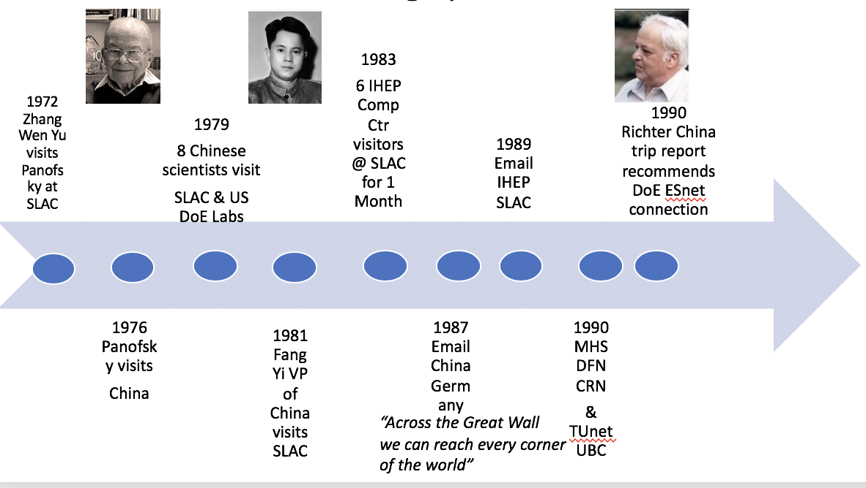
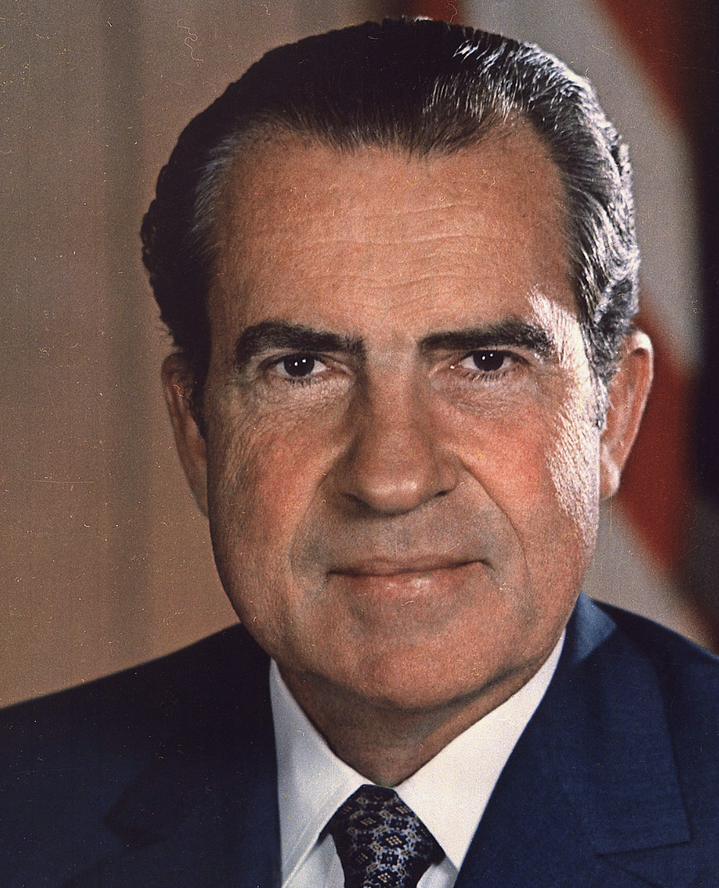
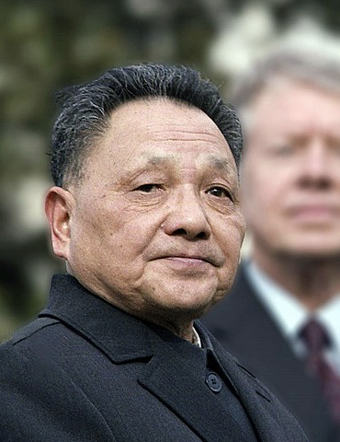
Prelude
Nixon
Deng Xaio Peng
Notes:
1970s and 1980s very active time:
for networks in particular packet switching and the merging of multiple networks into the public Internet using TCP/ip
the opening up of China,
1972 Nixon’s visit to China, https://en.wikipedia.org/wiki/Richard_Nixon%27s_1972_visit_to_China
1979 Deng Xiao Ping visits the US
SLAC Archives https://confluence.slac.stanford.edu/download/attachments/135445636/WWW_to_China_SLAC_role_Cottrell_20130308.pdf
1983 6 Chinese visit SLAC https://confluence.slac.stanford.edu/display/TAN/Chinese+Visitors+to+SLAC+1983
http://www.columbia.edu/~hauben/china-email.doc
Email 14th Sept 1987 from Chinese Institute of Computer Applications (ICA) over 300 Baud modem using X.25 via satellite link . Message said “Ueber die Grosse Mauer erreichen wie alle Ecken der Welt” "Across the Great Wall we can reach every corner in the world." PKTELCOM Beijing was connected over a satellite link to ITAPAC, which was the X.25 packet network of Italy. From there the message was sent via a gateway to the German X.25 network, DATEX-P, to be delivered to the Karlsruhe Siemens host. The Siemens host in Karlsruhe was connected via the Karlsruhe local area network with a VAX 11/750. That computer “irau11.germany.csnet” acted as the central CSNET node for Germany. What was missing was the official approval of the US authorities that funded CSNET. The US National Science Foundation (NSF) was the umbrella institution for all CSNET networking within the US and also abroad at that time. Immediately after the technical connectivity was achieved, Zorn worked with Wang to win acceptance from the NSF for worldwide email traffic to and from China. With the help of Lawrence Landweber, the Chairman of the CSNET project, and support from Dave Farber and Ira Fuchs, acceptance by the NSF was achieved less than two months later. When Zorn read the above article he wrote to me about Lawrence Landweber, "Without his everlasting support from 1984 and after, the whole work would not have been possible." Zorn also wrote that the email connection project was strongly supported by many leading network people worldwide. He named, besides Landweber, Dave Farber, Ira Fuchs, Richard Mandelbaum and Stephen Wolff in the US, Wang in China and for example Dennis Jennings in the US and Daniel Karrenberg in the Netherlands who attended the first CANET conference in Beijing in March 1988 and Kilnam Chon in Korea who was active in networking in the Asia/Pacific Rim region. (email messages April 28 and May 18, 2005).
Even with the support of the Chinese State Science and Technology Commission (SSTC), hardly any Chinese institution and no individual scientist could afford to send or receive email messages to or from abroad. That was because X.25 for international traffic increased in cost as the volume of email traffic increased. The cost on the Chinese side included charges for every message received as well as sent. Zorn estimated that longer email messages could cost a professor the equivalent of a whole month's salary. The charges, typically $2000 to $5,000 per month paid by each side were more of a burden for the Chinese side than the German side. Email usage was thus severely restricted. For computer networking activity, ICA was financially better off than were the Chinese universities because ICA was funded by the Ministry of Machinery Industry while the universities were funded by the Ministry of Education which could not distribute as much money as ICA received to each university.
1987 BEPC2 (VAX 785) @ IHEP linked to CERN via packet switched data network (PSDN)
May 1990 changed to CNPac (X.25 at 4.8kbps) from Ministry of Telecommunication, China
Provided Email connectivity via CERN VAX VXNODE in Geneva
https://confluence.slac.stanford.edu/download/attachments/135445636/WWW_to_China_SLAC_role_Cottrell_20130308.pdf?version=1&modificationDate=1492205223000&api=v2

Slide 3

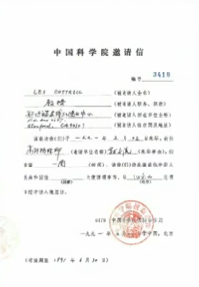
Invitation
Chinese scientists from IHEP, visit SLAC in April/May 1991
They were interested in computing and networking and as assistant director of computing I was invited to attend a meeting with them
They were particularly interested in a network connection to SLAC to support the Beijing Electron Spectrometer collaboration between IHEP, SLAC and other US institutions
With a meeting in Tokyo on Computing in
HEP starting May 11, I suggest extending
my trip to include a visit to IHEP in Beijing
IHEP were very supportive, invite me

Slide 4
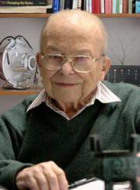
Concerns…
Not knowing what to expect in Beijing
  What was the technology available in IHEP
  I was worried…
I met with Pief Panofsky the Emeritus Director of SLAC
  He was very encouraging
  He had this vision of how excellent networking could make a worldwide physics collaboration really work well
But IHEP international calls needed an operator
How to make this work with a digital network …

Slide 5
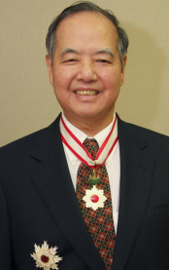


Panofsky to the Rescue
Panofsky called Nobel laureate T. D. Lee of Columbia for help
  Request top priority to installation of 3 phones with unattended international access.
  Get me a visa
3 weeks later after the CHEP conference in Tokyo I was met at the old Beijing airport
  Taken to the Friendship Hotel, used to be for Russian experts

Slide 6
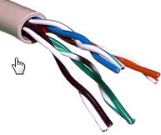
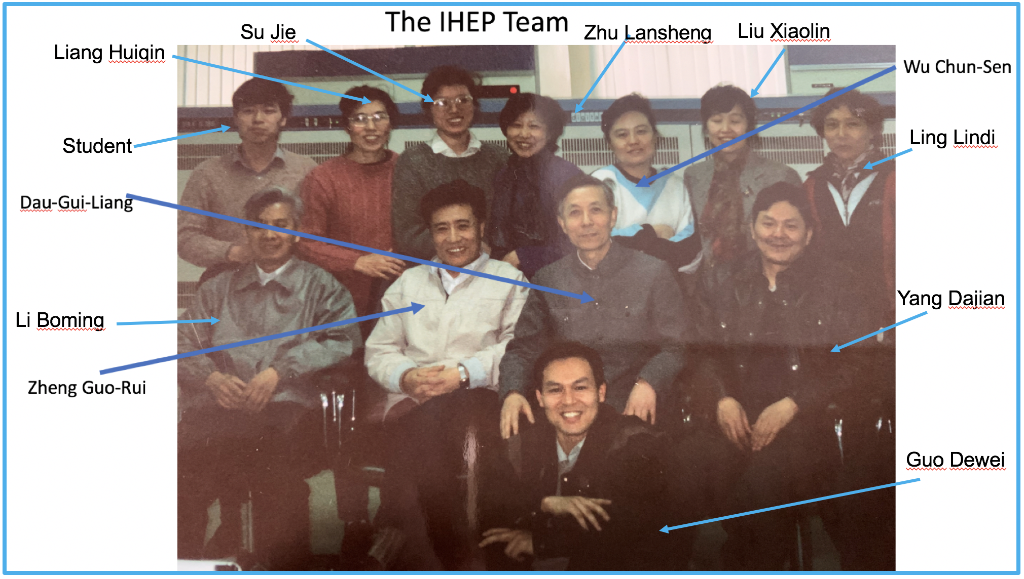
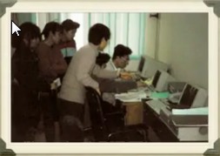
Working with IHEP staff
I was amazed to find the phone lines in place and working
They were excited about
working with western “experts”
  I was flattered to be considered
  “expert”, and by their attention,
  friendliness and enthusiasm
However, soon found that despite nods and smiles I was talking way too fast
  So wrote everything down as I talked, this
  forced me to go slowly and provided a
  written record

Slide 7
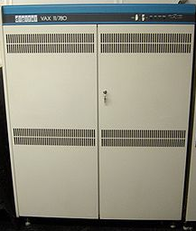



Accomplished at IHEP
Hooked up a 9600bps modem between phone & VAX 11/785
Used 2nd phone line to call Charley Granieri at SLAC (15 hours apart)
  Set up asynchronous DECnet dial-up connection SLAC – IHEP
  Effective 400 bits/sec, very noisy and hard to use
    Often unable (no international line available) to make connections
    Frequent disconnects in mid-session
  $3.0/min
IHEP
VAX
SLAC
Notes:
When Cottrell arrived in Beijing carrying a 9600-bps (bits per second) Telebit Corp. T2500 modem in his luggage, the three phone lines had been installed and were waiting for him. Before long, Cottrell, working with Charles Granieri, a computer systems specialist at SLAC, was able to get a direct modem connection between IHEP and SLAC that transmitted data at about 900 bps.

Slide 8


On return to US
Setup Tymnet connection via LLNL and CNPac
  Typically 5-10 emails/day and 5-20 mins for remote logon
  Very sluggish for remote logon (1.5 sec response time)
  Transfer rate few hundred bits/s
  Cost ~ $5K/month for US end and $7K for Chinese end
Interest from DoE community & the NSF
Convinced US/DoE needed upgrade to a permanent link
  Chose AT&T Skynet satellite
  For DoE: SLAC and SSC with SLAC taking US lead
  DoE approved proposal 1991
  Contract signed with AT&T January 1992
  $US cost $5K install & $5.5K/month, similar for IHEP

Slide 9
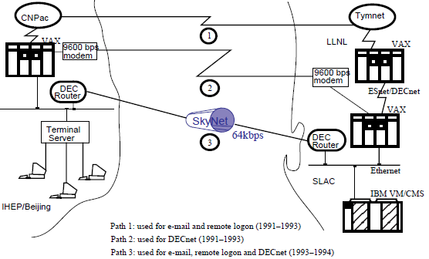
So then we had or were working towards
Original drawing from paper in 1994

Slide 10
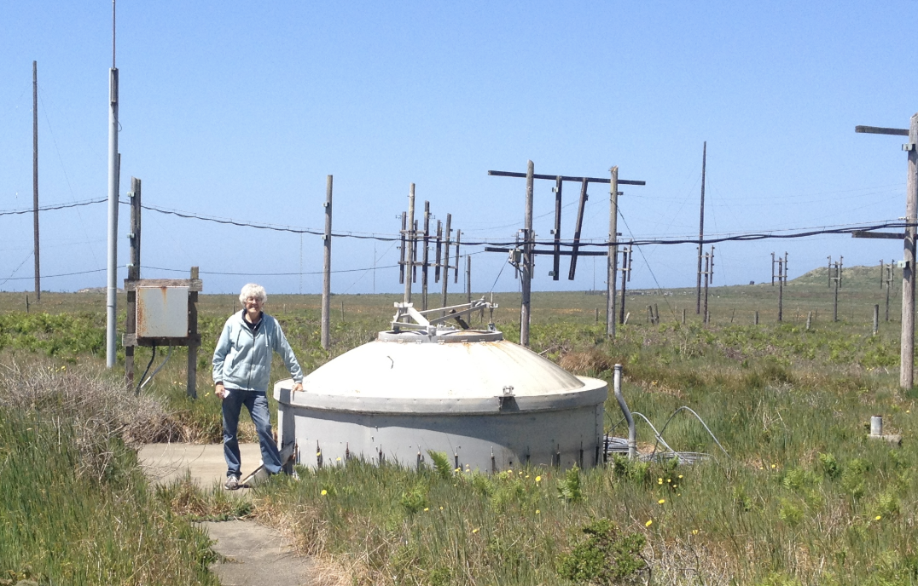
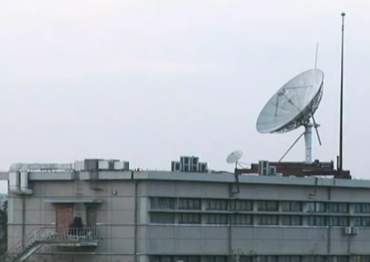
Then it got really hard
US downstation Point Reyes N of San Francisco
China downstation Beijing airport
From airport microwave to BTA bldg 801 35km away in center of Beijing
BTA 801 to 821 exchange bldg 2 blocks from IHEP
  Tried infrared, then microwave but error
  rates too high, eventually got a fibre route
  Last 2 blocks there was copper, but
  problems with converting fibre to copper
  March 1st 1993 acceptable error rates, handed over to IHEP
  Seconds later monitor program showed the SLAC DECrouter adjacent to IHEP
DoE/SLAC paid $50K/yr, similar from China
2010

Slide 11
How did it work & for what
Hundred times better:
  42kps file transfer
  Echo time < 1 second
  Error rate 1 in 10 million
  1-2 unscheduled outages/month
  Twice yearly occulted by sun directly in line with satellite
How was it used:
  Transfer physics data: 200MB/day (equivalent to that era’s tape cartridge – IBM 3480)
  2500 emails/day 400 sites in 21 countries via SLAC gateway
  News groups, collaboration coordination, code management
  Copying files, remote login, real-time communication

Slide 12
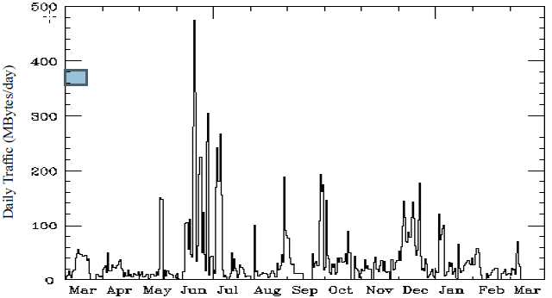
Daily Utilization 1993-1994

Slide 13
Connecting to the Internet
Once 64kbps link established many Chinese institutions wanted to connect to IHEP to get direct access to Internet
Dec 1994 Visit by US congressman George Brown to IHEP increased US government interest
Replaced DEC routers with Cisco routers
  Got export licenses from US DOC
  Received in Beijing Feb 1994, installed in March
  Worldwide HEPnet connected
Agreement for Internet to carry Chinese traffic (DOC, DoD, DoE)
  Required Internet wide-area email sent April 18, 1994, saying China connection April 25, 1994
IHEP fully Internetted via US West Coast interconnection point

Slide 14
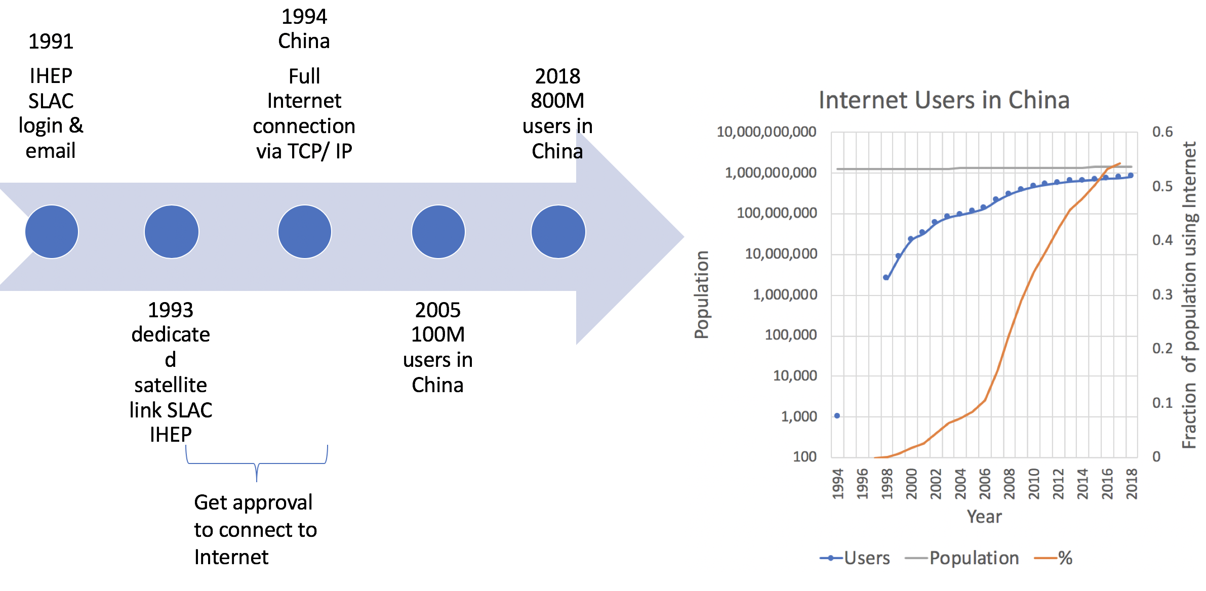
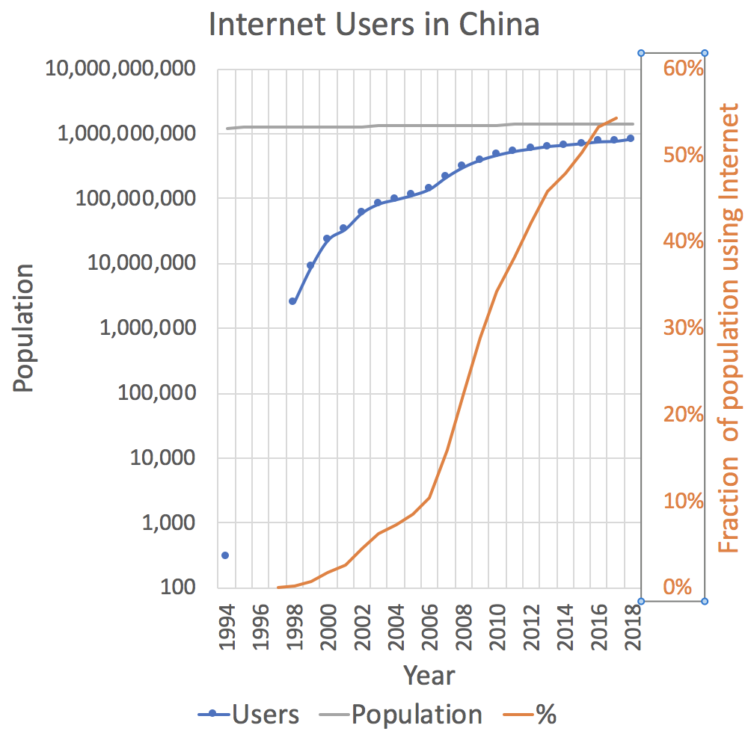
Since then

Slide 15
More Information
Overview
  confluence.slac.stanford.edu/display/TAN/China+Internet+Connection
1994: Academic paper on connection:
  www.slac.stanford.edu/pubs/slacpubs/6000/slac-pub-6478.html
2005: Essay on bringing the Internet to China
  https://www.symmetrymagazine.org/article/november-2005/essay-les-cottrell
2006: Contributions of HEP to China Internet:
  www.slac.stanford.edu/grp/scs/net/talk06/slac-ihep-net-history.ppt
2010: You Tube video
  www.youtube.com/watch?v=hzqr5x8dPV0

Slide 16

Early History
1987 BEPC2 (VAX 785) @ IHEP linked to CERN via packet switched data network (PSDN)
May 1990 changed to CNPac (X.25 at 4.8kbps) from Ministry of Telecommunication, China
Provided Email connectivity via CERN VAX VXNODE in Geneva

Slide 17
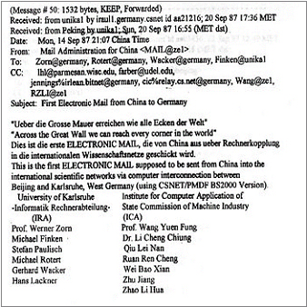
First Email China toGermany

