Slide 1
BES R Measurements and from BESII to BESIII
Zhengguo Zhao
University of Science and Technology of China
Symposium on 30 Years BES, IHEP, Beijing, September 5-6

Slide 2
Outline
BESII R scan - the first breakthrough in most difficult time
- Critical review to BES1 upgrade: MDT and Lum. monitor
- Why R scan
- The results and its impact to high energy physics
From BES2 to BES3
- Different plans: BEPC upgrade to 10³¹⁻³² single ring vs TCF
- The birth of double ring and new detector → BEPC2 and BES3
Where to go after BESIII → Super Tau Charm Factory (STCF)?
R scan was not an isolated project with great success,
it was closely related to BES’s entire program and efforts.

Slide 3
Senior Advisors of CAS President
T.D. Lee
Pief Panofsky
Maury Tigner
Fred Gilman
Their great contribution to promote the BEPC/BES project, the collaboration between the U.S. and China in sciences, high energy physics in particular, will never be forgotten.
The high energy physics in China has got strong support from US,
Japan (KEK), Europe (CERN), as well as international HEP community.

Slide 4
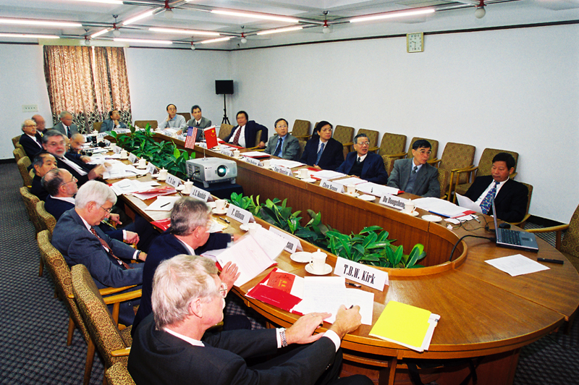
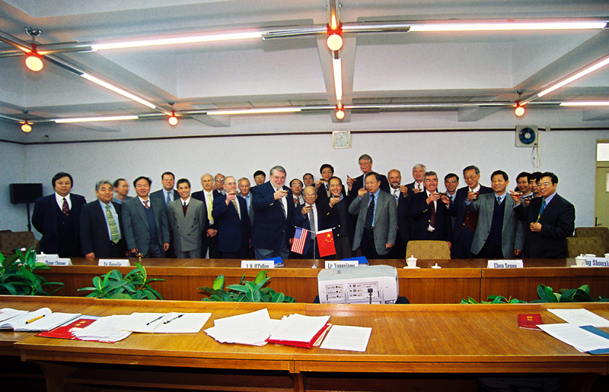
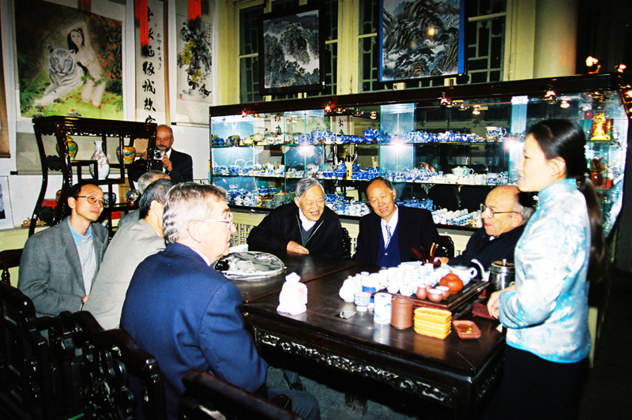
The 21th Joint Committee Meeting
A critical meeting for discussing HEP project after BEPC/BES2
IHEP, Beijing
IHEP, Beijing
Tea room in Prince Gongqi Palace
Proposed future program
for HEP in China for post BEPC
and BES2, and the overall
collaboration in HEP between
US and PRC.

Slide 5
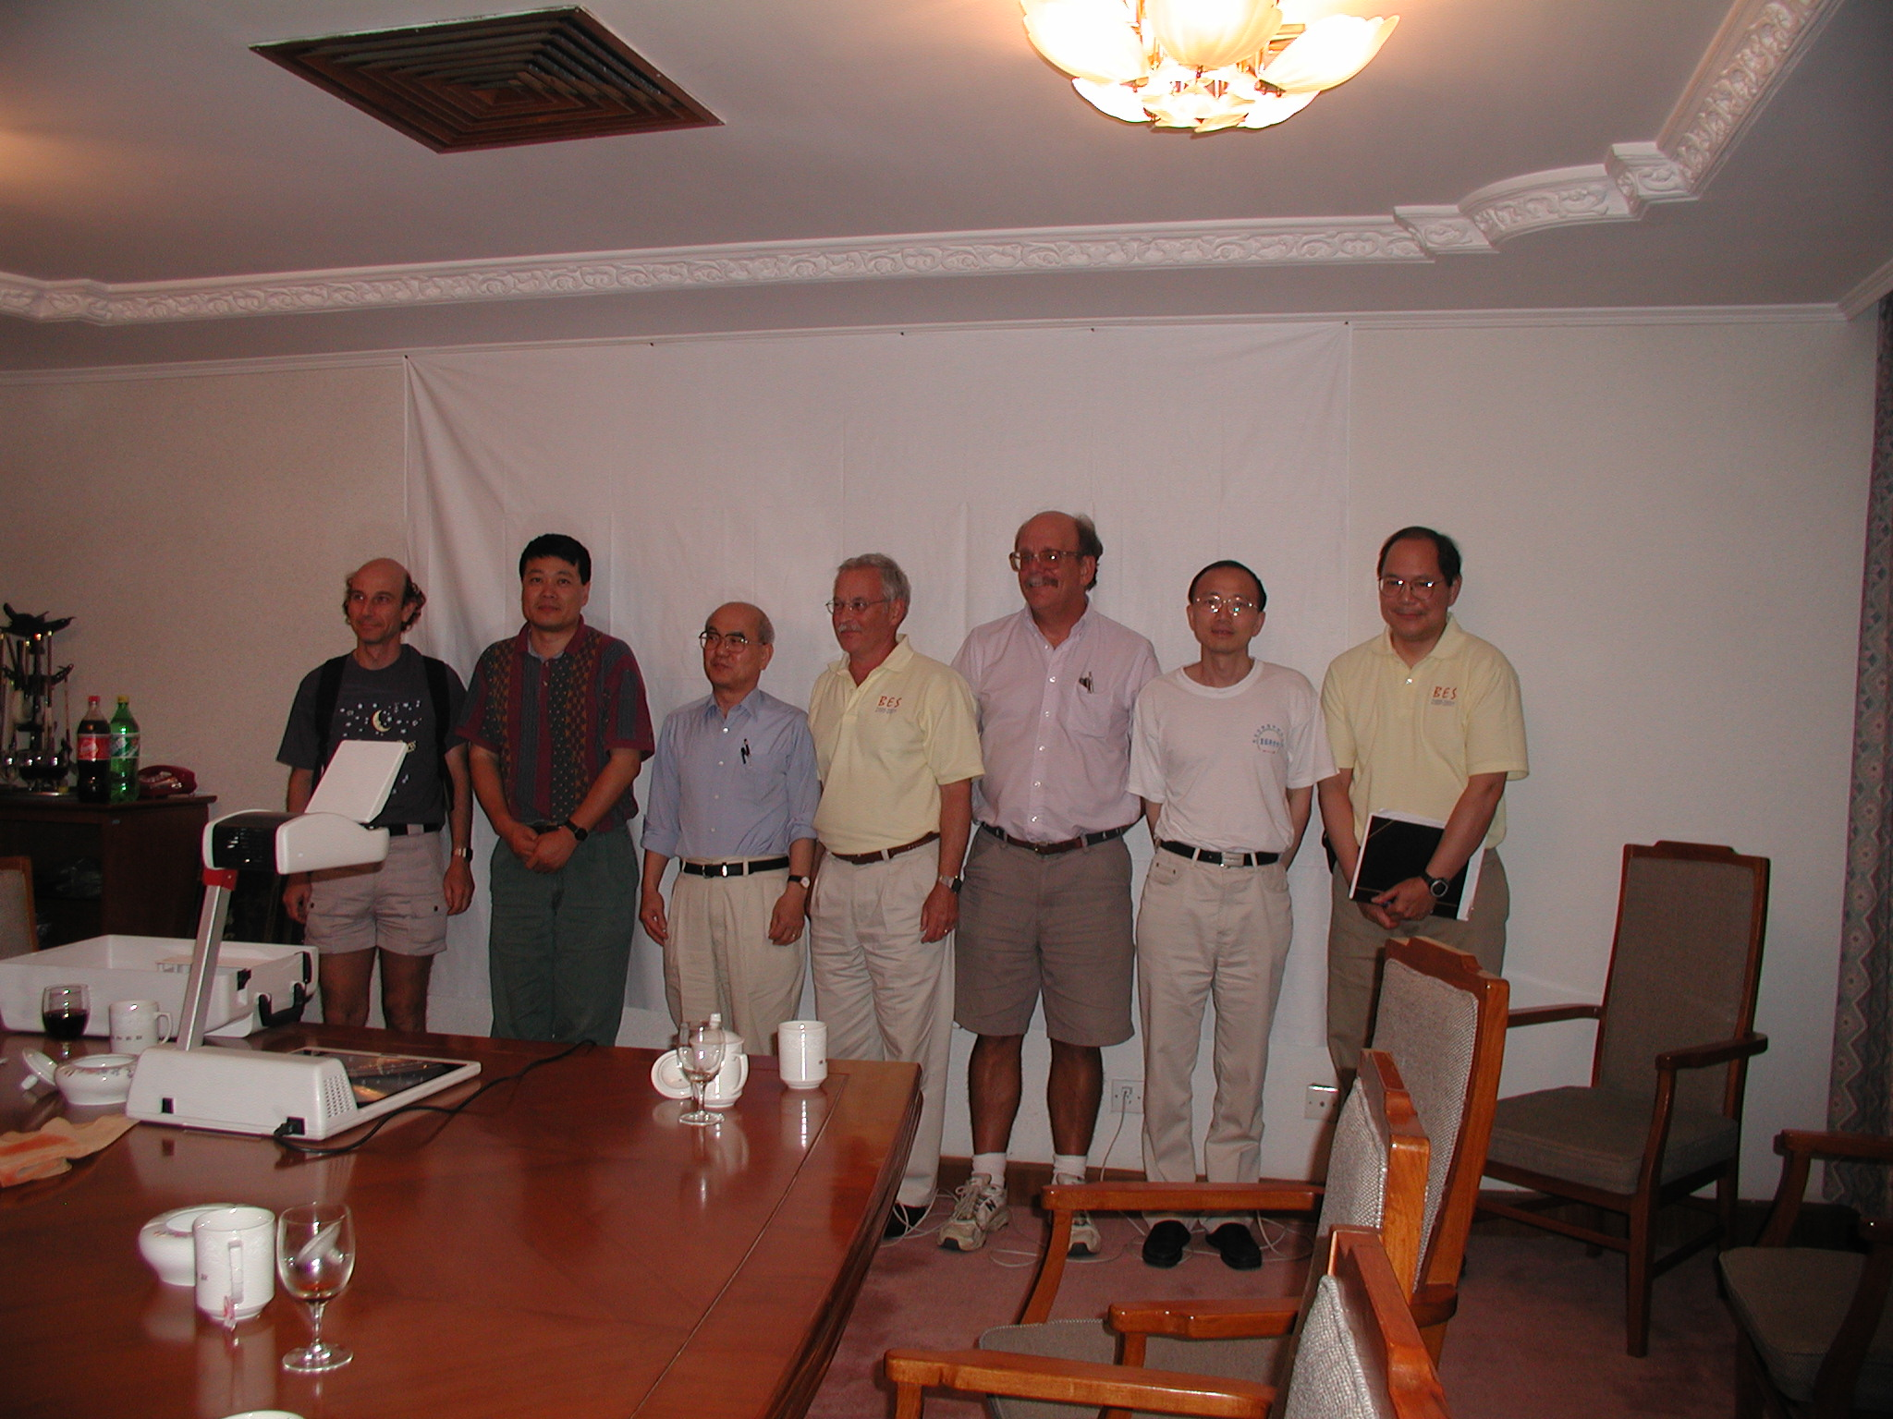
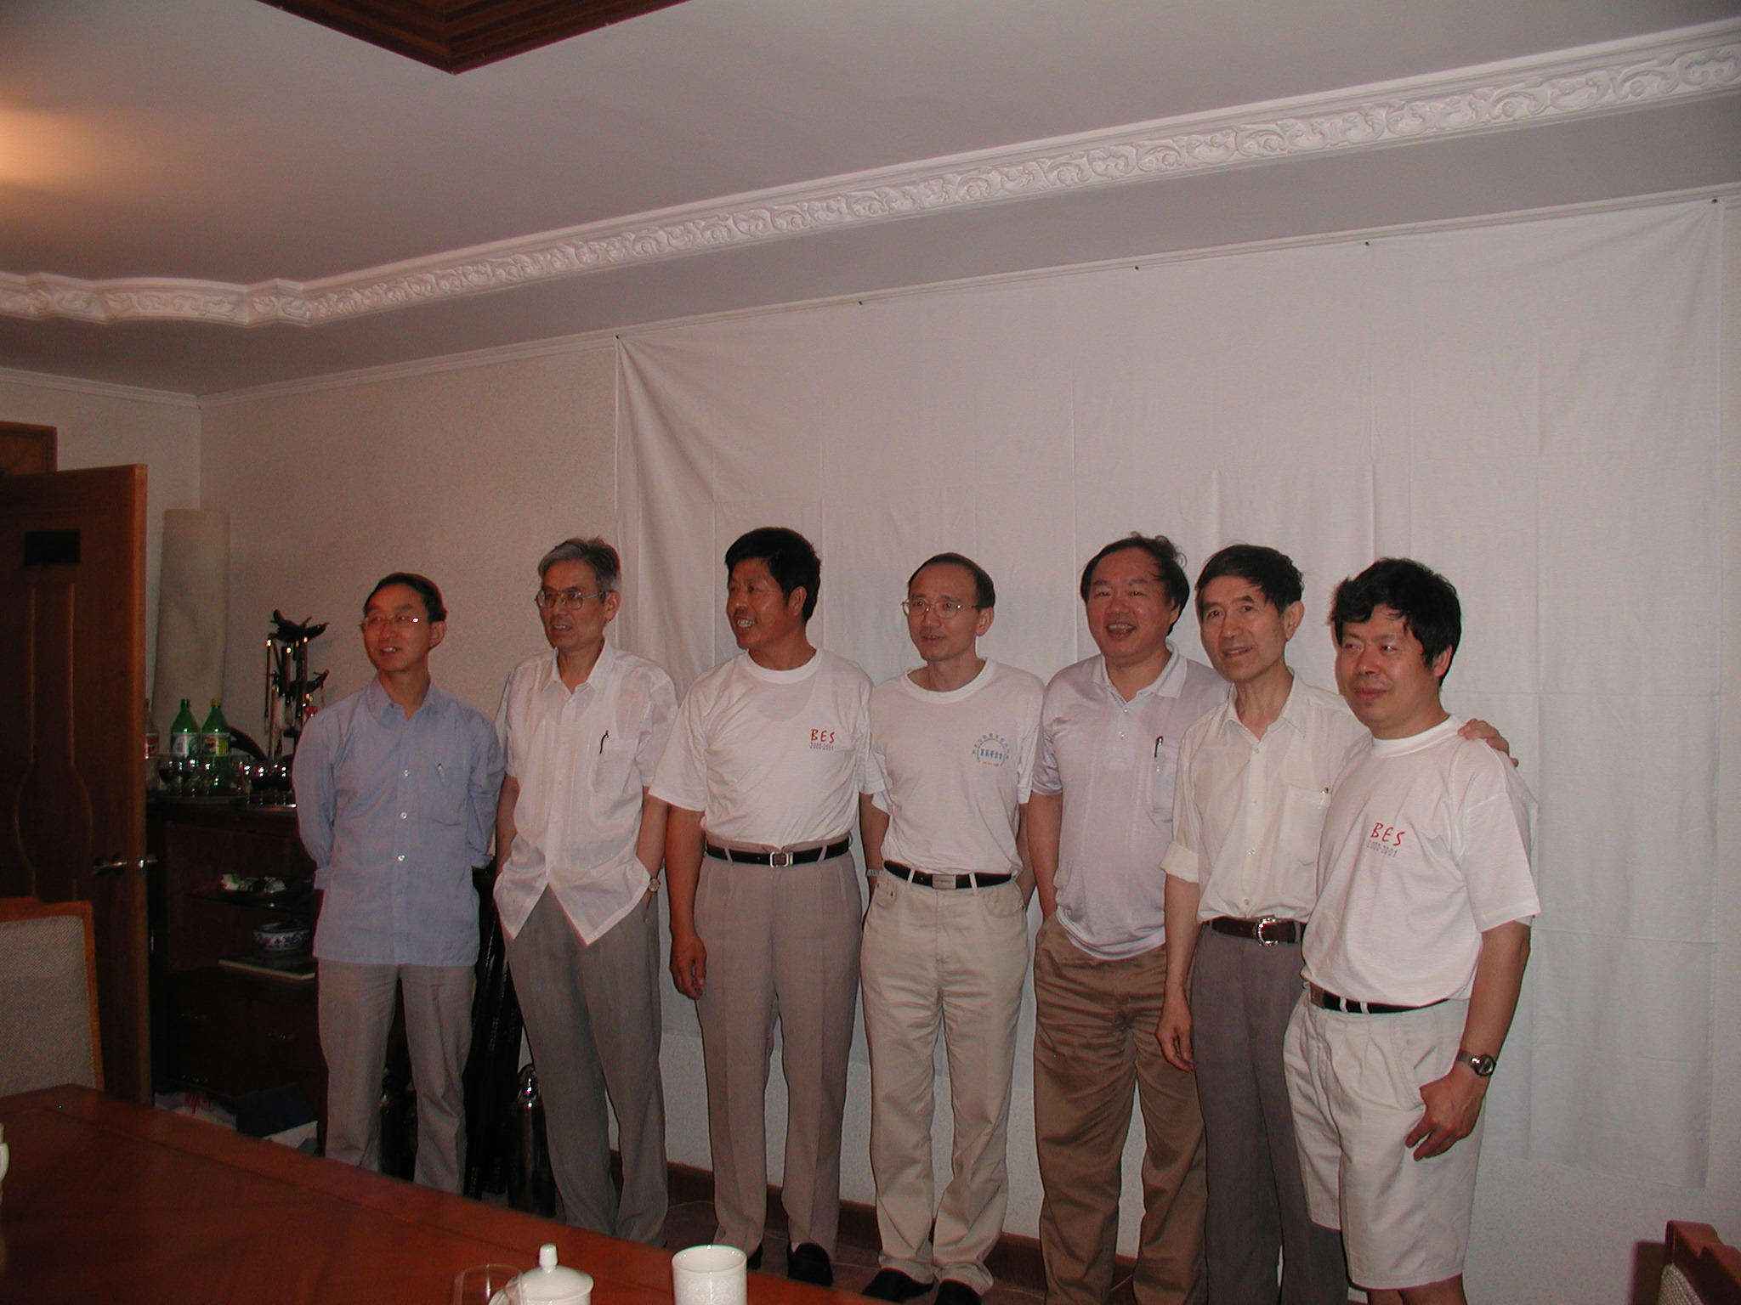
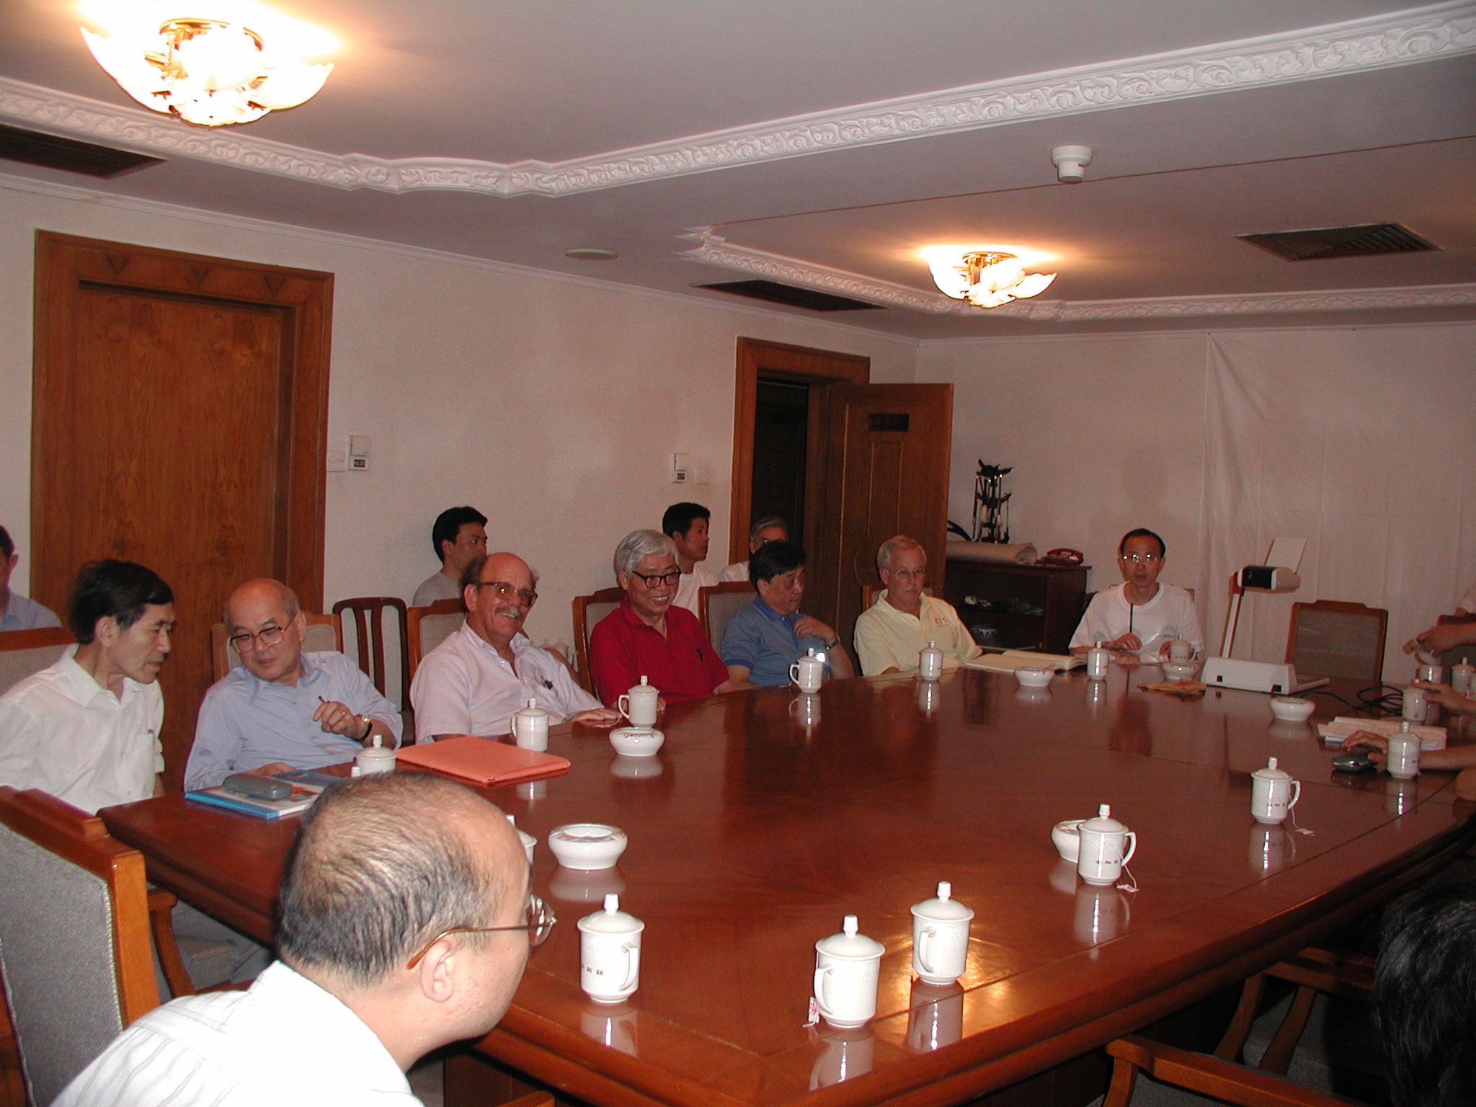
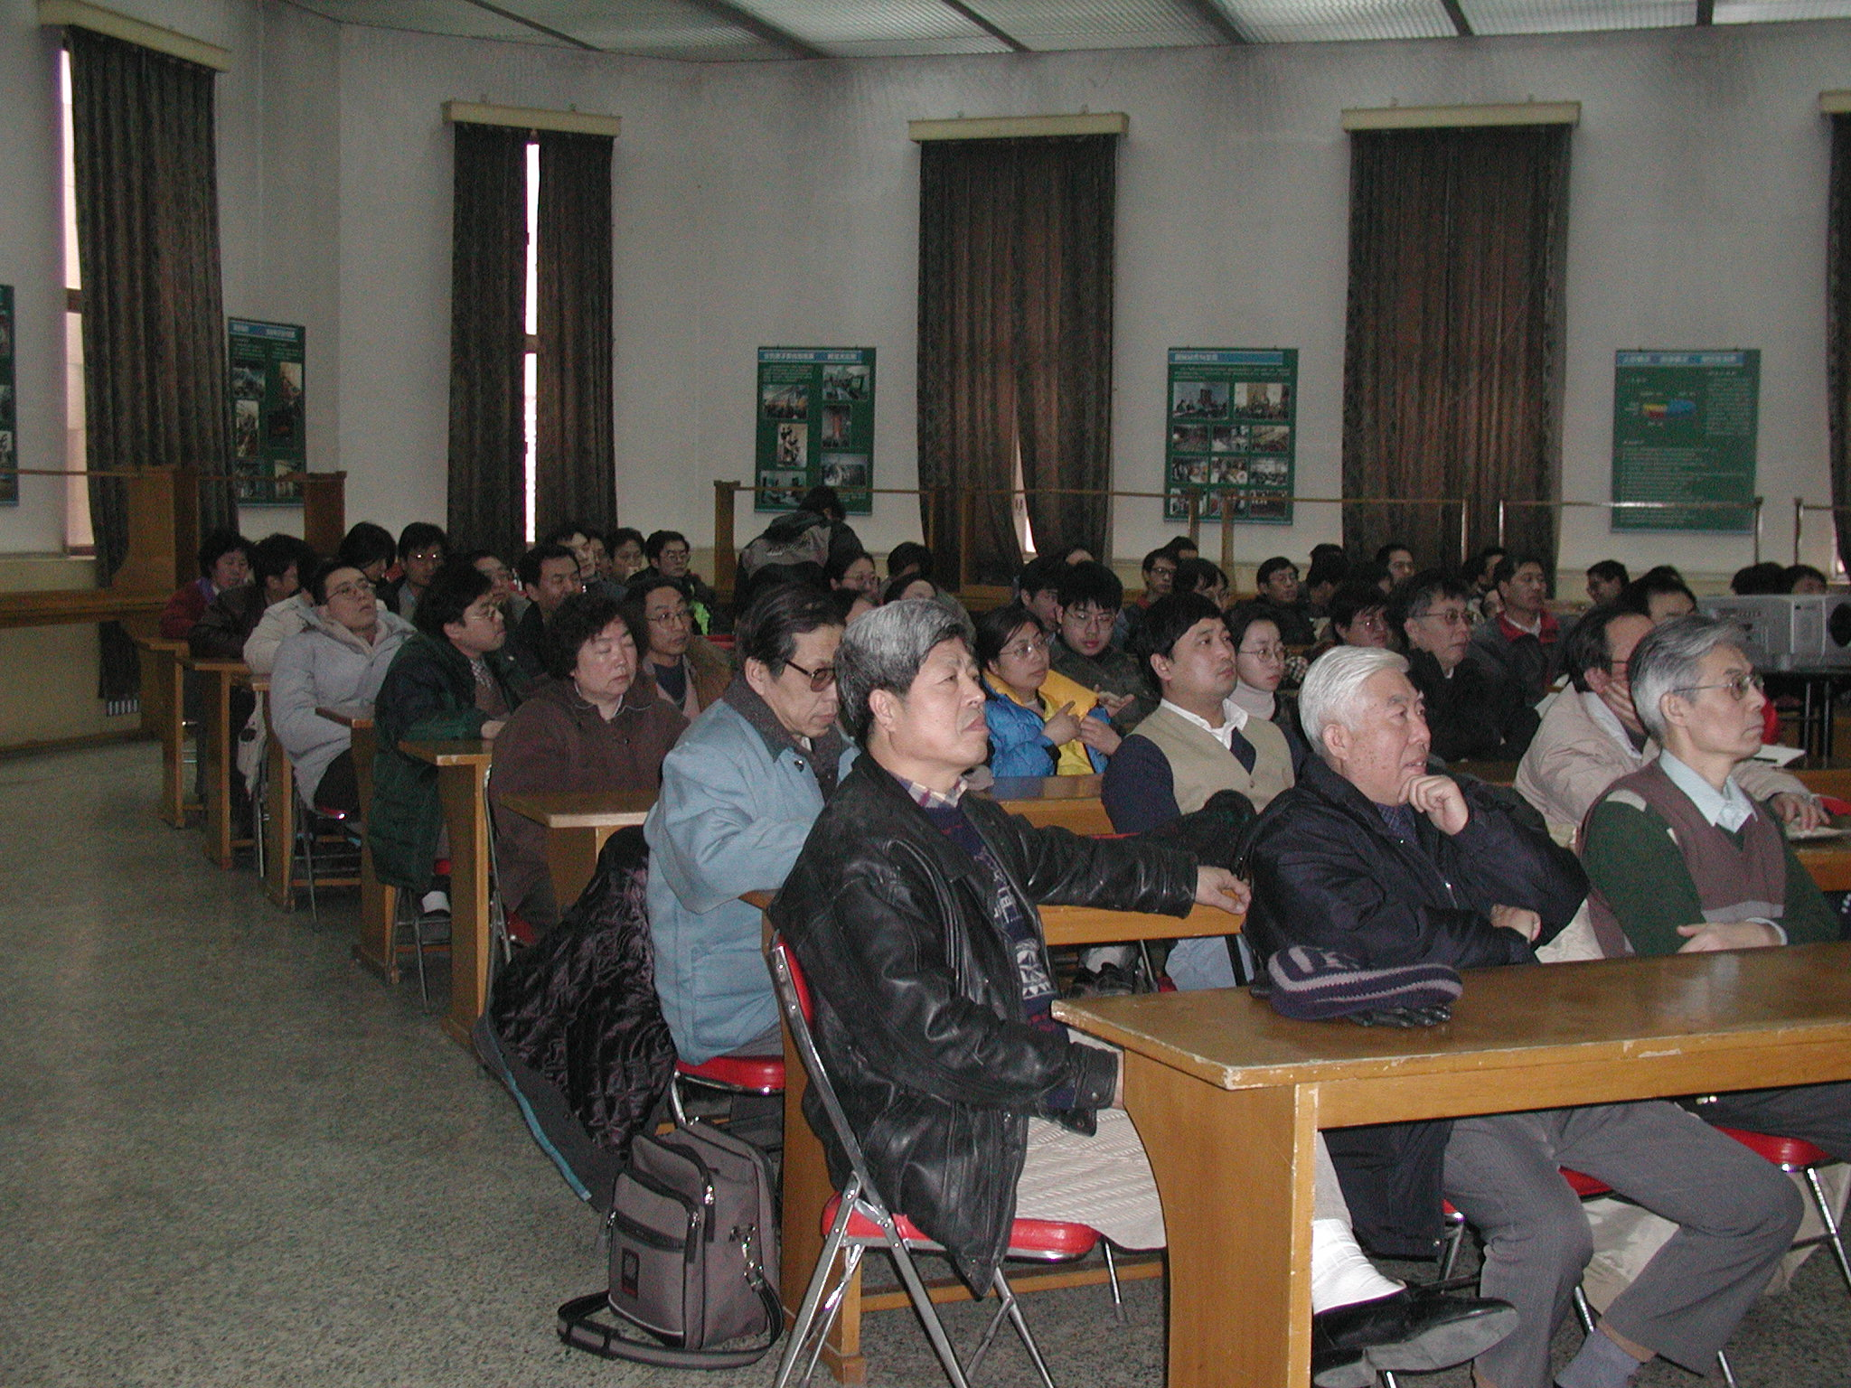
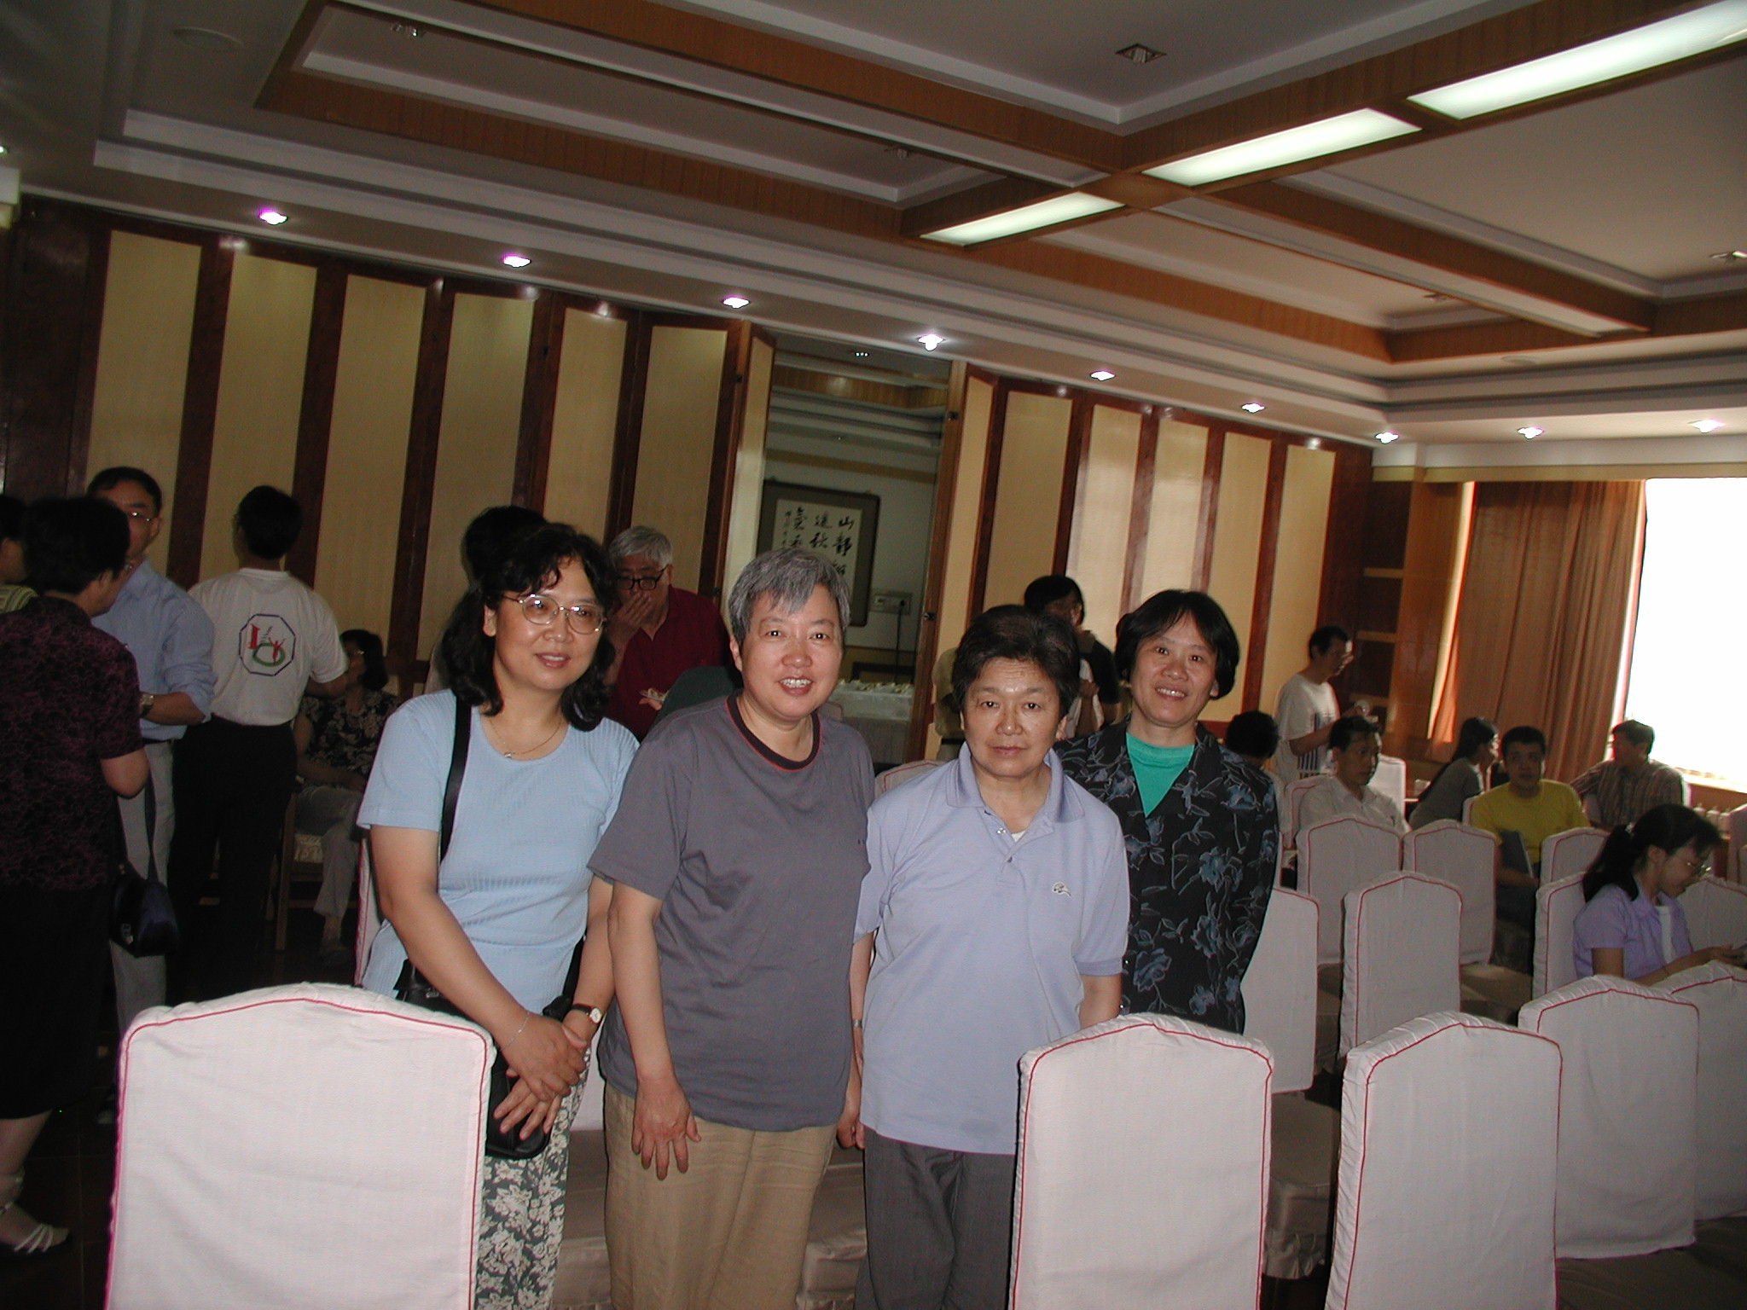
Happy Memories

Slide 6
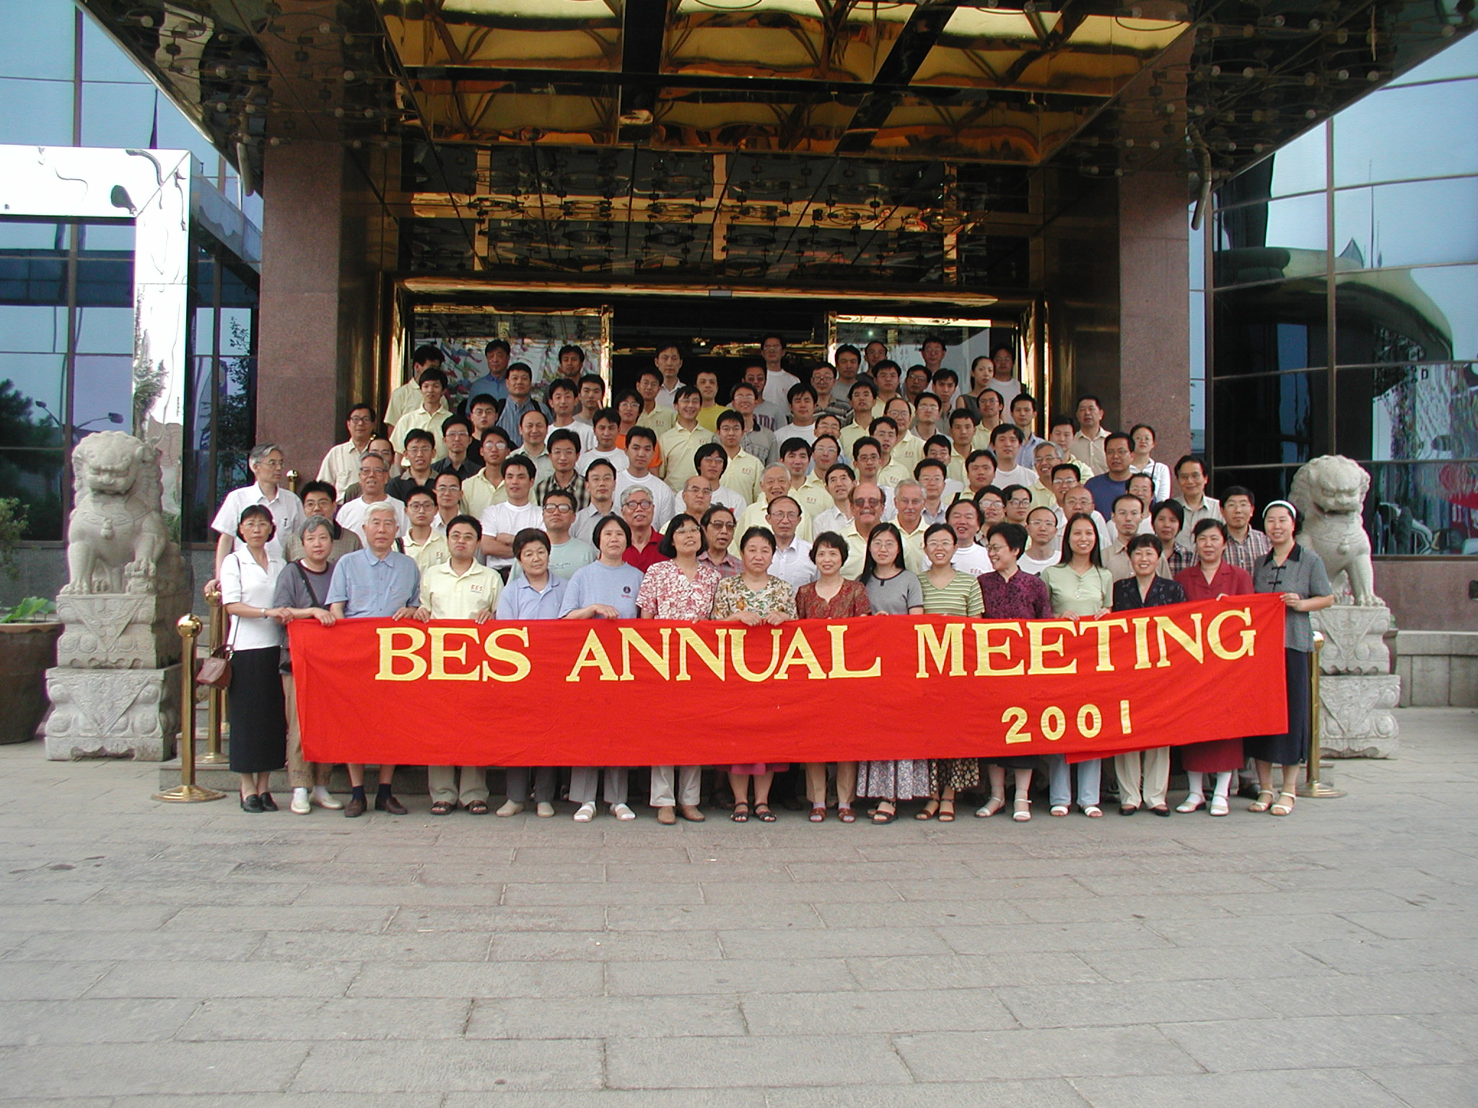
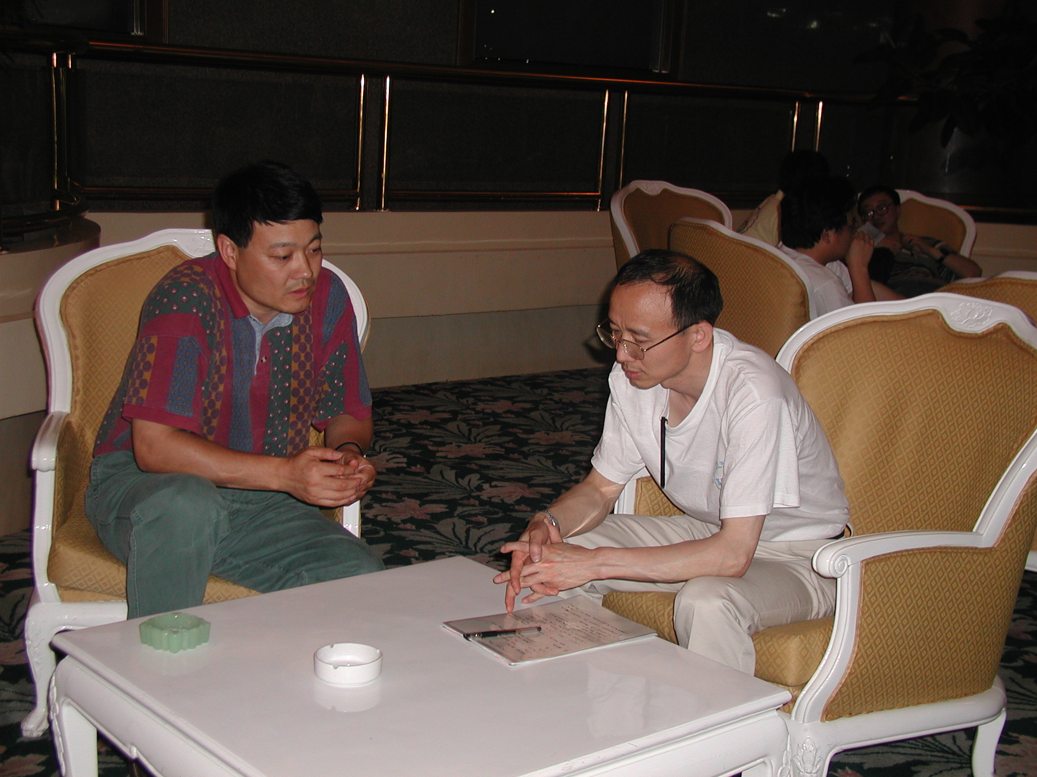
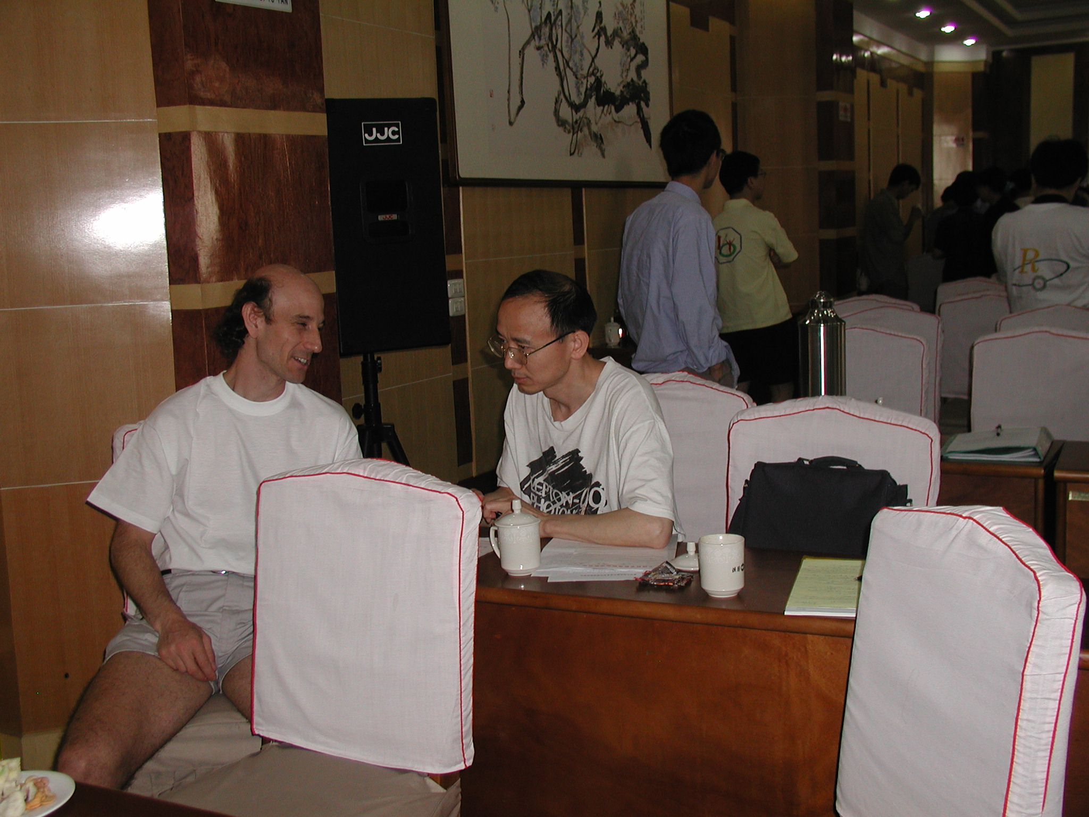
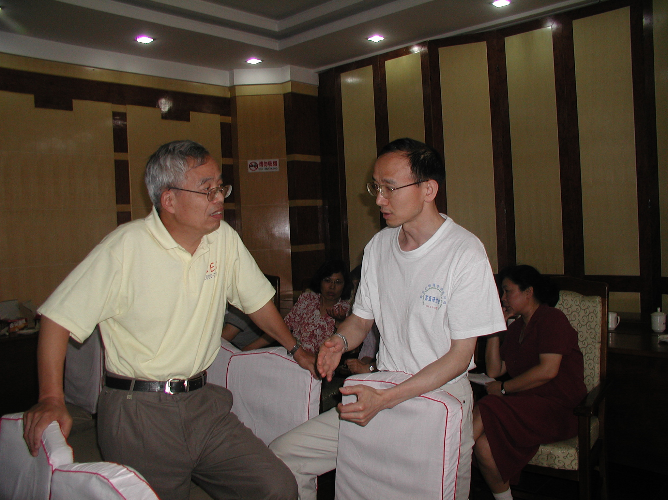
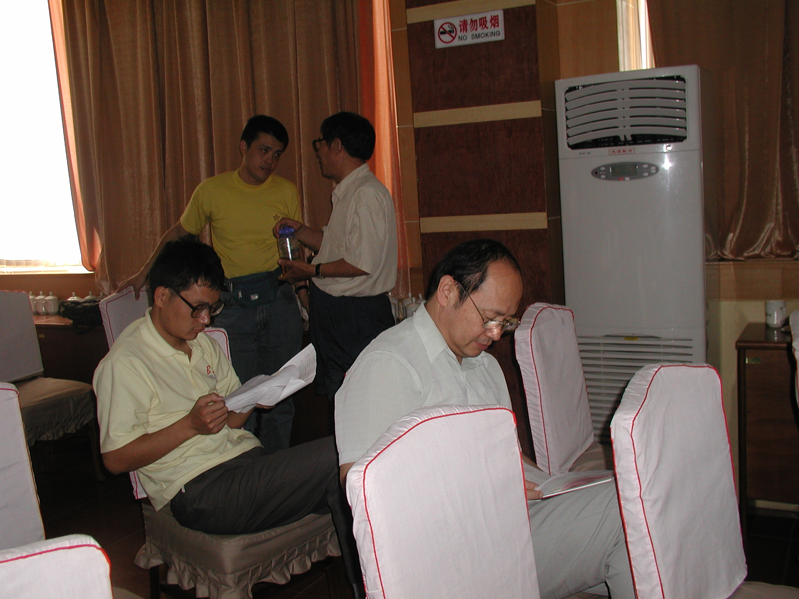
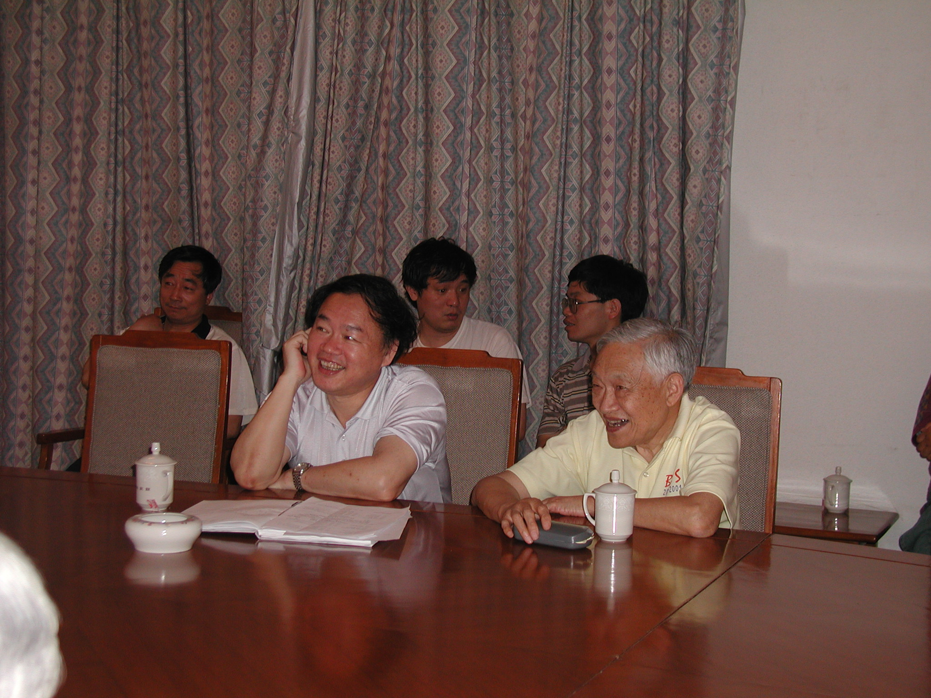
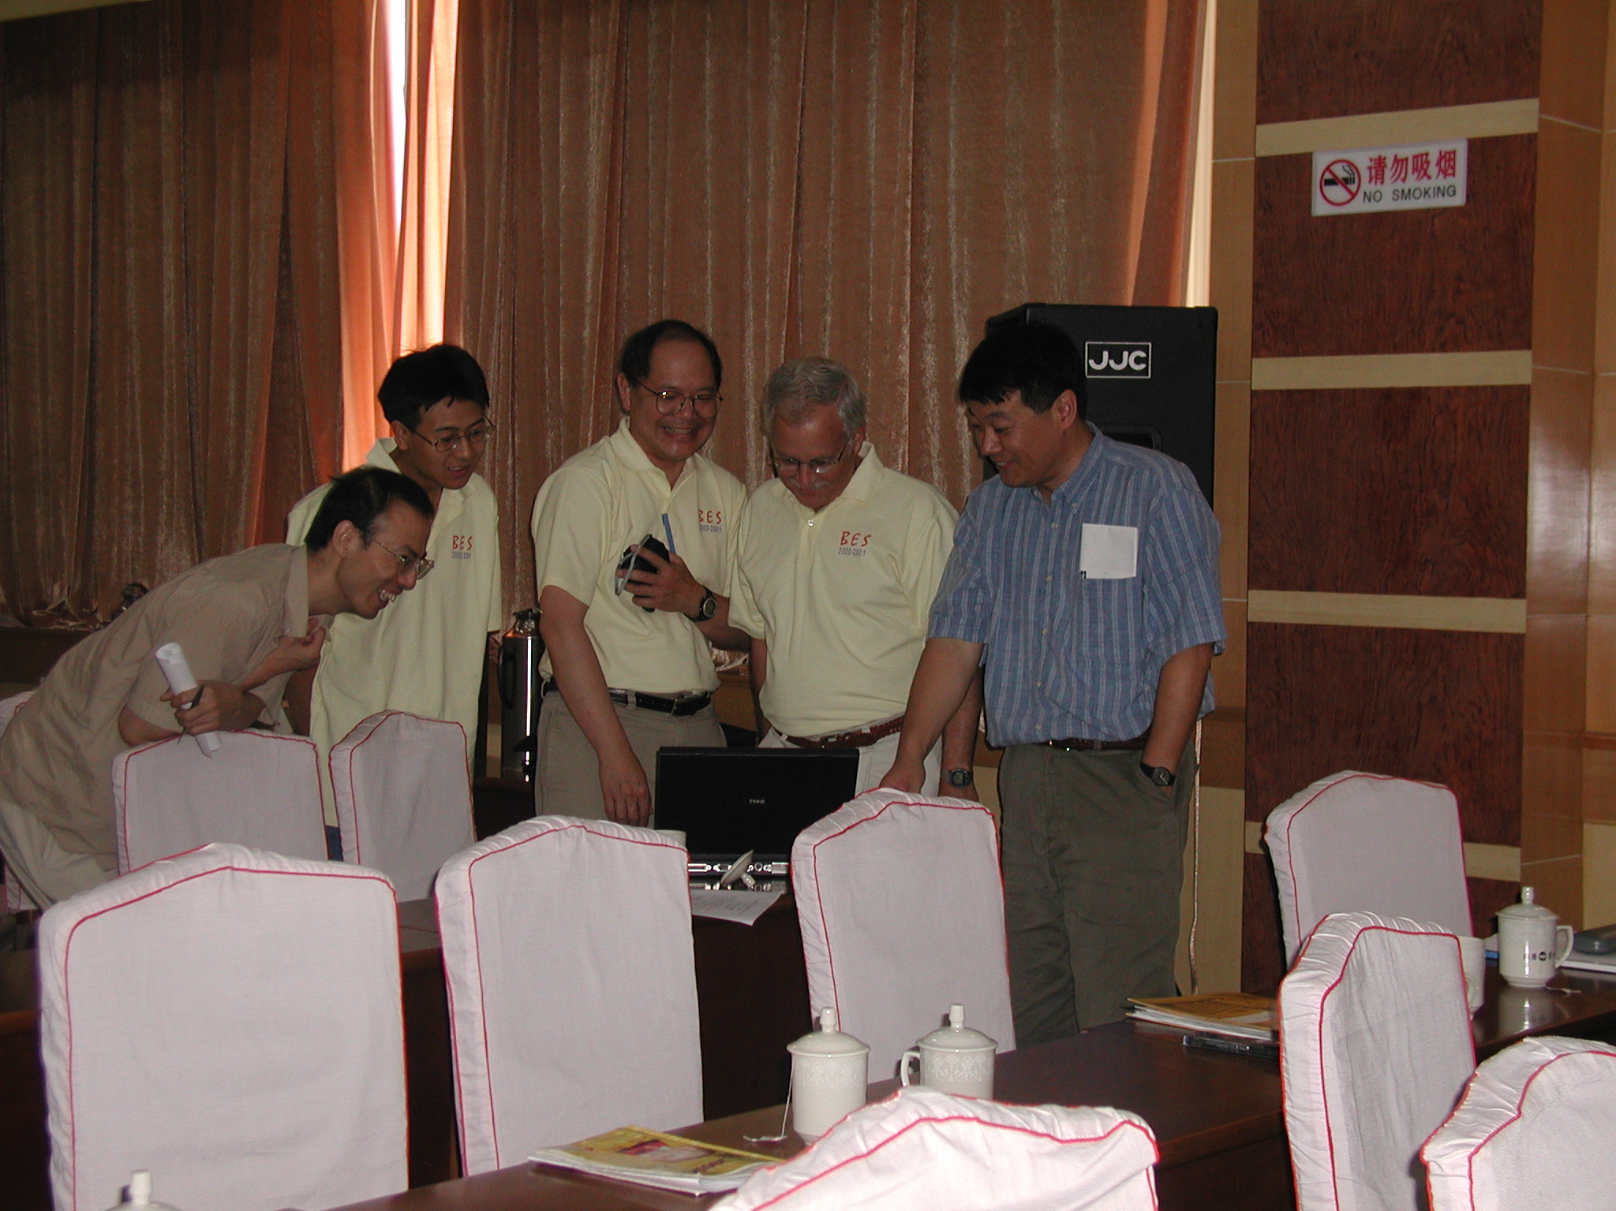
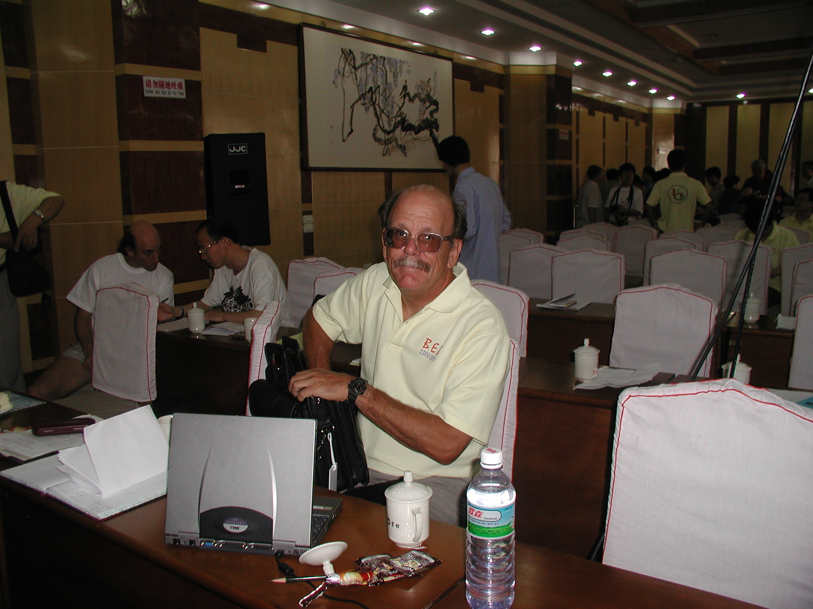
Happy Memories

Slide 7
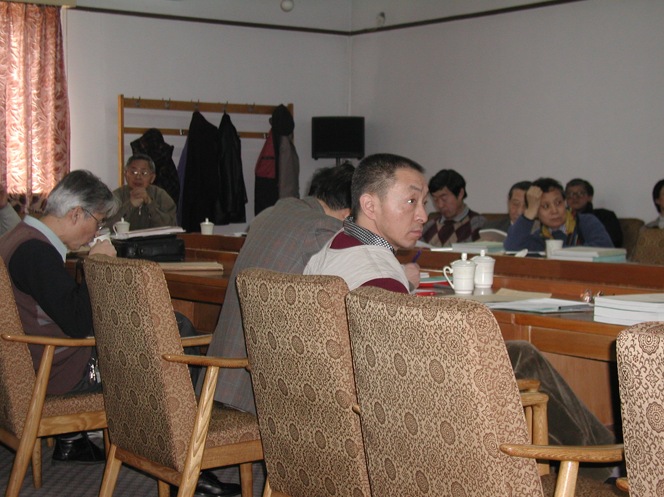
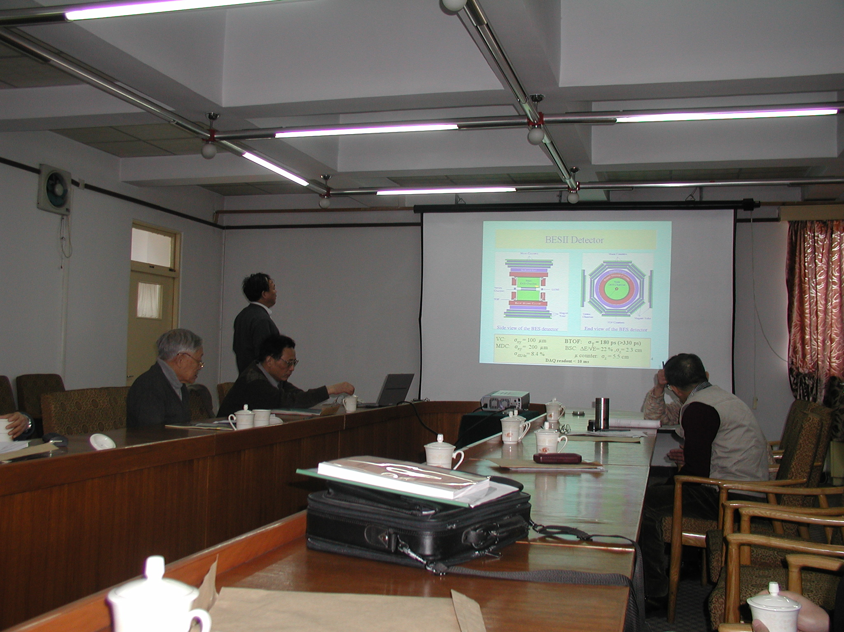
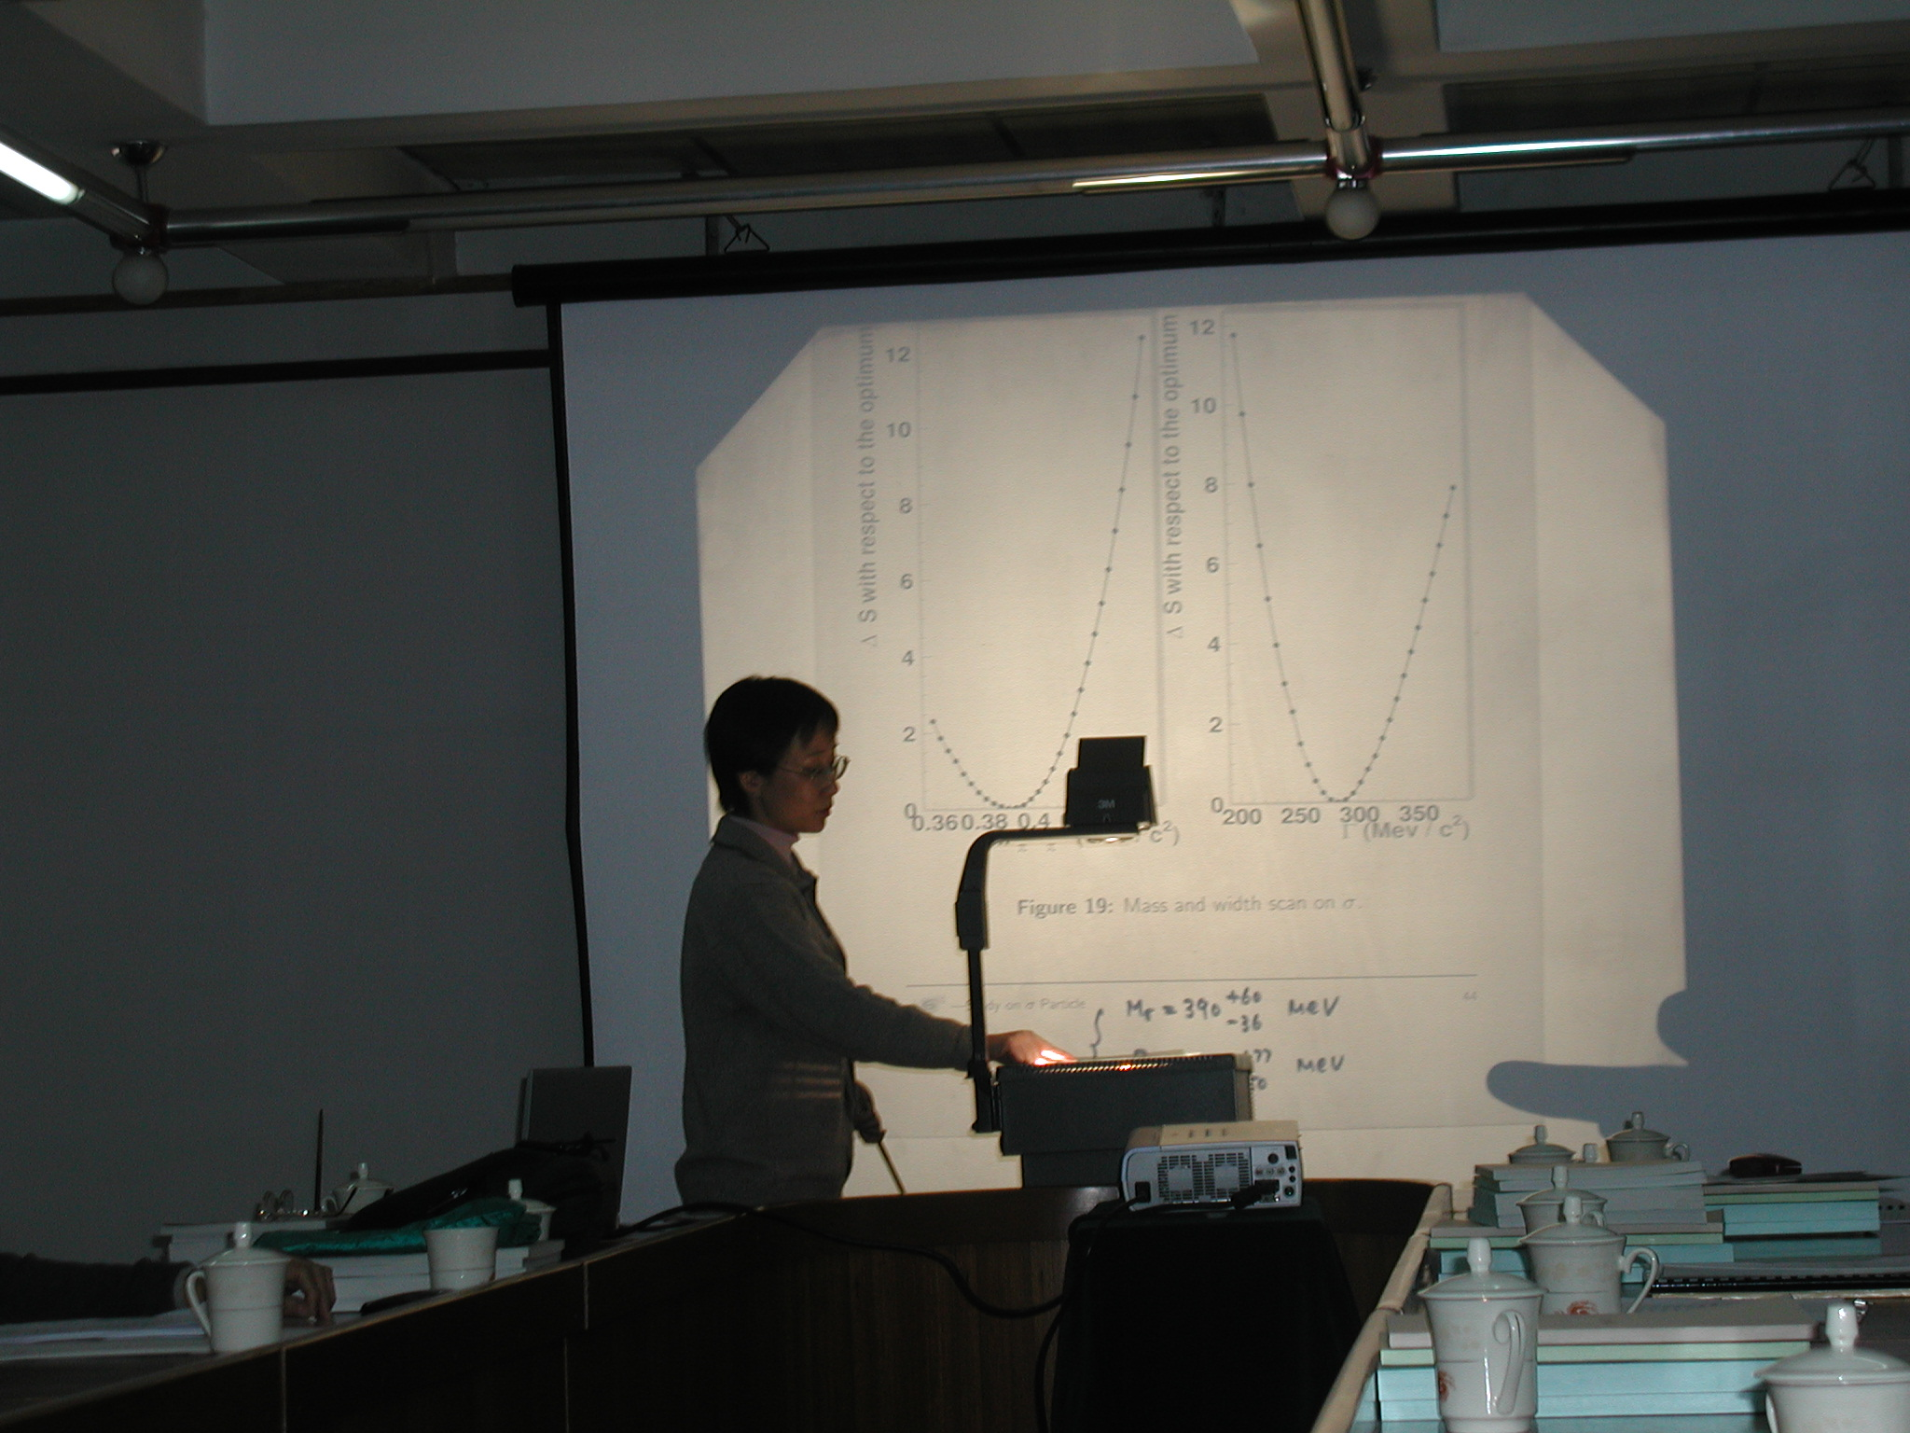
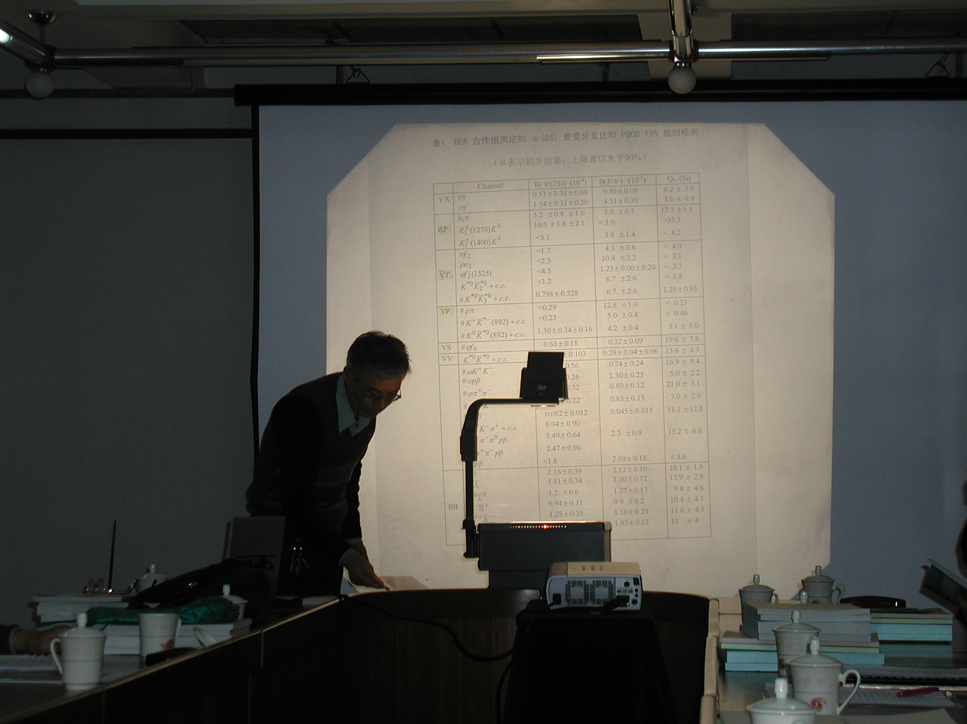
Prepare For J/psi and Psi’
7

Slide 8
Tough Situation of IHEP(1997-2001)
Research of basic science is not so encouraged, scientists are called for going to application, and ”jump into the sea” to do business.
Upgrade of BEPC/BESI were in difficulties due to that BEPC could not reach the nominal luminosity, and the BES MDC feedthrough had HV sparking.
Serious aging problem of BES: ~300 malfunctions of 5 months commissioning.
Within two years, 16 key persons retired (1 division, 6 group leaders), 31 young researchers left (1 division, 10 group/project leaders)
All funds from NSFC, CAS and MOST were stopped.
The future of BEPC/BES were unclear; leadership teams of IHEP and physics divisionone were changed, I became leader of BES and physics division one in such an extremely tough situation.

Slide 9
Thinking of you
BES leaders and key persons
Walter Toki, Joe Izen, Steve Olsen, Fred Harris, Russell Malchow, David Hitlin, Bill Dunwoodie, Xinchou Lou, Richard Yamamoto, Toby Burnett, Mark Mandelkern…
and D1/BES leaders and key persons
Changchun Zhang, Jingzi Bai, Yongsheng Zhu, Xiaonan Li, Jungang Lu, Zepu Mao, Qiming Zhu…. and all group leaders..
who greatly contributed and helped BES to
rise from her most difficult time

Slide 10
How Much BES Builders Loves BES
Before Zhipeng stepped down from IHEP director, he got 100 K
RMB from CAS as his “pocket money”. He gave me half, and said
to me: “Zhengguo, please try your best to treat the dead horse
as alive one, and to let BES be able to continue running. Use this
money to stable the BES team”. I then distributed this money to
BES key person in D1, 100 RMB per month per person, till it used
up, and division leaders whose age older then me,
including myself, got zero.

Slide 11
How Much US Friends Concerned and Helped BES
When we discuss about the upgrade of BEPC/BESII
Maury Tigner gave 5 lectures at D1 about accelerator (BEPC).
He strongly suggested to go with double ring machine.
In early 2000, in a heavy snowing day Maury invited me to visit
CERS/CLEOc, in a heavy snowing day
- arranged me to talk to a few CLEOc group leaders, and
Peterson (MDC expert). Peterson spent half a day to show all
the detail on their design, and gave me all the drawings
- opened CLEO detector to show me the IR, the shielding and
collimators, gave me a book on IR design….
During R scan test run, we suffered noise problem and scan stopped for over 10 days. Maury told me to check whether
DCCT cover in the beamline was opened, and that was it!

Slide 12
Fighting for Survival and Better Future
BES US and China teams were united and worked hard to solve MDT HV problem: split method to add HV, and prepare for building a new MDT.
Passed the assessment of upgrade project (BES1-BES2).
Promote young division and group leaders: >10 (later become the key persons for BESIII)
Reform the division and reorganize the BES Collaboration (Fred and I were both the spokespersons and physics coordinators)
Prepare for the R scan → hopeful the turning point for BES
Explore funds and supports → CAS president’s supervisory team
Propose double ring machine and new detector for the upgrade program for BESIII

Slide 13
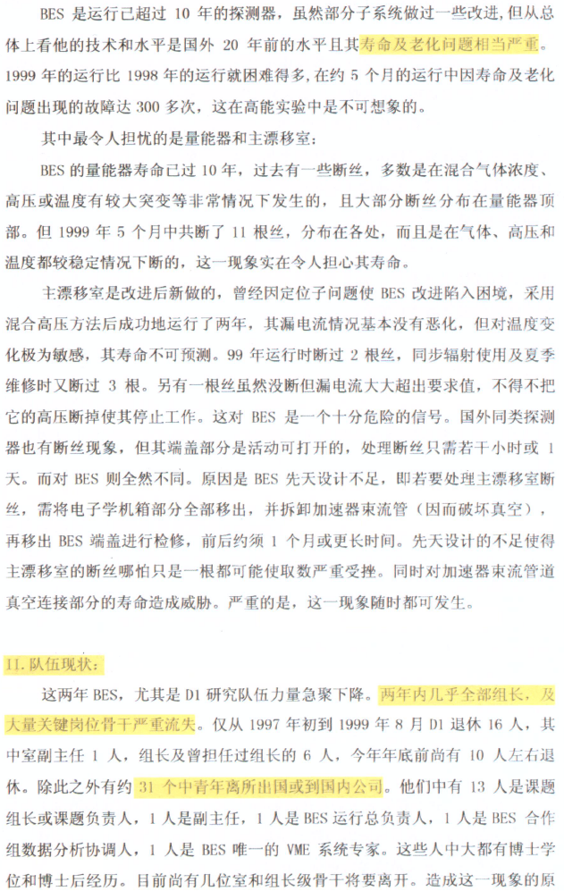
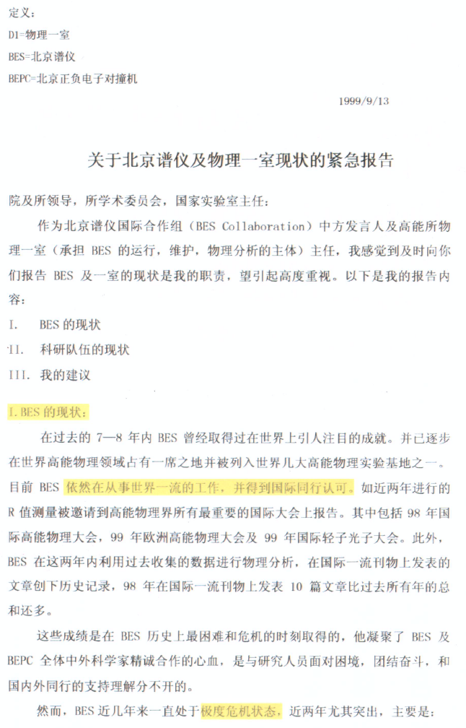
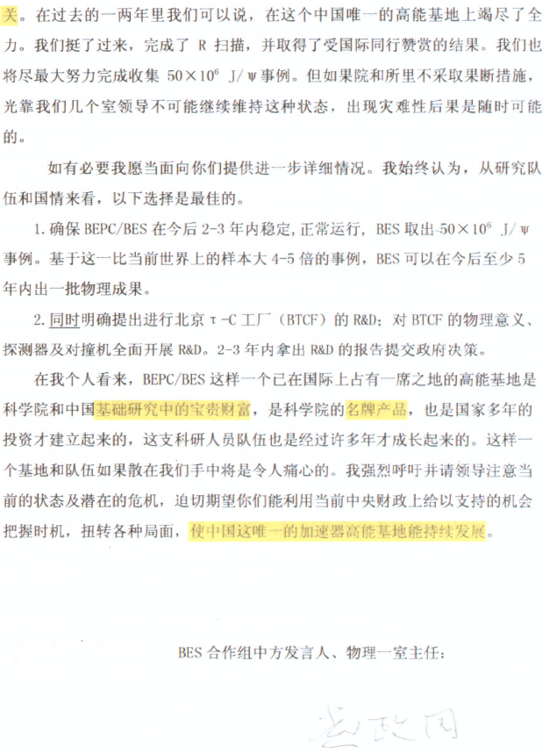
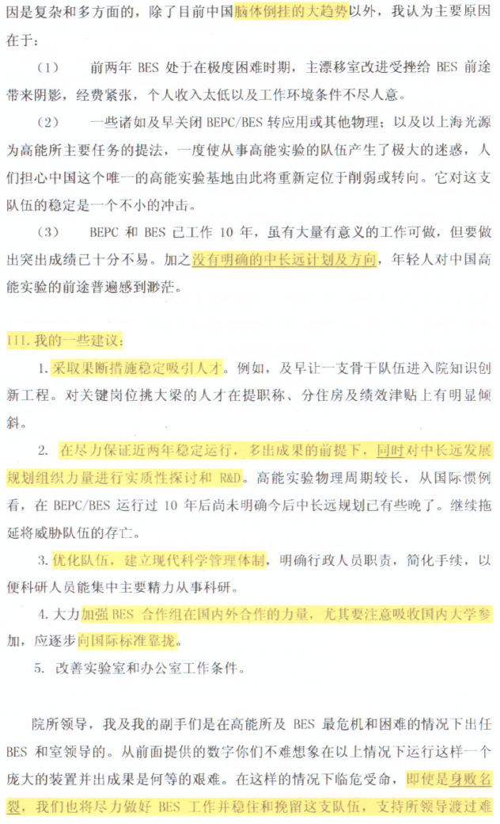
BES is suffering severe aging, 300 malfunctions in 5 months operation.
Stable and attract talents
Produce good results, prepare R&D for BESIII
Improve management
Enhance the collaboration, attract
more universities
5. Improve working condition.
My suggestions
Propose R&D for TCF
Current BES Status
Current BES Status
Current BES team status:
Within 2 years, 16 retired, 31 young
Left, including 2 division and all group
leaders.
Current status of the team

Slide 14
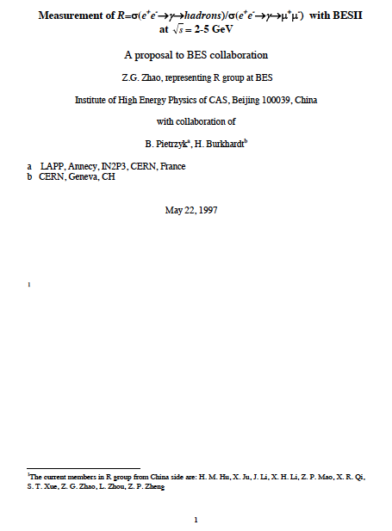
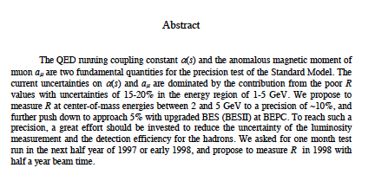
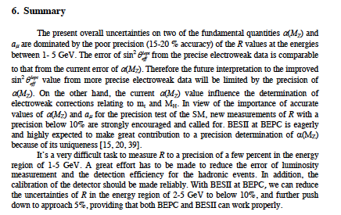
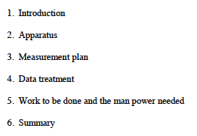
25 Page’s Proposal for R Scan
In 1995 Zhipeng called me to return to IHEP, and ask me to
investigate the R scan at BES. This proposal was drafted
at ETHZ in 1995-1996, after a few rounds of discussions
with Boleck and Burkhardt at ETHZ and CERN

Slide 15
Definition of R
N_{had}: observed hadronic events
N_{bg}: background events
L: integrated luminosity
ε_{had}: detection efficiency for N_{had}
δ: radiative correction
One of the most fundamental quantities in particle physics,
Counts directly the number, flavor and colors of quarks.

Slide 16
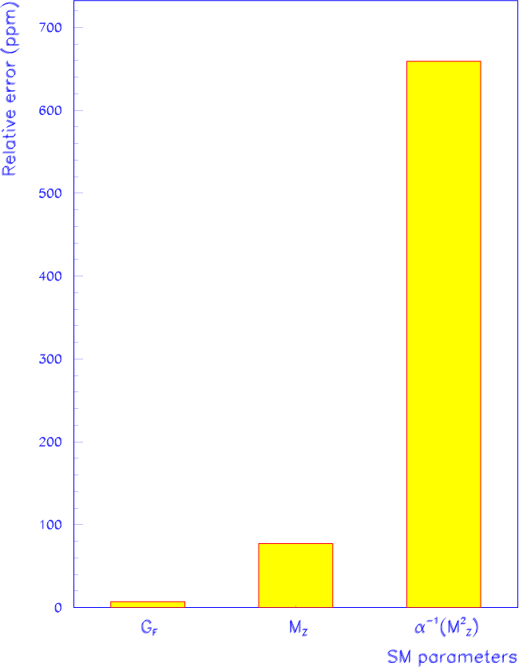
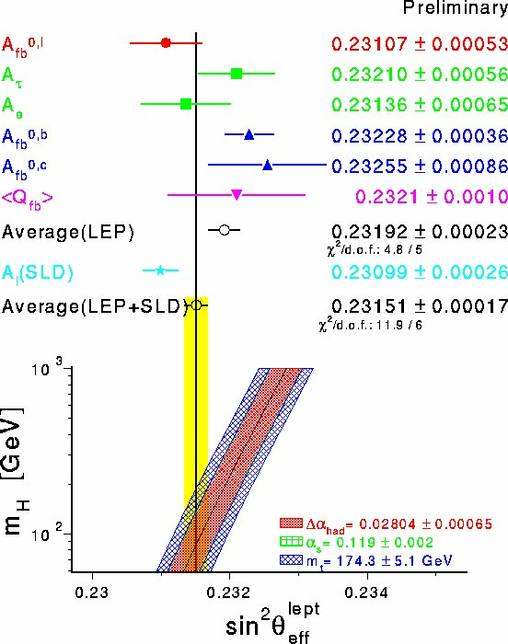
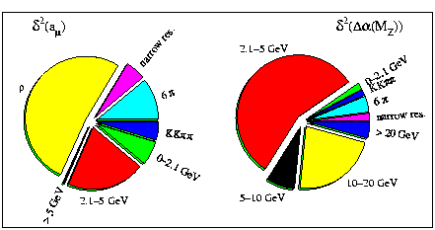
Motivations of the R Scan
Reducing the uncertainty of α(M_{Z}²) → essential for precision tests of the SM (m_{H})
Hunting for new physics from a_{μ}≡(g-2)/2 → interpretation of E821 at BNL
Relative contributions to the
uncert. of a_{μ} and Δα(M_{Z}²)

Slide 17
BES R Scan
March-May, 1998:
6 energy points at 2.6, 3.2, 3.4, 3.55, 4.6, 5.0 GeV + separated beam operation at each
Feb.- June, 1999:
85 energy points at 2.0-4.8 GeV
+ 24 energy points separated beam operation

Slide 18
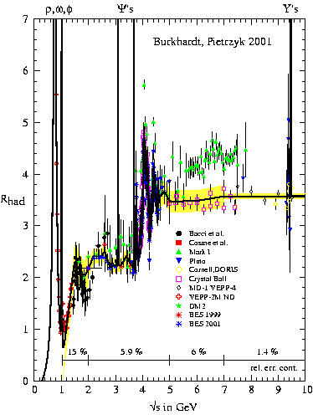
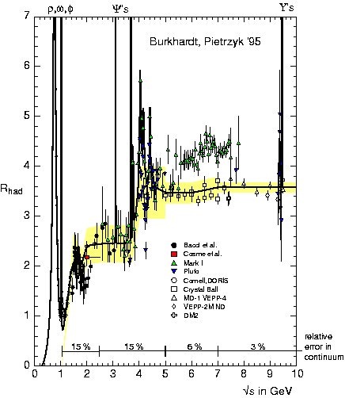
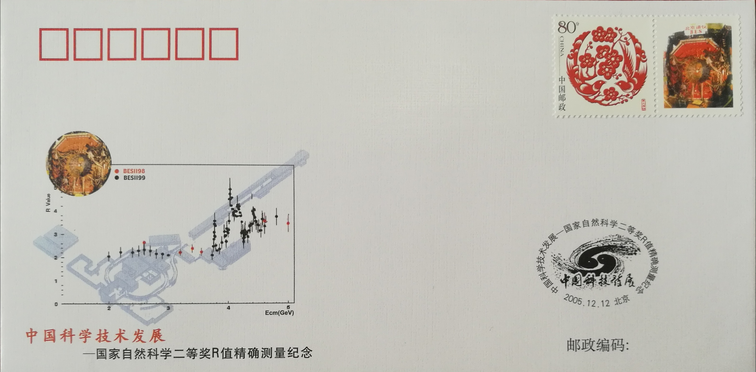
R Below 10 GeV
Excluded Mark I results
5.9%
15%
After BES R Scan
Notes:
March-May, 1998: 6 energy points at 2.6, 3.2, 3.4, 3.55, 4.6, 5.0 GeV + separated beam operation at each
Feb.- June, 1999: 85 energy points at 2.0-4.8 GeV + 24 energy points separated beam operation

Slide 19
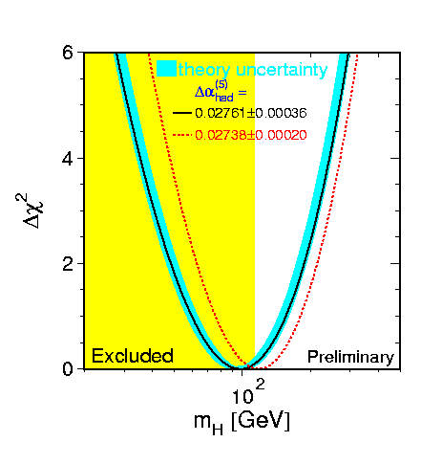
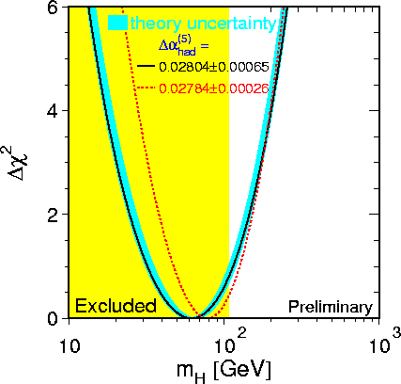
The SM Fit to m_{H}
At ICHEP Osaka 2000, Bolek Pietrzyk:
“without this result, we could have excluded the SM Higgs”
Without
BES data
With
BES data
95% C.L.
95% C.L.
(95% C.L.)
+58
- 38
+53
- 30
m_{H} = 98 GeV, m_{H} < 210 GeV
m_{H} = 62 GeV, m_{H} < 170 GeV

Slide 20
Impact of BES R Results to BES
The success of R scan was the effort from entire BES team, and
as well as BEPC staffs, IHEP management…
Well recognized and praised by international HEP community.
- Quoted by all important HEP conferences for over 10 years
(ICHEP, LP, EuroHEP……)
- Quoted by text books
Restored the reputation and confidence of BES collaboration,
paved the way of later data taking for J/ψ, ψ’….
Young BES key persons were growing up (2 division leaders
plus over 10 group/project leaders).
A breakthrough for IHEP to gain support and trust from CAS.
Regain the support from Chinese funding agencies

Slide 21
From BESII to BESIII
In the meantime, BES Collaboration was aggressively explore her better future
The future of BEPC/BES were unclear:
- Build a TCF, killed in 1999 after years debating
new machine, new detector, new location (Huailou 怀楼)
- Upgrade BEPC to L=5 x 10³¹ cm⁻²s⁻¹, upgrade BES calorimeter only
→ 40 M RMB plan
- Some even proposed to give up BES and run BEPC fully for SRF
CLEO wanted to degrade CESR energy to do charm physics
- upgrade BEPC to 10³² cm⁻²s⁻¹→ single ring with pretzel orbit
- lower version TCF→ double rings with new detector
I strongly supported STC, and insist in going for double rings
with a completely new detector, after the dead of TCF

Slide 22
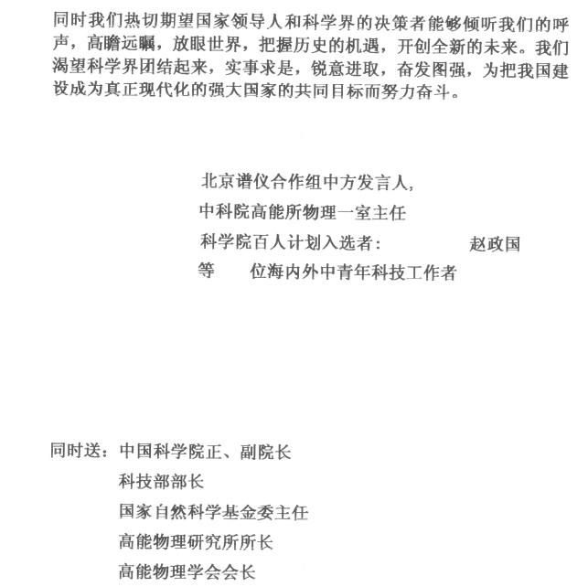
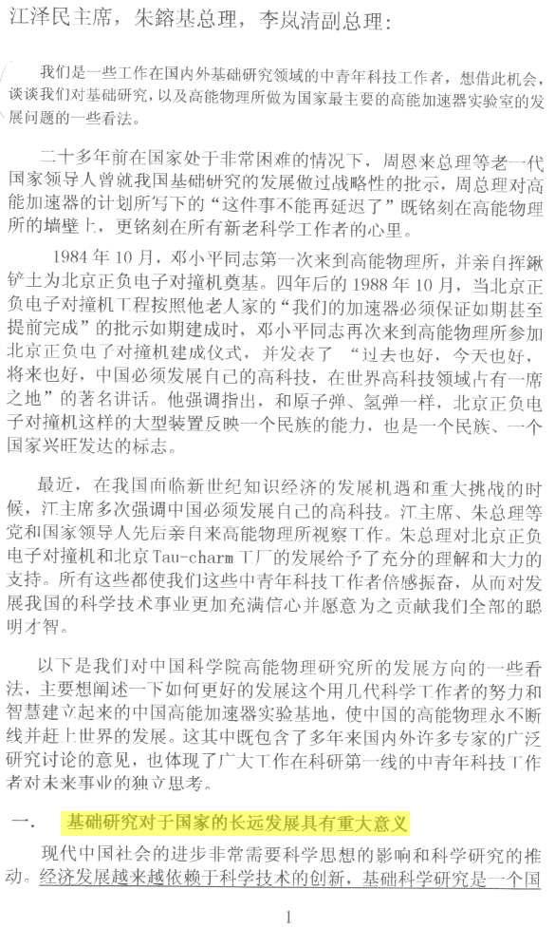
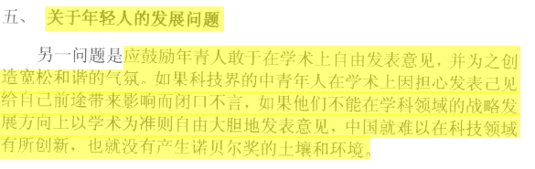
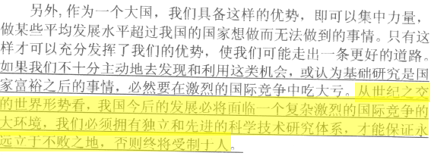

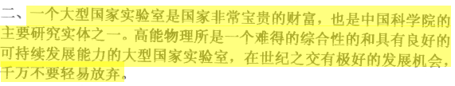
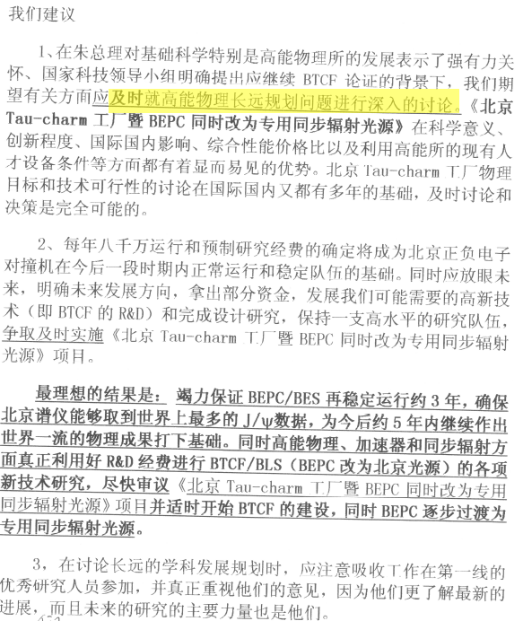
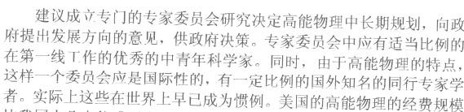
A Letter to Top Leaders (8 pages)
The importance of basic science to China
“At the turn of the century, China’s development will face
a complex and fierce international competition.
We must have an independent and advanced science and technology research system in order to ensure that we are invincible forever, otherwise, we will be held hostage"
2. National lab is valuable asset of the nation, and IHEP is the one
Opinion to decision making of big science
My opinion to construct a few big science facilities in China
On the promotion of young people
My wish to the HEP development in China
“make the future clear and better; R&D for TCF
and construct STF, shift BEPC fully to SRF”
Notes:
Answers from top leaders to the letter （I looked at the reply on my letter stored at IHEP Archives, based on my memory)
Jiang Zeming: gave a cycled
Zhu Rongji: Comrade Lu Yongxiang read it carefully, please 请路甬祥同志认真阅读
Li Nanqing: To do a good job of thinking about young people 要做好年轻人的思想工作

Slide 23
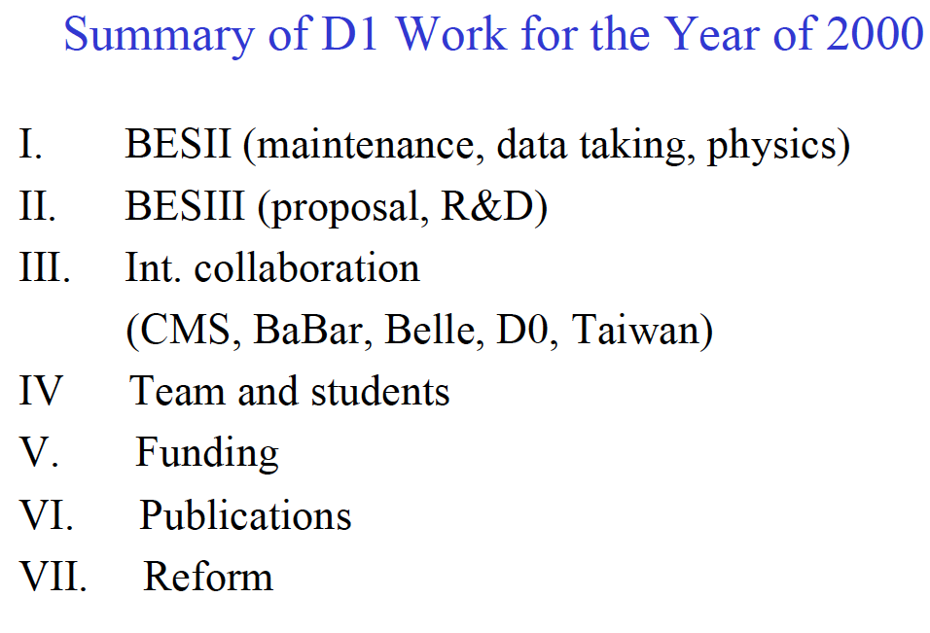
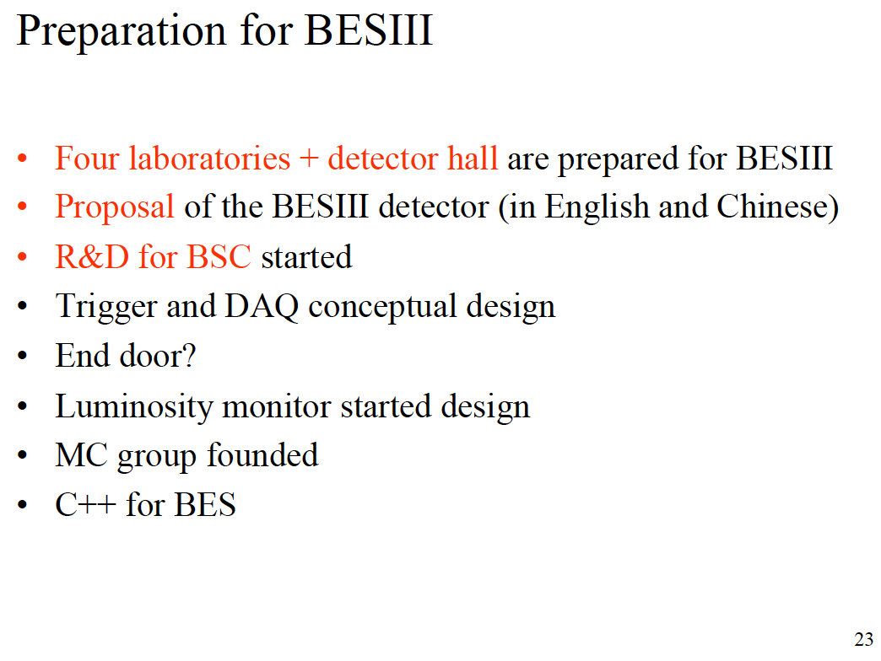
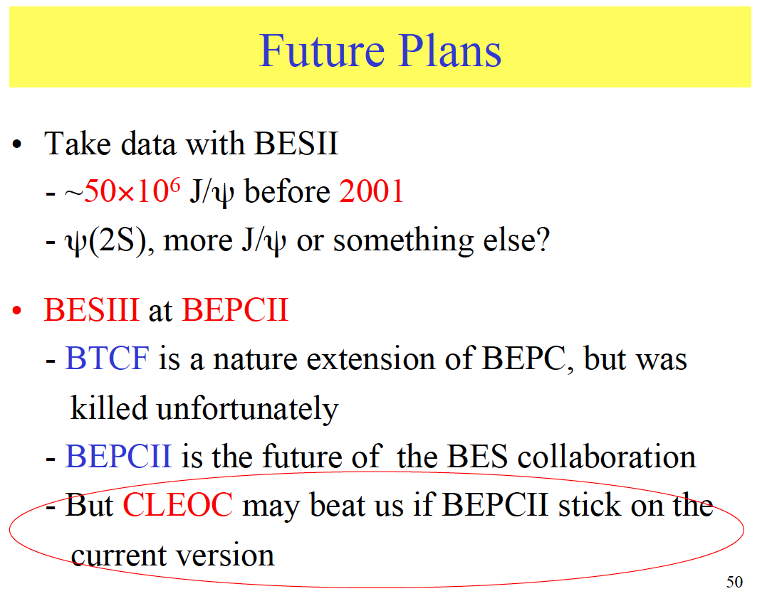
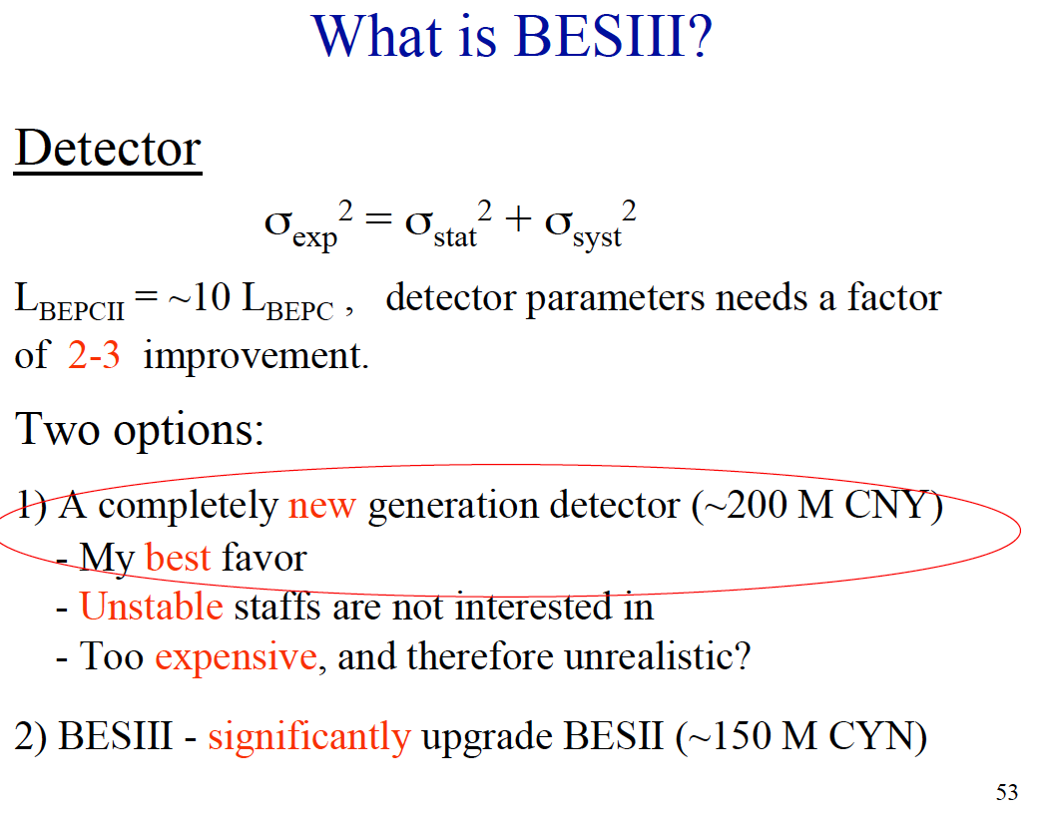
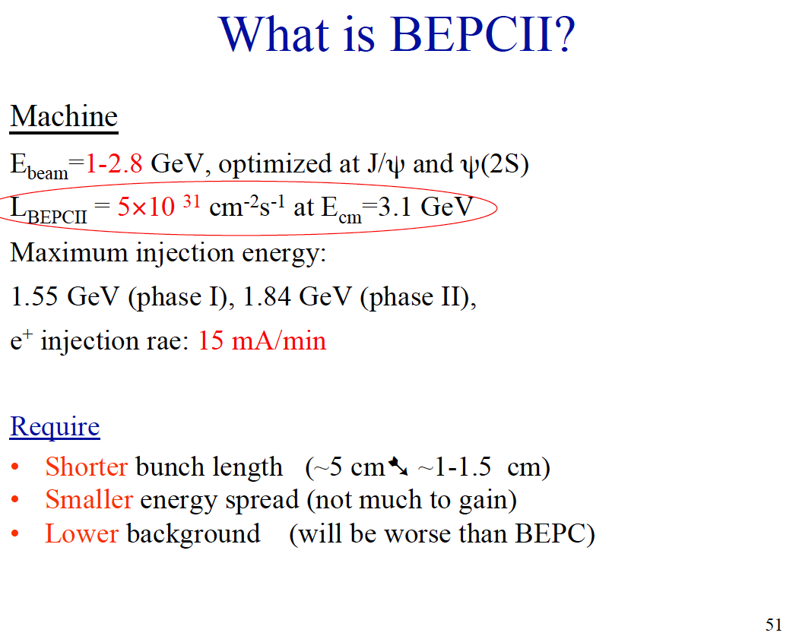
Year of 2000

Slide 24
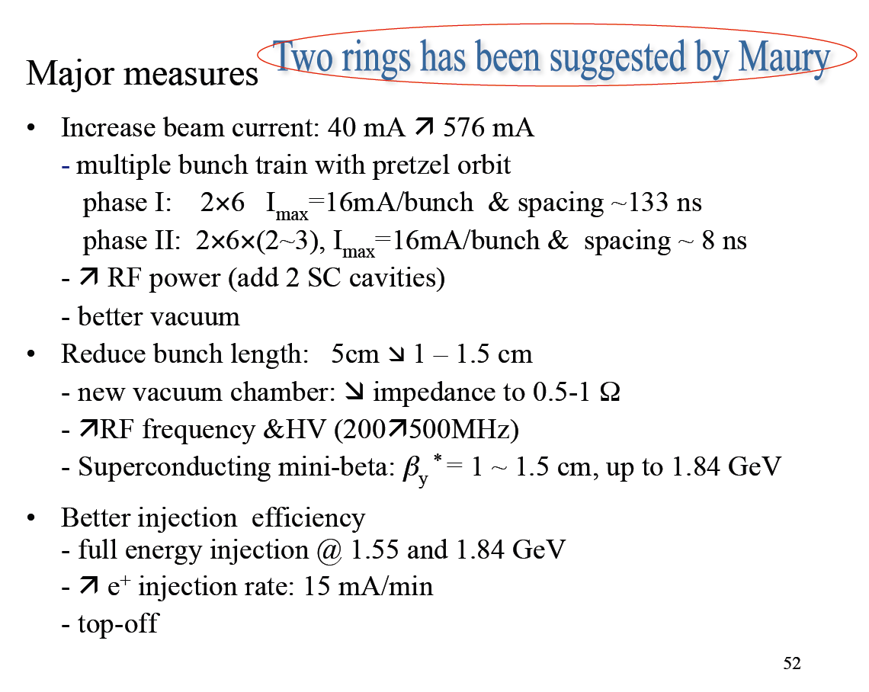
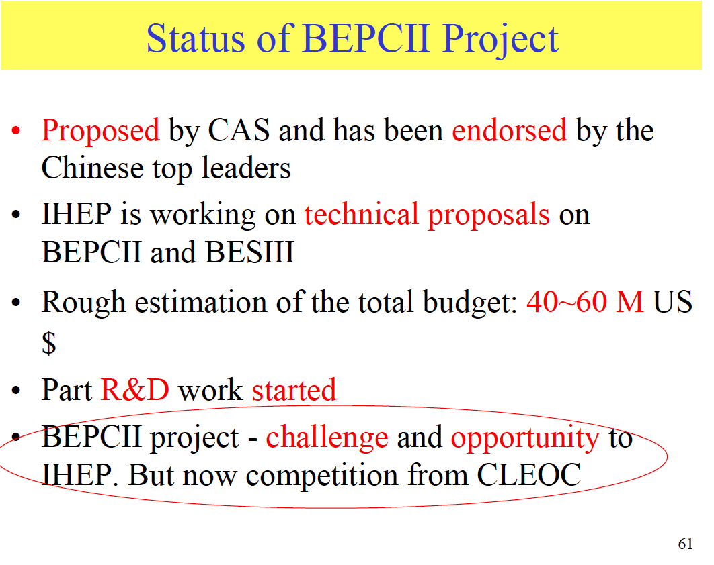


Year of 2000

Slide 25





Year of 2000

Slide 26






Year of 2001
65 pages!

Slide 27
Where to go after BESIII?

Slide 28

Physics in τ-c energy region
R=σ(e⁺e⁻→hadron)/
σ(e⁺e⁻→μ⁺μ⁻)
ISR
Nucleon form factors
Y(2175) resonance
Exotic states with s quark, Zs
MLLA/LPHD and QCD sum rule predictions
Light hadron spectroscopy
Gluonic and exotic states
Rare and forbidden decays
Physics with charmonium and τ lepton
XYZ particles
|Vcd|,|Vcs|
f_{D} and f_{Ds}
D₀-D₀ mixing, CPV
Charmed baryons
_
R scan: precision Δα_{QED}, a_{μ}, charm quark mass extraction.
Notes:
It’s an energy region that
bridges smooth and resonances, perturbative and non-perturbative QCD.
rich of resonances, charmonium and charmed mesons.
threshold characteristics (pairs of τ, D, D_{s}, charmed baryons…).
mass location of the exotic hadrons, gluonic matter and hybrid..
Because of these features, there are rich physics program in the energy region.

Slide 29


Fruitful Publications = Rich of Physics

Slide 30
Summary
BEPC/BES, the first big science facility in China, with the effort of a few generations, and the international collaboration, has been impressively successful and fruitful → 30 years painstaking, challenge, and happiness as well.
Physics in the tau charm energy sector is still rich and unique for studying the physics with c quark and tau leptons, the strong interaction and the hadron structure.
A machine with 100 times more luminosity than BEPC2 and a dedicated detector could continue exploring the key science questions in the filed → STCF.

Slide 31

Super Tau Charm Facility(STCF)
E_{cm}=2-7 GeV, L=1x10³⁵ cm⁻² s⁻¹ at 4 GeV
C=1000 m double rings
Total cost: 4 B CNY

Slide 32

















Spectrometer
DMAPs
MPGD
MDC
BCAL
pCsI
ECAL
LYSO
RICH
MUC
MRPC+RPC+Scintilator
DIRC

Slide 33
Institutions Shown Interest
中国科学技术大学
高能物理研究所
清华大学
北京大学
上海交通大学
复旦大学
山东大学
浙江大学
南京大学
南京师大
南开大学
中山大学
武汉大学
华中师大
南华大学
北京航天航空大学
湖南大学
湖南师大
四川大学
河南师大
河南科技大学
辽宁大学
广西大学
广西师大
兰州大学
香港大学
香港中文大学
黄山学院
Stanford University, USA
Wayne State University, USA
Carnegie Mellon University, USA
GSI Darmstadt and Goethe University Frankfurt,
Germany
Goethe University Frankfurt, Germany
GSI Darmstadt, Germany
Johannes Gutenberg University Mainz, Germany
Helmholtz Institute Mainz, Germany
LAL (IN2P3/CNRS and Paris-Sud University),
Orsay, France
Sezione di Ferrara, Italy
L'Istituto di Fisica Nucleare di Torino, Italy
L'Istituto di Fisica Nucleare di Firenze, Italy
Scuola Normale Superiore, Pisa, Italy
Laboratori Nazionali di Frascati, Italy
INFN, Padova, Italy
University of Pavia, Pavia, Italy
University of Parma, Italy
Institute for Basic Science, Daejeon, Korea
T. Shevchenko National University of Kyiv, Ukraine
University Ljubljana and Jozef Stefan Institute Ljubljana, Slovenia
Jozef Stefan Institute Ljubljana, Slovenia
University of Silesia, Katowice, Poland
Dubna, Russia
Budker Institute and Novosibirsk University, Russia

Slide 34







Workshops

Slide 35
Organization for STCF
Institutional Board
Steering Committee
International Advisory Committee (IAC)
Project coordinator
Theory & MC Simulation
Accelerator
Detector
Light Hadron
Charmonium
XYZ
Charm decay
Charm Spectroscopy
Tau
R&QCQ
New Physics
…
Design
RF
IP
Linac
Vacuum
Beam diagnose
…
Tracking
PID
ECAL
Muon
SC
Trigger
DAQ
Software
Computing & Network
…

Slide 36
Motivations
Reducing the uncertainty of α(M_{Z}²) → essential for precision tests of the SM and indirect search for Higgs boson
calculated measured
At M_{Z}² 0.03142 0.0280±0.0009
Hunting for new physics from a_{μ}≡(g-2)/2 → Interpretation of E821 at BNL
New physics

Slide 37


Slide 38














BESIII Collaboration
13 countries, 60 institutions, ~400 authros
Europe(14)
Germany: Univ. of Bochum, Univ. of Giessen, GSI
Univ. of Johannes Gutenberg, Helmholtz Ins. In Mainz, Univ. of Munster
Russia: JINR Dubna; BINP Novosibirsk
Italy: Univ. of Torino,Frascati Lab, Ferrara Univ.
Netherland:KVI/Univ. of Groningen
Sweden: Uppsala Univ.
Turkey: Turkey Accelerator Center
US (5)
Univ. of Hawaii
Carnegie Mellon Univ.
Univ. of Minnesota
Univ. of Rochester
Univ. of Indiana
Korea (1)
Seoul Nat. Univ.
Mongolia (1)
Inst. of Phys. and Tech.
Pakistan (2)
Univ. of Punjab, COMSAT CIIT
India (1)
Indian Inst. of Tech.
Japan (1)
Tokyo Univ.
China(32)
IHEP, CCAST, GUCAS, Shandong Univ.,
Univ. of Sci. and Tech. of China
Zhejiang Univ., Huangshan Coll.
Huazhong Normal Univ., Wuhan Univ.
Zhengzhou Univ., Henan Normal Univ.
Peking Univ., Tsinghua Univ. ,
Zhongshan Univ.,Nankai Univ.
Shanxi Univ., Sichuan Univ., Univ. of South China
Hunan Univ., Liaoning Univ.
Nanjing Univ., Nanjing Normal Univ.
Guangxi Normal Univ., Guangxi Univ.
Suzhou Univ., Hangzhou Normal Univ.
Lanzhou Univ., Henan Sci. and Tech. Univ.
Hong Kong Univ., Hong Kong Chinese Univ.
38

Slide 39



Slide 40

Detector
245 cm
PXD
Material budget ~0.15%X₀ / layer
σ_{xy}=50 μm
York/Muon
185 cm
MDC
σ_{xy}=130 μm
dE/dx<7%, σ_{p}/p =0.5% at 1 GeV
Superconducting magnet
(0.7-1 T)
York/Muon
135 cm
EMC
PID
π/K (and K/p) 3-4σ separation up to 2GeV/c
105 cm
PID-barrel
85 cm
20°
PID-endcap
EMC
Energy range: 0.02-2GeV
At 1 GeV σ_{E} (%)
Barrel(Cs(I): 2
Endcap (Cs): 4
MDC
15 cm
PXD/SSD
10 cm
MUD
μ/π suppression power >10
3~6 cm
IP
120 cm
140 cm
190 cm
240 cm
300 cm
Notes:
Better inner tracker to adapt high luminosity
Better PID
Better Muon detector
Better ECAL

