Slide 1
BEPC II/BES III
Hesheng Chen
Inst. of High Energy Physics

Slide 2
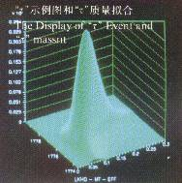
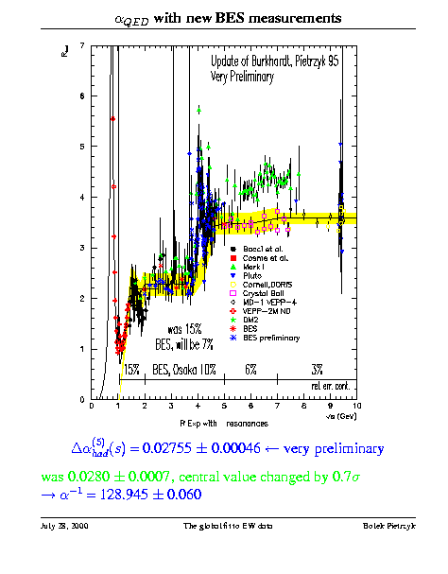
Physics Results from BES
30 years ago, BES started data taking:
Precision measurement of τ mass
Ψ (2S)
Precision measurement of R at 2 - 5 GeV
PDG: 420 items from BES
… …
The success of BES attracted more competition.
From middle of 90’, extensive discussion about the future Plan of BES.

Slide 3
Challenges: Serious shortage in funding
The Government was seriously under-invested in basic scientific research.
IHEP funding, including BEPC operating costs, is about only 70M RMB , including BEPC operating costs 27 M, which increased by only 30 % in a decade.
Equipment gradually aging, lack of maintenance updates, the failure rate increased, affecting the operating efficiency.
"One academy, two systems" encouraged scientists "going to sea” (spin-off & commercial).
Serious shortage in funding, stagnant research work, low pay, serious staff turnover, no R&D for new technology of accelerator and detector.

Slide 4
Challenges: Delay in upgrade project
In May 1993, CAS approved the BEPC/BES/BSRF Upgrade Project with 35M RMB.
However, the project was not met on schedule.
Linac: Klystron?
BES II lumi. monitor cable misconnection
BESII noise :
Big noise? DCCT
MDC HV feed through: MDC III?
It‘s been a long delay. Big pressure!

Slide 5
Challenge: Strategy for future
Discussion of the future development of IHEP began in 1993
1. 3rd generation synchrotron radiation light source
1993 DZ Ding, SX Fang, DC Xian proposed "to build a third-generation synchronous radiation light source”: IHEP?
IHEP is focused on TCF.
In 1995, FJ Yang, XD Xie proposed to build in Shanghai. Shanghai took over.
2. BEPC Development: TCF 1.2 billion at West of IHEP,.
CAS: the cost is too higher.
Debate :
physics goals?
Cost?
Feasibility: Monochrome beam

Slide 6
BEPCII Proposal
CAS did not support TCF proposal. IHEP has to find a realistic proposal for the future of BEPC.
I discussed with Prof. S.X. Fang and S.Y Chen. We think the pretzel and multiple bunch scenario based on the experience from CESR is a possible choice.
Feb. 1997, I was asked to in charge for the future strategy of BEPC.
July 1997, IHEP submitted CAS the "Proposal of the Pre-research Projects for BEPC Future Development ", proposed pretzel scenario of BEPCII, which will increase Lumi. by factor of 10 with estimated cost 400 million yuan.
BEPCII / BES upgrade design was under way.

Slide 7
Academician Consulting
June 1998, CAS organized a Academician Consulting to IHEP. The recommendation:
BEPC's future use of BEPCII solution,
Pay attention to the research of non-accelerator physics experiment
Pay attention to the application of radiation technology.
July 17,1998, the letter of TD Li to Primer Minister Zhu:
“If there are no recent breakthroughs in HEP, I don't think there is a need to build a TCF in China.”

Slide 8
BEPC progress
By the end of 1998,
Linac energy reached the design goal (1.55GeV, full energy at J/ Ψ)
Ring: Lumi. reached the goal (X 2)
Problem in BES II lumi. monitor solved
BESII noise solved: MDC ok, DCCT noise found
Feb. 1999 BEPC/BES/BSRF upgrade reached the design goals, and passed the assessment Fab. 7.
Spring 1999 Precision measurement of R value at 2 – 5 GeV was carried out.
IHEP get out of trouble.

Slide 9
China's HEP Development Strategy (June 1999)
According to the requirement from CAS，IHEP studied the road map of HEP in China, and submitted the report “China's High Energy Physics Development Strategy” :
Future of BEPC: BEPCII
Promote non-accelerator physics experiments
Accelerator: SR facility, Spallation Neutron Source……
IHEP commitments：significant improve the performance of BEPC with increasing operation budget and improving critical equipment's

Slide 10
IHEP commitments：
The annual running time 7 months → 9.5 months, BES 5 months, SR 3 months, MS 1.5 months.
The start-up time 1 month to less than half a month.
Increase enjection efficiency, and the injection-to-run ratio 1:3 → 1:5.
BEPC failure rate < 6%.
Over the next three years, collect 50 million J/ Ψ events
The SR beam energy 2.2GeV → 2.5GeV with current 100mA and life time > 20 hours.

Slide 11
“China's High Energy Physics Development Strategy” (1999)
June 28, 1999 CAS submitted the report to the 5th meeting of National Leading Group for Science and Education. The meeting decided :
To increase the BEPC operation budget 27M → 50M
Provided 30M X 3 years for the BEPC improvement and R&D for future development.
Study on the road map further.

Slide 12
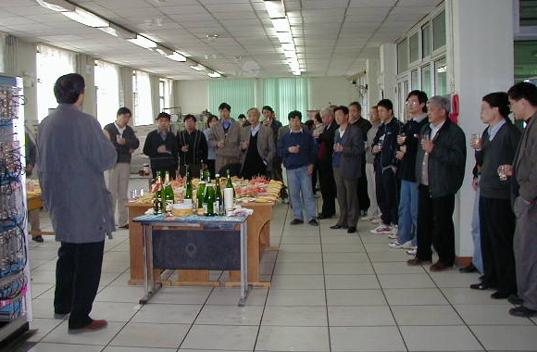
Celebration on 50M J/ψ (April 1, 2001 < 2 years )

Slide 13
China's Development Strategy for High Energy Physics and Accelerators (June 2000)
1. High energy physics
1）future development of BEPC: BEPC II i.e. major upgrade BEPC / BES, increase lumi. by a factor of 10
2）promote non-accelerator experiments：cosmic rays, astroparticle physics, neutrino exp. …
3）promote international cooperation
2. Build Shanghai SR facility
3. Accelerator technology and application:
High Power proton accelerator: Spallation neutron source, ADS ...
FEL
Spin-off

Slide 14
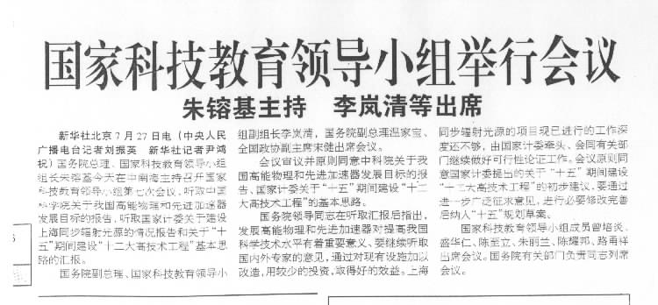
July 27, 1999 CAS reported the report to the 7th meeting of National Leading Group for Science and Education The meeting decided :
1) agreed to the CAS report in principle.
2) Agree to invest 400 M RMB in the major upgrade of BEPC, and continue to achieve high-level research results with less investment.

Slide 15
Competition from CESRc
IHEP implemented the strategies. Non-accelerator exp. and intl. cooperation went well, however 1# task:
CESR decreased the beam energy → CESRc, competing with BEPCII. M. Tigler became the director of CESR.
Jan. 2000 Zhang Chuang, Li Weiguo and I visited CESR and SLAC, discuss the double ring design:
CESR: Heavy snow. Talk coldly. SC cavity lab. and other key technologies were not open to us.
SLAC：Sunny and warm. Dorfan and Richter encourage us to go ahead with double ring scenario.
The impact on the big, some backbone think that high energy and CESR competition, will die no doubt, another great upheaval in IHEP !

Slide 16
Compete with CESRc ?
As the Home of Pretzel , CESR has good experience on pretzel and multiple bunch；
CESRc: hardware conditions other than Wiggler are available for faster implementation (2003)；
high performance detector CLEO ；
M.Tigner was a senior advisor in IHEP for more than 3 years, knowing all about our weaknesses. ；
On the other hand, we were weakly managed and have insufficient technical, experience and human reserves.
Pretzel of BEPC II can not compete with CESRc both in schedule and performance.

Slide 17
BEPC II: double ring design
CESRc is a shot cut scenario, never done before. It is hard to predict it works or not .
Discussion with S.X. Fang anf C. Zhang：using the large crossing angle design of KEKB.
Add a new ring the existing BEPC tunnel ,
Calculated lumi. 10³³ cm⁻² s⁻¹ @ 3.1GeV
BES III, with SC magnet new detector
SR: 250mA @ 2.5 GeV, increased by factor of 2
BEPC II optimized at J/ψ and ψ′, much higher potential than CESRc. If the designed Lumi. reached, BEPC II will keep the leading position in the Charm energy region.
Challenges: such big changes!
Technology issues?
Funding creasing 60% ?

Slide 18
Great effort to push double ring design
IHEP made the preliminary design of double ring machine and BESIII.
I reported President Lu, and obtain his support.
TDLi and Panofsky strongly supported the double ring scenario. TD wrote Prime Minister Zhu and CAS President Lu to promote.
US – China HEP meeting supported the double ring scenario. US Lab. help us for the design of accelerator and BESIII, the key technology R&D,
Budget 640M RMB: increased 240M
funding agency: +140M,
IHEP self： 100M.

Slide 19
BEPCII: milestone
2004.1 | BEPCII project started
2004.5 | BES II stopped，LINAC upgrade started
2004.12 | Beam from the upgraded Linac for SR
2005.7 | SR running finished, dismount Storage ring
2006.9 | Installation in the storage ring finished
2007.11 | The first collision in BEPCII
2008.7 | BEPCII/BES III joint commissioning successes
2009.5 | Lumi. reached 3×10³²cm⁻²s⁻¹
2009.7 | National acceptance，
2013.3 | BESIII announced the observation of Zc(3900)
2016.4 | Lumi. reached the design value 1×10³³cm⁻²s⁻¹
CESRc Lumi. reached 7X10³¹ cm⁻²s⁻¹ only,
and stopped running Mar. 2008

Slide 20
Challenges in Accelerator
Short tunnel: 240m (KEKB and PEPII: > 2km)
Narrow tunnel: two rings
Short IR: ± 14m （KEKB and PEPII: ± 80m)
Keep SR mode, no large change in the beam lines
SC cavities, cooperation with KEK
SC insert magnets, cooperation with BNL
Cryogenic systems, Valve boxes
Providing SR running during construction
Big leap of the accelerator technology in China

Slide 21
Challenges in BES III
SC magnet: 1Tesla
CsI Crystal calorimeter:
MDC: end plate manufacture; wiring……
Cryogenic systems, Valve boxes
Trigger:
DAQ
……
Big leap of the particle detector and electronics in China

Slide 22
Linac Test (2007.12): reach all design goals

Slide 23
Storage Ring Commissioning
Due to delay in the cryogenic system of the insert SC magnet, we added the beam scheme for conventional magnets in the interaction region, to meet the request of SR users,
1. The commissioning of the conventional magnet (2006/11/13-2007/08/03) and SR running, while the insertion SC magnet commissioning and field mapping.
2. The commissioning of the insert SC magnet scheme (2007/10/24-2008/03/28) while BESIII SC magnet commissioning
3. BESIII and Accelerator Joint Commissioning (2008/06/22-2009/05/13)
23

Slide 24
Storage Ring Test (2009.5） Lumi. & beam energy reached the designed value

Slide 25
BESIII Test (April 2, 2009) All performance reached the design values

Slide 26
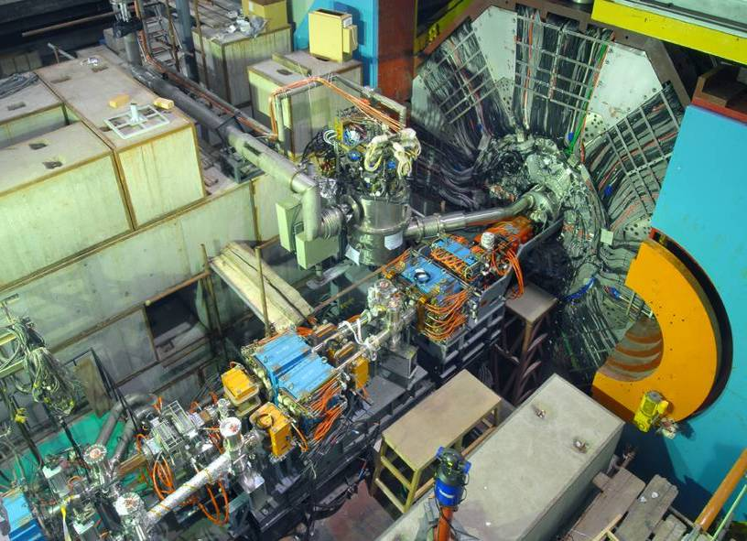
Phase III：Joint commissioning of BEPCII & BESIII
26

Slide 27
BEPCII operation
During construction provides SR
Before the ring upgrade, 6+ months SR provided.
After the ring upgrade finished, immediately provided SR for 5 month during commissioning of BEPCII + BES III: 700 topics from 90 insititutions
High-energy physics experiment extract
October 1-7, 2008 Trial Run
March 6 , 2009 - April 14 34 days to obtain 100 M y (2S) , Compared to 14 million s (2s) for 110 days of BEPC operation in 01-02, 7 times the data is only 1/3 of the time.
four times the previous world's largest big data sample
150 million J/y cases in 40 days from June to July 2009, three times the previous world's largest sample of big data
27

Slide 28
Closing Remark I
BECPII was finished on the schedule, within the budget, and reached the specification.
Maintain the fine tradition of BEPC at IHEP, the younger generation grows up.
Carried out in the market economy
BESIII physics results
Realized a big leap in China‘s technology of accelerator and particle detector ( SC RF, SC magnet, fast electronics... Etc) and supported the particle experiment and accelerator of China in last decade.
Strong intl. cooperation: major topics of China – US HEP annual meeting almost 10years: design, review, R&D, key components
28

Slide 29
Closing Remark II
As mega science facility, the right strategy is #1 issue.
“China‘s Development Strategy for HEP and Accelerators” (2000) was the guideline for the success during last two decades: BEPCII, SSRF, DYB, HXMT, CSNS, JUNO, LHAASO, SHINE, BHEPS…
Extensive discussion about the HEP strategy in future:
Chinese economy: fast growing and challenges?
Strong support to S&T innovation, S&T police? Priority?
Particle physics faces great challenges: dark matter? dark energy? beyond SM? Where is possible breakthrough?
Changes in intl. cooperation?
The right development strategy is #1 issue!
29

Slide 30
BES is one of most successful intl. collaboration in the World, and made great contribution to Chinese Sciences. Thank all physicists and engineers who worked BEPC/BEPCII and BES/BESII/BESIII, specially to intl. collaborators !

