Slide 1
Closing Remarks
Changzheng YUAN (for the LOC)
Changzheng Yuan (IHEP), Xinchou Lou (IHEP)
Beijiang Liu (IHEP), Xiaorui Lyu (UCAS)
Ryan Mitchell (IU), Xiaoyan Shen (IHEP)
Shengsen Sun (IHEP), Lijun Guo (IHEP)
Shanjun Ren (IHEP), Nan Song (IHEP)
Tianhong Xing (IHEP)

Slide 2
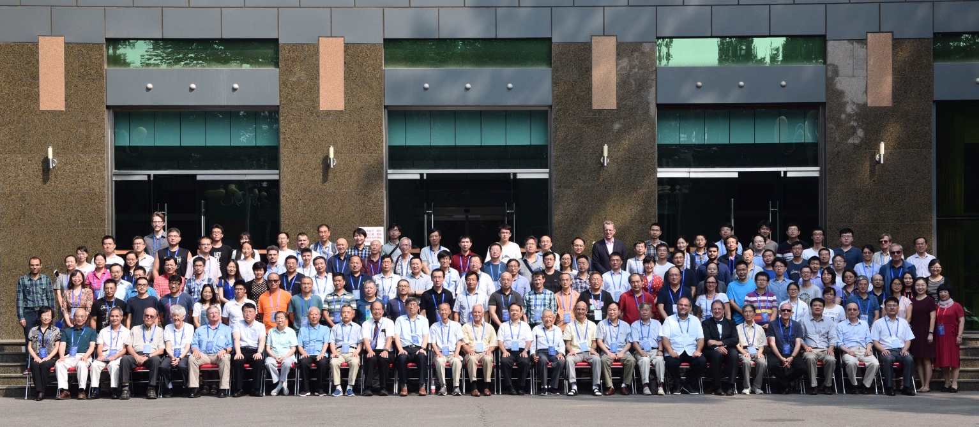
Thank all the speakers & all the participants
With all of you, we had a pleasant Symposium with very good talks on the history, physics achievements, and future!

Slide 3
Thank IAC (BES_{I,II,III} spokespersons + IHEP directors)
Hesheng Chen (IHEP, Beijing),Wolfgang Gradl (JGU, Mainz)
Fred Harris (UH, Honolulu), Joe Izen (UT, Dallas)
Jin Li (IHEP, Beijing), Weiguo Li (IHEP, Beijing)
Xiaorui Lyu (UCAS, Beijing), Russell L. Malchow Jr. (RSL, Nellis)
Yajun Mao (PKU, Beijing), Haiping Peng (USTC, Hefei)
Xiaoyan Shen (IHEP, Beijing), Walter Toki (CSU, Fort Collins)
Yifang Wang (IHEP, Beijing), Minghan Ye (IHEP, Beijing)
Zhongqiang Yu (IHEP, Beijing), Changzheng Yuan (IHEP, Beijing)
Zhengguo Zhao (USTC, Hefei), Yangheng Zheng (UCAS, Beijing)
Zhipeng Zheng (IHEP, Beijing)
Their suggestions made the program of the Symposium very attractive!
It is a pity some of them could not come.

Slide 4
I would like to thank
Our secretary team for their great effort in preparing this Symposium
Shanjun Ren, Nan Song, Li Zhang, Keren He
Zeqi Wei, Wanyu Niu, Yang Pan
Especially to
Ms. Shanjun Ren (任山君)
She led the secretary team and arranged everything (except the scientific program) of the Symposium!

Slide 5
Proceedings
All contributions will be published by World Scientific Publishing Co Pte Ltd. We very much hope that all speakers will submit papers so that we are able to publish the complete proceedings of the Symposium.
The number of pages including figures and tables are:
7 pages for 20' talks
10 pages for 30' talks
The deadline for submitting the proceeding is Oct. 31, 2019. We have to keep this date strictly in order to reduce the publication time. The publication of contributions received after this date cannot be guaranteed.
More information at the conference web page: https://indico.ihep.ac.cn/event/9761/page/5

Slide 6
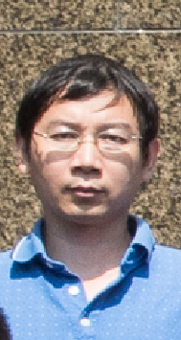
Guided tour to BEPCII/BESIII
4:00pm today
In front of the Main Building
Guided by Dr. Mingyi Dong

Slide 7
Next Symposium …
5 years later in 2024?
10 years later in 2029?
We will leave this to BESIII management and IHEP directors at that time.
Please remember your home work and send your proceedings to us before Oct. 31, 2019!
We wish you a smooth trip back home!
一路平安！
Thank you and good bye!
谢谢！再见！

