Slide 1
Simulation of PixelAnalog
Weiguo Lu
4 March, 2019

Slide 2
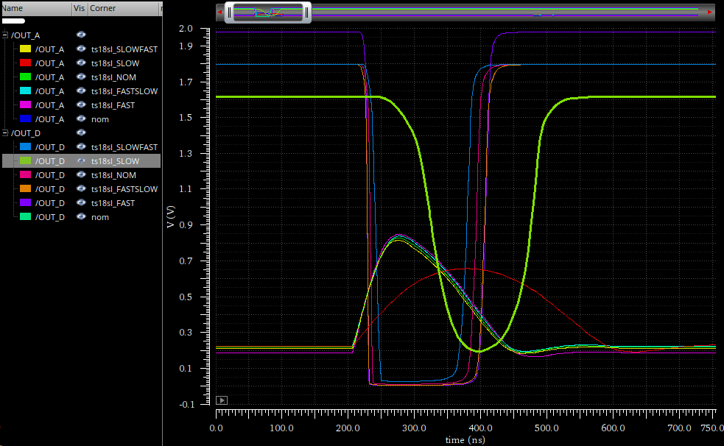
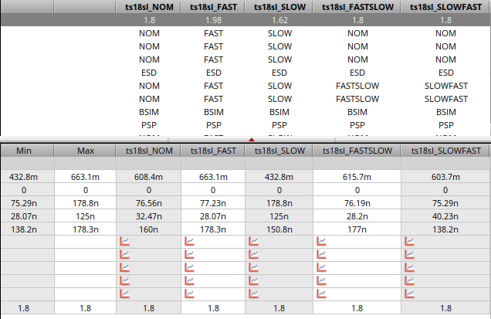
Corner sim of Front-end
Problem reported by Ying reproduced under slow_1.62_-20 corner

Slide 3
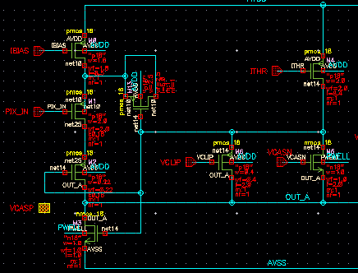
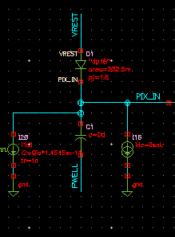
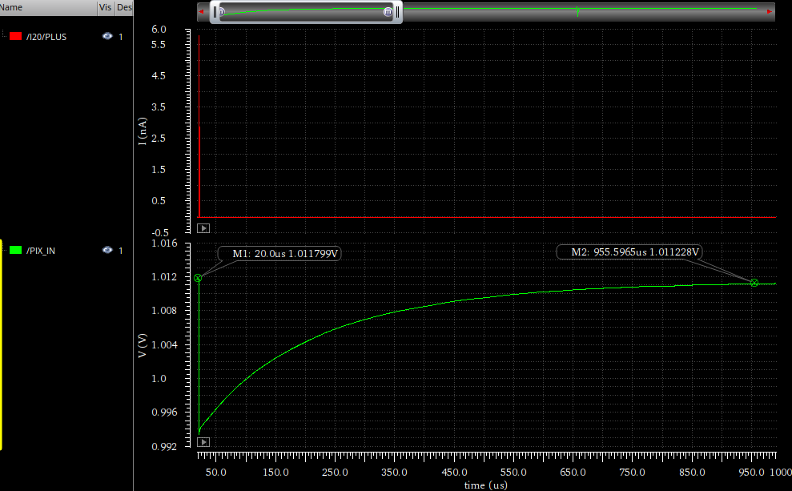
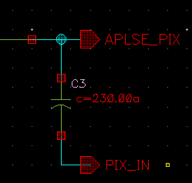
questions of Pixel_Analog
Diode reset
~1ms or 100us?
Some questions for schematic
Dedicated mos_cap ?
Sensor model cap connect to SuB -6V?
Calibration cap from ts018_prim?some mim_cap not supported in current flow, and 230aF exceeds the lower limit

