Slide 1
Simulation Tools for CepC Detector
Chengdong Fu
2019-6-6

Slide 2
Contents
Status
MokkaC
DD4Hep
Detector Geometry

Slide 3
Status
Geant4 simulation for full simulation, two toolkits/frameworks
MokkaC (a developing version of Mokka at CepC), Geant 4.9.6.p02 (updating in plan)
Applied for CDR
Updating for TDR
DD4hep, Geant 4.10.04.p02
Developing the geometries
Standalone application
Implemented into new software framework (Tao Lin’s talk)
Standalone MokkaC/DD4hep simulation
Generator
particle gun, gps, stdhep, hepevt, hepmc, pairs, slcio
MokkaC
slcio+Gear
Reconstruction: Marlin
Database/steering files
xml files
Detector geometry manager
Generator
DD4hep
slcio+Gear
Reconstruction: Marlin

Slide 4
MokkaC VS DD4hep
Geometry manager
MokkaC: general detector construction with parameters from database or steering file, more readable for Geant4 experts
DD4hep: organized by models with parameters from xml files, more intuitive for normal users
Physics List
Both support default Geant4 physics lists
Both easy to change the range cut values
Output
MokkaC→slcio
DD4hep: both slcio and root
Development at CepC
MokkaC: experimental, easy to add new support, such as generators
DD4hep: beginning

Slide 5
Simulation Tools⎯MokkaC
Mokka at CepC or Mokka for collider
Code development
http://cepcgit.ihep.ac.cn/cepcsoft/Mokka
Documents
Notes:
Full Simulation Software at CEPC (CEPC-SIMU-2017-001)
How to use (http://cepcsoft.ihep.ac.cn/guides/scratch/docs/quick_start/)
Default ILCsoft environment has included Mokka. If use a developing version
export MOKKA=“$WORKDIR/MokkaC/MokkaC-00-01”
export PATH=“$MOKKA/bin:$PATH”
export LD_LIBRARY_PATH=“$MOKKA/lib:$LD_LIBRARY_PATH”
Running MokkaC at foreground
Mokka [-option] <steering.macro>

Slide 6
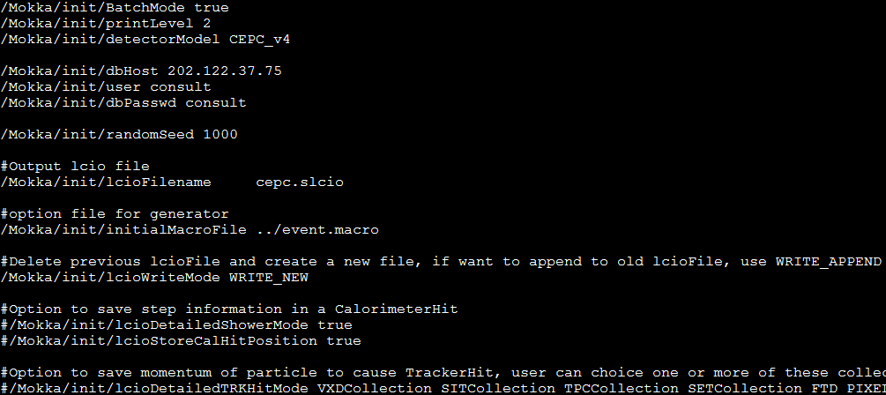
Steering file

Slide 7
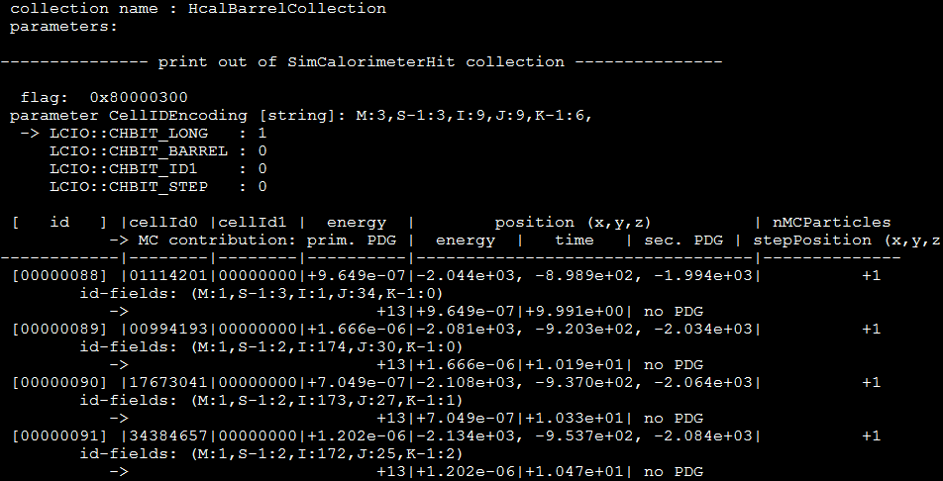
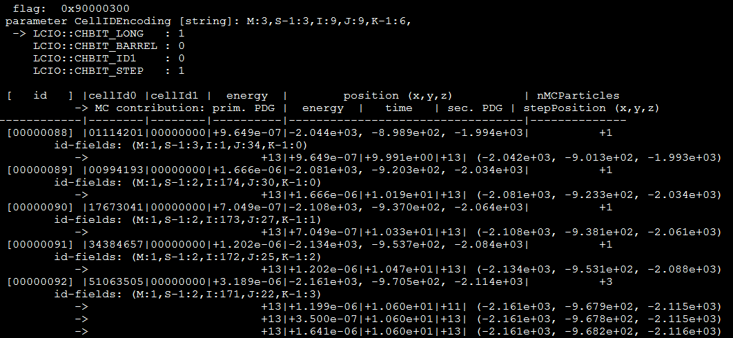
/Mokka/init/lcioDetailedShowerMode true /Mokka/init/lcioStoreCalHitPosition true

Slide 8
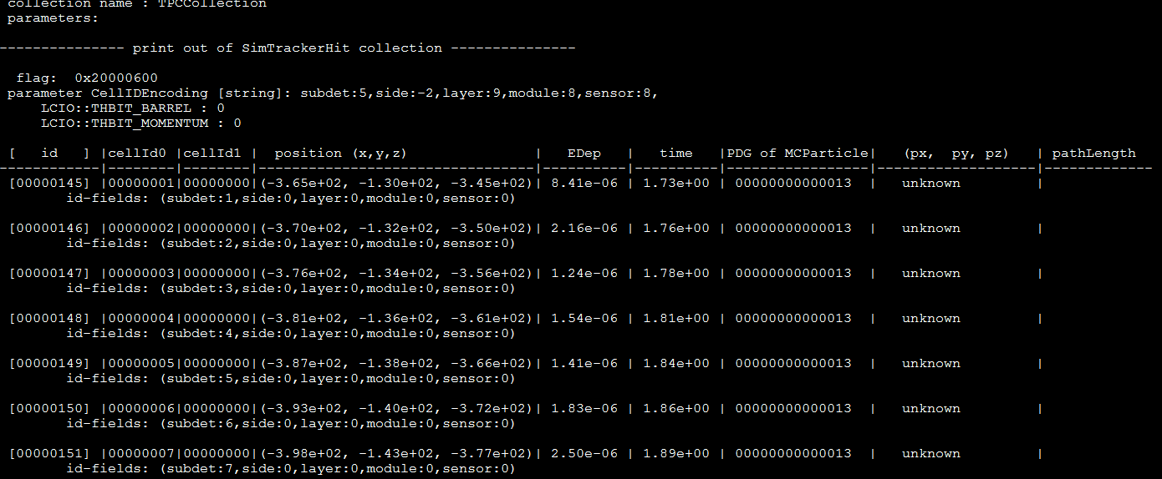
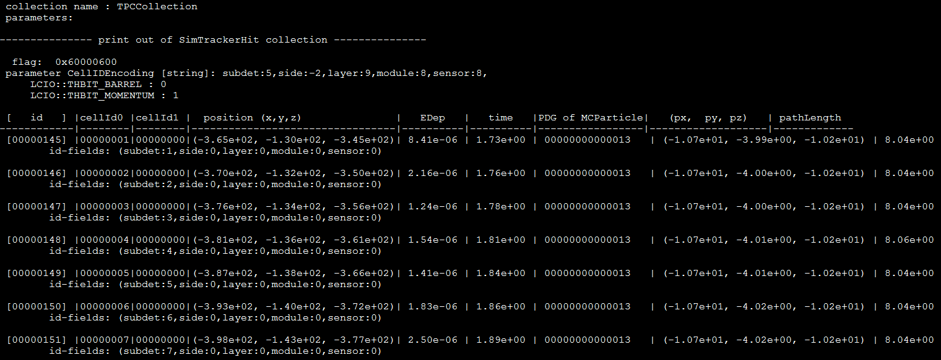
/Mokka/init/lcioDetailedTRKHitMode VXDCollection SITCollection TPCCollection SETCollection

Slide 9
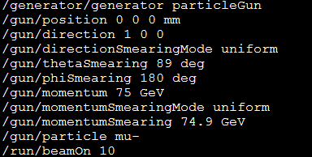
Generator option
/generator/generator events.stdhep
/run/beamOn 100
or

Slide 10
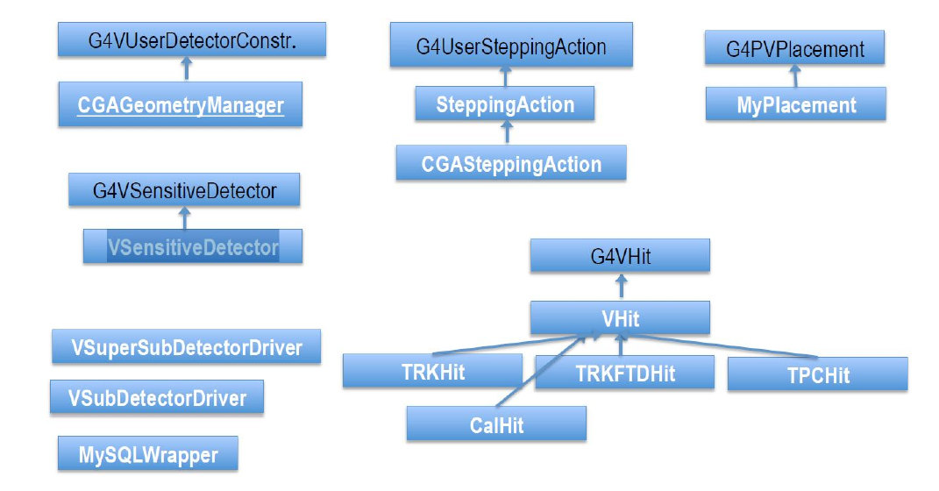
Mokka Kernel

Slide 11
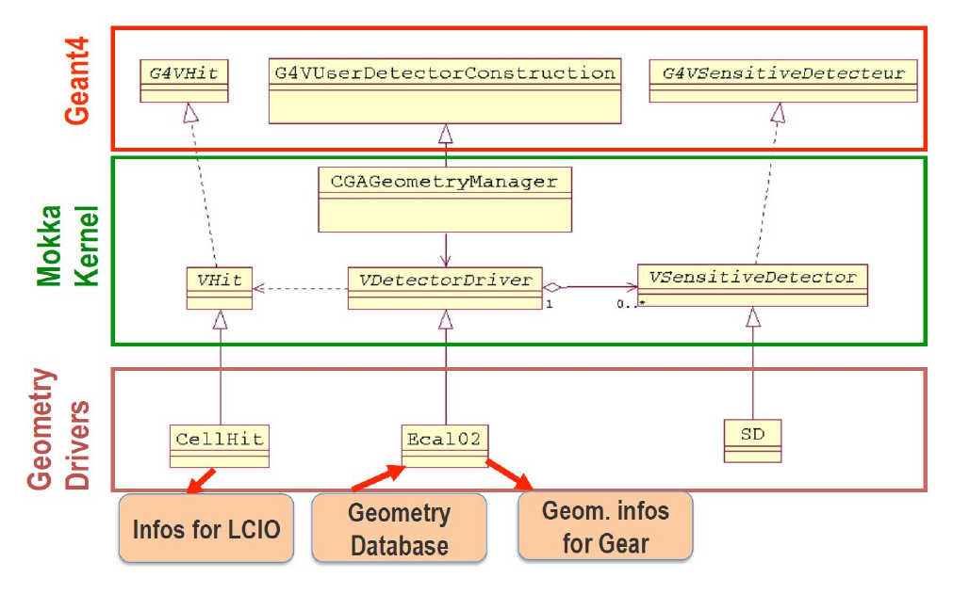
Interface to Geant4

Slide 12
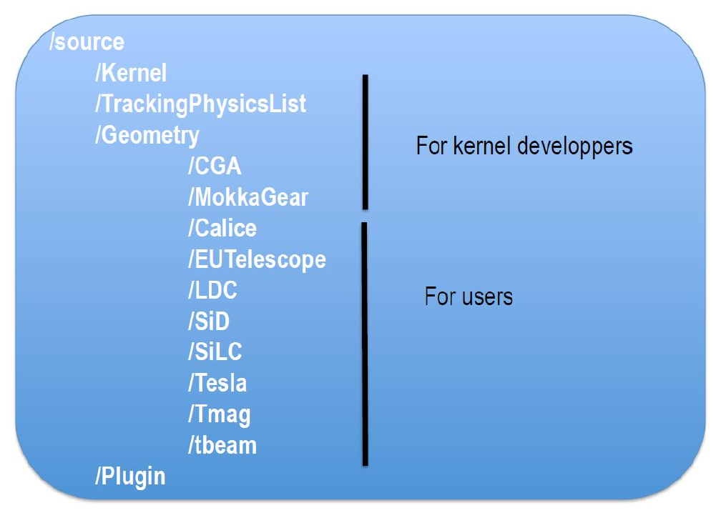
Codes
/CEPC
/SiCal
/SiTracker

Slide 13
Mokka VS MokkaC
Modellierung mit Objekten eines Kompakten Kalorimeters
Object Modeling for compact calorimeters
Mokka is a Geant4-based full simulation framework, in the original version, its detector data driven model is strongly based on MySQL
Store models information
Store geometry parameters
It is modified to break away from database partly, in order to compact new sub-detectors quickly and modify them flexibly.
Add new sub-detector into CEPC model
Input parameters through steering file
New more type of sub-detectors have been built.
A simple general calorimeter: silicon-based, BGO, LGO, Scintillator, THGEM, RPC, LYSO, BC420…
Silicon-based tracker: replace TPC
GeneralInterface: to intergrate sub-detector quickly

Slide 14
More update
Support to change database of driver in steering file
Previous:
/Mokka/init/EditGeometry/addSubDetector tube_cepc
/Mokka/init/EditGeometry/newSubDetector SiTracker01
Current:
/Mokka/init/EditGeometry/newSubDetector new_tube 150 Tube_cepc TMP_DB03_33_Cu
Support scintillator for SHcalRpc01 driver
Add optional parameters for VXD (scale of thickness) through steering file
Add optional parameters for Yoke (layer number and thickness) through steering file
Correct FTD Gear output for radiation length of support

Slide 15
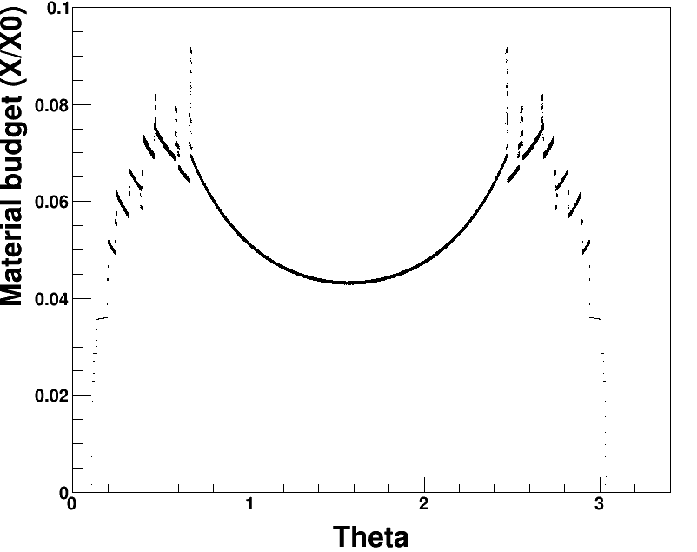
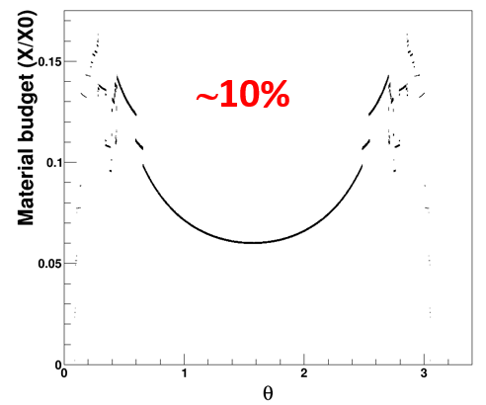
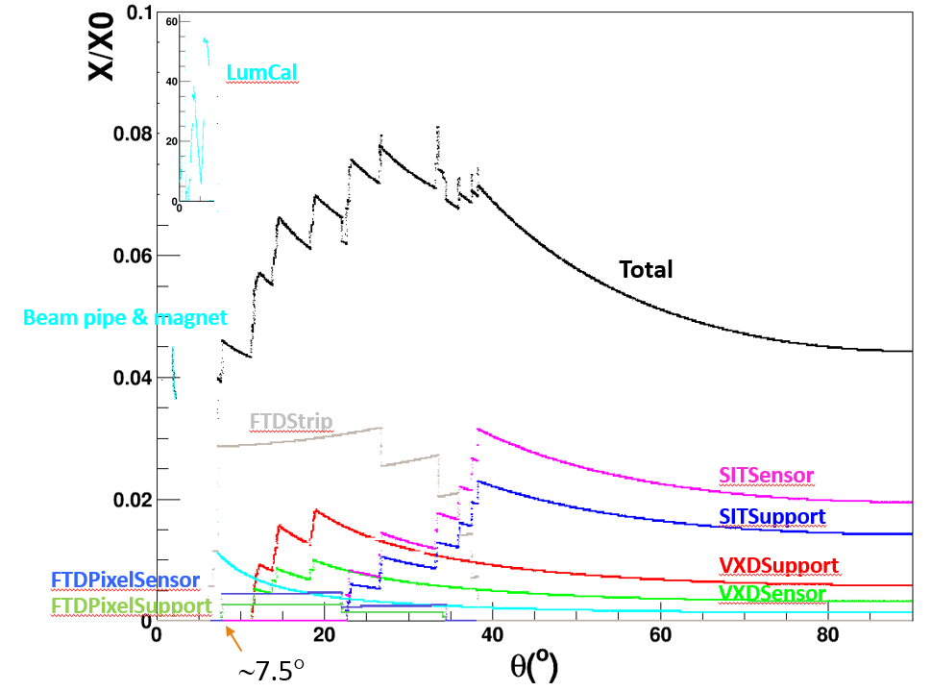
New tool⎯BudgetPlugin
calculated full silicon case
/Mokka/init/registerPlugin BudgetPlugin
/Mokka/init/userInitString OutputFile budget.root
/Mokka/init/userInitDouble zCut 2350
/Mokka/init/userInitDouble rCut 1850
/gun/particle geantino
/run/beamOn 100000
calculated TPC case Scaned full silicon case

Slide 16
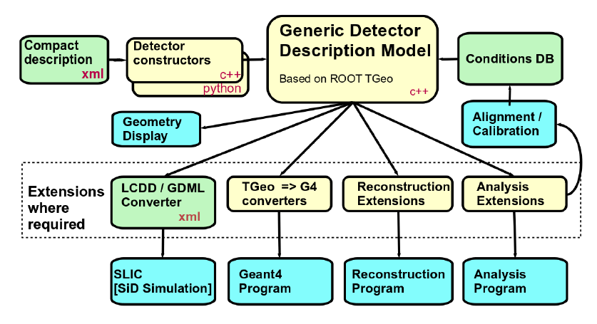
DD4hep Toolkit
From DD4hep manual

Slide 17
Detector compact
Xml
One main xml file include several xml file
elements.xml
materials.xml
Sub-detectors
constants
Keyword controlled parameters
Some common modules have been set in DD4hep

Slide 18
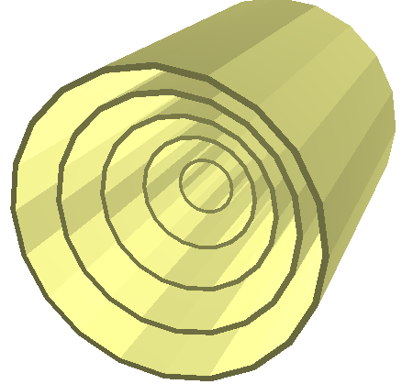
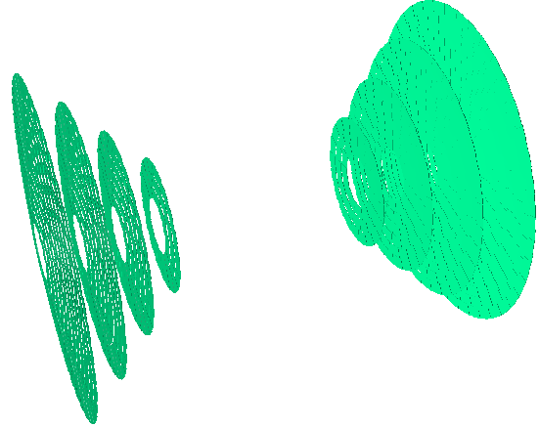
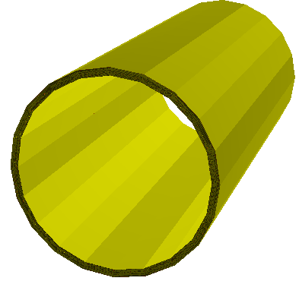
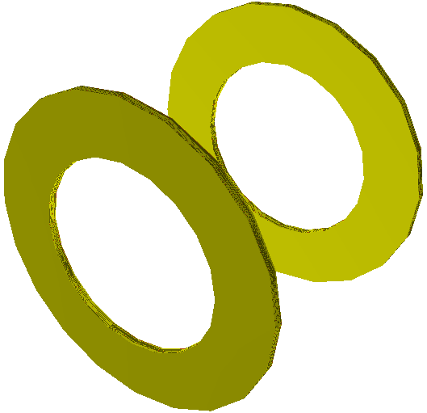
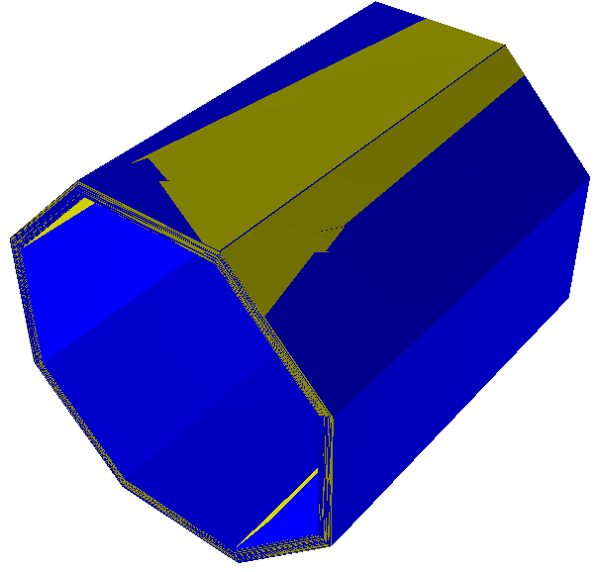
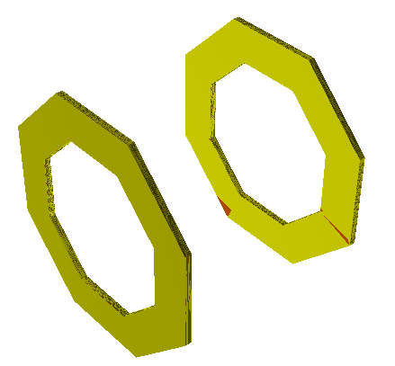
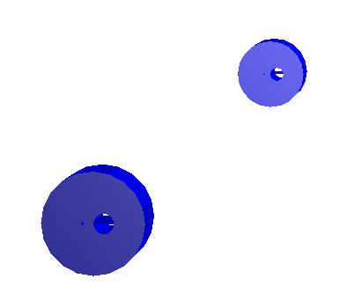
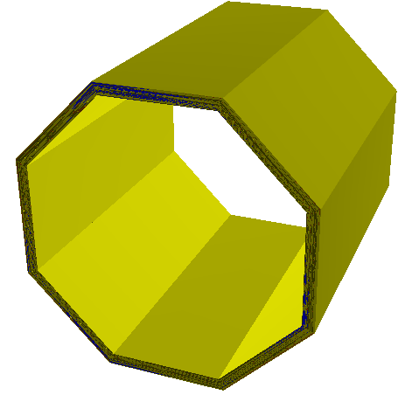
Standard DD4hep supplied detector palette
DD4hep_SiTrackerBarrel
DD4hep_SiTrackerEndcap2
DD4hep_MultiLayerTracker
DD4hep_DiskTracker
DD4hep_CylindricalBarrelCalorimeter
DD4hep_PolyhedraBarrelCalorimeter2
DD4hep_CylindricalEndcapCalorimeter
DD4hep_PolyhedraEndcapCalorimeter2
DD4hep_EcalBarrel
DD4hep_ForwardDetector

Slide 19
User-geometry
An example⎯lcgeo
detector model
calorimeter
CaloTB
fcal
tracker
other

Slide 20
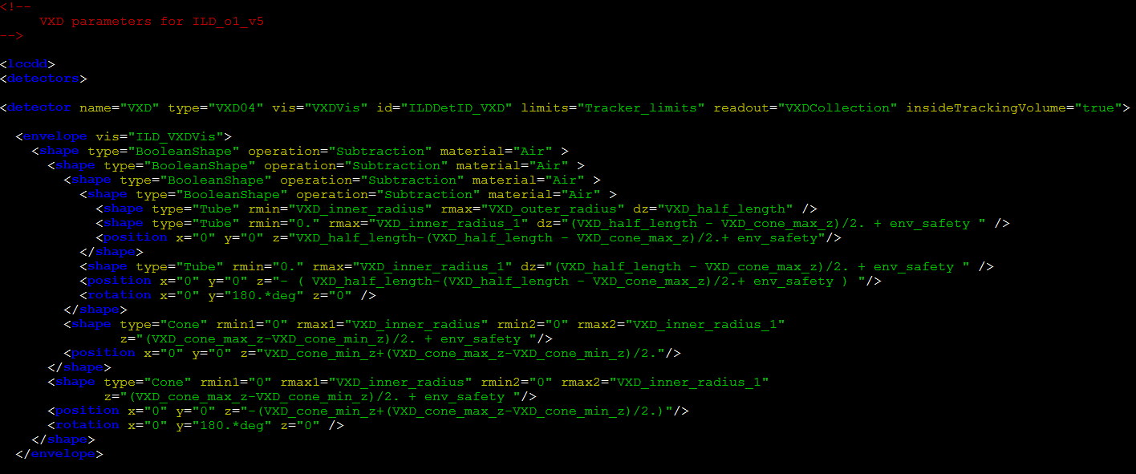
Envelope

Slide 21
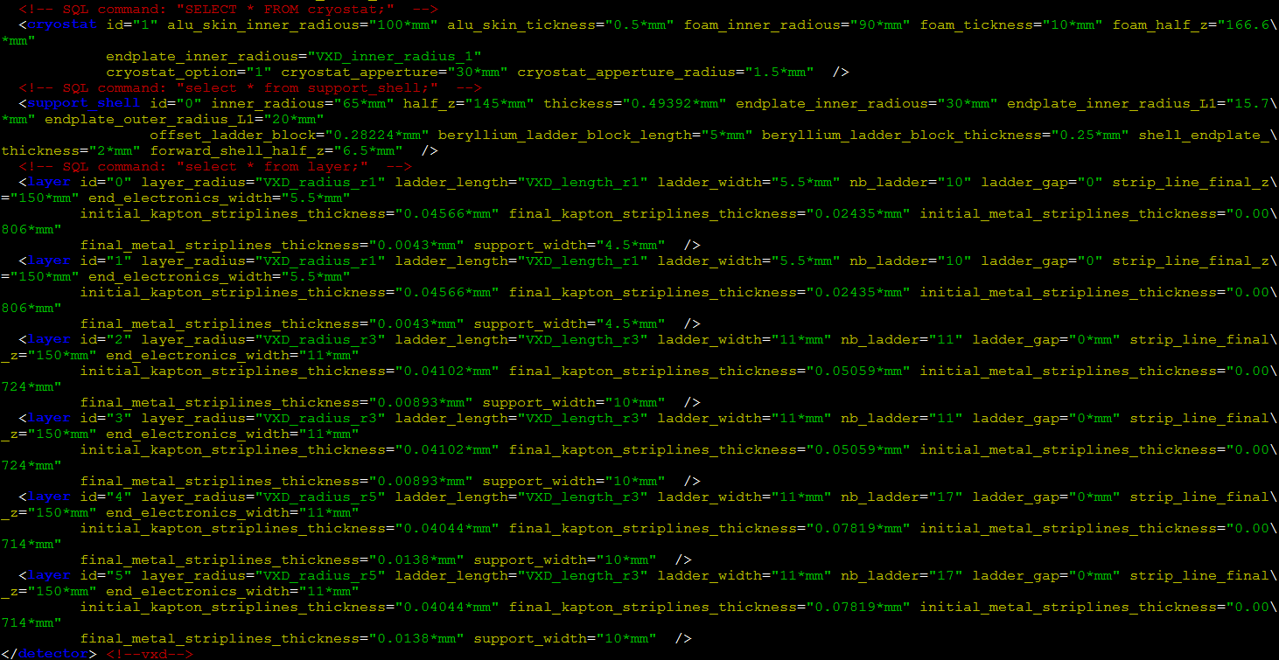
Layer

Slide 22
Usage
environment
source /cvmfs/cepc.ihep.ac.cn/software/cepcsoft/x86_64-sl6-gcc49/standby/DD4hep/01-09/env_all.sh
source /besfs/groups/higgs/users/fucd/lcgeo/bin/thislcgeo.sh
run
ddsim steeringFile.py

Slide 23
steering python file
from DDSim.DD4hepSimulation import DD4hepSimulation
from SystemOfUnits import mm, GeV, MeV, keV
SIM = DD4hepSimulation()
SIM.compactFile = "/besfs/groups/higgs/users/fucd/lcgeo/CepC/compact/CepC_v4.xml"
SIM.runType = "batch"
SIM.numberOfEvents = 2
SIM.inputFiles = "/besfs/groups/higgs/data/GeneratorSample/higgs/E250-TDR_ws.Pe1e1h.Gwhizard-1_95.eL.pL.I106475.001.stdhep"
SIM.gun.energy = 10*GeV
SIM.gun.particle = "e-"
SIM.gun.multiplicity = 1
SIM.gun.position = (0.0,0.0,0.0)
SIM.gun.direction = (0,0,1)
SIM.gun.thetaMin = 0.14
SIM.gun.thetaMax = 3.0015926
SIM.gun.distribution = 'uniform' #'uniform', 'cos(theta)', 'eta', 'pseudorapidity', 'ffbar'
SIM.enableGun = False
SIM.outputFile = "test.slcio"
SIM.part.minimalKineticEnergy = 1*MeV
SIM.physics.list = "FTFP_BERT"
SIM.physics.rangecut = 1*mm

Slide 24
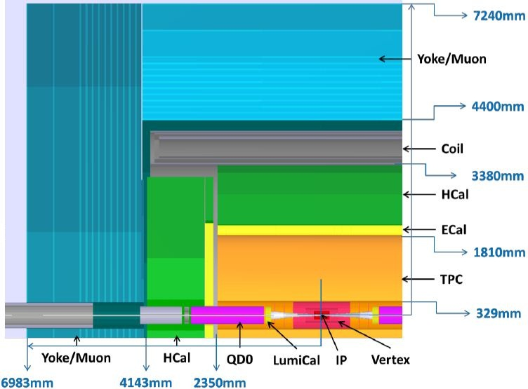
Geometries in MokkaC
Driver/SupperDriver to build sub-detector
Driver: general Geant4 detector construction
SupperDriver: building a temporary database needed by the corresponding driver, based on the parameters from Mokka’s geometry environment (database or steering file)
In CDR version CEPC_v4
Single driver:
MDI
SIT/SET
FTD
TPC
Ecal
Hcal
Yoke
Both driver and supper driver:
VXD
Coil
LumiCal
FTD
SET
SIT
(VXD)

Slide 25
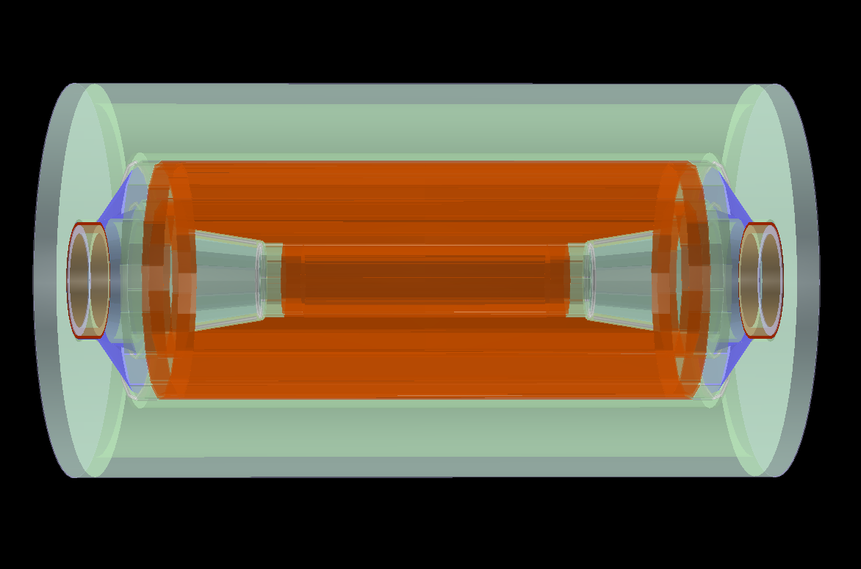
Vertex Detector
three double-layers
support layer thickness: 0.94 mm SiC foam, 0.05 flex cable, 0.01 metal traces
0.05 mm silicon
to TDR: support 1mm carbon fiber, revisable
outer support
endcap plate
inner support
cables etc.

Slide 26
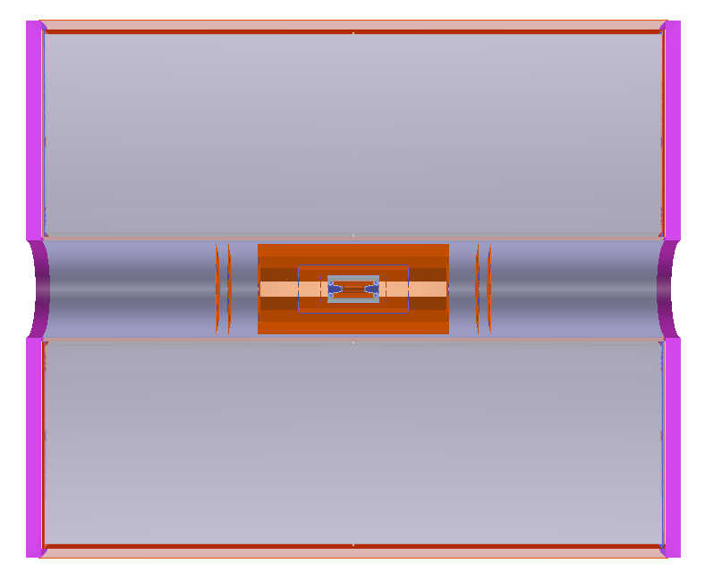
Tracker
SIT/SET
SIT: two double strip layers
SET: one double strip layers
to TDR: possible to add layers through database (MokkaC) or xml (DD4hep)
TPC
222 pad rows, adjusted by radius and pad height, $N=\frac{R_{outer, s}−R_{inner,s}}{Pad Height}$
FTD
two pixel disks
three strip disks

Slide 27
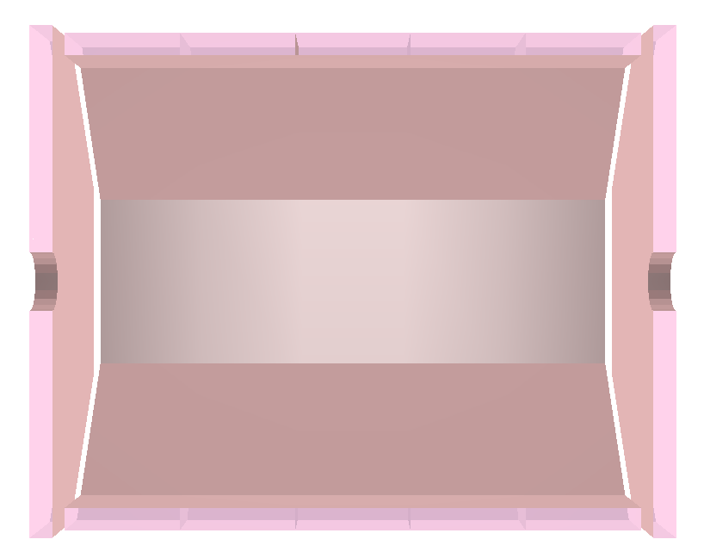
Ecal option
Optimized from CEPC_v1 to CEPC_v4, cell size from 5 mm to 10 mm
20 layers + 10 layers
0.5 mm silicon (optional)
2.1 mm (4.2 mm) tungsten (optional)
Support scintillator as sensitive layer

Slide 28
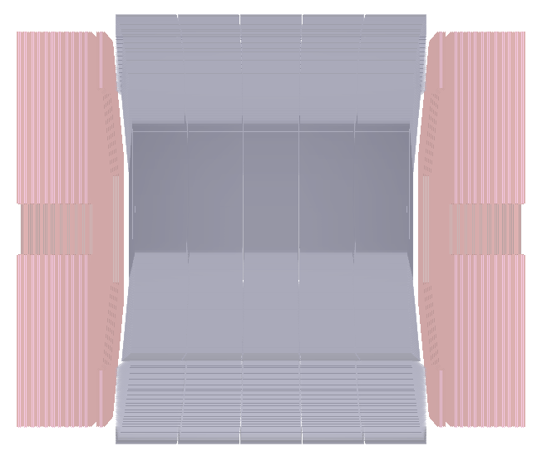
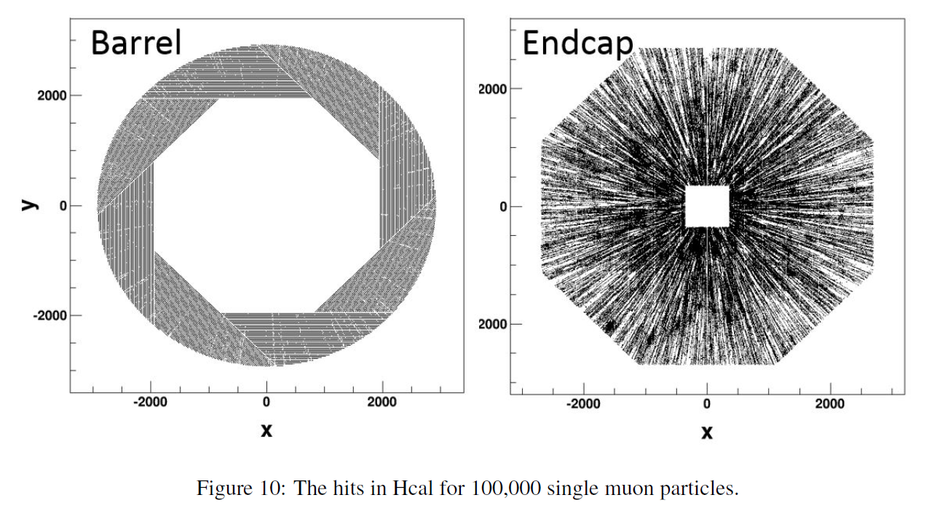
Hcal
Optimized from CEPC_v1 to CEPC_v4, from 48 to 40 layers
6.73 mm RPC chamber
20 mm stainless steel
cell size: 10 mm
optional scintillator readout

Slide 29
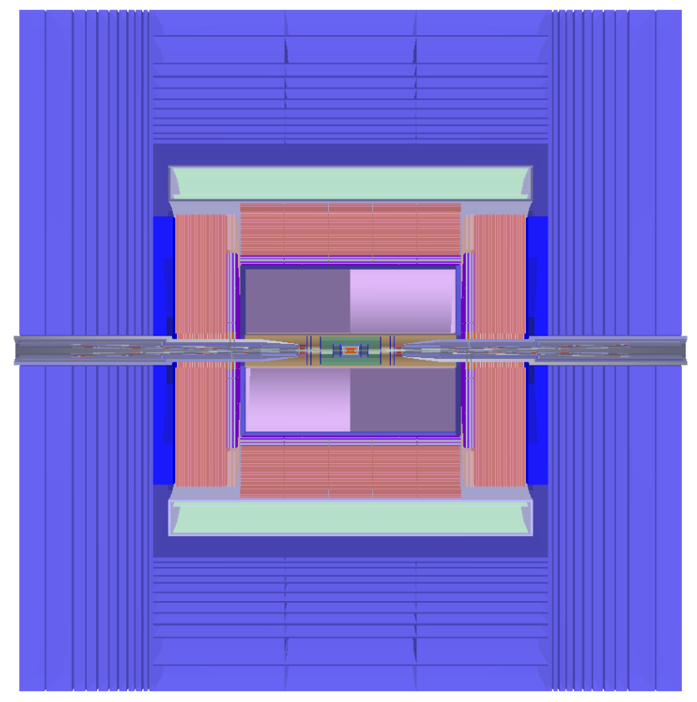
Yoke (muon detector) option
Default
yoke05 (12 iron layers, 13 RPCs for barrel and 12 RPCs for endcap)
To change (new driver yoke06)
/Mokka/init/globalModelParameter YokeUserLayer 1
/Mokka/init/globalModelParameter YokeGapThickness 25,40,40,40,40,40,40,40,40,40,40
/Mokka/init/globalModelParameter YokeIronThickness 80,80,120,120,160,160,200,200,240,540,540

Slide 30
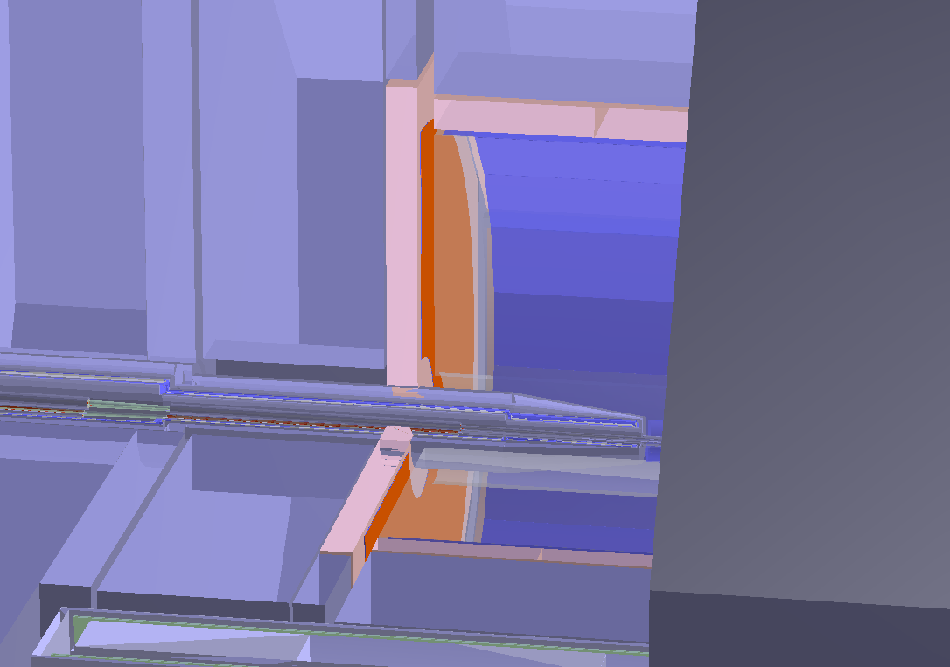
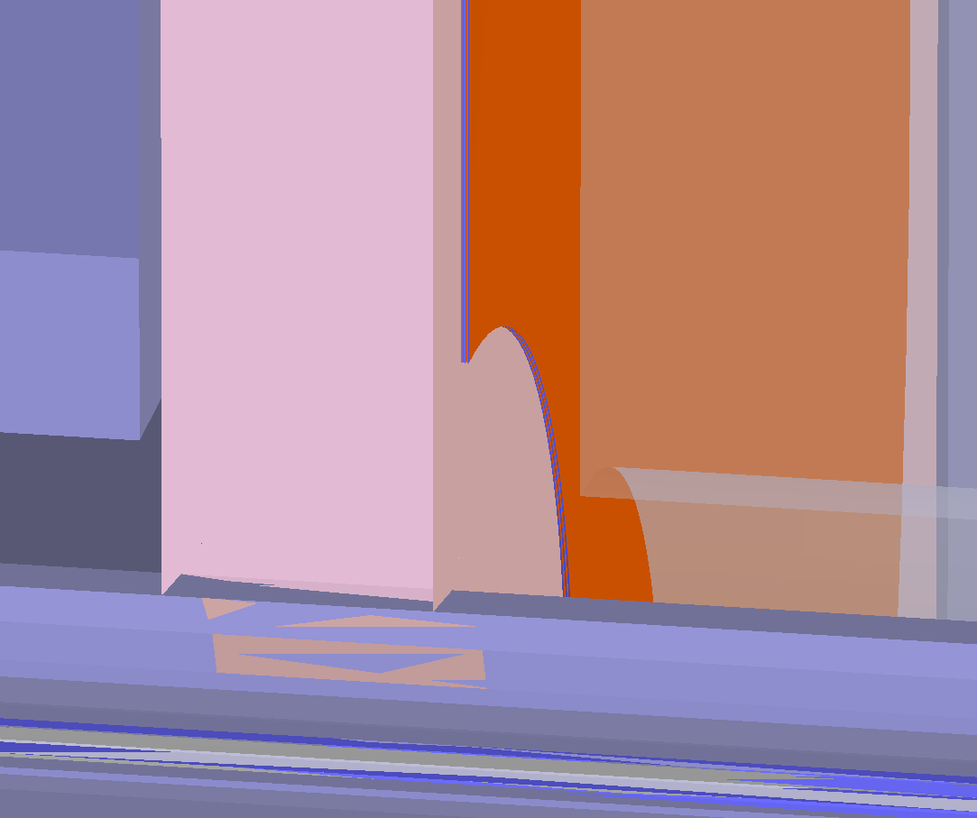
Geometry of ETD (not included in CEPC_v1 and CEPC_v4)
Simplify
Disc: G4Tubs, sensitive + support
3 layers? determined in future
Usage
Driver: ETD_cepc
Mokka version: xx, currently /workfs/bes/fucd/MokkaC/
Add into steering file:
/Mokka/init/EditGeometry/newSubDetector MyETD 240 ETD_cepc etd03
database

Slide 31
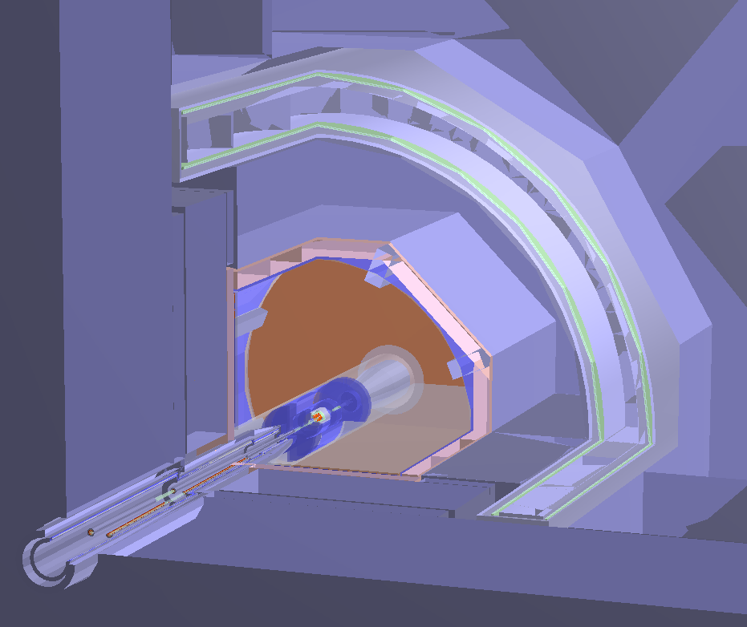
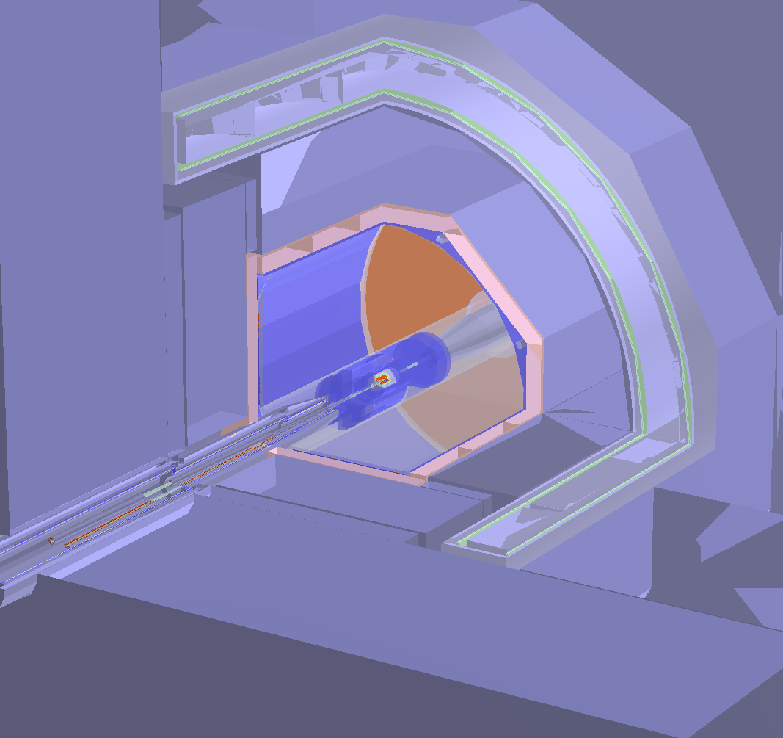
Geometry of Laser Calibration System (Not included in CEPC_v4 and CEPC_v4)
Simplify
No support and electronic: stainless_steel and TDR_gas (95.667%Ar+2.067%CH4+2.267%CO2)
Square tube： 4cm width and 5*mm thickness
Usage
Driver: LaserCalibration
Mokka version: xx, currently /workfs/bes/fucd/MokkaC/
Add into steering file:
/Mokka/init/EditGeometry/newSubDetector LaserCalibration 250
/Mokka/init/userInitDouble LaserCalibrationPhi0 22.5

