Slide 1




ATLAS Muon Detector Phase-II Upgrade
Quanyin Li
State Key Laboratory of Particle detection and electronics
University of Science and Technology of China
2019.10.26

Slide 2
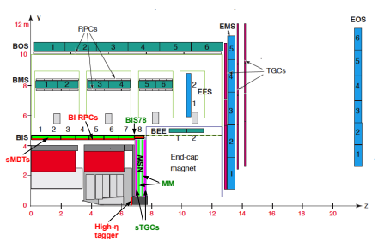
Outline
BI RPC upgrade
BI sMDT frontend electronics upgrade
High-eta tagger
Summary

Slide 3
BI RPC upgrade

Slide 4
Introduction: BI RPC and Improvement
Problem of current RPC in ATLAS
Exceed their service time (10 years @ LHC)
Rate capability limited: 20 Hz/cm²
Work under lower voltage ➔ 15-35% eff. Lost
The solution
Add BI RPC layers (3 layers of RPC)
Improvement of rate, longevity, time & spatial resolution.
Improvement of RPC gas gap:
Reduced gap size:
  Less charge produced per event → improve longevity, rate capability
  Less high voltage applied but higher field → better time resolution
Reduced bakelite thickness:
  Less voltage loss in bakelite → improve the rate capability
New generation FE electronic:
  Higher amplification factor and high S/N ratio to compensate the less gas amplification.
Improved readout panel and method
  Better mechanics structure, better signal transmission and good spatial resolution.
9 layers instead of 6
strips
Forex-board(or Honeycomb)
RPC gas gap
Gap size: 2mm→1mm
GND
Front-End board
Bakelite: 1.8mm→1.2mm

Slide 5
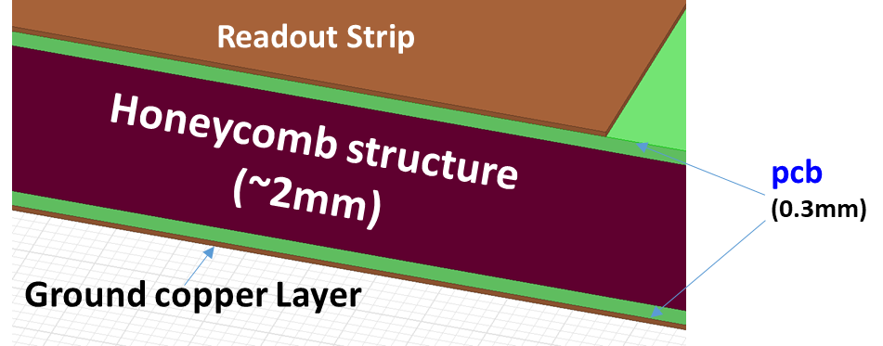
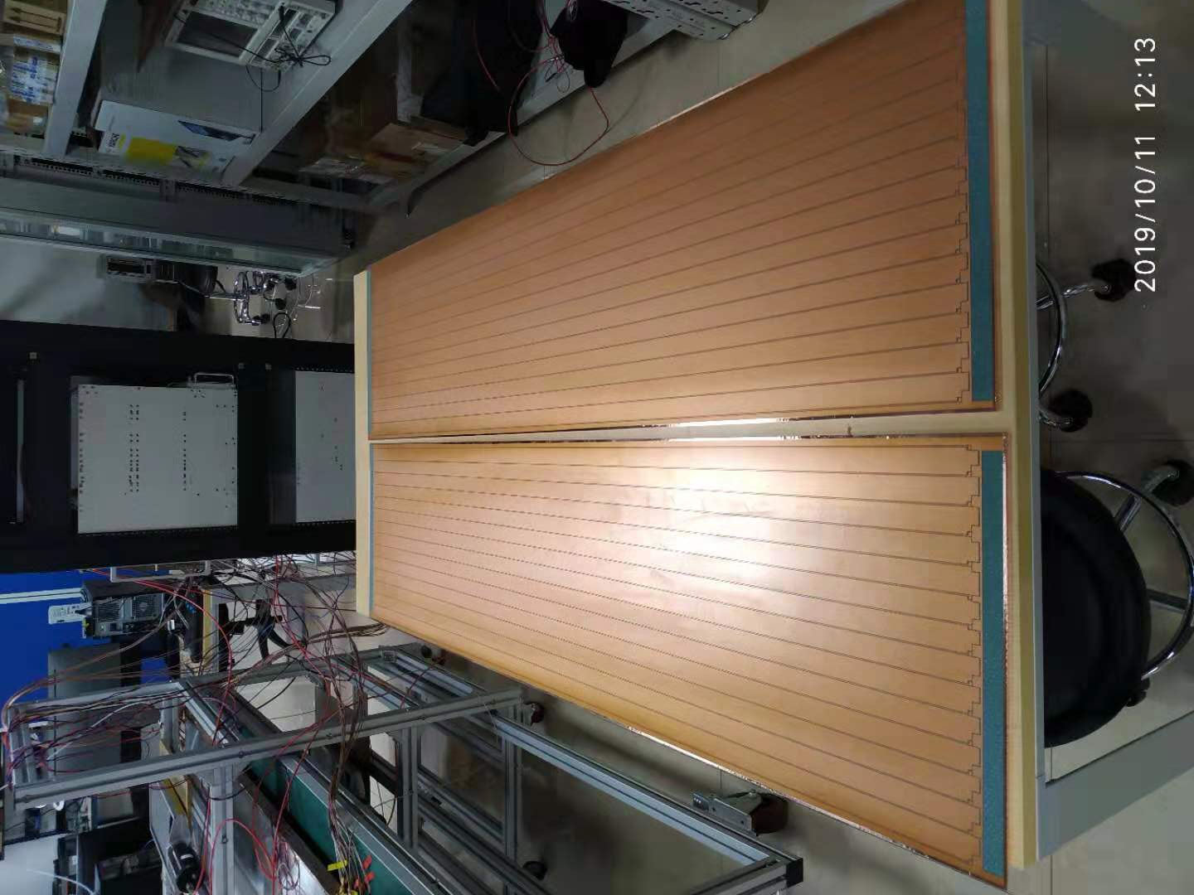

New material of readout panel
Main considerations of material: Dielectric constant (ε_{r}) , weight, rigidity
Old design: foam-like material (low ε_{r}, fragile and soft)
New design: honeycomb board (low ε_{r} and hard)
Design and parameter of honeycomb read panel
2 layers of PCB as readout strip and ground
~2 mm honeycomb plate as medium
Characteristic impedance: ~19 ohm
Good performance tested in the double-end readout test
Raw honeycomb board
Completed honeycomb readout panel

Slide 6
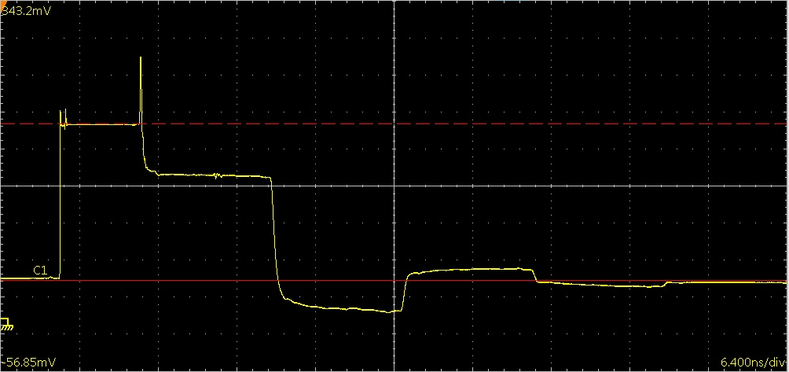

Measurement of characteristic impedance
Precise measurement of characteristic impedance. This is necessary in the test of BI RPC during chamber assembly and in the measurement of new panel.
Connect TDR and readout panel.
Characteristic impedance: R₁=50 Ω
Signals reflect
Characteristic impedance: R₂=??? Ω
Directly connect to the ground
Read the superposition of output and reflection.
Characteristic impedance: R₁=50 Ω
Time Domain Reflectometer(TDR)
SMA Cable
Long strip
Continuous point
Reflection point 1
Reflection point 2
Not perfect continuous point, but negligible
Output of TDR
V₁
Signal read by TDR: Overlap of output and reflection
V₂
V_{baseline}
The long tail: signal reflect between point 1 and point 2, at last tend to be stable and equal to the baseline.
$$\frac{V_{2}−V_{1}}{V_{1}−V_{baseline}}=\frac{R_{2}−R_{1}}{R_{2}+R_{1}}$$

Slide 7
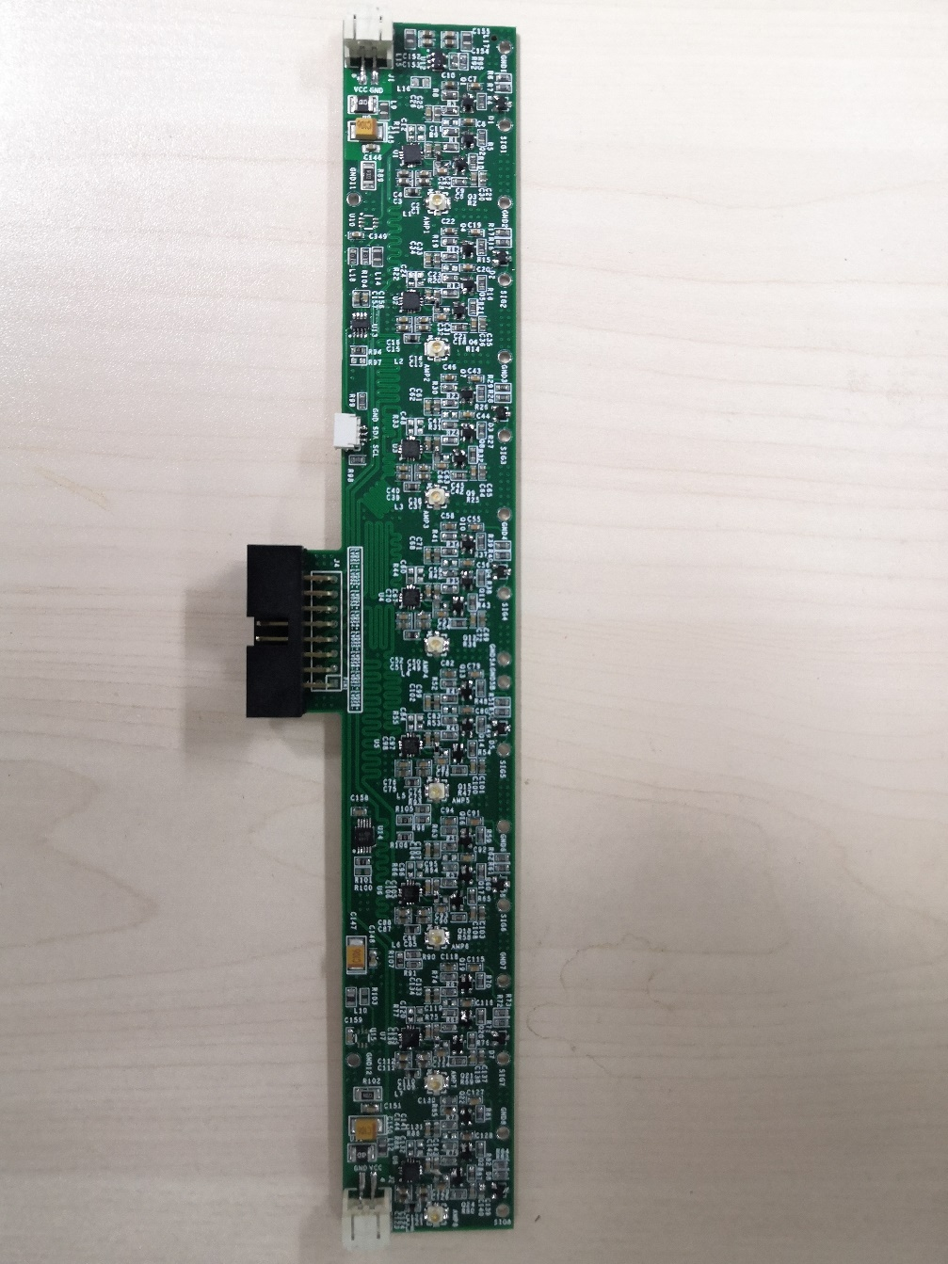
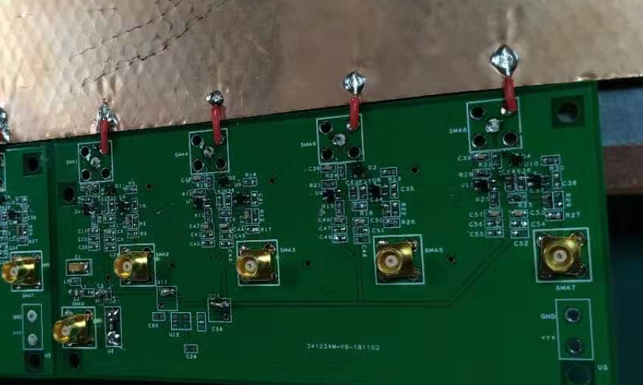
New FEE Board designed by USTC
Version 1 of FEE board(only amplifier):
Version 2 of FEE board(amplifier-discriminator-LVDS converter):
Two versions of FEE boards were designed by USTC.
Compared with that of INFN, USTC FEE board has larger gain, wider bandwidth and lower power consumption.
Current and voltage could be monitored by software.
Now the second version of FEE board is under testing in USTC.

Slide 8
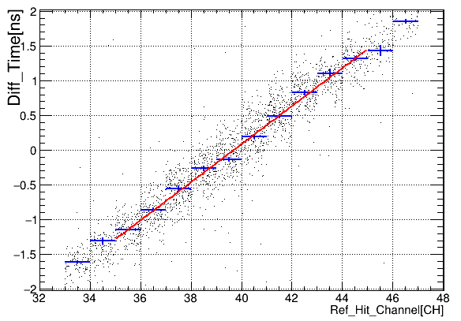
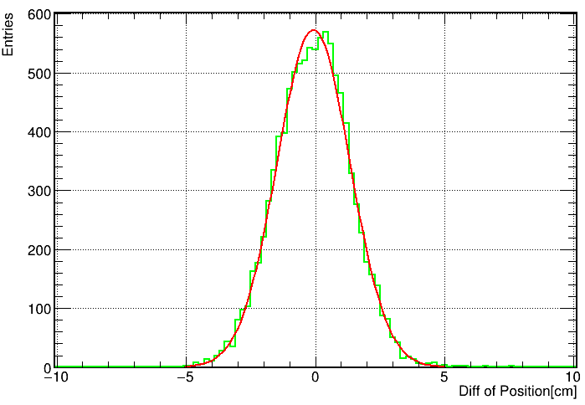
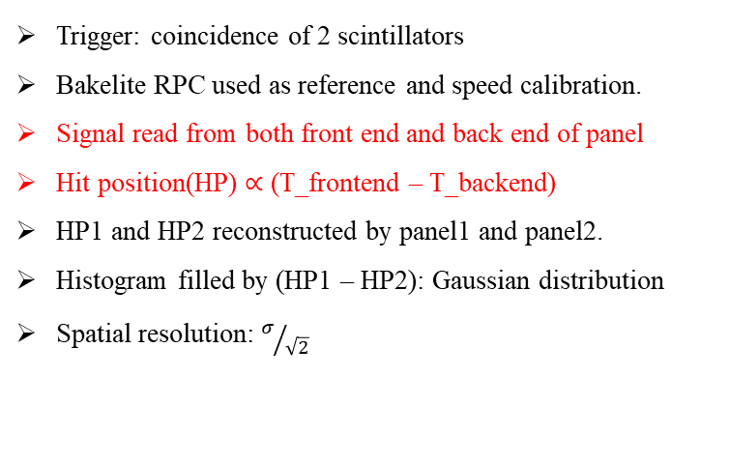
Double-ends Readout Method
Trigger: coincidence of 2 scintillators
Bakelite RPC used as reference and speed calibration.
Signal read from both front end and back end of panel
Hit position(HP) $∝$ (T_frontend – T_backend)
HP1 and HP2 reconstructed by panel1 and panel2.
Histogram filled by (HP1 – HP2): Gaussian distribution
Spatial resolution: $σ/{\sqrt{2}}$
Side View
8 channels
scintillator
8 channels
Galss RPC 1.4m*0.4m
8 channels
8 channels
Bakelite RPC 0.5m*0.5m
16 channels
scintillator
System setup
Fig (a): Scatter plot of 2 hit positions found by bakelite RPC and reconstructed by glass RPC. Transmission speed: 19.69 cm/ns.
Fig (b): Distribution of (HP1 – HP2). The best spatial resolution: 0.998 cm. Meet the requirement of Phase II Upgrade.
Fig (a)
Fig (b)

Slide 9
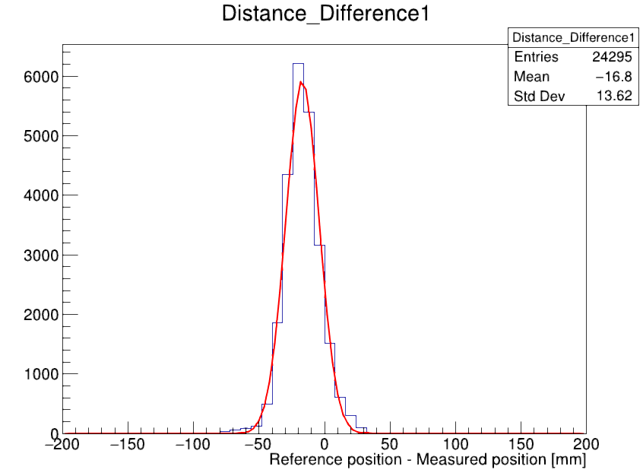
Hypothesis: Single-end reflection readout
Reference strips
Scintillator trigger area
Gas gap/Strip size: 100cm * 50cm
Strip width:
25mm
Strip gap width
2mm
Measured strips
Signal
Cosmic muon hit position
Reflected signal
Reference Position (mm)
An advancing improvement:
The backend of strips are open or connect to ground directly.
FEE board read signal and reflected signal from single end of the strips.
Hit position can be reconstructed by time difference between signal and reflected signal.
Measured result: 1.015 cm.
Entries
Difference of hit position [mm]

Slide 10
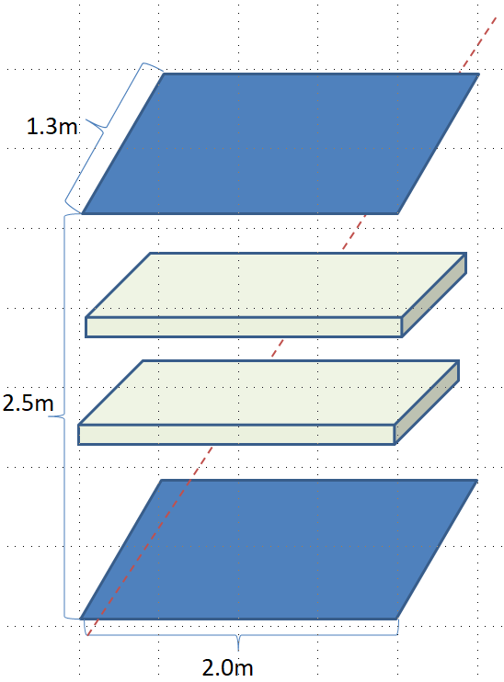
Big area trigger detector design (by SDU)
Trigger detector of the future RPC test system:
BIS RPC max area：
  1820mm*1096mm
Trigger detector sensitive area:
  2000mm*1300mm
Light tight box of the trigger detector:
  2200mm*1350mm*50mm

Slide 11
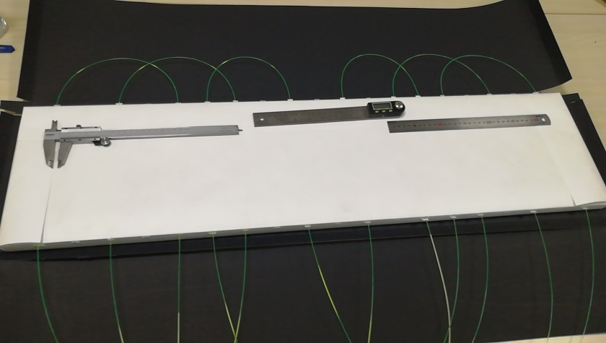
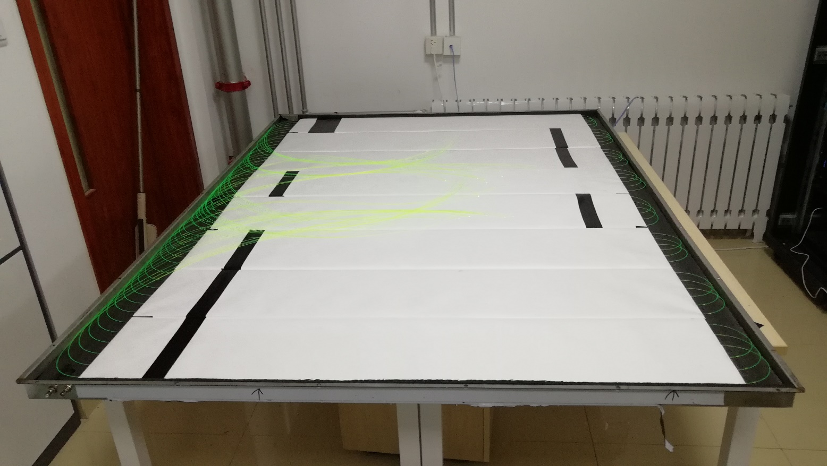
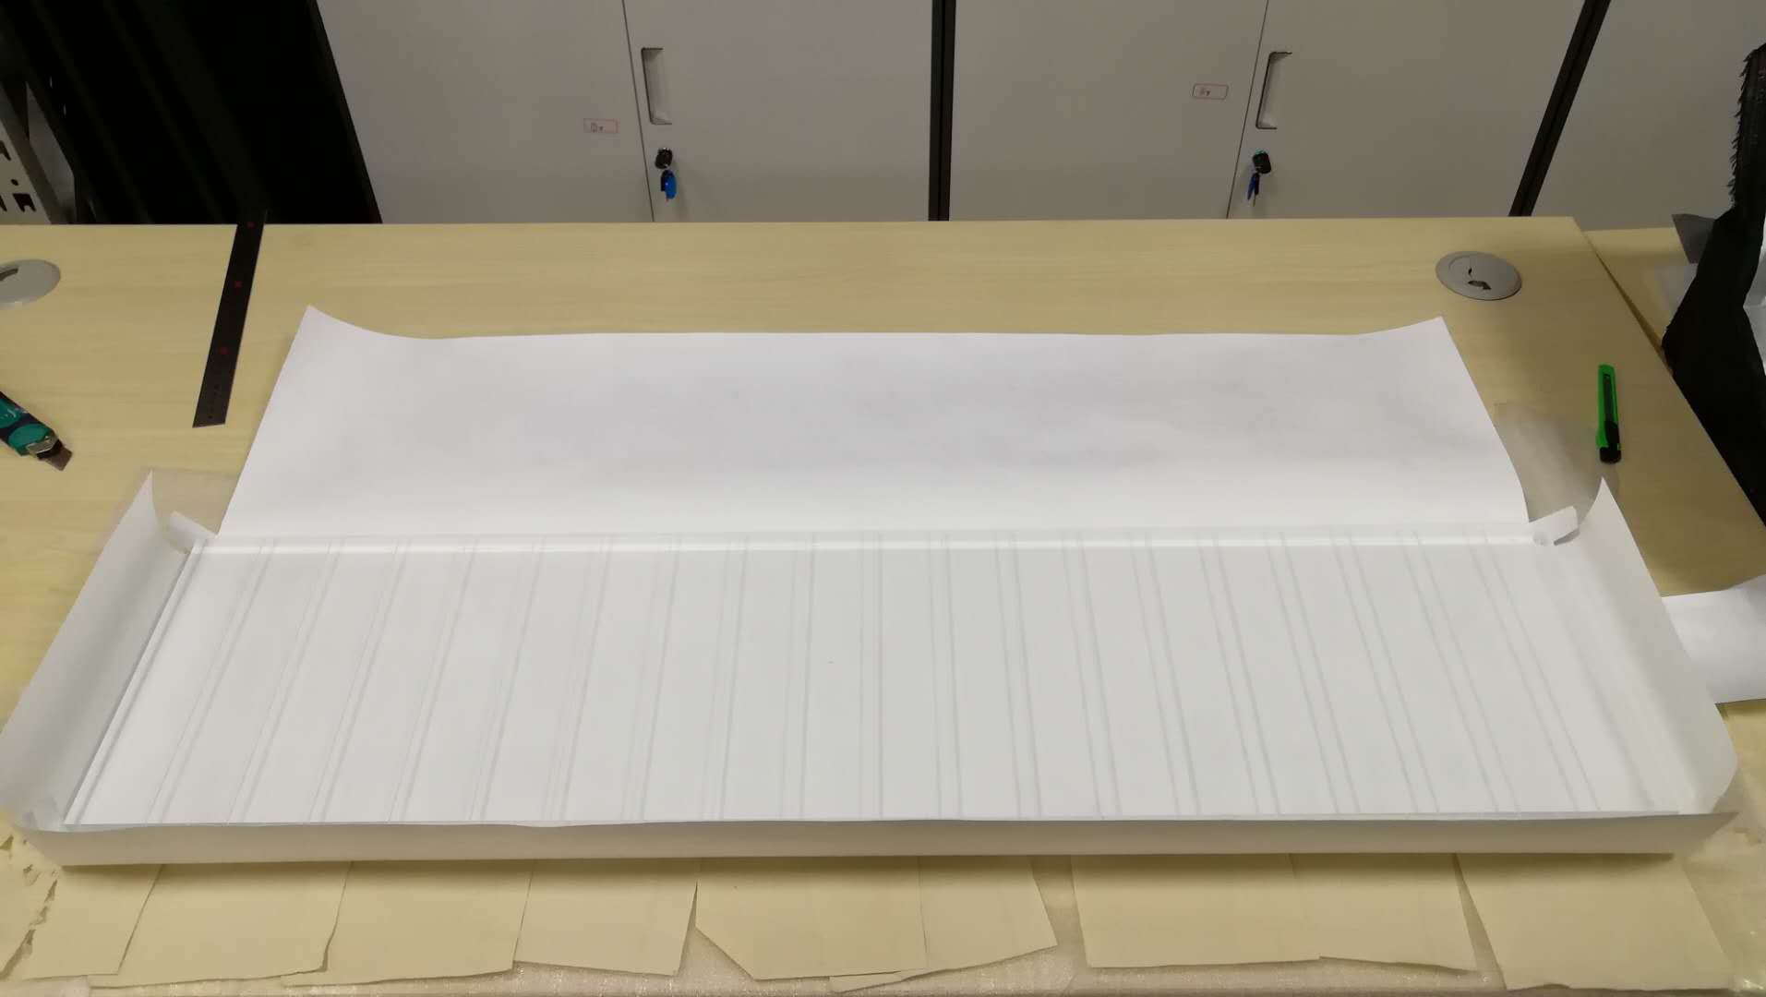
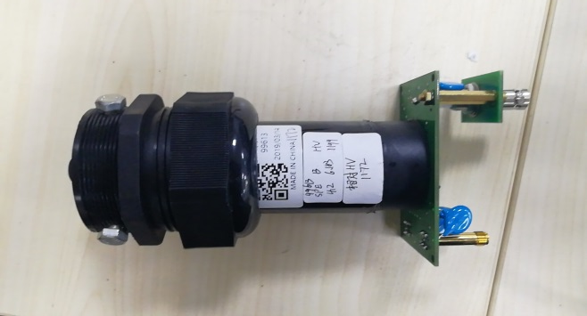
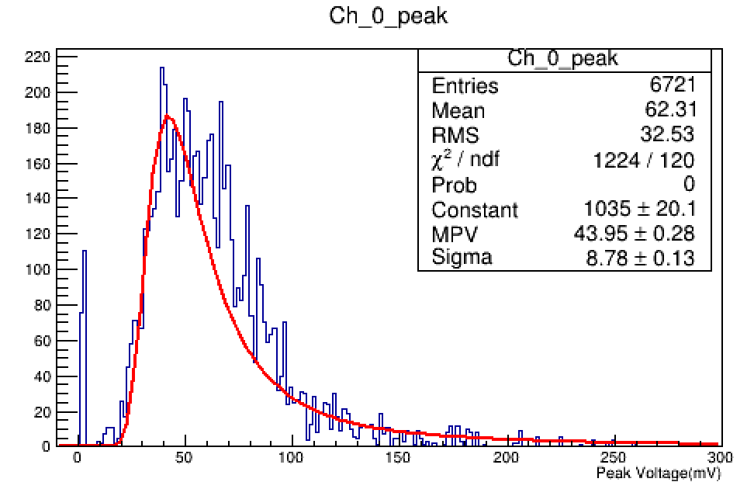
Trigger detector assembly(SDU)
WLS fiber insert into the grooves of the scintillator.
Scintillator tile with groove before package with tyvek paper.
Entries
PMT
8 piece scintillators install in one light tight box
  Each scintillator insert 6 WLS fibers
  One PMT couple to all the fibers
Quality of signal is good.
Waiting more scintillators for another detector.
Amplitude of signal from scintillator

Slide 12
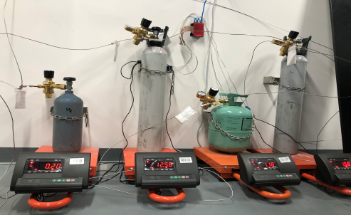
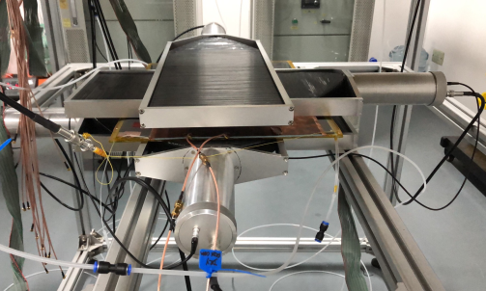
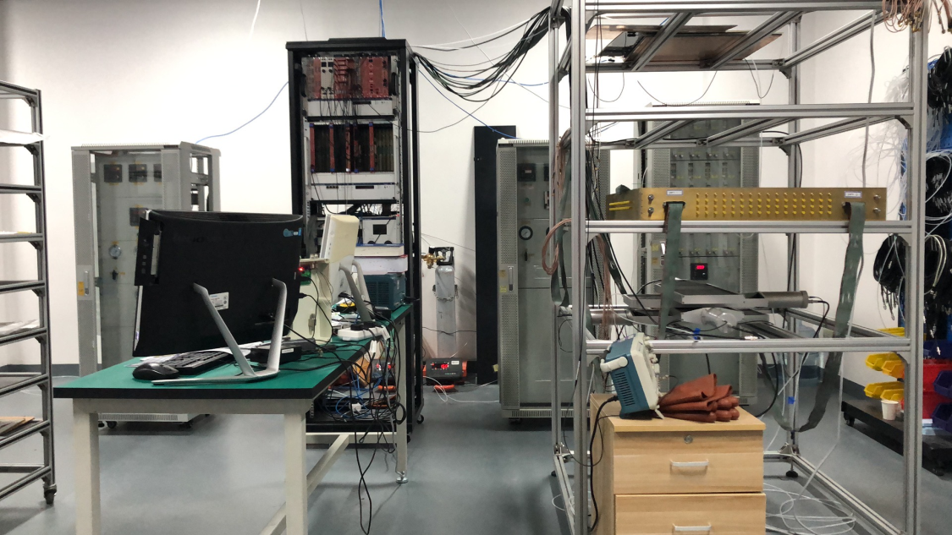
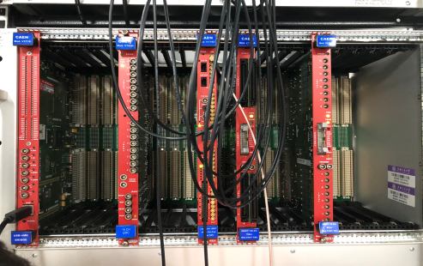
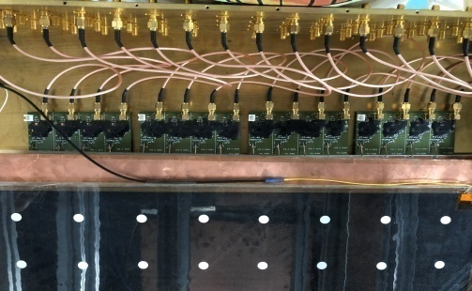
RPC Detector Laboratory in SJTU
The RPC detector test platform was built, including the gas distribution system, the trigger system, the test system and the readout system.
Gas system：Gas components(C₄H₁₀,SF₆, R134a, N₂)，Gas mixture, Gas distributor.
Trigger system：Scintillator, photomultiplier tube (PMT), and trigger module unit (TDC) for signal discrimination and selection.
Test system：High voltage module, gas channel, Faraday cage, RPC to be tested for the RPC performance testing.
Readout system：Sensitive detection unit (sensing strip), front-end electronics, analog-to-digital converter ADC, DAQ system.
Gas, trigger, test and readout system
RPC detector test platform

Slide 13
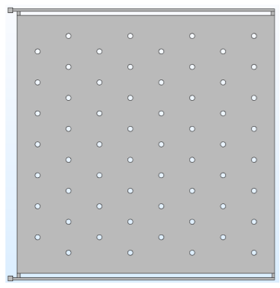
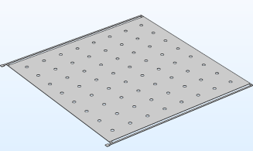
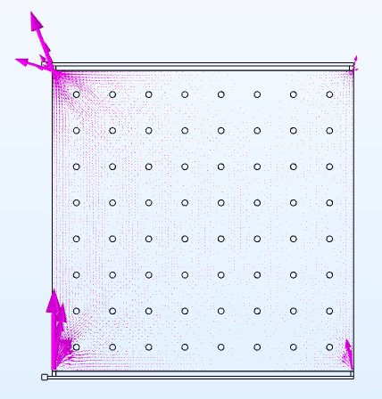
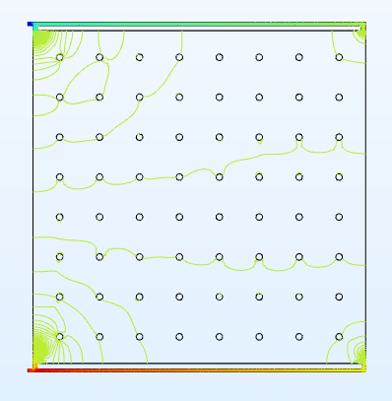
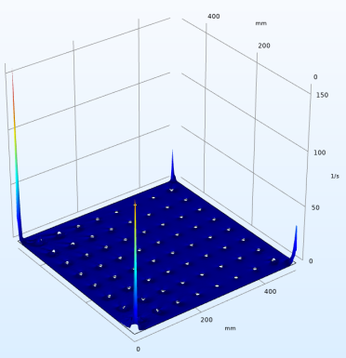
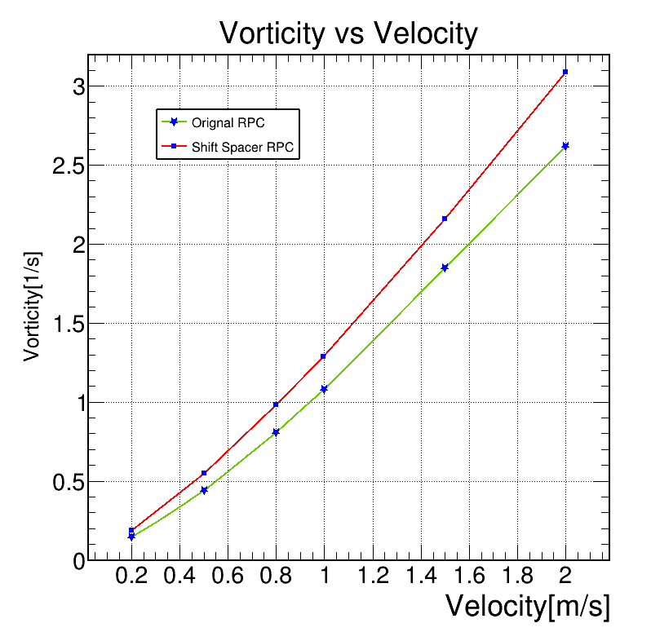
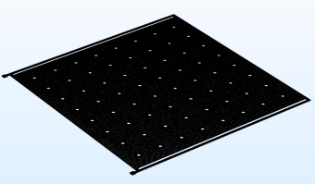
Gas Flow Simulation on RPC detector (by SJTU)
RPC model construction
Simulation and analysis
RPC size | Spacer placement | Inlet and outlet | Intake velocity
50cm*50cm*1mm | Alignment/ Misplacement | one in one out / one in multiple out on the same side /symmetrical on both sides | 0~2m/s
20cm*20cm*1mm
Different RPC design and simulation parameters
Misplacement of the spacer
RPC structure design and meshing
velocity distribution
Pressure distribution
Vorticity distribution
Average vorticity corresponding
to the two spacer placement methods
The gas flow simulation of the RPC detector obtained the velocity, pressure and vorticity distribution inside the RPC.
The average vorticity of the misplacement was smaller, that is, the gas flow stability was better.

Slide 14

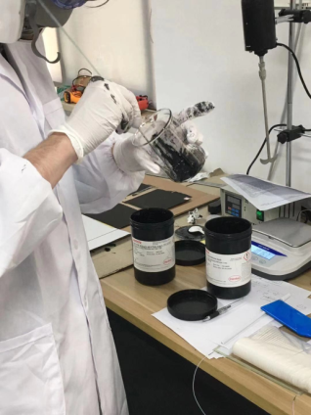
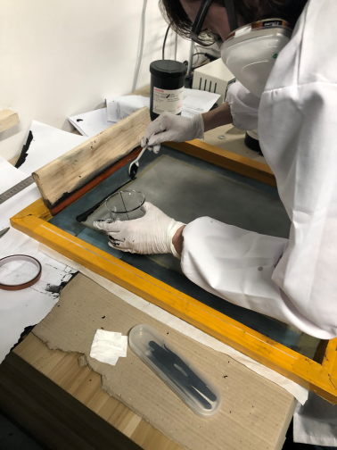
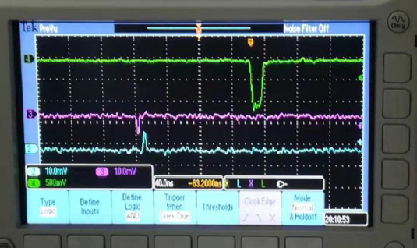
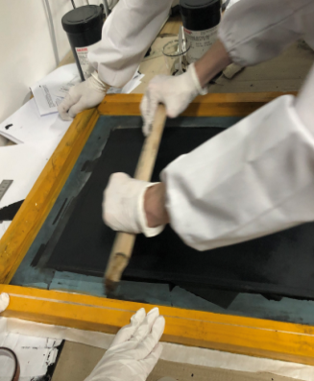
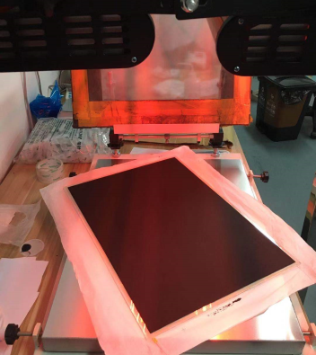
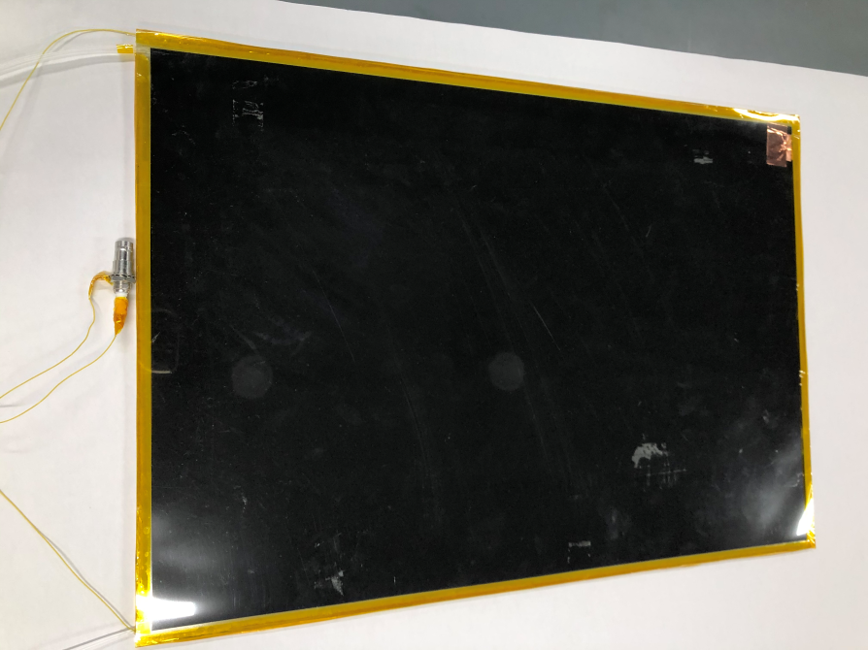
RPC construction and signal test (by SJTU)
The laboratory has been able to produce RPCs of the following sizes:
  200×120×1mm³、200×200×1.2mm³、500×350×1.2mm³.
After graphite coating(Silk Screen Coating), electrode soldering and packaging are completed, the signal is found.
RPC construction
RPC signal reading
Silk Screen Coating
RPC package

Slide 15
sMDT front electronics upgrade

Slide 16
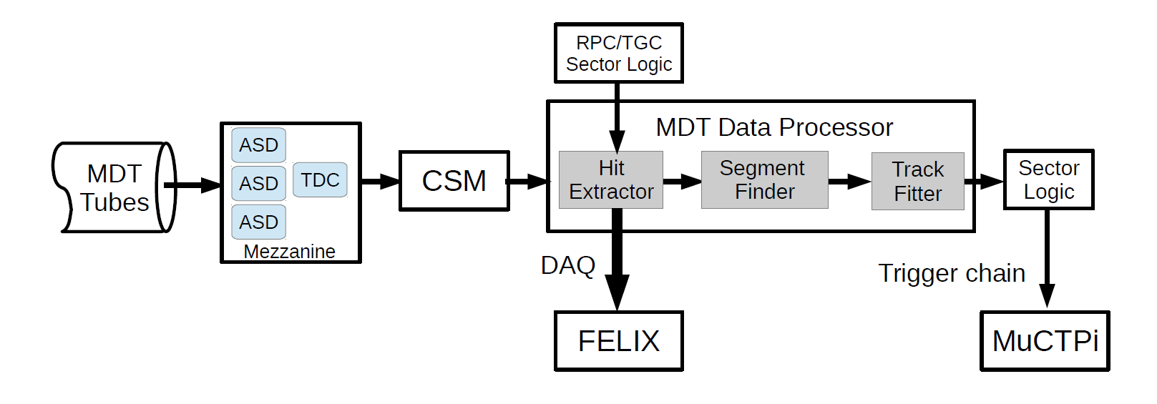
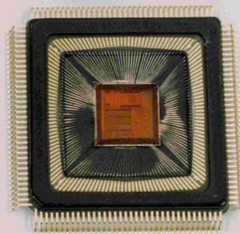
Introduction: MDT Frontend Electronics Upgrade
Monitored Drift Tube(MDT) in current system is only used for precision readout
After Phase II upgrade, MDT information will be used at the first-level trigger to sharpen the trigger turn-on curves
MDT electronics needs to cope with new ATLAS TDAQ scheme proposed
Block diagram of the MDT trigger and readout electronics for HL-LHC runs
Develop a new TDC ASIC for the MDT phase II upgrade:
Comparable timing performance (Tubes unchanged): 102.4us dynamic range, 0.78ns resolution (~200 ps RMS);
Time measurement: rising/falling edge/pair;
No cooling system, need to keep the current power consumption budget: 350mW;
Higher output data rates: 640Mbps;
Additional features: Triggerless mode + Triggered mode.
AMT
MDT-TDC UM

Slide 17
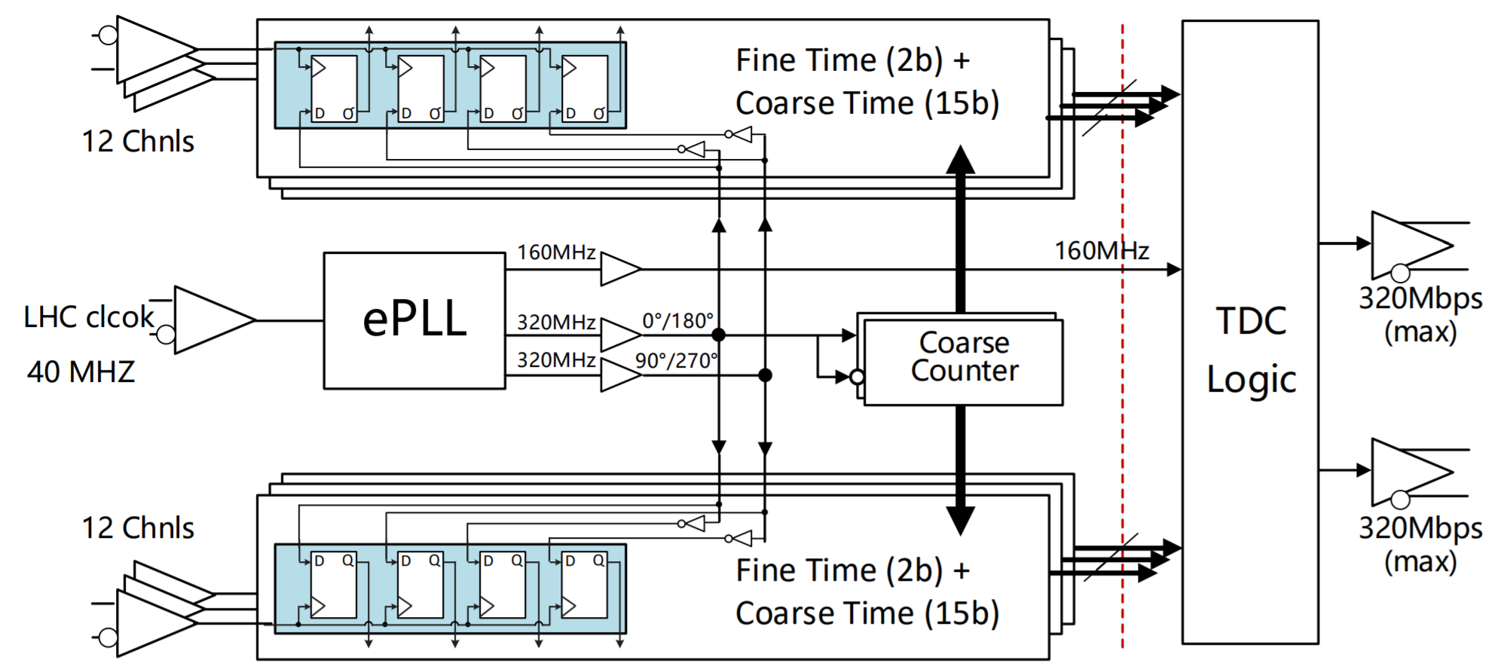
ASIC Design
Part 4: Interface
Serial outputs
Configuration
Reference clocks
TTC
Diff input: SLVS
Diff output: SLVS
Part 1: ePLL (extended Phase locked loop)
Migrate from CERN ePLL
Part 3: TDC logic:
Full feature logic
  Triggerless operation
  Trigger operation
  Output protocol
  High speed interface
Optimizations in power consumption
Part 2: Timing Circuit: same as TDC v0
Timing unit: fine time + coarse time
  4 clock phase time Interpolator
  Coarse time(15bit) + fine time(2bit)
  0.78 ns bin
Optimization in power consumption
Pair Mode
Edge Mode
Pair Mode
Edge Mode
Responsible for the time-digitization of the discriminated hit signal from ASD
TSMC 130 nm CMOS technology used
Triggerless mode used for data taking, triggered mode useful for chamber and test beam studies

Slide 18
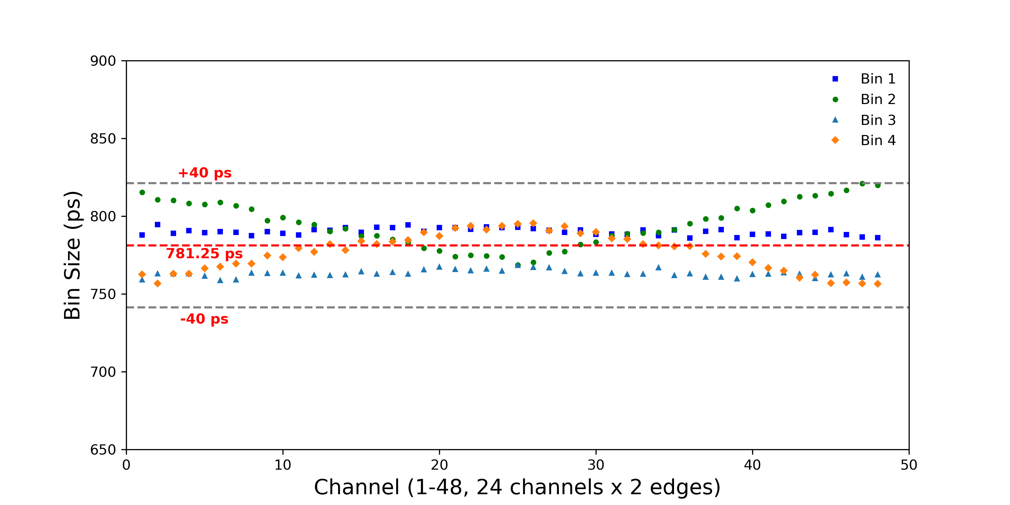
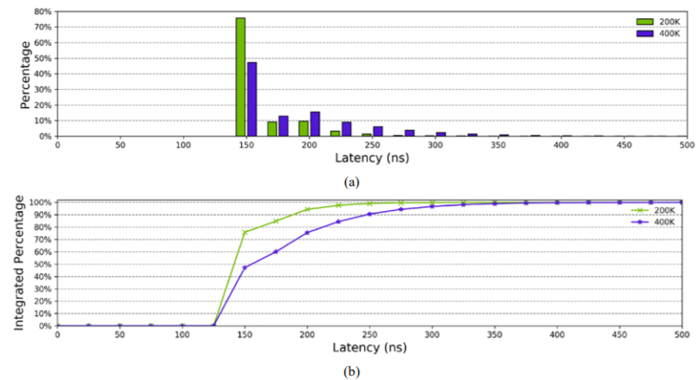
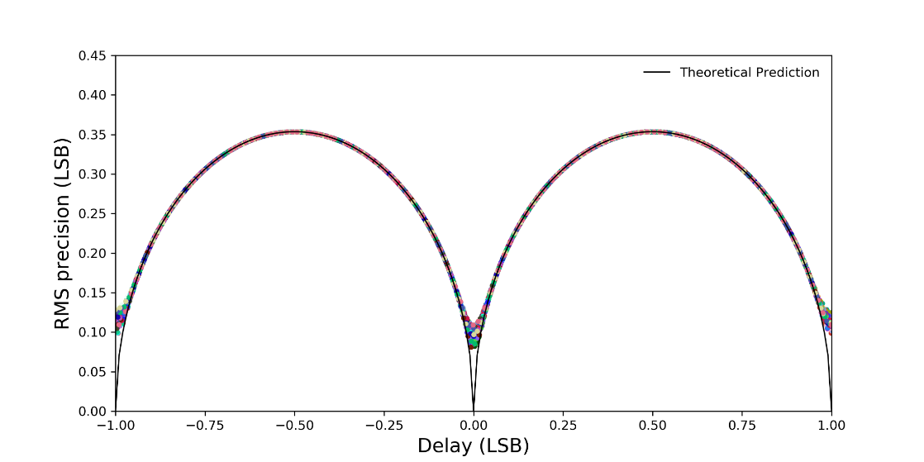
Performance of TDC
NIM-A 939 (2019) 10–15
  Bin sizes of all 48 channels (leading and trailing) are within (781 ± 40) ps
  timing resolution effect due to the TDC design is ~10% of the LSB (~80 ps)
  Latency is less than 350 ns (99% data read out) for a rate of 400 kHz per tube
  ~250 mW power consumption (360 mW from the current AMT)
  No data loss observed for average channel hits at 400 kHz

Slide 19
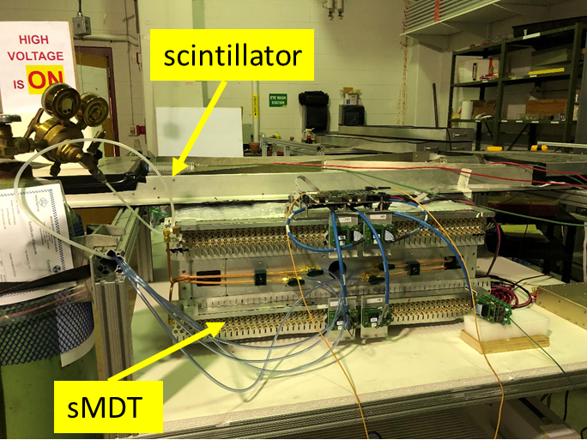
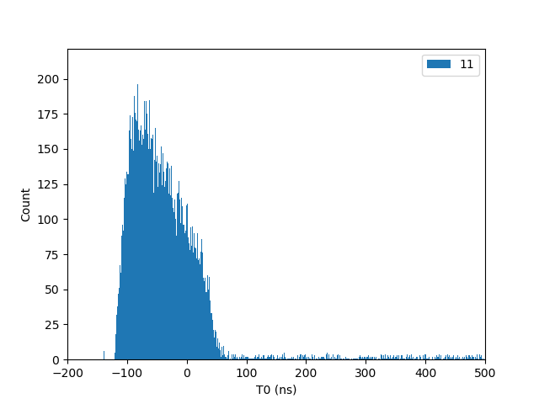
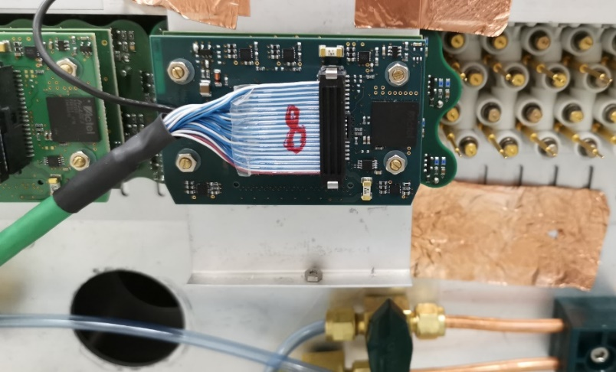
On sMDT chamber test
When configured as legacy mode, the TDC is compatible to the legacy readout system.
These pictures shows the scene when the TDC is tested on the newly built sMDT chamber at the university of Michigan
TDC Spectrum of cosmic ray

Slide 20
High-Eta tagger

Slide 21
Introduction: High-Eta tagger
Target of project:
Complete the prototype of forward muon detector for ATLAS Phase II Upgrade based on multi-gap resistive GEM
Expected performance：
Counting rate：～100kHz/cm²
Time resolution： < 1ns
Spatial resolution： < 150μm
Efficiency： > 95%
Goal of this year:
Time resolution of prototype < 1 ns

Slide 22
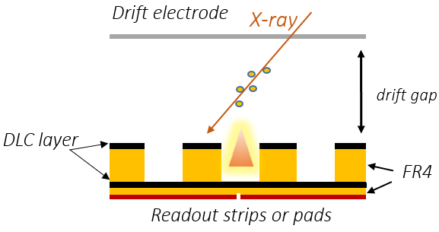
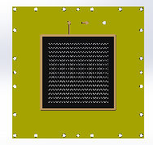
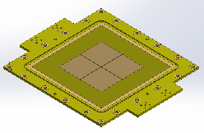
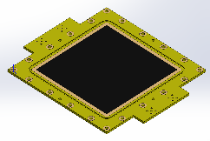
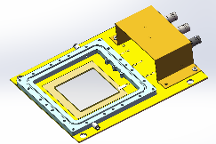
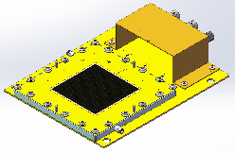
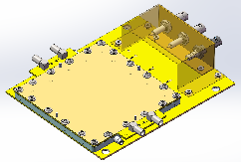
DLC-THGEM
New technology of detector is performed: resistive THGEM based on Diamond-like Crystal(DLC)
Resistive THGEM
Pad Readout
Coating DLC
Resistive THGEM：avalanche region in PCB covered by DLC
Ratio of avalanche region increase, gain increase
No corrosion of insulating material, independent research and development

Slide 23



  Performance test of DLC-THGEM
Gain vs. HV
Gain vs. X-ray rate
E_{drift}=2kV/cm
100Hz/mm² 8keV X-ray
Signal could be found in single layer DLC-THGEM, the gain is ~ 7000

Slide 24


  From single layer to 4-layers
Detector Assembly
Performance test

Slide 25



  Preliminary result
Ne:CH4/95:5
1-layer
ΔV=820V
3mm drift gap
Ar:ISO/95:5
4-layer
ΔV: from 850 to 1000V
1mm drift gap
Ne:CH4/95:5
1-layer
ΔV=790V
0.2mm drift gap
Obvious signal was found in 4-layers DLC-THGEM!

Slide 26
Summary
USTC-SJTU-SDU cluster made great contributions to ATLAS RPC Phase II Upgrade.
  Platform for RPC performance test and R&D test constructed
  Improvement study on detector performance and electronics
USTC participant in the TDC ASIC design and test of sMDT. Required performances achieved.
New technology(DLC-THGEM) has been introduced in micro-pattern detectors and good timing is expected.

Slide 27
Backup

Slide 28


原定的技术路线
全阻性GEM结构的研制路线
多气隙全阻性GEM结构
阻性电极是核心：DLC薄膜沉积技术

Slide 29




DLC(类金刚石碳）阻性电极的研制
科大牵头CERN RD51研发项目
与兰州化物所合作

Slide 30
DLC阻型电极 → DLC+Cu阻型电极
DLC太薄，无法完全阻止腐蚀液透过，导致孔型结构受损。
悬浮式井型结构存在不稳定性，影响探测器的正常运行。
解决方案：镀铜的双面DLC阻性薄膜 （复合DLC阻性电极）

Slide 31



“DLC+Cu”复合阻性电极的研制
“DLC+Cu”制作流程
“DLC+Cu” 结构和样品

Slide 32




利用DLC-Cu制作阻性GEM结构以及多气隙全阻性GEM探测器
铜
Apical
DLC
利用X射线测试探测器原型，读出电极有明显的输出电流，但观测不到任何感应信号。
原因推断：由于全阻性结构，使得雪崩区域只占权场区域很小一部分，造成感应信号微弱。此外，探测器增益偏低也是一个原因。

