Slide 1






ATLAS Detector Upgrade
Yongjie Sun
On behalf of the ATLAS Chinese Clusters
State Key Laboratory of Particle Detection and Electronics
University of Science and Technology of China

Slide 2
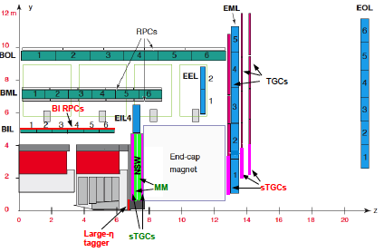
Outline
Thin-gap RPC
& elect.
MDT elect.
–TDC ASIC
Phase-I: New Small Wheel upgrade
Phase-II: ITK upgrade
Phase-II: Muon upgrade
  BI RPC trigger detector
  MDT TDC ASIC
  High-eta tagger
HGTD
Summary and Outlook
MDT
HGTD
NSW
sTGC & elect.
ITK strip:
Readout ASIC
Barrel module
High-eta tagger- mGEM

Slide 3

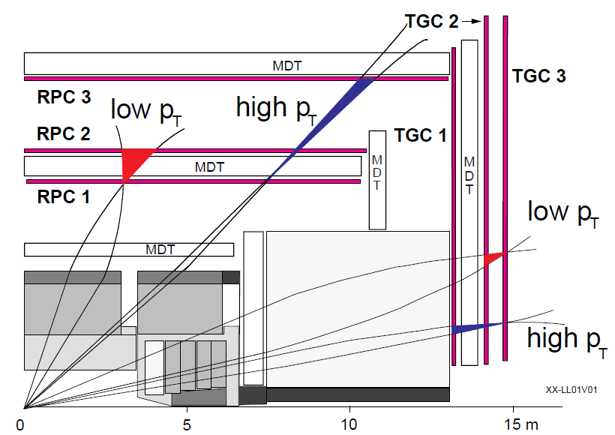
ATLAS Phase I:
Muon New Small Wheel Upgrade
Precise trigger and tracker extended to 1.3 < |η| < 2.7
super Thin Gap Chamber (sTGC) as trigger detector
end-cap
toroid
Micromegas (MM) as tracking detector
China-CERN Major international cooperation project “ATLAS Phase 1 Muon谱仪端盖NSW触发系统研究”
Shandong University: 128 QS2-sTGC detector construction,
1/6 of the total sTGCs
USTC: Front-end Electronics Board R&D + mass production, 800 + 800 FEB boards, ~ 360 kCHF core contribution (as estimated in 2014)
Applied for ￥13 M, approved ￥11M , 2015.01.01 - 2019.12.31

Slide 4
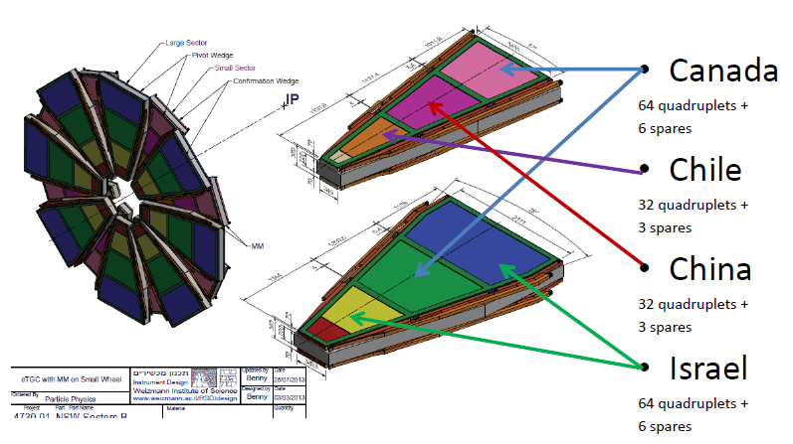
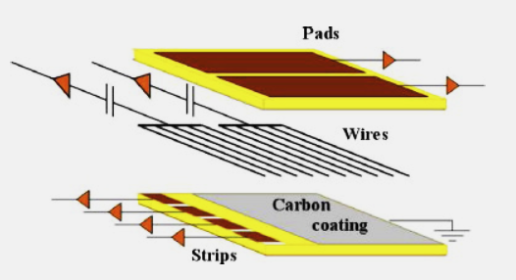
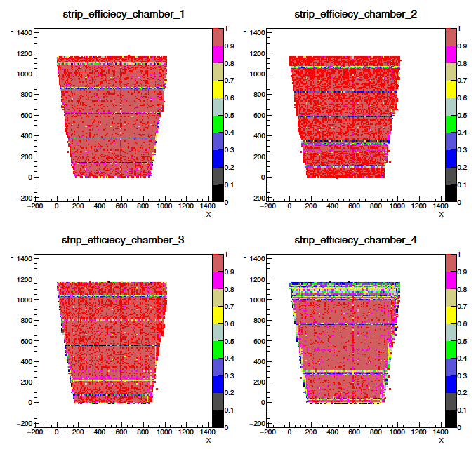
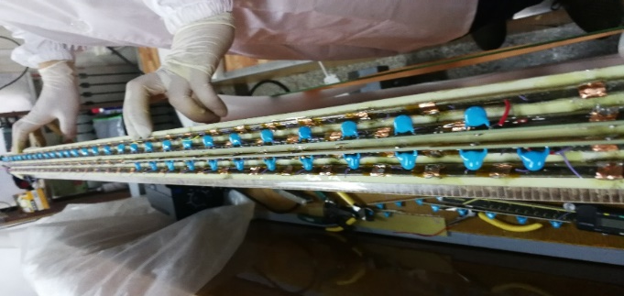
QS2-sTGC construction @ SDU
Cosmic test (efficiency map) at SDU
To build 144 detectors of the NSW trigger system, i.e. 1/6 + 10%
Quality control system has been established at SDU
95% of the detectors has been constructed, 50% has been shipped to CERN for installation

Slide 5
FEB R&D @ USTC
High channel density, wide dynamic range ADC & high speed output
NSW schedule | NSW status | USTC FEB R&D
2015年底，测试模数芯VMM2 + FEB功能设计 | VMM2封装失误，无法批量供应，科大仅得到2片可使用芯片。delay！ | ①完成VMM2功能调试FEB版 v1.0；②与厂家合作，开发高集成度芯片焊接技术与标准流程。On Schedule.
2016年秋，FEB v1.0与sTGC探测器联调 | 2016.5.28-6.1，NSW专家组山大、科大现场评估，对中国组进展表示满意 | ①完成不同sTGC信号的pFEB/sFEB改进版v1.2；②实现与山大sTGC探测的宇宙线联调。On Schedule.
2017年底，测试新版VMM3 + FEB设计定型 | 2017.10，v2.1通过CERN束测，性能良好；为sTGC生产单位提供38套FEB v2.1 | ①完成pFEB/sFEB v2.1版；②完成技术定型版v2.2，准备2018年量产。On Schedule.
2018年底，完成FEB v2.2量产，开始NSW安装 | 发现VMM3技术风险，需要改版VMM3a；输出芯片ROC设计与封装失误。delay！ | ①完成基于VMM3a的FEB技术定型v2.3a版，实现完整的触发链束流测试；②2018.12, Final Design Review(FDR)技术评审。Ahead of Schedule.
2019年底，希望FEB v2.3技术定型，开始量产准备 | 发现探测器转接板AB设计存在技术漏洞，提出希望科大在v2.3a基础上改版。delay！ | ①完成FEB v2.3E工程定型版，束测性能优异；②为合作组生产50+50套pre-product；③2019.9，通过Production Readiness Review(PRR)量产工艺评审。Ahead of Schedule.
FEB研发多次弥补NSW芯片、探测器缺陷，工作进度领先NSW日程

Slide 6
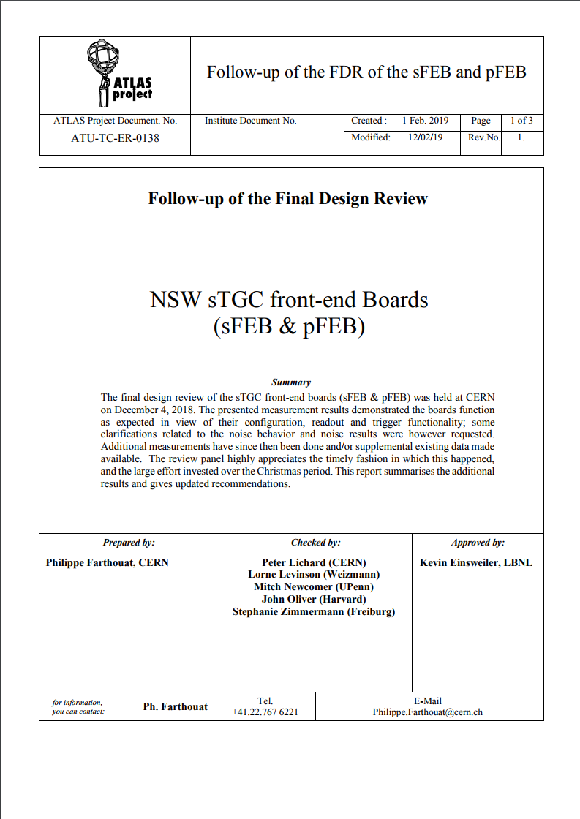
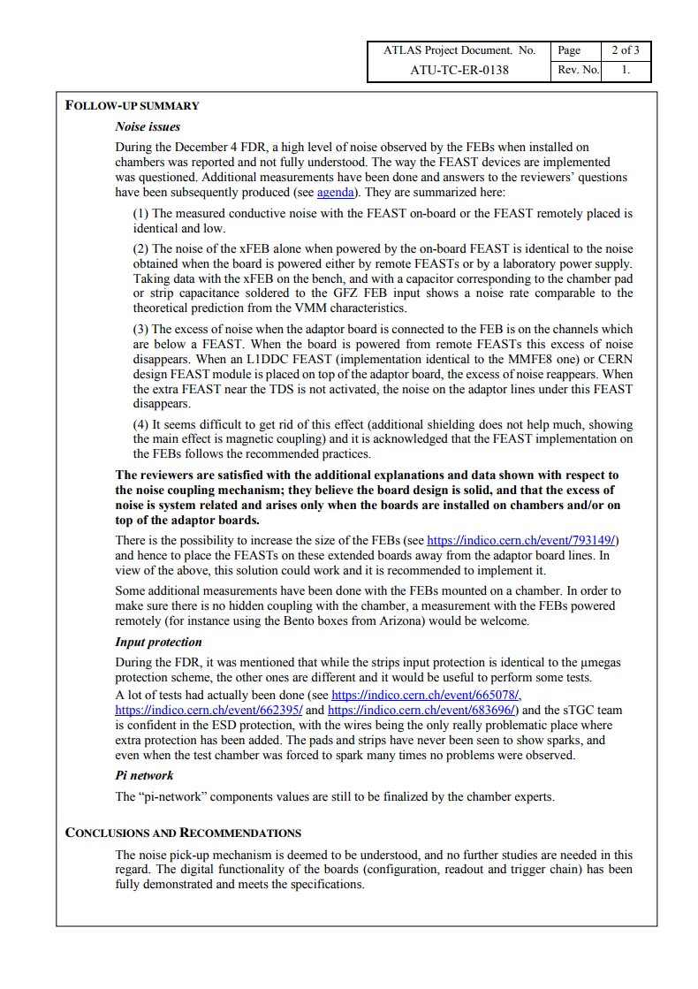
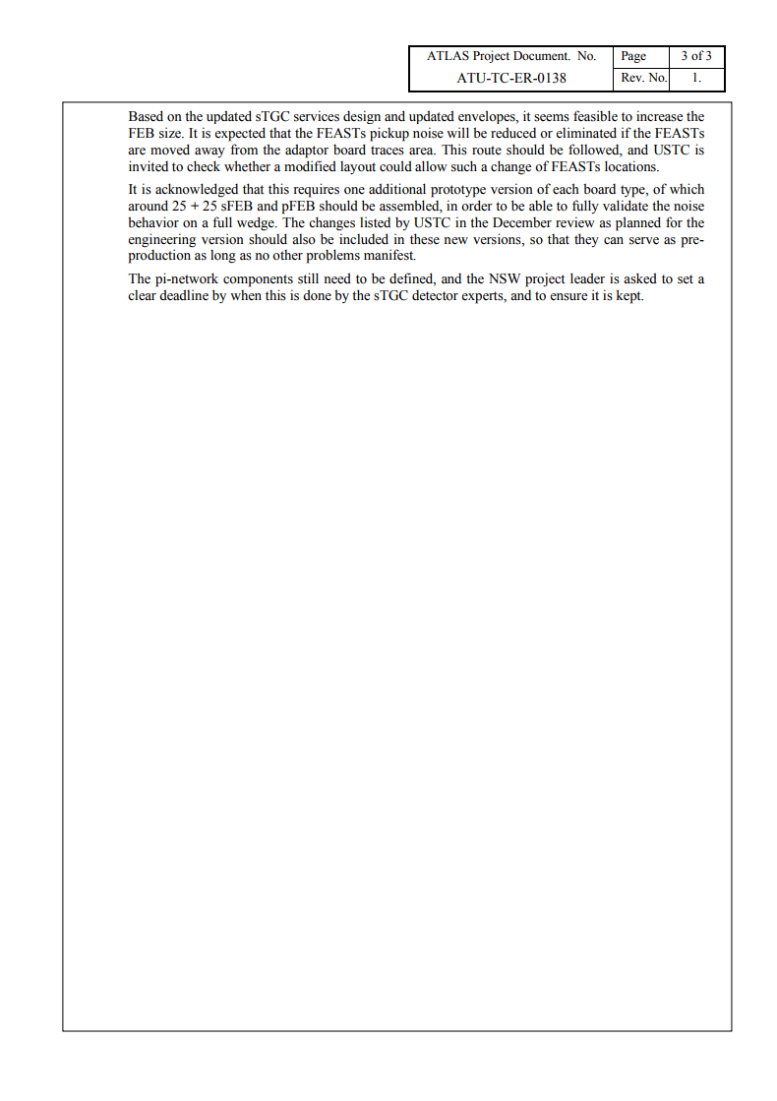
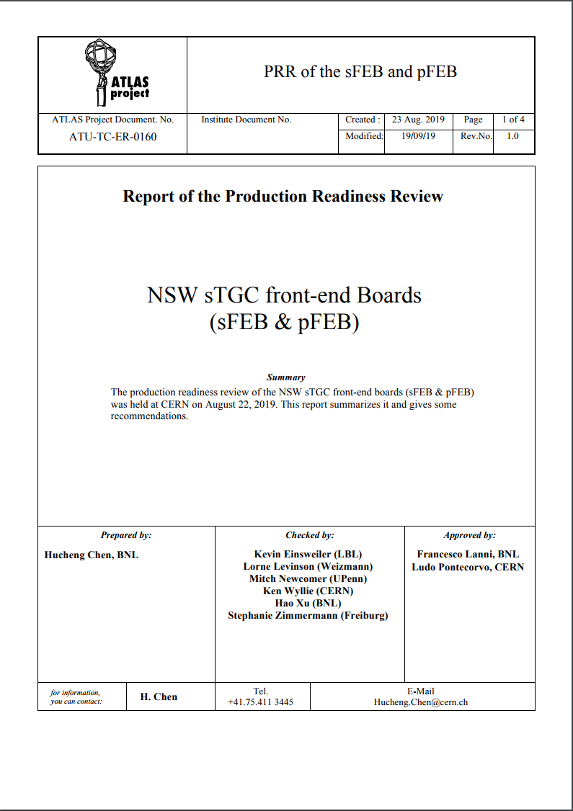
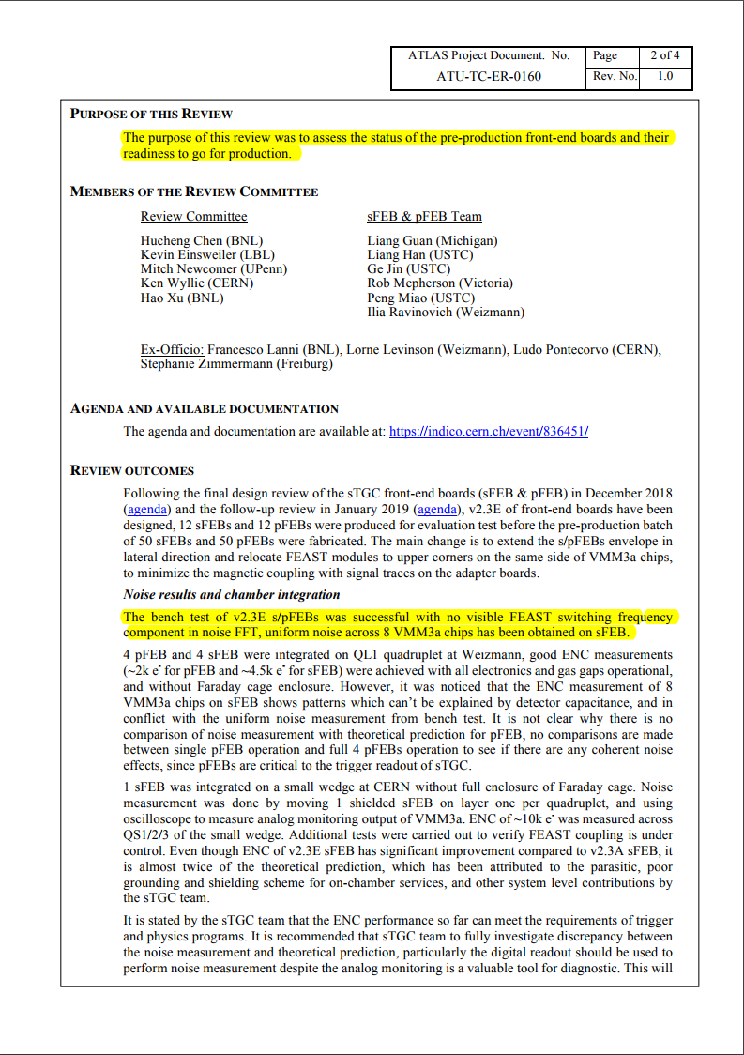
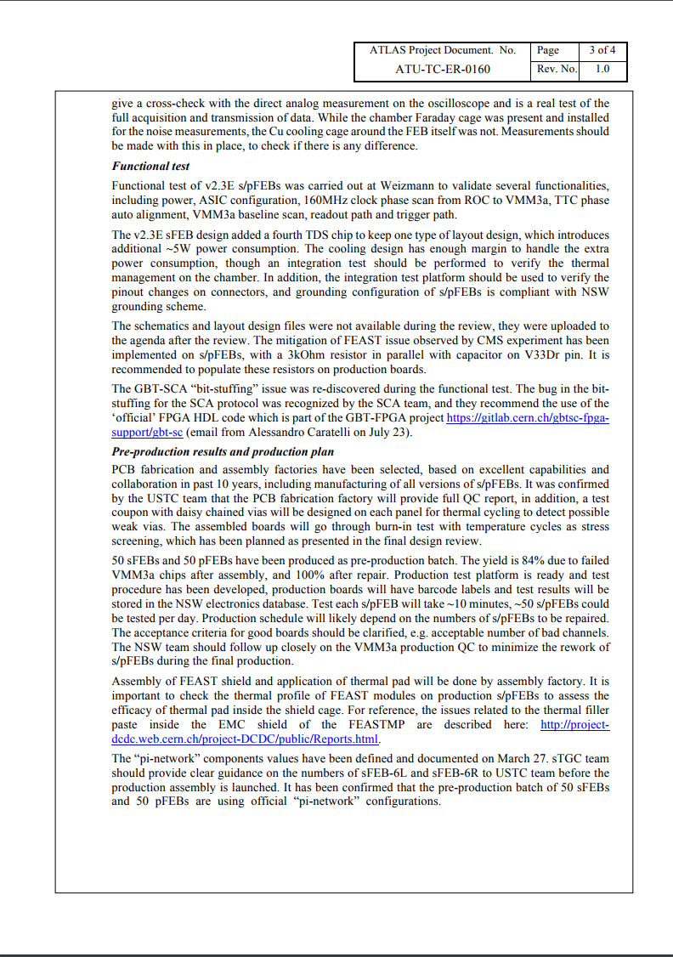
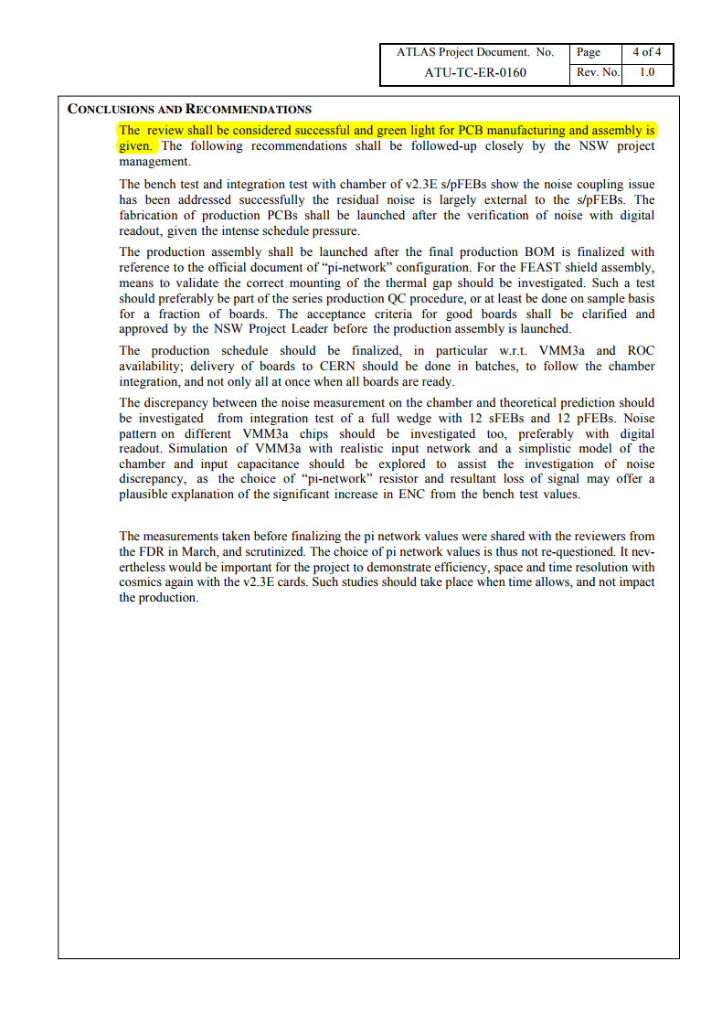
FEB R&D - status
Feb. 1 2019, FEB v2.3a passed the ATLAS “Follow-up of the Final Design Review”
Sep. 19 2019, FEB v2.3E passed the ATLAS “Production Readiness Review”

Slide 7
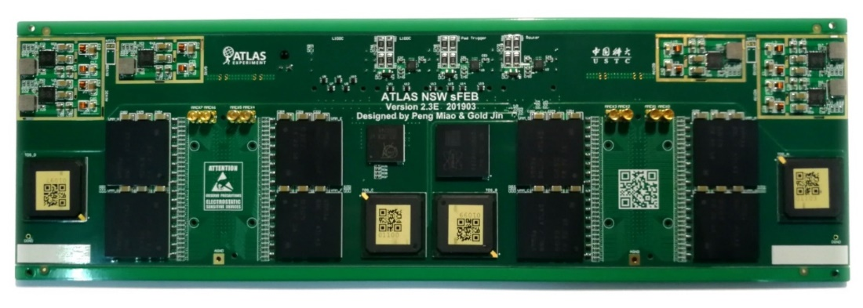
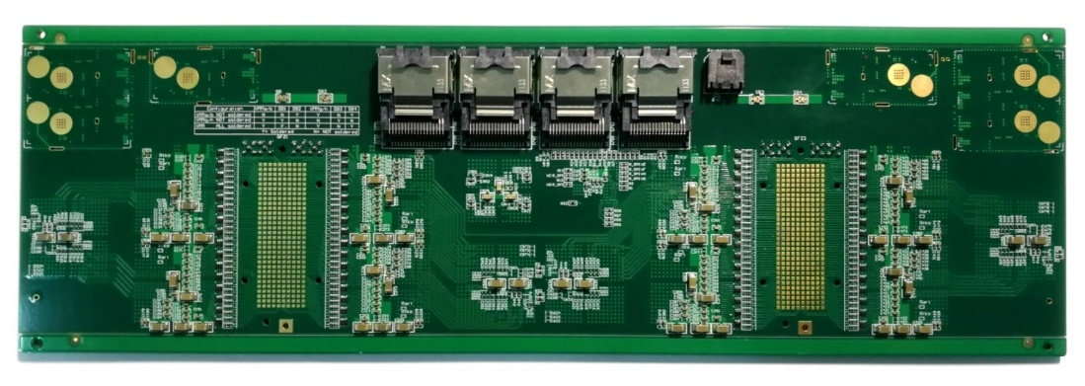
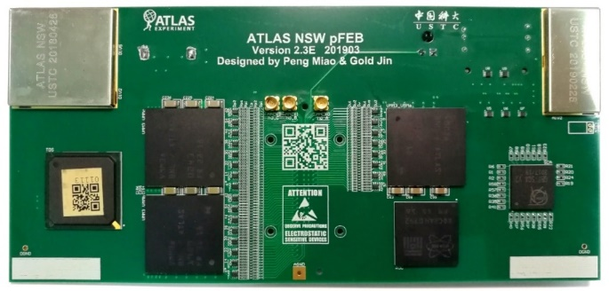
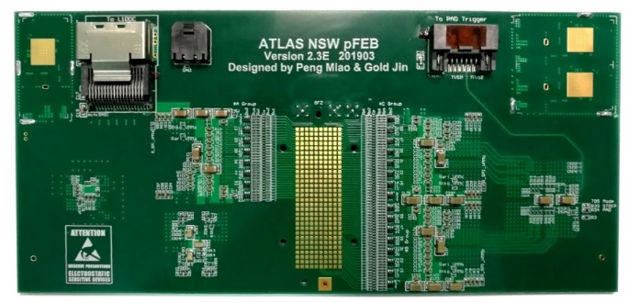
FEB v2.3E mass production
sFEB v2.3E
sFEB v2.3E
pFEB v2.3E
pFEB v2.3E
ATLAS will only install NSW on Side-A during LS2. Side-B has been postponed till Phase-II.
By the end of 2019 (the end of the NSFC project), 400+400 pFEB/sFEB will be mass produced for Side-A Phase-I installation.

Slide 8
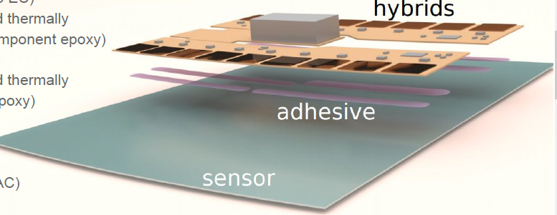
Phase-II:
ITK strip upgrade
Full silicon tracker (Inner Tracker, ITk) for ATLAS Phase II upgrade
ITk-Strip Module
Committed to deliver 1,000 silicon strip modules installed, which accounts for nearly 10% of the total strip barrel modules (US 50% + UK 40% ) – Core Contribution
  Export control issue (radiation hard ASICs) to be fully resolved with tremendous helps from the CERN microelectronics group
  Agreed: to build 500 modules at RAL and 500 at IHEP
Additional contributions to module loading (with RAL); Strip barrel system integration, installation and commissioning (1 FTE at CERN, 2/1 FTE’s from US/UK) – Non-Core Contribution

Slide 9
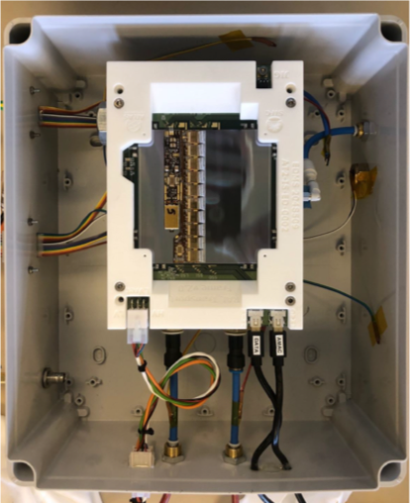
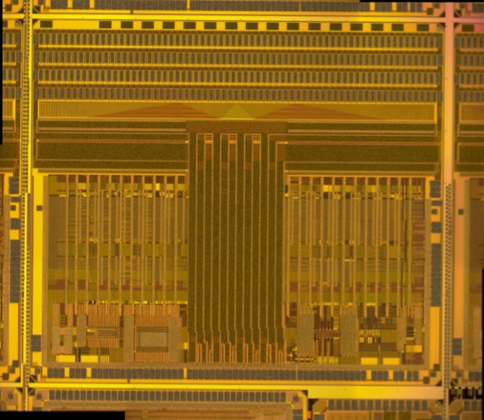
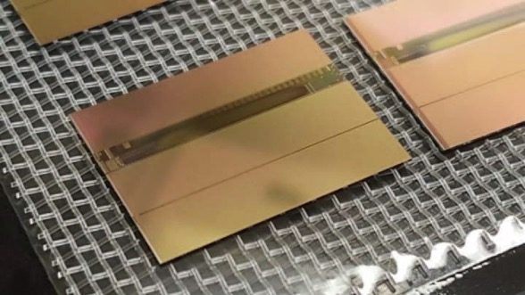
Research Activities
Have actively worked on the following topics:
  Design & verification of digital blocks of ABCSTAR – already used for prototype modules → to study SEE effects
  Module assembly & test (QC/QA steps) – prototype modules assembled → in preparation for the pre-production & site qualification
  Performance evaluation of novel CMOS strip sensors – R&D dropped, to complete the tests of CHESS 2
1st LS STAR Module
CHESS 2 CMOS Sensor
FE ASIC ABCSTAR
In collaboration with CERN/UPenn
In collaboration with RAL & other UK institutions
In collaboration with SLAC/UCSC

Slide 10
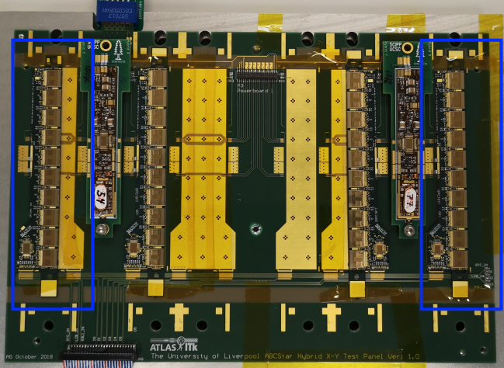
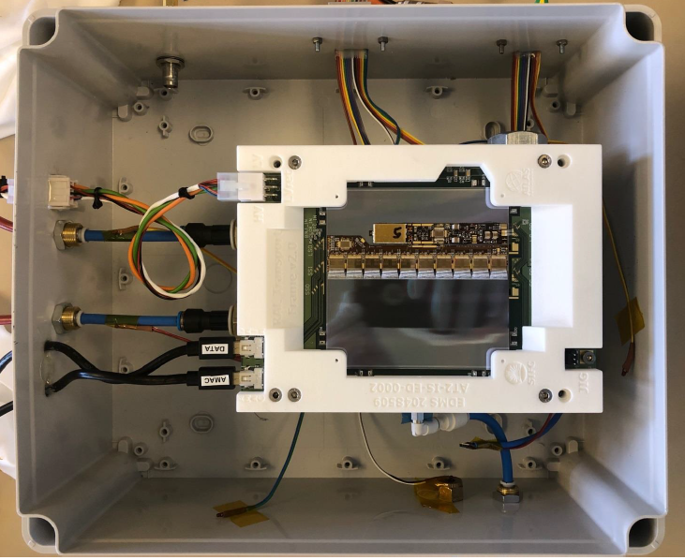
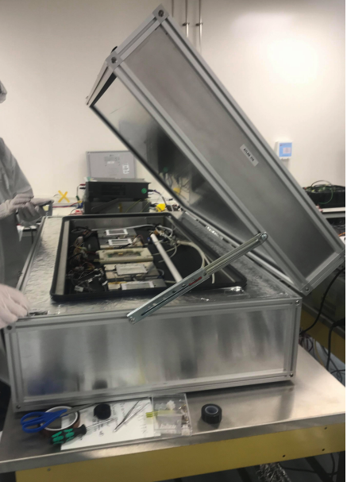
STAR Module Assembled & Tests at RAL
Moved to STAR modules: ABCSTAR & HCCSTAR chips
Assembled hybrids on the panel for electrical qualification
Assembled and tested the first LS STAR module with RAL colleagues
LS STAR module in the Warwick cold box for thermal cycling

Slide 11
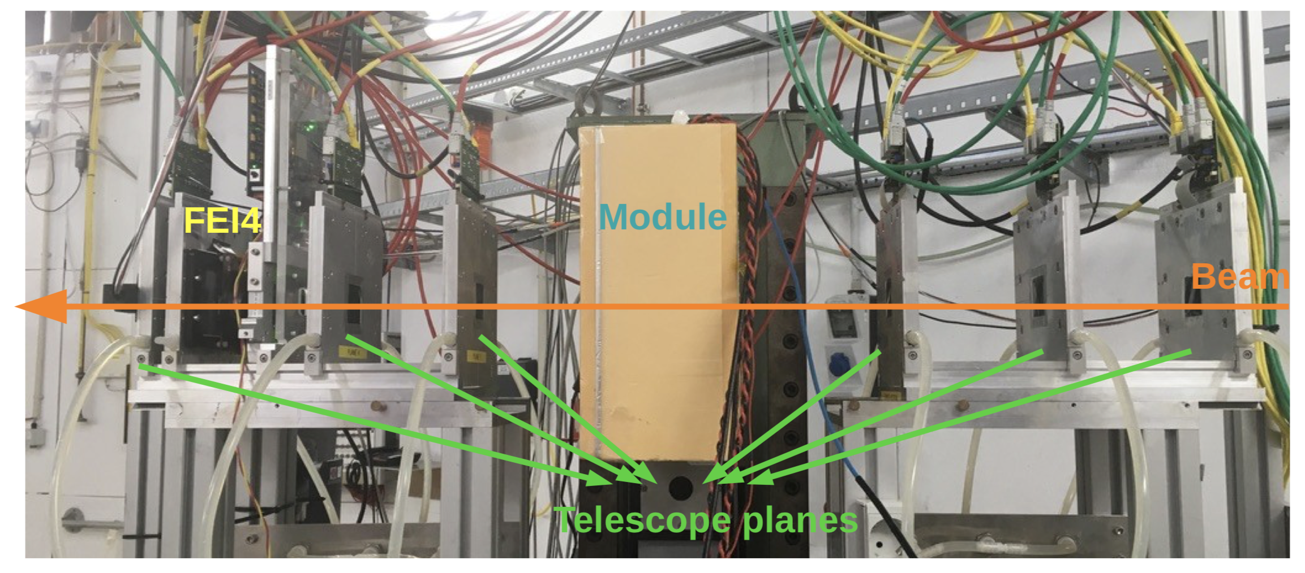
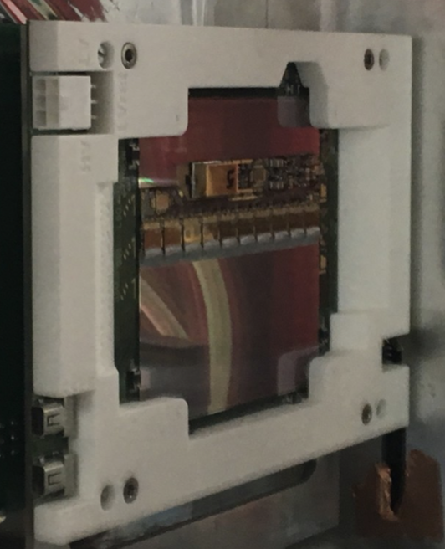
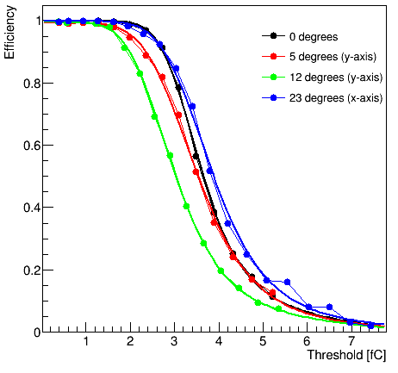
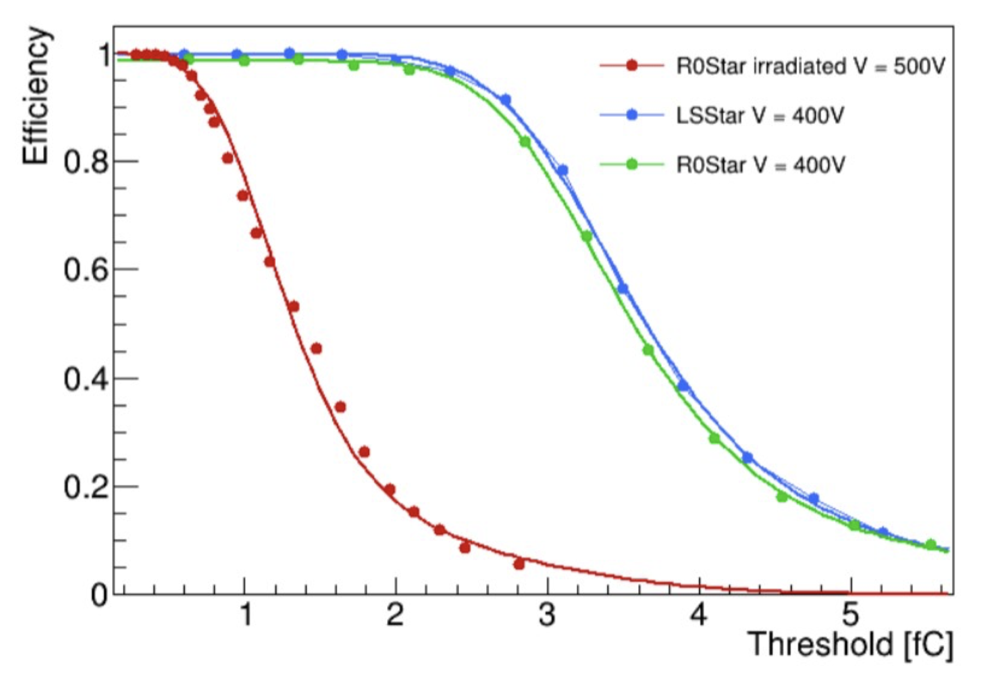
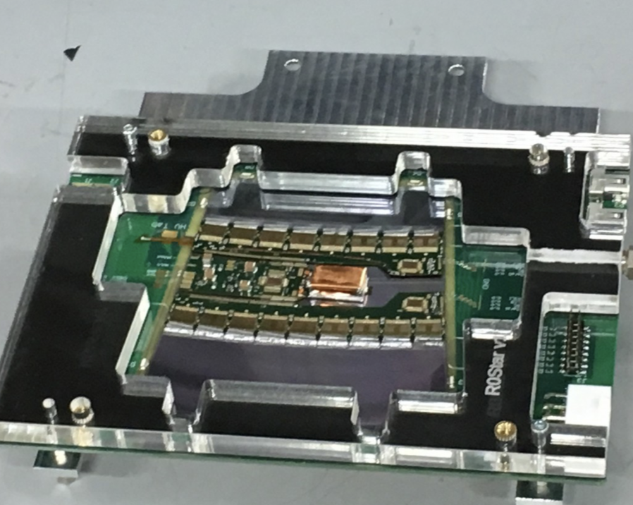
Testbeam Activities
ALPIDE readout board developed by USTC, the full ALPIDE beam telescope being developed
First time installing ABC* modules at Testbeam
Three DESY testbeams, in 2019 Objectives:
  Demonstration of star module performance with as many sensor types as possible
  New cooling infrastructure for testing irradiated devices, using Peltier and dry ice to achieve a temperature of <-20℃
ALPIDE
Non-Irradiated LS
Irradiated and Unirradiated Comparisons

Slide 12
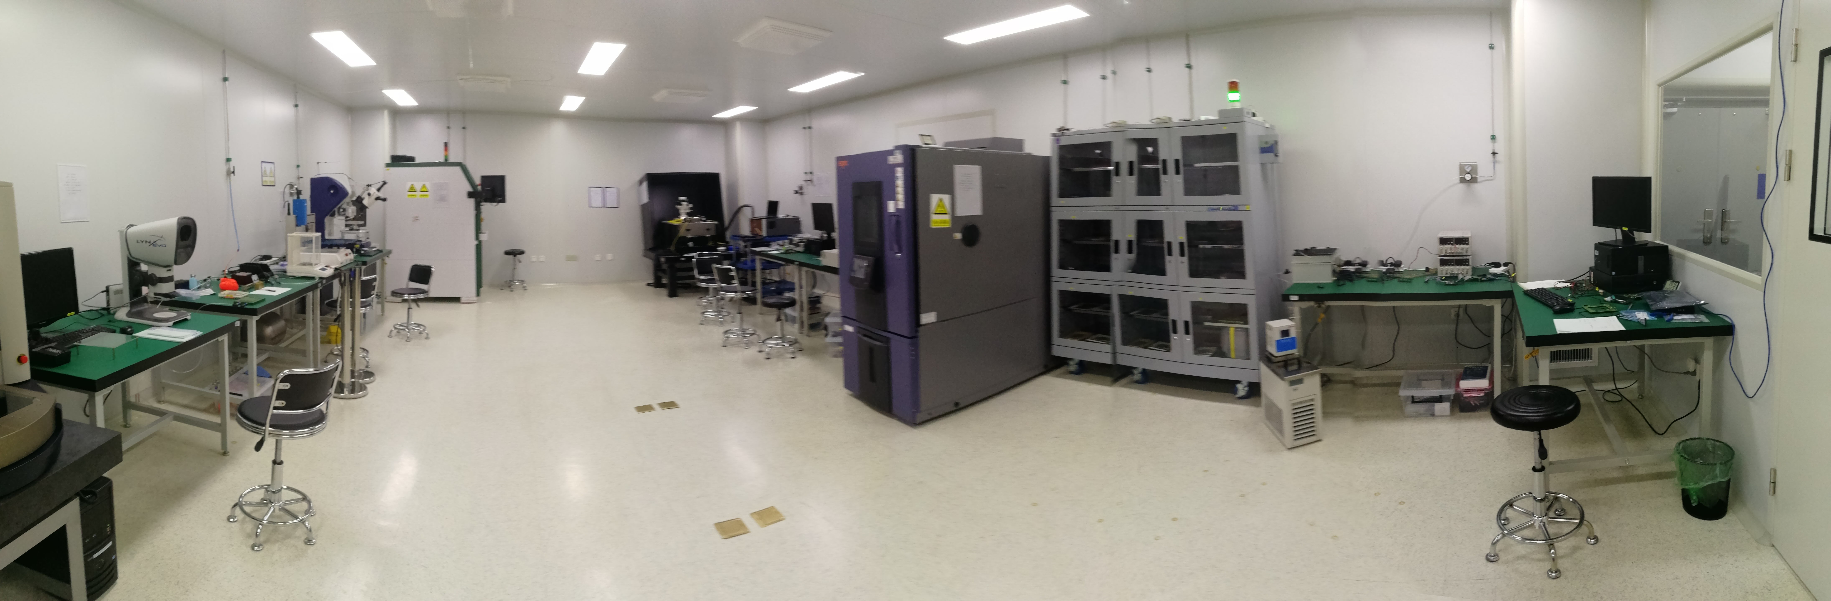
New Clean Room
Constructed a ISO Class 7 clean room dedicated for the upgrade project (in operation)
Not in the picture: high resolution digital microscope, cold box for module thermal circling, more storage boxes, …
High Speed Bonding Machine
Automatic Probe Station
TCT System
Dry Box
Electrical Test Setup
SmartScope
Glue Dispenser
Climate Chamber
Mini Chiller
Microscope

Slide 13
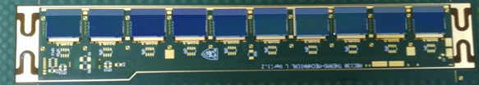
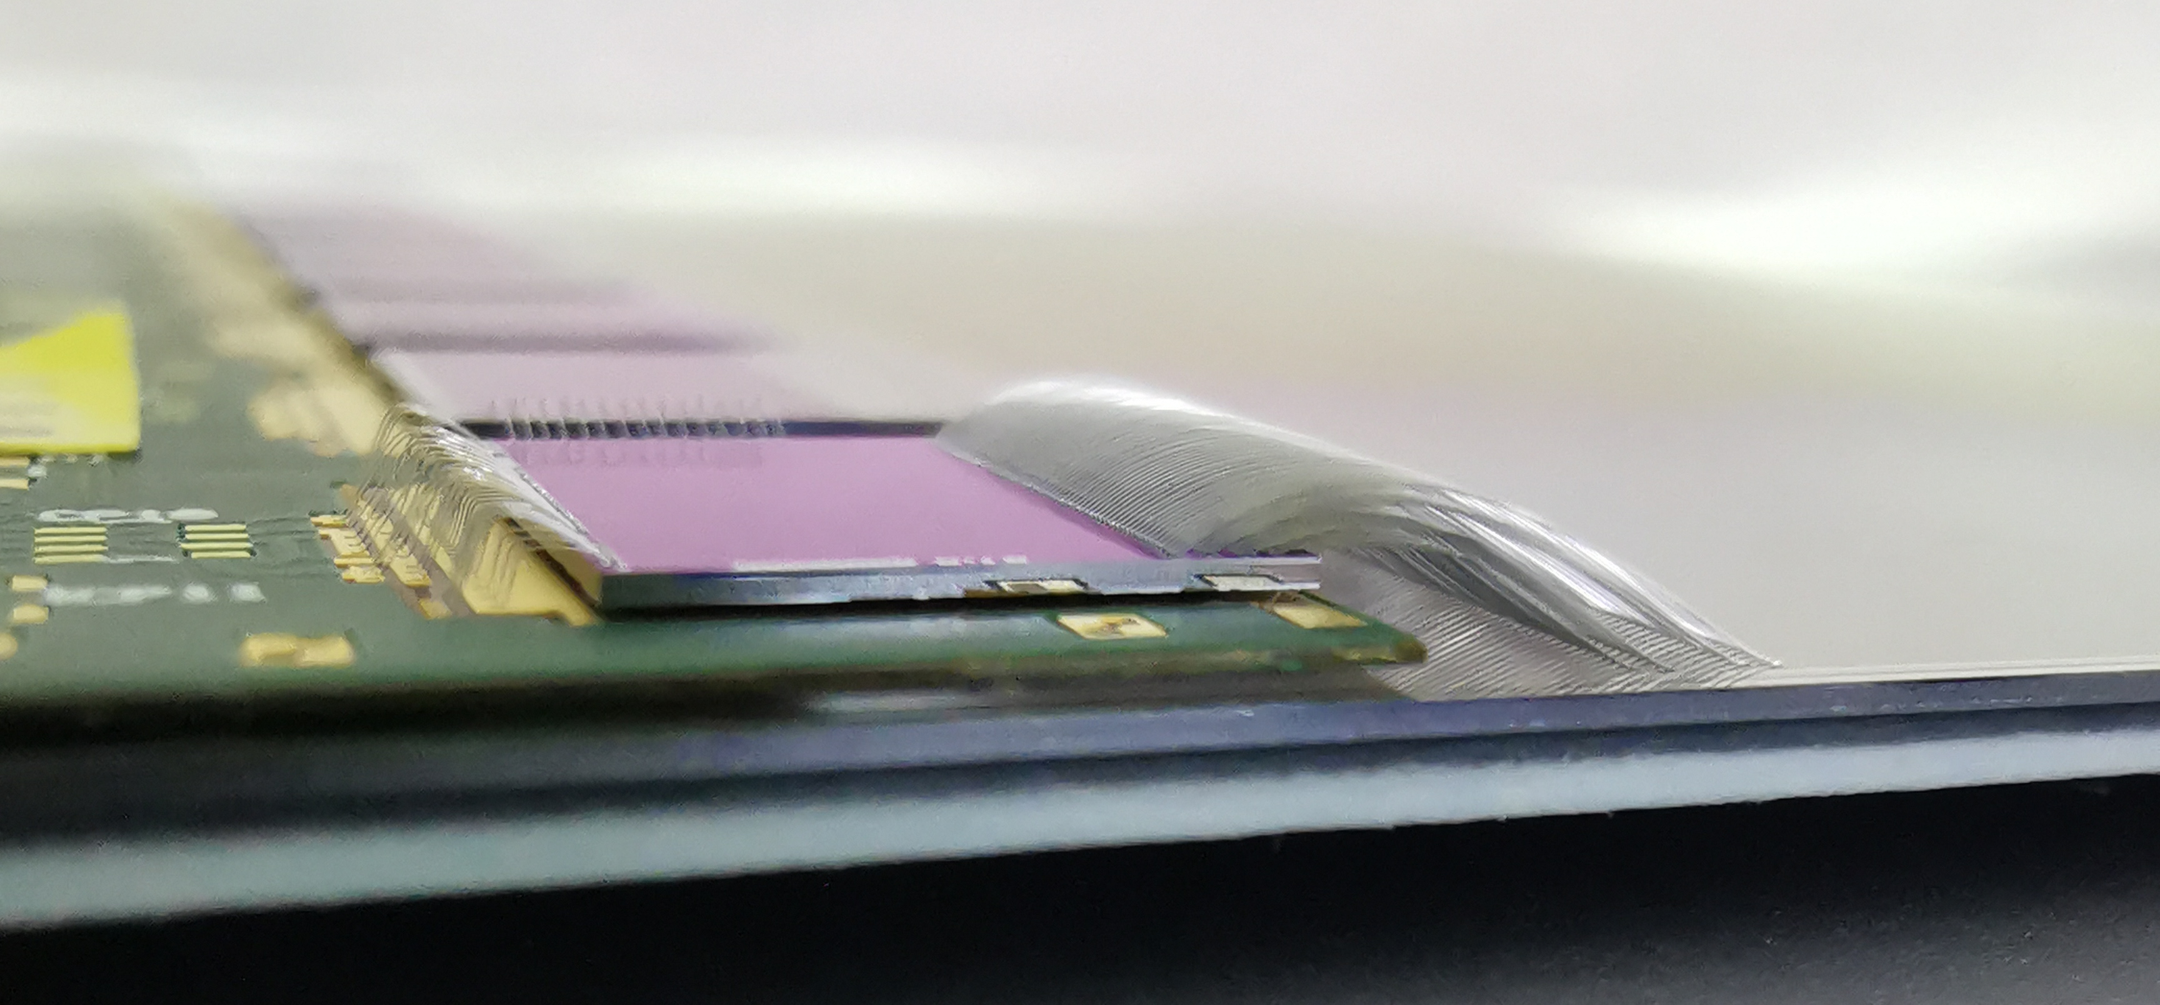
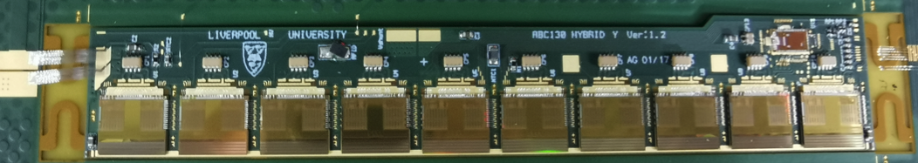
Module Assembly & Tests at IHEP
Ramping up hybrid & module assembly and tests; started with dummy components and then electrical ones
Test system already set up for hybrid panel and single module testing → hybrid (crate holding multiple panels) burn-in and module (up to 5 modules) cycling in preparation
Site qualification and pre-production next year
Mechanical hybrid with dummy silicon chips
Mechanical module (wire-bonded)
Electrical hybrid with ABC/HCC 130 chips

Slide 14
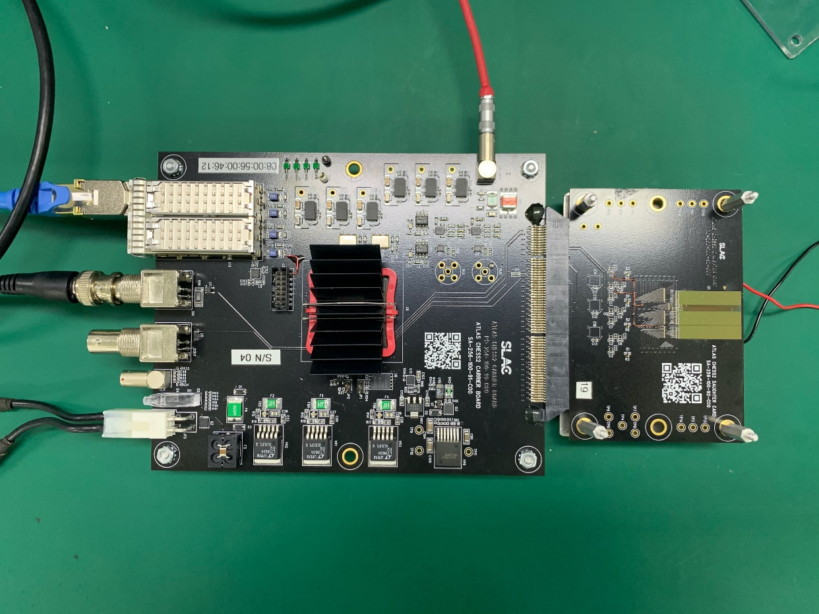
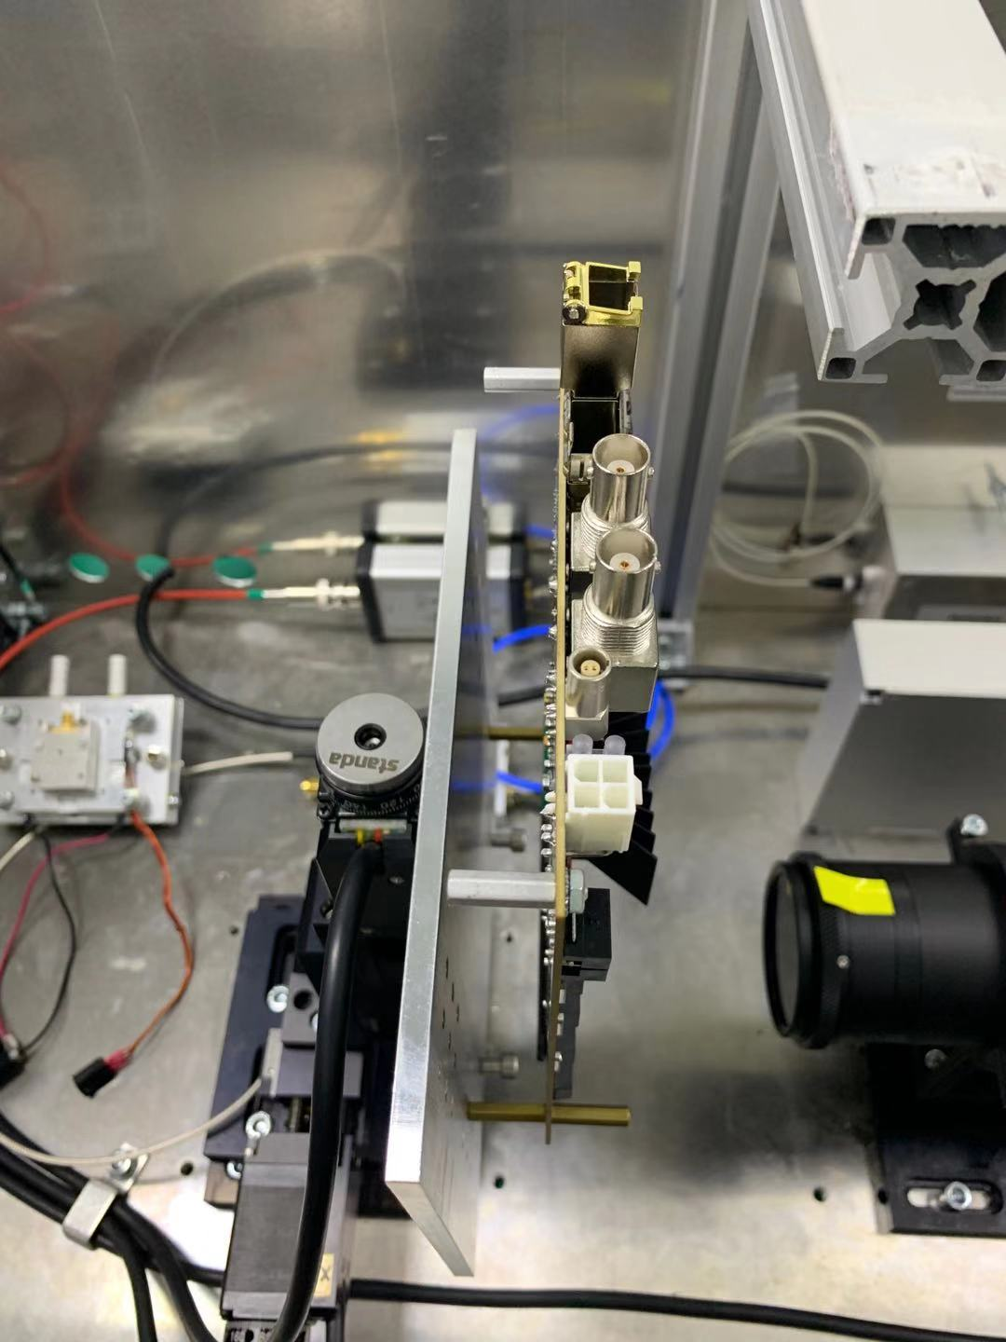
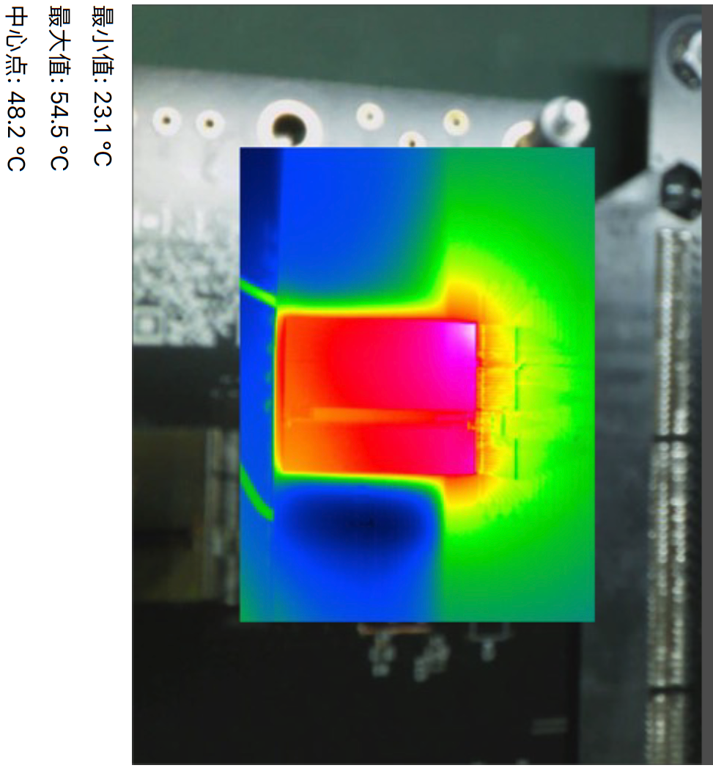
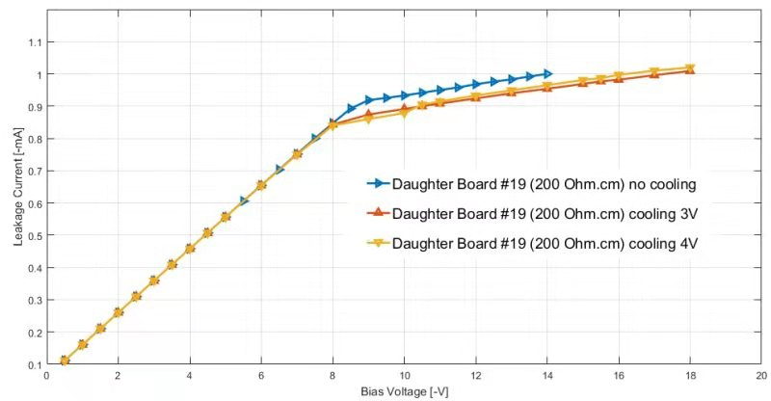
Completing CHESS 2 Tests
Two daughter boards with CHESS 2 wire-bonded shipped from SLAC to IHEP (via CERN, with the Swiss export license)
Setup for TCT scans and further tests with radioactive sources
Mounted on an X-Y stage
TCT box

Slide 15


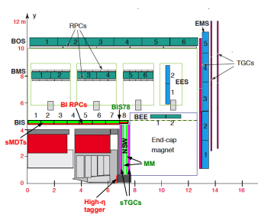
Phase-II:
Muon upgrade
BI RPC upgrade
  Thin-gap RPC detector R&D
  Front-End electronics
  Chamber production and qualification
BI sMDT electronics upgrade
  MDT TDC ASIC design and test
High-eta tagger
  Micro-pattern detector with good timing performance.

Slide 16
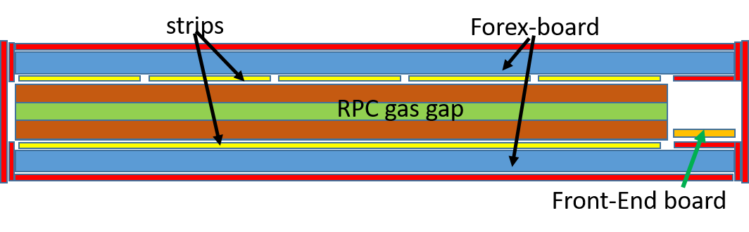
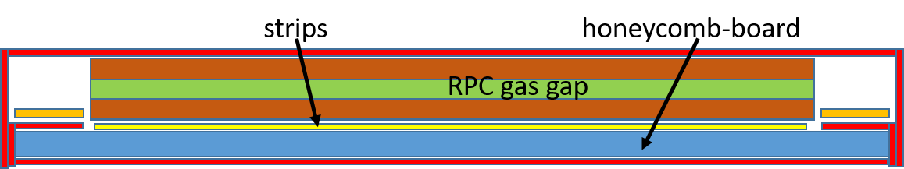
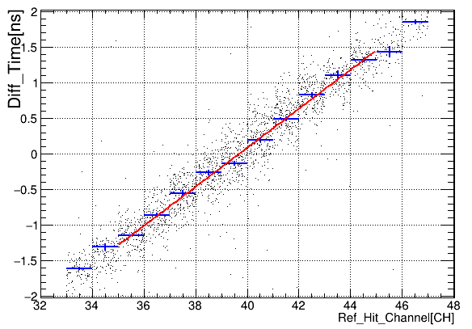
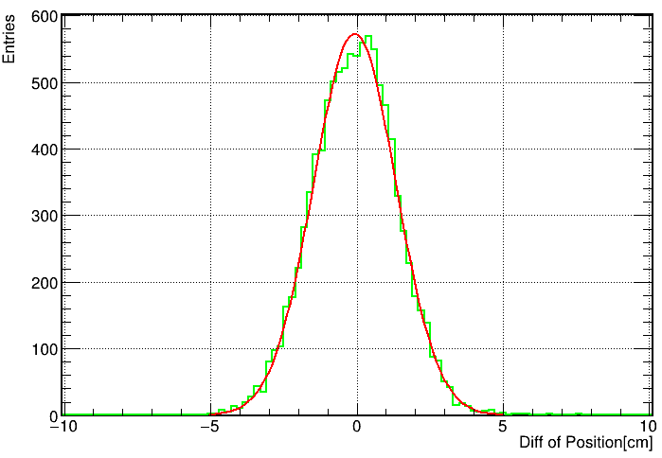
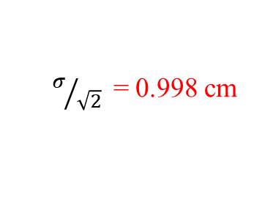
RPC: Double-end Readout
The current read-out scheme
  Two single-end readout panels in η & φ direction
  Spatial resolution relies on the strip pitch
The double-end readout
  One double-end readout panel in η direction
  Time difference for positioning
  Save FEE, reduce dead area, reduce thickness
Side View
8 channels
scintillator
8 channels
Galss RPC 1.4m*0.4m
$σ/{\sqrt{2}}$= 0.998 cm
8 channels
8 channels
Bakelite RPC 0.5m*0.5m
16 channels
scintillator
v = 19.69 cm/ns
System setup
Signal speed
Spatial resolution

Slide 17
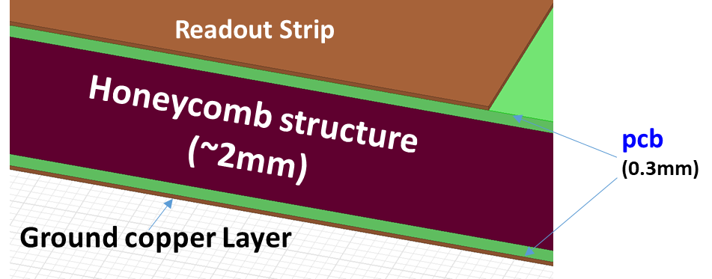

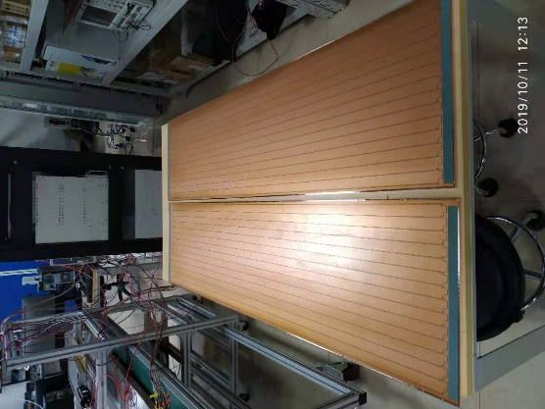
RPC: New readout panel
Main constraints:
Dielectric constant (εr) , weight, rigidity
foam-like material (low εr, fragile and soft)
honeycomb board (low ε_{r} hard and strong)
Raw honeycomb board
honeycomb readout panel
2 layers of PCB as readout strip and ground
~2 mm honeycomb as medium
Characteristic impedance: 18.5 ohm
Good performance achieved in the double-end readout RPC
Completed honeycomb readout panel

Slide 18
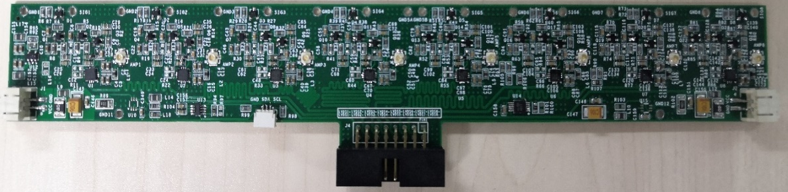
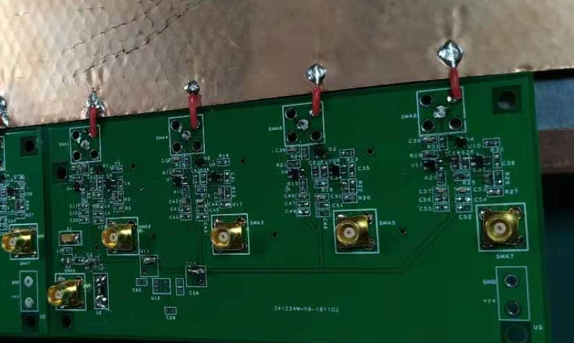
RPC: New FEE Board
Version 1 of FEE board(only amplifier):
Version 2 of FEE board(amplifier-discriminator-LVDS converter):
Two versions of FEE boards were designed by USTC.
Compared with that of INFN, USTC FEE board has larger gain, wider bandwidth and lower power consumption.
Current and voltage could be monitored by software.
Now the second version of FEE board is under testing in USTC.

Slide 19
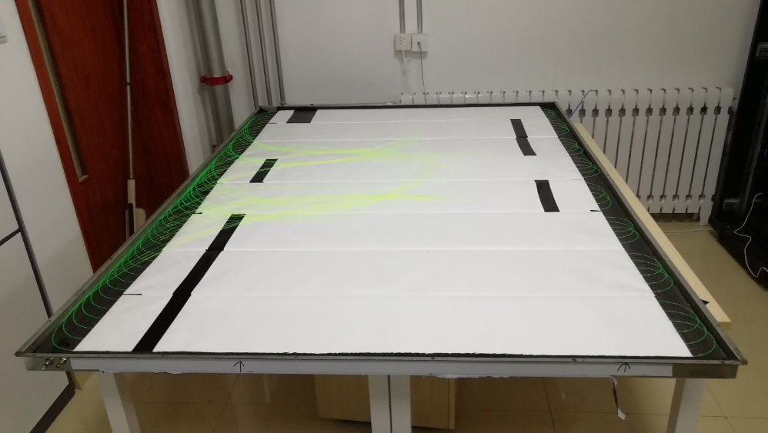
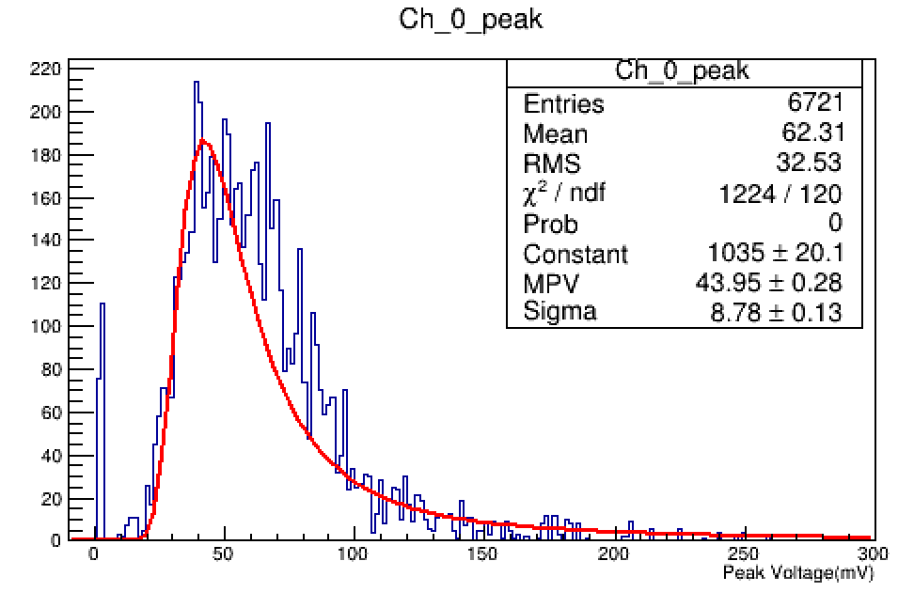
Large Trigger detector (SDU)
Trigger detector of the future RPC test system:
BIS RPC max area：
  1820mm*1096mm
Trigger detector sensitive area:
  2000mm*1300mm
Light tight box of the trigger detector:
  2200mm*1350mm*50mm
8 piece scintillators install in one light tight box
  Each scintillator insert 6 WLS fibers
  One PMT couple to all the fibers
Quality of signal is good.
Waiting more scintillators for another detector.
Amplitude of signal from scintillator

Slide 20
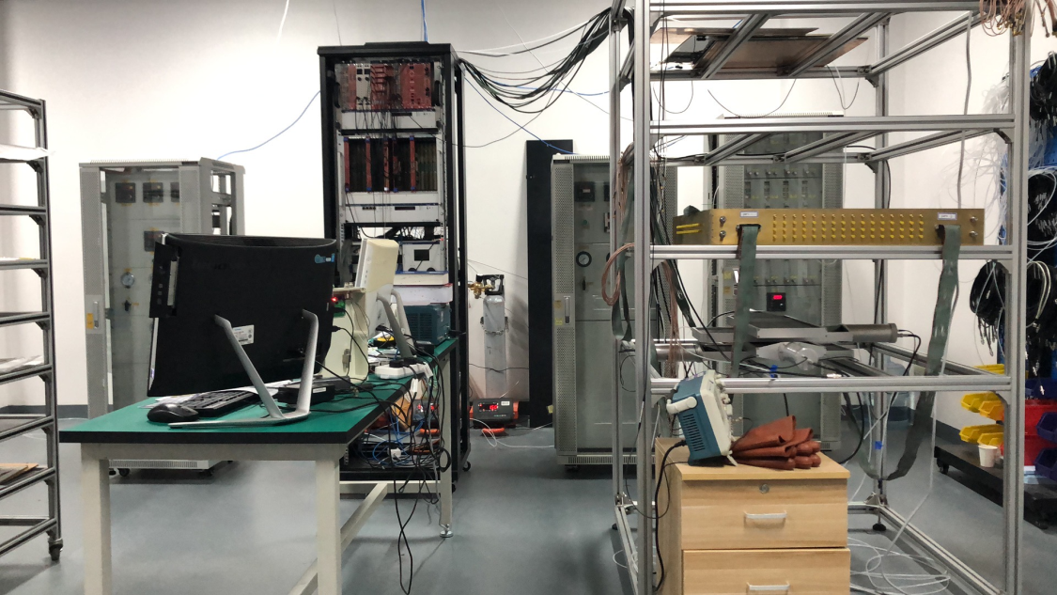




RPC Detector Laboratory in SJTU
The RPC detector test platform, including the gas distribution system, the trigger system, the test system and the readout system.
Gas Flow Simulation on RPC detector
  The gas flow simulation of the RPC detector obtained the velocity, pressure and vorticity distribution inside the RPC.
  The average vorticity of the misplacement was smaller, that is, the gas flow stability was better.
Design and construct the SJTU GRPC gas gap and read signal from the detector successfully.
RPC detector platform in SJTU
Pressure distribution
Average vorticity corresponding
to the two spacer placement methods
RPC gas gap production and signal

Slide 21


MDT Frontend Electronics Upgrade
Monitored Drift Tube (MDT) in current system is only used for precision readout
After Phase II upgrade, MDT information will be used at the first-level trigger to sharpen the trigger turn-on curves
MDT electronics needs to cope with new ATLAS TDAQ scheme proposed
Block diagram of the MDT trigger and readout electronics for HL-LHC runs
Develop a new TDC ASIC for the MDT phase II upgrade:
Comparable timing performance (Tubes unchanged): 102.4us dynamic range, 0.78ns resolution (~200 ps RMS);
Time measurement: rising/falling edge/pair;
No cooling system, need to keep the current power consumption budget: 350mW;
Higher output data rates: 640Mbps;
Additional features: Triggerless mode + Triggered mode.
AMT
MDT-TDC UM
Performance of TDC is test to be very good!

Slide 22



DLC-THGEM
New technology of detector is performed: resistive THGEM based on Diamond-like Carbon (DLC)
Resistive THGEM：avalanche region in PCB covered by DLC
Ratio of avalanche region increase, gain increase
No corrosion of insulating material, independent research and development
Ne:CH4/95:5
1-layer
ΔV=790V
0.2mm drift gap
Obvious signal was found in 4-layers DLC-THGEM!

Slide 23

High-Granularity Timing Detector
ATLAS will upgrade endcap calorimeter in 2026
  LGAD for MIP timing measurement ( 30-50ps )
  6.4m² area silicon detector
  Coverage: 2.4 < |η| < 4.0
Thickness: 7.5 cm
2 double layers per endcap
z position: ± 3.5 m

Slide 24

IHEP group in HGTD detector
IHEP takes many Leading roles in ATLAS HGTD upgrade project
  Resources/risk coordinator (Joao Guimaraes Da Costa)
  Trigger and DAQ coordinator (Juanan Garcia ,IHEP)
  Technical design report co-editors（Zhijun Liang ,Joao, Juanan)
IHEP
IHEP

Slide 25




HGTD sensor: Low gain avalanche diode (LGAD)
Low gain avalanche diode(LGAD) is new technology for HGTD sensor
  high drift velocity, thin active layer ( fast timing)
  High S/B, no self-triggering
IHEP has developed domestic LGAD sensors
  Time resolution reach 30ps in HGTD beam test
  will compete with HPK/FBK/CNM sensors
Prototype of IHEP-NDL LGAD sensors
Time resolution of IHEP-NDL LGAD sensors
50ps

Slide 26



HGTD detector Module R&D
IHEP developed first batch of HGTD modules with ALTIROC1_v2
IHEP modules showed good performance in DESY beam test
  Will be the major results in HGTD technical design report (TDR)
IHEP HGTD module prototypes
2019 DESY beam test for HGTD modules
Time resolution

Slide 27



HGTD trigger and DAQ system
Juanan Garcia (IHEP postdoc) is HGTD trigger and DAQ coordinator
  Design data format and encoding
  Optimize DAQ systematics and manage data transfer rate

Slide 28

Fast readout ASIC R&D
Fast readout ASIC (ALTIROC) R&D is one of the key for HGTD Project
  TDC Time resolution is better than 10ps
  Radiation hard electronics: >200MRad
IHEP is one of key institute in ALTIROC design team
  leading part of ALTIROC2 digital blocks design
  Leading chip emulator development

Slide 29


Irradiation campaign
Irradiation hardness is important for HGTD project
IHEP is responsible for irradiation tests
  Leading total ionization dose (TID) study for sensor and module
    X ray irradiator in IHEP, TID up to 200MRad
  Carried out one irradiation campaign for non-ionization damage
    Collaboration with China Institute of Atomic Energy for 100MeV proton irradiation
    Fluence up to 4x10¹⁵ n_{eq}/cm²
X ray irradiation in IHEP
Proton irradiation campaign in CIAE

Slide 30


HGTD detector mechanical design
IHEP is leading the mechanical design of HGTD outer ring
IHEP design of HGTD outer ring structure

Slide 31
An overview of USTC HGTD activities
Design of LGAD sensors
Test of HPK sensors
R&D on ASIC chip
Studies of the assembly
Contribution to the digitization software
A team of 6 faculty members, 1 postdoc and 6 students. Officially joined the ATLAS project in January 2019

Slide 32

USTC Design of sensors
TCAD Synopsis to design the structure, fabrication process
Verification with simulation
Iteration with foundry to finalize the design
Ready for production

Slide 33





Sensor tests at USTC
Measurement of electrical properties (I-V and C-V)
Measurement of timing resolution, gain, efficiency, uniformity
Do the same for sensors from all vendors, before and after irradiation to understand the key point of irradiation hardness
Amplifier board
Designed by USTC
Probe station
5x5 sensors at probe station
Position scan for uniformity

Slide 34


ASIC tests
Test of analogue functionality of ALTIROC1 in collaboration with LAL-in2p3(efficiency of discriminator, timing resolution, noises …)
Long-term: develop radiation-hard ASIC

Slide 35



Studies of assembly
Bump-bonding is the key technique to connect sensor and ASIC
SINANO demonstrated abilities to bond full-size modules
  now technical associate institute in ATLAS, hosted by USTC-SDU-SJTU
Producing full-size (15x30 array) mechanical dummy modules for assembly studies for ATLAS

Slide 36


Digitization software and test beam
Implemented a realistic digitization in the simulation, which will be used to produce the MC samples for the TDR
Contributed to the test beam data-taking and data analysis

Slide 37
Index of the Presentations
Task | Title | contactor
ITK | Strip detector assembly and tests for the ATLAS Phase-II inner tracker upgrade | Emma Bushanan (IHEP)
 | ATLAS Itk-Strip module assembly and test | Yebo Chen (IHEP)
Muon | ATLAS Muon detector Phase-II upgrade | Quanying Li (USTC)
 | Development of RPC for ATLAS Phase-II muon upgrade | Francois Lagarde (SJTU)
 | Double-end readout for ATLAS Phase-II RPC detector | Quanying Li (USTC)
 | Readout electronics for ATLAS Phase-II RPC detector | Jiajing Ge (USTC)
 | Readout electronics for ATLAS Phase-II sMDT detector | Songfu Lan (USTC)
HGTD | HGTD activity at IHEP | Joao de Costa (IHEP)
 | HGTD activity at USTC | Chihao Li (USTC)
 | Characterization of IHEP-NDL LGAD sensors for HGTD | Yuzhen Yang (IHEP)
 | Study of radiation hardness of IHEP-NDL LGAD sensors in CIAE Proton irradiation campaign | Yang Tao (IHEP)
 | Test beam results of IHEP-NDL LGAD sensors | Bo Liu (IHEP)
 | Study of total ionization does effects on IHEP-NDL LGAD sensors | Yunyun Fan (IHEP)
 | IHEP LGAD Sensor Design for ATLAS HGTD | Kewei Wu (IHEP)
 | ATLAS HGTD module R & D in IHEP | Liaoshan Shi (IHEP)
 | Sensor design for ATLAS Phase-II High Granularity Timing Detector | Xiao Yang (USTC)

Slide 38
Summary and Outlook
Many activities in several main upgrade projects have been carried out in many Chinese Institutes.
Hopefully, all these efforts will become solid contributions to the ATLAS experiment.
Thank you!

