Slide 1
LEPTOGENESIS and DARK MATTER
Ang Liu,Zhi-Long Han,Yi Jin,Fa-Xin Yang
University of Jinan
October 24,2019

Slide 2
Overview
The Model
Leptogenesis
Dark Matter

Slide 3
Model
$vTHDM$ and Dark Sector
$$N_{R}$$
DM
LG

Slide 4
Model
Higgs Potential

Slide 5
Model

Slide 6
LEPTOGENESIS
CP asymmetry

Slide 7
LEPTOGENESIS

Slide 8
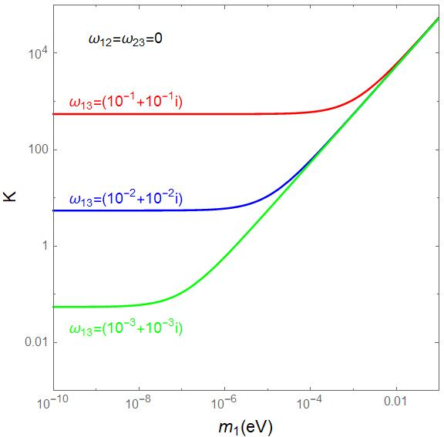
LEPTOGENESIS

Slide 9
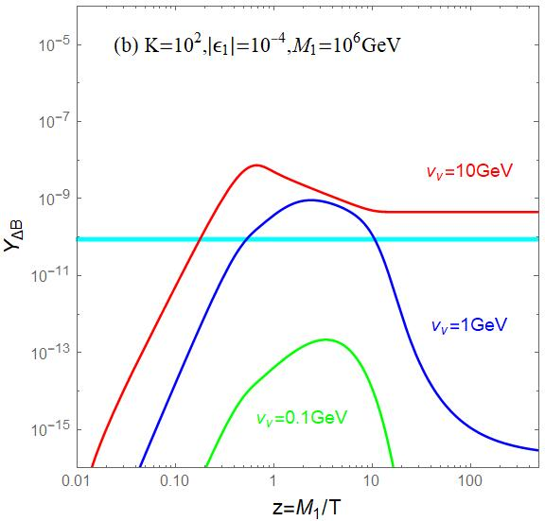
LEPTOGENESIS

Slide 10
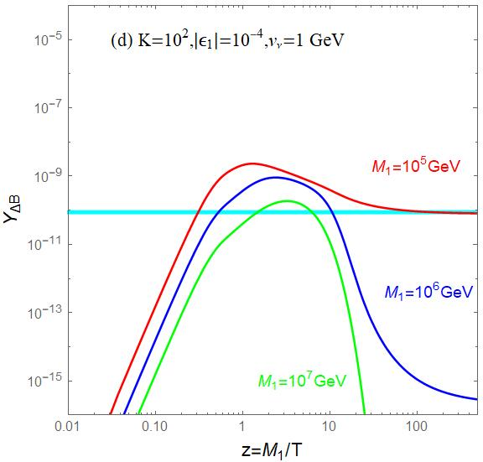
LEPTOGENESIS

Slide 11
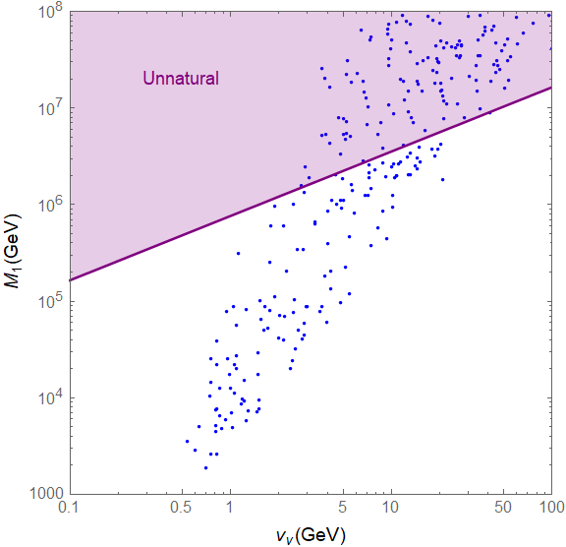
LEPTOGENESIS

Slide 12
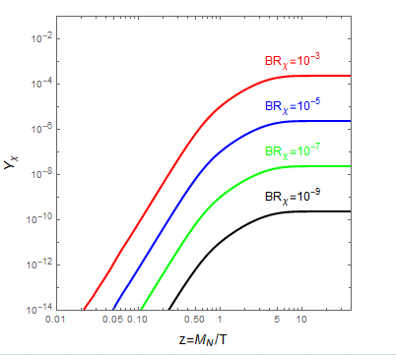
DARK MATTER

Slide 13
DARK MATTER
Constraint Free Streaming Length

Slide 14
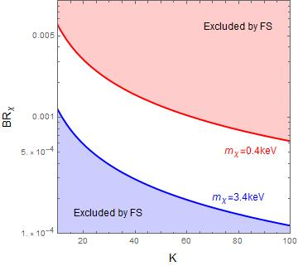
DARK MATTER

Slide 15
CONCLUSIONS
$Dark sector Dark Matter vTHDM Lepto$genesis
CP asymmetry is enhanced by small
Washout effect is enhanced by small and big
Mass of FIMP is

Slide 16
THANKS ！

