Slide 1
Online monitor for ATLAS Phase I RPC cosmic ray test
Xiangyu Xie (USTC)

Slide 2
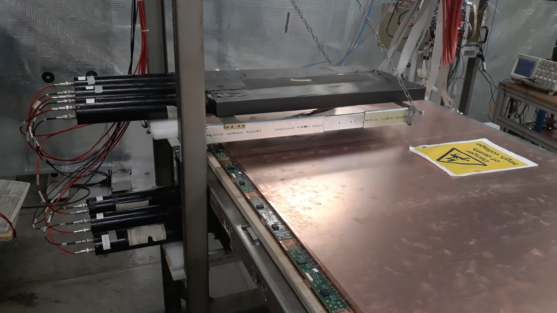
About the cosmic ray (CR) test
Motivation:
To qualify RPC gas gaps and FEE after assembled in BB5, CERN. (QC)
Prior CR test workflow
Singlet DAQ
Go to offline analysis to check the performance
Fix the problems if exist
Re-DAQ to check if fixed
Triplet HV-efficiency scan
~13 HV points (from 4600 – 5800V)
8 areas/Chamber, due to the limitation of TDC channels
~ 100 runs are required
Each run needs ~2 mins to initialize
Area 1
Area 5
η
Setup of DAQ system
φ
Area 2
Area 8
Area 7
Area 6
Area 3
Area 4
Chamber division

Slide 3
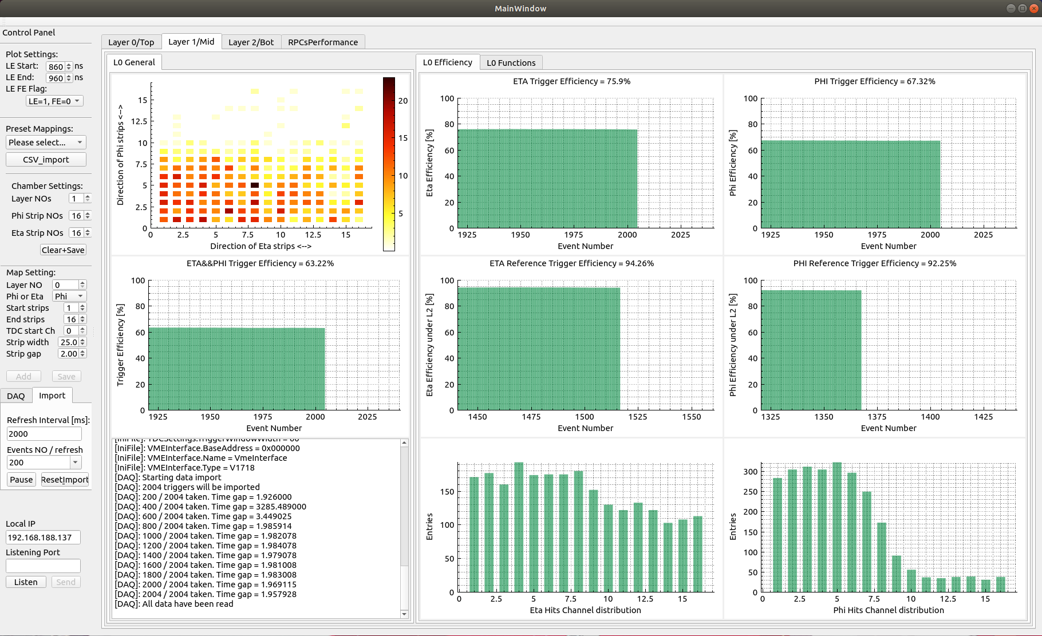
The online monitor
Motivation
Get the primary results while DAQing
One-step workflow
Speed up the test
Features:
GUI instead of terminal
Control the VME&TDC
Reconstruct & display in real time
Quick analysis report
Support offline re-analysis
Screenshot of the monitor

Slide 4
Hardware & software setup
TDC: CAEN V1190a
VME controller: CAEN V1718
Server: CentOS 7.6, GCC 4.8
Developing environment:
Qt (GCC 4.8)
Root 6.14.06
3rd plot library
The DAQ part based on the GIF_DAQ developed by Alexis Fagot
Source code of the monitor is fully available on my Gitlab

Slide 5
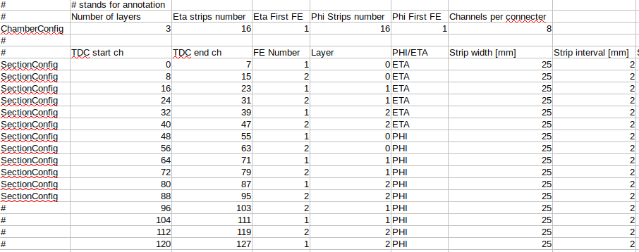
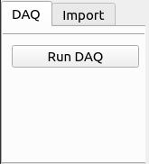
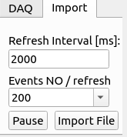
Workflow of the monitor
Config files import:
Mapping file
TDC inifile
Data taking / data re-analysis
Read from TDC / import from disk
Reconstruct & refresh
Prepare for next DAQ
Save the raw data
Clear the TDC buffer & plots
Mapping file
DAQ/Import modes

Slide 6
Demo of the latest version

Slide 7
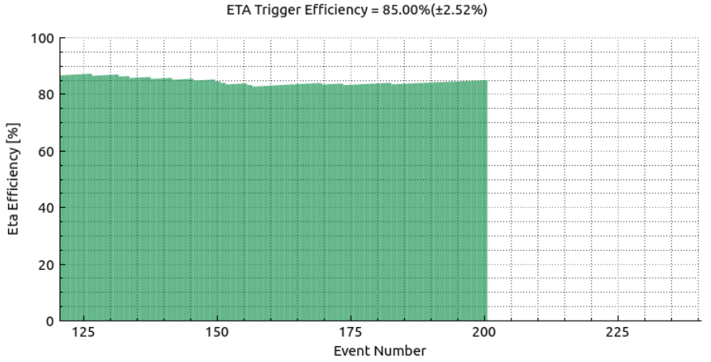
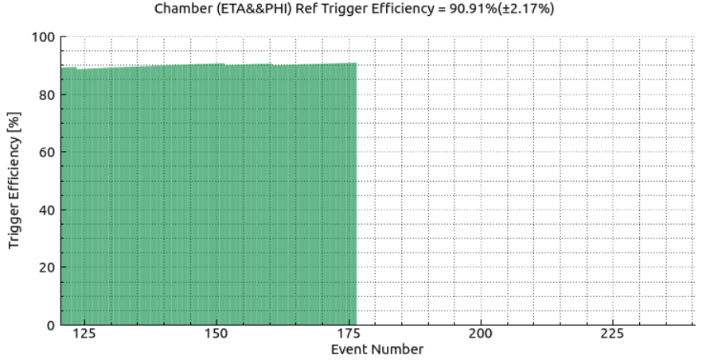
Plots: efficiency curves
Trigger efficiency (for Eta, Phi, Eta&&Phi)
Definition: P(triggered | scintillators triggered)
Motivation: to show the RPC acceptance comparing to the scintillators
Reference trigger efficiency (For Eta, Phi , Eta&&Phi, Eta||Phi)
Definition: P(triggered | reference singlet triggered)
Motivation: reflects the real efficiency of the chamber / gas gap
|delta ch| <= 2,
|delta LE| <=10.0 ns

Slide 8
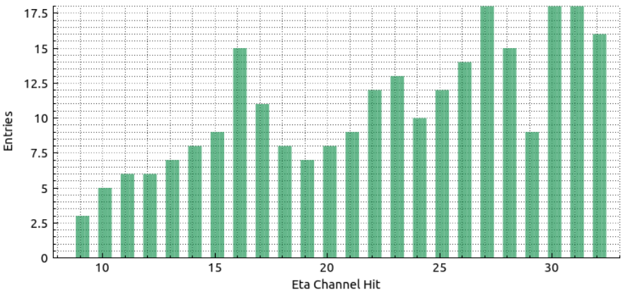
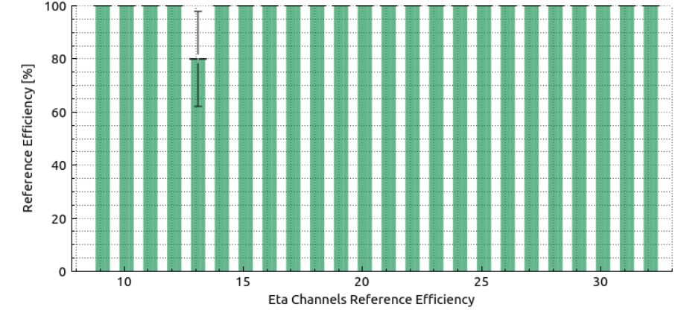
Plots: efficiency of channels
Hits distribution (for Eta, Phi)
Definition: each entry ←→ one hit
Motivation: To give a quick look if there are broken / noisy FEE channels.
Channel efficiency bar (for Eta, Phi)
Definition: bin height ←→ reference efficiency of one channel
Motivation: reflects the efficiency of separate channel
|delta ch| <= 2
|delta LE| <=10.0 ns

Slide 9
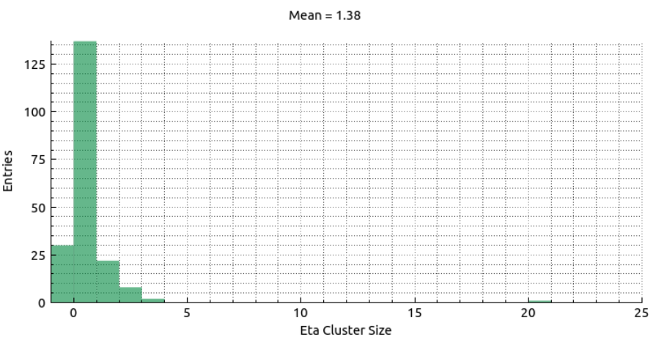
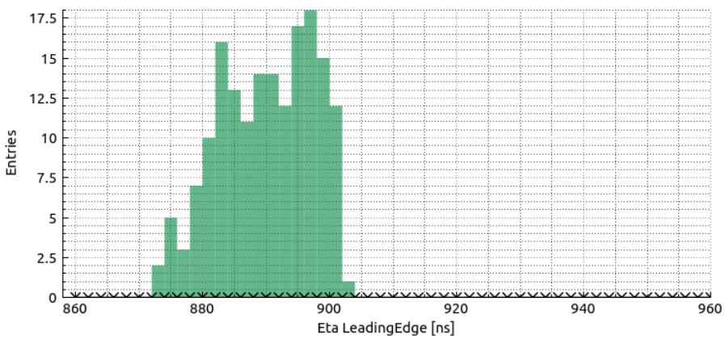
Plots: CS & LE histograms
Cluster size
Definition: the number of strips fired by one hit.
Motivation：to check out the CS distribution
Leading edge
Motivation: to confirm the time window
Distribution width dominated by scintillators

Slide 10
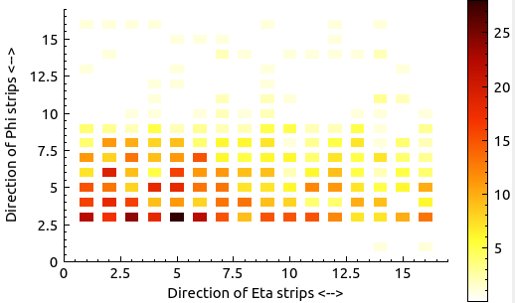
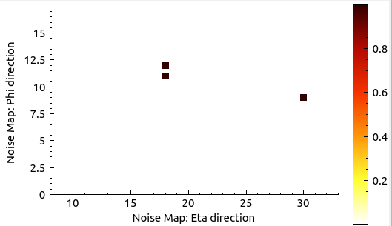
Plots: 2D plots
2D hit distribution
Definition:
One grid ←→ One Eta strip && one Phi strip
Whole plot ←→ One singlet
Temperature ←→ Hits number
Motivation:
The overall hits distribution
Easy to find the false welding channels / noisy channels
2D noise distribution
Definition: as above, but only hits outside the LE window
Motivation: to check out the noisy points of gap
Hit map, a typical example with Phi Ch1&2 disconnected
Noise map

Slide 11
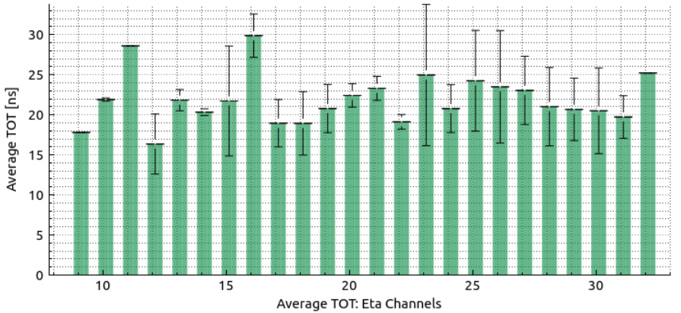
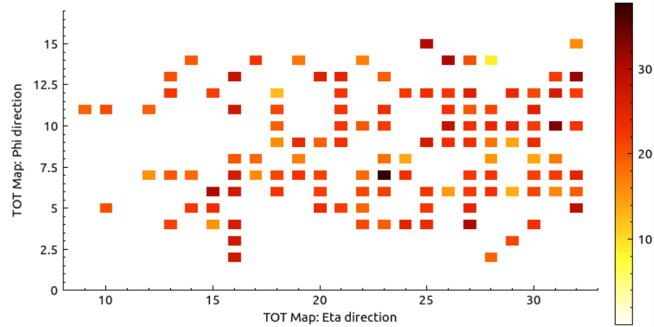
Plots: TOT (time over threshold)
TOT 1D distribution (for Eta, Phi)
Definition:
The bin height ←→ the average TOT of the channel
The error ←→ one standard deviation
Motivation: to check the uniformity of amplifiers
TOT 2D distribution
Definition:
temperature ←→ average TOT of eta and phi signals
Motivation:
To check the uniformity of amplifiers and gas gaps

Slide 12
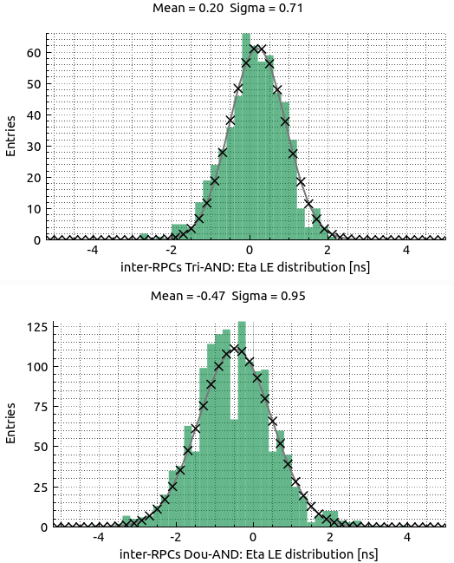
Plots: Time resolution
Use three singlets
When three singlets triggered
All channels are utilized
Definition: $\frac{{LE}_{top}\text{+ }{LE}_{bot}}{2}−{LE}_{mid}$
Time resolution = $\frac{σ}{\sqrt{1.5}}=$ 0.58 ns
Use two singlets
When two singlets triggered
Definition:${LE}_{top}−{LE}_{bot}$
Time resolution = $\frac{σ}{\sqrt{2}}=$ 0.67 ns
Only primary results provided
The time of walk not calibrated

Slide 13
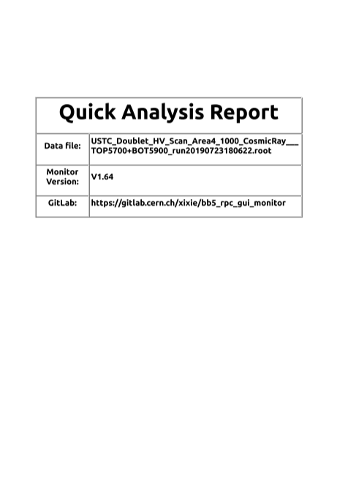
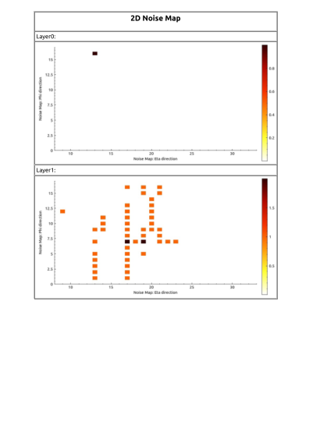
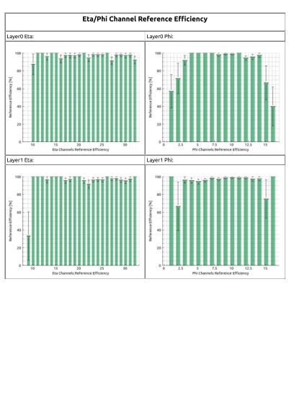
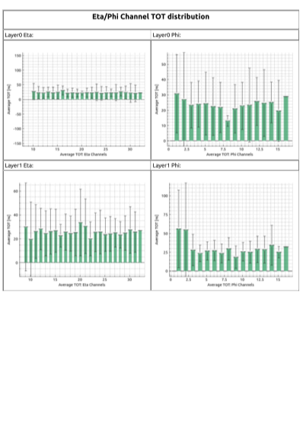
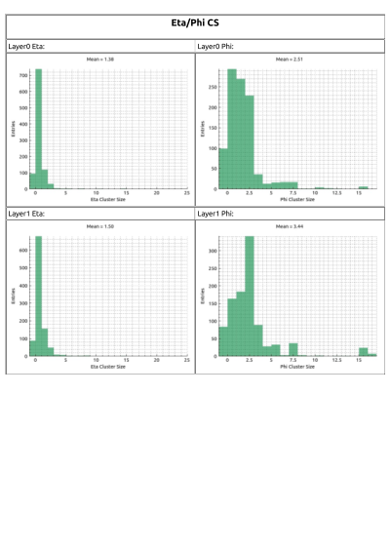
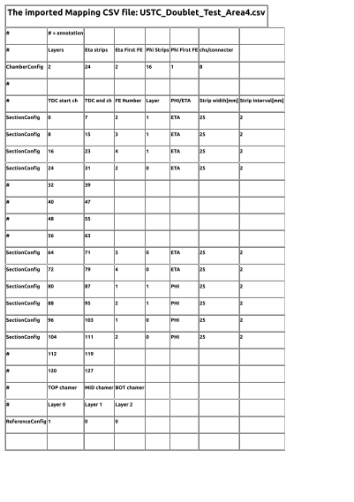
Quick analysis report
A pdf-version quick analysis report
Automatically generated
Printed all plots

Slide 14
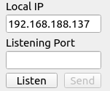
Extra: tracks broadcasting for AR
Reconstruct tracks from hits of all chambers
Linear reconstruction:
In mm unit
Broadcast via TCP/IP
The event number
$k_{1}$,$k_{2}$, $c_{1},$ $c_{2}$ to be sent
Received by an AR program
A project proposed by Giulio
For outreach
May help detector maintaining
A demo program developed
Serer config

Slide 15
Demo of the AR program

Slide 16
Summary
An online monitor for RPC cosmic ray test developed
Simplify the workflow
Speed up the test
Provide various plots
To check gap/chamber efficiency
To check gap status
To check FEE status
Quick analysis report
Potential in Phase II RPC mass production in China sites
Potential for outreach and detector maintaining

