Slide 1
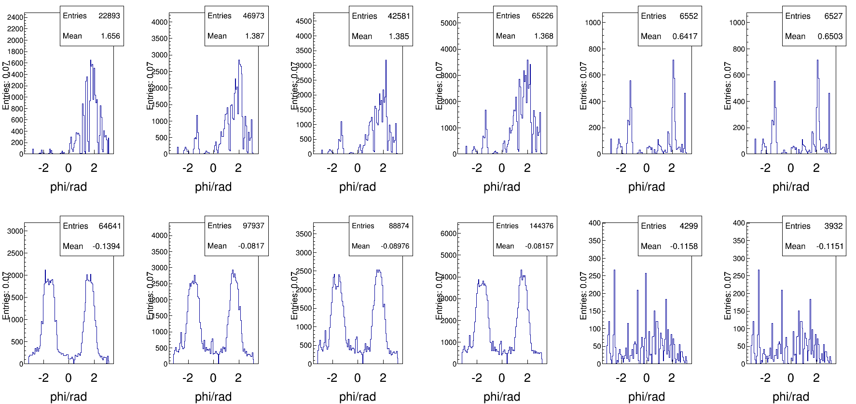
X cluster position
Run1 Run2 Run3 Run4 Run5 Run6
Layer1
Layer2

Slide 2
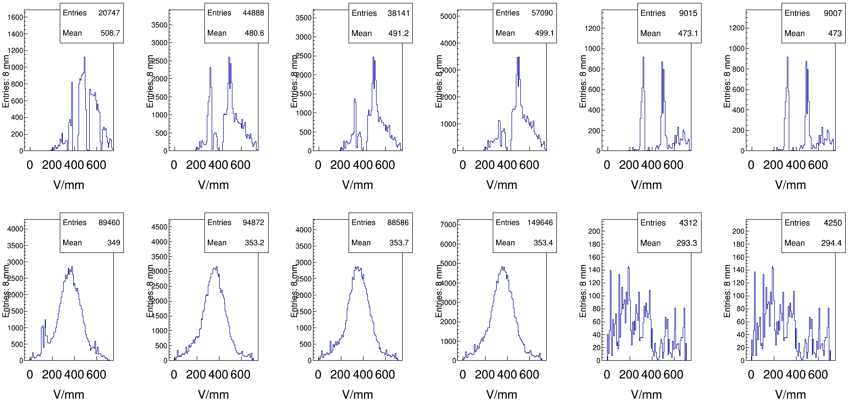
V cluster position
Run1 Run2 Run3 Run4 Run5 Run6
Layer1
Layer2

Slide 3
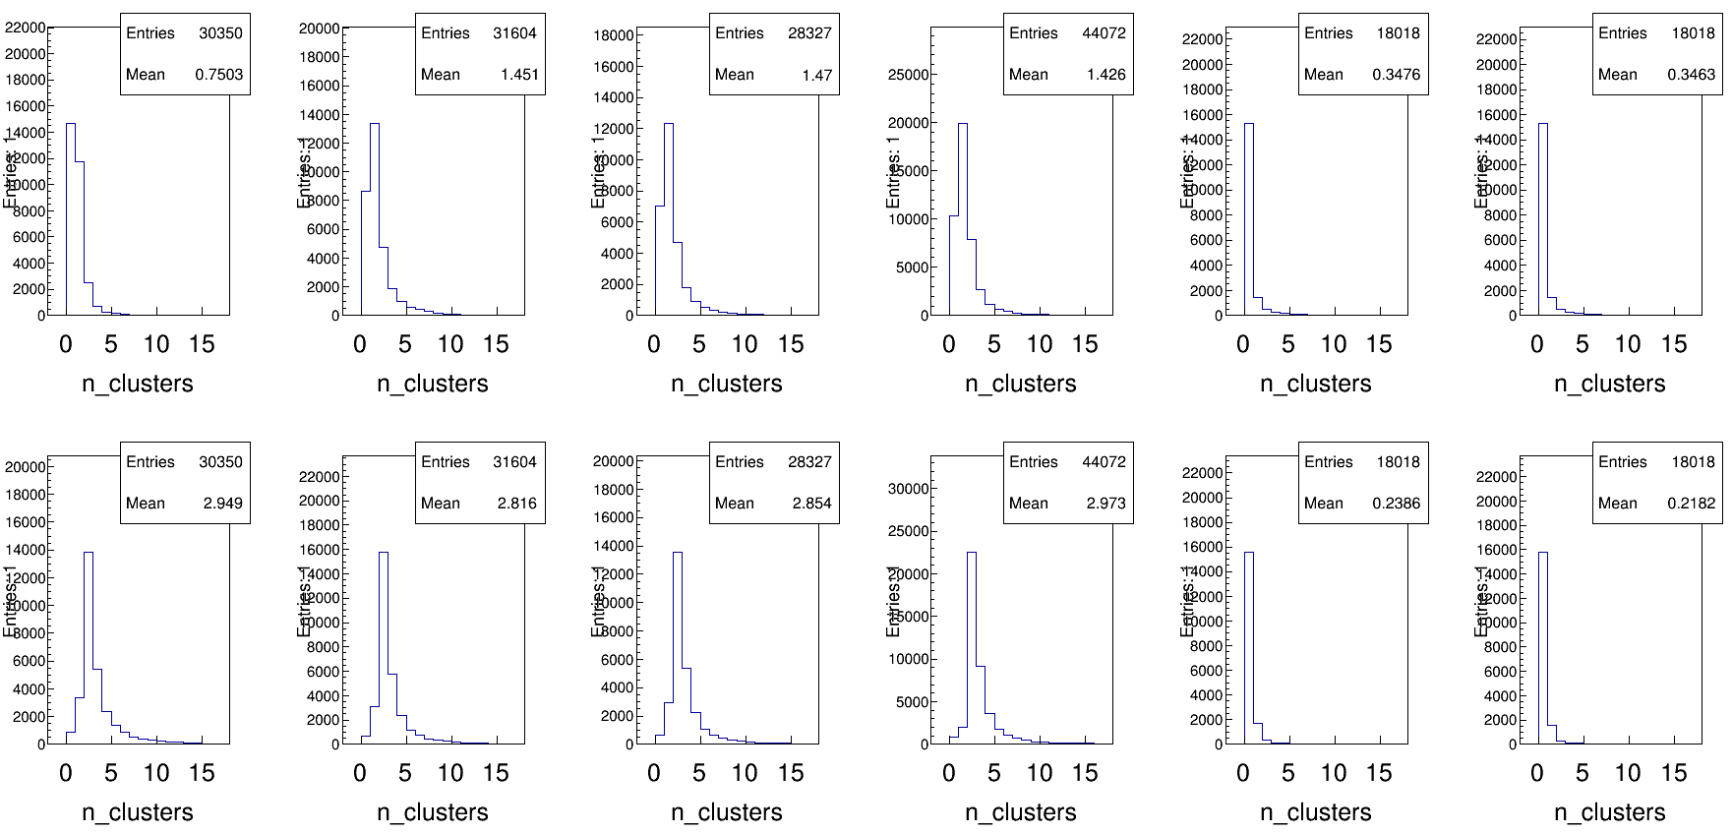
Number of X cluster
Run1 Run2 Run3 Run4 Run5 Run6
Layer1
Layer2

Slide 4
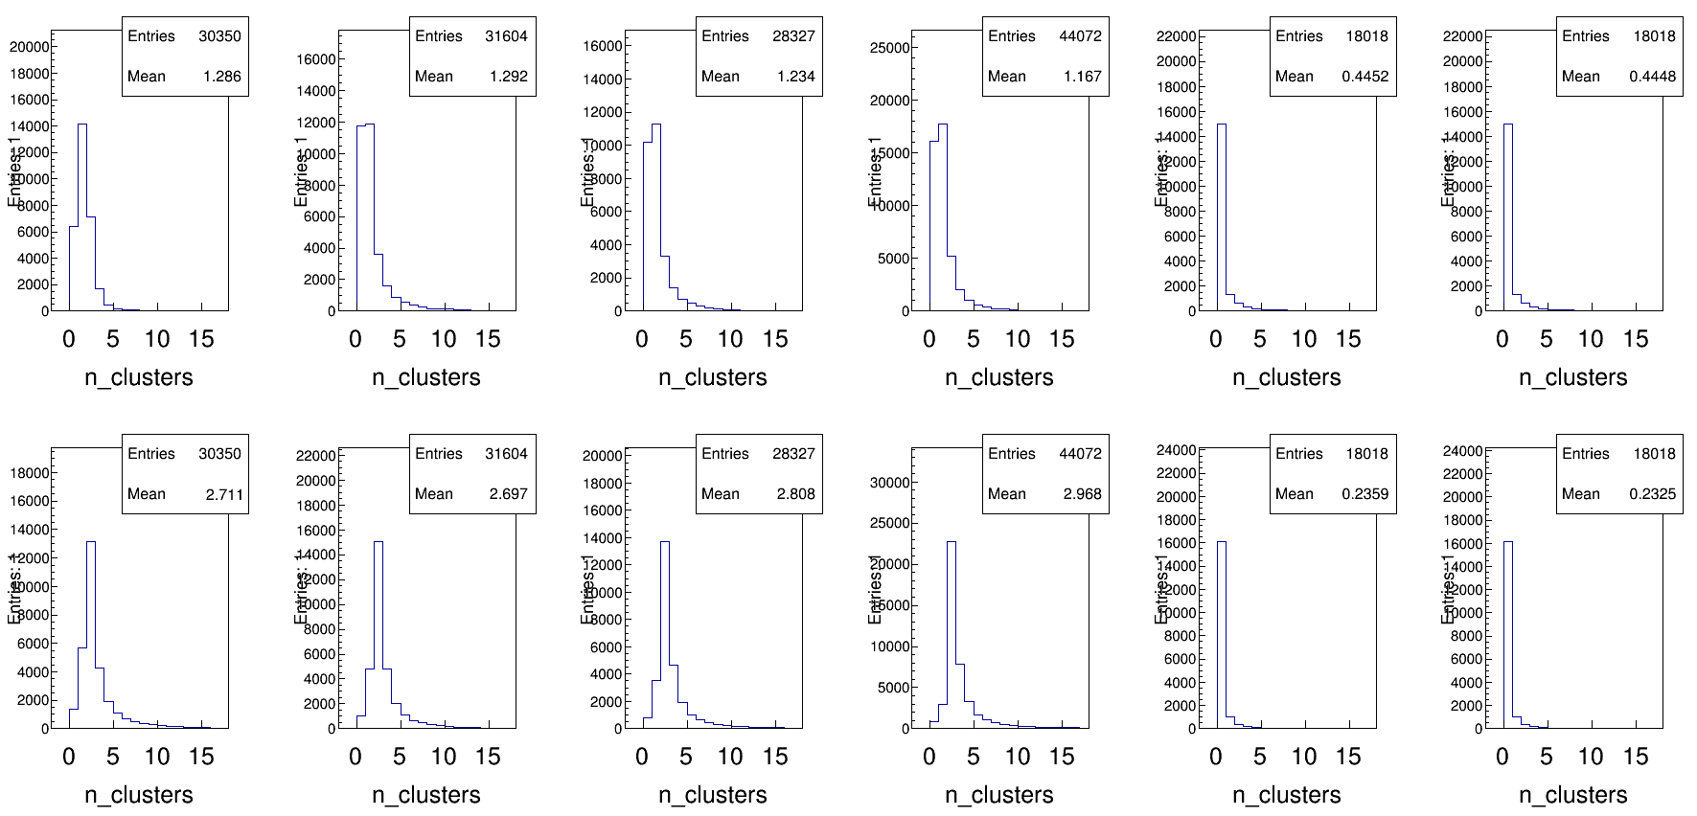
Number of V cluster
Run1 Run2 Run3 Run4 Run5 Run6
Layer1
Layer2

Slide 5
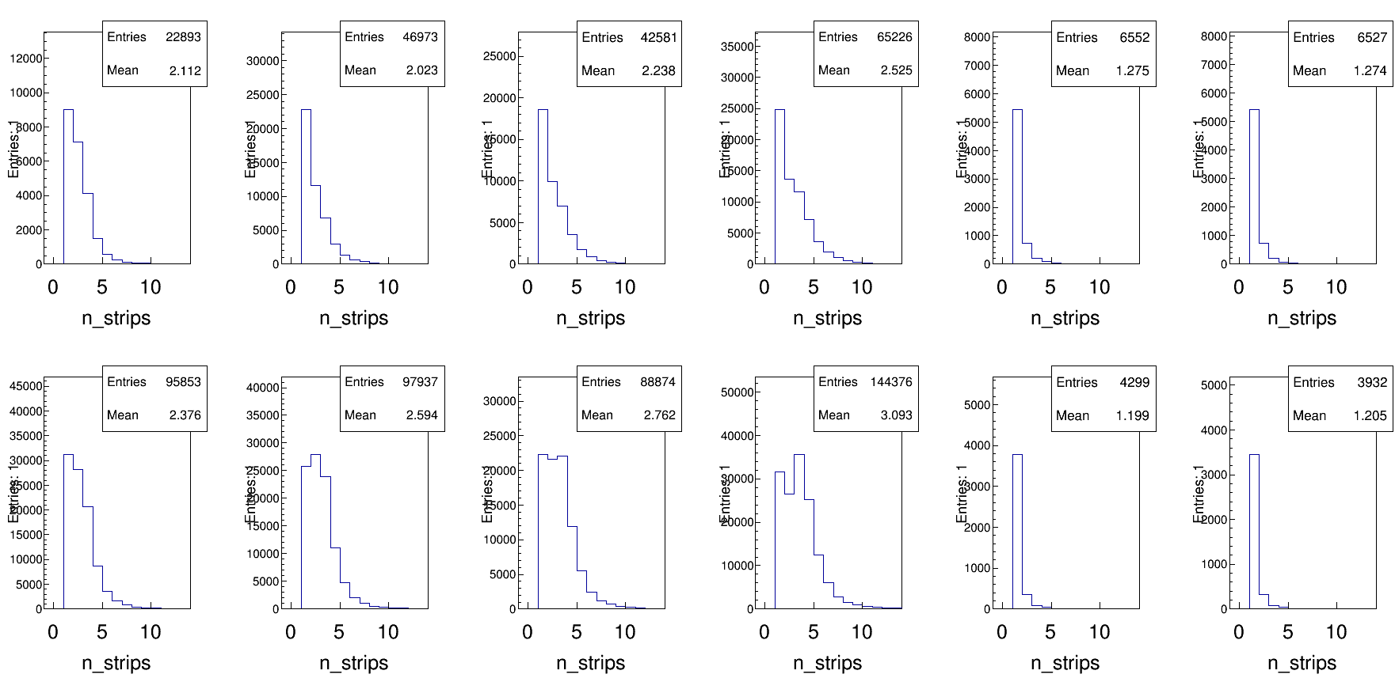
Number of X strips per cluster
Run1 Run2 Run3 Run4 Run5 Run6
Layer1
Layer2

Slide 6
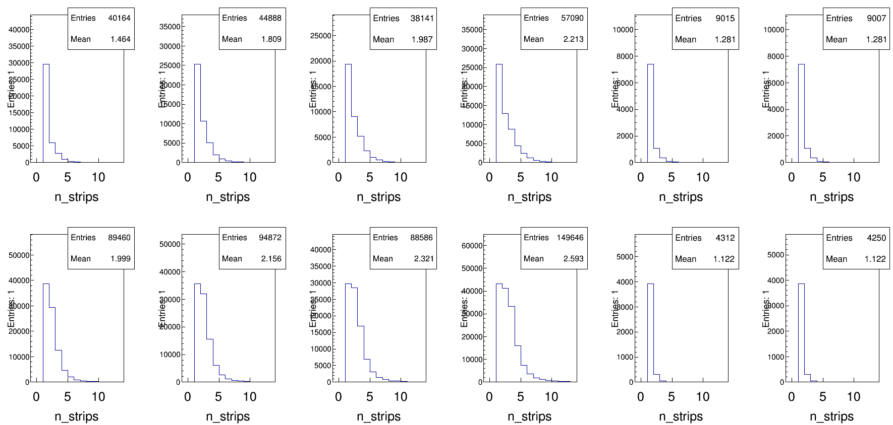
Number of V strips per cluster
Run1 Run2 Run3 Run4 Run5 Run6
Layer1
Layer2

Slide 7
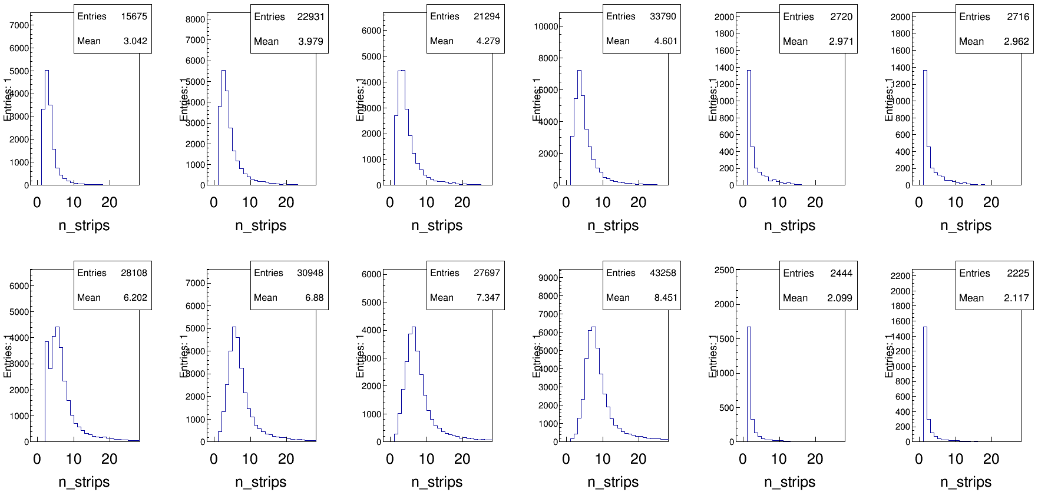
Number of X strips per event
Run1 Run2 Run3 Run4 Run5 Run6
Layer1
Layer2

Slide 8
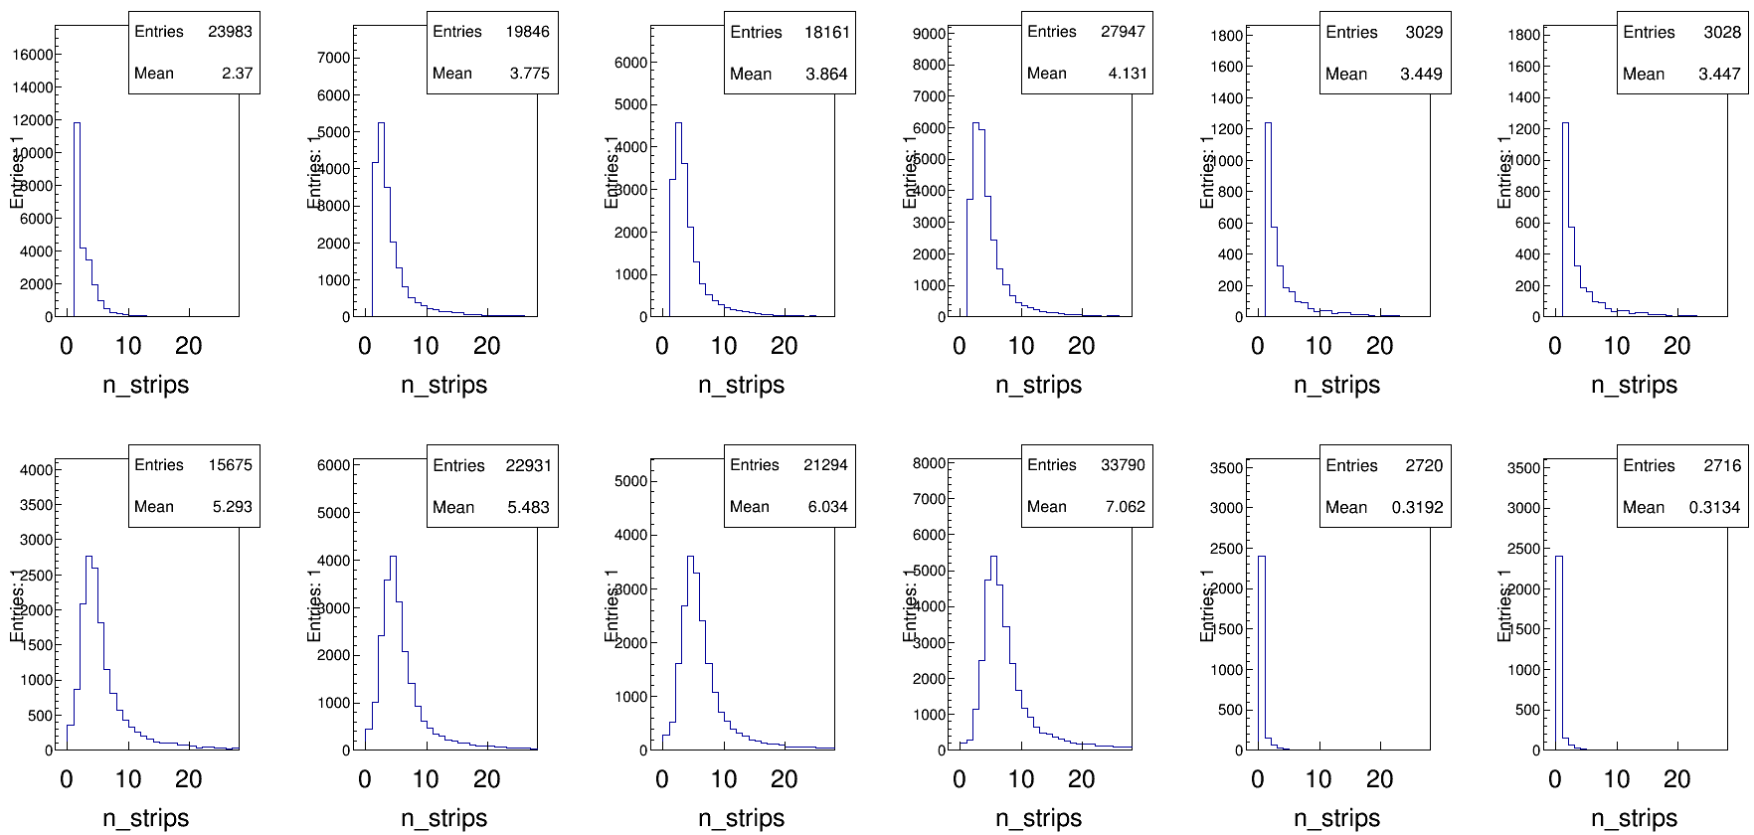
Number of V strips per event
Run1 Run2 Run3 Run4 Run5 Run6
Layer1
Layer2

Slide 9
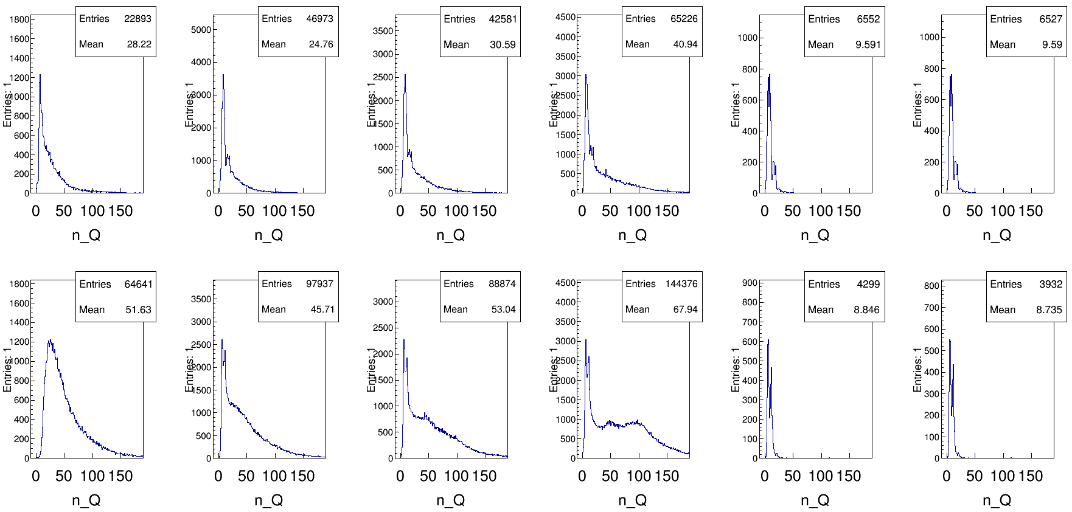
Q of X per cluster
Run1 Run2 Run3 Run4 Run5 Run6
Layer1
Layer2

Slide 10
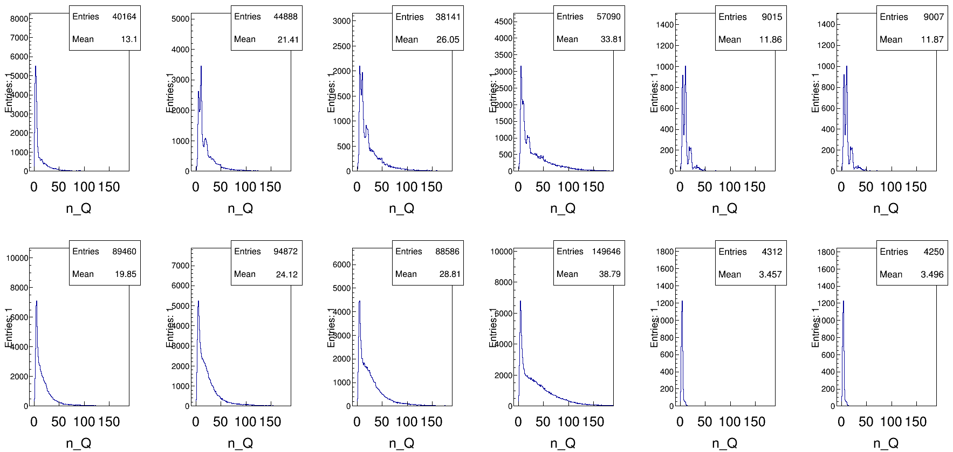
Q of V per cluster
Run1 Run2 Run3 Run4 Run5 Run6
Layer1
Layer2

Slide 11
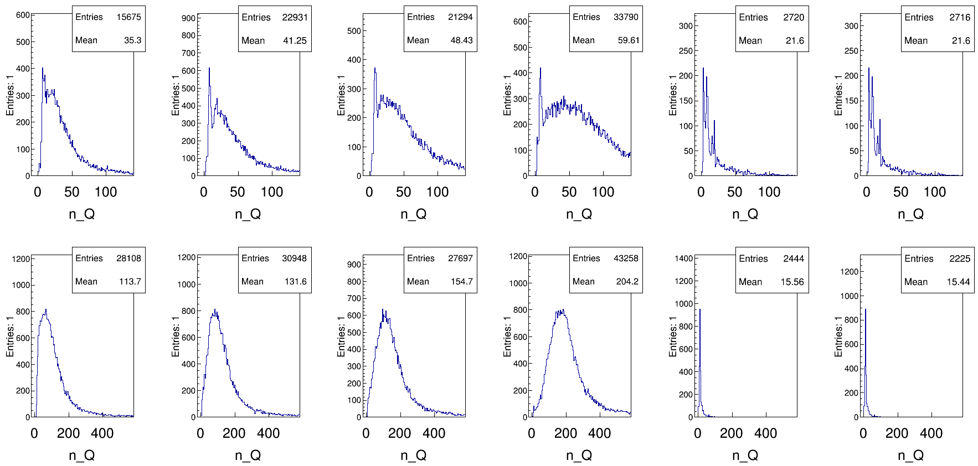
Q of X per event
Run1 Run2 Run3 Run4 Run5 Run6
Layer1
Layer2

Slide 12
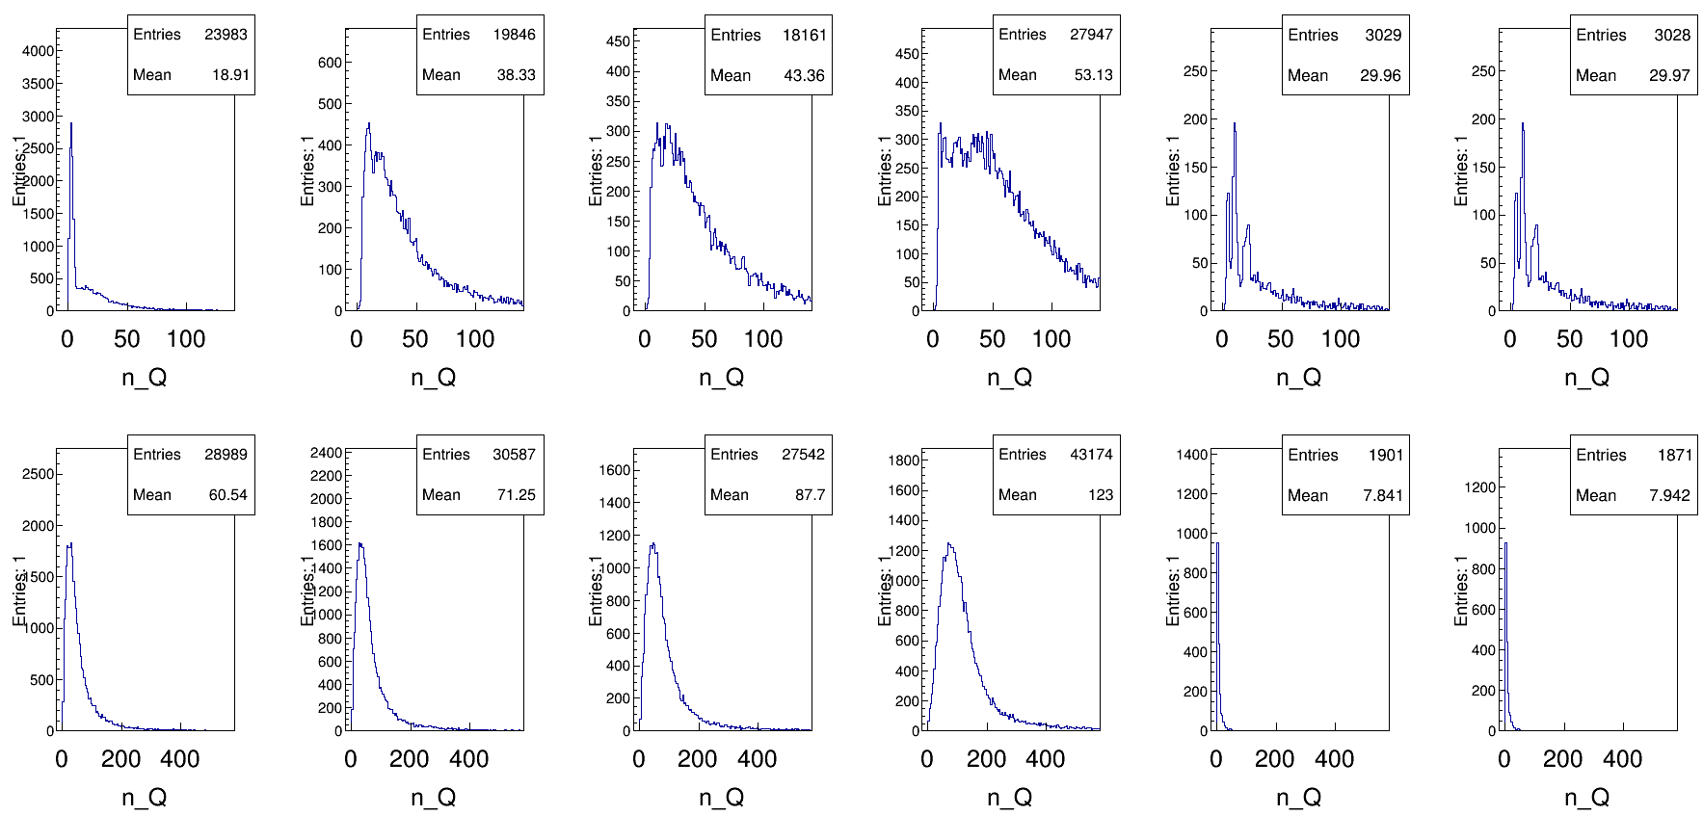
Q of V per event
Run1 Run2 Run3 Run4 Run5 Run6
Layer1
Layer2

