Slide 1
CgemLineFit
Hongpeng Wang
Liangliang Wang

Slide 2
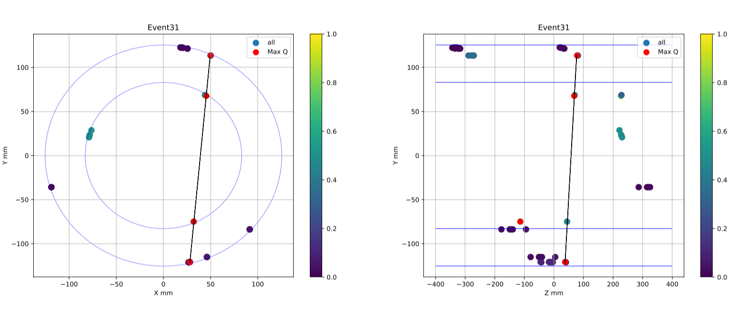
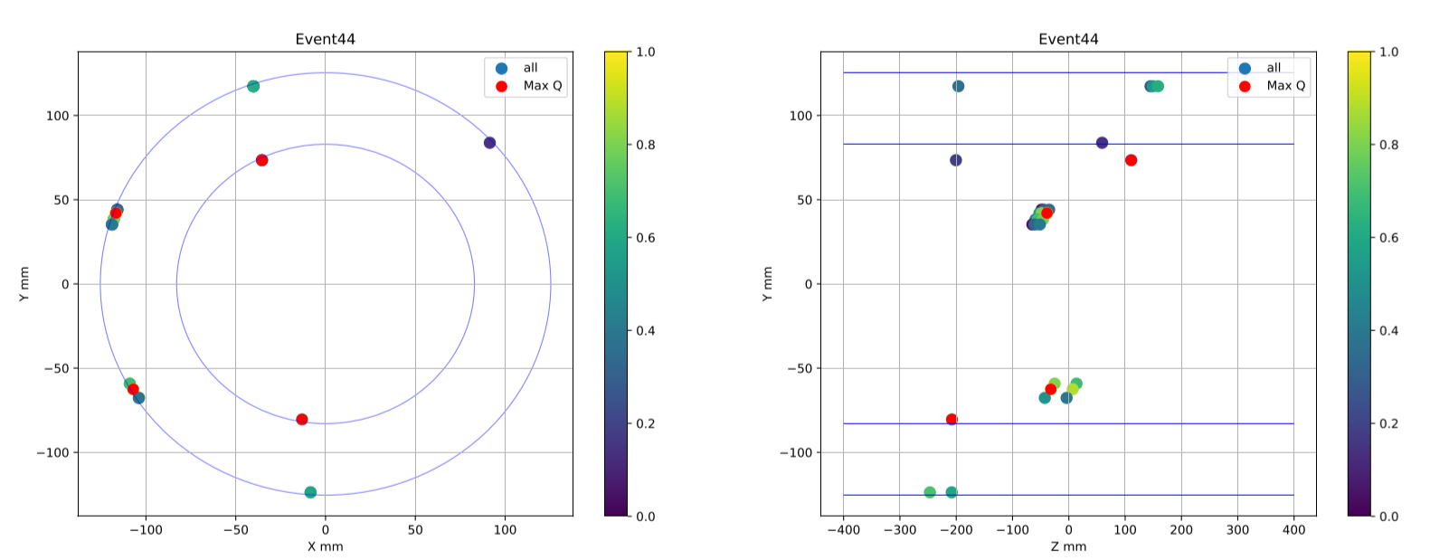
Max-Charge Method
In inner layer, the v-cluster is reused in 2 xv-clusters.
In some events , the right clusters have smaller charge
than wrong xv-cluster.

Slide 3
Loop All Method
Loop all x-clusters clusters combinations，and do a line fit in X-Y plane to find the combination with smallest FCN:
$χ_{x}^{2}={\left(\frac{φ−φ^{′}}{\frac{σ}{R_{n}}}\right)}^{2}$.
Find the matching v-clusters, do a 3-D line fit and get the right combination with FCN:
$χ_{xv}^{2}={\left(\frac{φ−φ^{′}}{\frac{σ}{R_{n}}}\right)}^{2}$ + ${\left(\frac{V−V′}{σ}\right)}^{2}.$

Slide 4
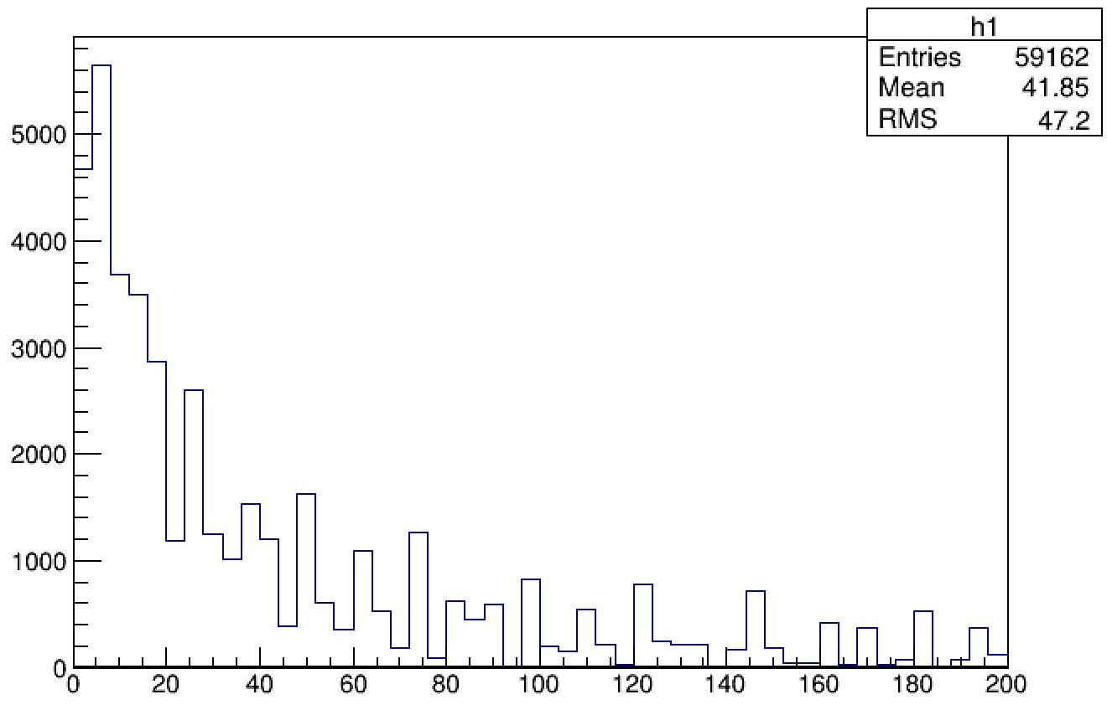
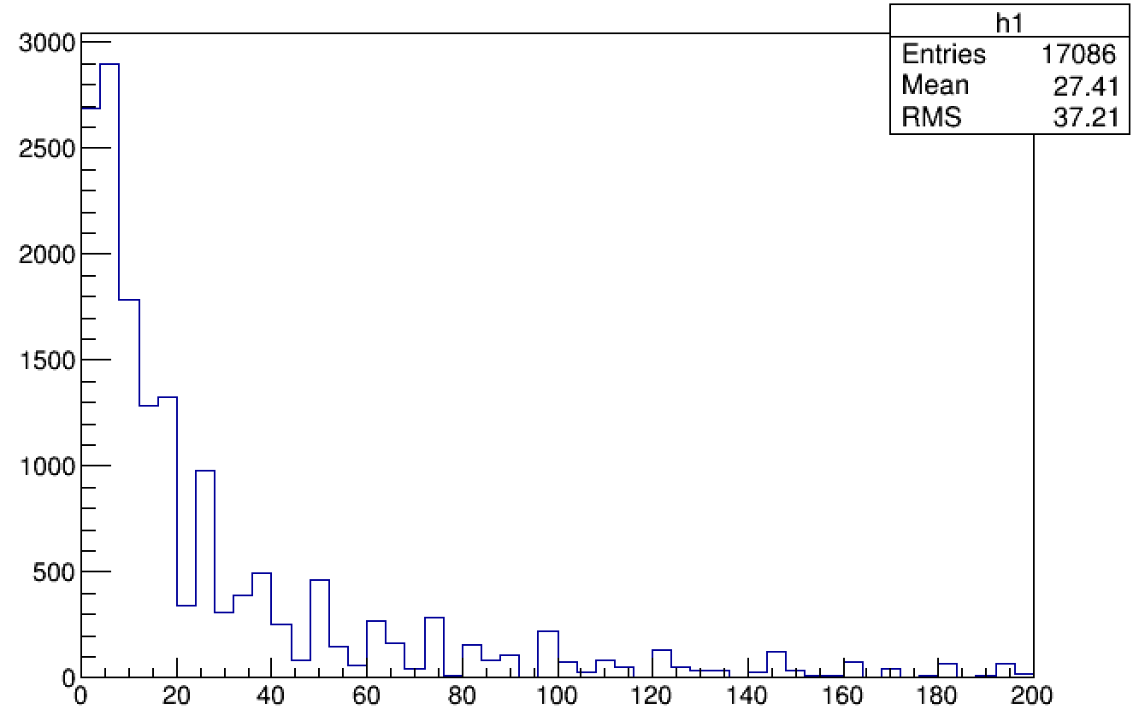
Combinations number
Combinations number of phi
Combinations number of V clusters
(with a fixed phi combination )
Run 10 data.
Set $χ_{phi }^{2}$<2000.
combination number of phi <50, combination number of V number <50.
Strict cut for fast check

Slide 5
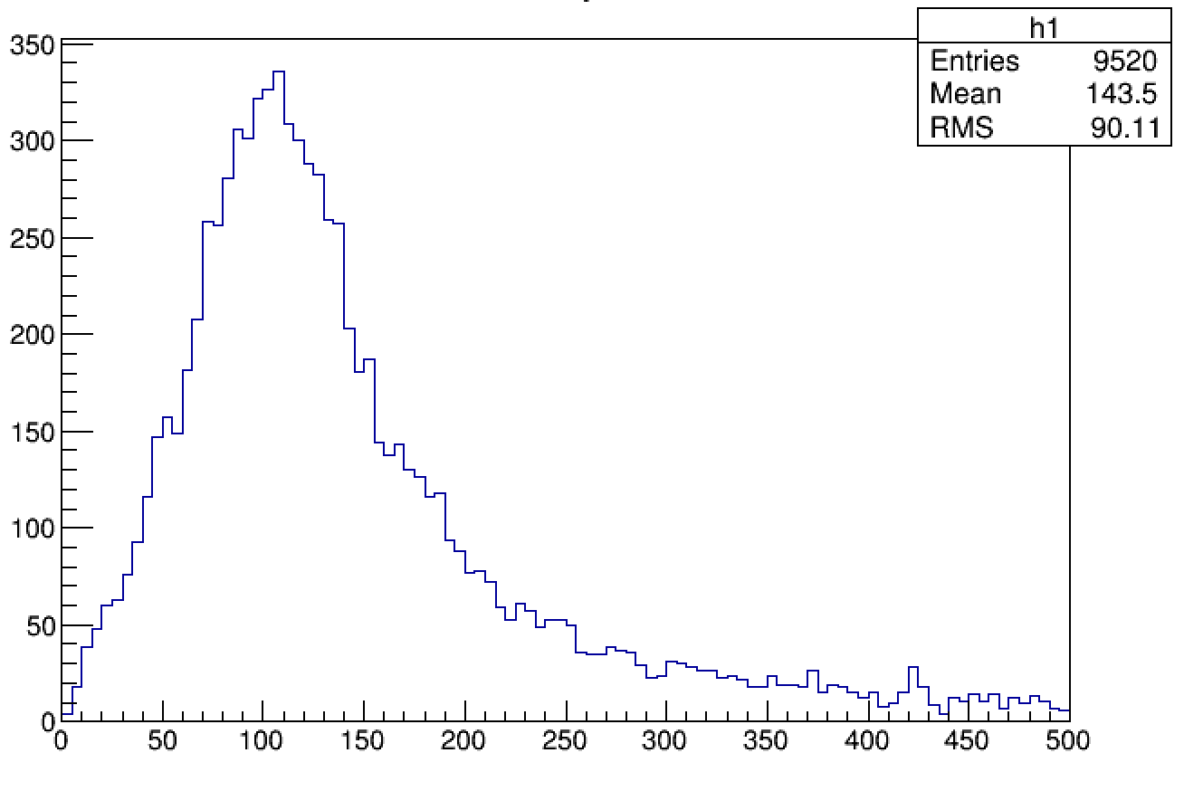
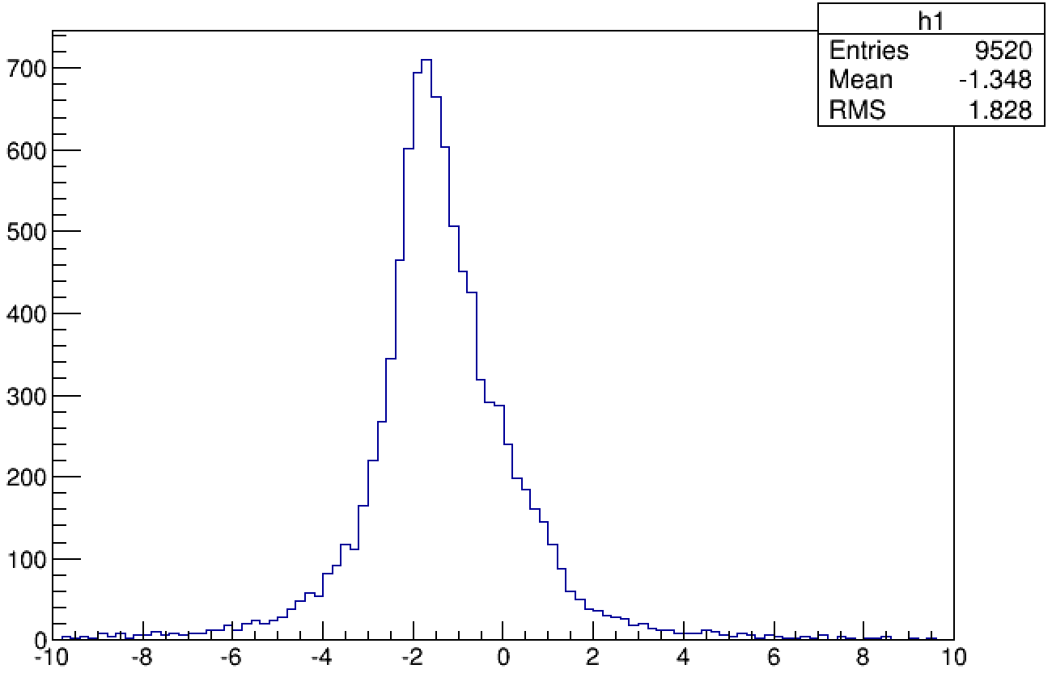
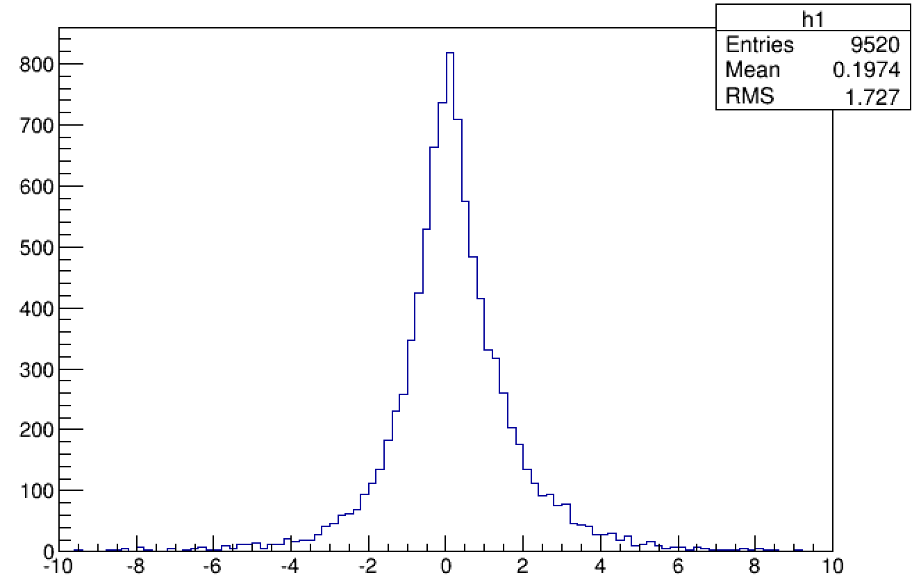
Chisq and Residual distribution
Chisq
(set resolution as 130 um )
Residual of phi in middle layer upper sheet.
(Unit:mm )
Residual of V in middle layer upper sheet.
(Unit:mm )

Slide 6
Thanks!

