Slide 1
Validation of CGEM alignment package
Aiqiang Guo, Ryan Mitchell , Linghui Wu
Indiana University
IHEP

Slide 2



Track based alignment – Millepede for Cgem
Strategy: obtain the mis-alignment information by fit the track with least-square method.
To reduce the computing time, we transfer the local information (track parameters) to the global (detector mis-alignment parameters) Hessian C (“Schur complement”)
For each layer, 4 possible parameters: δx, δy, δz, θz
$$l(dρ,dz,φ_{0},tanλ)$$
$$R_{i}=f\left(x_{i},dρ,dz,φ_{0},tanλ, ∆z\right)−{meas.}_{i}$$
Residual $R_{i}$
$$∆z$$
$${meas.}_{i}$$
δy
δx
Y
X
δz
θz
Z

Slide 3
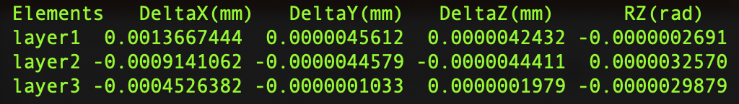


Status in last workshop
Validate the algorithm with 5000 signal muon events
Generate MC with and without mis-alignment
Hit position, residual and derivatives are checked
Compare input/output, but found that the output values are inconsistent with input values
$${45}^{°}$$
$$μ$$
Input DeltaX= 1.5 mm for layer1

Slide 4

Progress: More MC
Simulate more MC with random incident angles
50,000 events for each different type of mis-alignment effect
Initial position: Y = 200 mm X $∈[$-40, 40]mm Z $∈[$-200, 200]mm
Incident angle: cos($θ$)$∈[$-0.426 0.426] $φ∈$[-2.636 -0.5054]

Slide 5
Progress: More MC
Simulate more MC with random incident angles
50,000 events for each different type of mis-alignment effect
Initial position: Y = 200 mm X $∈[$-40, 40]mm Z $∈[$-200, 200]mm
Incident angle: cos($θ$)$∈[$-0.426 0.426] $φ∈$[-2.636 -0.5054]
Vertical tracks are insensitive to the shift in Y

Slide 6
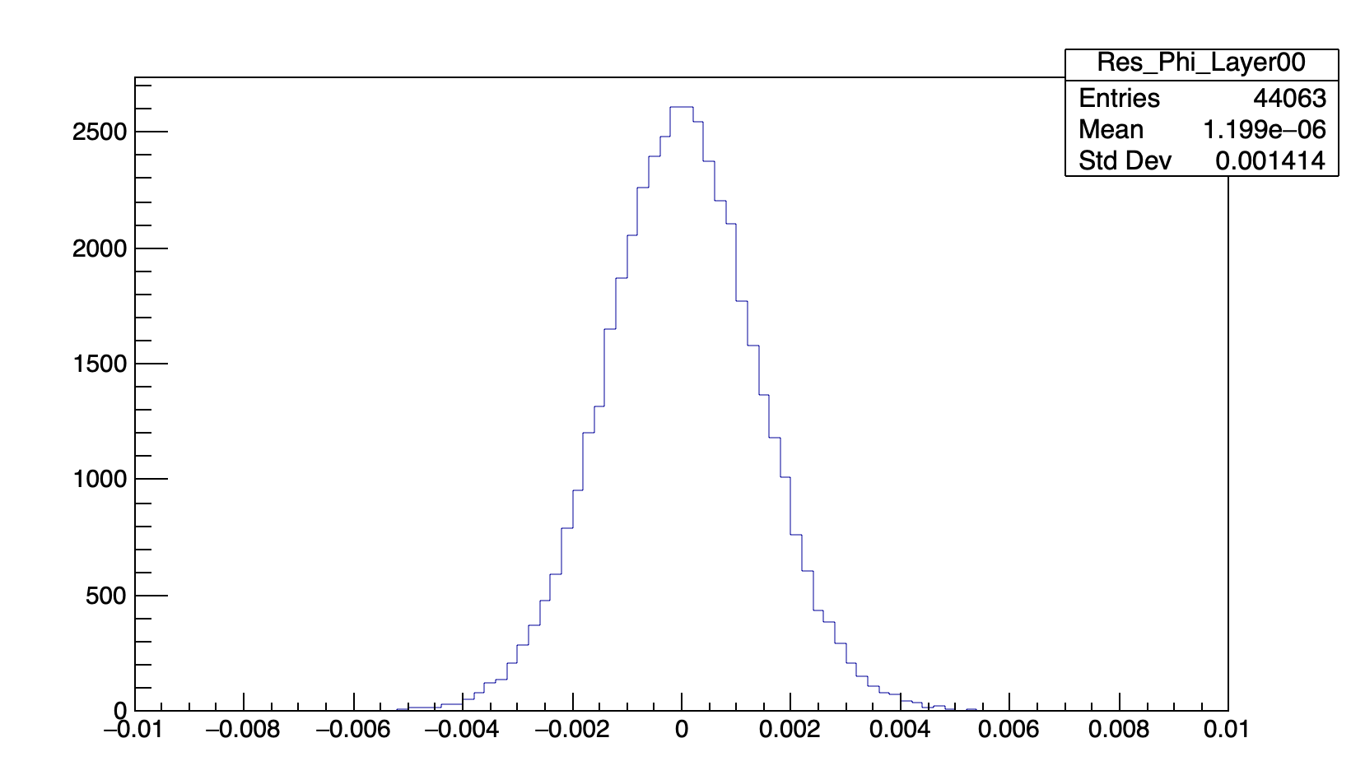
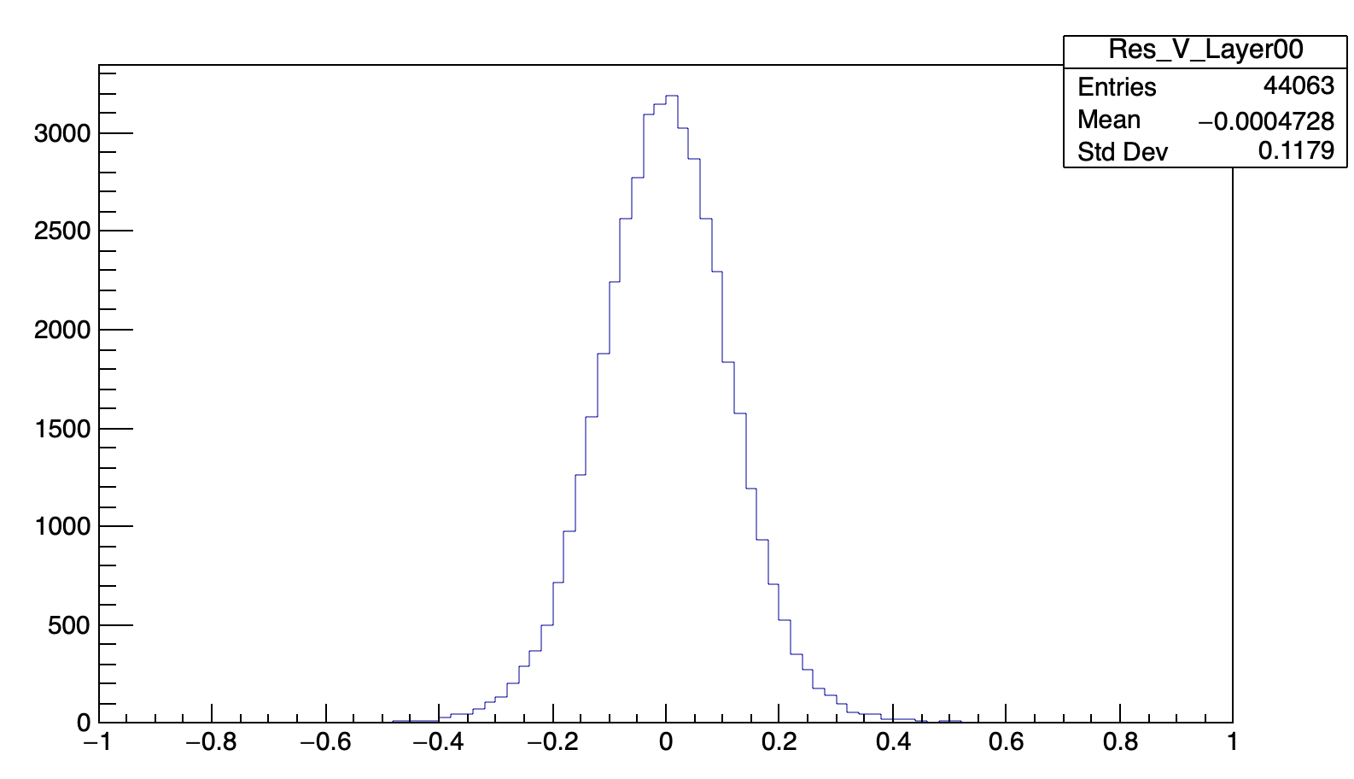
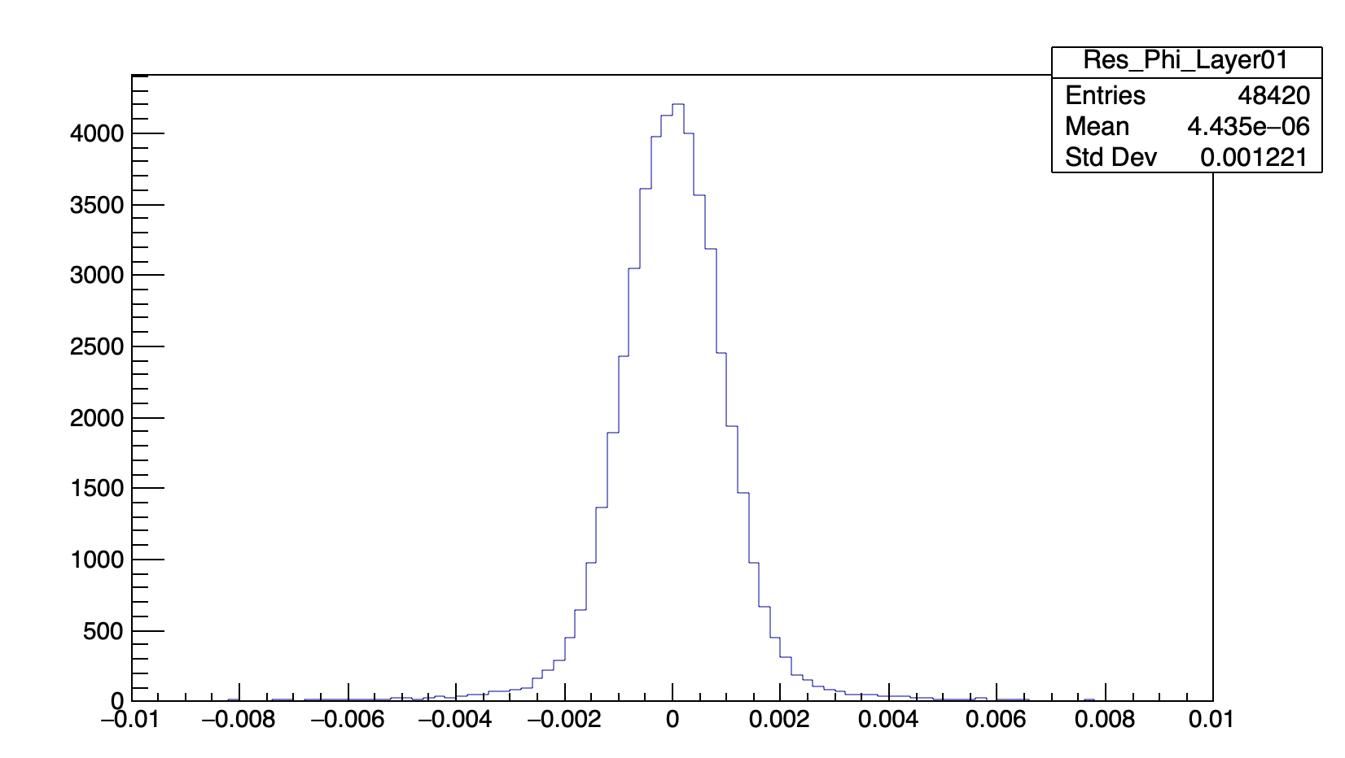
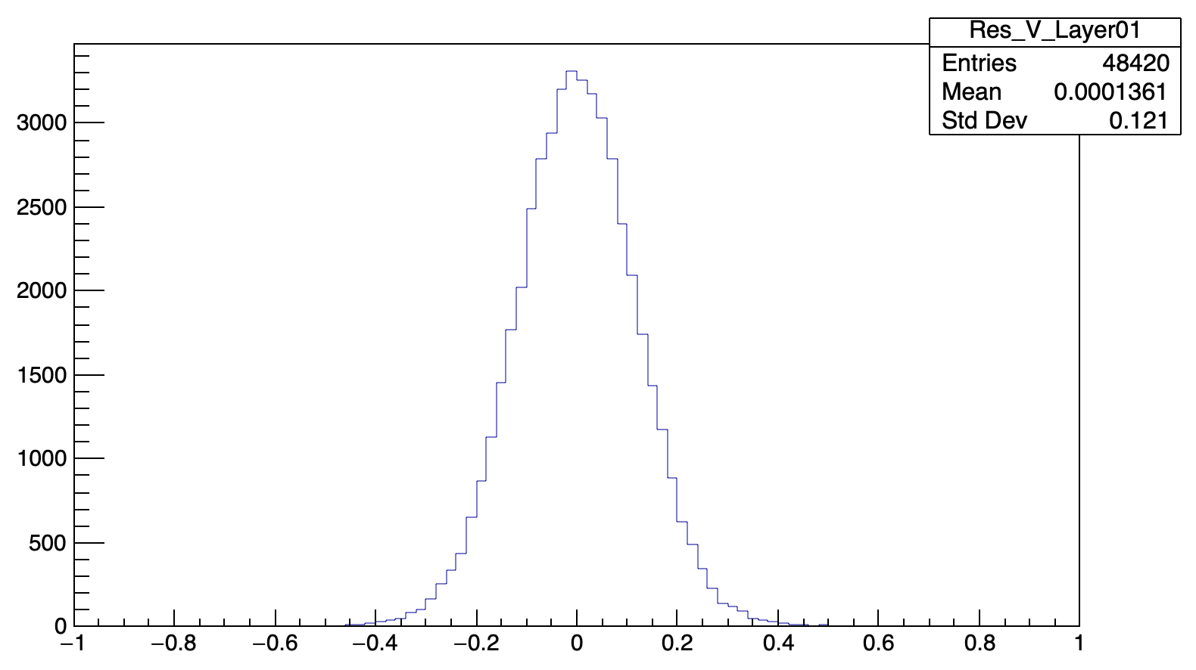
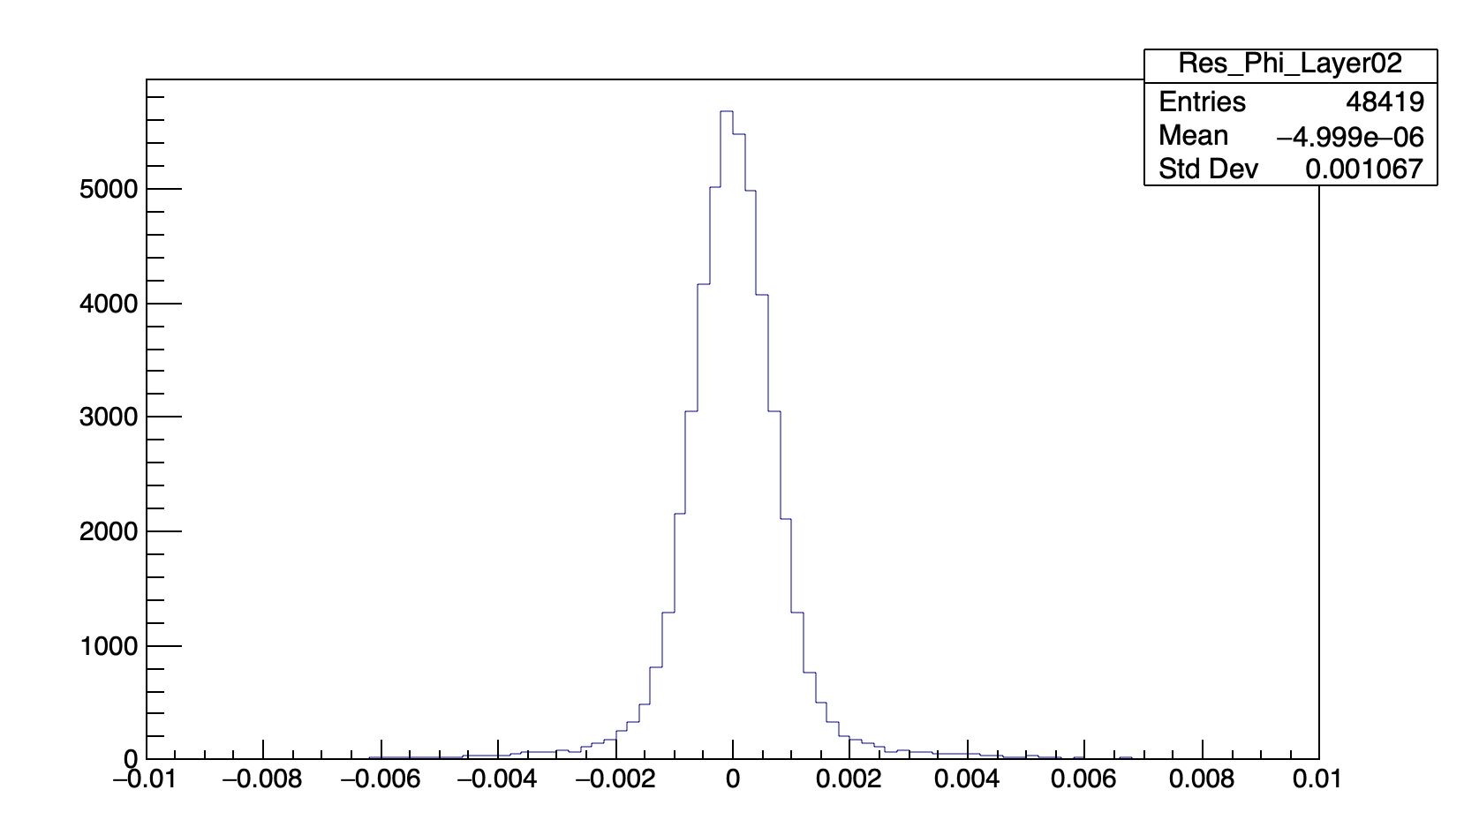
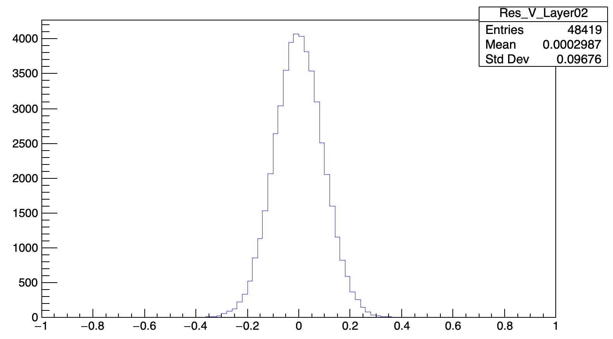







Set errors of $φ$ and V according to simulation
$Δφ$L1
$ΔV$L1
$Δφ$L2
$ΔV$L2
$Δφ$L3
$ΔV$L3

Slide 7
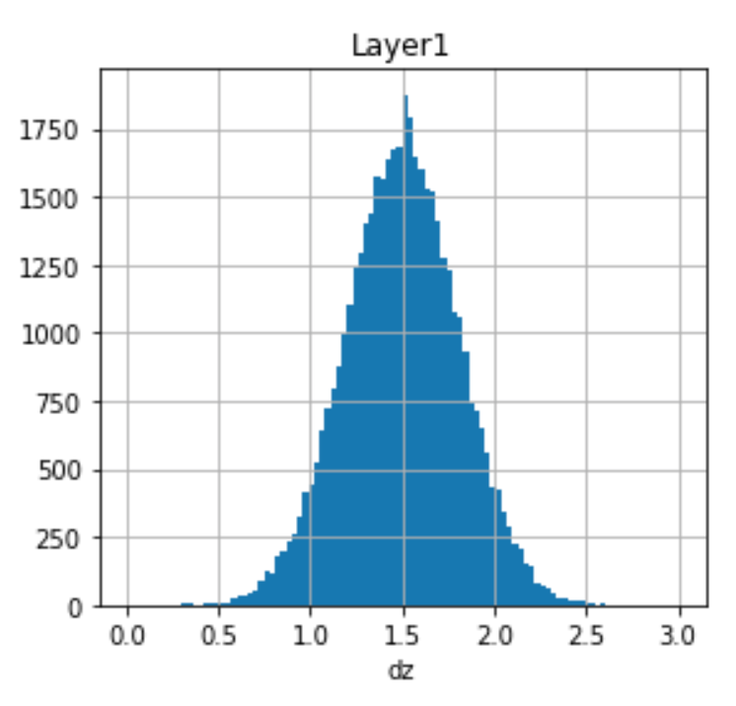
Cluster position and track trajectory
Input mis-alignment: dz = 1.5mm for layer1
expected
measured
Difference between red and blue dots

Slide 8
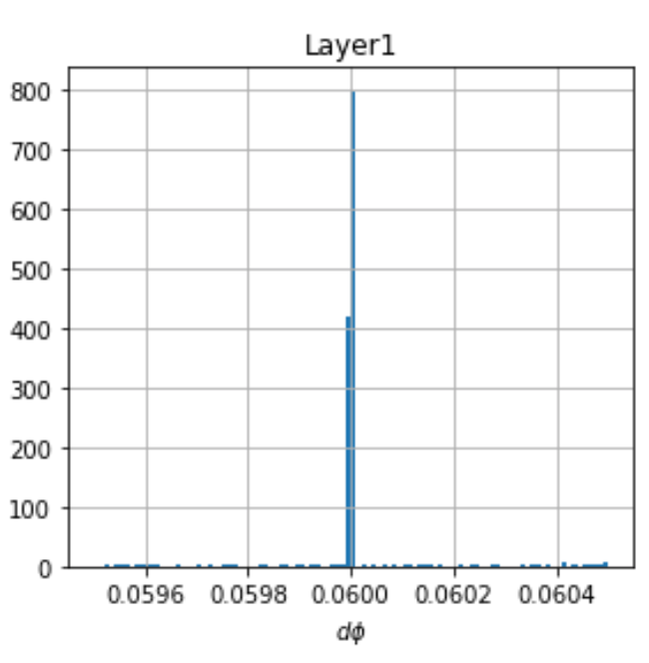

Cluster position and track trajectory
Input mis-alignment: $θ_{z}$ = 0.06 rad for layer1
Difference between red and blue dots

Slide 9
Constrain the outermost layer
Because the track parameters and the position of detector are all floated in the fit, the shift or rotation of whole system will produce an unstable fit result

Slide 10
Constrain the outermost layer
Because the track parameters and the position of detector are all floated in the fit, the shift or rotation of whole system will produce an unstable fit result
Outermost layer is fixed

Slide 11
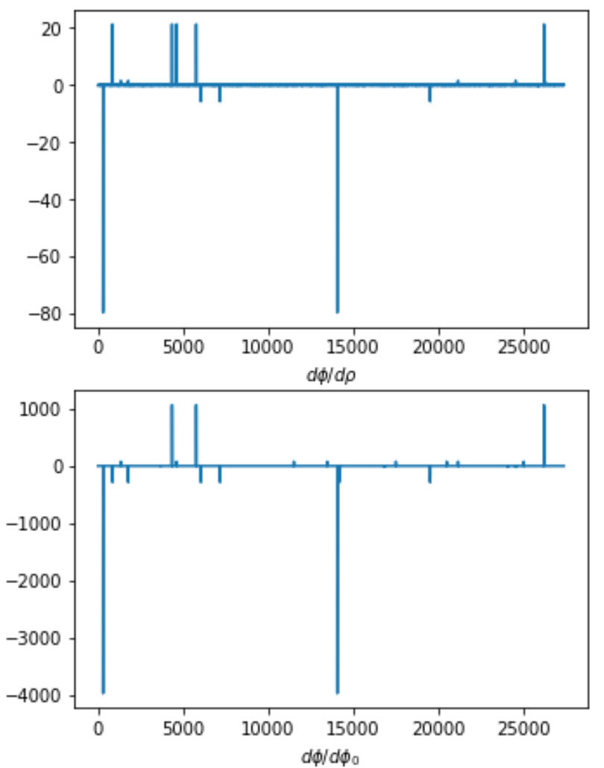
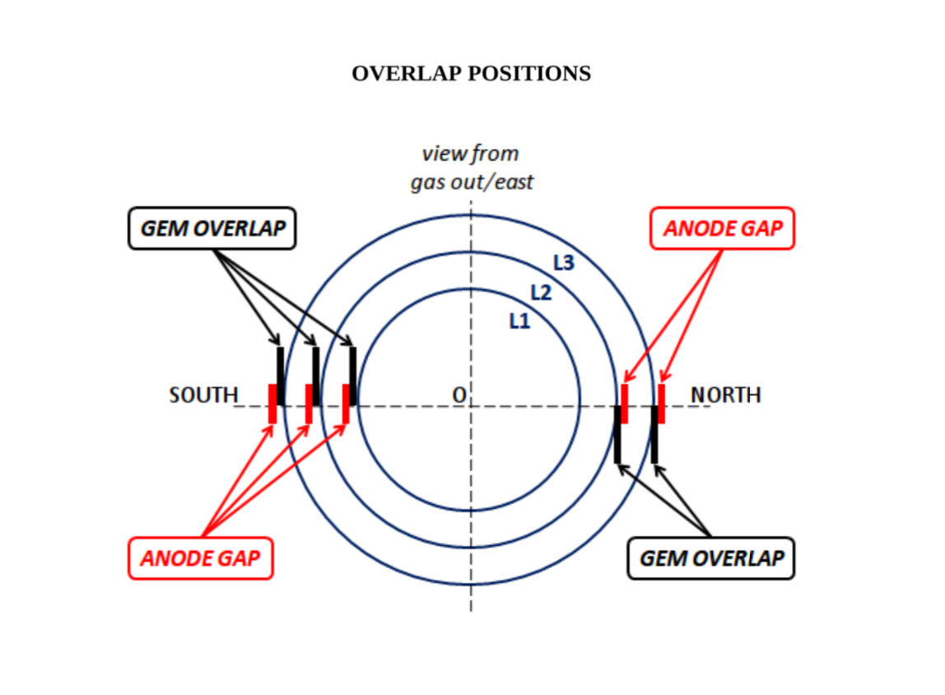
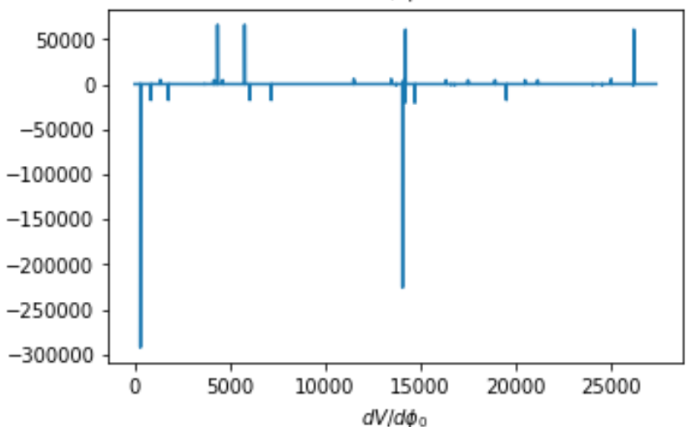


Check the derivatives
The abnormal derivatives are due to the discontinuous distribution of
$Φ$ at $φ$=0
$$φ$$

Slide 12

Check the derivatives
The abnormal derivatives are due to the discontinuous distribution of
$Φ$ at $φ$=0
V at $φ$=0 and $φ$=$π$
$$φ$$

Slide 13


Check the derivatives
The abnormal derivatives are due to the discontinuous distribution of
$Φ$ at $φ$=0
V at $φ$=0 and $φ$=$π$
$dρ\sim r$
$$dρ$$

Slide 14
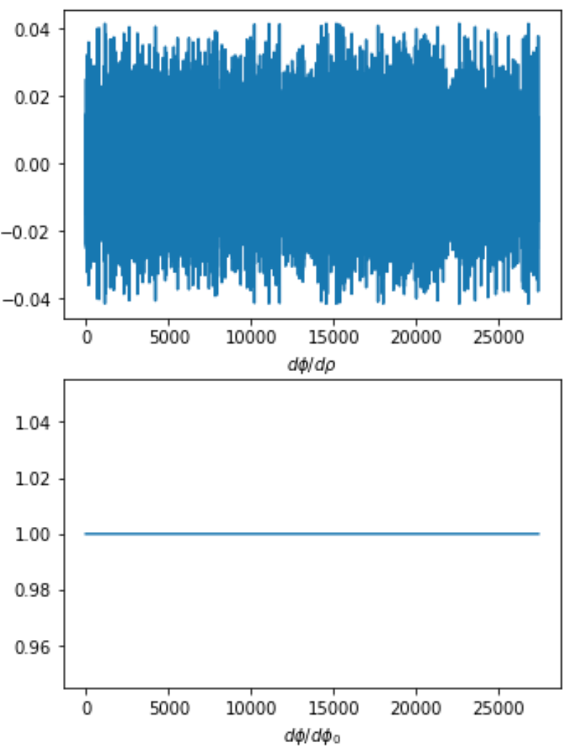
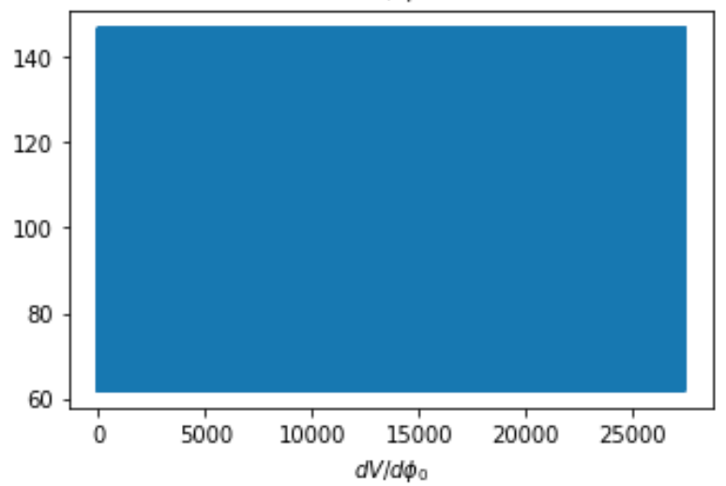
Check the derivatives
After filter

Slide 15
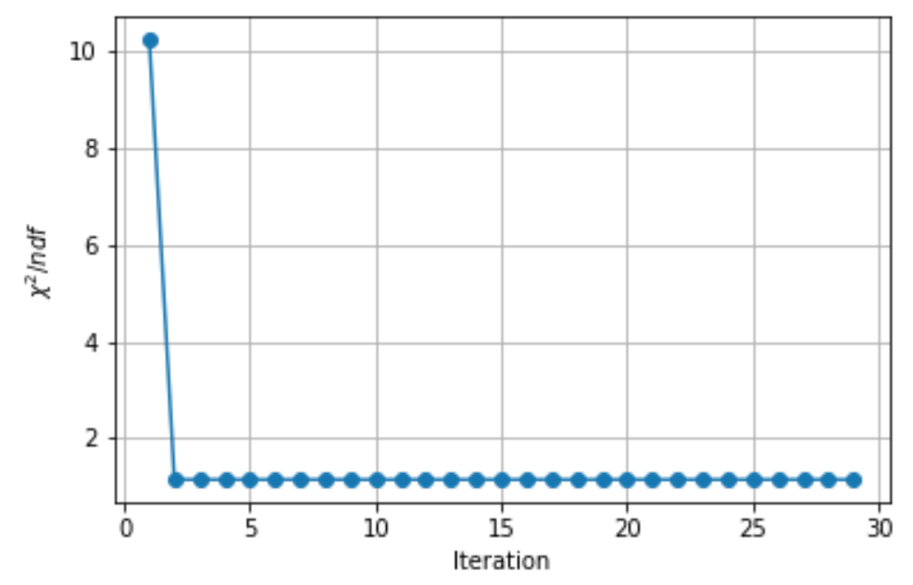
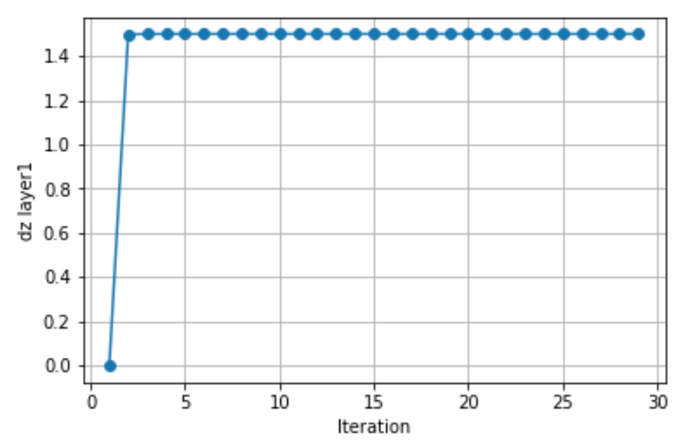
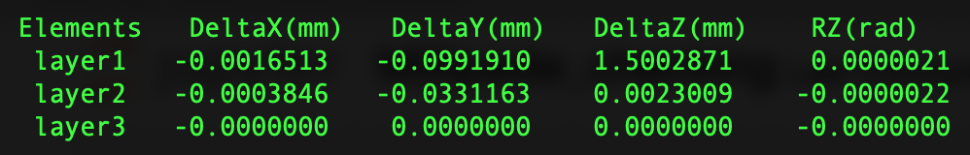
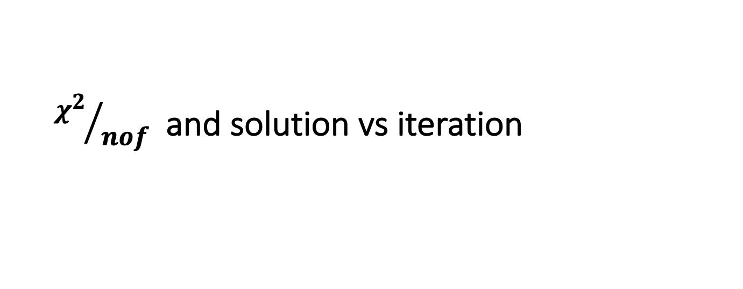
${χ^{2}}/{nof}$and solution vs iteration
~24000 tracks are used in the fit
Input dz = 1.5 mm
Output

Slide 16
Input output comparison and summary
Input output comparison (layer1)
Mis-alginment | Input (mm) | Output (mm) | Error (mm)
Shift in x | 2.0 | 2.0009 | 0.0008
Shift in y | 2.0 | 1.9010 | 0.002
Shift in z | 1.5 | 1.5003 | 0.002
Rotation around z | 0.06 | 0.0600 | 0.00001

Slide 17
Input output comparison and summary
Input output comparison (layer1)
Summary and outlook:
  Millipede alignment algorithm is tested with more MC
  Some improvements are made:
    Some parameters are optimized
    More constraint is applied
    Bad hits are removed
  Output results are consistent with the input!
  Next step: study more complex mis-alignment situations.
Mis-alginment | Input (mm) | Output (mm) | Error (mm)
Shift in x | 2.0 | 2.0009 | 0.0008
Shift in y | 2.0 | 1.9010 | 0.002
Shift in z | 1.5 | 1.5003 | 0.002
Rotation around z | 0.06 | 0.0600 | 0.00001

