Slide 1
Global tracking of pipiJ/psi
Zhen Huang
2019/08/29

Slide 2
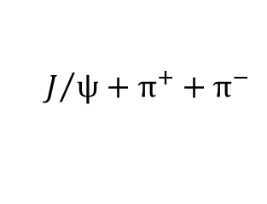

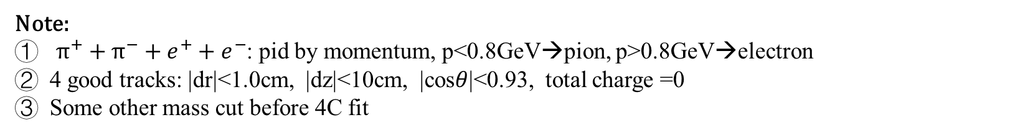
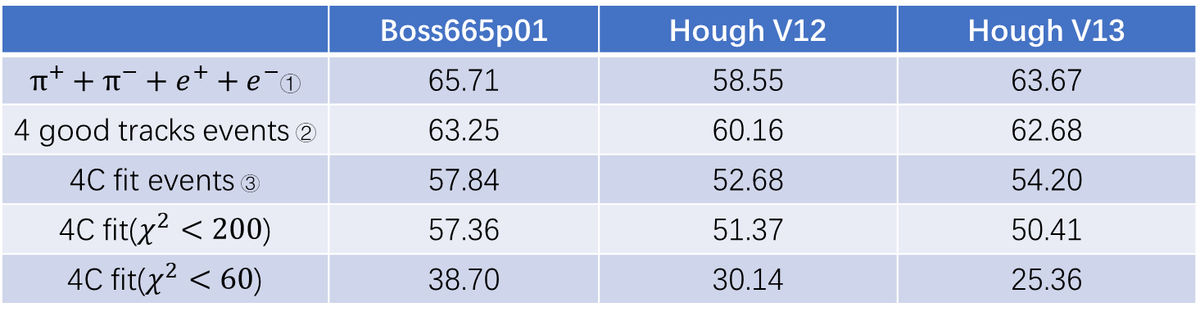

Compare Tracking Efficiency
$$ψ^{′}$$
$$J/ψ+π^{+}+π^{−}$$
Sample:
$$e^{+}+e^{−}$$
 | Boss665p01 | Hough V12 | Hough V13
$π^{+}+π^{−}+e^{+}+e^{−}$① | 65.71 | 58.55 | 63.67
4 good tracks events ② | 63.25 | 60.16 | 62.68
4C fit events ③ | 57.84 | 52.68 | 54.20
4C fit($χ^{2}<200$) | 57.36 | 51.37 | 50.41
4C fit($χ^{2}<60$) | 38.70 | 30.14 | 25.36
Note:
$π^{+}+π^{−}+e^{+}+e^{−}$: pid by momentum, p<0.8GeV→pion, p>0.8GeV→electron
4 good tracks: |dr|<1.0cm, |dz|<10cm, |cos$θ$|<0.93, total charge =0
Some other mass cut before 4C fit

Slide 3
Current Problem
Kalman filter failure
Memory leakage
In Hough V13, the global fitting is implemented 16 times more then in Hough V12 for each track, some dynamic data need to clear after each global fitting.
 | Boss665p01 | Hough V12 | Hough V13
Kalman filter failure tracks | 2.4% | 4.58% | 18.48%

