Slide 1
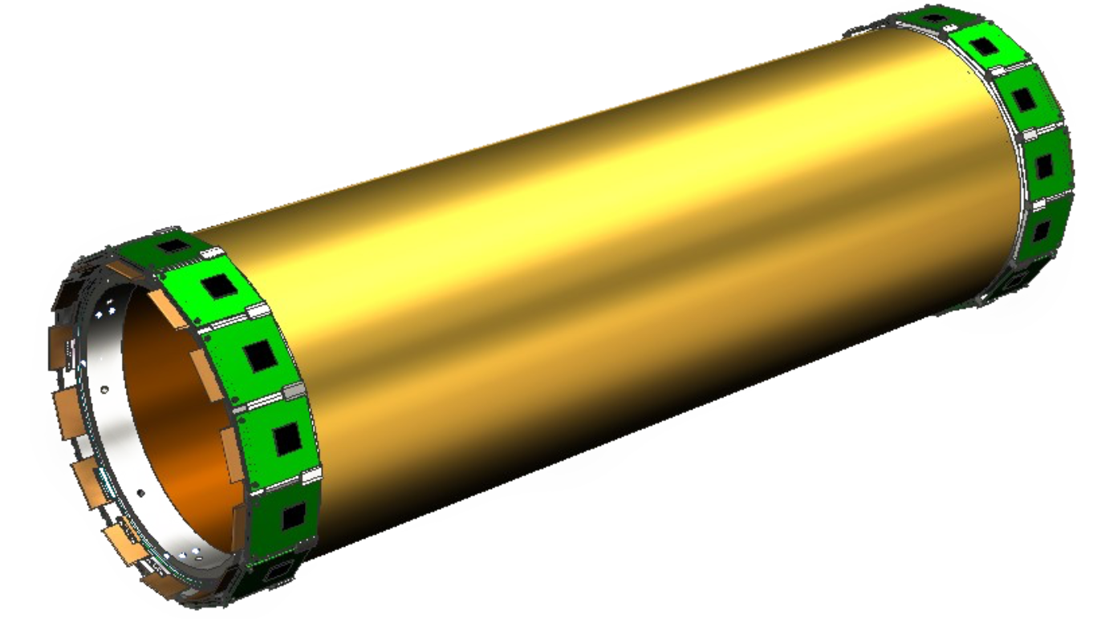
Progress of global tracking
Zhen Huang (PKU), Liangliang WANG (IHEP)
2019.12.10

Slide 2
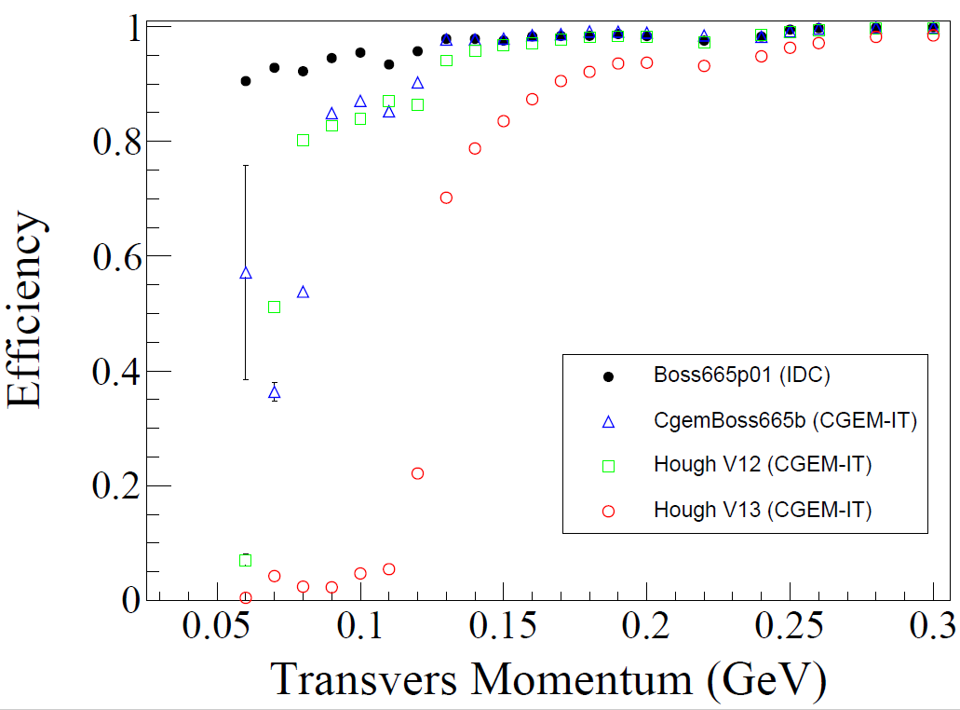
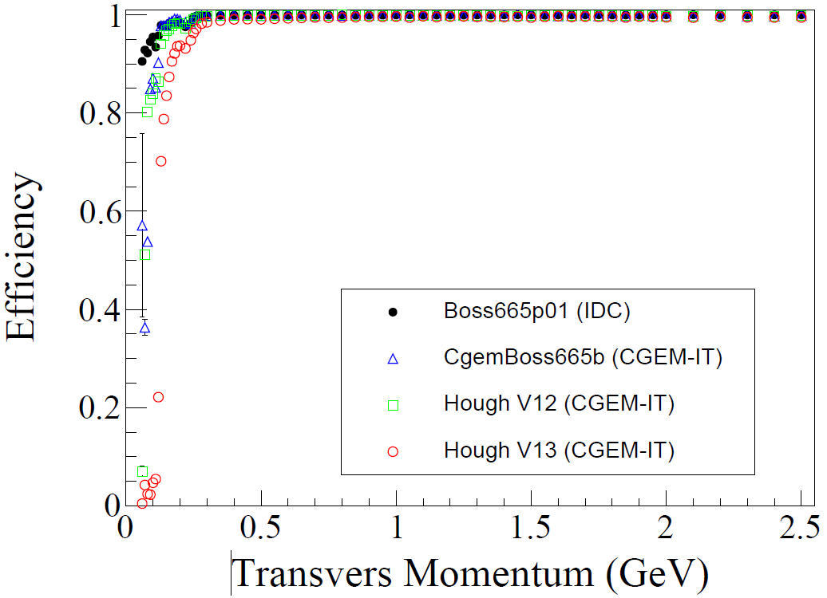
Kalman filter efficiency
Compare Kalman filter of good tracks
$efficiency=\frac{kalman filter success track number }{total good track number}$
Hough V13
The Kalman filter failure may be caused by the bad hits instead of poor initial track parameters, need further study.

Slide 3
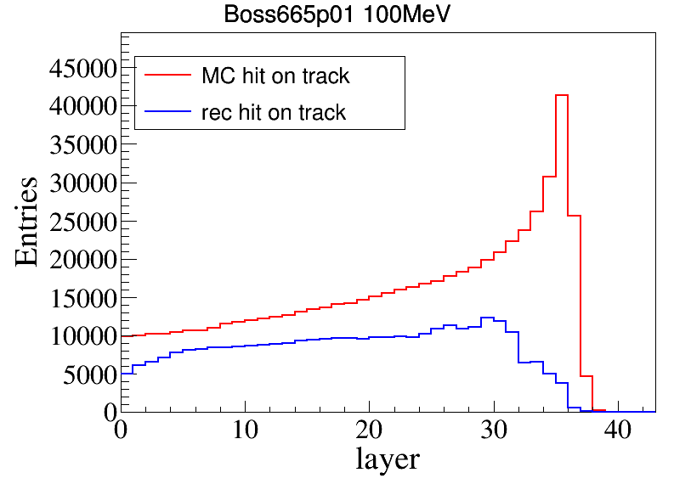
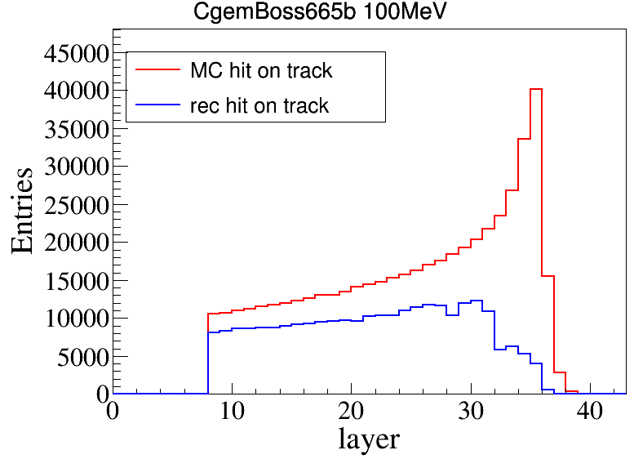
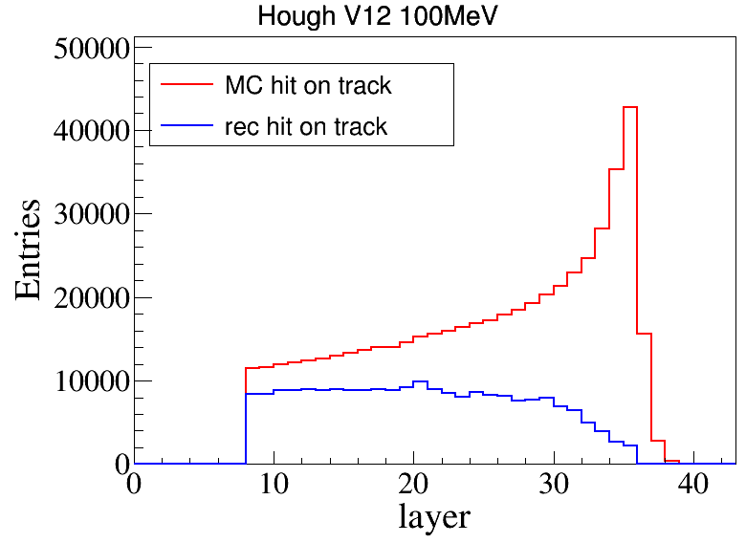
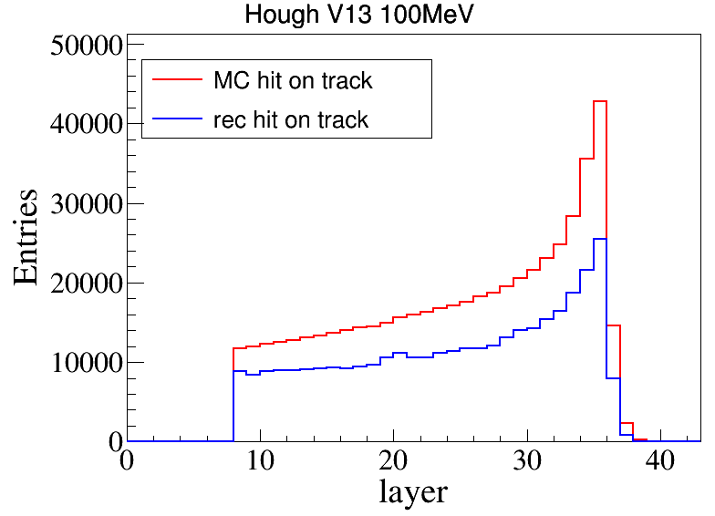
Hit distribution of each layer
$\left|V_{xy}\right|<1cm$, $\left|V_{z}\right|<10cm$, $\left|\cos{θ}\right|<0.93$，$Q_{rec}$= $Q_{truth}$
Hits is on the first half of the track circle in x-y plane

Slide 4
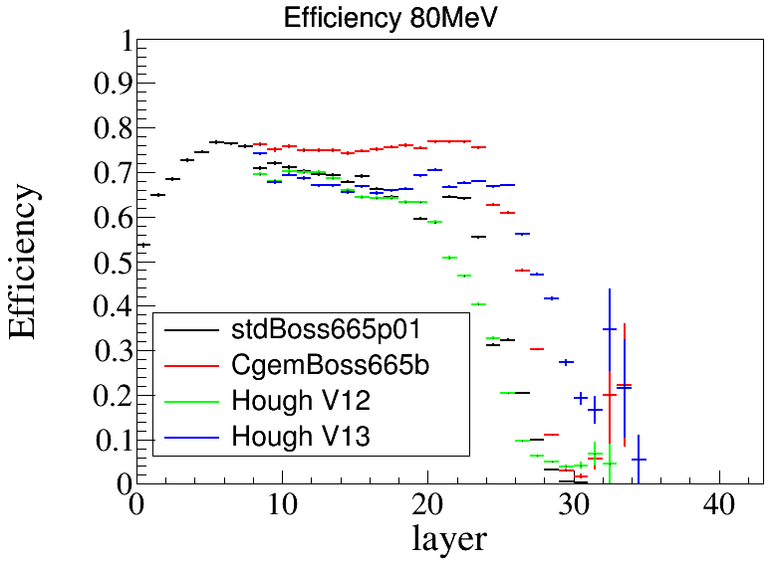
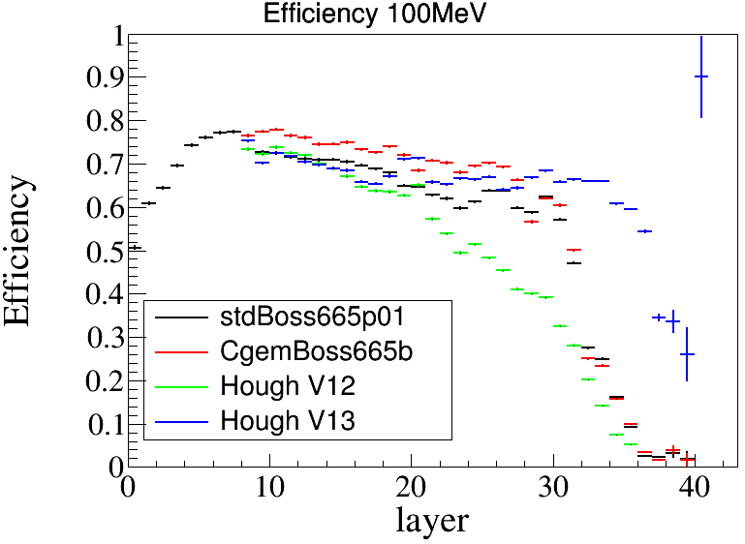
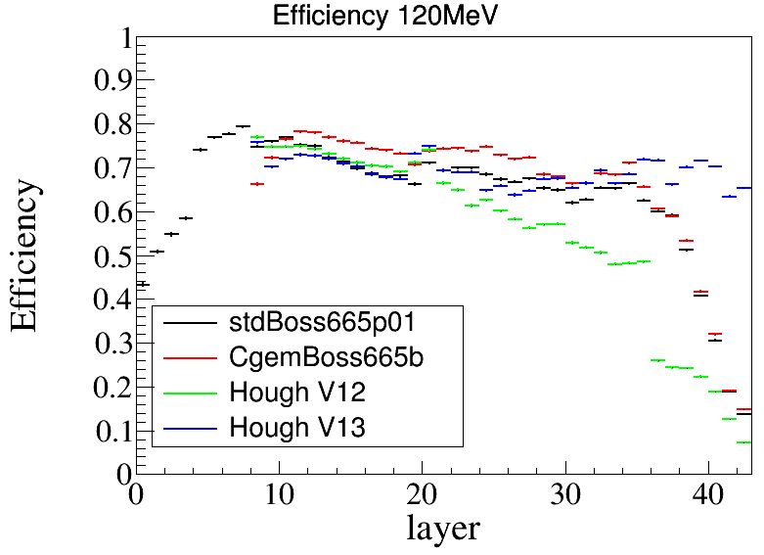
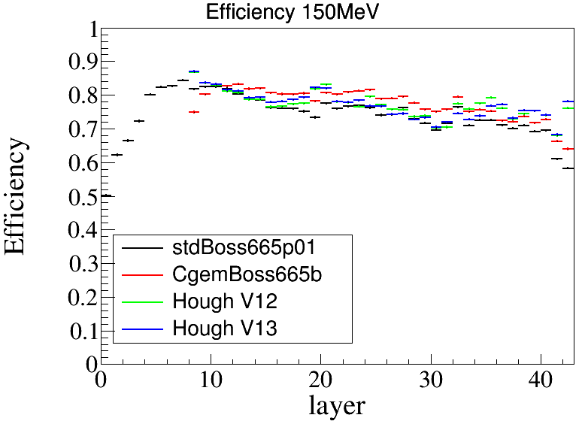
Hit efficiency of each layer

