Slide 1
Beam background simulation in CgemBoss
Influence of different levels of beam background on track reconstruction efficiencies

Slide 2
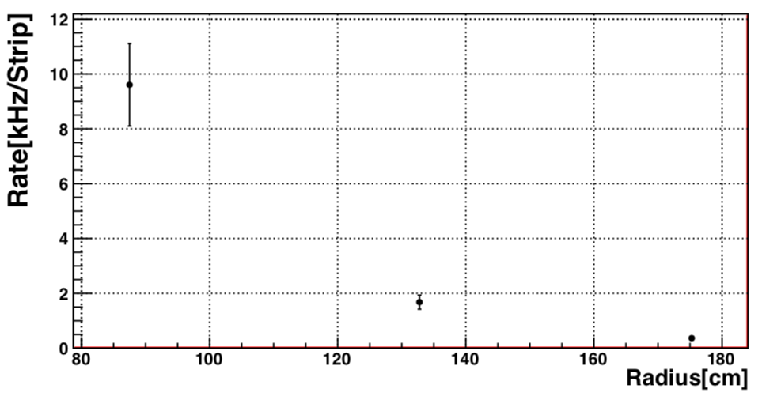
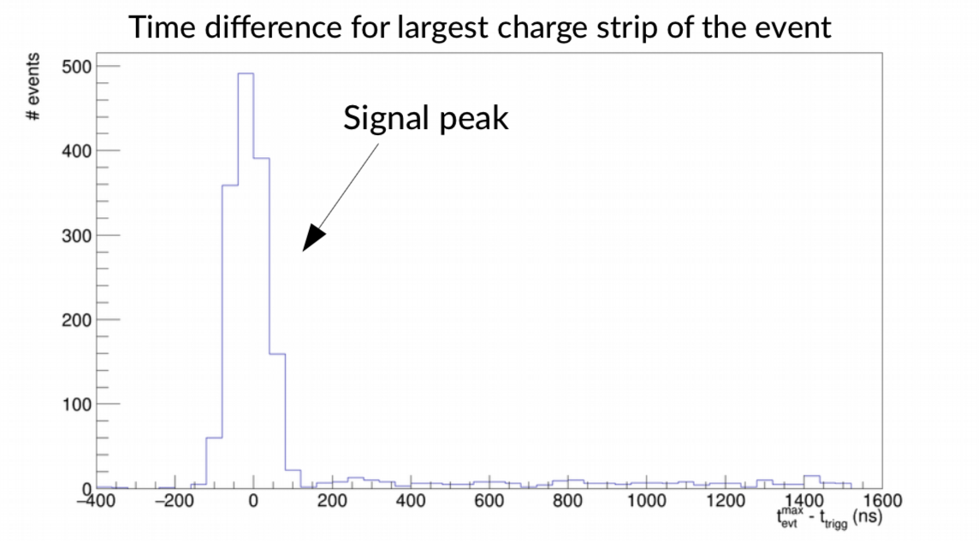
Beam background simulation
Simulate additional (random) background clusters
Probability of background clusters per event
$p=\left(background rate\right)∗(time window)$
Beam background rate per layer
Details: CGem CDR
Estimation based on beam background measurement of current chamber
Nominal estimate for 1th layer: $r_{1}=9.5$kHz/x-strip
Conservative estimate for 1th layer: $r_{1}=60$kHz/x-strip
Time window
Time resolution of CGEM
Intrinsic time spread of primary ionisation
Nominal: ${δt}_{1}=210ns$
Conservative: ${δt}_{1}=300ns$
Per event ~1-2 additional
clusters on the 1th layer
Beam background rate estimate
CGEM CDR
Layer 1
Layer 2
Layer 3
Neglect beam background in layer2+3
Giulio
preliminary + uncalibrated

Slide 3
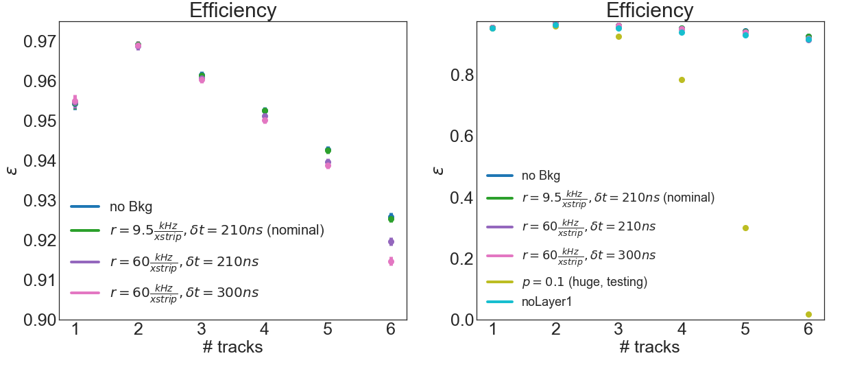
Effect on reconstruction efficiency
Sample reaction $e^{+}e^{−}→{\left(π^{±}\right)}^{N}$
$N∈[1;6]$ $π^{±}$ tracks
$\sqrt{s}=4.6 GeV$
Same momentum distribution
nTrk | noBkg | Nominal | Consv. | Consv2. | Huge | w/o layer1
--------------------------------------------------------------
1 0.954 0.954 0.955 0.955 0.953 0.954
2 0.969 0.969 0.969 0.969 0.959 0.964
3 0.962 0.961 0.961 0.96 0.927 0.953
4 0.953 0.953 0.951 0.95 0.784 0.939
5 0.943 0.943 0.94 0.939 0.302 0.93
6 0.926 0.925 0.92 0.915 0.017 0.917
$$σ\sim 0.01$$

Slide 4
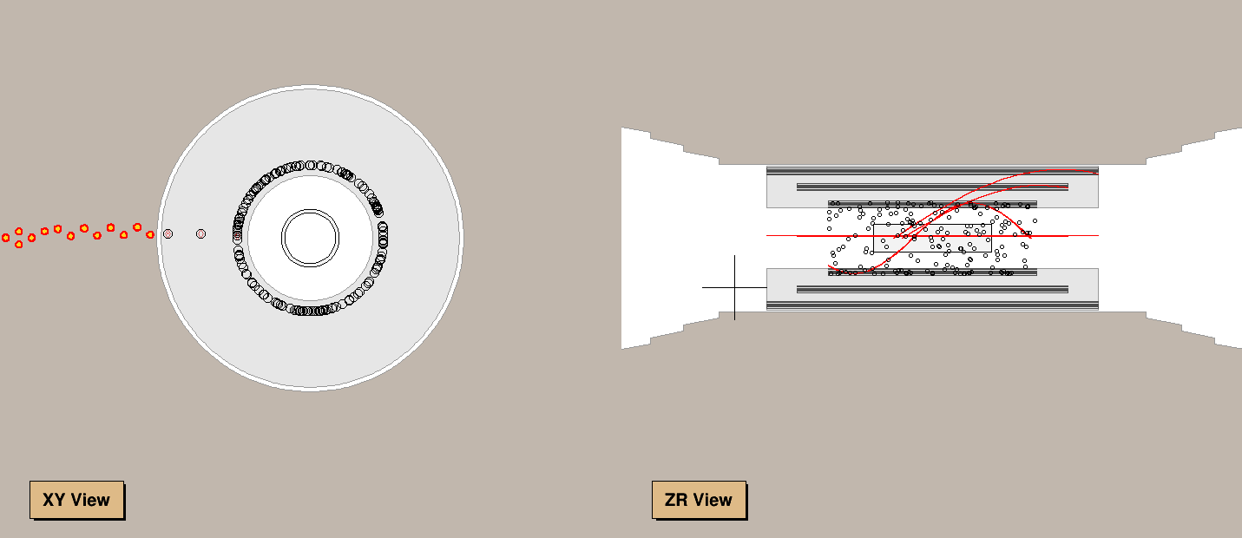
Implementation details
New algorithm CgemBeamBkg
Available in CVS, part of the next CgemBoss release
Add clusters random in (z,ϕ) to RecCgemClusterCol
Run after CgemClusterCreate, before MdcHoughFinder
Cross-check
Huge background $\left(p_{1},{ p}_{2}, p_{3}\right)=(0.1, 0, 0)$
Homogeneously distributed in (z,ϕ)
#include "$CGEMCLUSTERCREATEROOT/share/CgemClusterCreateOption.txt"
#include "$CGEMBEAMBKGROOT/share/jobOptions_CgemBeamBkg.txt" CgemBeamBkg.ProbLayer1=0.001995; //p1 default value
CgemBeamBkg.ProbLayer2=0.; //p2 default value
CgemBeamBkg.ProbLayer3=0.; //p3 default value
#include "$MDCHOUGHFINDERROOT/share/jobOptions_MdcHoughFinder.txt"
EventDisplay
π track

Slide 5
Summary
Nominal beam background expectation 1th layer : $r_{1}=9.5$kHz/x-strip, ${δt}_{1}=210ns$
Neglect layer 2 and 3
New algorithm CgemBeamBkg
Effect on reconstruction efficiency is negligible for low multiplicity events
and small for high multiplicity events

