Slide 1
Production of strange and charm hadrons in Quark Combination Model (QCM)
Fenglan Shao (邵凤兰)
Qufu Normal University (曲阜师范大学）
Phys. Lett. B 774 (2017) 516; Phys. Rev. D 96 (2017), 094010;
Eur. Phys. J. C 78 (2018) 344; Phys. Rev. C 97 (2018), 064915
Workshop on QCD Physics & Study of the QCD Phase Diagram and New-type Topologic Effect, Weihai , July, 17-25, 2019

Slide 2
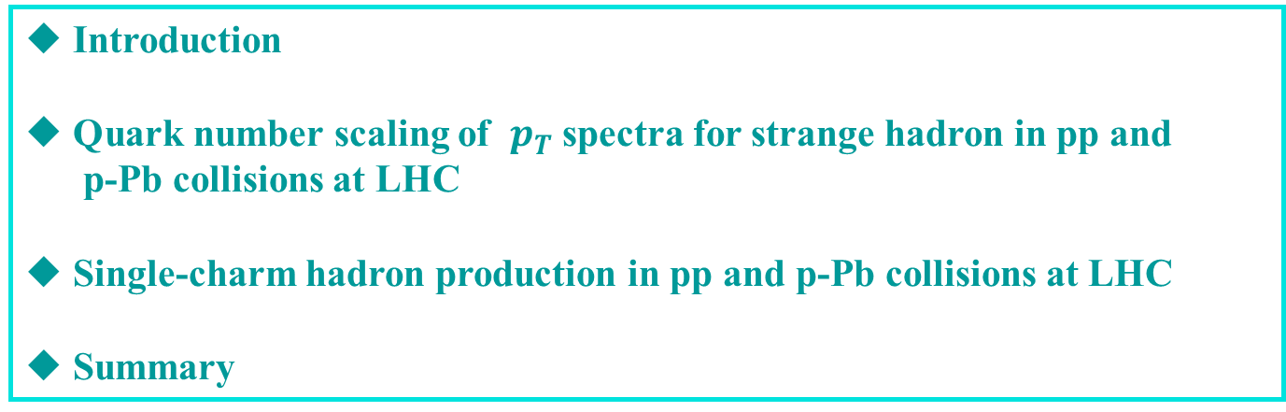
Outline
◆ Introduction
◆ Quark number scaling of $p_{T}$spectra for strange hadron in pp and
p-Pb collisions at LHC
◆ Single-charm hadron production in pp and p-Pb collisions at LHC
◆ Summary

Slide 3
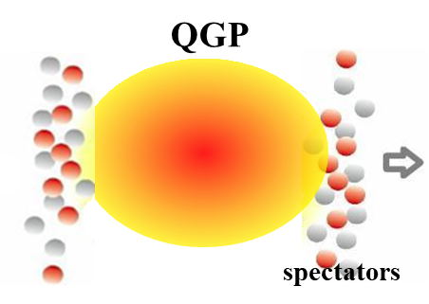
Introduction
AA
p-Pb
p-p
The features observed recently by ALICE, CMS, LHCb collaborations in high multiplicity events in pp and p-Pb collisions at LHC, e.g,
long range angular correlations (ridge), CMS JHEP1009(2010), CMS PLB718(2013),742(2015)
flow-like patterns, NPA932(14), CMS PLB742(2015),765(2017)
enhanced strangeness, ALICE Nature Phys.13(2017)
enhanced Baryon/meson ratios,
……
A core problem is whether Quark Gluon Plasma (QGP) is also formed in such small system in pp and p-Pb collisions.

Slide 4
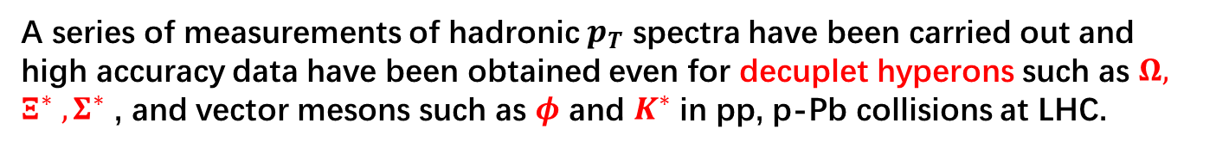
Introduction
A series of measurements of hadronic $p_{T}$ spectra have been carried out and high accuracy data have been obtained even for decuplet hyperons such as $Ω, Ξ^{∗} , Σ^{∗}$ , and vector mesons such as $φ$ and $K^{∗}$ in pp, p-Pb collisions at LHC.
It is of particular interest to see whether such data show any regularities that may lead to deeper insights into reaction mechanism.
Notes:
Because the decay influence is almost negligible, behaviors of such hadrons are usually believed as carrying more direct information from hadronization.

Slide 5
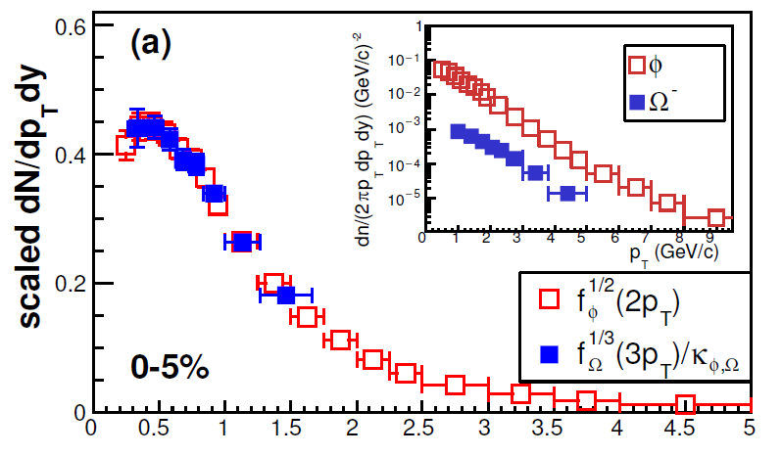
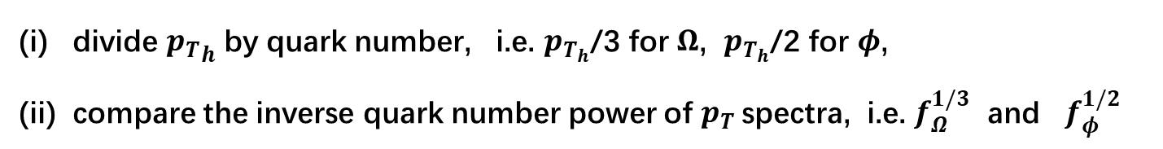




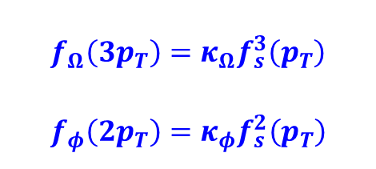
Quark number scaling of $p_{T}$spectra in p-Pb collisions at 5.02 TeV
J.Song, X.R.Gou, FLS, Z.T.Liang, Phys.Lett. B774(2017), 516
By looking at the midrapidity data on $p_{T}$ spectra of $Ω$ and $φ$
$$f\left(p_{T}\right)≡dN_{h}/dp_{T}dy$$
(i) divide ${p_{T}}_{h}$ by quark number, i.e. $p_{T_{h}}$/3 for $Ω$, $p_{T_{h}}$/2 for $φ$,
(ii) compare the inverse quark number power of $p_{T}$spectra, i.e. $f_{Ω}^{1/3}$ and $f_{φ}^{1/2}$
More precisely,
$$f_{Ω}^{1/3}\left(3p_{T}\right)=κ_{φ,Ω}f_{φ}^{1/2}(2p_{T})$$
in other words,
$$f_{Ω}\left(3p_{T}\right)=κ_{Ω}f_{s}^{3}\left(p_{T}\right)$$
$$f_{φ}\left({2p}_{T}\right)=κ_{φ}f_{s}^{2}\left(p_{T}\right)$$
where $κ$ is independent of $p_{T}$
p-Pb 5.02TeV
$p_{T}$(GeV/c)
ALICE data : Phys. Lett. B 758, 389(2016).
Eur. Phys. J. C76, 245 (2016)
We call this property the “quark number scaling ”
-----similar to that the elliptic flow
Notes:
The first important result is that we find that the pt spectra of hadrons exhibit a QNS property.
By looking at the mid-y data of the pt spectra of Omega and phi in pPb collisions at 5 TeV, do some operations on the data. (1) divide the measured pt bin by the quark number, that is, Omega’ pt is divided by 3, and phi pt by 2, (2) for the measured number density of Omega and phi, we take the inverse quark number power of the density, (3) divide 𝛀 data a constant to keep the same magnitude with that of 𝝓
The scaled data in high-multiplicity events in p-Pb collisions at 5 TeV are shown in this figure, we see that the scaled data for Omega and phi coincide with each other.
This scaling property can expressed by this mathematica relation, red one, or this form, the blue one, which may be more easily understood. Here fs(pt) denote the distribution function of s quark. Here kappa is constant.
We call this property as the quark number scaling, because it is very similar with that happened in elliptic flow of hadrons in heavy ion collisions.

Slide 6
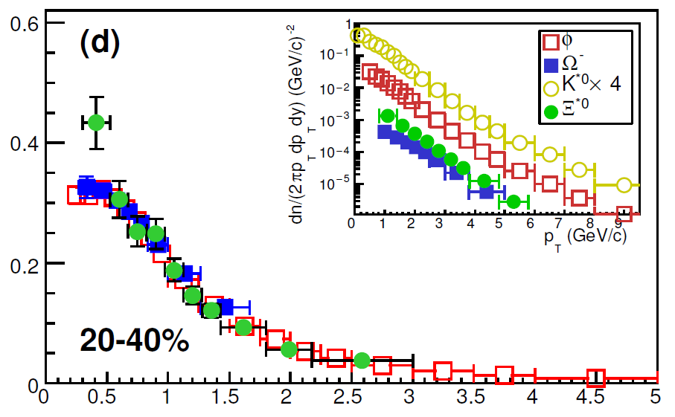
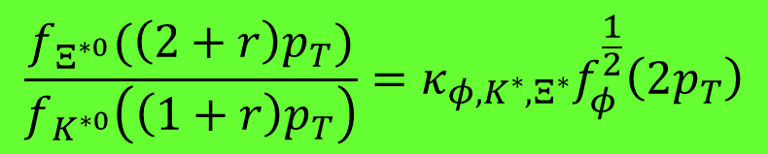


Quark number scaling of $p_{T}$spectra in p-Pb collisions at 5.02 TeV
For $Ξ^{∗0}(uss)$ and $K^{∗0}(d\overline{s})$, we also find
$$\frac{f_{Ξ^{∗0}}(\left(2+r\right)p_{T})}{f_{K^{∗0}}\left(\left(1+r\right)p_{T}\right)}=κ_{φ,K^{∗},Ξ^{∗}}f_{φ}^{\frac{1}{2}}\left(2p_{T}\right)$$
where $r≈2/3$
ALICE data, Eur. Phys. J. C77, 389(2017)

Slide 7
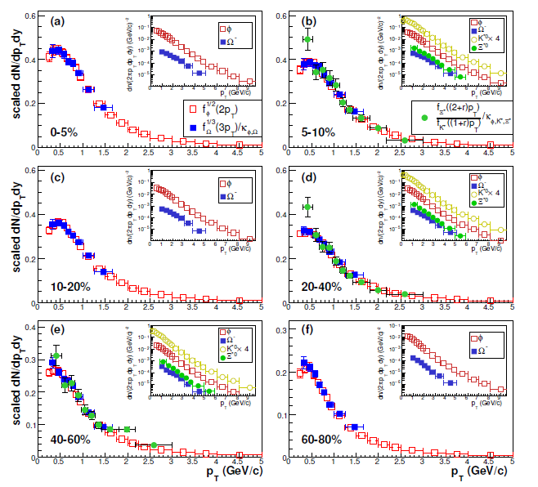

Slide 8
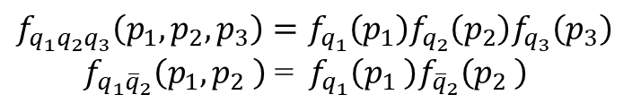
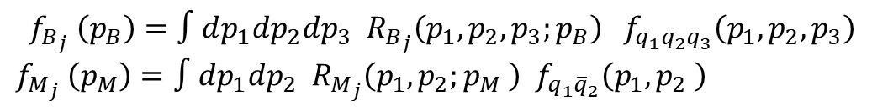
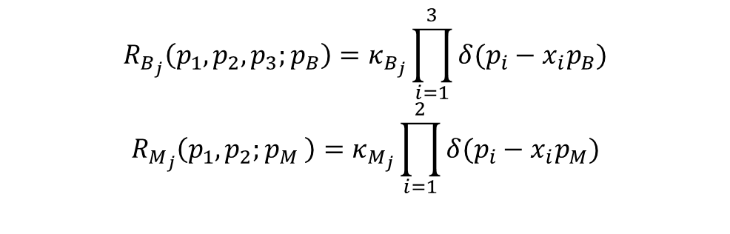
Quark Combination Model
Start from general formula
$$f_{B_{j}} \left(p_{B}\right)=∫dp_{1}dp_{2}dp_{3} R_{B_{j}}\left(p_{1},p_{2},p_{3};p_{B}\right) f_{q_{1}q_{2}q_{3}}\left(p_{1},p_{2},p_{3}\right)$$
$$f_{M_{j}} \left(p_{M}\right)=∫dp_{1}dp_{2} R_{M_{j}}\left(p_{1},p_{2};p_{M} \right) f_{q_{1}{\overline{q}}_{2}}\left(p_{1},p_{2} \right)$$
Assume independent distribution of (anti-)quarks
$$f_{q_{1}q_{2}q_{3}}\left(p_{1},p_{2},p_{3}\right)=f_{q_{1}}\left(p_{1}\right)f_{q_{2}}\left(p_{2}\right)f_{q_{3}}\left(p_{3}\right)$$
$f_{q_{1}{\overline{q}}_{2}}\left(p_{1},p_{2} \right)$ =$f_{q_{1}}\left(p_{1} \right)f_{{\overline{q}}_{2}}\left(p_{2} \right)$
Suppose the combination takes place mainly for quark and/or antiquark that takes a given fraction of momentum of the hadron,
$$R_{B_{j}}\left(p_{1},p_{2},p_{3};p_{B}\right)=κ_{B_{j}}\prod_{i=1}^{3}{δ(p_{i}−x_{i}p_{B})}$$
$$R_{M_{j}}\left(p_{1},p_{2};p_{M} \right)=κ_{M_{j}}\prod_{i=1}^{2}{δ(p_{i}−x_{i}p_{M})}$$

Slide 9
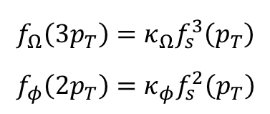
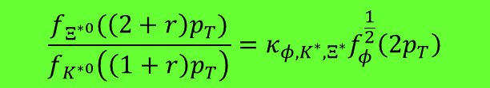
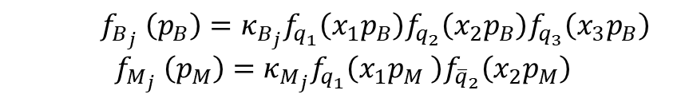
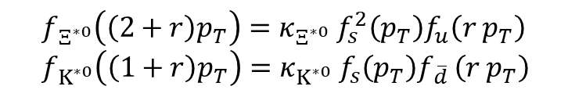
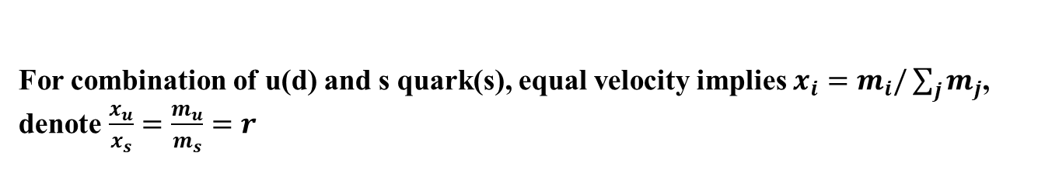

We obtain
$f_{B_{j}} \left(p_{B}\right)=κ_{B_{j}}f_{q_{1}}\left(x_{1}p_{B}\right)f_{q_{2}}\left(x_{2}p_{B}\right)f_{q_{3}}\left(x_{3}p_{B}\right)$
$$f_{M_{j}} \left(p_{M}\right)=κ_{M_{j}}f_{q_{1}}\left(x_{1}p_{M} \right)f_{{\overline{q}}_{2}}\left(x_{2}p_{M}\right)$$
which directly leads to
$$f_{Ω}\left(3p_{T}\right)=κ_{Ω}f_{s}^{3}\left(p_{T}\right)$$
$$f_{φ}\left({2p}_{T}\right)=κ_{φ}f_{s}^{2}\left(p_{T}\right)$$
$$f_{Ω}^{\frac{1}{3}}\left(3p_{T}\right)=κ_{φ,Ω}f_{φ}^{\frac{1}{2}}(2p_{T})$$
For combination of u(d) and s quark(s), equal velocity implies $x_{i}=m_{i}/\sum_{j}{m_{j}}$,
denote $\frac{x_{u}}{x_{s}}=\frac{m_{u}}{m_{s}}=r$
$$f_{Ξ^{∗0}}\left(\left(2+r\right)p_{T}\right)=κ_{Ξ^{∗0}} f_{s}^{2}\left(p_{T}\right)f_{u}\left(r p_{T}\right)$$
$f_{K^{∗0}}\left(\left(1+r\right)p_{T}\right)=κ_{K^{∗0}} f_{s}\left(p_{T}\right)f_{\overline{d} }\left(r p_{T}\right)$
$$\frac{f_{Ξ^{∗0}}(\left(2+r\right)p_{T})}{f_{K^{∗0}}\left(\left(1+r\right)p_{T}\right)}=κ_{φ,K^{∗},Ξ^{∗}}f_{φ}^{\frac{1}{2}}\left(2p_{T}\right)$$
$r≈2/3$ if we take $m_{s}=500$ MeV and $m_{u}=m_{d}=330$ MeV.

Slide 10
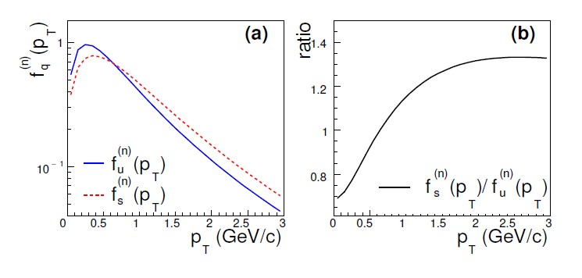
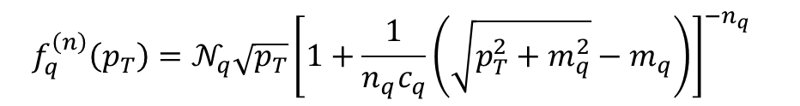

Extraction of quark $p_{T}$ spectra from the data
$$f_{q}^{\left(n\right)}\left(p_{T}\right)=𝒩_{q}\sqrt{p_{T}}{\left[1+\frac{1}{n_{q}c_{q}}\left(\sqrt{p_{T}^{2}+m_{q}^{2}}−m_{q}\right)\right]}^{{−n_{q}}_{}}$$

Slide 11
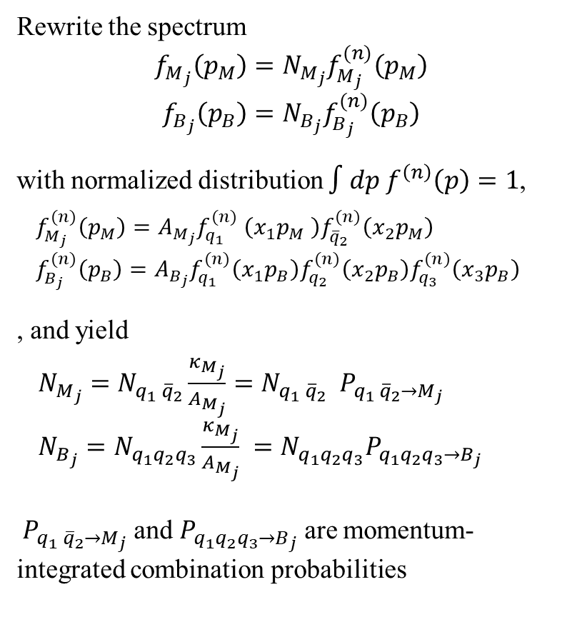
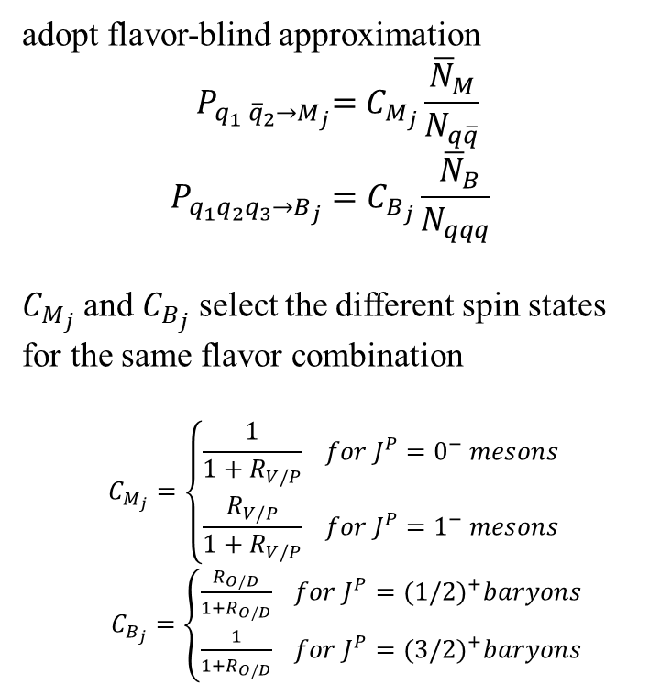
Rewrite the spectrum
$$f_{M_{j}}\left(p_{M}\right)=N_{M_{j}}f_{M_{j}}^{(n)}\left(p_{M}\right)$$
$$f_{B_{j}}\left(p_{B}\right)=N_{B_{j}}f_{B_{j}}^{(n)}\left(p_{B}\right)$$
with normalized distribution $∫dp f^{\left(n\right)}\left(p\right)=1$,
$f_{M_{j}}^{(n)}\left(p_{M}\right)=A_{M_{j}}f_{q_{1}}^{(n)} \left(x_{1}p_{M} \right)f_{{\overline{q}}_{2}}^{(n)}\left(x_{2}p_{M}\right)$
$f_{B_{j}}^{(n)}\left(p_{B}\right)=A_{B_{j}}f_{q_{1}}^{(n)}\left(x_{1}p_{B}\right)f_{q_{2}}^{(n)}\left(x_{2}p_{B}\right)f_{q_{3}}^{(n)}\left(x_{3}p_{B}\right)$
, and yield
$N_{M_{j}}=N_{q_{1} {\overline{q}}_{2}}\frac{κ_{M_{j}}}{A_{M_{j}}}=N_{q_{1} {\overline{q}}_{2}} { P}_{q_{1} {\overline{q}}_{2}→M_{j}}$
$N_{B_{j}}=N_{q_{1}q_{2}q_{3}}\frac{κ_{M_{j}}}{A_{M_{j}}} =N_{q_{1}q_{2}q_{3}}P_{q_{1}q_{2}q_{3}→B_{j}}$
${ P}_{q_{1} {\overline{q}}_{2}→M_{j}}$ and $P_{q_{1}q_{2}q_{3}→B_{j}}$ are momentum-integrated combination probabilities
adopt flavor-blind approximation
$${ P}_{q_{1} {\overline{q}}_{2}→M_{j}}=C_{M_{j}}\frac{{\overline{N}}_{M}}{N_{q\overline{q}}}$$
$$P_{q_{1}q_{2}q_{3}→B_{j}}=C_{B_{j}}\frac{ {\overline{N}}_{B}}{N_{qqq}}$$
$C_{M_{j}}$ and $C_{B_{j}}$ select the different spin states for the same flavor combination
$$C_{M_{j}}=\left\{\begin{aligned}\frac{1}{1+R_{V/P}} for J^{P}=0^{−} mesons \\ \frac{R_{V/P}}{1+R_{V/P}} for J^{P}=1^{−} mesons\end{aligned}\right.$$
$C_{B_{j}}=\left\{\begin{aligned}\frac{R_{O/D}}{1+R_{O/D}} for J^{P}={(1/2)}^{+}baryons \\ \frac{1}{1+R_{O/D}} for J^{P}={(3/2)}^{+}baryons\end{aligned}\right.$
Notes:
We can reformulate the hadron momentum distribution and , we introduce few parameter for the unclear NP-QCD dynamics in combination kernels. Here, we para R_V/P denotes the relative ratio of vector meson to pseudo-scalar meson of the same quark content.
And a para R_O/D to denote the relative ratio of Octet baryon to Decuplet bayons of the same quark content.
Their values are taken from previous works.

Slide 12
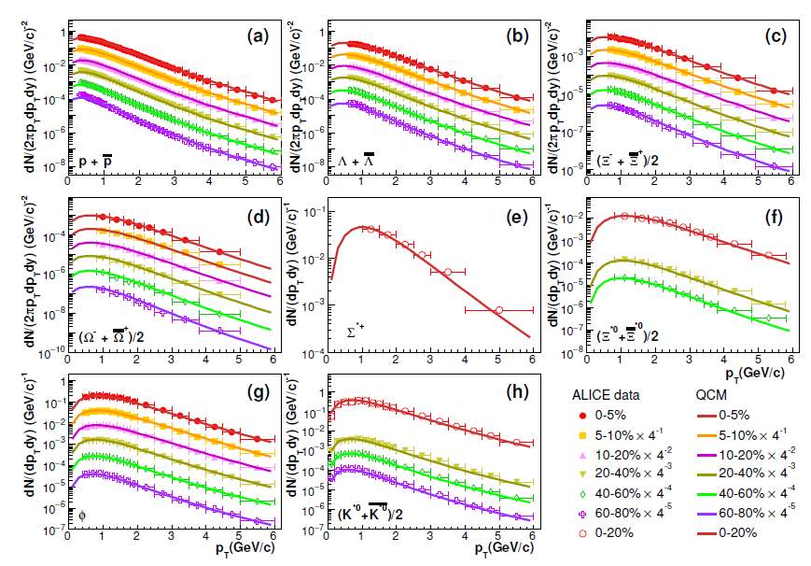

Slide 13
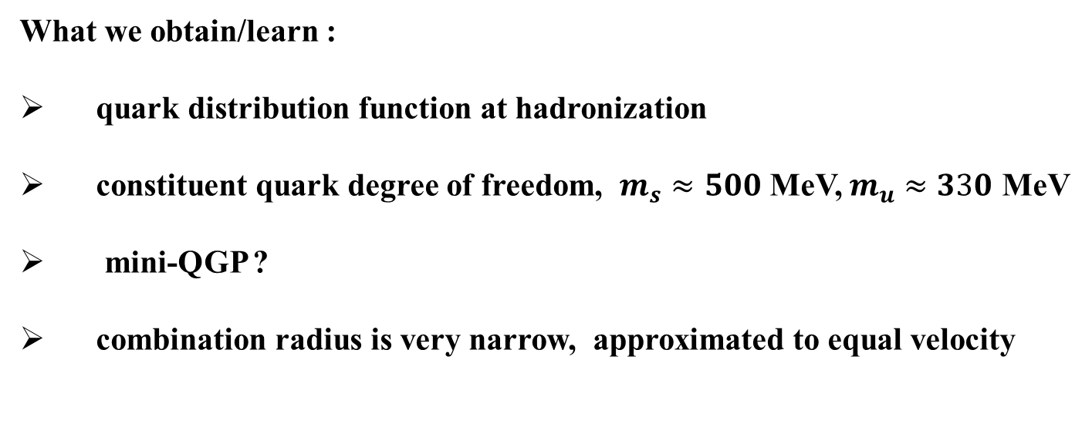
What we obtain/learn :
quark distribution function at hadronization
constituent quark degree of freedom, $m_{s}≈500$ MeV, $m_{u}≈330$ MeV
mini-QGP ?
combination radius is very narrow, approximated to equal velocity

Slide 14
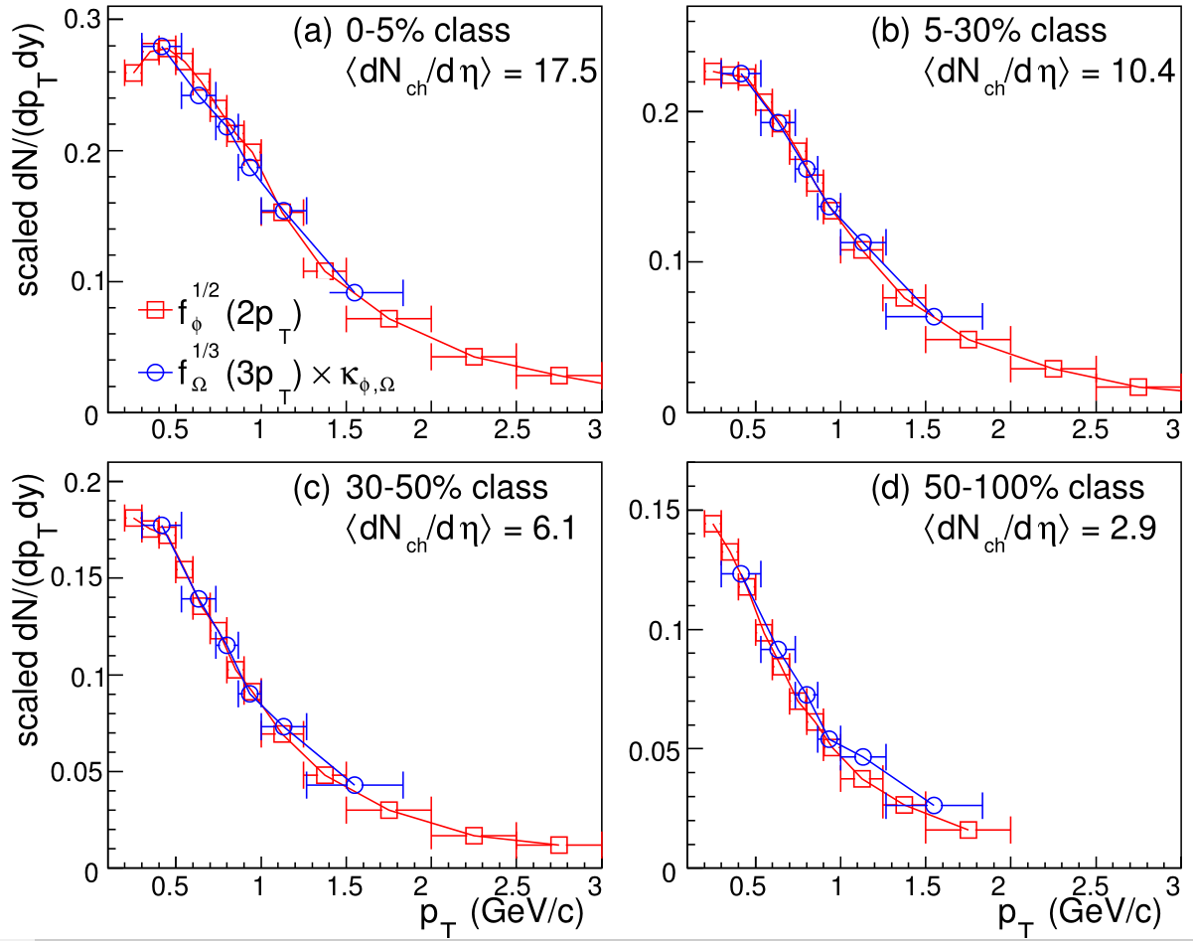
Strange hadron production in pp collisions at 7 TeV
X.R.Gou, FLS, J.Song, et al, Phys.Rev.D 96 (2017), 094010
pp at 7TeV
pp at 7TeV
high multiplicity events
QNS holds well
pp at 7TeV
pp at 7TeV
small multiplicity events
QNS is broken
Notes:
We also check the scaling property in pp collisions at 7 TeV, we also see that in high multiplicity events QNS hold very well, and in small multiplicity events QNS is broken to a certain extent.
Here we emphasize that the broken may be related to the threshold effects of small strange quark number in such small multiplicity events.

Slide 15
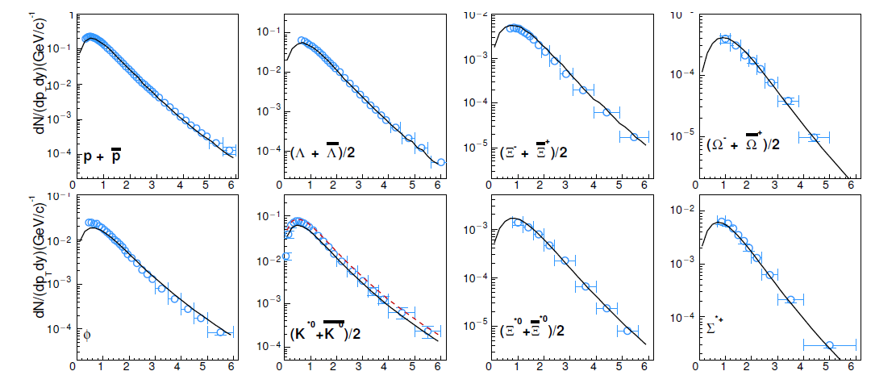
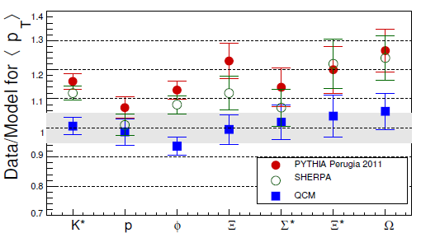
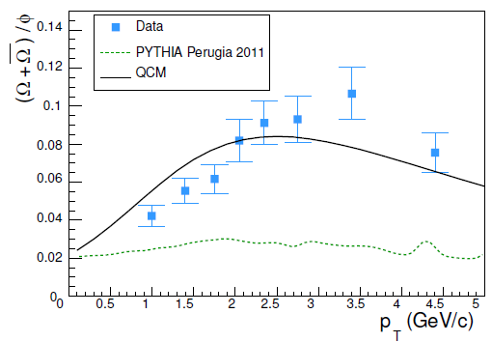

Minimum bias events
$p_{T}$(GeV/c)
Notes:
Here are results in pp coll at 7 TeV, minimum-bias events.
This figure is single-hadorn pt spectra. This is average pt, we see that the QCM deviation from the data is small than that in pythia kinds of models.
The right figure show Omg/phi ration, we see that QCM can describe the bump structure at intermediate pt, also we note that fragmentation fails to explain this feature.

Slide 16
hadrons in different multiplicity classes in pp collisions at 7 TeV
Notes:
This figure is single-hadorn pt spectra. This is average pt, we see that the QCM deviation from the data is small than that in pythia kinds of models.
The right figure show Omg/phi ration, we see that QCM can describe the bump structure at intermediate pt, also we note that fragmentation fails to explain this feature.

Slide 17
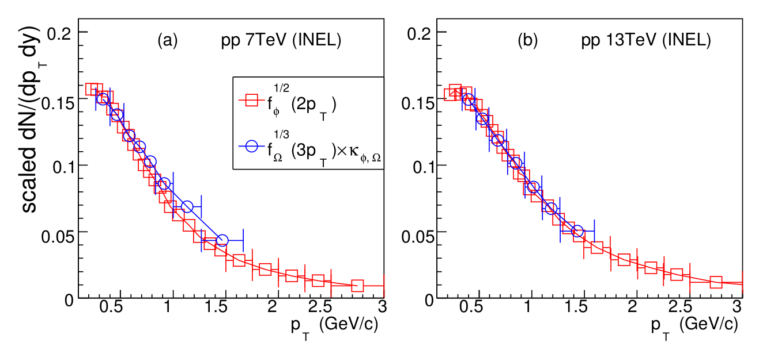
Strange hadron production in pp collisions at 13 TeV
J.W.Zhang, FLS, J.Song, arXiv:1811.00975
Scaling property in pp collisions at different collision energies
Notes:
Finally, we check the scaling property in pp coll at different coll energies, the left is the scaled data in inelastic events in pp 7 TeV and the right fig is that at 13 TeV,
We see that QNS holds better at 13 TeV,

Slide 18
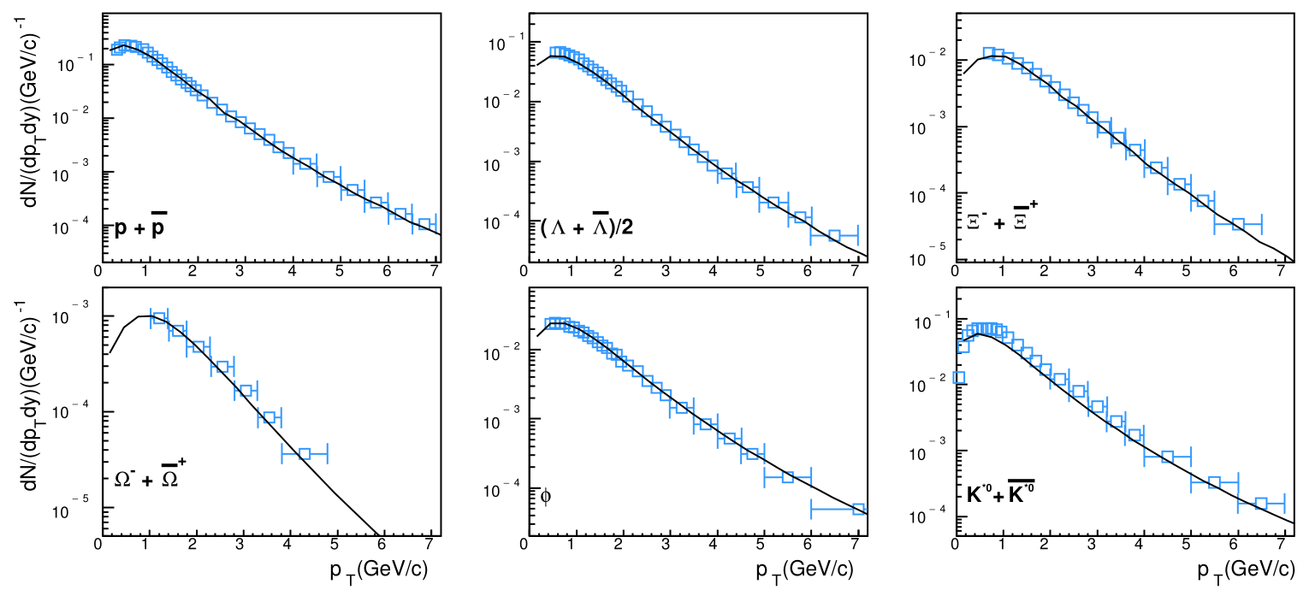
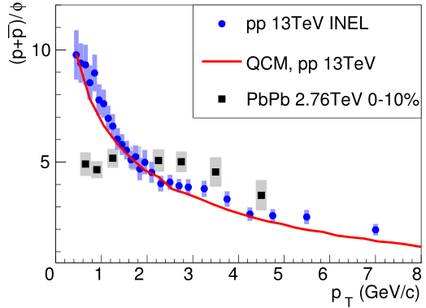
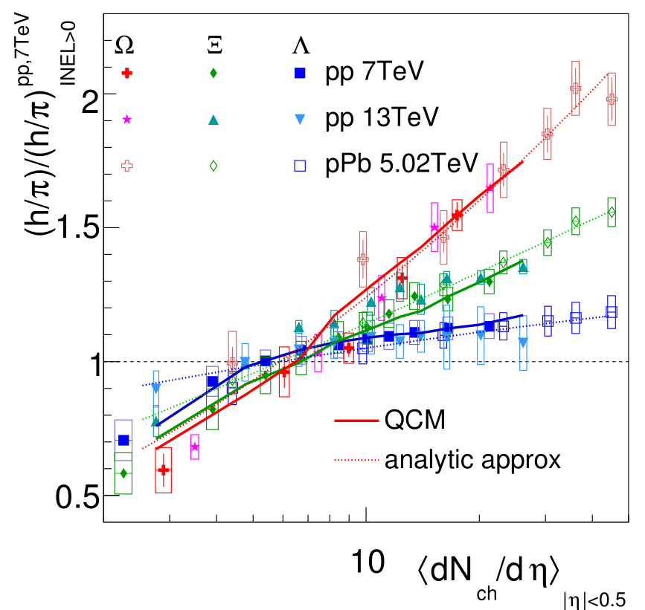
Notes:
hierarchy
This is our latest results in pp at 13 TeV, This figure is single-hadron pt spectra, we see that QCM can explain the data, and the agreement is better than that in pp at 7 TeV.
This figure show the ratio of proton to phi, the two hadrons have similar masses, and the rapid change of ratio as function of pt show that their production should be more related to their quark contents not by their masses as in statistical model and hydro model.
This right figure show the double ratio of hyperon relative to pion, we emphasize that the measured hirerarchy structure among Lambda, Xi, Omega, see data here, can be naturally explained by QCM.

Slide 21
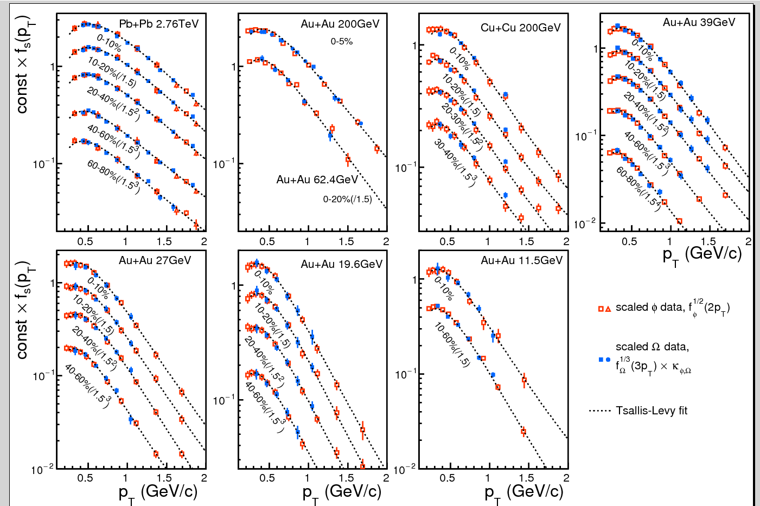
AA反应中的标度性
Jun Song, FLS, Z.T. Liang, In progress

Slide 22
Charm quark hadronization by combining soft light-flavor quarks !

Slide 23
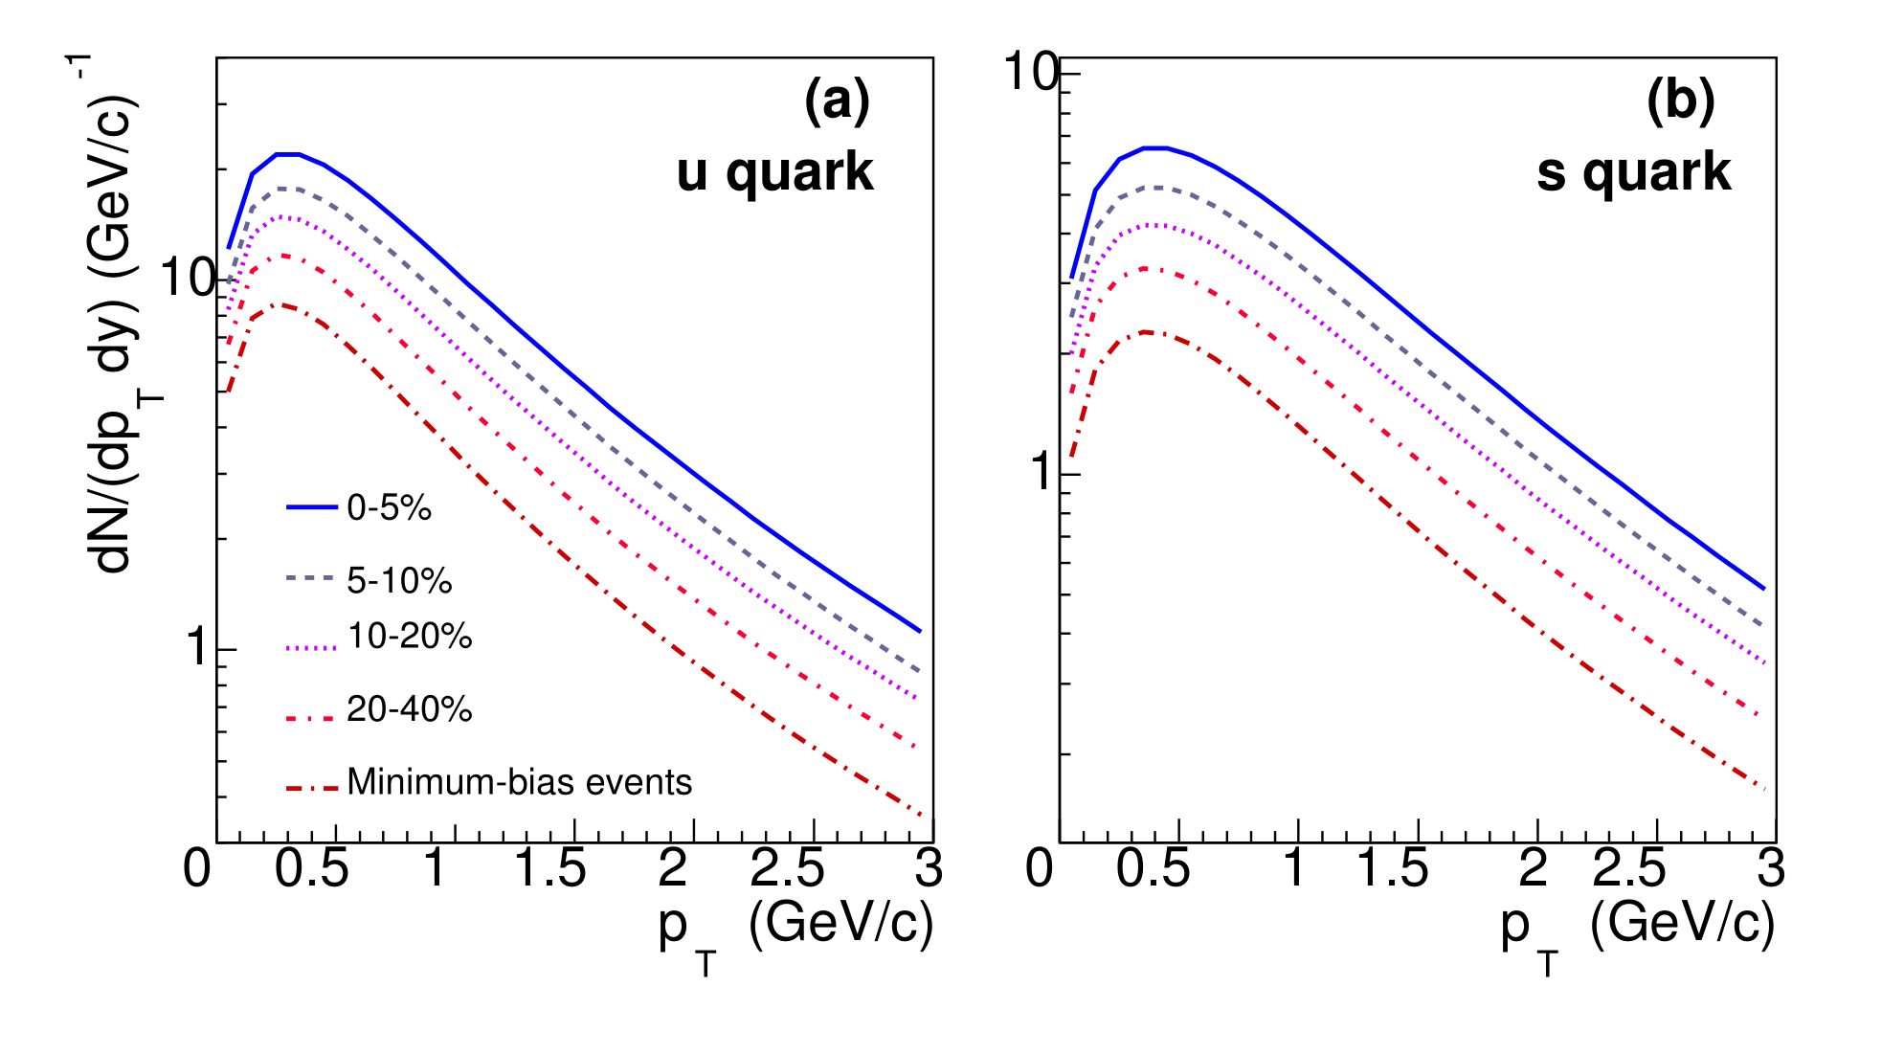
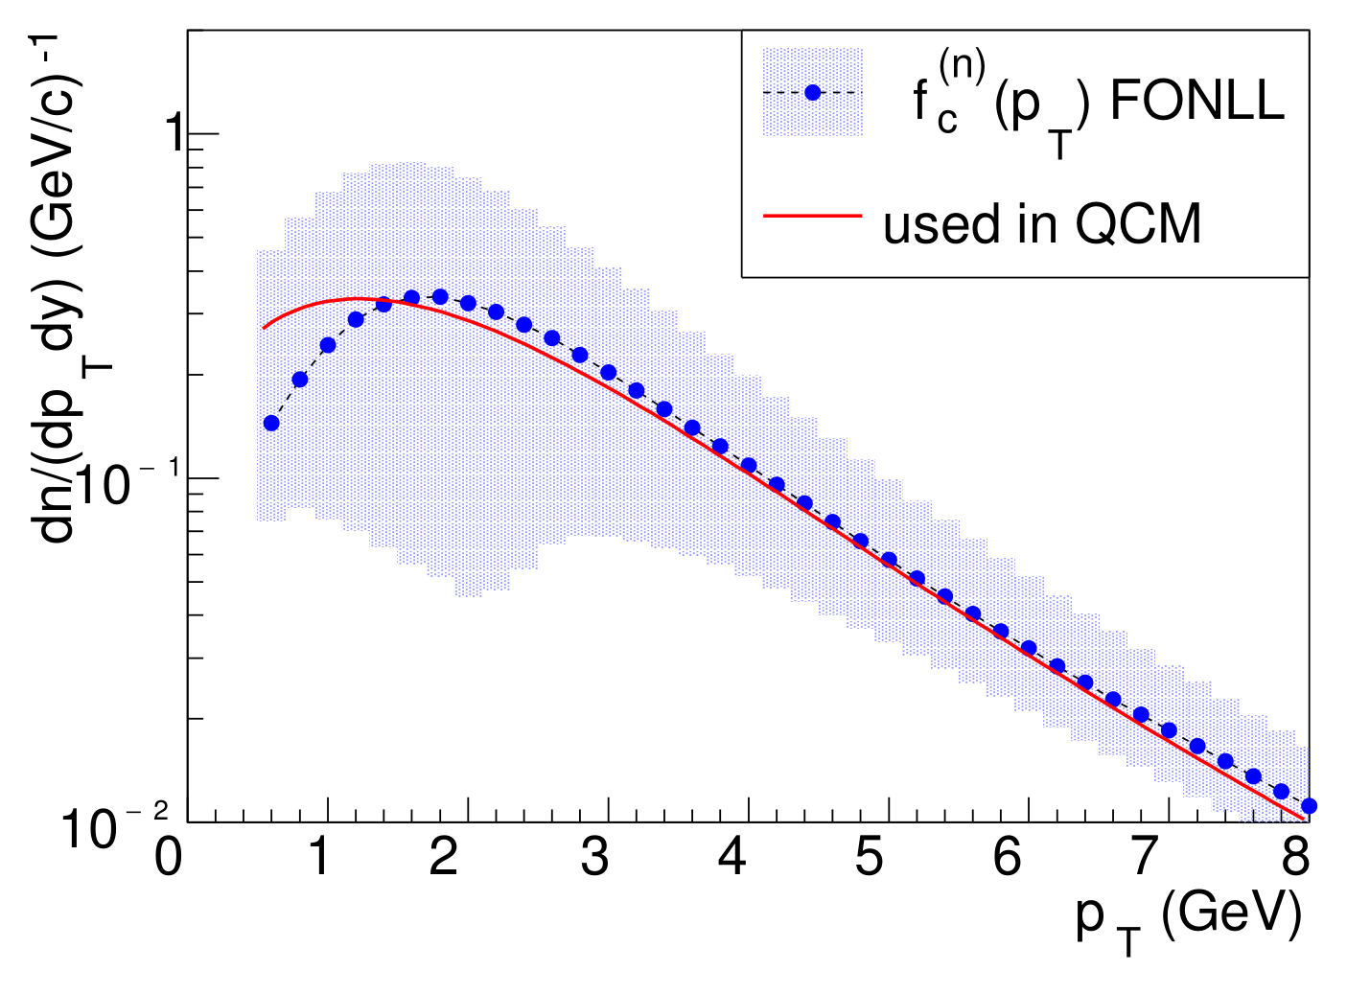
Production of single-charm hadrons in pp and p-Pb collisions at LHC
J.Song, H.H.Li, FLS, Eur.Phys.J. C78 (2018) 344
H.H.Li, FLS, J.Song, PRC97(2018), 064915
Equal-velocity combination of charm quark and light-flavor (anti)quarks
Quark spectra at hadronization
got from light-flavor hadrons
consistent with pQCD calculations
Notes:
We also study the combination of light-flavor quarks with charm quark to fit the data of single-charm hadrons in pp and p-Pb coll at LHC.
Here, we also apply the equal velocity combination approximation.
The spectra of u quark and s quark are already obtain by fitting light flavor hadrons. The pt spectrum of charm quark are taken from the PQCD calculation.

Slide 24
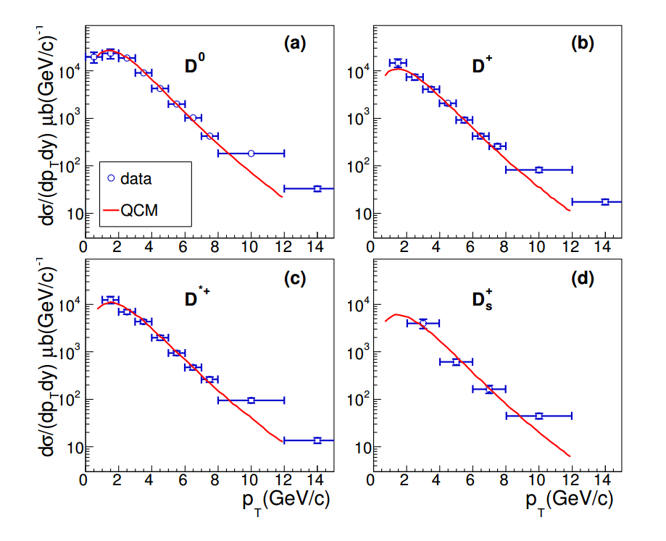
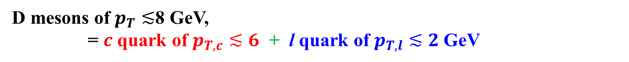
D mesons of $p_{T}≲$8 GeV,
= $c$ quark of $p_{T,c}≲6$ + l quark of $p_{T,l}≲2$GeV
Notes:
This figure show the pt spectra of D mesons. We see that the QCM results, red lines, are good agreement with the data for pt smaller than about 8 GeV. In this pt range, the formation of D mesons is by the combination of charm quarks with pt smaller than about 6 GeV and light quarks with pt small than about 2 GeV.

Slide 25
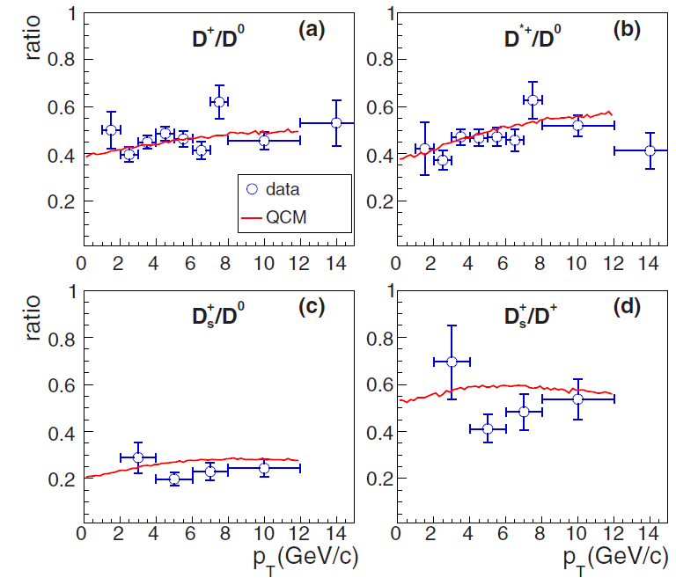

Slide 26
Notes:
This fig show the pt dependence of Lambda_c/D0 ratio. We see the QCM, Green lines, can well explain the pt dependence of the data with a parameter RBM to tune the global magnitude.

Slide 27
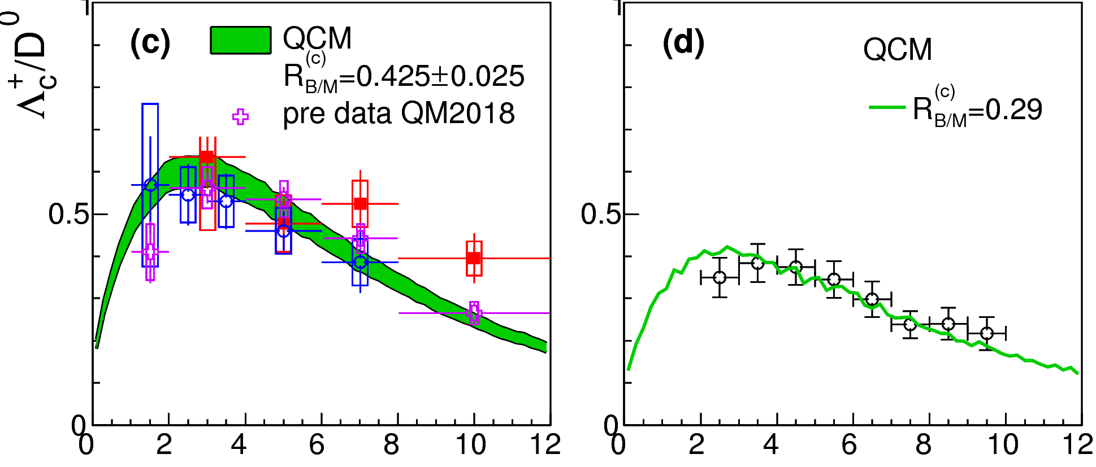


$p_{T}$ dependence of charmed Baryon/Meson ratio
p-Pb 5.02TeV
p-Pb 5.02TeV
1.5<y<4
pp 7TeV
$p_{T}$(GeV/c)
$p_{T}$(GeV/c)
Alice data
LHCb data
Notes:
This fig show the pt dependence of Lambda_c/D0 ratio. We see the QCM, Green lines, can well explain the pt dependence of the data with a parameter RBM to tune the global magnitude.

Slide 28
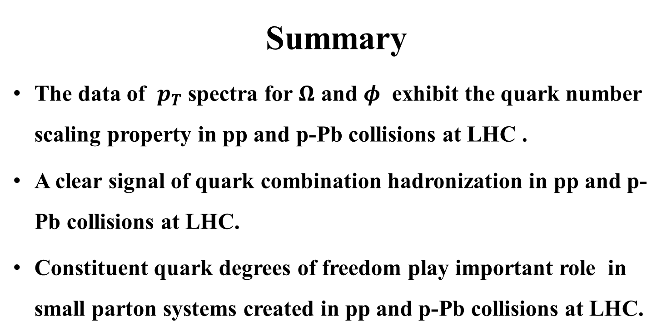
Summary
The data of $p_{T}$ spectra for $Ω$ and $φ$ exhibit the quark number scaling property in pp and p-Pb collisions at LHC .
A clear signal of quark combination hadronization in pp and p-Pb collisions at LHC.
Constituent quark degrees of freedom play important role in small parton systems created in pp and p-Pb collisions at LHC.
Thanks!
Notes:
Finally, I give a short summary,
We show that data of …, this is clear signal ….,
We use a working model under equal velocity approximation to systematically study the pt spectra of different identified hadrons and we get a good agreement with the data at LHC.
This indicates that ….
This NPQCD feature should be incorporated in developing more sophisticated hadronization models in the future.

Slide 29
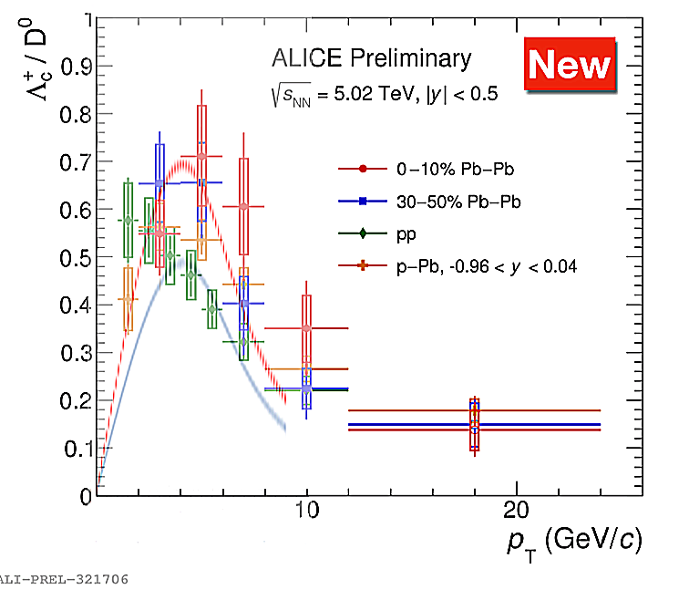
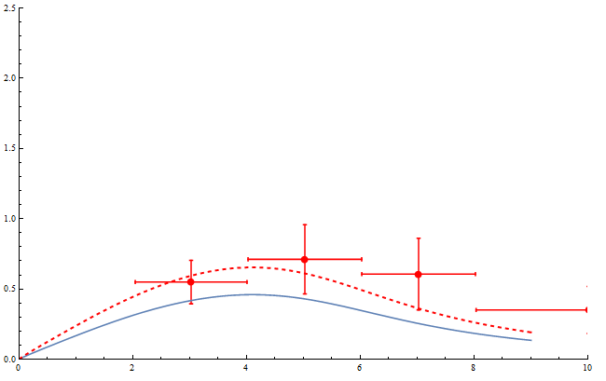
0-10% R_{BM}=0.32

Slide 30
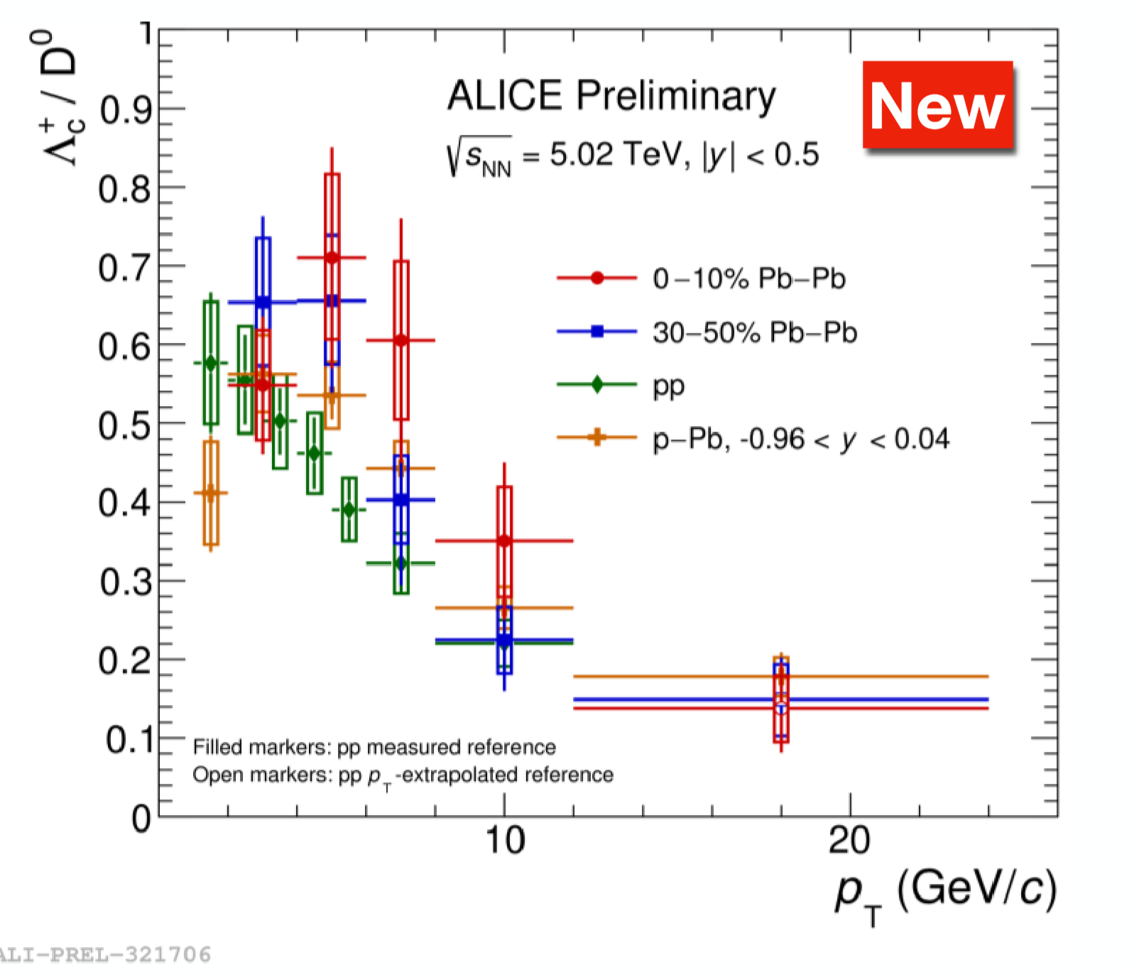

Slide 31
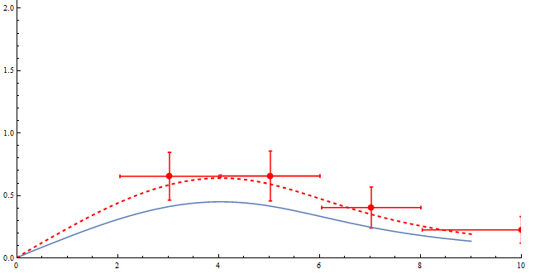
30-50% R_{BM}=0.32

Slide 32
Notes:
This fig show the pt dependence of Lambda_c/D0 ratio. We see the QCM, Green lines, can well explain the pt dependence of the data with a parameter RBM to tune the global magnitude.

Slide 33
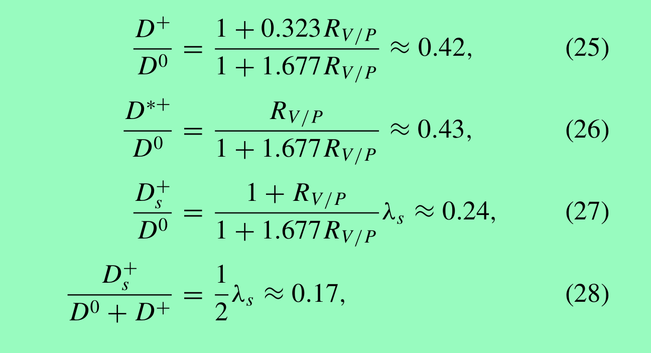
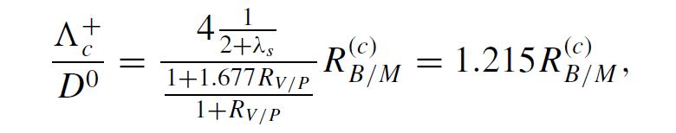

Slide 34
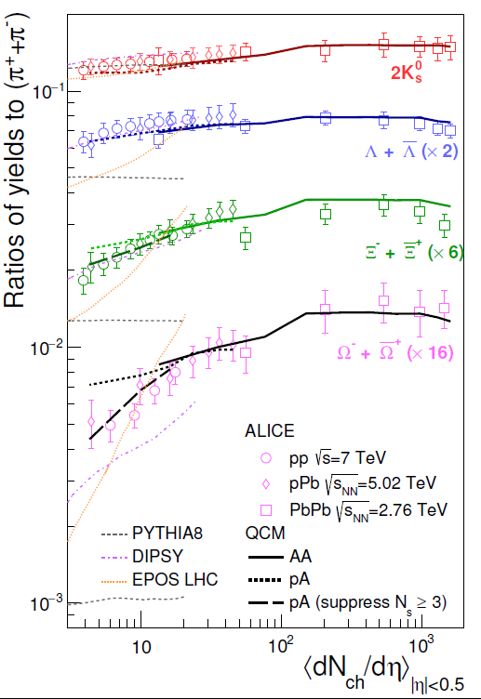
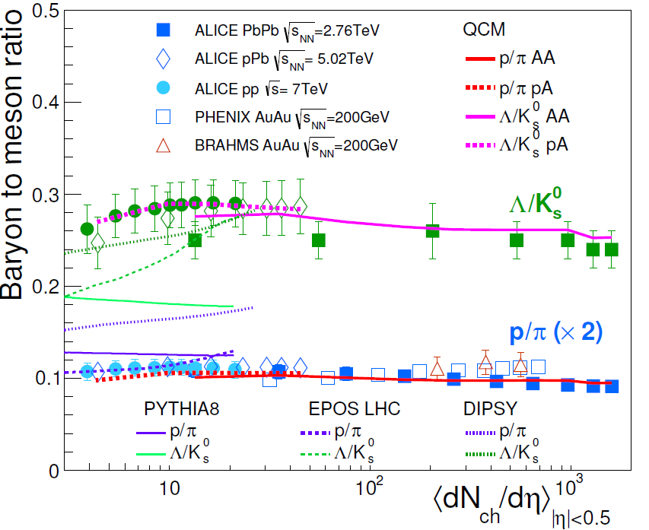

(1) Yield ratios & $p_{T}$ ratios
System size dependence
SFL,SJ, et al, Phys.Rev.C95, 064911 (2017)
Notes:
LHC上，正反强子产生是对称的，可以研究不同强子种类的产额比，
左边这个图是重子介子比，右边是奇异强子的相对产生，相对于pion。
大家注意横坐标，是nch的函数，因此nch大的地方是AA反应的实验，nch小的地方是pA和pp反应。
用QCM我们可以比较简单的解释这些实验结果，pp,pA and AA
我们注意到，在LHC pp和pA上，传统的碎裂机制,图中比较细的这些线，表现的不是很好。
我们的观点是，对于强子产额，很多人不太重视，实际上还是很能说明问题的。

Slide 35
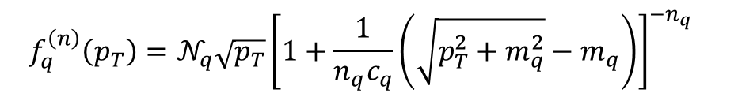

Extraction of quark $p_{T}$ spectra from the data
$$f_{q}^{\left(n\right)}\left(p_{T}\right)=𝒩_{q}\sqrt{p_{T}}{\left[1+\frac{1}{n_{q}c_{q}}\left(\sqrt{p_{T}^{2}+m_{q}^{2}}−m_{q}\right)\right]}^{{−n_{q}}_{}}$$
20-40%
similar to AA collisions at RHIC and LHC energies!
J.H. Chen, et al, PRC78,034907(08); RQ Wang, Shao, Song, PRC91,014909(15); Shao, Song, et al, PRC80,014909(09);

Slide 36


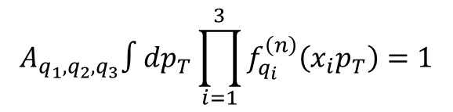

$κ_{M_{i}}$ and $κ_{B_{i}}$ can be well determined in QCM with a few parameters
$$κ_{B_{i}}≈A_{q_{1},q_{2},q_{3}}C_{B_{i}}N_{iter}/15{\left\langle N_{q}\right\rangle }^{2}$$
$$κ_{M_{i}}≈4A_{q_{1},{\overline{q}}_{2}}C_{M_{i}}/5{\left\langle N_{q}\right\rangle }^{}$$
where $\left\langle N_{q}\right\rangle$ is total quark number. $C_{B_{i}}$ and $C_{M_{i}}$ are determined by parameters $R_{D/O}$ and $R_{V/P}$.
$𝒩_{q_{1},q_{2},q_{3}}$ and $𝒩_{q_{1},{\overline{q}}_{2}}$ are determined by quark $p_{T}$ spectrum
$$A_{q_{1},q_{2},q_{3}}∫dp_{T}\prod_{i=1}^{3}{f_{q_{i}}^{\left(n\right)}\left(x_{i}p_{T}\right)}=1$$
$$A_{q_{1},{\overline{q}}_{2}}∫dp_{T}f_{q_{1}}^{\left(n\right)}\left(x_{1}p_{T}\right)f_{{\overline{q}}_{2}}^{\left(n\right)}\left(x_{2}p_{T}\right)=1$$

Slide 37
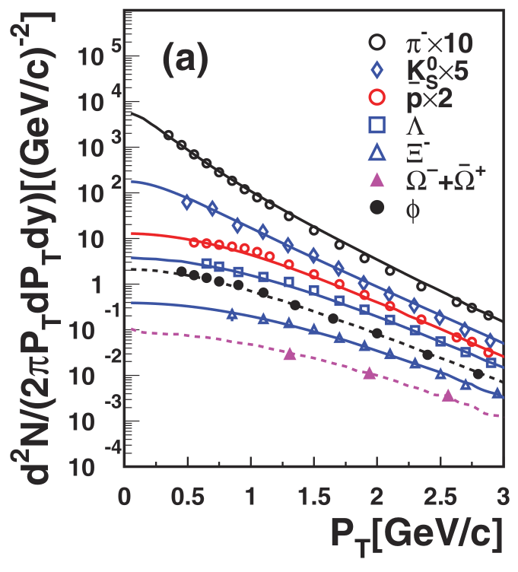


(1) Yield ratios & $p_{T}$ ratios
WRQ,SJ,SFL,PRC91, 014909(2015)
ZK&SJ&SFL, PRC86,014606(2012)
SFL,SJ,ZMS,CPC41,014101(2017)
LHC 2.76TeV
RHIC 200 GeV
Input f_{q}(p_{T}),f_{s}(p_{T})
Notes:
在动量谱上，输入轻夸克和奇异夸克的pt分布，就可以系统解释pion, k, p, Lambda, Xi, Omega, phi的pt谱，这个是RHIC200GeV的结果，右边这个是LHC2.76TeV的几个。
这些pt谱间也存在系统关联，比如p/pi比，Lambda/Kso, Omega/Phi 比，这个大家以前研究的比较多，都可以用组合解释。

Slide 38



(1) Yield ratios & $p_{T}$ ratios
WRQ,SJ,SFL,PRC91, 014909(2015)
$p_{T}$ ratios of D_{s}/D₀
WRQ,SJ,SFL,PRC91, 014909(2015)
equal $p_{T}$ combination, a ~ 0.5,
ratio peak ~ 4 GeV
equal velocity combination, a ~ 0.25,
ratio peak ~ 8 GeV
Notes:
此外，在15年的工作中，我们还研究了Ds/D的pt谱的比值，一个简单的分析可以看到，这个比值与奇异性随有关。奇异性随pt的分布，如蓝线显示，有个峰在2GeV左右。
当c夸克和轻夸克组合时，如果是等pt组合时，Ds/D的峰值出现在4GeV附近，
而等速度组合时，峰值则出现在8GeV左右，因此两种不同的组合动力学可以通过峰值的位置来鉴别，
绿色的两个点是实验数据，误差较大，还不足以下结论。希望以后有更精细的实验数据。

Slide 39

(1) Yield ratios & $p_{T}$ ratios
SJ&FLS, PRC88,027901(2013)
Yield ratios
Fragmentation fails!
Notes:
产额和动量谱的实验数据是很丰富的，可以用来系统的检验强子产生模型，例如，这样一个多粒子产额关联的图，k-/k+ vs pbar/p，
实验上发现不同能量下，不同快度区间上的实验数据形成一个明显的变化曲线。用组合模型（13年的这个工作中，图中较粗的实线）可以很容易解释，如果用传统的弦碎裂机制，这些彩色的线，跟实验偏离的比较远。

Slide 43



Slide 45


