Slide 1
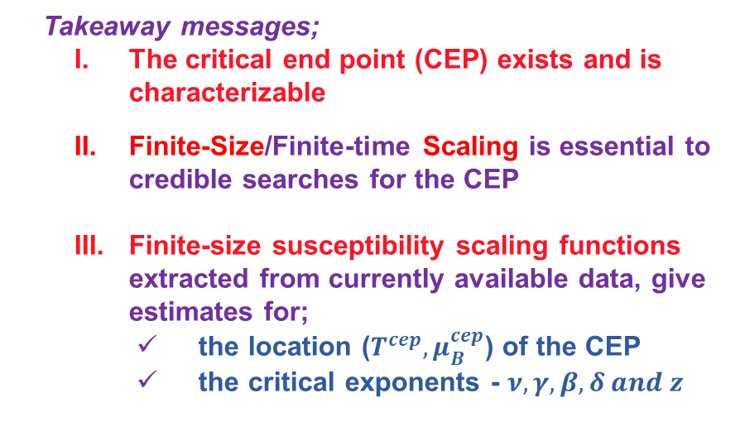
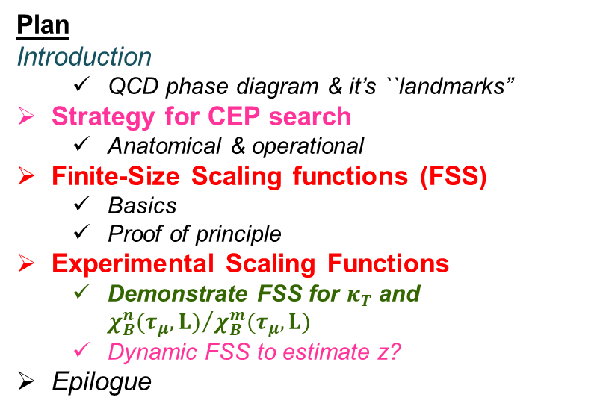
Search for the critical point in the phase diagram
for QCD matter
Roy A. Lacey
Stony Brook University
Roy.Lacey@Stonybrook.edu
Plan
Introduction
  QCD phase diagram & it’s ``landmarks”
Strategy for CEP search
  Anatomical & operational
Finite-Size Scaling functions (FSS)
  Basics
  Proof of principle
Experimental Scaling Functions
  Demonstrate FSS for $κ_{T}$ and ${χ_{B}^{n}(τ_{μ},L)}/{χ_{B}^{m}(τ_{μ},L)}$
  Dynamic FSS to estimate z?
Epilogue
Takeaway messages;
  The critical end point (CEP) exists and is characterizable
  Finite-Size/Finite-time Scaling is essential to credible searches for the CEP
  Finite-size susceptibility scaling functions extracted from currently available data, give estimates for;
    the location ($T^{cep}, μ_{B}^{cep}$) of the CEP
    the critical exponents - $ν, γ, β, δ and z$

Slide 2
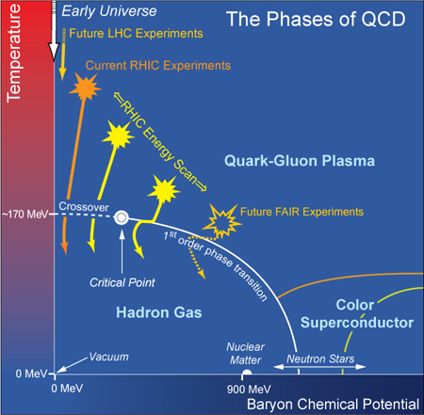
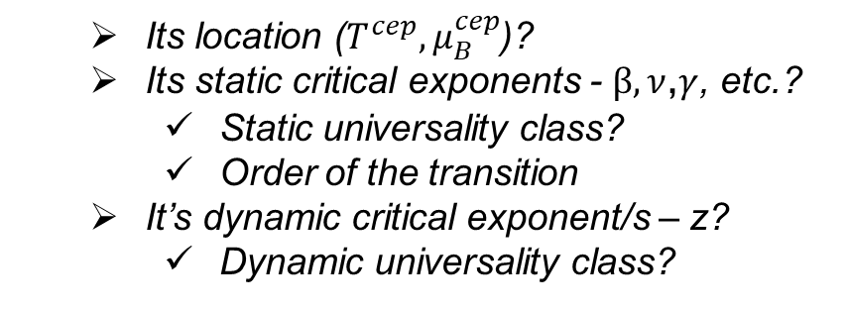

QCD Phase Diagram
Quantitative study of the QCD phase diagram is a major focus of our field
NICA
$$m_{s}>m_{s}^{crit}>m_{u,d}$$
CEP validation requires knowledge about;
  Its location ($T^{cep}{, μ}_{B}^{cep}$)?
  Its static critical exponents - $β,ν$,$γ$, etc.?
    Static universality class?
    Order of the transition
  It’s dynamic critical exponent/s – z?
    Dynamic universality class?
M. A. Halasz, et. al.
Phys. Rev. D 58, 096007 (1998)
All are required to fully characterize the CEP!

Slide 3
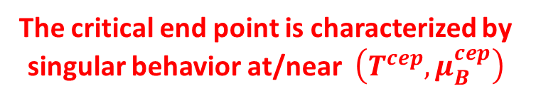

Exploration strategy - Anatomical(
The critical end point is characterized by singular behavior at/near $\left(T^{cep}, μ_{B}^{cep}\right)$
J. Cleymans et al., Phys. Rev. C73, 034905
Andronic et al., Acta. Phys.Polon. B40, 1005 (2009)
3D-Ising Universality Class
If reaction trajectories pass through the critical region, it can;
Influence baryon number susceptibility and the associated critical fluctuations
  The freezeout and the critical region should not be too far apart
Influence baryon number susceptibility and the associated expansion dynamics
  The freezeout and the critical region do not have to be similarly close
Vary the beam energy ($\sqrt{s_{NN}}$ ) to explore the (${T, μ}_{B}$)-plane for anomalous transitions which signal the CEP

Slide 4
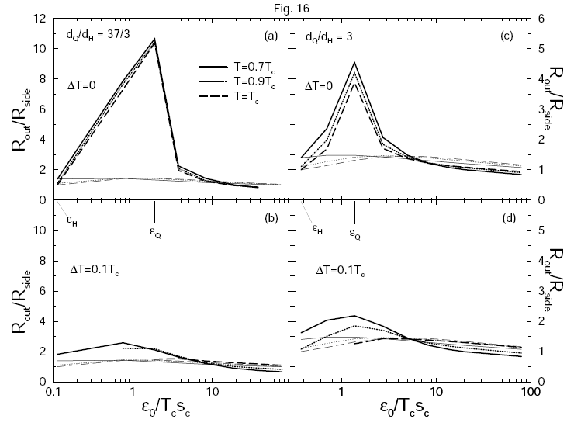
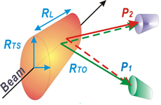
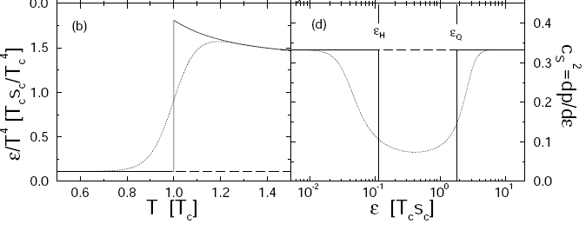




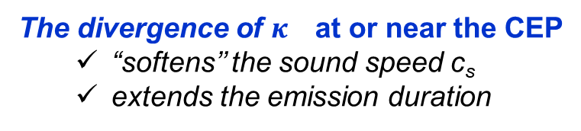
Exploration strategy - Dynamics driven
Dirk Rischke and Miklos Gyulassy
Nucl.Phys.A608:479-512,1996
The radii of the “fireball” encode
space-time information related to
the expansion dynamics
$H_{2}$O
$c_{s}^{2}=\frac{1}{ρκ_{s}}$
$$\frac{κ_{s}}{κ_{T}}=\frac{c_{V}}{c_{P}}$$
The divergence of $κ_{}$at or near the CEP
  “softens’’ the sound speed c_{s}
  extends the emission duration
(R²_{out} - R²_{side}) sensitive to $κ_{}$
The compressibility, which influence the expansion dynamics, shows a (power law) divergence at/near the CEP
Search for this influence with femtoscopy?
Measure (R²_{out} - R²_{side}) as a function of $\sqrt{s_{NN}} [μ_{B}, T]$, to search for non-monotonic signature signaling the CEP!
Proviso → Finite size/time effects

Slide 5

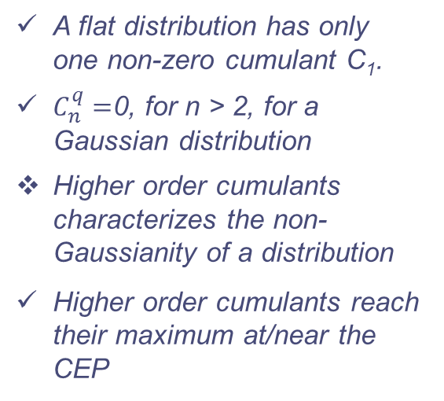





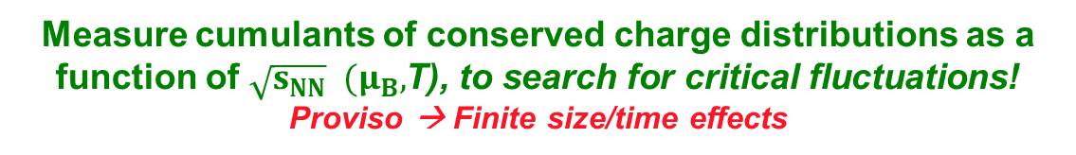



Exploration strategy – Fluctuations driven
Anomalous transitions near the CEP lead to critical fluctuations of the conserved charges (q = Q, B, S)
Cumulants often used to
Characterize distribution
The moments of these distributions grow as powers of
$$C_{1}^{q}=\left\langle N\right\rangle$$
$$C_{2}^{q}=\left\langle {\left(δN\right)}^{2}\right\rangle$$
$$C_{3}^{q}=\left\langle {\left(δN\right)}^{3}\right\rangle$$
$$δN=\left(N−\left\langle N\right\rangle \right)$$
$$C_{4}^{q}=\left\langle {\left(δN\right)}^{4}\right\rangle −{\left\langle {\left(δN\right)}^{2}\right\rangle }^{2}$$
A flat distribution has only one non-zero cumulant C₁.
$C_{n}^{q}=$0, for n > 2, for a Gaussian distribution
Higher order cumulants characterizes the non-Gaussianity of a distribution
Higher order cumulants reach their maximum at/near the CEP
$${M=C}_{1}^{B}$$
$${σ^{2}=C}_{2}^{B}$$
$${S=\frac{C_{3}^{B}}{{\left(σ^{2}\right)}^{3/2}}}_{}^{}$$
$${κ=\frac{C_{4}^{B}}{{\left(σ^{2}\right)}^{2}}}_{}^{}$$
**Fluctuations can be
expressed as a ratio
of susceptibilities**
Measure cumulants of conserved charge distributions as a function of $\sqrt{s_{NN}} (μ_{B},$T), to search for critical fluctuations!
Proviso → Finite size/time effects

Slide 6
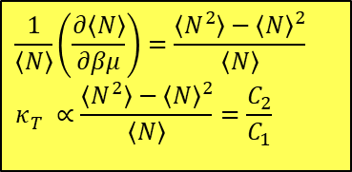
Exploration strategy – Fluctations/Dynamics
Non-monotonic patterns for cumulants or susceptibility ratios could signal the CEP
→ strong dependence on
  model specifics
  reaction trajectory
Holographic QCD phase diagram with critical point
Consistency Check
$$\frac{1}{\left\langle N\right\rangle }\left(\frac{∂\left\langle N\right\rangle }{∂βμ}\right)=\frac{\left\langle N^{2}\right\rangle −{\left\langle N\right\rangle }^{2}}{\left\langle N\right\rangle } \\ κ_{T}^{}∝\frac{\left\langle N^{2}\right\rangle −{\left\langle N\right\rangle }^{2}}{\left\langle N\right\rangle }=\frac{C_{2}}{C_{1}}$$
The singular contributions to baryon number susceptibility ratios are universal features for phase transitions and the existence of the CEP!
Proviso → Finite size/time effects

Slide 7
Finite-Size effects strongly influence characterization of the CEP
Collision systems are small and short-lived!
Significant signal attenuation
Shifts the CEP to a new pseudocritical point
Finite-size effects on the sixth order cumulant
-- 3D Ising model
E. Fraga et. al.
J. Phys.G 38:085101, 2011
Pan Xue et al arXiv:1604.06858
Displacement of pseudo-CEP & pseudo-first-order transition lines due to finite-size
FSE on temp
dependence
of minimum
~ L^{2.5n}
A flawless measurement, sensitive to FSE, cannot locate and characterize the CEP directly

Slide 8
Basics of the Finite-Size Effect
Illustration
large L
T > T_{c}
small L
L characterizes the system size
T close to T_{c}
note change in peak heights,
positions & widths
→ The curse of Finite-Size Effects (FSE)
In addition to signal attenuation, only a pseudo-critical point (shifted from the genuine CEP) can be observed!

Slide 9

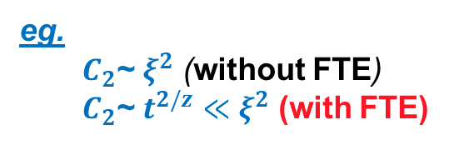
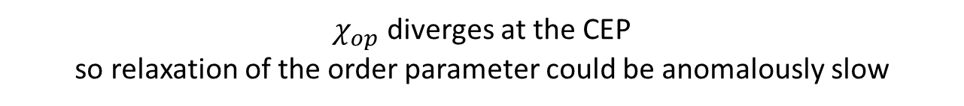

Basics of the Finite-Time Effect
$χ_{op}$ diverges at the CEP
so relaxation of the order parameter could be anomalously slow
z is the dynamic
critical exponent
Consequence
$$t_{eq}\sim ξ^{z}≡τ^{−νz}$$
$$ξ_{}\sim t^{1/z}$$
Non-linear dynamics →
Multiple slow modes
z_{T} ~ 3, z_{v} ~ 2, z_{s} ~ -0.8
z_{s} < 0 - Critical speeding up
z > 0 - Critical slowing down
Y. Minami - Phys.Rev. D83 (2011) 094019
Significant signal attenuation for
short-lived processes
with z_{T} ~ 3 or z_{v} ~ 2
eg.
  $C_{2}$~ $ξ^{2}$ (without FTE)
  $C_{2}$~ $t^{2/z}$ $≪$ $ξ^{2}$ (with FTE)
**Note that observables driven by thermoacoustic
coupling would not be similarly affected**
FTE complicate the search for the CEP in short-lived systems.

Slide 10
Anatomy of search strategy - Summary
Inconvenient truths:
  Finite-size and finite-time effects complicate the search for the CEP, as well as its characterization.
    They impose non-negligible constraints on the growth of ξ.
  The observation of a non-monotonic experimental signature, while instructive, would not be sufficient to identify and characterize the CEP.
    One should not associate the onset of non-monotonic CEP-driven signatures with the actual location of the CEP.
Solution?
Leverage susceptibility scaling functions to locate and characterize the CEP
  To date, this constitutes the only credible experimental approach
  to characterize the CEP!

Slide 11
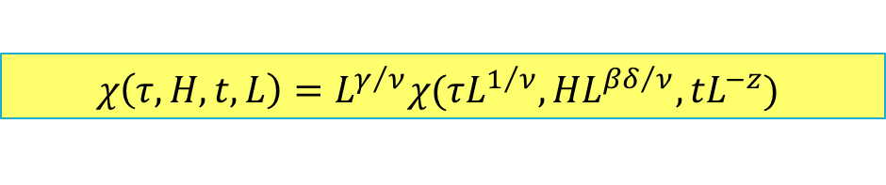
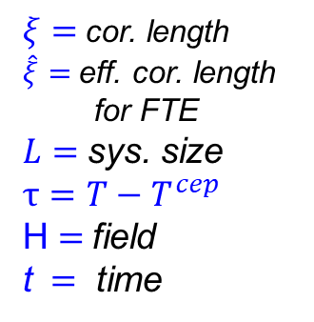
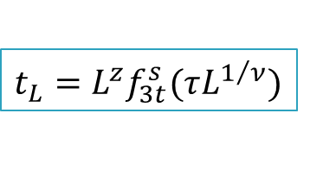
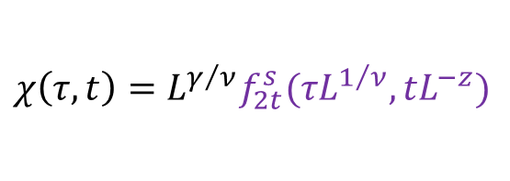
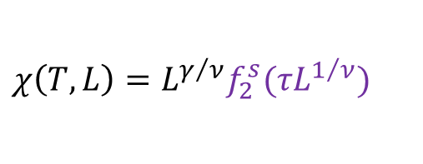
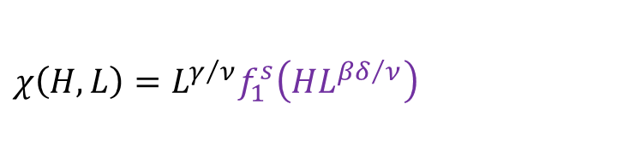

Finite-Size-Scaling (FSS) - Anatomical(
Generalized Finite-Size-Finite-Time Scaling form for $χ$
$$χ\left(τ,H, t,L\right)=L^{γ/ν}χ(τL^{1/ν},HL^{{βδ}/ν},tL^{−z})$$
$ξ=$cor. length
$\hat{ξ}=$eff. cor. length
for FTE
$L=$sys. size
$$τ=T−T^{cep}$$
H $=$field
t $=$ time
Finite-Size Scaling
For $ξ>\hat{ξ}>L$
$$χ\left(H, L\right)=L^{γ/ν}f_{1}^{s}\left(HL^{{βδ}/ν}\right)$$
$$χ\left(τ, t\right)=L^{γ/ν}f_{2t}^{s}(τL^{1/ν},tL^{−z})$$
dynamic finite-size scaling form for the correlation time
$$χ\left(T,L\right)=L^{γ/ν}f_{2}^{s}(τL^{1/ν})$$
$${t_{L}=L}^{z}f_{3t}^{s}(τL^{1/ν})$$
An observation of Finite-Size Scaling of susceptibility measurements would give access to the CEP’s location and the critical exponents

Slide 12
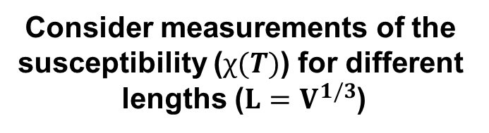
Finite-Size-Scaling (FSS) - Operational(
Consider measurements of the
susceptibility ($χ(T)$) for different
lengths ($L=V^{1/3}$)
Scaling Function
M. Suzuki, Prog. Theor. Phys. 58, 1142, 1977
Finite-size effects lead to characteristic dependencies of the peak heights, widths & positions on L, which
scale with the critical exponents.
The scaling of these dependencies give access to the CEP’s location, critical exponents and a non-singular scaling function.

Slide 13




Finite-Size Scaling Functions
$$χ(H,L)=L^{γ/ν}P_{χ}({HL}^{βδ/ν})$$
$$χ^{}$$
$${χL}^{−γ/ν}$$
$${HL}^{βδ/ν}$$
Finite-Size Scaling functions validate the CEP’s location and the associated critical exponents.

Slide 14
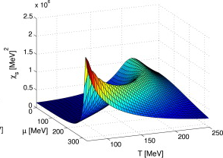




FSS - Proof of Principle
E. Fraga et. al. J. Phys.G 38:085101, 2011
$$τ_{T}=T^{cep}\left(V\right)−T^{cep}\left(∞\right)\sim L^{−1/υ}$$
$$T^{cep}\left(∞\right)$$
$$τ_{μ}=μ^{cep}\left(V\right)−μ^{cep}\left(∞\right)\sim L^{−βδ/υ}$$
Finite Size Scaling confirms the CEP’s infinite-volume location and it’s associated critical exponents.
$$μ^{cep}\left(∞\right)$$
Apply similar idea to data?

Slide 15
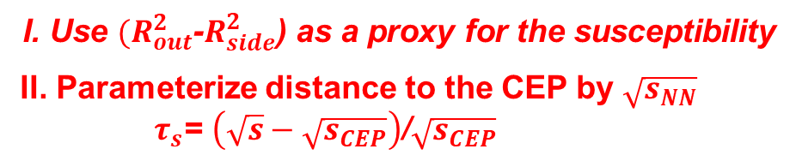
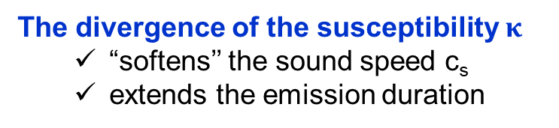
$$Size dependence of HBT excitation functions$$
The divergence of the susceptibility $κ_{}$
  “softens’’ the sound speed c_{s}
  extends the emission duration
The measurements indicate non-monotonic behavior!
I. Use ${(R}_{out}^{2}$-$R_{side}^{2}$) as a proxy for the susceptibility
II. Parameterize distance to the CEP by $\sqrt{s_{NN}}$
$τ_{s}$= $\left(\sqrt{s}−\sqrt{s_{CEP}}\right)$/$\sqrt{s_{CEP}}$
characteristic patterns, signal the effects of finite-size
Perform Finite-Size Scaling analysis
with length scale

Slide 16
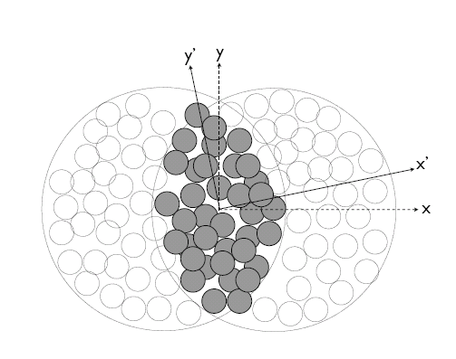

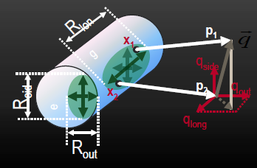
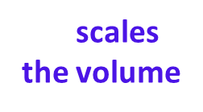



Length Scale for Finite Size Scaling
Lacey QM2014
.
Adare et. al. (PHENIX)
arXiv:1410.2559
is a characteristic length scale of the
initial-state transverse size,
$$\bar{R}≡L$$
σ_{x} & σ_{y} → RMS widths of density distribution
scales
the volume
$$\bar{R}≡L$$
scales the full RHIC and LHC data sets
$$\bar{R}≡L$$

Slide 17



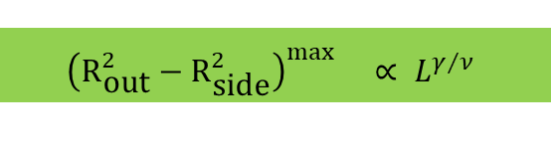

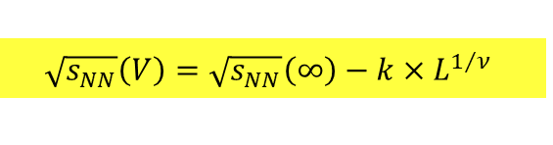


$$Finite Size Scaling of the Succeptiblity proxy$$
Phys.Rev.Lett. 114 (2015) no.14, 142301
$$\sqrt{s_{NN}}\left(V\right)=\sqrt{s_{NN}}\left(∞\right)−k×L^{1/ν}$$
$${\left(R_{\text{out}}^{2}−R_{\text{side}}^{2}\right)}^{\max{}}∝ L^{γ/ν}$$
$$\bar{R}≡L$$
$$\sqrt{s_{NN}}\left(∞\right)\sim{48.0} \text{GeV}$$
$$T^{cep}\left(∞\right)$$
$$ν\sim{0}.63$$
$\sqrt{s_{NN}}\left(CEP\right)\sim{48.0} \text{GeV}$
The extracted critical exponents ($ν$ and $γ$) validate
    the 3D Ising model (static) universality class
    2nd order phase transition for the CEP

Slide 18



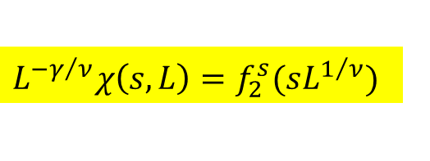
$$Succeptiblity Scaling Function$$
$$L^{{−γ}/ν}χ\left(s,L\right)=f_{2}^{s}(sL^{1/ν})$$
$$\bar{R}≡L$$
s= $\left(\sqrt{s}−\sqrt{s_{CEP}}\right)$/$\sqrt{s_{CEP}}$
Data collapse onto a single curve, confirms the expected non-singular scaling function.

Slide 19







$$Finite Size Scaling of the Succeptiblity proxy (μ_{B})$$
Karsch et. al
$$τ_{μ}=μ^{cep}\left(V\right)−μ^{cep}\left(∞\right)\sim L^{−βδ/υ}$$
Strong Vol. dependence
$$μ^{cep}\left(∞\right)$$
Mapping $\sqrt{s_{NN}}→(T,μ_{B})$
$\sqrt{s_{NN}}\left(CEP\right)\sim{48.0} \text{GeV}$
$$μ_{B}^{cep}\sim{90} \text{MeV} (V→∞)$$
$$T^{cep}\sim{155} \text{MeV}\text{, }μ_{B}^{cep}\sim{90} \text{MeV} (V→∞)$$
$$δ\sim{4.8}$$
$$β\sim{0}.33$$
Further validation of the CEP and the critical exponents
→ 3D Ising universality class

Slide 20


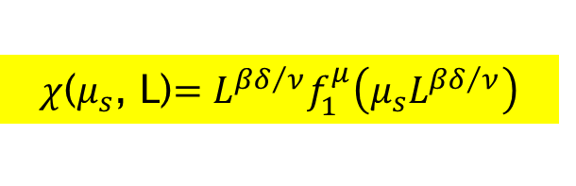
$$Succeptiblity Scaling Function$$
$χ$($μ_{s}$, L)$=L^{{βδ}/ν}f_{1}^{μ}\left(μ_{s}L^{{βδ}/ν}\right)$
$$\bar{R}≡L$$
Use $\sqrt{s}$as a proxy for $μ_{B}$ →${ μ}_{B}^{CEP}\sim 90 MeV$
Data collapse onto a single curve, confirms the expected non-singular scaling function.

Slide 21
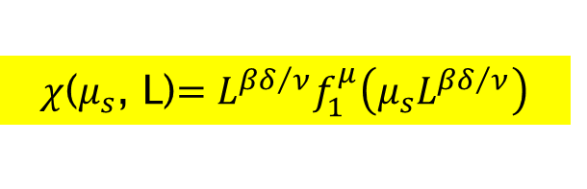
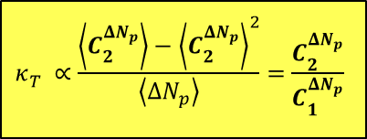
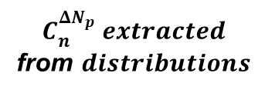
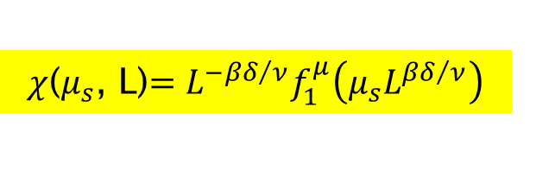
$$Scaling Function for Net baryon Succeptiblity ratio$$
$χ$($μ_{s}$, L)$=L^{{−βδ}/ν}f_{1}^{μ}\left(μ_{s}L^{{βδ}/ν}\right)$
$χ$($μ_{s}$, L)$=L^{{βδ}/ν}f_{1}^{μ}\left(μ_{s}L^{{βδ}/ν}\right)$
$$C_{n}^{{ΔN}_{p}} extracted$$
from $distributions$
$$κ_{T}^{}∝\frac{\left\langle C_{2}^{{ΔN}_{p}}\right\rangle −{\left\langle C_{2}^{{ΔN}_{p}}\right\rangle }^{2}}{\left\langle {ΔN}_{p}\right\rangle }=\frac{C_{2}^{{ΔN}_{p}}}{C_{1}^{{ΔN}_{p}}}$$
Data collapse onto a single curve, confirms the expected non-singular scaling function.

Slide 22
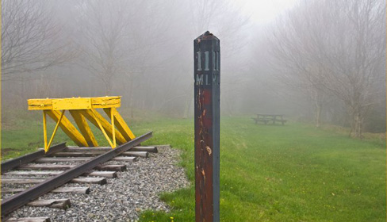
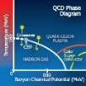



Epilogue
Strong experimental indication for the CEP and its location
  New Data from RHIC (BES-II) together with theoretical modeling, are essential for further validation tests for characterization of the CEP and the coexistence regions of the phase diagram
(Dynamic) Finite-Size Scalig analysis
3D Ising Model (static) universality class for CEP
2nd order phase transition
$$β\sim{0}.33$$
$$T^{cep}\sim{155}\text{MeV}\text{, }μ_{B}^{cep}\sim{90} \text{MeV}$$
$$z\sim{0}.87$$
Landmark validated
Crossover validated
Deconfinement
validated
(Static) Universality
class validated
Model H dynamic
Universality class?
Other implications!
Excitation functions for more systems are especially important

Slide 23
End

Slide 24
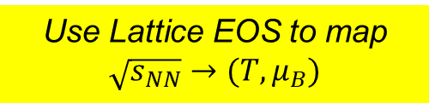

$$Mapping \sqrt{s_{NN}} to ({T, μ}_{B})$$
Karsch et. al
Use Lattice EOS to map $\sqrt{s_{NN}}→(T,μ_{B})$
Note that $\left(μ_{B}^{f}, T^{f}\right)$ is not strongly dependent on L

Slide 25







$$Dynamic Finite−Size Scaling$$
2nd order phase transition
$$ν\sim{0}.63$$
$$γ\sim{1}.2$$
$$T^{cep}\sim{155} \text{MeV}\text{, }μ_{B}^{cep}\sim{90} \text{MeV} (V→∞)$$
DFSS ansatz
at time t when T is near T_{cep}
$$χ\left(L,T,t\right)=L^{γ/ν}f\left({τL}^{1/ν},tL^{−z}\right)$$
For
T = T_{c}
$$χ\left(L,T_{c},t\right)=L^{γ/ν}f\left(tL^{−z}\right)$$
M. Suzuki,
Prog. Theor. Phys. 58, 1142, 1977
Experimental estimate of one of the dynamic critical exponents

Slide 26
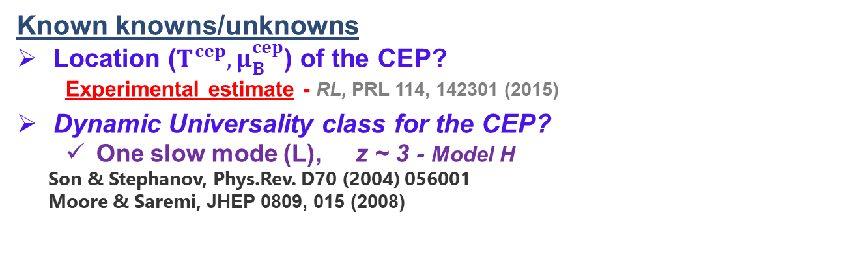
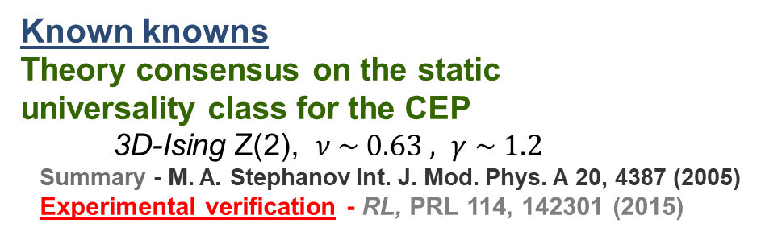
CEP Knowns & unknowns
Scaling relations
S. Datta, R. V. Gavai and S. Gupta, QM 2012
Known knowns
Theory consensus on the static
universality class for the CEP
3D-Ising Z(2), $ν \sim 0.63 , γ \sim 1.2$
Summary - M. A. Stephanov Int. J. Mod. Phys. A 20, 4387 (2005)
Experimental verification - RL, PRL 114, 142301 (2015)
Frithjof Karsch CPOD 2016
Known knowns/unknowns
Location ($T^{cep}{, μ}_{B}^{cep}$) of the CEP?
  Experimental estimate - RL, PRL 114, 142301 (2015)
Dynamic Universality class for the CEP?
  One slow mode (L), z ~ 3 - Model H
Son & Stephanov, Phys.Rev. D70 (2004) 056001
Moore & Saremi, JHEP 0809, 015 (2008)
Three slow modes (NL)
  z_{T} ~ 3
  z_{v} ~ 2
  z_{s} ~ -0.8 [critical speeding-up]
Y. Minami - Phys.Rev. D83 (2011) 094019
Large theoretical uncertainties
[critical slowing down]
Additional experimental
study to further
characterize the
CEP is an imperative

