Slide 1


Recent AMPT Developments Relevant for
the Study of Chiral Magnetic Effects
Zi-Wei Lin (林子威)
East Carolina University
Central China Normal University
QCD物理研讨暨基金委重大项目学术交流会
July 17-25, 2019, Shandong University Weihai Campus

Slide 2
Outline
Introduction
Recent developments of AMPT relevant for CME
Ongoing works
Summary

Slide 3
A Multi-Phase Transport (AMPT)
serves as a comprehensive event generator for heavy ion collisions.
So it aims to evolve the system from initial condition to final observables;
  include particle productions of different flavours at different P_{T} & y;
  study non-equilibrium features and dynamics (e.g. fluctuations).
A+B
Initial conditions
Parton Interactions
Hadronization
Long paper: ZWL, Ko, Li, Zhang & Pal, PRC 72 (2005);
source codes at the ECU website
http://myweb.ecu.edu/linz/ampt/
Hadron Cascade
Final particle spectra

Slide 4
String melting AMPT
can now simultaneously describe
dN/dy, p_{T} –spectra & v₂
of low-p_{T} bulk data in
high energy AA collisions
ZWL, PRC 90 (2014)
Predictions for 5TeV Pb+Pb in
Ma & ZWL, PRC 93 (2016).

Slide 5
Difference between transport and hydro for finite systems
v₂ from escape (w/o collective flow) / total v₂
Hydro assumes local equilibrium;
transport model does not.
Transport model for a large system with many scatterings approaches hydro.
The escape mechanism:
anisotropic parton escape
is an interaction-induced
response to spatial anisotropy
Anisotropic particle escape
is dominant for v₂ in small systems
& even semi-central AuAu at 200GeV
At very large σ or opacity,
hydrodynamic collective flow will dominate
L He et al. PLB 753 (2016);
ZWL et al. NPA 956 (2016)
Notes:
“maybe” refers to the possibility that the coupling between v2(1: pure anisotropic escape) and v2(2:pure anisotropic collective flow) may not be linear.
If quadratic, then each may contribute to 71% of final v2 separately.

Slide 6
Transport model and hydro are complementary
Escape mechanism reflects difference between transport model
& hydrodynamics at finite opacity/size
It is important to develop transport model/kinetic theory &
compare with hydro to understand the physics of different systems
Heiselberg and Levy 1999; Borghini and Gombeaud 2011; Borghini et al. 2018; Kurkela et al. 2018
Transport model and hydro are complementary, e.g.
Easy: Difficult:
Transport model: built-in initial condition QGP EOS
finite muB hadronization of parton matter
follow conserved charges extract e.g. eta/s
non-equilibrium evolution
Hydro: EOS (at muB~0) external initial condition
eta/s as input finite muB
Notes:
“maybe” refers to the possibility that the coupling between v2(1: pure anisotropic escape) and v2(2:pure anisotropic collective flow) may not be linear.
If quadratic, then each may contribute to 71% of final v2 separately.

Slide 7
AMPT is also a test-bed of different ideas for the community
Discovery of the triangular flow v₃
Longitudinal (de)correlations of flows
CME signal and background
Vorticity & polarization observables
Charm v₁
Alver & Roland, PRC 81 (2010)
Pang et al. PRC 91 (2015)
& EPJA52 (2016)
Shou, Ma & Ma, PRC 90 (2014)
Huang, Ma & Ma, PRC 97 (2018)
Zhao, Ma & Ma, PRC 97 (2018),
PRC 99 (2019) & PLB 792 (2019)
Tang, arXiv:1903.04622
Huang, Nie & Ma, arXiv:1906.11631
Li et al. PRC 96 (2017)
Xia et al. PRC 98 (2018)
Wei, Deng & Huang, PRC 99 (2019)
Nasim & Singha, PRC 97 (2018)
We are further developing AMPT to more accurately
describe the dense matter evolution and extract its properties

Slide 8
Recent developments of AMPT include
Improvement of quark coalescence
Take general p & n density profiles in nucleus
Correction of hadron cascade for charge conservation
Include finite nuclear thickness in string-melting AMPT
Implement modern PDF and nuclear shadowing
& improvements of heavy flavor productions
Extension with potentials, NJL & chiral dynamics
He & ZWL, PRC 96 (2017)
HJ Xu et al. PRL 121 (2018)
& CPC 42 (2018)
ZWL & GL Ma
ZWL, PRC 98 (2018)
He & ZWL (in progress)
Zhang et al. PRC 99 (2019)
Zheng et al. (in progress)
J Xu et al.

Slide 9
Recent developments of AMPT include
Improvement of quark coalescence
Use general p & n density profiles in nucleus
Correction of hadron cascade for charge conservation
Include finite nuclear thickness in string-melting AMPT
Implement modern PDF and nuclear shadowing
& improvements of heavy flavor productions
Extension with potentials, NJL & chiral dynamics
He & ZWL, PRC 96 (2017)
HJ Xu et al. PRL 121 (2018)
& CPC 42 (2018)
ZWL & GL Ma
ZWL, PRC 98 (2018)
He & ZWL (in progress)
Zhang et al. PRC 99 (2019)
Zheng et al. (in progress)
J Xu et al.

Slide 10
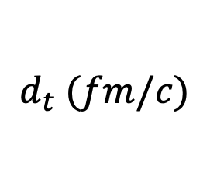
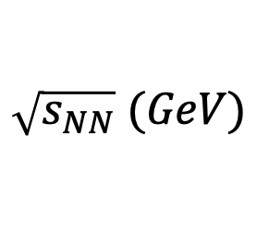
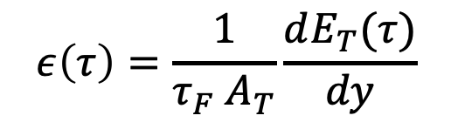
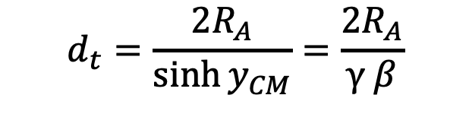

  Include Nuclear Thickness in String Melting AMPT
$$ε\left(τ\right)=\frac{1}{τ_{F} A_{T}}\frac{dE_{T}(τ)}{dy}$$
0
The Bjorken formula
neglects the finite thickness of (boosted) nuclei
→ it is only valid at high energies
where crossing time d_{t} < τ_{F}
z
t = 0
Crossing time from
hard-sphere model:
$$d_{t}=\frac{2R_{A}}{\sinh{y_{CM}}}=\frac{2R_{A}}{γ β}$$
t = d_{t} /2
For example, for central Au+Au collisions:
 | 5 | 11.5 | 27 | 50 | 200
 | 5.3 | 2.2 | 0.91 | 0.49 | 0.12
$$\sqrt{s_{NN}} (GeV)$$
$$d_{t} (fm/c)$$
t = d_{t}
→ the Bjorken formula is only valid for
for τ_{F} = 0.5 fm/c
$$\sqrt{s_{NN}}>50GeV$$

Slide 11



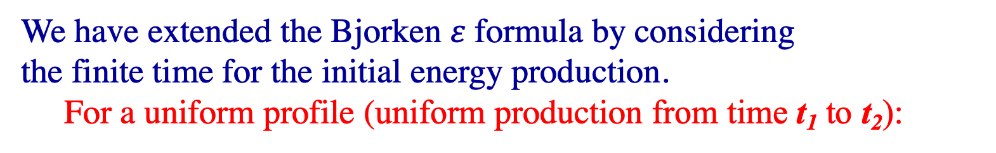
We have extended the Bjorken $ε$formula by considering
the finite time for the initial energy production.
For a uniform profile (uniform production from time t₁ to t₂):
ZWL, PRC 98 (2018)
t₂₁ ≡ t₂ − t₁
$$ε(t)$$
1) At low energy: t₂₁ /τ_{F} >>1:
Peak energy density:
<< Bjorken value
much less sensitive to τ_{F}
FWHM width in t >> Bjorken
At t >> (t₂+τ_{F})
Bjorken formula
Central Au+Au@11.5GeV
$$ε_{uni}^{max}$$
$$ε_{uni}(t)→ε_{Bj}(t)$$
Uniform formula
2) For t₂₁ /τ_{F} → 0 (high energy):
our result → Bjorken
t₁+τ_{F}
t₂+τ_{F}

Slide 12

FT effects are included in an extended string melting AMPT model
FT=finite thickness
AMPT extended with FT effect
~analytical extension
of Bjorken formula
AMPT w/o FT
~ Bjorken formula.
Small FT effect
at high energy.
At low energy:
At high energy,
solution ~ Bjorken.
<< Bjorken value,
is much less sensitive to τ_{F} :
factor of 2.1 or 2.5 change (not factor of 9)
when τ_{F} changes from 0.1 to 0.9 fm/c.
$$ε^{max}$$
ZWL, PRC 98 (2018)

Slide 13


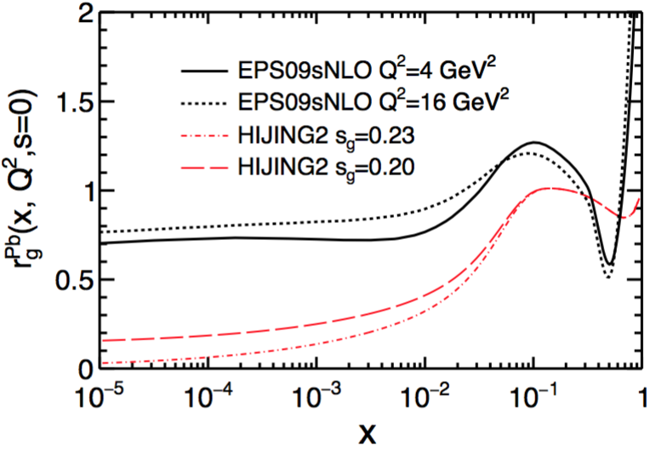
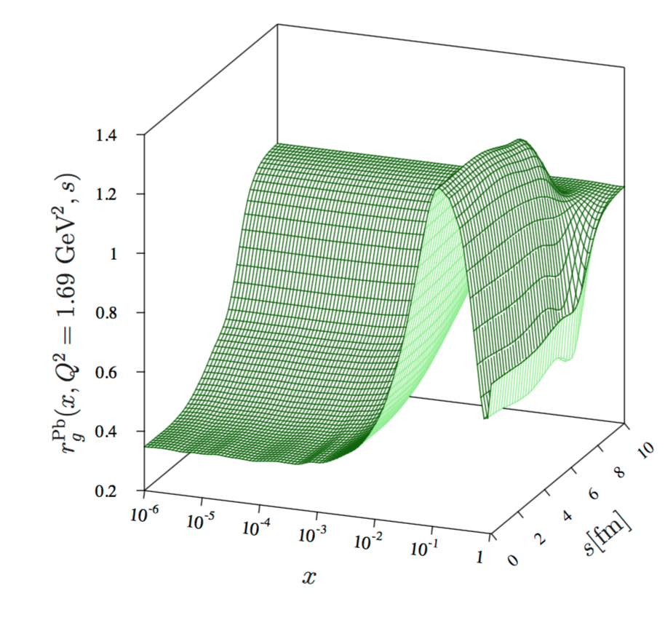
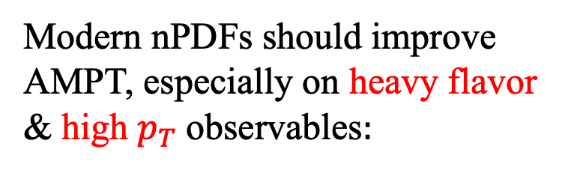
Improve AMPT with Modern PDFs of Nuclei
C. Zhang, L. Zheng, F. Liu, S.S. Shi & ZWL, PRC 99 (2019)
Modern nPDFs should improve AMPT, especially on heavy flavor & high $p_{T}$observables$:$
We now use (arXiv:1903.03292)
CTEQ6.1M PDFs for free nucleon;
EPS09s: spatial-dependent nuclear shadowing, has Q² evolution.
Nuclear Shadowing for Pb:

Slide 14
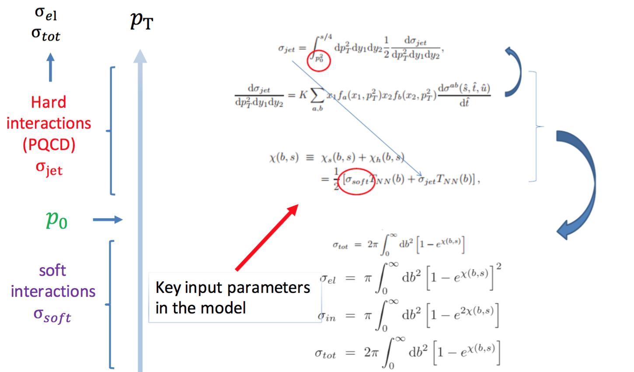
Initial condition: the HIJING two-component model

Slide 15
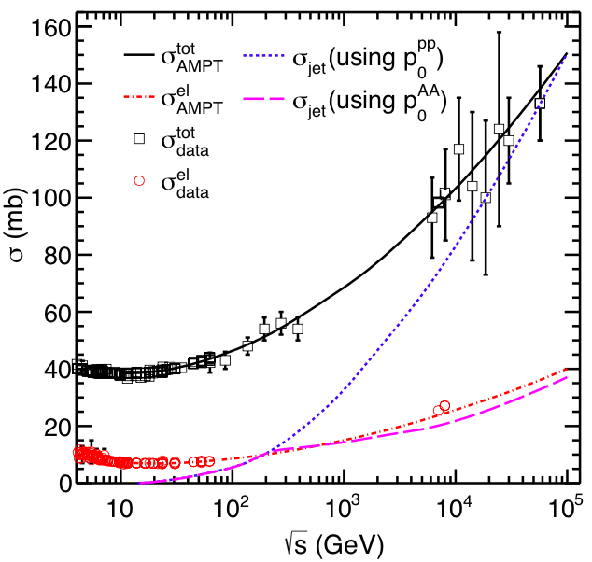
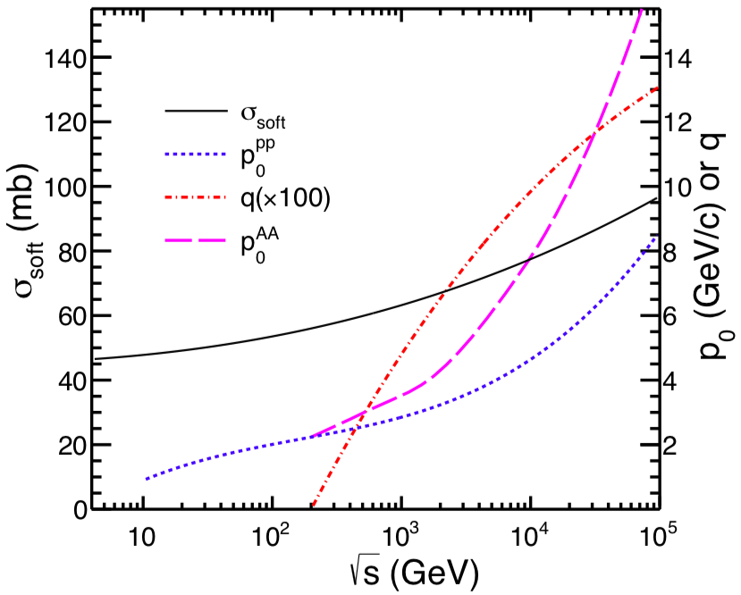
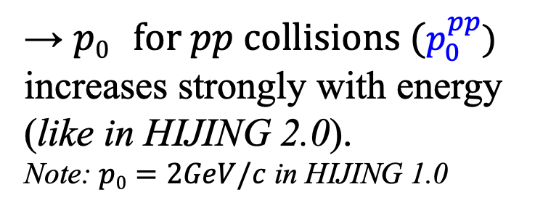
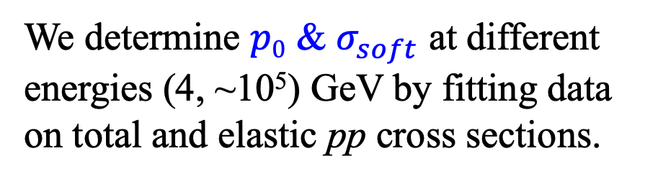
Fitting $p0$ & $σ_{soft}$ in the two-component model
We determine $p0$ & $σ_{soft}$ at different energies (4, ~10⁵) GeV by fitting data on total and elastic pp cross sections.
→ $p0 for pp collisions (p_{0}^{pp})$
increases strongly with energy
(like in HIJING 2.0).
Note: $p0=2GeV/c$ in HIJING 1.0

Slide 16

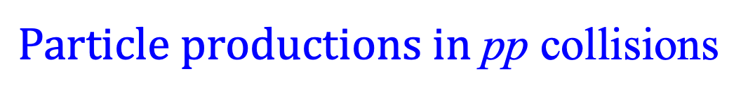
$Particle productions in$pp collisions
With constant Lund parameters a=0.8 & b=0.4/GeV²,
string melting version of AMPT can well describe pp data.
The Lund symmetric
fragmentation function:

Slide 17
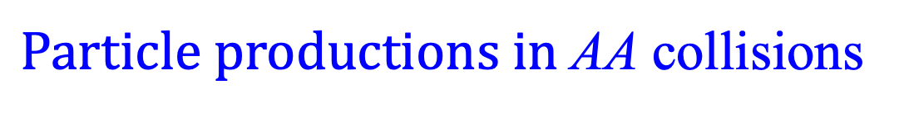
$Particle productions in$AA collisions
Using same parameters as pp,
string melting AMPT fails to describe AA.
It overestimates most particle yields and gives too-soft p_{T} spectra.

Slide 18
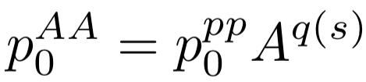
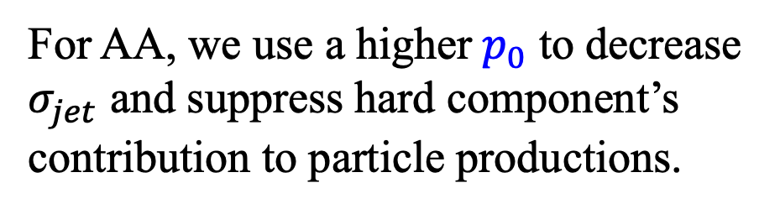
Introduction of nuclear scaling of $minijet cutoff { p}_{0}$
For AA, we use a higher${ p}_{0}$ to decrease $σ_{jet}$ and suppress hard component’s contribution to particle productions.
For central AA, we introduce
motivated by Q_{s} in saturation physics.
q(s): starts from 0 at 200A GeV,
~0.16 at ~10⁸A GeV.

Slide 19

$Particle productions in$AA collisions
After A-scaling of p₀ , string melting version of AMPT
can reasonably describe central AA data at RHIC and LHC energies
(with constant Lund parameters a=0.8 & b=0.15/GeV²)

Slide 20
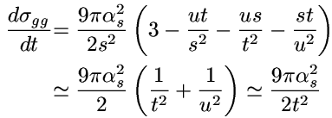
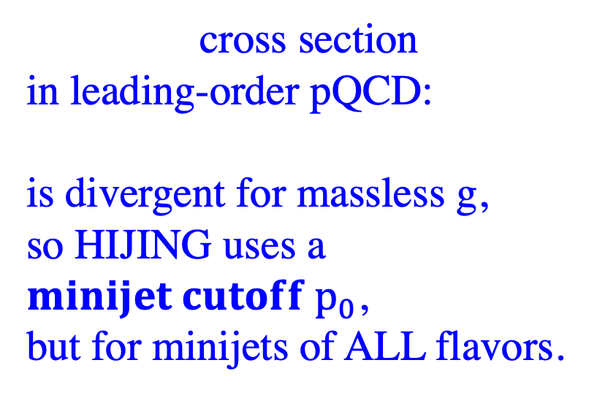
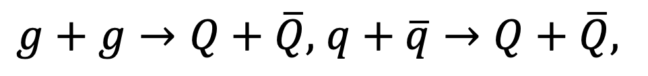
Improve Heavy Flavor Productions in AMPT
cross section
in leading-order pQCD:
is divergent for massless g,
so HIJING uses a $minijet cutoff p_{0}$,
but for minijets of ALL flavors.
But heavy flavor production may NOT be subject to this cutoff
due to heavy quark mass >> Λ_{QCD} (e.g. in FONLL)
$g+g→Q+\overline{Q},$ $q+\overline{q}→Q+\overline{Q},$
1) So we now remove the p₀ cut on HF productions
in the two-component model HIJING & AMPT.

Slide 21
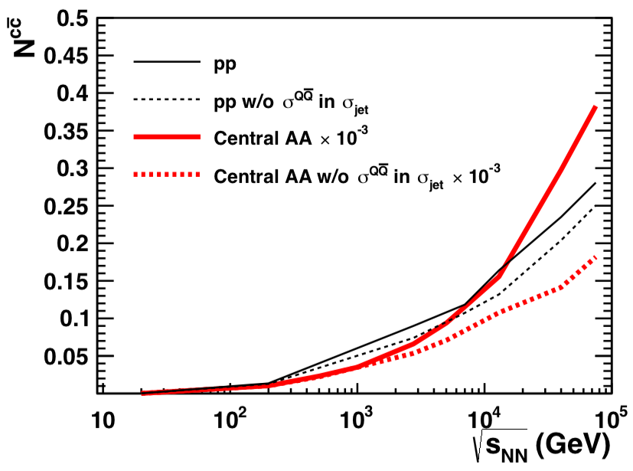
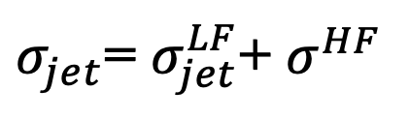
σ_{jet} in the HIJING two component model
currently only includes light flavor (LF: u/d/s) minijets.
Then HF & LF minijets
are generated according to
their relative cross sections.
2) We now include HF in σ_{jet}:
3) We also make corrections
on factor of ½
for certain σ_{jet} channels
$σ_{jet}$= $σ_{jet}^{LF}$+ $σ^{HF}$
Notes:
since $σ^{HF}$ can be a sizable fraction of $σ_{jet}$ at high energies (given the high p₀ cut for LF minijets).

Slide 22
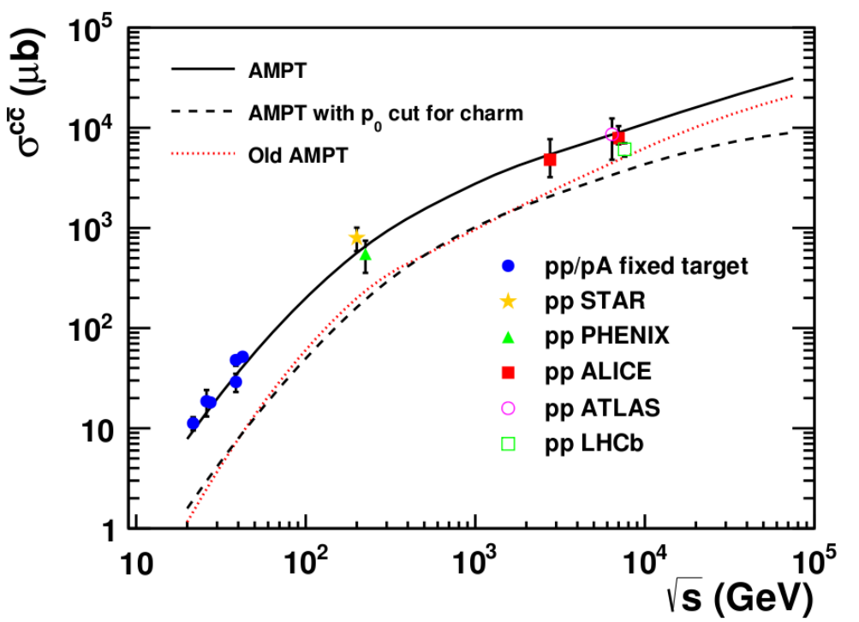
Charm quark productions in pp collisions
Old/public AMPT charm yield << data
Removing p₀ greatly enhances charm yield
Updated AMPT model well describes world data

Slide 23
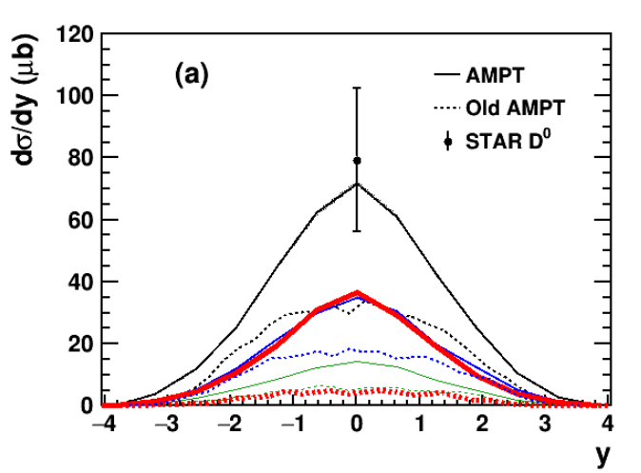
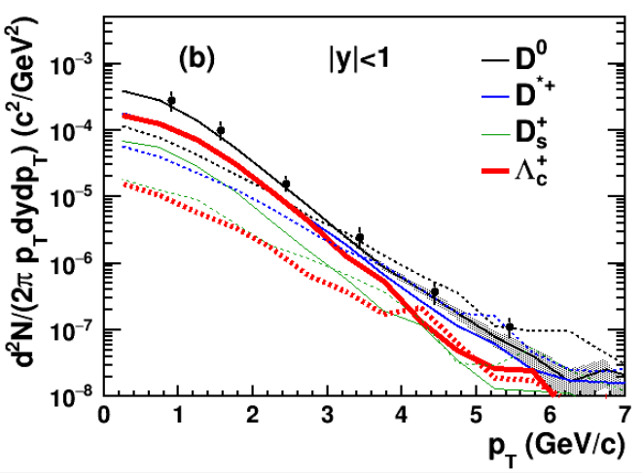
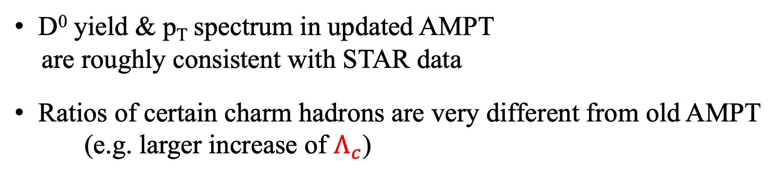
Open charm hadrons in pp collisions
pp at 200 GeV
D⁰ yield & p_{T} spectrum in updated AMPT
are roughly consistent with STAR data
Ratios of certain charm hadrons are very different from old AMPT
(e.g. larger increase of $Λ_{c}$)

Slide 24
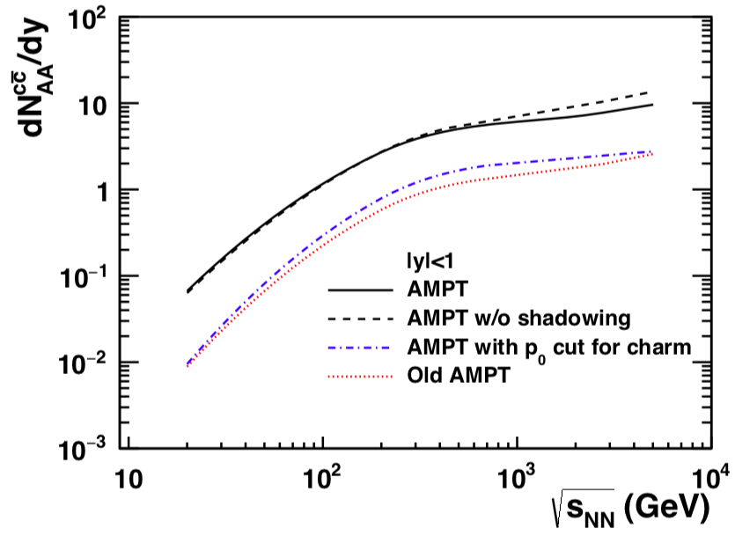
Charm quark productions in AA collisions
Removing p₀ greatly enhances charm yield
Updated AMPT yield >> Old/public AMPT
Shadowing effect becomes sizable for charm at LHC energies

Slide 25
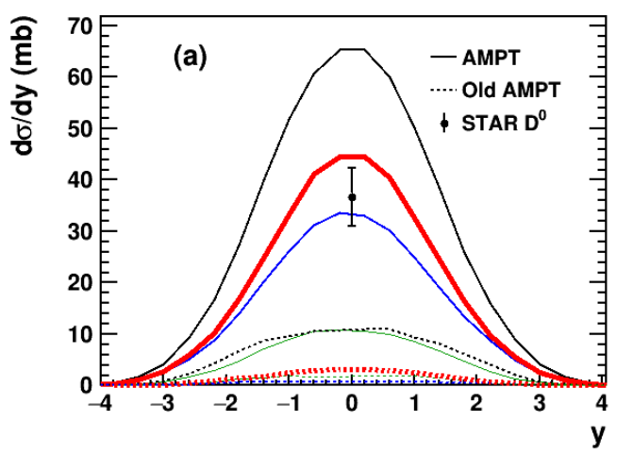
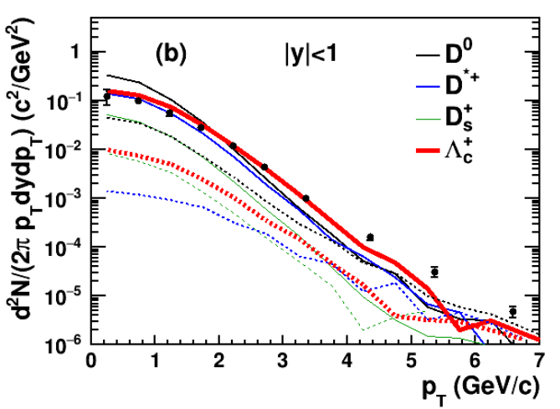
Open charm hadrons in AA collisions
AuAu at 200A GeV
D⁰ yield higher than STAR data
D* yield is much higher than old AMPT
D⁰ spectrum is softer than data, but depends on parton cross section and flavor excitation process (not yet explored)

Slide 26
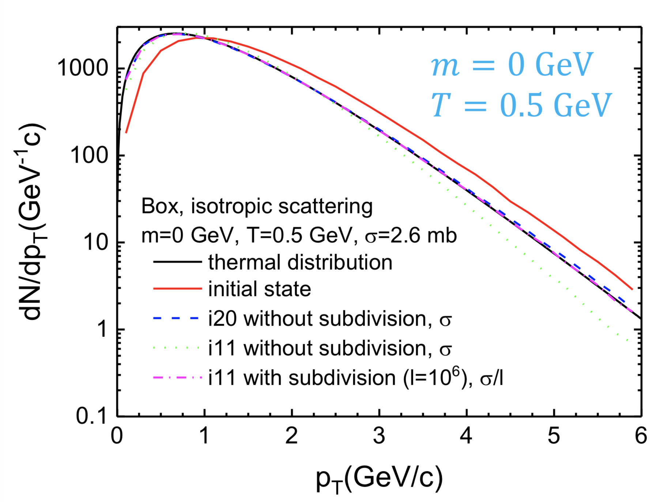
  Ongoing: Validation and Improvement of Parton Cascade
ZPC/MPC cascade solution
of the Boltzmann equation
has causality violation.
Parton subdivision solves this problem:
but is very CPU-consuming &
reduces e-by-e fluctuation/correlation.
Zhao Xinli & ZWL
default ZPC (green) does not keep thermal equilibrium
→ Study accuracy of ZPC
→ find better way to solve
Boltzmann equation w/o subdivision
→ plan to incorporate into AMPT
→ plan to calculate dynamical
E&M fields of parton matter

Slide 27
  Ongoing: Connect AMPT with FRG to Study QCD Critical Effects
Weijie Fu, Guo-Liang Ma & ZWL
AMPT & FRG/NJL theories complement each other:
AMPT
is dynamical model including parton and hadron evolution
& can directly compare with experimental observables;
but connection to fundamental theory is often weak
FRG (Functional Renormalization Group)
is a non-perturbative static QCD approach,
well describes QCD phase transitions & consistent with lattice QCD,
but has no dynamical evolution and very hard to compare to data
Connecting the two should lead to significant improvements:
model parton collisions with FRG at finite T and muB,
study hadronic modification of CEP signals,
…

Slide 28
Summary
AMPT serves as a comprehensive event generator
for heavy ion collisions
Recent improvements will make AMPT more reliable
Inclusion of finite nuclear thickness to string melting AMPT:
changes parton matter evolution at lower energies like BES
Update with new PDFs in nuclei:
lays the foundation for extension to heavy flavor & high pT
Improved heavy flavor productions:
enables simultaneous study of light and heavy flavors
Work is ongoing to include new physics into AMPT
Thank you!

