Slide 1

Dynamical modelings for RHIC BES
Huichao Song
宋慧超
Peking University
Workshop on QCD Physics & Study of the Phase digram and New Type of Topological Effects
Shangdong Wehai, July 17-25 . 2019.
May. 18, 2019

Slide 2
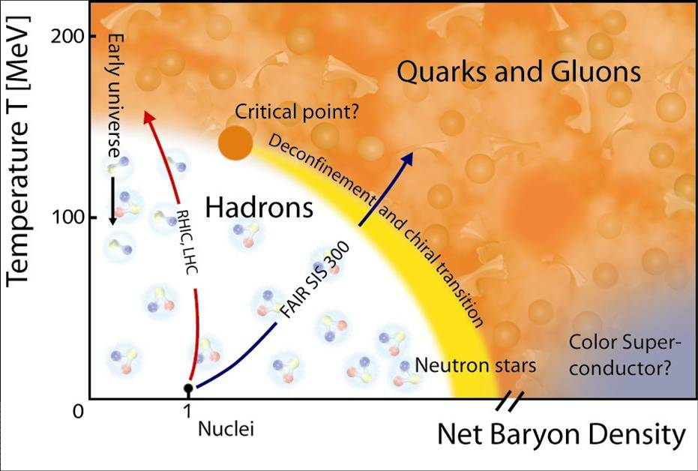

Slide 3
Dynamical modeling for RHIC BES
- Hydro & hybrid model for collective flow, collective expansion
- Dynamical modeling near the critical point
& non-equilibrium critical fluctuations
- Dynamical modeling for non-critical fluctuations

Slide 4
Dynamical modeling for RHIC BES
- Hydro & hybrid model for collective flow, collective expansion
- Dynamical modeling near the critical point
& non-equilibrium critical fluctuations
- Dynamical modeling for non-critical fluctuations

Slide 5
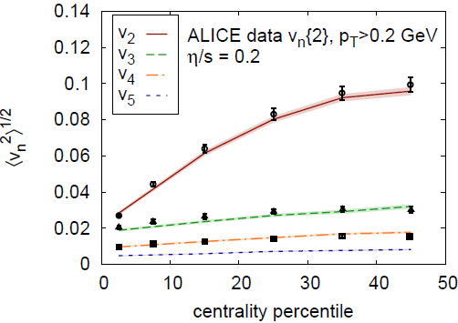
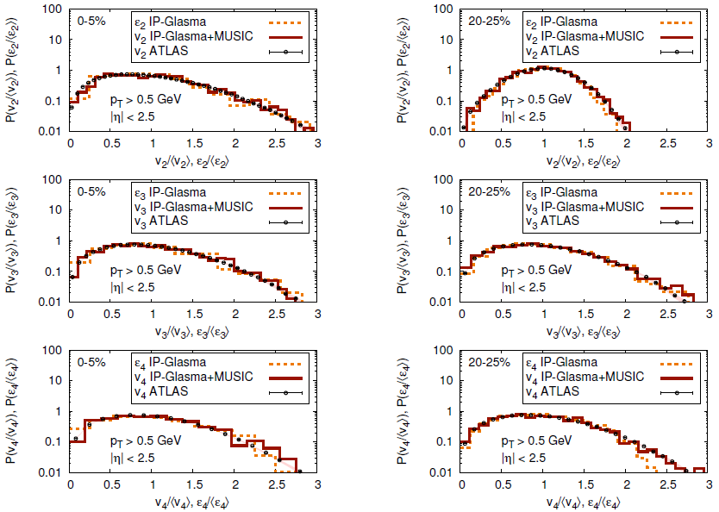
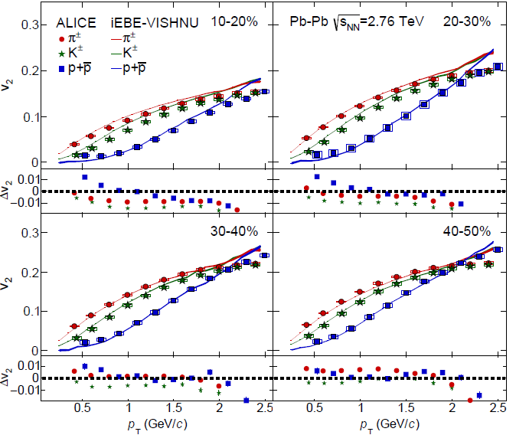
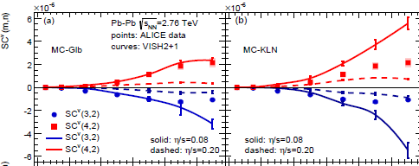
Hydro & Hybrid model
for LHC & top RHIC energies
H. Song, S. A. Bass, U. Heinz, T. Hirano and C. Shen, Phys. Rev. Lett. 106, 192301 (2011)
B. Schenke, P. Tribedy and R. Venugopalan, Phys. Rev. C 86, 034908 (2012)C. Gale, S. Jeon, B. Schenke, P. Tribedy, and R. Venugopalan,Phys. Rev. Lett. 110, 012302 (2013), W. Zhao, H.-j. Xu, and H. Song, Eur. Phys. J. C77, 645, 1703.10792 (2017)
… … … … … …
Great Success
Hybrid model for RHIC BES
- proper initial condition
(dynamical initial cond., vorticity…)
- 3+1-d hydro
(effects from heat conductivity … )
-hadronic afterburner
- EoS with T & µ
Still under-development

Slide 6
Recent development of hybrid model for RHIC BES
Dynamical initial conditions
EoS with finite T & µ
C. Shen and B. Schenke, Phys. Rev. C97 (2018) 024907
Net baryon diffusion
A. Monnai, B. Schenke and C. Shen, arXiv:1902.05095 [nucl-th].
G. Denicol, C. Gale, S. Jeon, A. Monnai, B. Schenke and C. Shen, Phys. Rev. C98, 034916 (2018) ; M. Li and C. Shen, Phys. Rev. C98, 064908 (2018)

Slide 7
Dynamical modeling for RHIC BES
Hydro, hybrid model & Collective flow, collective expansion
Tools: Hybrid model
- proper initial condition
(dynamical intial cond., vorticity…)
- 3+1-d hydro
(effects from heat conductivity … )
-hadronic afterburner
- EoS with T & µ
Still under-development
Physics:
- Shear viscosity bulk viscosity
heat conductivity
- EoS, phase transition
- Initial state fluctuations
- Lambda Polarization
& vorticity
… … … …
Observables:
-Particle yields, spectra …
- Various Flow obserbables
- Lambda Polarization
… … … …

Slide 8
Extracting η/s($\sqrt{s}$) from RHIC BES (I)
-early attempt
Data
- RHIC BES Au+Au 7.7-200 A GeV
Model
-3+1d viscous hydro + UrQMD
-pre-equilibrim stage UrQMD
-EoS (Chiral Model with T, μ)
I. A. Karpenko, P. Huovinen, H. Petersen and M. Bleicher, Phys. Rev. C91, no. 6, 064901 (2015)

Slide 9
Extracting η/s($\sqrt{s}$) from RHIC BES (II)
-using Bayesian statistics
Future:
η/s(T,μ) ζ/s(T,μ) heat conductivity
J. Auvinen, J. E. Bernhard, S. A. Bass and I. Karpenko, Phys. Rev. C97, no. 4, 044905 (2018)

Slide 10
Effects of heat conductivity
Net baryon diffusion
G. Denicol, C. Gale, S. Jeon, A. Monnai, B. Schenke and C. Shen, Phys. Rev. C98, 034916 (2018) ; M. Li and C. Shen, Phys. Rev. C98, 064908 (2018)
-Net baryon diffusion transports more baryon numbers to the mid-rapidity region
-Need a systematical study of various flow data in the near future
-Extracting heat conductivity in the future

Slide 11
Global Λ polarization
Liang & Wang, PRL 94 (05) 102301
Liang & Wang, PLB 629(05)20
Gao et al, PRC 77 (08) 044902
STAR, Nature 548, 62–65
Most vorticial fluid (ω/T ~ 0.001)
Measured through 𝝠 polarization
Li,Pang,Wang&Xia, PRC 96 (2017) 054908; F. Beccattini et al. EPJC 75(2015)406 ... ...

Slide 12
Dynamical modeling at RHIC BES
-Collective flow / Collective expansion
-Critical fluctuations
-Non-critical fluctuations

Slide 13
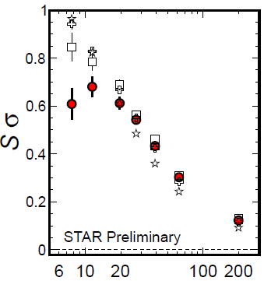
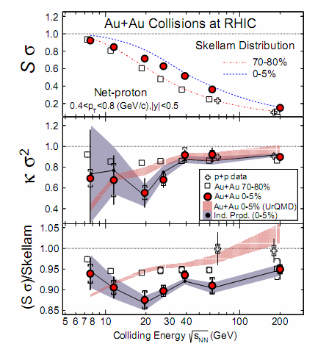
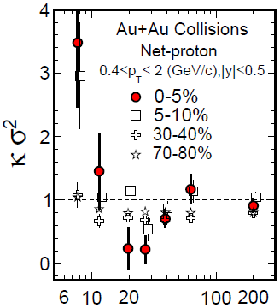
STAR BES: multiplicity fluctuations of net protons
STAR PRL 2014
Xiaofeng Luo CPOD 2014
PT=(0.4-2) GeV
PT=(0.4-0.8) GeV
-Non-monotonic behavior, large deviation from the Poisson baseline

Slide 14






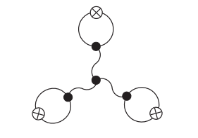
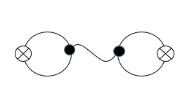
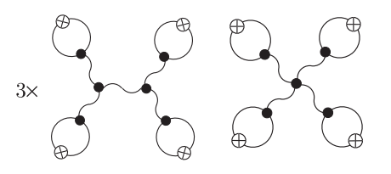
Equilibrium critical fluctuations (I)
Stephanov PRL 2009
Critical Fluctuations of particles :
Higher cummulants (ratios) of net protons are sensitive observables to probe the QCD critical point

Slide 15
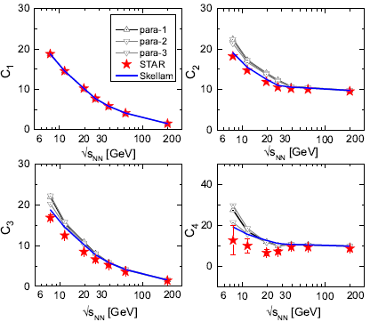
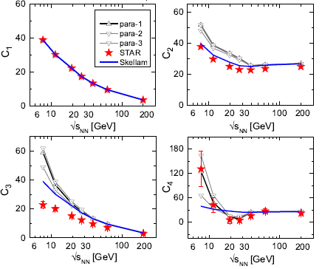
Equilibrium critical fluctuations (II)
Net Protons 0-5%
Jiang, Li & Song, PRC2016
PT=(0.4-0.8) GeV
PT=(0.4-2) GeV
Equilibrium Critical fluctuations give positive contribution to C2 , C3; well above the poisson baselines, can NOT explain/describe the C2 , C3 data

Slide 16
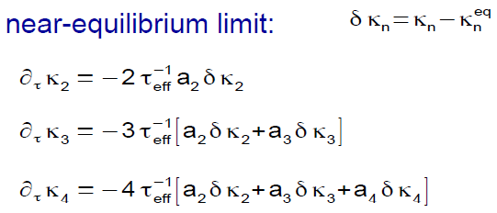
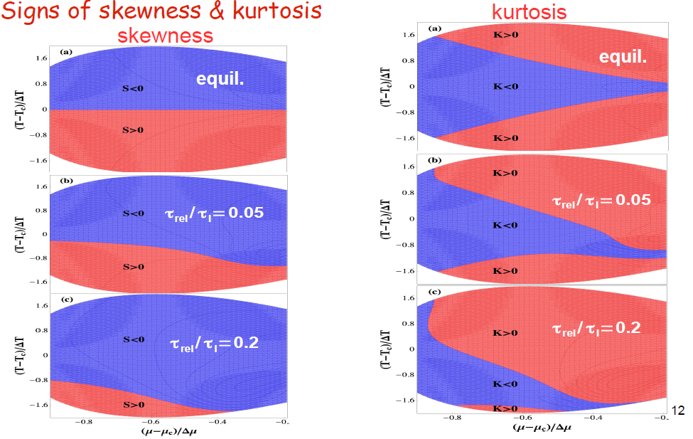
Non-equilibrium critical fluctuations--Fokker-Planck approach
-Model A
sign of non-Gaussian cumulants can be different from equilibrium one
Dynamical Model is a must to study the critical phenomena
S. Mukherjee, R. Venugopalan, Y. Yin, PRC92 (2015)

Slide 17
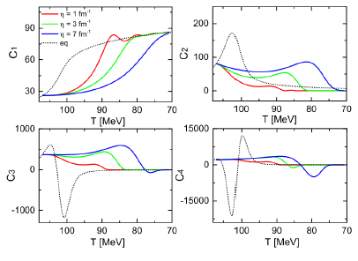
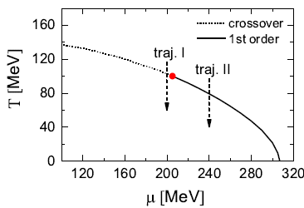
Non-equilibrium critical fluctuations—Langevin dynamics
Langevin dynamics:
-Model A
with effective potential from linear sigma model with constituent quarks
Jiang, Wu, Song, NPA 2017, paper in preparation
-The signs of C3 & C4 are different from the equil. ones due to memory effects
-in the near future: maping with 3D Ising model; extend to model B;
dynamical universal behavior

Slide 18
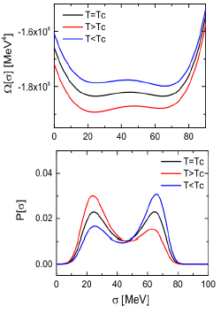
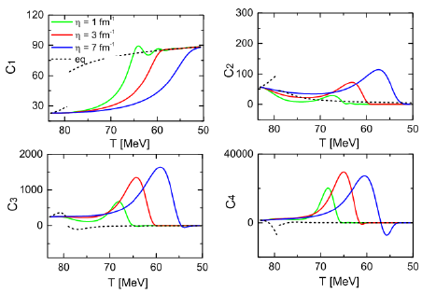
Fluctuations across the first order phase transition line
Langevin dynamics:
-Model A
with effective potential from linear sigma model with constituent quarks
Jiang, Wu, Song, NPA 2017, paper in preparation
-Super cooling & bubble formations:
C3 & C4 are largely enhanced compared
with the equil. ones

Slide 19
Dynamical modeling near the critical point—hydro+
Stephanov & Yin, PRD 98, 036006 (2018)
Numerical simulations are still under-development

Slide 20
Kibble-Zurek scaling
Dynamical models near the critical points
-Model A,B, hydro+, chiral hydro...
-final results / observables are largely influenced by the inputs or free parameters of model calculations
Kibble-Zurek scaling:
Please refer to Mukherjee, Venugopalan,Yin,PRL.117.222301(2016)；
S. Wu, Z. Wu & H.Song 1811.09466

Slide 21
Kibble-Zurek scaling: Fokker-Planck approach
Mukherjee,Venugopalan,Yin,PRL.117.222301(2016)

Slide 22
Approximate KZ scaling: Langevin dynamics
Langevin dynamics:
with effective potential from linear sigma model with constituent quarks
S. Wu, Z. Wu & H.Song, PRC 2019

Slide 23
Dynamical modeling for RHIC BES
-Collective flow / Collective expansion
-Critical fluctuations
-Non-critical fluctuations

Slide 24
Non-Critical (Thermal) Fluctuations
Detection and analysis technology
The efficiency corrections and acceptance of the detector
Bzdak A, Holzmann R, Koch V. arXiv preprint arXiv:1603.09057, 2016…
Bin width effect and centrality dependence
McDonald D, STAR Collaboration. Nuclear Physics A, 2013, 904: 907c-910c…
Auto-correlation effects(ACE)
Luo X, Xu J, Mohanty B, et al. JPG, 2013, 40(10): 105104…
Acceptance dependence of fluctuation
Ling B, Stephanov M A. arXiv preprint arXiv:1512.09125, 2015; Bzdak A, Koch V. Phys. Rev. C, 2012, 86(4): 044904;
Masayuki Asakawa and Masakiyo Kitazawa. arXiV:1512.0038…
physical effect
Conservations law for charges and baryons
Bzdak A, Koch V, Skokov V. PRC, 2013, 87(1): 014901…
Volume fluctuations
Xu H..arXiv:1602.07089, 2016; Xu H. arXiv:1602.06378, 2016; S. Jeon, hep-ph/0304012; M. I. Gorenstein, Phys.Rev. C 78, 041902; V. Skokov, Phys.Rev. C 88, 034911…
Hadronic evolution & rescattering
X.Luo,J. Xu, B. Mohanty,and N. Xu, J.P.G 40,105104(2013); Xu, Ji; Yu, Shili; Liu, Feng; Luo, Xiaofeng arXiv:1606.03900 …
Resonance decay
Garg P, Mishra D K, et al. Phys. Lett. B, 2013, 726(4): 691-696; Andronic A, Braun-Munzinger P, Stachel J. Nucl. Phys. A , 2006, 772(3): 167-199; Andronic A, Braun-Munzinger P. Phys. Lett. B, 2009, 673(2): 142-145;
Cleymans J, Kämpfer B, Kaneta M, et al.. Phys. Rev. C, 2005, 71(5): 054901…

Slide 25





Hadron Resonance Gas Model
Garg P, Mishra D K, Netrakanti P K, et al.
Phys. Lett. B, 2013, 726(4): 691-696.
-Grand canonical ensemble(GCE)
-With Boltzmann approximation
-The susceptibilities
Poisson Baselines!
- A realistic heavy ion collision: dynamical evolutions
- late hadronic evolution:
Chemical and thermal equilibrium can not be maintained

Slide 26
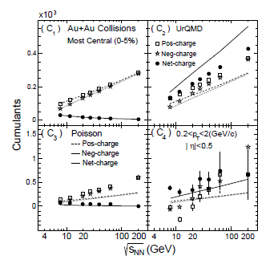
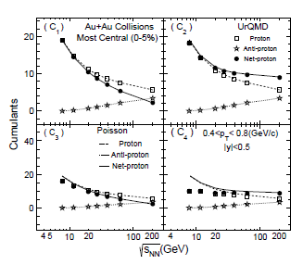
Non-Critical fluctuations
-results from UrQMD
J. Xu, S. Yu, F. Liu and X. Luo, Phys. Rev. C 94, no. 2, 024901 (2016); S. He and X. Luo, arXiv:1704.00423 [nucl-ex].Z. Yang, X. Luo and B. Mohanty, Phys. Rev. C 95, no. 1, 014914 (2017)

Slide 27
Multiplicity fluctuations of (net) Charges
and (net) protons from iEBE-VISHNU
Li, Xu, Song, PRC 2018
iEBE-VISHNU
QGP
HRG
HRG
Initial conditions viscous hydro hadron cascade
Various fluctuations in the hybrid model
-Initial state fluctuations
-Thermal fluctuations in viscous hydrodynamics
-Thermal fluctuations during the switching between hydro & UrQMD
(statistical hadronization, GCE; → Poisson fluctuations )
-fluctuations from UrQMD hadron cascade

Slide 28
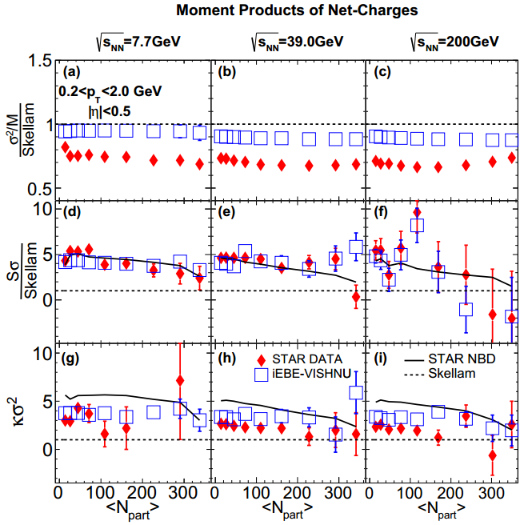
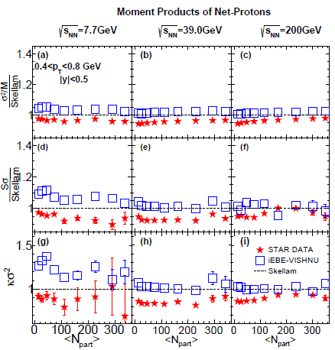
Multiplicity fluctuations of net-charges & net protons
net-charges
net-protons
-For net charges, IEBE-VISHNU roughly describes the data of S and κ and the
related ratios, shows large deviations from the Poisson baselines.
-For net protons: small deviation from the Poisson baselines, roughly describe the data.

Slide 29
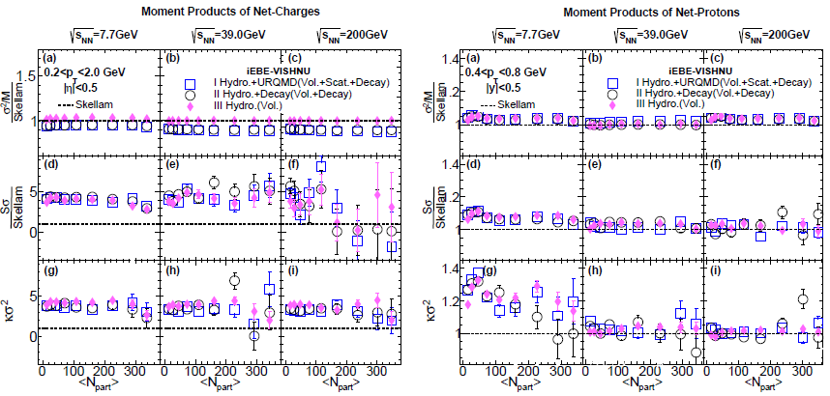
Volume corrections, resonance decays & hadronic evolution
net-charges
net-protons
-The effects of hadronic scatterings and resonance decays are very small
-Volume fluctuations plays the dominant role for multiplicity fluctuations
-For net protons, the effects of volume fluctuations are relatively small
–>close to Poisson fluctuations
Li, Xu, Song, PRC 2018

Slide 30
net-protons
Effects of charge conservations
-Net baryon conservation has been added to freeze-out with SER algorithm
- Effects from charge/baryon conservation are important, should be systematically included in hybrid model simulations
Li, Xu, Song, PRC 2018

Slide 31
Machine Learning for
dynamical modeling & observables

Slide 33
Motivation: dynamical model simulations are time-consuming, which may even a bottleneck for some particular investigations
Key questions: can machine leaning capture the main feature of non-linear hydro-evolution, largely accelerate the simulations
Key questions: can machine discover /define various observables directly from data without explicit instructions from human being?

Slide 34
Traditional hydrodynamics
Deep Learning
-Such deep learning systems do not need to be programmed with the hydro
equation Instead, they learn on their own

Slide 35
sUnet prediction vs. hydro simulations
-for a closer look

Slide 36
Simulation time: sUnet vs. hydro
P
With the well trained network, the final state profiles can be quickly generated from the initial profiles. (5-10 times faster for GPU based calculations)

Slide 37
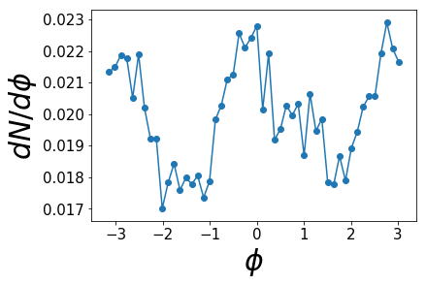
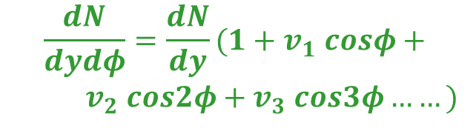
PCA for flow analysis
events
eigenvector (PCA)
from a single events
The eigenvector (PCA) is similar to the Fourier ones
$$\frac{dN}{dydφ}=\frac{dN}{dy}(1+v_{1} cosφ+$$
$v_{2} cos2φ+v_{3} cos3φ……)$
Z. Liu, W. Zhao, and H. Song, arXiv: 1903.09833

Slide 38
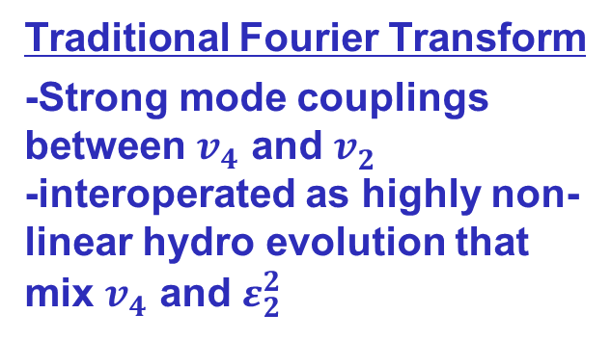
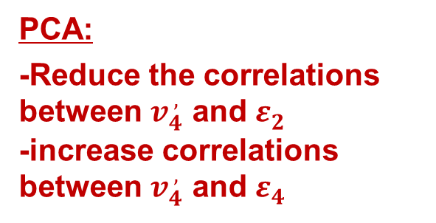

${ v}_{n}^{ ,}$(PCA) vs. ${ v}_{n}^{ }$ (Fourier)
？
？
？
Traditional Fourier Transform
-Strong mode couplings between $v_{4}^{ }$ and $v_{2}^{ }$
-interoperated as highly non-linear hydro evolution that mix $v_{4}^{ }$ and $ε_{2}^{2}$
Pearson Coefficients
PCA:
-Reduce the correlations
between $v_{4}^{ ,}$ and $ε_{2}^{ }$
-increase correlations between $v_{4}^{ ,}$ and $ε_{4}^{ }$
Z. Liu, W. Zhao, and H. Song, arXiv: 1903.09833

Slide 39
Summary
Tools: Dynamical models
-Hydrodynamics & hybrid
models for collective phenomena
-Dynamical modeling near the
critical point
-Dynamical modeling for NON-
critical fluctuations
Observables:
- Particle yields, spectra
- Various flow observables
- Lambda Polarization
- fluctuations of net protons & net
charges
… … … …
Still under-development
Much more coming in the future
Physics:
- Shear viscosity, bulk viscosity &
heat conductivity
- EoS, phase transition
- initial state fluctuations
- Lambda Polarization & vorticity
- Location of the critical point
… … … …

