Slide 1
Off-equilibrium infrared structure
of self-interacting scalar fields
自相互作用标量场的非热平衡红外结构
Jian Deng, Shandong University(Qing Dao)
with: Soeren Schlichting, Raju Venugopalan, Qun Wang
Workshop on QCD Physics & Study of the QCD Phase Diagram
and New type Topologic Effect，Weihai, July 17-25, 2019

Slide 2
Outlines
Background and Motivation, NTFP…
2. From relativistic Φ⁴ to non-rel. GPE, mapping, NREFT…
3. Simulation in 2D, scaling exponents, vortex dynamics…
4. Summary and Outlook

Slide 3
Physical systems far from equilibrium at different scales
Universe Heavy-ion collisions Ultracold atoms
Quite different in size, energy, dynamics, share common feature
Question:
Do they have common properties on control?
Classical and quantum turbulence
3

Slide 4
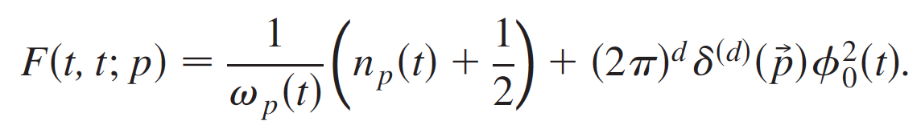
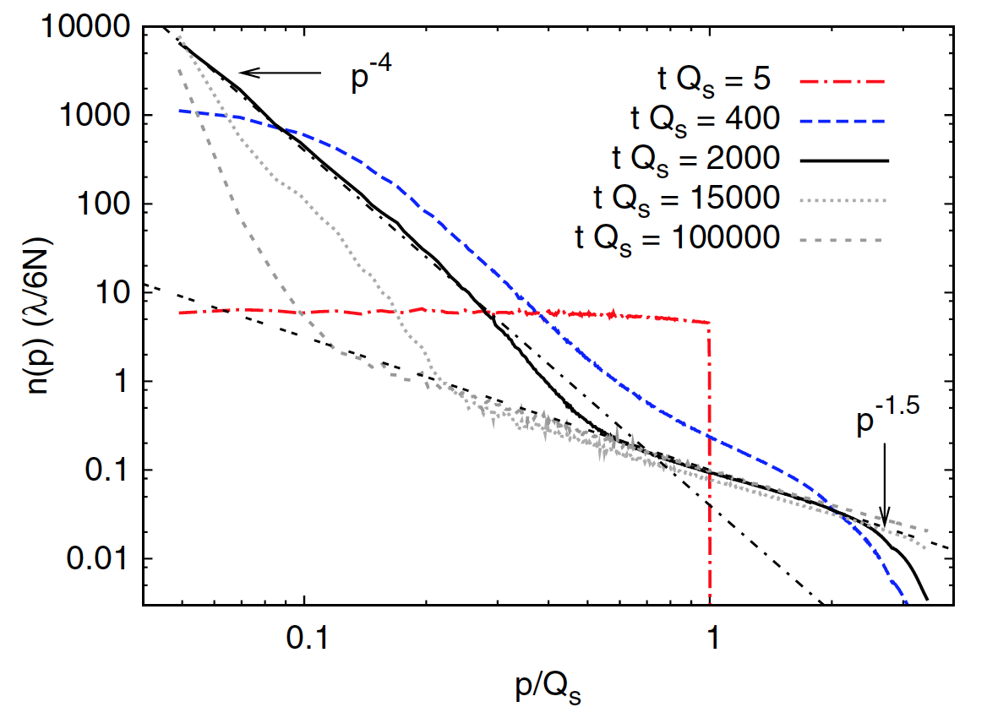
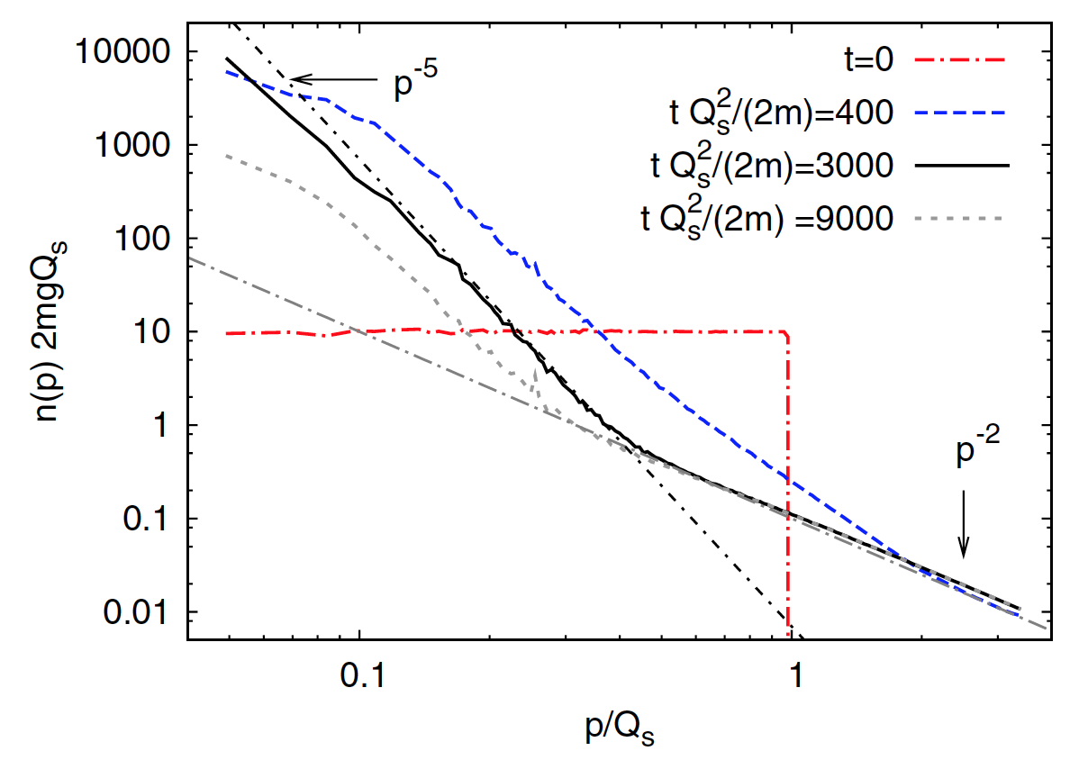
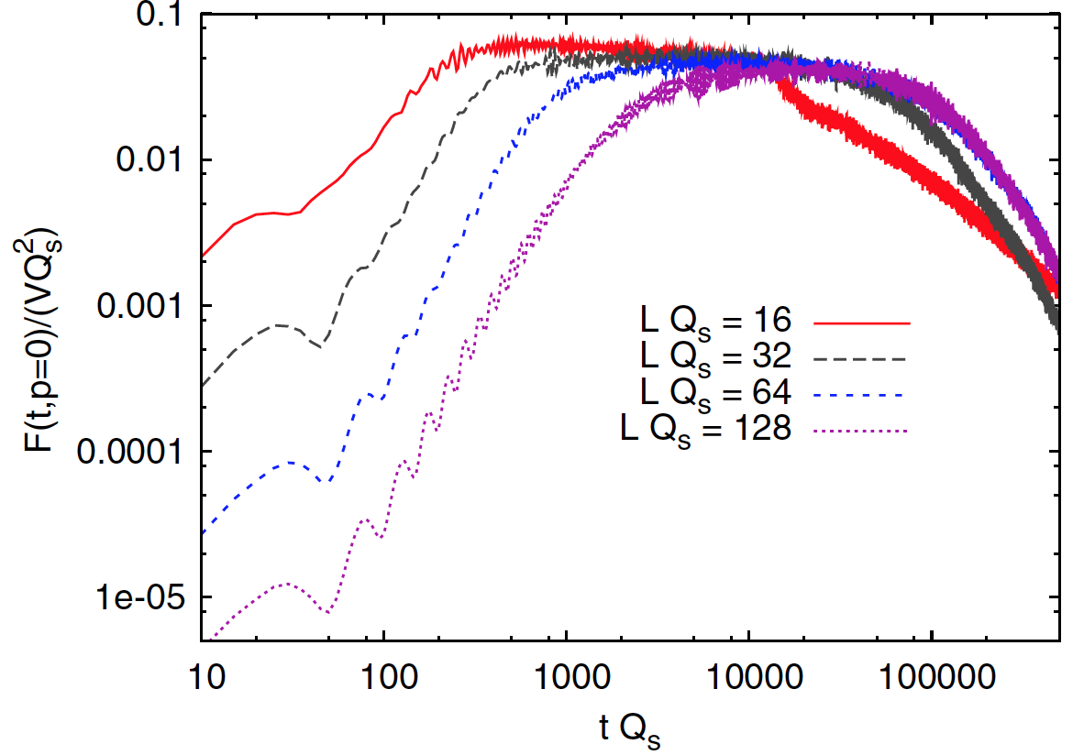
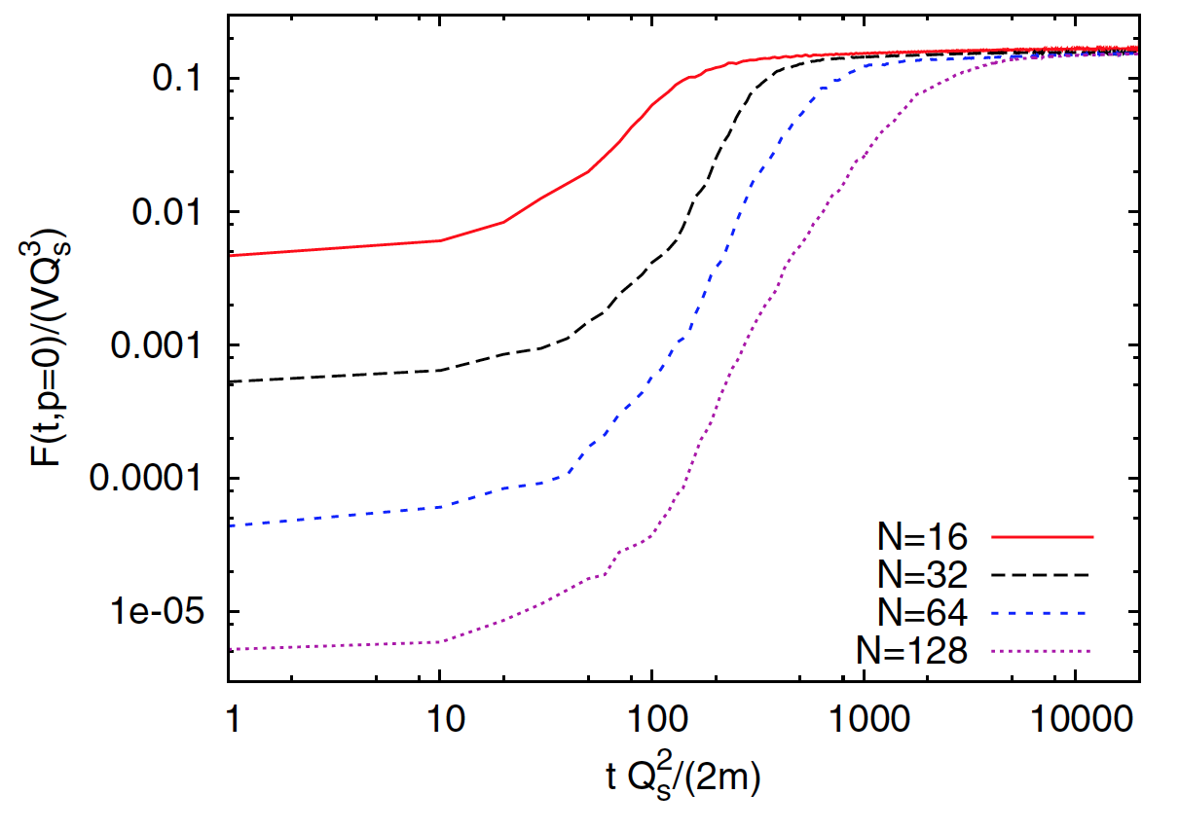
BEC with rel. scalar field or non-rel. complex field
J Berges and D. Sexty, PRL 2012
Far from equilibrium, a singularity in spectrum is generated in infrared limit.
A sizable fraction of particles condensate in the lowest energy mode
(Φ⁴ theory)
(GPE)

Slide 5
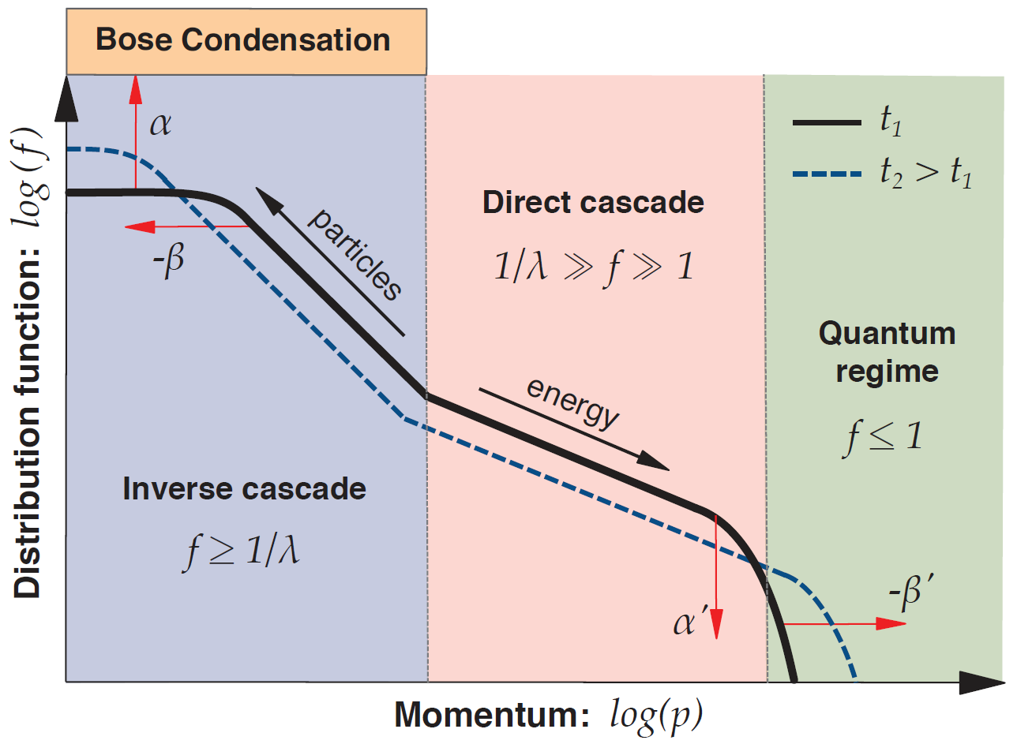
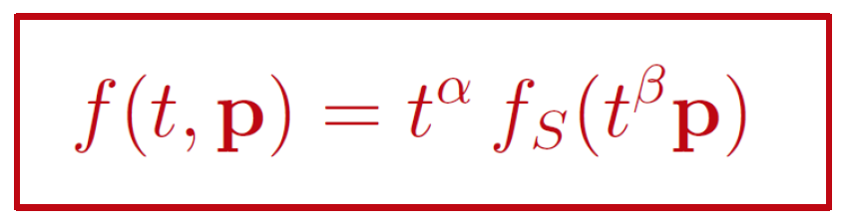
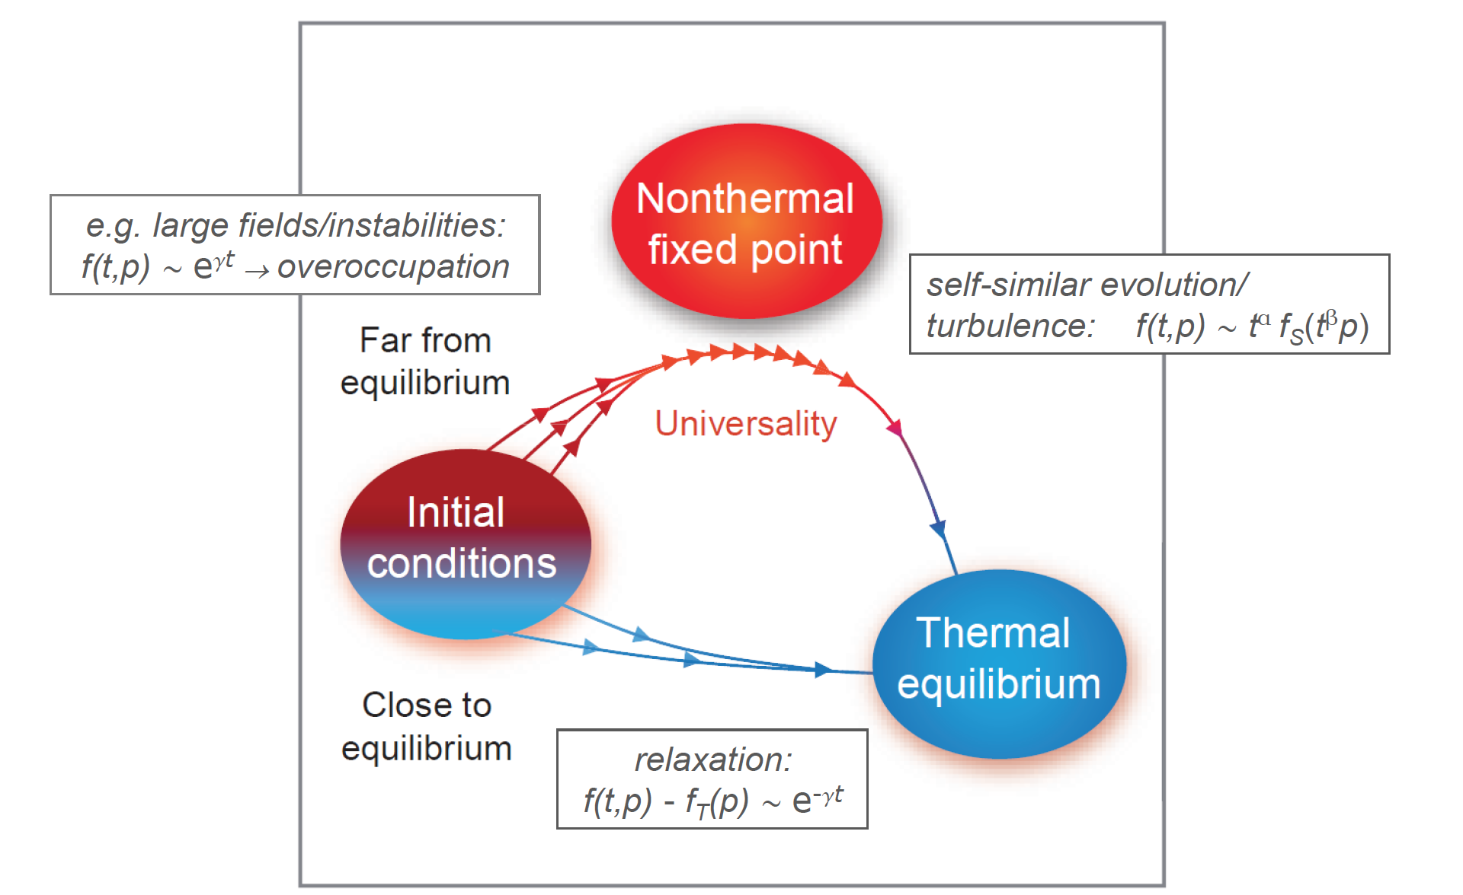
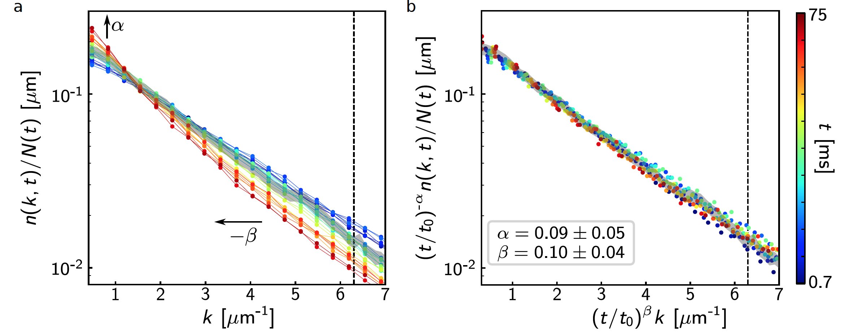
Non-Thermal Fixed Point and First Observation
Particle cascade,
Energy cascade,
Universal exponents,
Observation of universal dynamics in an isolated one-dimensional Bose gas far from equilibrium
S. Erne, R. Buecker, T. Gasenzer,, J Berges and J. Schmiedmayer, nature 2018

Slide 6
Non-thermal fixed-points & universality classes
At a non-thermal fixed point
→ Memory loss of the details of the initial conditions;
→ Self-similar evolution of distribution function f_{s}(x)
(critical slowing down)
→ Scaling behavior in time
→ Often connected to kinetic processes (turbulence) or
topological defects (vortices)
Classification: universality classes for system far from equilibrium
→ by NTFP with dynamical exponents α, β and the scaling
function f_{S}(x)
What’s the common property in rel. and non-rel. dynamics?
6

Slide 7
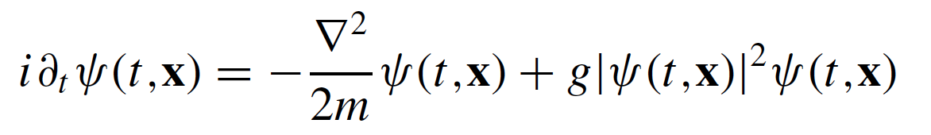
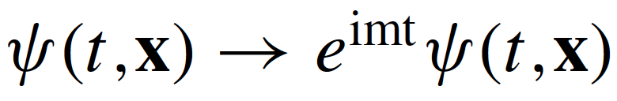

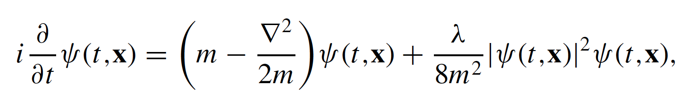
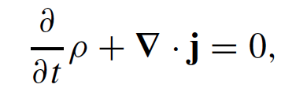
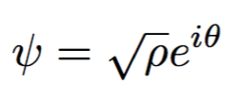
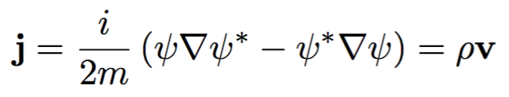
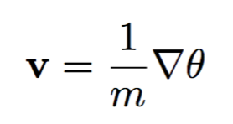
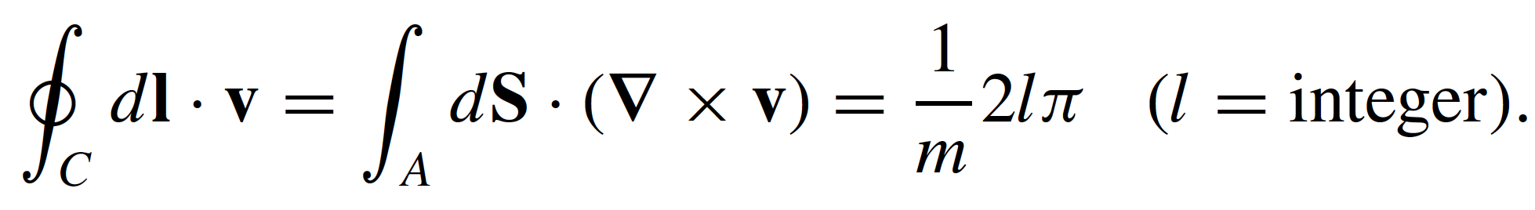
First glance of Gross-Pitaevski Equation
Constant global phase
U(1) symmetry ➔
particle number conservation:
Feynman-Onsager quantization condition:
Singular point of fluid velocity means the existence of vortex

Slide 8
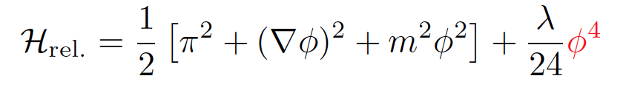
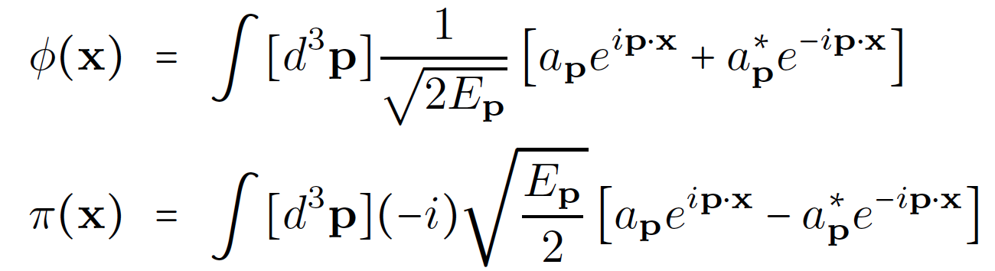
From a relativistic field theory to NREFT
Hamiltonian density of Φ⁴ theory, real scalar field and its conjugate momentum
Fourier transform to the momentum space
a_{k} and a*_{k}
all complex
classical variables
Hamiltonian with a_{k} and a*_{k}
non-resonant terms, particle number changes, break U(1)
resonant term, particle number conserves, U(1)
8

Slide 9

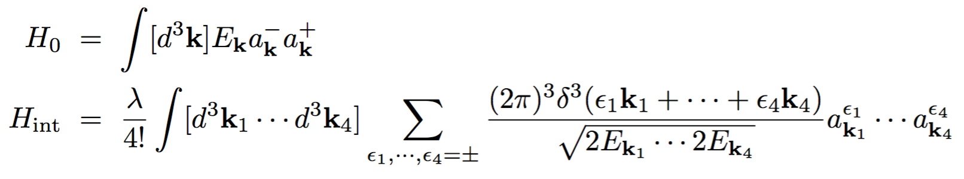
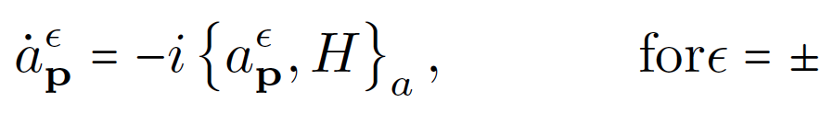
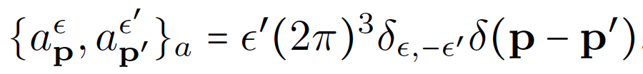
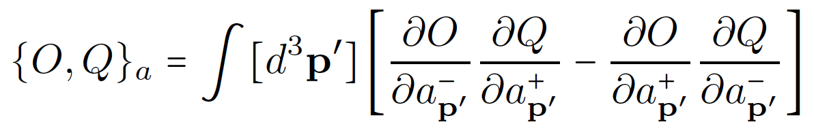


Equation of motion with Poisson Bracket
EOM:
Poisson Bracket:
Our goal:
Eliminate the “non-resonant terms”
with canonical transformation of variables
9

Slide 10

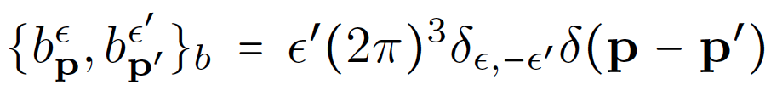
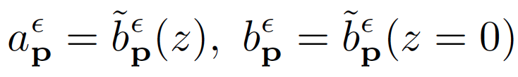
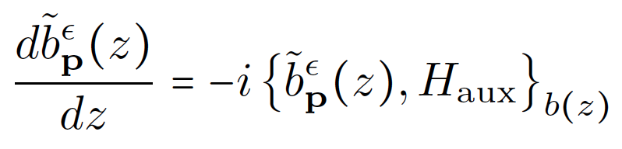
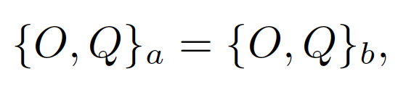
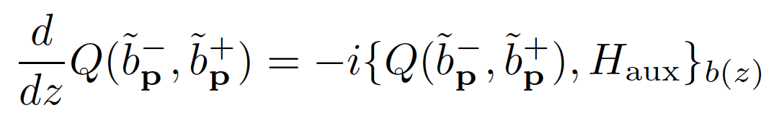
Canonical Transformation with P.B.
Construct another canonical variables, which satisfy
Introduce auxiliary time z to tune up the transform
?unknown
Auxiliary EOM on control
Properties of P. B:
1, independent of basis,
2, same EOM for functions,

Slide 11
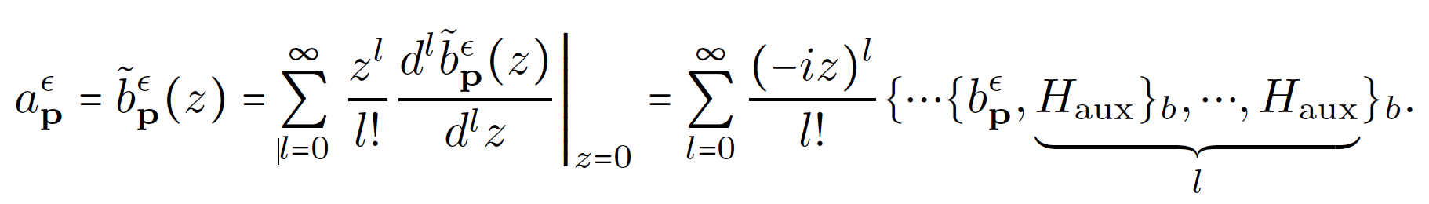
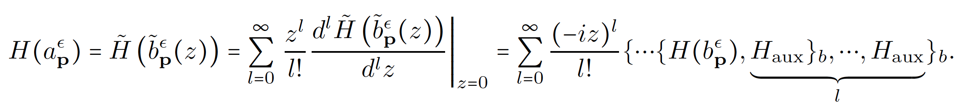
Eliminating the non-resonance terms
Taylor expansion, followed with EOM, then nested P.B.
?unknown
Ansatz:
Perform the transformation order by order, first exercise:
?
2nd order
4th order
Order = number of b_{k}

Slide 12
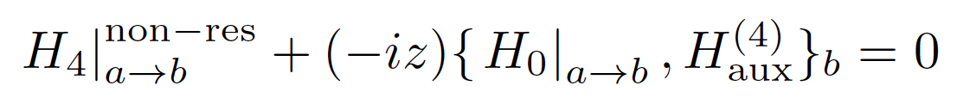
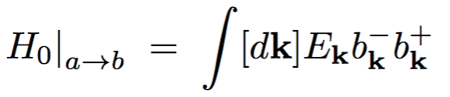
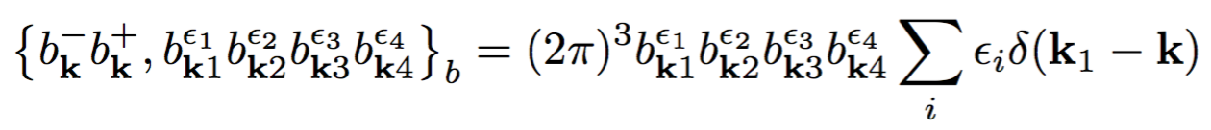
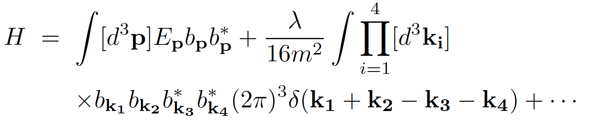
Solution at 4th order
At the lowest nontrivial order, we demand:
?
☑ known
The new Hamiltonian can serve as a NREFT at 4th order
U(1) symmetry
restored,
non-resonant
→higher order
This procedure can be proceeded iteratively and explicitily

Slide 13



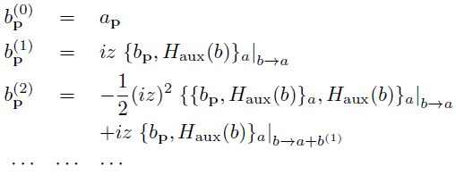
Relation between the fields, express b_{p} as function of a_{p}
With the auxiliary Hamiltonian, it is straightforward to get the relation between the field of ϕ and ψ.
In case of known , how to get , and the field ?
Change the basis from b_{p} to a_{p} for all Poisson brackets
b_{p} can be solved as a function of a_{p} perturbatively

Slide 14

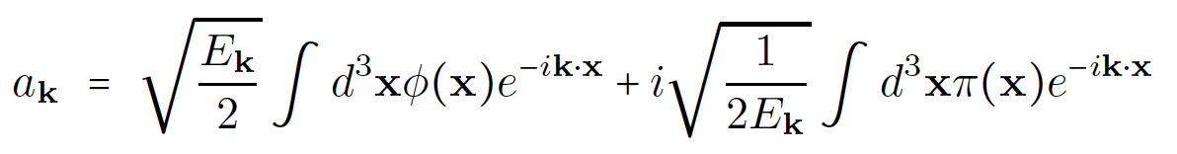
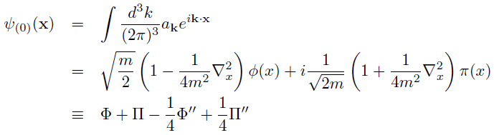


Mapping from (ϕ, π) to (ψ, ψ*)
Transform to coordinate space
Express (Ψ, Ψ*) as function of (ϕ,π). In the large mass limit, the zeroth order is
14

Slide 15


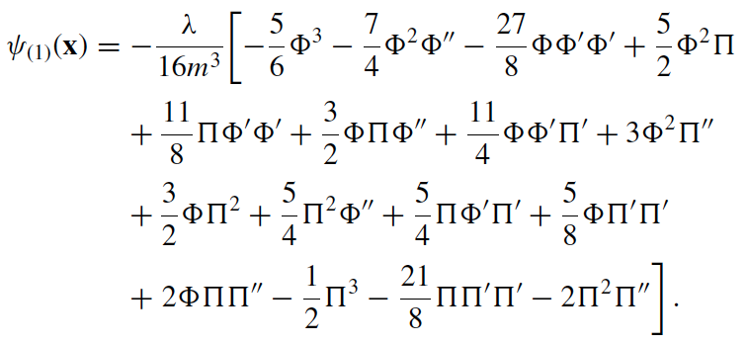
Mapping from (ϕ, π) to (ψ, ψ*)
At first order, take
➔ can be used to analyze the infrared dynamics of the relativistic ϕ field simulations, in terms of the effective non-relativistic ψ degrees of freedom

Slide 16



Power counting for this transformation
There are two directions to estimate the corrections of each higher order,
To be nonrelativistic,
the interaction energy:
the kinetic energy:
The dynamics of this system is classical, where the canonical transformation with P.B. hold on, the occupation number for
each mode must be much larger than one-half.
These two conditions are independent
With the explicit mapping and well controlled power counting, this procedure is especially suitable for the discussion of the infrared dynamics of a relativistic field theory.
It is a non-relativistic effective field theory (NREFT) built in a classical way !

Slide 17
Numerical simulation of massive relativistic scalar fields in (2+1)D
Solve classical EOM for (ϕ, π) in real time lattice simulation
With fluctuating initial condition
Single particle distribution
Sampled with Gaussian magnitude and uniform random-phase distribution
Fourier transform of ϕ(t,x) and π(t,x)
17

Slide 18
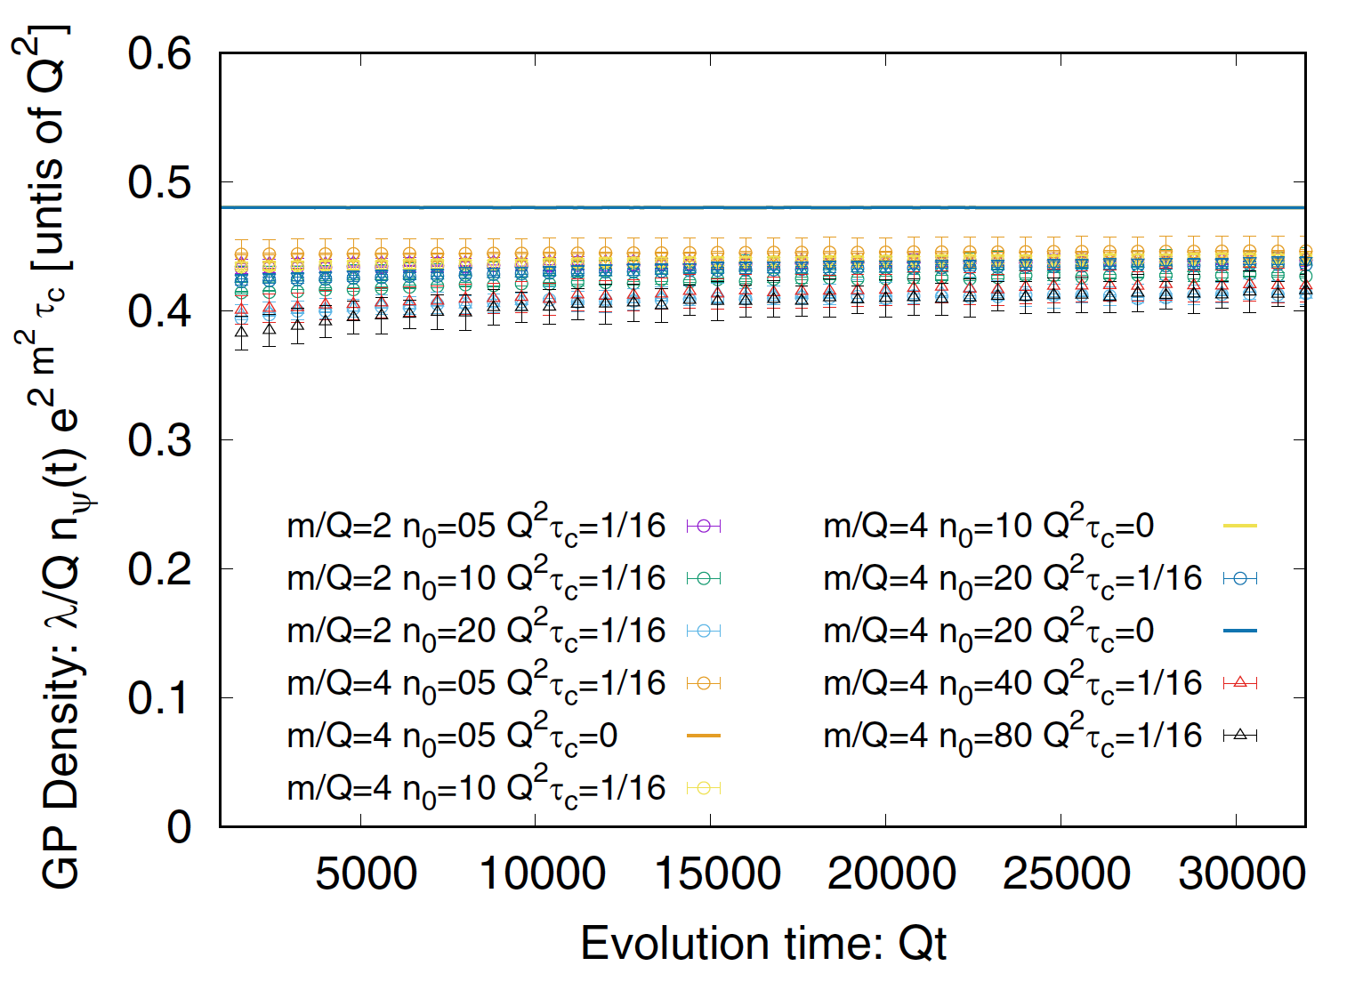
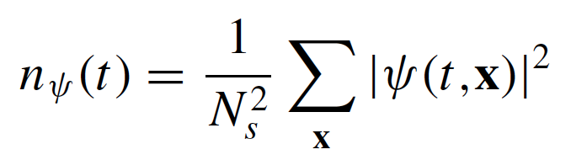
Number density evolution
The number density of nonrelativistic modes is approximately conserved on average.
The coupling between soft and hard modes appears to be weak.
The IR dynamics can be studied separately from UV cascade.
18

Slide 19
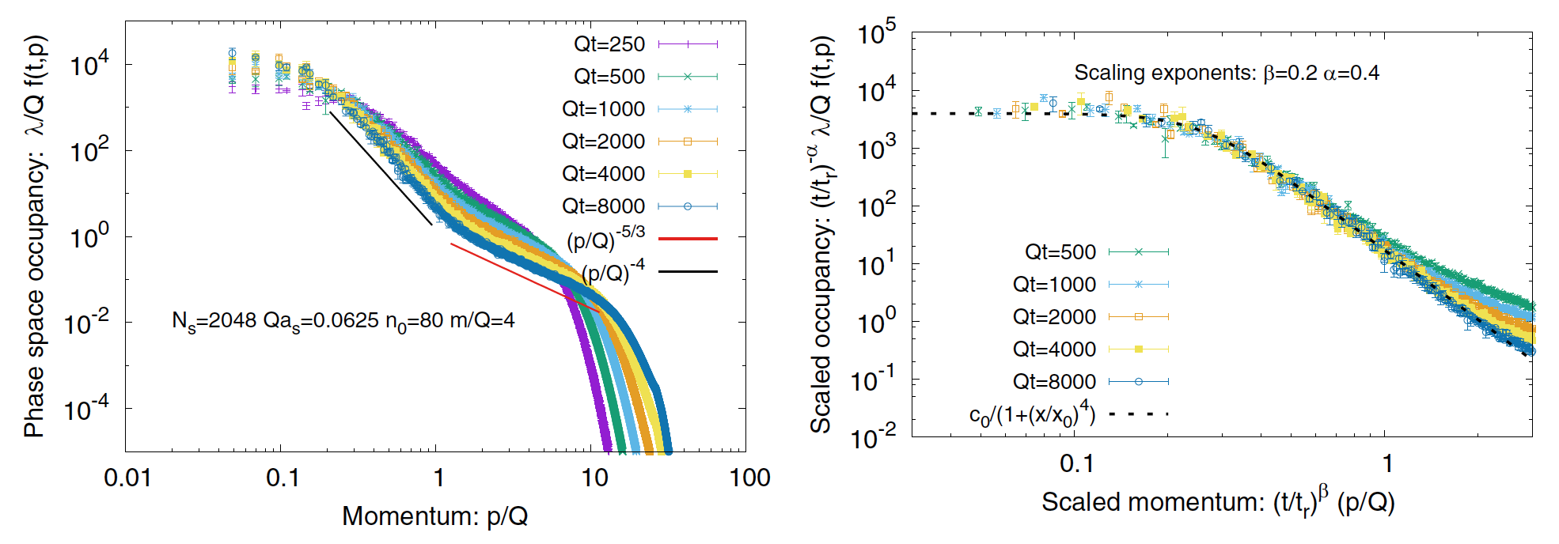
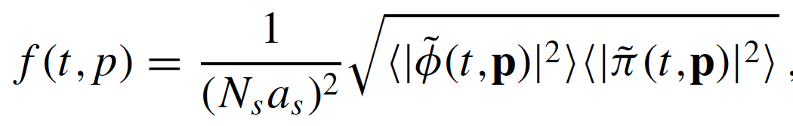

Spectrum evolution – NTFP with anomaly
Momentum spectrum of massive relativistic scalar theory in 2-D
✔ Non-thermal IR fixed-point associated with self-similar cascade
✗ Different exponents from 2PI 1/N prediction
♬ Anomalous scaling, vortex cluster, weak coupling to thermal noise
Strongly anomalous NTFP, M. Karl and T. Gasenzer, New J. Phys. 2017

Slide 20
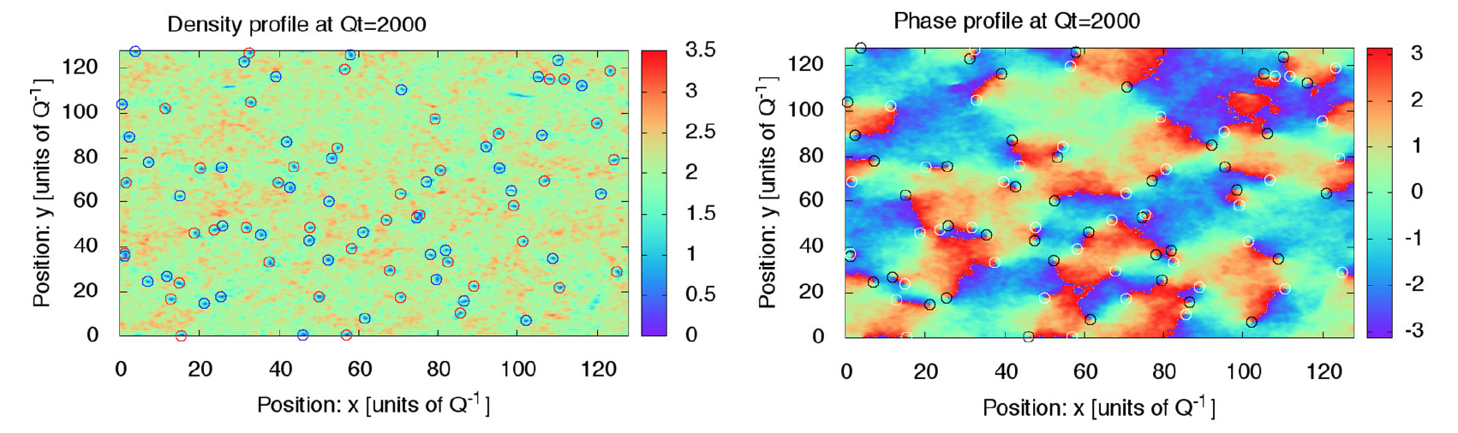


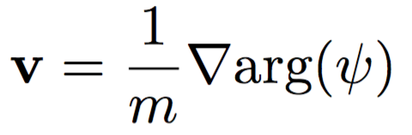
Spatial structure of ψ field, vortex
Striking similarities with previous observations
in the simulations of Gross-Pitaevskii equation
Clear evidence of long lived vortex defects
20

Slide 21
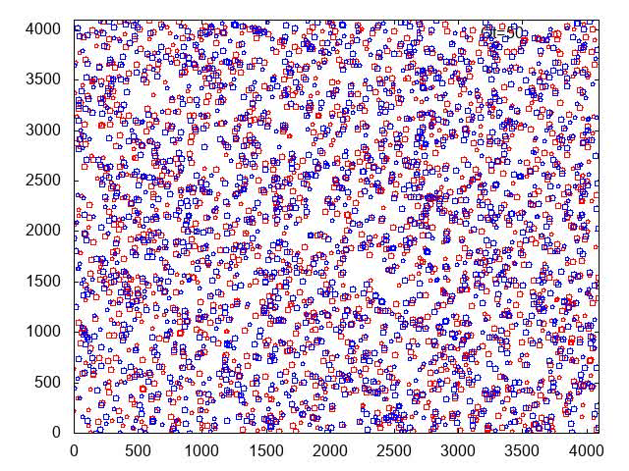
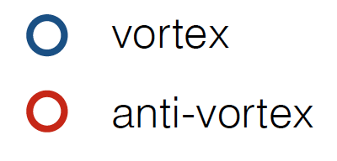
Evolution of vortex and anti-vortex

Slide 22
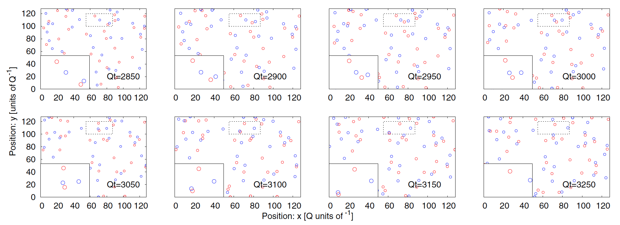
Interaction between vortex and anti-vortex
Vortex-antivortex annihilation occurs frequently at initial stage.
Slowing down toward later time, vortex-antivortex pairs bounded.
Annihilation occurs via multiple vortices int., pair+single, pair+pair

Slide 23
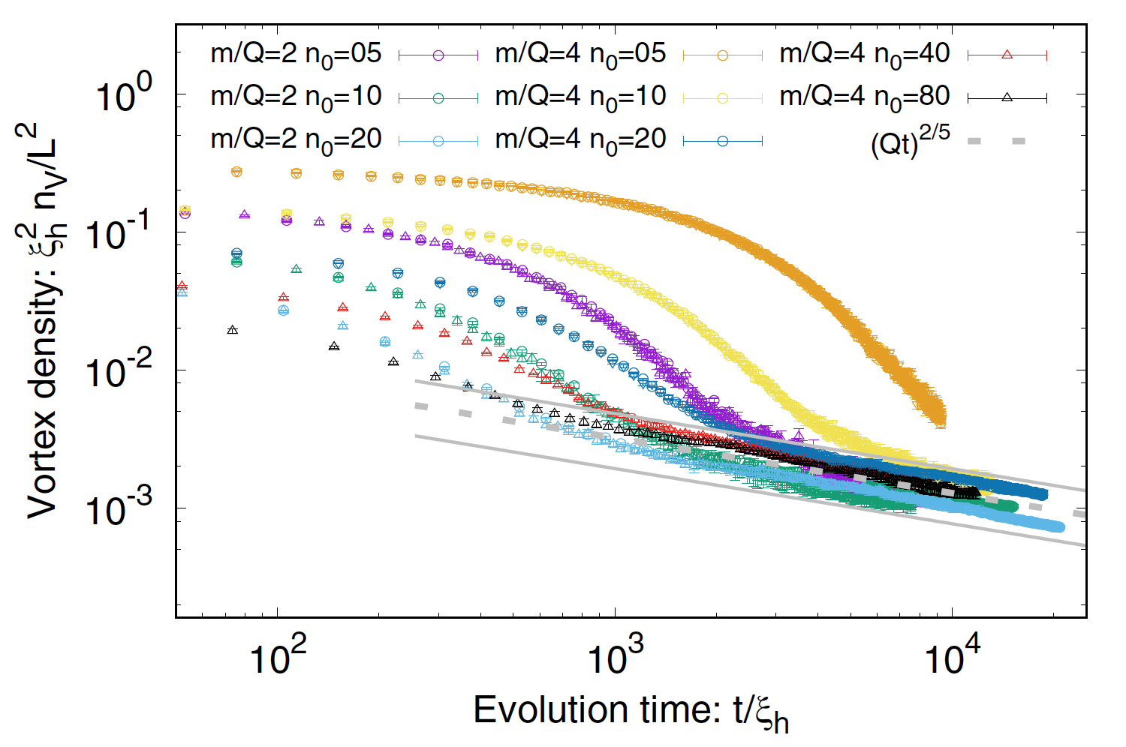
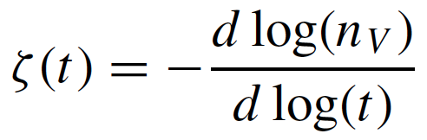

Time evolution of vertex density
Evolution of self-similar spectrum +
vortex interaction
coincide with “strongly anomalous”
NTFP with GPE
Decay of vortex density consistent with vortex kinetic picture near the strongly anomalous NTFP, which is responsible for the smaller scaling exponents.
ζ =2/5 in Karl and Gasenzer, New J. Phys, 2017
23

Slide 24
Summary
A mapping between the relativistic scalar field ϕ and the non-relativistic complex ψ field is established explicitly and systematically. Serve as NREFT.
The infrared feature of the dynamical evolution of a self-interacting relativistic field is observed, which is well described by GPE with U(1) symmetry.
3. A NTFP with “strongly anomalous” scaling is numerically observed ,
which can be understood with the correlated vortex dynamics.
Outlook
1. Global polarization → vorticity, vortex dynamics.
Dark matter, axion …...

Slide 25
Summary
A mapping between the relativistic scalar field ϕ and the non-relativistic complex ψ field is established explicitly and systematically. Serve as NREFT.
The infrared feature of the dynamical evolution of a self-interacting relativistic field is observed, which is well described by GPE with U(1) symmetry.
3. A NTFP with “strongly anomalous” scaling is numerically observed ,
which can be understood with the correlated vortex dynamics.
Thanks
Outlook
1. Global polarization → vorticity, vortex dynamics.
Dark matter, axion …...

