Slide 1
Spin effects from quantum transport theory
Jian-Hua Gao (高建华)
Shandong University at Weihai
ArXiv:1902.06510 JHG and Z.T. Liang
The Workshop on QCD Physics & Study of the QCD Phase Diagram and New-type Topologic Effect
Weihai，China， July 17 – July 25，2019

Slide 2
Outline
Introduction
Quantum Transport Theory
Spin Effects from Quantum Transport Theory
Summary and Outlook

Slide 3
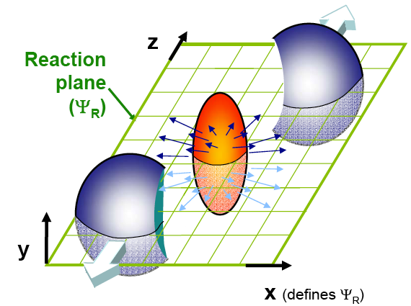

Global Polarization in HIC
Global polarization induced by the global strong vorticity:
$$\vec{ω}$$
Z.T. Liang, X.N. Wang, PRL 94 (2005) 102301
STAR collaboration, Nature 548 (2017) 62-65
See Wang’, Niida’s and Huang’ talks
Notes:
3
3

Slide 4
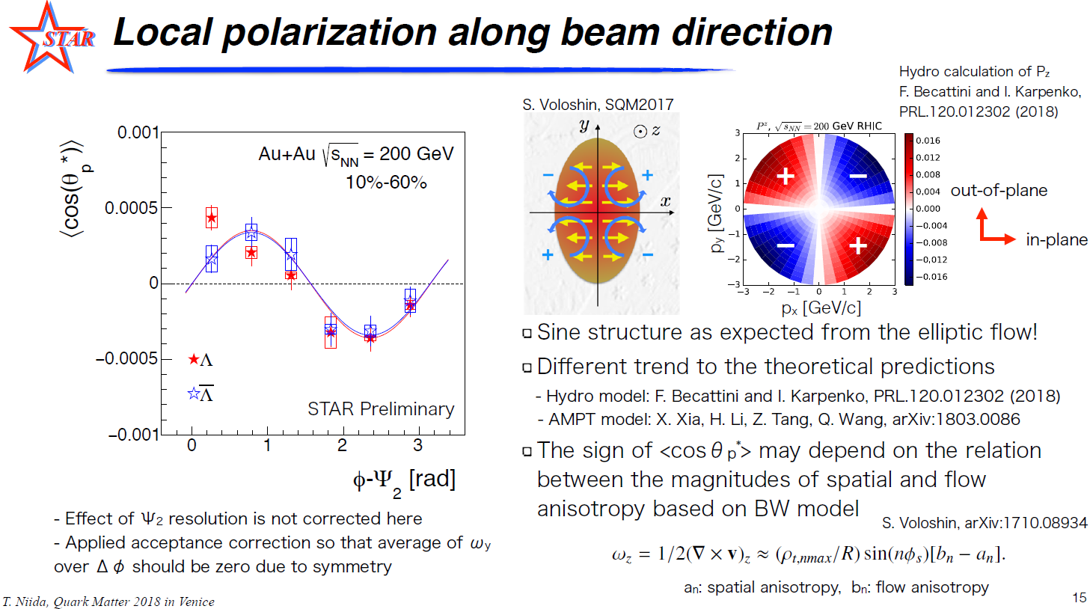
Local Polarization in HIC
Local polarization induced by the local strong vorticity:
S.Voloshin SQM2017
F.Becattini and I. Karpenko PRL 120.012302(2018)
See Wang’, Niida’s and Huang’ talks
Notes:
4
4

Slide 5
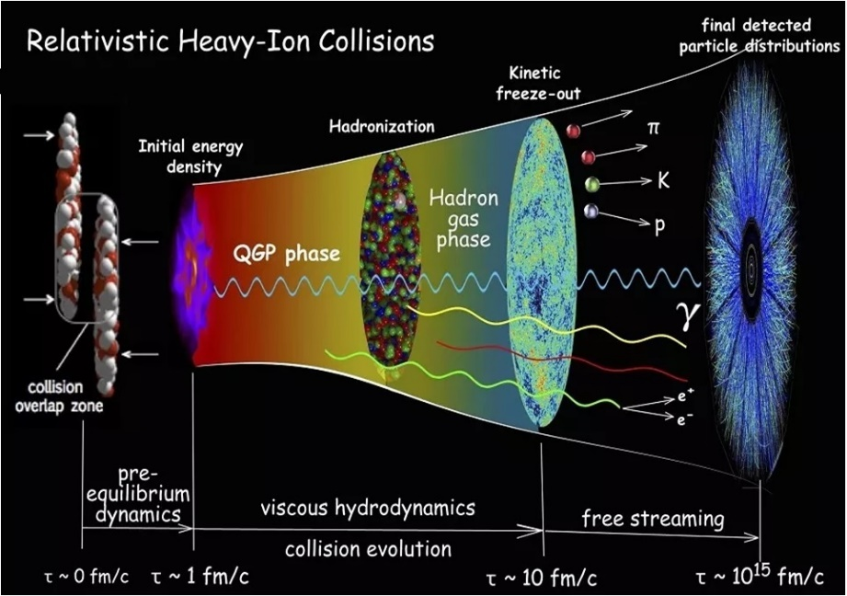
Quantum Transport Theory
Made by Chun Shen
Non-equilibrium Effect
Spin polarization Effect
Quantum Transport Theory
Hydrodynamics with Spin:
Florkowski, Friman, Jaiswal & Speranza PRC2018; Becattini & Karpendo PRL2018;
Florkowski, Speranza & Becattini APPB2018;Becattini, Florkowski & Speranza PLB2019;
Hattori, Hongo, Huang, Matsuo & Taya 1901.06615 … … … …
See Huang’ talk
Notes:
5
5

Slide 6
Quantum Transport Theory
……
Heinz PRL1983
Vasak, Gyulassy, Elze NPB 1986; AP1987
Elze, Heinz, Phys. Rept.1989
Zhuang, Heinz, AP1996; PRD1998
Ochs,Heinz, AP1998
……
Gao, Liang, Pu, Wang, Wang PRL2012
Chen, Pu, Wang, Wang PRL 2013
Hidaka, Pu, Yang PRD2017
Huang, Shi, Jiang, Liao, Zhuang PRD2018
Gao, Liang, Wang, Wang PRD 2018
……
Gao, Liang 1902.06510；
Weickgenannt, Sheng, Speranza, Wang 1902.06510；
Wang, Guo, Shi, Zhuang 1903.03461；
Hattori, Hidaka, Yang 1903.01653
……
…….
Stephanov, Yin PRL2012;
Son & Yamamoto PRD2013;
Manuel & Torres-Rincon PRD2014;
Chen, Son & Stephanov PRL2015
Mueller & Venugopalan PRD2018;
Lin & Shukla JHEP 2019
…….

Slide 7
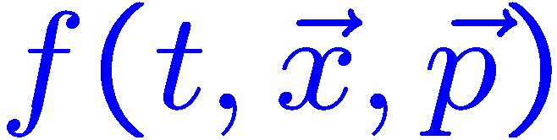
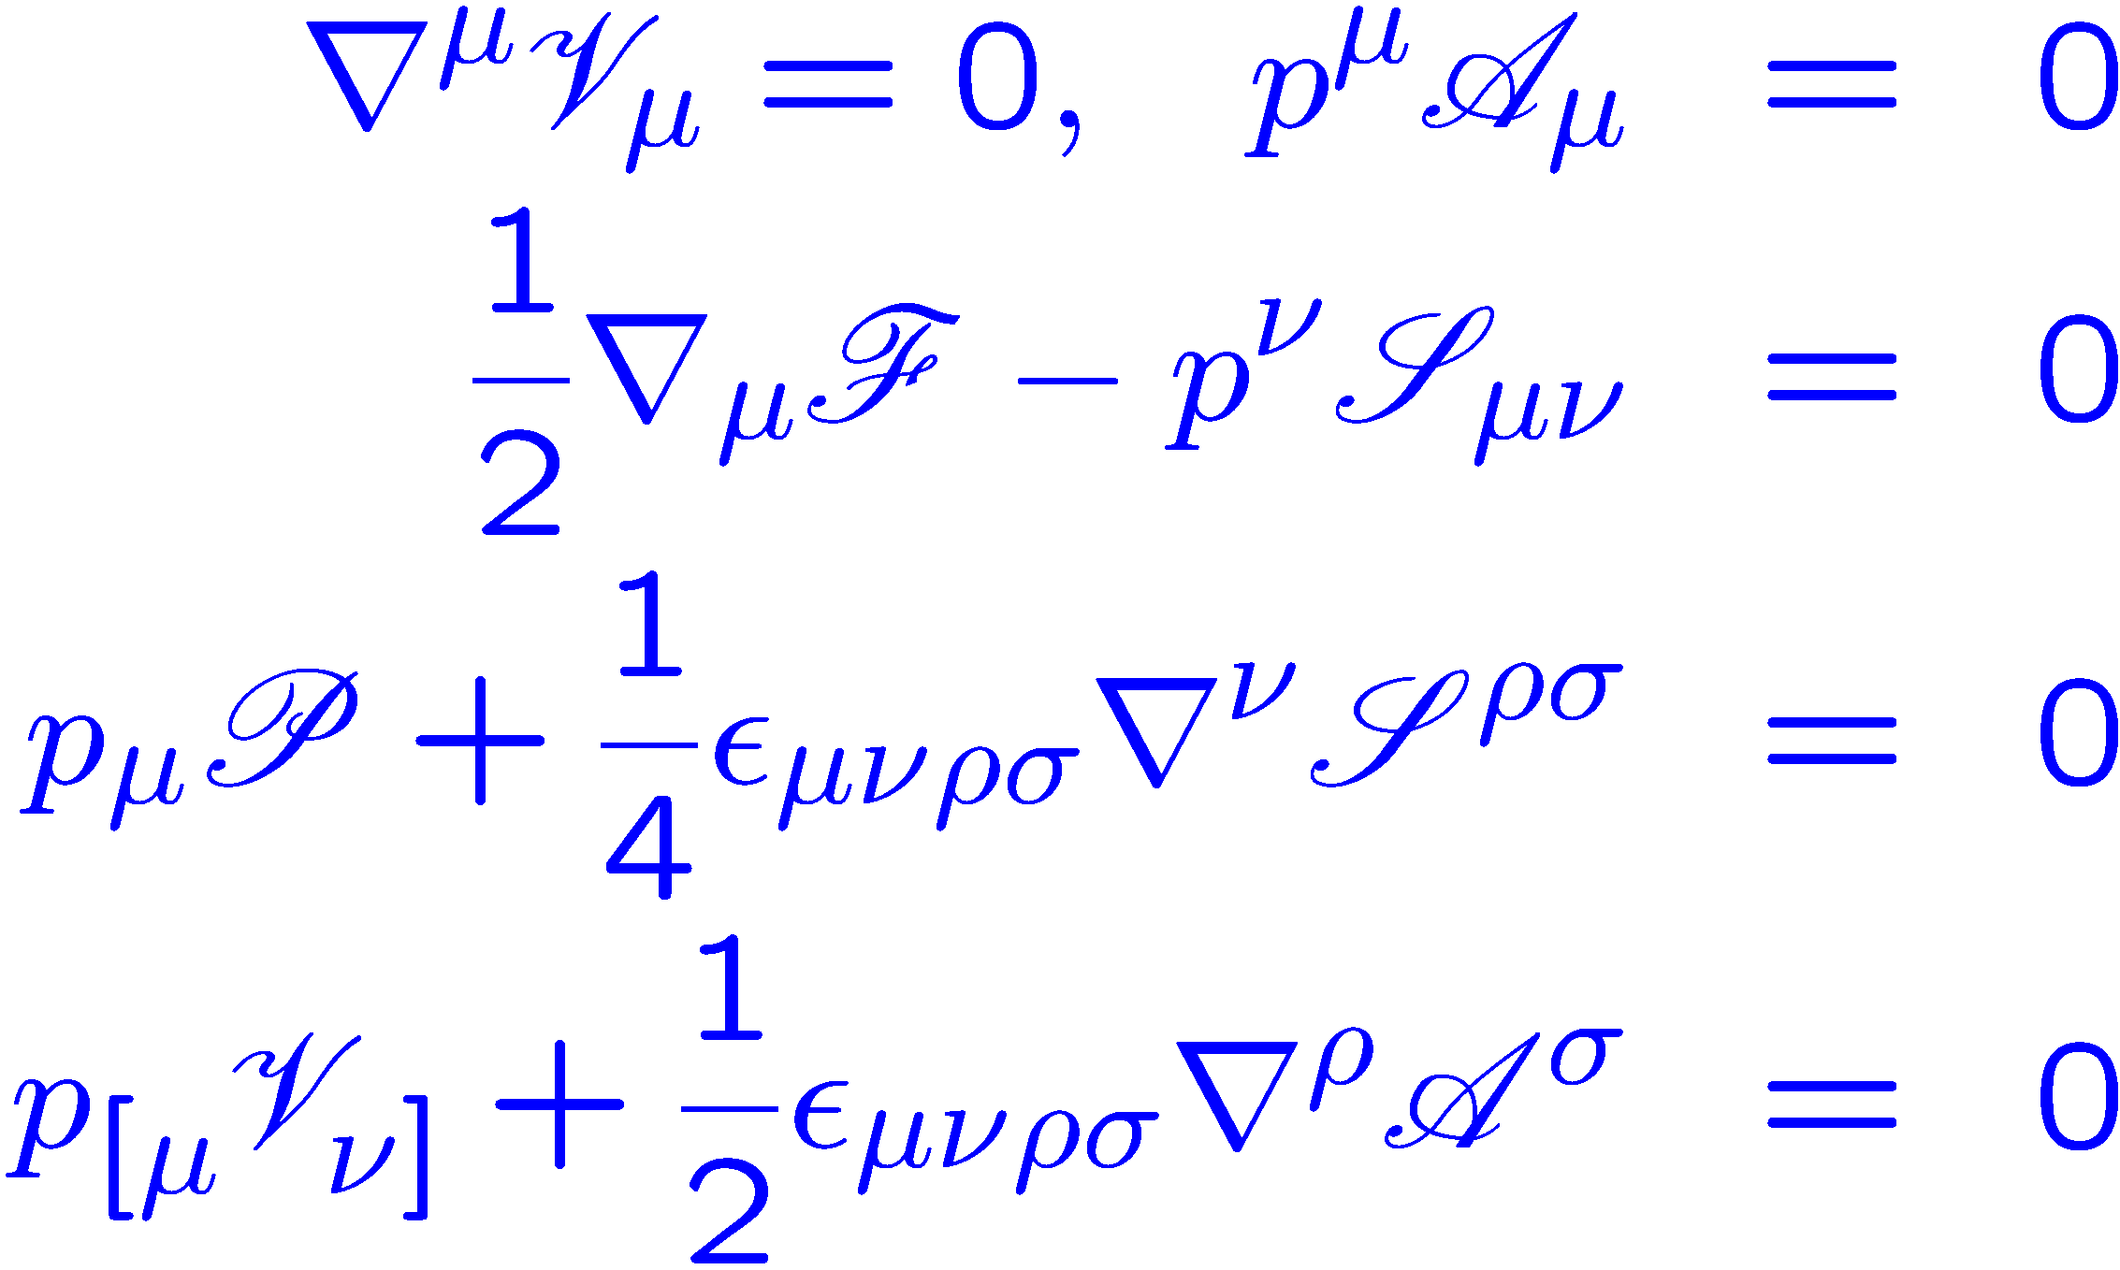
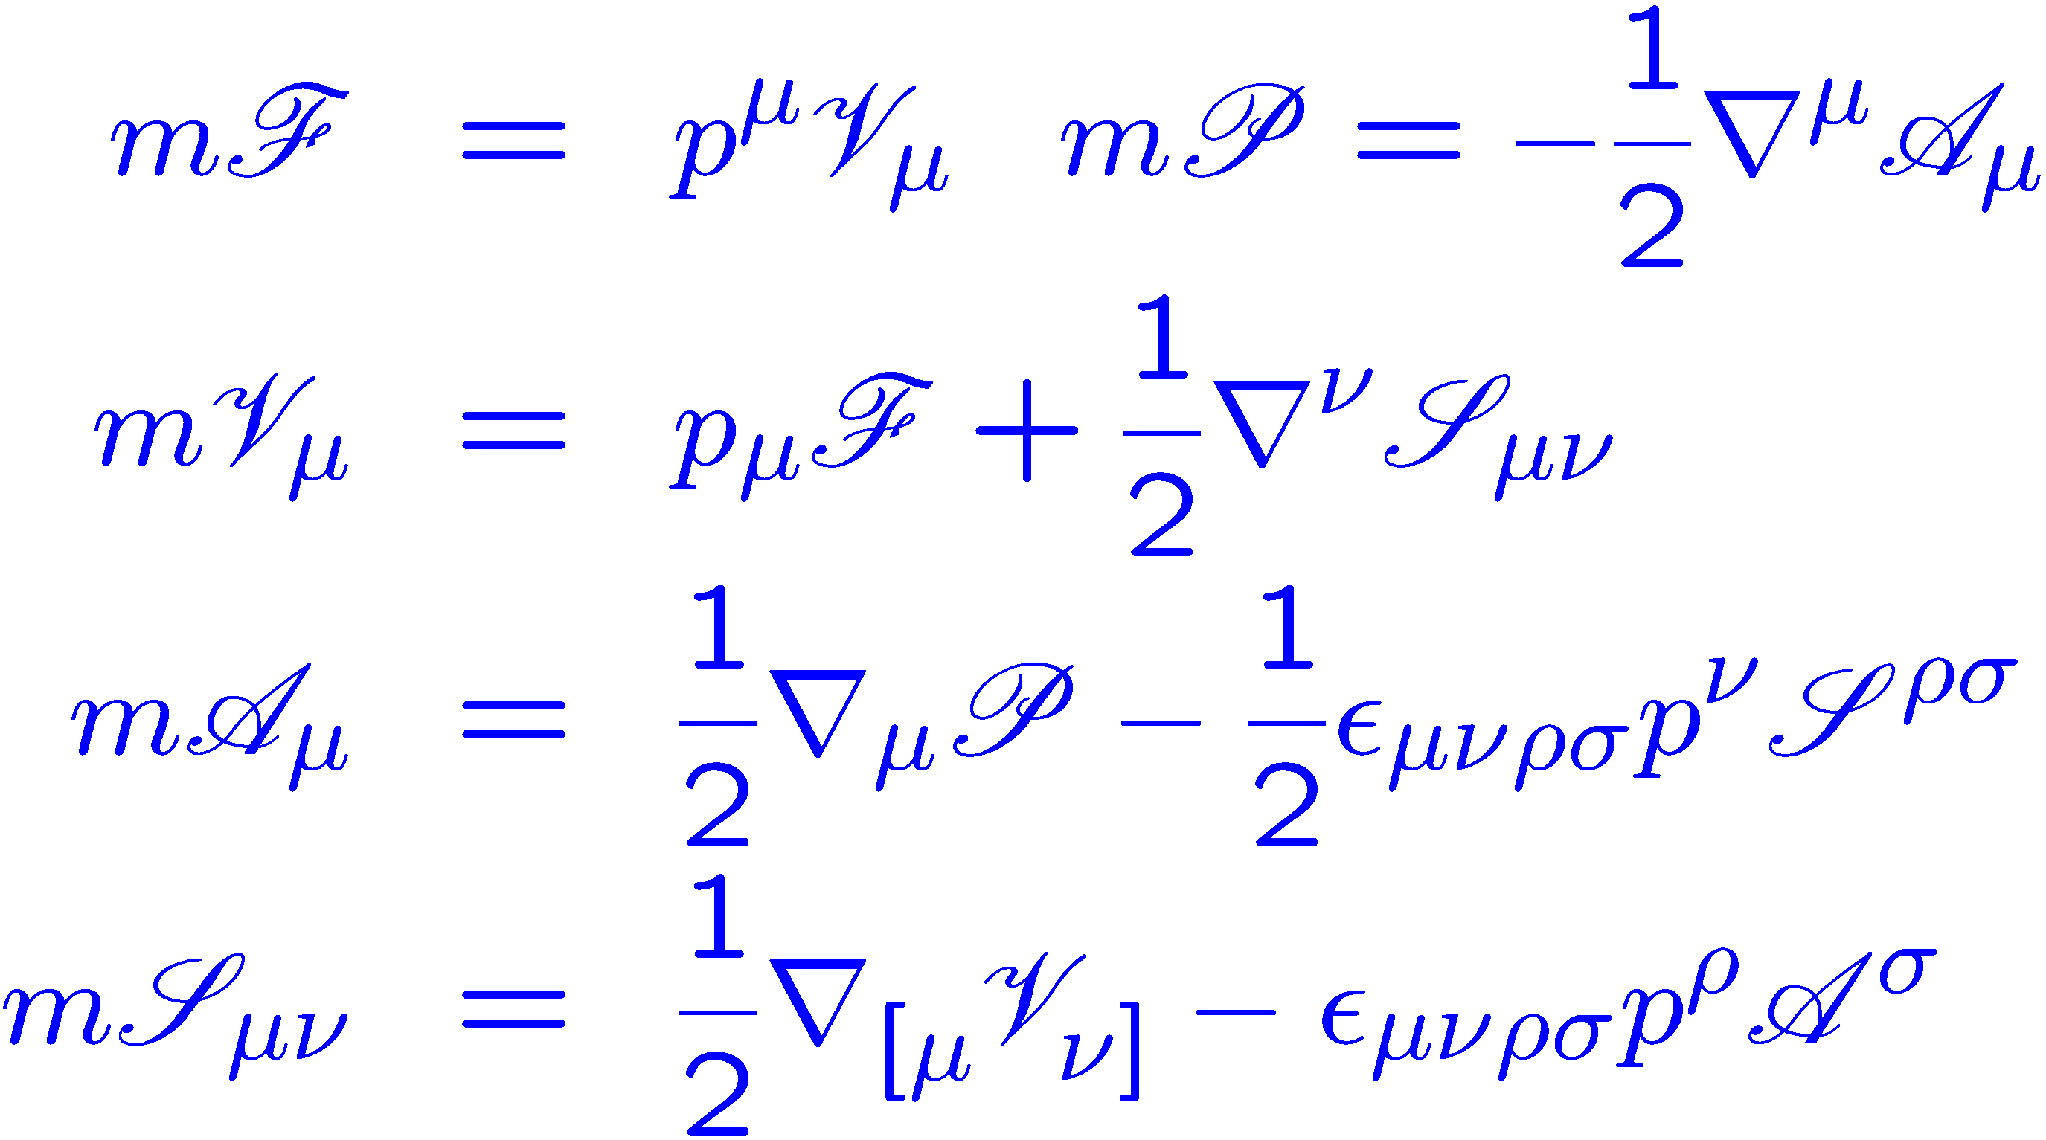
Classical VS Quantum Transport
Classical transport theory:
1 distribution function :
1 Boltzmann equation:
Quantum transport theory:
scalar pseudo vector axial tensor
16 Wigner functions:
Spin 1/2
32 Wigner equations:
Background approximation
Vasak, Gyulassy, Elze, Annals Phys. 1987

Slide 8






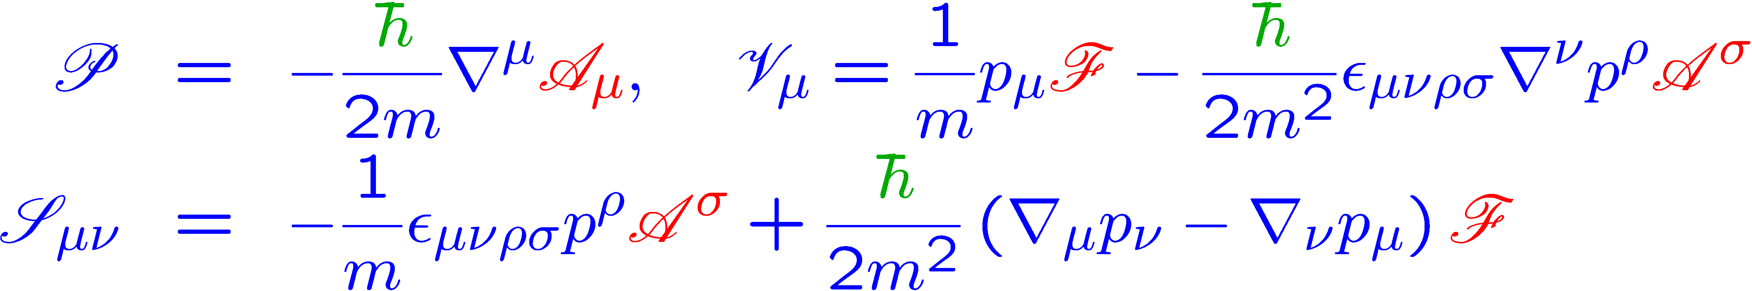
Wigner functions
Physical meaning of Wigner functions:
Mass density, particle number distribution function
space components: spin density, spin polarization vector
Charge density and current density, current vector
space components: magnetic moment density
Pseudo scalar density
Vasak, Gyulassy, Elze, Annals Phys. 1987;
Bialynicki-Birula, Gornicki, Rafelski PRD 1991
Choose and as the independent fundamental components
Eleven of 32 provide the expressions of other components:
Other works:
Weickgenannt, Sheng, Speranza, Wang & Rischke 1902.06513;
Hattori, Hidaka & Yang 1903.01653; Wang, Guo, Shi & Zhuang 1903.03461

Slide 9
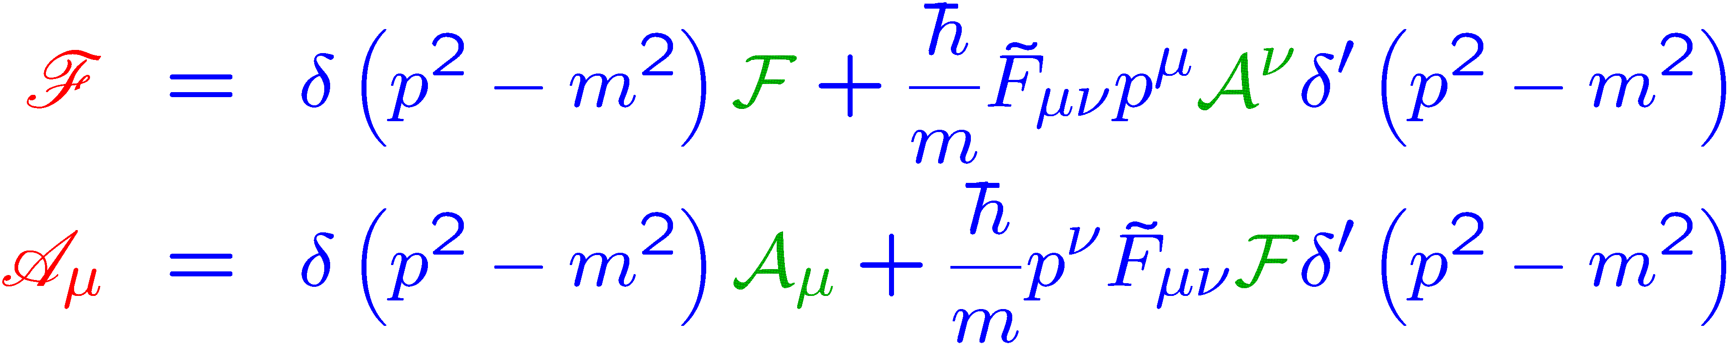


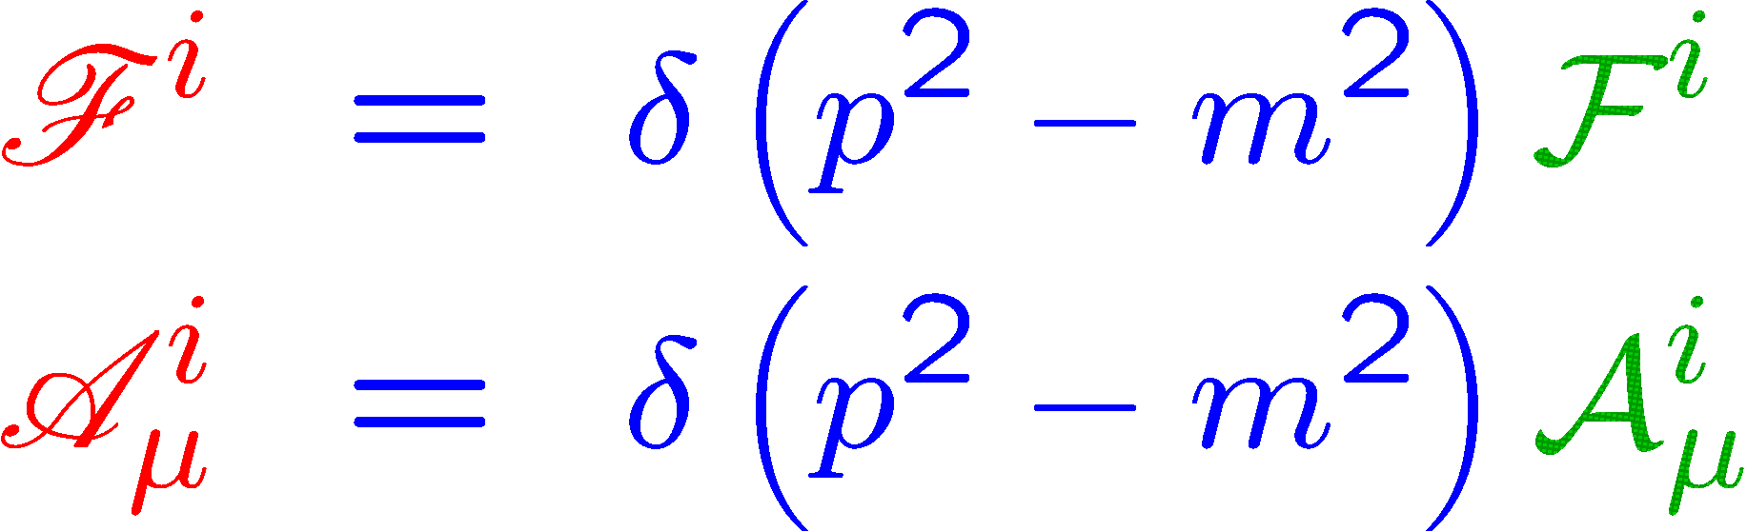
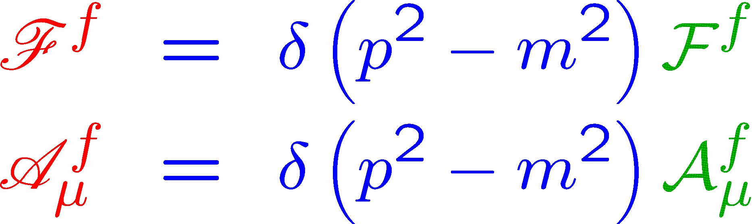





New Wigner functions
Five of 32 give the modified on-shell conditions:
Regard and as new independent Wigner functions.
Convenient to deal with transient EM field or scattering process:
Interaction
$$t<t_{i},{ F}^{μν}=0$$
$$t_{i}<t<t_{f},{ F}^{μν}≠0$$
$$t>t_{f},{ F}^{μν}=0$$
$$t=t_{i}$$
$$t=t_{f}$$

Slide 10
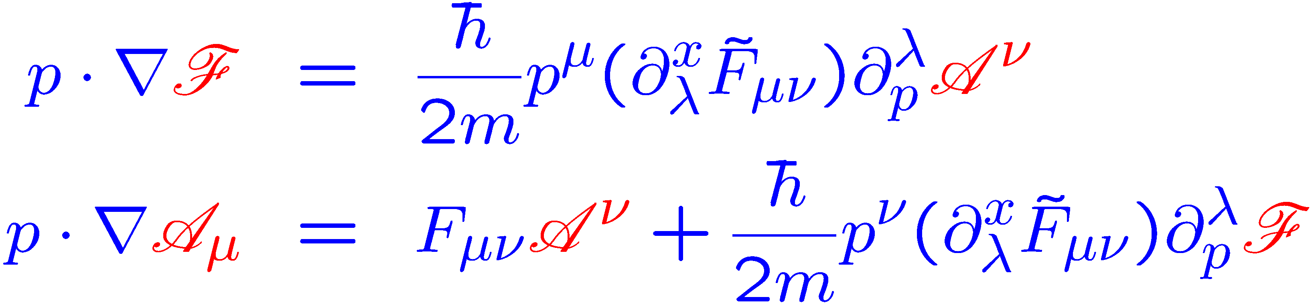
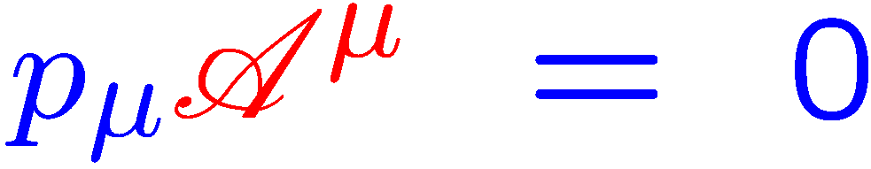
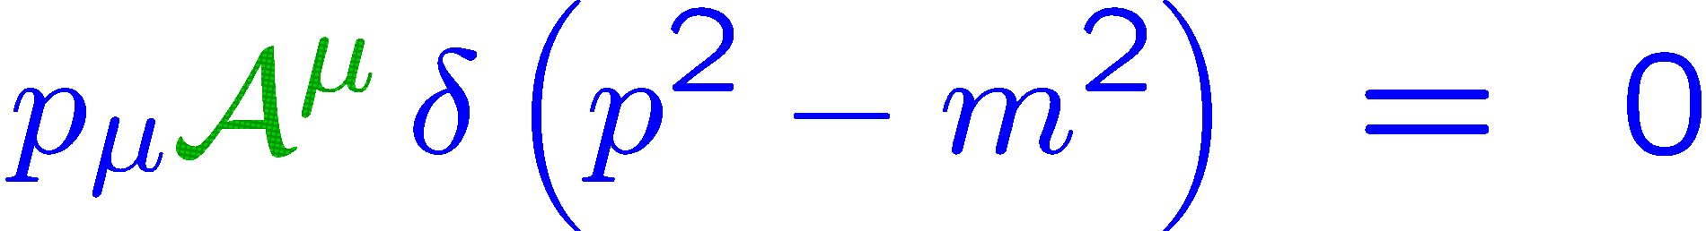
Independent Functions and Equations
Five of 32 lead to coupled transport equation for and :
One of 32 provide a subsidiary condition:
All the rest 10 of the 32 Wigner equations are satisfied automatically !
4 independent Wigner functions + 4 transport equations
Vasak, Gyulassy, Elze Annals Phys. 1987； ArXiv:1902.06510 JHG and Liang

Slide 11

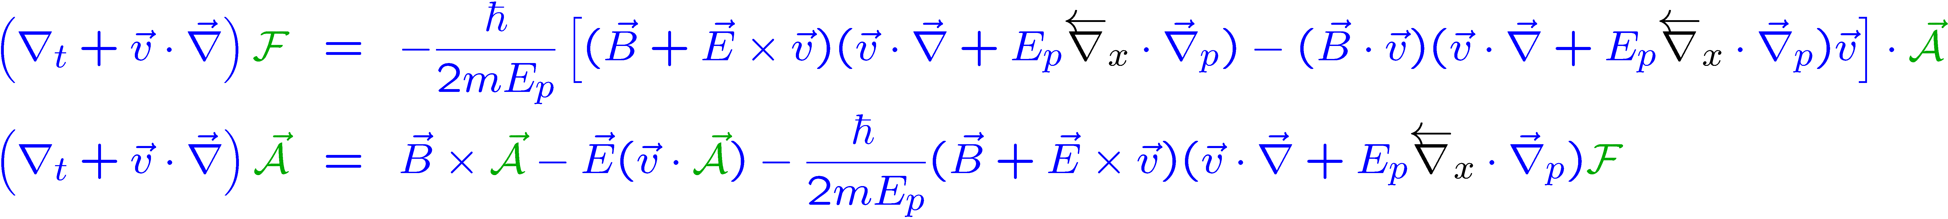
Integrated Kinetic Equations
Unintegrated kinetic equations in 4-vector form:
Manifest Lorentz Covariance ! Singular Dirac delta function !
Integrated kinetic equations in 3-vector form:
Manifest Lorentz Covariance Broken! More suitable for simulation!

Slide 12
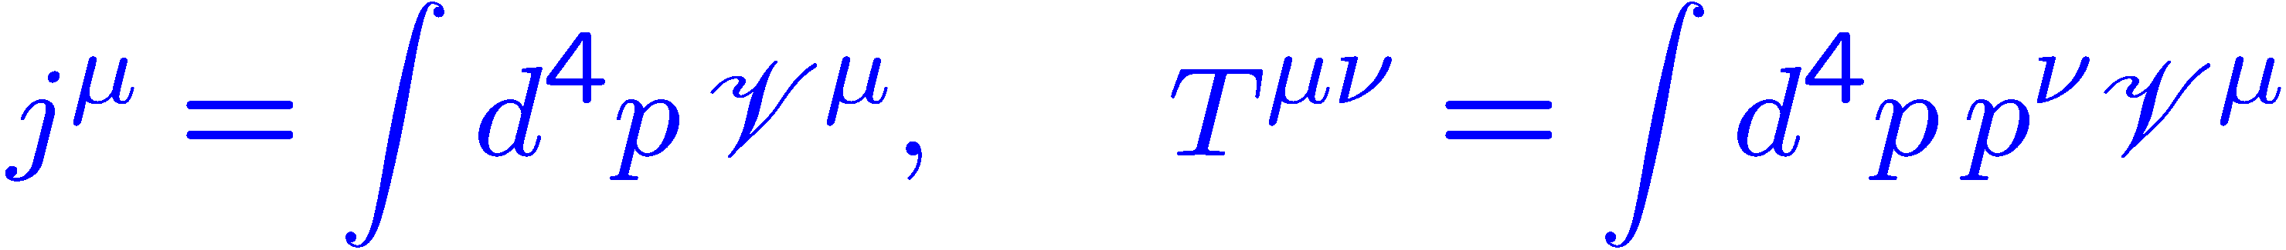
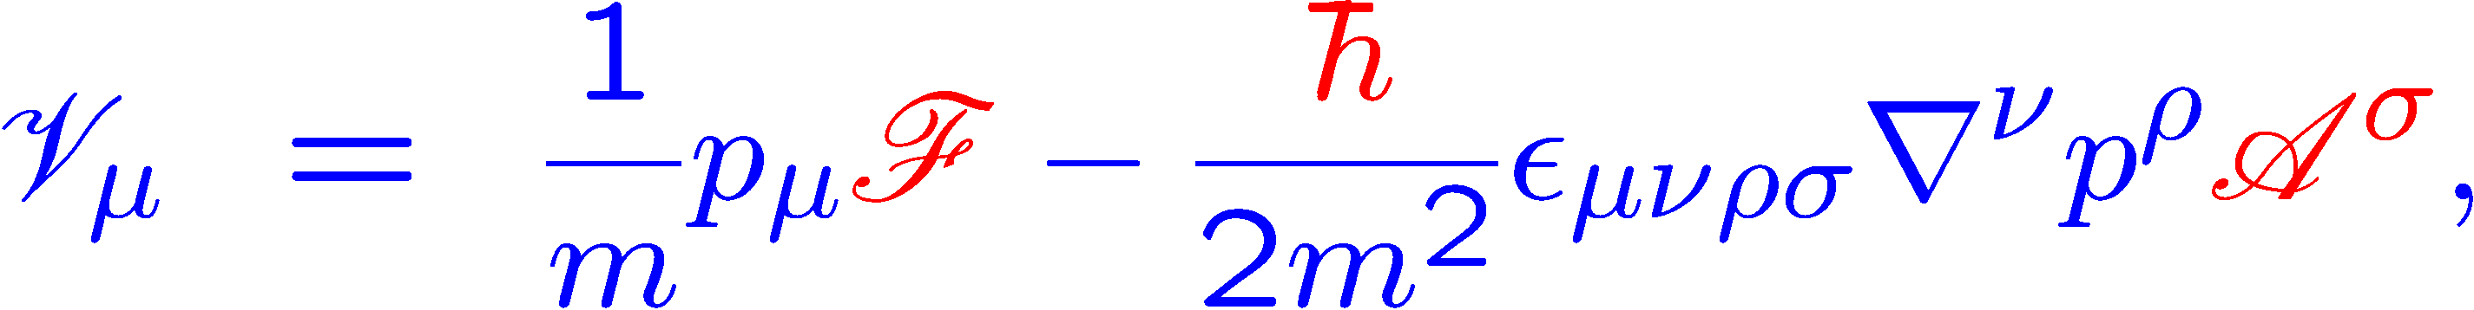
Simplified Version
Vector current and energy-momentum tensor at $O(ℏ)$:
Covariant unintegrated kinetic equations for at $O(1)$ :
+
Inserting the solved into the transport equation for

Slide 13
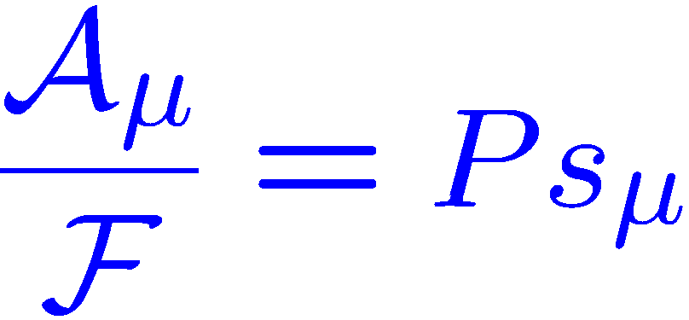
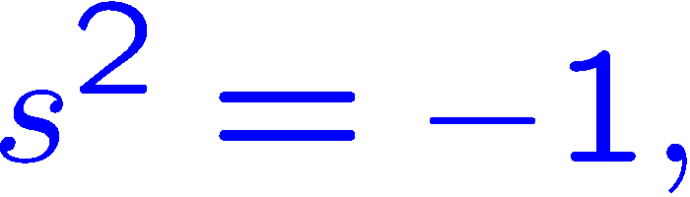
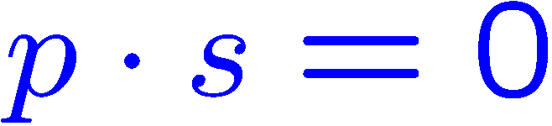


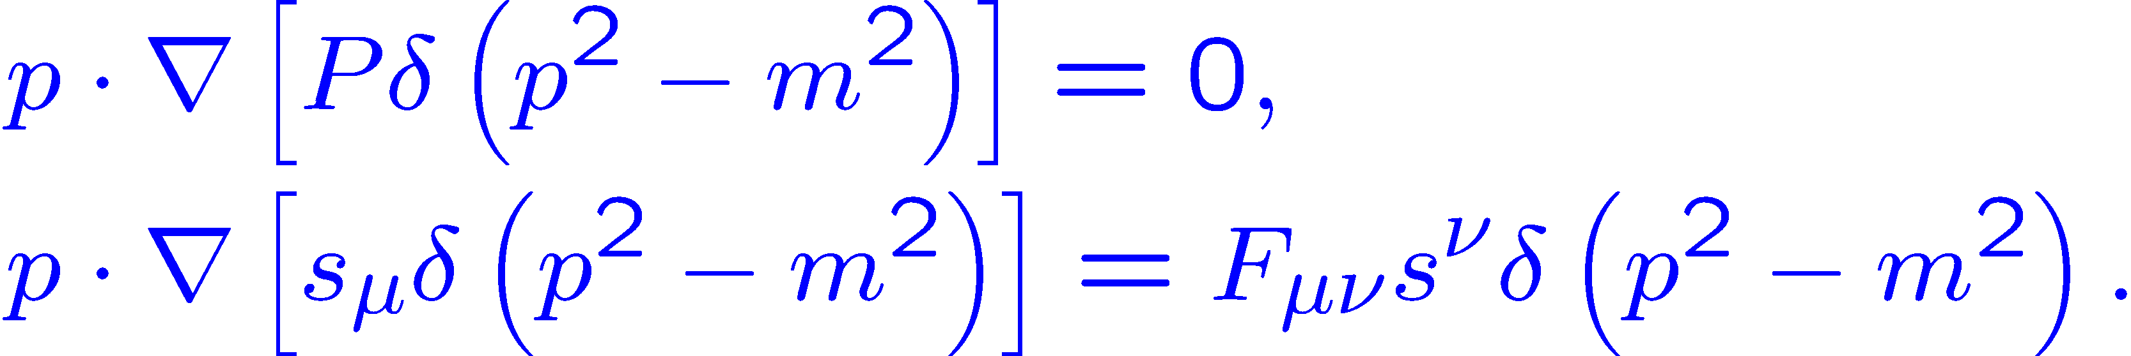

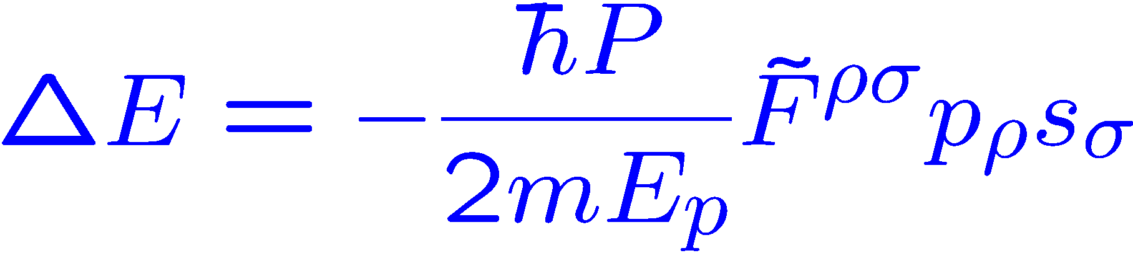


Simplified Version
$P$ : Spin polarization magnitude
Define:
$s^{μ}$ : Spin polarization direction
Decoupled equations for and :
Vlasov equation:
BMT equation:
Rewrite the transport equations for as:
The effective interaction energy:

Slide 14
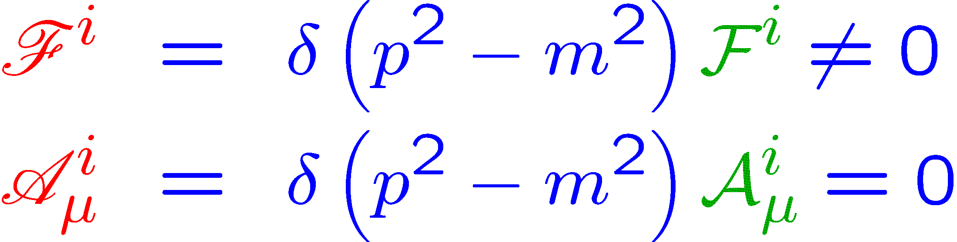
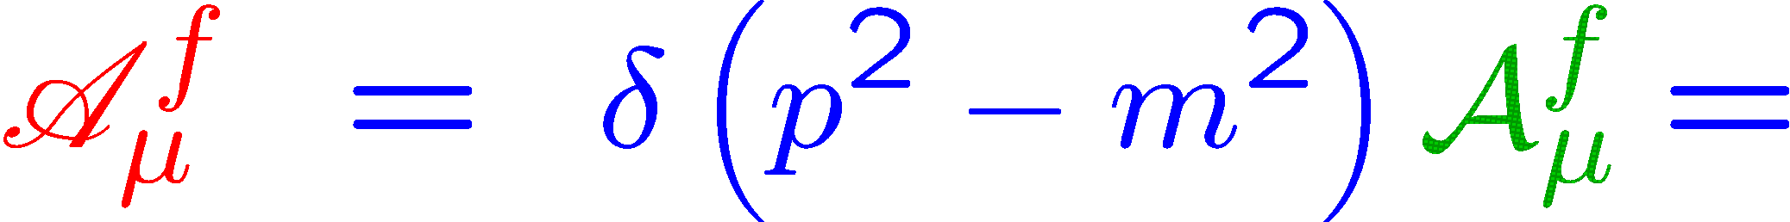
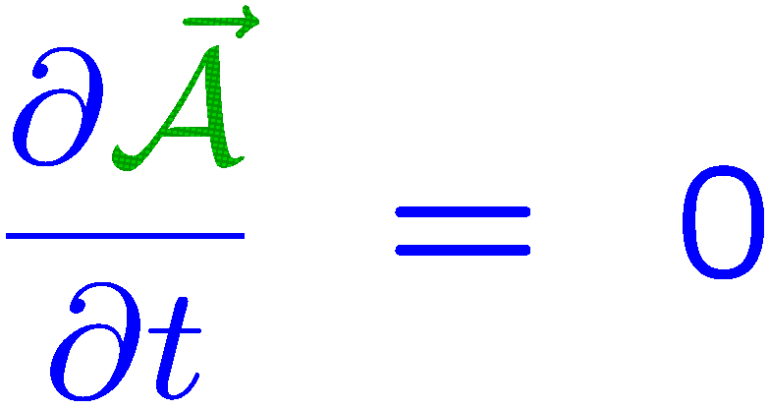
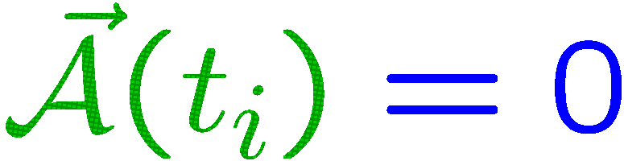






Spin Polarization Generation
Transient EM field process:
Interaction
?
$$t<t_{i},{ F}^{μν}=0$$
$$t_{i}<t<t_{f},{ F}^{μν}≠0$$
$$t>t_{f},{ F}^{μν}=0$$
$$t=t_{i}$$
$$t=t_{f}$$
Evolution equation for spin polarization vector up to $O(1)$:
near $t_{i}$
No way to generate the polarization from a zero initial value !

Slide 15
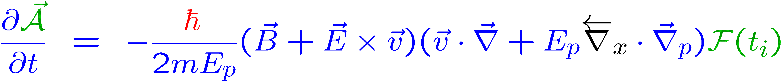
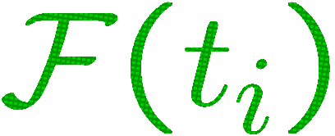
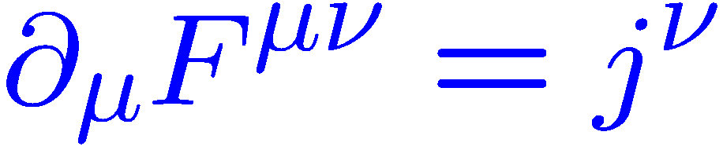
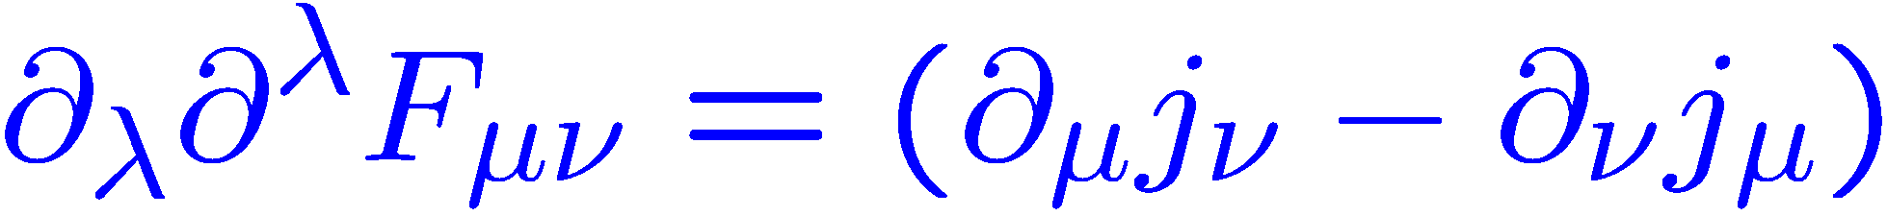



Spin Polarization Generation
Evolution equation for spin vector up to $O(ℏ)$:
near $t_{i}$
Polarization seed: EM field + inhomogeneous
Self-consistent background EM field:
Vasak, Gyulassy, Elze, Annals Phys. 1987
Global polarization:
Vorticity $→$EM field $→$ polarization
Particle scattering generation: arxiv:1904.09152,
Wang’ talk

Slide 16


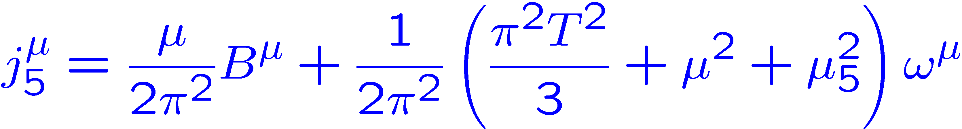
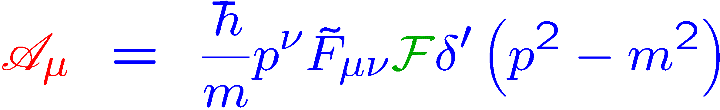
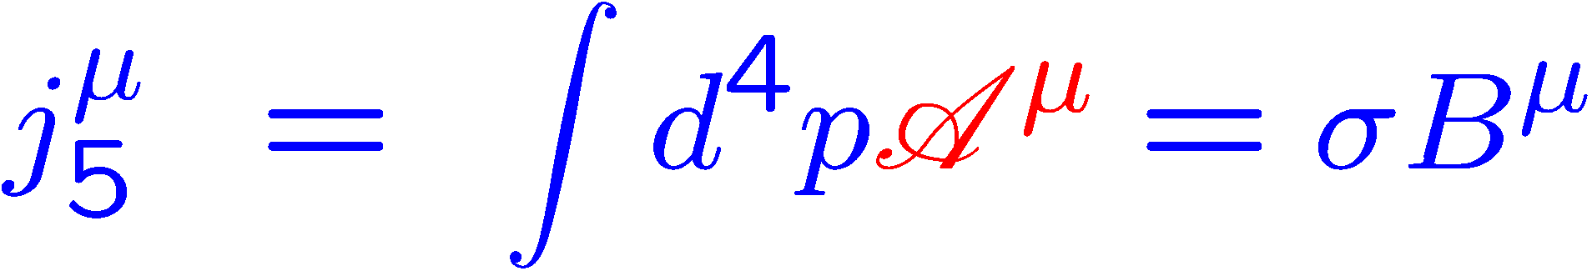
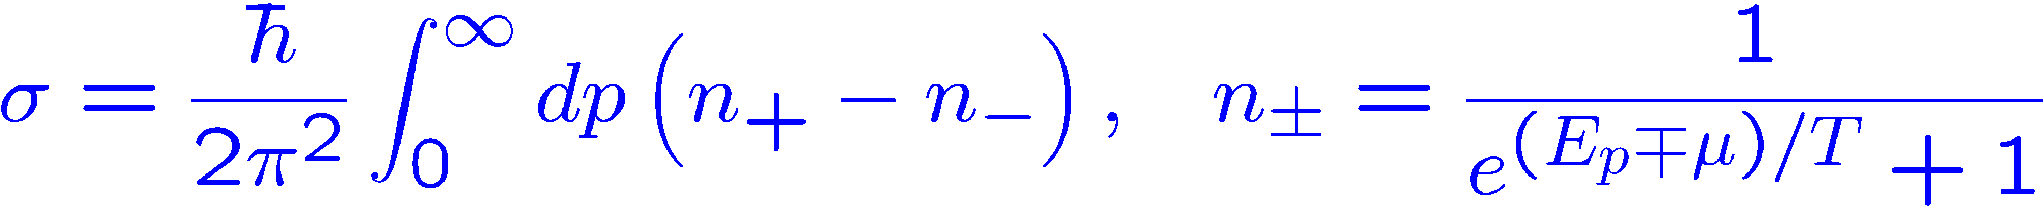
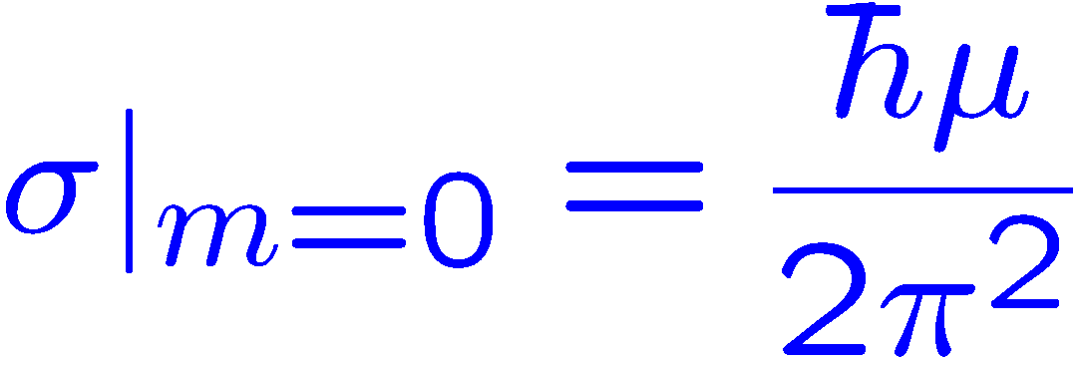
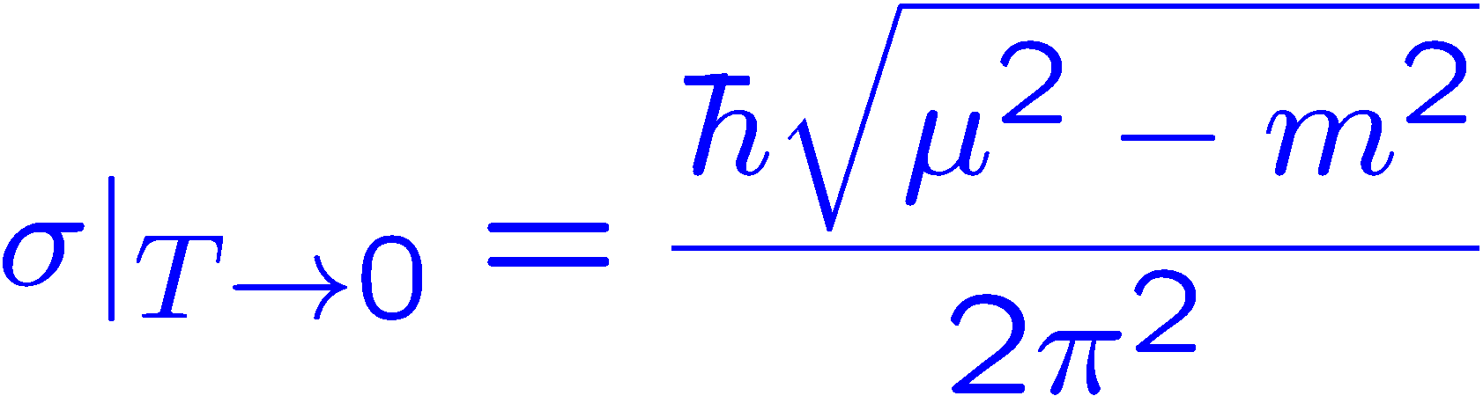


CSE with mass correction
Chiral separation effect:
Global equilibrium solution with constant $Ω_{μν} \& F_{μν}$
$$β_{μ}=u_{μ}/T$$
$$Ω_{μν}=∂_{μ}β_{ν}−∂_{ν}β_{μ}$$
Lin & Yang PRD2018
Chiral limit:
Zero temperature limit:

Slide 17
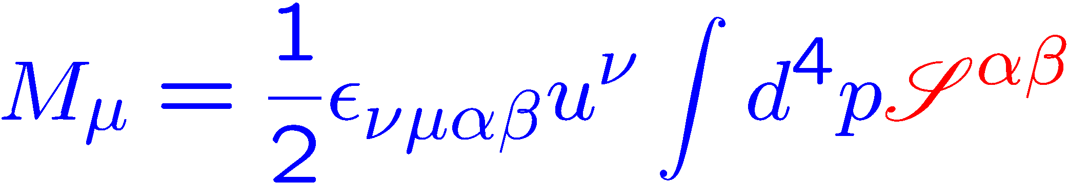
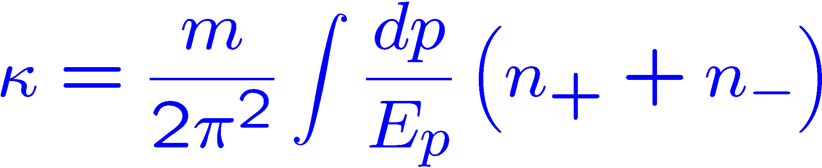
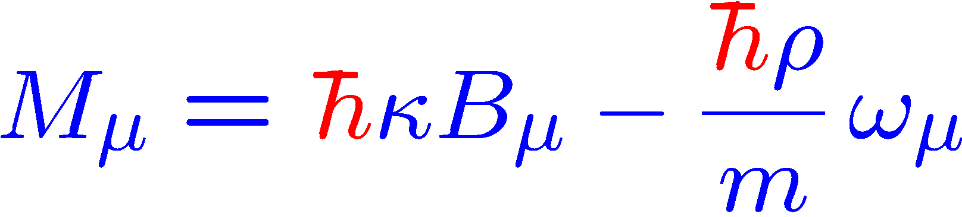
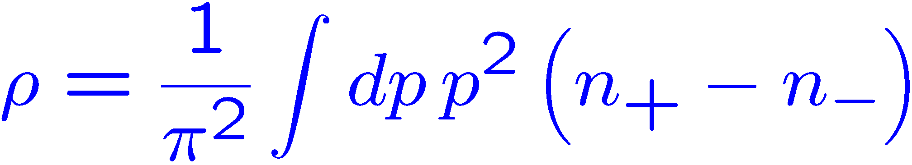
Quantum magnetization effect
Wigner function associated to spin magnetic moment density:
Spin magnetic moment vector:
Global equilibrium solution with constant $Ω_{μν} \& F_{μν}$:
Quantum magnetization effect
Susceptibility:
Charge density:

Slide 18
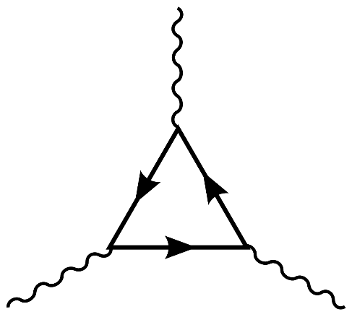
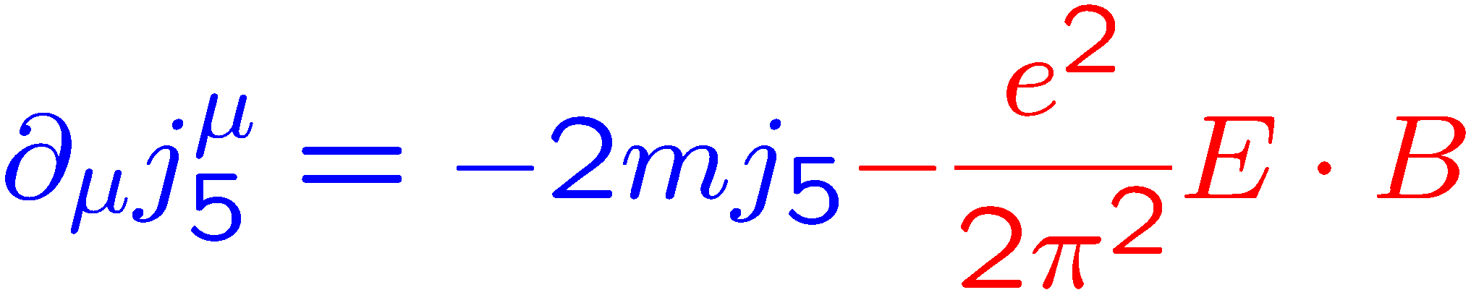
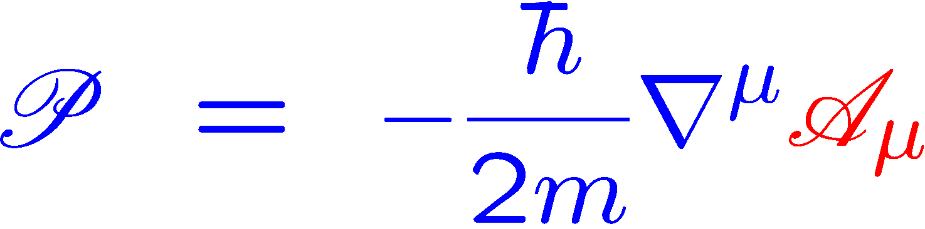
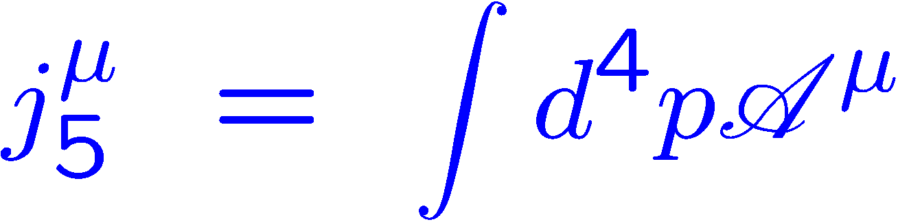
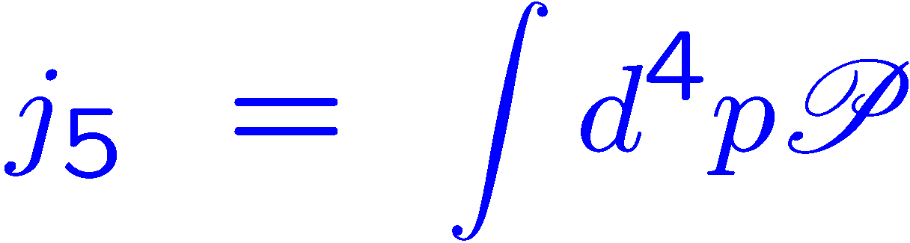
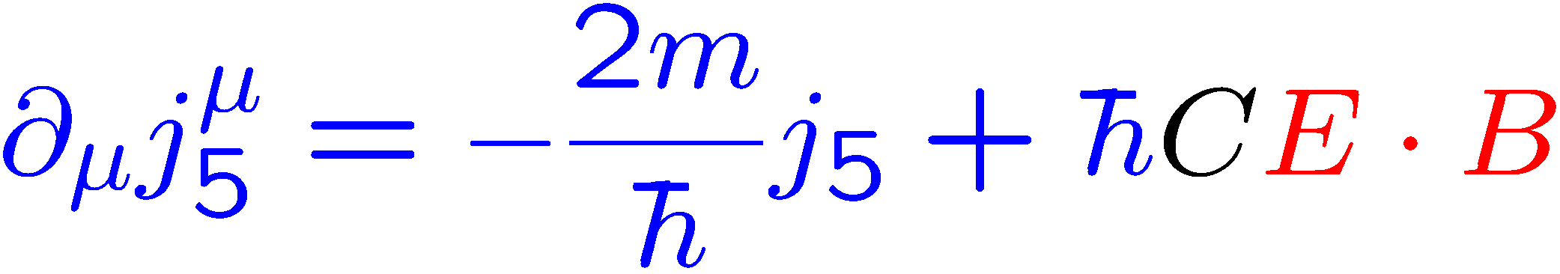
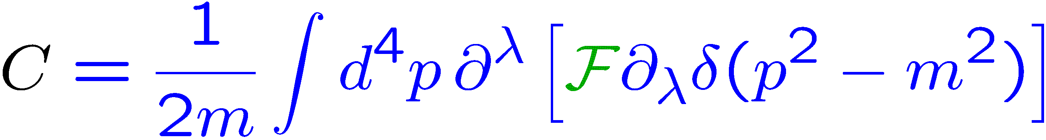
Chiral Anomaly
Chiral anomaly:
Pseudo scalar Wigner function:
Integrate over momentum:

Slide 19
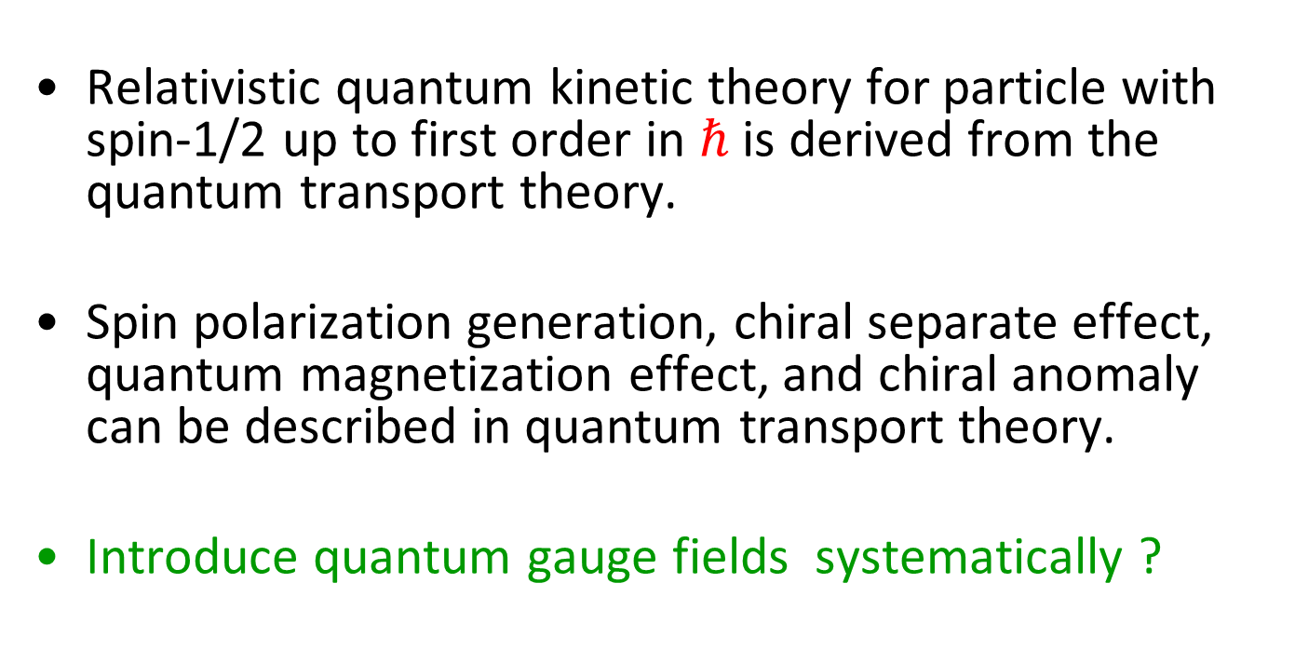
Summary and outlook
Relativistic quantum kinetic theory for particle with spin-1/2 up to first order in $ℏ$ is derived from the quantum transport theory.
Spin polarization generation, chiral separate effect, quantum magnetization effect, and chiral anomaly can be described in quantum transport theory.
Introduce quantum gauge fields systematically ?
Thanks for your attention！

